Slide 1
Particle Physics Faculty Meeting
Agenda
News/Update
Research group updates

Slide 2
TRIUMF is located on the traditional, ancestral, and unceded territory of thexʷməθkʷəy̓əm (Musqueam) people, who for millennia have passed on their culture, history, and traditions from one generation to the next on this site.
TRIUMF’s home has always been a seat of learning.

Slide 3
UCN Search
Five interviewed candidates
Efrain Segarra, PSI Villigen
Marie Blatnik, Los Alamos
Skyler Degenkolb, U Heidelberg
Wolfgang Schreyer, Oak Ridge NL
Noah Yazdandoost, PSI Villigen
Noah is visiting TRIUMF and Vancouver on Friday.
If you are interested in joining for lunch (12:30 tomorrow) let me and Ruediger know

Slide 4
CNSC Visit: Date and Scope
Confirmed Date: March 18-20
CNSC already requested for documents including TSOP-04, Training Plans, Training Audits, Training Implementation Panel (TIP) Meeting Minutes, Key Performance Indicators
Workday Learning Guide
Make sure all your (and your groups) training is up to date by February 21st!

Slide 5
Expired Courses (Previously Completed but Expired)
 | Wk Ending Jan 17 | Wk Ending Jan 31 |  | Wk Ending Jan 17 | Wk Ending Jan 31
Division | Digital Courses | Digital Courses |  | Offline Courses | Offline Courses
ACC | 27 | 17 |  | 138 | 71
PSD | 33 | 29 |  | 64 | 35
LSD | 15 | 13 |  | 23 | 14
P&I | 21 | 15 |  | 63 | 37
F&SC | 4 | 0 |  | 2 | 1
C&E | 4 | 4 |  | 5 | 0
CS | 25 | 18 |  | 45 | 30

Slide 6
Outstanding Courses (In Progress or Not Started)
 | Wk Ending Jan 17 | Wk Ending Jan 31 |  | Wk Ending Jan 17 | Wk Ending Jan 31
Division | Digital Courses | Digital Courses |  | Offline Courses | Offline Courses
ACC | 75 | 75 |  | 130 | 119
PSD | 123 | 120 |  | 50 | 41
LSD | 13 | 11 |  | 19 | 16
P&I | 39 | 35 |  | 63 | 62
F&SC | 8 | 8 |  | 4 | 3
C&E | 6 | 5 |  | 0 | 0
CS | 85 | 73 |  | 54 | 39

Slide 7
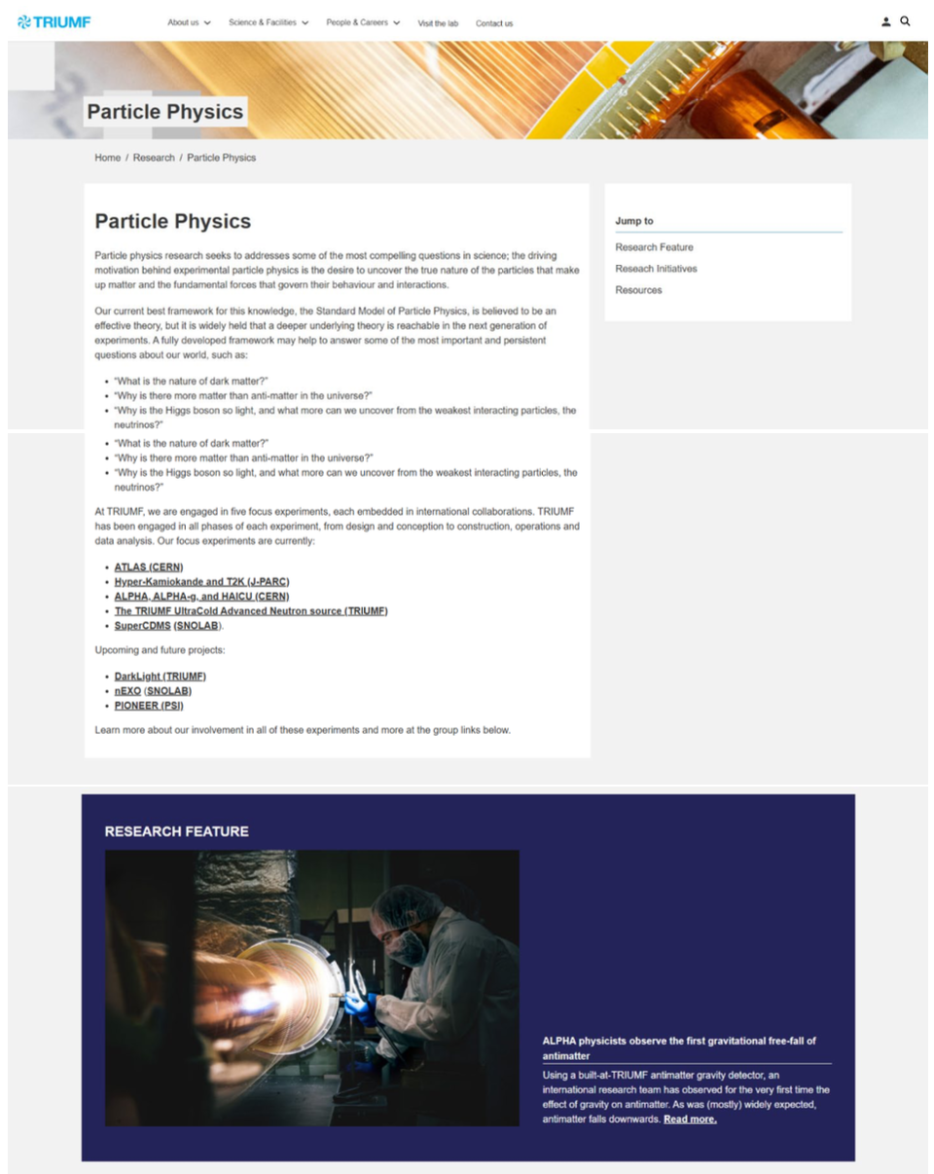
TRIUMF New Website
Launched on Feb 10th
Particle Physics page https://triumf.ca/research/particle-physics/ - Suggestions for 2 new research features for the next 2 months?

Slide 8
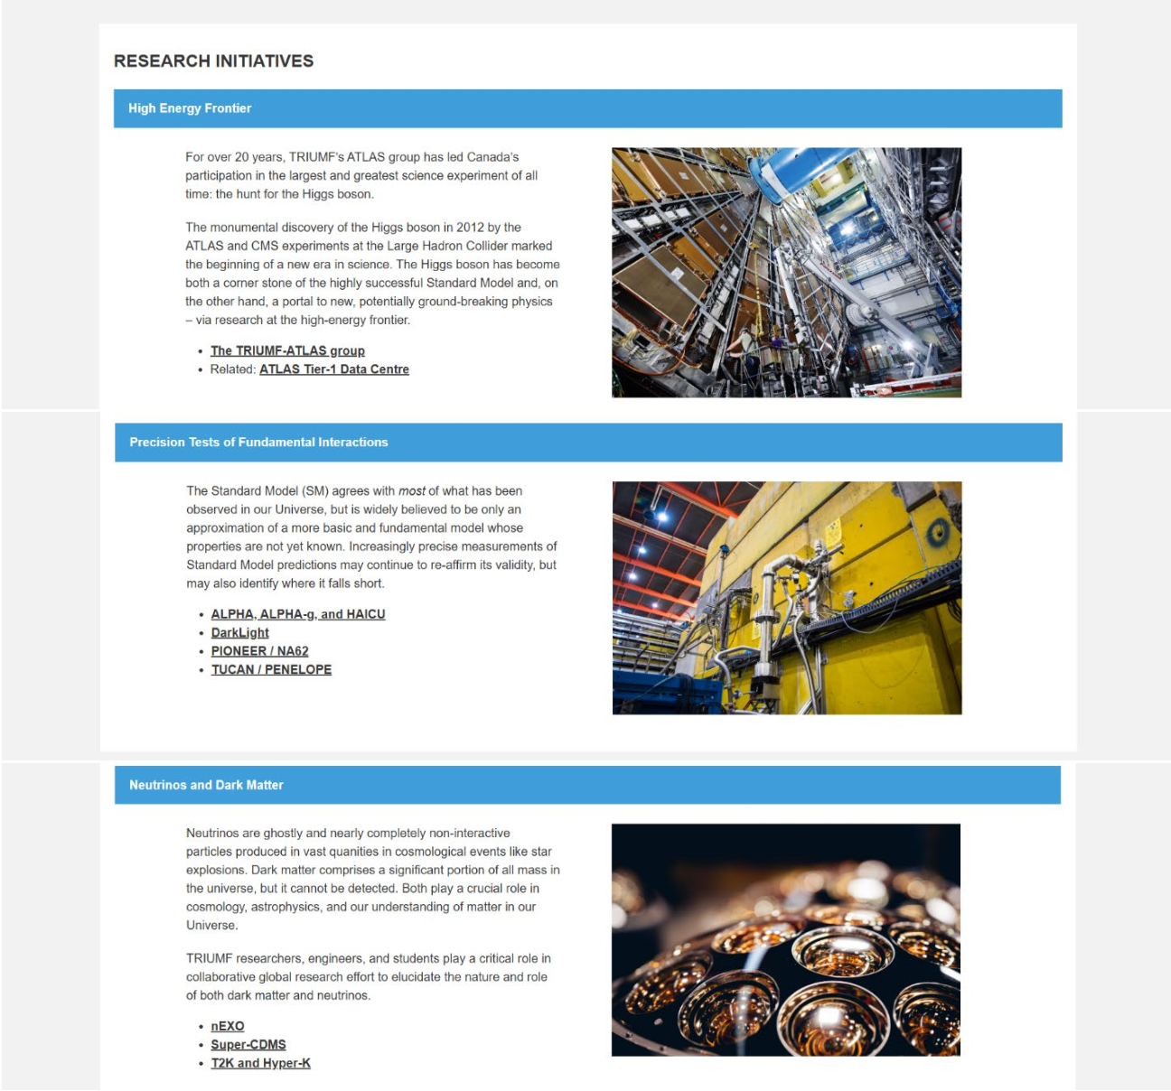
TRIUMF New Website
Particle Physics page - a separate page (8 in total) for each experiment
content pasted from existing documentation / previous pages or link to a separate website
Please provide feedback or suggestions for content change/update Chloé (PP contact point for the website) is channeling the feedbacks

Slide 9
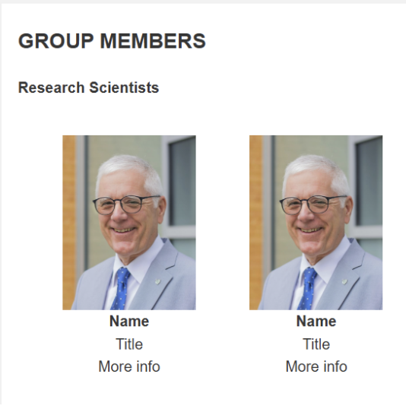
TRIUMF New Website
Currently missing:“personnel 'cards' of department members Will be added in the next days within an accordion on the main landing page. For now simply headshots and titles - can link to a personal page.
- would you like to have a personal page linked? as far as we know it will have to be a standard formal for all - current list below. Any update?
Emeriti:
Georges Azuelos
Dave Gill
Rich Helmer
Toshio Numao
Art Olin
Jean Michel Poutissou
Stan Yen
Faculties:
Andrea Capra
Makoto Fujiwara
Akira Konaka
Xiaoyue Li
Chloé Malbrunot
Ruediger Picker
Oliver Stelzer-Chilton
Max Swiatlowski
Isabel Trigger
Joint Faculties:
Thomas Brunner (McGill)
Ken Clark (with Queens, MI)
Doug Gingrich (UofA)
Mark Hartz (with IPMU)
Dean Karlen (UVic)
Wolfgang Rau (with MI)
Pierre Savard (UofT)
Bernd Stelzer (SFU)
Mike Vetterli (SFU)
Affiliates:
Sampa Bhadra (YorkU)
Barry Pointon (BCIT)
Doug Bryman (UBC)
Matthias Danninger (SFU)
Mike Hasinoff (UBC)
Alex Khramov (BCIT)
Robert Mcpherson (UVic)
Taka Momose (UBC)
Willem van Oers (Manitoba)
Scott Oser (UBC)
Patrick De Perio (IPMU/Tokyo)
Rob Thompson (Calgary)
Project Scientists:
Louise Poley
Chukman So

Slide 10
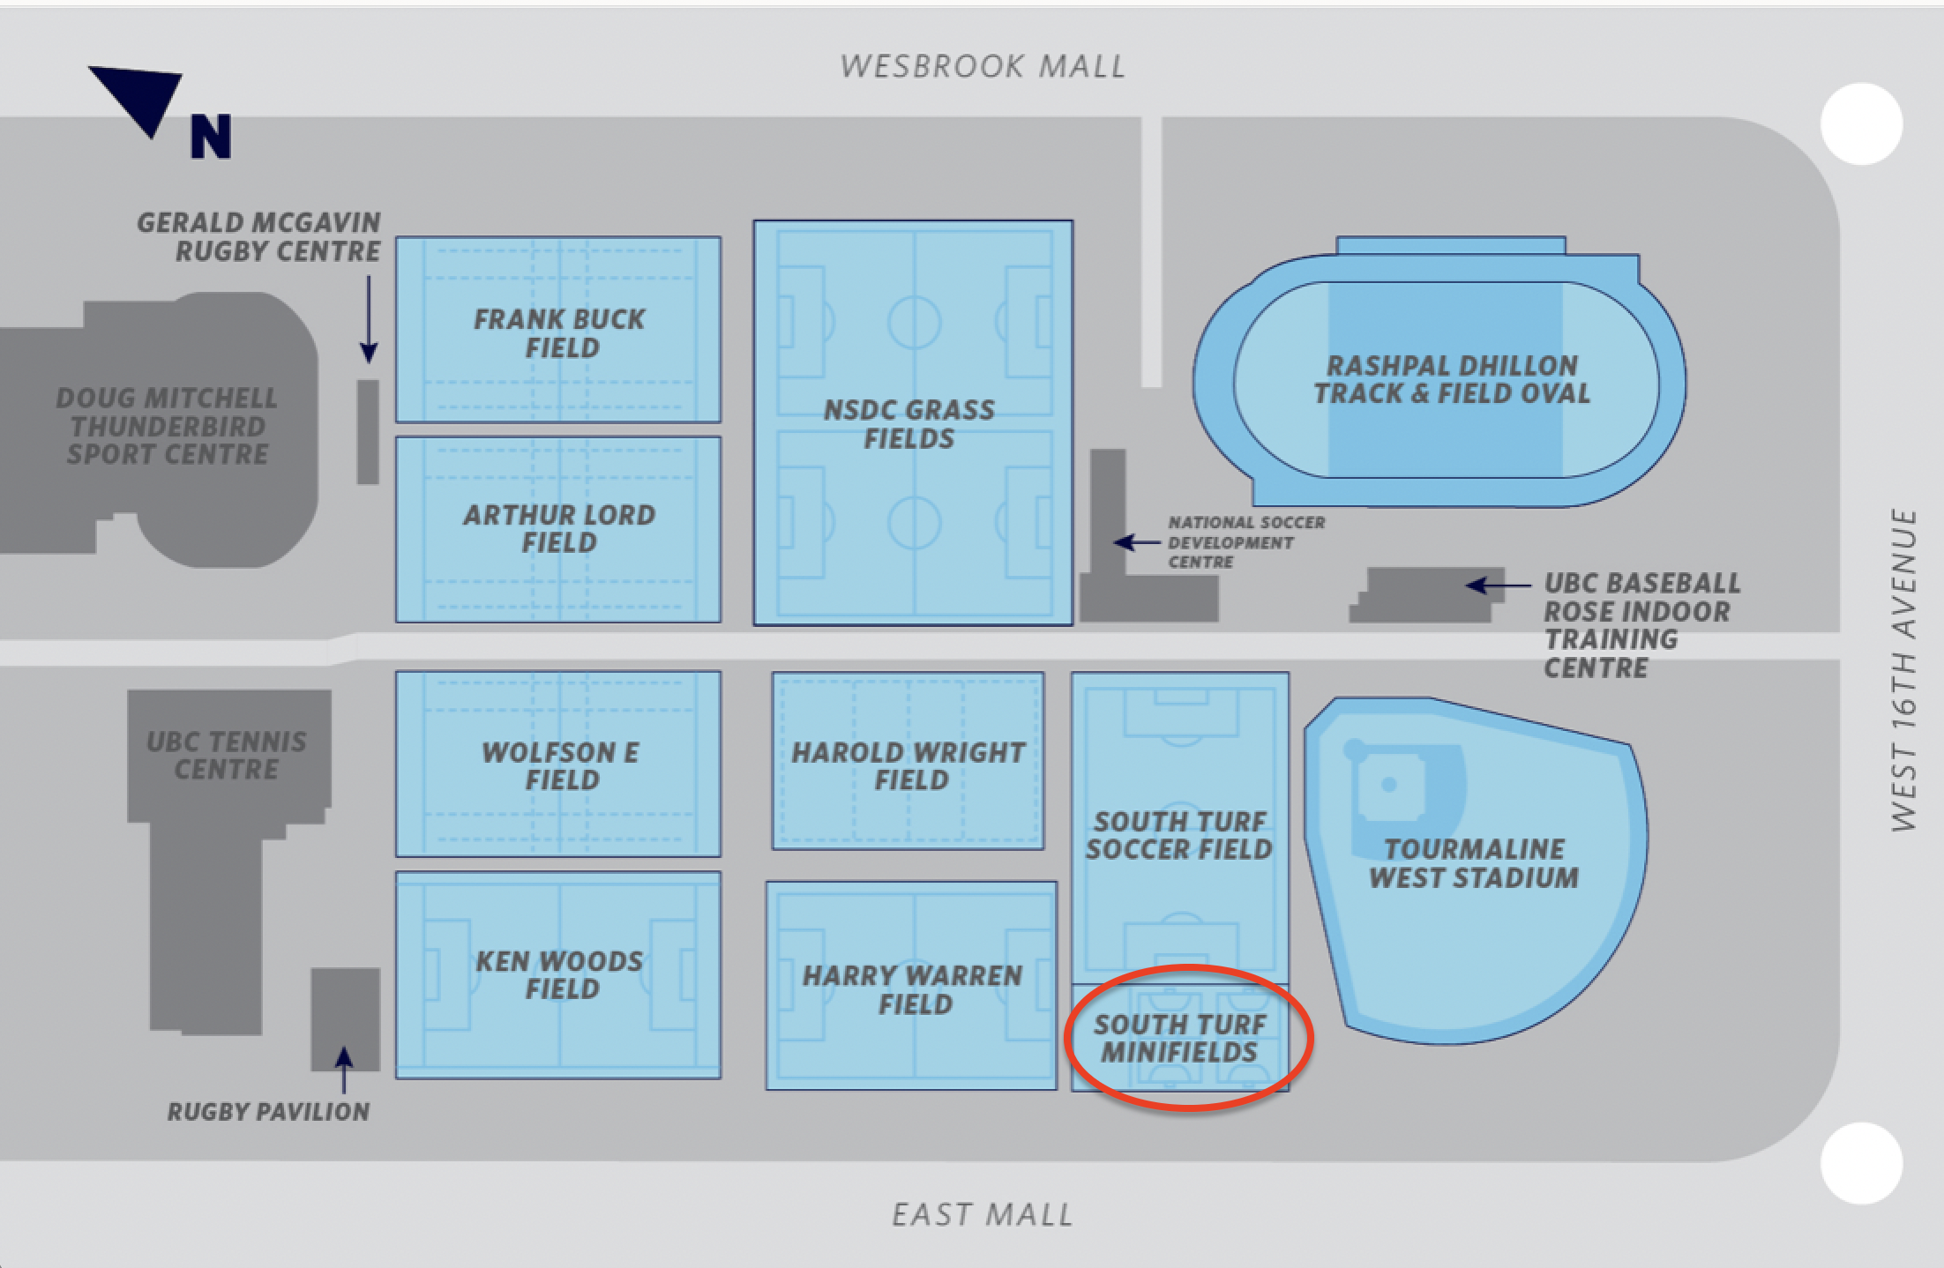
PP + Friends Soccer
biweekly trainings / games starting April 1st - targeting UBC south turf mini-fields If interested fill the poll (before March 1st): https://newdle.cern.ch/newdle/JsXd35jw

Slide 11
Various
KEK-TRIUMF Symposium
Jan 28-30
Feedback?
Fermilab
Lia Merminga steps down, Young Kee Kim interim director
SNOLAB
Jeter Hall steps down as Director of Research
“Quantum Discussion” with Nigel S. and Ritu next week
Colloquium today
Speaker: Katelin Schutz (McGill)
Title: Revealing hidden particles and forces with gravitational clues

Slide 12
AOB

Slide 13
Round Table
ATLAS
T2K/HyperK
TUCAN
ALPHA
SuperCDMS
DarkLight
n-EXO / PHORWARD
PIONEER
NA62
P-One
SNO+
HALO
g-2
Belle
Theory

Slide 14

Physical Sciences

Slide 15

Physical Sciences​

Slide 16
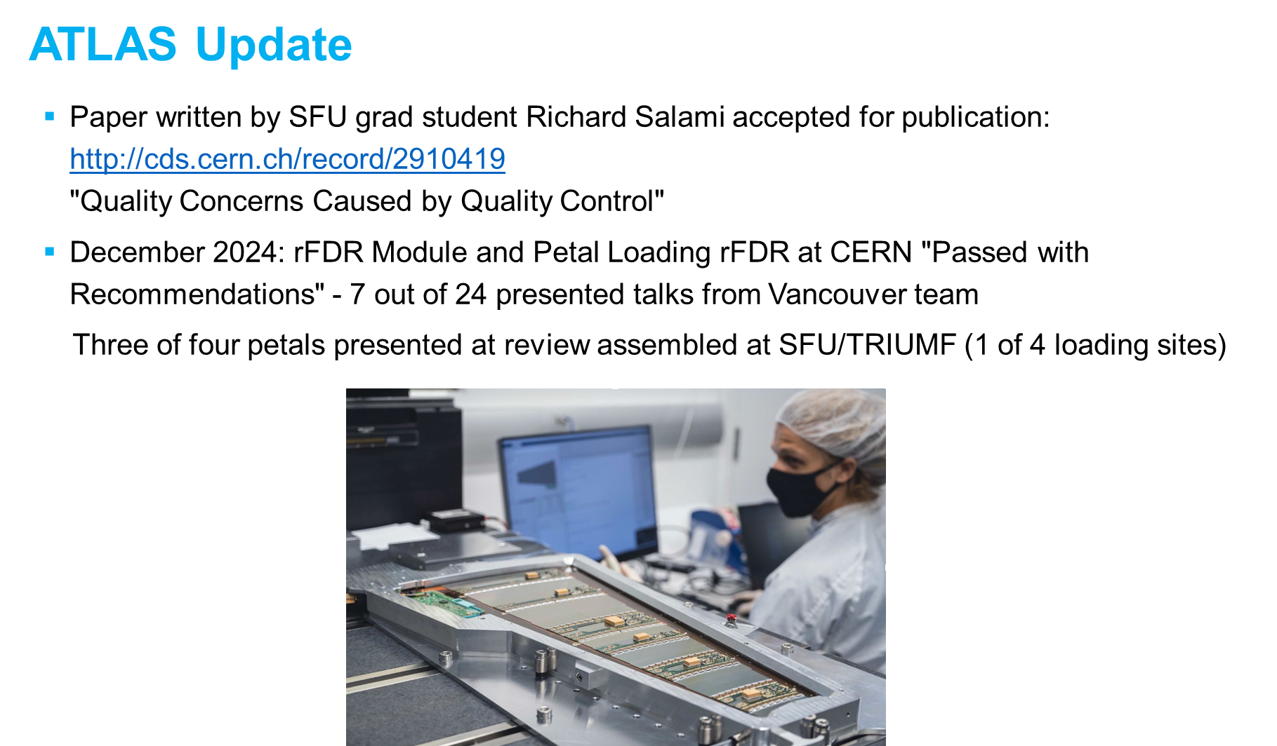
Physical Sciences​

Slide 17
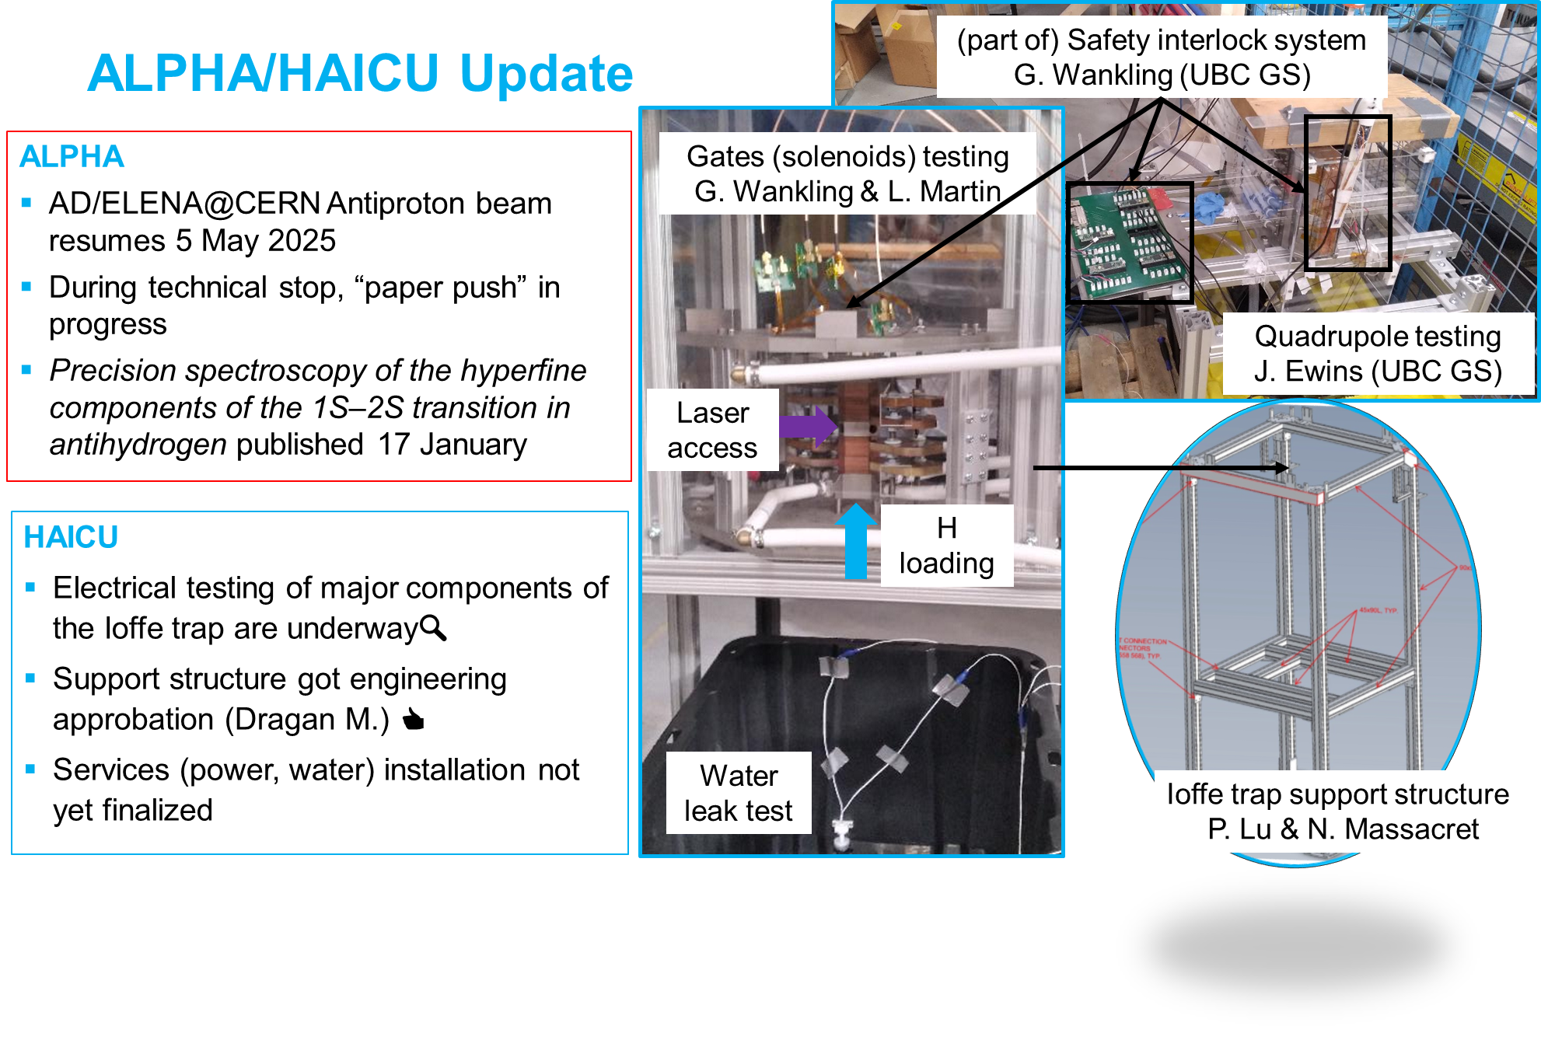
Physical Sciences​

Slide 18
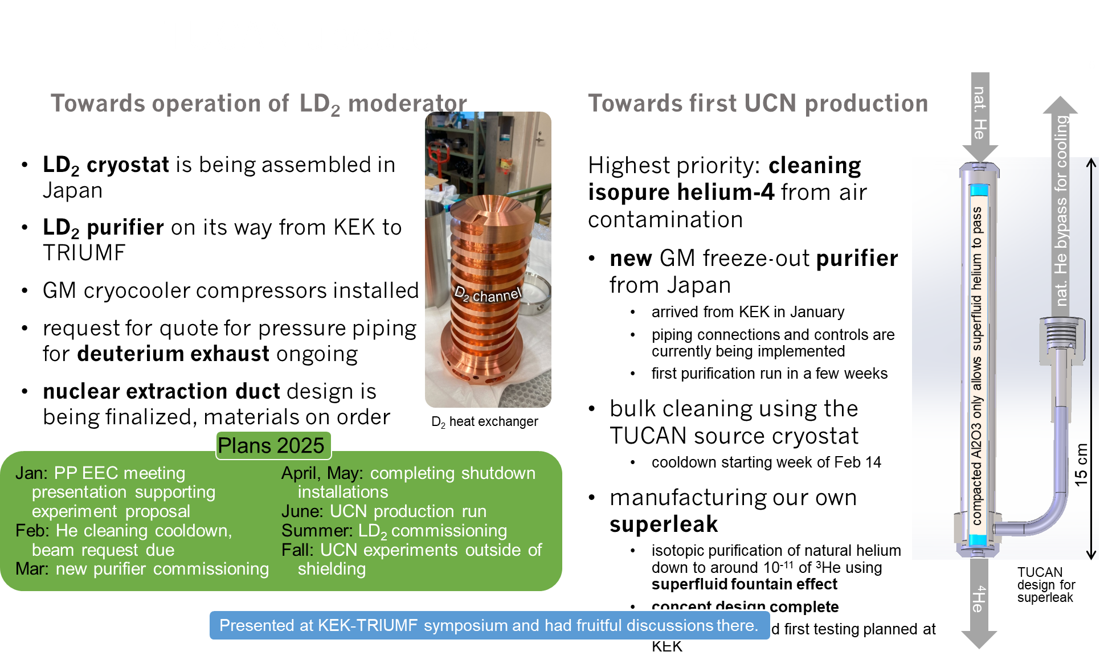
Physical Sciences​

Slide 19
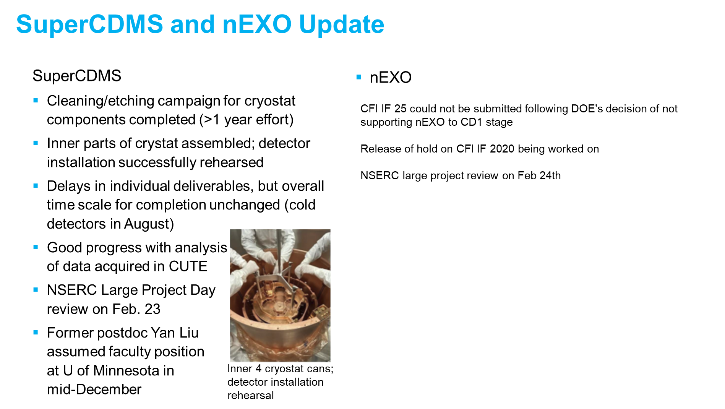
Physical Sciences​

Slide 20
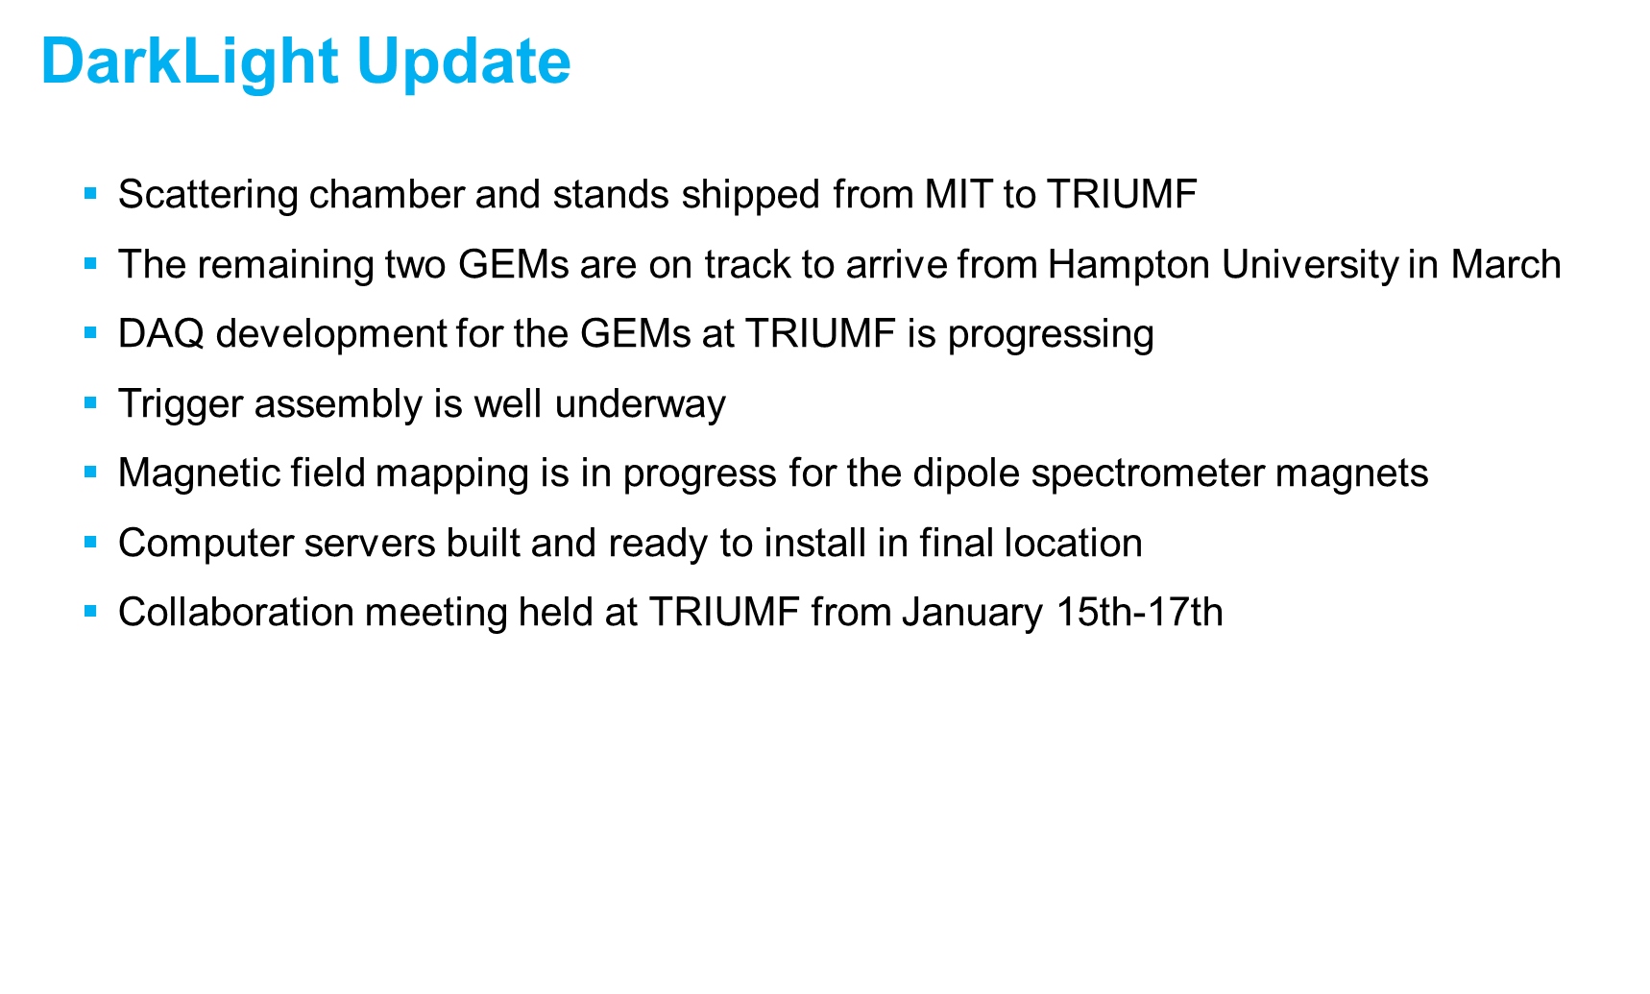
Physical Sciences​

Slide 21
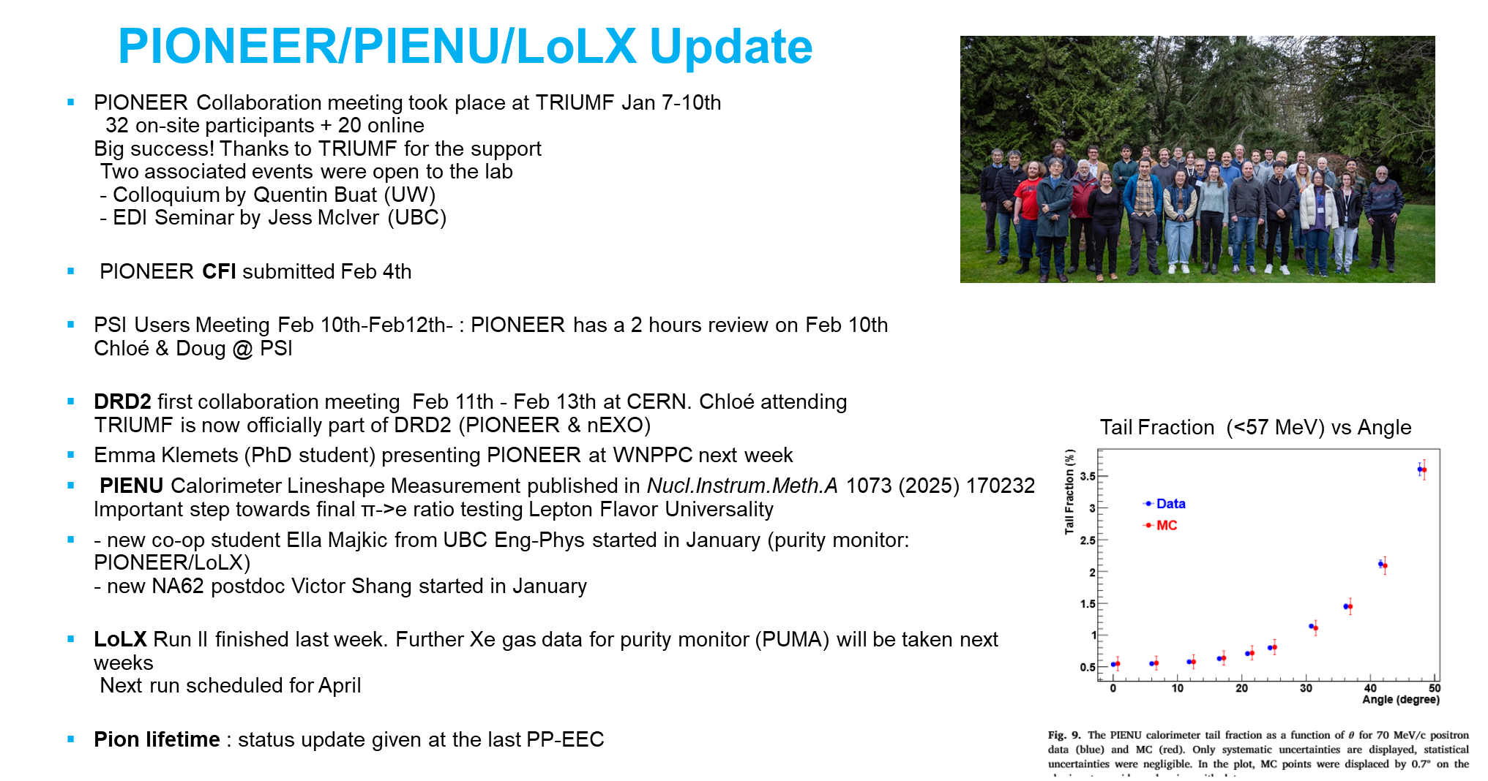
Physical Sciences​​

Slide 22
Next Meeting
March 13th

