Slide 1
Welcome to the BeEST Collaboration Meeting
TRIUMF – May 13 - 15

Slide 2
TRIUMF is located on the traditional, ancestral, and unceded territory of thexʷməθkʷəy̓əm (Musqueam) people, who for millennia have passed on their culture, history, and traditions from one generation to the next on this site.
TRIUMF’s home has always been a seat of learning.

Slide 3
Code of Conduct
For the BeEST collaboration meeting at TRIUMF we are adopting the code of conduct of our hosting institution. By registering for this meeting all participants agree to abide by this code of conduct. Behaviour that violates our code of conduct will not be tolerated and under given circumstances can have the consequence of revoking the privilege to participate in the BeEST collaboration meeting.
“In line with our core values of Equity and Inclusion, we are committed to providing a safe and inclusive environment that fosters the exchange of scientific ideas, encourages open and respectful dialogue, and is free of harassment and discrimination. We respect each other, take care of each other, and support the success of all.
We do not tolerate discrimination, harassment, or bullying. Conference participants have a right to belong and a responsibility to treat one another with respect. Acts of discrimination, harassment, or bullying will result in immediate action, and notification of appropriate authorities, if necessary. This includes, but is not limited to: sexual harassment, intimidation, threatening behaviour, sustained disruption, use of offensive or demeaning language including unwelcome or offensive jokes, unwanted photography, screenshots or recording without consent, engaging in biased, demeaning, or hostile commentary based on individual characteristics such as age, race, ethnicity, sex, sexual orientation, gender identity or expression, marital status, nationality, political affiliation, ability status, educational background, or any other characteristic protected by law.”
If you believe that you have been subject to or have witnessed behavior that violates this code of conduct, please report it immediately to the organizers (lennarz@triumf.ca)

Slide 4
Program & Presentations
Schedule is available on the indico page:
https://indico.triumf.ca/event/742/overview
Review instructions for speakers on the indico page; “how to upload your talks”
Please upload your talk in advance
All talks shared on zoom with online participants
Use microphone for questions in the room
For online questions, please raise your hand or post your question in the chat

Slide 5
TRIUMF Tour & Collaboration Photo
TRIUMF Tour:
When? – Today (Tuesday, May 13), 11:30 am
Where? – Leave together from auditorium
Photo:
When? – Today (Tuesday, May 13), end of tour ~1PM
Where? – On top of the cyclotron

Slide 6
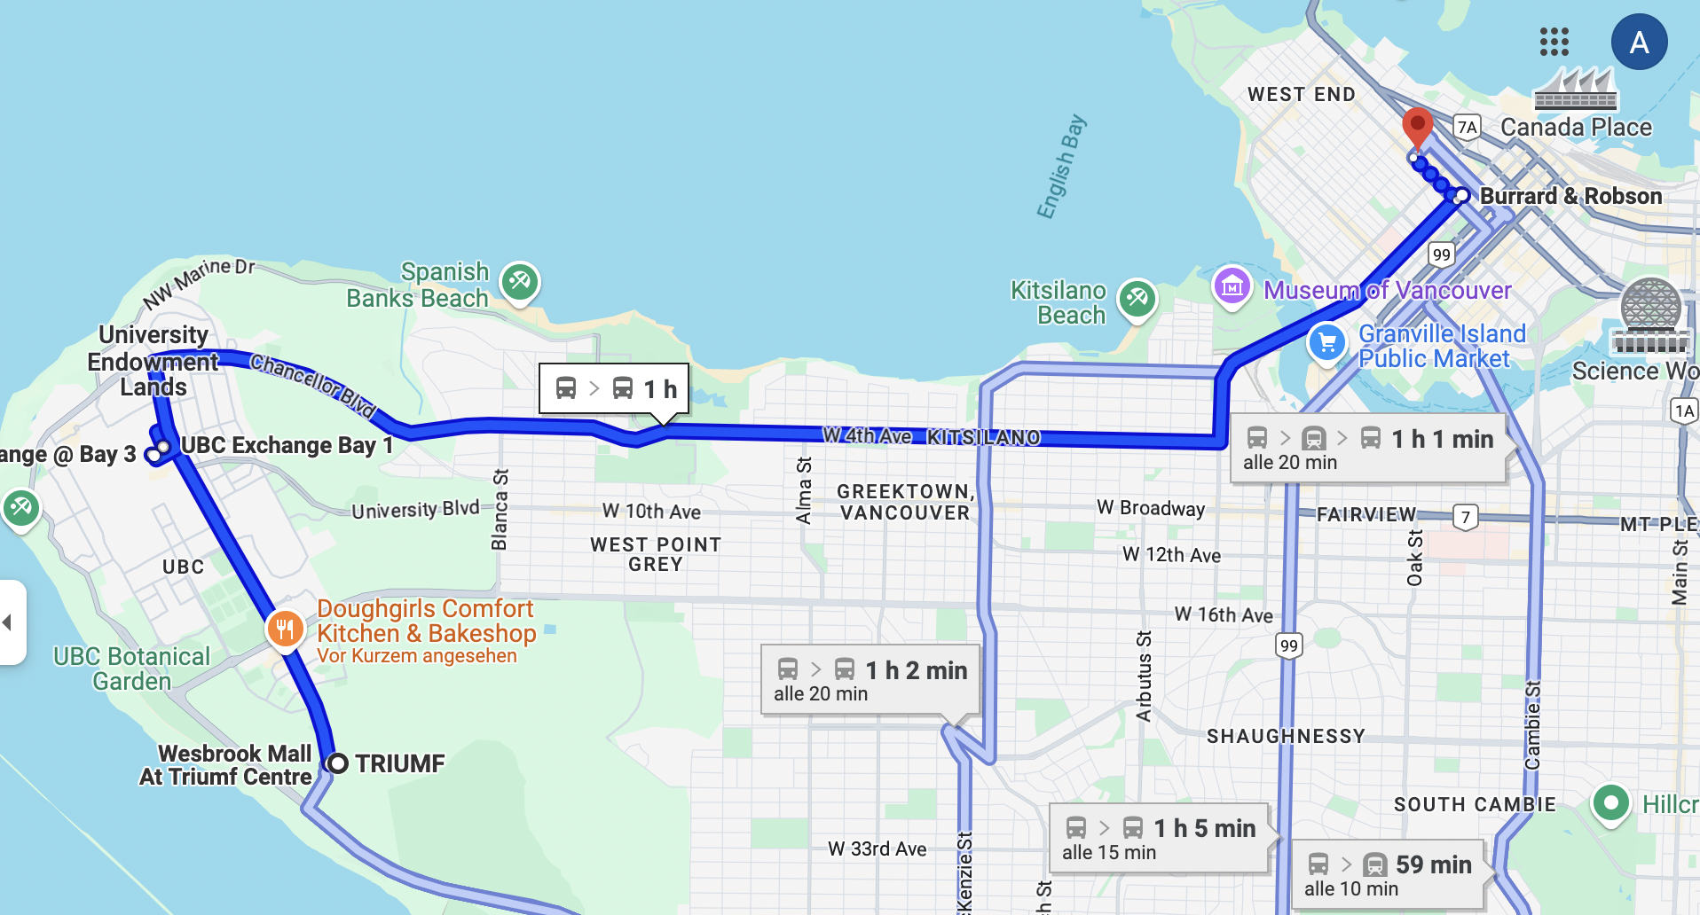
Meals
Coffee breaks & lunches:
Coffee breaks just outside the auditorium
Lunches & drinks for registered participants only, please!
Collaboration Dinner:
Please join us this evening!
Please join us at 7pm this evening
BEEST Ramen Restaurant
770 Bute St, Vancouver, BC V6E 1C2

Slide 7
Enjoy the Meeting!

