Slide 1
The BeEST Experiment History, Accomplishments, and Future
Kyle Leach Colorado School of Mines - Physics | Quantum Engineering | Nuclear Engineering Michigan State University - Facility for Rare Isotope Beams National Institute of Standards and Technology - Quantum Sensing Division
BeEST Collaboration Meeting
TRIUMF, Vancouver, Canada
May 13, 2025

Slide 2
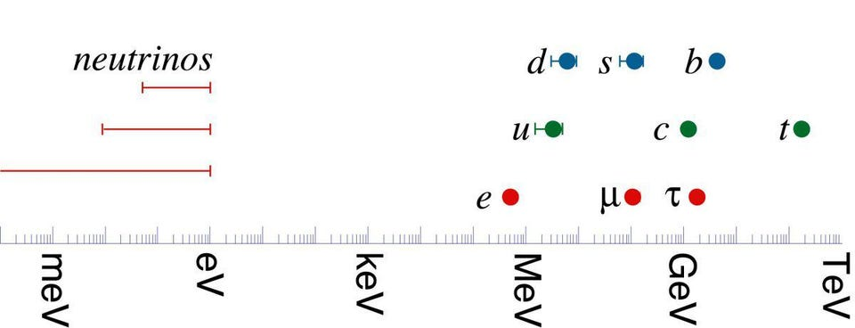
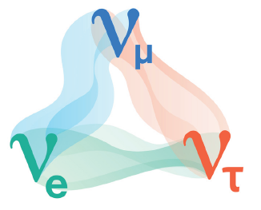
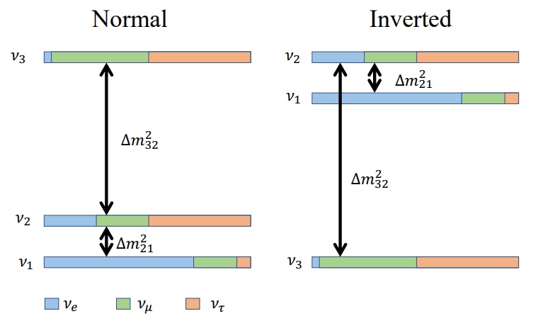
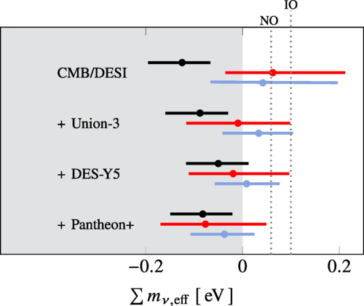
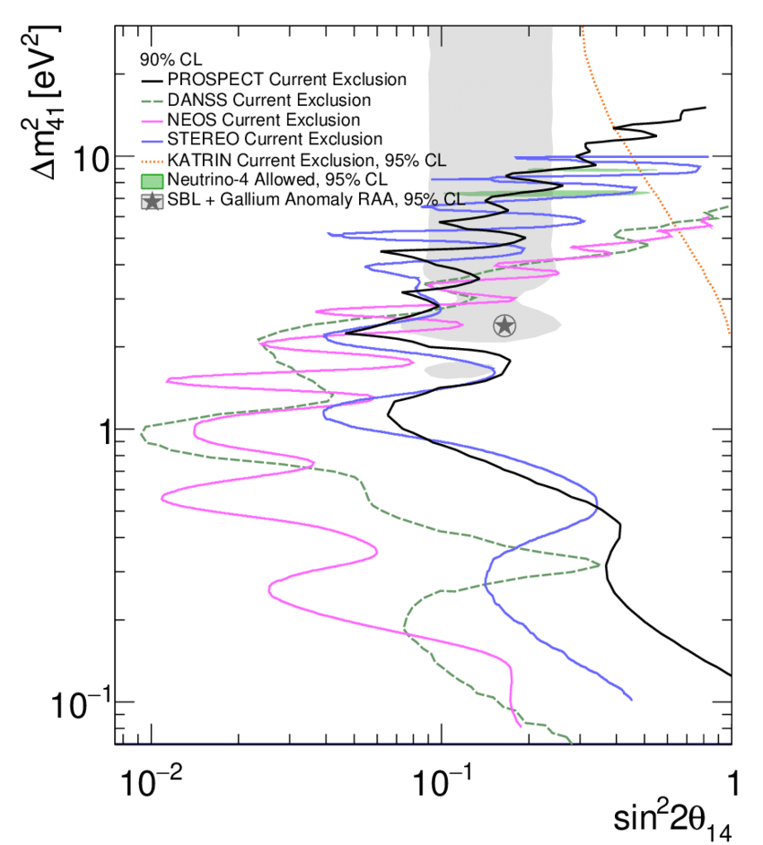
The Neutrino: Our Portal Between Cosmology and the Lab
Σm_{ν} > 0.06 eV (oscillations)
Σm_{ν} < 0.043 eV (cosmology)
(PDG Review) - PRD 110, 030001 (2024)
(DESI + CMB) PRD 110, 103536 (2024)
Masses are Very Light
The Standard Model
Douglas Tucker - this morning
Non-Zero ν Masses
Majorana Masses?
> 3 flavours?
m_{ββ}< 0.028-0.122 eV (ββ decay)
m_{νe}< 0.45 eV (β decay)
2015
(¹³⁶Xe KamLAND-Zen) arXiv:2406.11438
(KATRIN) Science (2025); arXiv:2406.13516
Right-Handed
State
Majorana
Mass
The Dark Matter Problem
Experimental problems/curiosities in the neutrino sector:
Mass ordering not know (oscillations)
Inconsistent mass data among probes (cosmology vs laboratory)
Sterile anomalies (oscillation fits, gallium anomaly)
Lepton mixing vs quark mixing for 3x3 (PMNS vs CKM)
Hints of Sterile Flavours
Baryon Asymmetry of the Universe

Slide 3
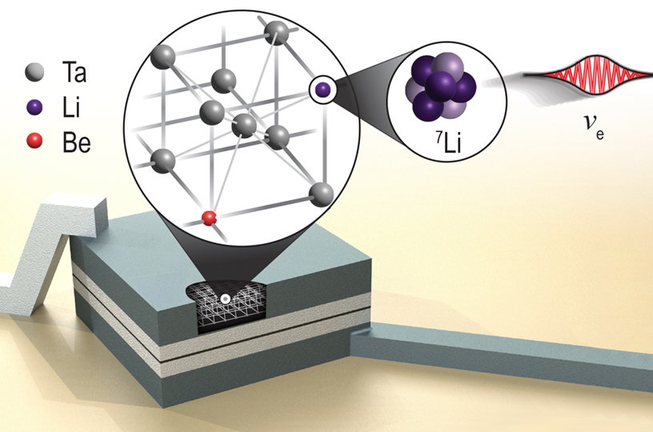
The BeEST Experiment – ⁷Be in STJs
Collimator
Chamber
Element- and mass-selective delivery
Purity > 80% (<20% ⁷Li (stable))
Rate > 10⁶ ⁷Be⁺ per second
Photoresist
Annika Lennarz- this morning
(T_{1/2} ~ 53 days)
50 μm
Stephan Friedrich - this morning

Slide 4
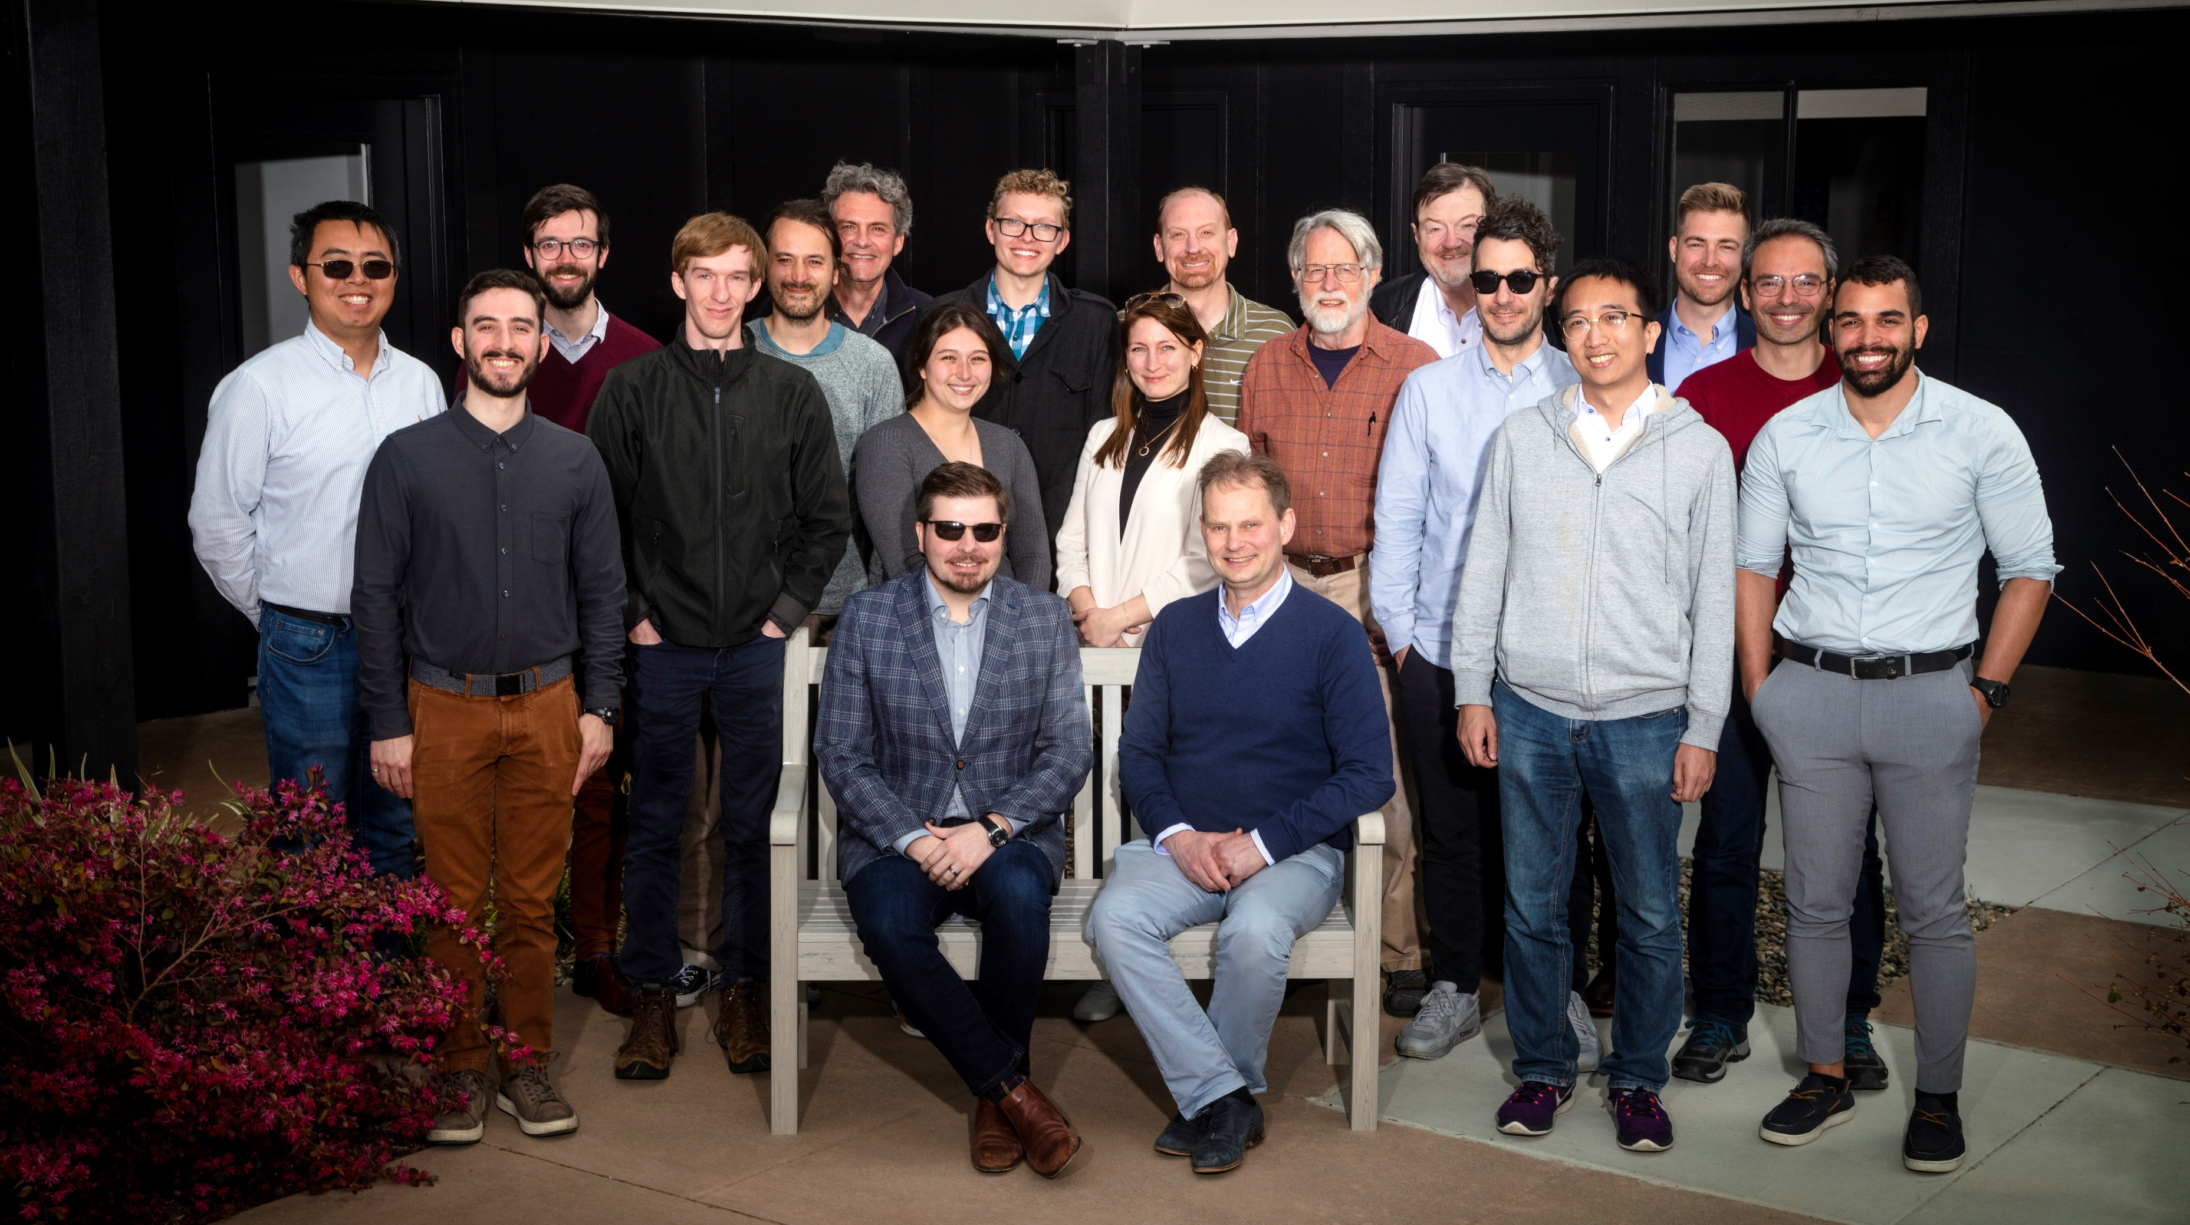
The BeEST Collaboration (To Date)
Connor Bray, Harris Crocker, David Diercks, Spencer Fretwell, Abbi Gillespie, Cameron Harris, Calvin Hinkle, Kyle Leach, Drew Marino, Ben Waters, Gigi Schalk, Joe Smolsky, Caitlyn Stone-Whitehead, Joseph Templet, Wouter Van De Pontseele, Grace Wagner
Colorado School of Mines, Golden CO USA
Ashley Marie Evangelista, Annika Lennarz, Peter Machule, Dave McKeen, Chris Ruiz, Maisy Willett
TRIUMF, Vancouver BC Canada
Stephan Friedrich, Geon-Bo Kim, Inwook Kim, Vincenzo Lordi, Amit Samanta
LLNL, Livermore CA USA
Pedro Amaro, Mauro Guerra, Jorge Machado, José Paulo Santos
NOVA School of Science and Technology, Lisbon Portugal
Adrien Andoche, Paul-Antoine Hervieux
Université Strasbourg, Strasbourg France
Robin Cantor, Ad Hall
Star Cryoelectronics LLC, Santa Fe NM USA
Jack Harris, Bill Warburton
XIA LLC, Oakland CA USA
Francisco Ponce
PNNL, Richland WA USA
Xavier Mougeot
CEA Paris-Saclay, Paris France
Leendert Hayen, Mohamad Kanafani
LPC Caen, Caen France
2023 Collaboration Meeting
Livermore, CA
PRL (submitted) arXiv:2411.08076
PRD 111, 052010 (2025)
Nature 638, 640–644 (2025)
PRC 109, L022501 (2024)
JLTP 2024, 1-9 (2024)
PR Applied, 19 014032 (2023)
JLTP 2, 1-8 (2022)
JLTP 1, 1-7 (2022)
PRL 126, 021803 (2021)
PRL 125, 032701 (2020)

Slide 5
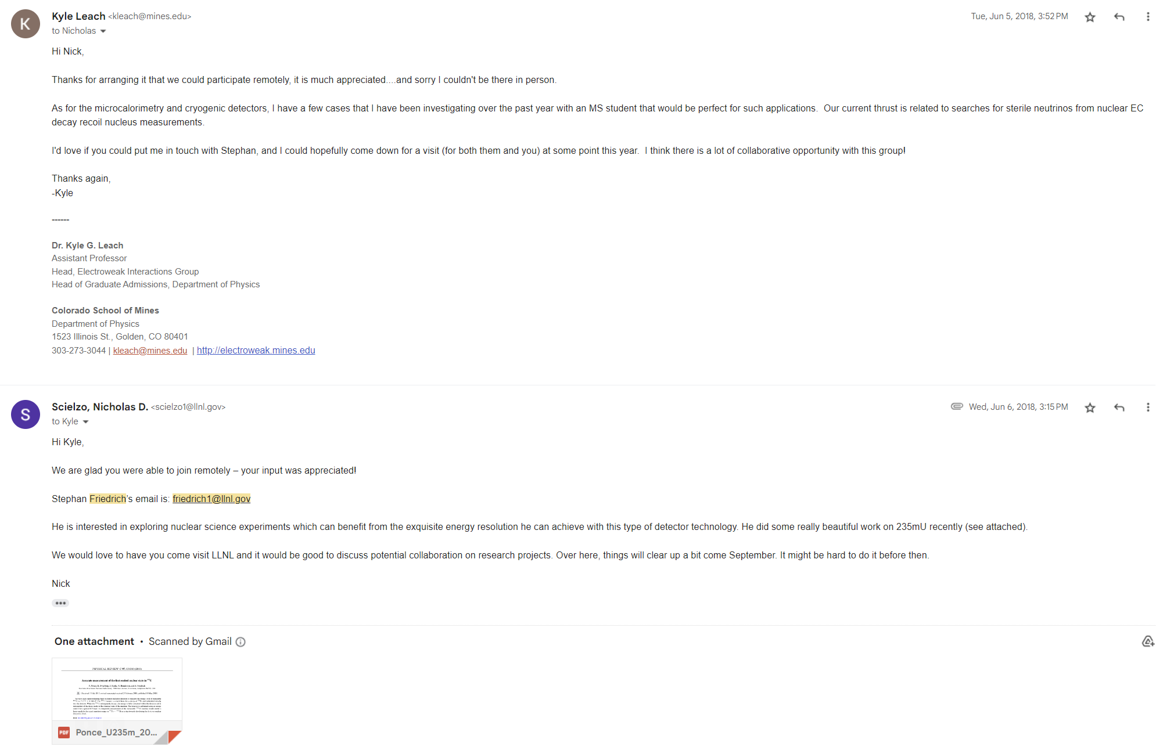
How Did This All Start?

Slide 6
How Did This All Start?

Slide 7
How Did This All Start?

Slide 8
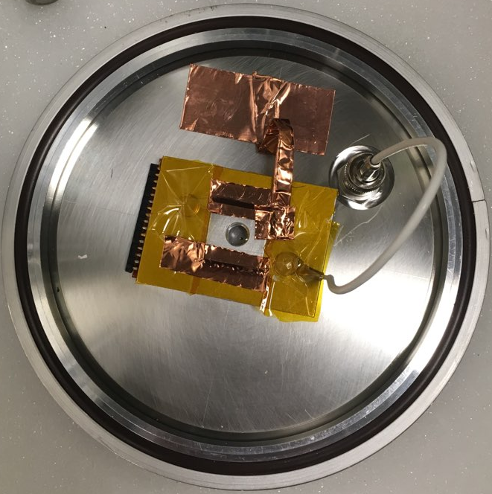
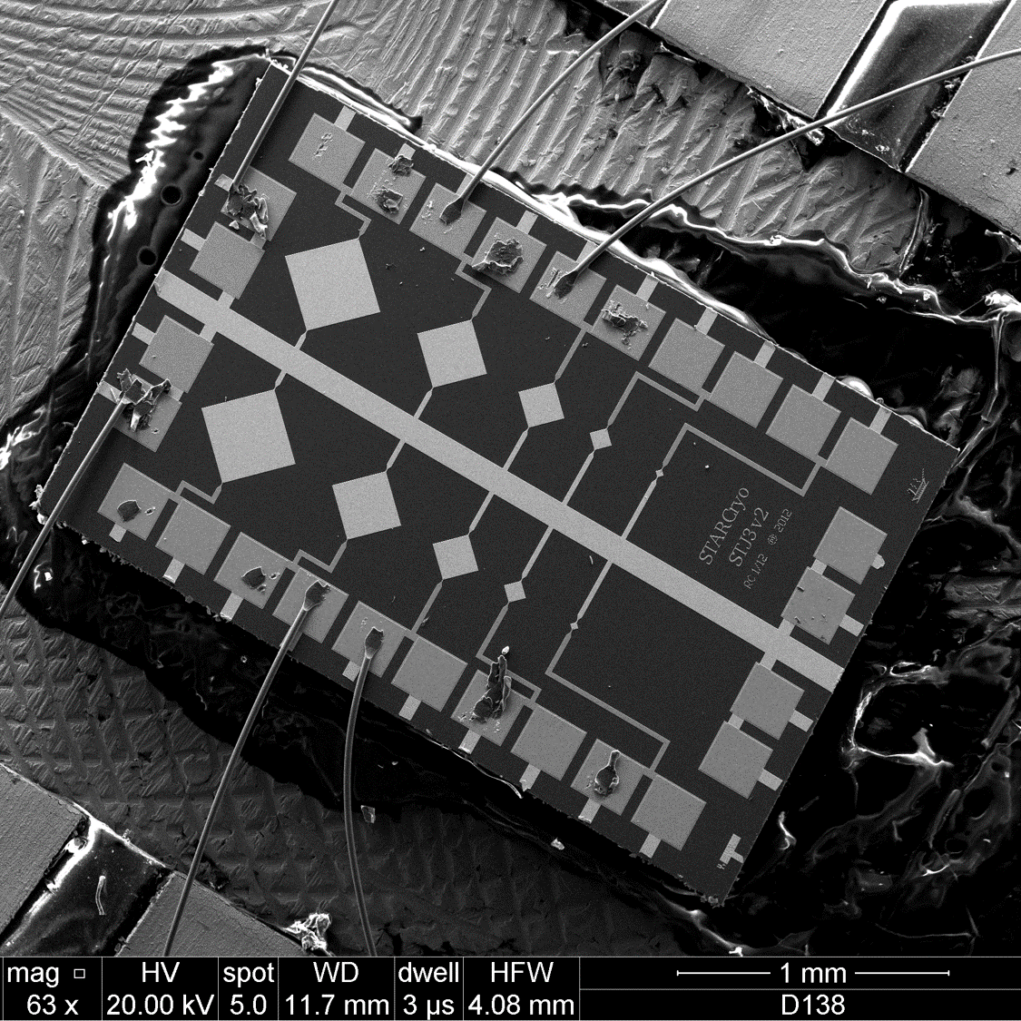
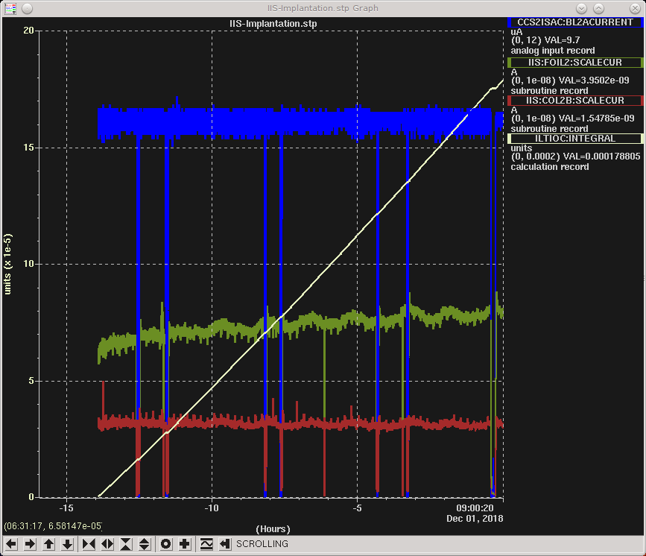
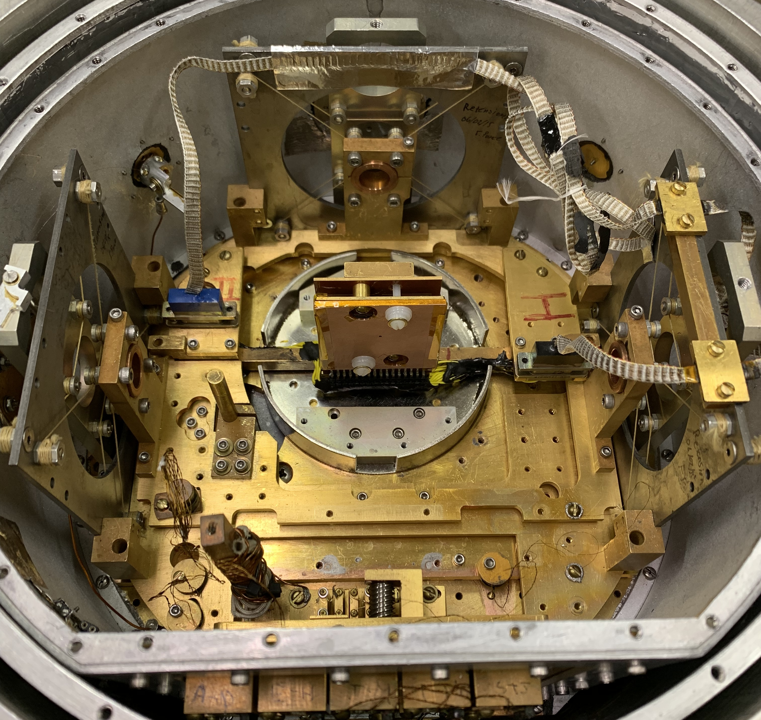
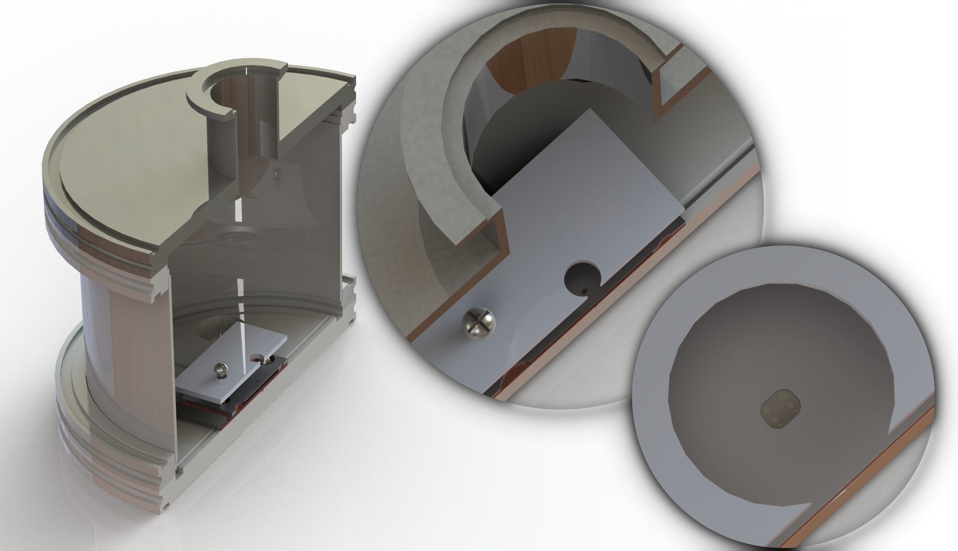
The BeEST Phase-0 (Implantation #1 - Dec 2018)
Goal: Pure test of “can we see anything”
Used Ta “test” chip from LLNL
Implantation chamber designed, fabricated, and tested by Spencer (M.S.) in 3 weeks
12 hr implantation:
Measured activity on chip: 7.5(4) kBq
Total Implanted (Li+Be) | 1.23E+12
7Be Implanted | 4.68E+10

Slide 9
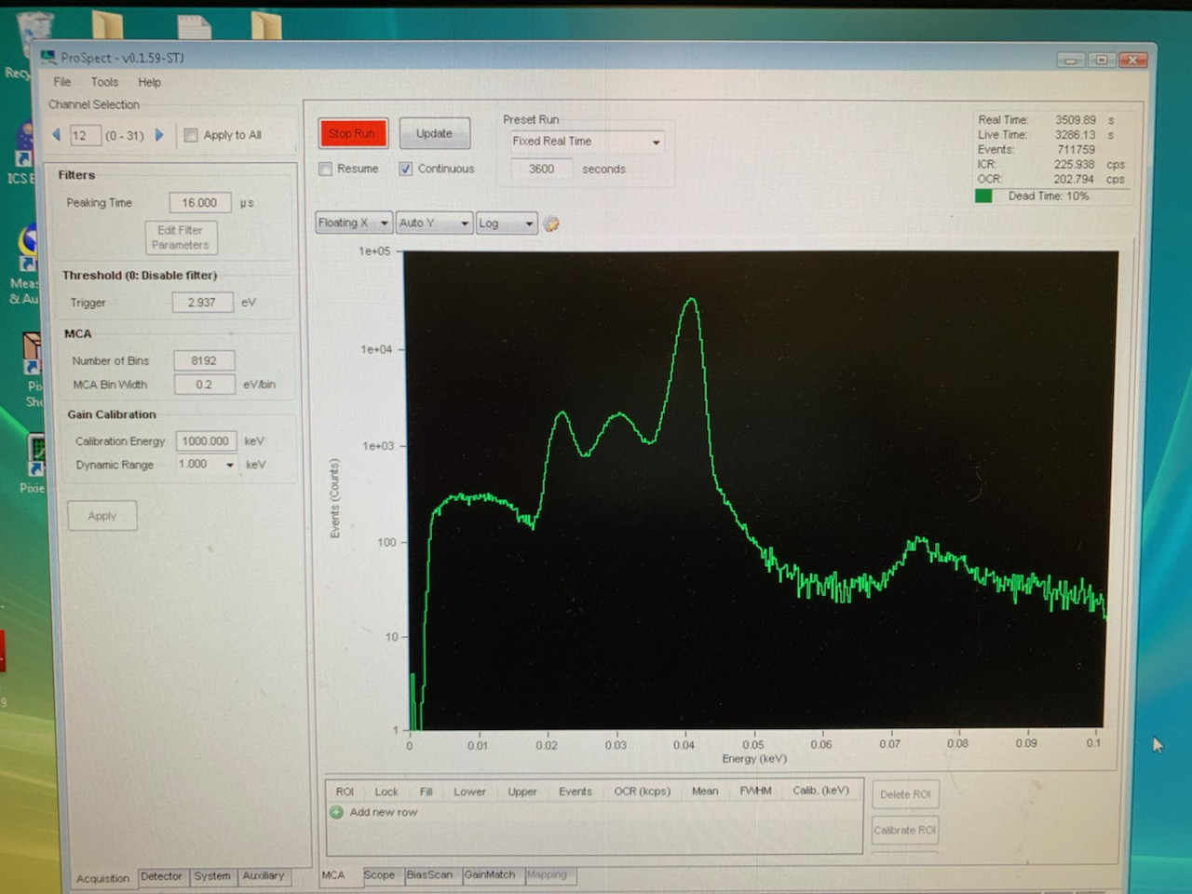
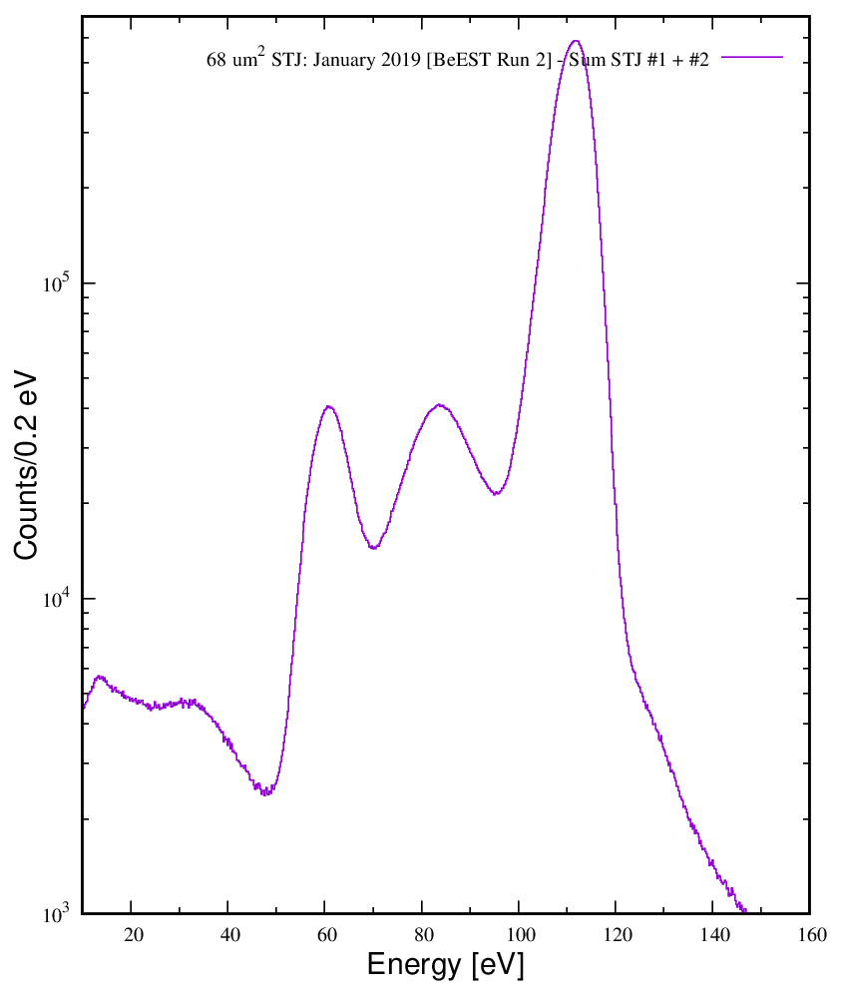
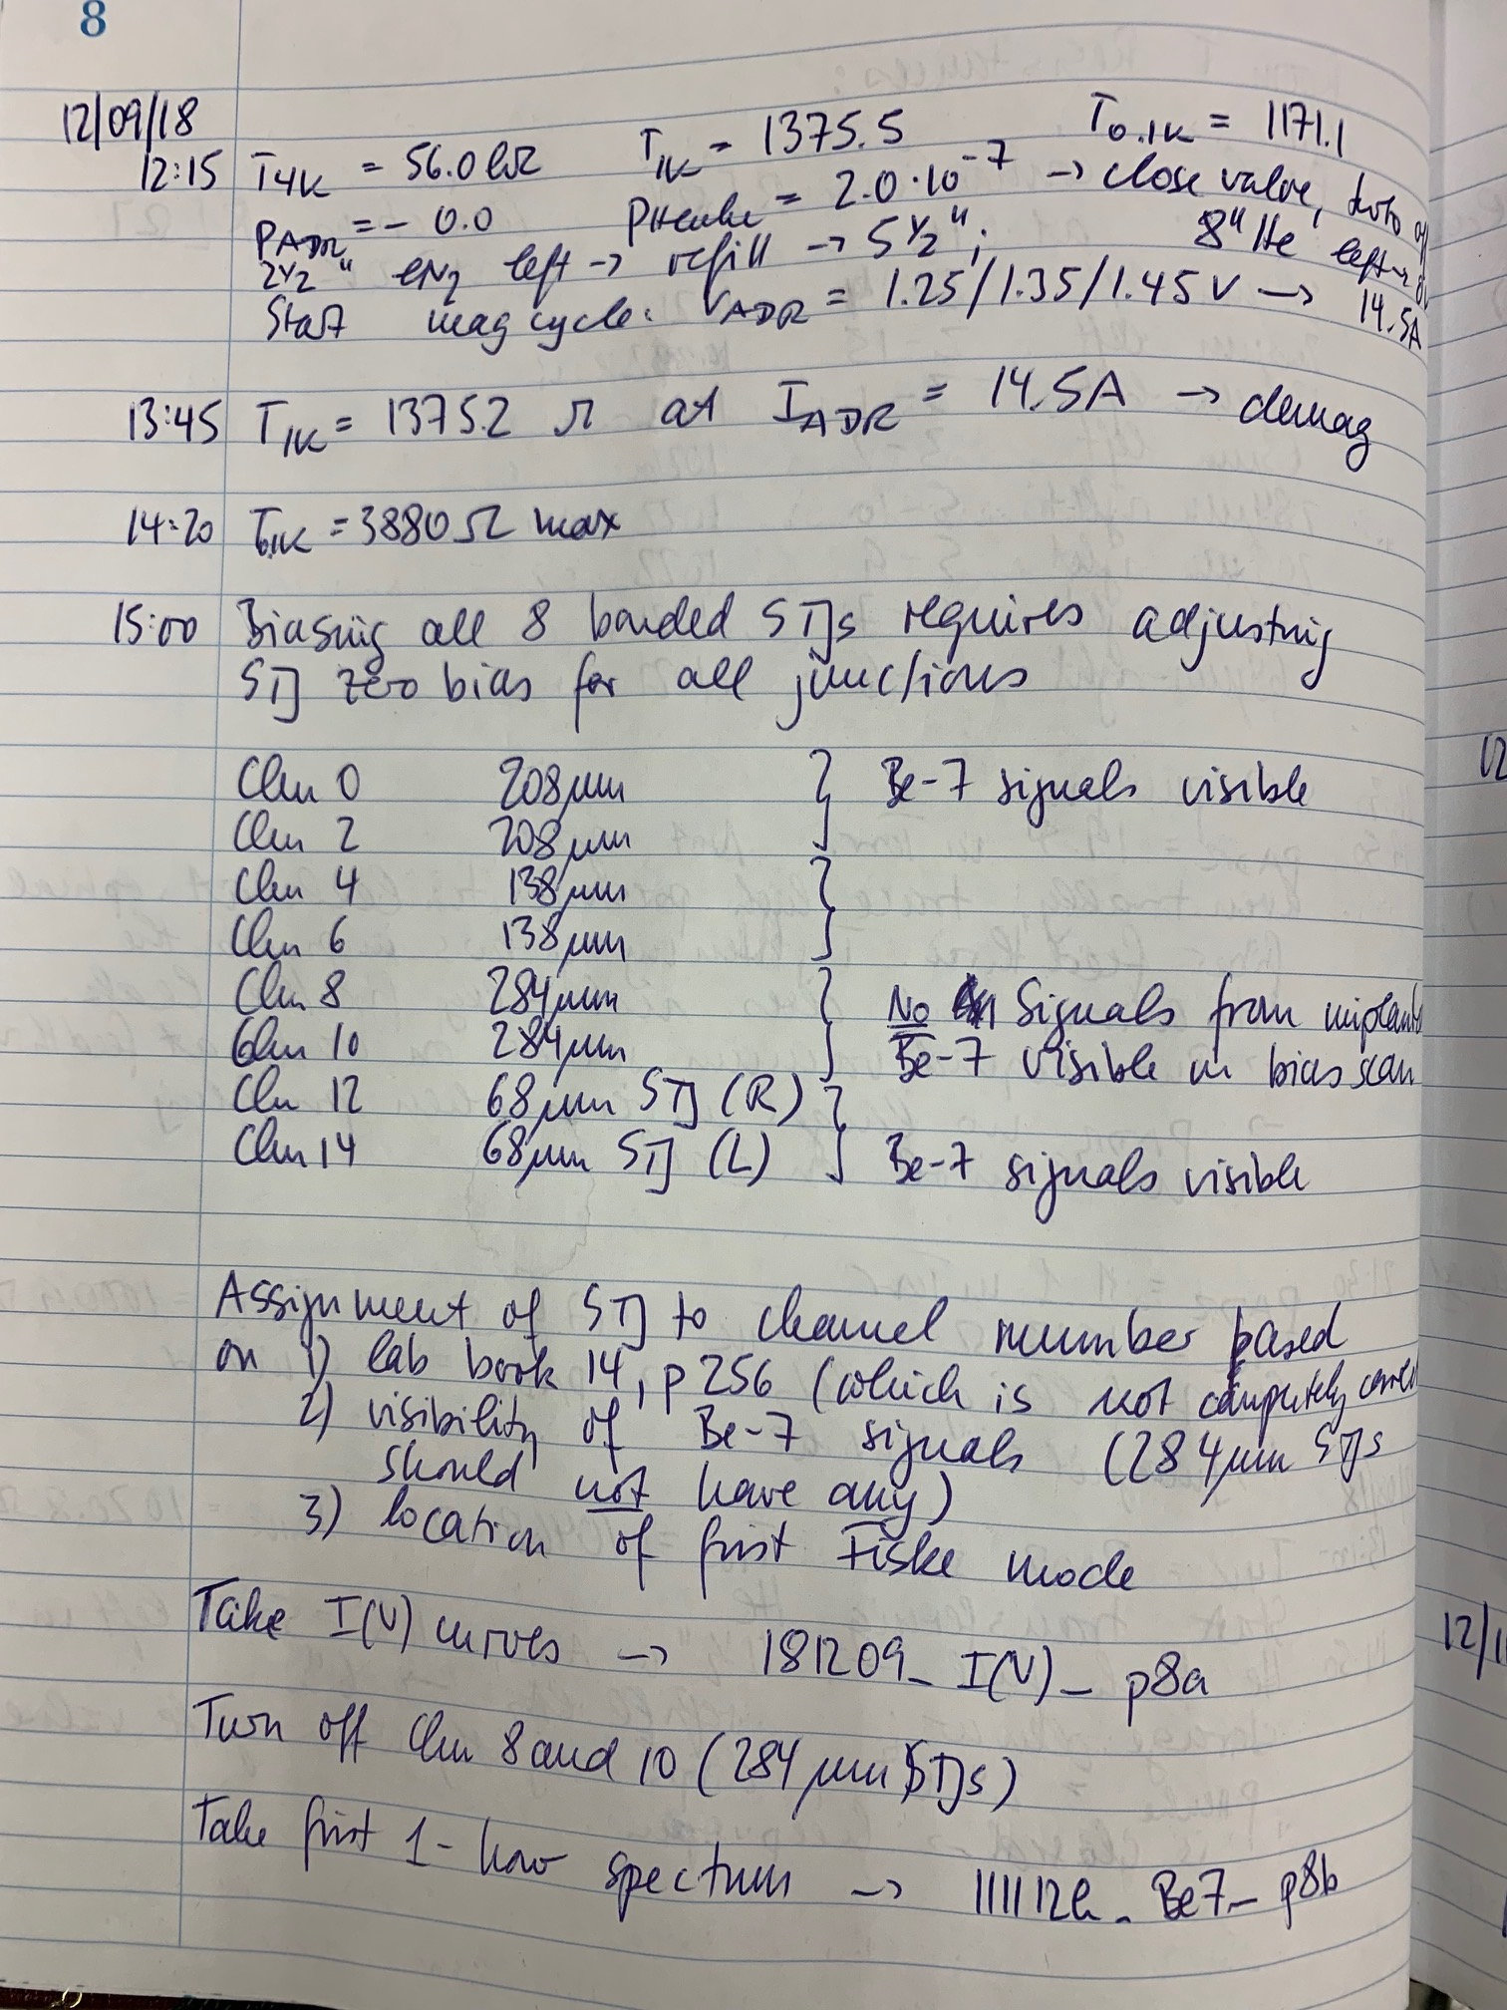
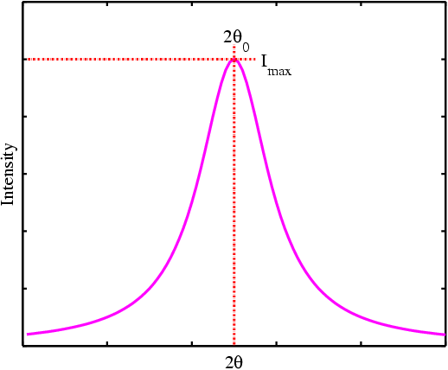
“First Light” of the BeEST
December 2018: Shipped to LLNL from TRIUMF
Dec 2018 – March 2019: Installed in ADR for three separate runs
April 2019: Analyzed data from two 68x68 μm² STJs
⁷Be K-shell EC to ⁷Li g.s.
⁷Be L-shell EC
to ⁷Li g.s.
⁷Be K-shell EC to
⁷Li excited state
“First Light” Dec 9, 2018
…“Be-7 signals visible”…
Recall: The basic expectation is 4 peaks
⁷Be L-shell EC to
⁷Li excited state
0
50
100
Energy (eV)
K.G. Leach – The BeEST Experiment
University of Regina Physics Colloquium
October 22, 2021

Slide 10
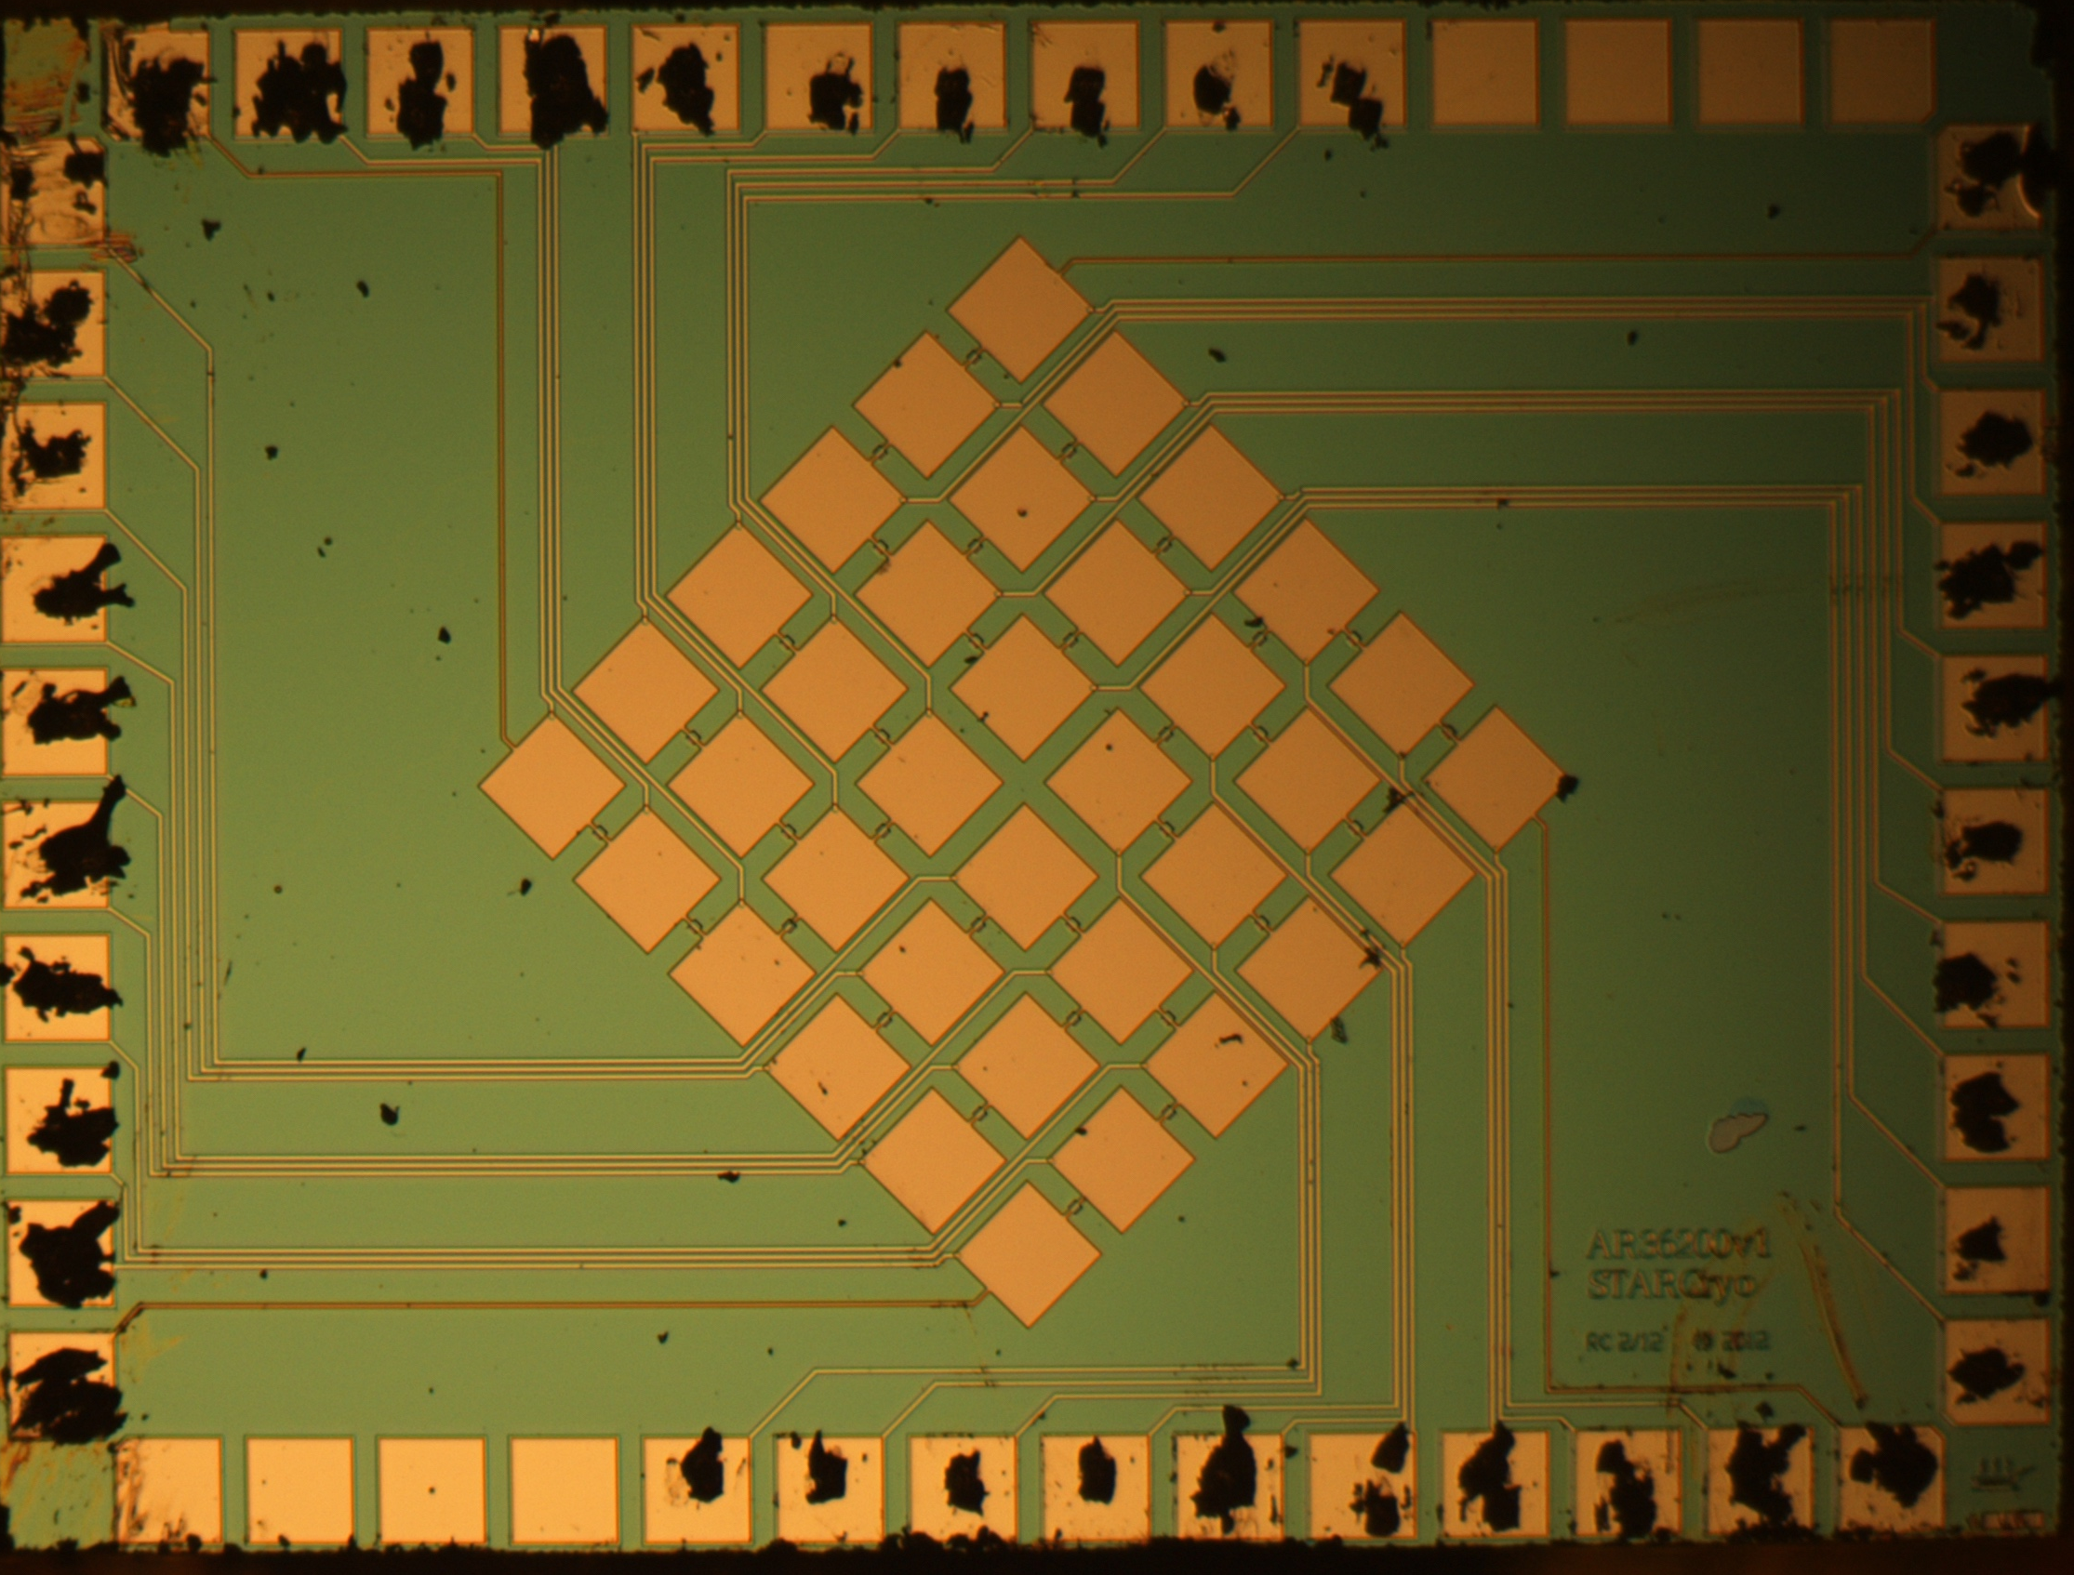
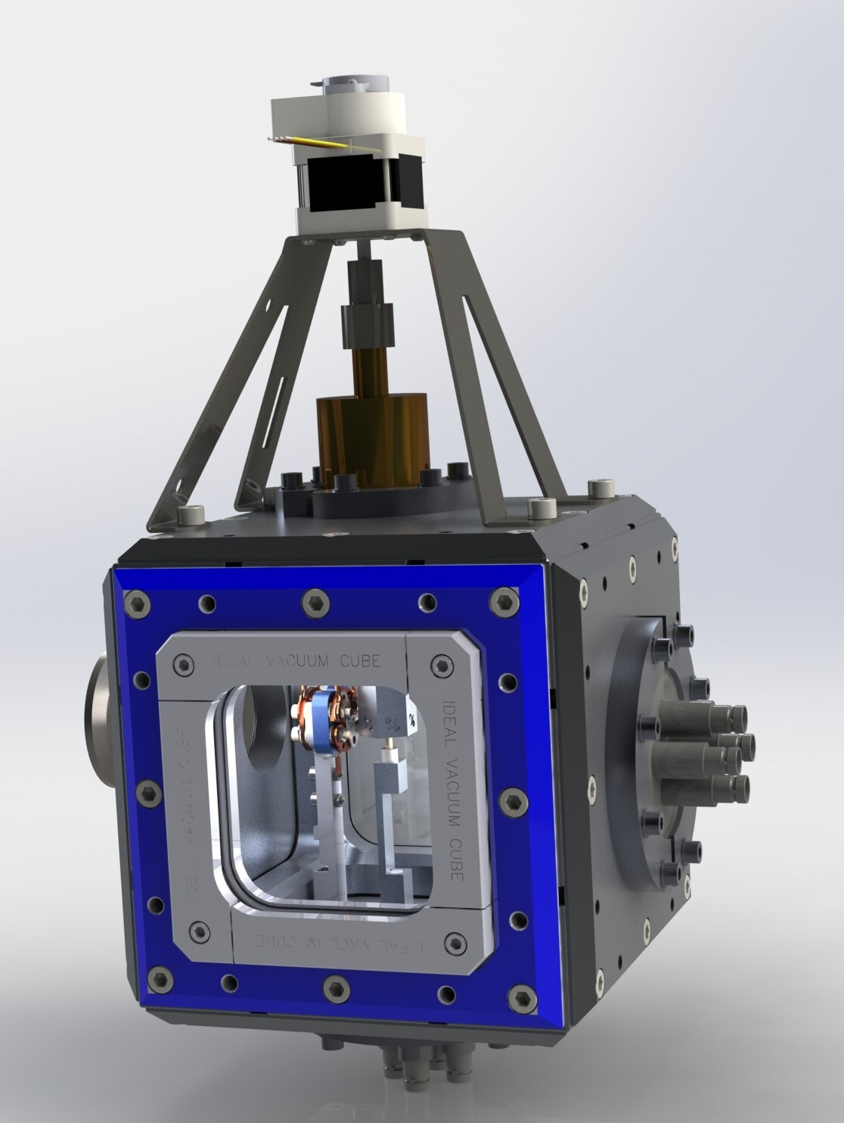
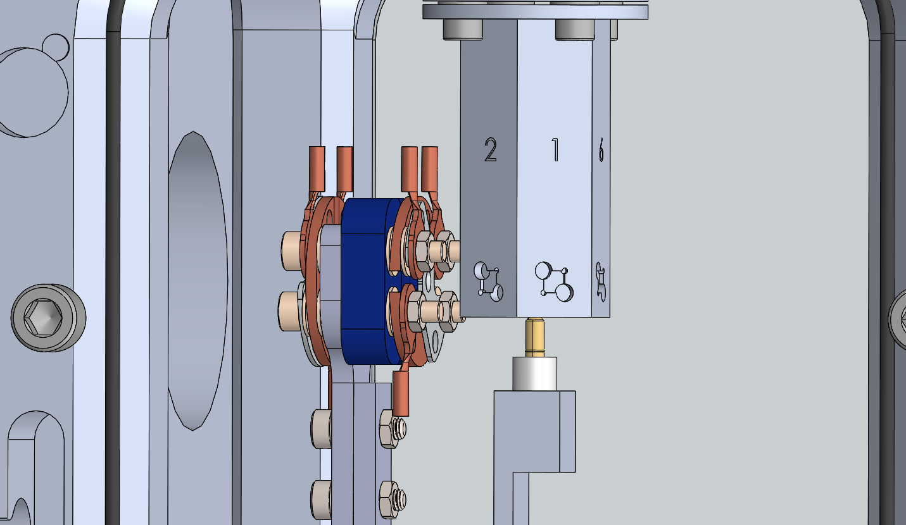
The Current Status of the BeEST Experiment
Phase-I: Proof of Concept
2018-2020
I
First implantation of rare isotopes into STJs
“First Light” December 2018 – concept demonstrated
L/K capture ratio
PRL 125, 032701 (2020)
JLTP 200, 205 (2020)
JLTP 209, 796 (2022)
2019-2021
II
Phase-II: First Search for Heavy Neutrinos
First physics limits
PRL 126, 021803 (2021)
JLTP 209, 857 (2022)
JLTP 209, 1063 (2022)
First precision calibration in-situ
Characterization of decay-induced backgrounds
2021-2025 (Data Unblinding Stage)
III
Phase-III: Scaling to Multi-Pixel Arrays
36-Pixel Ta STJ array
Pure ⁷Be beam (TRIUMF)
First atomic/materials estimates
Wavepacket, masses, particles search
PR Appl. 19, 014302 (2023)
PRC 109, L022501 (2024)
PRD 111, 052010 (2025)
Nature 638, 640 (2025)
arXiv:2411.08076 (PRL submitted)
2025-2030 (Development)
IV
Phase-IV: High-Sensitivity Search with 128-Pixel Al STJ Array
Development of new Al STJs (higher resolution)
Experimental running in Dilution Refrigerator
Improved searches

Slide 11
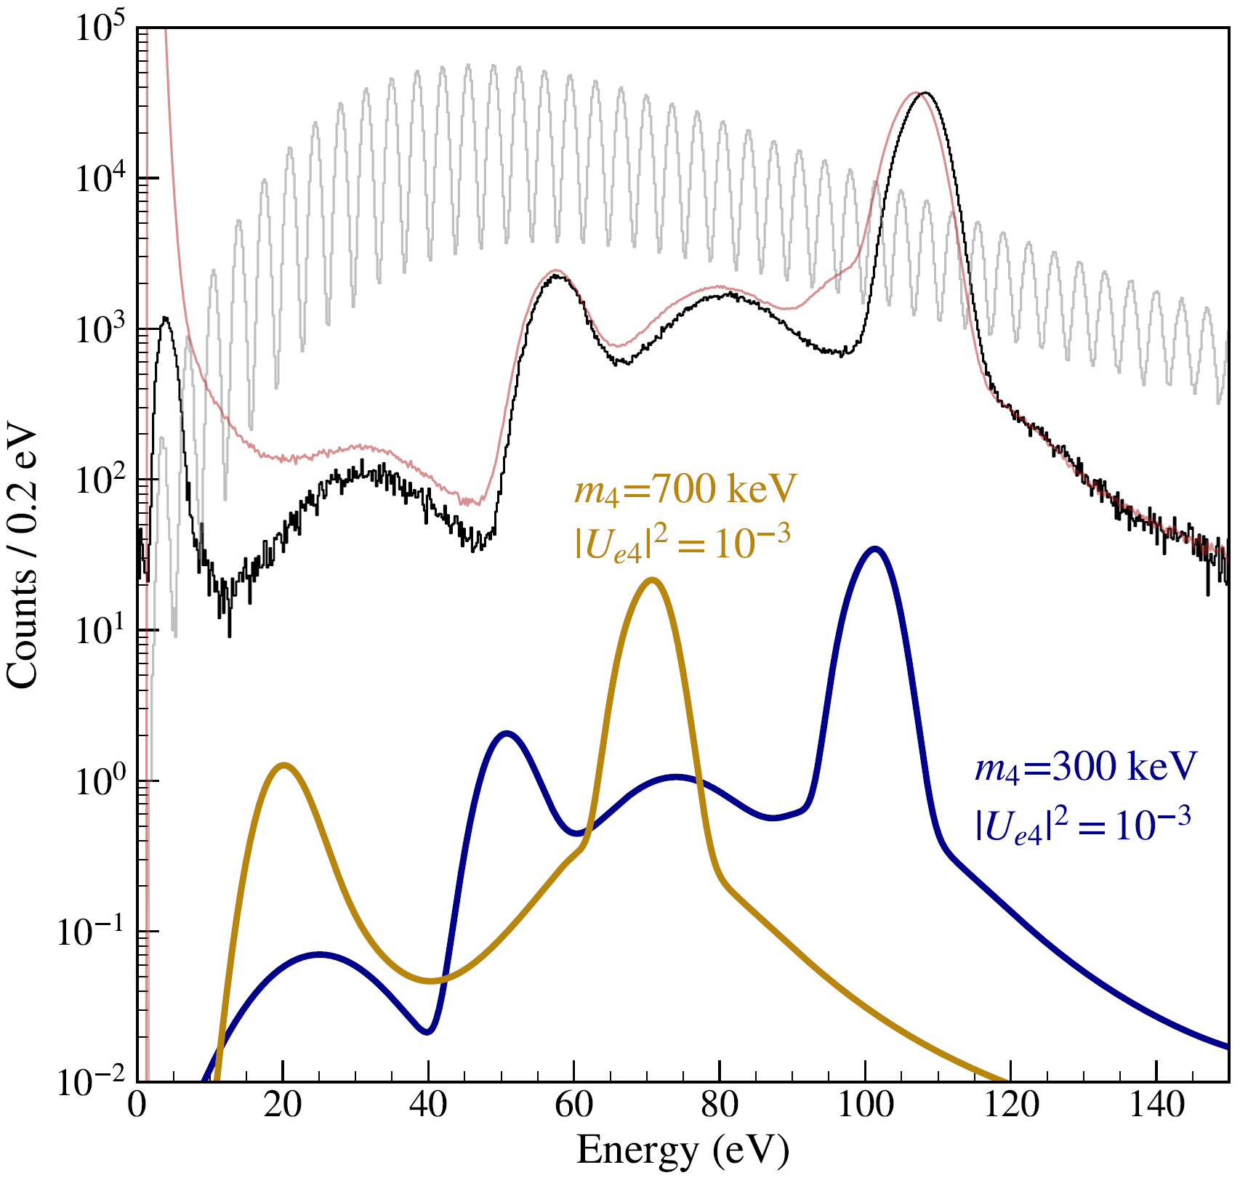
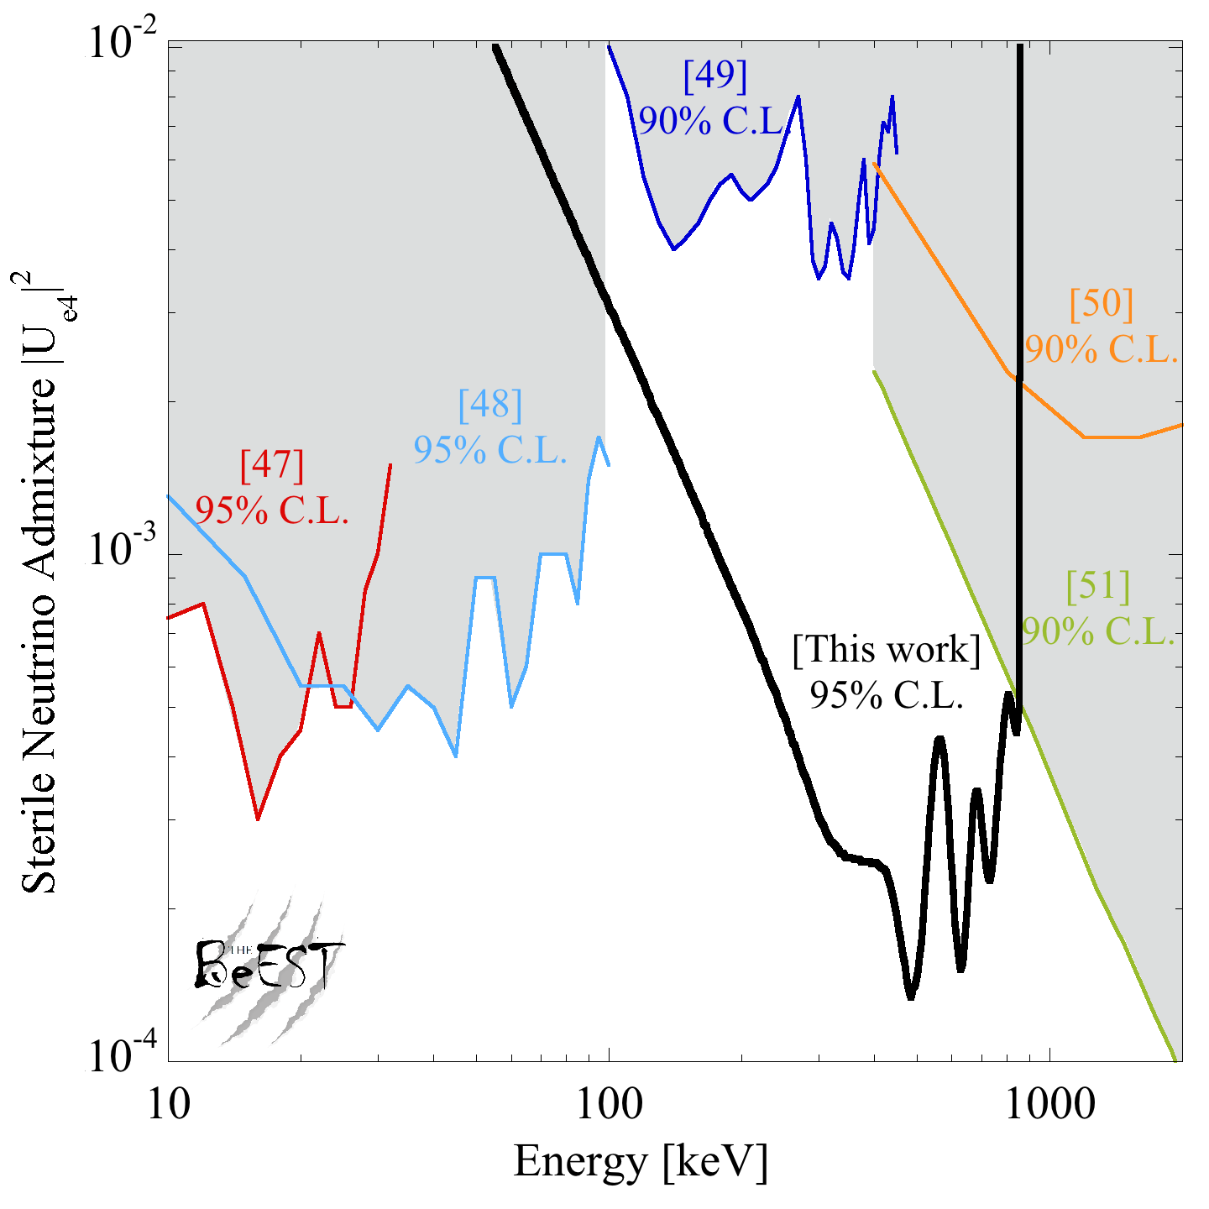
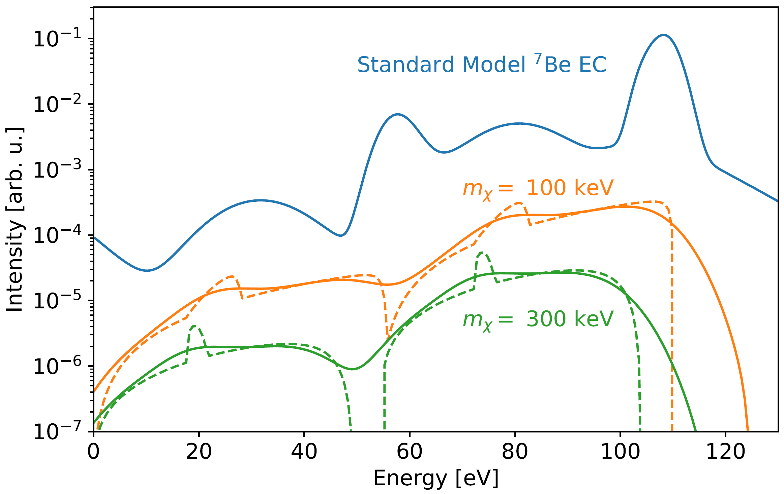
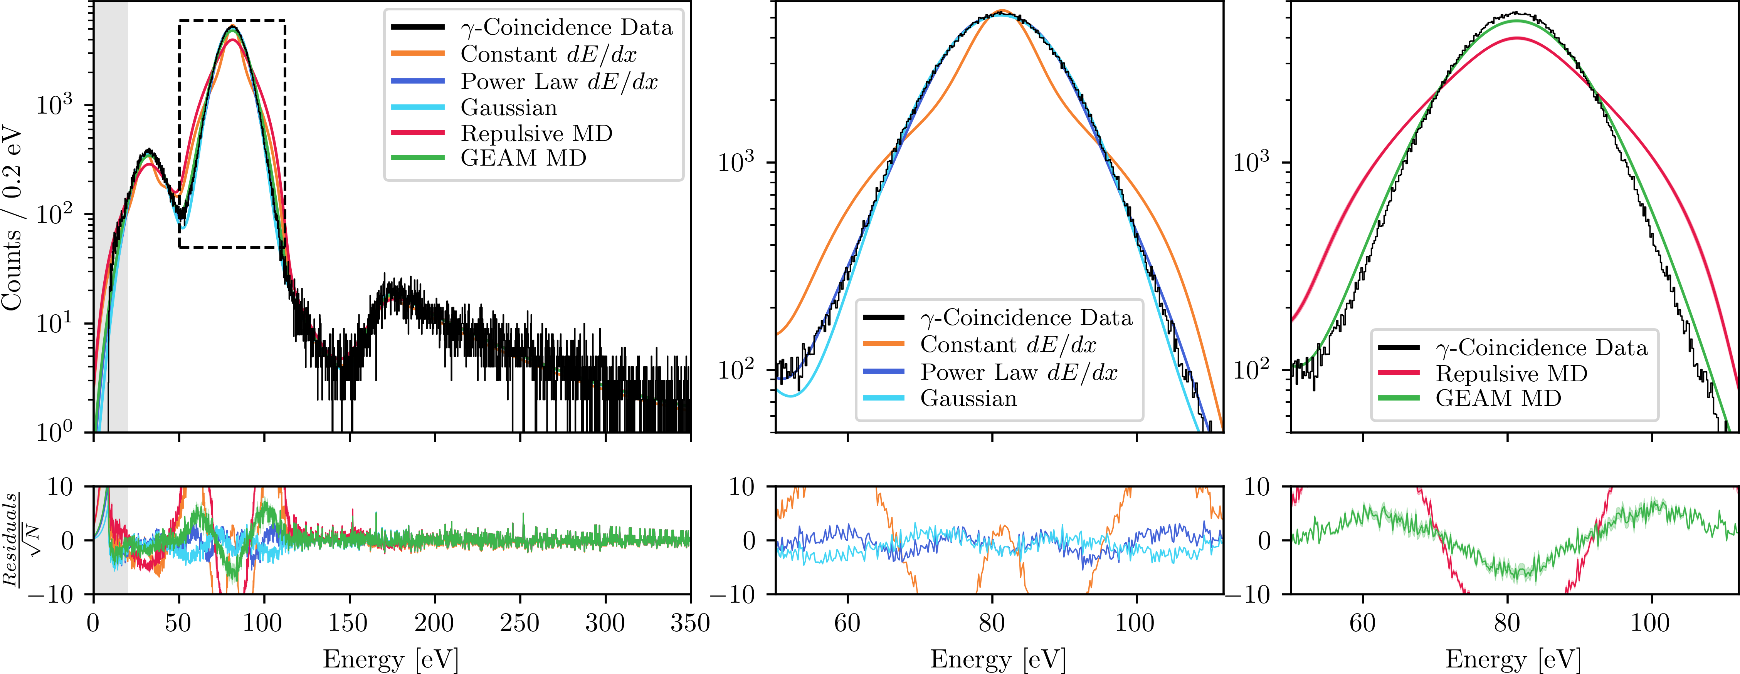
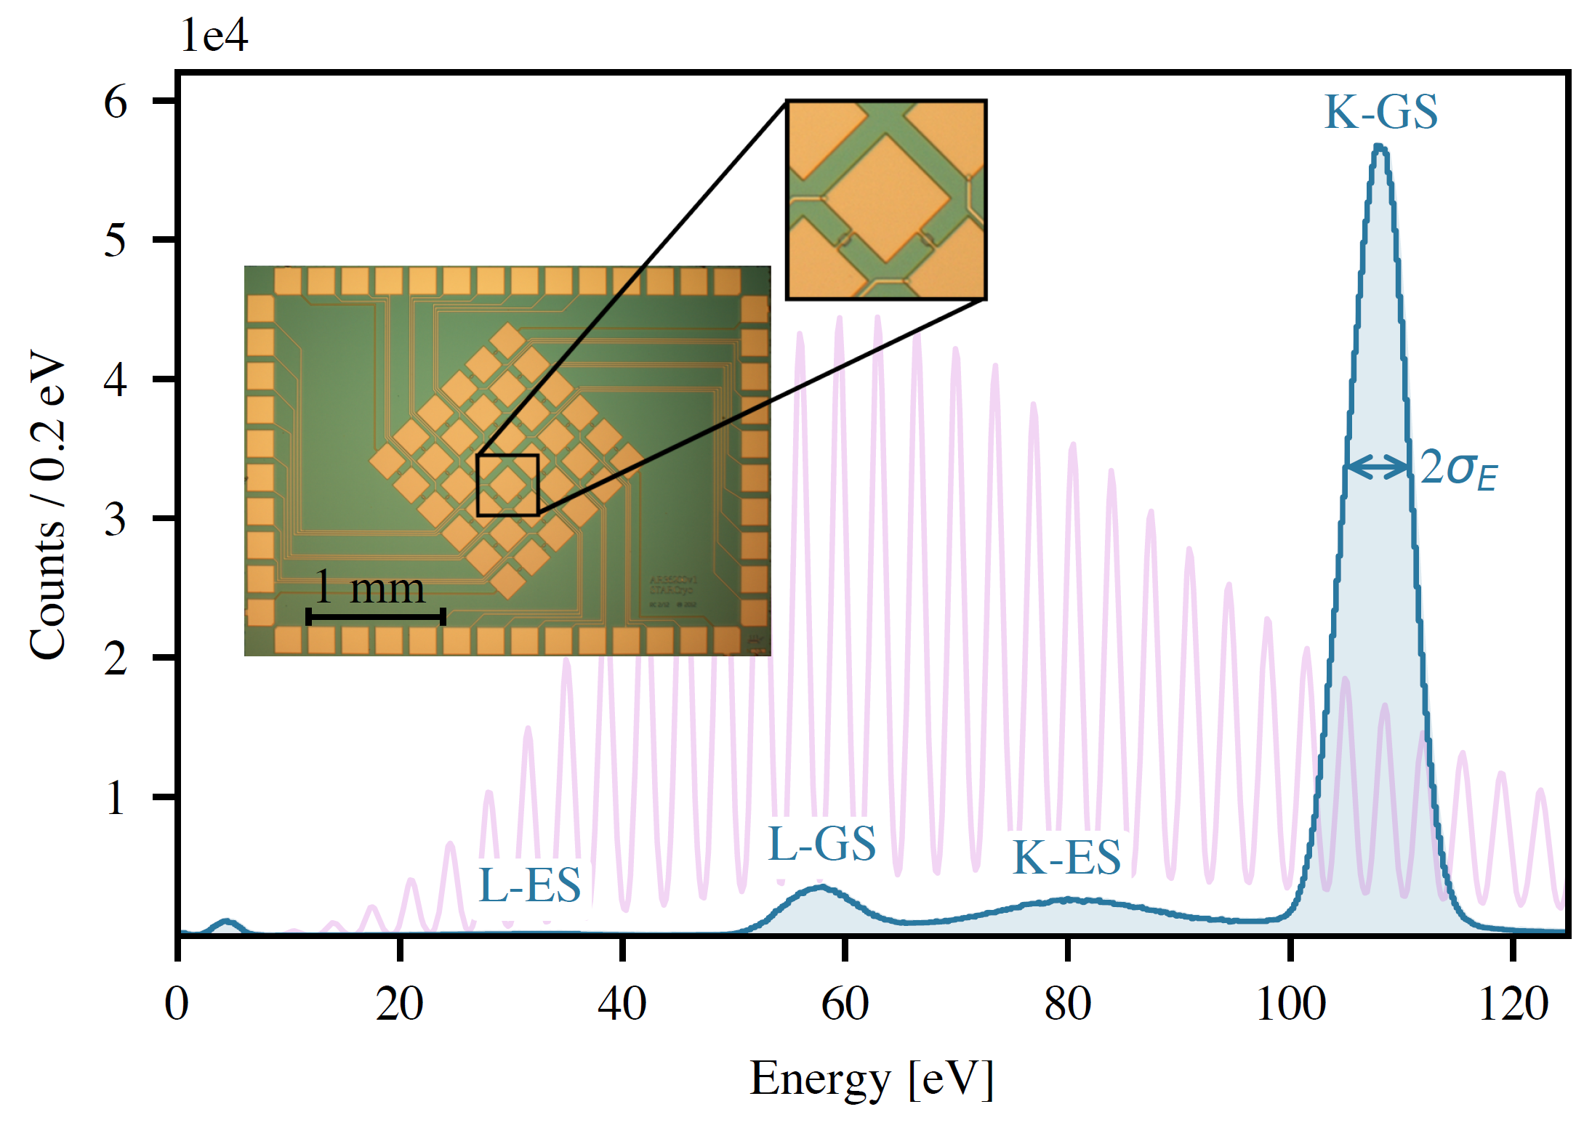
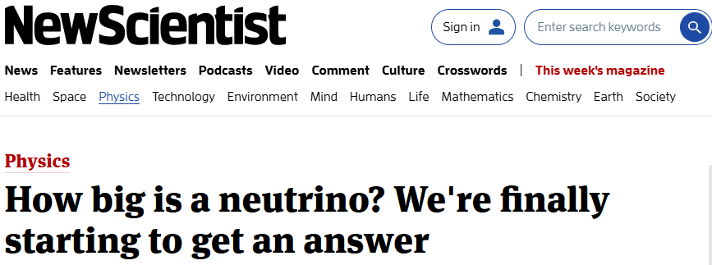
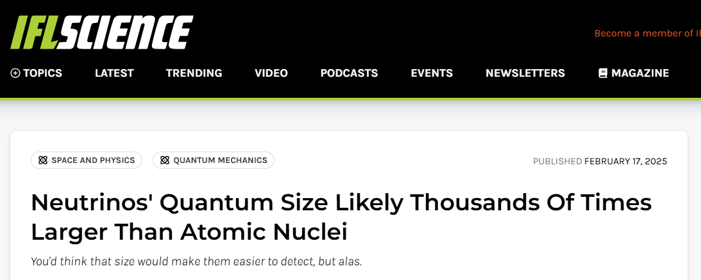
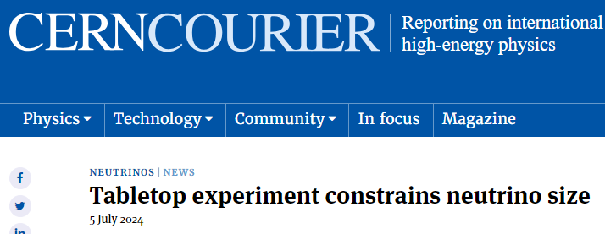
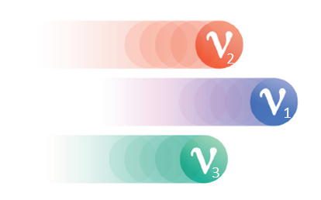
Existing Fundamental Science Program with the BeEST
Heavy Neutral Lepton Search (Sterile Neutrinos)
Search for sub-MeV New Particles (e.g. Majorons)
χ
Leendert Hayen – tomorrow afternoon
Inwook Kim – this afternoon
Phase-II: PRL 126, 021803 (2021)
Phase-III: PRD 111, 052010 (2025) – Analysis Procedure
(coming soon!) – Updated Sterile Search
eV-Scale Nuclear Stopping Powers in Matter
Fundamental Tests of QM: Localization and Entanglement
Connor Bray – tomorrow afternoon
Joe Smolsky – tomorrow afternoon
Nature 638, 640–644 (2025)
PRL (submitted) arXiv:2411.08076

Slide 12
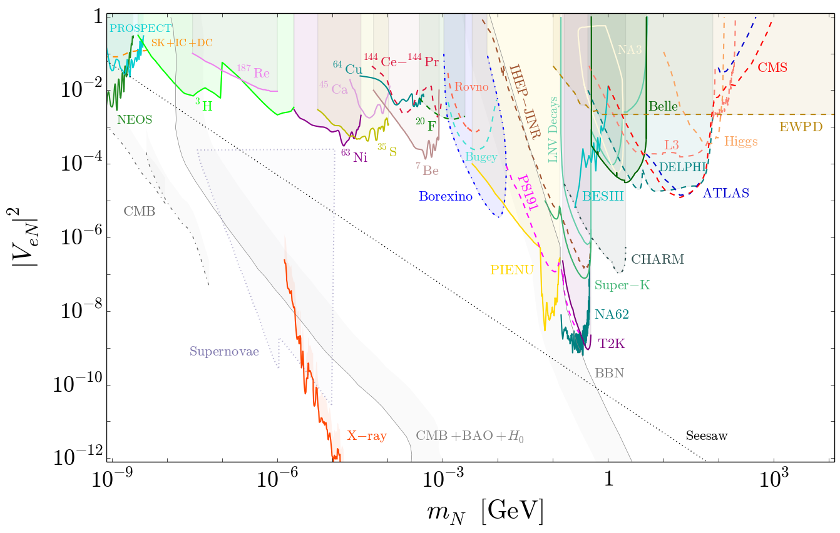
From Phase-III to –IV, and Beyond
Beyond the BeEST – Thursday Afternoon
⁷Be
³⁷Ar
Increased statistics
New STJ sensors
Improved stability
Better modeling
New physics directions
tomorrow afternoon

Slide 13
Comments from 2023 Meeting – Starting Phase-III
A better understanding of the ⁷Be decay spectrum in Ta including atomic and materials effects
Theoretical spectrum of radiation following ⁷Be decay including atomic rearrangement/effects
Modeling of material shifts to the spectrum to possibly understand broadening
Materials imaging of our samples using TEM, SEM, and APT
Optimization of ⁷Be implantation at TRIUMF-ISAC
Higher energy and purity ⁷Be source for implantation
Understanding depth profile and uniformity for implantation into Ta
Scaling of experiment to 36- and 112-pixel arrays of Ta-based STJs
Evaluate scaling effects (electronics, backgrounds, cooling, etc.)
Quantify uniformity of detector and electronics response across pixels
Examine possibility of continuous DAQ with pulse shape analysis
Measurement of experimental spectrum via gamma coincidence. (related to point 1)
Major milestone: Limits on sub-MeV BSM neutrino mass from STJ array counting for 1 month at a rate of 1 kHz

Slide 14
Comments from 2023 Meeting – Starting Phase-III
A better understanding of the ⁷Be decay spectrum in Ta including atomic and materials effects
Theoretical spectrum of radiation following ⁷Be decay including atomic rearrangement/effects
Modeling of material shifts to the spectrum to possibly understand broadening
Materials imaging of our samples using TEM, SEM, and APT
Optimization of ⁷Be implantation at TRIUMF-ISAC
Higher energy and purity ⁷Be source for implantation
Understanding depth profile and uniformity for implantation into Ta
Scaling of experiment to 36- and 112-pixel arrays of Ta-based STJs
Evaluate scaling effects (electronics, backgrounds, cooling, etc.)
Quantify uniformity of detector and electronics response across pixels
Examine possibility of continuous DAQ with pulse shape analysis
Measurement of experimental spectrum via gamma coincidence. (related to point 1)
Major milestone: Limits on sub-MeV BSM neutrino mass from STJ array counting for 1 month at a rate of 1 kHz

Slide 15
Goals of the 2023 Meeting
Collect ourselves in person for the first time! Enjoy discussion and collaboration within our group.
Develop a clear path forward for extracting the Phase-III data and its subsequent analysis.
Understand limiting factors in the existing spectral response from our experience with Phase-I and Phase-II, and how to better model/understand these in the Phase-III data.
Discuss order of information dissemination for 2023 and Phase-III in general
More formally define leadership roles within the collaboration, and responsibilities
Look at our resources as a group and see where we need to increase effort or funding.

Slide 16
Goals of the Meeting This Year
Collect ourselves in person for the first time in 2 years! Enjoy discussion and collaboration within our group, and the hospitality of the TRIUMF team
Expand the collaboration with new members from McGill, SLAC, Yale, and others
Finalize steps for extracting primary physics from the Phase-III data analysis.
Explore new physics directions with existing data, and new concepts.
Formally initiate Phase-IV and inform members of group of plans and roles.
Look at our resources as a group and see where we need to increase effort or funding.
Look beyond “The BeEST” more broadly at the concepts of nuclear recoil detection with advanced sensors

