Slide 1
Superconducting Tunnel Junction Radiation Detectors
Stephan Friedrich, LLNL
Outline
• Textbook case: “Standard” STJs
• Real life: “Non-standard” events cause artifacts
• What’s next?

Slide 2
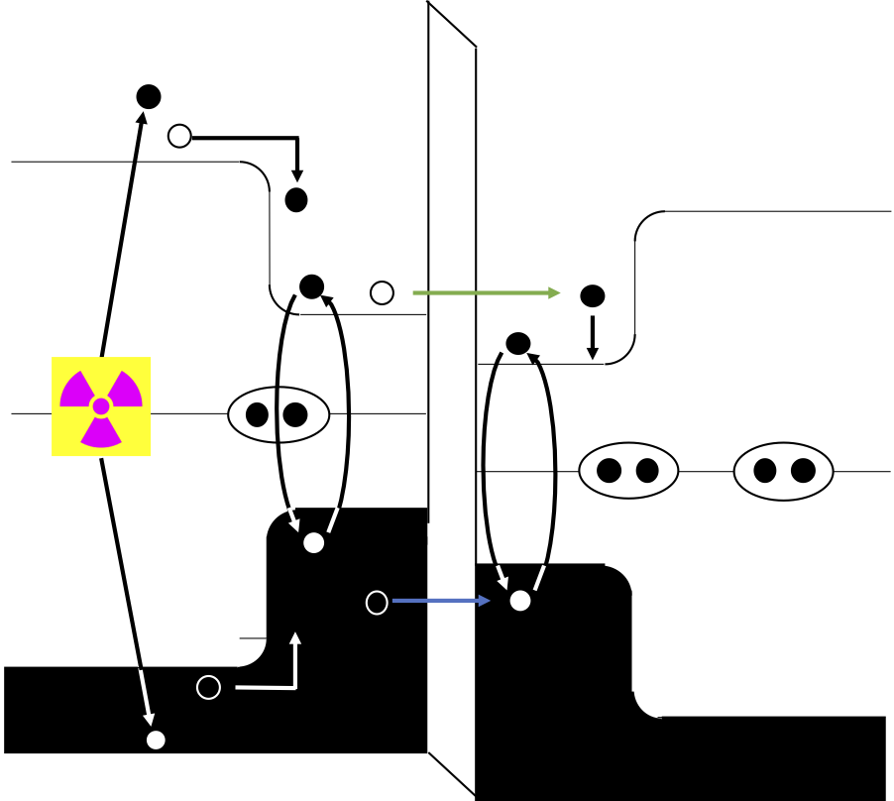

The Workhorse: Ta-Based STJs
STJ Cross Section
STJ Operating Principle
Ta Al AlOx Al Ta
Photon or ⁷Be
E_{F}+Δ_{Ta}
Al₂O₃
Ta Absorber
E_{F}
Al
Al
Ta
Si Substrate
E_{F}–Δ_{Ta}
• High efficiency ⇒ Thick, large gap absorber
• Fast tunneling ⇒ Thin, small gap trap
• Small (~1 meV) gap Δ ⇒ High resolution (~1-2 eV)
• Short (~100 µs) life-time ⇒ Fast (>1 kcps per pixel)
For some of you, this is all you need to know.

Slide 3
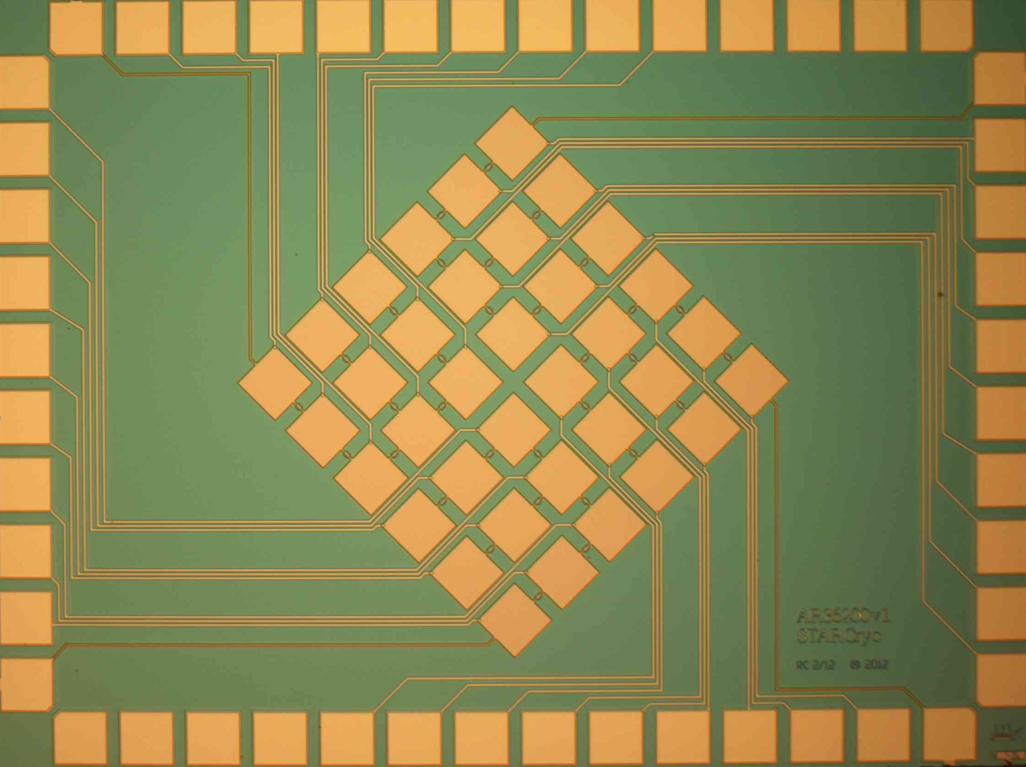
The Workhorse: Ta-Based STJs
STJ Cross Section
The BeEST Experiment
Ta-STJ
Photon or ⁷Be
Al₂O₃
Ta Absorber
Al
Al
Ta
Si Substrate
• High efficiency ⇒ Thick, large gap absorber
• Fast tunneling ⇒ Thin, small gap trap
• ~2eV FWHM is enough for BeEST experiment
• Interactions with Ta absorber affect spectral details
For some of you, this is all you need to know.

Slide 4
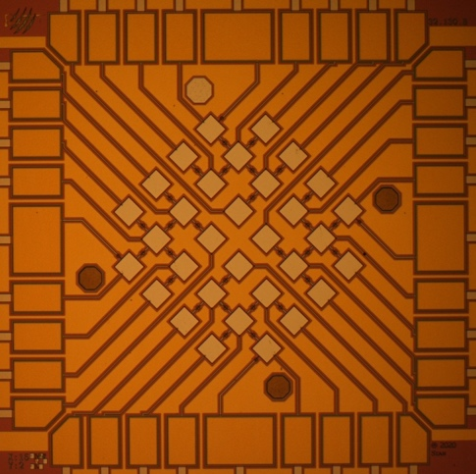
The Alternative: Al-Based STJs
STJ Cross Section
Al-STJ
Photon or ⁷Be
Al₂O₃
Al Absorber
Al
Si Substrate
• Need thick Al absorber for high efficiency
⇒ Slow tunneling ⇒ small signal ⇒ low resolution

Slide 5
The Alternative: Al-Based STJs
STJ Cross Section
Al-STJ Performance
Photon or ⁷Be
Al₂O₃
Al Absorber
Al
Si Substrate
• Need thick Al absorber for high efficiency
⇒ Slow tunneling ⇒ small signal ⇒ low resolution
• Not great, but good enough
• Can be improved (thinner barrier) if needed
With STJs from two materials, we are I think in pretty good shape.

Slide 6
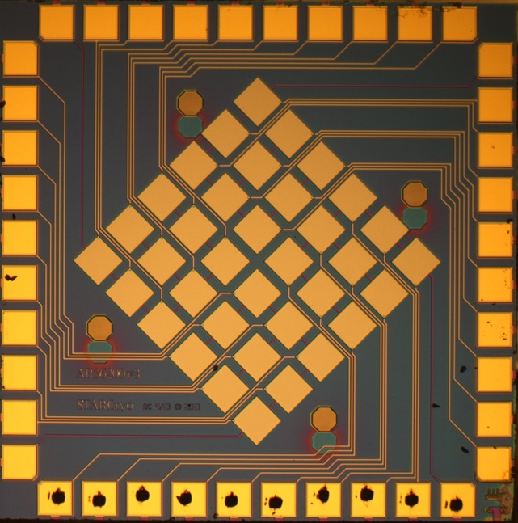
The Third Option: Nb-Based STJs
STJ Cross Section
Nb-STJ
Photon or ⁷Be
Al₂O₃
Nb Absorber
Al
Al
Nb
Si Substrate
• High efficiency ⇒ Thick, large gap absorber
• Fast tunneling ⇒ Thin, small gap trap
Possible reasons to develop Nb-STJs: 1) Yet another material. 2) Speed.

Slide 7
The Third Option: Nb-Based STJs
STJ Cross Section
1990’s Nb STJ Performance
[Friedrich 1998]
[Friedrich 2002]
Photon or ⁷Be
Al₂O₃
Nb Absorber
Al
Al
Nb
Si Substrate
• High efficiency ⇒ Thick, large gap absorber
• Fast tunneling ⇒ Thin, small gap trap
• We do have good Nb-STJs from the 1990s
• Current Nb-STJs have (so far) lower resolution
Possible reasons to develop Nb-STJs: 1) Yet another material. 2) Speed.

Slide 8
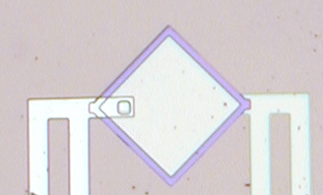
Events at “Non-Standard” Locations Cause Spectral Artifacts
Artifacts are much worse in Nb-STJs where life-time is much shorter
Nb-STJ (1990s)
Wire
above
STJ
↓
Surface Oxide
Edge
Via
↓
Wire
Wire
Wire above STJ
Surface Oxide
Oxide
Absorber
Wire
Wire
Si substrate
Base layer

Slide 9
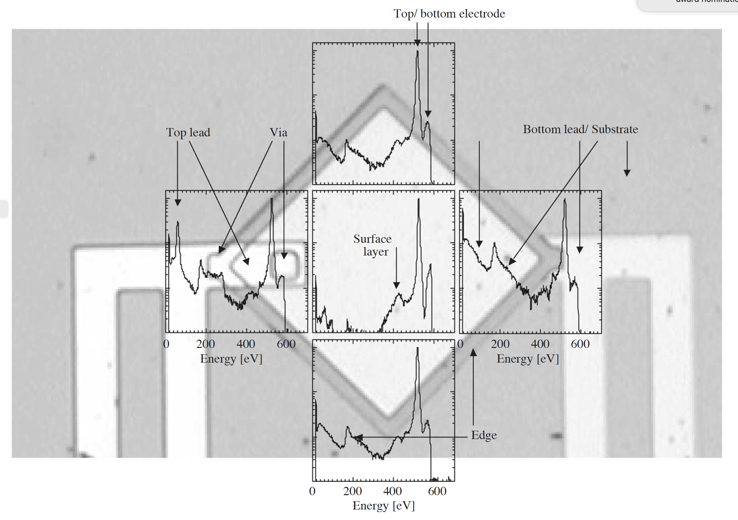
Artifacts (1): Line Splitting Due to Base Layer Events
Top/bottom electrode
X-rays or ⁷Be
Top (absorber)
Bottom electrode
Remedies:
1) High-Z absorber (Nb → Ta)
2) Thick absorber (165 → 300nm → ?)
3) Low E implantation or low E photons
Events in bottom electrode have different responses from top electrode. ⇒ Avoid

Slide 10
Artifacts (2): Edge Events Can Produce Tails
Top
X-rays or ⁷Be
Top (absorber)
Edge
Bottom electrode edge
Edge
Edge
Remedies:
1) Minimize edge area
2) Do not expose edge to radiation
(Si collimator or photoresist mask)
Edge
Charge recombination in edge of base electrode causes tail. ⇒ Minimize!

Slide 11
Artifacts (3): Wire on Top of STJ is Bad
Top
X-rays or ⁷Be
Top lead
Top (absorber)
Remedies:
1) Minimize insulator (SiO₂ → anodization)
2) Minimize wiring overlap
3) Do not expose edge to radiation
(Si collimator or photoresist mask)
Events in wiring have different responses. ⇒ Minimize!

Slide 12
Artifacts (4): Surface Oxides are Bad (Native Ta₂O₅ Seems OK)
X-rays or ⁷Be
Surface SiO₂
Remedies:
1) No SiO₂ on top of absorber
2) Native Ta₂O₃ seems ok
Residual SiO₂ at surface produces broad background. ⇒ No SiO₂!

Slide 13

Improved STJ Designs Minimize (but do not Fully Remove) Artifacts
Nb-STJs (1990s)
Ta-STJs (2020s)
Small
wire
overlap
↓
Large
wire
overlap
↓
Residual SiO₂
on surface
No SiO₂
on surface
↑
Narrow
contact
↑
Wide
contact
↑
Narrow edge
↑
Wide edge
Via
Residual SiO₂
SiO₂
Anodization→

Slide 14

Photoresist Masking Does Remove (Most) Artifacts
Ta-STJs with PR Mask
Ta-STJs (2020s)
Ta-STJ →
Photoresist mask →
Photoresist
e-
mask
Removes all artifacts except those form e- escape.

Slide 15
Capping Layer Suppresses Electron Escape
One (out of 10) Ta-STJs with Ta Cap
Ta-STJs (2020s)
Photoresist
Ta cap layer
mask
Works! So far yield is small. (We know how to fix this.)

Slide 16
Capping Layer Suppresses Electron Escape
One (out of 10) Ta-STJs with Ta Cap
Ta-STJs (2020s)
Ta cap layer
Works! So far yield is small. (We know how to fix this.)

Slide 17
Ta-STJ Response Function
Tail in Low-E Response
e- escape tail
e-

Slide 18
Ta-STJ Response Function
Tail in Low-E Response
Line Splitting at Higher Energy
⁷Be implantation in Ta base is really bad!
e- escape tail
e-
e-

Slide 19
Summary: STJ Detector Status
Absorber | Status | Resolution | Speed
Ta-STJs | Work well | 1 – 2 eV FWHM | >1 kcps
Al-STJs | Work | 2 – 4 eV FWHM | >1 kcps
Nb-STJ | Could work | ? (2 eV in 1990s) | >10 kcps

Slide 20
Summary: STJ Detector Status
Absorber | Status | Resolution | Speed
Ta-STJs | Work well | 1 – 2 eV FWHM | >1 kcps
Al-STJs | Work | 2 – 4 eV FWHM | >1 kcps
Nb-STJ | Could work | ? (2 eV in 1990s) | >10 kcps
Artifact Source | Consequence | Solution | Status
Base layer | Line splitting | Thick high-Z absorber | Works but restricts E range
Wiring + Edges | Low-E Structures | Minimize and Mask | Works (need to quantify?)
Electron escape | Low-E Tail | Capping layer | Doable (must address shorts)

Slide 21
Summary: STJ Detector Status
Absorber | Status | Resolution | Speed
Ta-STJs | Work well | 1 – 2 eV FWHM | >1 kcps
Al-STJs | Work | 2 – 4 eV FWHM | >1 kcps
Nb-STJ | Could work | ? (2 eV in 1990s) | >10 kcps
Artifact Source | Consequence | Solution | Status
Base layer | Line splitting | Thick high-Z absorber | Works but restricts E range
Wiring + Edges | Low-E Structures | Minimize and Mask | Works (need to quantify?)
Electron escape | Low-E Tail | Capping layer | Doable (must address shorts)
I think we are in pretty good shape (but improvements are always possible).

