Slide 1
STJs in Colorado –
Fridges at CURIE and Mines
May 14, 2025
Wouter Van De Pontseele
Colorado School of Mines

Slide 2
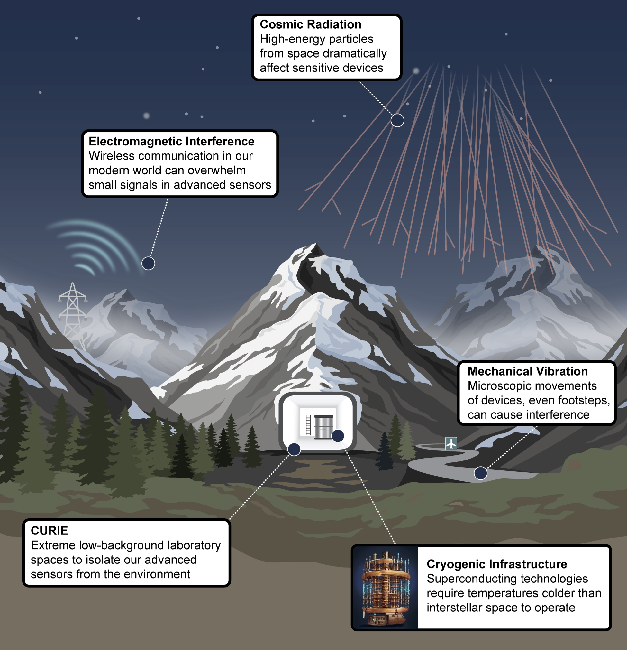

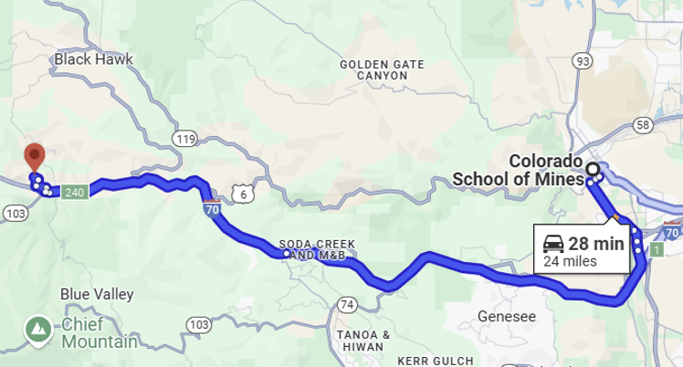
Colorado Underground Research Institute

Slide 3
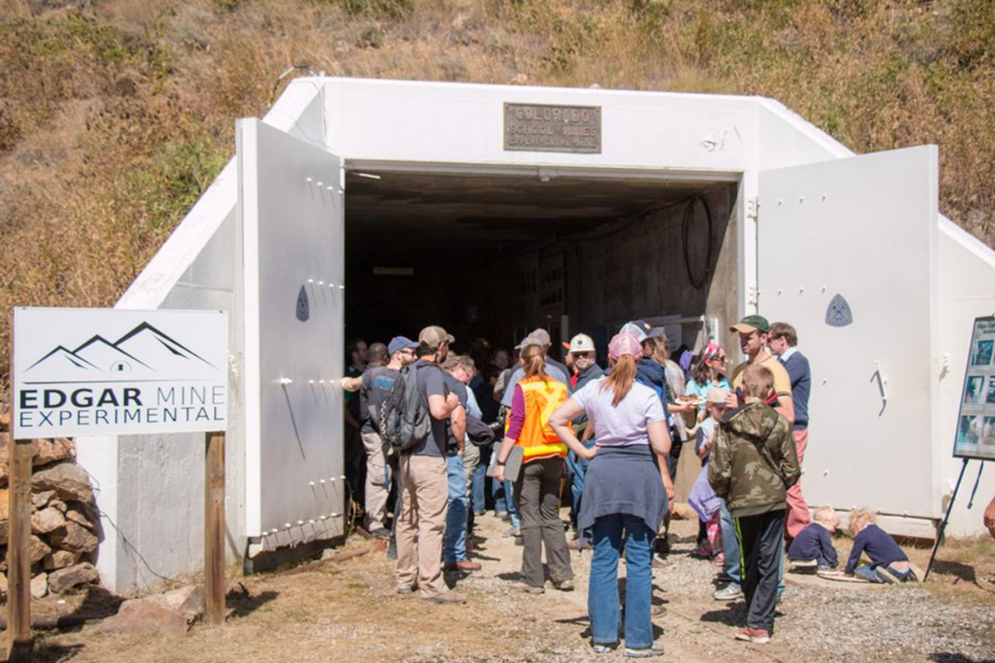
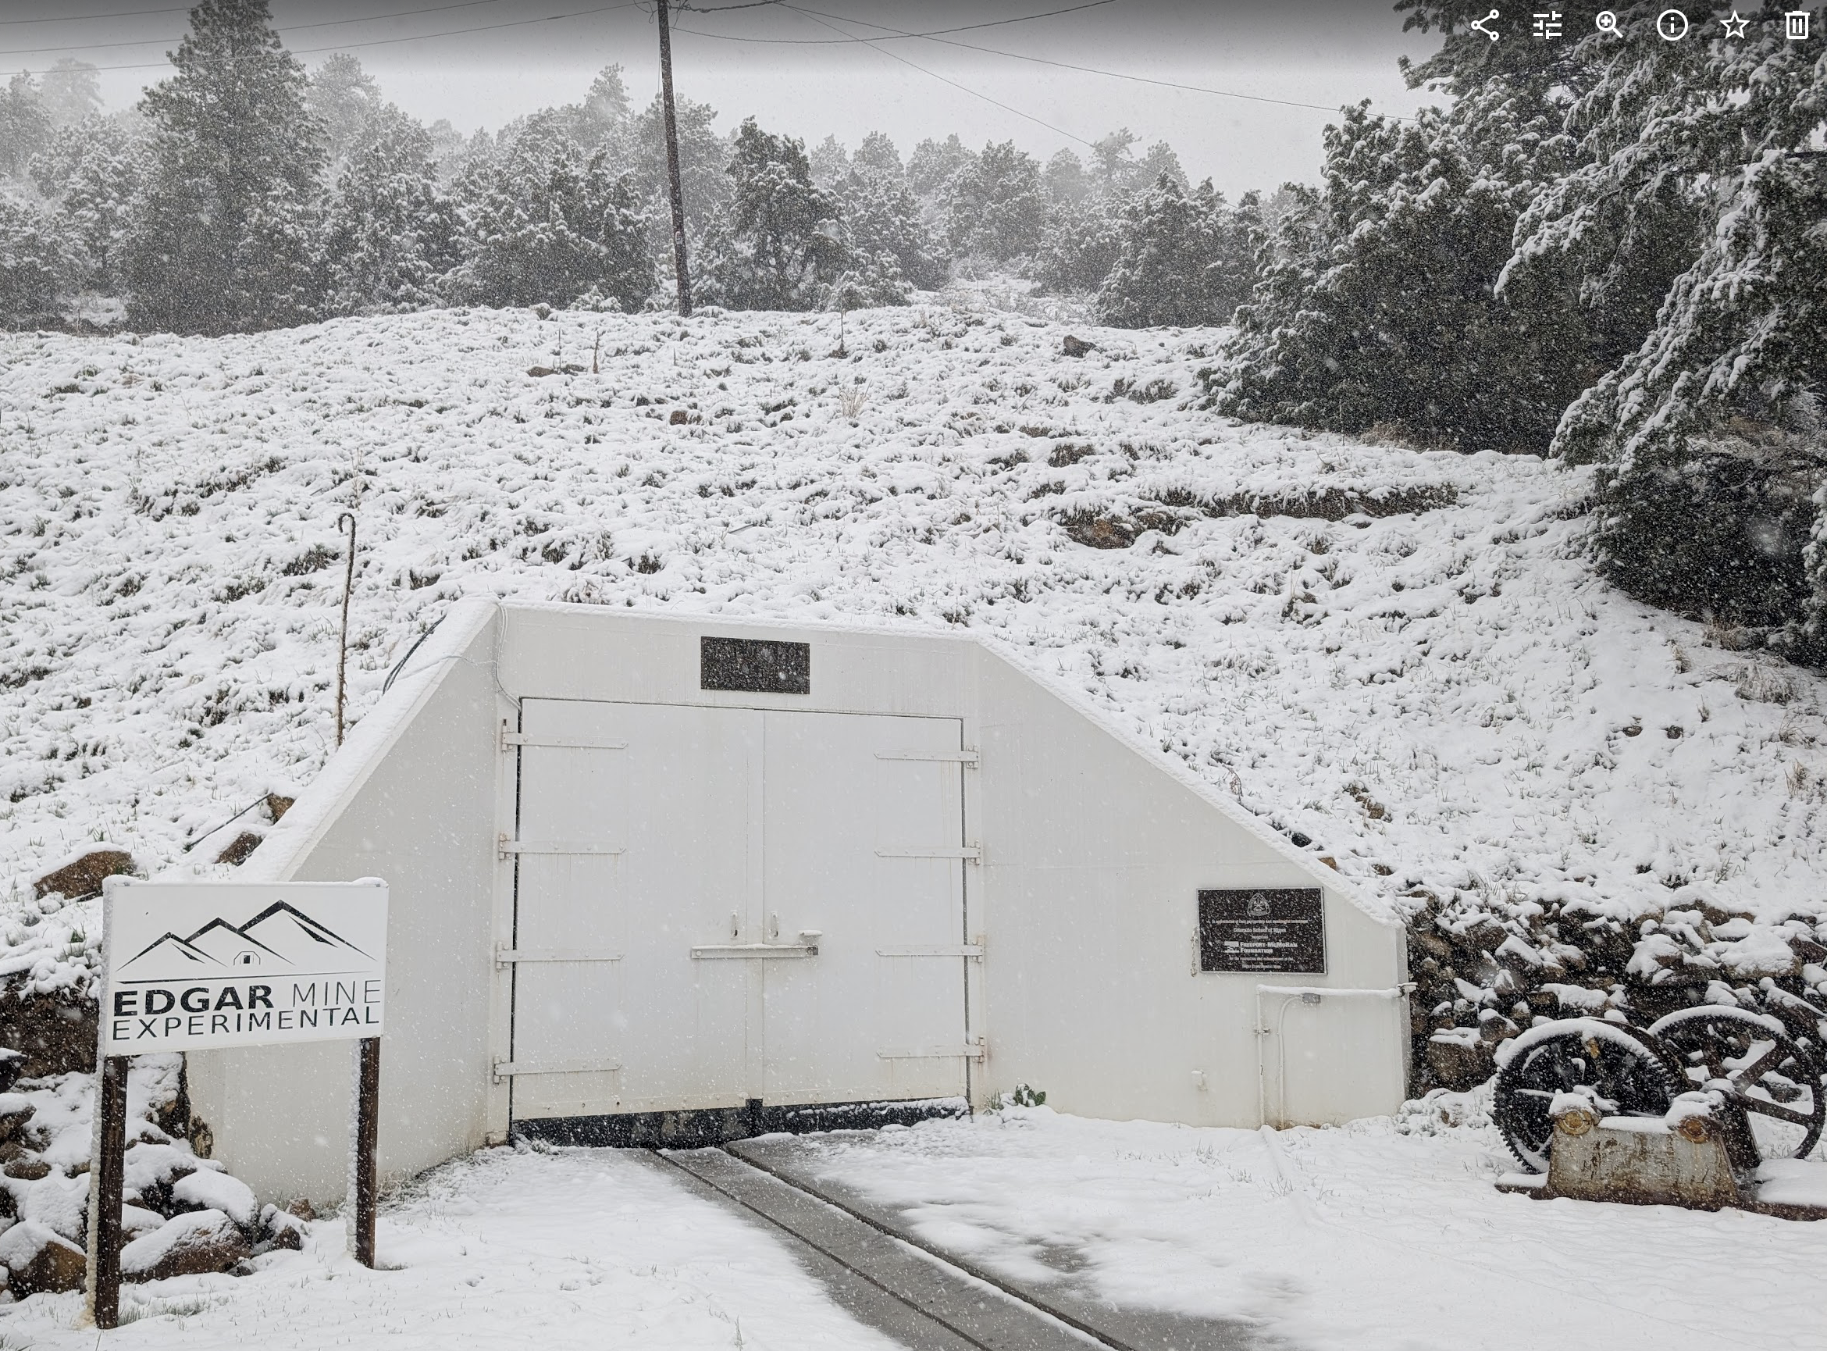
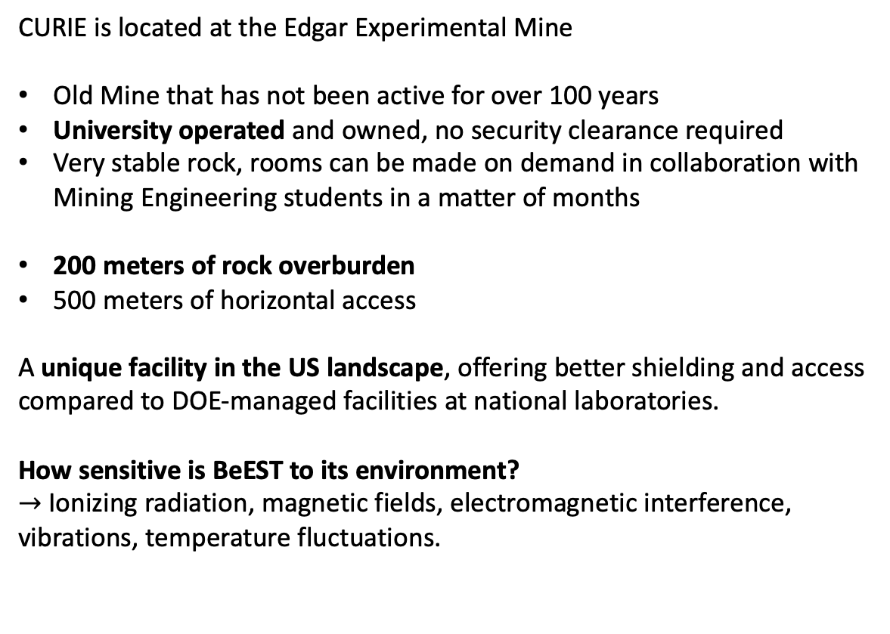
CURIE for future BeEST developments
CURIE is located at the Edgar Experimental Mine
Old Mine that has not been active for over 100 years
University operated and owned, no security clearance required
Very stable rock, rooms can be made on demand in collaboration with Mining Engineering students in a matter of months
200 meters of rock overburden
500 meters of horizontal access
A unique facility in the US landscape, offering better shielding and access compared to DOE-managed facilities at national laboratories.
How sensitive is BeEST to its environment?
$→$ Ionizing radiation, magnetic fields, electromagnetic interference, vibrations, temperature fluctuations.

Slide 4
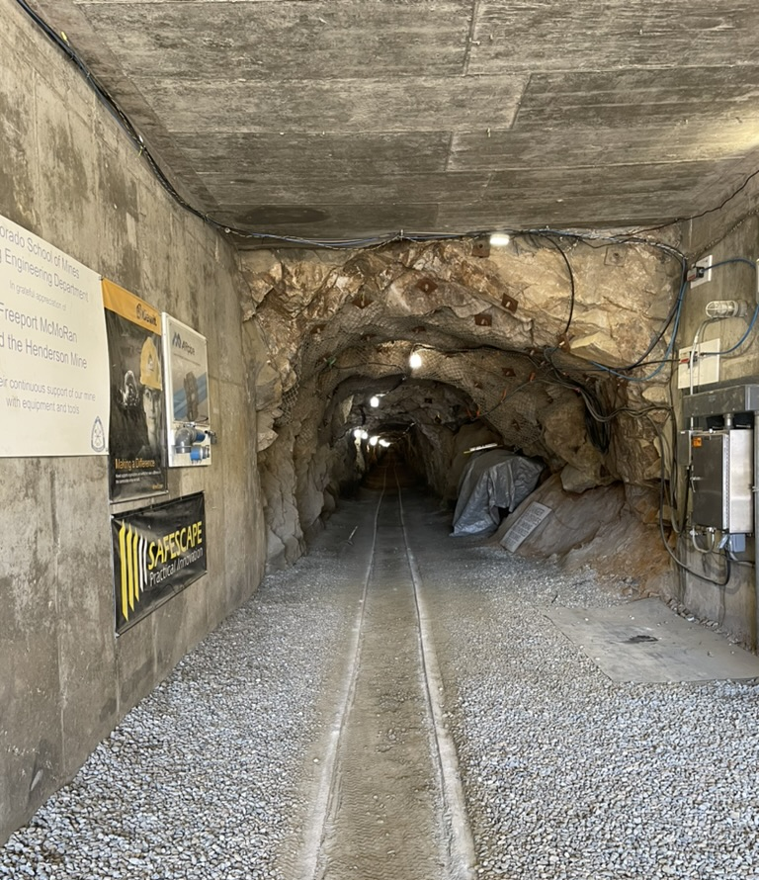
Available Infrastructure:
Power
High-speed internet
Compressed air
Radio communication
Ventilation system
Lab equipment delivery via railway system
Access tunnel (Miami)
level and roughly 2 x 2 m
Physics labs sit 400 m
from Mine entrance
CURIE
Area

Slide 5
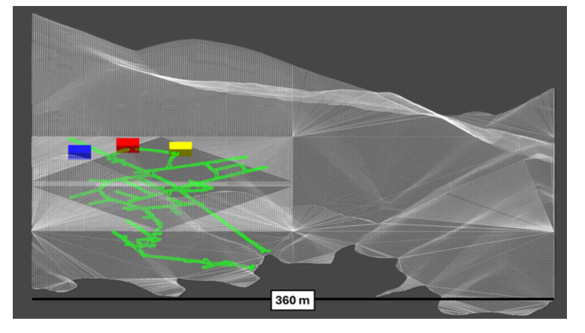
Current Physics
Lab Sites in
CURIE
Site 2: Low background 16’x15’x40’ Cryolab #1
➜ In preparation
400 m
Site 0:
Initial Tests
3D topo with
mine and sites
Future
Sites
≈200 m
0
2
Site 1: Finished
9’x9’x18’ Room
1
1 km

Slide 6
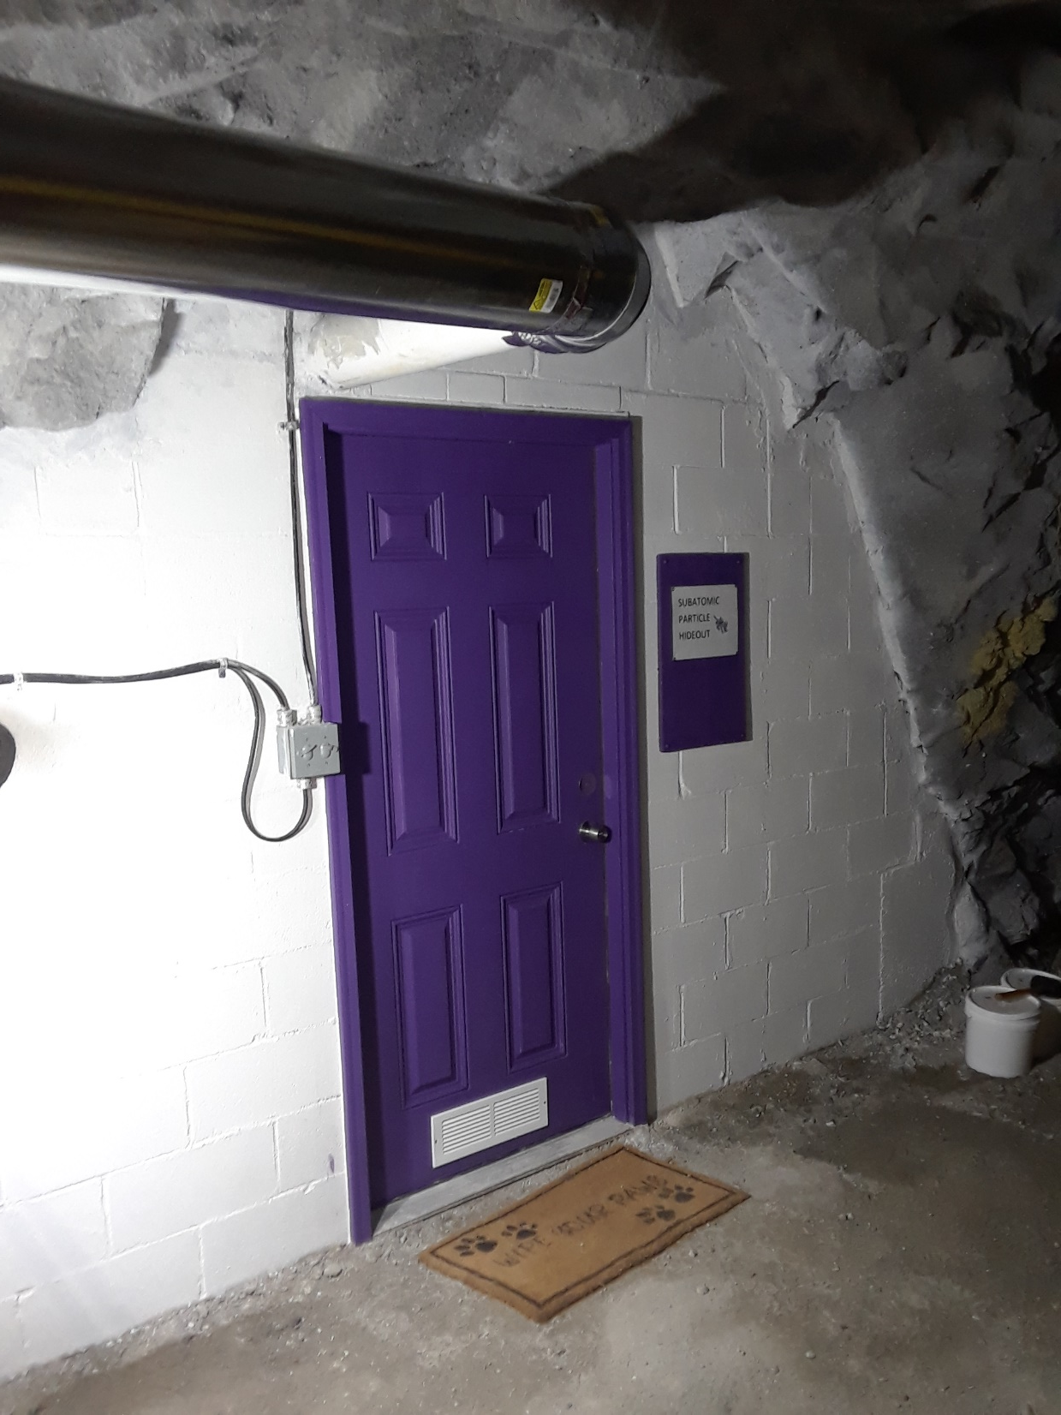
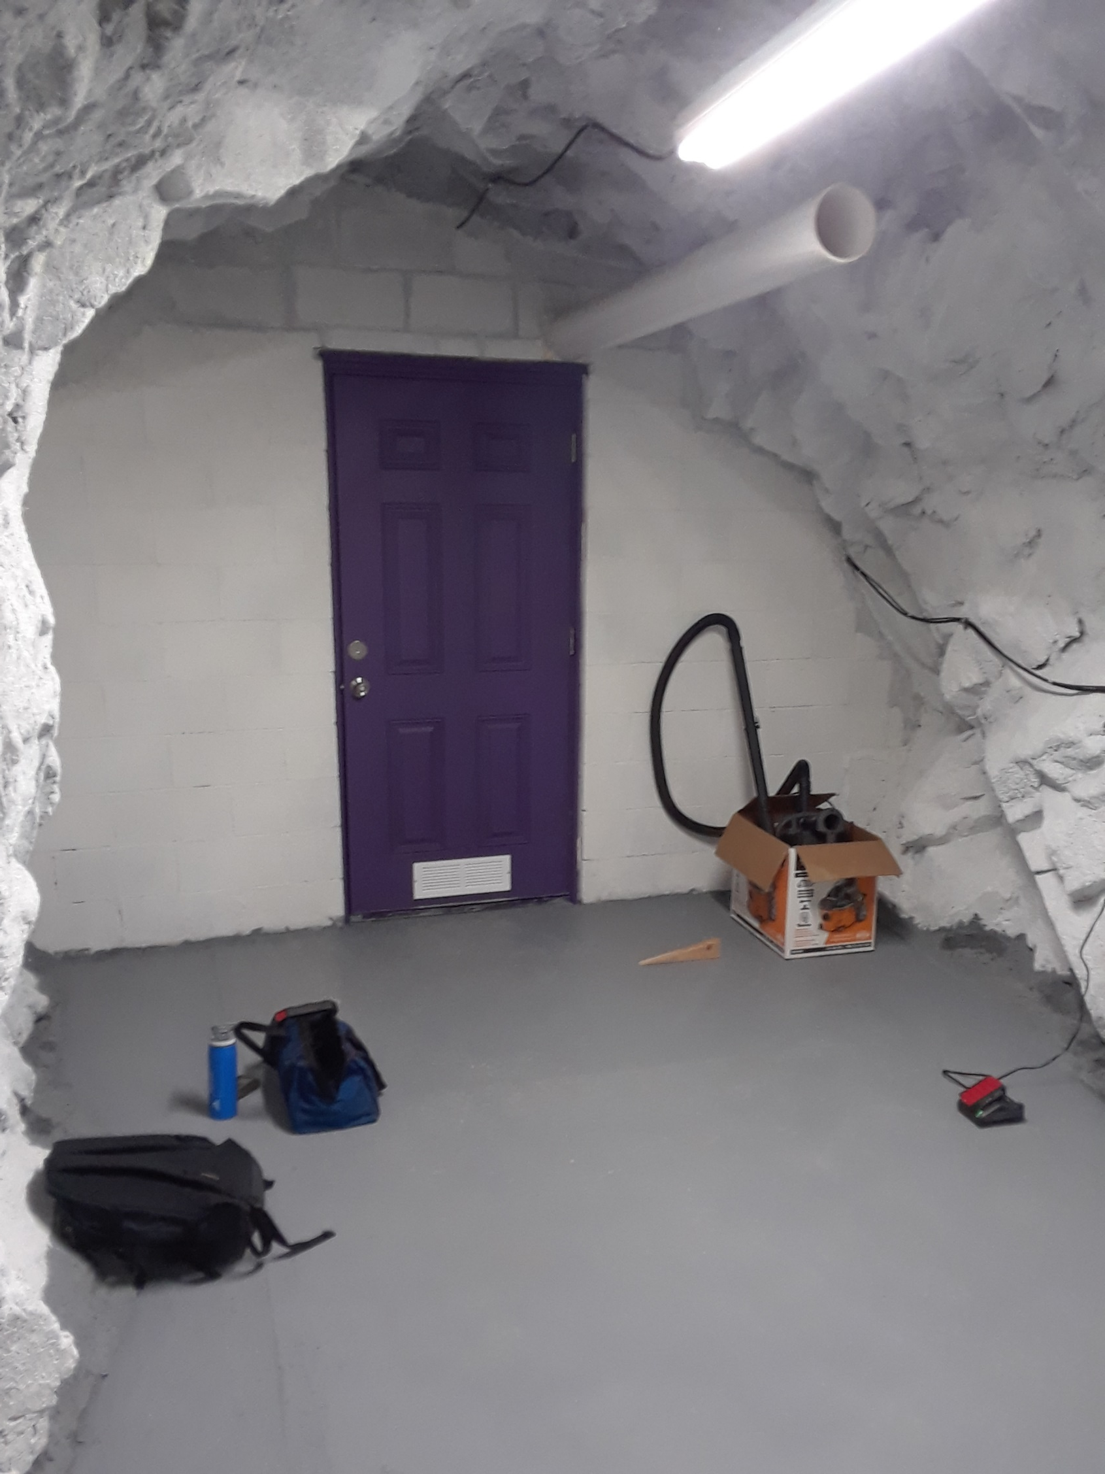
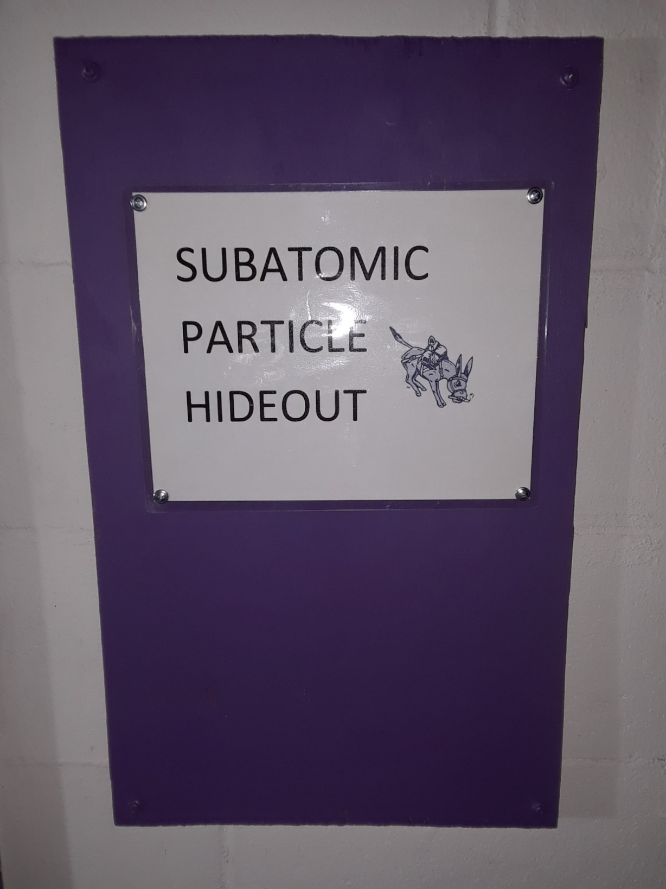
Site 1: First smaller prototype lab space
Finished July 2024

Slide 7
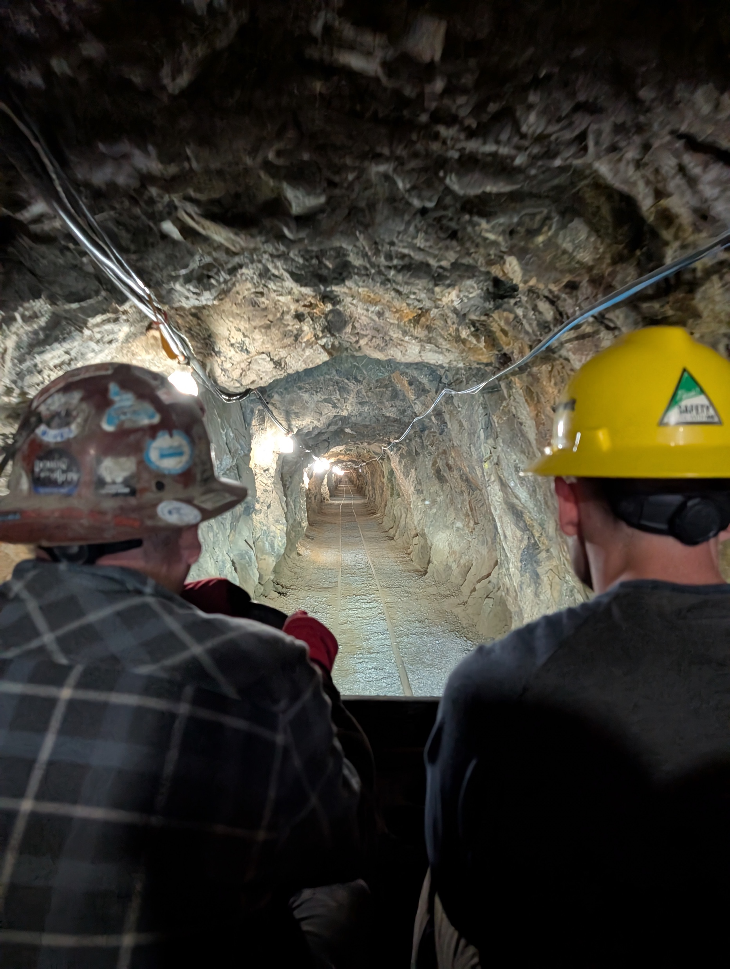
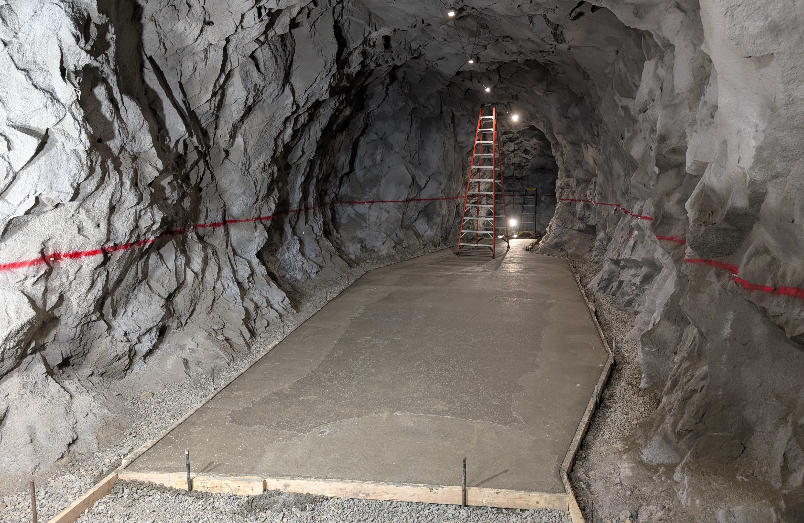
Next: Quantum Technologies at Sensitivity Frontier Lab

Slide 8
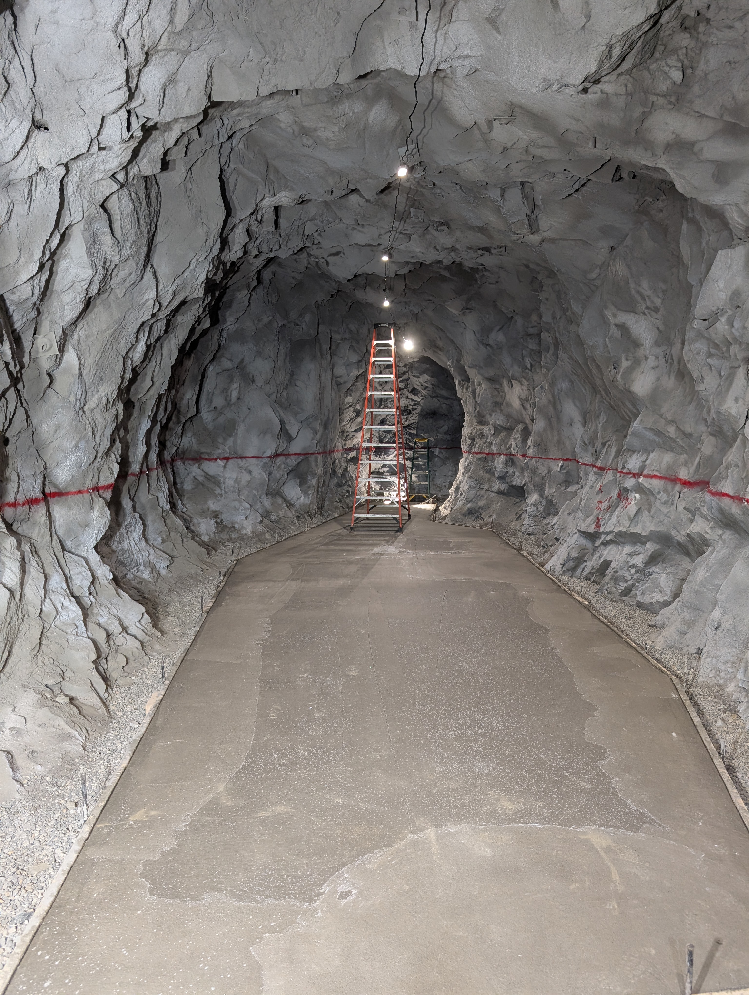
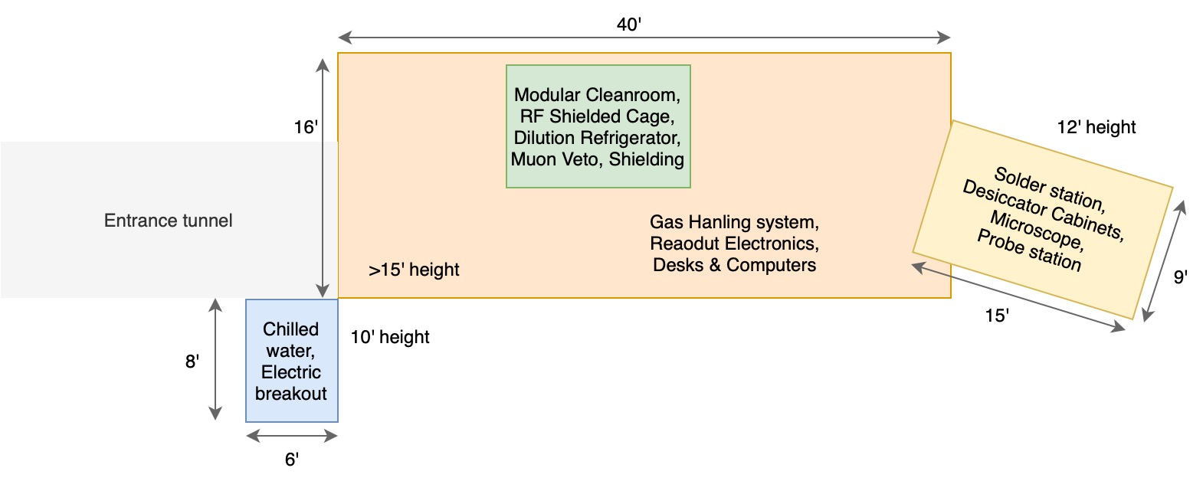
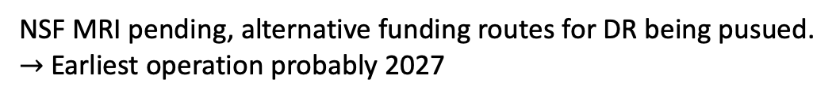
Next: Quantum Technologies
at Sensitivity Frontier Lab
Next Steps: Separation wall, radon mitigation, ventilation, electricity,
modular class 10 000 cleanroom, closed loop chilled water supply
NSF MRI pending, alternative funding routes for DR being pusued.
$→$ Earliest operation probably 2027

Slide 9
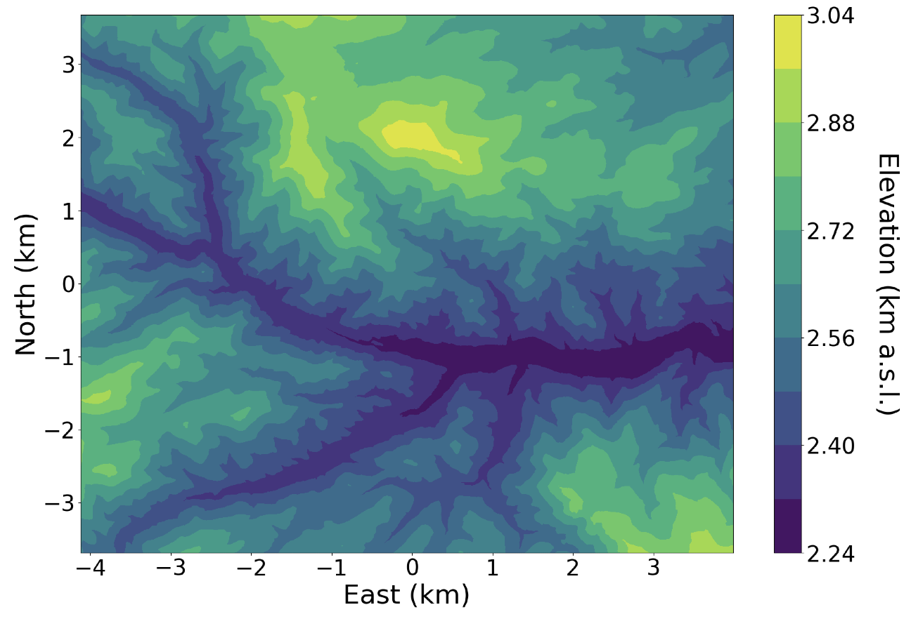
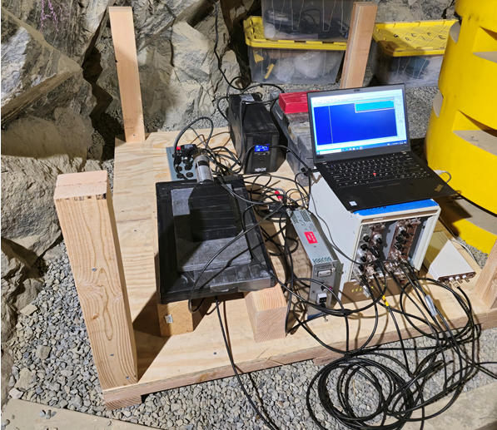
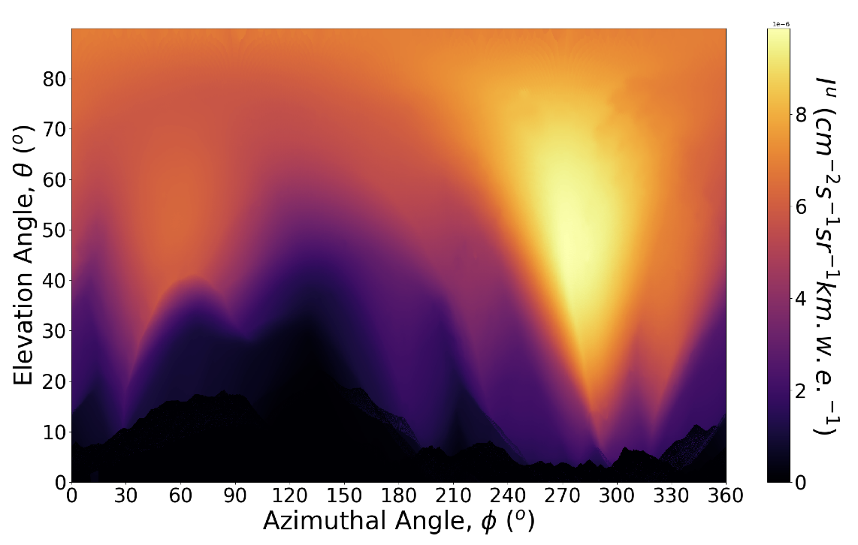
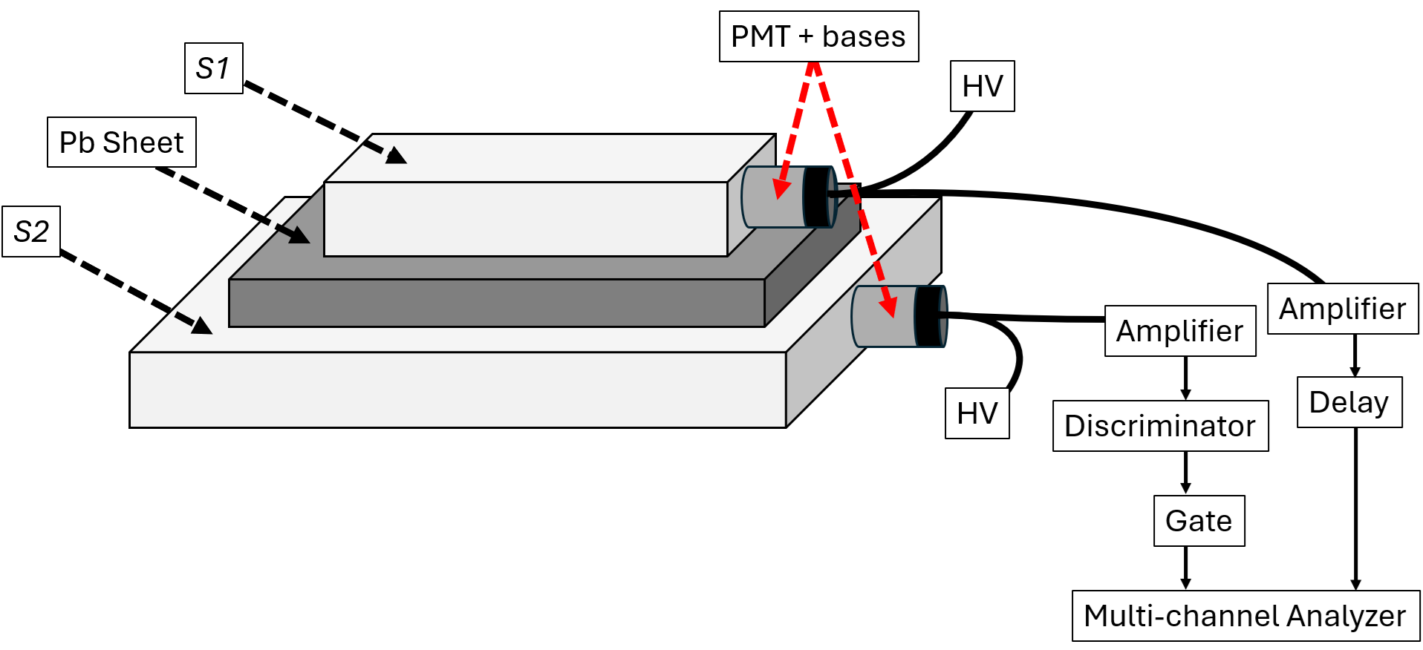
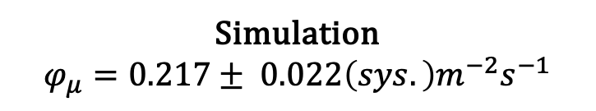
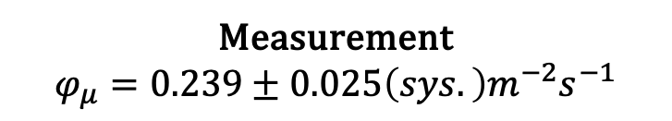
Muon Flux Characterization: Simulation & Measurements
Muon flux measurement made with scintillators in coincidence setup.
Muon flux simulated using Mute, DaemonFlux, and USGS data
Simulation enables modeling
  Muon energy spectra
  Seasonal variation
  Secondaries
  Angular dependence
USGS DEM
Angular Intensity
Measurement
$$φ_{μ}=0.239±0.025\left(sys.\right)m^{−2}s^{−1}$$
Simulation
$$φ_{μ}=0.217± 0.022\left(sys.\right)m^{−2}s^{−1}$$

Slide 10
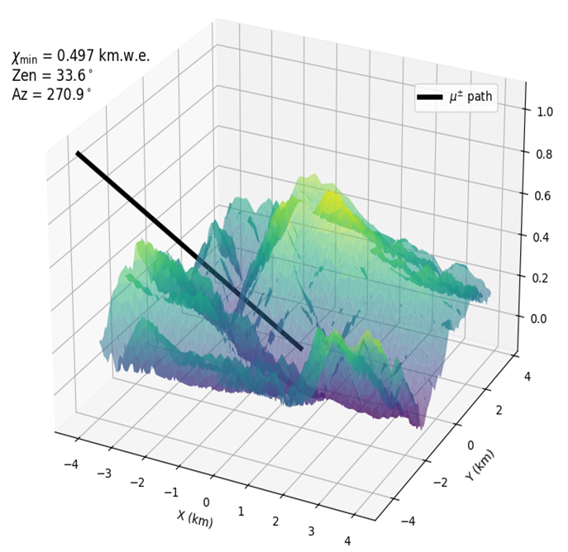
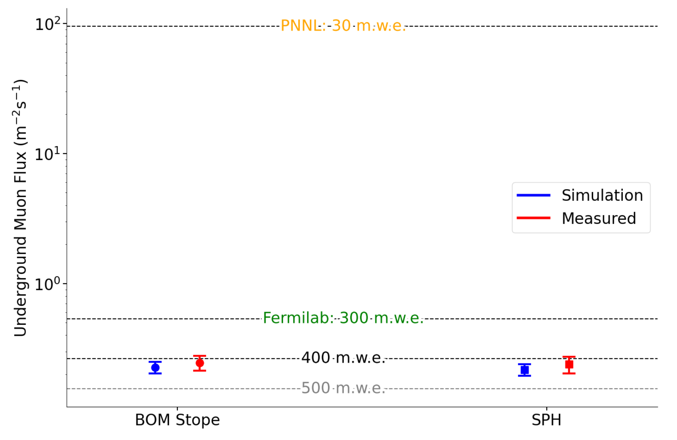
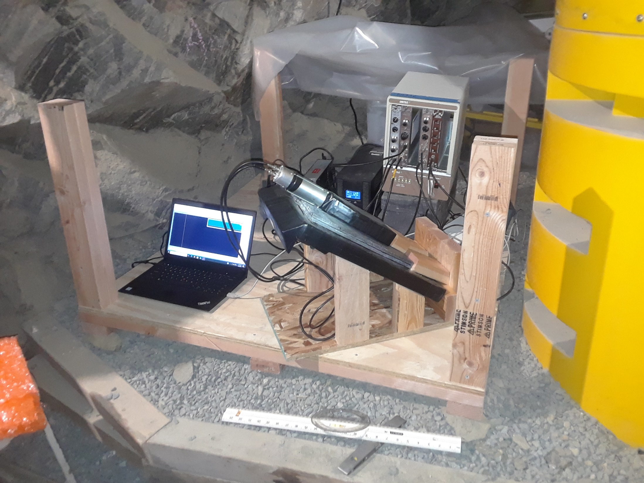


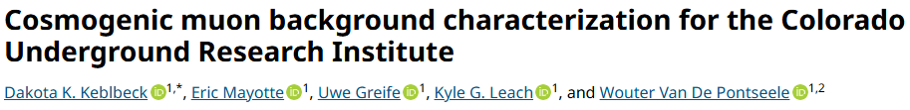
Muon Measurements: Published
Angular validation compare predicted and measured flux for detector pointing maximum and minimum shielding
Reduction Measured = 22.8% +/- 1.3%
Reduction Simulated = 24.0% +/- 2.3%

Slide 11
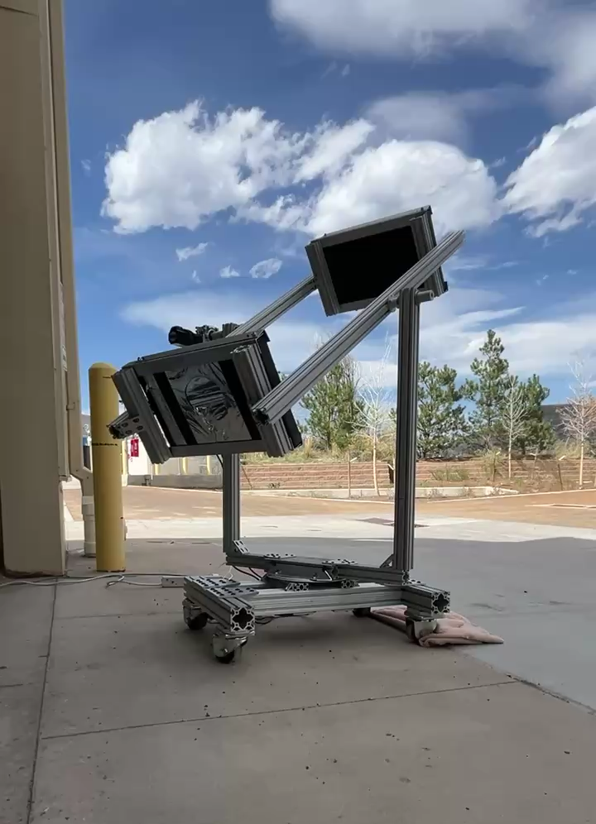
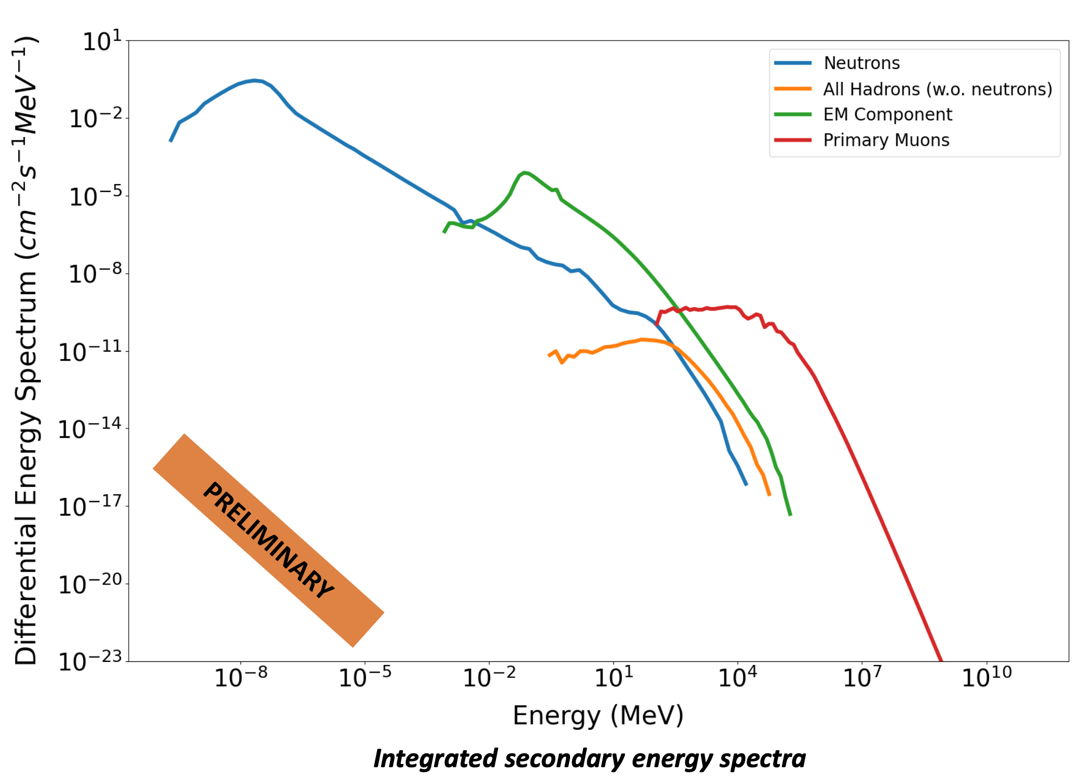
Muon Measurements: Full angular muon scans and modelling/measurements of secondaries

Slide 12
On Campus Cryo Lab @ Mines
While the underground lab is the ultimate low-background facility for low-threshold detector developments, it will take at least another year
On campus Dilution Fridge from Maybell Quantum will arrive July 7th
Neutrino Physics program
  Project 8 Neutrino Mass
  RICOCHET coherent neutrino-nucleus scattering with superconductors
  Qubit sensitivity and quantum-limited amplification
  The BeEST

Slide 13
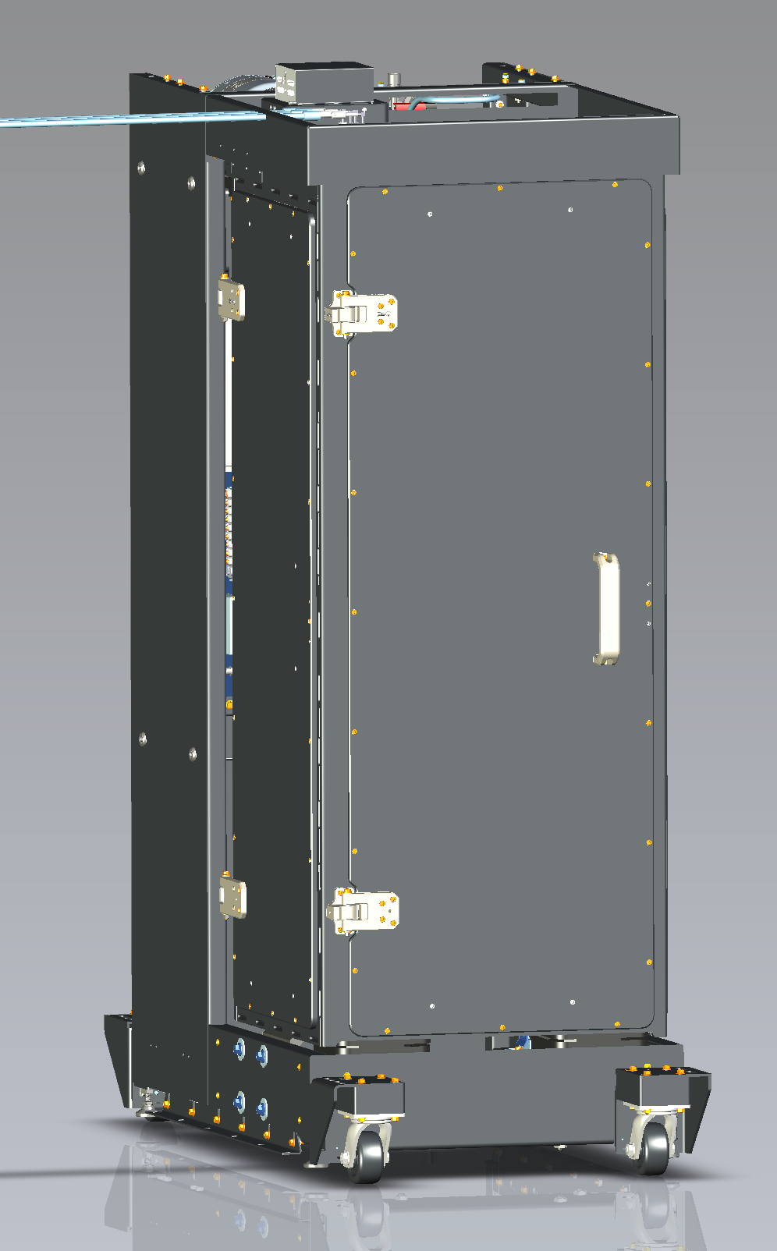
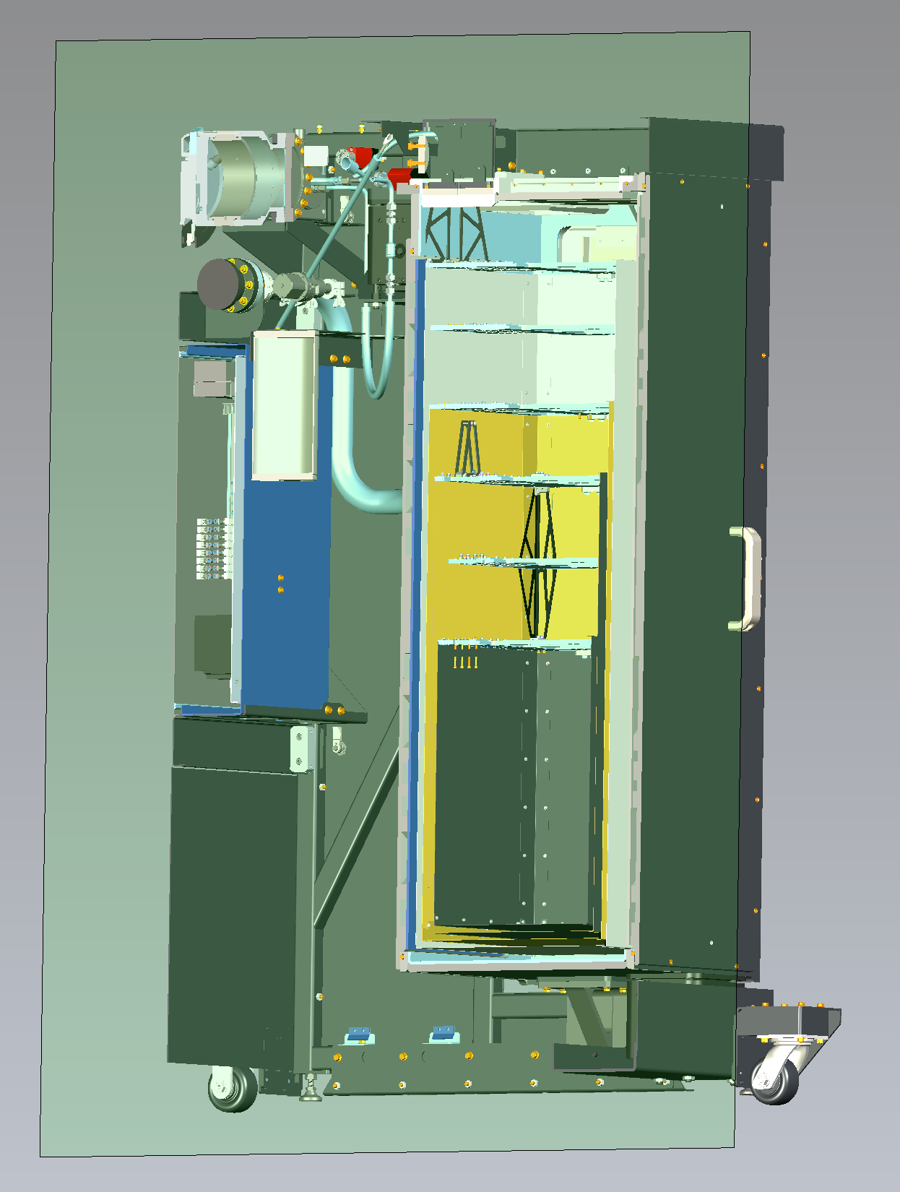
Maybell Quantum Collaboration
Maybell Quantum is the only “reasonable”
US manufacturer of dilution refrigerators
New player: High risk
Located within 20 minutes drive from campus
Assembly and innovation space on campus
Existing collaborations:
Several master student projects with different faculty members.
Started some innovations: Less soldering joints, roots pumps, python API, compact form factor, concentric in and out flows of mixture …

Slide 14
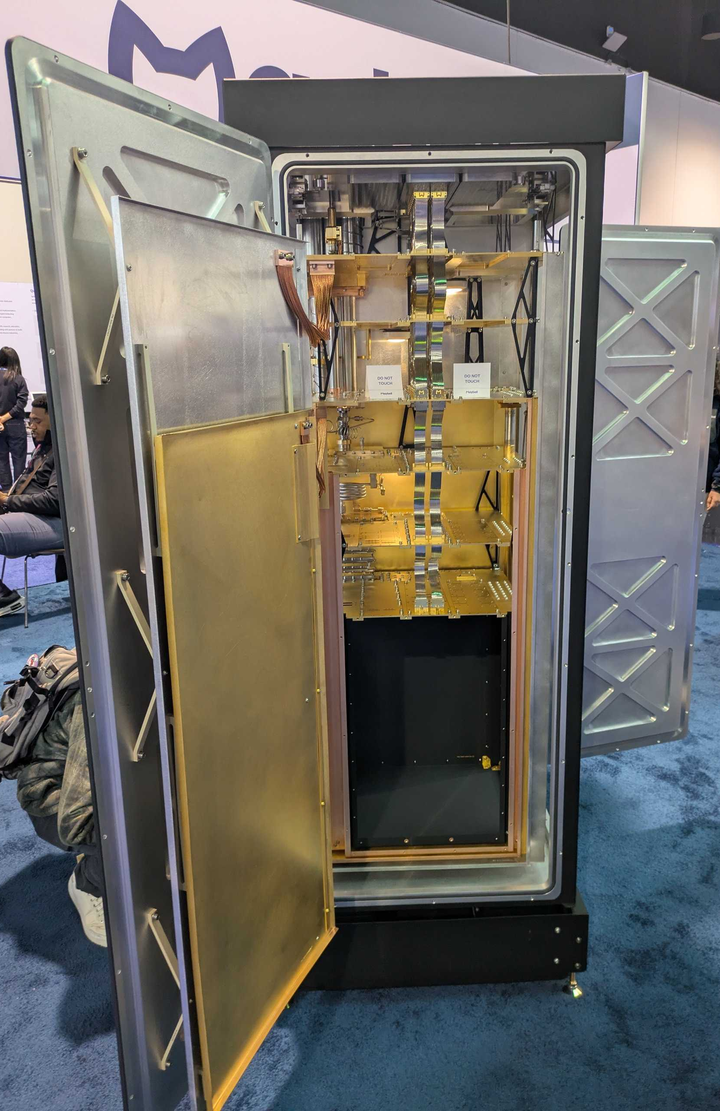
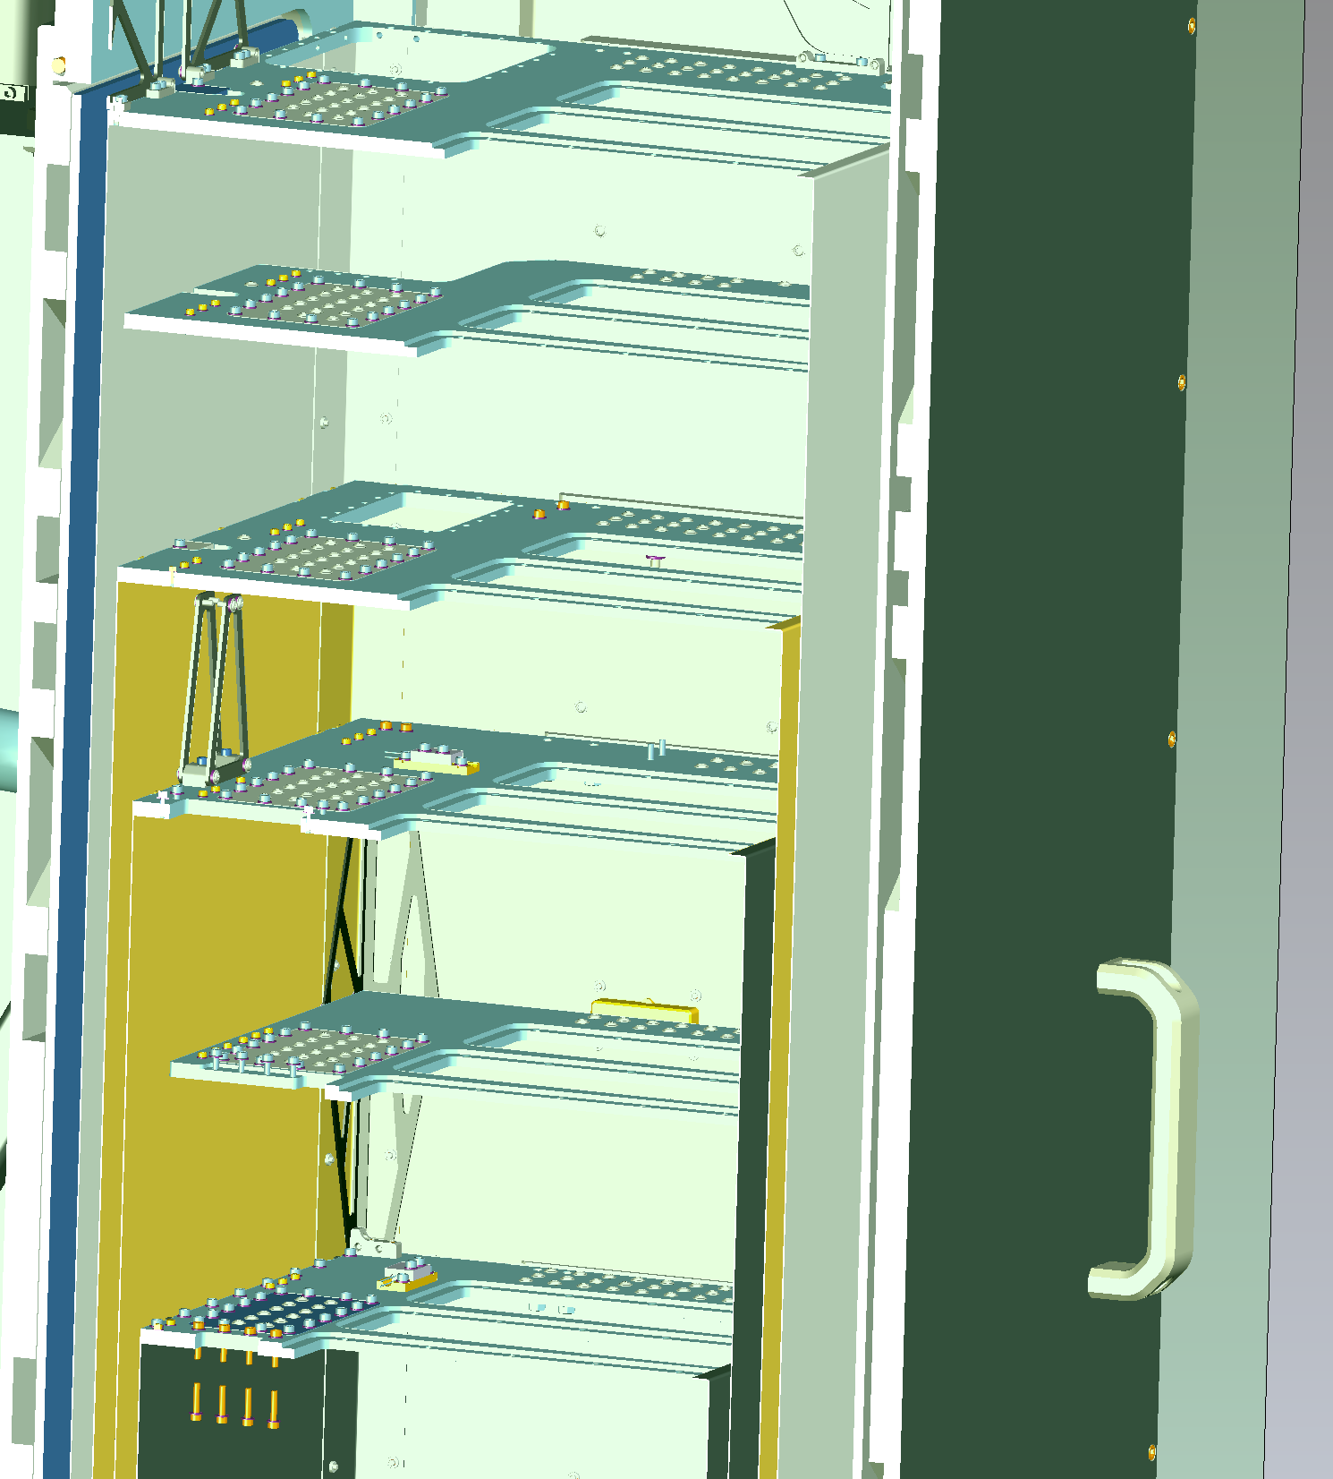
Maybell Quantum Collaboration
Ordered Maybell “The Fridge+” for on campus laboratory
Presented at March Meeting
Vibration suspended lower 3 plates and pneumatic lifted pulse tube elements.
Average displacement at MXC plate is <10nm in 10-200Hz region.
>500uW @100mK
>14uW @20mK
Experimental volume approx. 35 cm x 45cm x 50cm (vertical),
3 large removable inserts.

Slide 15
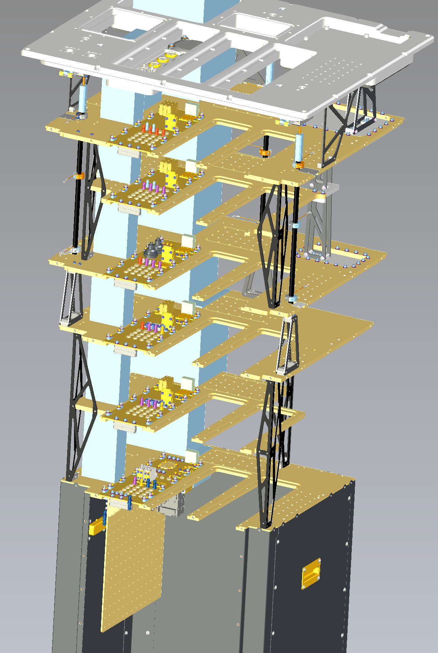
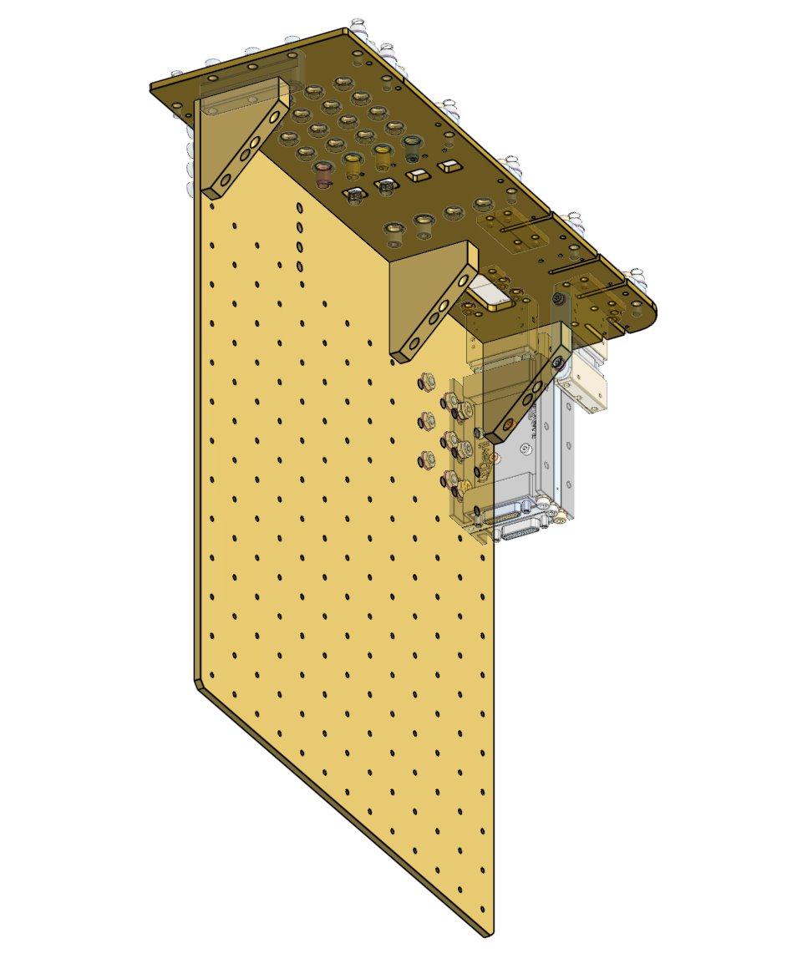
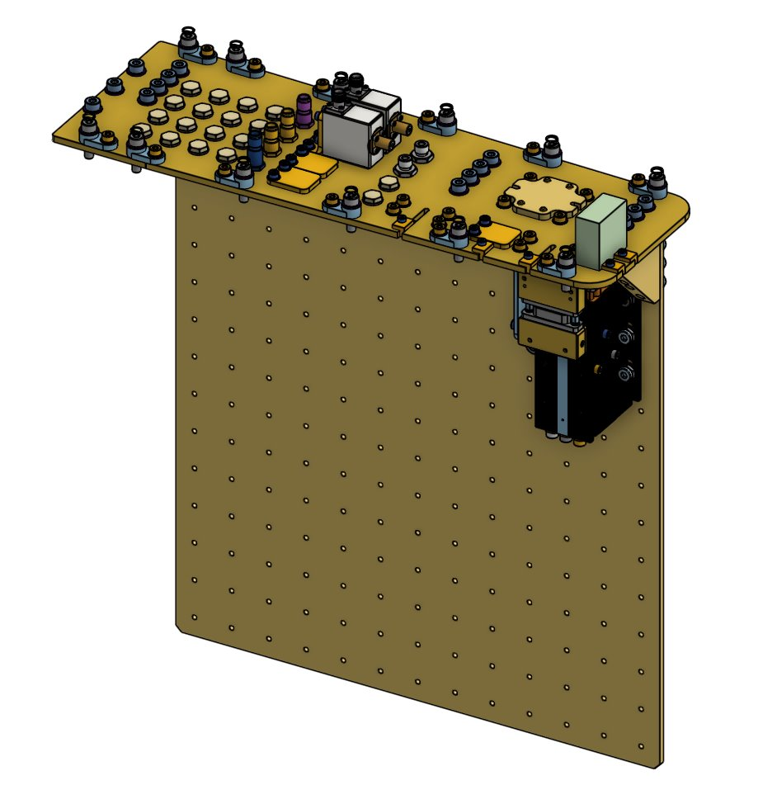
Maybell Fridge Insert

Slide 16
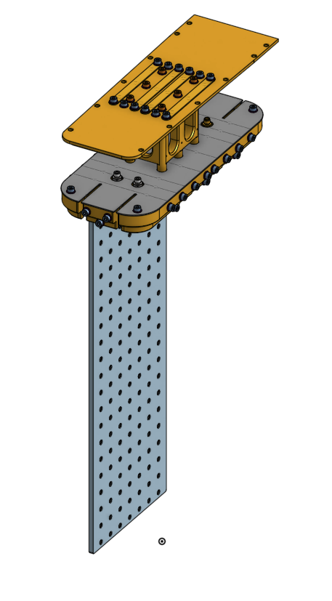
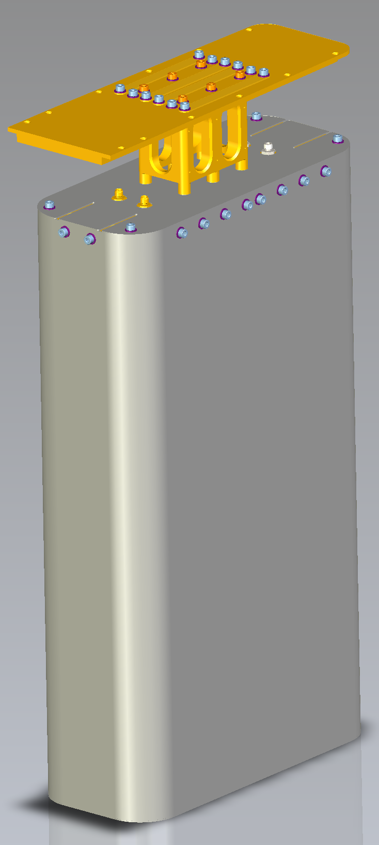
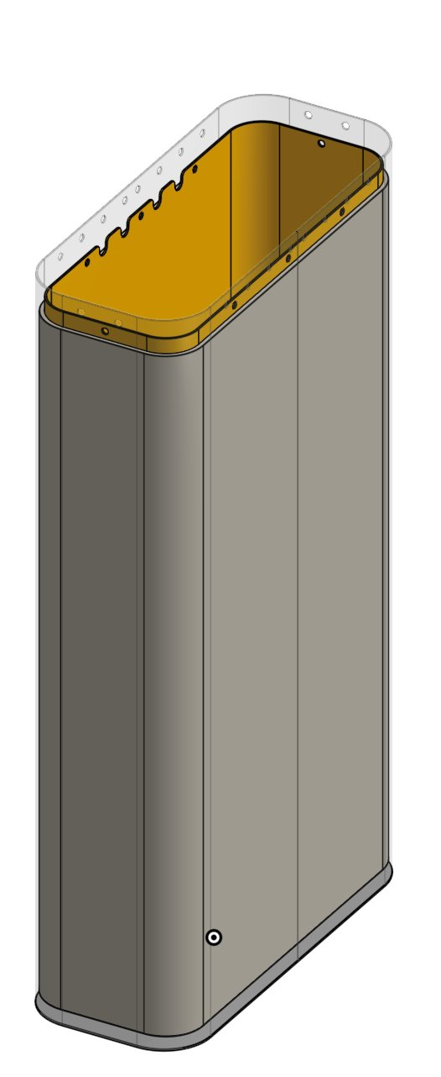
Magnetic Shielding Designs
High aspect ratio
A4K (Mumetal) outer shield
Modular/optional inner shield:
  Cu plated with 10 micron Sn
  3mm Lead
Hope is that the lead shield can provide
both shielding against magnetic fields
and ionizing radiation below 200keV.
Risk is weight, cooldown time,
and magnetization of the shield itself.

Slide 17
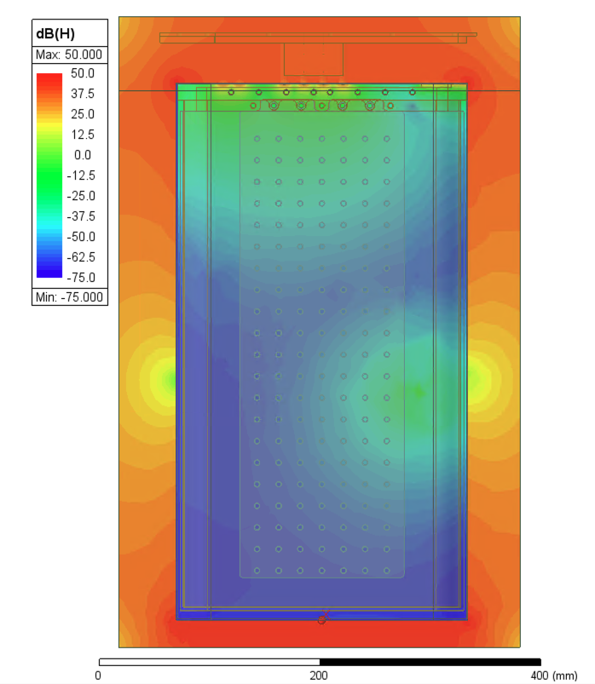
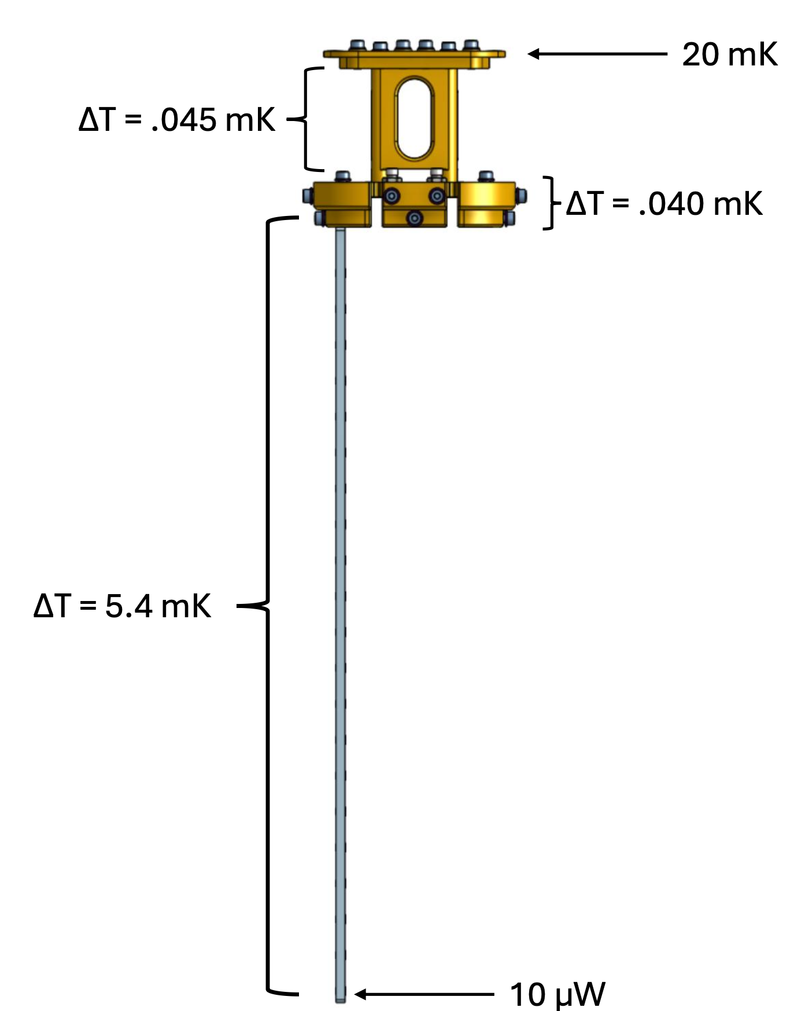
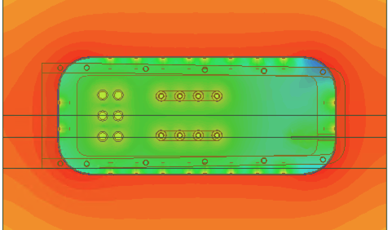
Magnetic Shielding Simulation
Frist steady-state
thermal model of the fridge with the shield included.
Cooldown model in progress to assess the impact of the ~20kg of lead.
Side view
Magnetic simulations using
Ansys Maxwell demonstrate
100dB attenuation of top-down
magnetic component
Measurements planned with SQUID systems
Top view

Slide 18
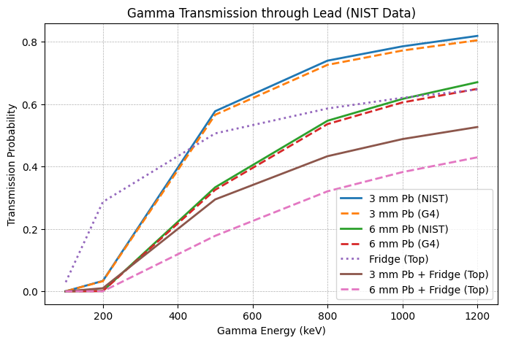
Ionization Radiation Shielding
Simulations using Geant4 of ionizing radiation
through the fridge cans and the shield at the
coldest stage
Fridge top vs Fridge top + 3mm Pb shows
added suppression when including 3mm lead
When going underground, we hope to add a
mixture of external lead, polyethylene,
water bricks, and borated polyethylene.
Bare fridge
3mm inner lead shield

Slide 19
Summary & Outlook
Progress Plans
CURIE Cryogenic room being prepared with >400m.w.e shielding and 700x reduced muon flux
Dilution refrigerator on campus installed in July 2025
Magnetic and ionization shielding being finalized. SQUID magnetometer and vibration sensing systems in progress.
Hopefully first STJs operation in Fall 2025
Integration with Magnet designed by Joseph Templet
Test site for various technologies:
  Microwave multiplexing
  TES sensors
  Bulk crystals
  … add your ideas

Slide 20
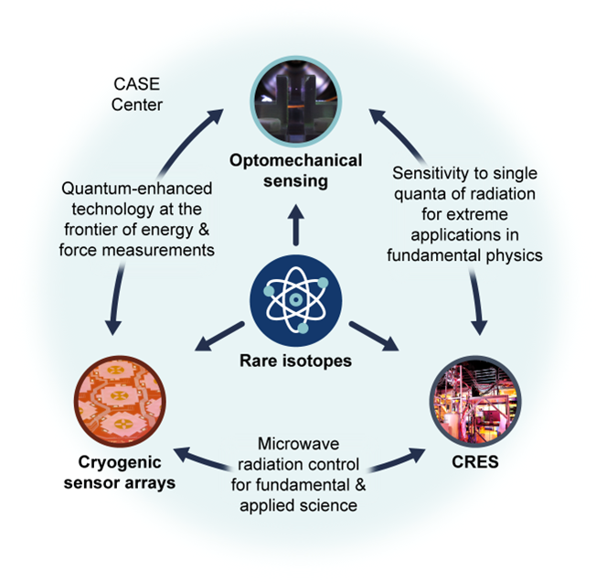
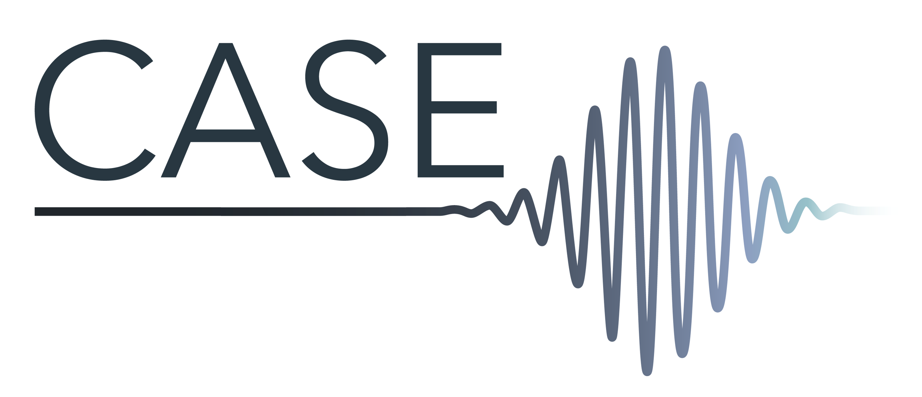
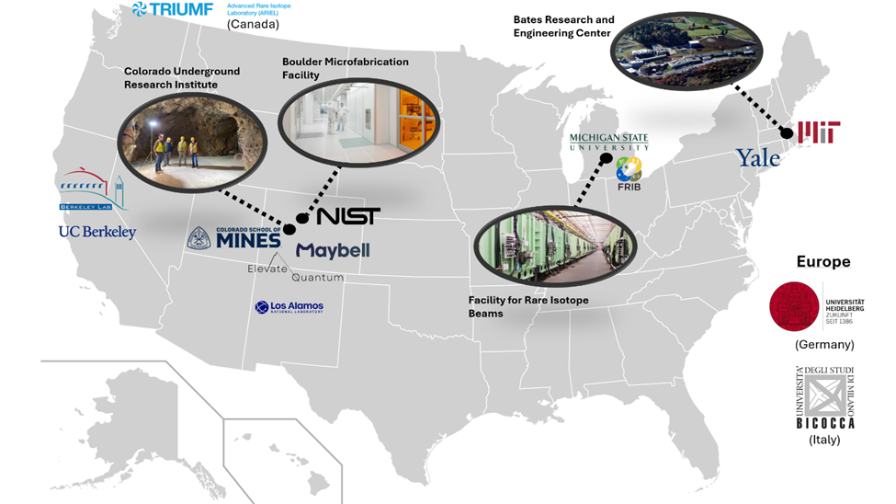
Bigger Picture in the further future
NSF pre-proposal

