Slide 1
G4CMP Usage and Development for the BeEST Experiment
Caitlyn Stone-Whitehead

Slide 2
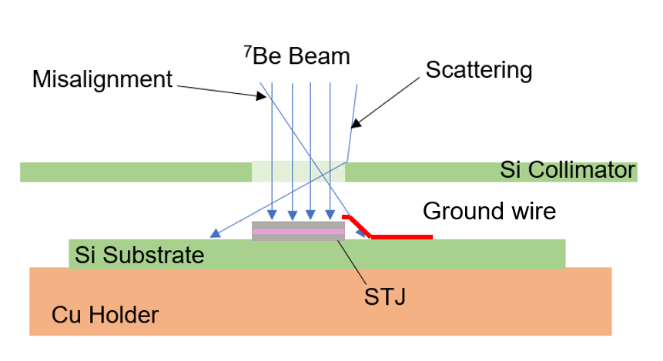
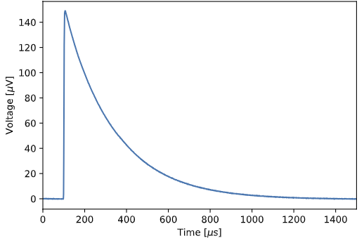
The BeEST Simulation Framework
GOAL: Increase sensitivity to BSM physics by constraining the SM allowed background
How do we model substrate backgrounds?
How do we model pulses out of the STJ?
How do we model the BeEST spectrum?
Notes:
With the creation of a complete Monte Carlo simulation framework for the BeEST experiment, we can better extract new physics from the BeEST spectrum via comparing with model-lead predictions. Specifically, by decreasing the uncertainty in standard model backgrounds increased sensitivity in the BSM parameters, but extraction of other potential new physics. This MC methodology considers the environment (materials and geometry), the energy deposition mechanisms of decay products, and the materials response. Using the results of the energy deposition and the time and special distribution of excitations in the material, a Rothwarf-Taylor phenomology is currently in progress for modelling the pulses out of the detector. In order to create such a comprehensive framework, it is crucial to use the proper validated physics toolkits.

Slide 3
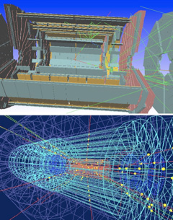
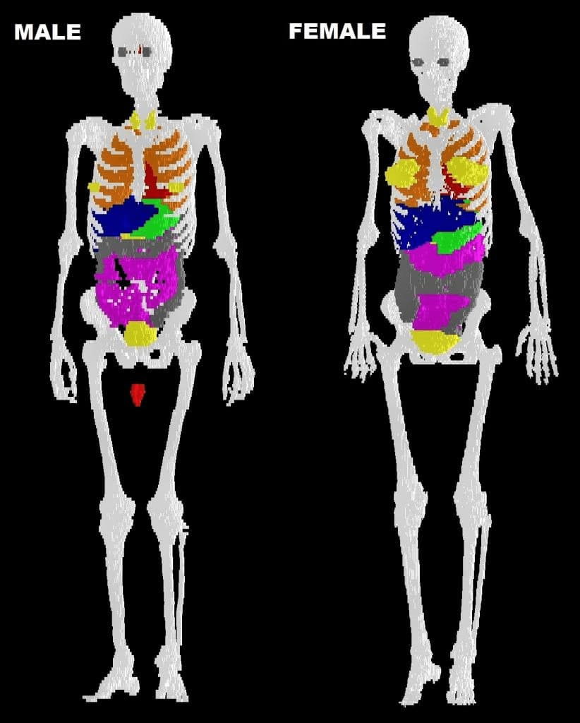
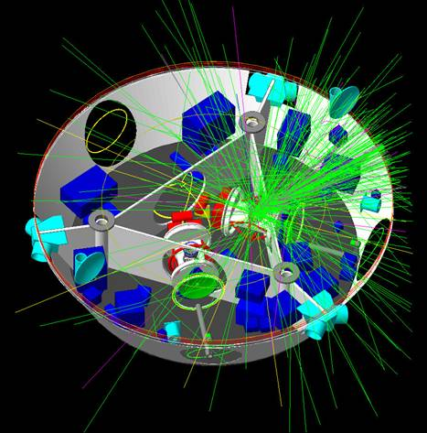
Notes:
GEANT4 stands for geometry and tracking. It is a physics c++ toolkit developed by CERN for the large hardron collider. It allows for the simplified development of simulations for radiation interactions with materials. Although developed for HEP, over the years it has expanded to lower energies, handle robust geometries as well as many interesting applications. For example, the images shown above are the Human Phantom example for radiotherapy, the ATLAS experiment at the LHC and radiation shielding for space travel.

Slide 4
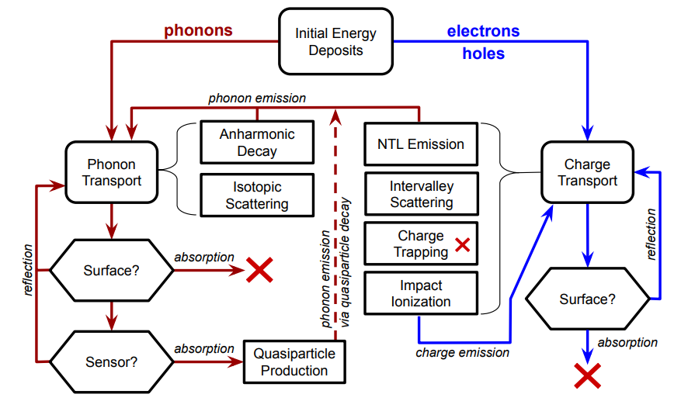
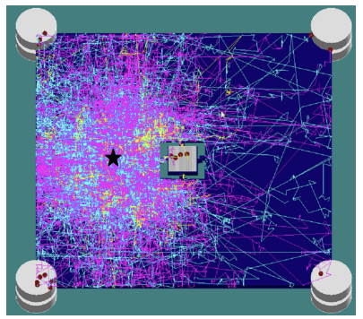
GEANT4 Condensed Matter Physics
[1]
[1] D. Brandt et al., "Semiconductor phonon and charge transport Monte Carlo simulation using Geant4," Nuclear Instruments and Methods in Physics Research Section A: Accelerators, Spectrometers, Detectors and Associated Equipment 1055, 16847 (2023).
Notes:
GEANT4 Condensed Matter Physics (G4CMP) [9] was published as an extension to GEANT4 to simulate the excitation of phonons and/or charges in cryogenic semi- conductor crystals in response to deposited energy. This toolkit, developed for the Cryogenic Dark Matter search, is geared towards simulating excitations in a cryogenic crystal coupled to superconducting detectors. The flowchart (Figure 2) shows the processes implemented in the G4CMP physics constructor, the most basic of these processes being phonon and charge transportation. When coding detector geometry, the probability for absorption and reflection is a defining parameter between surfaces. When a phonon is traveling through a crystal, it may undergo anharmonic decay due to the an- harmonic interaction with the lattice causing the initial phonon energy to be redistributed into two lower energy phonons. Phonons can also be scattered due to isotopic content or other defects in the periodic lattice structure. Similarly, charges can be scattered between different valleys in the conduction or valence band. If a charge is accelerated in an electric field, it will emit phonons along it’s path via Neganov–Trofimov–Luke (NTL) emission. Now, shown on the right, is a simulation showing how designs can be optimized for, or in this case against, phonon collection on a superconducting device.

Slide 5
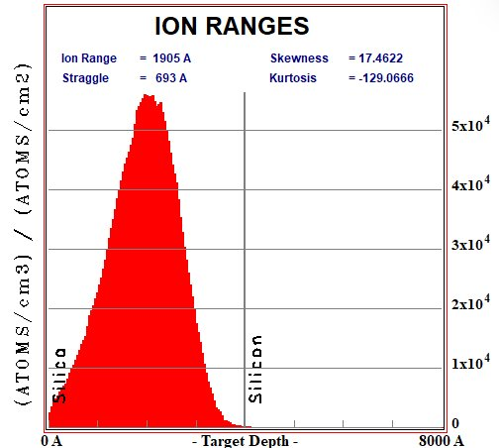
Substrate Recoil Simulation Framework
Where are the implanted isotopes?
How do the decay products deposit energy in the material?
What phonons/charges are excited and how do they interact with the detector?
G4CMP!
Notes:
The current BeEST simulation framework is optimized for substrate events. The framework has currently been applied to the implantation background adjacent to STJ pixels. The implantation profile in the SiO2/Si substrate is modelled with SRIM. The daughter and Auger electron are implemented as the initial event. The energy deposition for the recoiling nucleus and the scattering are implemented with GEANT4 (electron- electron scattering, elastic nucleus-nucleus scattering) . Once the energy has been deposited in the silica or silicon oxide, phonon and charge excitation are handled by G4CMP. G4CMP uses the Kaplan models for the probability to break a cooper pairs from an incident phonon. The output is then the spacial distibution and time of pair breaking phonon hits from the substrate.

Slide 6
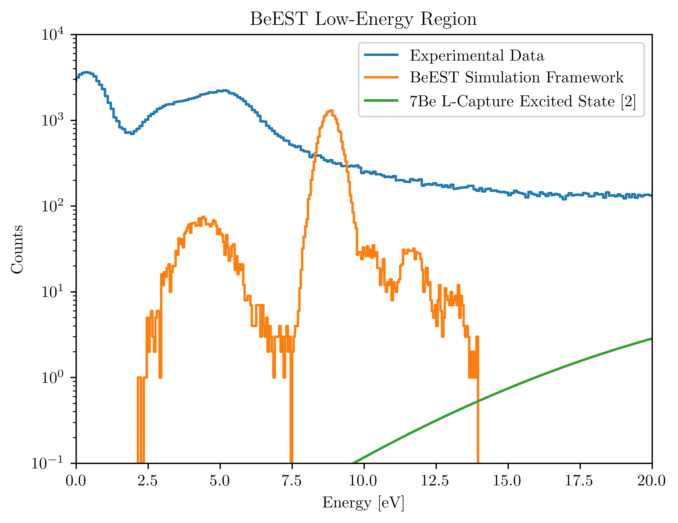
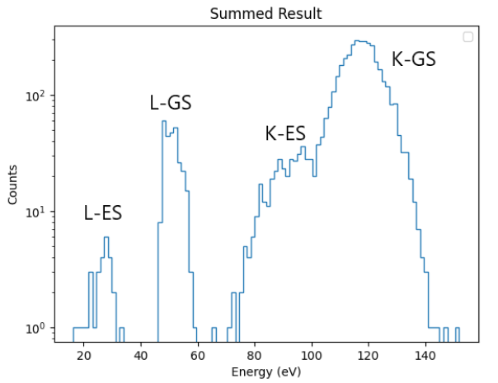
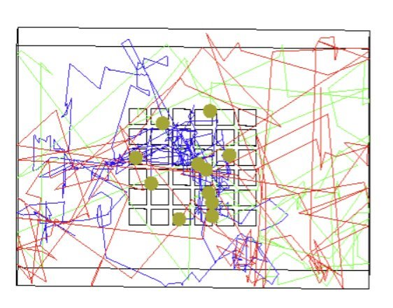
Substrate Recoil Simulation Results
Notes:
First, I check my implementation of the primary decay products by confining all phonons generated in a simple silicon crystal and propagating them until they reach a sensor. Once verified that the base physics is working as anticipated, the copper holder is then implemented using the acoustic mismatch to determine the probability of phonon escape. Additionally, calculations were performed to make the implementation of the thermal silica oxide with appropriate phonon and electrical properties. This implementation will be discussed further in the following slides. Once simulation results were obtained, the final results were produced by processing the data in accordance to the data collection (assuming a threshold of 0.1 eV and a timing resolution of 800us). I then processed the multiplicity with a 3.4us window and displayed the results overlayed with BeEST data. The events are scaled by assuming beam scattering from the collimator in ratio to events implanted in the pixels.

Slide 7
G4CMP New Materials
[2] I. Hernandez et al., arXiv:2408.04732 (2024).
Notes:
I was able to make the implementation following the methodology presented from the work above. These materials were implemented in g4cmp for Qubit based sensor designs. The necessary computations are the density of states and phonon band structure, tamara models for isotopic scattering and anharmonic decay, as well as the Christoffell-Green equations for phonon propagation among caustics. These calculations are then validated by comparing against experimental results. The materials above are currently implemented with phonon properties into G4CMP for user implementation.

Slide 8
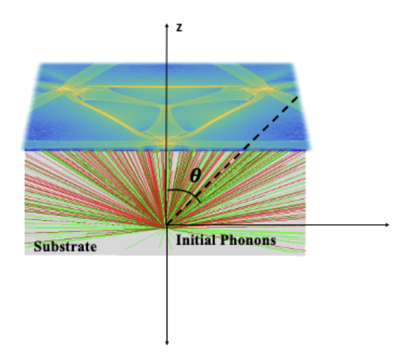
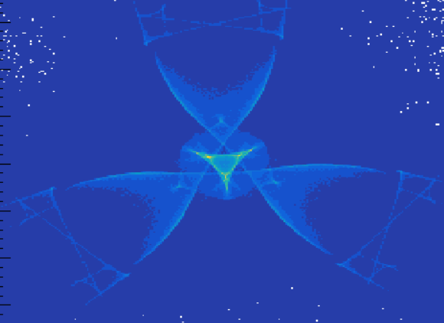
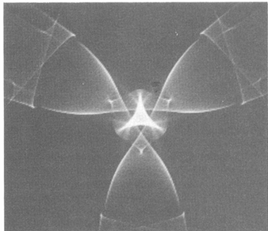
G4CMP New Materials
Thermal silica and alpha-Quartz implemented (GitHub)
G4CMP material implementation paper in progress with Israel Hernandez
Notes:
I extended this work for alpha quartz and fused silica for in order to implement the thermal oxide in G4CMP. Theses materials are now pushed on the GitHub for outside use, using alpha quartz due to its defined caustic pattern as a control. The caustics are generated by creating a point like isotropic source of phonons at the bottom of a crystal and propagating them along a crystal direction to the surface. The lighter areas depict where there are the most phonon hits and the darker areas correspond to the least. The amorphous silica was computed using Elastic constant measurements from fused silica and following the same methodology. There is currently a paper in progress for submission at LTD regarding the details of this work as well as some other technical subtleties that may aid developers and users in implementing their own materials.

Slide 9
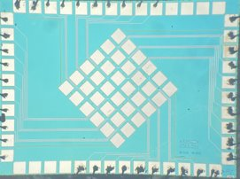
Quantum Device Response
How does the STJ response differ for varying decay products?
GOAL: Improved energy calibration
Notes:
Quantum Device Response is an extension of G4CMP that takes the results and uses the physics as well as systematics of your sensors, in order to simulate measurable pulses. This is done using a Rothwarf-Taylor excess QP density based phenomenology for the evolution of liberated quasiparticles in time for MKIDs, Qubits and TESs for the Quantum Science Center at Fermilab. This is done by linking individual sensors and their properties to G4CMP geometry. By using a similar methodology, we can analyze the shape, rise and fall time of substrate events. This work is currently in development as an additional sensor class for this software. Additionally, this work can be extended for quasiparticles liberated in the top electrode of STJs, allowing analysis of the pulse differences for low energy recoils compared to UV photons. This work also offers a powerful tool for simulating pulses from different STJ designs.

Slide 10
Superconducting Processes
Quasiparticle diffusion implemented with a random walk model
QPs can be reflected or absorbed
Notes:
However, a MC based methodology for pulse simulation in superconducting devices is being explored and the relevant processes being implemented. Currently, the implementation of superconducting materials is in progress with quasiparticle diffusion has being implemented for thin films using a random walk model. Additionally, these QPs can be reflected for absorbed at defined interfaces.

Slide 11
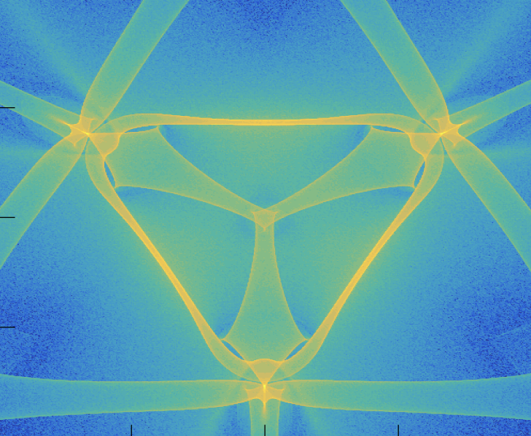
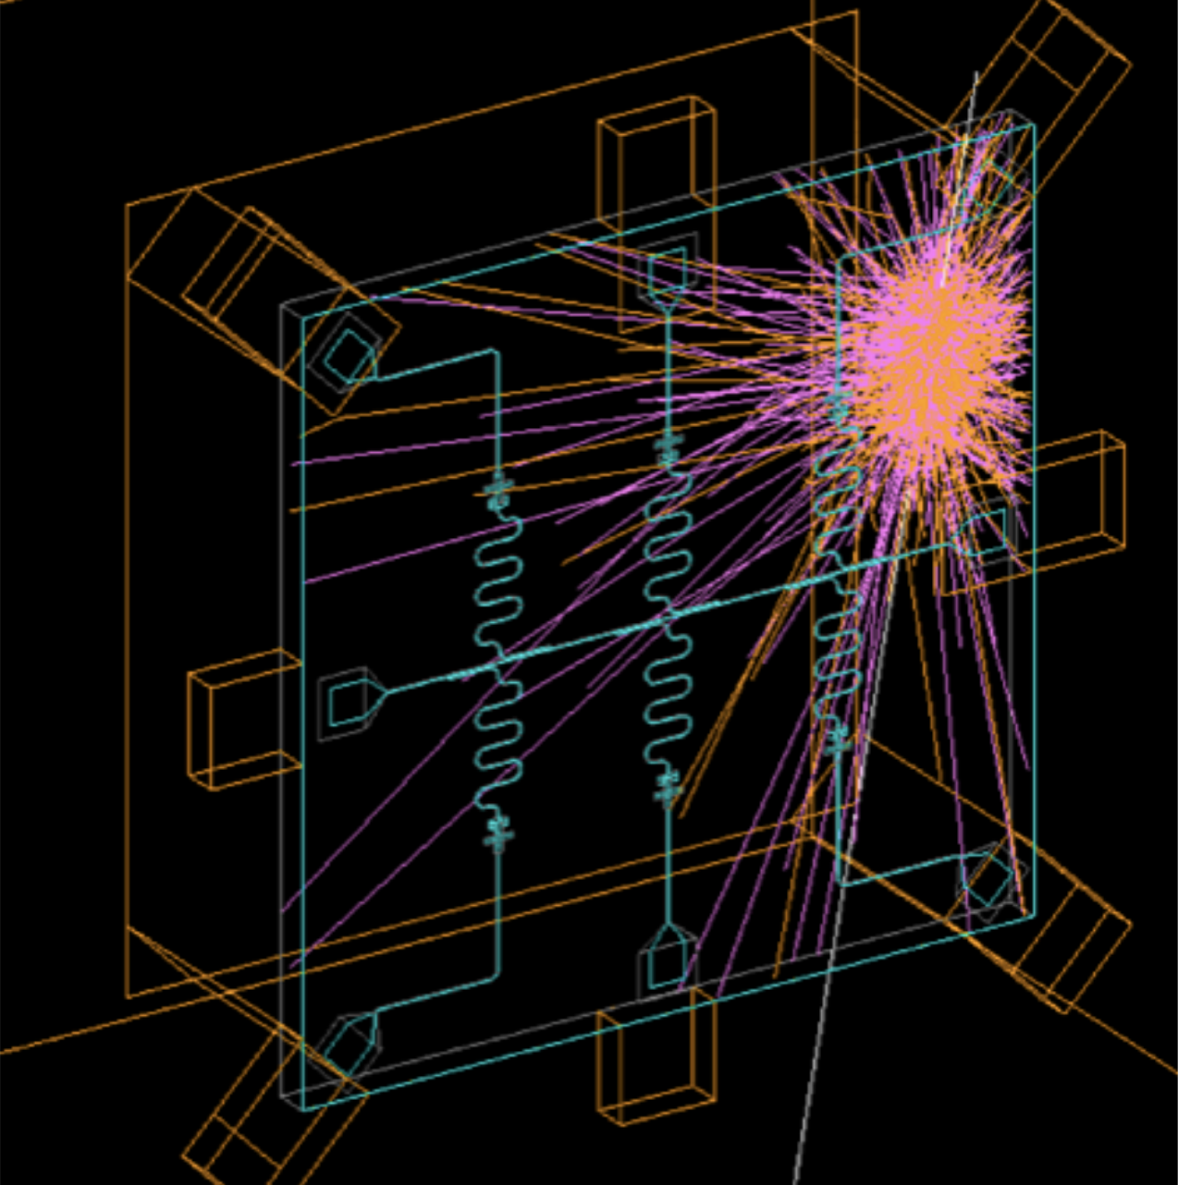
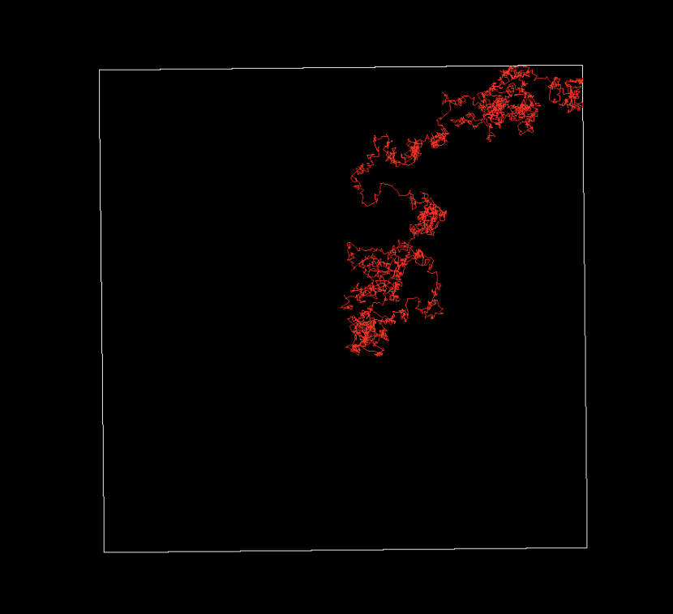
In Development
Radiation Impacts
Charge/Phonon Transport
Near future
Cooper pair implementation
Phonon accurate transmission across boundaries
Phonons breaking Cooper Pairs
Cooper pair recombination and phonon emission
Tunnelling processes
Long term
Validation of results for QP interaction models
COMING SOON:
energy-dependent quasiparticle diffusion
Consortium Info + Listserv
Notes:
Some features coming soon in G4CMP are cooper pairs as a particle definition, increased accuracy of phonon transmission process, and Phonon mediated interactions such as pair breaking and phonon emission. In the long term, these models will be compared with experimental data in order to ensure use of validated physics only for in superconductor interactions.

Slide 12
The G4CMP Consortium
Radiation Impacts
Charge/Phonon Transport
Developer group for modeling low-energy physics processes in cryogenic devices
Started mid-2024
Members from 31 institutions participating
Contact info: linehan3@fnal.gov, kelsey@slac.stanford.edu
Biweekly coordination/technical meetings
Join us!
UW-Madison
UMD LPS
University of Waterloo
INFN
HRL Labs
PNNL
SNOLAB
Caltech
LLNL
Colorado School of Mines
University of Florida
IN2P3
Fermilab
University of Montreal
Syracuse University
Google
Northeastern University
IIT
Northwestern University
Brookhaven National Lab
Texas A&M University
MIT
SLAC
WashU St. Louis
…and more!
COMING SOON:
energy-dependent quasiparticle diffusion
Consortium Info + Listserv

Slide 13
Supplemental Slides

Slide 14
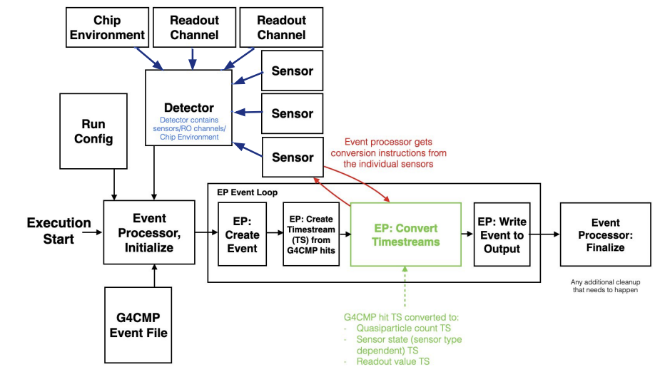
Quantum Device Response

Slide 15
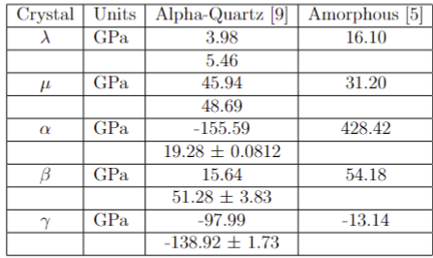
Lamé and TOEC-dependent Parameters
How do we quantify stress and strain in a given crystal?
Elastic Constants!
[9] J. Zhao, J. M. Winey, and Y. M. Gupta, Phys. Rev. B 75, 094105 (2007). https://doi.org/10.1103/PhysRevB.75.094105

Slide 16
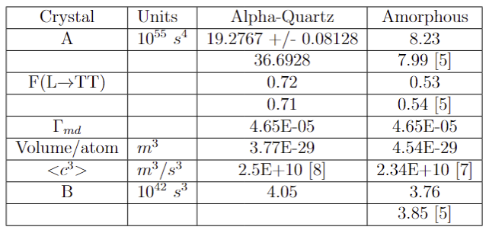
Anharmonic Decay and Isotopic Scattering Rates
[7] B. M. Auld, Acoustic Fields and Waves in Solids (1973)
[8] W. T. Yost and M. A. Breazeale, J. Appl. Phys. 44, 1909(1973).

Slide 17
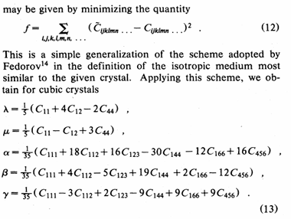
Lamé Constants – Amorphous Silica
Spontaneous decay rates of LA phonons in quasi-isotropic solids (Tamara 1984) [5]

Slide 18
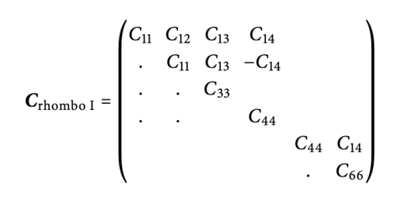
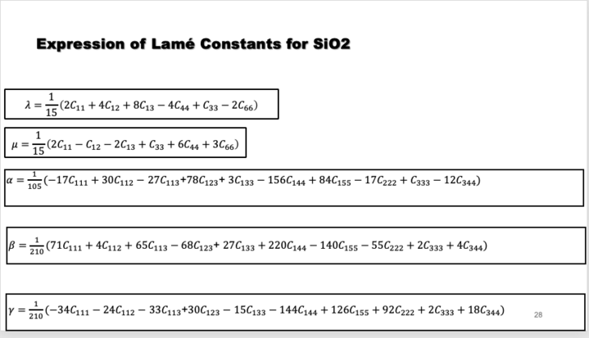
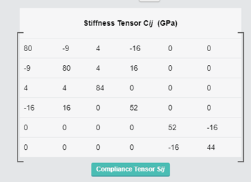
Lamé Constants – Alpha Quartz
[☺]
[12]
[☺]
[10] mp-7000: SiO2 (trigonal, P3_121, 152)

