Slide 1
β-NMR Spectroscopy of Ta films for the BeEST Sterile Neutrino Search
Iain McKenzie
Centre for Molecular ad Material Science, TRIUMF

Slide 2
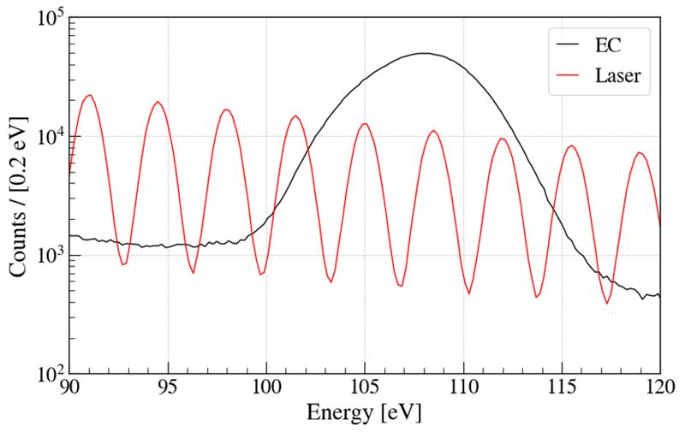
Motivation for the BeEST
Notes:
The BeEST experiment is being used to look for the existance of sterile neutrinos but one of the biggest limiting factors which currently exists is the the width of the energy peaks observed are currently much wider then the 2eV laser peaks that set the energy resolution of the STJs
Sterile neutrinos in the sub MeV mass range would reduce the Li7 recoil energy and produce additional peaks in the spectra
This means that currently we cannot see small peak shifts in the spectra as our sensitivity in limited
This makes it hard to find small sterile neutrino masses which are especially interesting as warm dark matter candidates
One possible reason that these peaks are wider then expected is due to variations in Li 1s binding energies when implanted in different local or chemical environments
This 1s could be responsible for the K capture peak being broadened

Slide 3
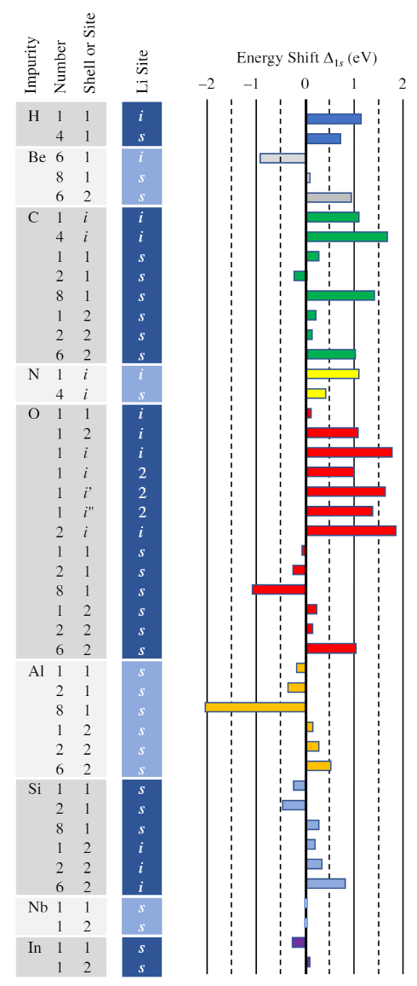
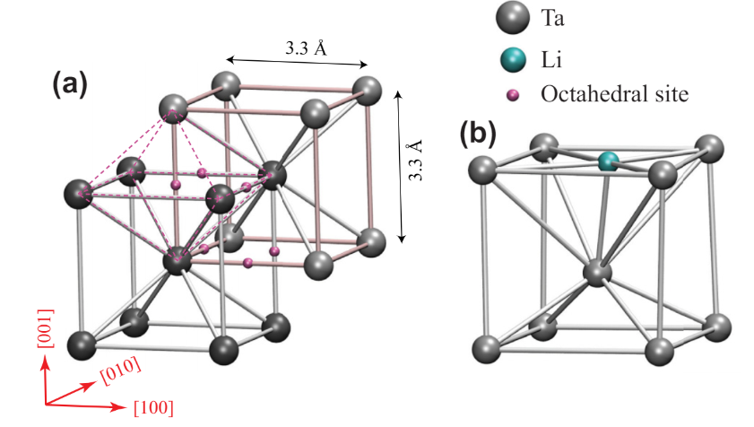
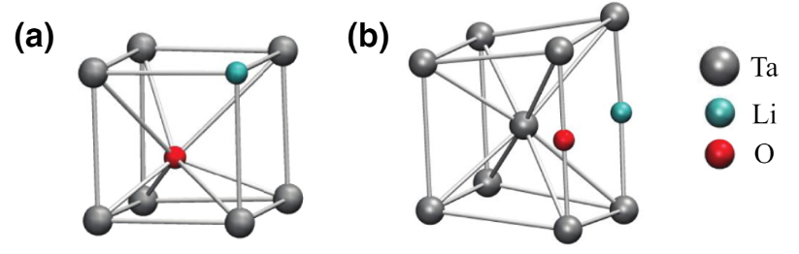
Motivation for the BeEST
A. Samanta et al. Phys. Rev. Appl. 19, 014032 (2023)
Notes:
Here it can be seen that the Ta used to make the STJs has a body centered cubic lattice structure
As Ta is so similar to Nb in its properties we assumed that it would act in a similar way
DFT calculations have been done for this work and suggest that the Li will either land in a substitutional or octahedral site
The BeEST is limited in the fact that we currently have no direct Ta experimental evidence of the actual sites that the implanted ions occupy
One method to look at this to try to determine the site the Li actually lands in the Ta is through the use of bNMR

Slide 4
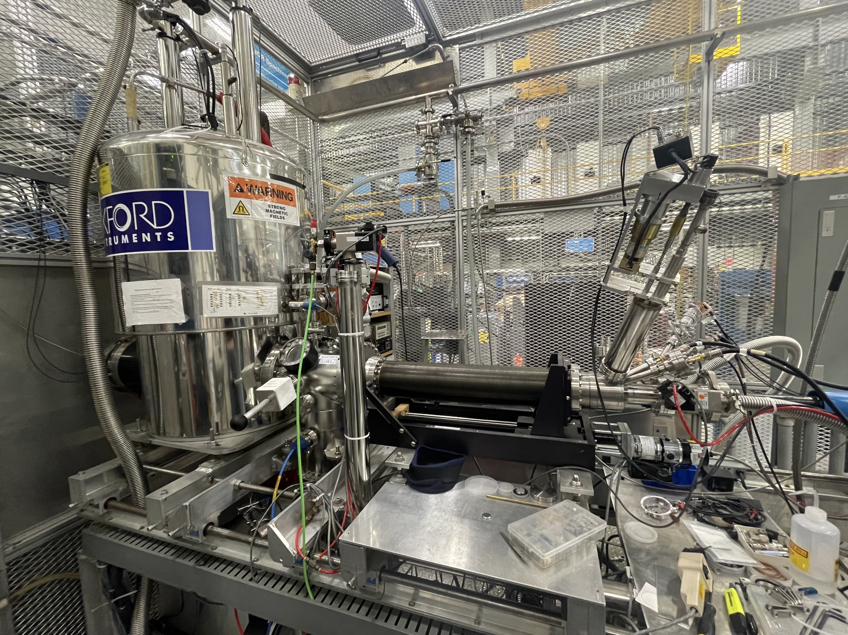
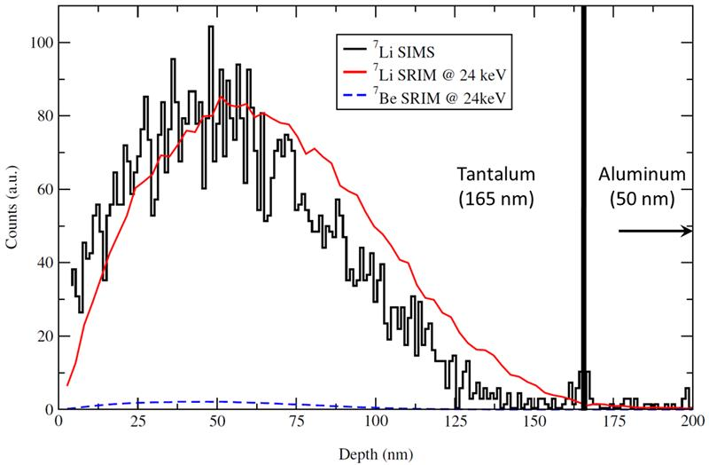
What is βNMR?
βNMR set up at TRIUMF
Sensitivity is 10 orders of magnitude higher than NMR
Control implantation energy – depth-resolved measurements and thin films
Notes:
bNMR is a highly sensitive spectroscopy technique which uses radionuclei to probe local magnetic and electrical environments
bNMR can resolve materials at the atomic level by embedding polarized radioactive isotopes into a substance
Using bNMR which allows us to have control over the implantation energy makes it ideal for us to be able to implant at the same energies as in the BeEST experiment making it a very good mimic
Knowing the energies that we are implanting at allows us to implant at the depth we want to get the most amount of counts possible
It also allows us to take measurements down to cryogenic temperatures which is crutial to understanding the local environment in Ta for the BeEST experiment as we want to know how the local environment will be at mK temperatures

Slide 5
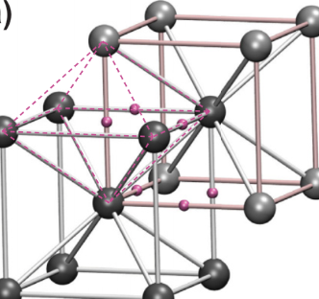
How does βNMR work?
200 nm Ta
Si
β
1.2 s
Monitor spin polarization via asymmetric β decay
Probe local environment
Implant spin-polarized ⁸Li⁺
Notes:
I’ve used βNMR to study the depth dependence of dynamics in polymer films without needing multilayer films or bulky probes. In the βNMR technique we implant a spin-polarized radioactive probe. Today I will be talking about lithium-8, which has a lifetime of 1.2 s, but we can also do measurements with sodium-26 and magnesium-31. The lithium-8 ion comes to rest within the material. In polystyrene it resides between two phenyl rings in a metallocene-like structure. Fluctuations of the electric field gradient caused by motion of the phenyl rings leads to spin-lattice relaxation and a return to thermal equilibrium. The lithium-8 then decays and by monitoring the time and asymmetry of the beta decay we can reconstruct what is happening at the molecular level. The spin polarization and the beta detection scheme results in βNMR being about 10 orders of magnitude more sensitive than conventional NMR.

Slide 6
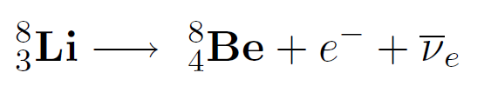
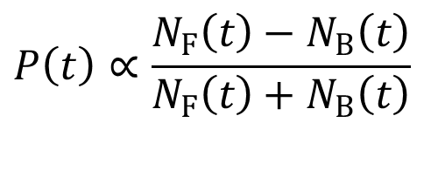
How does βNMR work?
Backward
1.21 s
β
⁸Li⁺
RF
Forward
$$P\left(t\right)∝\frac{N_{F}\left(t\right)−N_{B}\left(t\right)}{N_{F}\left(t\right)+N_{B}\left(t\right)}$$
β Emission Probability Relative to Spin
Notes:
Lithium-8 decays with a lifetime of 1.2 s. The betas are emitted preferentially in the direction opposite to the lithium-8 spin. The daughter nucleus is beryllium-8, which immediately decays to two alpha particles, which leave the sample. This means that there is no buildup of decay products in the samples. On the right-hand side of the slide, I show a schematic of the βNMR spectrometer. There are beta detectors in the forward and backwards directions with respect to the lithium-8 momentum. The polarization is determined by measuring the number of betas emitted in the forward and backwards directions. We can monitor the relaxation of the polarization, or we can apply an RF field and do the equivalent of CW NMR.

Slide 7
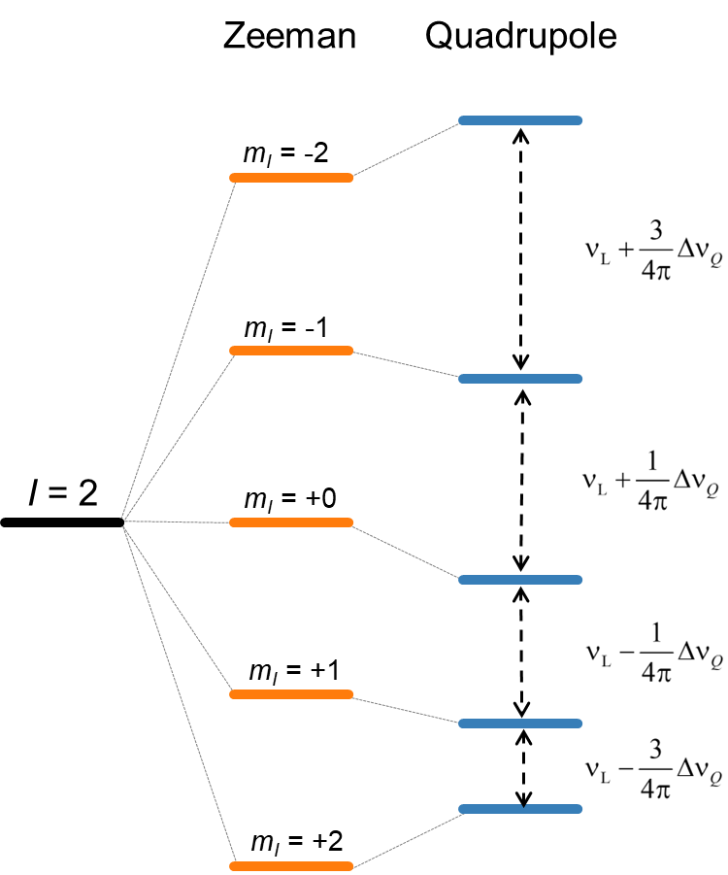
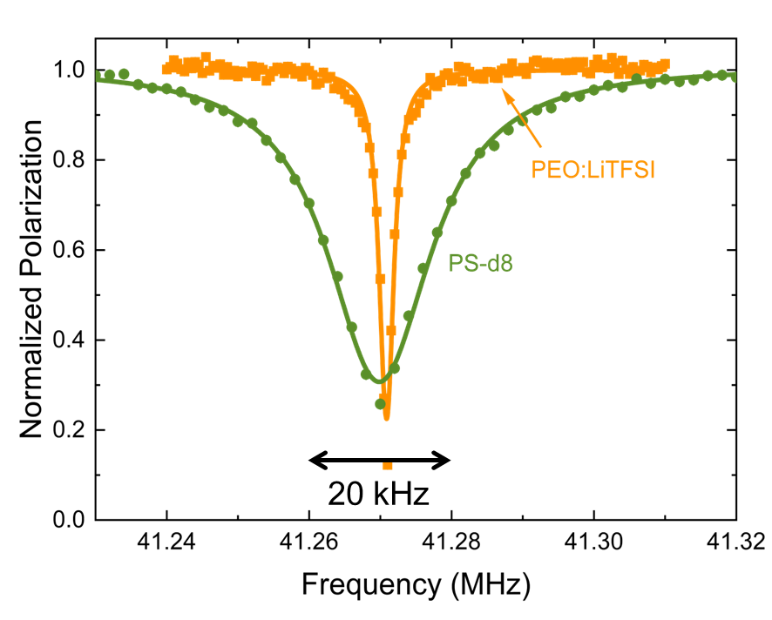
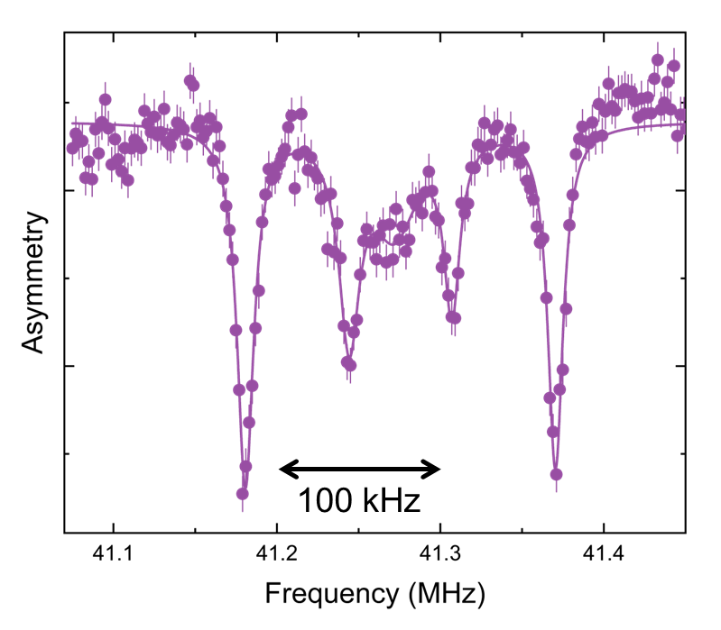
Resonance spectra – Zeeman and quadrupolar splitting
Polymers
α-Al₂O₃
Notes:
Here we show a comparison between the resonance peaks observed for the Nb and Ta from experimental data when both taken at the same external magnetic fields
Naively we would have assumed considering that Nb and Ta are so similar in their properties that we would have seen a similar trend where the resonances are single peaks at high temperatures but when much lower temperatures, we see quadrupolar splitting
The quadrupolar splitting suggests that the Li probe isn’t sitting in a highly symmetrical site in the lattice
However this isn’t the case of what we see in our Ta sample as we only observe single resonances at all temperatures
We do though see that the line widths of the peaks are broader then in Nb so we used a comb spectra to see if there was a hidden quadrupola splitting that this broadening wasn’t allowing us to observe

Slide 8
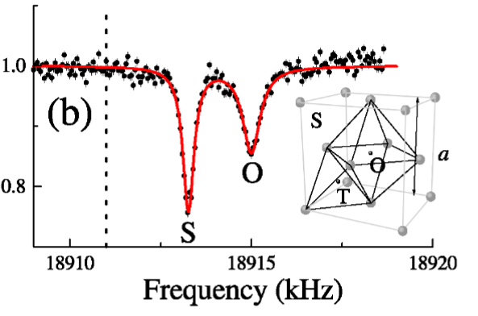
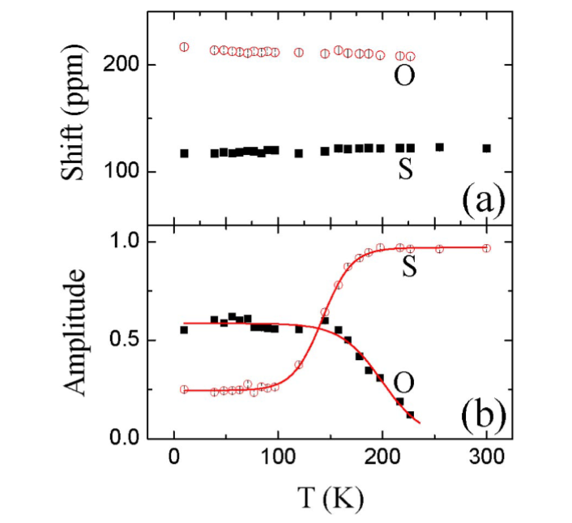
Resonance spectra – site identification of ⁸Li⁺ in Ag (fcc)
MgO

Slide 9
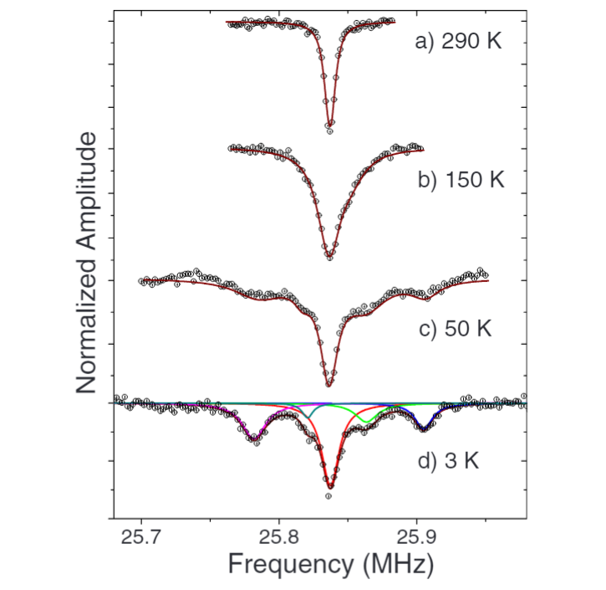
Resonance spectra – Nb versus Ta (bcc)
Niobium resonance
Tantalum resonance
4.1 T
6.55 T
Notes:
Here we show a comparison between the resonance peaks observed for the Nb and Ta from experimental data when both taken at the same external magnetic fields
Naively we would have assumed considering that Nb and Ta are so similar in their properties that we would have seen a similar trend where the resonances are single peaks at high temperatures but when much lower temperatures, we see quadrupolar splitting
The quadrupolar splitting suggests that the Li probe isn’t sitting in a highly symmetrical site in the lattice
However this isn’t the case of what we see in our Ta sample as we only observe single resonances at all temperatures
We do though see that the line widths of the peaks are broader then in Nb so we used a comb spectra to see if there was a hidden quadrupola splitting that this broadening wasn’t allowing us to observe

Slide 10
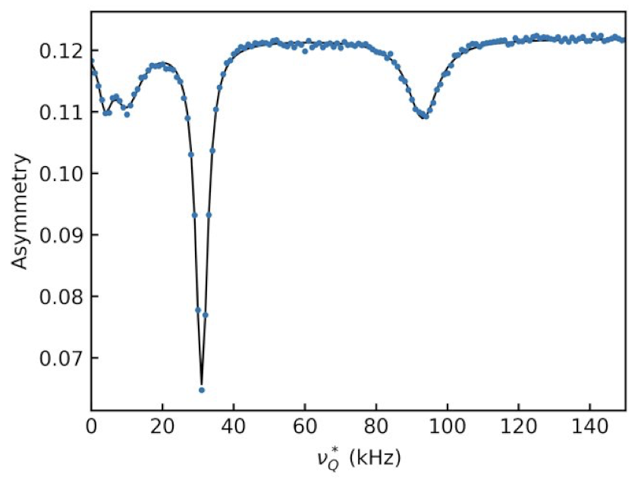
Comb Spectra
Aluminum Oxide
Tantalum
ν_{Q}/3
3ν_{Q}
ν_{Q}
6.55 T
6.55 T
Notes:
To take a comb spectra instead of sweeping 1 RF frequency, multiple are used and spaced at regular intervals like a comb
In the first graph It shows the comb spectral for aluminum oxide. This was taken at 300 K at 6.55T
However the Ta comb spectra at no temperatures indicates that there will be quadrupolar splitting
If Ta was to follow Nb then a similar kind of spectra as seen in the aluminum oxide at 4K
Because quadrupolar splitting isn’t observes that suggests that for this sputtered film, that the Li must be landing in a highly symmetrical site, suggesting it should be in a substitutional site or an octahedral site
However this may not be the best final idea of Ta as the film used had quite a lot of impurities in it so until we do a comparison sample, we wont know if this is the true probe landing site

Slide 11
Temperature dependent properties
Correlates to change in SLR rate
Motional narrowing
Shift in resonance frequency
Notes:
Then decided to look more into what we have observed in the resonance peaks to gain a better understanding
Baseline: increases with temperature, has to do with change in the SLR rate
The next 2 graphs show that when the temperature increases, the the peaks become narrower which is most likely a result of motional narrowing
Final graph shows the knight shift with respect to temperature
The knight shift is related to the central frequencies of the resonances and this shows that at low temperatures this central frequency drops quite a lot.
A preliminary idea for this drop in the central frequency could be due to there being some kind of paramagnetic impurities in the film used
This result is very surprising as the knight shift should be independent of temperature and it is especially interesting with regards to the BeEST experiment as measuremnts are taken at cryogenic temperatures
We wont know until we compare with a more pure film if these effects show up

Slide 12
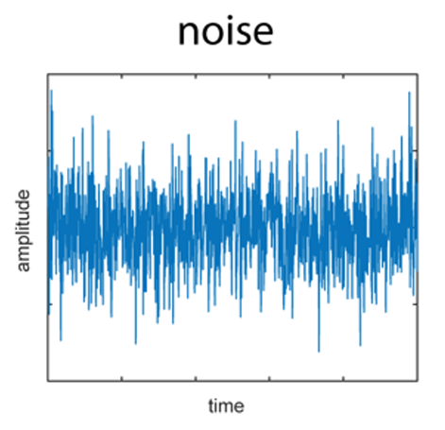
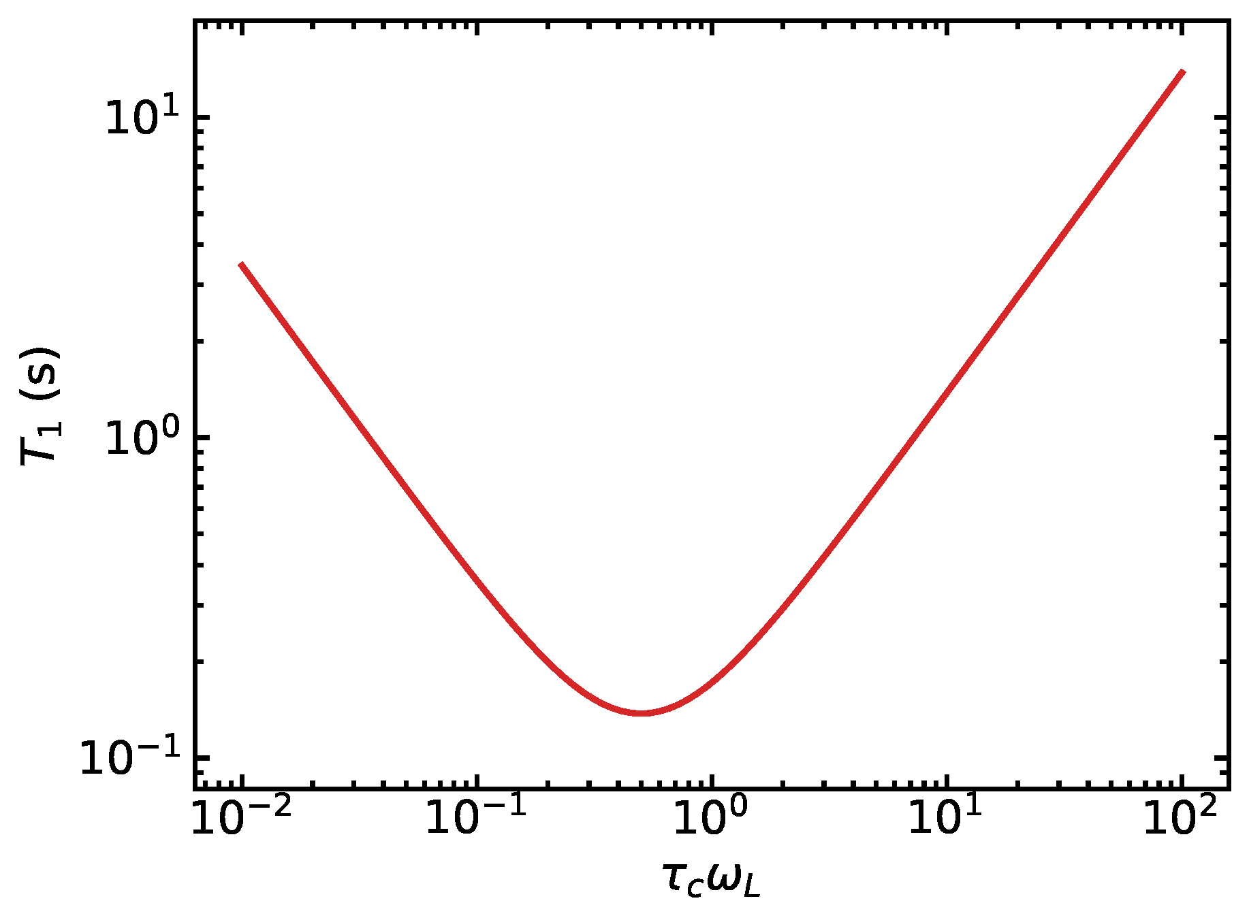
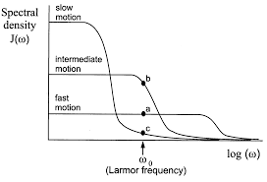
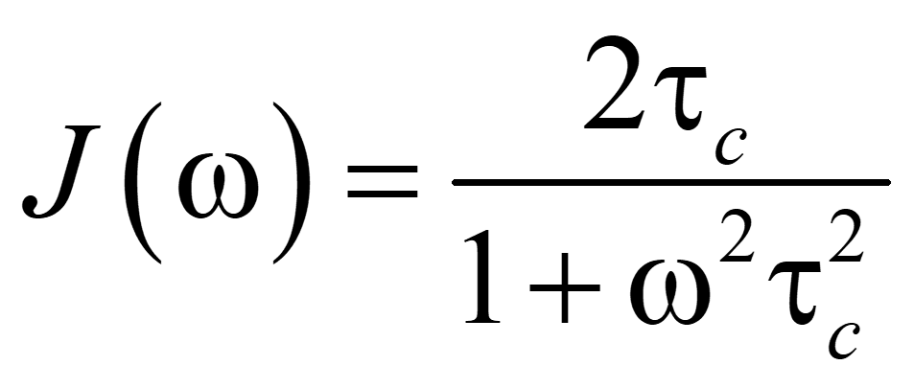
Spin-Lattice Relaxation (SLR)
Slow fluctuation limit
1/T₁ ∝ ω⁻²τ_{c}⁻¹
c
a
time
Spectral density
J(ω)
slow motion
ħω₀
b
BPP
ω_{L} = 2π⋅41 MHz
intermediate motion
fast
motion
Increasing viscosity or molecular size
log (ω)
ω₀
(Larmor frequency)
Notes:
The final type of data we took with bnmr was the slow lattice relaxation data
SLR data is obtained by pulsing the beam of the aligned nuclear spins Li and gradually waiting for them to fall back into equilibrium by measuring how the asymmetry decreases over time
In our experiment we pulse the laser for 4 seconds and then allow the Li to relax
At the fast fluctuation limit, the spins quickly fall back to equilibrium but this didn’t agree with

Slide 13
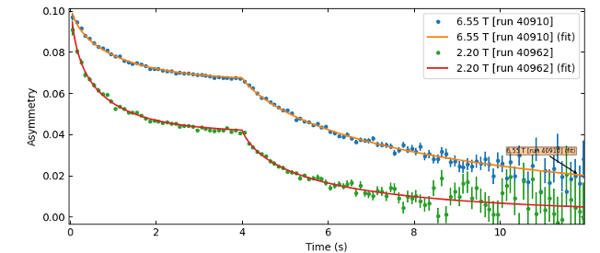
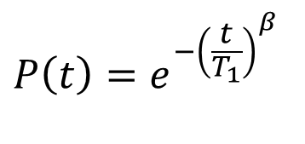
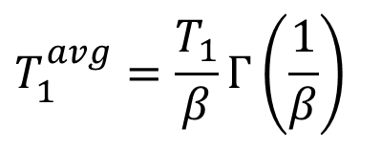
Spin-Lattice Relaxation (SLR)
300 K
⁸Li⁺ pulse
Notes:
The final type of data we took with bnmr was the slow lattice relaxation data
SLR data is obtained by pulsing the beam of the aligned nuclear spins Li and gradually waiting for them to fall back into equilibrium by measuring how the asymmetry decreases over time
In our experiment we pulse the laser for 4 seconds and then allow the Li to relax
At the fast fluctuation limit, the spins quickly fall back to equilibrium but this didn’t agree with

Slide 14
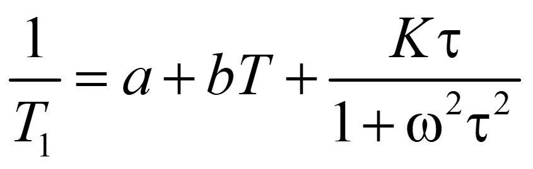
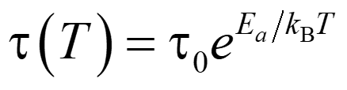
SLR of typical metal – titanium
⁸Li⁺ hopping above ~200 K. Spin-lattice relaxation suppressed in high magnetic field. Activation energy for hopping is 260 meV.
E_{a} = 0.26 eV
Korringa relaxation
Slope = 2.9(1) x 10⁻⁴ s⁻¹ K⁻¹
|K| = 59(1) ppm

Slide 15
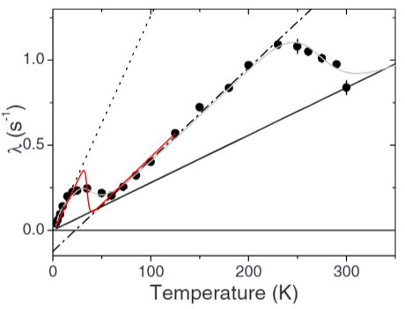
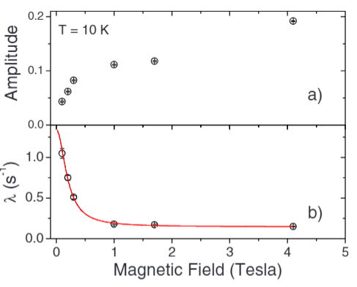
SLR of niobium

Slide 16
SLR of 200 nm Ta on Si
Relaxation rate vs Temperature
Arrhenius data

Slide 17
Summary
Next Steps?
Sputtered Ta ≠ Nb
Could be due to impurities in the film or Li⁺ hopping above 200 K
Li⁺ is acting differently in Ta then what’s expected from metals in general?
Identify ⁸Li⁺ stopping location(s) by comparing with DFT calculations
  Knight shift
  Quadrupolar coupling for different sites
βNMR of high-purity Ta
  Ta single crystal with a well-defined crystallographic axis to be measured July 9th – 11th
βNMR of Ta film with implanted ⁷Li?
Depth-resolved measurements?

