Slide 1
An Experimental Design for Testing STJs in Dilution Refrigerators for The BeEST: PNNL & Mines
Joe Templet
Colorado School of Mines
M.S. Quantum Engineering
The BeEST Conference | 2025

Slide 2
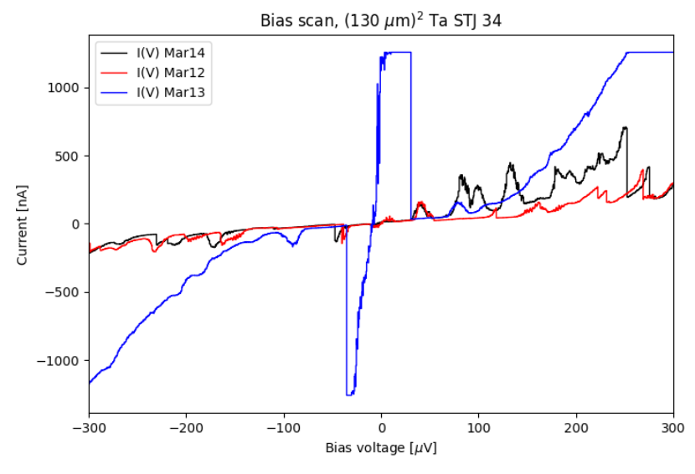

MOTIVATION
DR Provides Continuous Cooling
No more re-characterization → → →
Longer experimental runtime
Improved thermal stability
Bias scan, 64-pix, ${\text{(130}\text{um}\text{)}}^{2}$ Ta STJ 34
Current [nA]
Bias Voltage [μV]
Notes:
General problems – Vibrational noise and Thermal Load minimization
Specific to the BeEST – Magnet current limitation
The challenges that I was mainly concerned with tackling in my design were the minimization of the thermal load at cold stages due to signal wires and the amperage limit on the wire used to produce our desired >150 Gauss magnetic field.

Slide 3
MOTIVATION
DR Provides Continuous Cooling
No more re-characterization → → →
Longer experimental runtime
Improved thermal stability
Bias scan, 64-pix, ${\text{(130}\text{um}\text{)}}^{2}$ Ta STJ 34
General DR Challenges:
Increased vibrational noise
  - Future microphonic tests @ PNNL
Minimize thermal load
Current [nA]
Bias Voltage [μV]
Notes:
General problems – Vibrational noise and Thermal Load minimization
Specific to the BeEST – Magnet current limitation
The challenges that I was mainly concerned with tackling in my design were the minimization of the thermal load at cold stages due to signal wires and the amperage limit on the wire used to produce our desired >150 Gauss magnetic field.

Slide 4
MOTIVATION
DR Provides Continuous Cooling
No more re-characterization → → →
Longer experimental runtime
Improved thermal stability
Bias scan, 64-pix, ${\text{(130}\text{um}\text{)}}^{2}$ Ta STJ 34
General DR Challenges:
Increased vibrational noise
  - Future microphonic tests @ PNNL
Minimize thermal load
Current [nA]
BeEST Specific Challenge:
Magnet limited to 500mA @PNNL
  Maximize B-Field
Bias Voltage [μV]
Notes:
General problems – Vibrational noise and Thermal Load minimization
Specific to the BeEST – Magnet current limitation
The challenges that I was mainly concerned with tackling in my design were the minimization of the thermal load at cold stages due to signal wires and the amperage limit on the wire used to produce our desired >150 Gauss magnetic field.

Slide 5
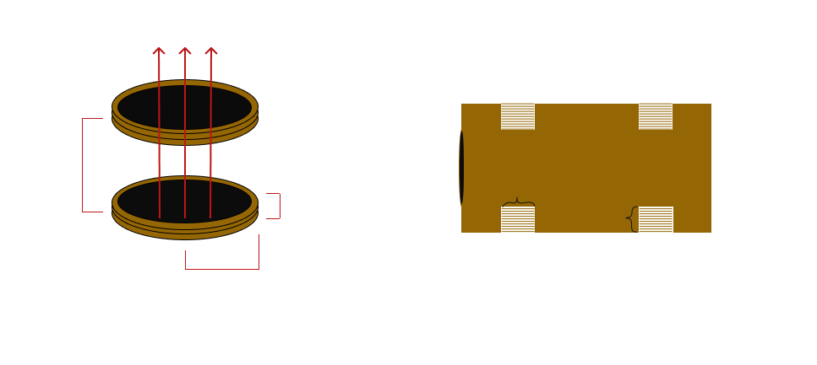
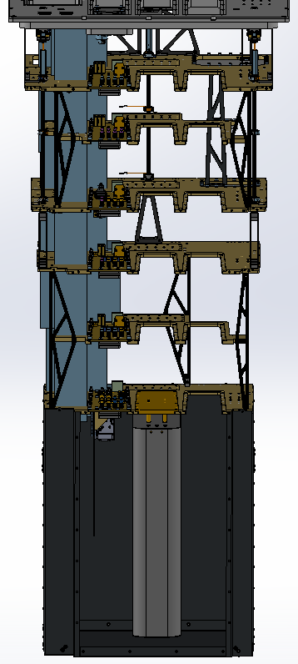
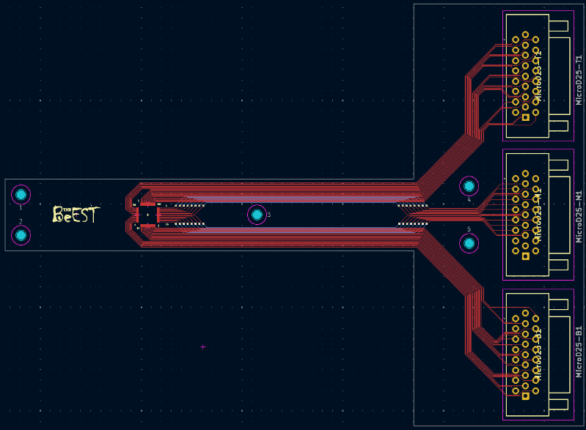
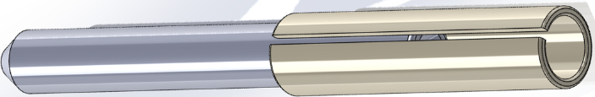
Requirements for STJ Operation
PCB
32-pix Readout
Magnet
>150 Gauss
Magnetic Shielding
Laser
Notes:
Misalign image, dim

Slide 6
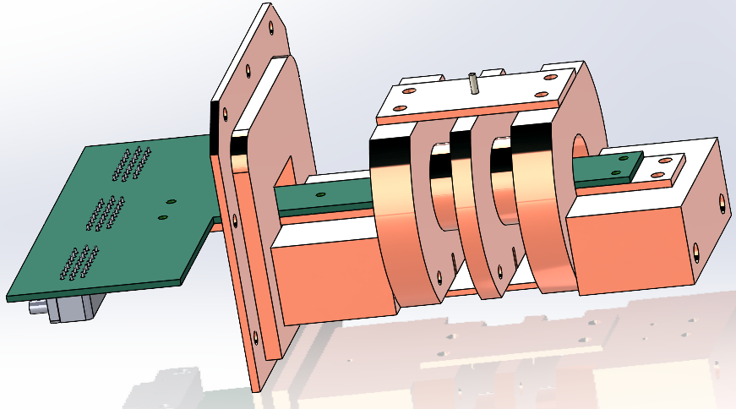
Design Overview
STJ + Collimator Mount onto PCB
Located @MXC
No Ferromagnetic Materials (Nickel)
Currently intended for calibration results
Notes:
Misalign image, dim

Slide 7
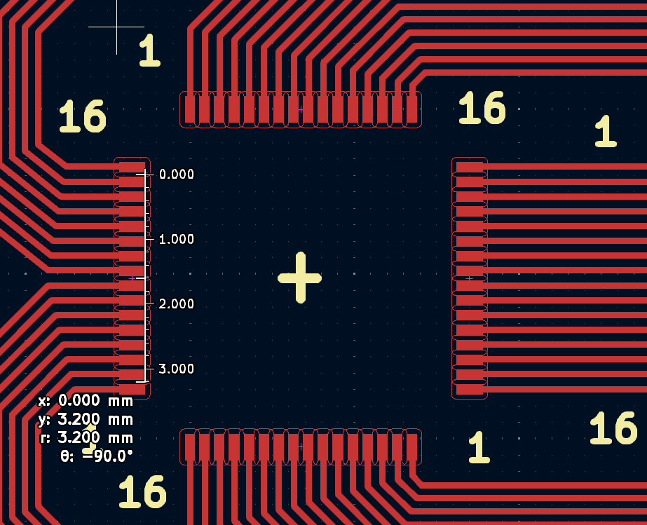
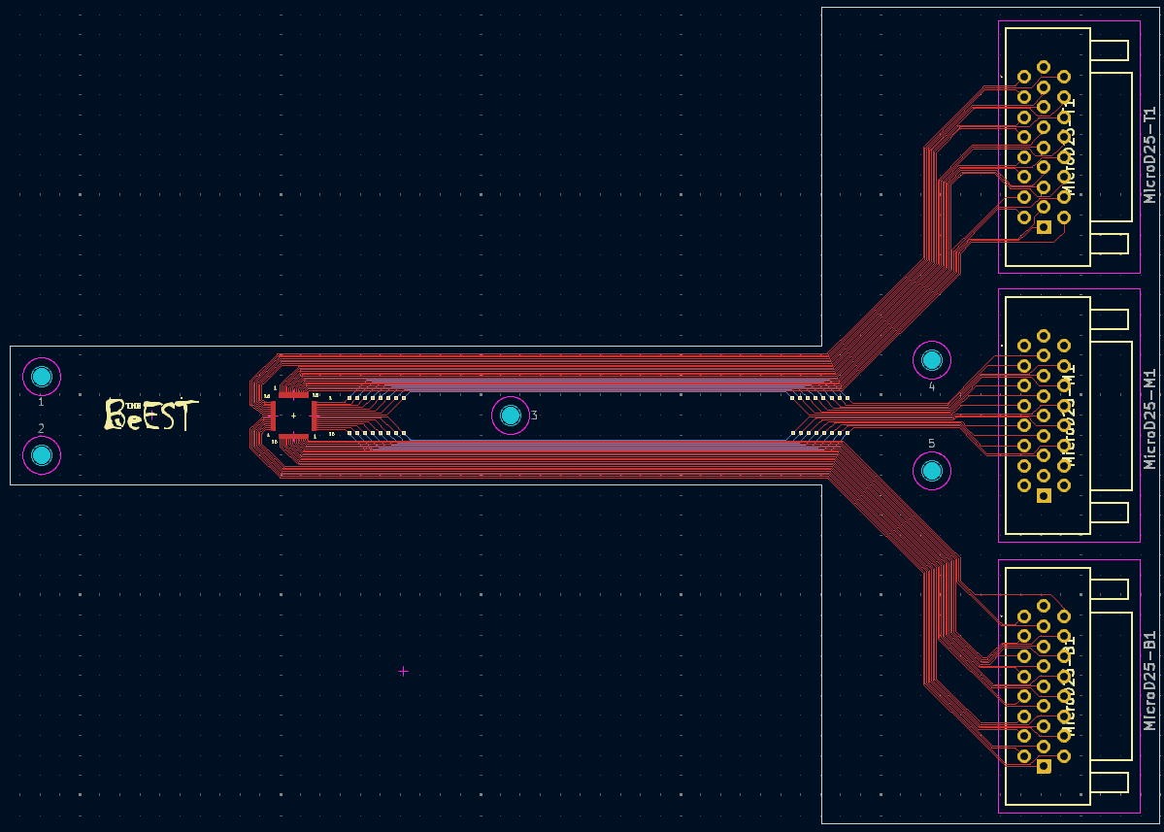
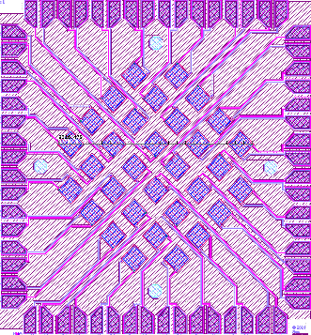
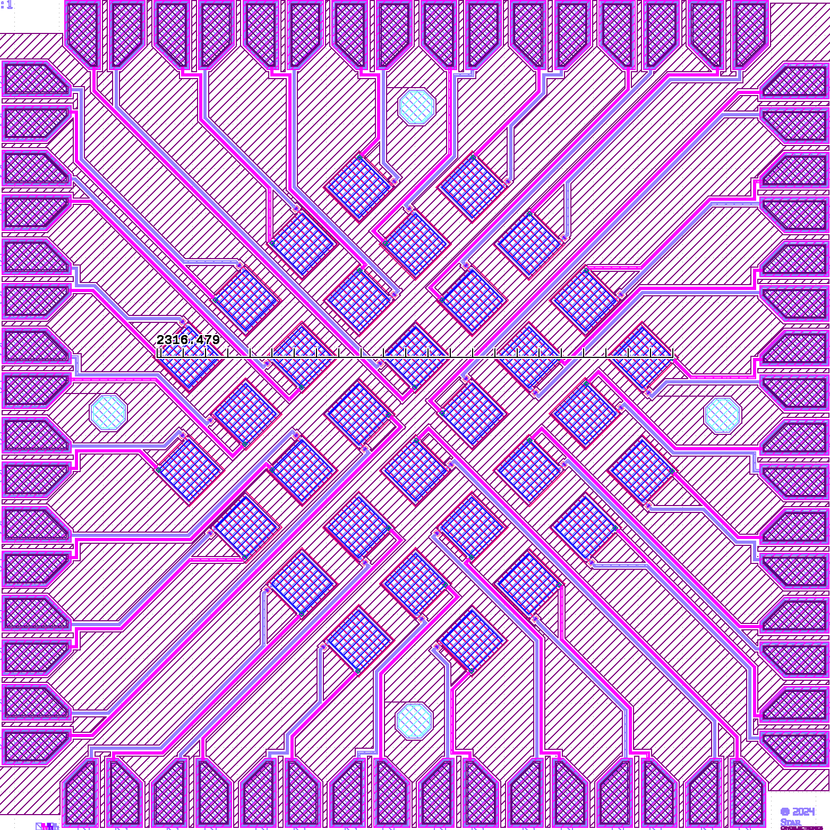
PCB Design
  32-pixel chip design
  PCB Finish: Electroless Palladium Immersion Gold (EPIG)
  PCB width: 17.6mm
  PCB Pitch: 9mil (228.6μm ) /// Sensor Pitch: 200μm
Notes:
Misalign image, dim

Slide 8


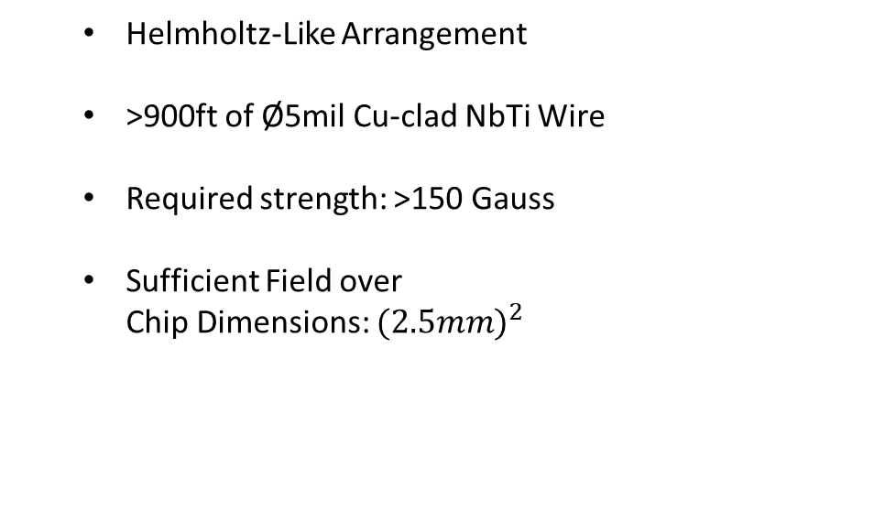


Magnet Design
$${\vec{B}}_{z}$$
  Helmholtz-Like Arrangement
  >900ft of Ø5mil Cu-clad NbTi Wire
  Required strength: >150 Gauss
  Sufficient Field over
  Chip Dimensions: ${(2.5mm)}^{2}$
$$X$$
$$n$$
$$w$$
$$D_{in}/2$$
Notes:
Misalign image, dim

Slide 9
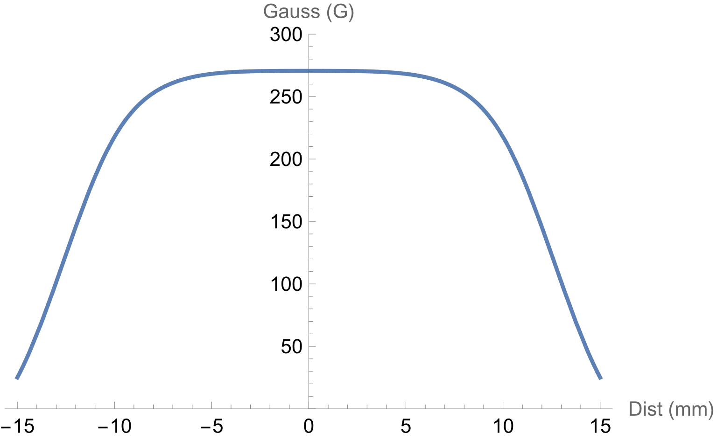
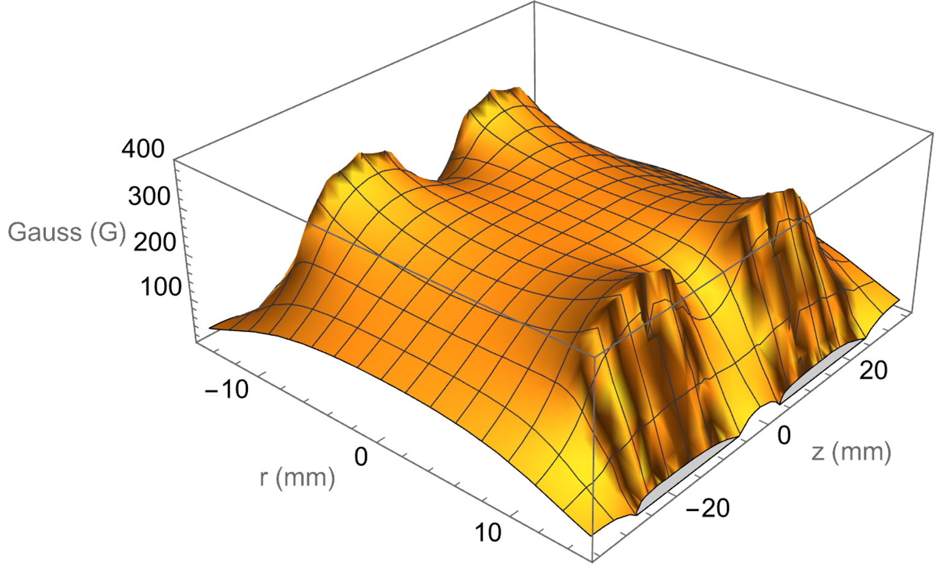
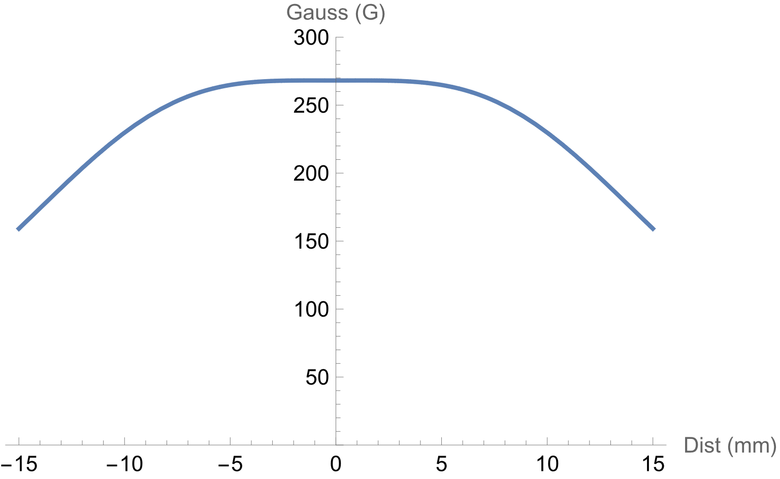


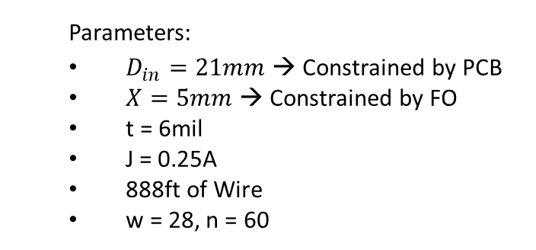






Magnet Results
$$Gauss (G)$$
  Parameters:
  $D_{in}=21mm$ → Constrained by PCB
  $X=5mm$ → Constrained by FO
  t = 6mil
  J = 0.25A
  888ft of Wire
  w = 28, n = 60
$$r (mm)$$
$$Gauss (G)$$
$$B_{z}(z=0, r)$$
$$Gauss (G)$$
$$r (mm)$$
$$z (mm)$$
$$z (mm)$$
$$B_{z}(z, r=0)$$
Notes:
Misalign image, dim

Slide 10
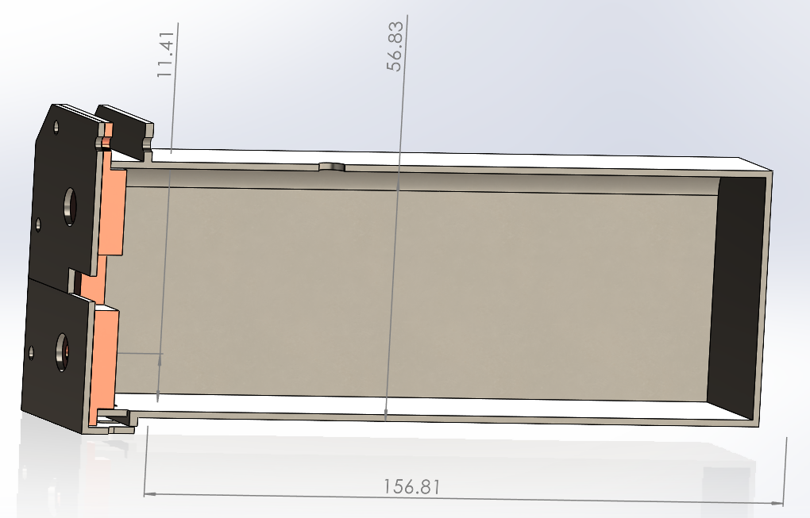
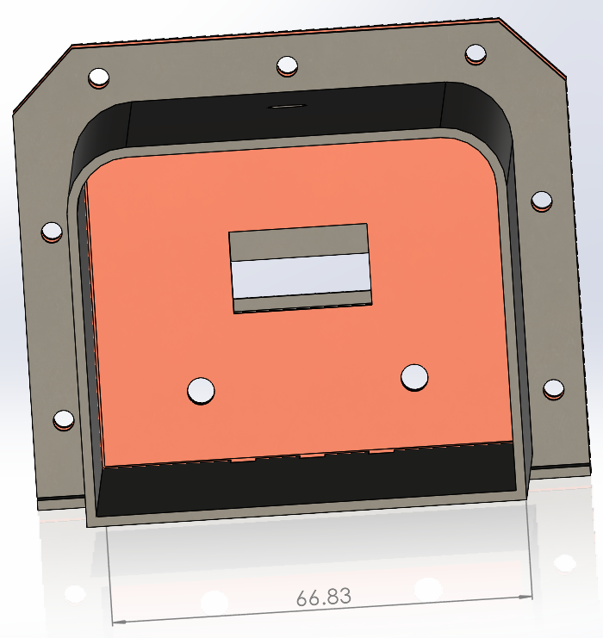
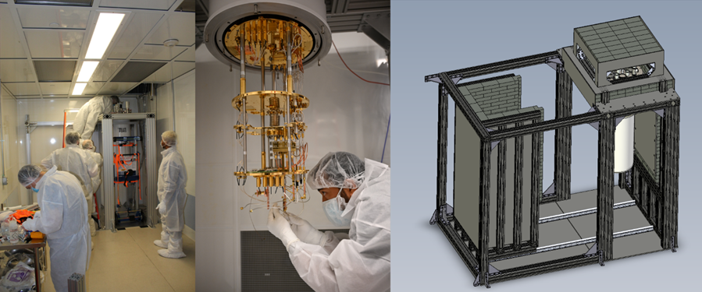
Magnetic Shielding: PNNL (Bluefors)
  Smaller shield
  Cryoperm Material
  Dimensions (mm)
Dimensions (mm)
Notes:
Misalign image, dim

Slide 11
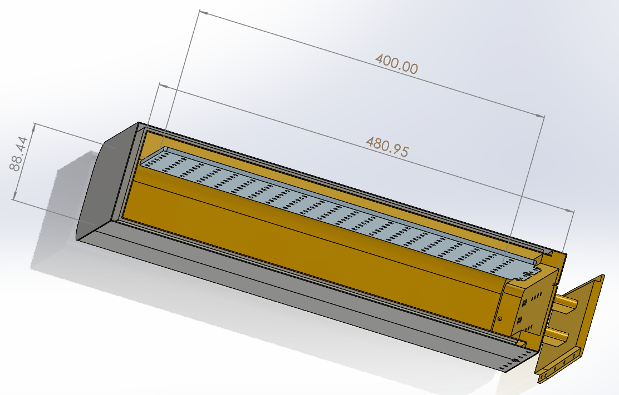
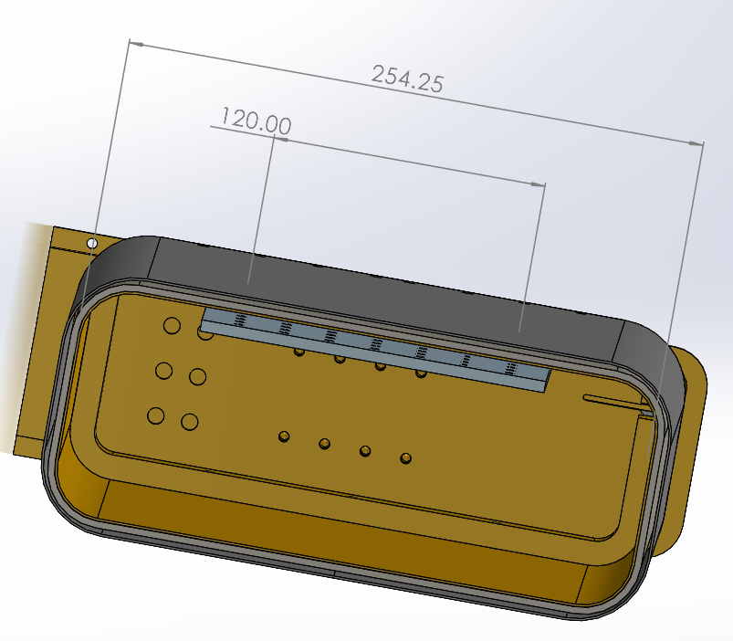
Magnetic Shielding: Mines (Maybell)
  Larger shield
  1mm A4K MuMetal -> 3 mm Pb
  5Kg Pb shield also helps reduce vibrational noise
[1]
[1] Shield design brought to you by: Wouter Van De Pontseele, Grace Wagner, and Maybell Quantum
Notes:
Misalign image, dim

Slide 12
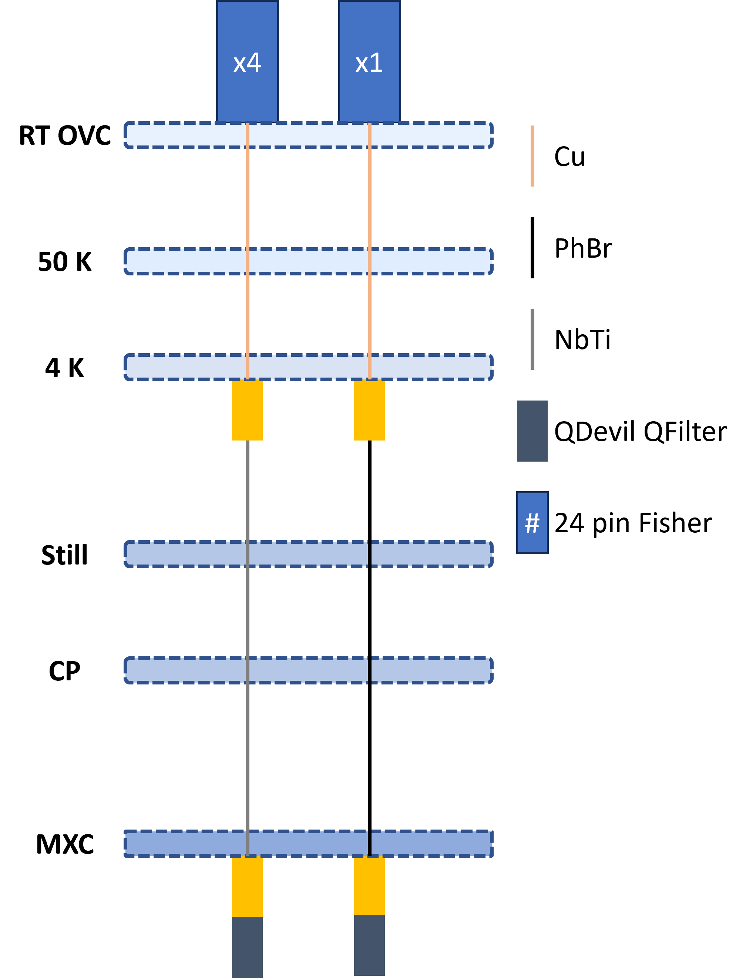

Wiring Tree Configurations
PNNL
(Bluefors LD400)
Mines
(Maybell Fridge2.0)
S
M
S
M
Cu (AWG35)
PhBr (AWG36)
RT
70K
9K
3K
Cu (AWG35)
Cu (AWG35)
NbTi-Cu (5mil)
NbTi-Cu (5mil)
NbTi-CuNi (5mil)
NbTi-CuNi (5mil)
Notes:
Misalign image, dim

Slide 13
Thermal Load Results: PNNL (Bluefors)
PNNL | 2x RRR=300 (TC + JH) | 2x RRR=150 (TC + JH) | 2x RRR=100 (TC + JH) | 2x RRR=50 (TC + JH) | 64x Signal (CuNi & PhBr) | Total (PhBr) | 64x Signal (CuNi & Cu50) | Total (Cu50) | Thermal Budget
50K | 2.5W | 2.46W | 2.39W | 2.44W | 0.1W | 2.6W | 0.75W | 3.25W | -------
4K (3-5K) | 42mW | 35mW | 32mW | 36mW | 4.45mW | 47mW | 0.34W | 0.35W | 0.6-1.5W
120mK | 14μW | 6.8μW | 4.5μW | 2.25μW | 0.16μW | 15μW | 0.16μW | 15μW | 0.6mW
100mK | 14μW | 6.8μW | 4.5μW | 2.26μW | 0.16μW | 15μW | 0.16μW | 15μW | 0.4mW
20mK | 81nW | 41nW | 28nW | 14nW | 0.96nW | 82nW | 0.96nW | 82nW | 14μW
<0.1x
0.1x – 1x
Too Hot!
Notes:
Misalign image, dim

Slide 14
Magnet Wire: Purity of Cu is largely inconsequential
Signal Wires: PhBr is better than Cu, but either will work for 64-pix
PNNL | 2x RRR=300 (TC + JH) | 2x RRR=150 (TC + JH) | 2x RRR=100 (TC + JH) | 2x RRR=50 (TC + JH) | 64x Signal (CuNi & PhBr) | Total (PhBr) | 64x Signal (CuNi & Cu50) | Total (Cu50) | Thermal Budget
50K | 2.5W | 2.46W | 2.39W | 2.44W | 0.1W | 2.6W | 0.75W | 3.25W | -------
4K (3-5K) | 42mW | 35mW | 32mW | 36mW | 4.45mW | 47mW | 0.34W | 0.35W | 0.6-1.5W
120mK | 14μW | 6.8μW | 4.5μW | 2.25μW | 0.16μW | 15μW | 0.16μW | 15μW | 0.6mW
100mK | 14μW | 6.8μW | 4.5μW | 2.26μW | 0.16μW | 15μW | 0.16μW | 15μW | 0.4mW
20mK | 81nW | 41nW | 28nW | 14nW | 0.96nW | 82nW | 0.96nW | 82nW | 14μW
<0.1x
0.1x – 1x
Too Hot!
Notes:
Misalign image, dim

Slide 15
Thermal Load Results: Mines (Maybell)
Mines | 2x RRR=300 (TC + JH) | 2x RRR=150 (TC + JH) | 2x RRR=100 (TC + JH) | 2x RRR=50 (TC + JH) | 64x Signal (CuNi & PhBr) | Total (PhBr) | Thermal Budget
70K | 1.58W | 1.53W | 1.53W | 1.55W | 0.15W | 1.73W | 20W
9K | 53mW | 41mW | 35mW | 31mW | 11mW | 64mW | 1W
3K | 6mW | 3.8mW | 2.7mW | 2.4mW | 0.16mW | 7mW | 0.25W
0.7K | 0.16mW | 73μW | 49μW | 22.5μW | 1.74μW | 162μW | 22mW
200mK | 3.9μW | 3.9μW | 2.6μW | 1.3μW | 50nW | 4μW | 1mW
20mK | 0.67μW | 0.17μW | 0.13μW | 57nW | 8nW | 0.68μW | 14μW
<0.1x
0.1x – 1x
Too Hot!
Notes:
Misalign image, dim

Slide 16
Thermal Load Results: Mines (Maybell)
Mines | 2x RRR=300 (TC + JH) | 2x RRR=150 (TC + JH) | 2x RRR=100 (TC + JH) | 2x RRR=50 (TC + JH) | 64x Signal (CuNi & PhBr) | Total (PhBr) | Thermal Budget
70K | 1.58W | 1.53W | 1.53W | 1.55W | 0.15W | 1.73W | 20W
9K | 53mW | 41mW | 35mW | 31mW | 11mW | 64mW | 1W
3K | 6mW | 3.8mW | 2.7mW | 2.4mW | 0.16mW | 7mW | 0.25W
0.7K | 0.16mW | 73μW | 49μW | 22.5μW | 1.74μW | 162μW | 22mW
200mK | 3.9μW | 3.9μW | 2.6μW | 1.3μW | 50nW | 4μW | 1mW
20mK | 0.67μW | 0.17μW | 0.13μW | 57nW | 8nW | 0.68μW | 14μW
<0.1x
0.1x – 1x
Too Hot!
Notes:
Misalign image, dim

Slide 17
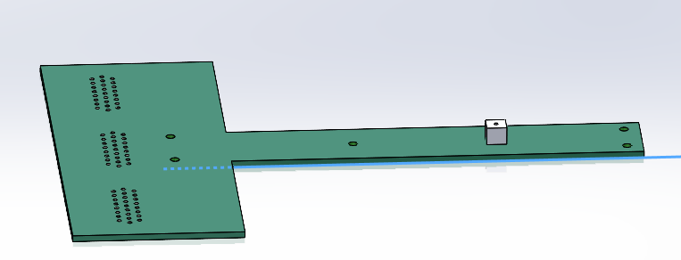
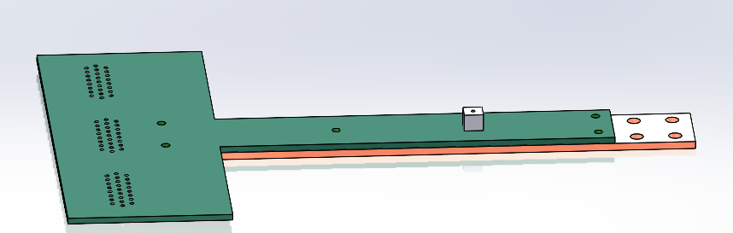
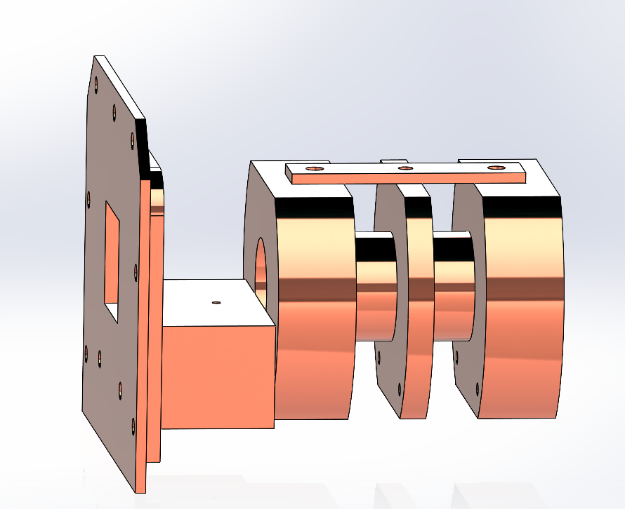
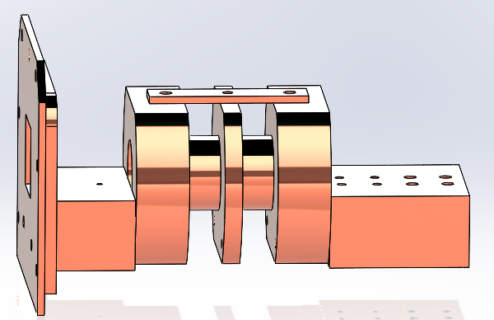
Design Assembly
Notes:
Misalign image, dim

Slide 18
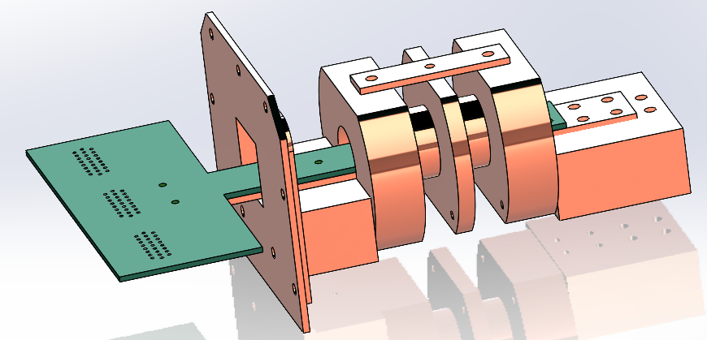
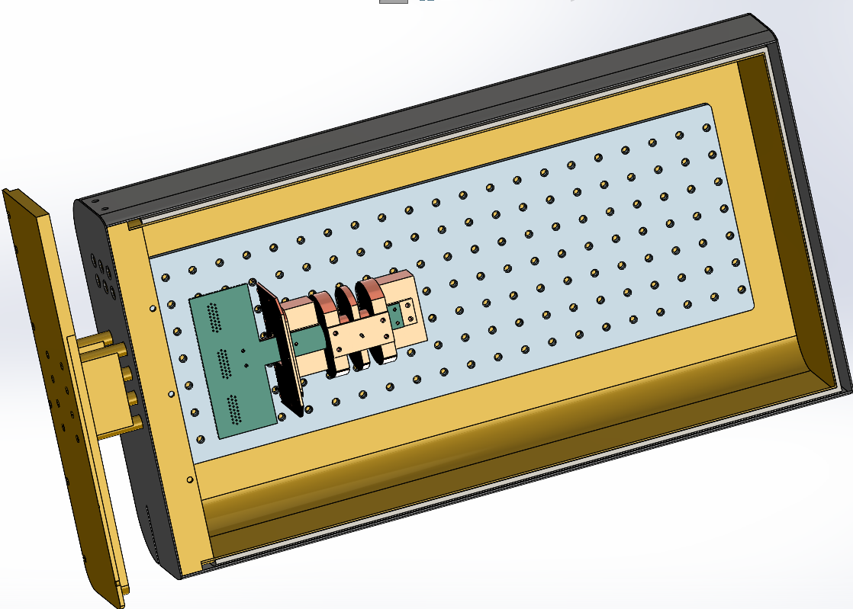
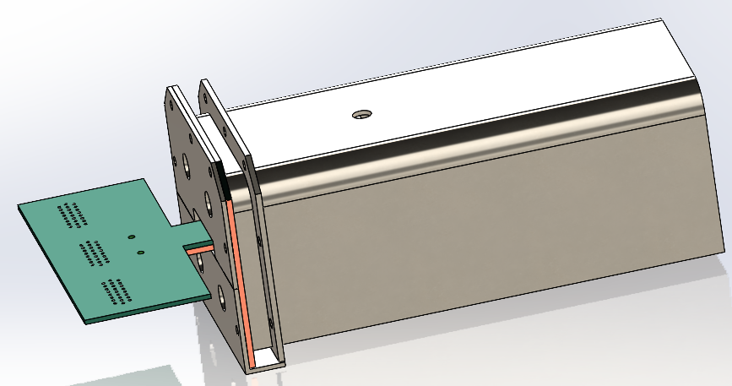
Design Assembly
Notes:
Misalign image, dim

Slide 19
Moving Forward
PhBr v. Cu Signal Wires: For >64 wires above 4K, PhBr is the only suitable option
Testing @ PNNL: The first test for this device will be at PNNL from May 24-30
Testing @ Mines: New Maybell fridge set to be installed July 7-11
Notes:
Misalign image, dim

Slide 20
Refrences
  Brammertz, G. B. W. (2003). Development of low critical temperature superconducting tunnel junctions for
  application as photon detectors in astronomy.
  Cremers, C., Fine, H., & Fine, H. A. (1990). Thermal conductivity. Springer Science & Business Media.
  cryogenic material properties OFHC Copper. (n.d.).
  https://trc.nist.gov/cryogenics/materials/OFHC%20Copper/OFHC_Copper_rev1.htm
  Flachbart, K., Feher, A., Jánoš, Š., Málek, Z., & Ryska, A. (1978). Thermal conductivity of NbTi alloy in the low-
  temperature range. Physica Status Solidi (B), 85(2), 545–551. https://doi.org/10.1002/pssb.2220850217
  Ho, C. Y., Ackerman, M. W., Wu, K. Y., Oh, S. G., & Havill, T. N. (1978). Thermal conductivity of ten selected binary alloy
  systems. Journal of Physical and Chemical Reference Data, 7(3), 959–1178. https://doi.org/10.1063/1.555583
  Previous courses | The CERN Accelerator School. (2025). https://cas.web.cern.ch/previous-schools
  Tuttle, J., Canavan, E., DiPirro, M., & Balachandran, U. (2010). THERMAL AND ELECTRICAL CONDUCTIVITY
  MEASUREMENTS OF CDA 510 PHOSPHOR BRONZE. AIP Conference Proceedings, 55–62.
  https://doi.org/10.1063/1.3402333
Notes:
Misalign image, dim

Slide 21
Supplemental Slides

Slide 22
Thermal Load Results: PNNL (Bluefors)
PNNL | 2x RRR=300 (TC + JH) | 2x RRR=150 (TC + JH) | 2x RRR=100 (TC + JH) | 2x RRR=50 (TC + JH) | 1024x Signal (CuNi & PhBr) | Total (PhBr) | 1024x Signal (CuNi & Cu50) | Total (Cu50) | Thermal Budget
50K | 2.5W | 2.46W | 2.39W | 2.44W | 1.2W | 3.7W | 9W | 12.7W | -------
4K (3-5K) | 42mW | 35mW | 32mW | 36mW | 53.4mW | 96mW | 4.1W | 4.2W | 0.6-1.5W
120mK | 14μW | 6.8μW | 4.5μW | 2.25μW | 1.93μW | 15.93μW | 1.93μW | 15.93μW | 0.6mW
100mK | 14μW | 6.8μW | 4.5μW | 2.26μW | 1.93μW | 15.93μW | 1.93μW | 15.93μW | 0.4mW
20mK | 81nW | 41nW | 28nW | 14nW | 11.9nW | 94μW | 11.9nW | 94μW | 14μW
<0.1x
0.1x – 1x
Too Hot!
Notes:
Misalign image, dim

Slide 23
Signal Wires: PhBr is better than Cu, but either will work for 64-pix
Magnet Wire: Purity of Cu is largely inconsequential
PNNL | 2x RRR=300 (TC + JH) | 2x RRR=150 (TC + JH) | 2x RRR=100 (TC + JH) | 2x RRR=50 (TC + JH) | 1024x Signal (CuNi & PhBr) | Total (PhBr) | 1024x Signal (CuNi & Cu50) | Total (Cu50) | Thermal Budget
50K | 2.5W | 2.46W | 2.39W | 2.44W | 1.2W | 3.7W | 9W | 12.7W | -------
4K (3-5K) | 42mW | 35mW | 32mW | 36mW | 53.4mW | 96mW | 4.1W | 4.2W | 0.6-1.5W
120mK | 14μW | 6.8μW | 4.5μW | 2.25μW | 1.93μW | 15.93μW | 1.93μW | 15.93μW | 0.6mW
100mK | 14μW | 6.8μW | 4.5μW | 2.26μW | 1.93μW | 15.93μW | 1.93μW | 15.93μW | 0.4mW
20mK | 81nW | 41nW | 28nW | 14nW | 11.9nW | 94μW | 11.9nW | 94μW | 14μW
<0.1x
0.1x – 1x
Too Hot!
Notes:
Misalign image, dim

Slide 24
Thermal Load Results: Mines (Maybell)
Mines | 2x RRR=300 (TC + JH) | 2x RRR=150 (TC + JH) | 2x RRR=100 (TC + JH) | 2x RRR=50 (TC + JH) | 1024x Signal (CuNi & PhBr) | Total (PhBr) | Thermal Budget
70K | 1.58W | 1.53W | 1.53W | 1.55W | 1.8W | 3.38W | 20W
9K | 53mW | 41mW | 35mW | 31mW | 132mW | 185mW | 1W
3K | 6mW | 3.8mW | 2.7mW | 2.4mW | 1.92mW | 7.92mW | 0.25W
0.7K | 0.16mW | 73μW | 49μW | 22.5μW | 20.9μW | 181μW | 22mW
200mK | 3.9μW | 3.9μW | 2.6μW | 1.3μW | 0.6μW | 4.5μW | 1mW
20mK | 0.67μW | 0.17μW | 0.13μW | 57nW | 96nW | 0.77μW | 14μW
<0.1x
0.1x – 1x
Too Hot!
Notes:
Misalign image, dim

Slide 25
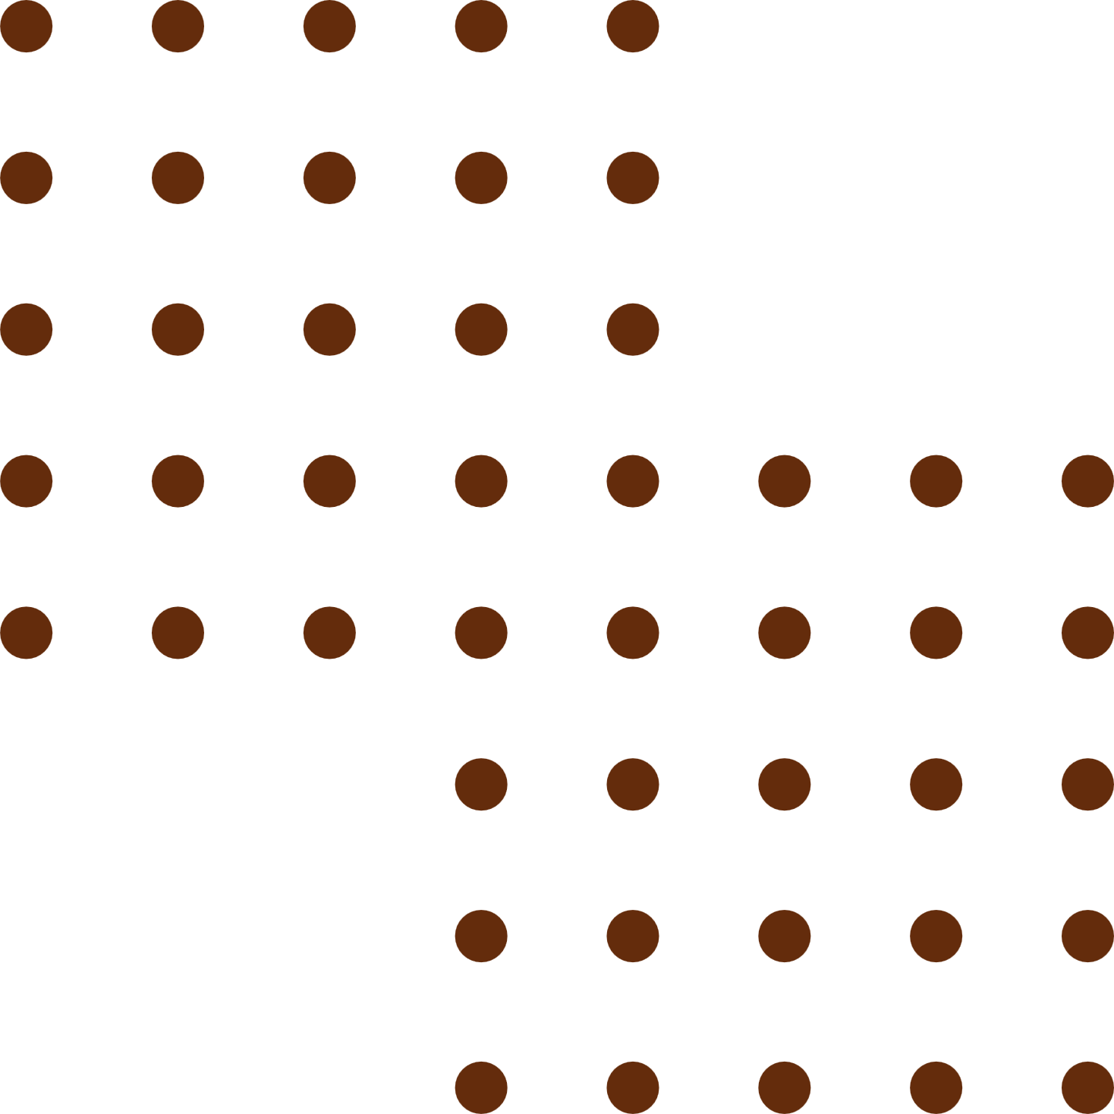

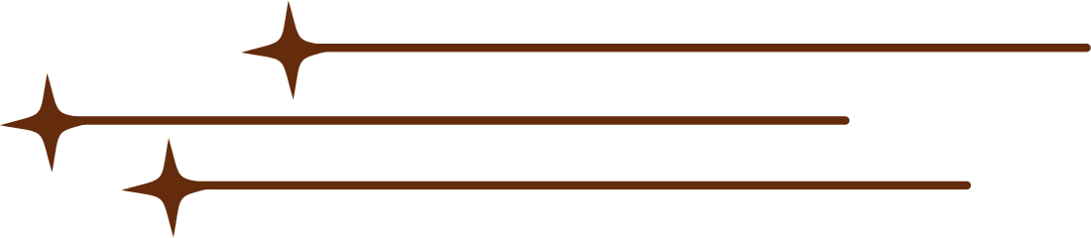

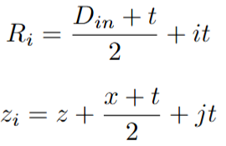

Magnet Design
Derivation
The BeEST Conference | 2025

Slide 26
Generalized Equations for Helmholtz-like Arrangements
Notes:
Misalign image, dim

Slide 27
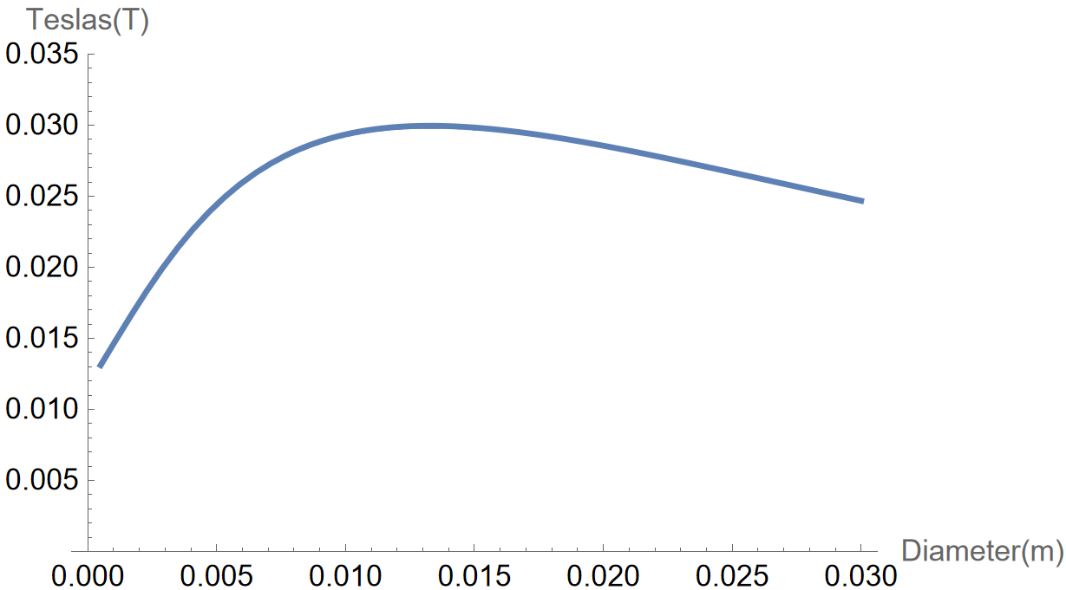
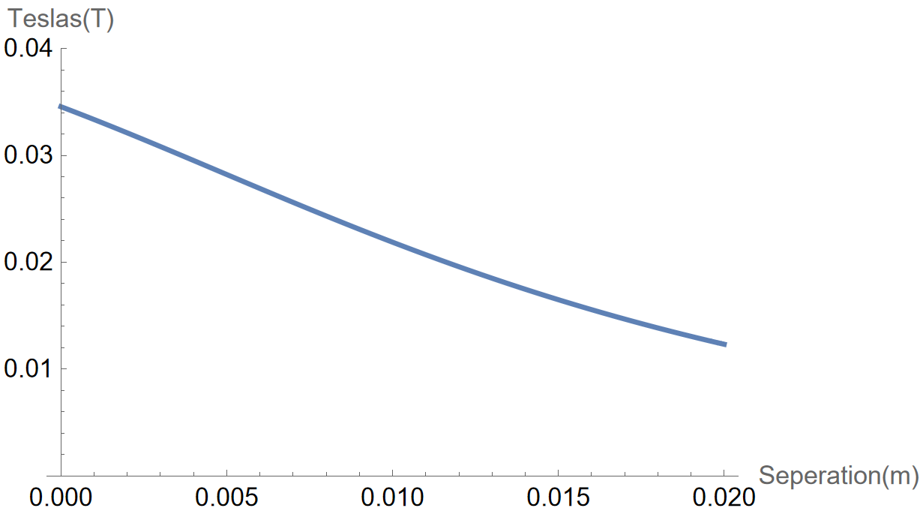

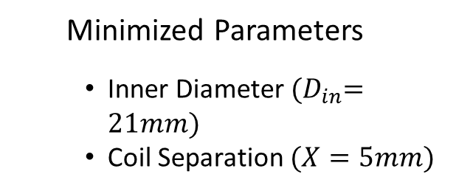
Magnet Design
B-Field Optimization
X=5mm
  Minimized Parameters
    Inner Diameter ${(D}_{in}=21mm)$
    Coil Separation $(X=5mm)$
Optimal winds-to-layers ratio?
D=21mm

Slide 28
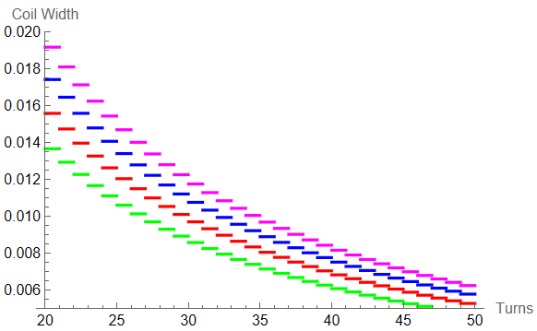
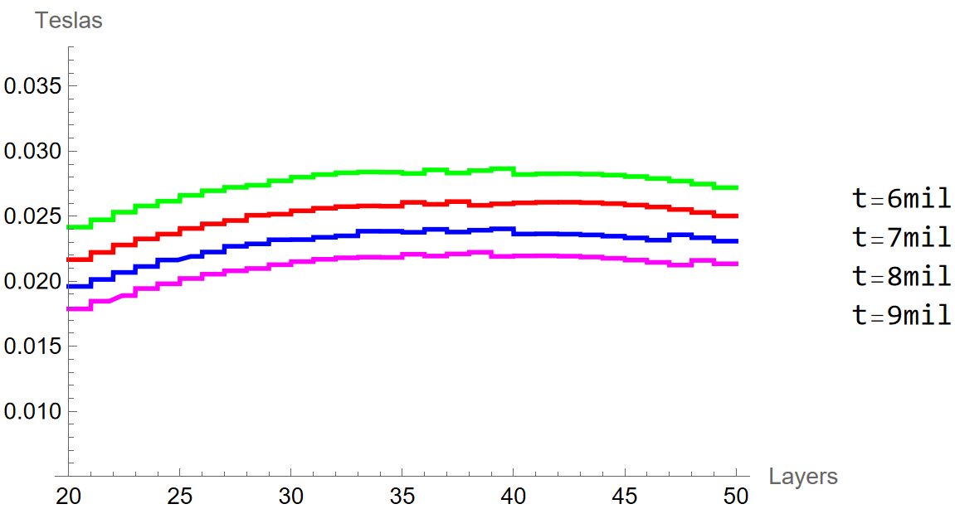
Magnet Design
B-Field Optimization
  Optimal winds-to-layers ratio? → Optimal Coil Length → 10mm

Slide 29

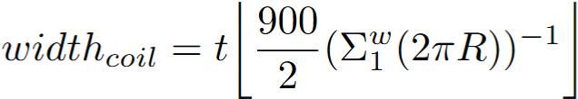
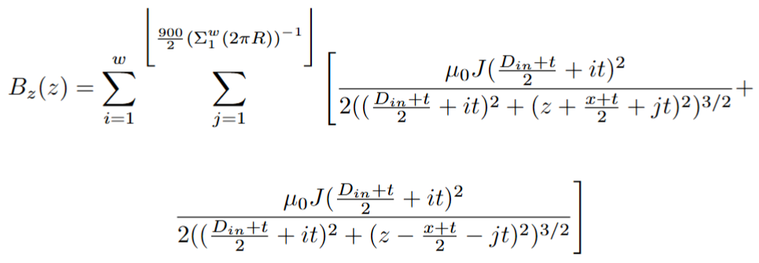
Magnet Design
B-Field Optimization
  Optimal winds-to-layers ratio? → Optimal Coil Length → 10mm

Slide 30
Magnet Design
B-Field Optimization
  Optimal winds-to-layers ratio? → Optimal Coil Length → 10mm

Slide 31
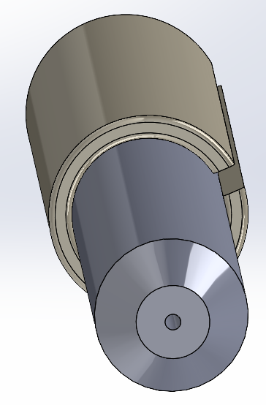
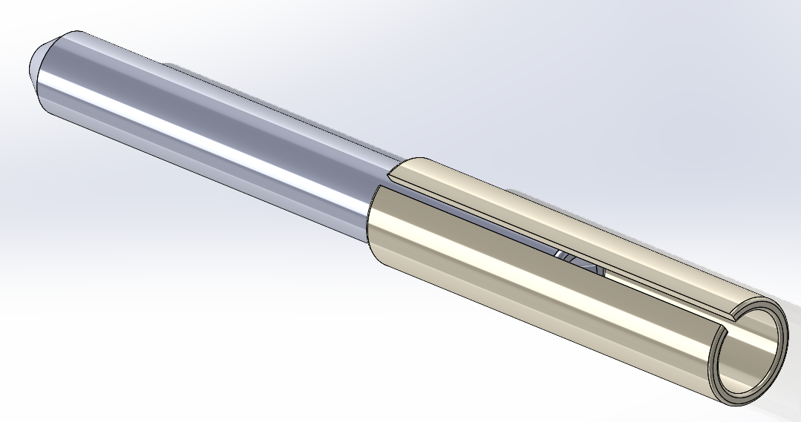
Fiber Optic Configuration
PNNL & Mines:
SMA 905 @ MXP
FO feed-through 1.5mm ferrule & ferrule sleeve
Fiber: MV11L1 - Ø100 µm, 0.22 NA, 11mm LTBR
The BeEST Conference | 2025

Slide 32
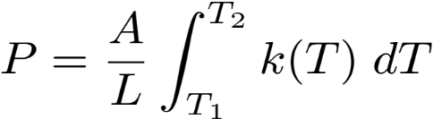
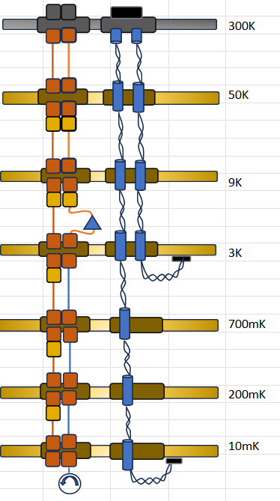
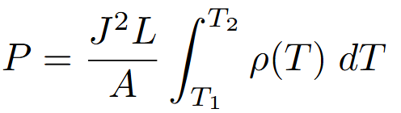
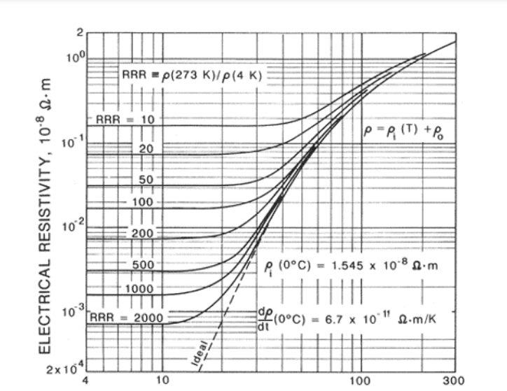
Thermal Load Calculations
Thermal Conductance & Joule Heating:
  TC:
  JH:
PNNL
(Bluefors LD400)
Mines
(Maybell Fridge 2.0)
NbTi-Cu
NbTi-CuNi

Slide 33
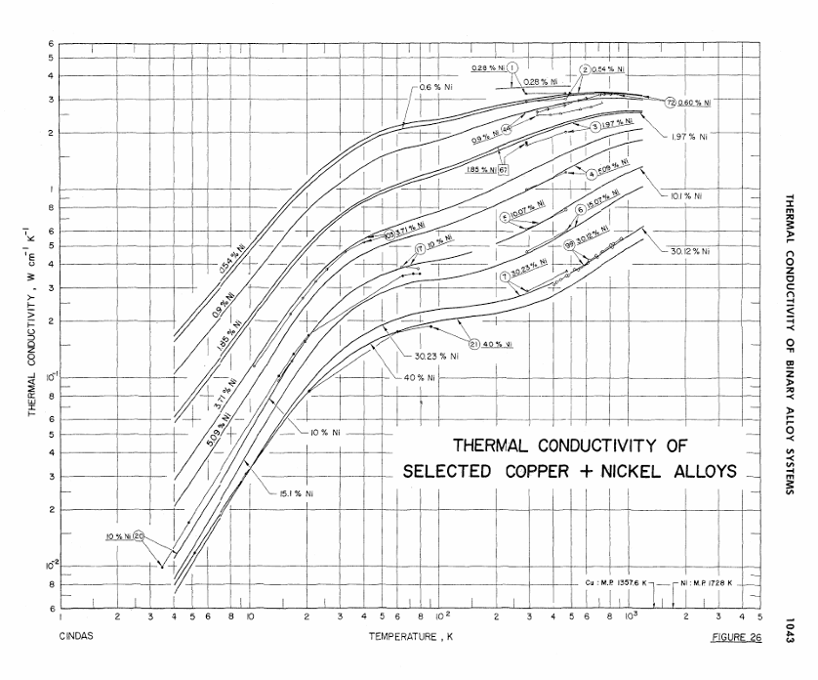
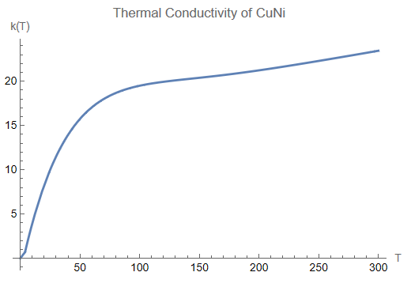
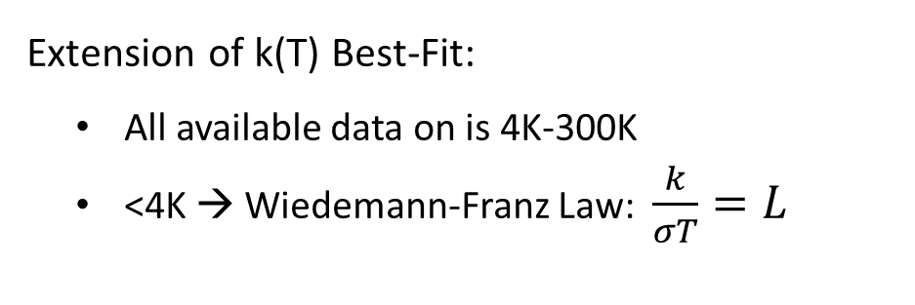
Thermal Load Calculations
Extension of k(T) Best-Fit:
  All available data on is 4K-300K
  <4K → Wiedemann-Franz Law: $\frac{k}{σT}=L$

Slide 34
Thermal Load Calculations
>4K Wire Configurations:
  Signal: 64x AWG36 PhBronze
  Magnet: 2x 35AWG Cu → PNNL Only
<4K Wire Configurations:
  Signal: 64x CuNi-clad NbTi
  Magnet: 2x 5thou Cu-clad NbTi
Mines | 300K-70K | 70K-9K | 9K-3K | 3K-700mK | 700mK - 200mK | 200mK - 10mK
Stage Separation | 150mm | 150mm | 150mm | 150mm | 150mm | 300mm
PNNL | 300K-50K | 50K-10K | 4K-Still | Still - 100K | 100mK - 10mK | --------------------
Stage Separation | 320mm | 340mm | 440mm | 250mm | 400mm | ---------------------
L = 1.5 x Length

Slide 35
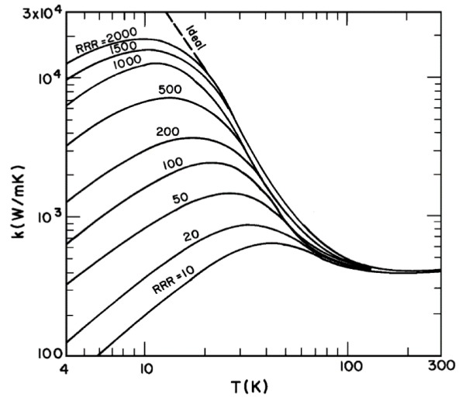
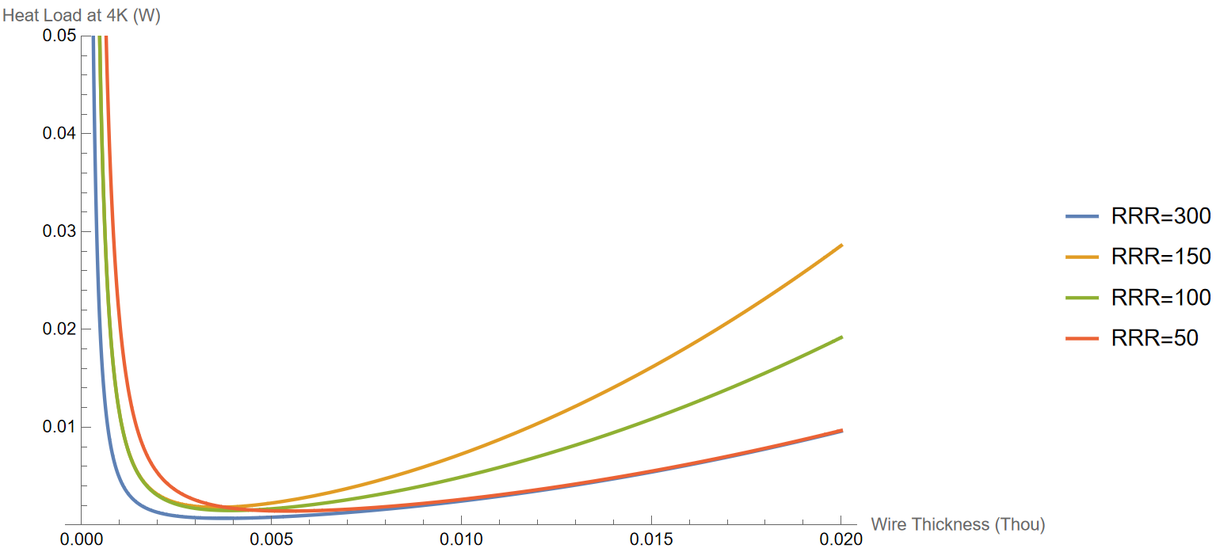
Thermal Load Calculations
Mines Fridge: What is the most optimal magnet wire gauge? → AWG36 (~5 thou)
Residual Resistivity Ratio (RRR): Resistivity @300k / @4K

Slide 36
Thermal Load Results: PNNL
PNNL | 2x RRR=300 (TC + JH) | 2x RRR=150 (TC + JH) | 2x RRR=100 (TC + JH) | 2x RRR=50 (TC + JH) | 256x Signal (CuNi & PhB) | 256x Signal (CuNi & Cu50) | PNNL
50K | 2.5W | 2.46W | 2.39W | 2.44W | 0.39W | 2.95W | -------
4K (3-5K) | 42mW | 35mW | 32mW | 36mW | 13.8mW | 1.33W | 0.6-1.5W
120mK | 14μW | 6.8μW | 4.5μW | 2.25μW | 0.64μW | 0.64μW | 0.6mW
100mK | 14μW | 6.8μW | 4.5μW | 2.26μW | 0.64μW | 0.64μW | 0.4mW
20mK | 81nW | 41nW | 28nW | 14nW | 3.85nW | 3.85nW | 14μW
The BeEST Conference | 2025

Slide 37
Thermal Load Results: Mines
Mines | 2x RRR=300 | 2x RRR=150 | 2x RRR=100 | 2x RRR=50 | 256x Signal (CuNi & PhB) | Mines
70K | 1.58W | 1.53W | 1.53W | 1.55W | 0.6W | 20W
9K | 53mW | 41mW | 35mW | 31mW | 43mW | 1W
3K | 6mW | 3.8mW | 2.7mW | 2.4mW | 0.62mW | 0.25W
0.7K | 0.16mW | 73μW | 49μW | 22.5μW | 6.9μW | 22mW
200mK | 3.8μW | 3.9μW | 2.6μW | 1.3μW | 0.19μW | 1mW
20mK | 0.67μW | 0.17μW | 0.13μW | 57nW | 32nW | 14μW
The BeEST Conference | 2025

Slide 38
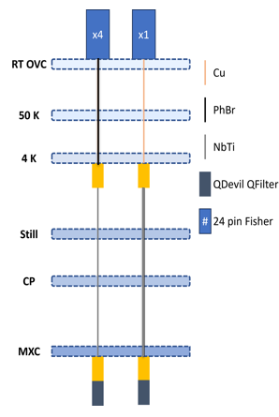

MOTIVATION
Bias scan, 64-pix, ${\text{(130}\text{um}\text{)}}^{2}$ Ta STJ 34
DR Provides Continuous Cooling
No more re-characterization → → →
Longer experimental runtime
Improved thermal stability
Current [nA]
Novel Challenges:
Increased vibrational noise
  - Future microphonic tests @ PNNL
Minimize amperage to magnet
Minimize thermal load
Bias Voltage [μV]
Notes:
Misalign image, dim

Slide 39










The BeEST Collaboration
Keith Borbridge, Connor Bray, Harris Crocker, David Diercks, Spencer Fretwell, Abbi Gillespie, Cameron Harris, Calvin Hinkle, Amii Lamm, Kyle Leach, Drew Marino, John Taylor, Joseph Templet, Ben Waters, Joseph Smolsky, Caitlyn Stone-Whitehead
Colorado School of Mines, Golden CO USA
Stephan Friedrich, Geon-Bo Kim, Inwook Kim, Vincenzo Lordi, Amit Samanta
Lawrence Livermore National Laboratory, Livermore CA USA
Ryan Abells, Annika Lennarz, Peter Machule, Dave McKeen, Chris Ruiz, Teja Upadhyayula, Louis Wagner
TRIUMF, Vancouver BC Canada
Pedro Amaro, Mauro Guerra, Jorge Machado, José Paulo Santos
NOVA School of Science and Technology, Lisbon Portugal
Adrien Andoche, Paul-Antoine Hervieux
Université Strasbourg, Strasbourg France
Robin Cantor, Ad Hall
Star Cryoelectronics LLC, Santa Fe NM USA
Jack Harris, Bill Warburton
XIA LLC, Oakland CA USA
Francisco Ponce
Pacific Northwest National Laboratory, Richland WA USA
Leendert Hayen
LPC Caen, Caen France
Xavier Mougeot
CEA Saclay, Paris France
2023 Collaboration Meeting
Livermore, California

Slide 40
BeEST Conference | 2025
THANK YOU
Presented by Joe Templet

