Slide 1
Plans at LLNL
Stephan Friedrich, LLNL
Outline
• What capabilities do we have now?
• What’s next?

Slide 2
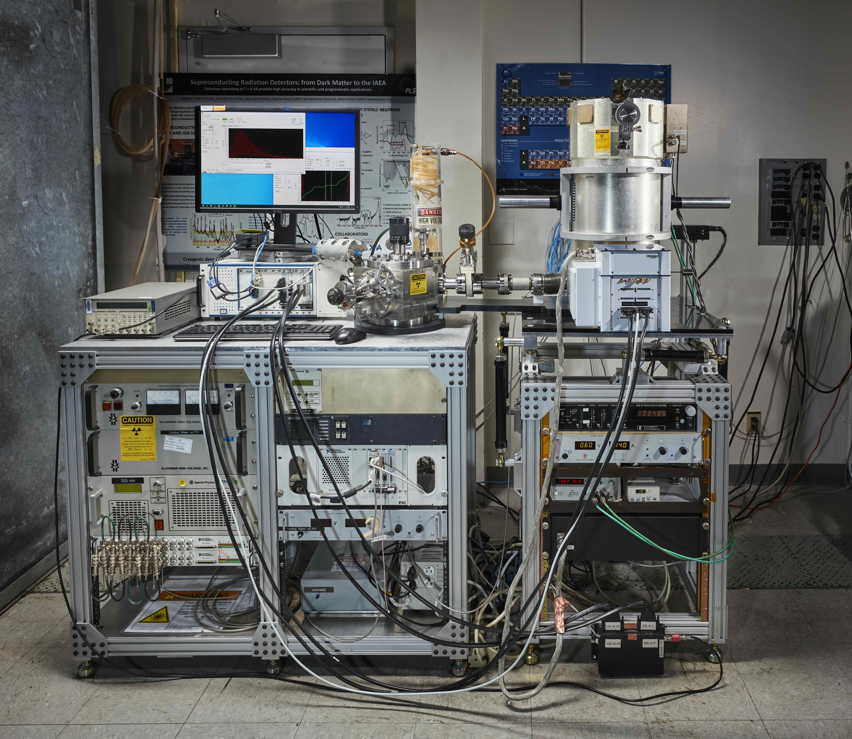
1) The BeEST Experiment (“R2D2”)
“Wet” ADR with STJs:
• Liquid N₂ and He precooling
• Base T ≈ 100 mK
• Up to 32 STJ pixels
• Pulsed 355nm Laser
• X-ray Source
• Can be operated at synchrotron
Pros:
• Works well, 1 – 2 eV FWHM
Cons:
• Expensive to operate (liquid He)
• Wiring only for ≤36 pixels
Most STJ / BeEST data have (so far) been taken with this setup.

Slide 3
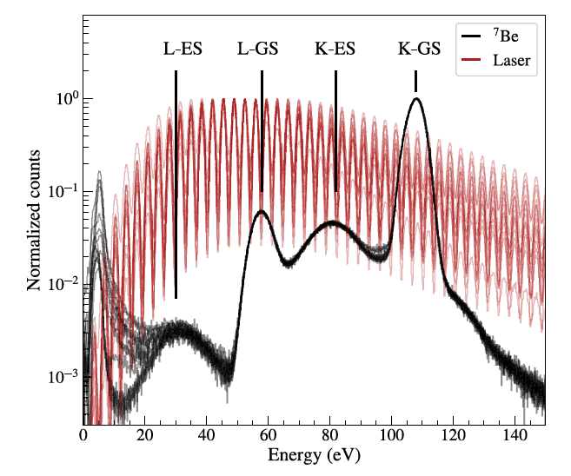
1) The BeEST Experiment (“R2D2”)
Laser Calibration
⁷Be Spectra
X-ray Spectra (Synchrotron)
Let’s not modify the workhorse experiment until alternatives are available.

Slide 4
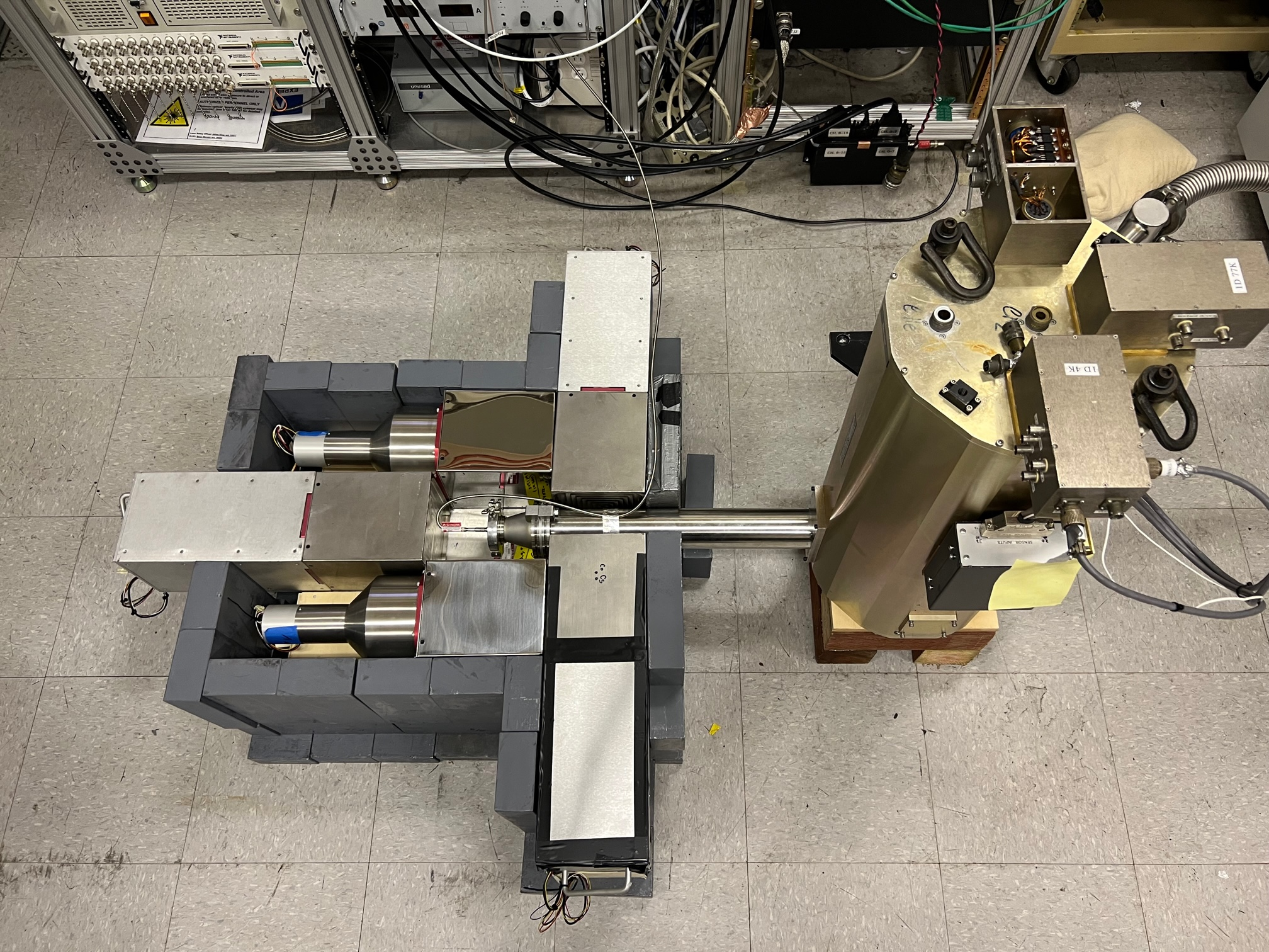
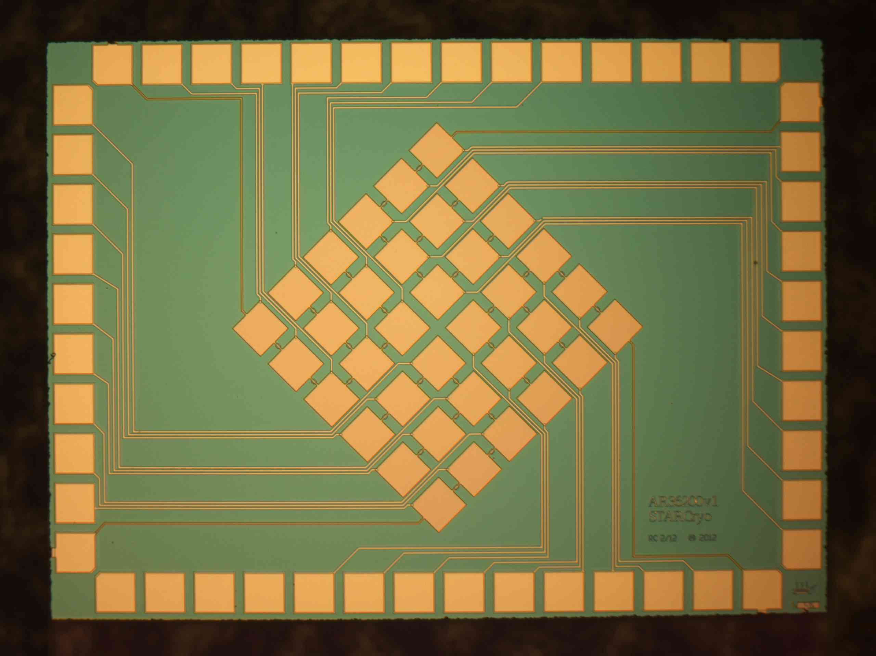
2) The Gamma Coincidence Experiment (“Bender”)
“Wet” ADR with Cold Finger:
• Liquid N₂ and He precooling
• Base T ≈ 100 mK
• Up to 32 STJ pixels
• Can be operated at synchrotron
Pros:
• Works, ~few eV FWHM
• Coincidence experiments possible
(if we re-install NaI and Pb)
Cons:
• Expensive to operate (liquid He)
• No pulsed laser (yet)
• No X-ray source
STJ
ADR
Pb
NaI
Cold Finger
NaI
NaI
Pb
(I think) coincidence measurements will continue to be important at LLNL.

Slide 5
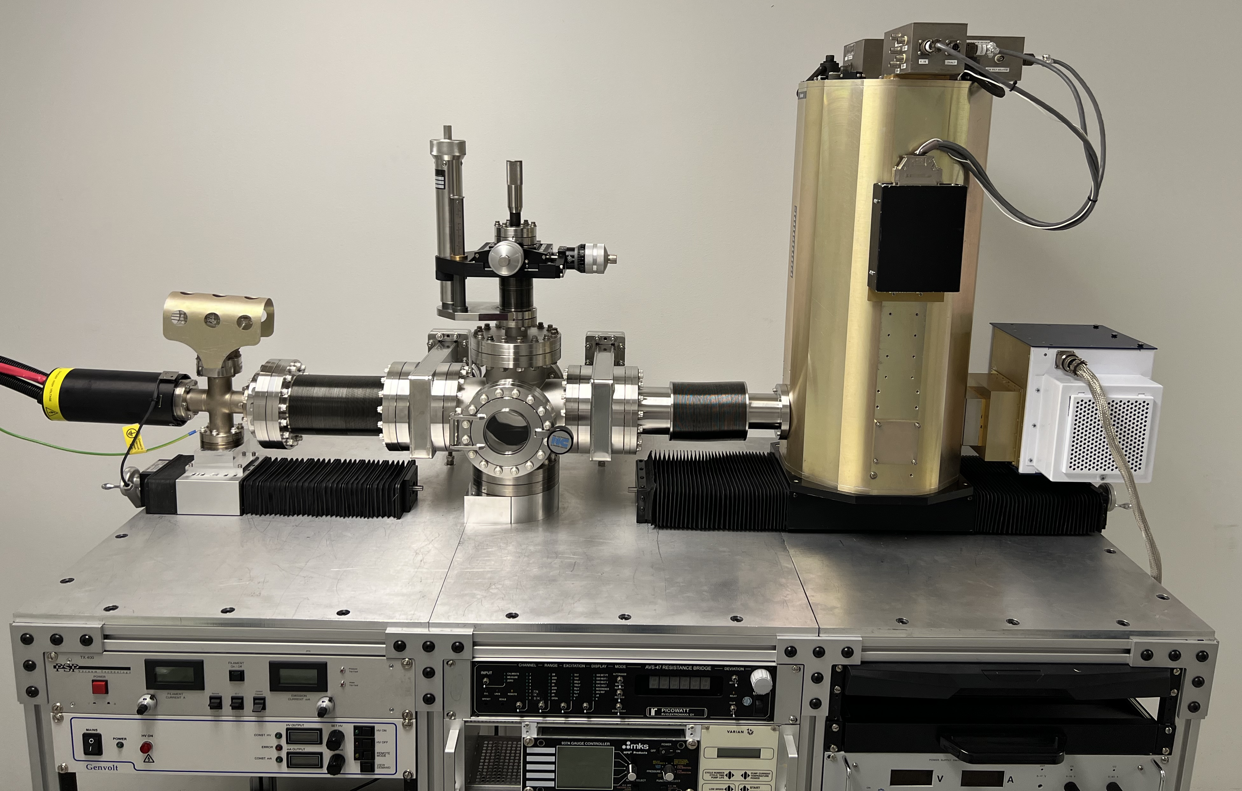
2b) Same ADR with Snout at X-ray Fluorescence / EXAFS Setup
“Wet” ADR with Cold Finger:
• Liquid N₂ and He precooling
• Base T ≈ 100 mK
• Up to 32 STJ pixels
• Can be operated at synchrotron
Pros:
• Works, ~few eV FWHM
• Fluorescence experiments possible
• Transmission EXAFS possible
Cons:
• Expensive to operate (liquid He)
• No pulsed laser (yet)
• No X-ray source (yet)
Sample Chamber
X-ray Tube
STJ
This setup will be used for Pa-229 experiment at FRIB (with Jaideep Singh).

Slide 6
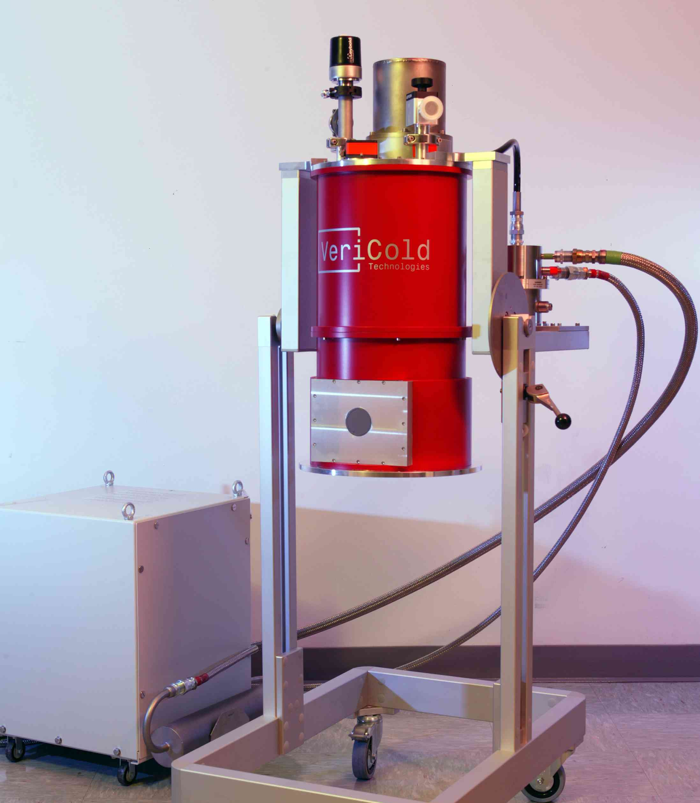
3) The Dry ADR (“EVE”)
“Dry” ADR:
• Pulse-tube precooling
• Base T ≈ 40 mK
Pros:
• Cheap to operate (“dry”)
• ADR works well
Cons:
• Not adapted for STJs
Currently disassembled and in our lab.
This is a thesis project. Possibly for NASA X-ray camera project (if funded).

Slide 7
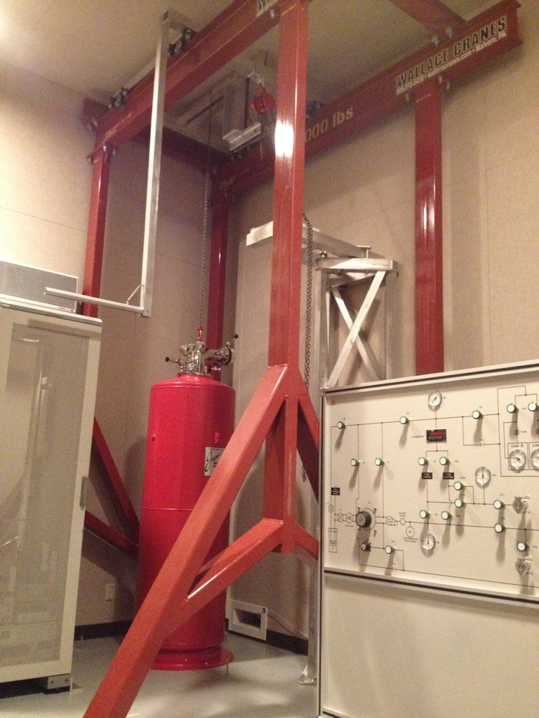
4) The Wet Dilution Fridge
“Wet” dilution fridge:
• Liquid N₂ and He precooling
• Base T ≈ 15 mK
Pros:
• Refrigerator works
• Continuous operation at 15 mK
• No pulse tube, no microphonics
Cons:
• Expensive to operate (liquid He)
• Not adapted for STJs
Currently disassembled and in our lab.
This is a thesis project.

Slide 8
What’s Next?
LLNL is a national security lab, not a science lab. ⇒ Lots of capabilities but expensive.
Limit experiments to 32 pixels
– 64 and 128 pixels at PNNL, FRIB and TRIUMF
LLNL focus on:
– Testing new STJ designs
– Different isotopes
– Coincidence measurements
– Student training

Slide 9

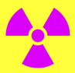
What’s Next (1)? STJ Improvements, Especially Ta Cap Layer
Deposit Ta Cap Using PR Mask
STJ Priorities
1) Add Ta cap to remove e- escape tail.
(Increase yield by shorting STJ during Ta depo.)
We already have Ta-STJs with separate grounds.
⁷Be implantation through PR mask does work.
2) Higher-resolution Al-STJs? Maybe…
3) SiN membranes? Maybe…
4) Nb-STJs? Maybe…
Ta-STJ →
Photoresist mask →
Ta cap layer
Our STJs are in decent shape.

Slide 10
What’s Next (2)? New Isotopes, Especially ³⁷Ar
10% of ⁷Be Decays to Excited ⁷Li*
³⁷Ar only Decays of ³⁷Cl Ground State
– Background dominated by ⁷Li* peaks
+ High recoil energy (56 eV)
+ No background from ³⁷Cl* peaks
– Lower recoil energy (9 eV)
K capture
Counts
L capture
M capture
10 100 1000
Energy [eV]
How will other physics be different?

Slide 11
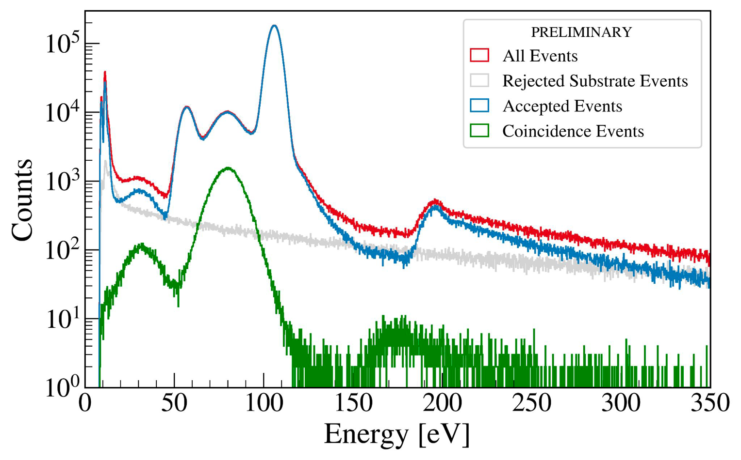
What’s Next (3)? Coincidence Measurements, Especially for ν Mass
Separate ⁷Be Decays to Excited ⁷Li*
Apply to ^{1??}Gd
Separating decay with Q ≈ 1 keV might enable sensitive neutrino mass measurement

Slide 12
What’s Next (4)? Modeling!
Open Questions for the BeEST
Extensive modeling capabilities
– Livermore Computing (LC) facilities
– Extensive density functional theory (DFT) modeling
Chemical shifts
– Extensive molecular dynamics (MD) modeling
New Li-Ta (GEAM) potential
– Electron-photon coupling
Ta 5d electron shake-up
Lattice damage by recoil?
Depends on new LDRD to be funded (which is likely).

Slide 13
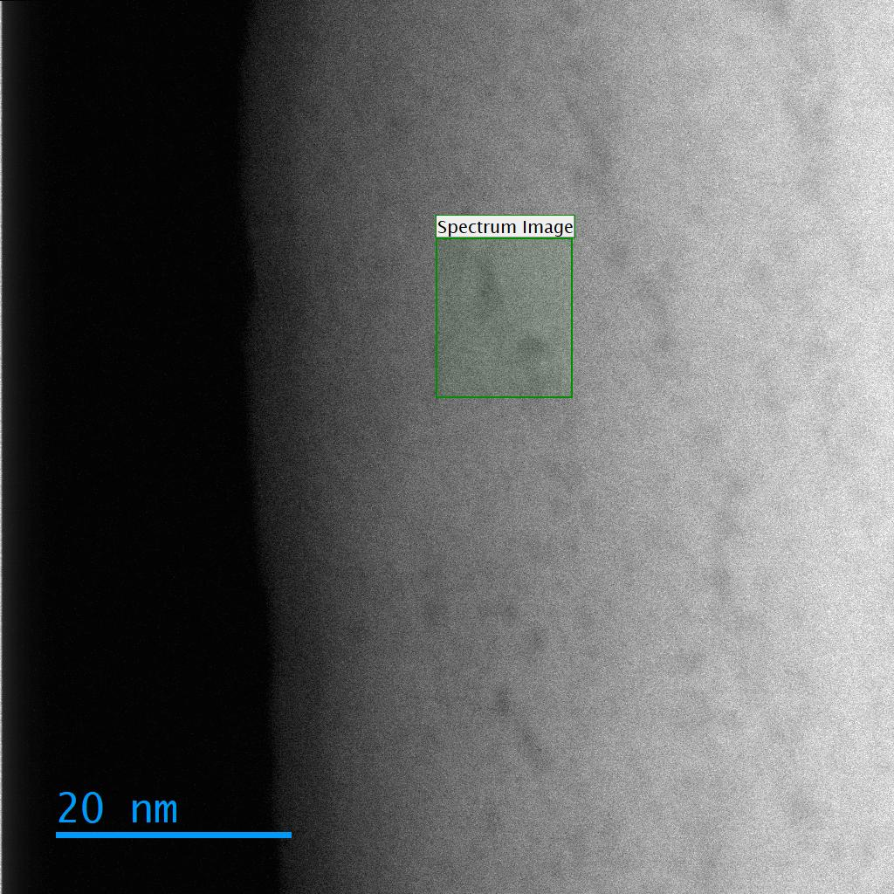
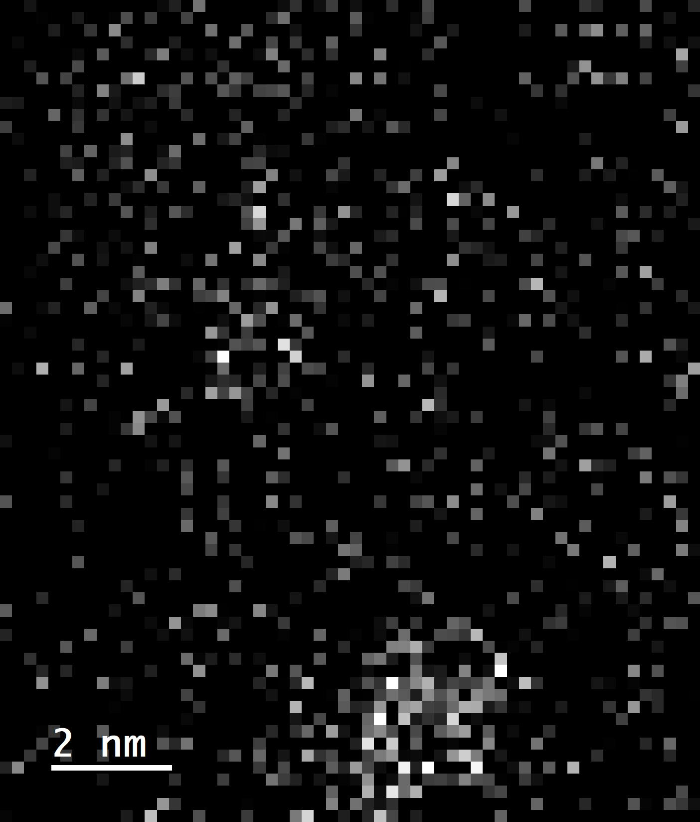
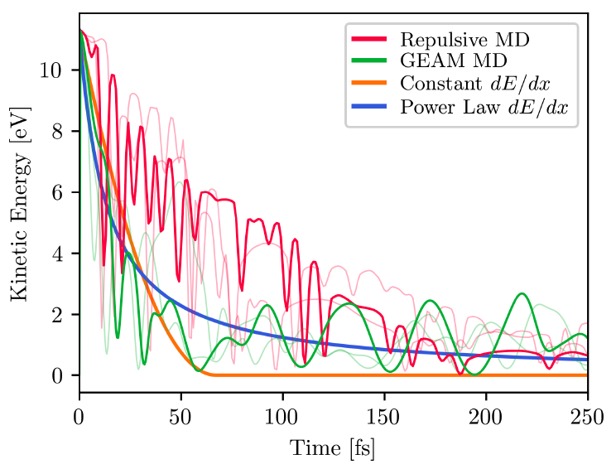
What Else at LLNL?
Samanta, DFT
There are many capabilities at LLNL:
Extensive modeling capabilities
– Livermore Computing (LC) facilities
– Extensive density functional theory (DFT) modeling
– Extensive molecular dynamics (MD) modeling
2) Extensive analytical capabilities
– Electron microscopy (SEM, TEM, EELS), also at NCEM
– Mass spectrometry (SIMS, RIMS, TOF-SIMS, nano-SIMS)
– Synchrotron access (ALS, SSRL)
3) Other cryogenic detectors (for keV / MeV science)
– Magnetic microcalorimeters (MMCs, Geon-Bo)
Li, TEM/EELS
2 nm
Zepeda-Ruiz, MD
20 nm
LLNL is a national security lab, not a science lab.

Slide 14
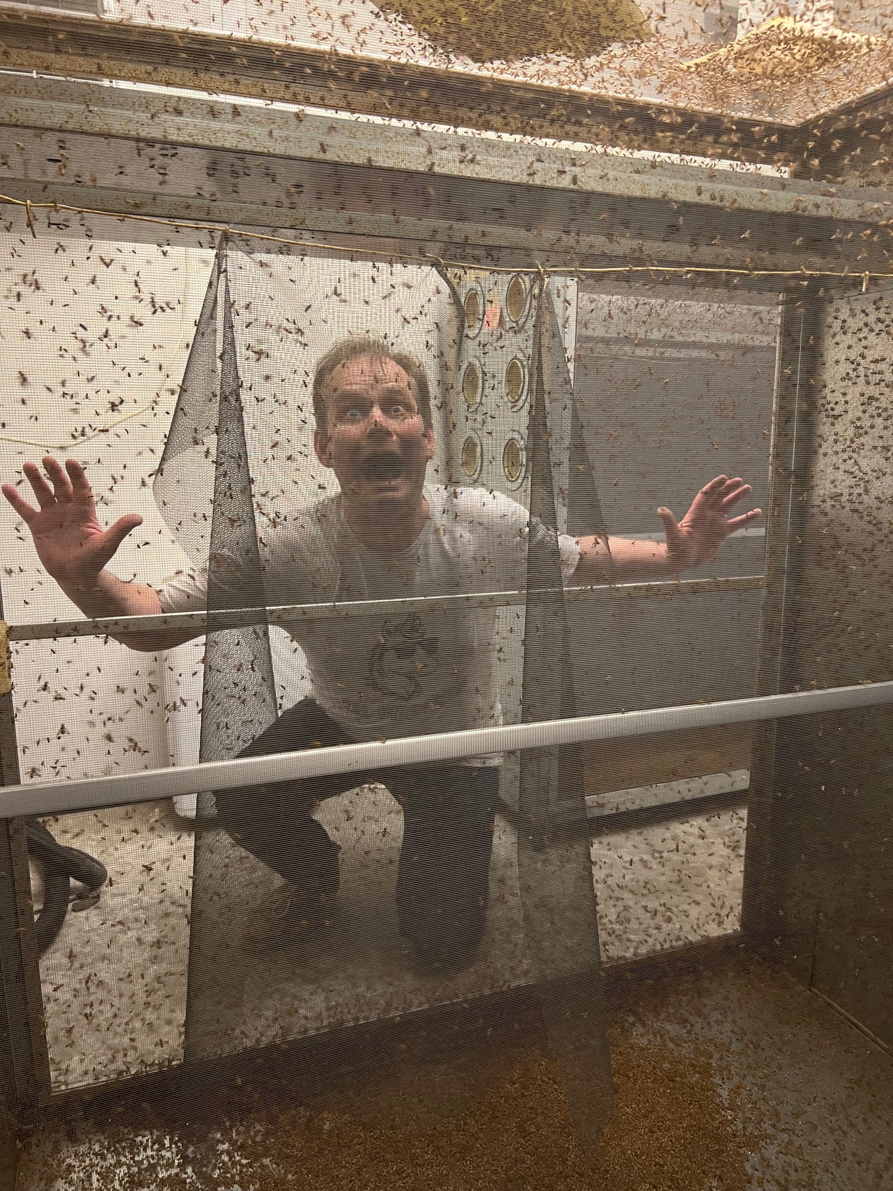
Stephan’s Current Thinking about Plans at LLNL
Limit experiments to 32 pixels
– 64 and 128 pixels at PNNL, FRIB and TRIUMF
LLNL focus on:
– Testing new STJ designs (Al-STJs, imagers…)
– Different isotopes (Cs-136, Ar-37…)
– Coincidence measurements (Gd ν mass…)
– Student training (“Intro to STJs” paper?)
Plans are flexible and depend on science drivers (=graduate students sent to LLNL).

