Slide 1
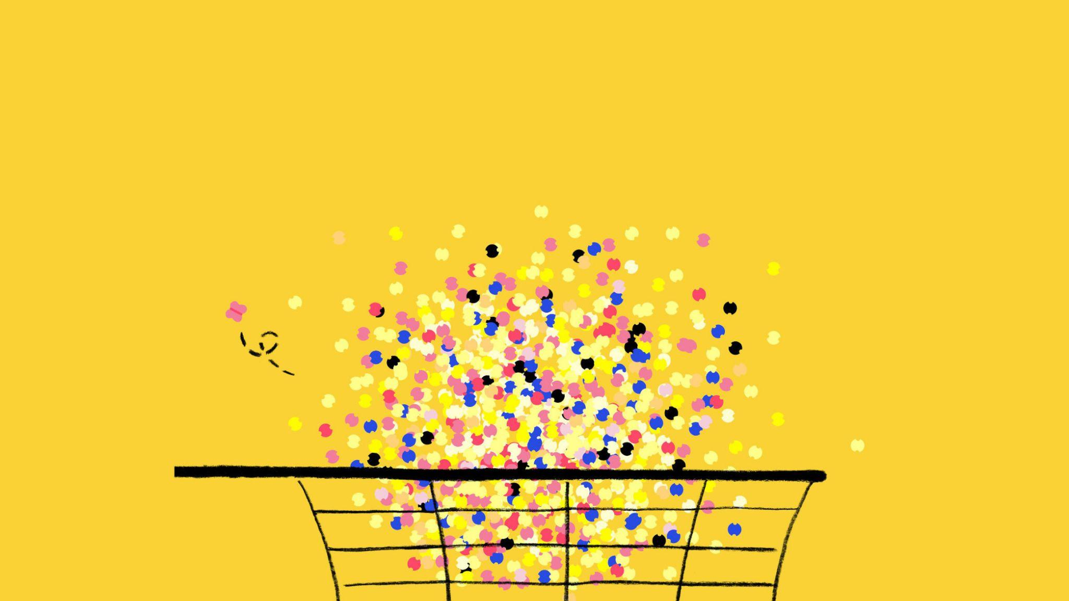
A novel probe for new physics
Aluminium Superconducting Grid Array for Radiation Detection
Superconducting quantum sensors
Beyond the Standard Model
BeEST collaboration meeting
7 May 2025
Leendert Hayen

Slide 2
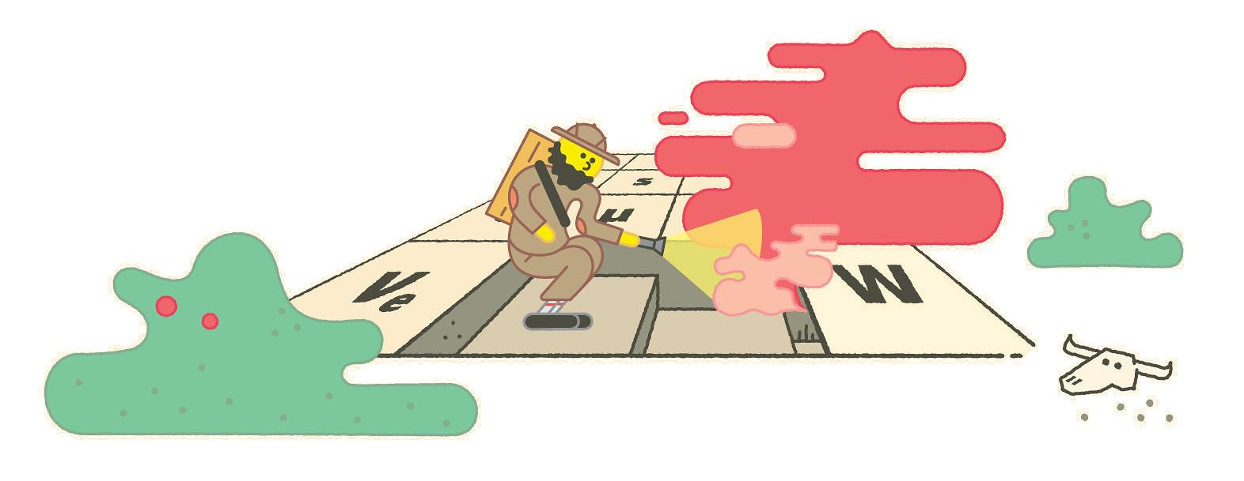
ASGARD: Tabletop experiment for particle physics
Direct collider searches don’t see new physics, but
tabletop experiments probe wealth of operators and energy scales
ASGARD will perform precise eV-scale spectroscopy on short-lived isotopes with superconducting quantum sensors
Novel TeV-scale new physics searches
New directions in nuclear physics
ASGARD will be world-first precision device
Artwork by Sandbox Studio, Chicago

Slide 3
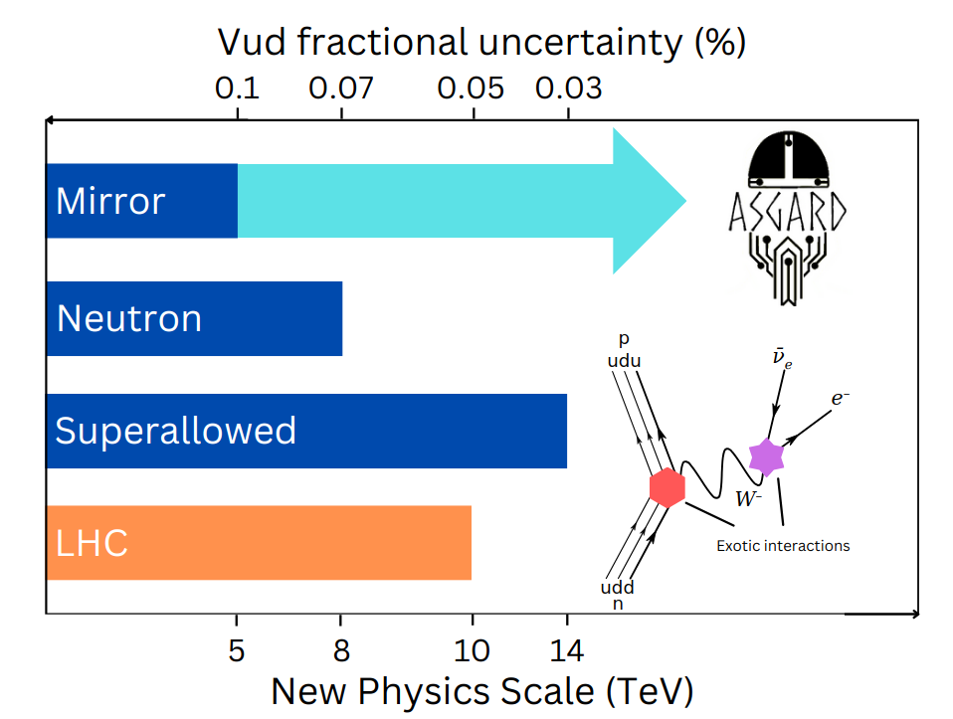
Recoil in electroweak sector
High precision at low energy probes new physics at high energy
In common channels, beta decay competitive with LHC ( )
TeV-scale new currents
Extra flavour components
but plateau due to systematics
Recoiling ion contains wealth of information, but technologically inaccessible and requires broad theory understanding
Hayen, Annual Reviews of Nuclear and Particle Science 74 (2024) 497
Hayen et al., Reviews of Modern Physics 90 (2018) 015008

Slide 4
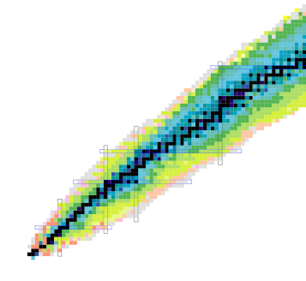
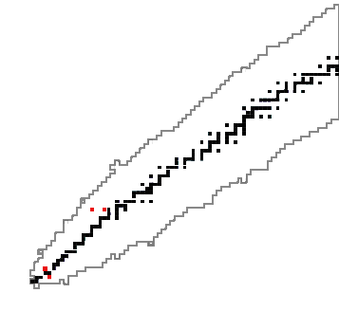
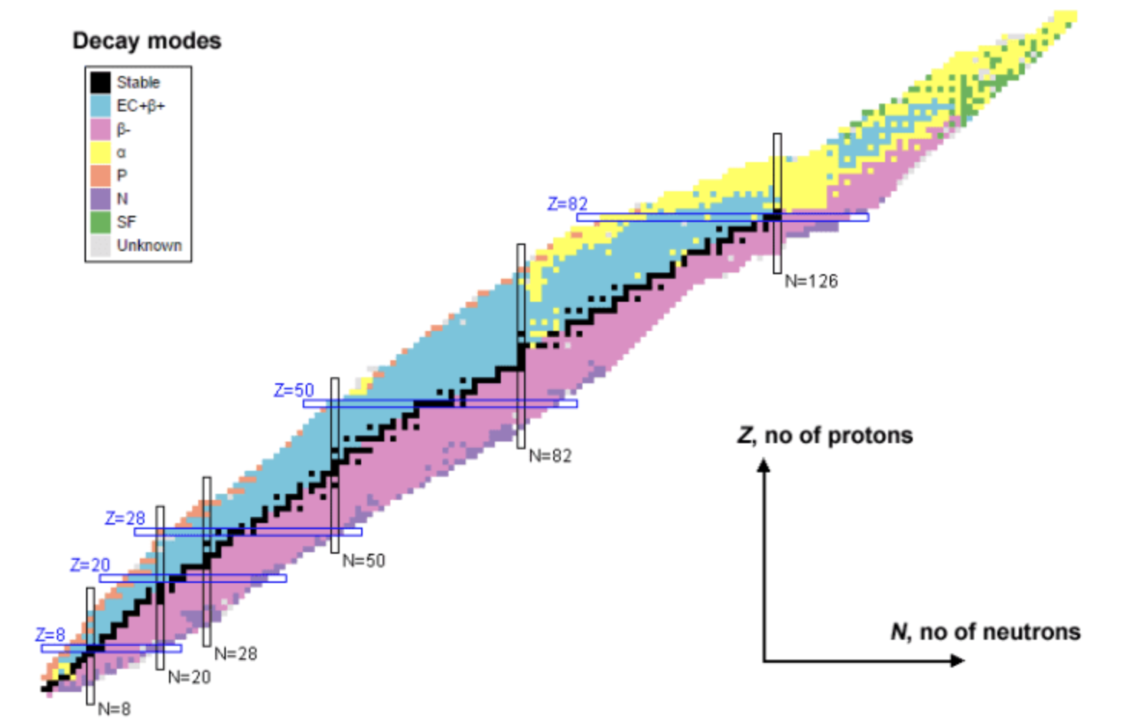
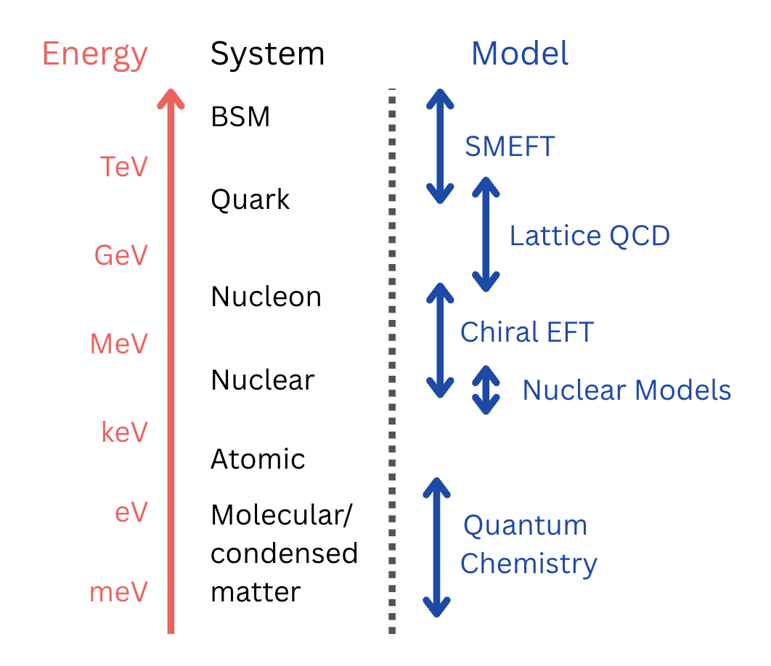
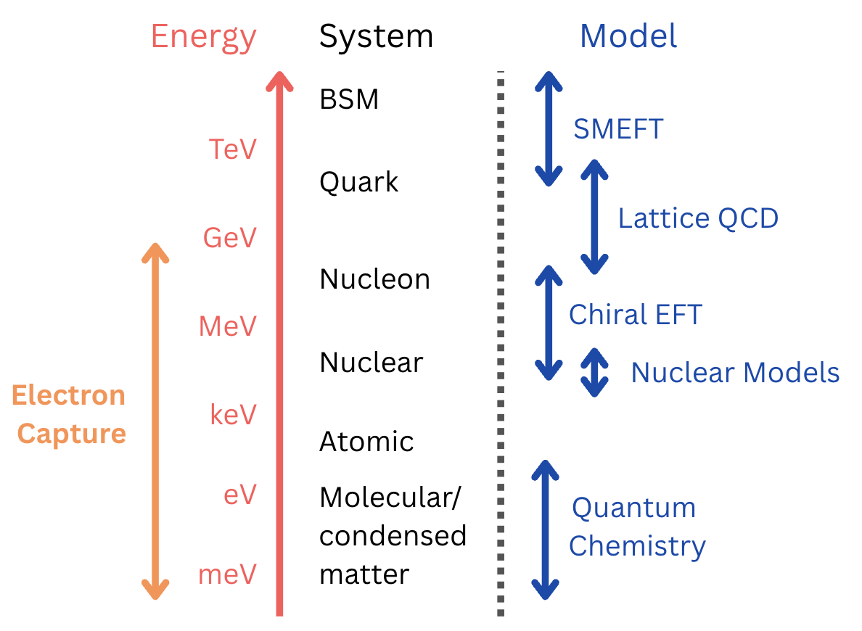
Recoil spectroscopy: broader scope
Out of thousands of known radioactive transitions,
only handful measured recoiling nucleus
Out of thousands of known radioactive transitions,
only handful measured recoiling nucleus
Coherent multi-scale framework
(QCD Chemistry) is crucial, but missing
Recoil: Access to electron capture &
electronic environment

Slide 5
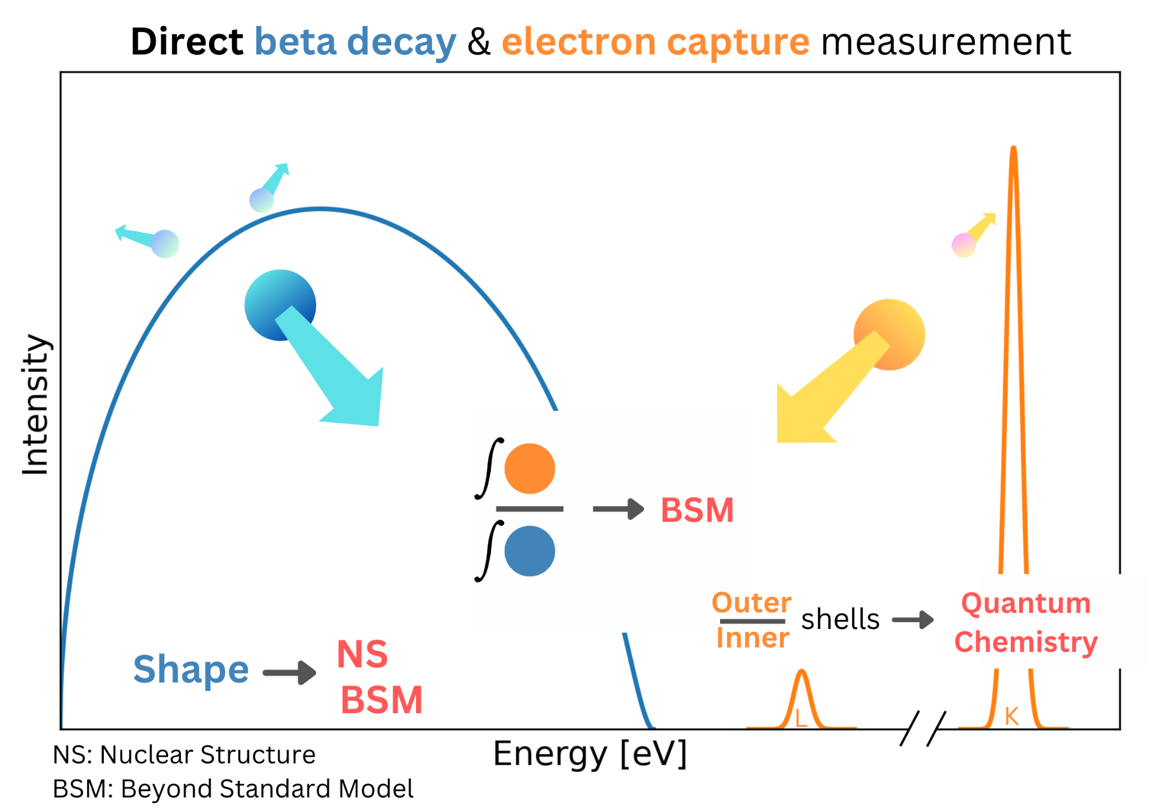
ASGARD: Methodology
Perform full spectroscopy of short-lived isotopes with quantum sensors
Two novel measurement schemes:
I: EC/B+ Branching ratio
II: B+ shape
probe new physics at tens of TeV in completely new way

Slide 6
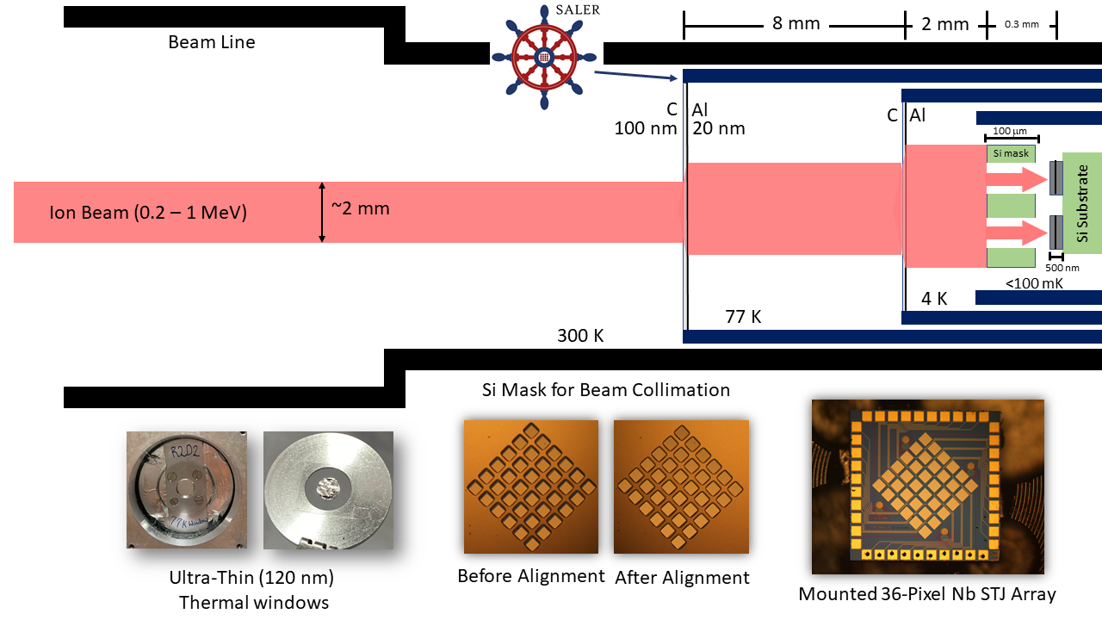
SALER: First short-lived measurements (Drew)
but
closed fridge
significant scattering
no precise implantation
limited isotopes

Slide 7
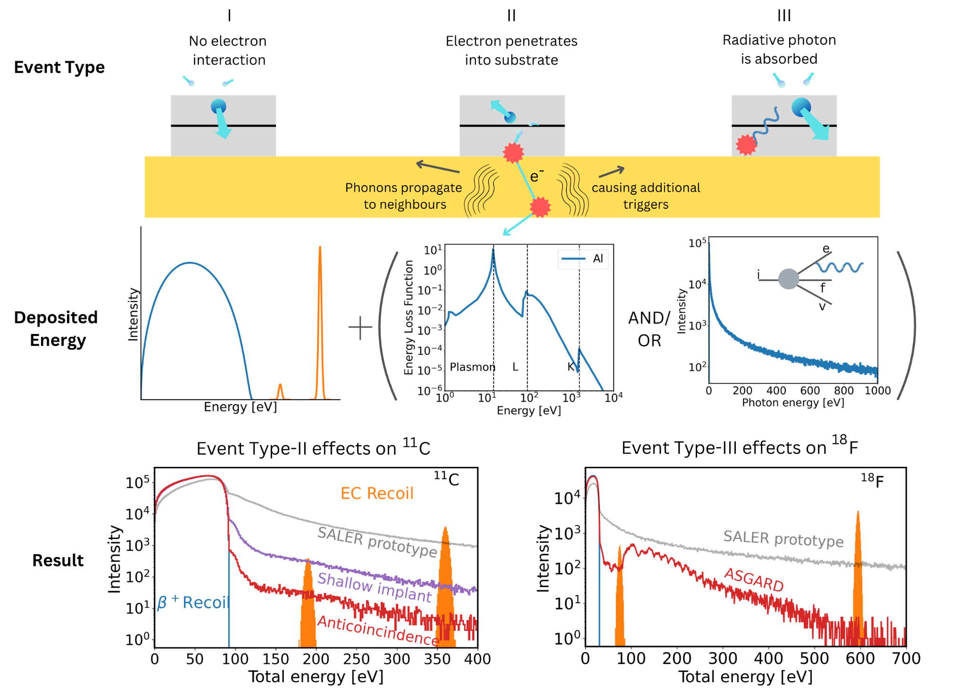
Systematic effects

Slide 8
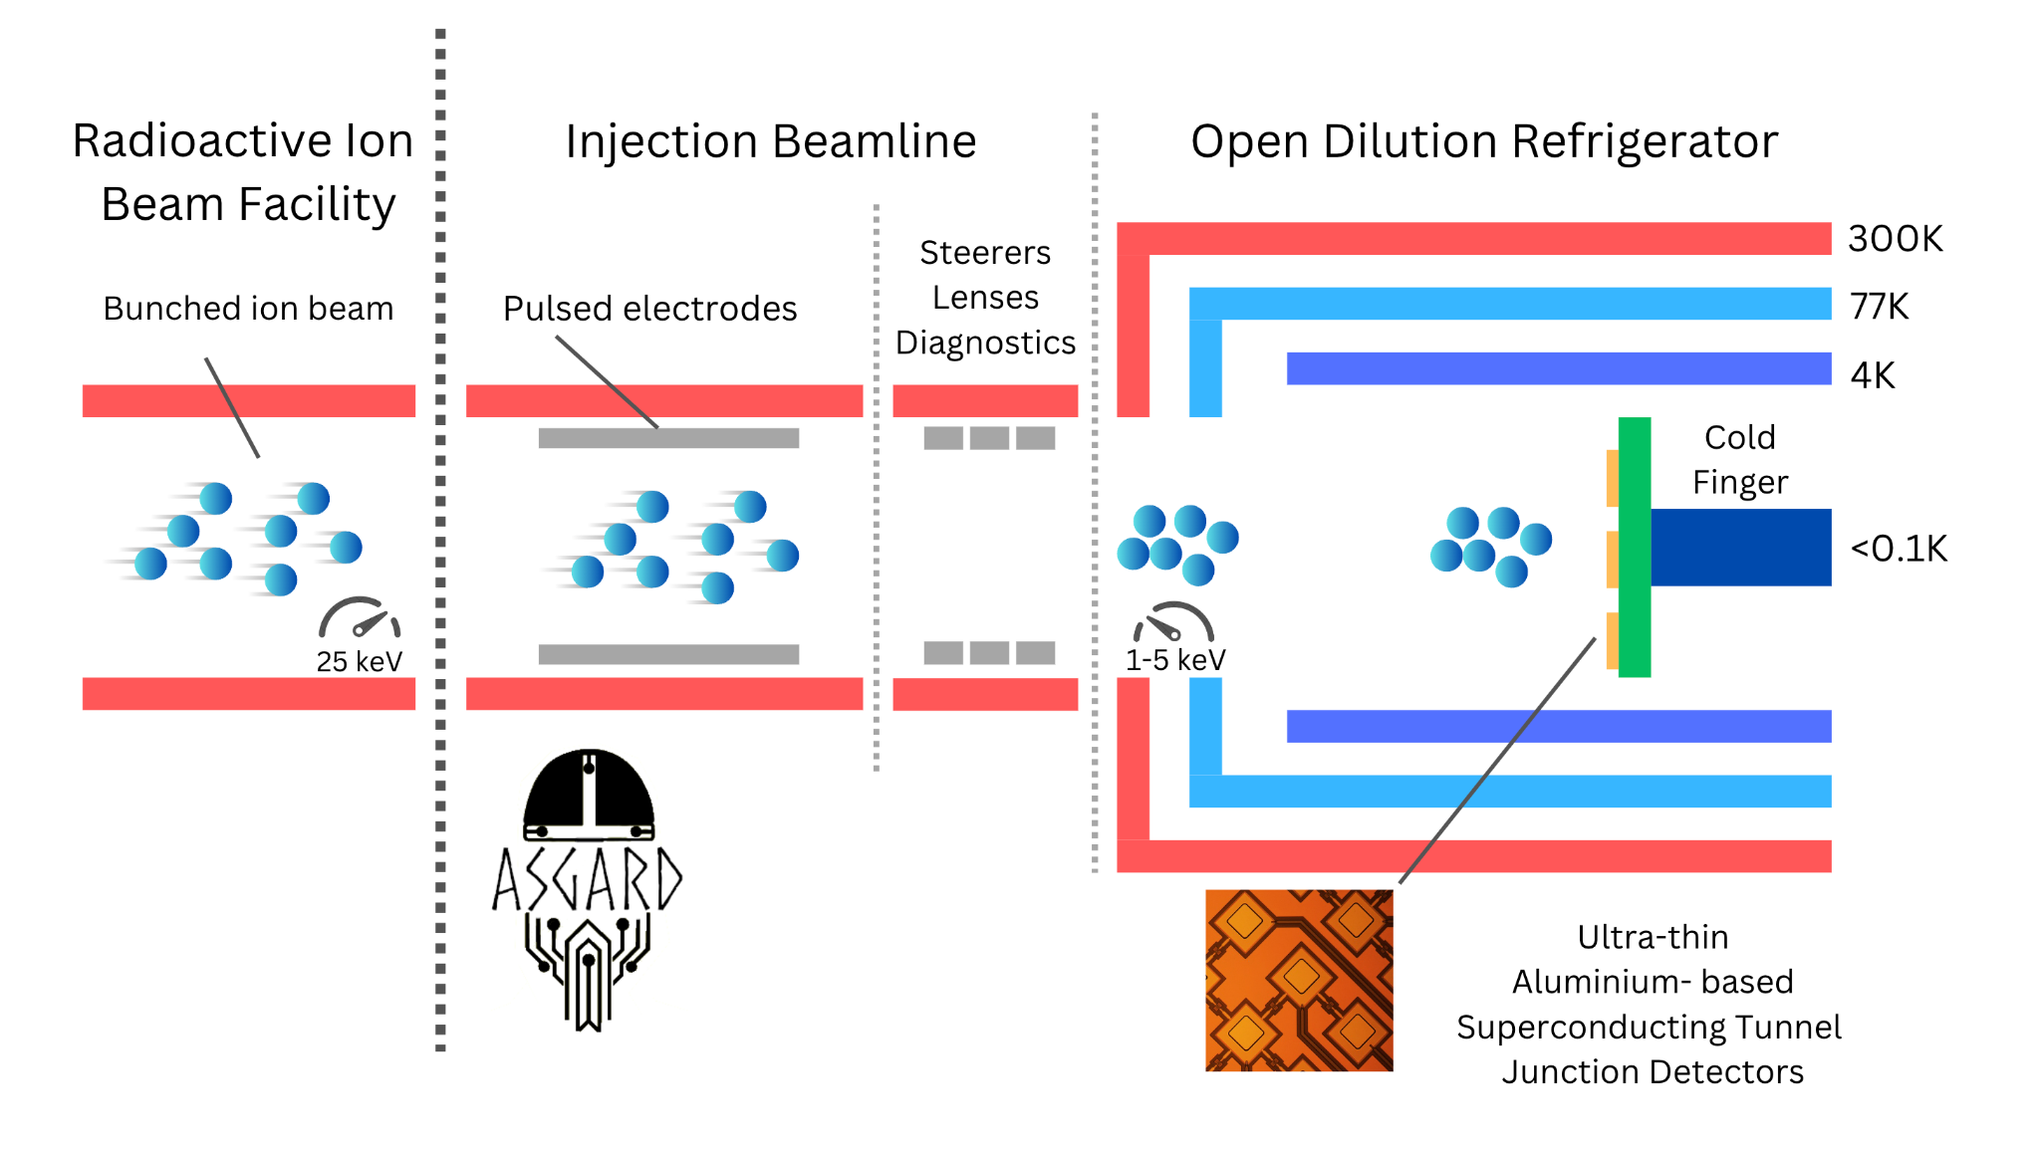
ASGARD: Methodology
Combination of expertise in beta decay and technical innovations
Orders of magnitude improvement in systematic effects and efficiency
Hayen et al. CPC 240 (2019) 152
Hayen et al. PRC 107 (2023) 065503

Slide 9
ASGARD: Methodology
Key #1: Windowless dilution fridge
Full access to nuclear chart
Key #2: Ultrathin Al-STJs
x100 reduced scattering
Key #3: Injection beam line
Extremely precise implantation
Together world-first precision device

Slide 10
Systematics improvement

Slide 11
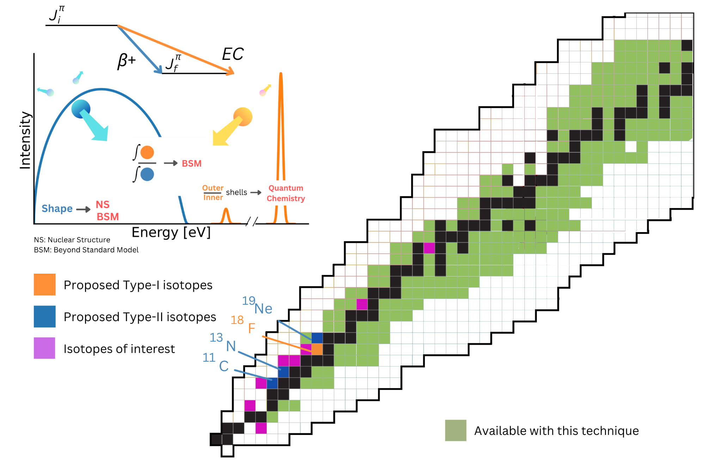
ASGARD: Methodology
Complementary high-impact isotopes for BSM
Unlock hundreds of isotopes for study
Nuclear structure
Auger spectroscopy
Completely unexplored variable

Slide 12
The team & host institution
Team of 3 PhD’s and 2 postdocs (to be recruited)
LPC Caen (HI, CNRS) has very strong technical support
expertise in design, construction and commissioning of complex systems
long history at radioactive ion beam facilities like GANIL
and long history in fundamental interactions
DESIR@GANIL will be world-class facility

Slide 13
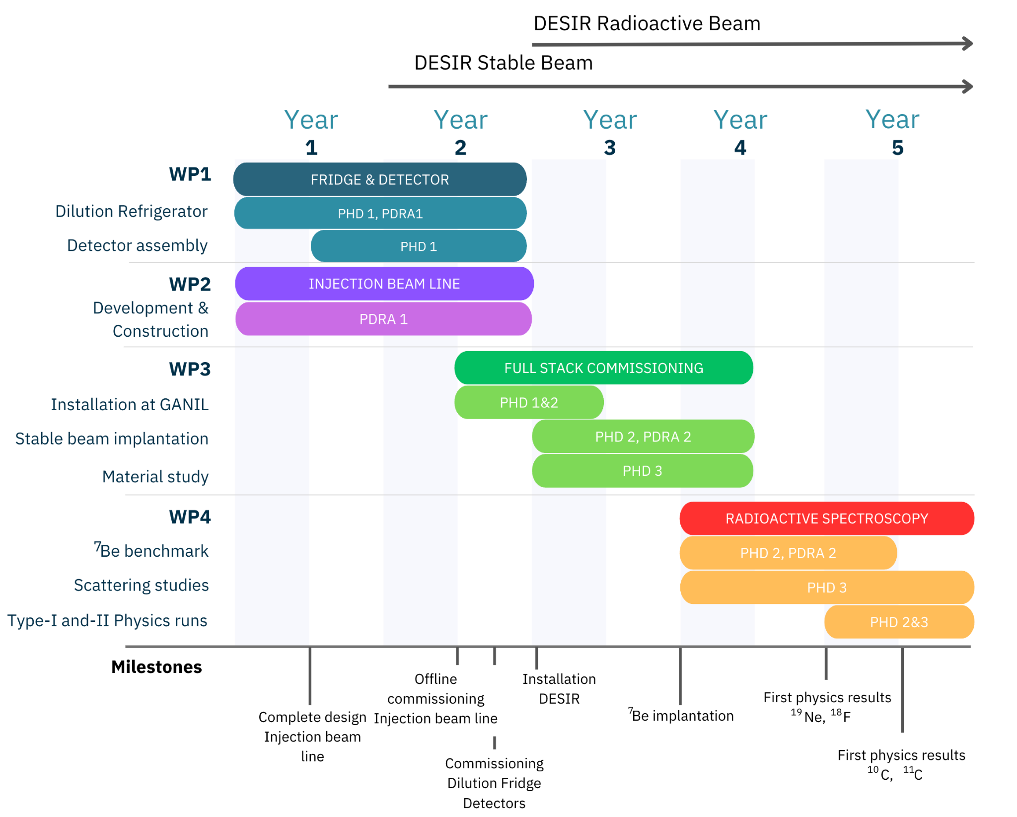
Timeline
DESIR comes online in 2027
High resolution separator + ion buncher + penning traps
20000 (HRS)
to 1E5 (Penning)

Slide 14
Impact
Recoil spectroscopy is a new frontier, enabled by new quantum sensors, pioneered by myself and collaborators
ASGARD will be a world-first for precise recoil spectroscopy after radioactivity, and push new physics searches to tens of TeV with novel schemes
Enable broader breakthroughs in nuclear and atomic physics,
extensions into medical physics

Slide 15
Host Institution and Facility
LPC Caen (HI, CNRS) has very strong technical support
expertise in design, construction and commissioning of complex systems
long history at radioactive ion beam facilities like GANIL
and personally coordinating complex deliverable
DESIR@GANIL will be world-class facility
Strong local support, and I am adjoint director for physics program of DESIR

Slide 16
Aluminium Superconducting Grid Array for Radiation Detection
A novel probe for new physics
Superconducting quantum sensors
Beyond the Standard Model
Leendert Hayen
Rehearsal I 7 May 2025

Slide 17
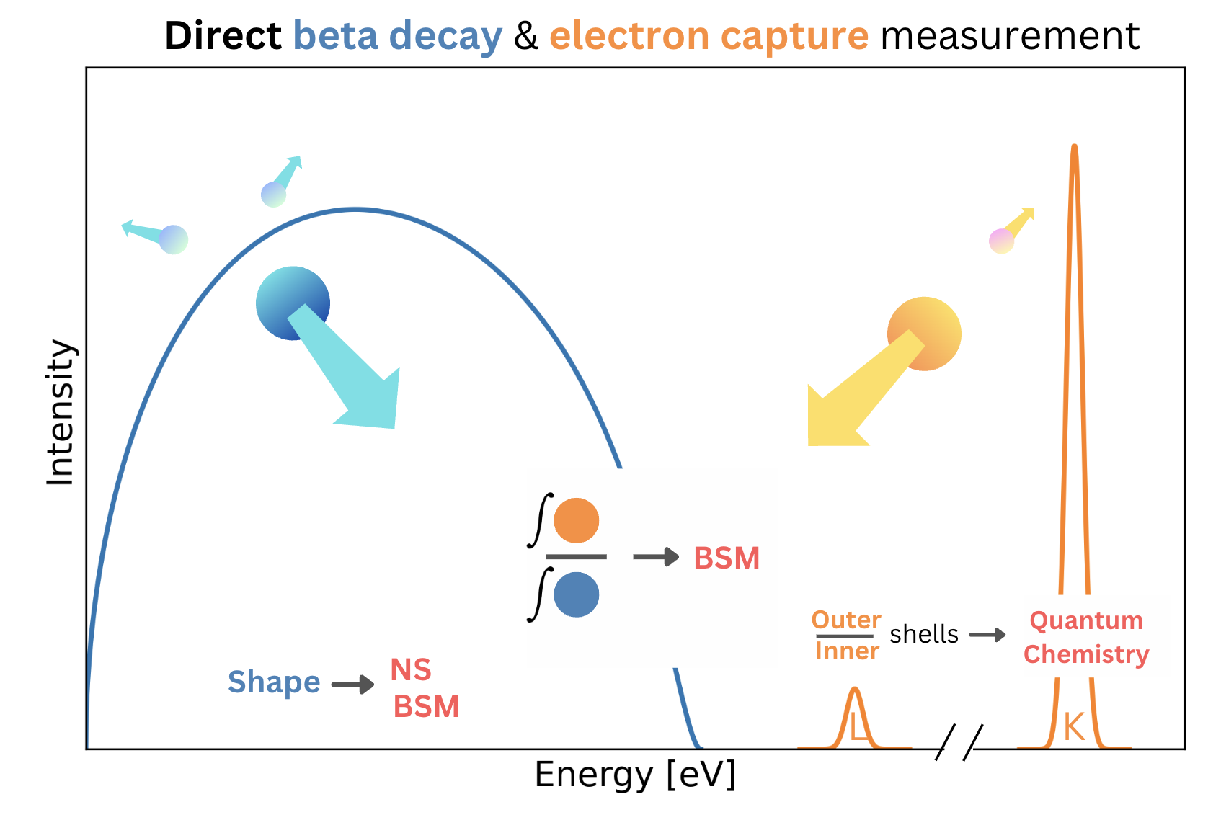

Slide 18
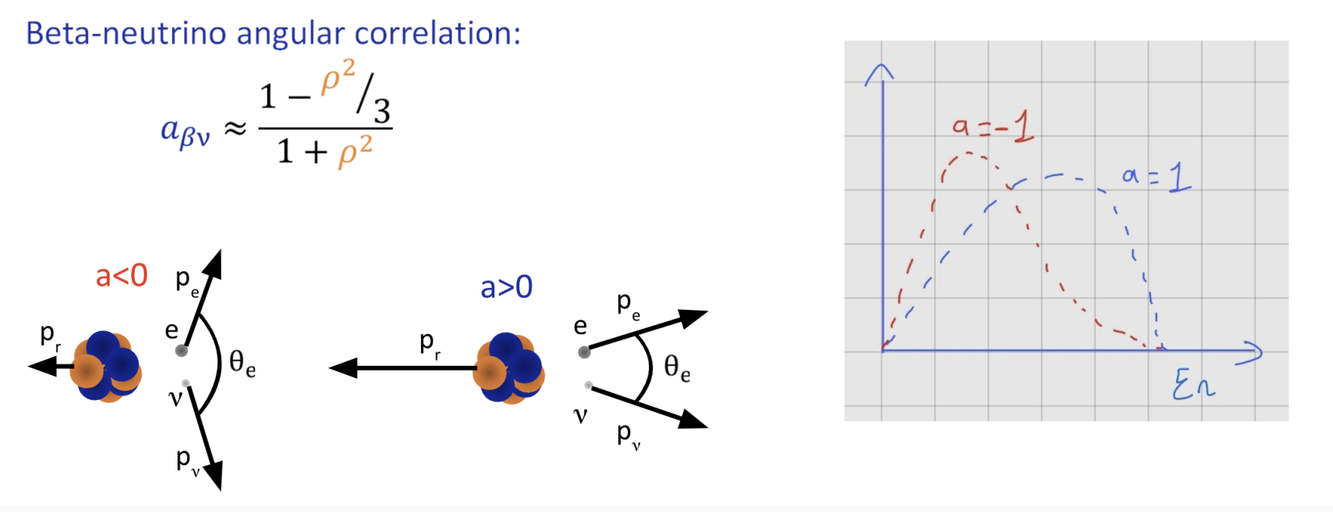
Recoil spectroscopy for angular correlations

Slide 19
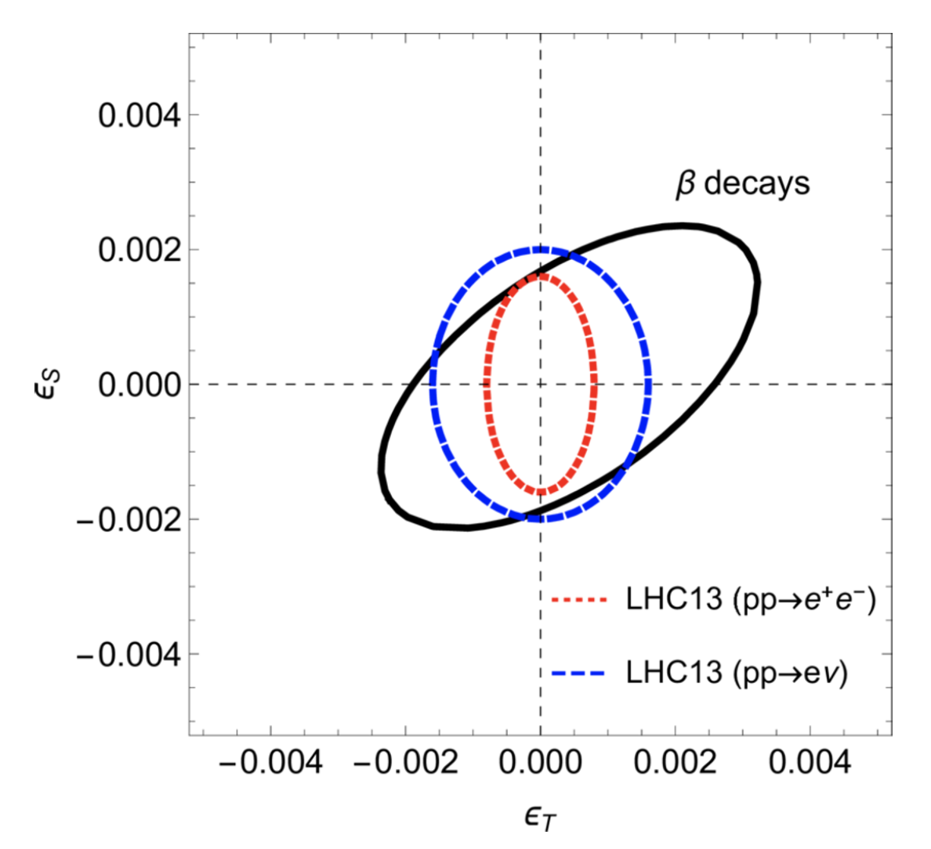
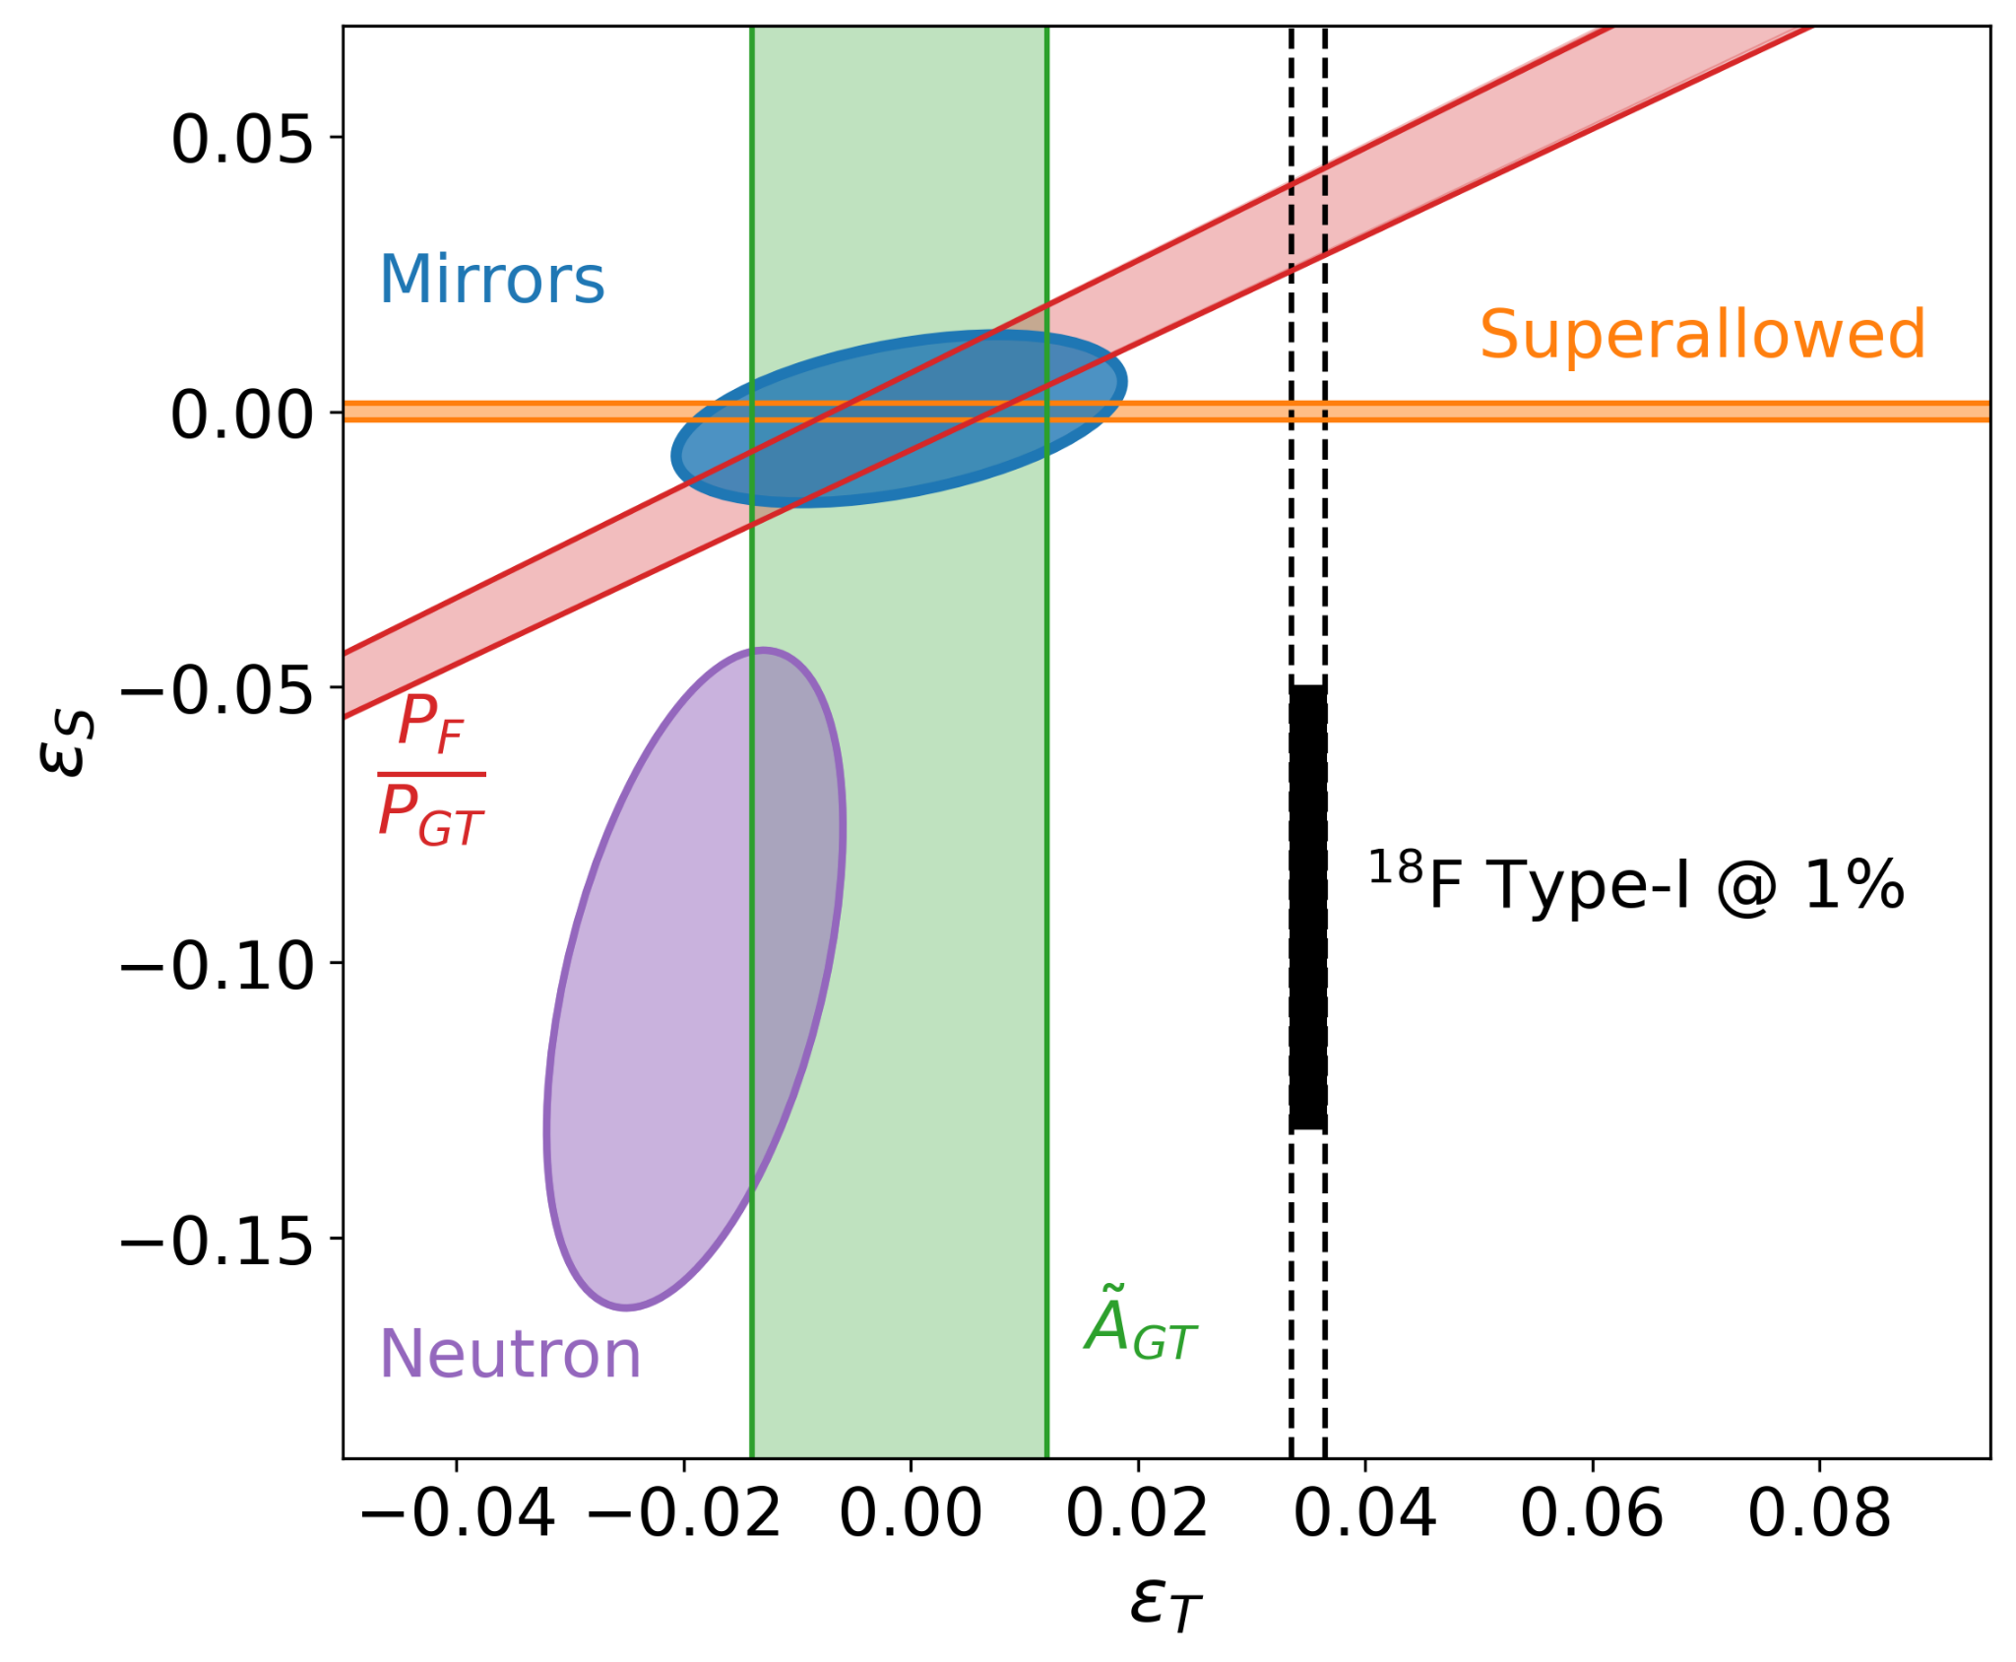
Scientific Challenge 2

Slide 20
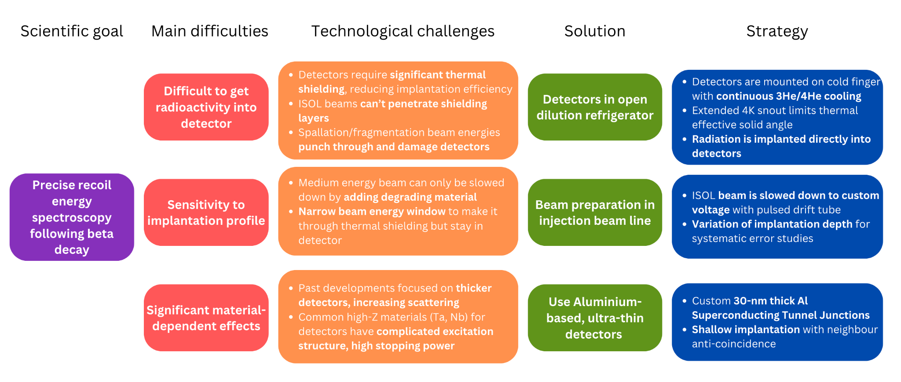

Slide 22
Novel nuclear structure methods
Total absorption recoil spectroscopy
branching ratio measurements
Lifetimes?
essentially tip of the iceberg

Slide 23
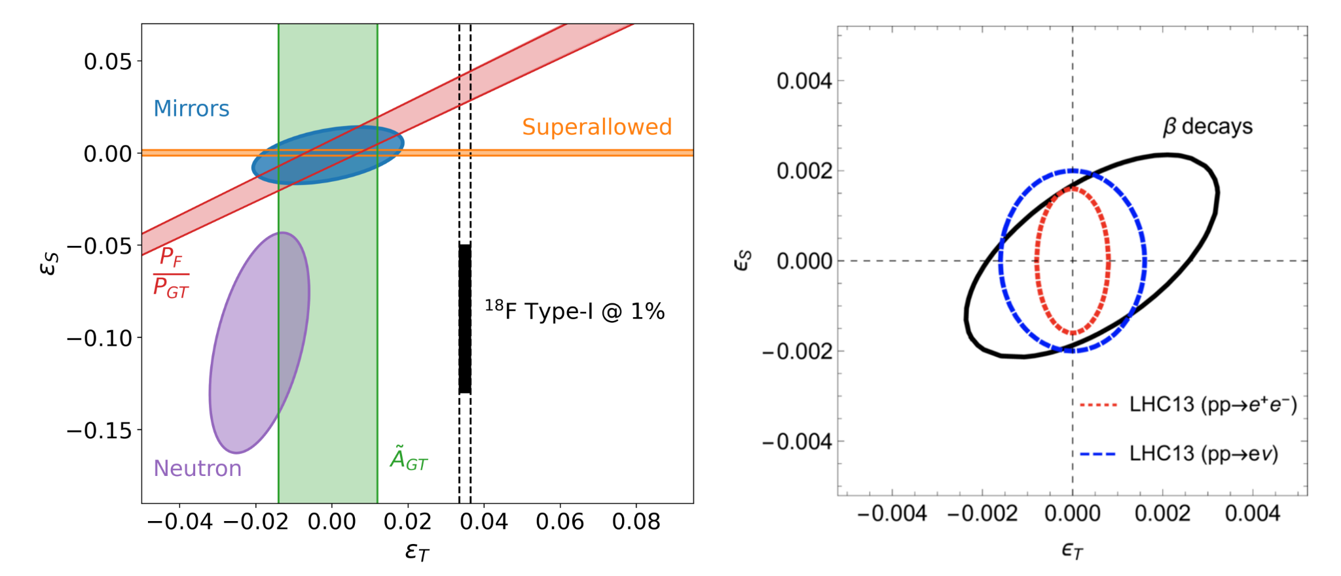
Exotic current constraints

Slide 24
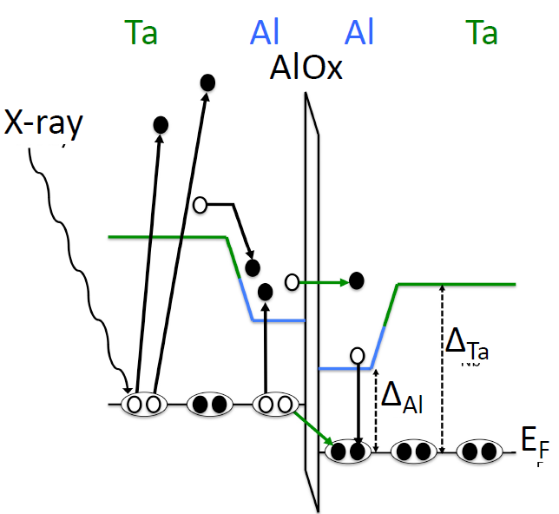

Slide 25
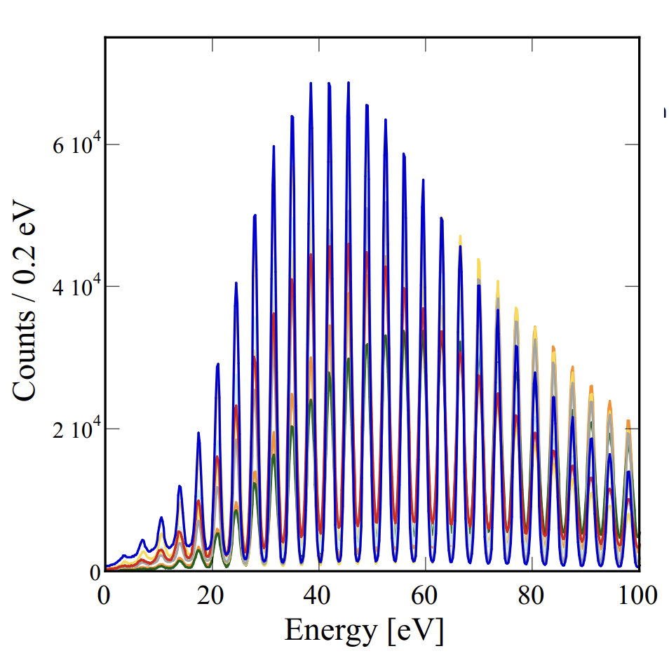
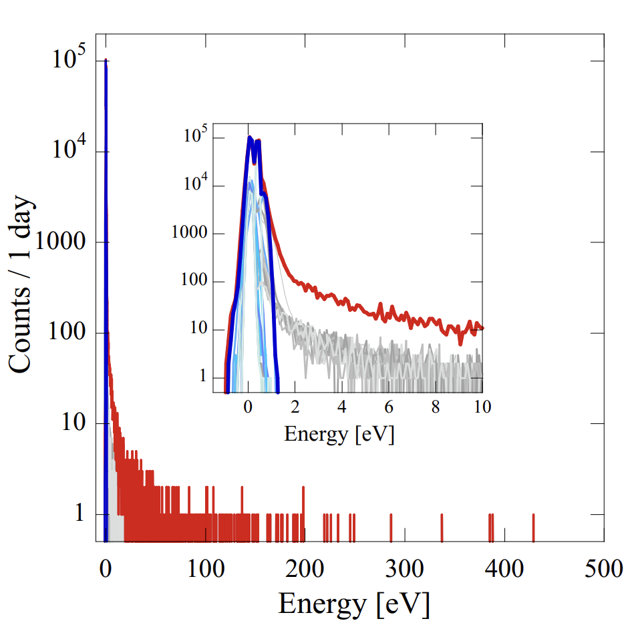

Slide 26
