Slide 1
Three body decays in the BeEST
Leendert Hayen, Driss Guillet
BeEST collaboration meeting
14 May 2025

Slide 2
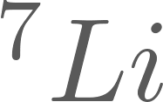
Three body decays
Electron capture is two-body process: mono-energetic peaks
Three-body decay means continuous spectrum
We’ll look at specific process:

Slide 3
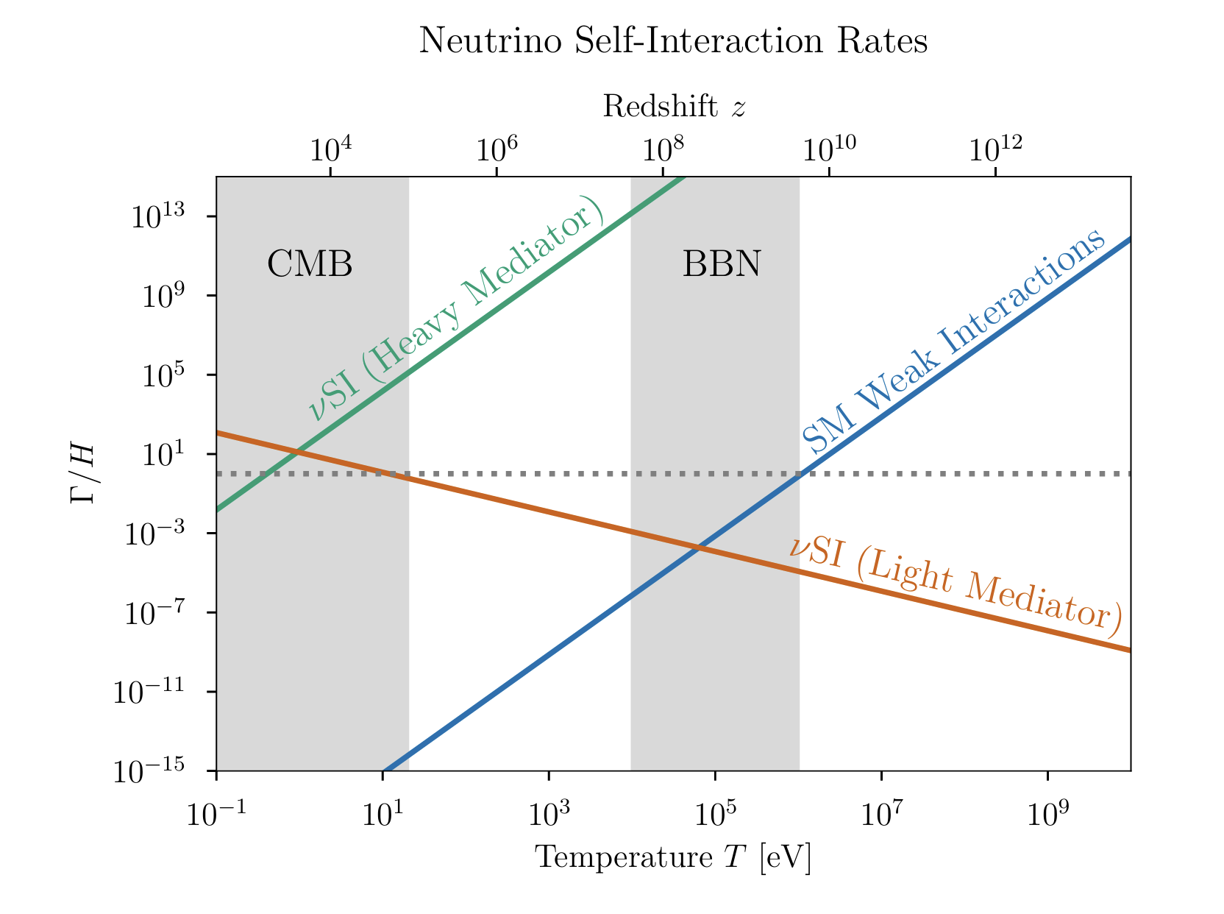
Neutrino self-interactions
Interaction is generic example of neutrino self-interactions
Neutrino’s are least studied
particle in SM
-> still leaves ‘a lot’ of room

Slide 4
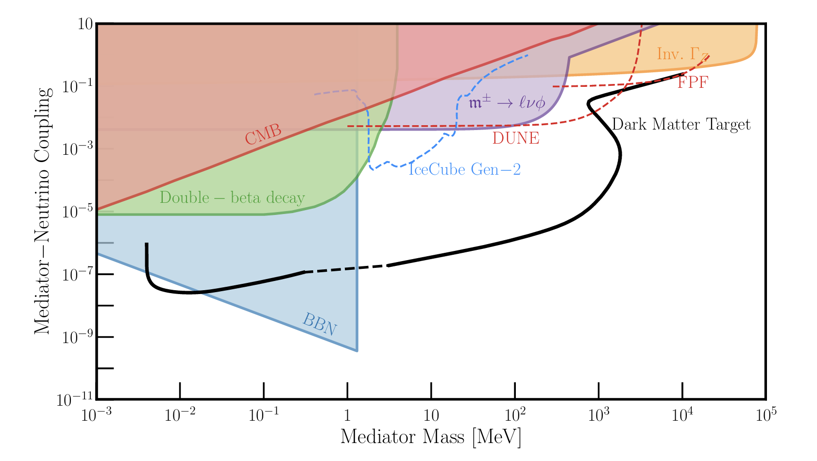
Probes and bounds
Important distinction between indirect (CMB, BBN) and direct tests (2vbb)
BeEST would provide a direct test

Slide 5
Majoron: Introduction
can in general be any scalar, but popular candidate is Majoron
Proposed in 1980, aims to do three things
Explain smallness of active neutrino masses (Type-I Seesaw)
Baryogenesis through leptogenesis
More recently: dark matter candidate
PRL 45 (1980) 1925
PLB 690 (2010) 145
arXiv: 2312.13417

Slide 6
Majoron: Introduction
Lagrangian with right-handed sterile neutrinos and one complex scalar
conserves lepton number ( ), U(1) symmetry
After EW phase transition get
but spontaneously break U(1) symmetry at some scale
Dirac mass
Majorana Mass
and massless Goldstone boson J

Slide 7
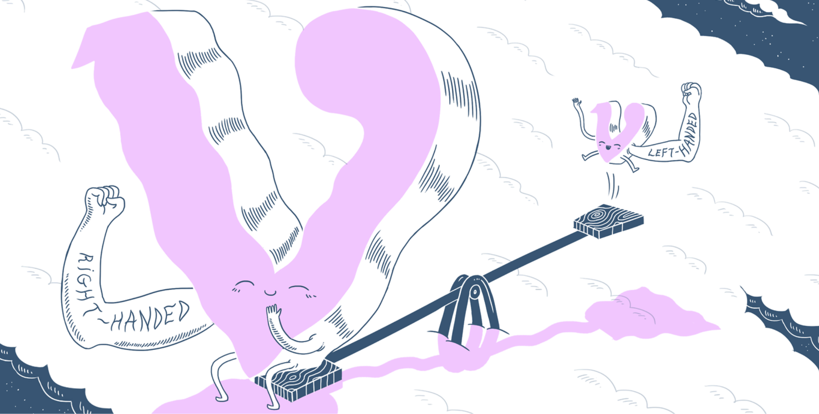
Majoron: Type-I Seesaw
Writing can write mass Lagrangian
with
Mass eigenstates of (mostly)
active neutrinos have mass

Slide 8
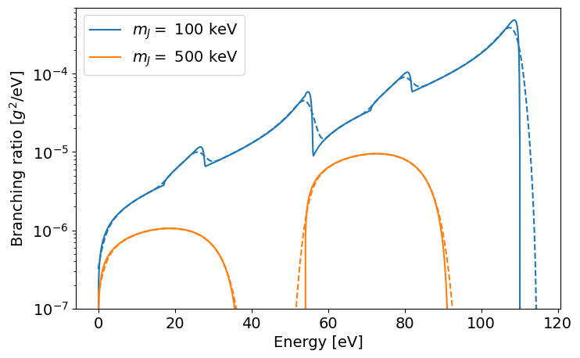
Majoron: Three body decay
Analogous 4-peak structure as in regular electron capture
Additional Doppler broadening of excited states not yet taken into account

Slide 9
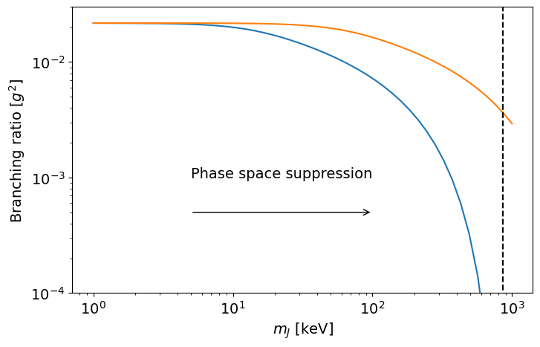
Majoron: Branching ratio
Branching ratio decreases polynomially as Majoron mass increases
However, strange that it does not depend on Q at all (Intuitively, BR should be proportional to Q)
All following results may be incorrect, but trends largely remain

Slide 10
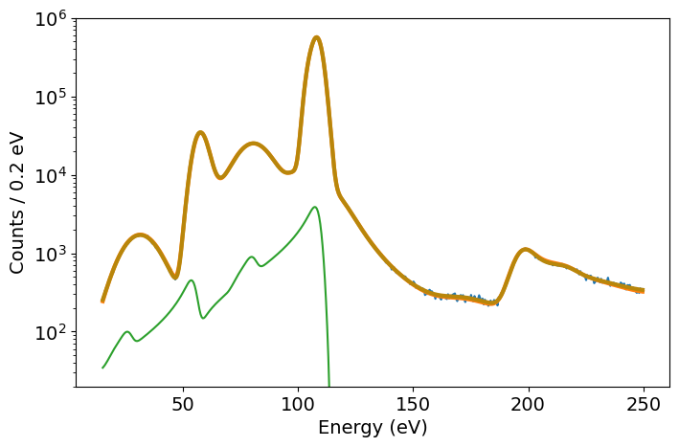
Majoron: Sensitivity
Monte Carlo generated data sets
from expt fits
Profiling likelihood/
Feldman-Cousins/Bayesian is
underway, but battling fit
instability with simple methods

Slide 11
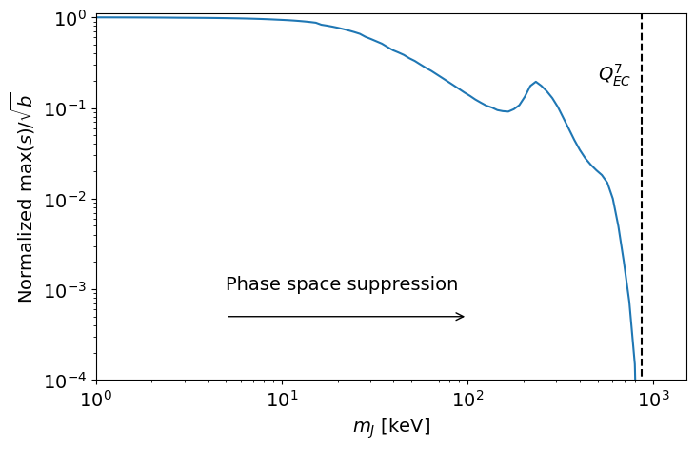
Majoron: Simple sensitivity
Use simplified estimate
Define sensitivity as
at the location of the
largest signal
KGS overlap
At Auger loss peak

Slide 12
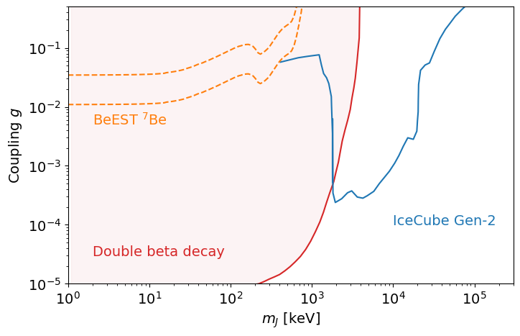
Majoron: Simple sensitivity
Sensitivity then scales as
for
normalized
PRELIMINARY

Slide 13
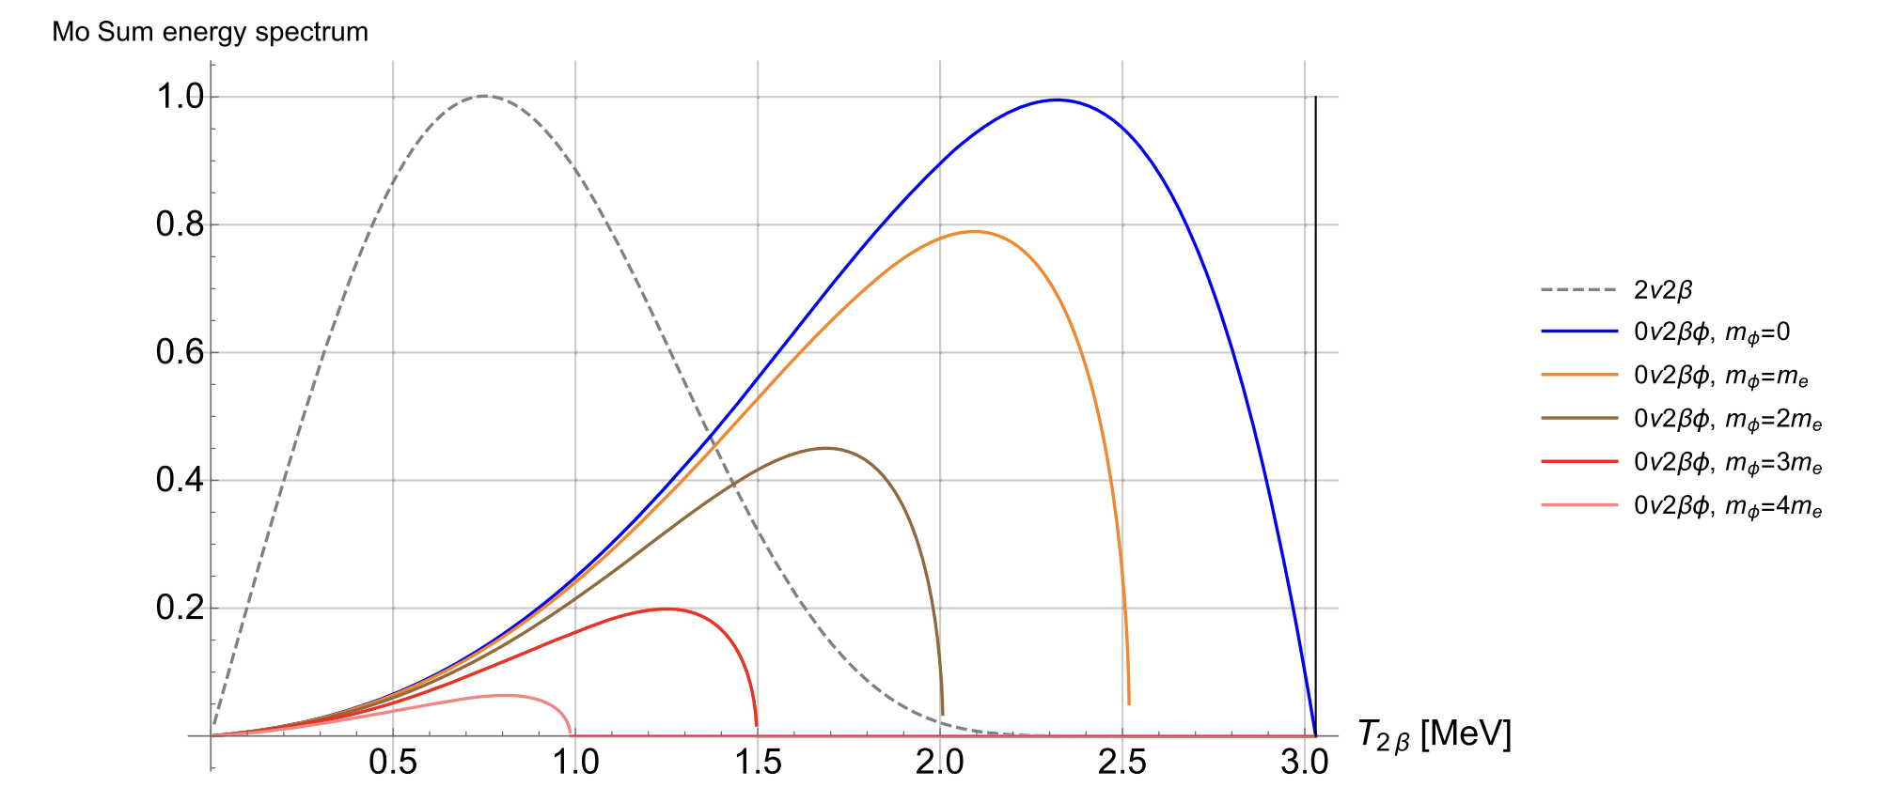
Majoron: Double beta decay
Signal maximum for low masses in region of low background, opposite of BeEST

Slide 14
Conclusions
BeEST is sensitive to well-motivated interactions through three body decays
Unclear if sensitivity will be competitive, however, mostly due to strong double beta decay limits (CMB & BBN can be worked around)
Theoretical analysis will be re-checked, might change overall scale (for better or worse)
Proper sensitivity estimate is underway, fit instability is part of bigger issue (see Inwook’s talk)

