Slide 1
Dilution Refrigerator @ TRIUMF:
Updates and Insights into Thermal Stability
Evangelista, TRIUMF
1
Notes:
Good morning, everyone.
Today, I’ll be presenting an update on the Dilution Refrigerator (DR) at TRIUMF, which we are now preparing to integrate into the BeEST experiment. Our primary motivation is to push our detector performance by accessing colder operational regimes—targeting 20 millikelvin as opposed to the current ~100 mK environment offered by our adiabatic refrigerator.

Slide 2
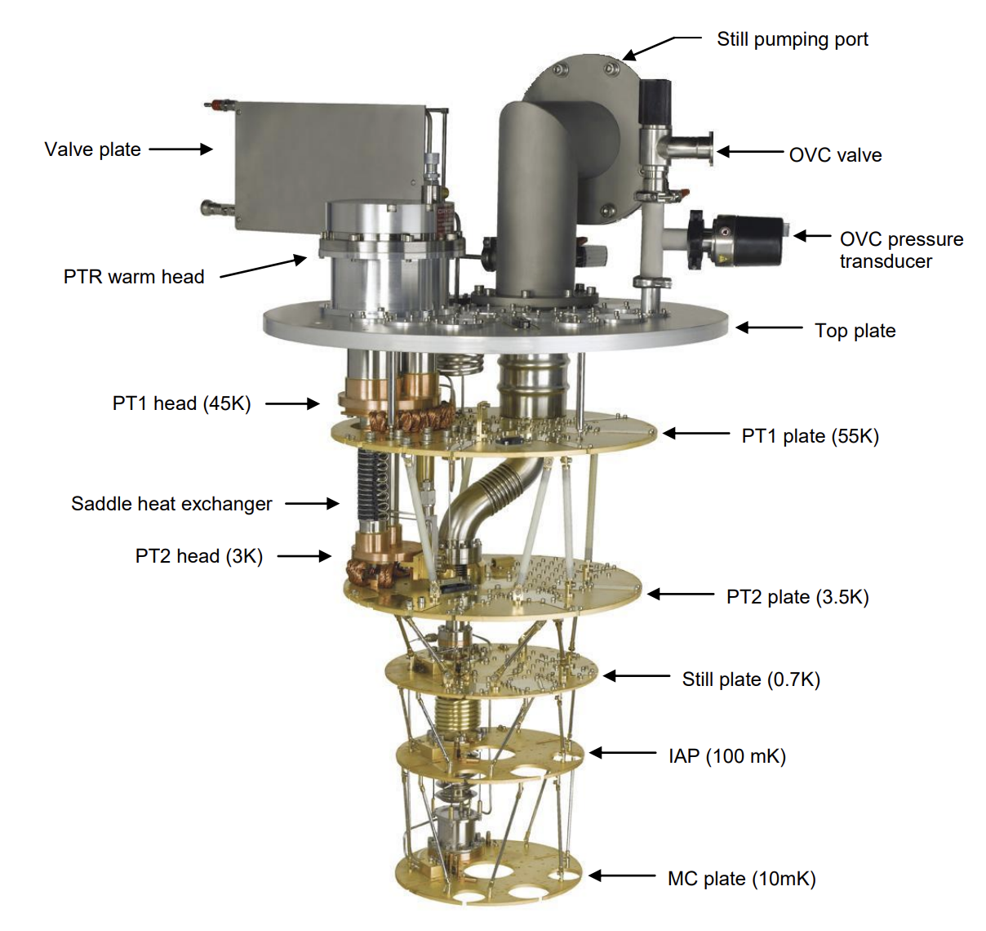
History of TRIUMF’s Dilution Refrigerator
The equipment previously used for SuperCDMS (Super Cryogenic Dark Matter Search) related research at TRIUMF.
Now being repurposed for the BeEST Experiment at TRIUMF.
Transition from a testing to operational facility
Enables stable long-term operation in comparison to the ADR at LNLL.
2
Notes:
The dilution refrigerator was formerly used for SuperCDMS, and we’re now adapting it for BeEST. This upgrade is key because:
At 20 mK, superconducting detectors such as STJs or TESs perform with higher resolution and reduced thermal noise.
These lower temperatures offer a cleaner quantum environment, which enhances sensitivity to rare or low-energy events—exactly what we aim for in the sterile neutrino search.
And practically, it enables stable long-term operation at ultra-low base temperatures without active cycling

Slide 3
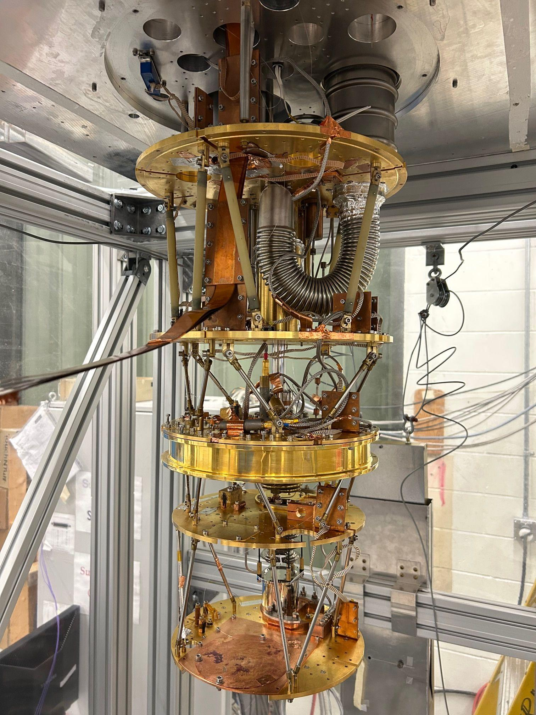
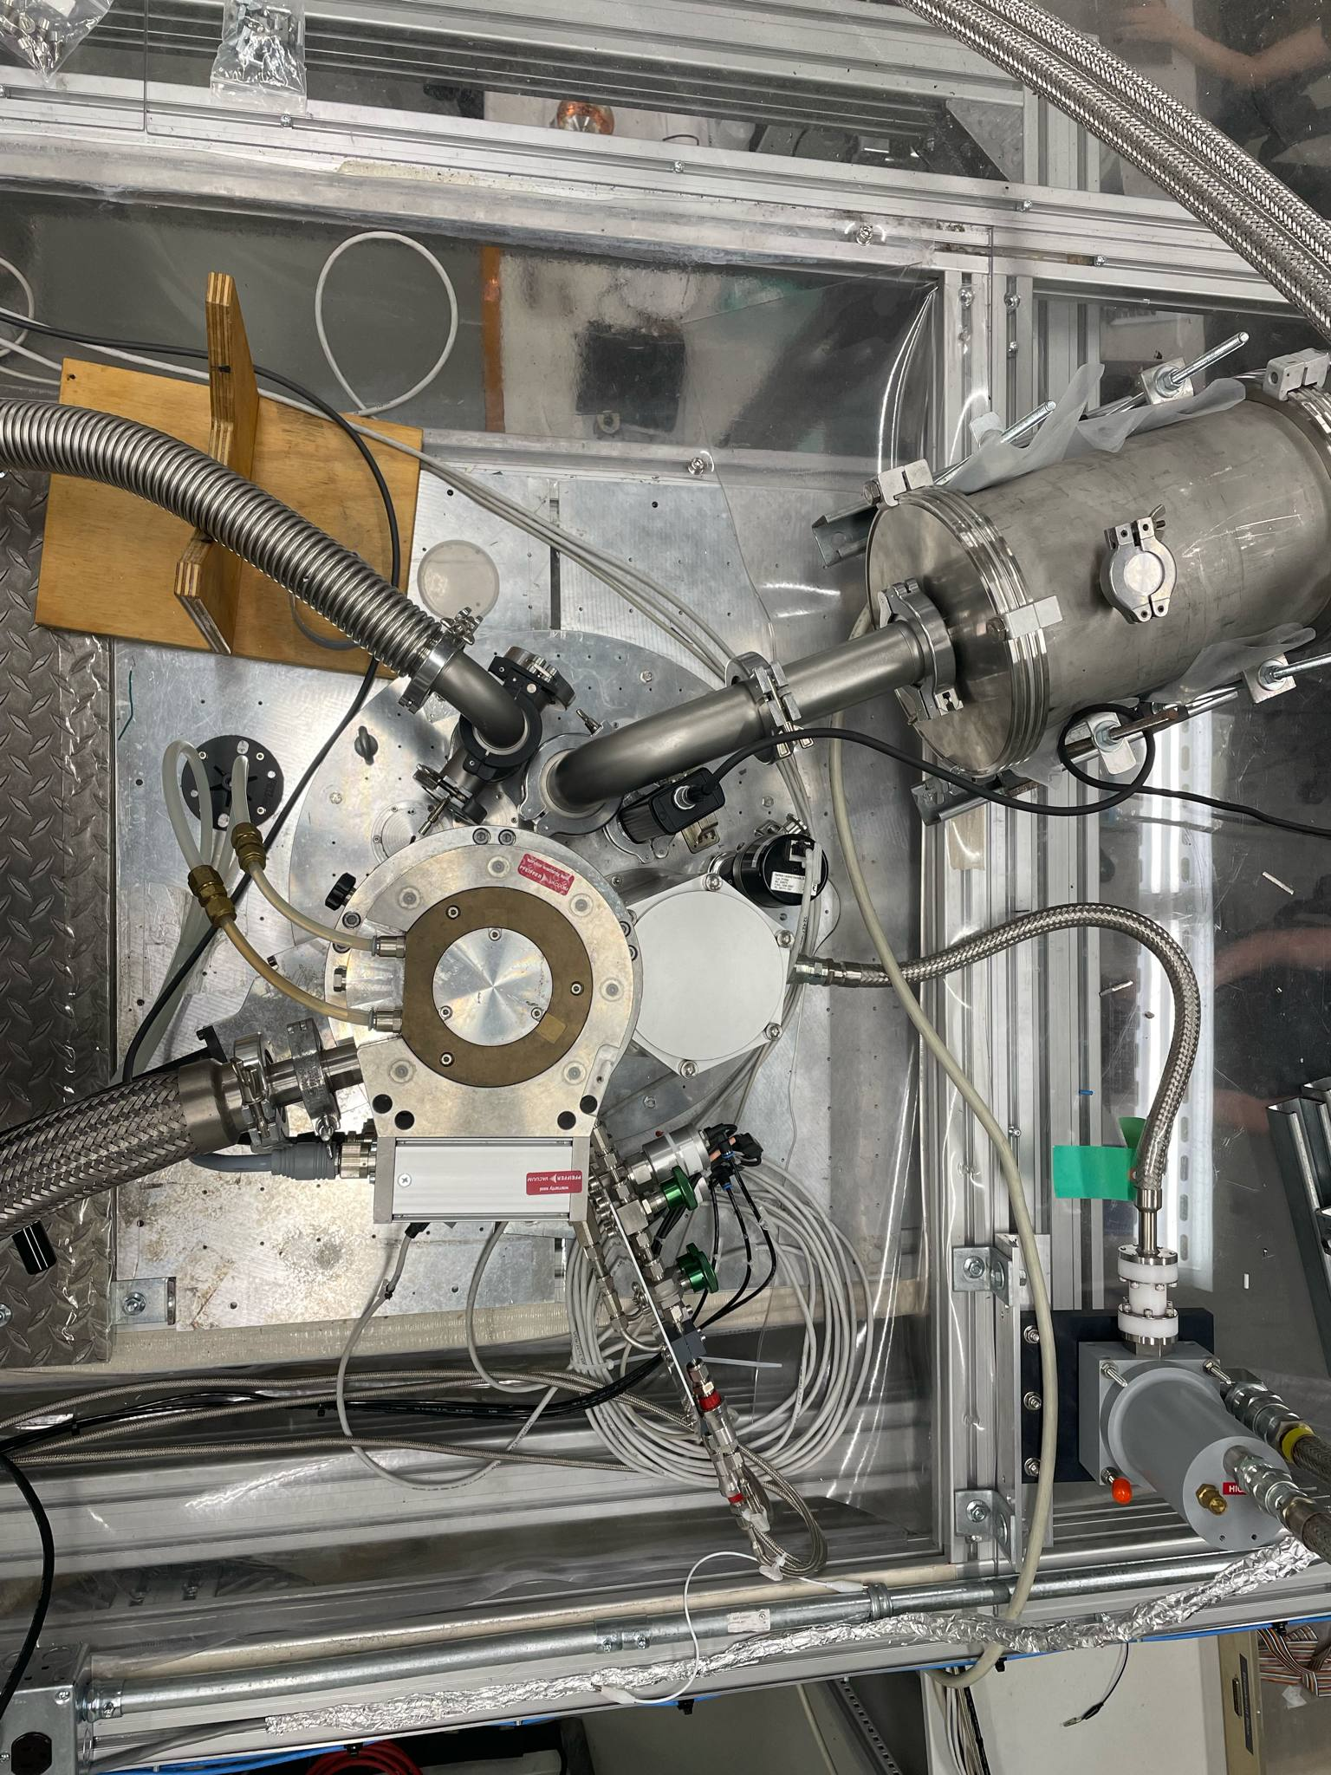
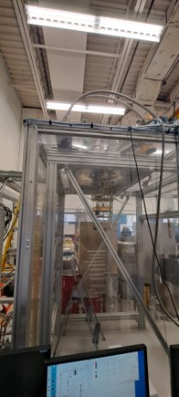
Dilution Refrigerator at TRIUMF
Inside the cleaning room without Vacuum Canisters
Outside the cleaning room in the Development Lab at TRIUMF
Top View of the DR
OVC/Vacuum Pipe
CP Plate (~55mK)
Turbo pump
MC Plate (~20mK)
3
Notes:
The dilution refrigerator was formerly used for SuperCDMS, and we’re now adapting it for BeEST. This upgrade is key because:
At 20 mK, superconducting detectors such as STJs or TESs perform with higher resolution and reduced thermal noise.
These lower temperatures offer a cleaner quantum environment, which enhances sensitivity to rare or low-energy events—exactly what we aim for in the sterile neutrino search.
And practically, it enables stable long-term operation at ultra-low base temperatures without active cycling

Slide 4
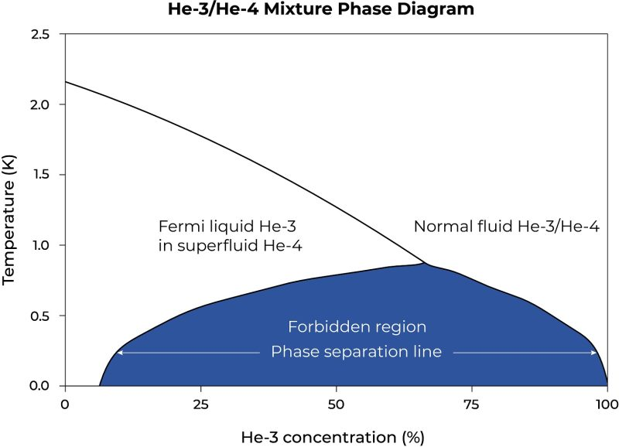
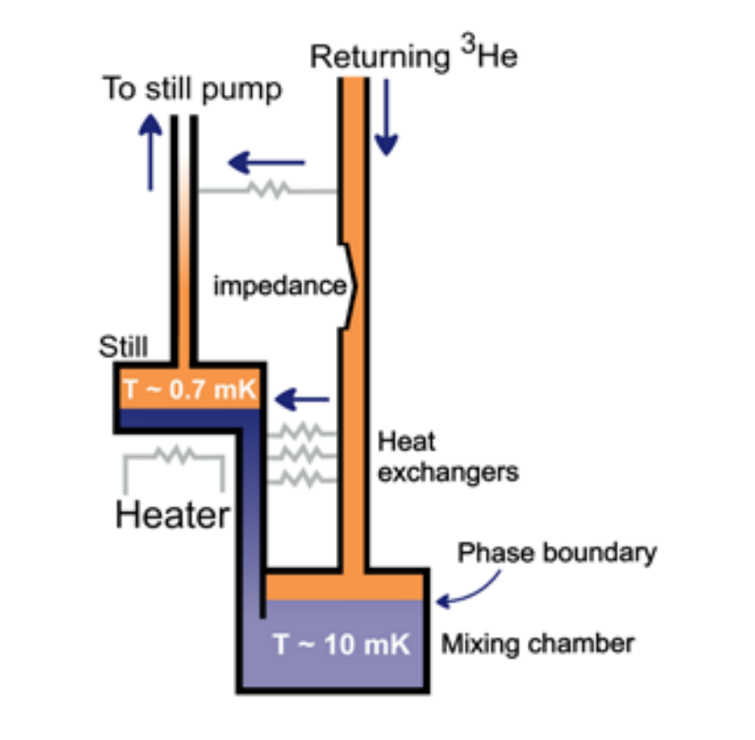
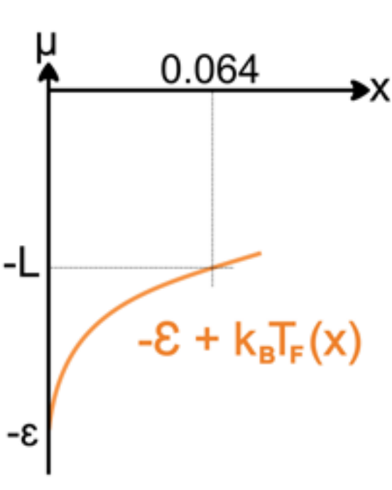
Principle of Dilution Refrigerators
The cooling core of a Dilution Refrigerator lies in the unique interaction between Helium-3 (³He) and Helium-4 (⁴He).
Phase separation between Isotopes at extremely low temperatures
‘Finite Solubility’ between ³He and ⁴He by Van der Waals Forces
Binding energy as an endothermic reaction
4
Notes:
Slide 3: How Dilution Refrigeration Works
The core principle involves the quantum properties of helium-3 and helium-4 mixtures. Below ~870 mK, the two isotopes phase-separate. This separation enables continuous cooling via the endothermic enthalpy of mixing as ³He atoms cross the phase boundary from the concentrated phase into the dilute phase. This is what allows us to reach the ~10–20 mK range.

Slide 5
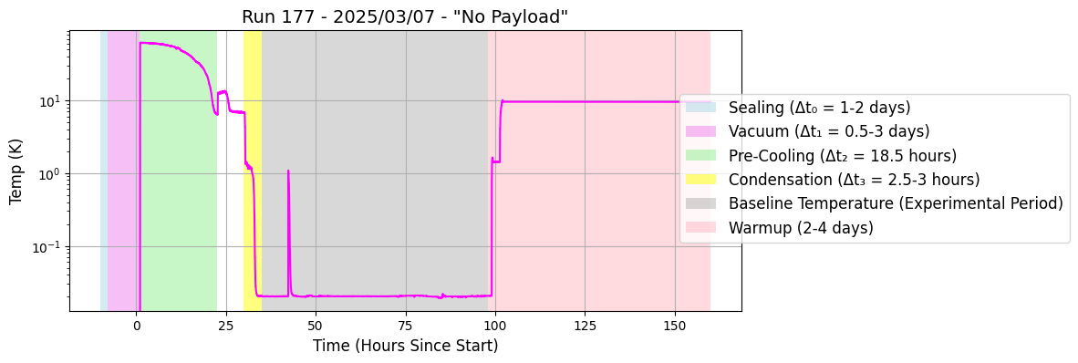
Process: Procedure and Expected Timeframe during a Cooldown
It takes about 1-2 hours to close the DR.
Approximately 6-14 hours to achieve a vacuum of 1×10⁻⁴ mbar.
18.5 hours to pre-cool the system.
2.5 - 3 hours to condensate the Helium mixture before it stabilize at baseline temperature.
5
Notes:
Here we show a typical cooldown profile from our dilution refrigerator system, specifically Run 177.
The process begins by sealing and evacuating the system—this takes roughly 14 hours to achieve a vacuum of 1×10⁻³ mbar. Creating vacuum in the DR chamber thermally isolates the cooling plates and provides the necessary environment for efficient precooling.
We then enter the pre-cooling phase, which lasts about 18.5 hours. Here, we circulate a gaseous mixture of helium-3 and helium-4 to remove the bulk of the thermal load from the system.
After precooling, we initiate condensation, where the helium mixture transitions into liquid phase under low temperature and high vacuum. This is the critical stage where ³He and ⁴He separate, initiating the dilution process. This step generally takes between 2.5 to 3 hours.
Once condensation completes, the system enters base temperature operation—the black curve here shows temperature settling in the 10–100 millikelvin range, where our detectors operate with maximum sensitivity.

Slide 6
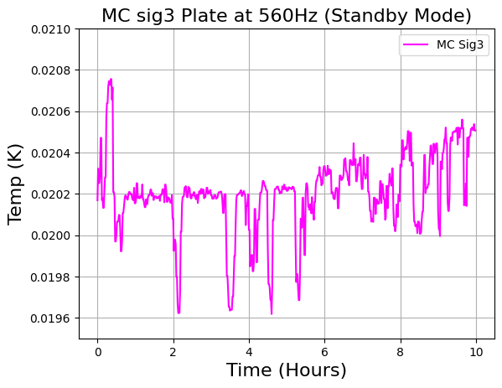
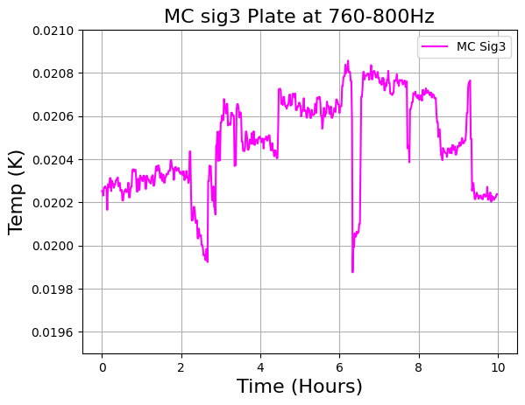
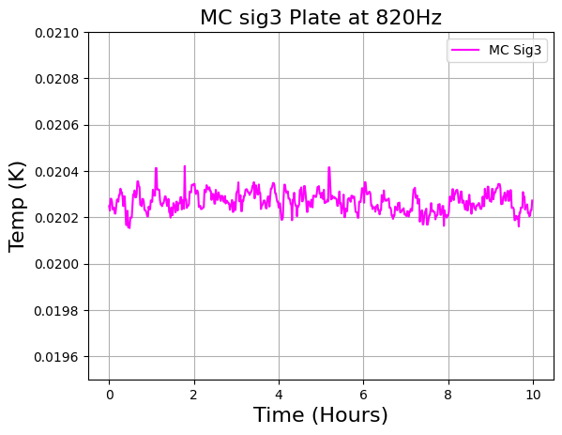
DR Optimization: Turbo Pump Effects
High cooling water helps to enhance the speed of the turbo pump, leading to greater thermal stability.
Conversely, a lower speed is likely to maintain a similar temperature but exhibit more temperature variation, potentially due to:
Less evaporation of ³He
Inconstant speed of turbo pump.
Warmer temperature of the pump due to slower cooling flow
6
Notes:
We've spent considerable time optimizing the turbo pump system, which turns out to be a critical factor in maintaining temperature stability at the mixing chamber—the coldest plate of the dilution refrigerator.
Interestingly, pump speed has a non-linear influence on thermal behavior:
If the turbo spins too fast, beyond our optimal range, it introduces mechanical vibrations. These vibrations convert to excess kinetic energy in the system, which in turn causes fluctuations in the base temperature—directly impacting detector performance.
On the other hand, if the pump runs too slow, we see reduced helium-3 evaporation. This weakens the endothermic mixing process fundamental to cooling, and as a result, our system struggles to reach target base temperatures.
To stabilize the pump, we actively cool it using water flow. We’ve found that maintaining a flow rate between 10 and 15 liters per minute holds the turbo at around 820 Hz, which is currently our most stable operating point. At this speed, we strike the right balance between minimizing vibrations and maximizing helium-3 evaporation efficiency.

Slide 7
DR Optimization: Helium Leaks
Minor Helium mixture leaks into the pre-cool loop can significantly raise baseline temperature.
Leaked mixture acts like an invisible thermal bridge, unintentionally linking cold stages and spreading heat.
Leaking is likely due to long period of dormancy however the scale of the leak is very small.
Controlled venting restores the original baseline temperature stability within ~20 minutes — no need for a full warm-up.
Leak testing completed; cooldown procedure updated to minimize future leak risks.
7
Notes:
Another key area of optimization we focused on was minimizing helium leaks, especially into the pre-cool loop.
Even small amounts of the He-3/He-4 mixture leaking into the system during cooldown can cause a noticeable rise in baseline temperature. That’s because when the mixture leaks into the entire inner region of the fridge, it essentially acts like an invisible thermal bridge, unintentionally linking various cold stages and distributing heat where we don’t want it — making it much harder to maintain stable millikelvin conditions.
What helped was slow, controlled venting to the recovery line. With that method, we were able to recover temperature stability in around 20 minutes, without needing to fully warm up the dilution fridge.
To reduce the risk of this happening again, we’ve now performed leak testing, and have updated the 'empty pre-cool' step in our cooldown procedure to better isolate the system in future runs.

Slide 8
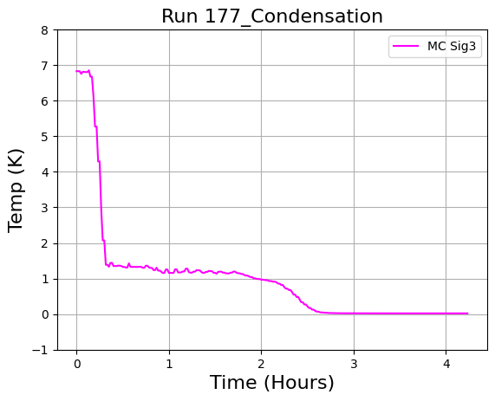
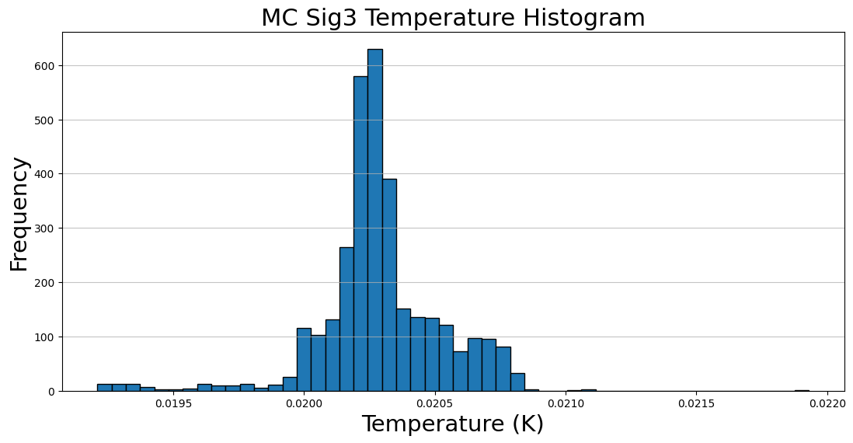
Results: How cold do we get?
Data analyzed the moment the condensation automation finished for the recent cooldown which took:
Δt₂= 2.76 hours
δt₂ = 0.01Δt₂ = 0.0276 hours
How stable is the baseline temperature?
Specifically at the Mixing Chamber located in the MC Sig3 plate with no payload:
x̄ = 20.29 mK
σ = 0.24 mK
Average temperature: 20.29 ± 0.24mK
8
Notes:
So, how cold do we actually get?
After 2.76 hours of cooldown for Run 177, the Mixing Chamber stabilized at an average temperature of 20.29 ± 0.24 mK. The histogram shows a slight left skew, with occasional short-lived temperature dips due to better helium evaporation and momentary isolation improvements. Additionally, more frequent right dips—repeated, higher temperature drops—are easier to replicate and typically occur due to minor fluctuations in heat load or the system's stabilization process.

Slide 9
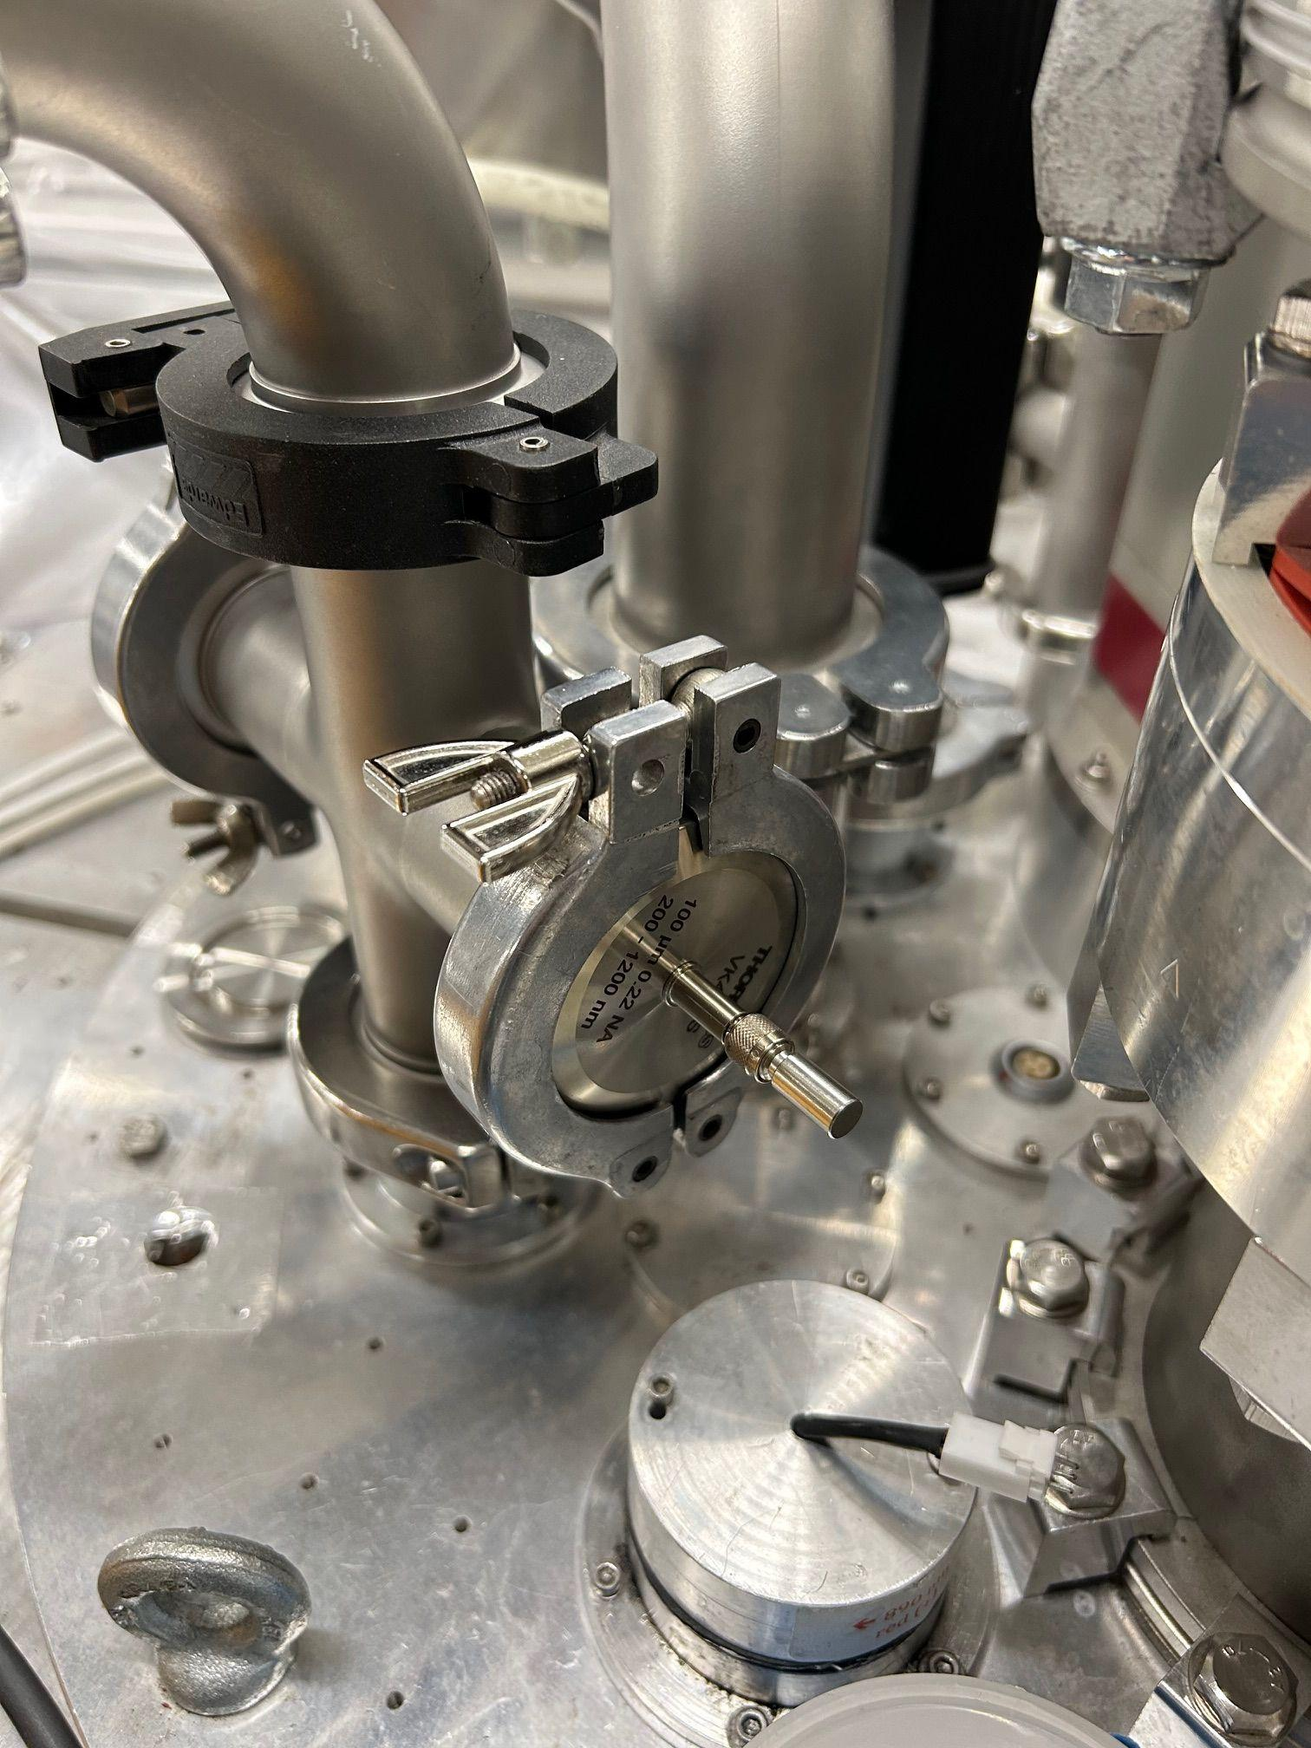
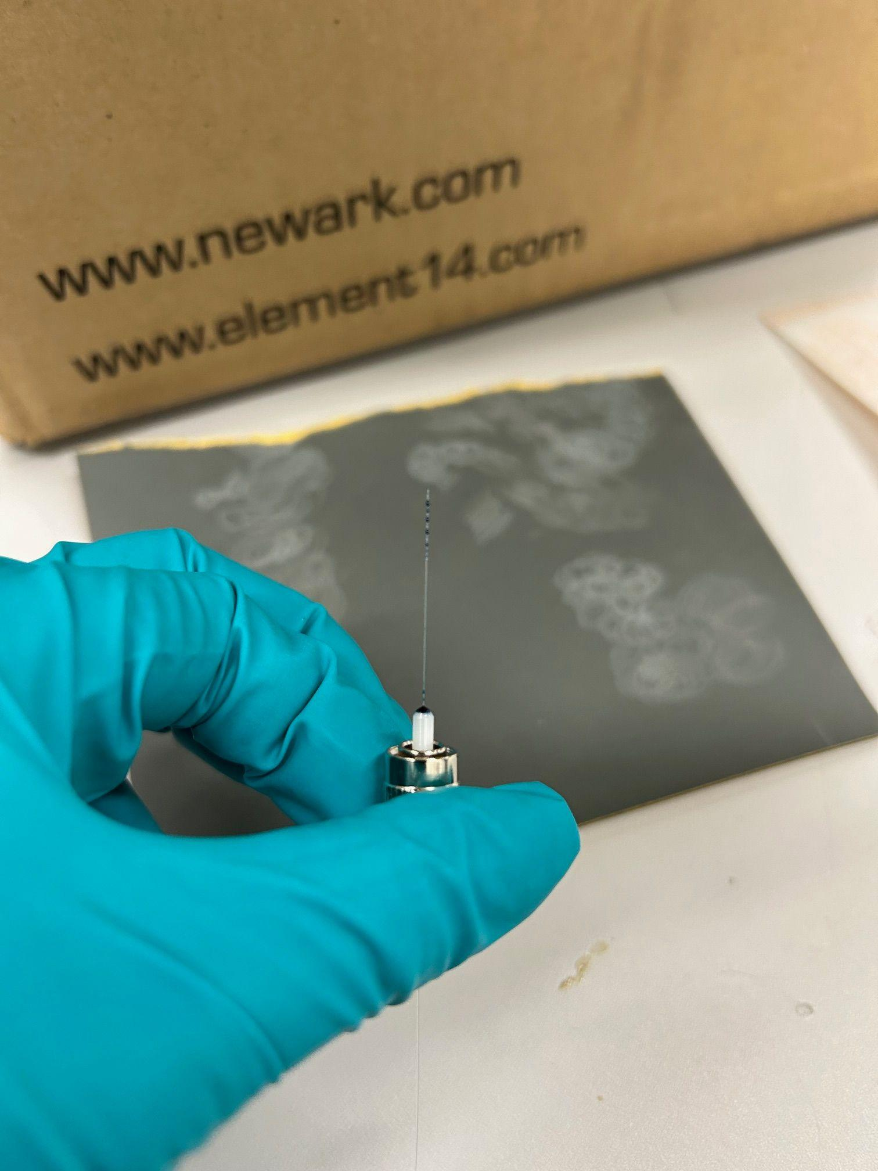
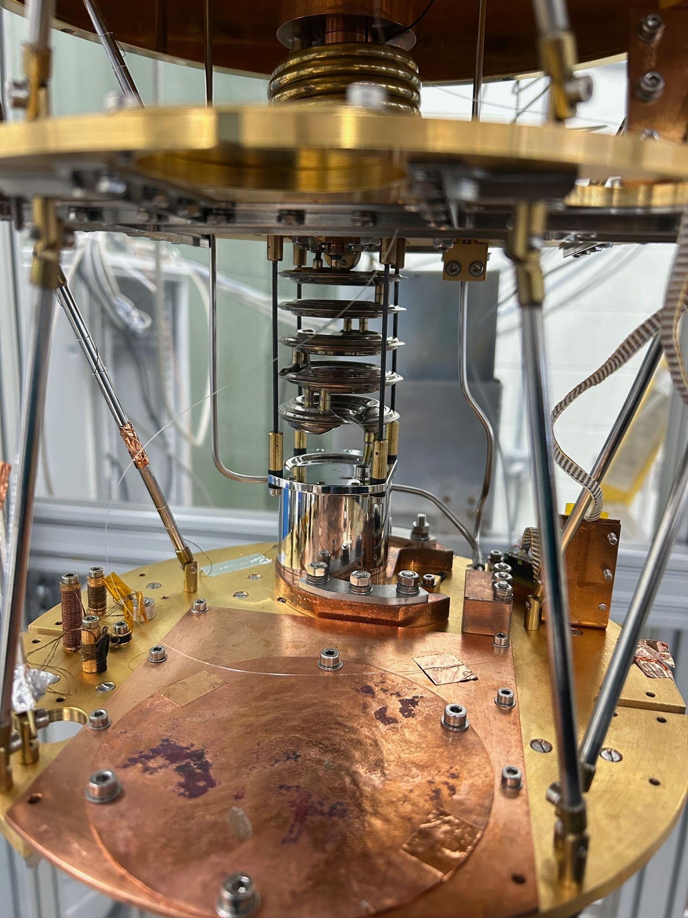
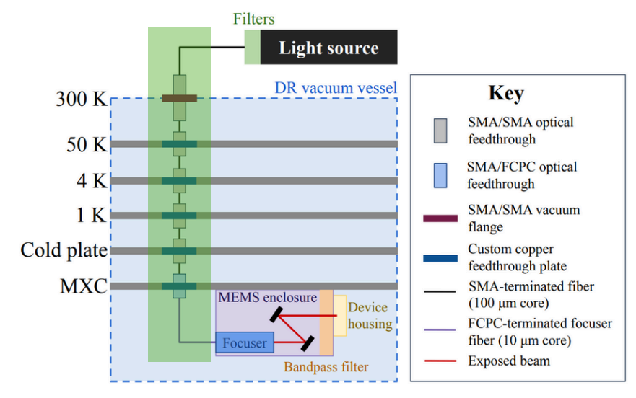
DR Upgrades: Cryogenic Optical Beam Installation
The BeEST requires a Cryogenic Optical Beam Steering for precise laser calibration and characterization of Cryogenic (e.g. STJ) Detectors
Current Progress Highlighted in Green
What’s next: Making draft designs for the Optical Steering Box
SMA connector attached to each feedthrough
Optical Fiber that goes all the way down to the MC Plate
Optical Feedthrough that is to be connected to the Laser source sitting outside the DR vessel
9
Notes:
A critical next step for the BeEST project is the installation of a sophisticated cryogenic optical beam system. As the first bullet point highlights, BeEST requires Cryogenic Beam Steering for precise laser calibration and characterization of our cryogenic detectors, such as STJ detectors.
The green area indicates the current progress in integrating this system within the DR vacuum vessel, spanning various temperature stages for proper heat sinking before going down to the MC plate.
The graph on the left represents the type of spectral data we aim to acquire using this precisely controlled optical beam. The multiple peaks illustrate the detailed energy information on our detectors we can access through accurate laser calibration.
Thus, the installation of this sophisticated cryogenic optical beam system into our dilution refrigerator is a key milestone, enabling us to run the experiment at TRIUMF in the near future.

Slide 10
Next Steps
Laser Source Design:
Working towards first designs and safety requirements.
Detector Cabling: Installations underway.
Superconducting Wires:
Orders confirmed; delivery expected within a month.
10

Slide 11
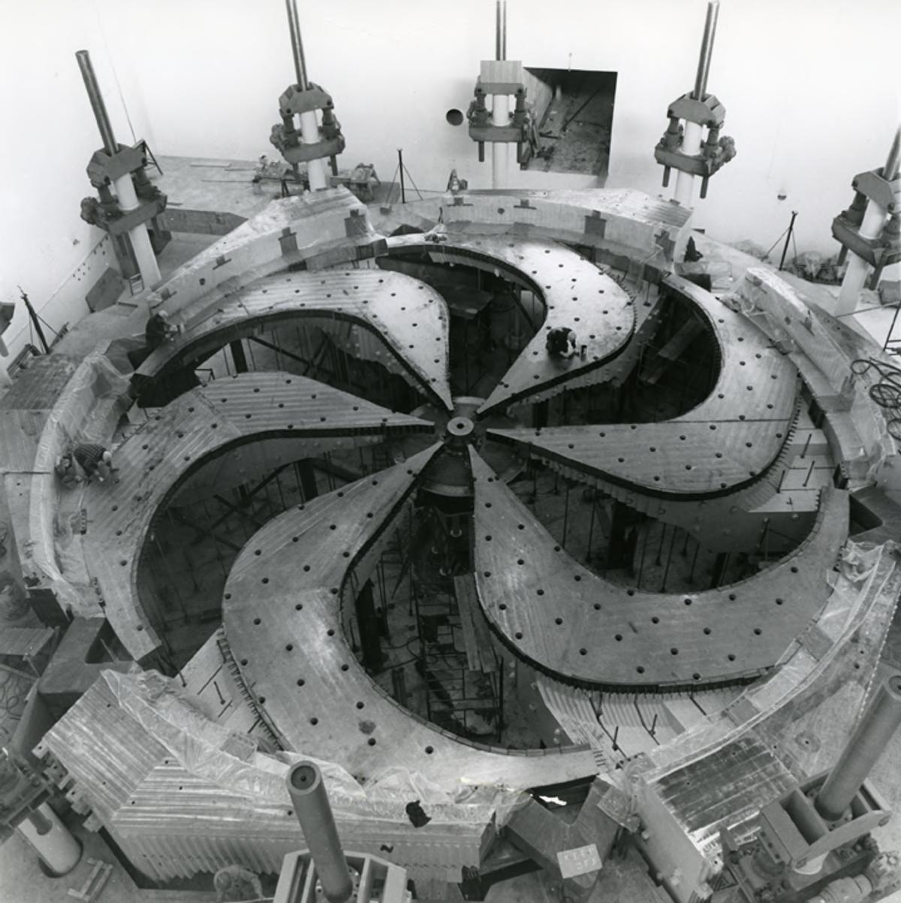
Thank You
Merci
11
Notes:
Thank you for your time. I'm available to answer your questions or elaborate on any technical specifics you wish to discuss.

Slide 12
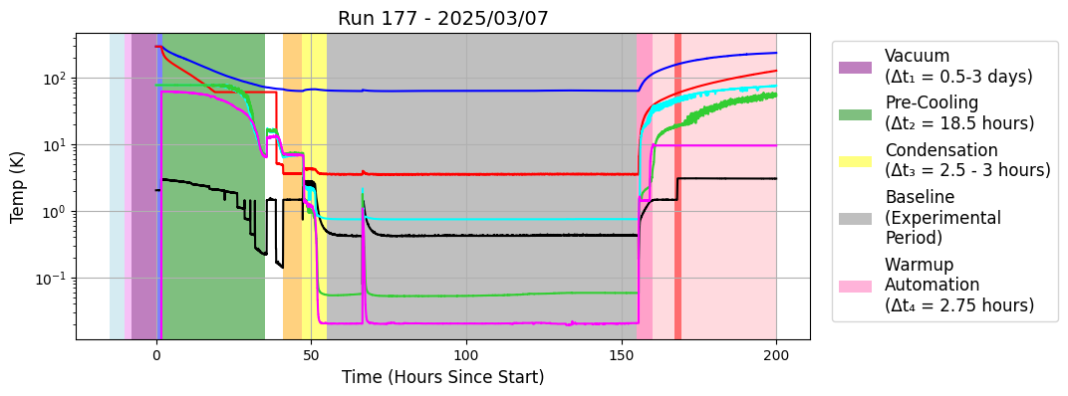
More detailed Cooldown Procedure
Consist of about 10 steps: Sealing, General Vacuum, Fine Vacuum, Introduce Gas Exchange, Pre-cooling, Emptying the Pre-cool Loop, Condensation, Baseline Temperature, Warm-Up Automation, Additional collection of mixture
12

