Slide 1
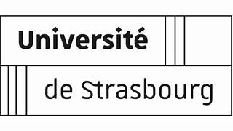






jjj
Influence of the environment on electron capture decay: update
Adrien Andoche and Paul-Antoine Hervieux
13/05/2025
Notes:
The results I’m going to show you come from Adrien Andoche's PhD thesis, which he defended last December. He is now post-doc at Xavier Mougeot's CEA Saclay laboratory.

Slide 2
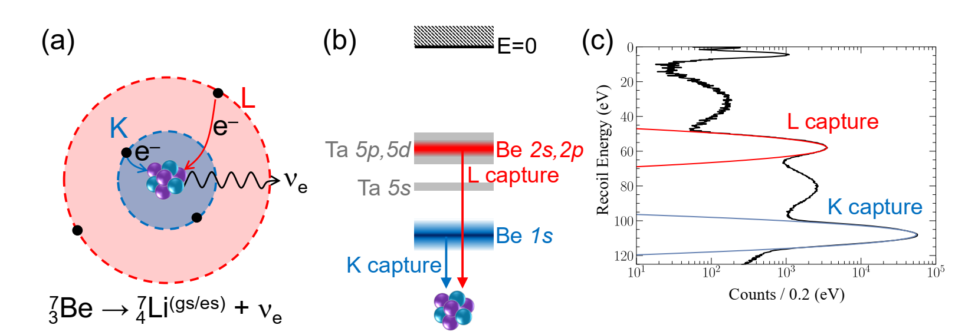

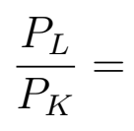

?
Key issue →
Environnement Ta →
13/05/2025
Notes:
You're all familiar with the BeEST spectrum. For the last three years, the key question for us has been to find a theoretical model for estimating the ratio of capture probabilities from the K and L shells. More important is the role that the tantalum matrix plays in this ratio.

Slide 3
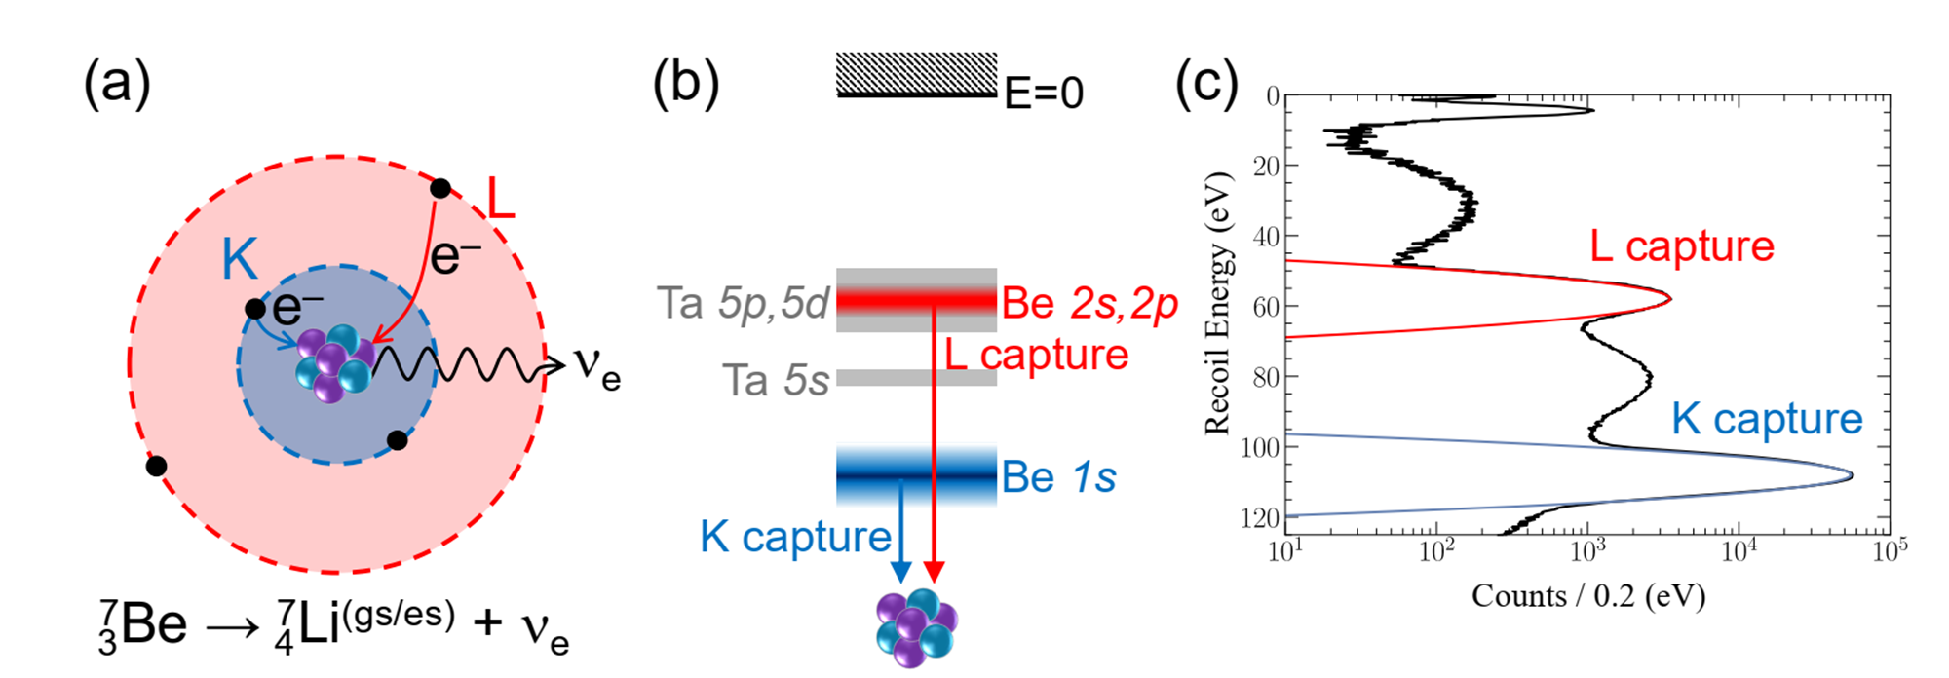
Electron Capture Decay in Vacuum
Already in vacuum, not everything is clear in the calculation of EC probabilities!
There is no experimental value of P_{L}/P_{K} for ⁷Be in a vacuum!
13/05/2025
Notes:
Before describing how to model the environment, it's important to understand the situation of a radioactive atom in a vacuum.

Slide 4
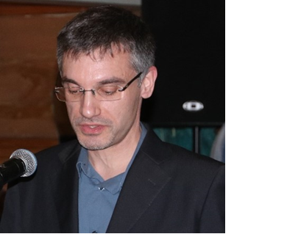


Electron Capture Decay in Vacuum
Coll: - Xavier Mougeot, CEA (France)
- Jorge Machado and José Paulo Santos, NOVA University Lisbon (Portugal)
13/05/2025
Notes:
This part has be performed in collaboration with…

Slide 5
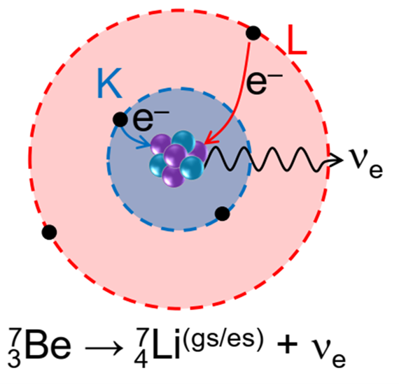
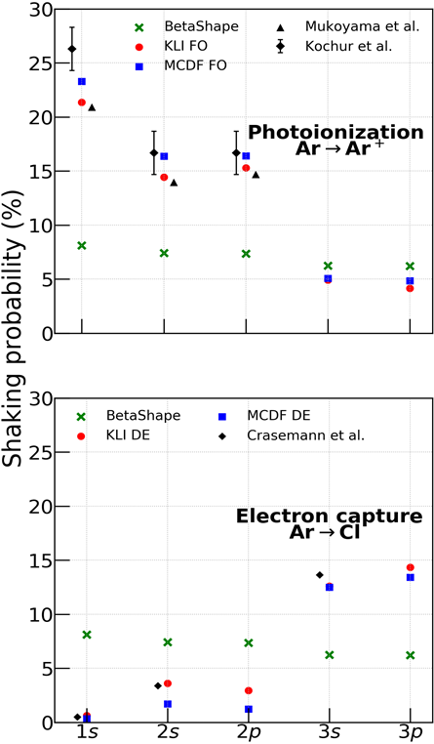
I. EC in vacuum
  1. Atomic modeling
  2. Motivation
  3. Shaking processes
  4. Exchange and overlap corrections
  5. EC decay: results

Slide 6

1. Atomic Modeling
RLDA-KLI-OEP code
Implemented with several options:
RLDA/LDA (VWN, PW, LB94 functional).
2. Self Interaction Correction (SIC).
3. Optimised Effective Potential (OEP).
4. Different nuclear charge distributions.
KLI = Krieger-Lie-Iafrate, OEP=Optimised Effective Potential
X.-M. Tong et al., PRA (1998)
13/05/2025
Notes:
Over the last few years, we have developed a rather sophisticated code for describing the electronic properties of radioactive atoms by electron capture or beta decay.

Slide 7
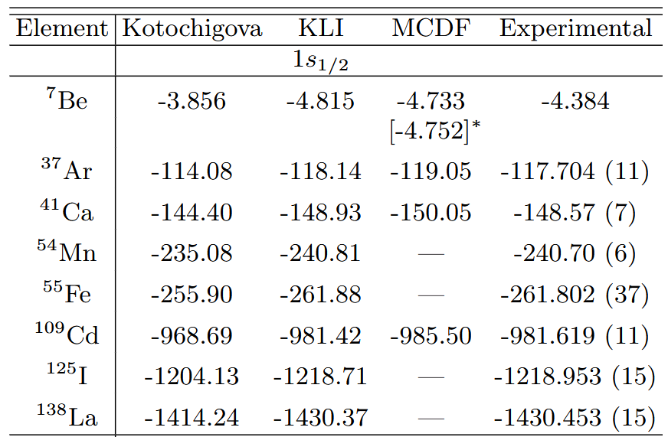
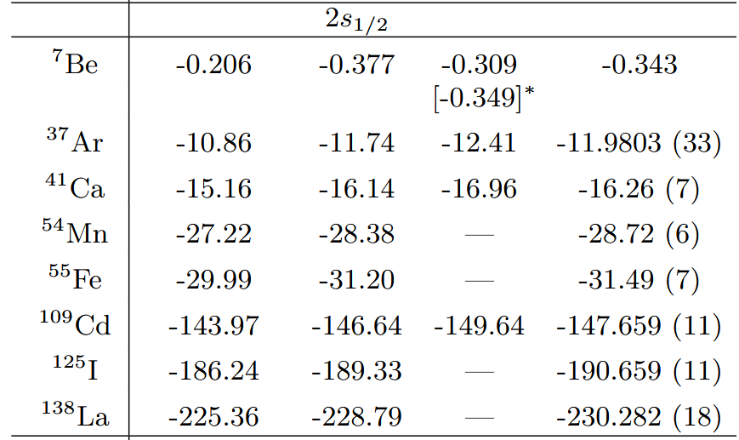
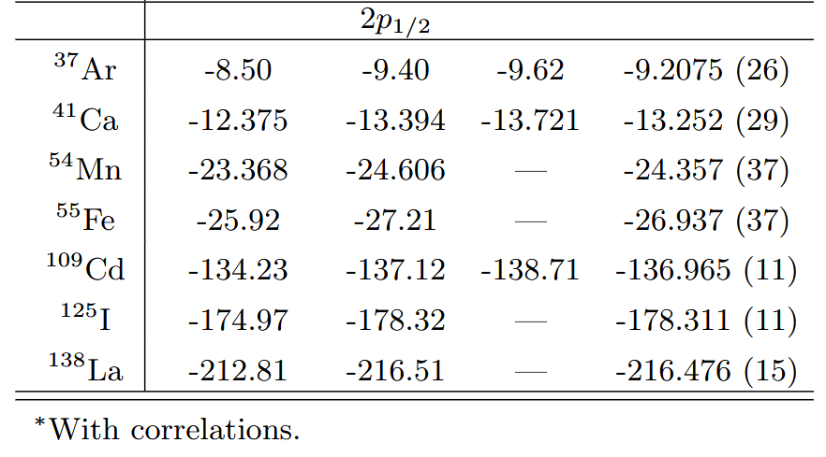
1. Atomic Modeling
Benchmarking of binding energies
A. Andoche et al., PRA (2024)
13/05/2025
Notes:
The calculated binding energies (inner and outer shells) of virtually all the atoms of interest are in good agreement with the experimental data.

Slide 8
1. Atomic Modeling
Benchmarking of binding energies
Improvement with respect to the BetaShape code. More accurate
wf’s and energies.
➔ Good description of the inner (outer) shell electrons.
Interface between RLDA-KLI-OEP and BetaShape codes
for EC decay rate calculation.
A. Andoche et al., PRA (2024)
13/05/2025
Notes:
Betashape is one of the reference codes for calculating disintegration rates. It was developed by Xavier Mougeot.

Slide 9



2. Motivation
How does it affect the EC decay rate?
  With only one electron
  With all electronic states
: nuclear matrix elements (contains g_{a} and g_{v}).
: exchange and overlap corrections.
: momentum of the ejected neutrino.
: shaking probability.
: relative occupation number.
: Coulomb amplitude.
What are these corrections?
13/05/2025
Notes:
Decay rates…

Slide 10
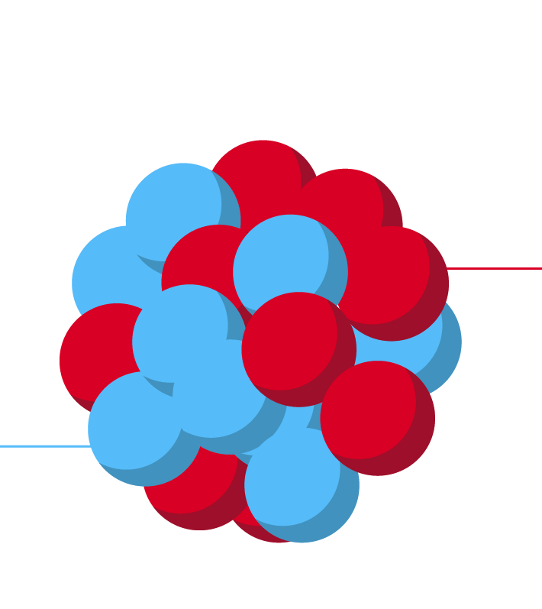



3. Shaking Processes
Shake-up
j
Daughter atom
i
Parent atom
h
Shake-up probability
i ➔ j knowing the hole state h
13/05/2025

Slide 11

3. Shaking Processes
Shake-off
E
i
Daughter ion
Parent atom
h
Shake-off probability
i ➔ E knowing the hole state h
Ejected electron 2 ➔ 3 body causing broadening of the recoil spectra
13/05/2025

Slide 12
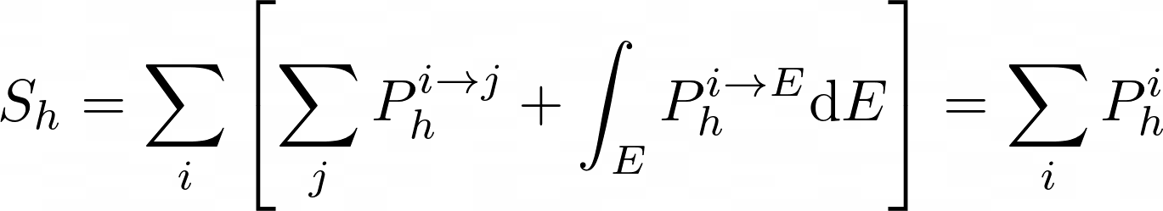
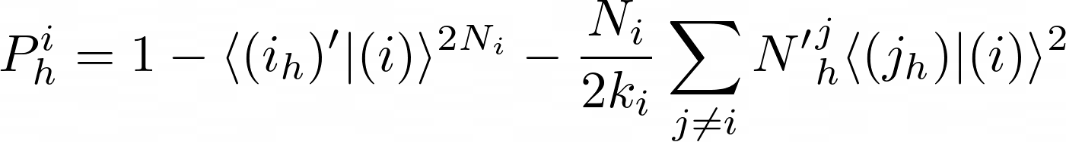
3. Shaking Processes
Total shaking probability knowing the capture in state h
Crasemann approximation
Advantages: Requires only one electronic configuration of the daughter atom.
Drawback: Doesn’t include multiple shake corrections or all electrons in the calculation.
Crasemann et al., PRC (1979)
13/05/2025

Slide 13
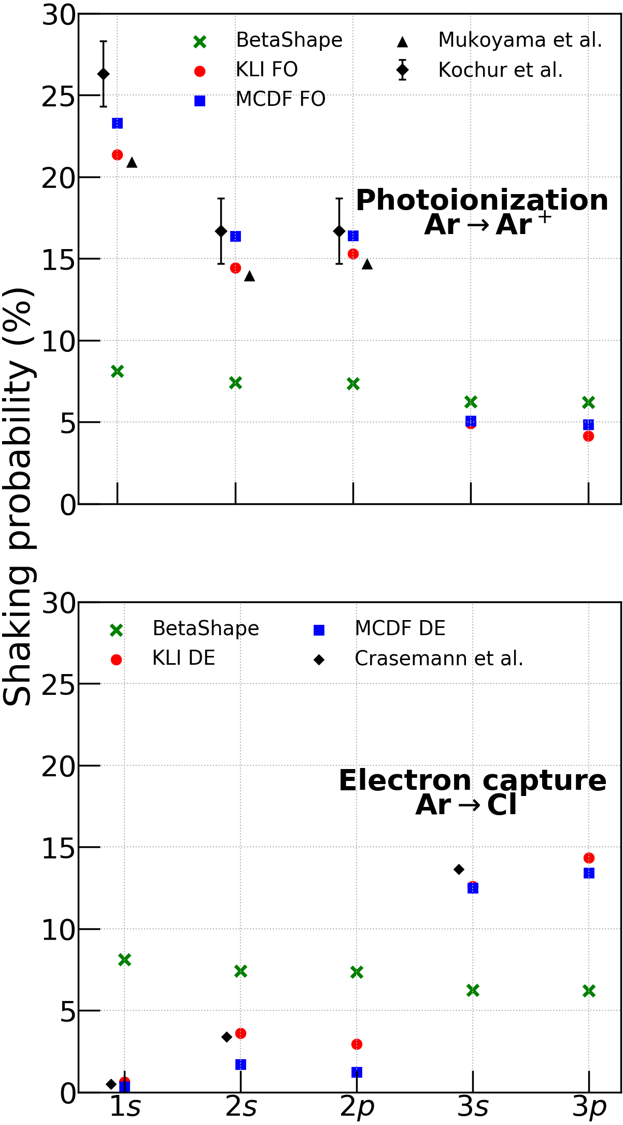
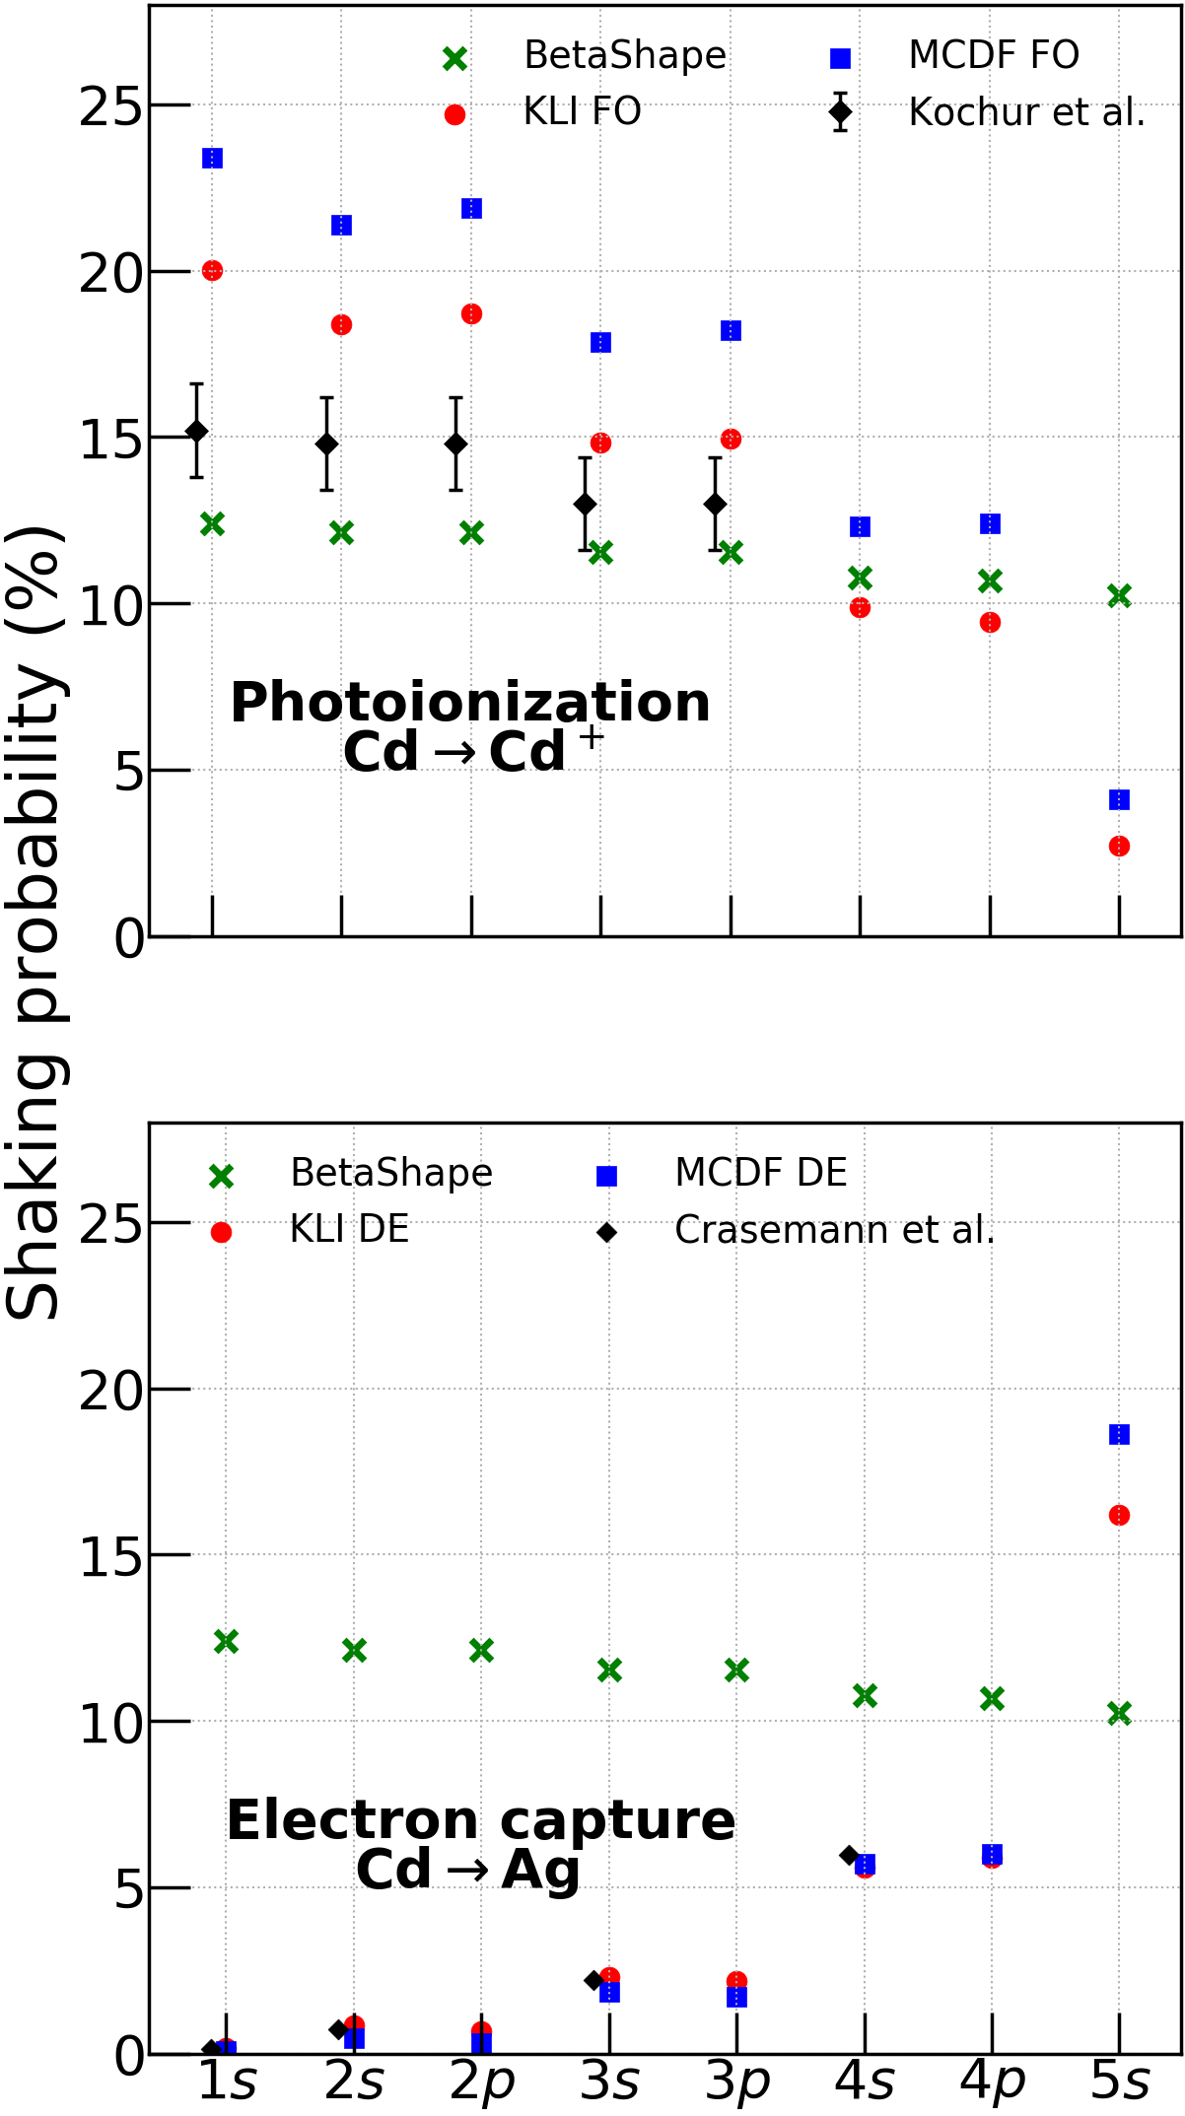




3. Shaking processes
Shaking probabilities after vacancy creation
Impact of atomic modeling (KLI, MCDF, BetaShape) on the shaking for two scenarios
1. BetaShape wave functions ➔ same shaking probabilities
1. Photoionization (FO).
2. Impact of the approximation (FO/DE) on the shaking probability
2. EC decay (DE)
3. Capture probability is depending on shaking (2 to 20%) correction.
Andoche et al., PRA (2024)
Recall:
Mukoyama et al., PRA (1987)
Kochur et al., Radiation Physics and Chemistry (2005)
Crasemann et al., PRC (1979)
13/05/2025

Slide 14


4. Exchange and Overlap Corrections
Exchange effects
Overlap effects
Daughter atom
Daughter
Parent atom
Parent atom
Ex.
Consequence of the non-perfect overlaping of initial and final atomic states.
Exchange satisfies selection rule
➔ Exchange and overlap corrections are purely quantum effects.
13/05/2025

Slide 15
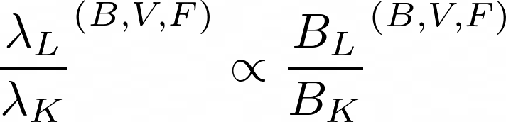
4. Exchange and Overlap Corrections
Determination of B
1. Bahcall (B): only s electrons subspace Bahcall, Nuclear Physics (1965)
2. Vatai (V): all electrons with an approximation Vatai, Nuclear Physics A (1970)
3. Faessler (F): all electrons full calculation Faessler, J. Phys. G (2015)
Recall:
➔
What is the magnitude of this correction?
13/05/2025

Slide 16
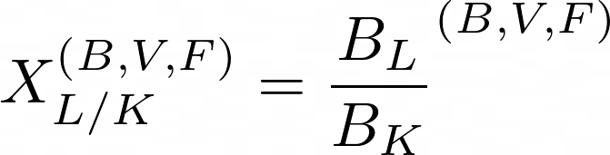
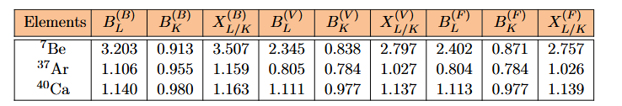
4. Exchange and Overlap Corrections
Results: B_{L} , B_{K} and X_{L/K}
Decay rates are proportional to X_{L/K}^{(B,V,F)}
Results obtained with DF
Sensitive to Z ➔ strong impact on ⁷Be.
Vatai is a good approximation for B.
Bahcall approximation is not recommended especially for low Z.
13/05/2025

Slide 17
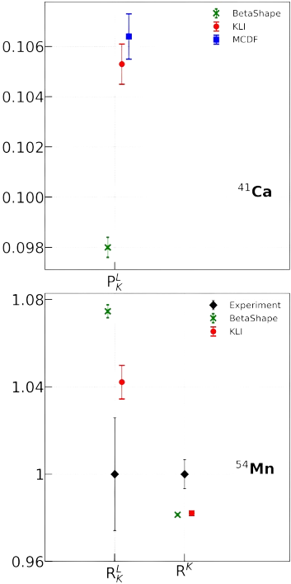
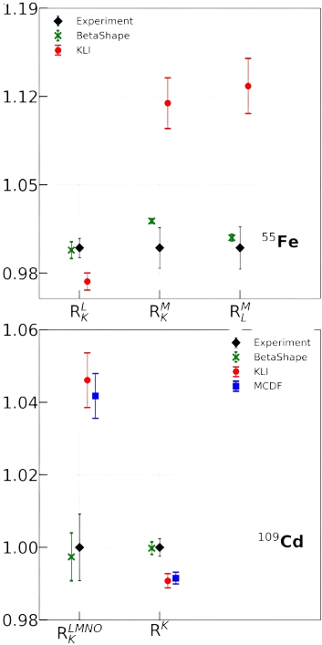
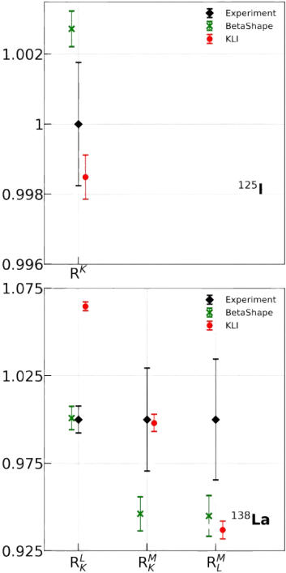
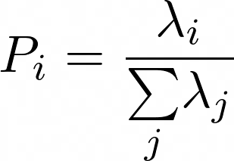
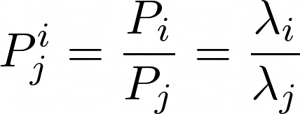
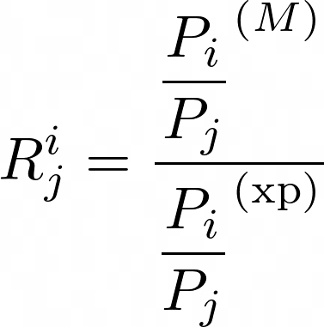
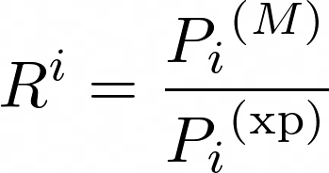
5. Results: EC Decay
Capture probabilities: the different theoretical models are compared with experiment.
Definition
Comparison with experimental ratios
M ➔ atomic model
xp ➔ experimental data
Andoche et al., PRA (2024)
13/05/2025

Slide 18
5. Results: EC Decay
Capture probabilities: the different theoretical models are compared with experiment.
RLDA/KLI and MCDF are in agreement and
differ from experimental data by 2 to 12%.
Surprisingly, BetaShape wave functions
are generally better for L/K ratio.
3. Possible explanations:
- Ratio compensation.
- Incorrectly account for shaking
probabilities.
Andoche et al., PRA (2024)
13/05/2025

Slide 19
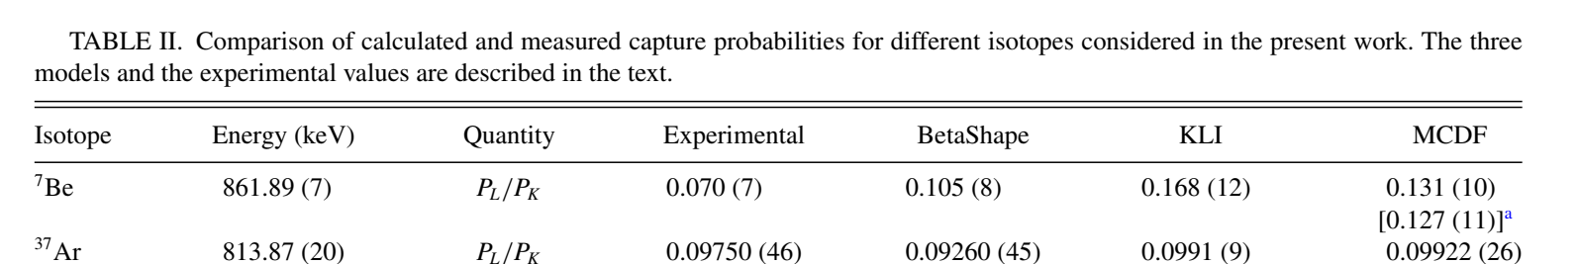

5. Results
Summary
Extensive study of the electronic corrections to ECD ➔ Shaking, exchange and overlap corrections.
⁷Be EC Decay spectra are obtained from in-medium experiment and give two values of the L/K ratio:
L/K = 4.0(1)% ⬅ P.A. Voytas et al., PRL (2002) [HgTe layer]
L/K = 7.0(7)% ⬅ S. Fretwell et al., PRL (2020) [Ta spra] ➔ The BeEST experiment.
Vacuum
13/05/2025

Slide 20
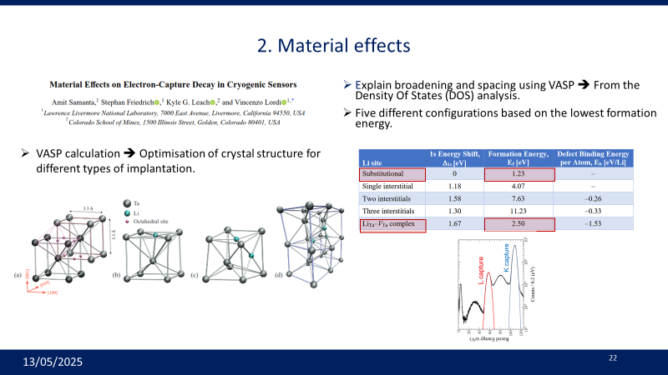
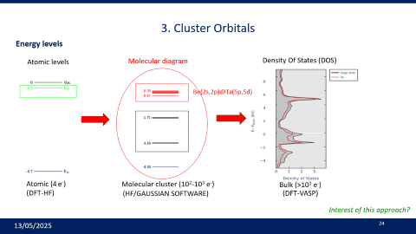
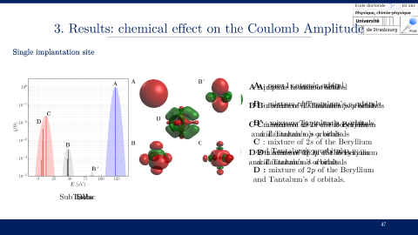
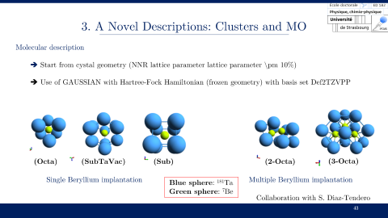
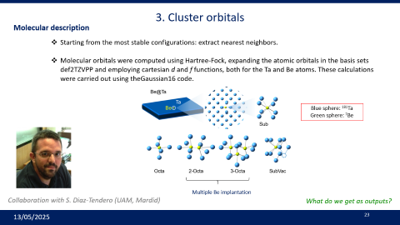
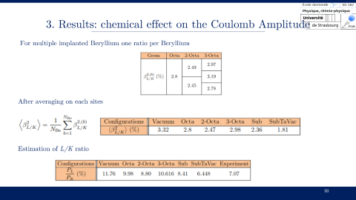
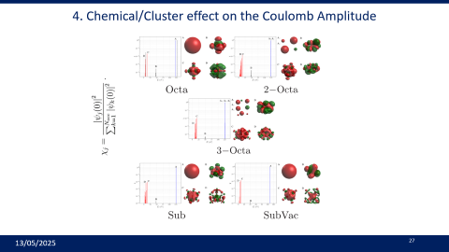
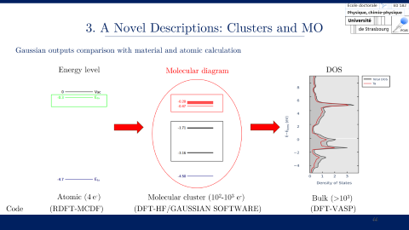
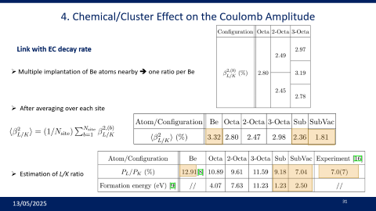
II. Material and Chemical Effects
  1. The BeEST Experiment
  2. Material Effects
  3. Cluster Orbitals
  4. Chemical/Cluster Effects on the Coulomb
  Amplitude

Slide 21
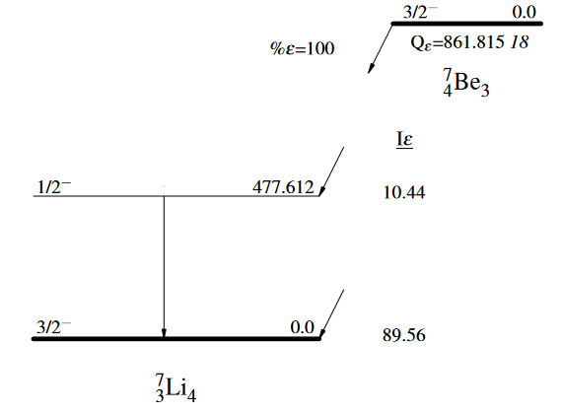
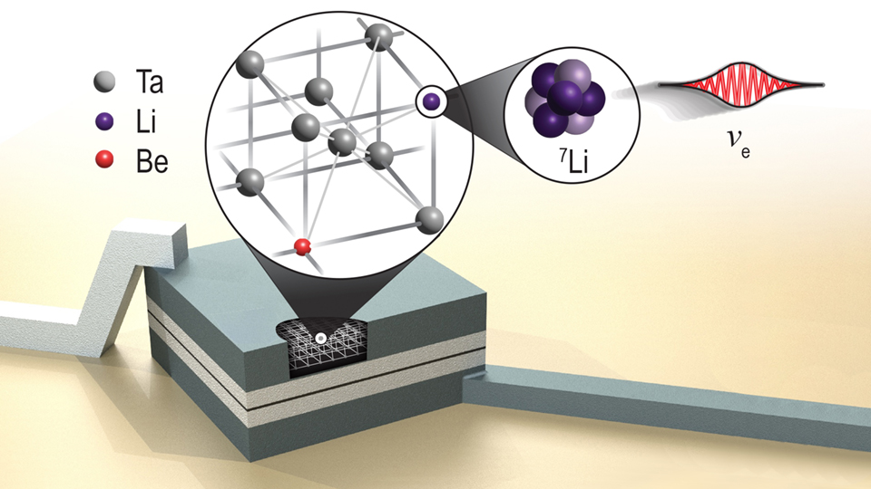

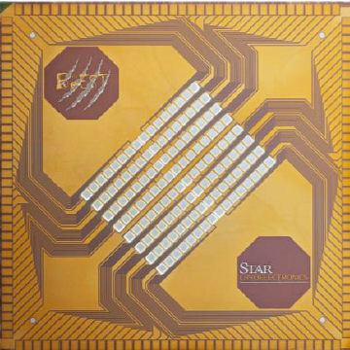
1. The BeEST experiment
Why ⁷Be?
2 body EC decay monochromatic recoil
2. No competition with β⁺
3. Lifetime: 53 days
Drawback: Two nuclear decays (GS➔GS) & (GS➔ES)
How to measure the recoil spectra?
Superconducting tunnel junctions (Ta’s STJs)
with implanted Be.
The BeEST collaboration, arXiv (2024)
What’s the effect of the material on the EC decay?
13/05/2025

Slide 22
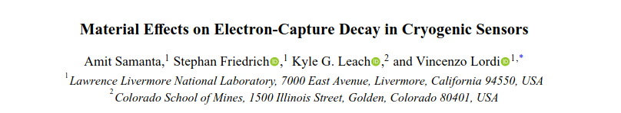
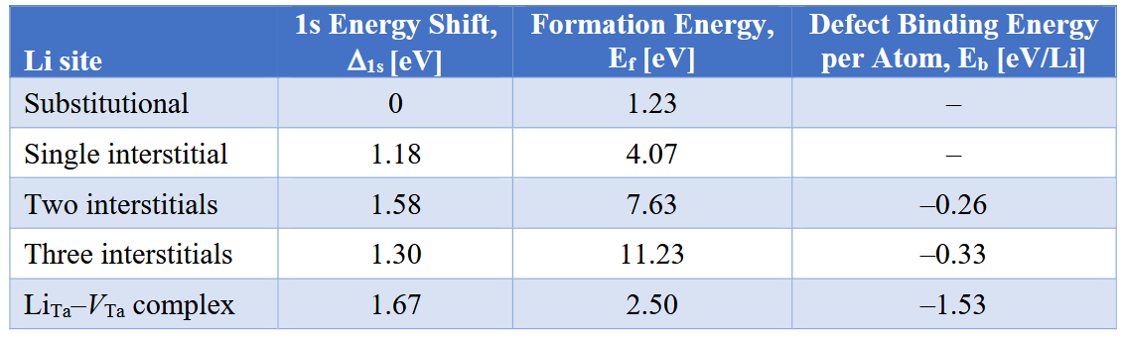
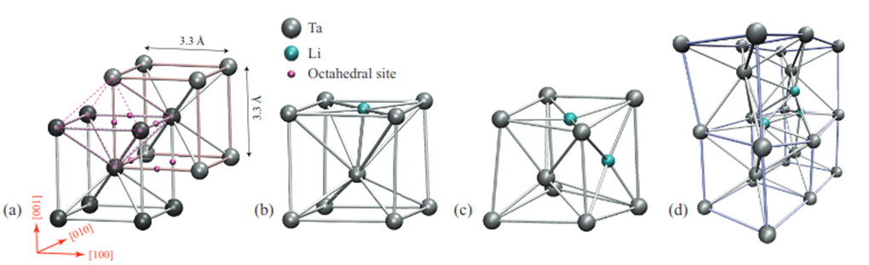
2. Material effects
Explain broadening and spacing using VASP ➔ From the Density Of States (DOS) analysis.
Five different configurations based on the lowest formation energy.
VASP calculation ➔ Optimisation of crystal structure for different types of implantation.
13/05/2025
Notes:
The Vienna Ab initio Simulation Package

Slide 23
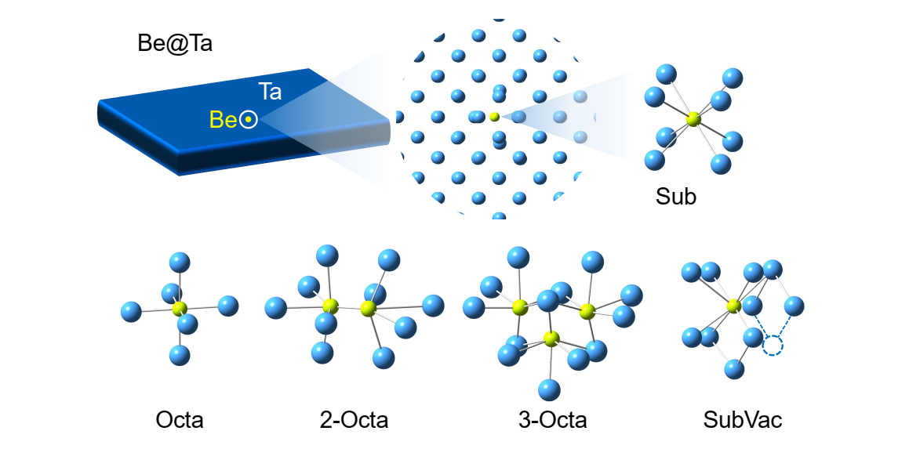

3. Cluster orbitals
Molecular description
Starting from the most stable configurations: extract nearest neighbors.
Molecular orbitals were computed using Hartree-Fock, expanding the atomic orbitals in the basis sets def2TZVPP and employing cartesian d and f functions, both for the Ta and Be atoms. These calculations were carried out using theGaussian16 code.
Blue sphere: ¹⁸¹Ta
Green sphere: ⁷Be
Multiple Be implantation
Collaboration with S. Diaz-Tendero (UAM, Mardid)
What do we get as outputs?
13/05/2025

Slide 24
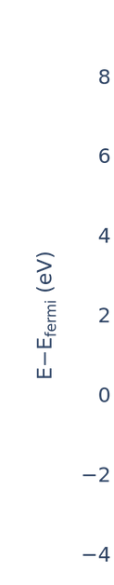
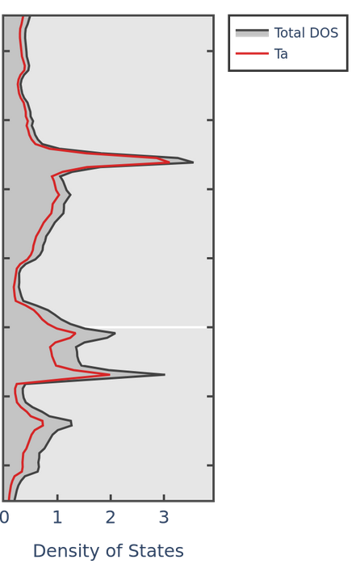
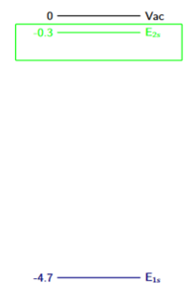
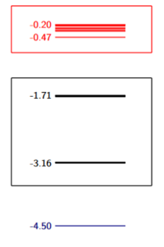
3. Cluster Orbitals
Energy levels
Atomic levels
Molecular diagram
Density Of States (DOS)
Be(2s,2p)@Ta(5p,5d)
Atomic (4 e⁻)
Molecular cluster (10²-10³ e⁻)
Bulk (>10³ e⁻)
(DFT-HF)
(HF/GAUSSIAN SOFTWARE)
(DFT-VASP)
Interest of this approach?
13/05/2025

Slide 25
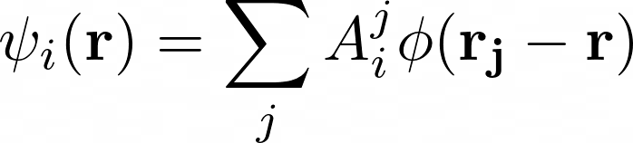
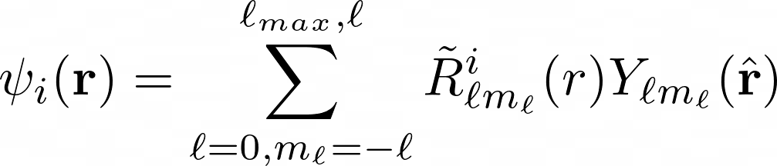



3. Cluster Orbitals
Method for obtaining recentered orbitals
Molecular orbital (MO) as a Linear Combination of Atomic Orbitals (LCAO) [from GAUSSIAN]:
2. Partial wave expansion of the MO (90 MO for 3-Octa):
3. State orthogonality and norm:
Example (Octa):
➔
13/05/2025

Slide 26
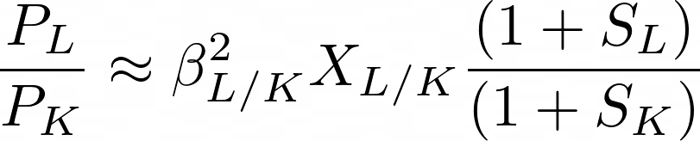
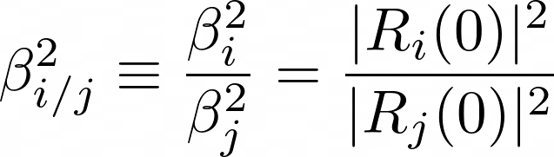



3. Cluster Orbitals
Link with the Coulomb amplitude and the decay rate
R(r)
Atomic calculation
0
Recall:
(holds only for s states)
Cluster calculation ➔ no more L and K shell
➔
Relative contribution to the Coulomb amplitude
Cluster with multiple Be →
where b refers to a particular beryllium atom within the configuration.
13/05/2025

Slide 27


4. Chemical/Cluster effect on the Coulomb Amplitude
13/05/2025

Slide 28
4. Chemical/Cluster effect on the Coulomb Amplitude
vacuum
Based on an analysis of the composition of the molecular orbitals in terms of the atomic orbitals of Be and Ta, they can be classified into 4 groups:
1s orbital of Be
p orbitals of Ta
combination of 2s orbitals of Be and 5p orbitals of Ta
combination of 2p orbitals of Be and 5d orbitals of Ta.
13/05/2025

Slide 29


4. Chemical/Cluster effect on the Coulomb Amplitude
1s orbital of Be
p orbitals of Ta
combination of 2s orbitals of Be and 5p orbitals of Ta
combination of 2p orbitals of Be and 5d orbitals of Ta.
13/05/2025

Slide 30





4. Chemical/Cluster Effect on the Coulomb Amplitude
Link with EC decay rate
A type of MO ➔ K peak: (1s Be)
C, D type of MO ➔ L peak: 2s and 2p orbitals of Be with p and d orbitals of Ta
Recall (in vacuum): in Ta:
Ratio of Coulomb amplitude per Be for a cluster
Ratio of probabilities proportional to
Hyp:
the value of is taken from vacuum.
13/05/2025

Slide 31




4. Chemical/Cluster Effect on the Coulomb Amplitude
Link with EC decay rate
Multiple implantation of Be atoms nearby ➔ one ratio per Be
After averaging over each site
Estimation of L/K ratio
13/05/2025

Slide 32
Conclusions & Perspectives

Slide 33
Conclusions
1. Atomic RLDA/KLI model is now connected with BetaShape code to provide accurate decay rates in vacuum for allowed and forbidden unique transitions. Andoche et al., PRA (2024).
2. EC decay of ⁷Be is strongly influenced by the Ta environment, which affects the Coulomb amplitude and leads to a better agreement with the L/K experimental ratio measured by BeEST. A joint paper on ⁷Be EC decay is in preparation.
13/05/2025

Slide 34
Perspectives
Study the influence of other types of medium on EC decay (e.g. Al STjs). Easy to do with the present methodology.
Calculate the excitation energy of a cluster with one hole in a given molecular orbital to obtain the recoil spectrum. Difficult. In progress.
Compute B and S for a cluster. Very difficult.
13/05/2025

