Slide 1
Auger electron loss simulation for the BeEST experiment
BeEST collaboration meeting 2025
Vancouver, Canada

Slide 2
Table of content
Motivations
Elastic and inelastic scattering approximations
Simulation and results
Conclusions and perspectives

Slide 3
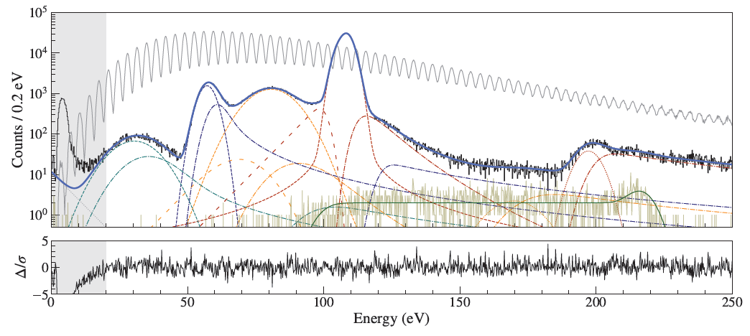
Motivations
Fit of the experimental recoil spectrum
Auger electrons energy loss: very poor knowledge!
Limiting factor for the sterile neutrinos sensitivity!
*I. Kim et al., Phys. Rev. D 111, 5 (2025)

Slide 4
What happens inside the detector?
Ta
Elastic scattering
Inelastic scattering
Free electron
Ta
Ta
Ta
T_{r}
Auger electron
Creation of a secondary electron
⁷Be
Ta
Ta
Ta
T_{e} ≈ 55 eV
ΔT_{e} ≈ 0
ΔT_{e} ≠ 0
Collective electrons
Ta
Ta
Ta
Creation of a plasmon
How can any of these very low energy electrons escape the detector?

Slide 5
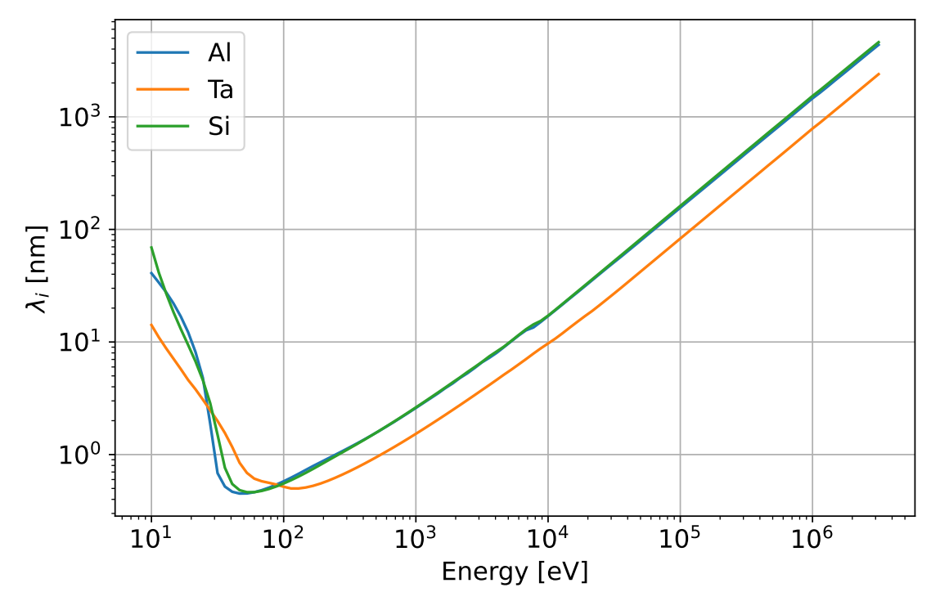
What happens inside the detector?
Secondary electrons with very low energy:
Big mean free path
Increased probability of escape!
Need for a precise simulation to constrain the energy loss!

Slide 6
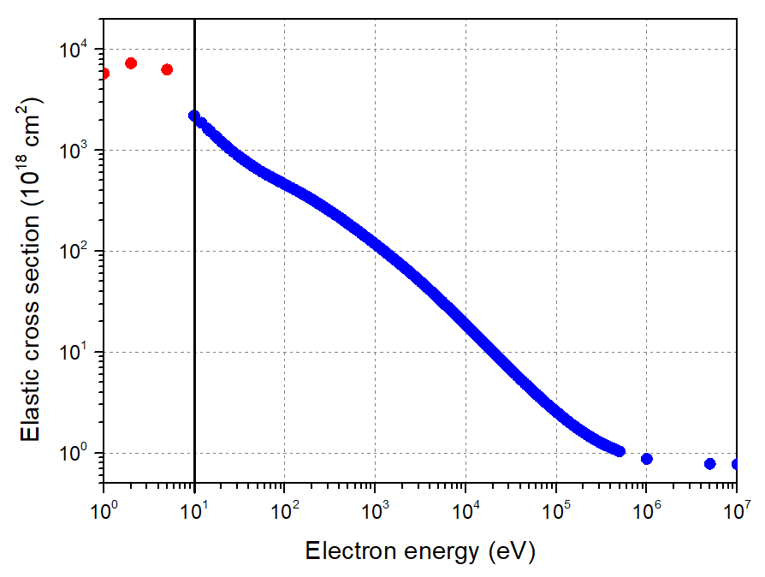
Elastic scattering of electrons
Valid down to 10 eV!
Al
Calculated with the ELastic Scattering of Electrons and Positrons by Atoms, positive ions and molecules (ELSEPA) code!
*F. Salvat et al., Computer Physics Communications 165, 2 (2005)

Slide 7
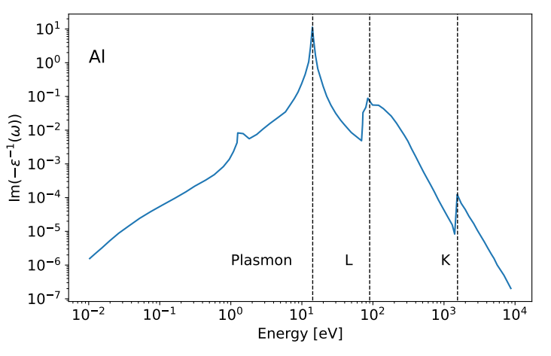
Inelastic scattering of electrons
Dielectric formalism: (Precise down to few eVs)
$$\frac{dσ}{d\left(ℏω\right)}=\frac{1}{πa_{0}E}\int_{q_{−}}^{q_{+}}{Im\left\{\frac{−1}{ε\left(q,ω\right)}\right\}\frac{dq}{q}}$$
Diff cross section:
Energy Loss Function (ELF) --> cannot be obtained with theoretical calculations
Penn (1987) proposed a method to extrapolate ELF(0, ω) to the (q, ω) plane
With ELF(0, ω) is calculated from the very abundant experimental optical data
*E.D. Palik, Handbook of Optical Constants of Solids (1985)

Slide 8
Electron scattering simulation
G4Microelec package:
Elastic scattering (1.1 eV -> 500 keV): ELSEPA cross-sections
Inelastic scattering (1.1 eV -> 10 keV): Dielectric formalism
Includes several materials: Al, C, Al₂O₃, Cu, Ge, Si, …
Our extension of G4Microelec:
Elastic scattering (1.1 eV -> 10 MeV): ELSEPA cross-sections
Inelastic scattering (1.1 eV -> 10 MeV): Dielectric formalism
Additional material: Ta
Electron energy loss simulations for the BeEST and SALER experiments
*Q. Gibaru et al., NIM B 487 (2021)

Slide 9
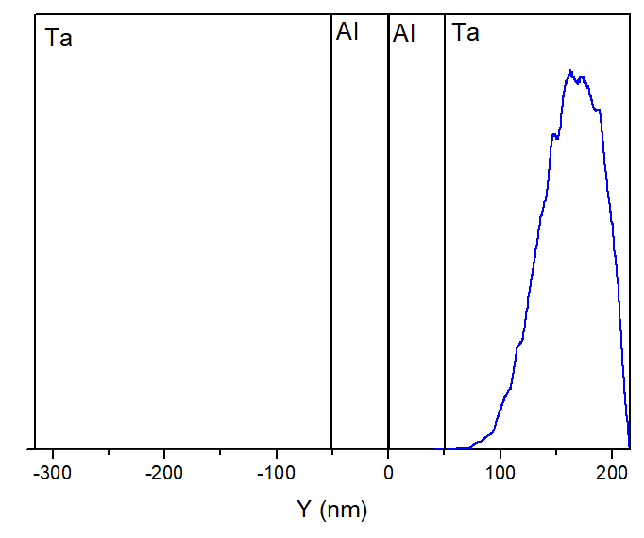
Simulation geometry
⁷Be @ 25 keV
Obtained with SRIM
Ta
Al
Al
Ta
Generate 55 eV electrons
Calculate deposited energy inside the STJ

Slide 10
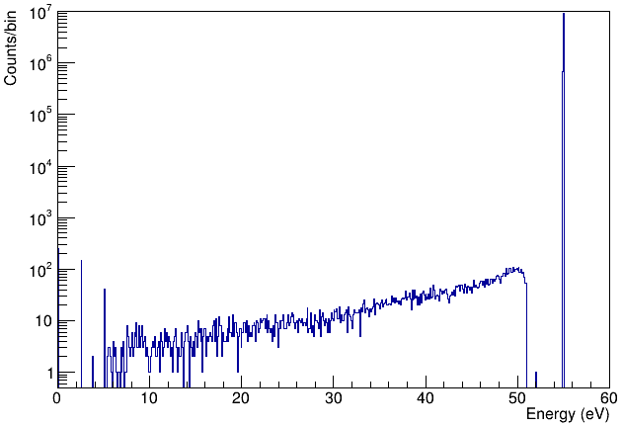
Electron scattering energy escape
Energy deposition inside the STJ
Primary electrons energy: 55 eV
The shape can be used to fit the experimental data!
The amplitude is not yet trustworthy due to unprecise cross-sections below 10 eV!

Slide 11
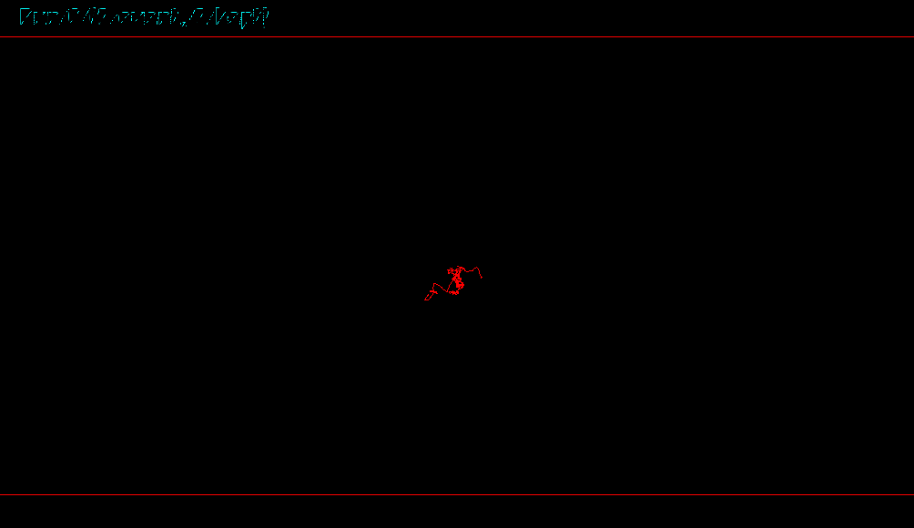
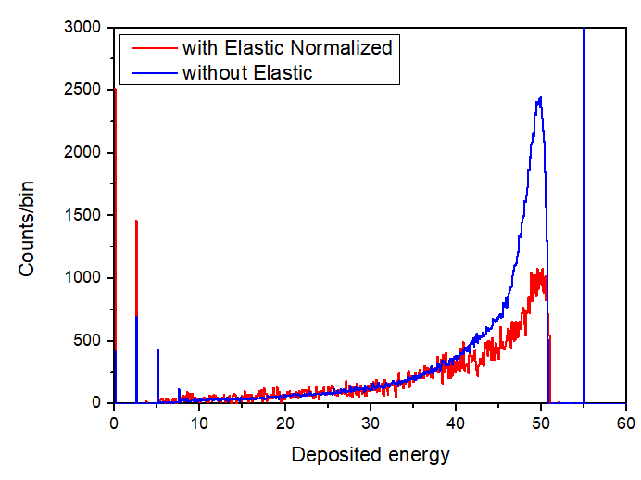
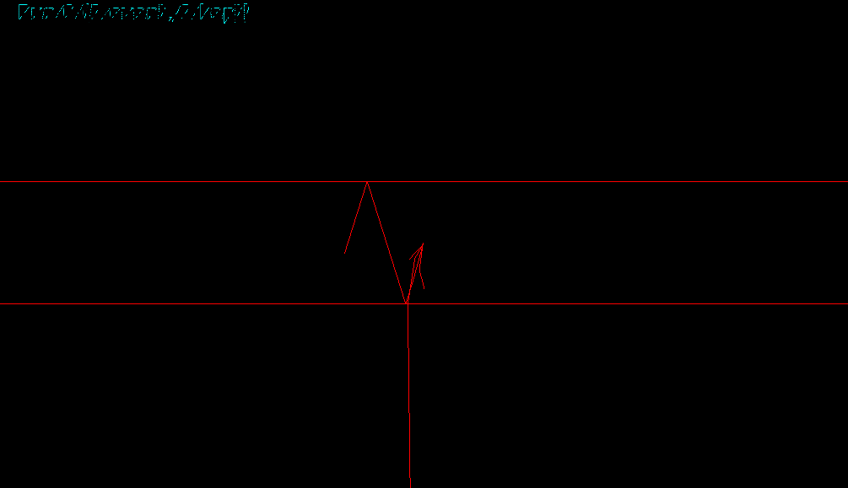
Elastic scattering involvement
With elastic scattering
0.1% of events with energy escape
1.5% of events with energy escape
without elastic scattering

Slide 12
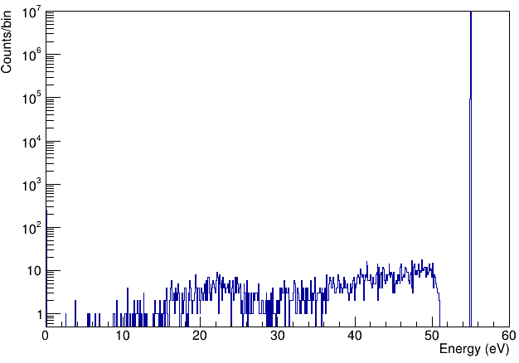
Low energy secondary electrons
With secondaries
Without secondaries
0.1% of events with energy escape
0.02% of events with energy escape
80% of the energy escape is caused by the low energy secondaries!

Slide 13
Conclusions and perspectives
The simulation for the electron energy loss can produce the shape of the Auger electrons energy escape tail despite the present limitations
The current status of the simulation can already be used to improve the fit of the experimental recoil spectrum of the BeEST experiment
The elastic cross-sections below 10 eV can be calculated and added to the simulation later on
The electron energy loss simulation can be used as well for the shake off tails

Slide 15
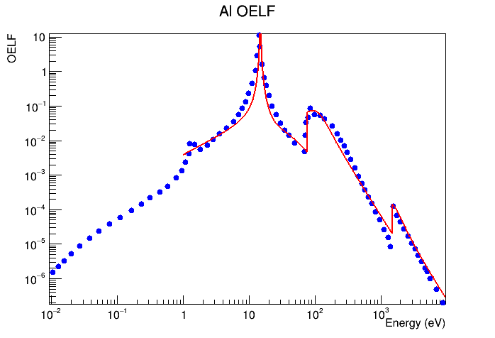
Inelastic scattering of electrons
$$ε_{M}\left(q,ω\right)=1+\frac{\left(1+iγ/ω\right)\left[ε_{L}\left(q,ω+iγ\right)−1\right]}{1+\left(iγ/ω\right)\left[ε_{L}\left(q,ω+iγ\right)−1\right]/\left[ε_{L}\left(q,0\right)−1\right]}$$
Mermin dielectric function:
$ε_{L}\left(q,ω\right)$ : Lindhard dielectric function
Fit of ELF(0, ω) with the Merimin function

Slide 16
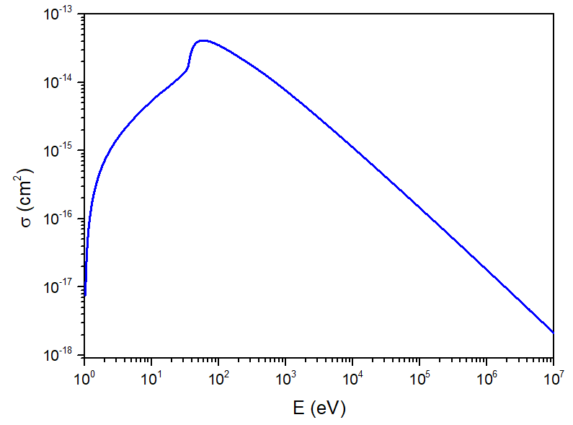
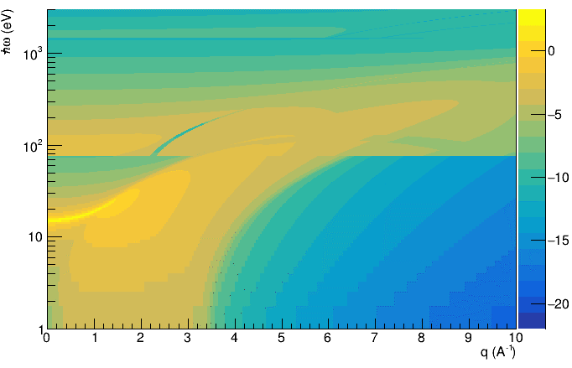
Inelastic scattering of electrons
Mermin dielectric functions are used to fit the optical ELF(0, ω)
-> Extrapolate ELF (q, ω)
Q-expansion of the optical ELF

Slide 17
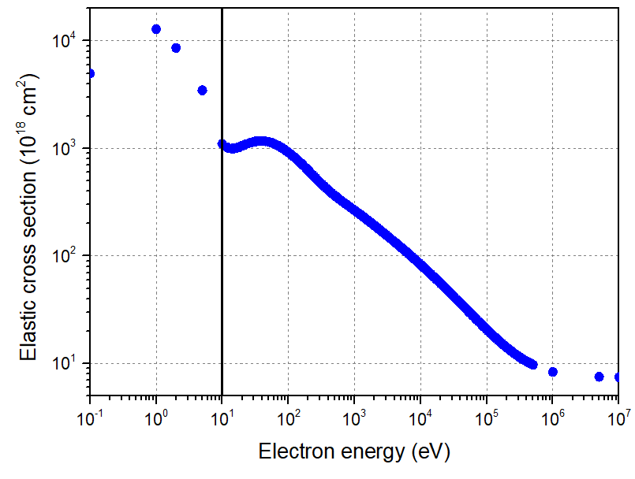
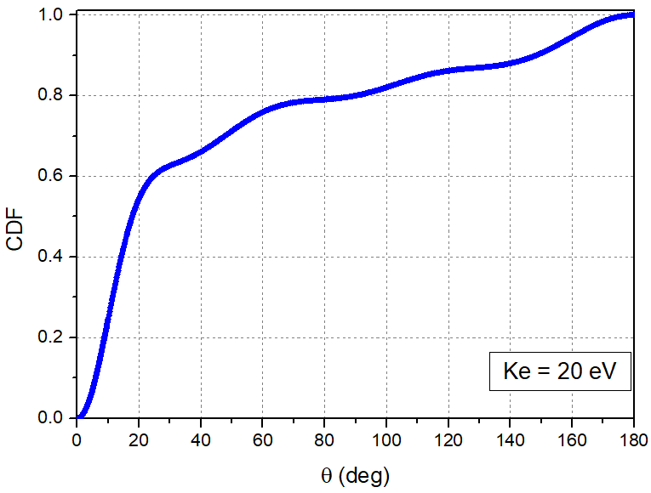
Elastic scattering cross-section
For Tantalum

