Slide 1
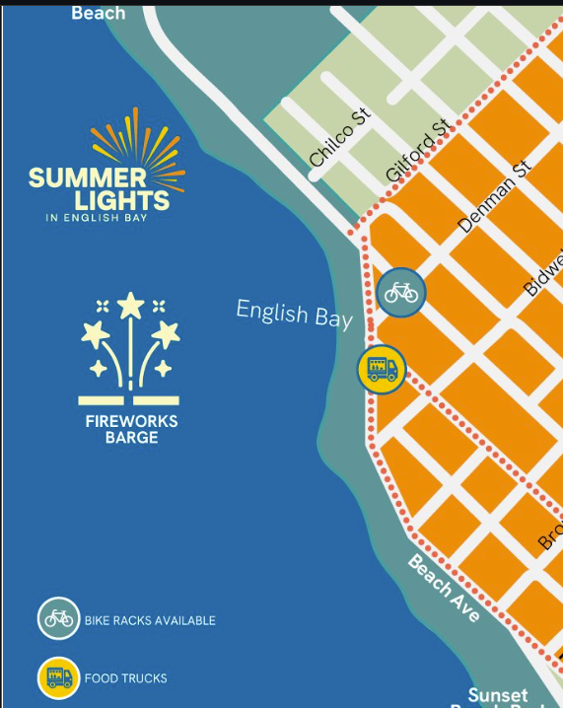
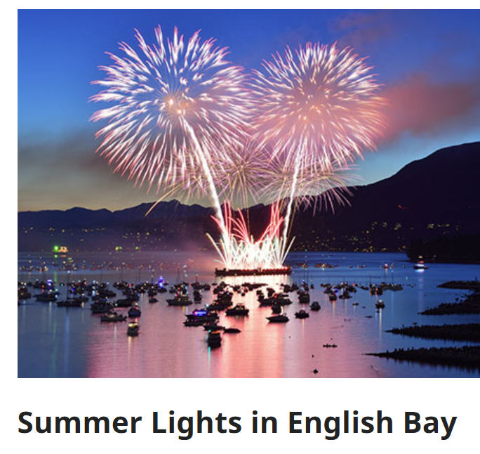
Friday July 31, 10pm
25min spectacle
Expect 200k+ spectators
Synchronized with music via radio
Very crowded areas along beaches
Very difficult public transport after event

Slide 2
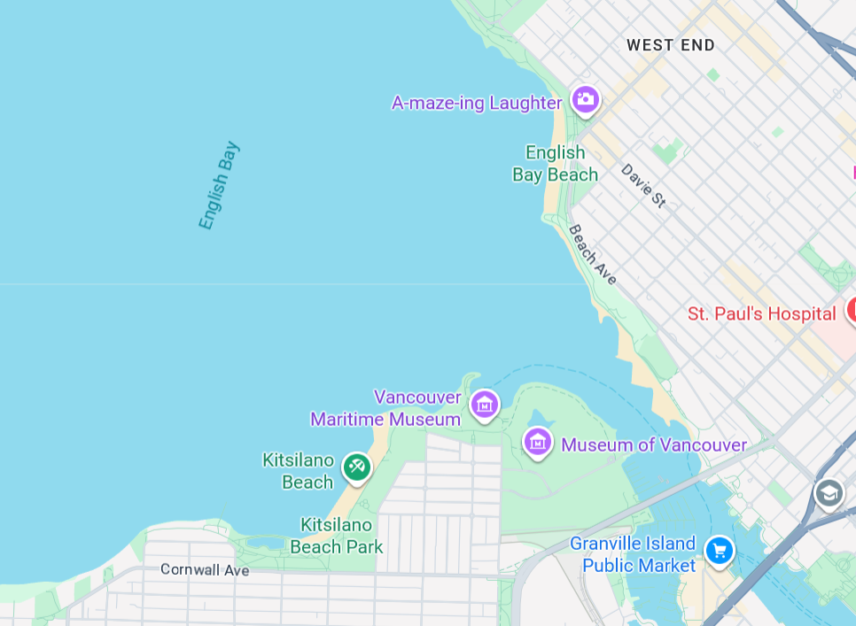
Where to watch?
Start 10:00 pm
Any beach around English Bay
Arrive early- at least 1-2h to get a good spot at the beach
Bridges: Arrive ~30min before for good viewing spots at center
From Burrard Bridge (crowded)
From Granville Bridge (less crowded)

