Slide 1
Particle Physics Faculty Meeting
Agenda
News/Update
ACOT preparations

Slide 2
TRIUMF is located on the traditional, ancestral, and unceded territory of thexʷməθkʷəy̓əm (Musqueam) people, who for millennia have passed on their culture, history, and traditions from one generation to the next on this site.
TRIUMF’s home has always been a seat of learning.

Slide 3
Physical Sciences – Particle Physics Updates

Slide 4
CERN - Canada
CERN has signed a joint Statement of Intent with Canada concerning future planning for large research infrastructure facilities, and novel and advanced techniques and tools.
It also establishes that, should the CERN Member States determine that the FCC is likely to be CERN’s next world-leading research facility following the HL-LHC, Canada intends to collaborate on its construction and physics exploitation, subject to appropriate domestic approvals.
The Statement builds on the decades-long participation of Canadian institutions and scientists in the scientific programme at the Large Hadron Collider (LHC) and at other CERN experiments and facilities, acknowledging the extensive collaboration of Canada and CERN in high-energy particle physics, technology development, innovation, training and education.

Slide 5
QRPP schedule
Mar 28 – projects ranked by LT for April-June 2025
Apr 4 – info session for project leaders
Apr 10 – 930-noon – QRPP presentations by “yellow projects”
Status report
Resource requests
Next step – allocate resources to projects, where available after operations and green/core priority projects
Mid-June – next QRPP in mid-June for July-Sep 2025 period

Slide 6
QRPP
From PMOG meeting
Next QRPP early April
All projects that are orange (other QRPP project) or blue (non conflicting) will present
Project status (color) can change from one QRPP to the next
Projects that are non-conflicting would:
Require no resources from
P&I, incl all Engineering Services, Machine Shop, Design Office, etc
Accelerator Division
(very?) Limited resources
Core services, including, E&HS, RPG, Procurement, Research Security, Other??
For Yellow projects, these resources can be available, but lower priority than the Big 3

Slide 7
QRPP Process for LS26
NRC Contribution agreement priorities | Other approved QRPP projects | Non-conflicting projects
Core priorities take precedence for resources: IAMI ARIEL BL1A Due the nature of these projects, the conflicts between them will be limited and can managed and replanned at the project level. | Must Proceed - cannot be delayed (1) (E.g. due to funding, impact to external commitments etc?) Lower priority but remain active. Require agreement from LT and PMOG. Can request resources for work at QRPP, but this work will be planned around core priorities. (2) | Can Proceed with no conflict with critical TRIUMF resources. Still report on status at QRPP but operate (somewhat) independently with their own resources.
 | Hibernated Projects (On hold until 2027)
 | Hibernate without impact to the project objectives, or with impact that can be managed. The project leaders must be informed of this decision and supported in conversations with funding agencies and collaborators.
Notes.
Requires analysis of work remaining to complete the project. Consider if it is feasible to complete on the required timeline, with the resources available, or if new hirings would be needed, or with contract labour (if the contractors would not then impact TRIUMF service groups(s), Labour estimates need to be produced or validated by service providers
Responsibility will shift to the service groups to coordinate work and not for the projects to to the service group.
Empowers services groups to have control of executing the priorities AND Increases accountability on these service groups

Slide 8
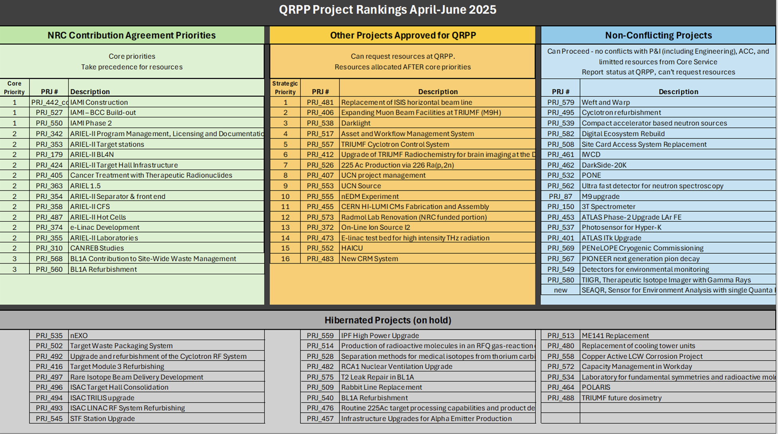
Notes.
Requires analysis of work remaining to complete the project. Consider if it is feasible to complete on the required timeline, with the resources available, or if new hirings would be needed, or with contract labour (if the contractors would not then impact TRIUMF service groups(s), Labour estimates need to be produced or validated by service providers
Responsibility will shift to the service groups to coordinate work and not for the projects to to the service group.
Empowers services groups to have control of executing the priorities AND Increases accountability on these service groups

Slide 9
ACOT
April 28-30
Agenda items I am aware of
9:00 - 10:15 Overviews PSD - Ritu (15 mins)
14:30 - 16:00 Parallel Sessions, joint with SciTech and SciComp
Slides are due April 24th
We got the Auditorium this time
Suggested to invite students and postdocs as well

Slide 10
ACOT
Sally Seidel will attend in person
she would like to get a survey of the full scope of activities that the particle physicists are involved in. So we suggest that we update and shorten the talks from last time.
Since we ran out of time, I suggest the following groupings. Let me know if that does not work.
· ATLAS (5’)
· T2K/Hyper-K (5’)
· ALPHA/ALPHA-G/HAICU (5’)
· TUCAN (3’)
· SuperCDMS/nEXO/DarkSide (3’)
· DarkLight (3’)
· PIONEER/PIENU/NA62 (3’)

Slide 11
ACOT
Specific questions to be addressed:
Generally it will not be necessary for the report to explain the scientific value or motivation for particular research activities as their contribution to the experiments, and the value of each experiment, are known to me.
1) I would appreciate to understand what TRIUMF facilities are being used for the current research, and any restrictions that the experimenters encounter due to limits on facilities. Please could you also mention links with other institutions in terms of personnel and facilities or equipment that are directly relevant to the TRIUMF program.
2) Please mention the size of the group including the number of people at each level of seniority. Please indicate the degree to which this may have varied over the past, say, 5 years, and what are the expectations on the number of persons at each level during the coming, say, 10 years.
Please give preference to give a high-level overview of the full scope of activities keeping 1) in mind and answering her specific questions 2) and 3)

Slide 12
ACOT
A few more questions that we can answer as a group.
Please could you discuss what research activities the group foresees during the coming decade, especially where this might involve any new undertakings. If TRIUMF personnel are now involved, or plan to become involved, in any of the proposed worldwide future facilities or colliders, please could you mention that - and also indicate if new resources would be needed.
The session in which we will be involved covers particle physics, technology, and scientific computing. Please could you indicate how these topics mesh at TRIUMF. For example, do particular researchers typically contribute to more than one of those areas (simultaneously or sequentially) or do they specialize; do junior scientists rotate among them; does the research enterprise connect all three of them or are there some activities that would be classified as some but not all of these areas?
If the overall schedule of the ACOT meeting will allow me to visit the laboratory space dedicated to particle physics/technology/scientific computing, I will welcome that opportunity
Discussing with Sean – there is an ISAC tour planned for Monday morning

Slide 13
Various
IPP had first townhall meeting to collect input for European Strategy Update
Submission to survey due April 16
IPP website for ESU
Canadian LRP
Paul Garrett (University of Guelph) and Alison Lister (University of British Columbia) have agreed to serve as the LRPC Co-Chairs
NSERC project grants?
Questions by Ritu
TRIUMF is having to prepare a risk tracker for projects with US contributions or impact. WIll you please let me know the following :
1. Which projects have significant funding contribution from the US? (such as CFI match or major equipment). What is the status - secured, received at TRIUMF ?
2. Are there major procurements from the US for projects (if so which ones)?
3. Any major personnel mobility concerns?

Slide 14
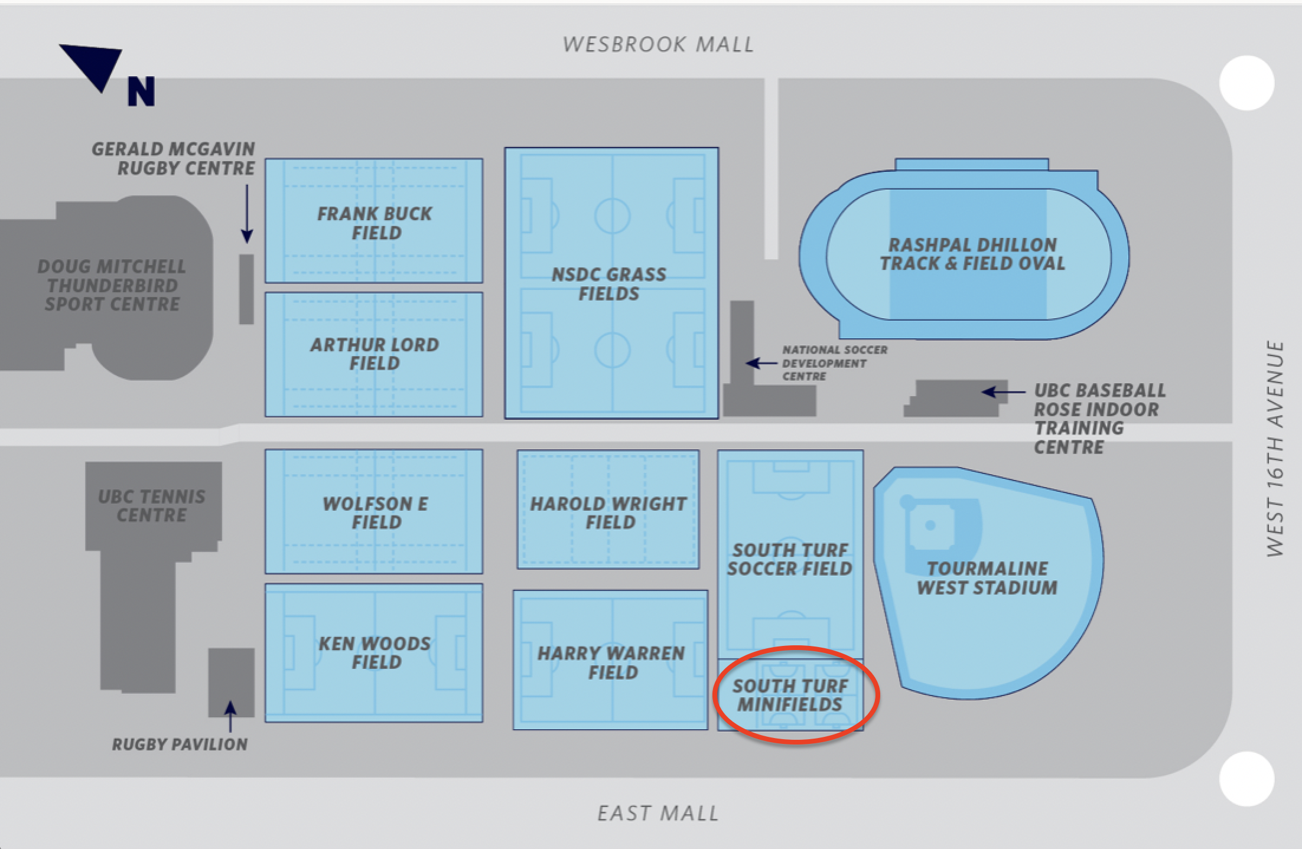
PP + Friends Soccer
biweekly trainings / games starting April 10th - UBC south turf mini-fields Let Chloe know if you are interested

Slide 15
AOB

Slide 16
Next Meeting
May 8th

