Slide 1
Twenty+ years of ab initio nuclear theory
ISAC20 Symposium
TRIUMF, Canada
21 August, 2019
Petr Navratil
TRIUMF

Slide 2
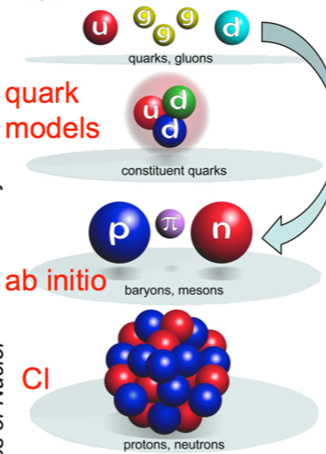
First principles or ab initio nuclear theory
Quantum Chromodynamics
(QCD)
Genuine Ab Initio

Slide 3

First principles or ab initio nuclear theory – what we do at present
Quantum Chromodynamics
(QCD)
Chiral Effective
Field Theory
(parameters fitted
to NN data)
Ab initio
Degrees of freedom: Nucleons
All nucleons are active
Exact Pauli principle
Realistic inter-nucleon interactions
  Accurate description of NN (and 3N) data
Controllable approximations
Current ab anitio
nuclear theory

Slide 4
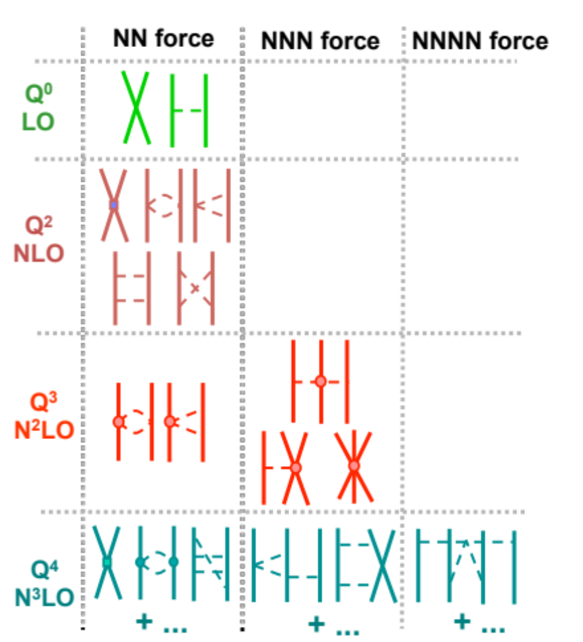
Chiral Effective Field Theory
Inter-nucleon forces from chiral effective field theory
  Based on the symmetries of QCD
    Chiral symmetry of QCD (m_{u}≈m_{d}≈0), spontaneously broken with pion as the Goldstone boson
    Degrees of freedom: nucleons + pions
  Systematic low-momentum expansion to a given order (Q/Λ_{χ})
  Hierarchy
  Consistency
  Low energy constants (LEC)
    Fitted to data
    Can be calculated by lattice QCD
Λ_{χ}~1 GeV :
Chiral symmetry breaking scale

Slide 5
Why three-nucleon forces?
Two-pion exchange with virtual Δ excitation
  Fujita & Miyazawa (1957)
Leading three-nucleon force terms
  Long-range two-pion exchange
  Medium-range one-pion exchange + two-nucleon contact
  Short range three-nucleon contact
The question is not: Do three-body forces enter the description?
The only question is: How large are three-body forces?
Better understanding
of the three-nucleon force
is a major challenge
of ab initio nuclear theory

Slide 6
Rapid developments in nuclear ab initio calculations

Slide 7
Oxygen chain with interactions from chiral EFT

Slide 8
TRIUMF Nuclear Theory
Unique to TRIUMF nuclear theory:
  Unified approach to nuclear structure and reactions for light nuclei: No-Core Shell Model with Continuum (NCSMC)
  Powerful valence-space method for medium mass nuclei: Valence-Space In-Medium Similarity Renormalization Group (VS-IMSRG)
Large-scale high-performance computation
  Massively parallel codes
  Summit@ORNL, Cedar@Compute Canada, Quartz@Livermore Computing

Slide 9





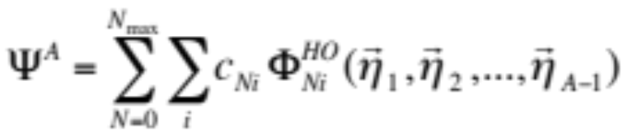

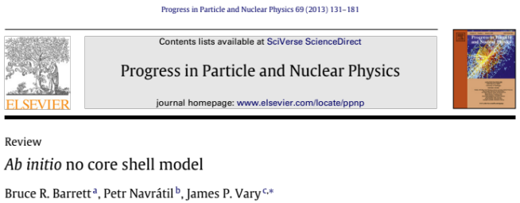
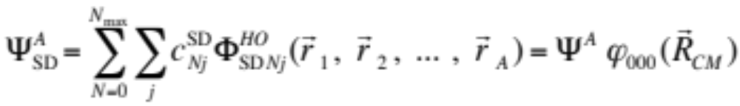
Conceptually simplest ab initio method: No-Core Shell Model (NCSM)
NCSM
Basis expansion method
  Harmonic oscillator (HO) basis truncated in a particular way (N_{max})
  Why HO basis?
    Lowest filled HO shells match magic numbers of light nuclei (2, 8, 20 – ⁴He, ¹⁶O, ⁴⁰Ca)
    Equivalent description in relative-coordinate and Slater determinant basis
Short- and medium range correlations
Bound-states, narrow resonances

Slide 10
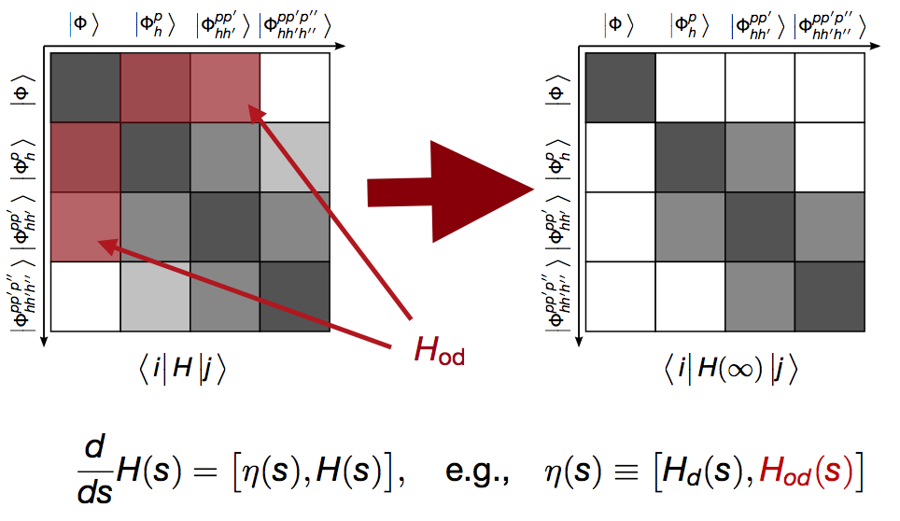
In-Medium Similarity Renormalization Group – Flow equation
The Hamiltonian matrix is never constructed explicitly!

Slide 11
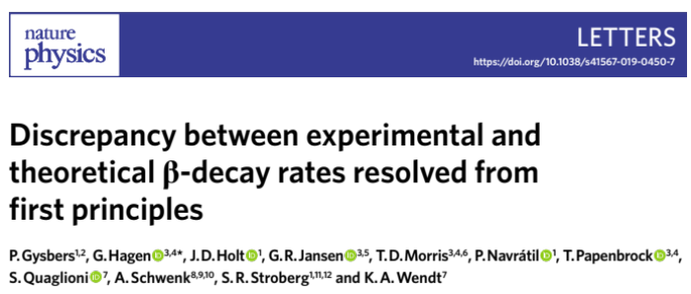
50 year old puzzle of quenched beta decays solved from first principles

Slide 12
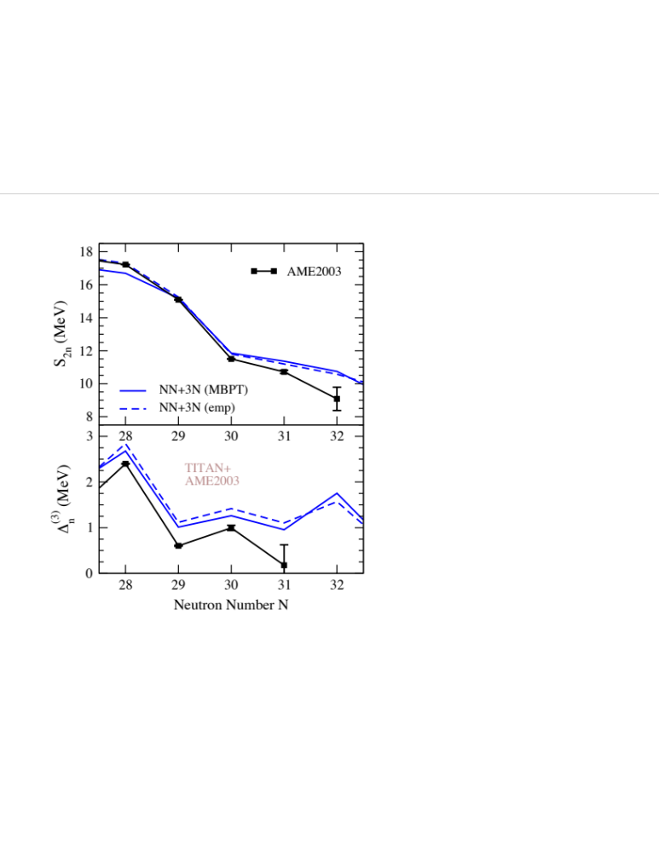
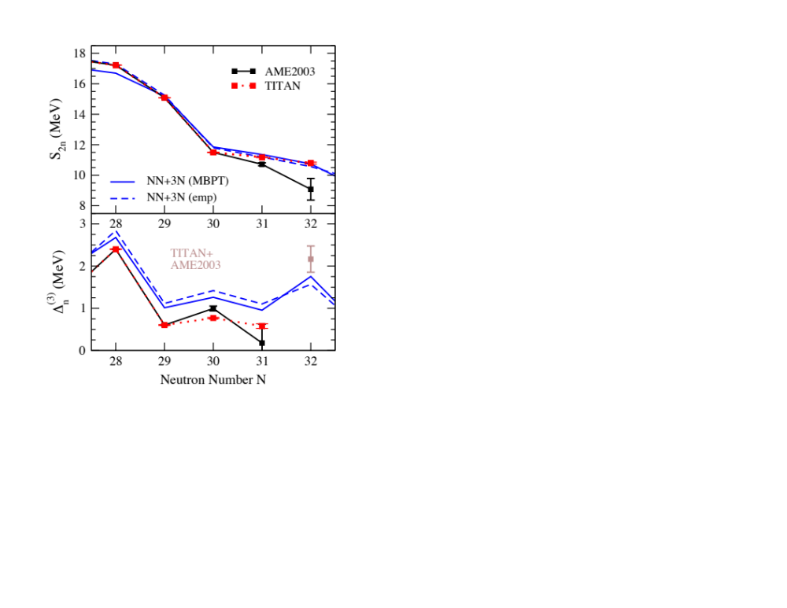

N=32,34 Magic Numbers from Masses
2013-2018 impressive series of experiments; ideal example of theory/exp overlap
Story starts at TRIUMF!
Ab Initio
With 3N forces, predicts doubly magic ⁴⁸Ca
Large discrepancy with AME trends

Slide 13
N=32,34 Magic Numbers from Masses
2013-2018 impressive series of experiments; ideal example of theory/exp overlap
Story starts at TRIUMF!
TITAN @ TRIUMF Measurement
Flat trend from ⁵⁰⁻⁵²Ca
⁵²Ca 1.74 MeV deviation from AME!
Ab Initio
Excellent agreement with TITAN data
Gallant et al., PRL 2012

Slide 14
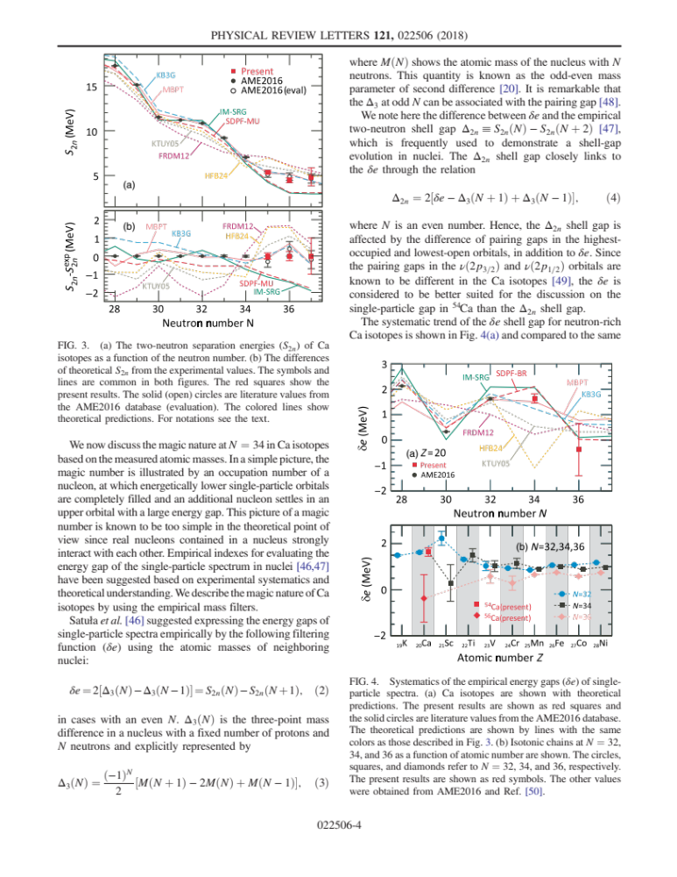
N=32,34 Magic Numbers from Masses
2013-2018 impressive series of experiments; ideal example of theory/exp overlap
Story continues at ISOLDE, RIKEN…
TITAN @ TRIUMF Measurement
Flat trend from ⁵⁰⁻⁵²Ca
⁵²Ca 1.74 MeV deviation from AME!
ISOLTRAP @ CERN Measurement
Sharp decrease from ⁵²⁻⁵⁴Ca
Confirms N=32 magic number
RIBF @ RIKEN Measurement
Modest decrease past ⁵⁴Ca
Confirms N=34 magic number
Ab Initio
Excellent agreement with RIBF data
Predicts doubly magic ^{48,52,54}Ca
Micnimasa et al, PRL 2018

Slide 15
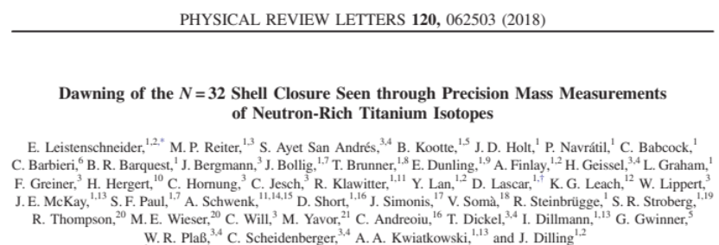
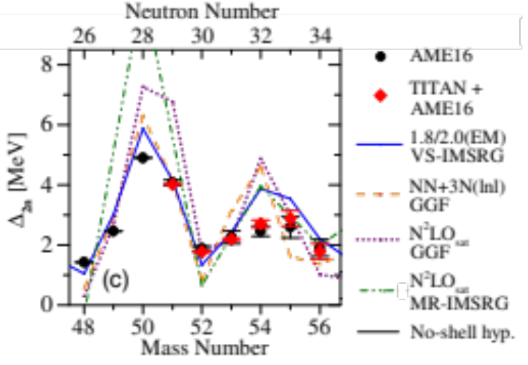
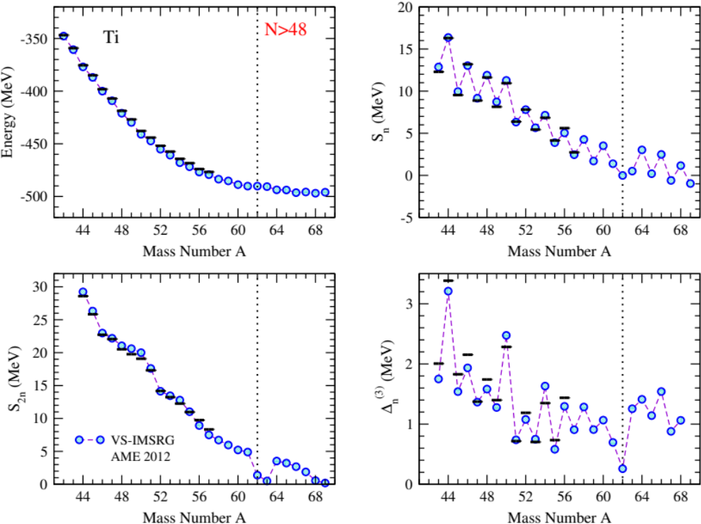
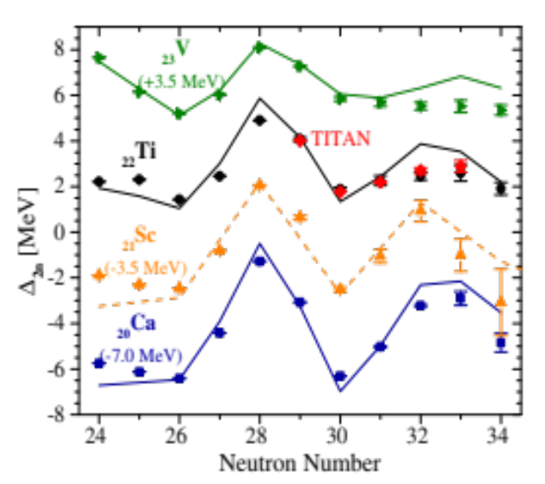
Evolution of N=32 Magic Number: Masses
New TITAN measurements ideal theory/experiment overlap: Ab initio in medium-mass region
New TITAN Measurements of Ti: Probe “dawning” of N=32 magic number
Ab initio VS-IMSRG: Generally good agreement, but predicts onset of N=32 too early

Slide 16
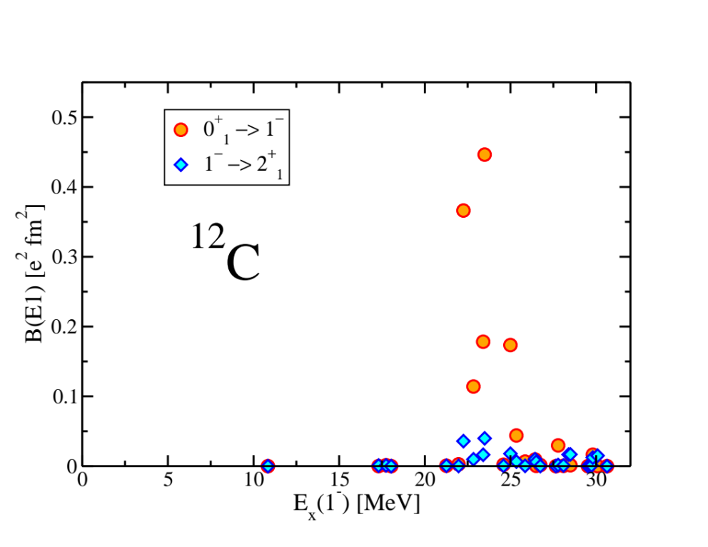
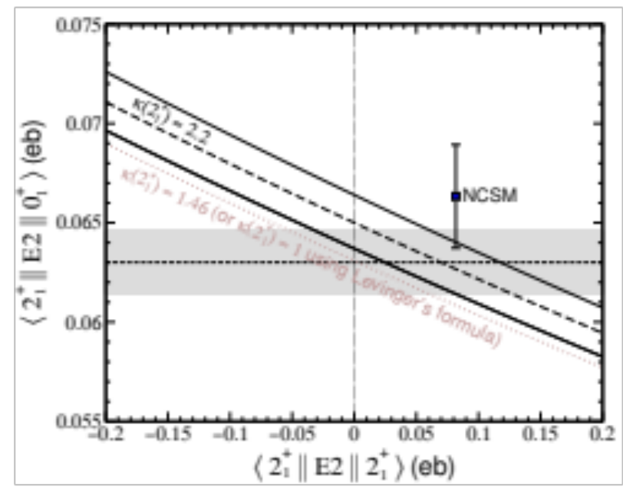
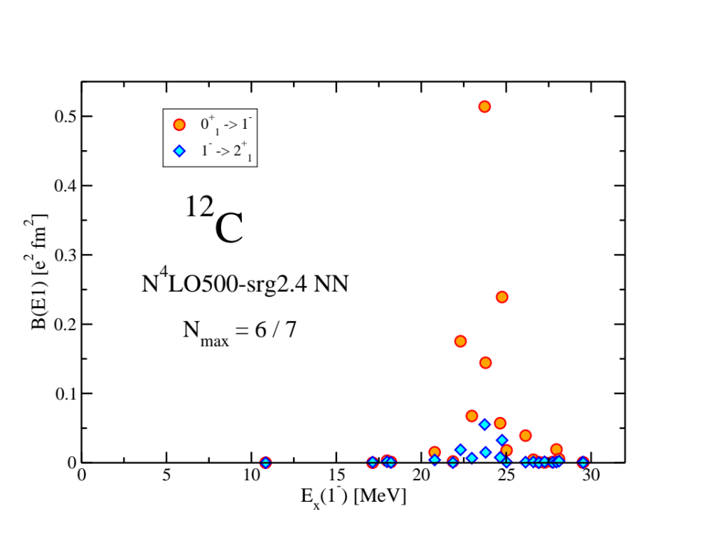
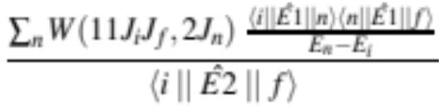
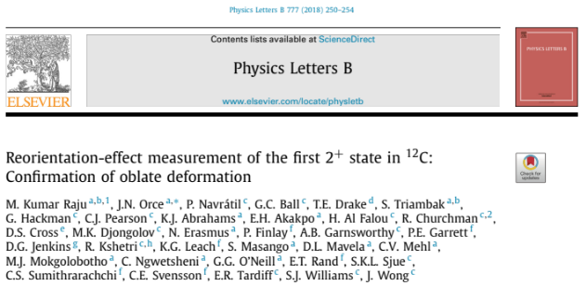

Quadrupole moment of ¹²C 2⁺ state
Coulomb excitation reorientation-effect measurement at TIGRESS
  Analysis by the semi-classical coupled-channel Coulomb-excitation least-squares code GOSIA
  Extraction of ⟨2⁺₁ || E2 || 2⁺₁ ⟩ matrix element
Nuclear polarizability for the ground and the 2⁺₁ states needed
  Calculated by the NCSM using chiral NN and NN+3N interaction
NN + 3N(350)
N_{max} = 4/5
New determination:
Oblate shape

Slide 17
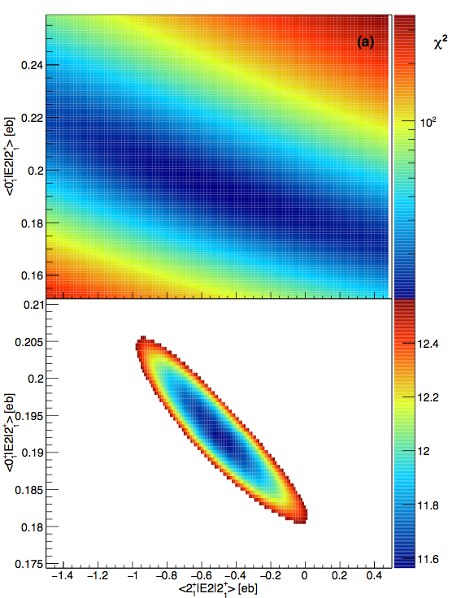
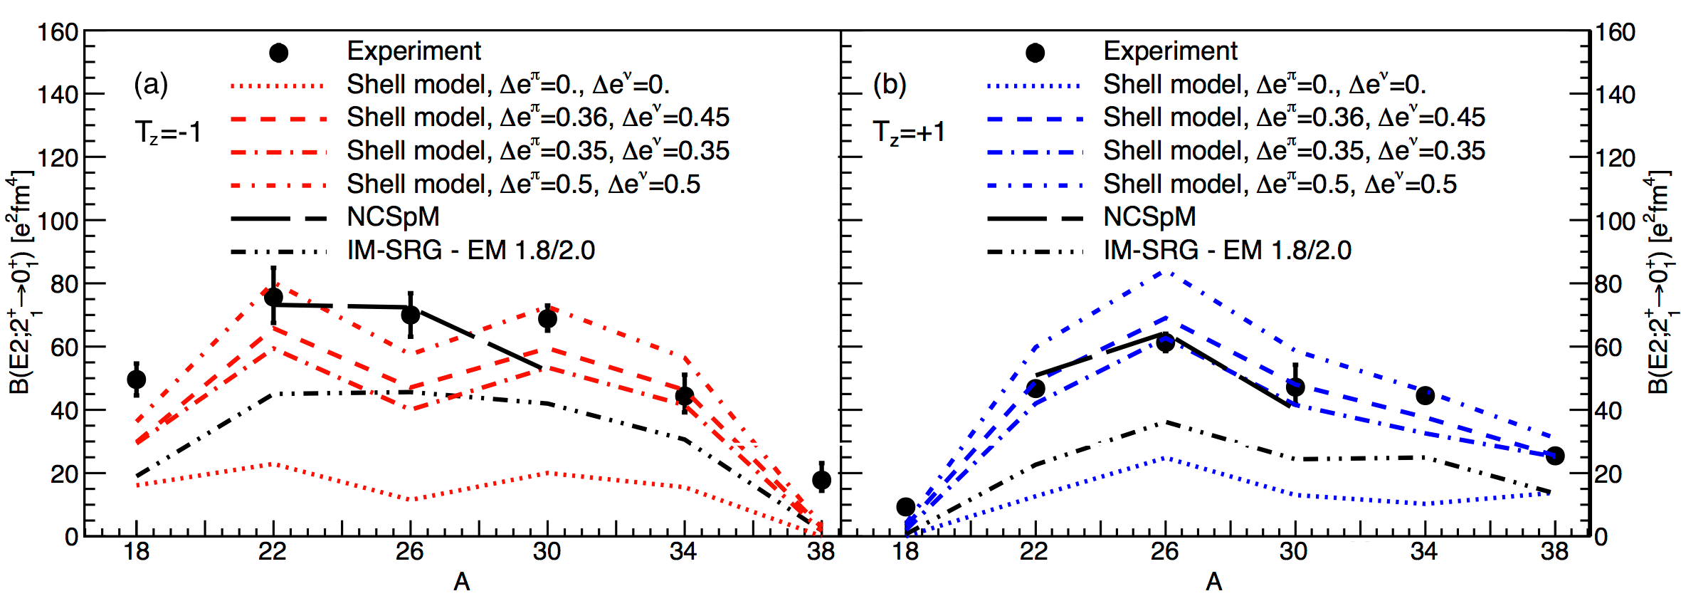
Testing Collectivity Microscopically: E2 Transitions
Recent measurements at TIGRESS
Compare with NCSpM (LSU) and VS-IMSRG (TRIUMF)
  NCSpM - does excellent job - expensive calculations
  VS-IMSRG underpredicts strength - relatively inexpensive - qualitative description excellent
Henderson et al., PLB (2018)

Slide 18
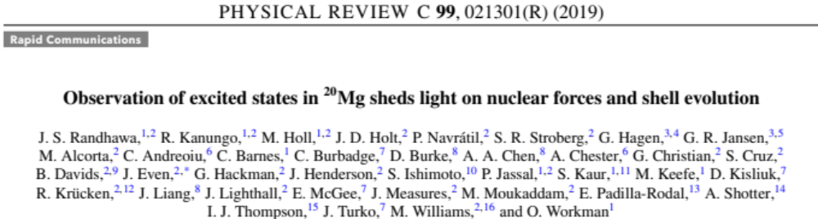
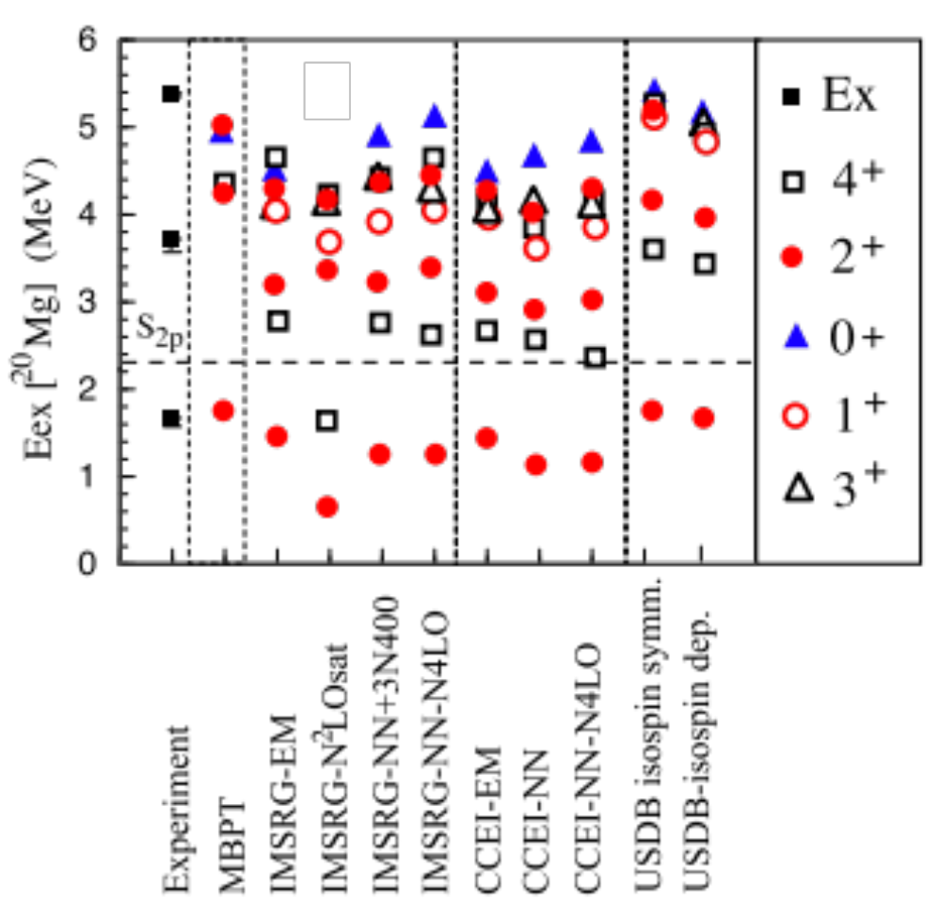
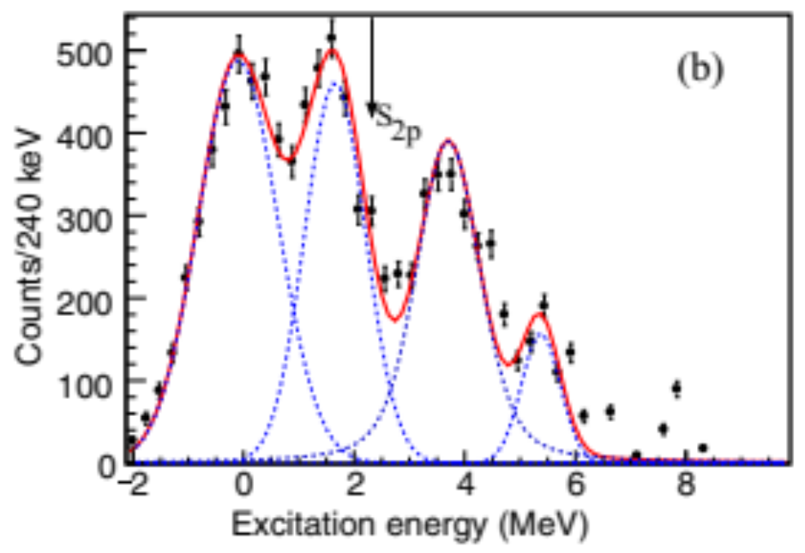
Observation of excited states in ²⁰Mg
IRIS experiment
Difficulties to describe the excited sates above the threshold
Missing continuum? Clustering? Deficient Forces?

Slide 19
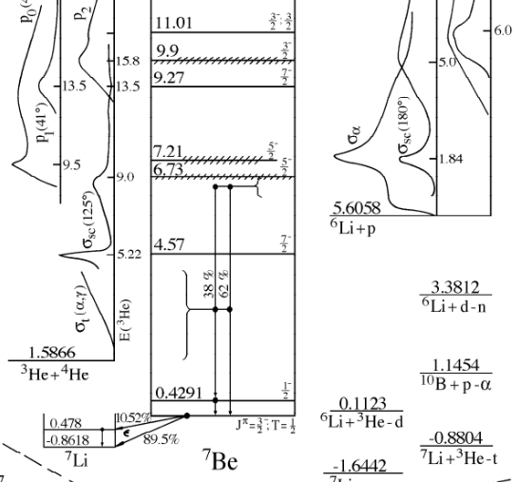
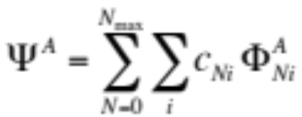










Extending no-core shell model beyond bound states
Include more many nucleon correlations…
A
+
…using the Resonating Group Method (RGM)
ideas
+
+
…

Slide 20
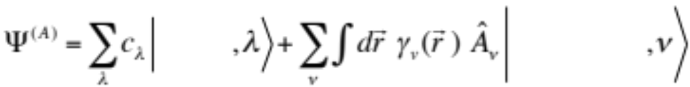



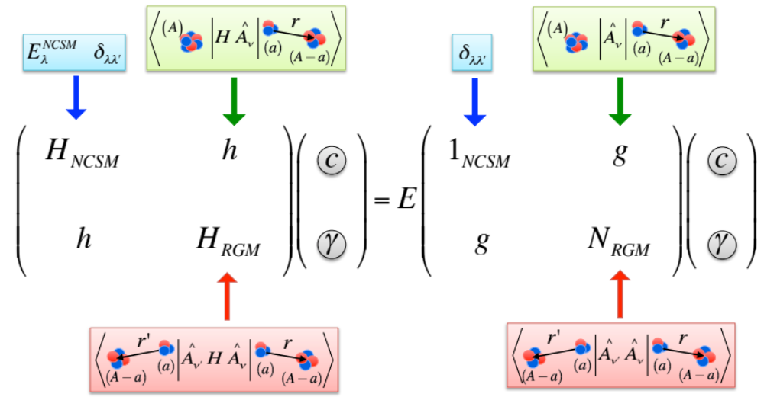
Coupled NCSMC equations
S. Baroni, P. Navratil, and S. Quaglioni,
PRL 110, 022505 (2013); PRC 87, 034326 (2013).
Solved by Microscopic R-matrix theory on a Lagrange mesh – efficient for coupled channels
Notes:
bb

Slide 21
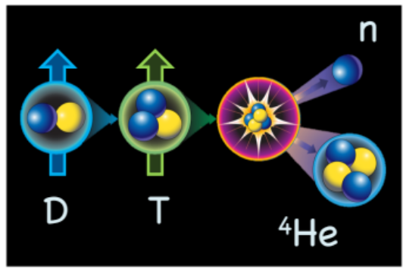
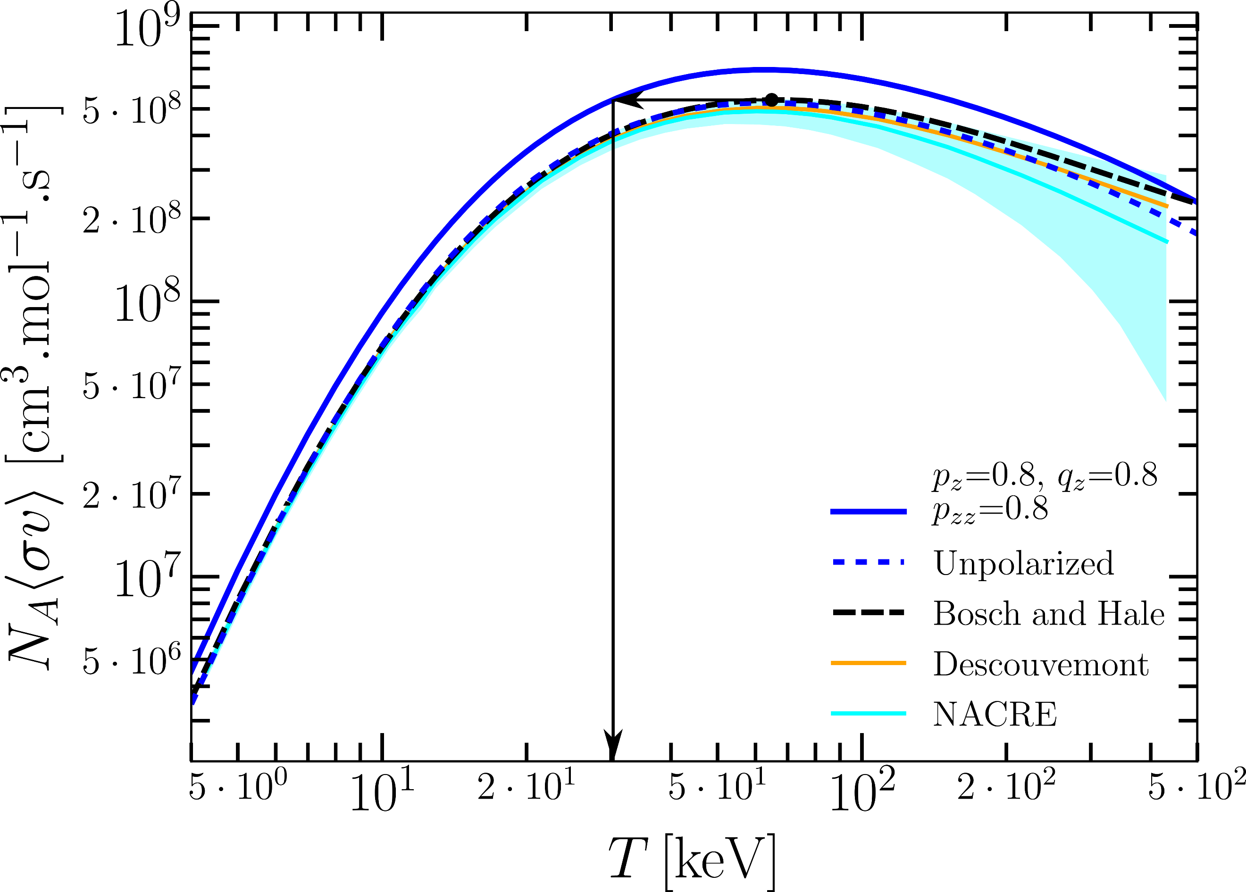
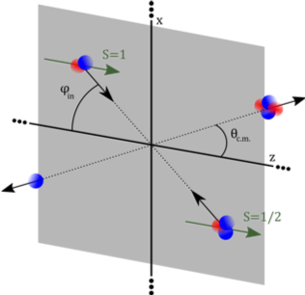
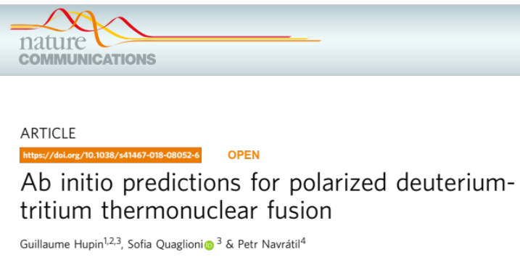
Ab initio predictions for polarized ³H(d,n)⁴He fusion
Important reaction for future energy generation
  high-profile experiments - NIF, ITER
Parallel polarization of the reactants expected to enhance the reaction rate
  Very difficult to measure
  Ab initio nuclear theory complements experimental efforts
    Confirms the rate enhancement
For a realistic 80% polarization,
reaction rate increases by ~32%
or the same rate at
~45% lower temperature
Notes:
bb < sigma v>

Slide 22
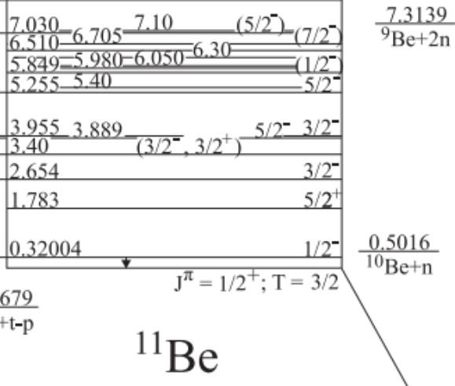
Neutron-rich halo nucleus ¹¹Be
Z=4, N=7
  In the shell model picture g.s. expected to be J^{π}=1/2⁻
    Z=6, N=7 ¹³C and Z=8, N=7 ¹⁵O have J^{π}=1/2⁻ g.s.
  In reality, ¹¹Be g.s. is J^{π}=1/2⁺ - parity inversion
  Very weakly bound: E_{th}=-0.5 MeV
    Halo state – dominated by ¹⁰Be-n in the S-wave
  The 1/2⁻ state also bound – only by 180 keV
Can we describe ¹¹Be in ab initio calculations?
  Continuum must be included
  Does the 3N interaction play a role in the parity inversion?
1s_{1/2}
0p_{1/2}
0p_{3/2}
0s_{1/2}

Slide 23
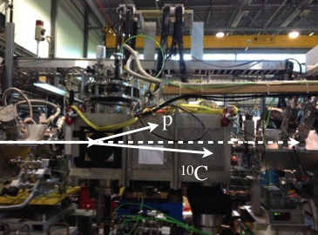
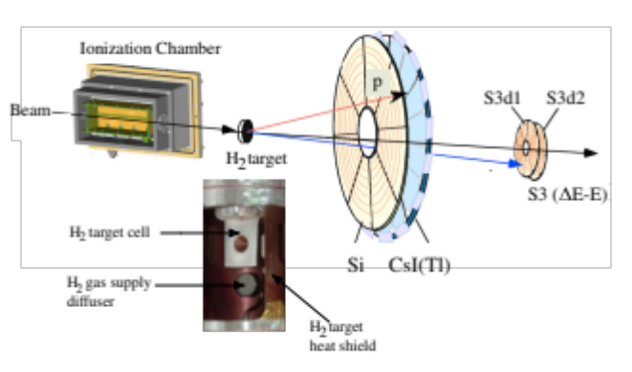
¹⁰C(p,p) @ IRIS with solid H₂ target
Experiment at TRIUMF with the novel IRIS solid H₂ target
  First re-accelerated ¹⁰C beam at TRIUMF
  ¹⁰C(p,p) angular distributions measured at E_{CM} ~ 4.15 MeV and 4.4 MeV
¹¹N ~ ¹⁰C+p
unbound
mirror system of
¹¹Be ~ ¹⁰Be+n
IRIS collaboration: A. Kumar, R. Kanungo, A. Sanetullaev et al.

Slide 24
Structure of ¹¹Be & ¹¹N from chiral NN+3N forces
NCSMC calculations including chiral 3N (N³LO NN+N²LO 3NF400, NNLOsat)
  n-¹⁰Be + ¹¹Be (p-¹⁰C + ¹¹N)
    ¹⁰Be (¹⁰C): 0⁺, 2⁺, 2⁺ NCSM eigenstates
    ¹¹Be (¹¹N): ≥6 π = -1 and ≥3 π = +1 NCSM eigenstates
+
A. Calci, P. Navratil, R. Roth, J. Dohet-Eraly, S. Quaglioni, G. Hupin, PRL 117, 242501 (2016)

Slide 25
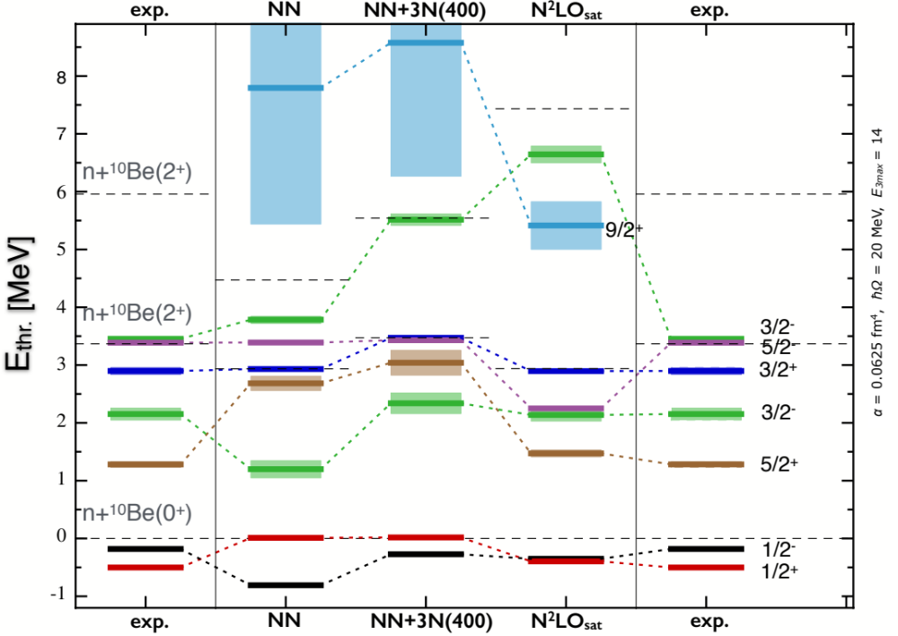
¹¹Be within NCSMC: Discrimination among chiral nuclear forces
A. Calci, P. Navratil, R. Roth, J. Dohet-Eraly, S. Quaglioni, G. Hupin, PRL 117, 242501 (2016)

Slide 26
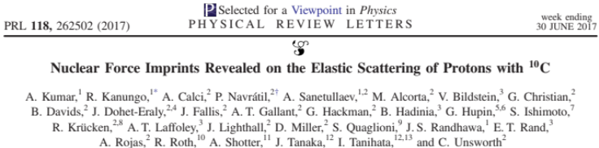
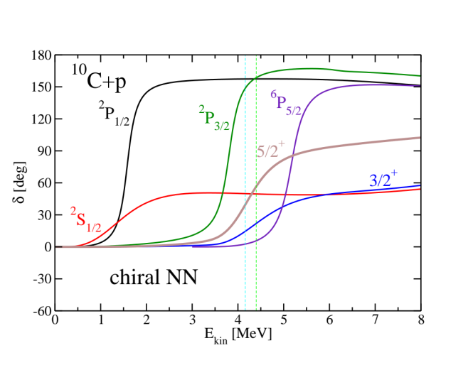
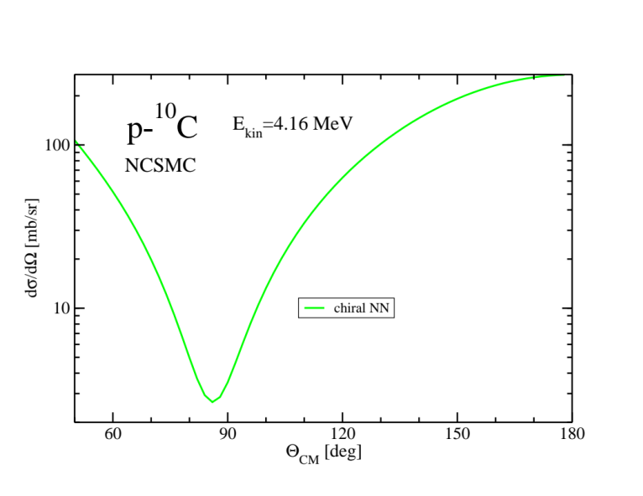
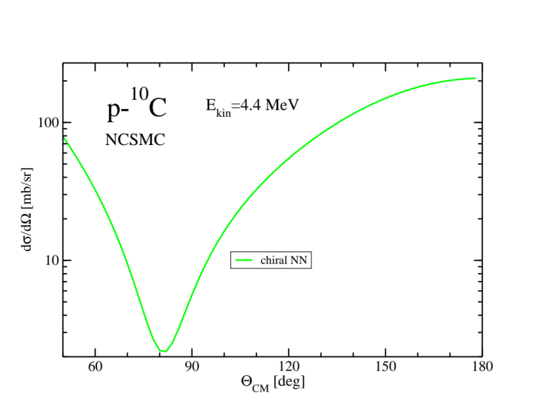
p+¹⁰C scattering: structure of ¹¹N resonances

Slide 27
¹¹Be within NCSMC: Discrimination among chiral nuclear forces
A. Calci, P. Navratil, R. Roth, J. Dohet-Eraly, S. Quaglioni, G. Hupin, PRL 117, 242501 (2016)

Slide 28
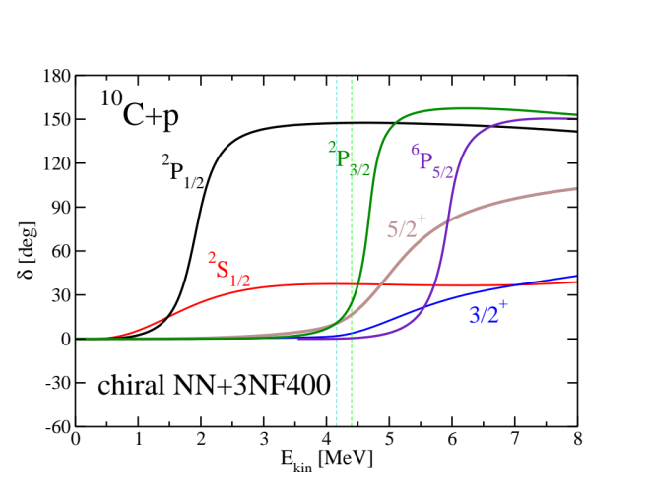
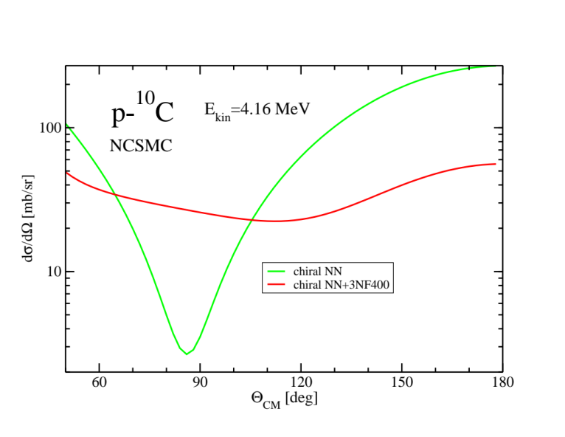
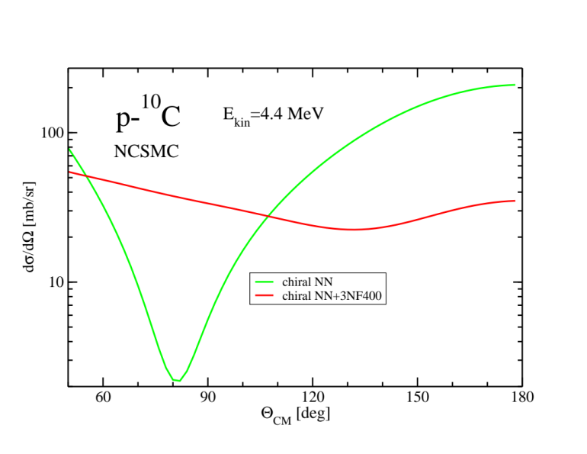
p+¹⁰C scattering: structure of ¹¹N resonances

Slide 29
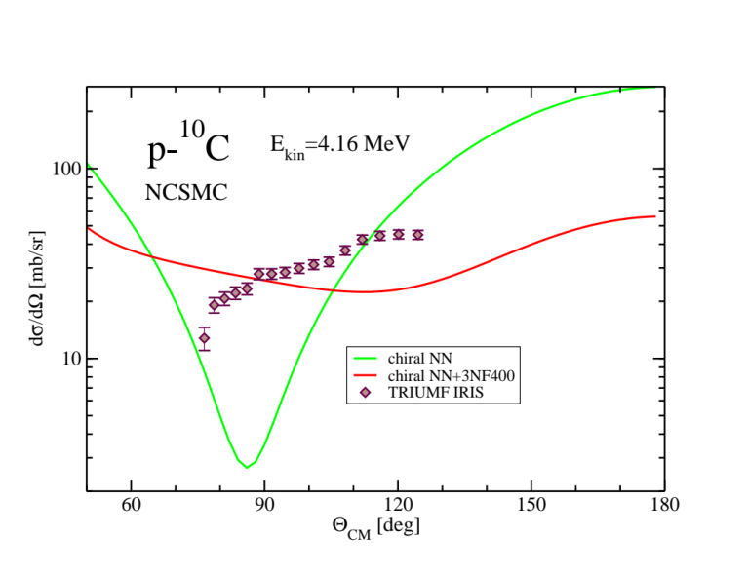
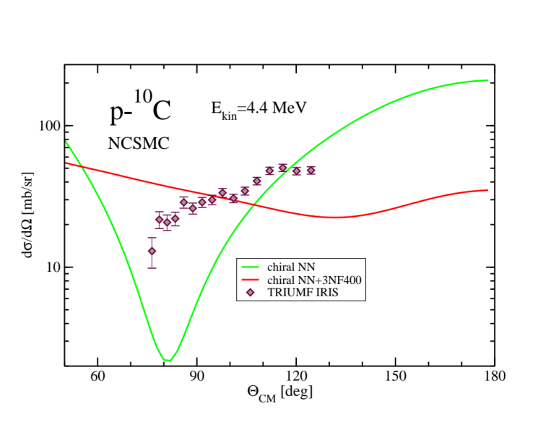
p+¹⁰C scattering: structure of ¹¹N resonances

Slide 30
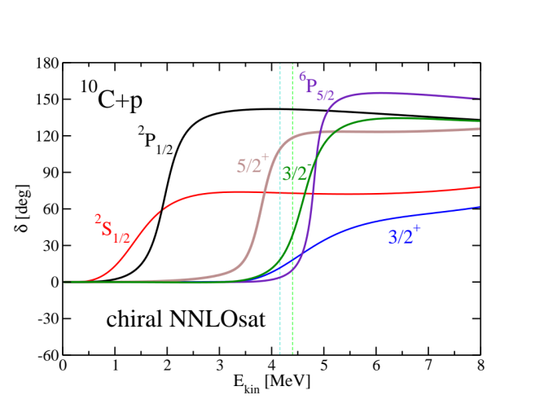
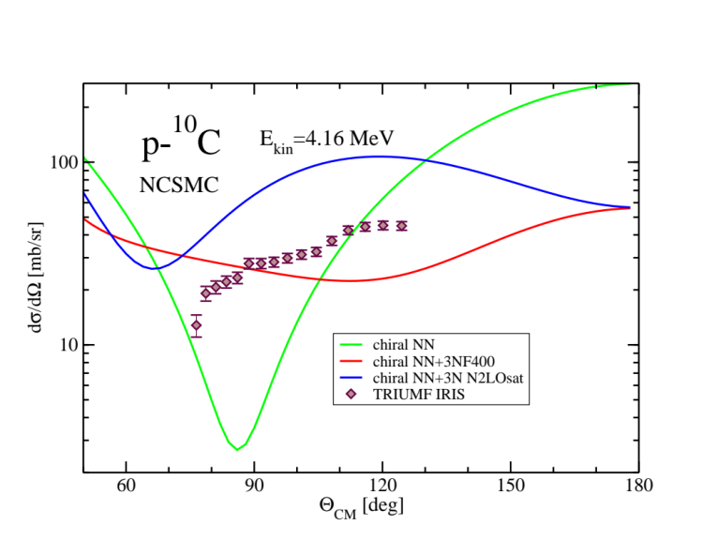
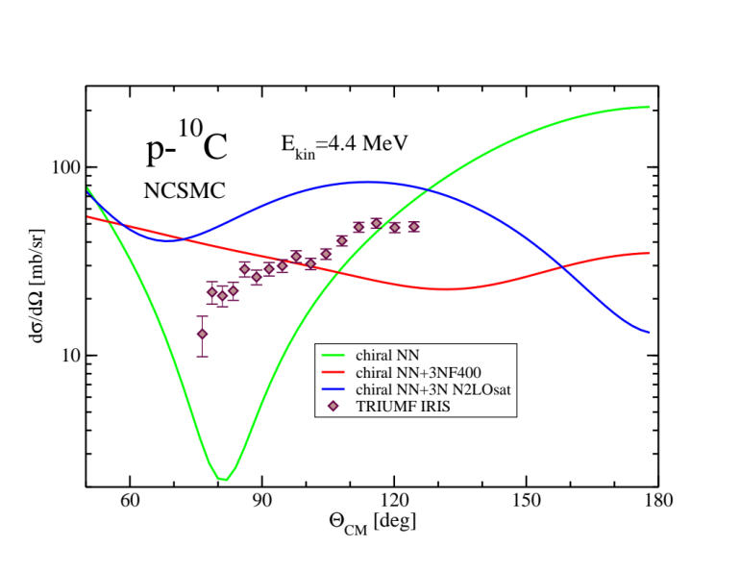
p+¹⁰C scattering: structure of ¹¹N resonances

Slide 31
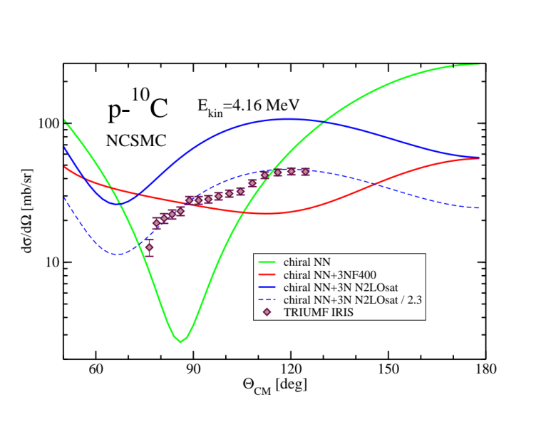
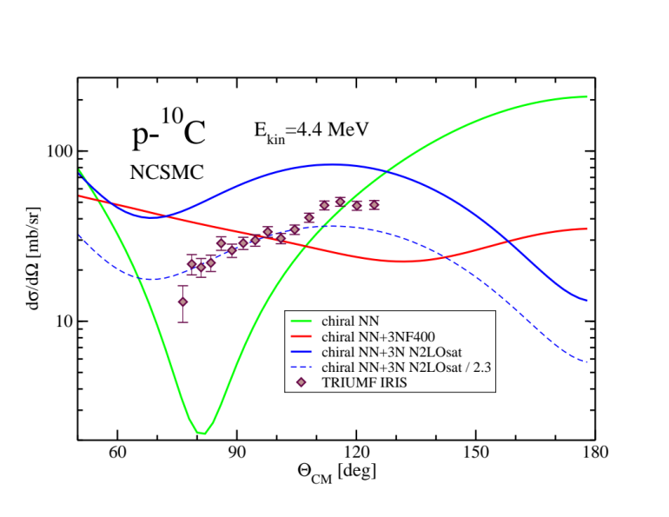

p+¹⁰C scattering: structure of ¹¹N resonances
Discrimination among chiral nuclear forces

Slide 32
¹¹Be within NCSMC: Discrimination among chiral nuclear forces
9/2⁺
Parity inversion
A. Calci, P. Navratil, R. Roth, J. Dohet-Eraly, S. Quaglioni, G. Hupin, PRL 117, 242501 (2016)

Slide 33




Photo-disassociation of ¹¹Be
Measured at ISAC
Bound to bound | NCSM | NCSMC-phenom | Expt.
B(E1; 1/2⁺➔1/2⁻) [e² fm²] | 0.0005 | 0.117 | 0.102(2)
Halo structure
Bound to continuum
cluster form factor
Notes:
bb cluster form factor

Slide 34


Solar p-p chain
p-p chain
7
Solar neutrinos
E_{ν} < 15 MeV

Slide 35



³He-⁴He and ³H-⁴He radiative capture
Measured at ISAC
E1 radiative capture with small E2 contribution at 7/2⁻ resonance
7/2⁻
E2
Theoretical calculations suggest
that the most recent and precise
⁷Be and ⁷Li data are inconsistent
NCSMC calculations with chiral SRG-N³LO NN potential (λ=2.15 fm⁻¹)
³He, ³H, ⁴He ground state, 8(π-) + 6(π+) eigenstates of ⁷Be and ⁷Li
Preliminary: N_{max}=12, hΩ=20 MeV

Slide 36

³He-⁴He S-wave phase shifts
NCSMC calculations with chiral NN+3N forces in preparation
Data analysis
of DRAGON measurement
of ⁴He+³He scattering
under way
NCSMC calculations with chiral SRG-N³LO NN potential (λ=2.15 fm⁻¹)
³He, ³H, ⁴He ground state, 8(π-) + 6(π+) eigenstates of ⁷Be and ⁷Li
Preliminary: N_{max}=12, hΩ=20 MeV

Slide 37


p+¹¹C scattering and ¹¹C(p,γ)¹²N capture
¹¹C(p,γ)¹²N capture relevant in hot p-p chain: Link between pp chain and the CNO cycle - bypass of slow triple alpha capture ⁴He(αα,γ)¹²C
p-p chain

Slide 38


p+¹¹C scattering and ¹¹C(p,γ)¹²N capture
Measurement of ¹¹C(p,p) resonance scattering planned at TRIUMF TUDA facility
NCSMC calculations of ¹¹C(p,p) with chiral NN+3N under way
    ¹¹C: 3/2⁻, 1/2⁻, 5/2⁻, 3/2⁻ NCSM eigenstates
    ¹²N: ≥6 π = +1 and ≥4 π = -1 NCSM eigenstates
NCSMC calculations to be validated by measured cross sections and applied to calculate the ¹¹C(p,γ)¹²N capture

Slide 39

p+¹¹C scattering and ¹¹C(p,γ)¹²N capture
Measurement of ¹¹C(p,p) resonance scattering planned at TRIUMF TUDA facility
NCSMC calculations of ¹¹C(p,p) with chiral NN+3N under way
    ¹¹C: 3/2⁻, 1/2⁻, 5/2⁻, 3/2⁻ NCSM eigenstates
    ¹²N: ≥6 π = +1 and ≥4 π = -1 NCSM eigenstates
NCSMC calculations to be validated by measured cross sections and applied to calculate the ¹¹C(p,γ)¹²N capture

Slide 40



S-wave resonance just above the threshold of ⁶He+p?
NCSMC study of ⁷Li and ⁷Be nuclei using all binary mass partitions
  Known resonances reproduced
  Prediction of several new resonances of both parities
S-wave resonance predicted
at low energy in ⁶He+p scattering
with possible astrophysics
implications.
Can this be investigated at ISAC?

Slide 41

Conclusions
Ab initio calculations of nuclear structure and reactions becoming feasible beyond the lightest nuclei
  Make connections between the low-energy QCD, many-body systems, and nuclear astrophysics
Ab initio nuclear theory essential for precision applications such as tests of fundamental symmetries
  Double beta decay matrix elements
Numerous applications with direct connections to ISAC/ARIEL experiments
  Good synergy between TRIUMF ISAC experimentalists and TRIUMF
  nuclear theory
Currently the most pressing issue is a deeper understanding
of the three-nucleon interaction
RIKEN
Odd-K isotopes
In synergy with experiments, ab initio nuclear theory is the right approach to understand low-energy properties of atomic nuclei

Slide 42
Thank you!
Merci!

