Slide 1
Data Science and Quantum Computing projects @TRIUMF
Wojtek Fedorko, Olivia di Matteo

Slide 2
Data Science and Quantum Computing initiative @TRIUMF
Data intensive sciences @ TRIUMF for 50 years
New (~1yr) concentrated effort:
  Enhance science output
  Provide educational opportunities
  Establish industry cooperation
Pilot projects ranging from particle and nuclear physics to material science: (details here)
  Two projects shown here
  Will do more rounds of consultations – get in touch!

Slide 3
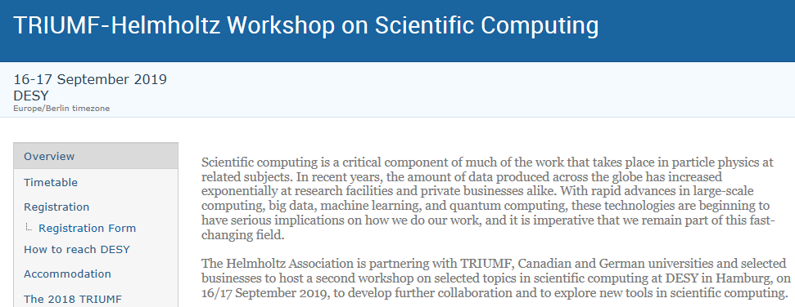
Helmholtz Association TRIUMF workshop on Scientific Computing September 16-17 DESY Hamburg
Helmholtz-TRIUMF MOU for collaboration
Three working groups:
  Large Scale Computing
  Quantum Computing
  Big Data
Sign up at:
https://indico.desy.de/indico/event/22522/

