Slide 1
Welcome to the ML hands-on session!
Wojtek Fedorko

Slide 2
About this Tutorial
Focus on technical aspects
Convince you that deep learning is not that hard and can be useful
Show you some common obstacles
Absolute minimum ‘theory’ background
  But that will only get you so far…
Now go to: https://github.com/wfedorko/Science_Week_ML_tutorial

Slide 3
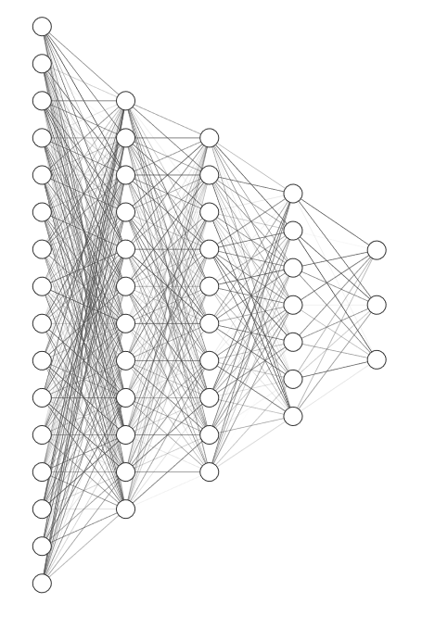
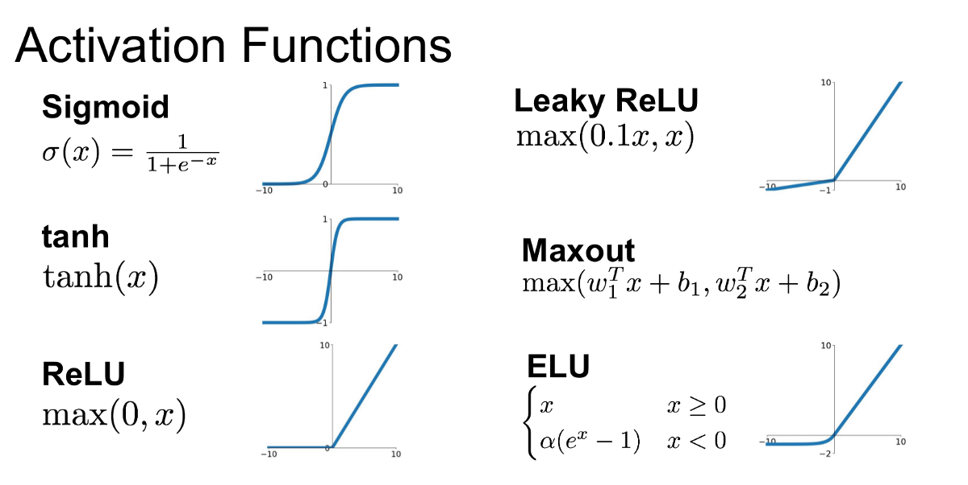
Multi-layer perceptron (MLP) at a glance
Composition of linear transformations and activation functions: h_{i}=f(W h_{i-1}+b)
Activation functions in the hidden layers:
Activation function on the output layer depends on the task
output layer o
hidden layers h_{i}
input layer x

Slide 4
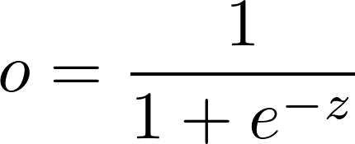
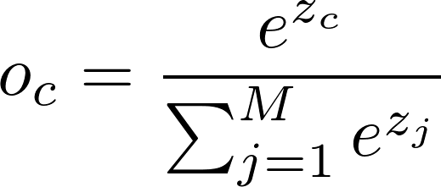

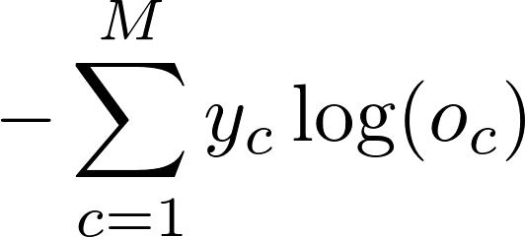

Tasks, output layer activations and appropriate loss functions: rules of thumb for supervised learning
o - output node value, z - output node before activation function, y - target value, c - class index, M – number of categories
Formulas for a single example (usually we need to calculate an average over batch)
Motivation from Maximum Likelihood Principle : Ian Goodfellow https://www.deeplearningbook.org ch. 5
Task: | Binary classification | Multi-class classification | Regression
Output layer activation: | sigmoid | softmax | linear
Loss function: | “Binary Cross Entropy” | “Cross-Entropy” | “Mean Squared Error”

Slide 5


Backpropagation and Stochastic Gradient Descent
Learning is an optimization problem: we want to find values of network parameters W that minimize loss L
SGD:
  Initialize W
  Iterate until convergence:
    At iteration i take a batch of examples and calculate the (average) loss L_{i} (forward pass)
    Compute the gradient wrt W_{i}
    Update the weights W_{i+1} ← W_{i}
Backpropagation! – recursively applying chain rule compute derivatives starting from the loss

Slide 6
Convolutional Neural Networks in a nutshell
Convolutional layers: slide learnable ‘filters’ across the image
Pooling layers: take max or average of a window, reduce ‘size’ due to stride>1

Slide 7
Suggested Exercises
Optimize simple CNN (hyperparameters)
  Network architecture + learning parameters tuning
  Kernel sizes
  Batchnorm
  Dropout
  Learning rate/optimizer
  Datanormalization
‘Advanced’ architectures
  ResNet
  Densenet
Regression problem
  ‘fit’ particle energy

