Slide 1
Accelerator Division Report
Oliver Kester
Associate Laboratory Director - Accelerator Division
Adjunct Professor - Dept. of Physics and Astronomy - University of Victoria
TUG-AGM, August 22, 2019

Slide 2
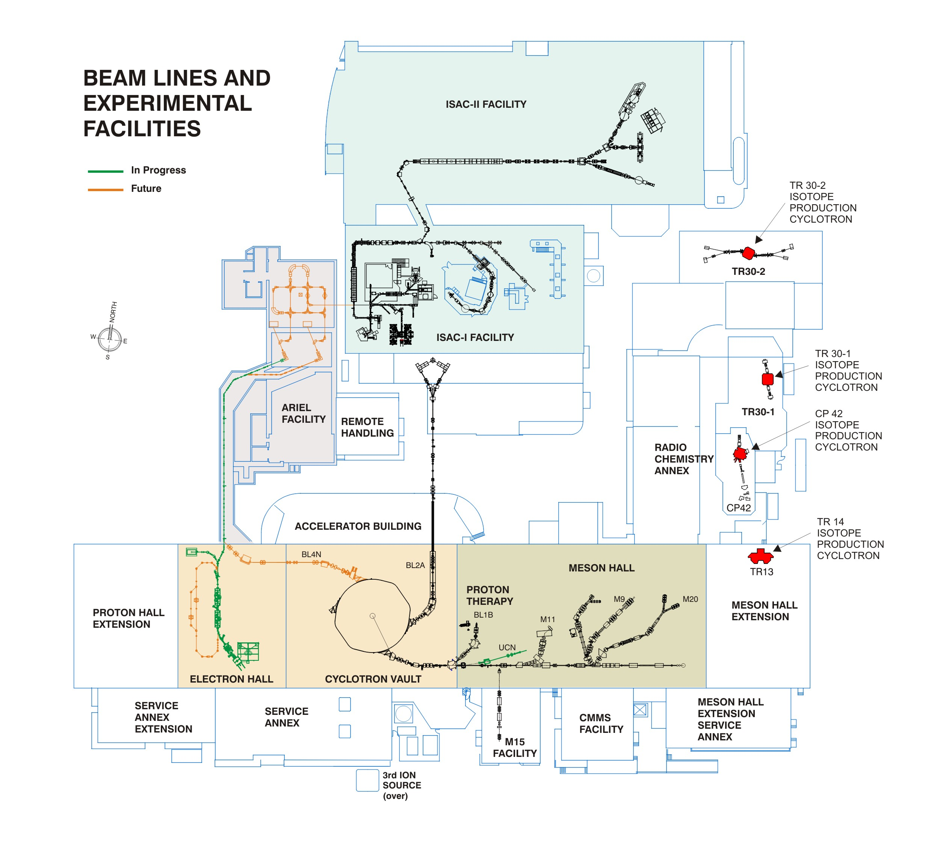
Outline
Accomplishments
ISAC target module status and strategy
Division support for ARIEL-II
Accelerator division science program and 5YP projects

Slide 3
Accomplishments

Slide 4
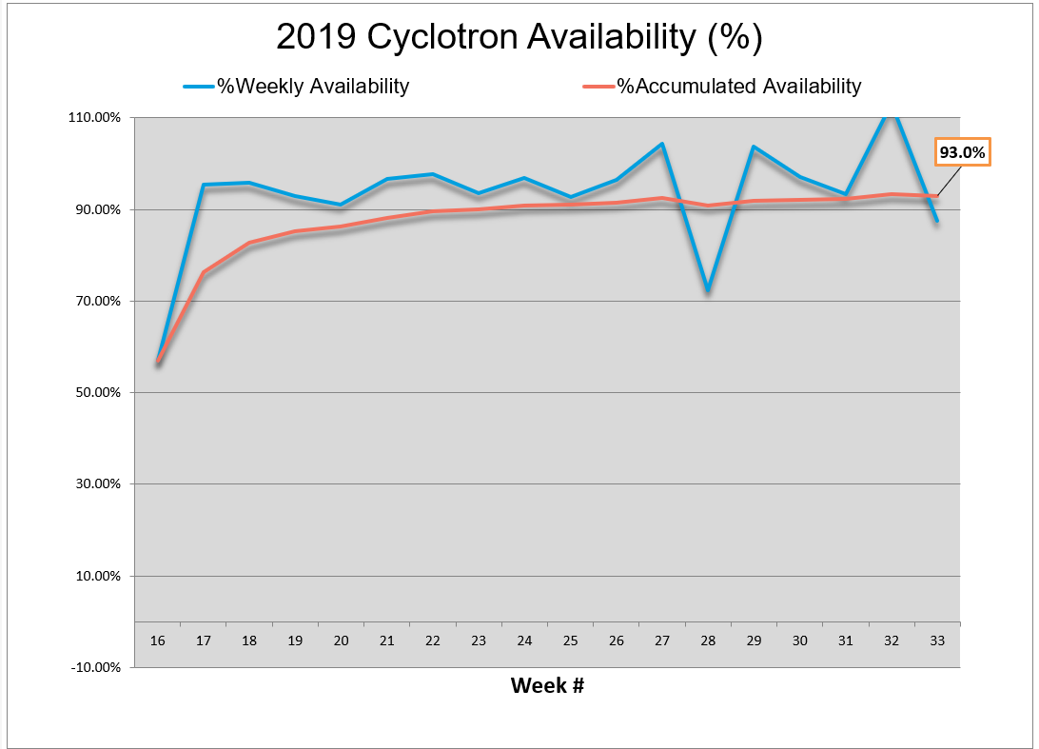
Cyclotron availability
Good start this year, high cyclotron availability due to several upgrade projects.
Issue with STF did require a reduced operation in week 28.

Slide 5
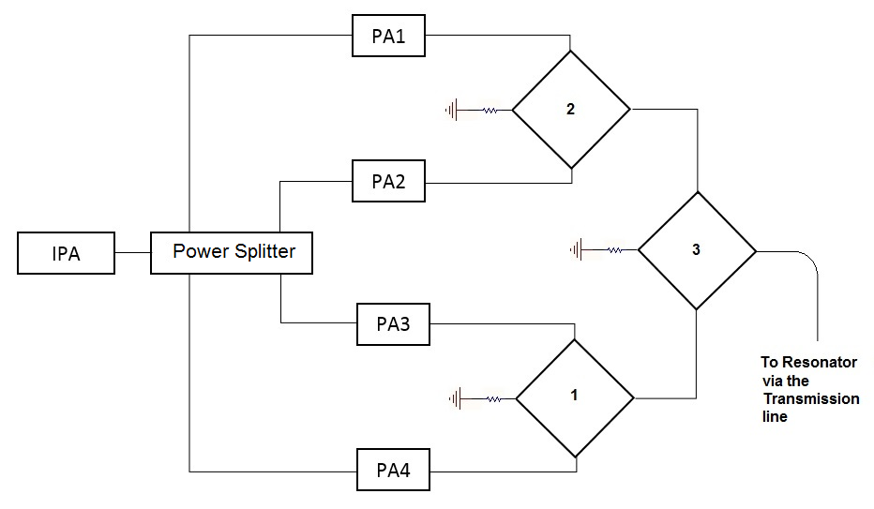
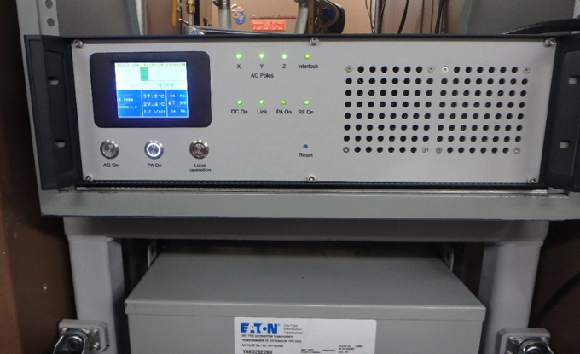
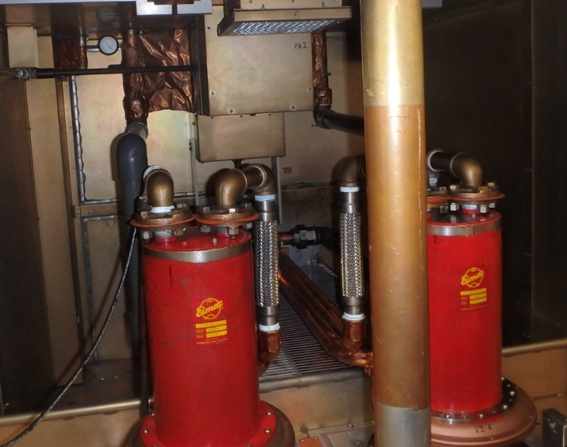
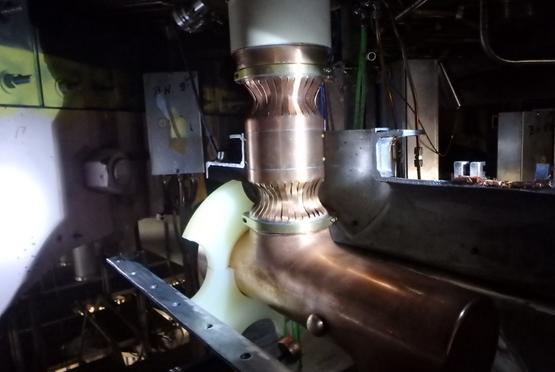
Cyclotron improvements
250 kW
Combiners
  Ageing cyclotron RF-system
  New 2 kW solid-state driver amplifier in rf system
  Power supply upgrades
  New power RF amplifier tube as no spares are available
  Consolidation of main 1 MW RF
  transmission line
    New diagnostics and protection
    → RF arc and water leak detectors
    New inner conductor – copper plated stainless steel

Slide 6
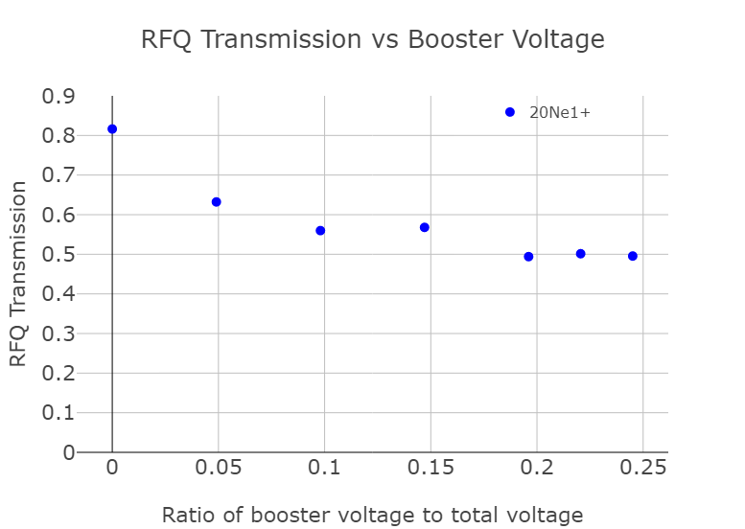
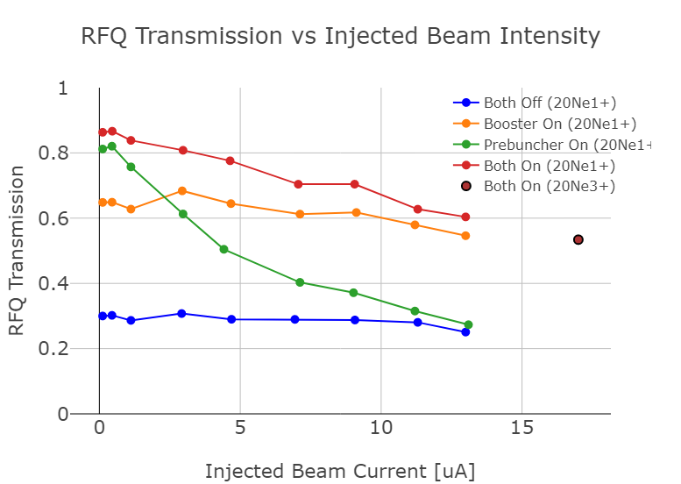
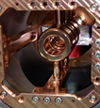
ISAC RF Booster Status
Bunching Mode
Due to 5.3 m from the prebuncher to the RFQ, longitudinal space charge effects arise around 1 µA.
Booster is more closely spaced to RFQ and can more effectively bunch beam into RFQ acceptance.
1.5e13 pps of ²⁰Ne³⁺ demonstrated through RFQ/DTL.
Used for ²²Ne delivery to DRAGON S1565 & S1793.
Booster Mode
Capacity to add 10 kV to a mass 20 beam demonstrated (~25% of total voltage).
RFQ transmission of ~50% demonstrated with booster at 10 kV compared to nominal (booster off) of 80%.
Confirmed presence of satellite peaks after RFQ to satisfy the current monitor system – ready for delivery to both ISAC-I and ISAC-II.

Slide 7
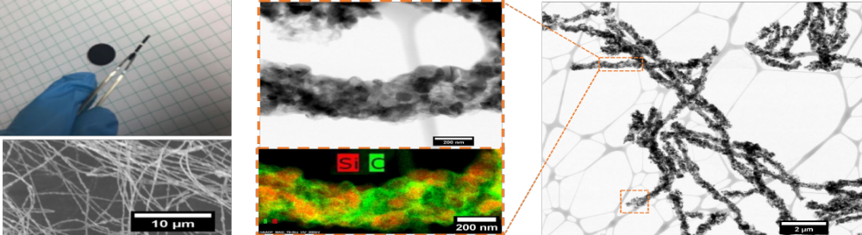
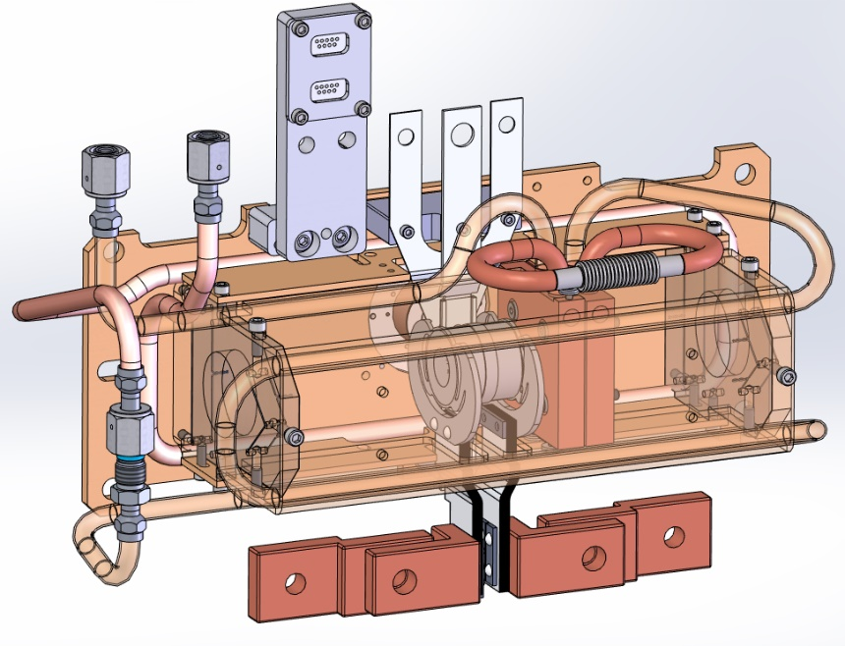
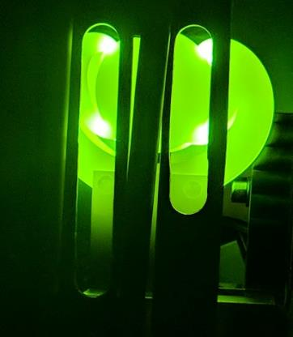
New Target Ion Source developments
SiC Nanofibres – increase porosity
Successful operation of a target up to 55 μA, no target failure, no signs of degradation
Change of licence limit for UC_{X} irradiations
Previous limit: 10 µA, 500 hours, for any target thickness
As of December 2018: 300,000 µA · h · g/cm²
→ Allows for optimizing between current, irradiation time and target thickness
ISAC Proton-to-Neutron Converter
(ready for beam tests)
  Suppressing neutron deficient isobaric
  components
  Overcome ISAC UC_{x} beam intensity
  limitation

Slide 8

ISAC Target Module status and strategy

Slide 9
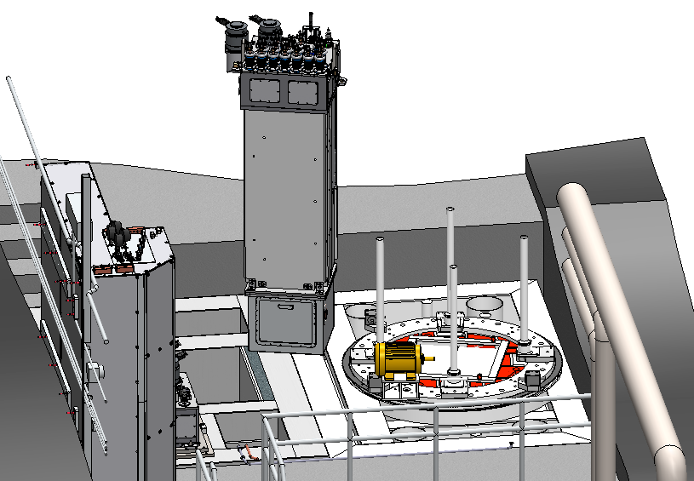
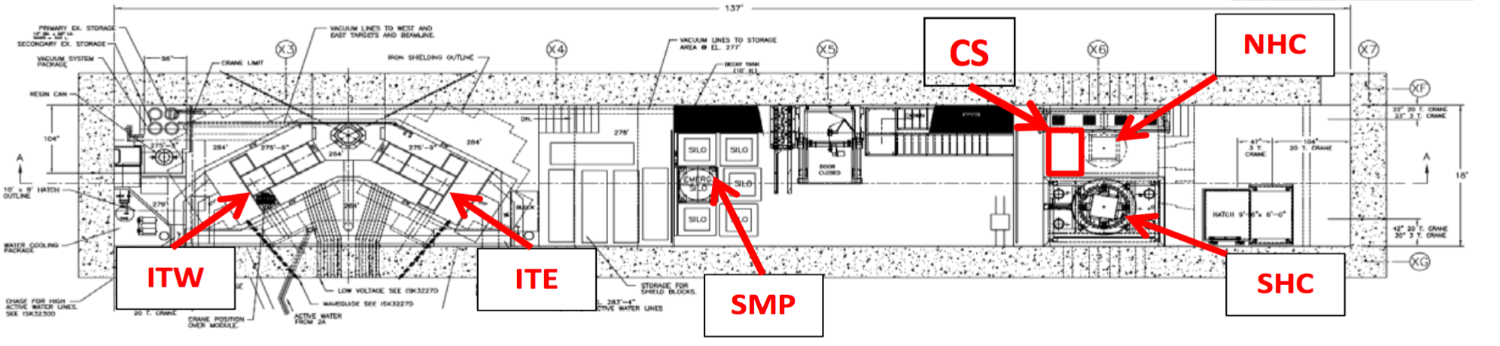
Reminder: ISAC Infrastructure Limitations
  Target hall crane is not equipped with rotational redundancy. South Hot Cell (SHC) needs to be vacated during every target module move.
  → Safe Module Parking (SMP)
  Regular target exchange is currently performed in SHC
  → will be done in North Hot Cell (NHC) in the future
  Long-duration repair or maintenance tasks of target modules in a hot cell was limited and impossible during operation → now possible!

Slide 10
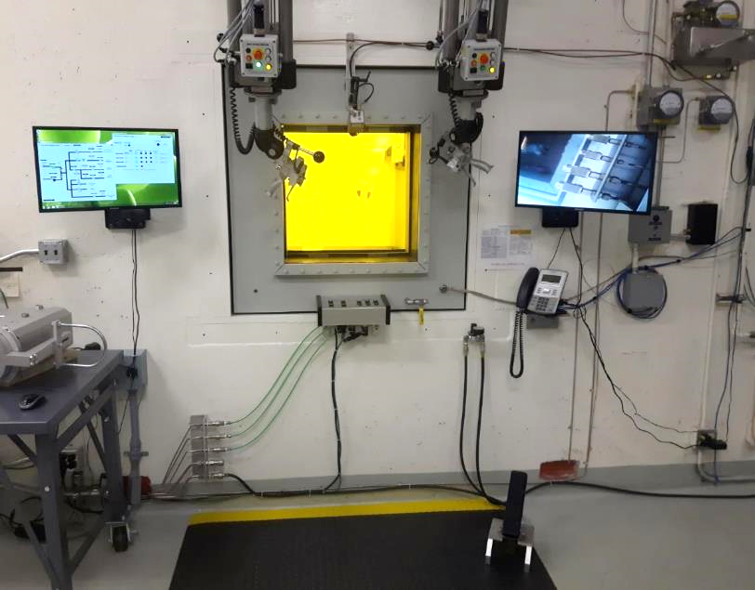
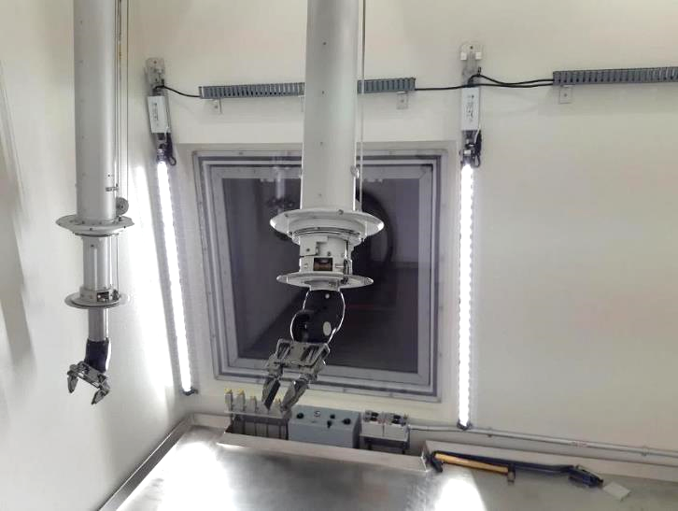
North Hot Cell – Current Status
Installation, tests and commissioning of North Hot Cell now complete!
Jigs and fixtures being assembled
Hand-over to operations for the
ongoing schedule

Slide 11
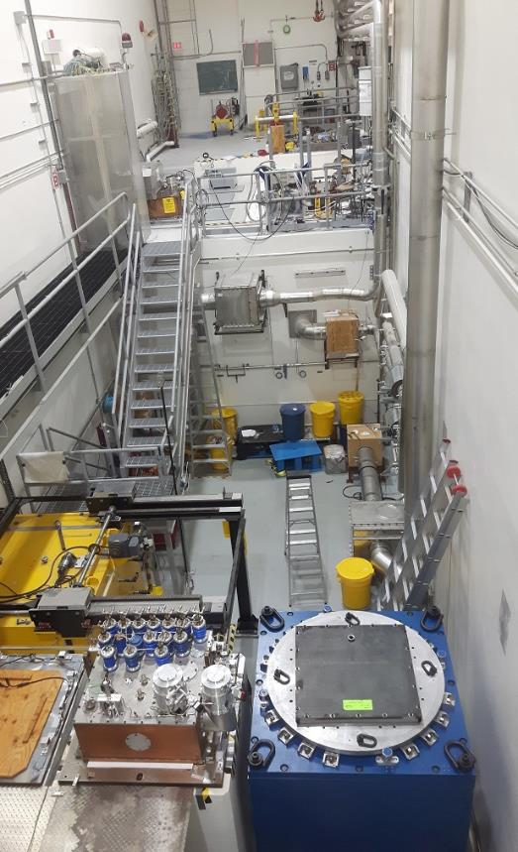
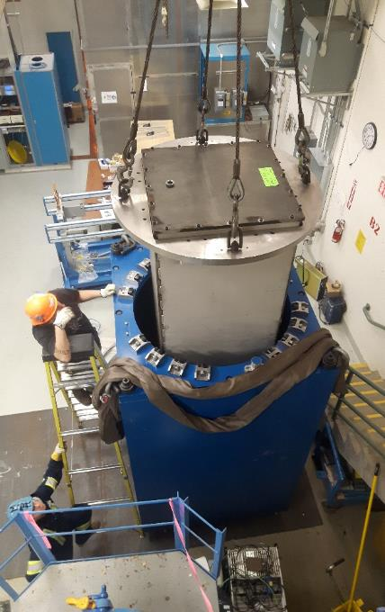
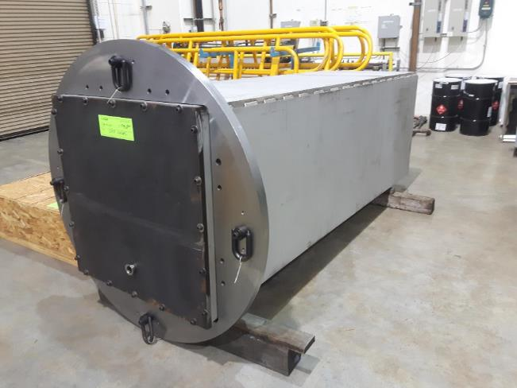
Safe Module Parking – Manufacturing
SMP is a shielded storage location for ISAC target modules. The vacuum vessel was received in February, installed and leak checked.
Shielding structure installed
Drive system installed and control
system deployed.
Commissioning ongoing

Slide 12
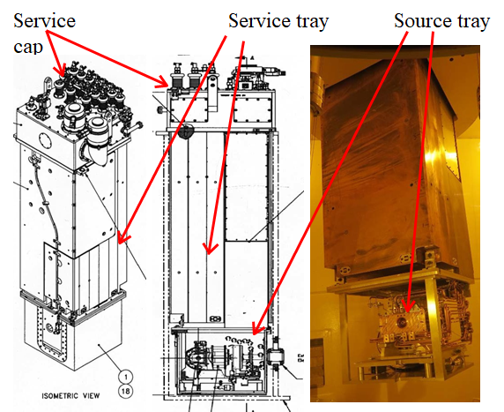
ISAC Target Module (TM)
TM1 highly limited, unique in design
Only TM2 and TM4 are in operation
TM3 is out of the Target Module rotation and is being refurbished.

Slide 13
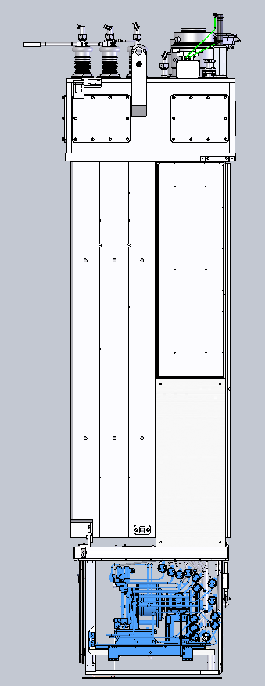
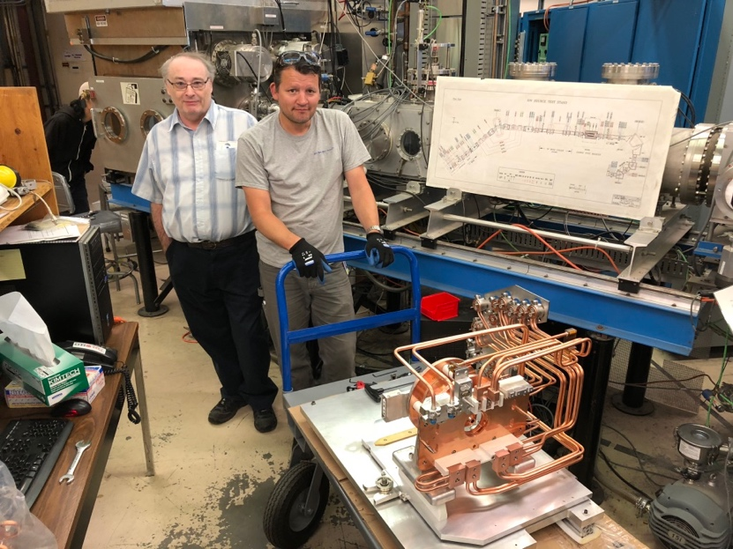
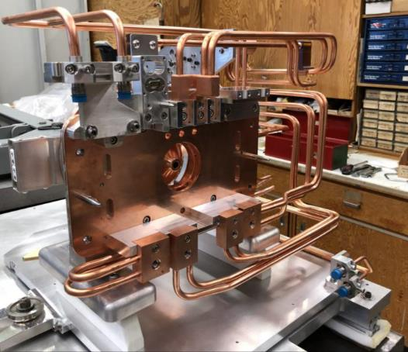
TM2 and TM4 activities
HV limitations required exchange of source trays → Installed new and improved source tray on TM2 and on TM4 in shut down 2019.
New source tray on TM2 and in operation
TM4 source tray exchange:
  Some issues with radiation-induced corrosion and corresponding water leaks
North Hot Cell completed
Notes:
Need updated picture

Slide 14
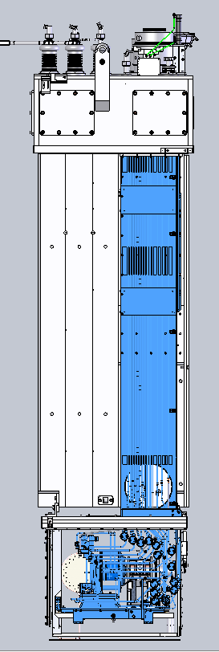
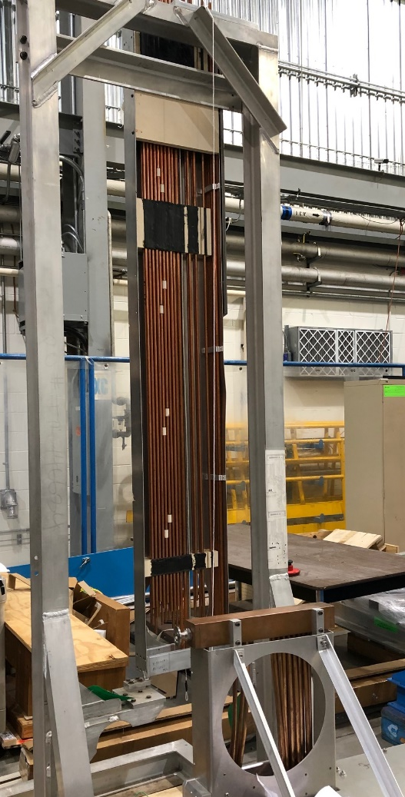
P416 TM3 refurbishment
After detailed investigations → service tray is an issue for HV stability → TM3 refurbishment project will lead to a
new and improved service tray
Refurbished TM3 with reduced number or
pipes, better HV lines routing will be the
model for a new target module TM5.
The 3D model and according drawings
will be used to build the new module in
industry not in house.
Service tray
Delivers all HV services from the module cap to the source tray
Source tray
Holds the target assembly and extraction optics
Notes:
Need updated picture

Slide 15
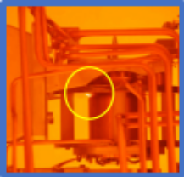
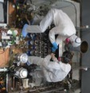
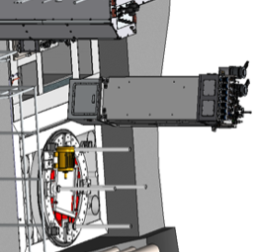
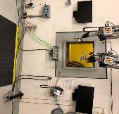
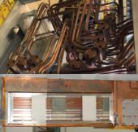
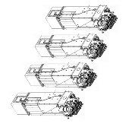

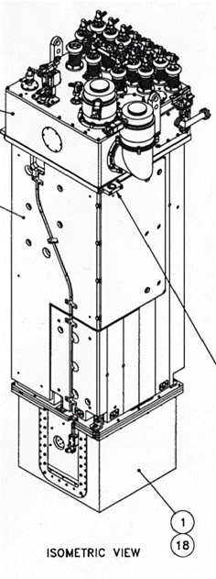
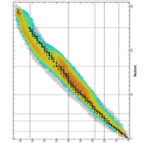
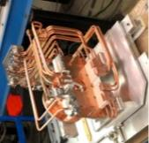
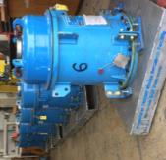
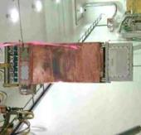
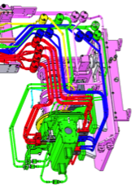
Target Module Strategy
Completed
On-track
Delayed
New Target Hall Engineer
New Target Chemist
Lift UC_{x}
10 µA limit
TM2 source tray
TM4 source tray
Source tray assembly line
TM5 design completion based on TM3 improvements
UC_{x} material production ramp up
Relax spent target disposal limits
TM3-service tray design completed, construction started
2022
…
…
…
Q1
Q2
Q3
Q4
Q1
Q2
Q3
Q4
Q1
Q2
Q3
Q2
Q3
…
2018
2019
North Hot Cell (NHC)
Safe module parking (SMP)
improve service tray design
2020
2021
2023
2024
TM3 investigation complete
New Target Hall Technician
Overall Target Hall Hazard Analysis and Risk Registry
TM3 completion and back in operation
TM5 complete
4 modules available, one in refurbish-ment
TM5 early construction completion

Slide 16
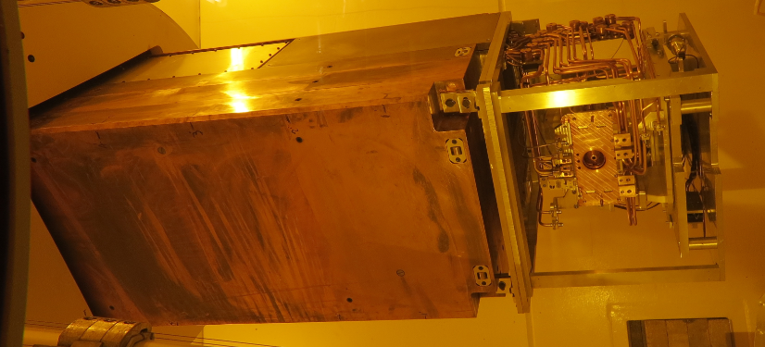
High level TM strategy
New Source Tray installation on TM2 and TM4
North Hot Cell (NHC) and Safe Module Parking (SMP)
→ South Hot Cell (SHC) is available for TM refurbishment
TM3 service tray re-design and exchange procedure
→ new service tray until Q3 2021
Completion of the design of a new (cold) module TM5 based on the redesign of the source and service tray until Q2 2022
Early construction completion and ready for operation of TM5 in Q3 2023 (baseline Q2 2024).
Regular refurbishment of modules starting with TM4 after TM3 is back in rotation

Slide 17
Division support for ARIEL-II

Slide 18
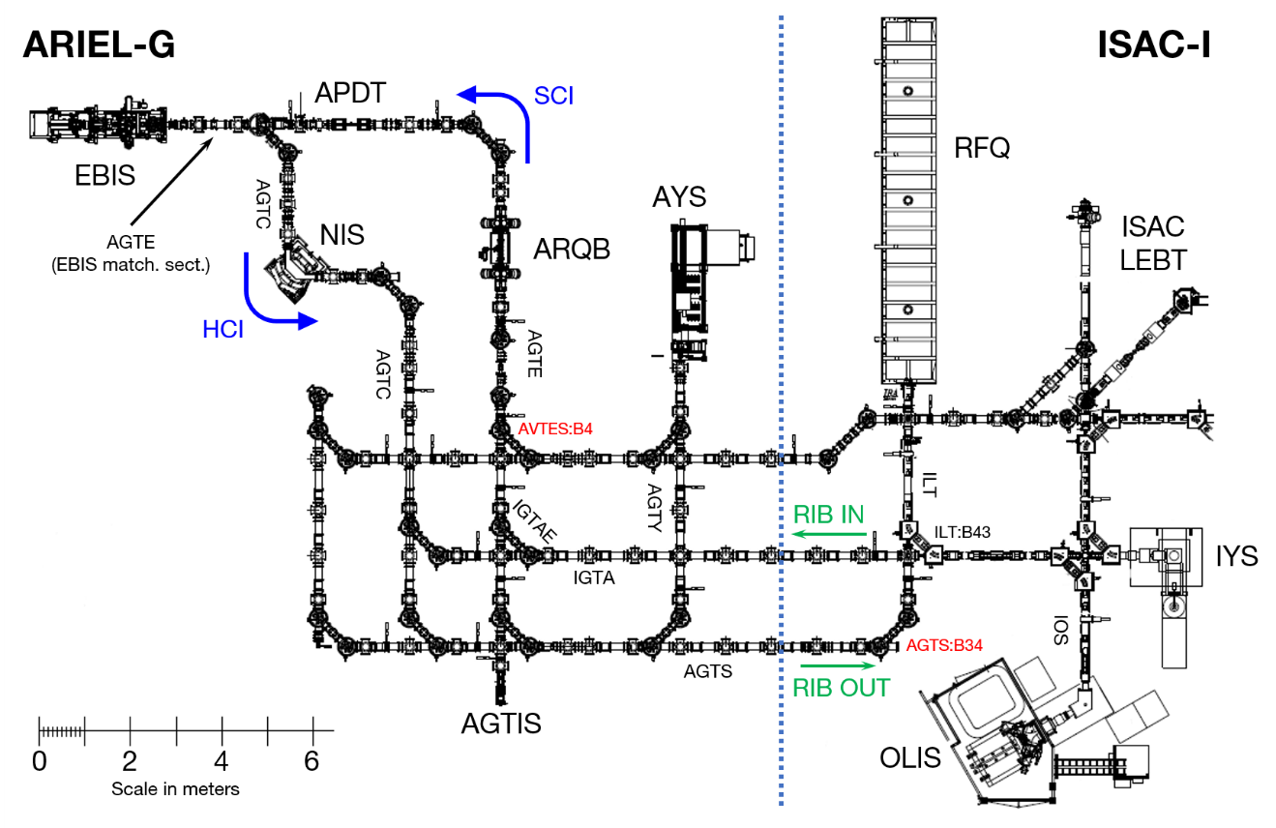
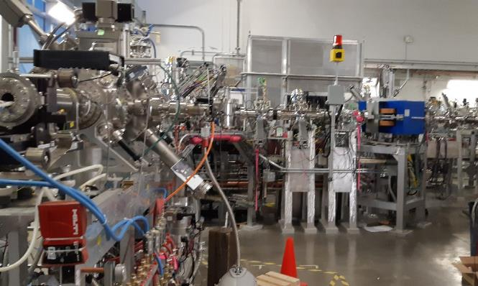
CANREB ground floor overview
AGTIS
P310 CANREB installation essentially completed – transfer of test ion sources ongoing

Slide 19
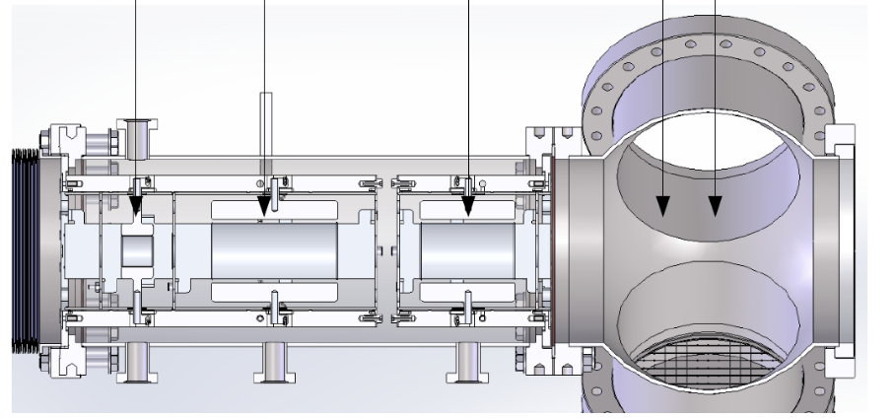
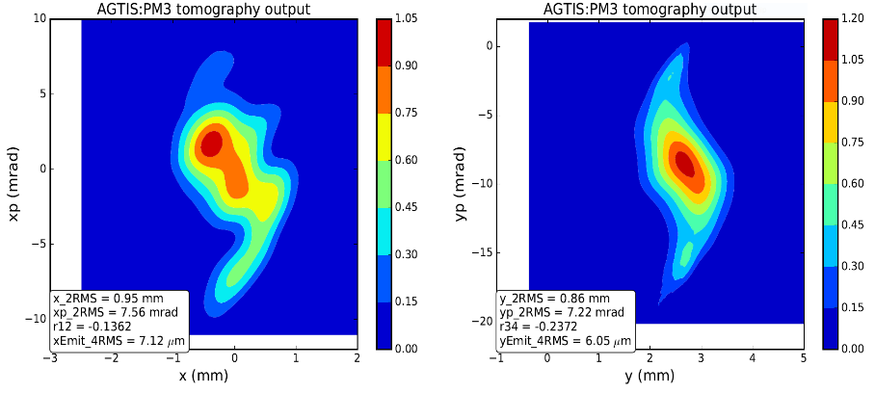
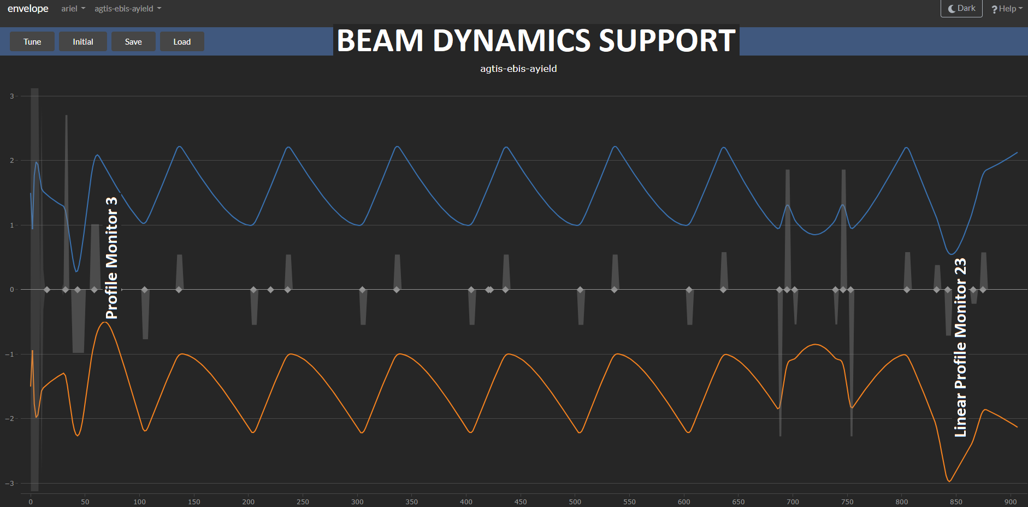
CANREB Commissioning
Q1/X0/Y0
Q2
Q3
PM3/FC3
First beam from AGTIS: February 21, 2019
Extracted a few nA of ¹³³Cs @ 60 keV
Higher sensitivity due to new Faraday cup current integrators < 1 pA sensitivity
Using theory values for optics worked perfectly
x
y
Beam tomography, Q1 scan (4rms emit. ~ 7 μm)

Slide 20
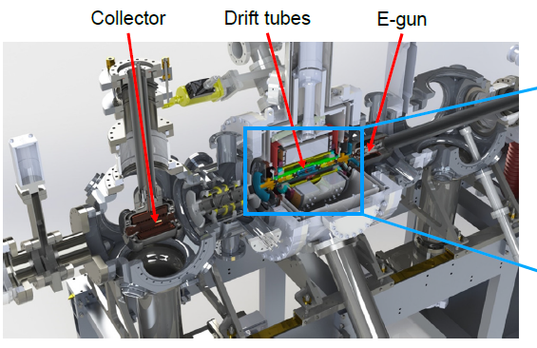
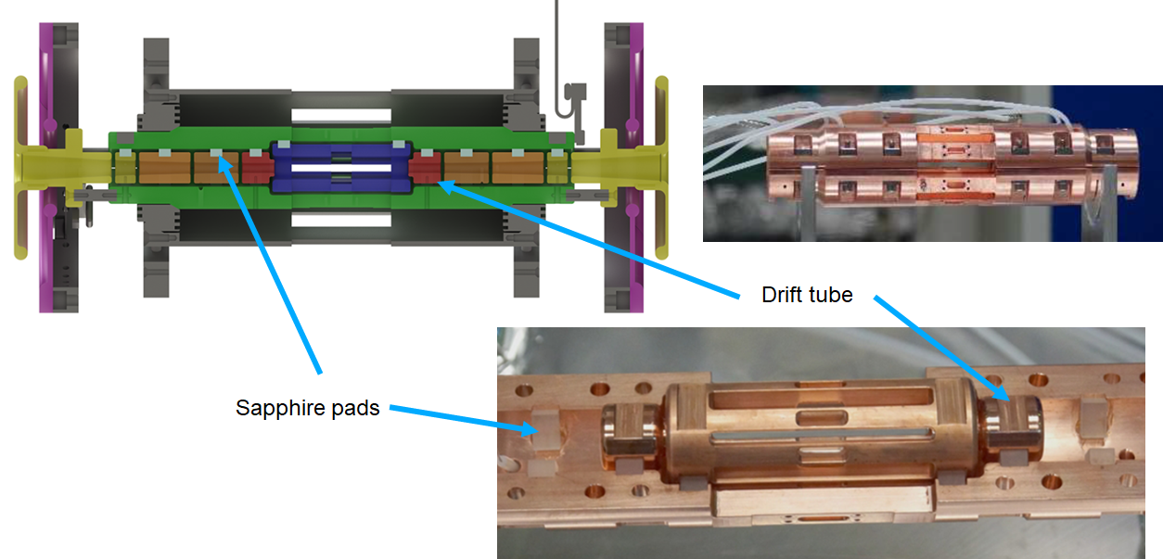
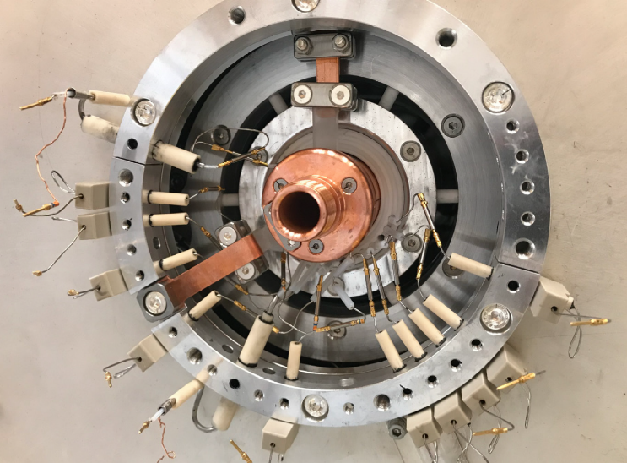
Issues with CANREB EBIS
Series of issues in the past months
  Magnet quench due to power outage in December
  Turbo pump failures
  Vacuum problems
  Shorts of electrodes → Decision made to open the magnet chamber
  Redesign of 40 K level HV wire feedthrough

Slide 21
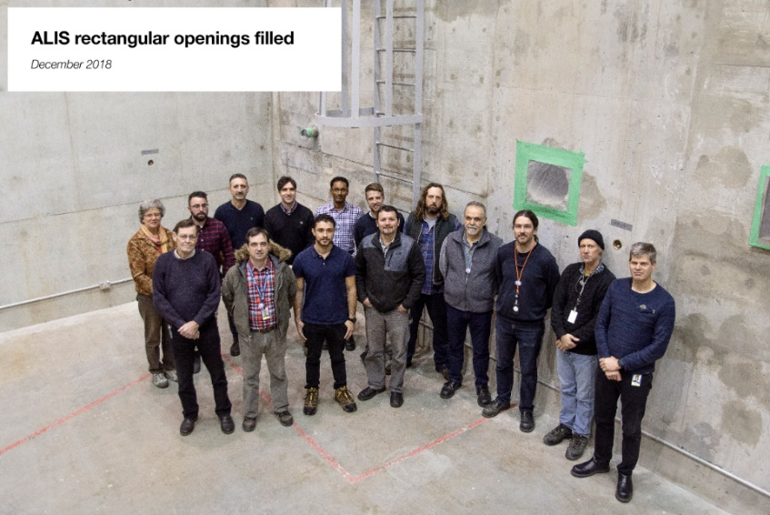
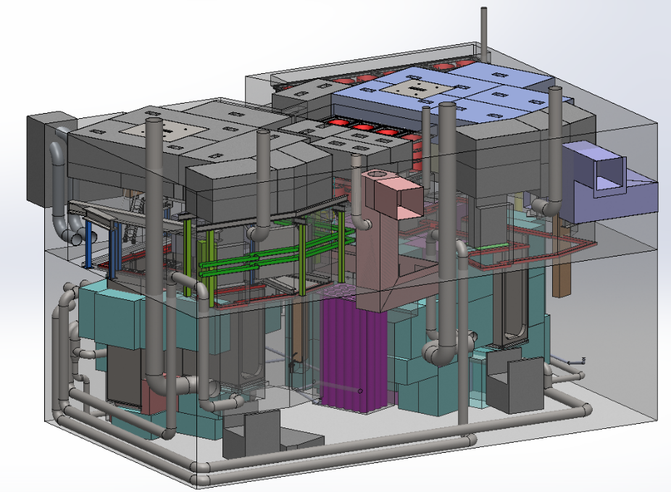
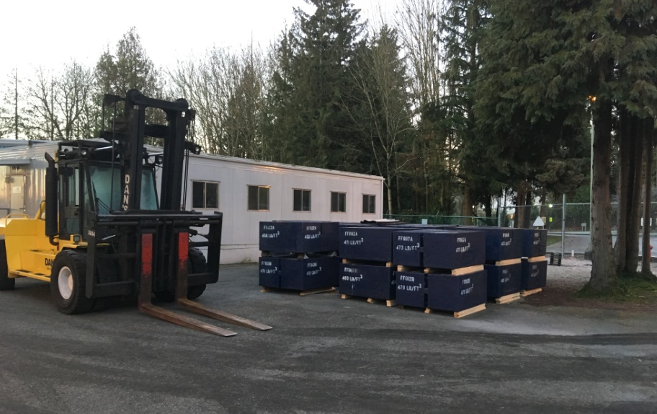
Target hall infrastructure
Dec-2018: ALIS wall openings to the
mass separator room filled
Opening to the mass separator room closed!
SEG blocks for shielding arrived→ reduced the required
number from 110 to 82 (value engineering)
Shielding optimized → radiation transport simulations
Dec-2018: SEG blocks arrive

Slide 22
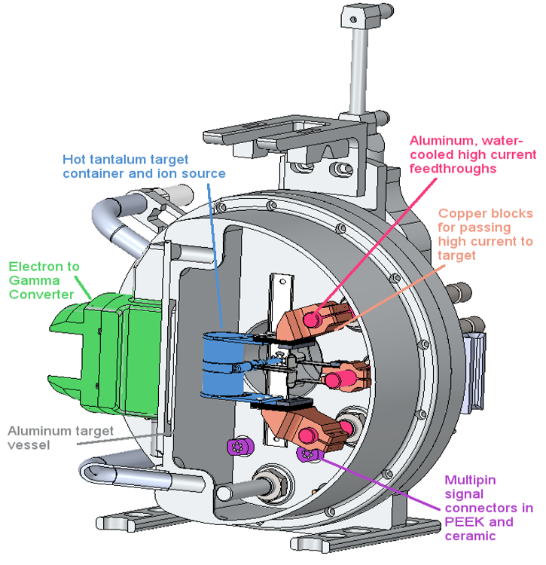



Test stand progress
Full target assembly prototype test stand (PHI) operational and commissioned.
Tests ongoing: target heating, thermal shielding, cooling, target service feedthroughs, vacuum sealing.
First ARIEL target at 2000 ºC → several target design issues identified and eliminated.

Slide 23



e-linac activities
Dog-leg installation (part of ARIEL 1.5) completed!
Difficult assembly task!
Microphonics mitigation → Sources and
transmission identified
  Sources: LN2 valves, cooling water
  (particularly klystron booster pumps)
  Transmission: Rigid bellows, hoses and water connections, via waveguides
  Significant noise reduction at certain frequencies!!
Studies of ponderomotive effects
→ Analysis & simulation
→ Piezo tuner installed and investigations are ongoing
However, 30 MeV design beam energy has been achieved with the e-linac!

Slide 24


Accelerator division science program and 5YP projects

Slide 25


Accelerator division science program,
The division science program provides Canada with three world-class platforms:
  Beam physics and instrumentation
  Secondary particle production
  SRF technologies
TRIUMF and UVic were successful in a joint appointment of
an Accelerator Physics Faculty to strengthen Accelerator
Science education in Canada:
Tobias Junginger (expert in SRF and RF cavities, former
Lancaster University, UK)
Also in engineering we have platforms for Remote
Handling technologies (automation, mechatronics,
nuclear technologies)

Slide 26



Student education and research topics
Ion sources
Plasma ion sources, high charge state ion sources (Charge state breeders)
Beam physics
Intense, space charge dominated beams (HL-LHC beam-beam effects, electron linac, cyclotrons)
High level computer applications, automatic tuning
Target research and development –
Material properties, ions source optimization (plasma physics)
Superconducting RF (SRF) and RF
Cavity design, cavity and cryo modules
Surface properties (β-NMR and μ-SR investigations and processing),
Digital low level RF technology

Slide 27
Acc division planning for the next 5YP
The implementation of the 5YP requires the definition and resource planning of projects. The projects being prepared by the ACC Division are related to
Cyclotron refurbishment and upgrades
Control system CCS2EPIS, Diagnostics, cryogenics, injection beam line, vacuum, cabling, RF-system
TCC – TRIUMF Control Center (combines Driver and RIB control room)
ISAC refurbishment
Target hall consolidation and module refurbishment, ISAC-I RF system, ISAC Target Ion Sources
Technologies towards hands-off control of routine Remote Handling activities
Proton Beam line upgrades and refurbishment
Power supplies, refurbishment of optics elements, vacuum

Slide 28
Thanks for your attention

Slide 29
Additional slides

Slide 30



HRS
Status
Dipoles installed and aligned, multipole corrector as well
All interconnecting beamlines installed and under vacuum.
ATIS moved downstairs; installation ongoing, HRS testing will follow
HRS 1
HRS 2
HRS mutlipole
Injection beam line

Slide 31



P416 TM3 Refurbishment – Schedule/Resources
Estimated total work
425 FTE days
Carla Babcock / Anders Mjøs

Slide 32


Target station accomplishments
Detailed design progressing: Deflections caused by the piston system validated, locating system development complete, component suppliers being identified
Motion systems (contamination shutter, coupling system, extraction electrode) being prototyped
Target service routing and service cooling being detailed
RIB
beam
RIB
beam
electron
beam
electron
beam

Slide 33
Divisional goals 2019
Contribute resources to accomplish planned ARIEL-II and CANREB project milestones in FY 2019.
Exceed accelerator metrics in terms of safety, reliability, availability and beam delivery.
Support a prioritized cyclotron and ISAC refurbishment program to prepare ARIEL operation and keying on future reliability and availability.
Perform cutting edge research projects and continue a strong student education program.
Champion accelerator physics and technology contributions to the HL-LHC project.
Establish and exploit collaborations with other labs to the benefit of TRIUMF.

