Slide 1
Application of ISAC facility for production of medical radionuclides: past, present and future perspectives
Valery Radchenko, TRIUMF
August 21, 2019

Slide 2

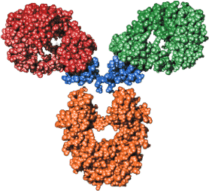
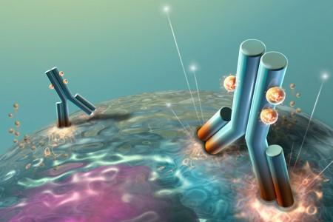

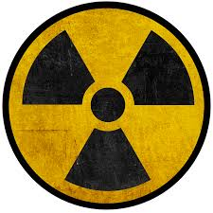




Modern radiopharmaceuticals
Chelator
Biomolecule
Radionuclide
Specific target
E.g. cancer
Diagnostic: PET, SPECT
Therapy: beta, alpha, auger

Slide 3
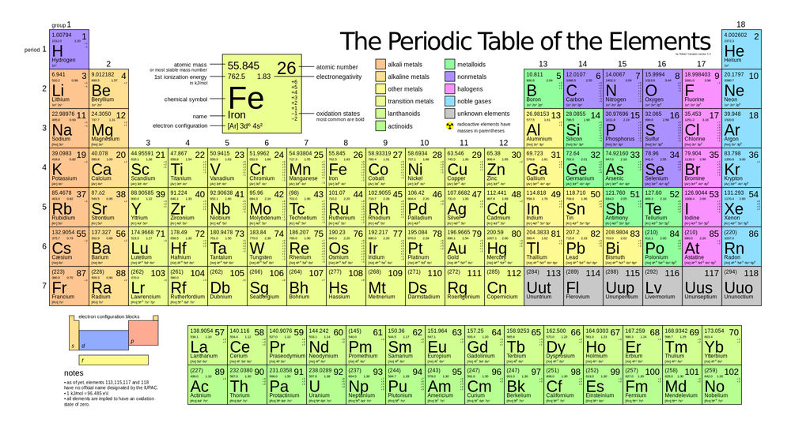
¹¹C PET
¹⁸F PET
⁴⁴Sc PET/ ⁴⁷Sc β⁻ therapy
⁴⁵Ti PET
^{52,54}Mn PET
⁵⁵Co PET
⁶⁴Cu PET/ ⁶⁷Cu β⁻ therapy
⁶⁸Ga PET/ ⁶⁷Ga Auger therapy
⁸⁶Y PET/ ⁹⁰Y β⁻ therapy
⁸⁹Zr PET
⁹⁰Nb PET
^{99m}Tc SPECT/ ^{94m}Tc PET
^{103m}Rh Auger therapy
¹¹¹In SPECT
¹¹⁹Sb Auger/¹¹⁸Sb PET/¹¹⁷Sb SPECT
¹²⁴I PET/ ¹²⁵I Auger therapy
¹⁴⁹Tb Alpha therapy/ ¹⁶¹Tb β⁻ therapy
¹⁶⁵Er Auger therapy
¹⁷⁷Lu β⁻ therapy
²⁰³Pb/ ²¹²Pb Alpha therapy
²¹³Bi Alpha therapy
^{223,224}Ra Alpha therapy
²²⁵Ac Alpha therapy
^{227,228}Th Alpha therapy
TRIUMF’s “Hot Kitchen”
Blue available
Green can/planning be produced
Yellow commercially available
ISAC and Th spallation provides
endless possibility for production of many
other medical isotopes

Slide 4
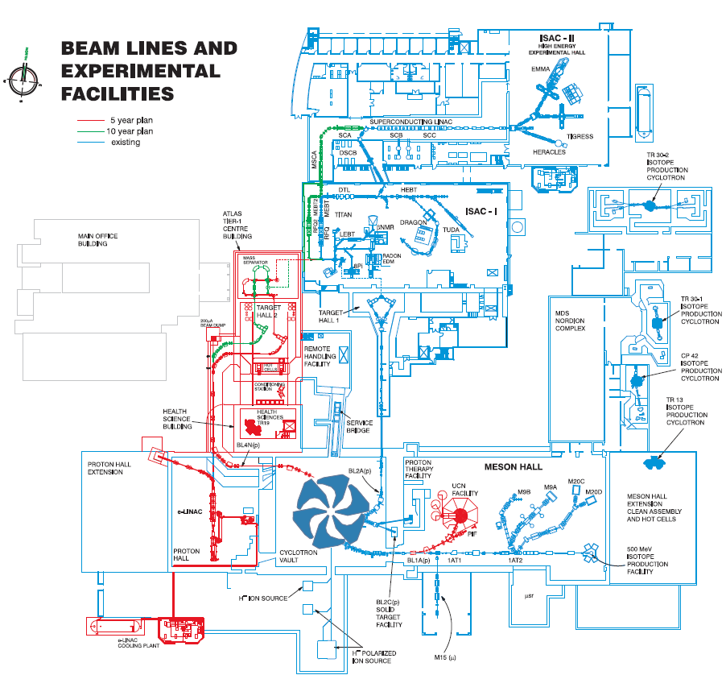
Production of medical radionuclides at TRIUMF:ISAC
TR-13
ISAC
Production of small (pre-clinical) quantitates of imaging and therapeutic radionuclides
Isotope Production Facility (IPF), BL1A
ARIEL
Collection chamber
Proton and electron beamlines
IAMI
TR-24
5

Slide 5
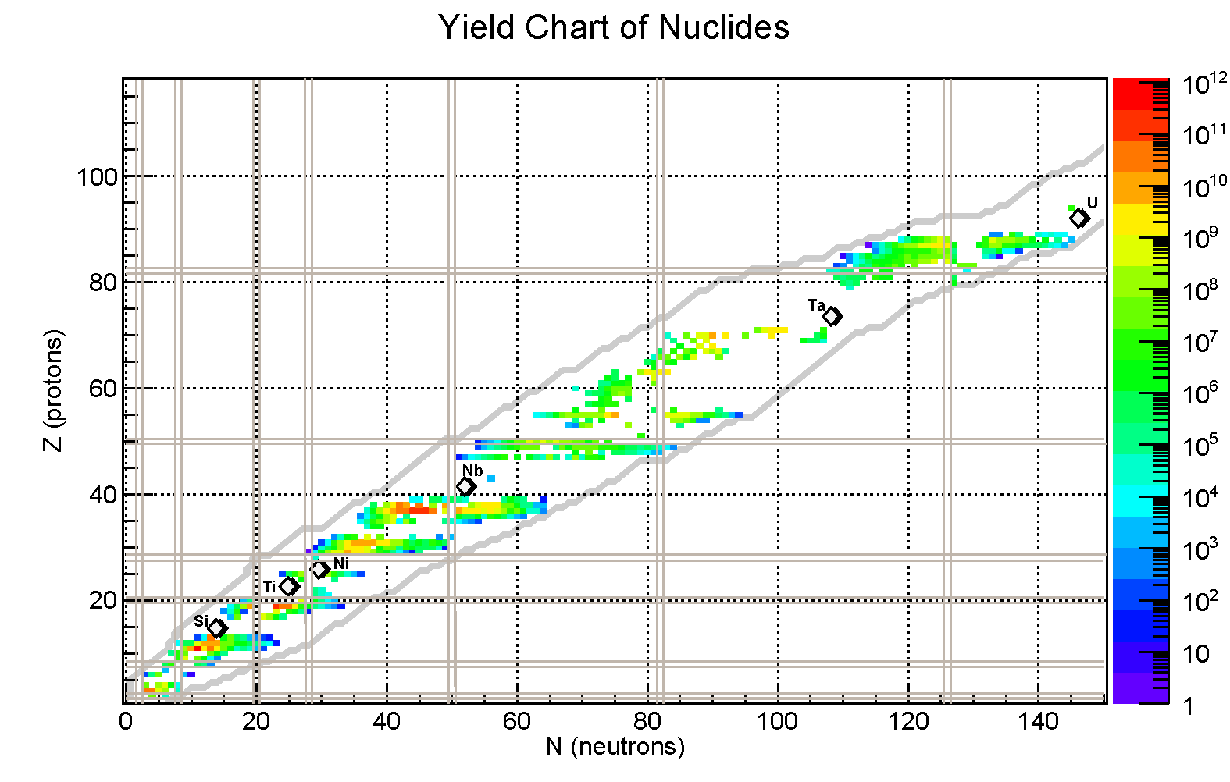
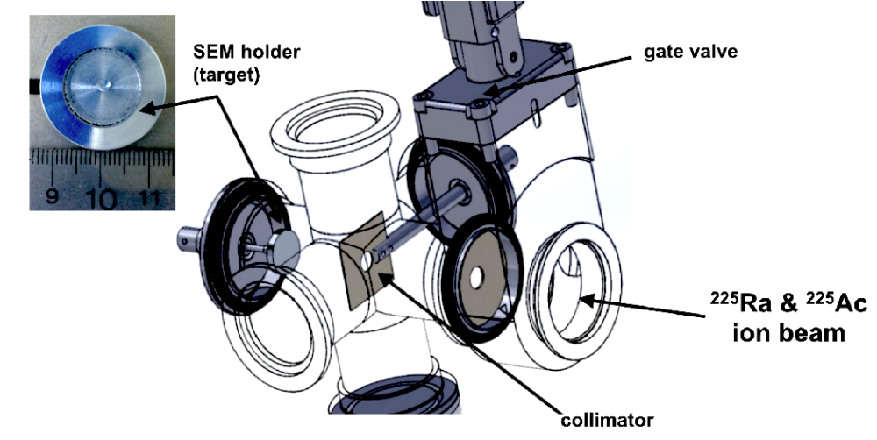
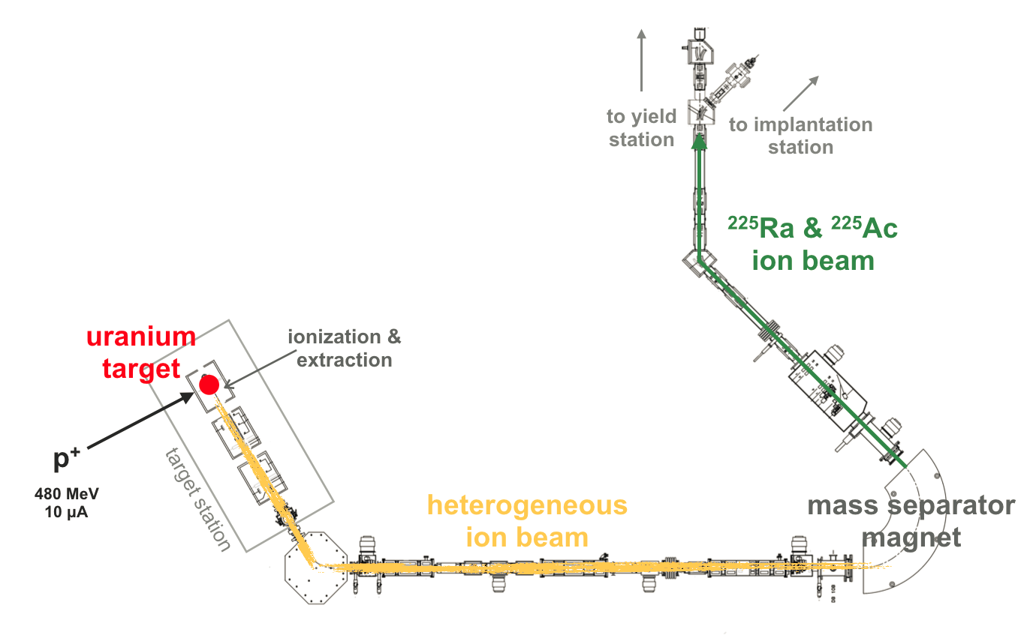

ISAC production of medical radionuclides
ISAC
Facilities for Rare-Isotope Beams
Peter Kunz

Slide 6

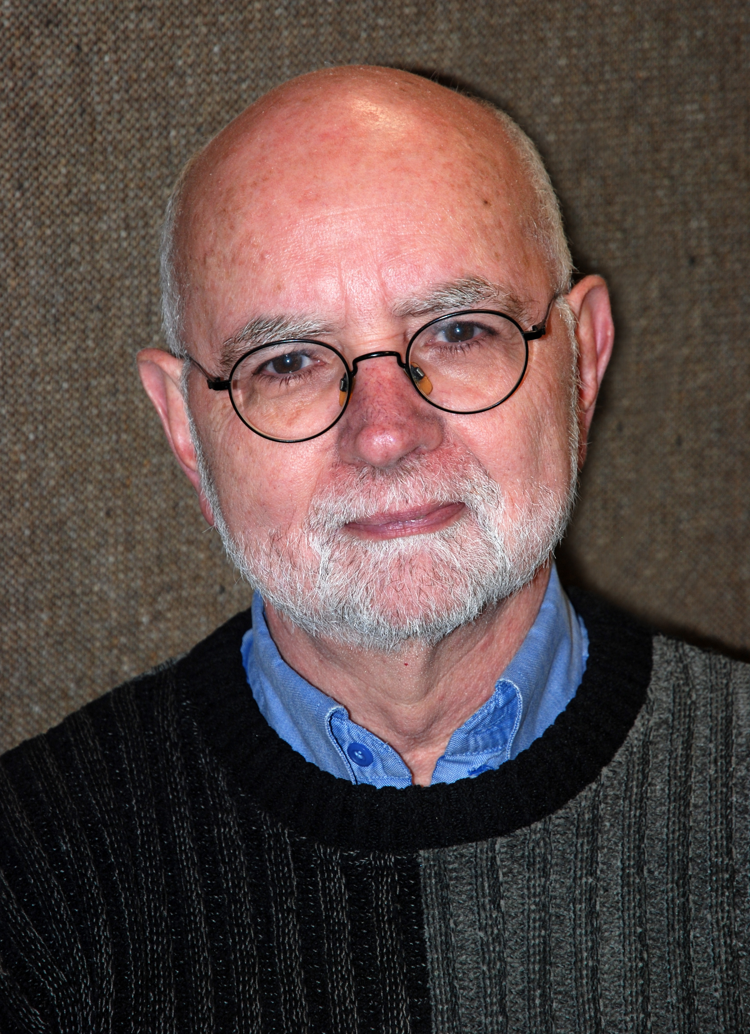
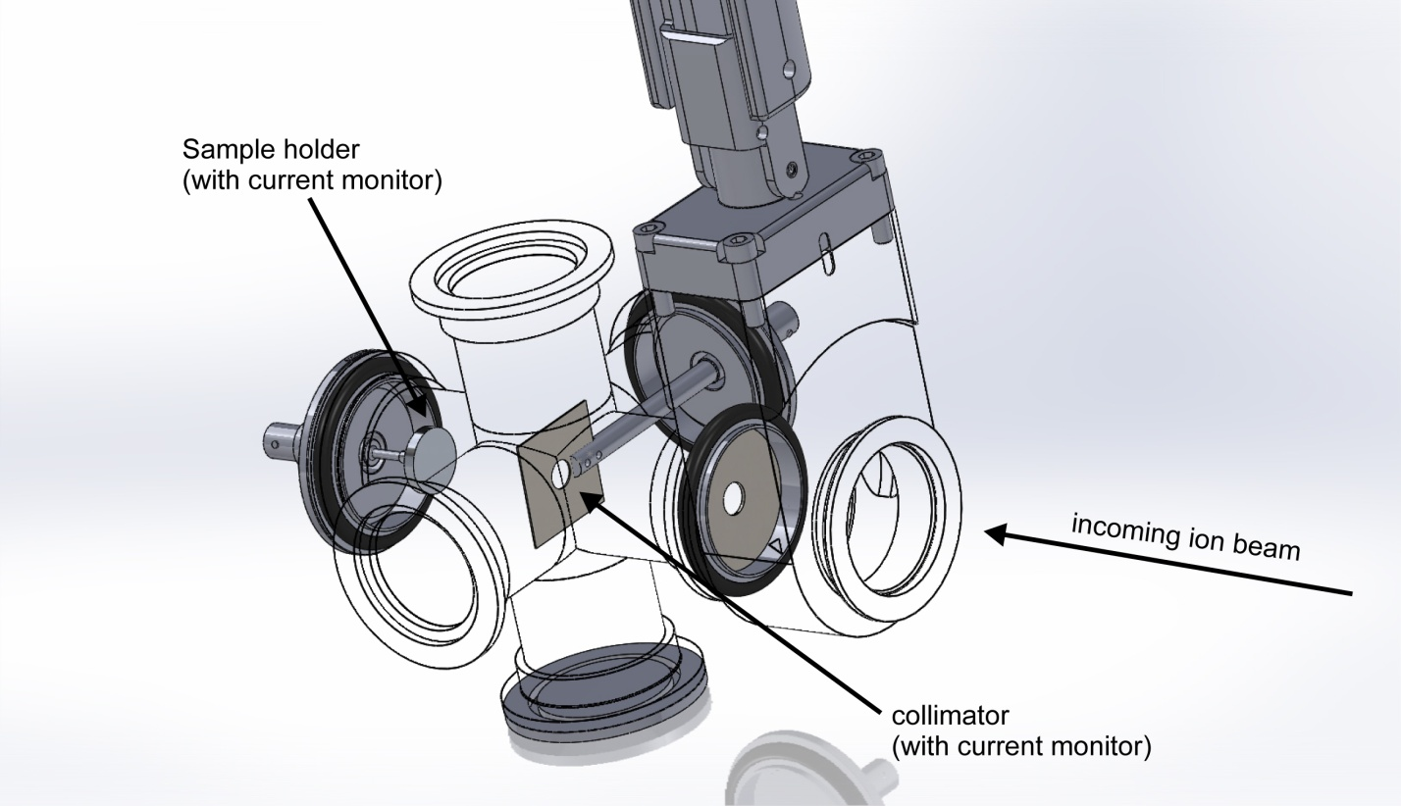
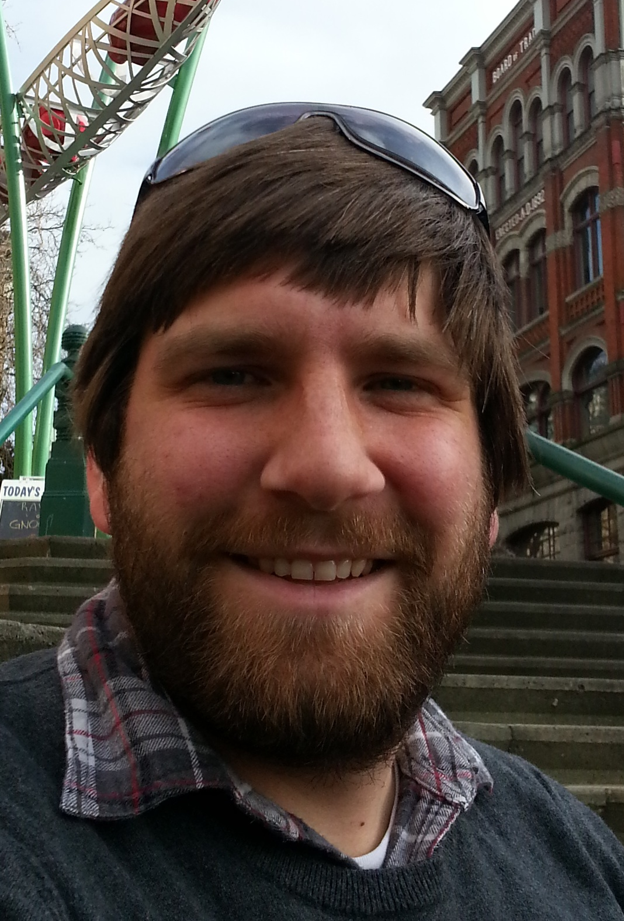
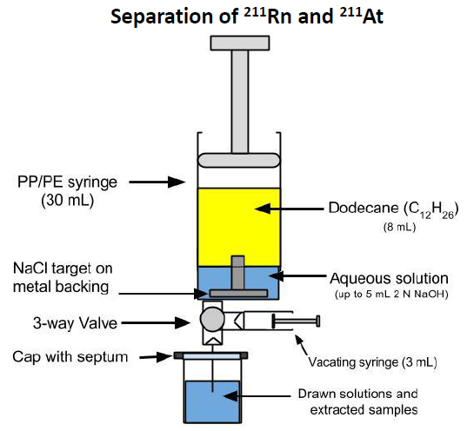

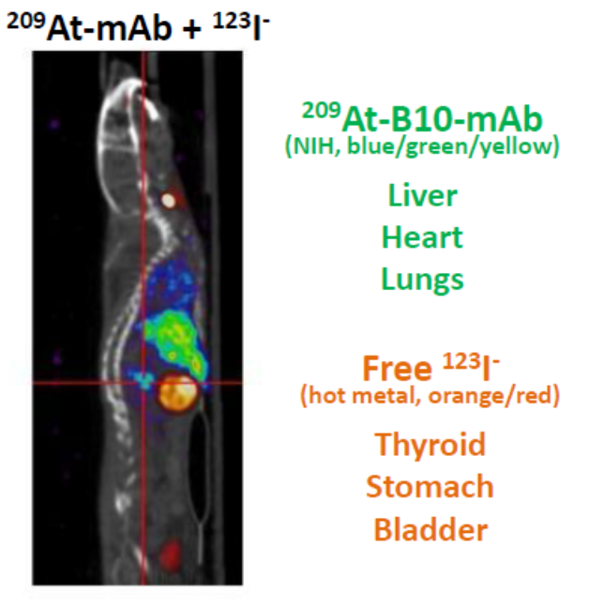
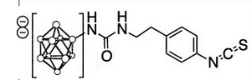
ISOL ²⁰⁹At-based imaging to establish ²¹¹At α-therapy
Imaging
Therapy
²⁰⁹At t_{1/2}= 5.4 h
²¹¹At
t_{1/2}= 7.2 h
Tom Ruth
(γ-emitter)
(α-emitter)
Jason Crawford
7

Slide 7
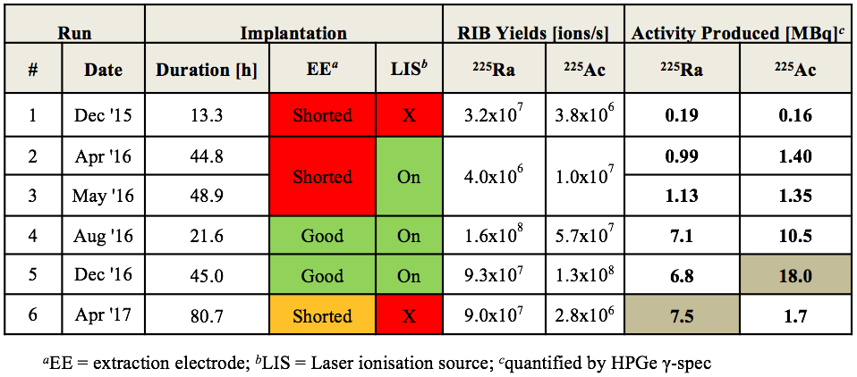

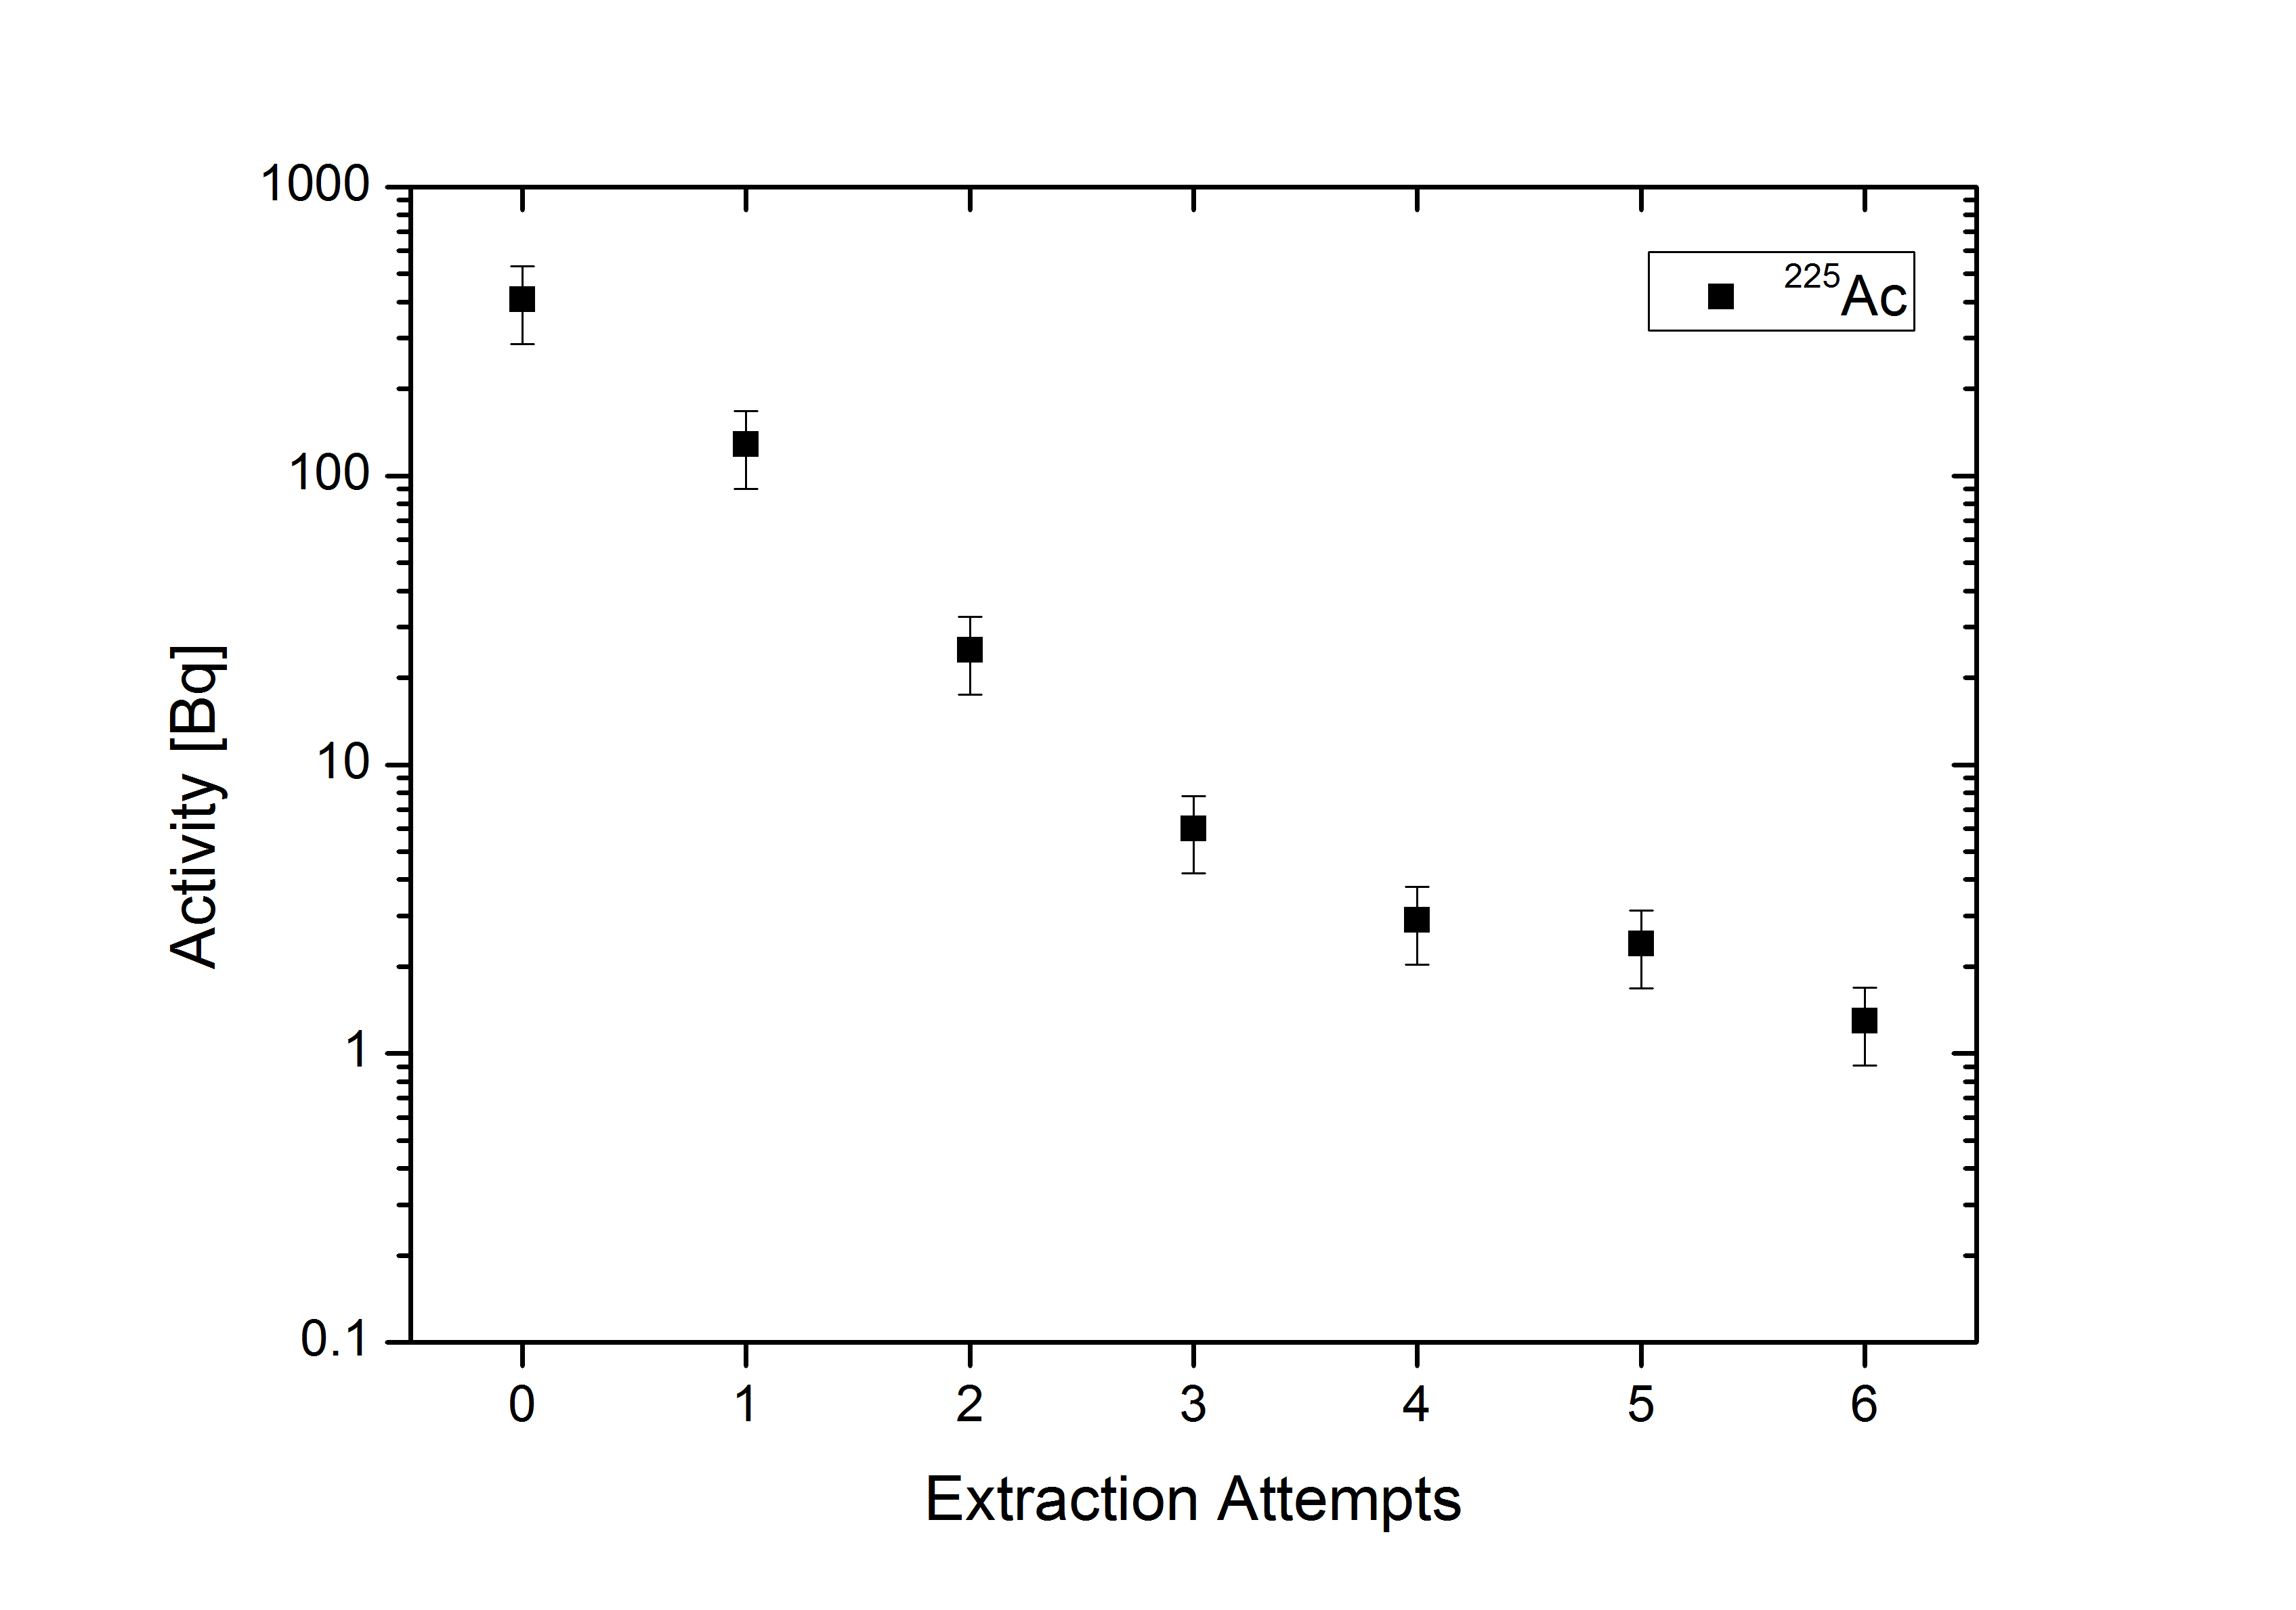
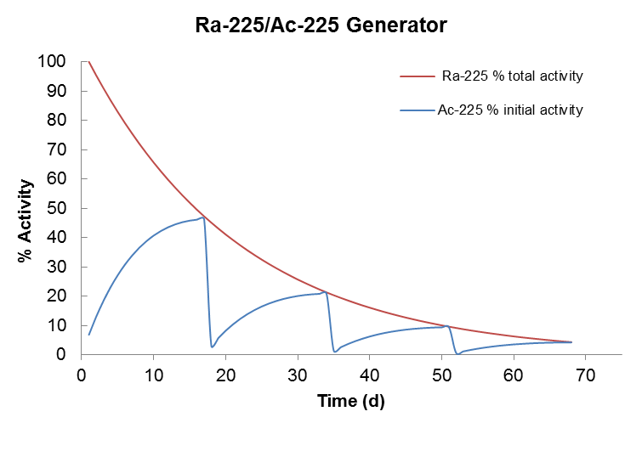
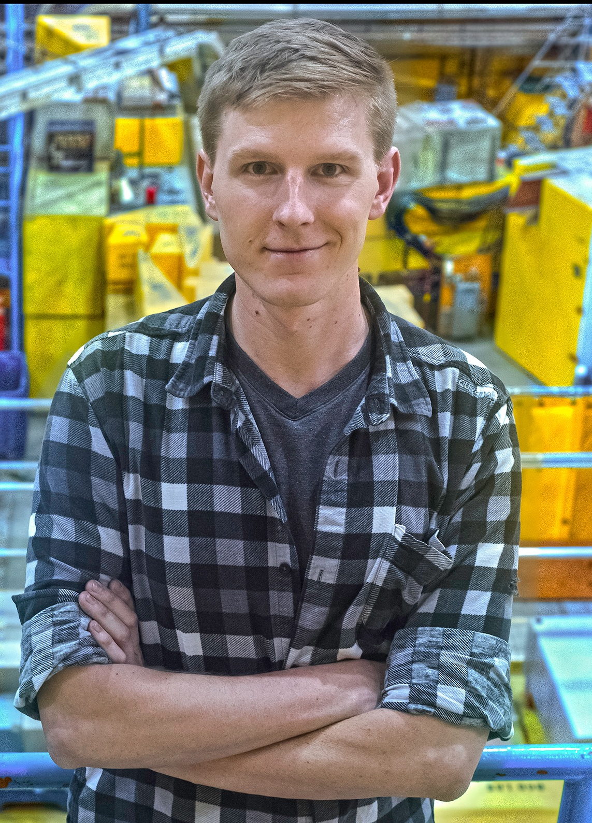
Production of ²²⁵Ac at ISAC
Summary of ISAC ²²⁵Ra/²²⁵Ac production runs to date
High radionuclidic purity
> 99% of all implanted ²²⁵Ra/²²⁵Ac activity
was retrieved from SEM stage
²²⁵Ac can be later obtained from ²²⁵Ra decay
Peter Kunz
Caterina Ramogida
Add
0.1 ml 0.1 N HCl
Evaporate
Andrew Robertson
Add and Retrieve
0.1 ml 0.1N HCl
Transfer from sample holder to 0.1N HCl solution
8

Slide 8
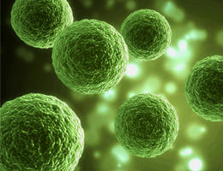

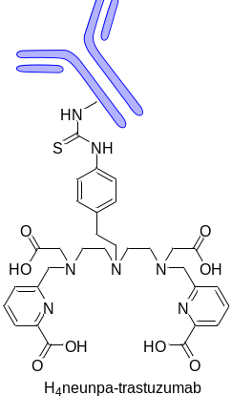
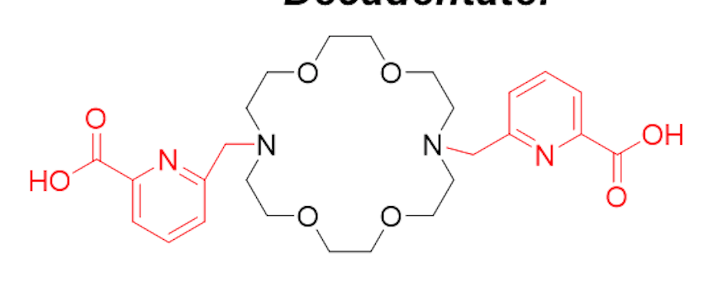
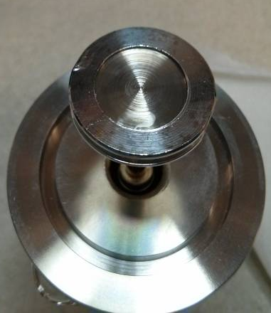
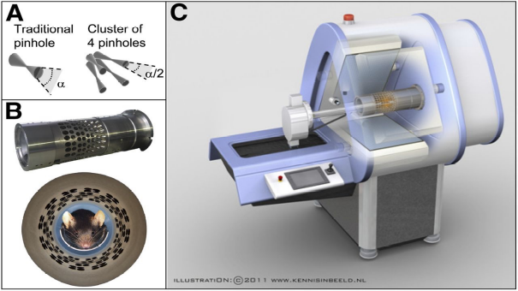
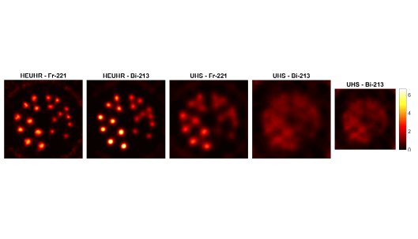
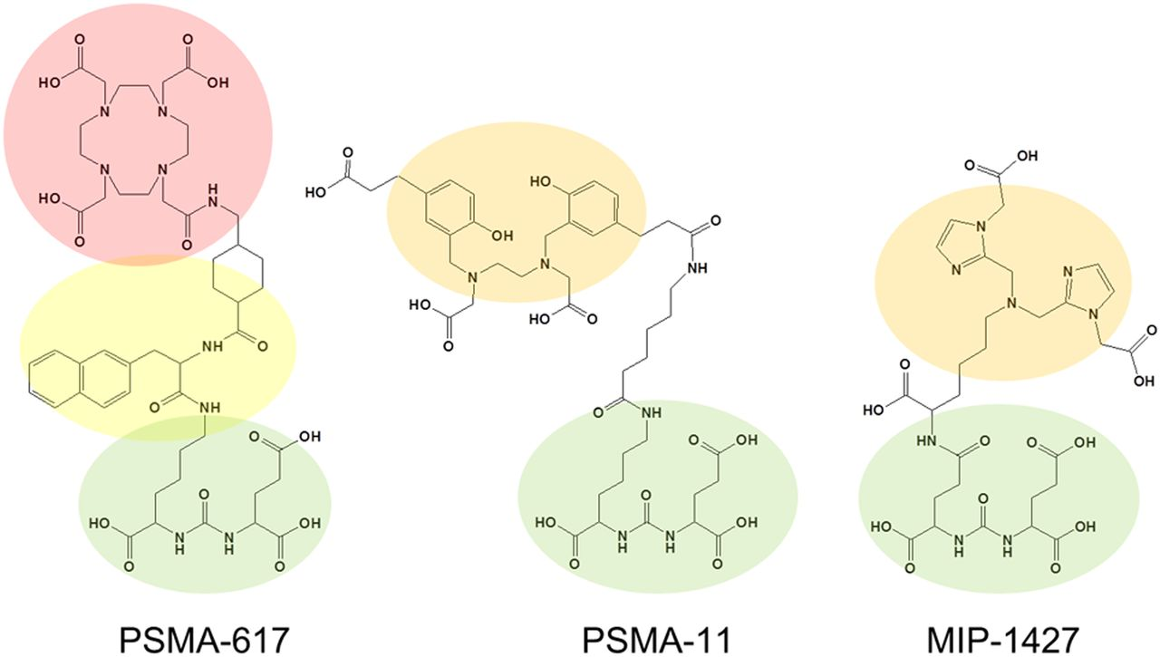

TRIUMF experience with ISAC derived ²²⁵Ac
New ligands design for
internalization approach
Encapsulation approach
Prof. Urs Hafeli
Prof. Chris Orvig
Polymers labeling with ²²⁵Ac
New ²²⁵Ac/²¹³Bi recoil
generator
²²⁵Ac
(alpha emitters)
Dr. Peter Kunz
Dr. Justin Wilson
In vivo distribution of
²²⁵Ac daughters
In vivo internalization approach
Prof. Francois Benard
Dr. Paul Schaffer
Prof. Vesna Sossi

Slide 9
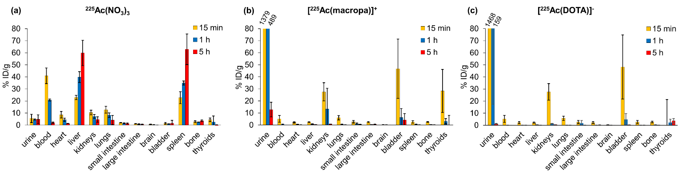
Testing of novel promising chelator for ²²⁵Ac
Biodistribution data of plain chelator labelled with ²²⁵Ac
(performed in collaboration with CCM at UBC)
Collaboration effort
with group of Prof. J. Wilson
TRIUMF ISAC source of ²²⁵Ac was used to test
promising chelators
Macropa showed significant advantage in labeling conditions
over existing “gold standard” DOTA
Bifunctional version of this chelate was synthesized and tested
in vitro and in vivo
Thiele N.A. et al. An Eighteen‐Membered Macrocyclic Ligand for Actinium‐225 Targeted Alpha Therapy Angew Chem Int Ed Engl. 2017 doi: 10.1002/anie.201709532.

Slide 10
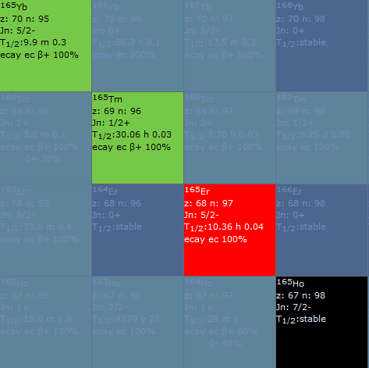
¹⁶⁵Er: motivation
Er 165
10.4 h
ε: 100.00 %
γ
g
¹⁶⁵Er t_{1/2} 10.4 h
Appropriate half-life for Targeted Radionuclide Therapy
Absence of other accompanying emissions except X-ray
Number and energy of auger electrons
Electrons:
Energy (keV) |  | Intensity (%) | Dose ( MeV/Bq-s )
Auger L | 5.33 | 65.6 % | 0.00350
Auger K | 38.4 | 4.8 % | 0.00184
Gamma and X-ray radiation
Energy (keV) |  | Intensity (%) | Dose ( MeV/Bq-s )
XR kα1 | 47.547 | 37.9 % | 0.0180
XR kβ3 | 53.695 | 3.99 % | 0.00214
Using ¹⁶⁵Ho target the ¹⁶⁵Er can be produced in clinical quantities (GBq’s) by low energy (13-19 MeV) cyclotrons
(future plan)
Ildiko Kalomista

Slide 11
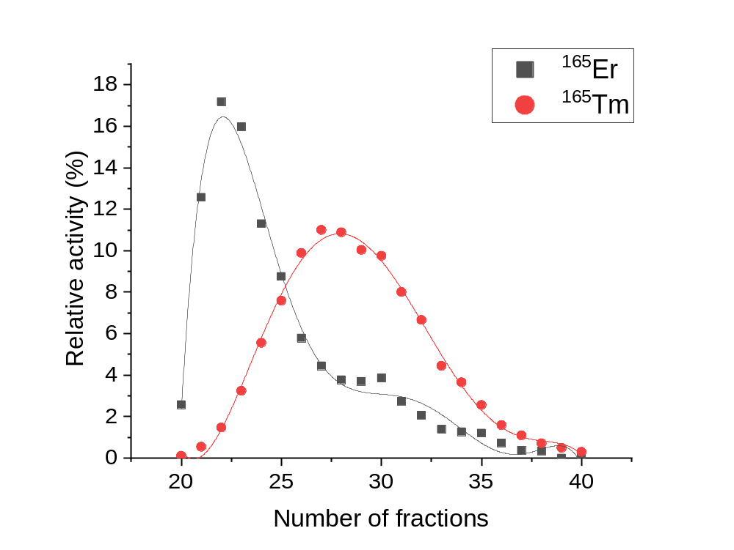
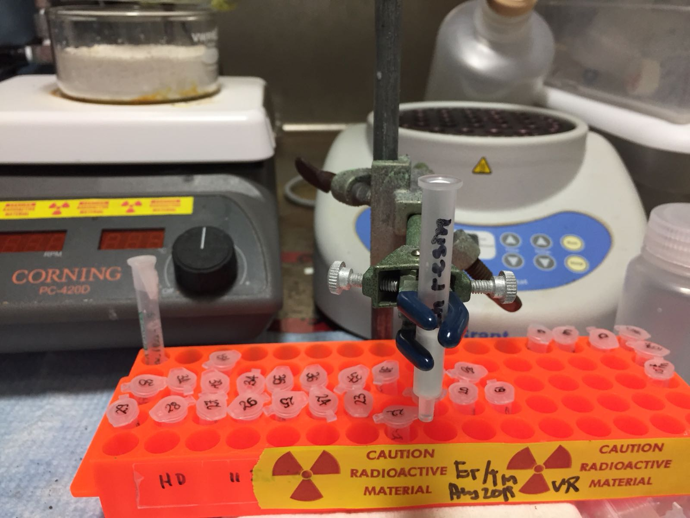
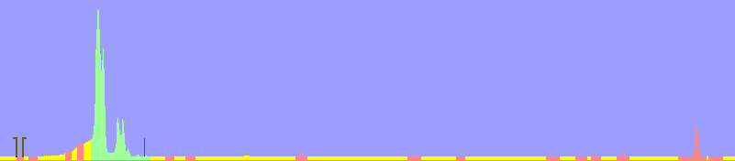

Separation of ¹⁶⁵Er/¹⁶⁵Tm
Ln resin (100 mg)
V=200 μL
Load – 0.25 M HCl media
Elution with 1.0 M HCl media
Fraction 1-19 → no separation
Before column (load solution)
Fraction 22 (highest ¹⁶⁵Er content)
Elution – 3.0 M HNO₃
Fraction 20-40
¹⁶⁵Er
¹⁶⁵Tm
¹⁶⁵Er
¹⁶⁵Tm
Ildiko Kalomista

Slide 12
Production of medical radionuclides at TRIUMF: ARIEL
TR-13
ISAC
Isotope Production Facility (IPF), BL1A
ARIEL
Collection chamber
Proton and electron beamlines
IAMI
TR-24

Slide 13
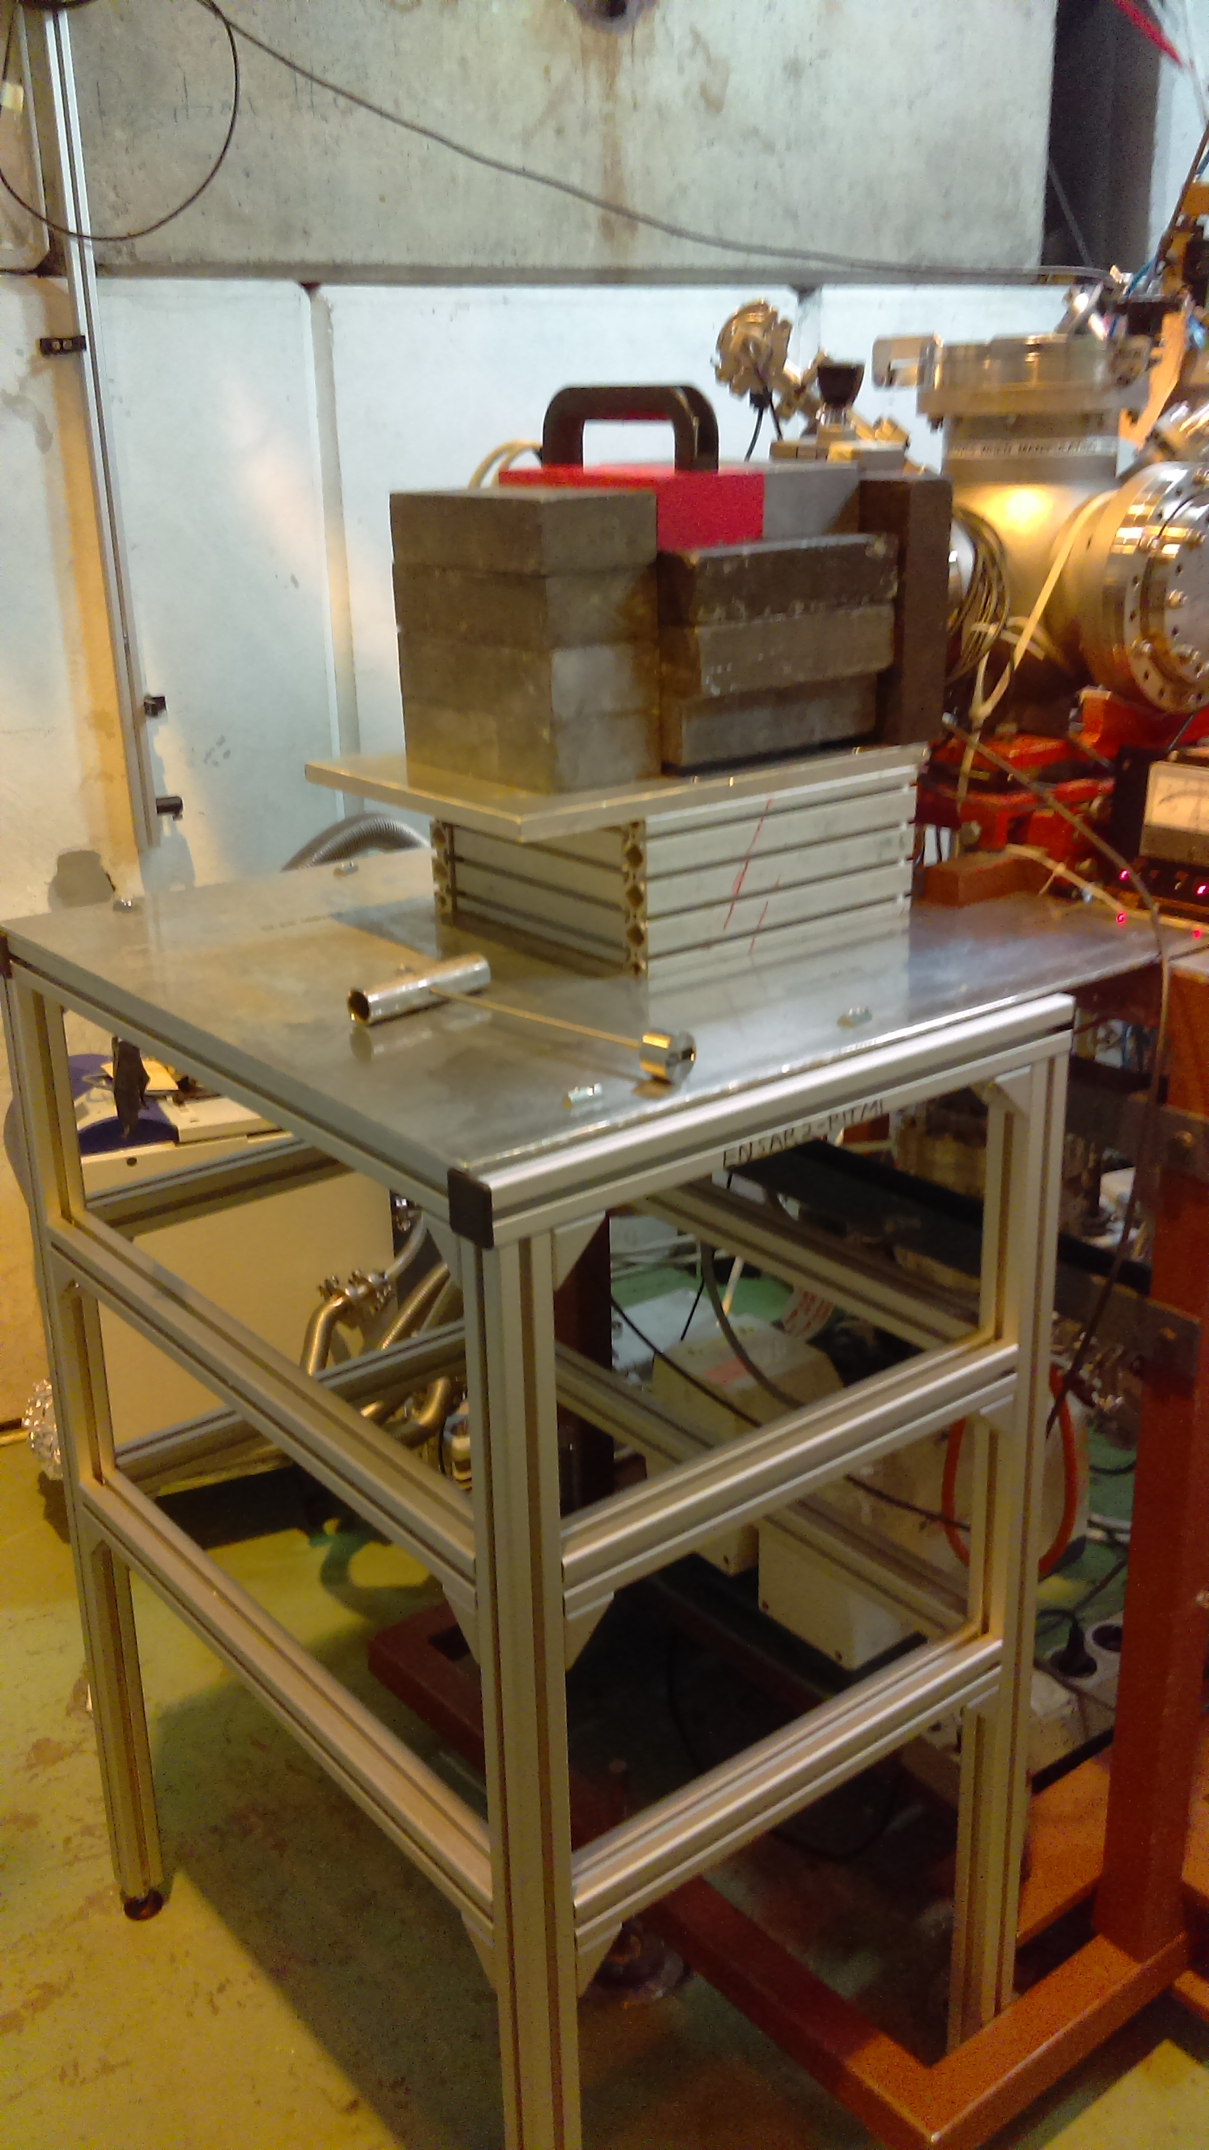
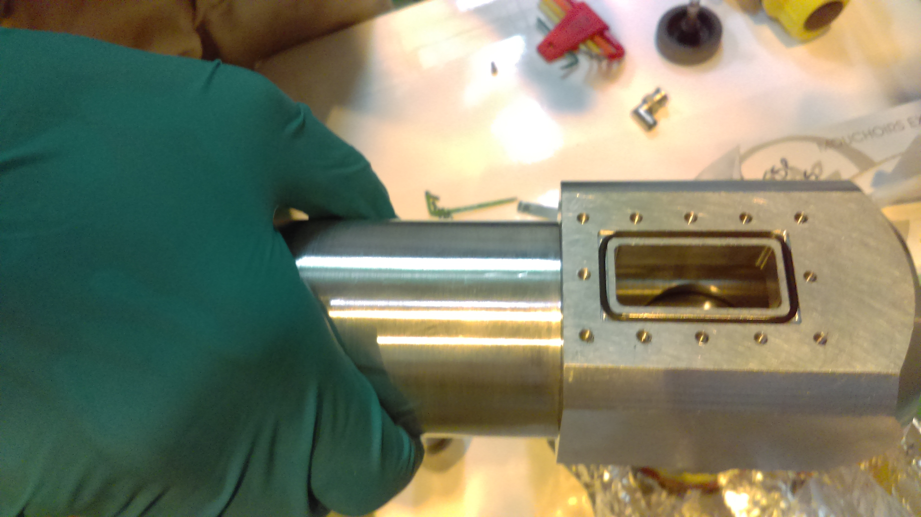
ARIEL implantation chamber
ARIEL implantation station:
- Will allow more time for medical
isotopes collection
More robust/advanced implantation
chamber
More appropriate collection
environment
(Liquid, ice, salts, etc.)
- Larger activities can be collected
- Broader isotopes varieties
²²⁵Ra/²²⁵Ac/²¹³Bi, ²¹¹At,
²²⁴Ra/²¹²Pb/²¹²Bi, ^{149,152, 155, 161}Tb, ¹⁶⁶Ho,¹⁶⁷Tm, ^{169,175}Yb,
medical isotopes implantation
chamber designed by Ulli Koester
(CERN)
ISOLDE medical isotopes
implantation station

Slide 14

Acknowledgments
TRIUMF
Pierre Bricault
Victoria Brown
Jason Crawford
John D’Auria
Alex Gottberg
Linda Graham
Conny Hoehr
Joe Huser
Una Jermilova
Yetvart Hosepyan
Reiner Kruecken
Peter Kunz
Keith Ladouceur
David Prevost
Louis Moskven
Jozef Orzechowski
Caterina Ramogida
Andrew Robertson
Tom Ruth
Paul Schaffer
Monika Stachura
Samuel Varah
UBC chemistry
Chris Orvig
Orvig group
British Columbia Cancer Agency
Francois Benard
Kuo-Shyan Lin
Bernard and Lin labs

Slide 15




Thank you
Merci
www.triumf.ca
Follow us @TRIUMFLab

