Slide 1
Report to WG9
Bradley Sherrill Associate Director for Fragment Separation sherrill@frib.msu.edu
27 May 2025

Slide 2
Outline
FRIB Overview – The Facility for Rare Isotope Beams is a US Department of Energy User Facility open to scientists from around the world (one of 28 user facilities; other NP facilities RHIC, JLAB, ATLAS)
Our mission is to support scientific users
Summary of Secondary Beams Delivered
Summary of the First Three FRIB PACs
FRIB Users are Publishing Science Results in High-Impact Journals
FRIB Power Ramp Up and Equipment Upgrade Plans
Summary of the energy upgrade plans to 400 MeV/u, FRIB400

Slide 3
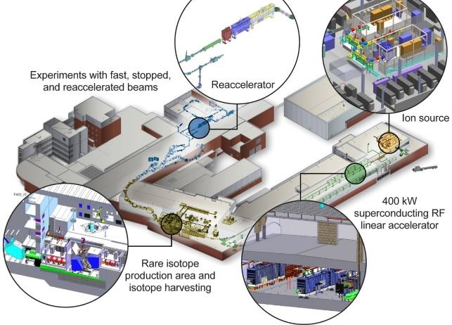
The Facility For Rare Isotope Beams – US DOE User Facility
FRIB’s key feature is 400 kW beam power
8 p𝜇A or 5 x 10¹³ ²³⁸U /s
42 p𝜇A or 2.6 x 10¹⁴ ⁴⁸Ca /s
Range of beam energies
Fast – 20 to 200 MeV/u
Stopped – 10 kV
Reaccelerated – 3-10 MeV/u
Funded for 4,000 hours/y of operation
Run about 2,000/y for single event upset studies
FRIB Users Organization, FRIBUO, with 1,800 members
Isotope harvesting capability ( e.g., from beam dump water)
1 experiment completed so far (see talk of G Severin)
Thomas Glasmacher, FRIB Laboratory Director

Slide 4
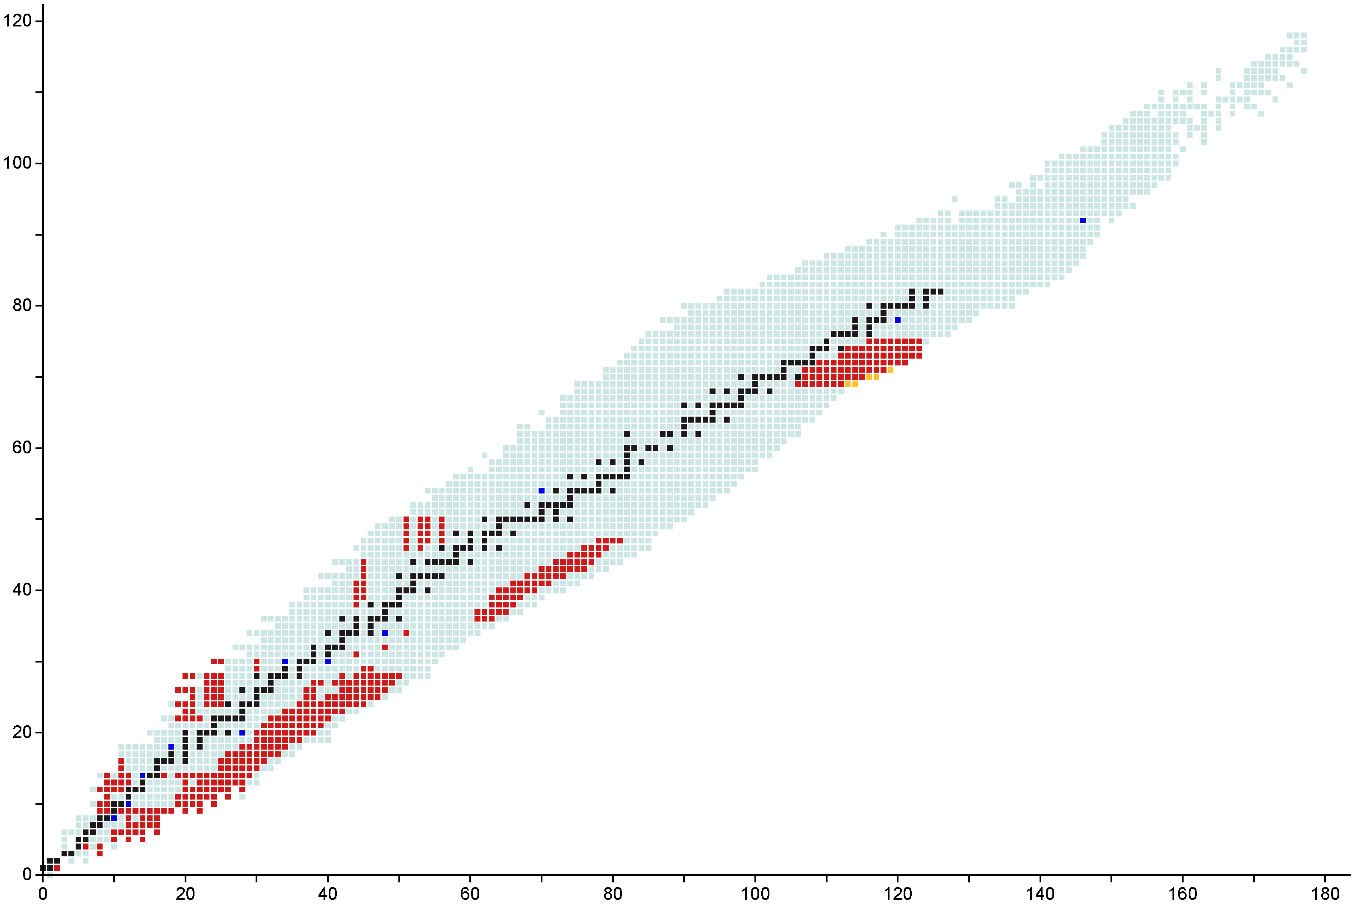
410 Rare Isotope Beams Delivered for Experiments
Approximately 410 Rare Isotope Beams Delivered to FRIB users from May 2022 to May 2025
For the last year, 6081 scheduled operating beam hours at 95.% availability
Beam rates have ranged from 10⁹/s to 10⁻⁵/s
Some experiments use “cocktails” while others use a pure single-isotope beam
Experiments since January 2025:
E23076: ⁶⁸⁻⁷¹Co, ⁷⁰Ni E23055: ⁵⁶⁻⁶²Ti, ⁵⁹⁻⁶⁵V, ⁶²⁻⁶⁹Cr, ⁶⁵⁻⁷²Mn, ⁶⁸⁻⁷⁴Fe, ⁷¹⁻⁷⁶Co, ⁷⁴⁻⁷⁸Ni
E21035: ⁹⁷⁻⁹⁹Kr, ⁹⁸⁻¹⁰²Rb, ¹⁰¹⁻¹⁰⁴Sr, ¹⁰²⁻¹⁰⁶Y, ¹⁰⁴⁻¹⁰⁹Zr, ¹⁰⁷⁻¹¹²Nb, ¹¹⁰⁻¹¹⁵Mo, ¹¹³⁻¹¹⁹Tc, ¹¹⁶⁻¹²¹Ru, ¹¹⁹⁻¹²³Rh, ¹²²⁻¹²⁵Pd, ¹²⁵⁻¹²⁸Ag E21056: ³H
E23023: ⁴¹⁻⁴³Ti, ^{43,44}V, ^{43-45,47-49}Cr, ^{46,48-50}Mn, ^{45-47,49-51}Fe, ^{48,49, 51-53}Ni, ⁵⁴⁻⁵⁵Zn
E21049: ^{97,99}Pd, ^{98,100}Ag, ^{99,101}Cd, ^{100,102}In, ^{101,103}Sn
E21038: ⁴²⁻⁴⁴Ti, ^{43,44}V, ⁴³⁻⁴⁵Cr, ⁴⁶Mn, ⁴⁵⁻⁴⁷Fe, ^{48,49}Ni
E23063: ^{31,33-36,38}Si
Protons
Primary Beams
¹⁸O
²²Ne
²⁸Si
³⁶Ar
⁴⁸Ca
⁶⁴Zn
⁷⁰Zn
⁸²Se
¹²⁴Xe
¹⁹⁸Pt
²³⁸U
^{182,183}Tm, ^{186,187}Yb, ¹⁹⁰Lu
Stable isotopes
Primary Beams
Observed isotopes
Experiments at FRIB
Discovered at FRIB
Data Date: 2025-05-05
Neutrons

Slide 5
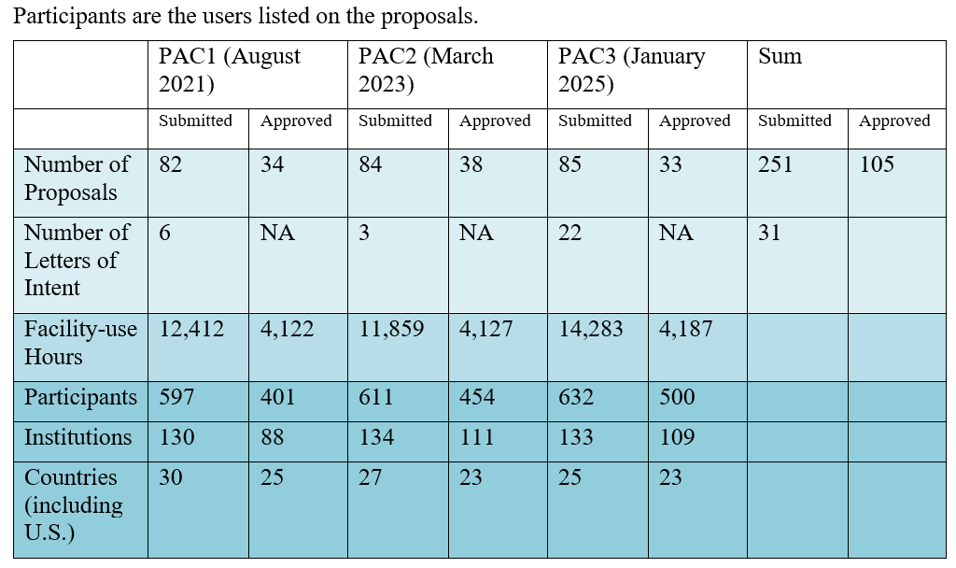
FRIB Has Had Three Program Advisory Committee Meetings
FRIB continues to be oversubscribed by 3:1
User are unique individuals listed on proposals
Proposals are fairly evenly divided between instruments and fast, stopped and reaccelerated beams

Slide 6
FRIB Scientific Results
58 experiment have run since May 2022
Many results have been presented in talks at this conference
Spectroscopy of rare isotopes with the Active Target Time Projection Chamber D. Bazin et al.
Study of the full electric dipole strength of the double halo nucleus ¹¹Li J.M Lopez Gonzalez
A foundation model for TPC data M. Kuchera et al.
β-delayed 2p emission E. Jensen et al.
Lifetime measurements in N=Z ⁸⁸Ru M. Bentley et al.
Investigations near N=20 using nucleon transfer reactions with HELIOS and SOLARIS (FRIB Reaccelerator) N. Watwood et al.
²²Al, ²³Si, ^{101,103}Sn, … Mass measurements F.M. Maier et al.
Structure within the N=40 island of inversion H. Crawford et al.
…

Slide 7
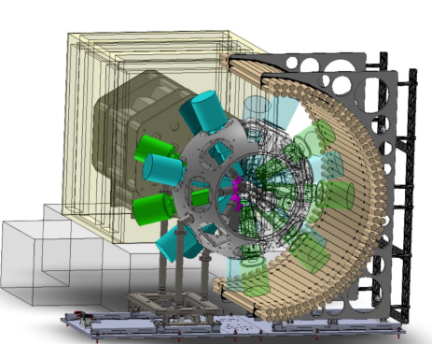
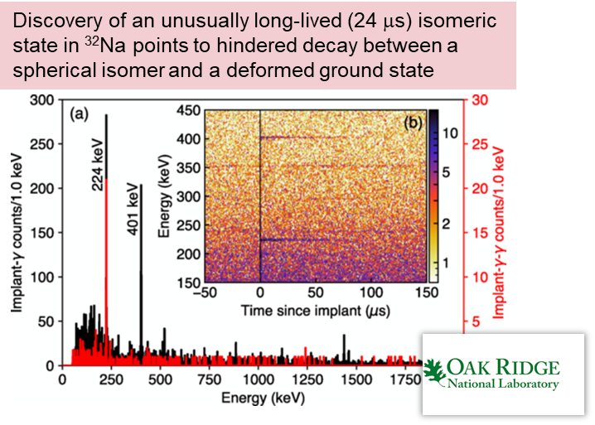
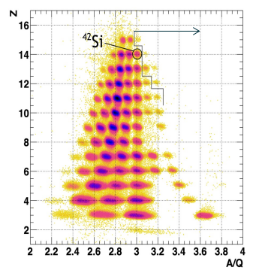
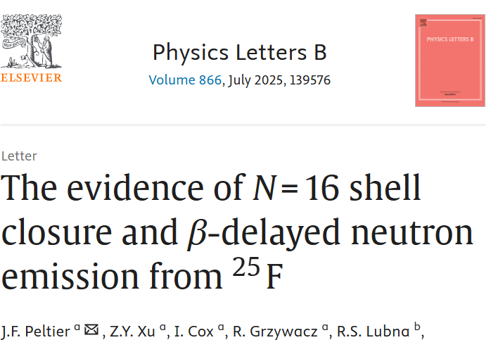
FRIB Decay Station Initiator: FDSi Published Results
FDSi
Phys. Rev. Lett. 132, 152503 (2024)
Phys. Rev. Lett. 130, 242501 (2023)
Phys. Rev. Lett. 129, 212501 (2022)
³⁹Mg Short Half-life
Published in Nov 22
et al.

Slide 8
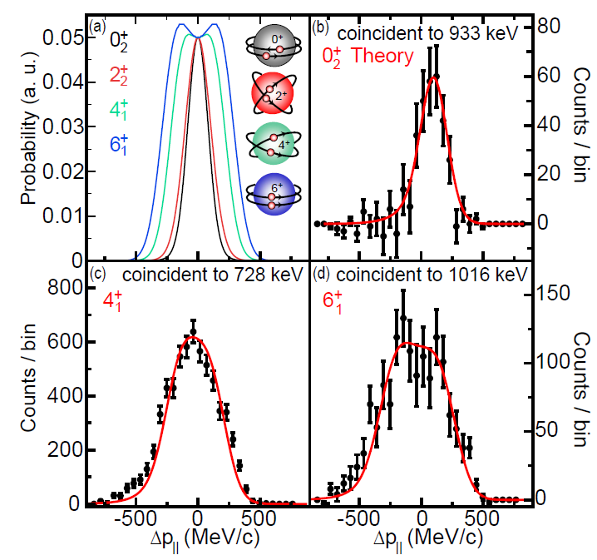
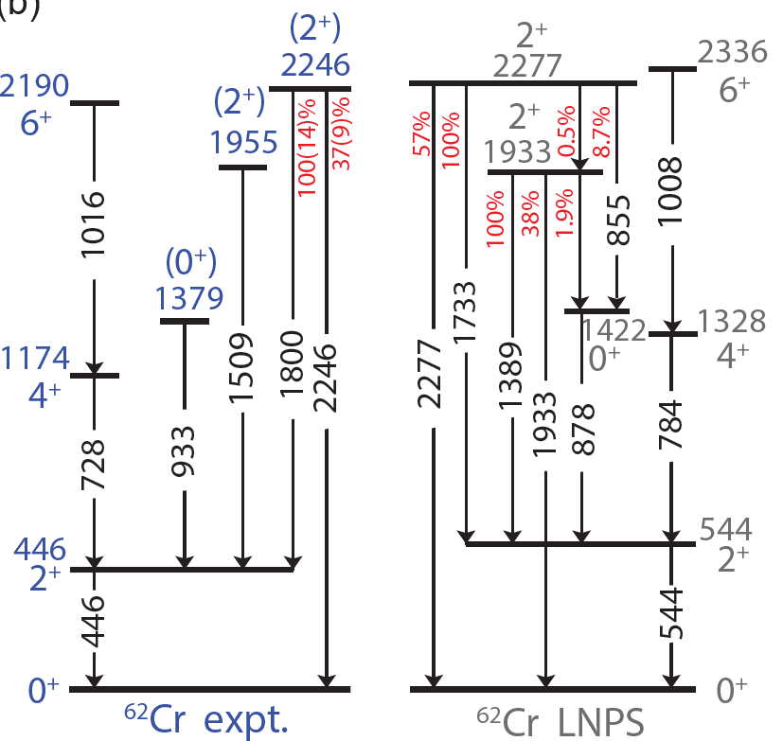
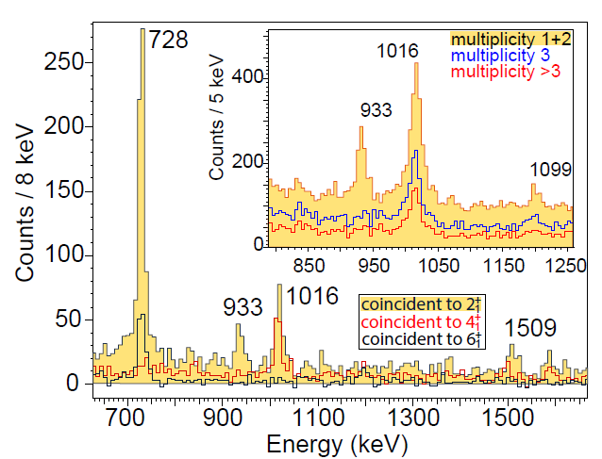
First in-beam spectroscopy at the FRIB reveals competing nuclear shapes in the rare isotope ⁶²Cr
GRETA gamma-ray array has been a powerful tool
Calculations allowing excitations across N=40 lead to discovery of potentially interesting collective structures
Find and characterize the 0⁺ states in ⁶²Cr
Measure longitudinal momentum distributions of ⁶²Cr in ⁹Be(⁶⁴Fe,⁶²Cr+γ) are sensitive to the final-state J
A. Gade et al., Nature Physics (2024)

Slide 9
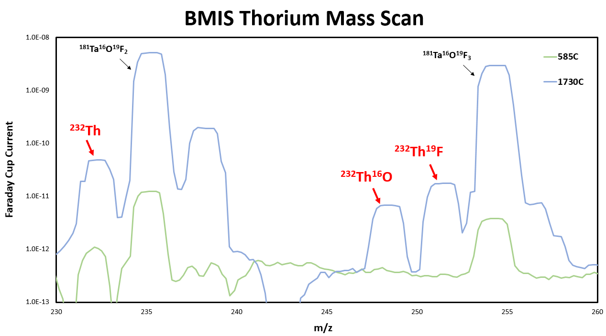
First Measurements On The Path to Using Molecules That Contain Heavy Rare Isotopes Have Begun
^{229,232}Th, ^{229,232}ThO, and ^{229,232}ThF beams are isotopes of interest for beyond-standard-model studies
MIT-led PAC-recommended laser spectroscopy experiments with RISE/BECOLA facility started
Rotational and hyperfine structure of the molecules ^{229,232}ThO and ^{229,232}ThF for future studies of symmetry-violating nuclear properties
FRIB’s nuclear chemistry group synthesized suitable Th compound with for use in batch mode ion source – Th, ThO, ThF delivery confirmed
Longer term: Isotope harvesting will provide research quantities of Th and other candidate isotopes that the batch mode ion source can provided for a range of fundamental symmetry studies
Various efforts in exploratory stages, aspiring different radioactive molecules and trapping approaches from ranging from Penning traps to capturing candidate nuclei in a solid noble-gas matrix.
Engaged community is scientifically very diverse and skills needed straddle nuclear physics, AMO, radiochemistry, computational quantum chemistry, nuclear many-body theory …
Garcia Ruiz Lab
Mass separator scan after the batch-mode ion source for different oven temperature

Slide 10
FRIB Improvements Build of Operational Experience
6 Epochs defined in the process to reach full power – do not correspond to years
Epoch transitions are based on experience and hardware upgrades to address issues
We are currently operating in Epoch 2 at 20 kW
New beams added; ²⁸Si, ⁵⁶Ni, ²³⁸U
2 new vaults added
Epoch 3 will begin in FY2026 with 30-50 kW
New beams, e.g., ²⁰⁸Pb added
New beam dump
Epoch 4 – 50 kW
Epoch 5 – 100 kW
Epoch 6 – 200 kW to 400 kW

Slide 11
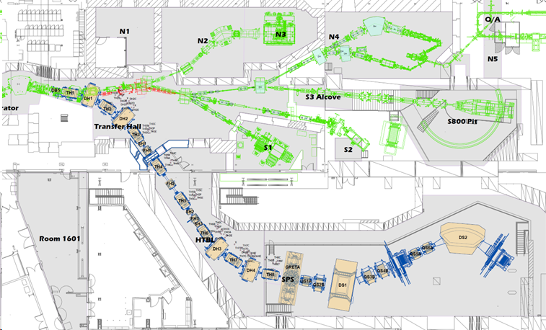
FRIB Major Equipment Upgrade – High Rigidity Spectrometer
New 8 Tm spectrometer for use with very neutron rich and high-energy beams
Multiple ion-optical modes optimize different experiments
Achromatic mode
Dispersion matching mode
Achromatic mode with intermediate beam image
HRS includes a High Transmission Beam Line (HTBL) and a Spectrometer (SPS)
HRS-HTBL under construction
SPS DOE Office of Project Assessment (OPA) Review in October

Slide 12
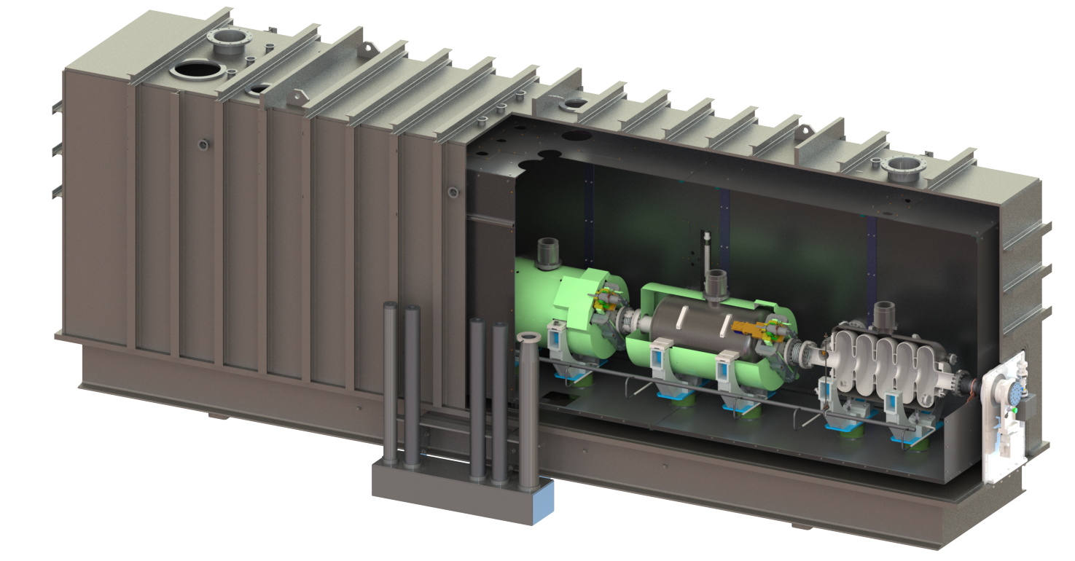
FRIB400 – Upgrade to 400 MeV/u Primary Beam Energy for Uranium will Expand Science Reach
FRIB was designed to allow addition cryomodules (shown in blue)
The upgrade would consist of 55 SC elliptical cavities (β_{OPT}=0.65, 644 MHz) in 11 cryomodules at 17.5 MV/m accelerating field
Addition would allow at least 400 MeV/u for all beams at 400 kW
Installation could be in phases with minimal facility down time
Proposed but not funded
Space in the FRIB tunnel for the needed 11 cryomodules – lends itself to staged implementation

Slide 13
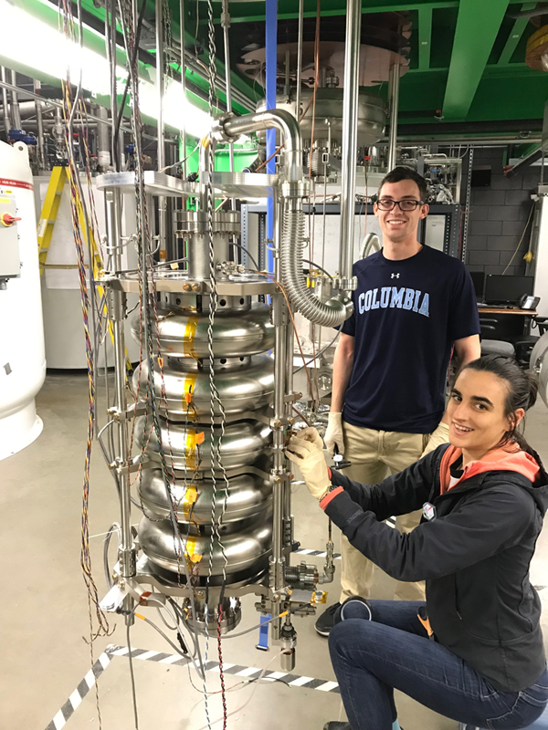
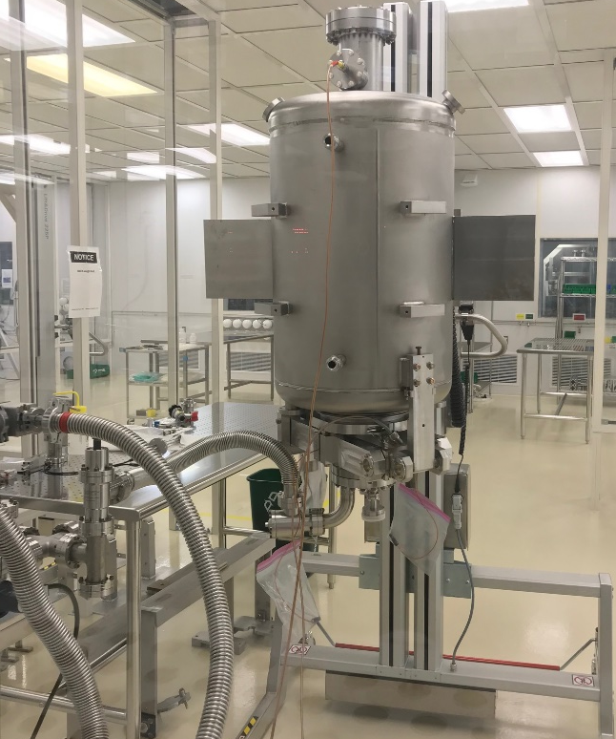
R&D for FRIB400 is Progressing Well
P. Ostroumov et al.
Technology being demonstrated
High-Q is demonstrated with nitrogen doping and mid-T furnace baking
Fully-dressed cavity is ready for testing
Titanium He vessel
Combined tuner includes a stepper motor and piezo element
High power RF coupler is being developed
Two niobium cavities were tested multiple times and met specifications
The dressed cavity is being prepared for cold testing
Preparation for cold testing
Cavity in He vessel
Bare niobium cavity
Cryomodule

Slide 14
Summary
FRIB Overview – Facility for Rare Isotope Beams is a US Department of Energy User Facility open to scientists from around the world (one of 28 user facilities; other NP facilities RHIC, JLAB, ATLAS)
Our mission is to support scientific users
Summary of Secondary Beams Delivered
Summary of the First Three FRIB PACs
FRIB Users are Publishing Science Results in High-Impact Journals
FRIB Power Ramp Up and Equipment Upgrade Plans
Summary of the energy upgrade plans to 400 MeV/u, FRIB400

Slide 15
FRIB and FRIB400 beam energies

Slide 16
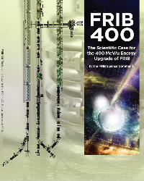
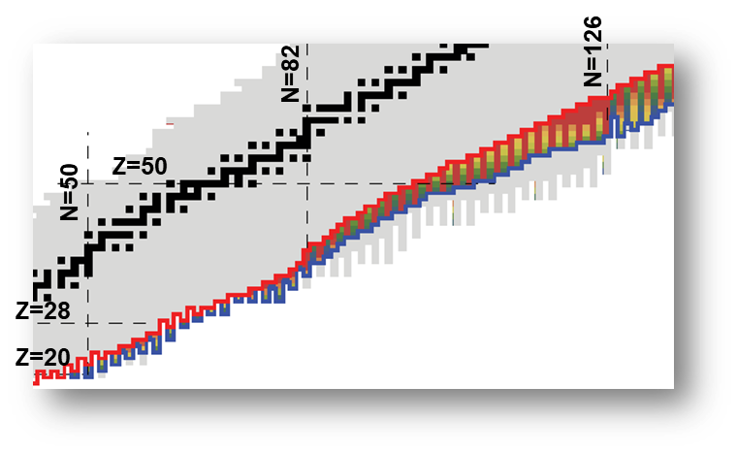
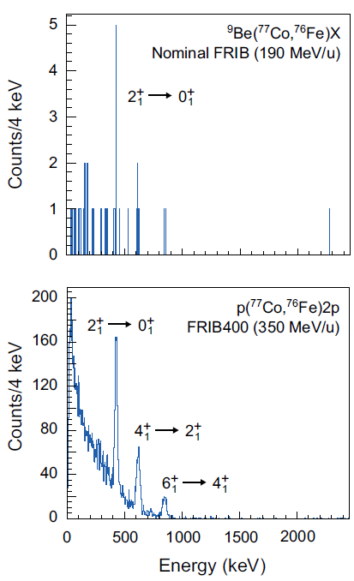
FRIB400 Would Expand Science Reach
www.frib.msu.edu
Major Science Themes:
Dense nuclear matter can be created and studied up to twice saturation density, relevant for neutron star modeling
Double the reach of FRIB along the neutron dripline from Z=30 to Z=60 into a region relevant for neutron-star crusts and to allow study of extreme, neutron-rich nuclei such as ⁷⁰Ca
The emergence of neutron-star mergers as a likely site of the r-process highlights the need to study the most neutron-rich isotopes. FRIB400 will significantly extend the study of these isotopes.
Nuclear reactions can be performed in an energy regime of optimum nuclear transparency, improving their interpretation by reaction theory.
FRIB400 will allow a kinematically-complete study of nuclear fission
FRIB400 will expand the scientific impact of harvested isotopes by increasing the available yield of many isotopes by factor 10
FRIB400 whitepaper: https://frib.msu.edu/_files/pdfs/frib400_final.pdf
FRIB400 might allow reaching the dripline up to Z=60 (Z=30 for FRIB)
FRIB400 will allow γ-ray spectroscopy with GRETA@HRS in regions out of reach at FRIB

