Slide 1
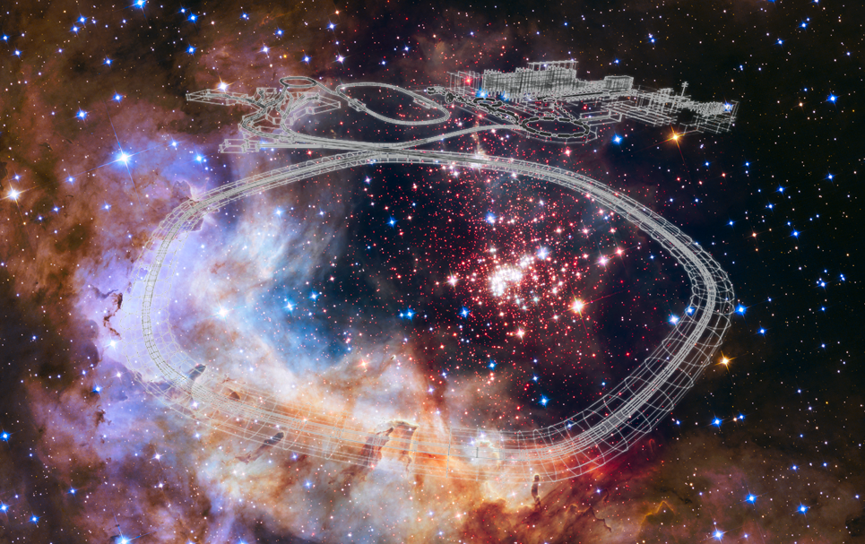


Status of FAIR
Yvonne Leifels
GSI Helmholtzzentrum für Schwerionenforschung, Darmstadt /
FAIR Facility for Antiproton and Ion Research

Slide 2

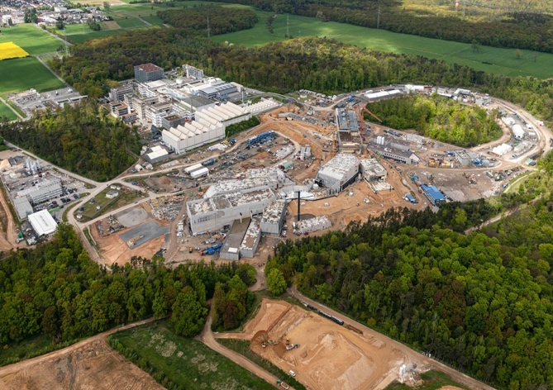
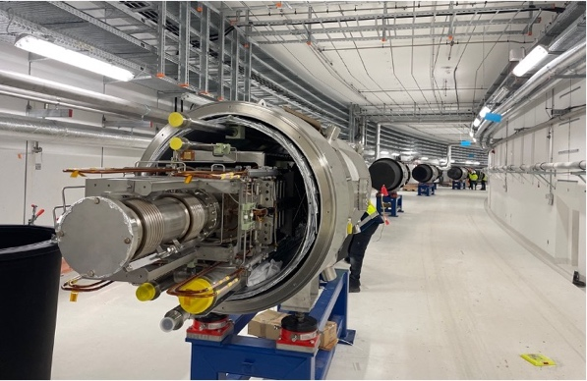
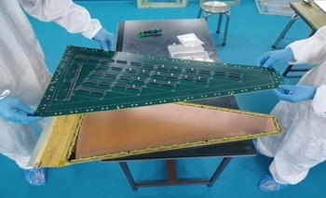
Outline
Introduction
Civil construction
  Concrete works completed
  Cables, ventilation, etc (TBI) ongoing
Accelerators
  Installations started beginning of 2024
Experiments
  On track for FAIR 2028
FAIR Commissioning
  Start in 2025
  First experiments with Super-FRS@SIS18 end of 2027/2028
SIS100
CRYO 2
CBM
S-FRS
NUSTAR HEB
April 2024, D. Fehrenz, GSI FAIR

Slide 3


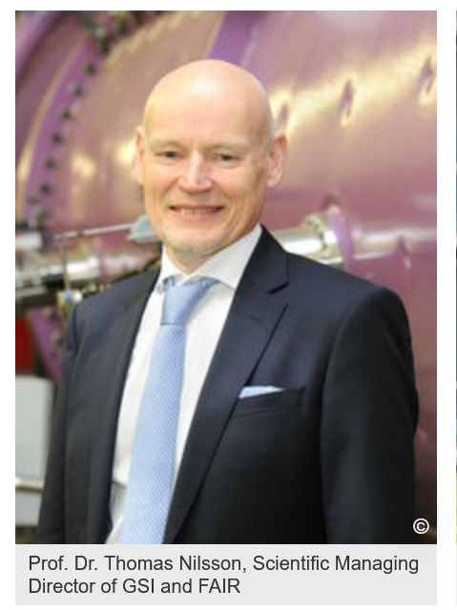
New management team

Slide 4
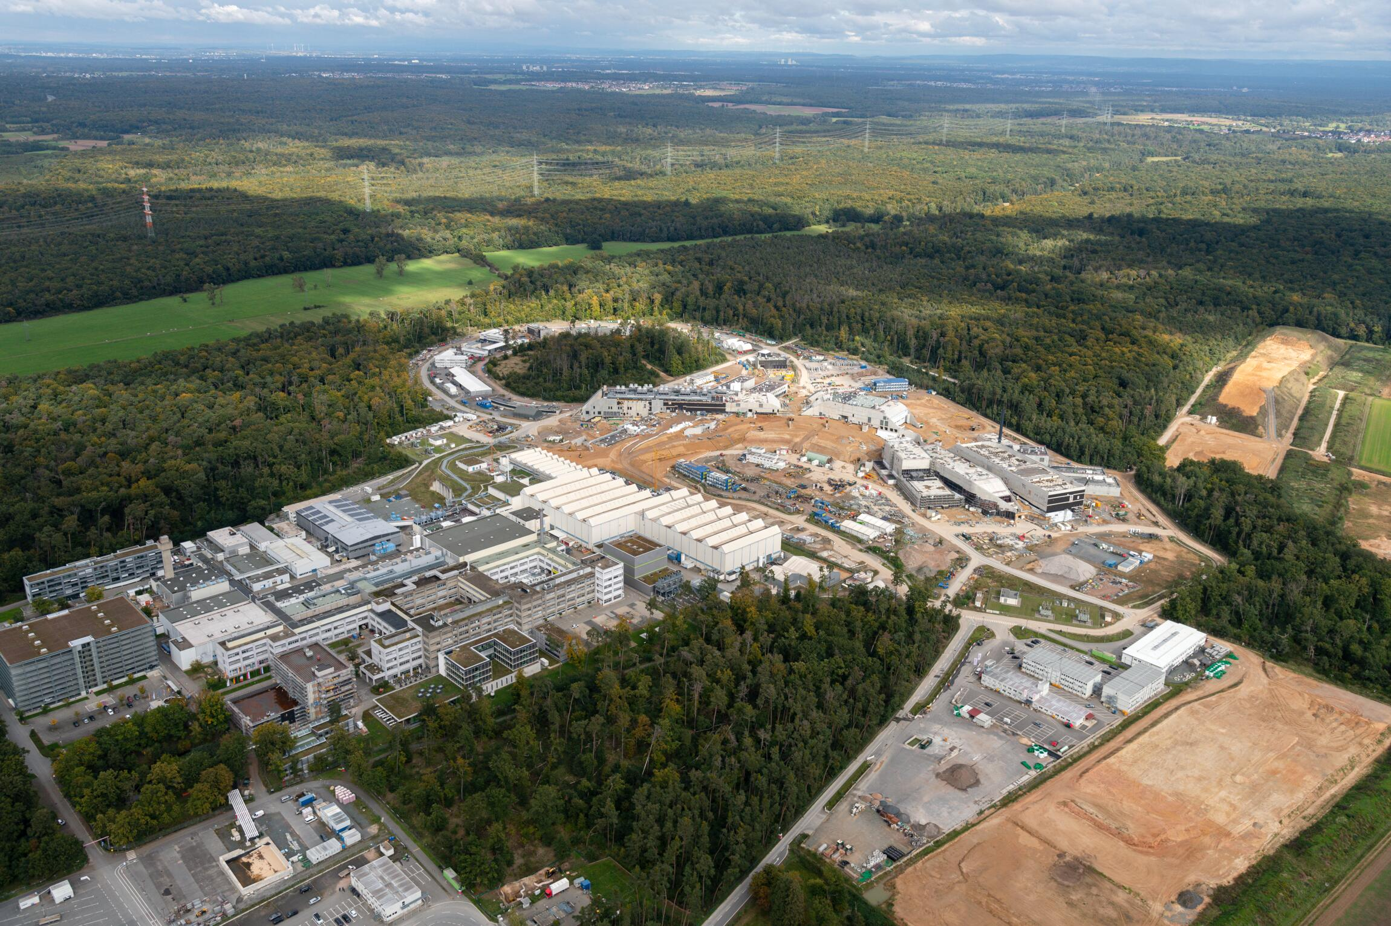
FAIR Facility for Antiproton and Ion Research
GSI Helmholtzzentrum
für Schwerionenforschung
Notes:
ESFRI Landmark and strategic goal of the nuclear physics community, 3000 users from more than 50 countries

Slide 5
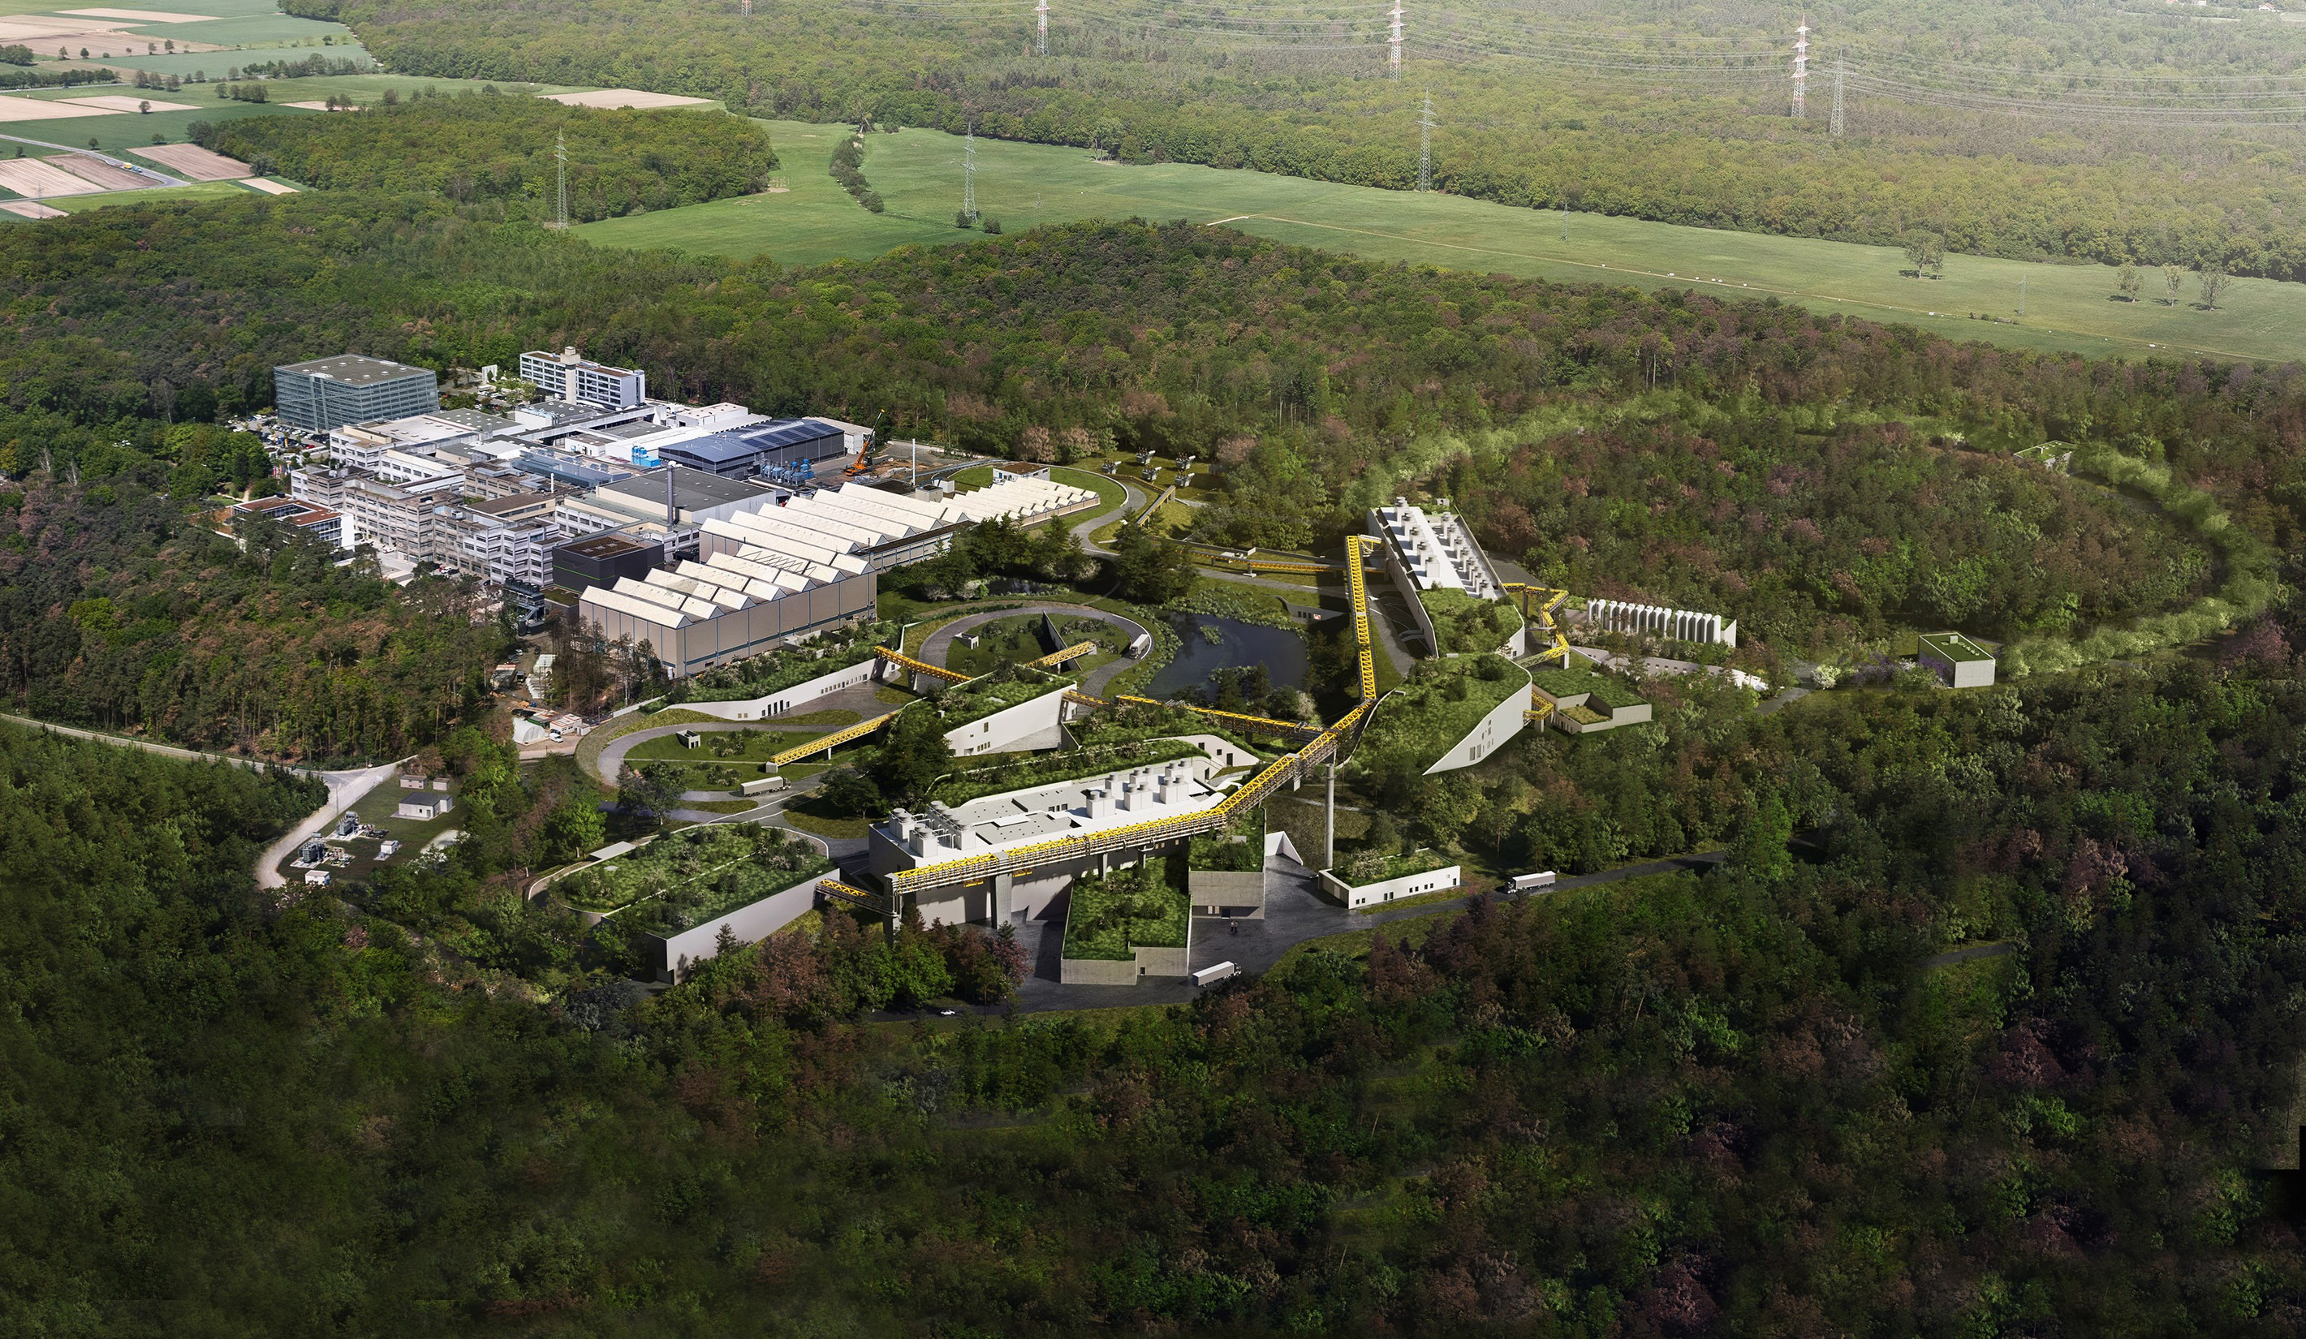
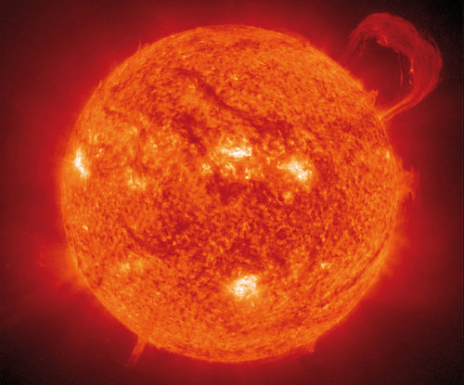

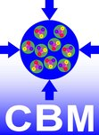
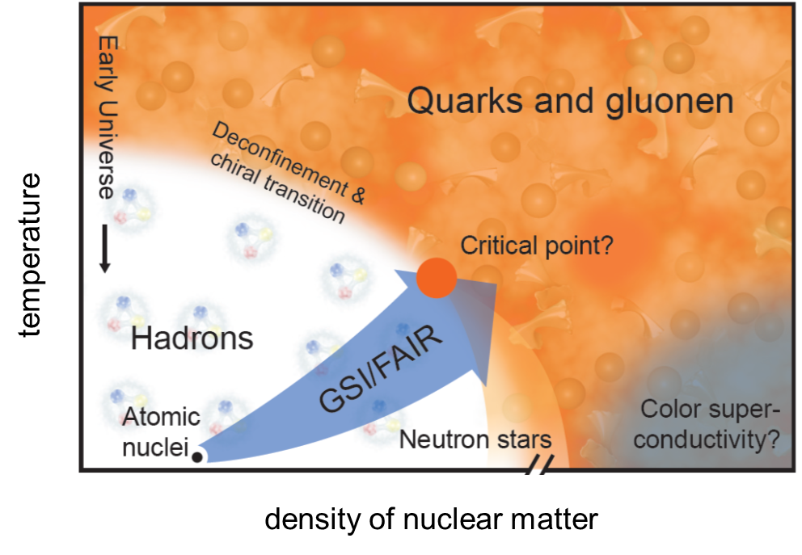

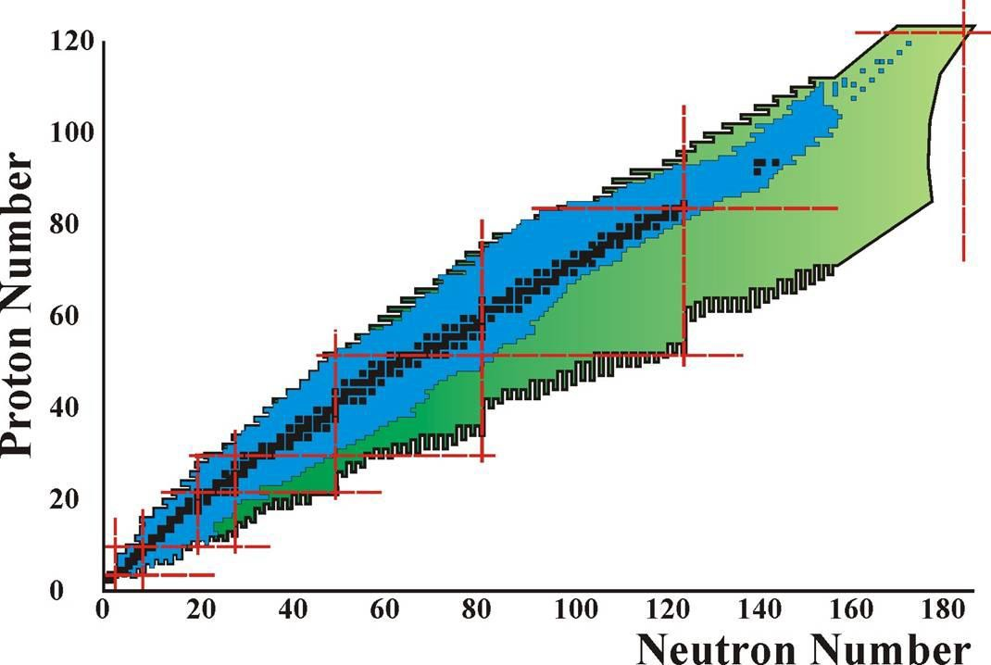

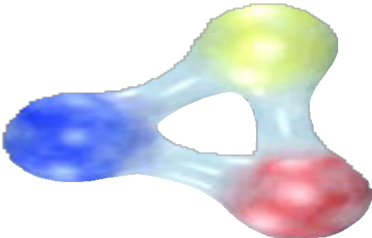


Slide 6
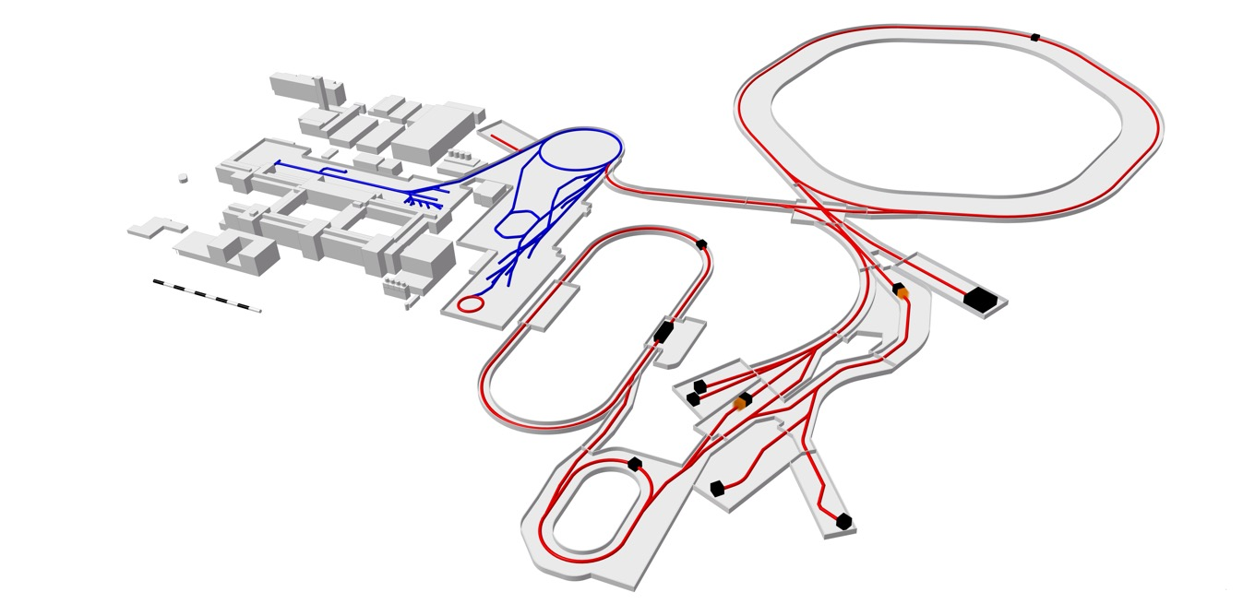
GSI and FAIR – Facilities
GSI, existing (upgraded to integrate with FAIR)
UNILAC
SIS !00
HITRAP
SIS18
FRS
ESR
100 m
CRYRING
HESR
ESR, CRYRING, & HITRAP are part of FAIR
Synchrotron SIS100
Super-FRS
Storage rings
Antiproton beams
Super FRS
CR

Slide 7
FAIR Status
CRYO2
SIS100
APPA
CBM
S-FRS
NUSTAR HEB
NUSTAR LEB

Slide 8
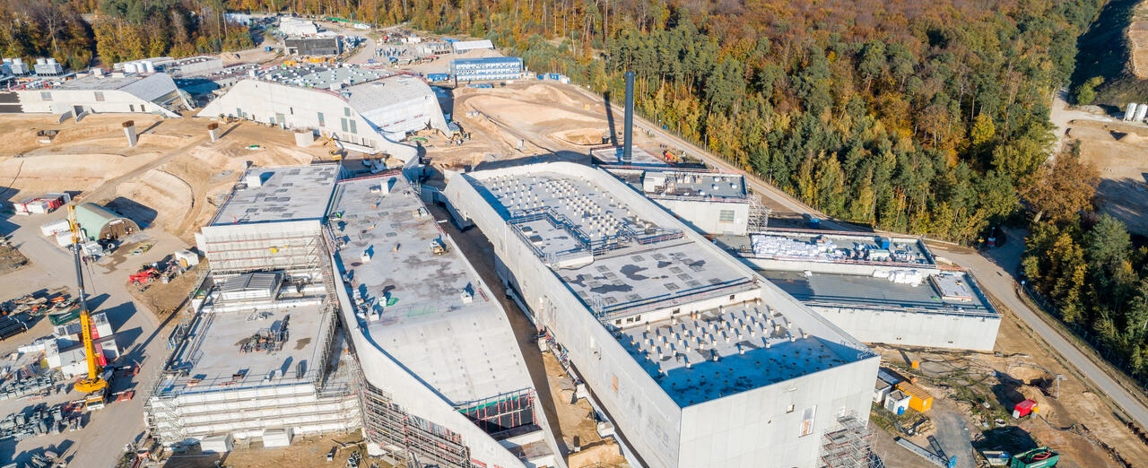
FAIR Progress – Civil Construction
View of south area with all buildings completed and soil modelling in progress

Slide 9
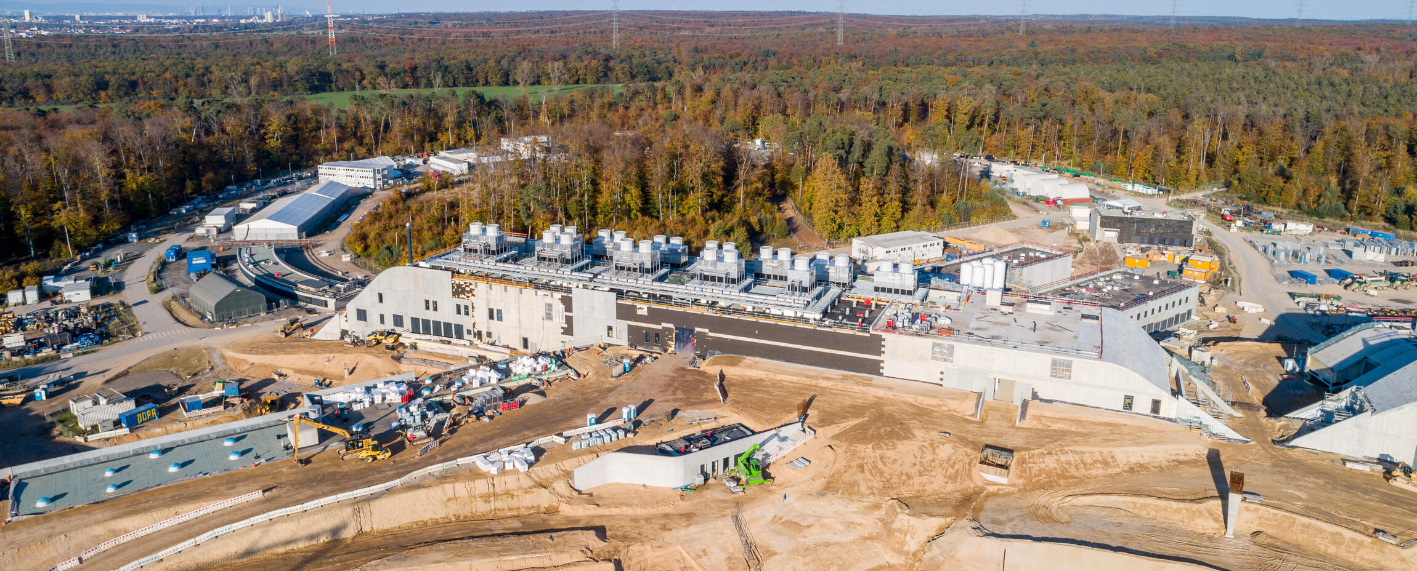
FAIR Progress – Civil Construction
View of north area (SIS100) with all buildings completed

Slide 10
FAIR Project – Civil Construction
Central transfer building

Slide 11
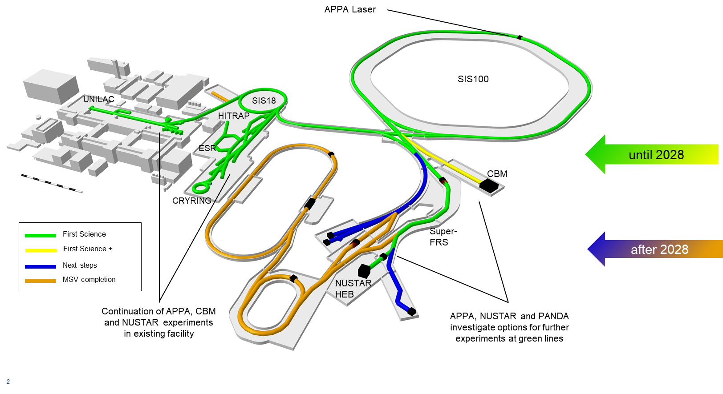
FAIR Project - Current Scope

Slide 12
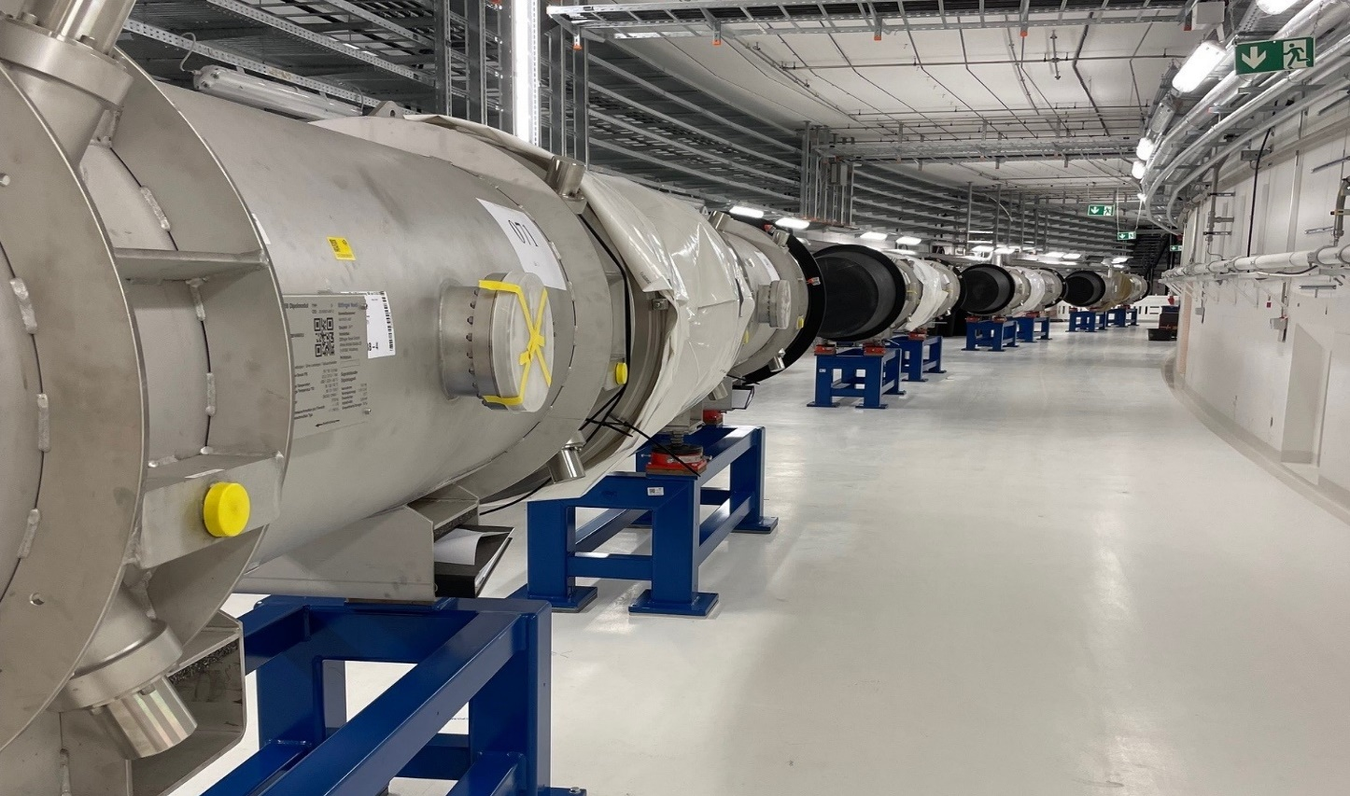
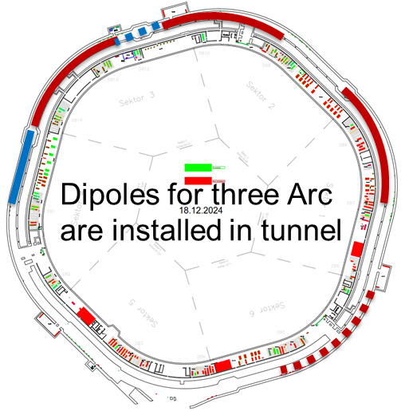
FAIR Progress – Accelerators
SIS100

Slide 13
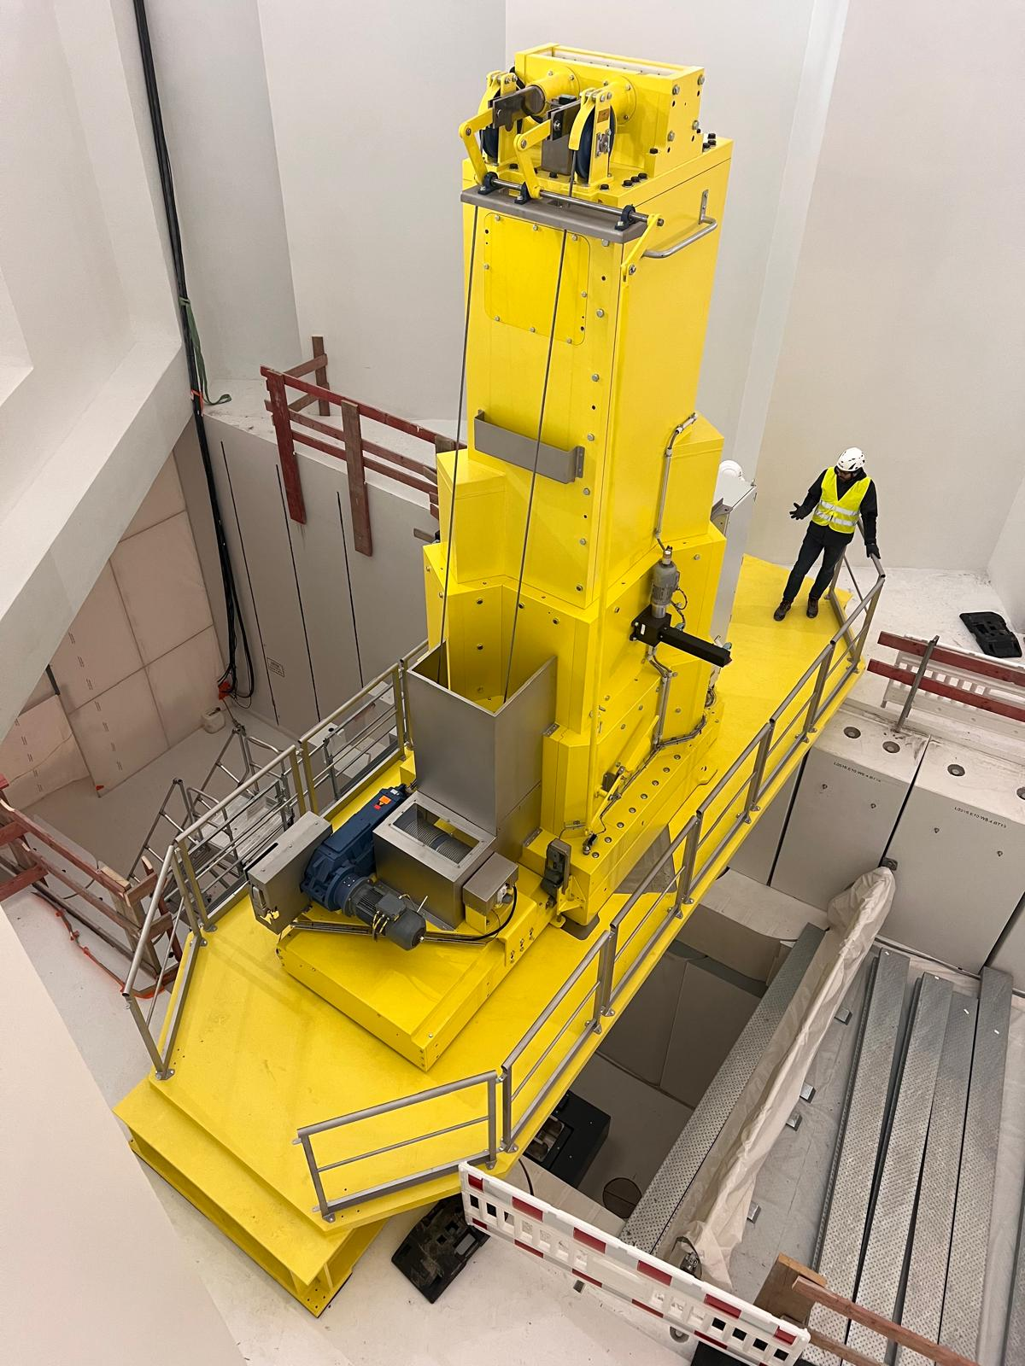
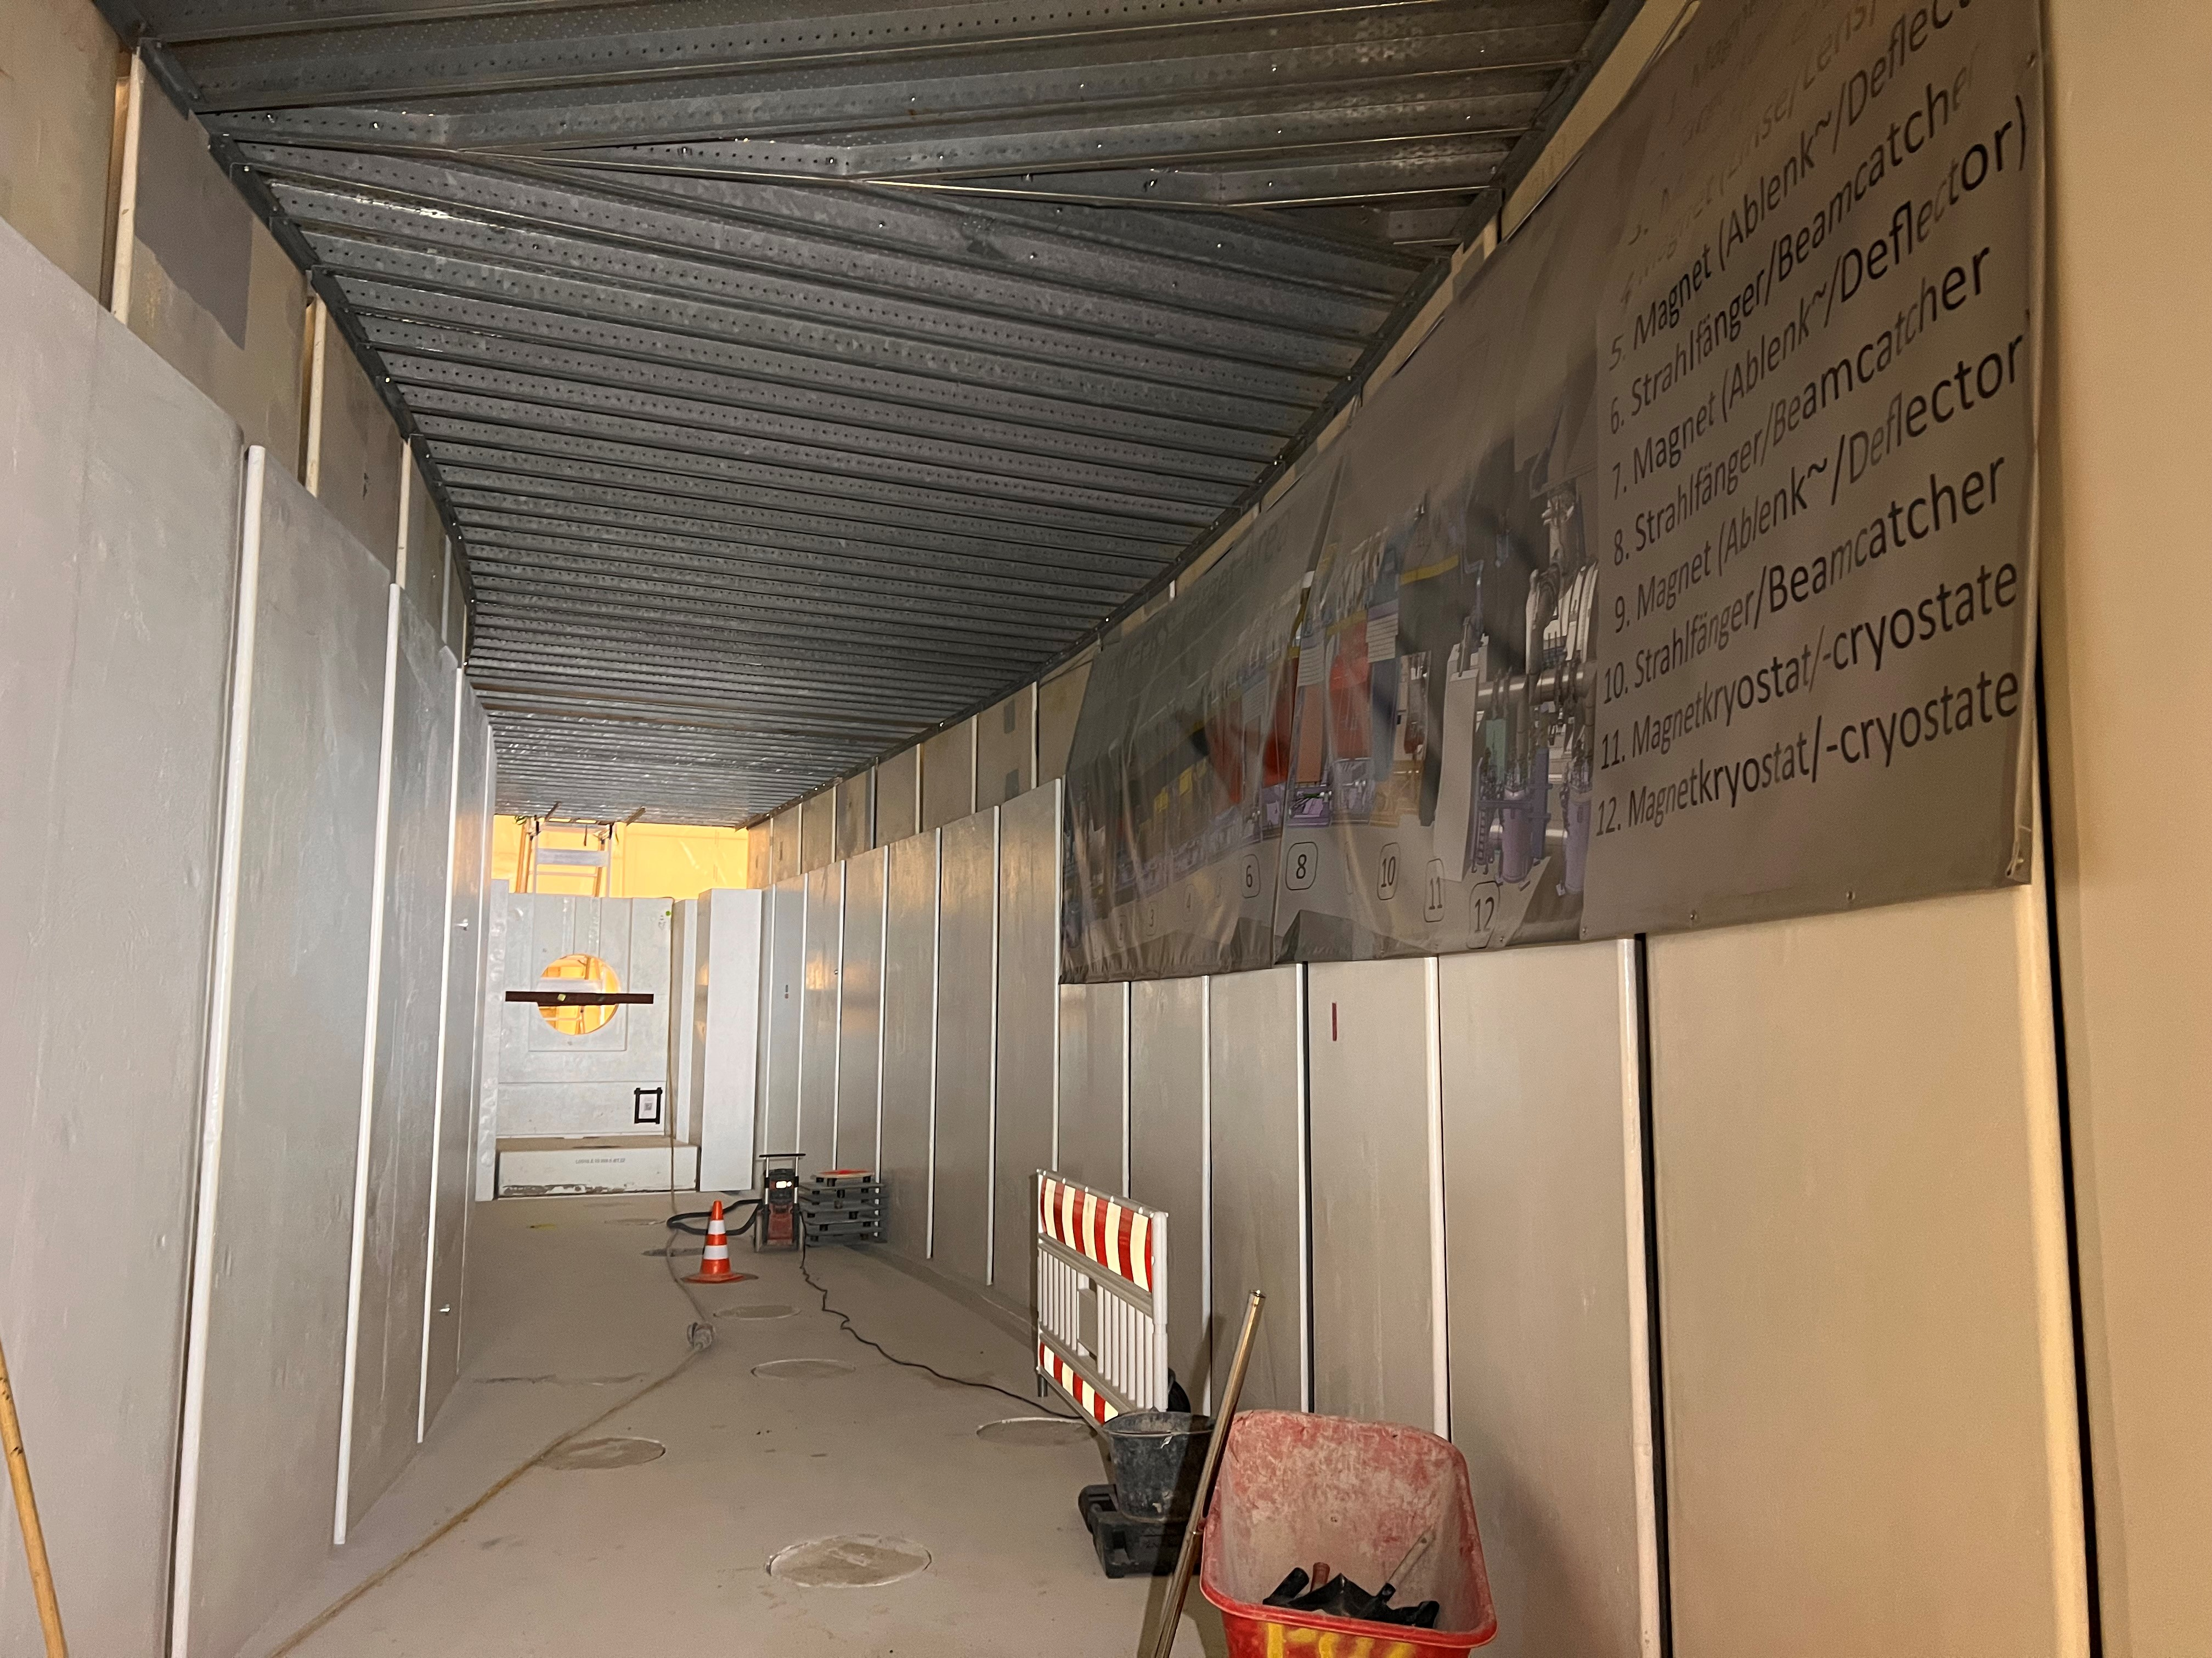
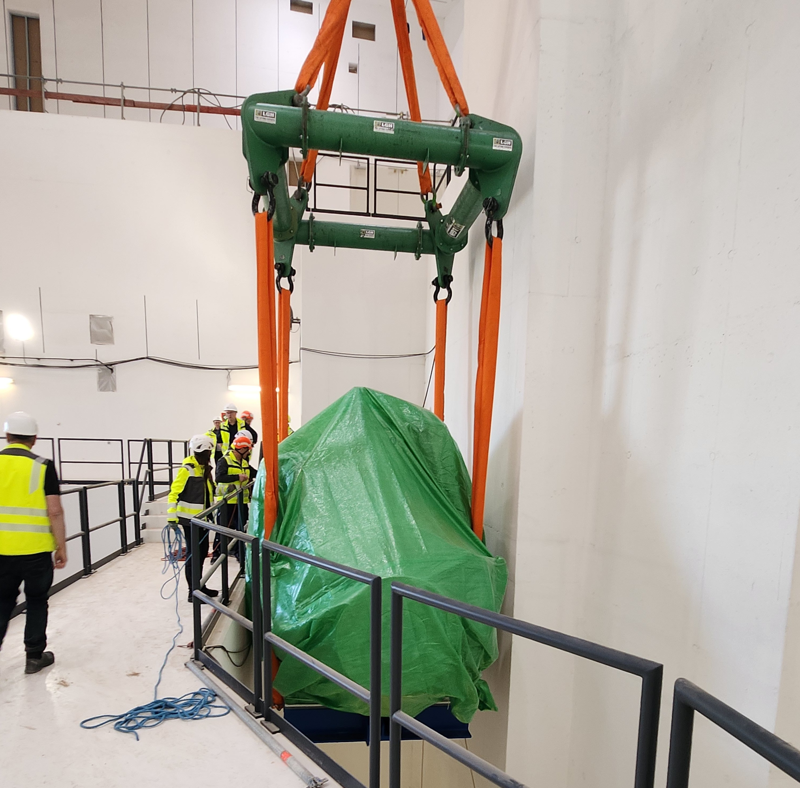
FAIR Progress - Accelerators
Super-Fragment Separator
Target area
Low energy branch
High energy
branch
Lateral shielding installed
Target flask installed
CR
Experimental sites
Installation 1st multiplett

Slide 14
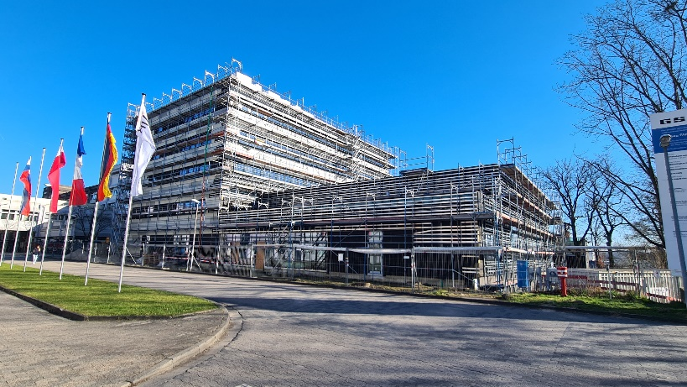
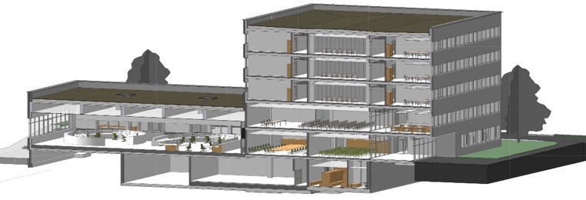
FAIR Progress - FAIR Control Center
Main control room for FAIR & GSI accelerators with new FAIR Control System
Completion mid 2026
Main Control Room
Conference rooms
Offices

Slide 15
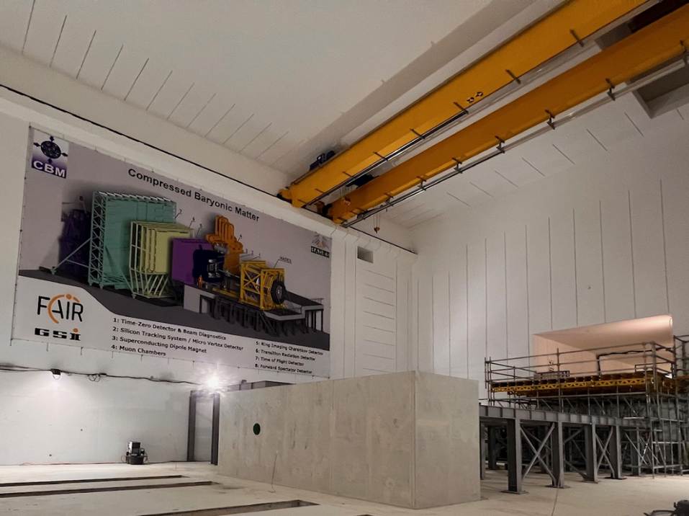
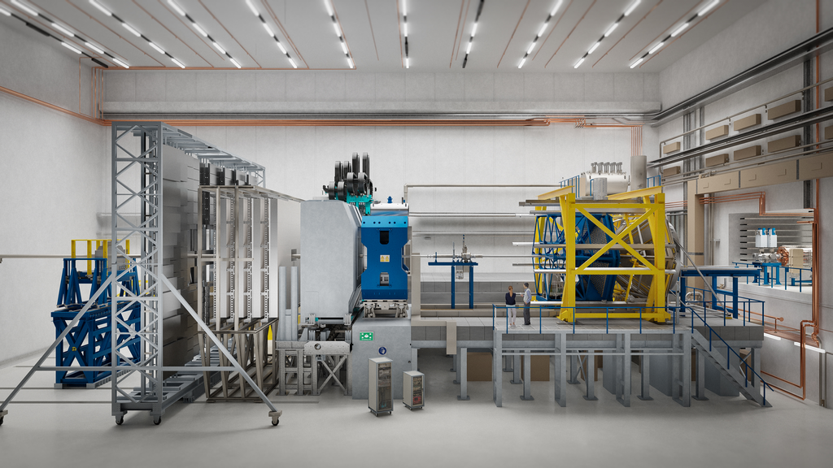
FAIR Progress – Experiments
CBM Cave
Experiment platform and magnet foundation
ready for next installation steps
Artistic view of CBM and HADES experiment
Notes:
CBM and HADES cave

Slide 16

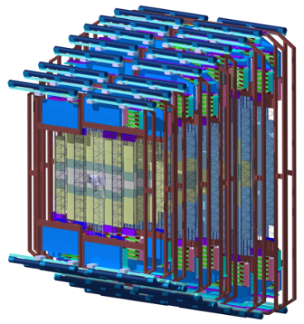
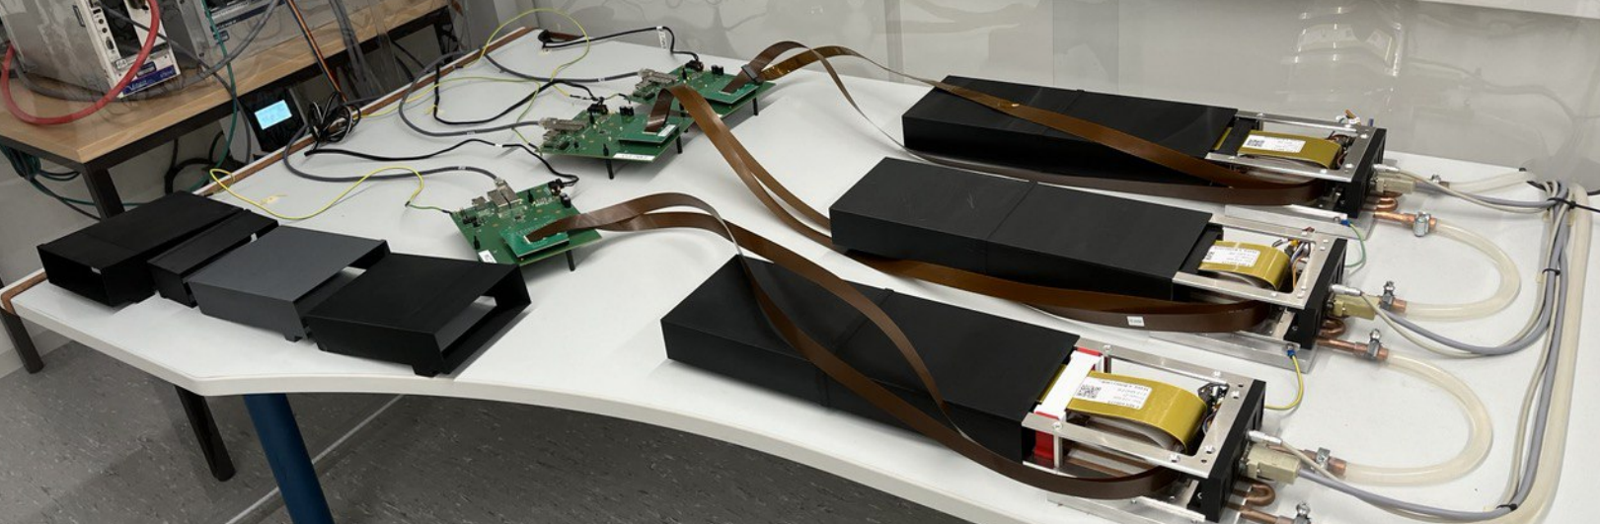
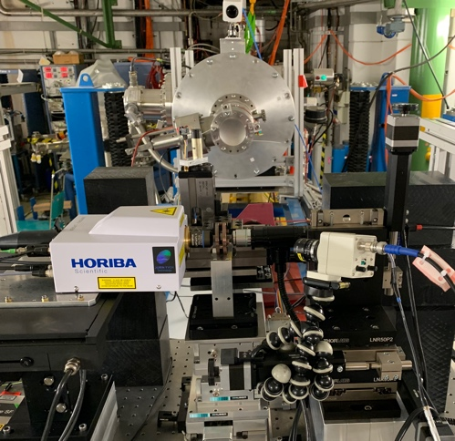
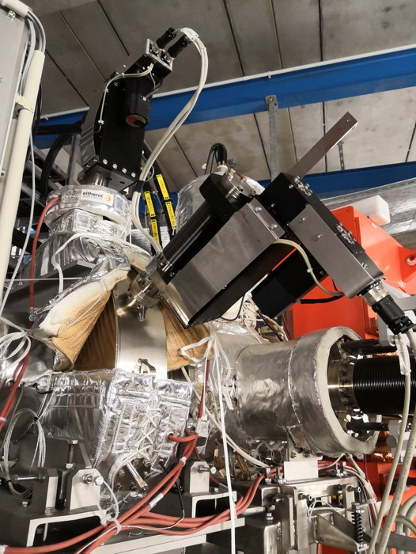
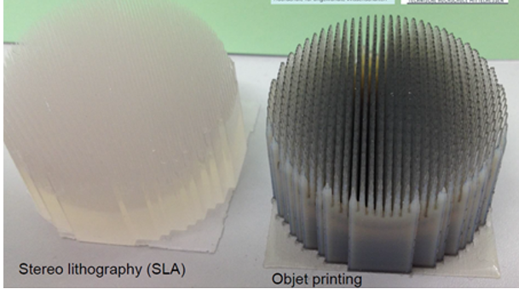
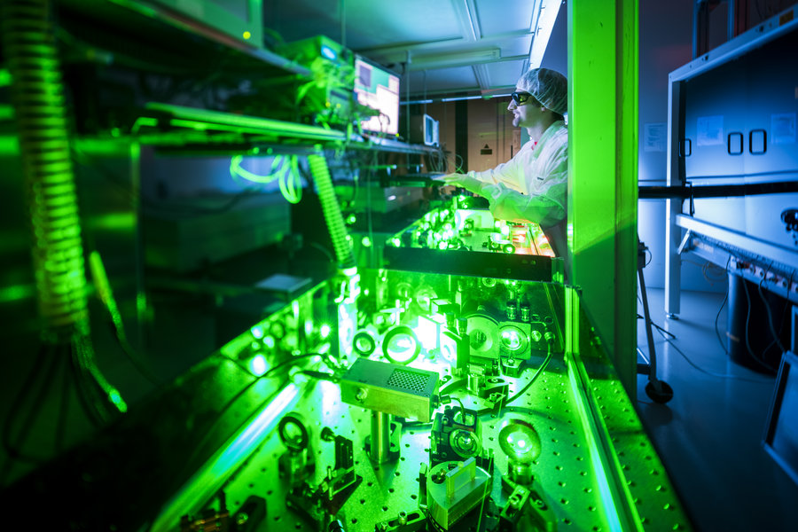
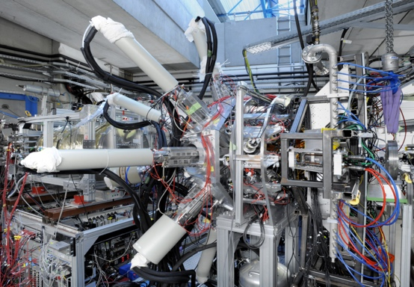
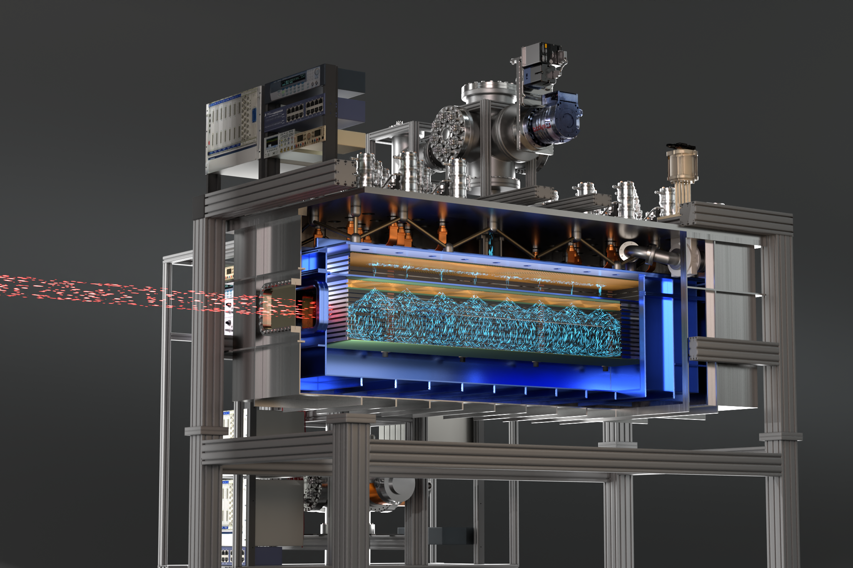
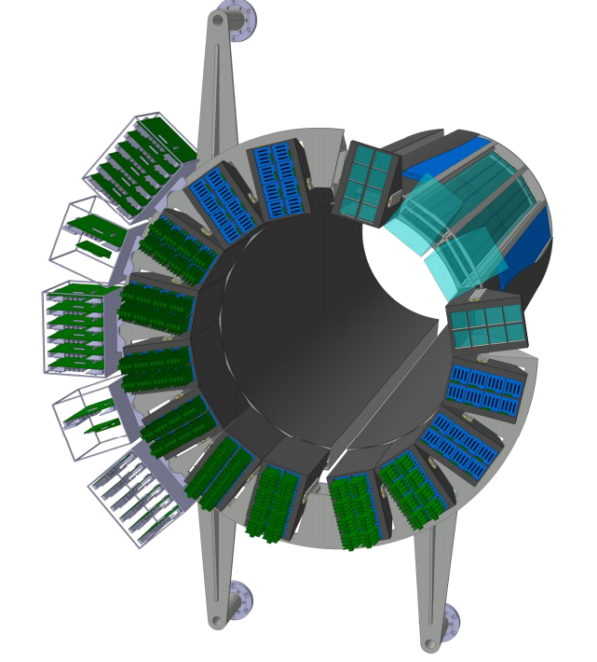
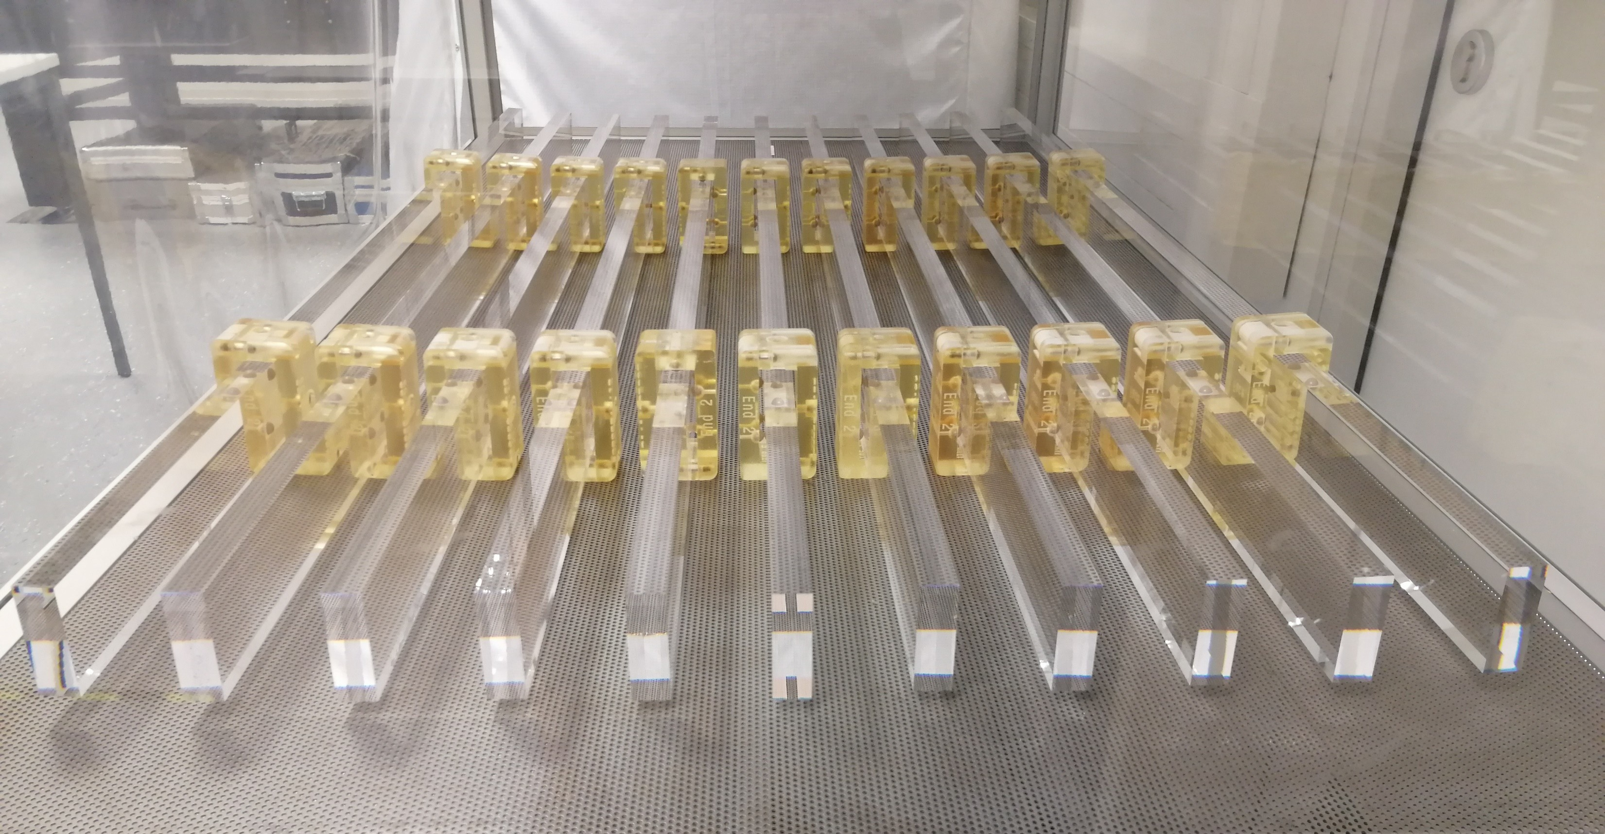

FAIR Progress - Experiments
CBM Silicon Tracker
Silicon Tracker
Schottky
detectors
3d printed modulator
Diamond anvil cells
Laser
technology
Cryogenic
stopping
cell
Barrel DIRC
DESPEC
Gamma-ray
hybrid array
R3B Proton Arm Spectrometer

Slide 17

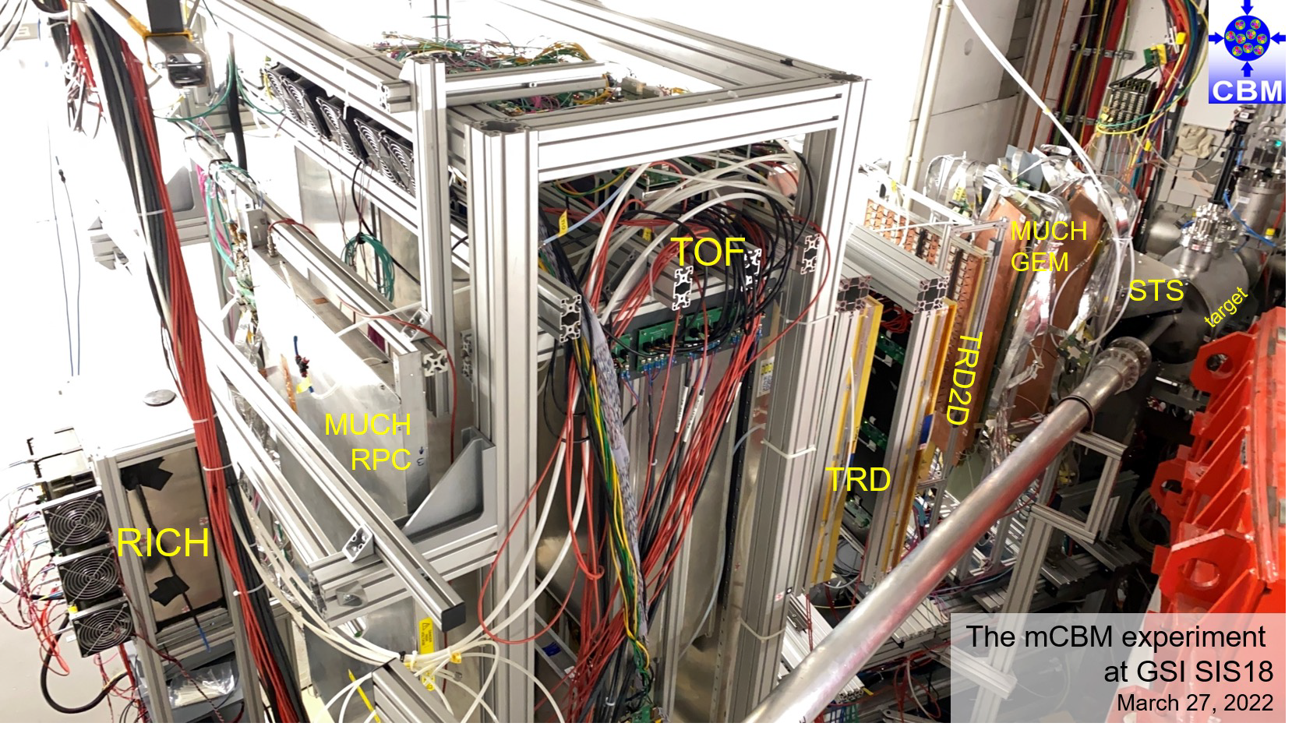
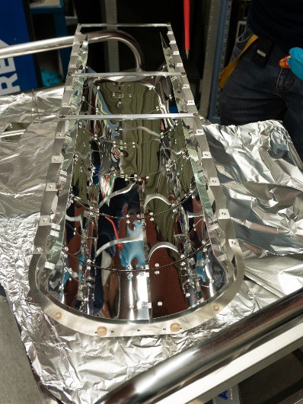
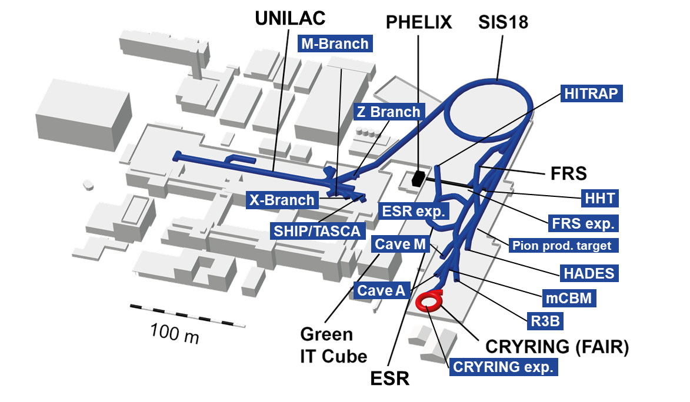
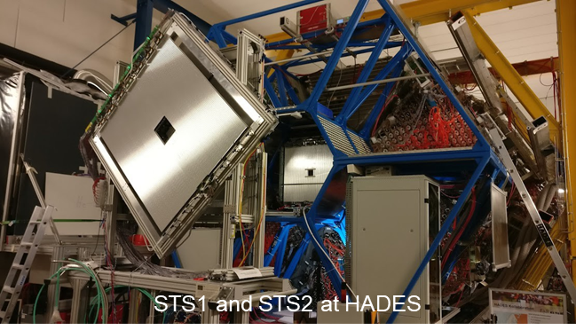
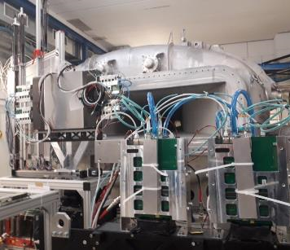
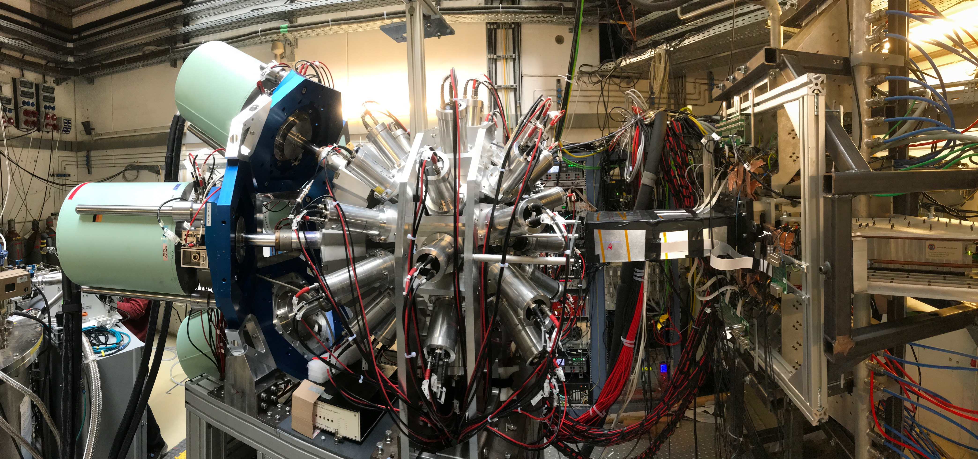
FAIR Phase-0
Stepwise approach to FAIR science
FAIR Phase-0 started in 2019
100 days of beam time per year until FAIR starts operation
Commissioning and operation of upgraded GSI accelerators and newly built FAIR detectors

Slide 18
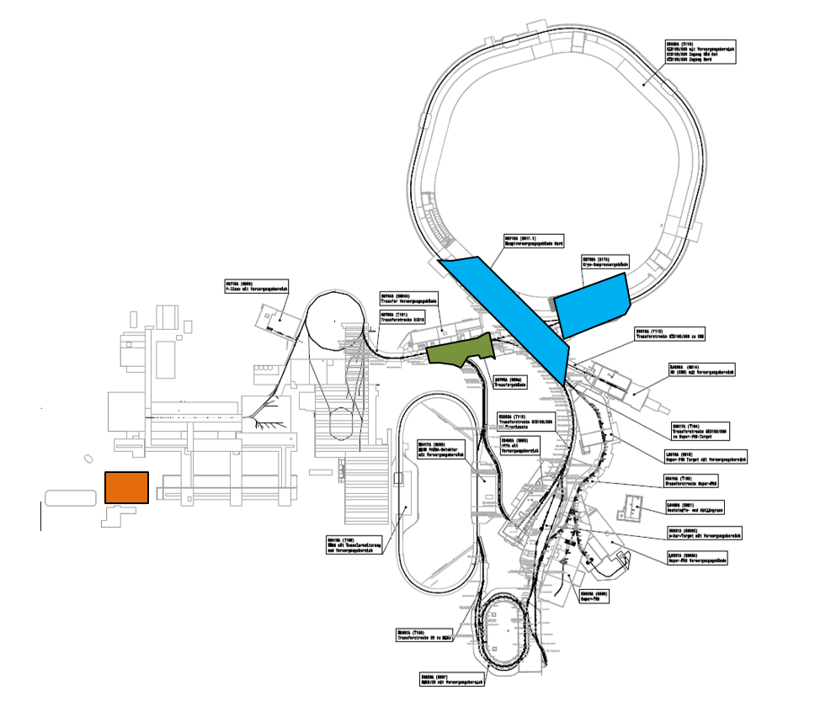
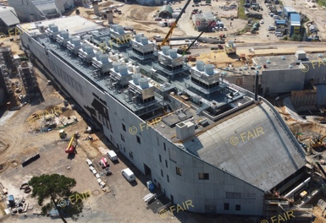
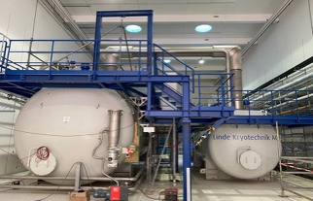
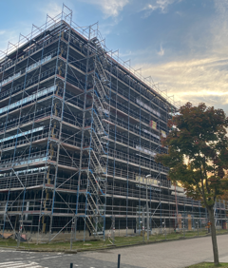
FAIR Progress – Commissioning
Start in 2025
Q3 2025: Start of commissioning of Cryo plant and Cooling water system
Q4 2025: Initial steps for HEBT commissioning
Q4 2025: Takeover of main control room in FAIR Control Center (FCC)

Slide 19
Integrated Time Schedule
2024 2025 2026 2027 2028
Beam Time
Beam Time
Beam Time
Beam Time
FAIR Control Center and Technical infrastructure - Construction
GSI ACC operation with new FAIR control system
from new FAIR Control Center
FAIR Buildings and Technical Infrastructure - Construction
FAIR Accelerator / Experiments - Procurement, Manufacturing & Installation
Cryo 2
Commissioning
FAIR Hardware-Commissioning Super FRS
Beam Commissioning
start of early
science program
FAIR Hardware-Commissioning SIS-100
Beam Commissioning
start of first
science program
& first science+ program

Slide 20
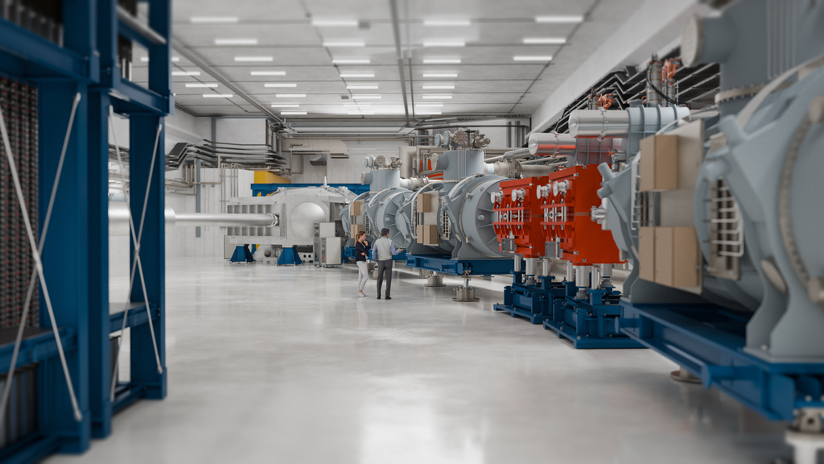
Thank you!
Questions?

Slide 21












FAIR’s international convention
  9 shareholders:
  + 1 associated partner:
  + 1 aspirant partner:
3000 users from more than 200 institutions from 53 countries are involved
Finland
France
Germany
India
Poland
Romania
Russia
Slovenia
Sweden
UK
Notes:
Germany, Slowenia, Romania, Poland, Russia, India, Finland, Sweden, UK, Czech

Slide 22
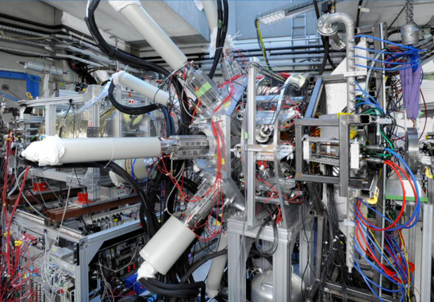
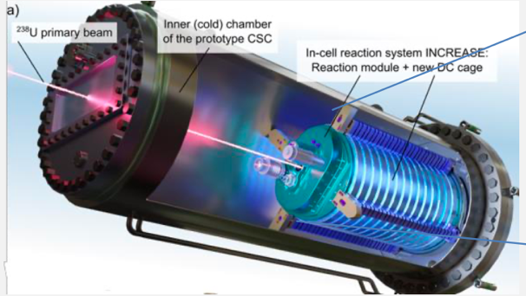
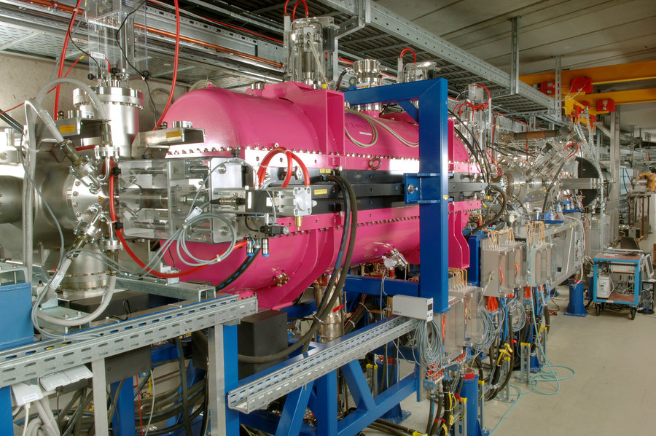
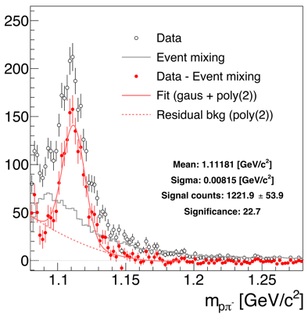












FAIR Phase-0 Scientific Programme
DESPEC
HITRAP

Slide 23











FAIR Phase-0 Highlights
Bound state β-decay of ²⁰⁵Tl⁸¹⁺
Half-life of
²⁰⁵Tl⁸¹⁺ ~290Tage
²⁰⁵Tl is a stable atom, the bare ²⁰⁵Tl⁸¹⁺ nucleus decays to ²⁰⁵Pb
Process becomes relevant in stellar medium (~10 Millionen Kelvin)
Modifies the abundance of ²⁰⁵Pb
  which is created by slow in neutron capture in AGB stars
²⁰⁵Pb abundance relevant for the evolution of the solar system
G. Leckenby et al., Nature (2024)
R. S. Sidhu et al., Phys. Rev. Lett. (2024)

Slide 24
Vision for the future: FAIR 2028
FAIR in 2028 will feature the most valuable science program which can be hosted in the then existing infrastructure
The „FAIR 2028“ science program will include:
  APPA experiments at the low-energy rings, at SIS100, at the caves at SIS18 and UNILAC with and at PHELIX and a limited set of experiments which could be hosted at all the caves served by SIS100
  NUSTAR at the Super FRS with SIS100 beams, plus SHE experiments at UNILAC and ILIMA at the low-energy rings
  CBM at the new cave with SIS100 beams, and HADES at SIS18
  PANDA is developing a hadron physics program to be carried as bridge towards the program with antiprotons, when possible using the caves and beams available at GSI/FAIR and synergies with other experiments

