Slide 1
Particle Physics Faculty Meeting
Agenda
News/Update
ARIEL (Alex Gottberg)
Committee Updates

Slide 2
TRIUMF is located on the traditional, ancestral, and unceded territory of thexʷməθkʷəy̓əm (Musqueam) people, who for millennia have passed on their culture, history, and traditions from one generation to the next on this site.
TRIUMF’s home has always been a seat of learning.

Slide 3
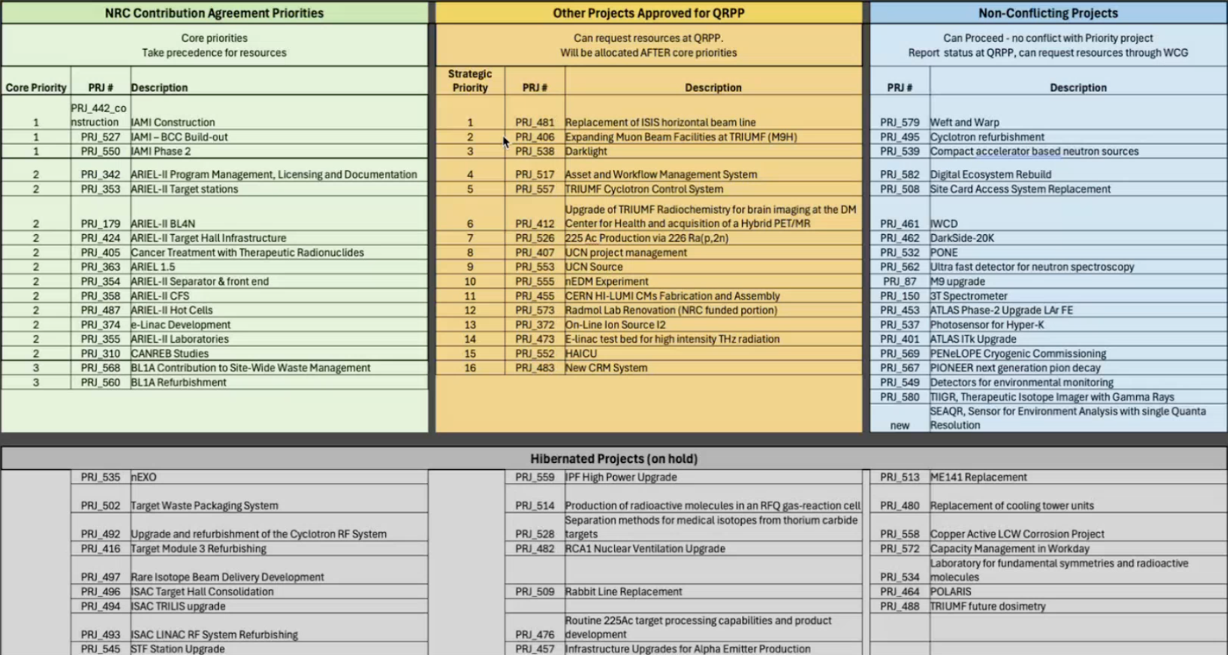
QRPP

Slide 4
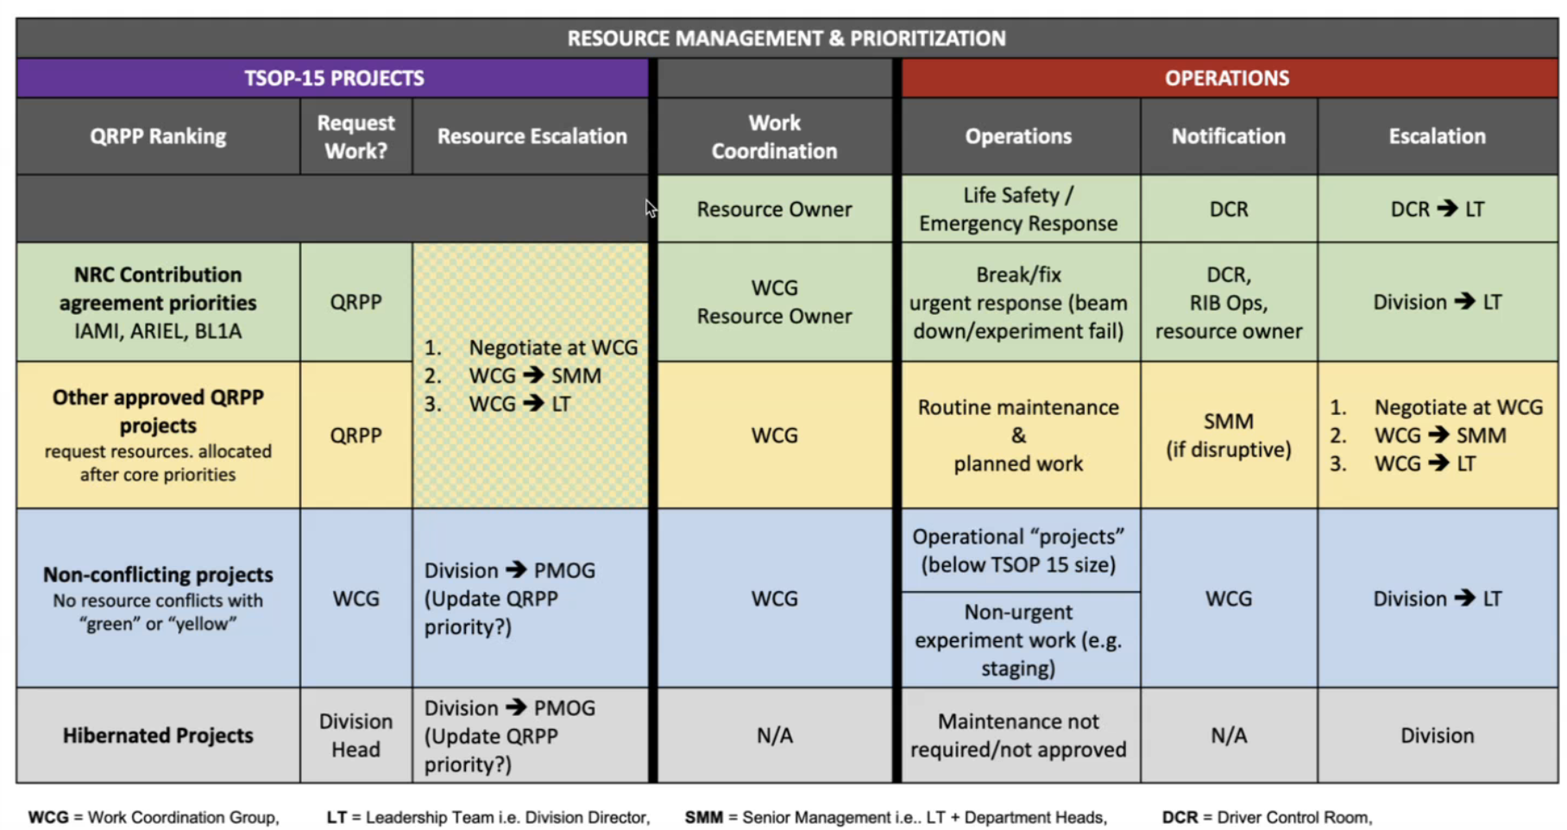
QRPP

Slide 5
ACOT
April 28-30
9:00 - 10:15 Overviews PSD - Ritu (15 mins)
14:30 - 16:00 Parallel Sessions, joint with SciTech and SciComp
Good feedback from committee
Thanks to everyone for preparing slides and staying on time

Slide 6
HQP Seating Map
From Mark
Please find the initial pass at seating here:
The undergraduate students are generally assigned to Trailer FF. They can freely swap desks or use desks in the side offices that are unused.
All of the graduate students and postdocs should have desks in MOB 299 or MOB 201 now. There appears to be one open desk in MOB 299. I would suggest sharing that among the undergraduates and any visitors.

Slide 7
PP Website
From Chloe
To populate the PP website page could you send me by May 9th:
A publication-quality photo/headshot, if desired
A brief (100-200 words) bio.3. Any other links you would like to have displayed (inspire, university website etc..)
See an example here: https://triumf.ca/people/david-morrissey/
So far we have only BAEs listed - we will eventually add joint, affiliates, P&S and emeritus.
Other groups have included their RAs, postdocs, and graduate students. Let us know if you'd like to add your group members as well. The list will likely grow quite long, but it could be useful for visibility. One caveat: we don’t yet know how much editing access we’ll have (so far, none), so making frequent updates may not be feasible.

Slide 8
Various
Canadian LRP
Paul Garrett (University of Guelph) and Alison Lister (University of British Columbia) have agreed to serve as the LRPC Co-Chairs
Deadline for IPP Briefs May 23rd
BoG quarterly report due by May 13th, please send updates by May 12th
Priorities and Resource Allocation Discussion - LT/BAEs May 22nd 3pm
Seminar: Julieta Gruszko from UNC
Title: Discovering the Origin of Matter with LEGEND

Slide 9
AOB

Slide 10
Committee Updates
IPP Council / CINP / CAP
Science Council
Space
Seminar/Colloquia
SciTech seminars / Quantum Forum / Dark Matter Forum
Mixer
Science Week
TUEC
Safety
Summer schools
EDI committee
IDSSD - Earth Humanity Coalition

Slide 11
Next Meeting
Jun 12th

