Slide 1
ARIEL Discussion Particle Physics Meeting
May 8, 2025
Alexander Gottberg
ARIEL Program Leader Senior Scientist Department Head – Targets and Ion Sources

Slide 2
ARIEL Scope and Status

Slide 3
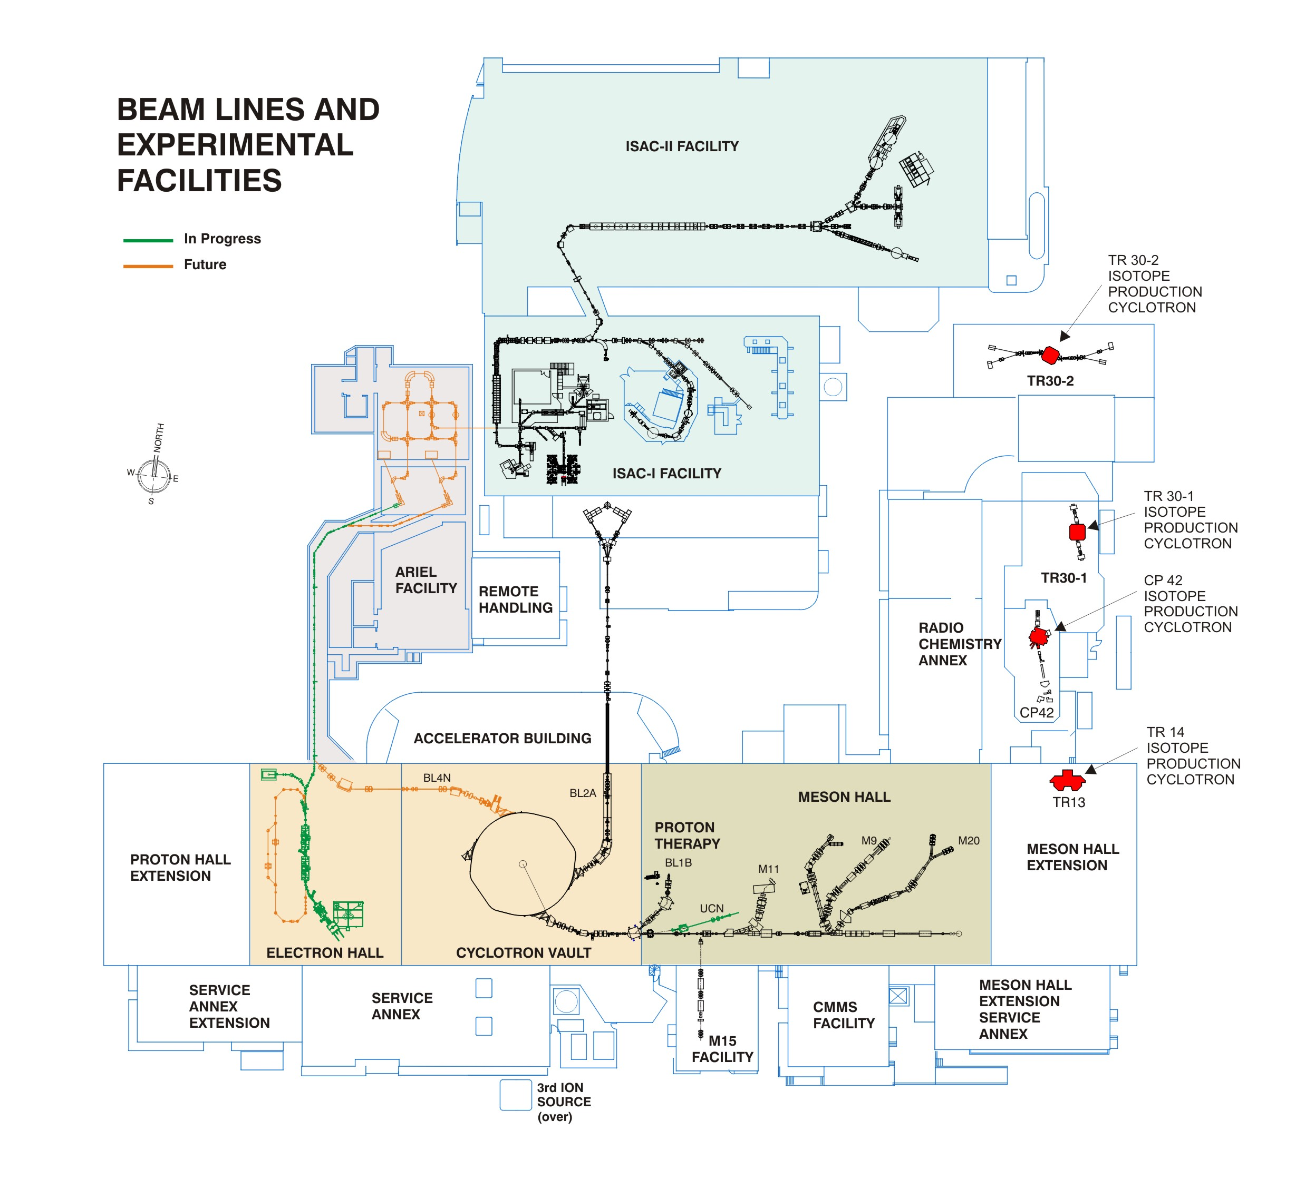
ARIEL Technical Deliverables
Driver beams
30 MeV, 100 kW electron linac
BL4N 500 MeV extraction probe from main cyclotron
Shared driver beam transport tunnel
Electron beamline to AETE
Proton beamline (cyclotron to APTW)
Proton and electron beam entrance modules
Two new radioisotope production target stations
AETE 100 kW electron target and APTW 50 kW protons,
Target auxiliary systems, mechanical and electrical services
Shielding, remote handling, target production laboratories, waste management
Beam dump module…

Slide 4
ARIEL Technical Deliverables
RIB Beam transport
RIB extraction modules
RIB switchyard (ARIEL target stations to ISAC and CANREB)
CANREB (HRS, EBIS, RFQ) and ARIEL yield station
Medical Isotopes
Medical target irradiation module,
Medical target transfer system,
Target send/receive station and packaging infrastructure
Integration
Mechanical, electrical, ventilation, safety systems,
Control system
Safety and regulatory documentation

Slide 5
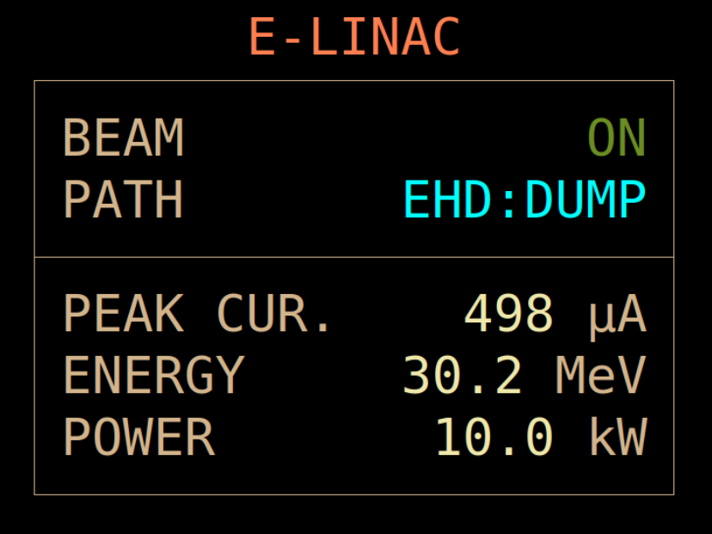
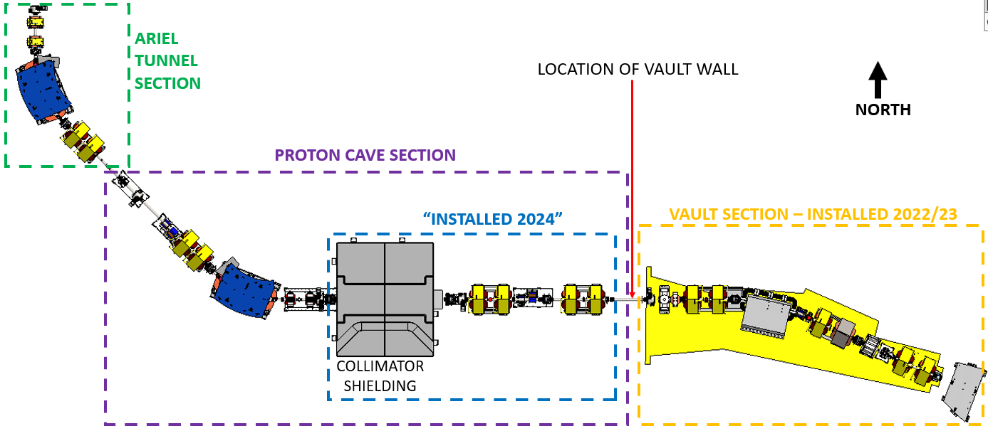
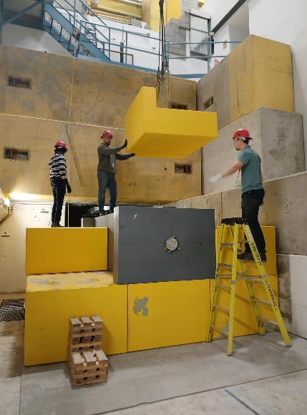
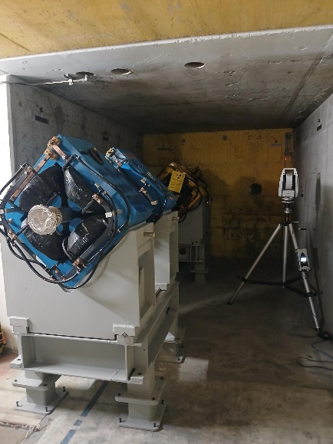
Status of Electron and Proton Driver Beams
Completed:
High-intensity 30 MeV electron linac
Produced nominal electron beam at the e-linac and delivered beam to high-energy beam dump for several days at a time
500 MeV BL4N extraction probe in the cyclotron
Construction of driver-beam transport tunnel
Ongoing:
Electron and proton beam lines
Integration and testing of the joint machine protection system
Commissioning electron linac, proton beam extraction and initial transport to AETE and APTW
Electron and proton target stations beam entrance modules
Nominal electron beam

Slide 6
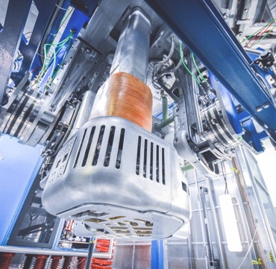
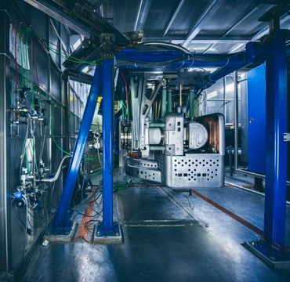
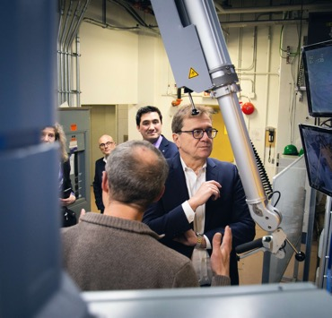
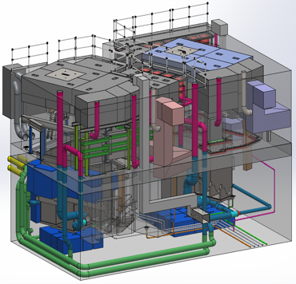

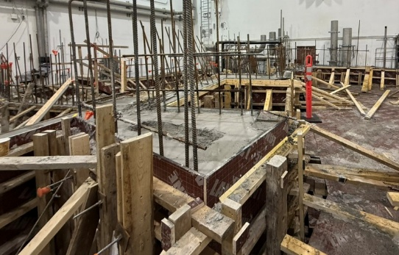
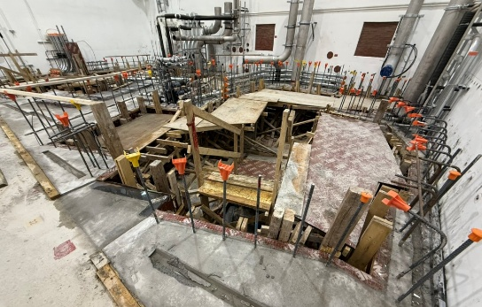
Status of Target Systems
Completed:
Target building and building systems
Target ion source systems designed and prototyped
Target shielding and embedded services, last fixed shielding installation ongoing
Hot cells and module storage structure
ARIEL laser ion source installation
Ongoing:
Target production laboratories
High-active water, gas supply, radioactive gas decay systems, target pit services room installation
Target station modules assembly and installation
Medical target transfer/send/receive station installation
Removable and entrance shielding
Target decay storage vault

Slide 7
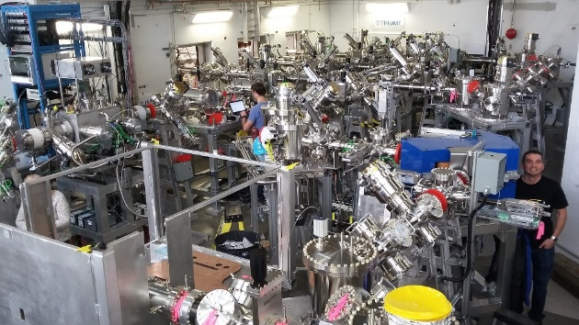
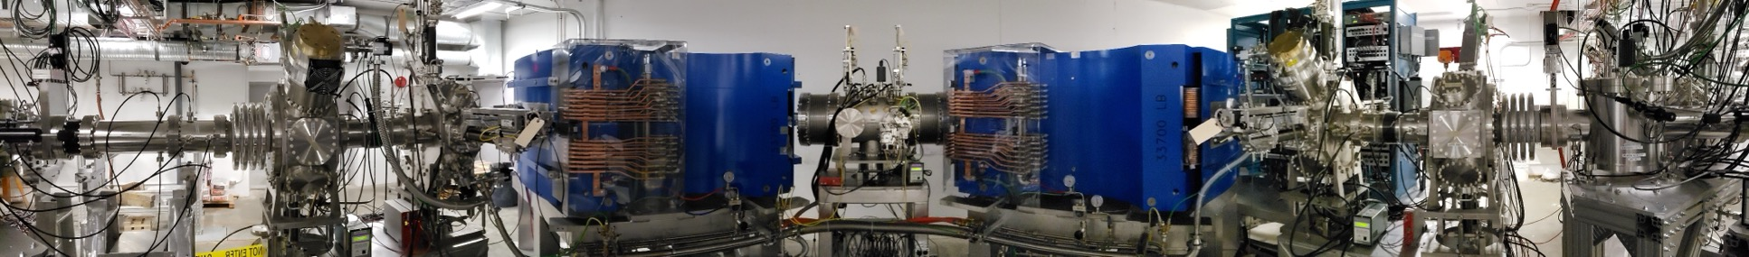
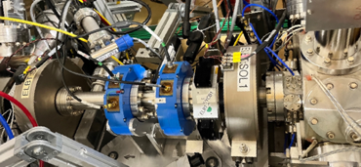
Status of Beam Delivery Systems
Completed:
250 m of RIB beam distribution switchyard
CANREB HRS with world-record mass resolving power
ARIEL yield station
Ongoing:
Address remaining issues with CANREB EBIS and CANREB RFQ
HRS HV enclosure
Target station RIB modules

Slide 8
ARIEL Organization
A

Slide 9
Tripling TRIUMF ‘s Radioisotope Science Program
Advanced Radioisotope Laboratory (ARIEL)
ARIEL-I (2012 - 2014) e-linac, beam tunnel, target building
ARIEL-II (2017 - 2027) target stations, shielding, hot cells, RIB distribution
CANREB (2014 - 2019) charge state breeding and purification for post-acceleration in ISAC II
Therapeutic Isotopes (2020 - 2027) production and processing of medical isotopes at ARIEL proton target station
$200 million investment by federal and 6 provincial governments; supported by 21 universities across Canada, about 700 FTE years total effort.
A

Slide 10
ARIEL Organization Chart
C

Slide 11
Planning towards LS26
Nov 1 - Feb 13
Jan 1 - Dec 31
Aug 1 - Apr 1
May 1 - Dec 27
Jan 1 - Feb 24
Jun 30 - Dec 31
Jan 1 - Nov 1
Jan 1 - May 1
Feb 1 - Oct 2
2522 days
1216 days
1523 days
1130 days
783 days
175 days
300 days
133 days
75 days
2012
2029
CY 2024
CY 2025
CY 2026
CY 2027
CY 2028
Q1
Q2
Q3
Q4
Q1
Q2
Q3
Q4
Q1
Q2
Q3
Q4
Q1
Q2
Q3
Q4
Q1
Q2
Q3
Q4
ARIEL Core Team
Start FTE ramp-up
LS26
Expanded Team
Transferring resources to ops and other projects
Shielding
Removable shielding Install
Fixed Component Installation
Driver Beam Lines
Integr, Design, Manuf.
Installation, Integration
Testing, Commissioning
RIB & Entrance Modules
Construction
Assem, Testing
Install
Commissioning
ARIEL-II: Proton & Electron Stations
Target Modules
FE Assem, Tests
Offline Installation
Install
Commissioning
Beam Dumps
Manuf.
Assem.
Install
Commissioning
Alignment Rails
Det. Design
Manuf.
Installation
Secondary Gas*
Offline Manufacturing
Install
Service Spaces
Offline Prep
Installation
High-Voltage Chases*
Offline Prep
Installation
Auxiliary Systems*
Manufacturing
Assem, Testing
Installation
Test., Comm.
Med. Isotopes CFI Early Closeout
Med. Isotopes to Users
Therapeutic Isotopes
Medical Target*
Design, Prototype
Manufacturing
Installation
Commissioning
Transfer System
Manufacturing
Installation
Commissioning
ARIEL User Operation
ARIEL Operations Ramp Up
E-linac Upgrades
Installation
Power & Reliability Ramp-Up
CANREB Upgrades
Installation
Spent Target Vault
Det. Design
Manuf.
Installation
Target Laboratories*
Conv. Chem.
Actinide Chemistry
Assembly Lab
Production Ramp Up
Today
First Beam on APTW
First Beam on AETE
ARIEL-II CFI Early Closeout
Three Beam Capability
C

Slide 12
Project Goals for 2025 to 2027
2025 is the foundation for 2026
Complete most of the designs, while keeping the machine shop fully occupied in 2025 and into 2026
First equipment needs to be ready to install in TH in October
In 2026, people will be ready and available to help
Planning is essential: Machine shop finishes items as they are needed
In 2026 we need to use the available resources to advance the assembly and installation
By the end of 2026, we are aiming at installation completed but not perfected for all the above systems
Commissioning in 2027 and start of beam delivery in 2028
C

Slide 13
Requests for Contributions
A

Slide 14
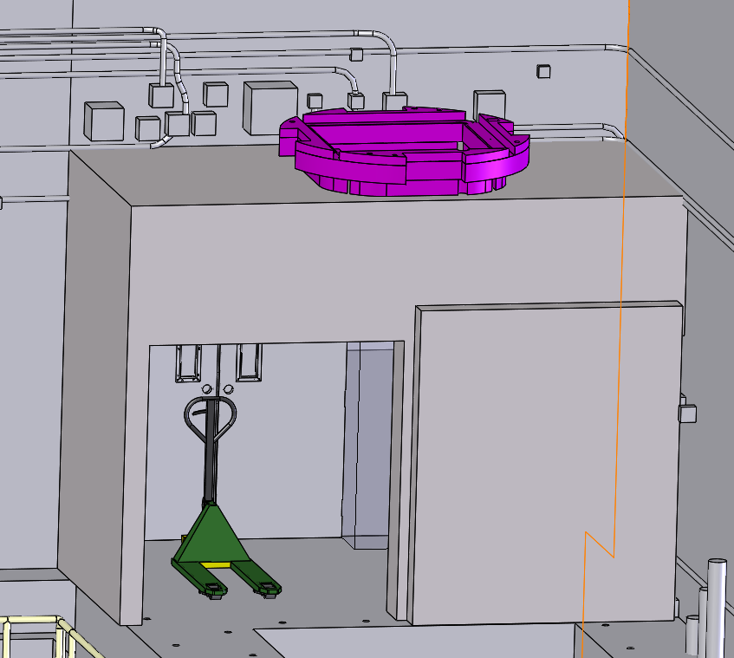
Expanding the ARIEL Team
Several groups previously outside the core ARIEL team have taken ownership of large work packages. Examples:
SciTech – Target stations mechanical services (secondary gas management, high-active gas storage,…)
SRF - Target hall entrance shielding, Target Pit Services Room entrance shielding, target actuators
TPO – High-voltage chases, high-voltage connections, high-voltage terminals, target production labs
Ops – Overall cable management, installation team support
ATG – Medical target system design support
Nuclear Physics Department – FLUKA support, CANREB support, MPS, operations manuals, TIS development
C

Slide 15
Open Work Packages
There are several design and installation packages that ARIEL is looking for support with.
Pre-separator integration (support stand)
ALIS integration (connecting the laser ion source system to the ARIEL pre-separator)
Assembly of Wire Scanners and BPMs could be performed by other TRIUMF technicians to take load off of diagnostics group. Would require training.
UHV cleaning of beampipes & vacuum envelope components
Mapping Magnet Stray fields of optics

Slide 16
Development Contributions
The TISA target and ion source test stand will be used to test target ion source front ends before installation in late 2025. After that the system is available for target and ion source development. Stefan Malbrunot is interested but needs support.
Developing mass markers
Long-term testing and calibration of AETE/APTW target geometry
Thick target container wall
Integrate the FEBIAD into ARIEL HTV, including calibrated leak, gas delivery
IG-LIS, including RF delivery
CTL, variable transfer line

Slide 17
Individual Contributions
In 2025:
Design and fabrication support (targets, target modules, RIB diagnostics, removable shielding components, waste drum handling tools…)
Procurement support
Support in defining controls and interlock documentation
Electronics development
Collecting commissioning inputs and support/coordinate/write commissioning documentation
Collecting licensing inputs and support/coordinate/write commissioning documentation
Operations manuals
Module assembly and assembly coordiation
For the installation in 2026:
Installation technical support
Cable management and cable pulling
Coordinate or support subsystem testing
Support in moving ISAC target laboratories and setting up ARIEL target laboratories

Slide 18
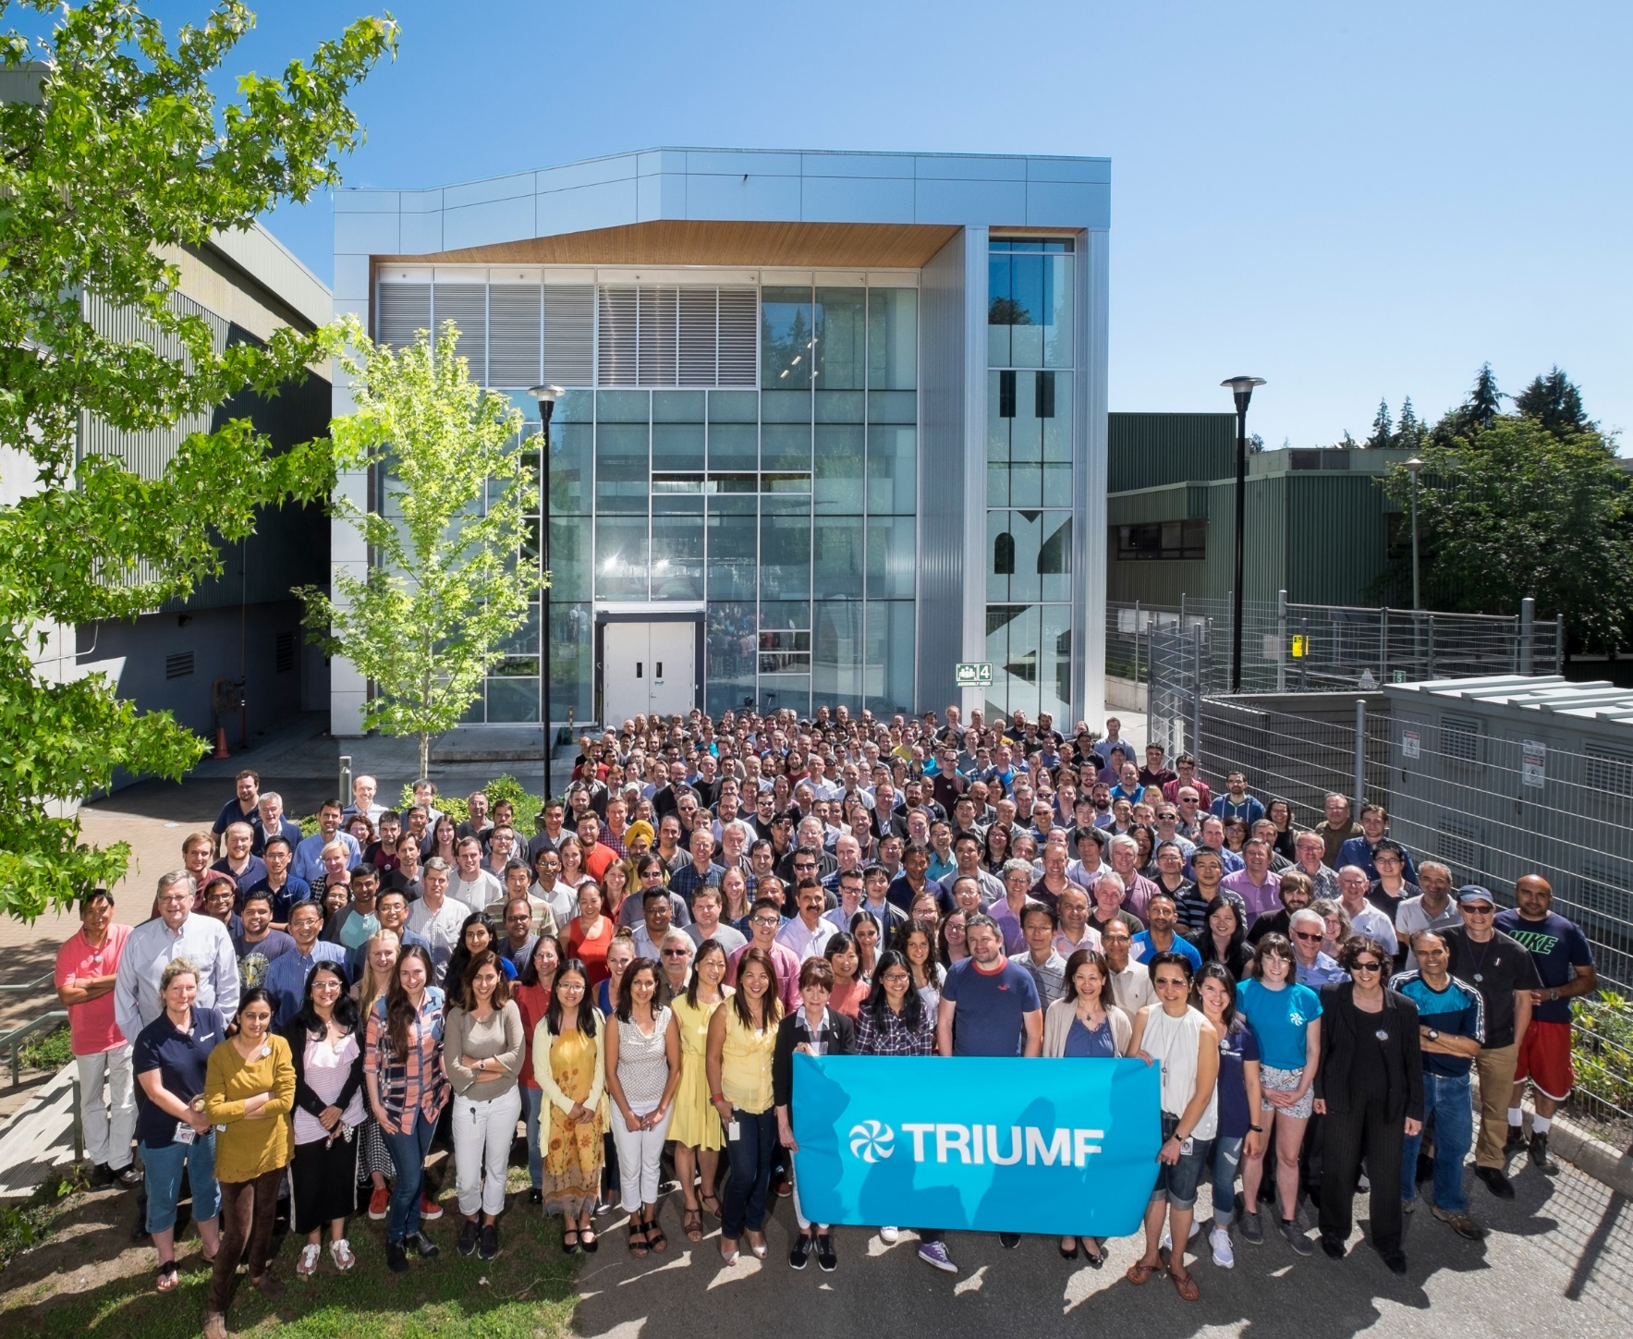




Thank you Merci
www.triumf.ca
Follow us @TRIUMFLab
Discovery,
accelerated

Slide 19
BACKUP

Slide 20
Milestone Trend Analysis
The sequencing of AETE and APTW installation in a result of resource leveling, not technical limitation.
C

