Slide 1
Particle Physics Faculty Meeting
Agenda
News/Update
Research groups Updates

Slide 2
TRIUMF is located on the traditional, ancestral, and unceded territory of thexʷməθkʷəy̓əm (Musqueam) people, who for millennia have passed on their culture, history, and traditions from one generation to the next on this site.
TRIUMF’s home has always been a seat of learning.

Slide 3
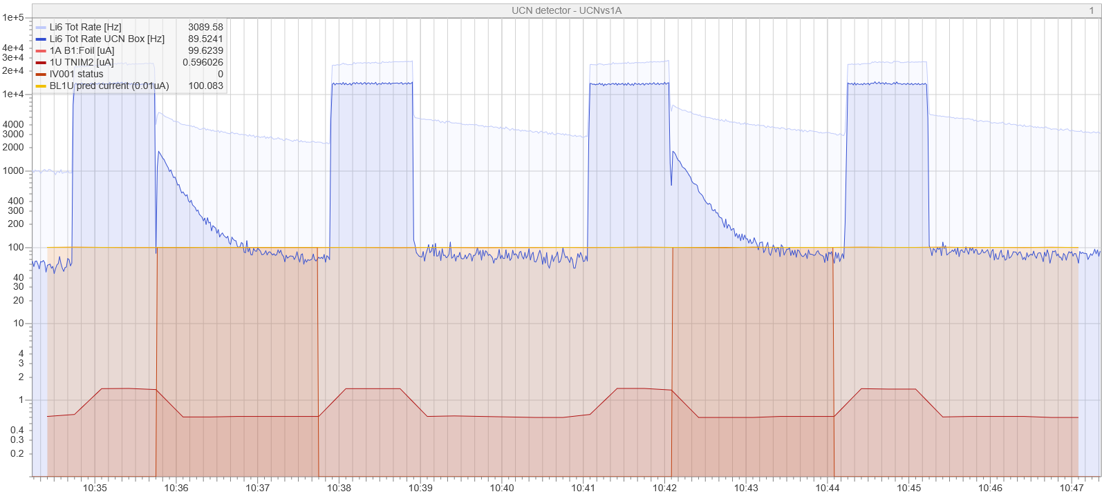
TUCAN
UCN production on Friday June 13th!
Congratulations!
After subtracting background see 26000 UCN per shot (within 15 % off from predictions)

Slide 4
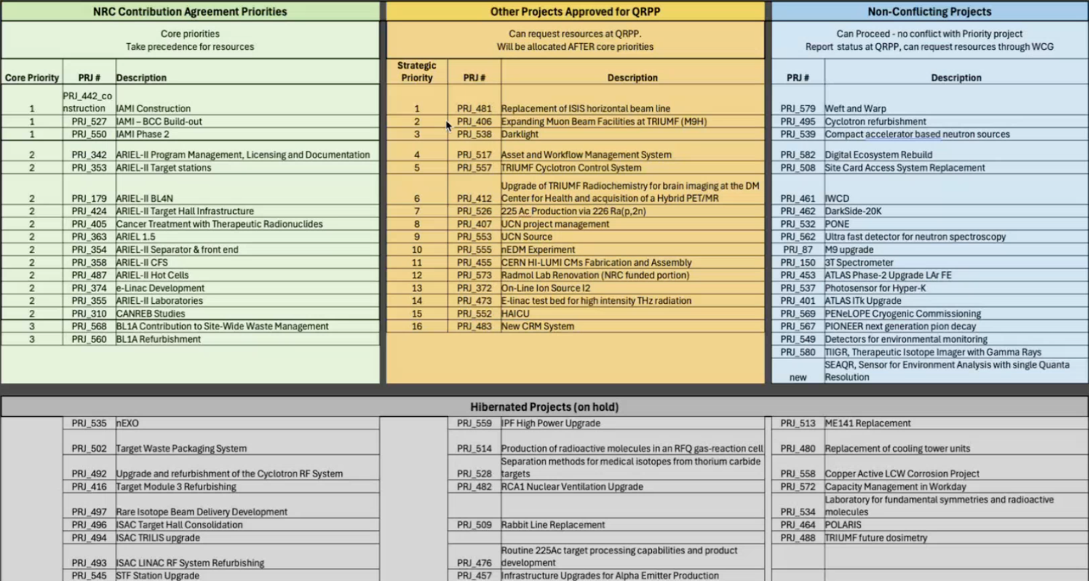
QRPP

Slide 5
QRPP
Link to the QRPP Report for July–September 2025: QRPP Reports June 2025.xlsx
Group and Project Leaders can now begin reviewing which jobs may not be supportable. For Group Leaders, please add your feedback directly in the GroupReports tab, using the blue-shaded column R.
Chris and Peter are hoping to receive your updates and suggestions by the end of this week (Friday).

Slide 6
PP Website
For the PP website page if you have not done so already could you to Chloe
A publication-quality photo/headshot, if desired
A brief (100-200 words) bio.3. Any other links you would like to have displayed (inspire, university website etc..)
See examples here: https://triumf.ca/research/particle-physics/
So far we have only BAEs listed - add joint next then affiliates, P&S and emeritus.
Let’s add a new Research Feature: UCN?

Slide 7
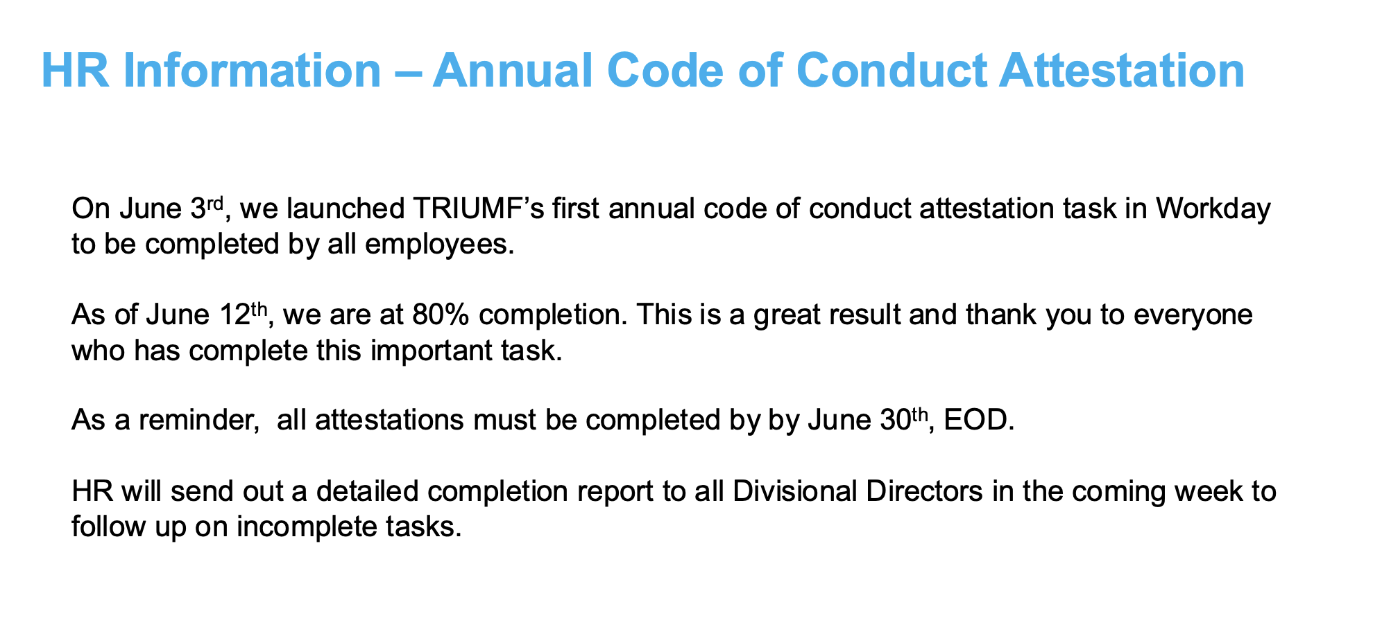
HR
Completion is a requirement for salary adjustments

Slide 8
HR
Completion is a requirement for salary adjustments

Slide 9
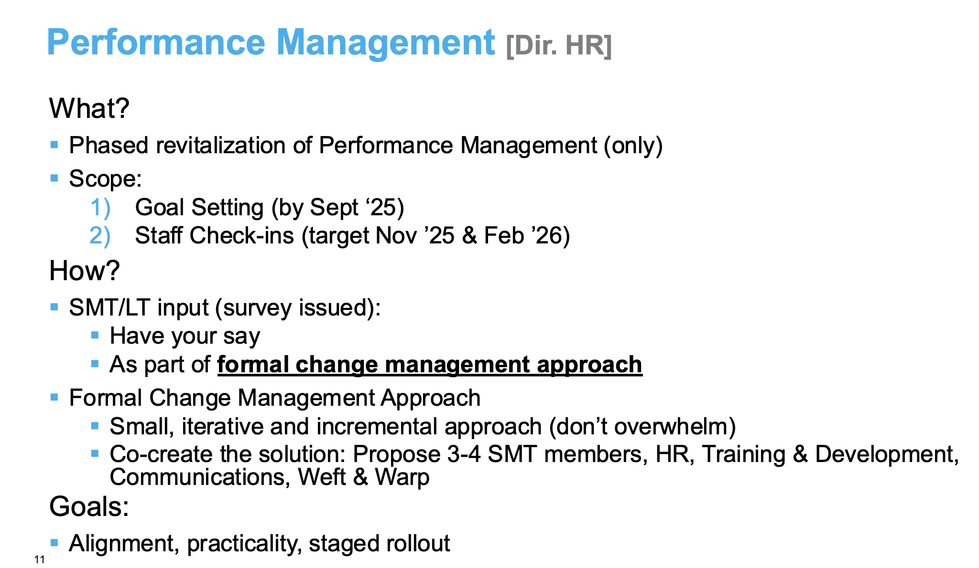
HR

Slide 10
Various
Canadian LRP
Paul Garrett (University of Guelph) and Alison Lister (University of British Columbia) have agreed to serve as the LRPC Co-Chairs
Town Hall today
Budget
PSD got $30,000 this year for SAP detector development in NRC budget.
Hope this helps in some R&D project work.
Cost center is Science Technology, Program is PRG_2360
How to use it?
Thank you to Xiaoyue Li to agree to be our Particle Physics rep on the PSD space cttee
Martin Alcorta and Nicole Vassh will chair PSD wide space cttee
PSD retreat planned for October 3rd (expected topic: updated 20 Year vision)
Follow up: Priorities and Resource Allocation Discussion - LT/BAEs from May 22nd
Follow up: Discussion with Alex Gottberg on ARIEL

Slide 11
AOB

Slide 12
Round Table
ATLAS
T2K/HyperK
TUCAN
ALPHA
SuperCDMS
DarkLight
n-EXO / PHORWARD
PIONEER
NA62
P-One
SNO+
HALO
g-2
Belle
Theory

Slide 13
Next Meeting
July 10th

