Slide 1
Particle Physics Faculty Meeting
Agenda
  News/Update
  Research groups Updates

Slide 2
TRIUMF is located on the traditional, ancestral, and unceded territory of thexʷməθkʷəy̓əm (Musqueam) people, who for millennia have passed on their culture, history, and traditions from one generation to the next on this site.
TRIUMF’s home has always been a seat of learning.

Slide 3
New Salary Framework
Introduced at All Hands
Backgrounder document shared
Info sessions this week
Impact on grant funded personal
BAE framework separately
Phase 3 taking effect July 1st

Slide 4
Next PSD Retreat
Planning of Division Retreat
Date : October 3
Venue : Golf Club or Robert Lee Alumni Center
Possible Agenda:
  Goals for 2025 - 2030 (current FYP) - first half
  Next FYP and 20 Year Vision - second half
Propose to cancel our August meeting and have at least 2 meetings in September to prepare for retreat

Slide 5
Particle Physics Prioritization and Succession Planning
Ritu requested updated prioritization
Currently have
Lead in Scientific Discovery through focus projects
  Projects where we are involved in all areas
  detector design/construction, operations, data analysis
  Ensure critical mass is established
  Maintain leadership in all areas
Current experiments
  ATLAS, T2K/Hyper-K, ALPHA, TUCAN, SuperCDMS
New experiments expected to reach that point in the future
  DarkLight, nEXO, PIONEER
For ACOT we also report on DarkSide, HAICU, NA62/Pienu, DRD, SNO+?
Feedback: Particle Physics is doing too much

Slide 6
Particle Physics Prioritization and Succession Planning
Proposal
Lead in Scientific Discovery through focus projects
  Projects where we are involved in all areas
  detector design/construction, operations, data analysis
  Ensure critical mass is established
  Maintain leadership in all areas
Focus Projects
Flagship ATLAS, T2K/Hyper-K, ALPHA, TUCAN
Have two more categories
  Other Focus projects
  Projects with individual (<1FTE) contributors
Update our succession / hiring priority by this fall

Slide 7
Various
New ARIEL Operation Department
  New hire of Engineer (Mechanical), Mahdiar Khosravi, in the ARIEL Experiments
Joint position in nuclear physics with the University of Guelph
  Applications will be reviewed in August
Need Division list of students and post docs
  Lauren will setup a shared Excel sheet that supervisors should update when new HQP joins or one leaves
Exclusive Particle Physics Department mailing list (for PSD information specific to one department)
  particlephysicsdepartmentlist@triumfoffice365.onmicrosoft.com
Next Mixer (next week Friday)
  Ritu requested 1-2 slides per department on selected highlights for the upcoming PSD Mixer

Slide 8
Round Table
  ATLAS
  T2K/HyperK
  TUCAN
  ALPHA
  SuperCDMS
  DarkLight
  n-EXO / PHORWARD
  PIONEER
  NA62
  P-One
  SNO+
  HALO
  g-2
  Belle
  Theory

Slide 9
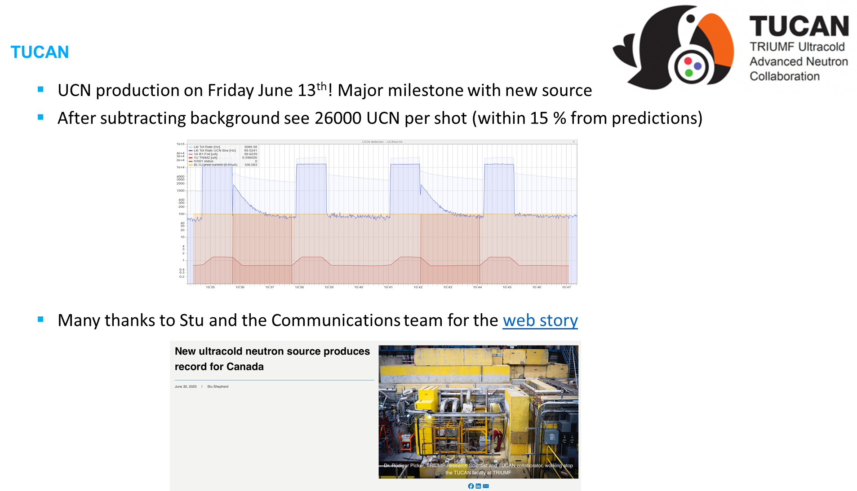
Physical Science Update

Slide 10
ATLAS
WZ Full Run 2 Inclusive Cross-Sections paper (with EFT interpretations)
  Submitted to JHEP and on the arXiv (results shown at EPS) - Juan Cristóbal has been working on this (with Rob and Isabel, and several other members of the UVic group)
ATLAS successfully ran p-O, O-O and Ne-Ne collisions this past week, all for the first time
Add “toponium update” and ITK

Slide 11
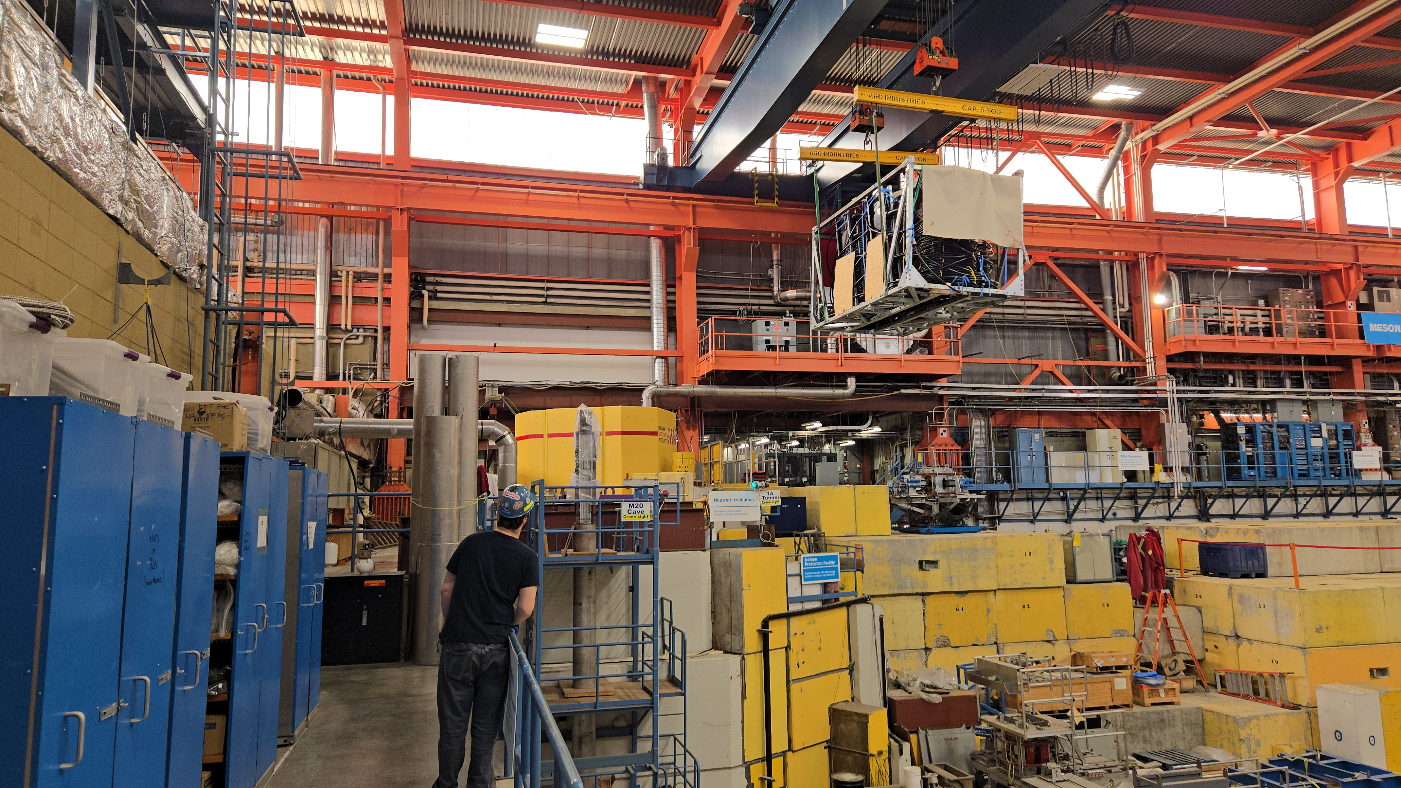
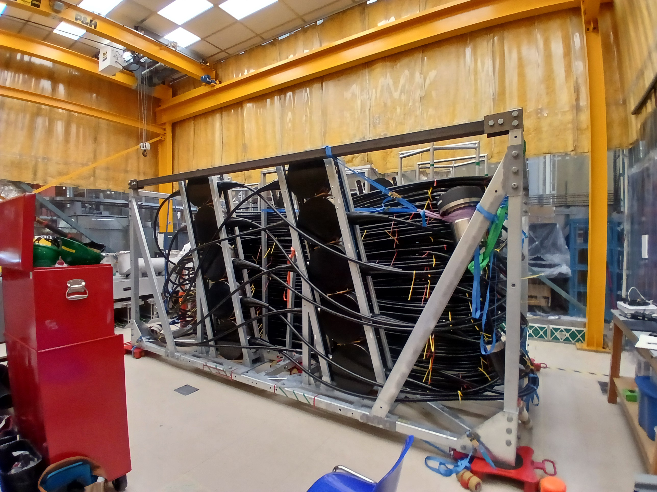
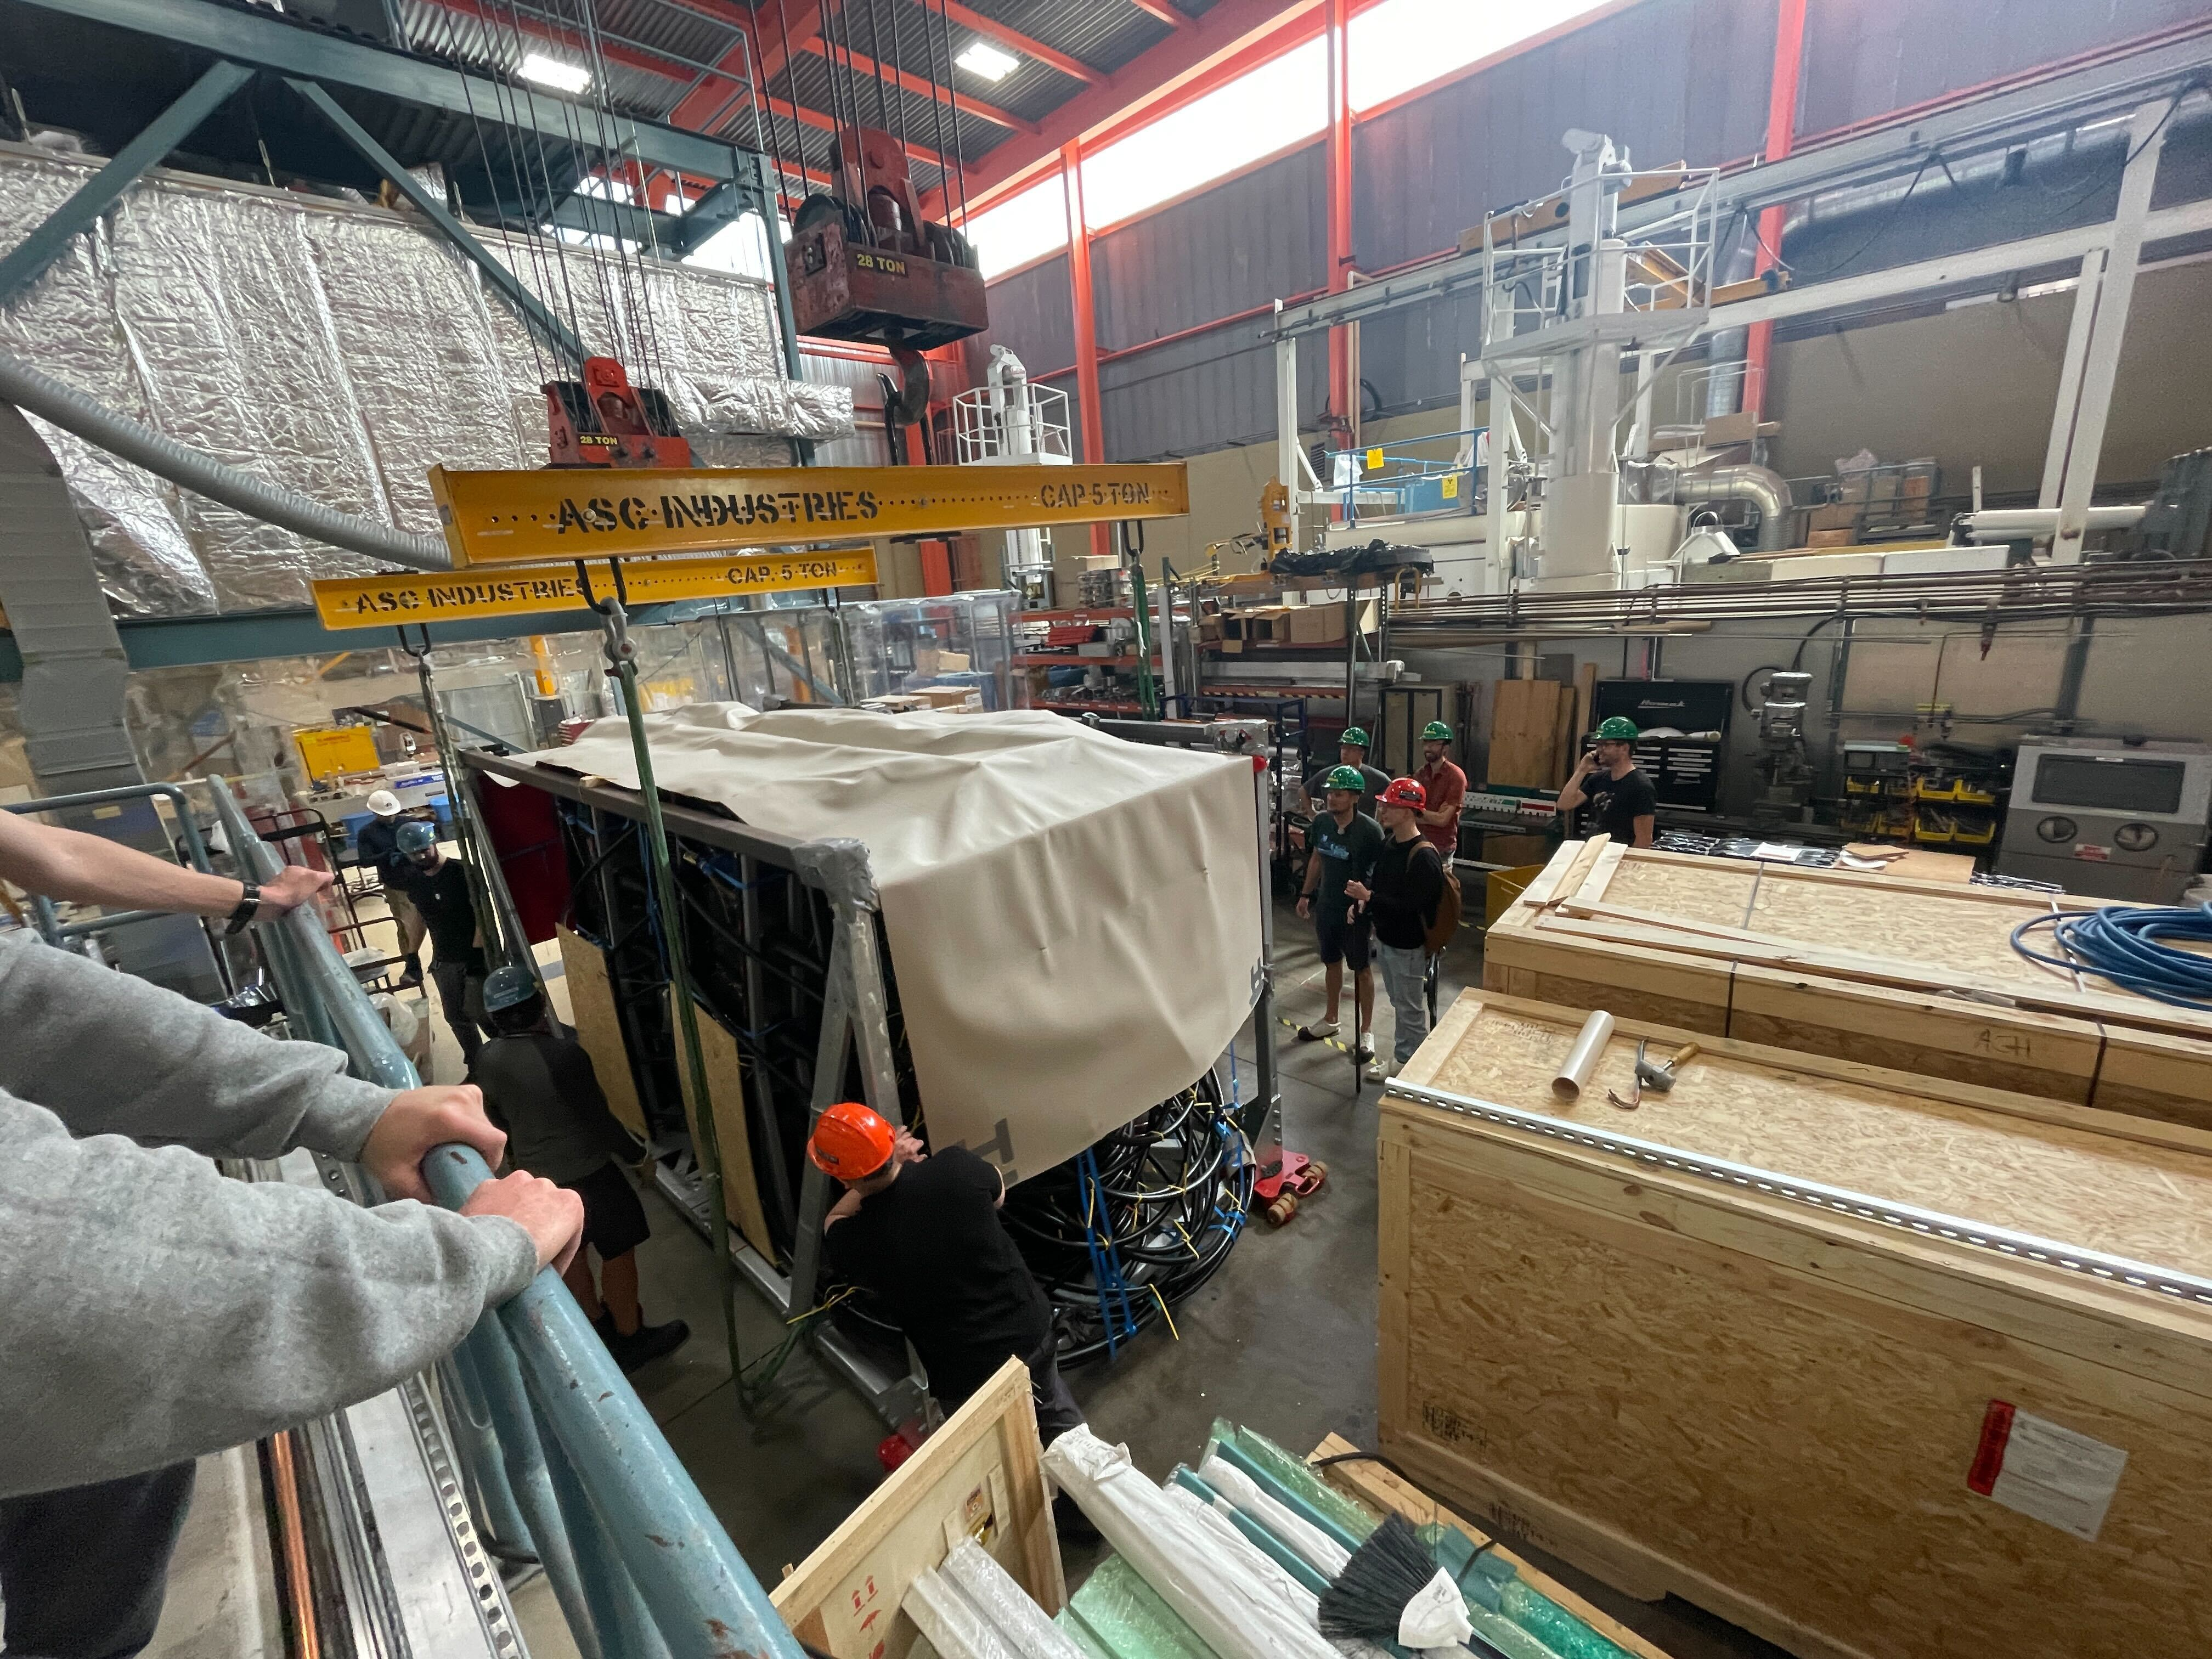
P-ONE
First detector line: backbone cable and all detector components have arrived at TRIUMF end of June for final detector integration and testing
This marks a huge milestone for P-ONE and we are all grateful to members of SciTech, OPs team, and DAQ team for their support

Slide 12
AOB

Slide 13
Next Meeting
  Sept 11th and Sept 25th?

