Slide 1

Exploration of High-Entropy Alloys (HEAs) for Irradiation Applications
Michael Moorehead, Calvin Parkin, Mohamed Elbakhshwan, Kumar Sridharan, Dan Thoma, Adrien Couet
University of Wisconsin-Madison

Slide 2








Funding and Collaborations
Financial Support:
Scientific Collaborations::
Institute for Nuclear Energy Systems (INES)
Grainger Institute for Engineering (GIE)
Materials Science Center (MSC)

Slide 3
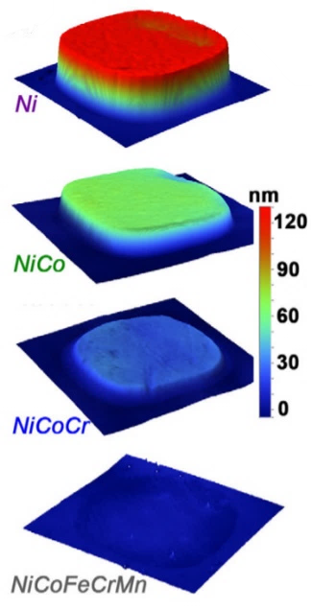
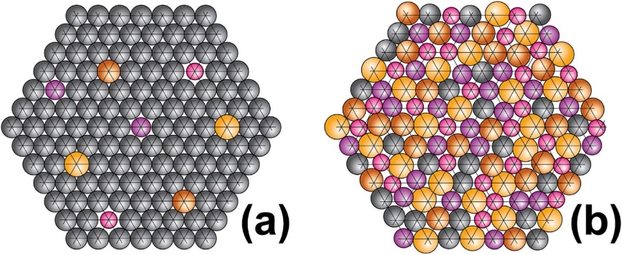
High-Entropy Alloys (HEAs) Overview
High-entropy alloys (HEAs) are alloys with multiple principal elements
Typically, no element >35 at%
Usually defined as being primarily a solid-solution matrix
Promising properties have been observed:
High-temperature strength
High specific strength
Enhanced radiation tolerance
(a) Conventional alloy, (b) High-entropy alloy (Miracle, Senkov | 2017)
Swelling of increasingly complex alloys under ion irradiation (Jin | 2016)

Slide 4
Radiation Damage in Metals
Damage Cascade
Primary Knock-on Atom (PKA)
Vacancies
Self-Interstitials
Thermal Spike
Incoming Particle (n, p⁺, etc.)

Slide 5
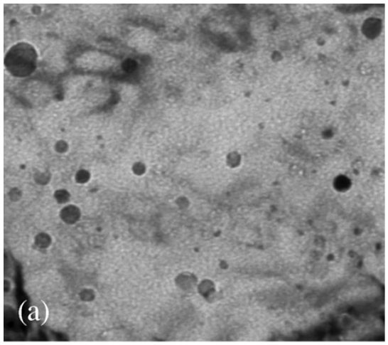
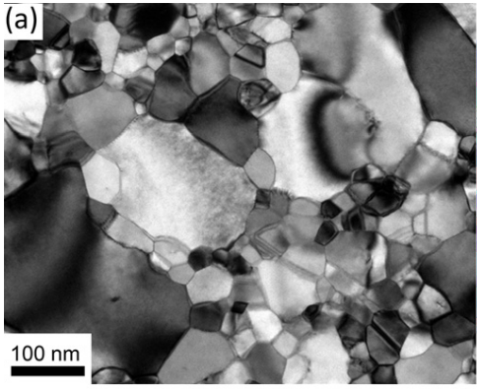
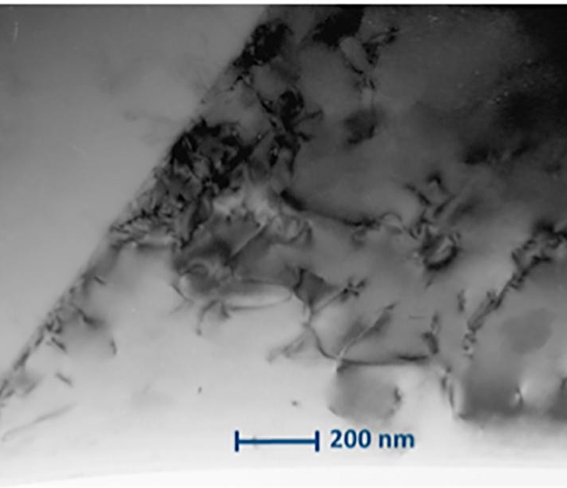

Radiation Tolerant Microstructures
Typical approach to improving radiation tolerance: increase sink density
Oxide-dispersion strengthened (ODS) alloys
Nanocrystalline alloys
Cold-worked alloys
HOWEVER
These engineered microstructures are not stable under all temperature and damage regimes
100 nm
(Allen | 2008)
(Barr | 2018)
(Alshater | 2018)

Slide 6
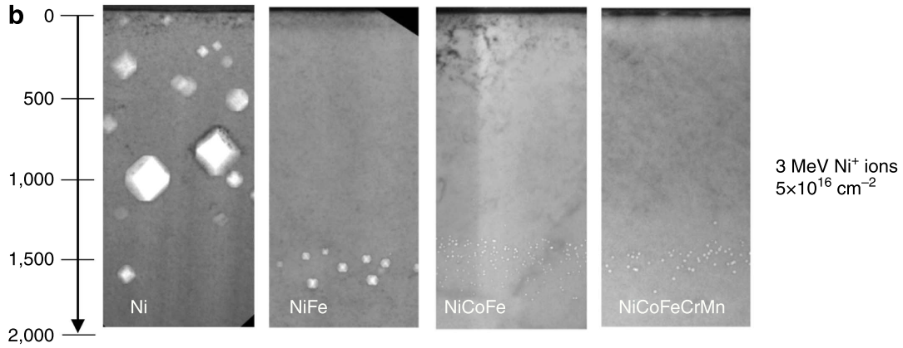
Radiation Tolerance in HEAs
Both modeling and experimentation have shown HEAs can exhibit enhanced radiation tolerance in the matrix
T = 500 °C
(Lu | 2016)

Slide 7
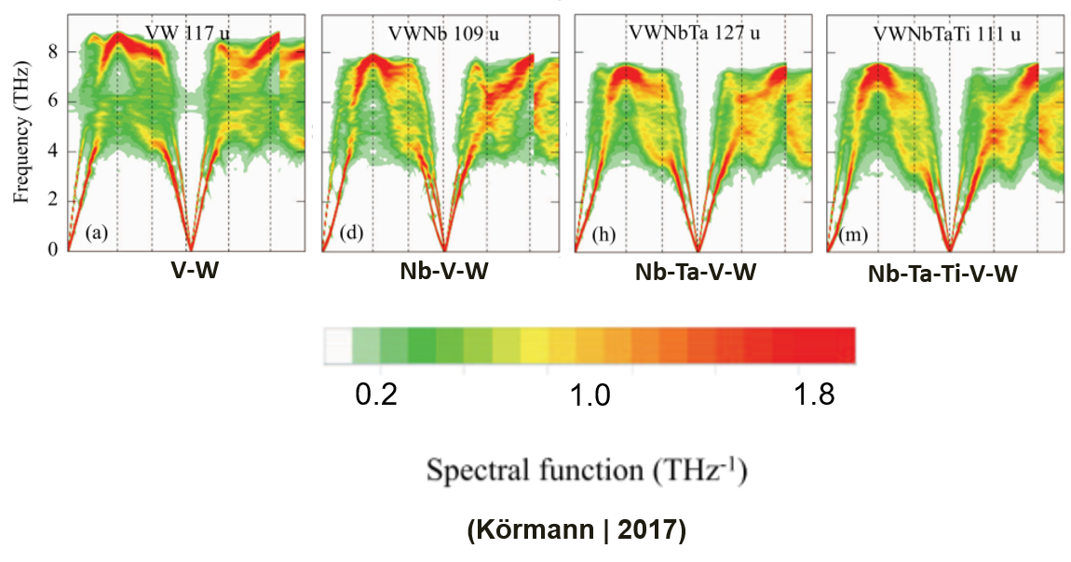
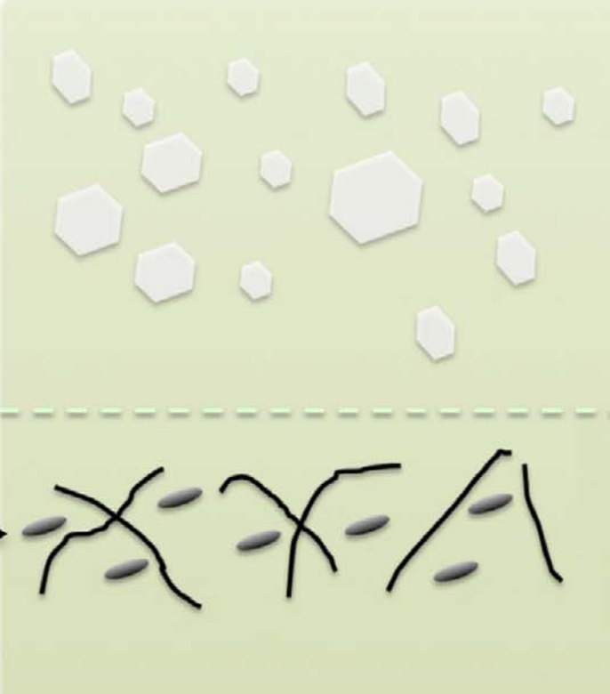
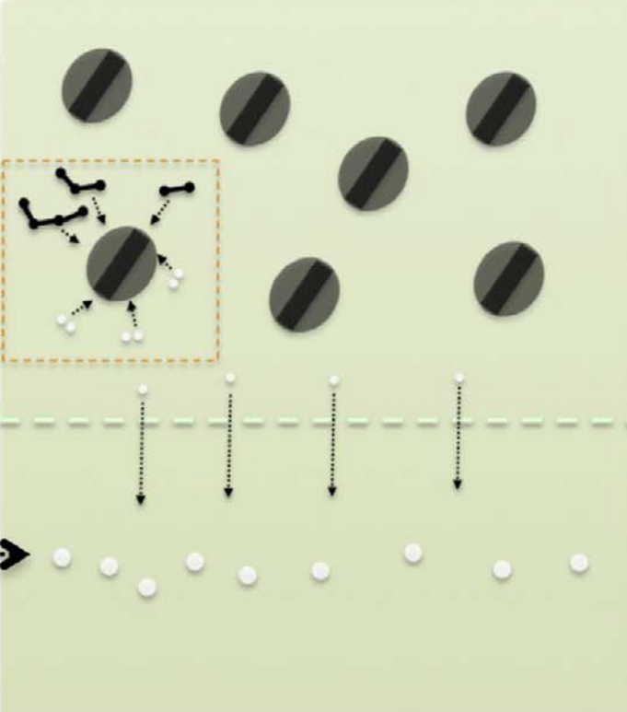
Radiation Tolerance in HEAs
Proposed mechanisms:
Greater phonon scattering
Sluggish diffusion of interstitial loops
More trapping sites
Broad migration energies
And more!
Alloy with mobile interstitial loops
Alloy with sessile interstitial loops
…
(Lu | 2016)

Slide 8
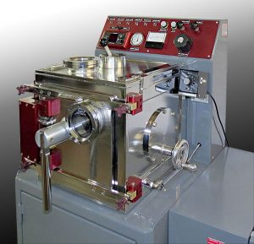
Challenges Investigating HEAs
Atomistically modeling many compositions is computationally expensive
CALPHAD modeling offers faster results, but not without problems:
  Dilute solution approximations
  Extrapolations from binary/ternary diagrams
  Extrapolations from high temperatures
Traditional metallurgy (e.g. arc melting) of many compositions is similarly time consuming
Arcast Arc200 arc melter

Slide 9
Proposed Solution: Develop High-Throughput Capabilities
Use inexpensive modeling to predict stable phases and properties
Use high-throughput synthesis and experimentation to generate phase/property data

Slide 10
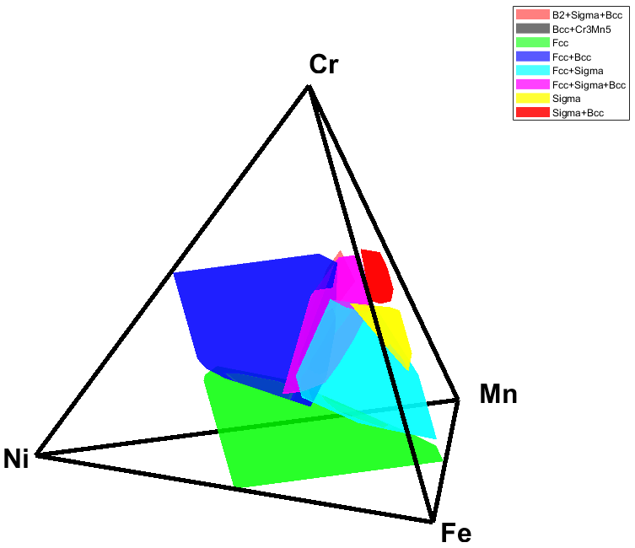
Example: Cr-Fe-Mn-Ni Phase Stability
High-throughput CALPHAD calculations performed using PanDat, Computherm LLC
Stable phases and compositions were calculated for in the Cr-Fe-Mn-Ni family
0-50 at% for each element
Step size: 5 at%

Slide 11

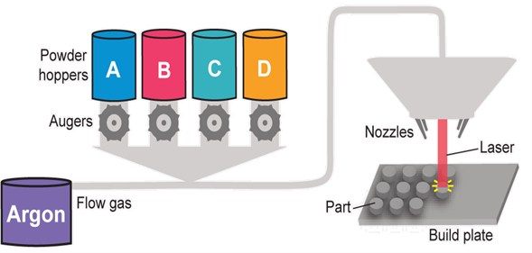

High-Throughput (HTP) Synthesis Techniques
Combinatorial Thin Films
Additive Manufacturing
Co-deposition schematic (Gebhardt | 2012)
In situ alloying schematic (Moorehead | 2019)

Slide 12
LENS Additive Manufacturing Process
Powder Hoppers
Flow Gas
Cr
Fe
Mn
Ni
Auger
Nozzle
Argon
Laser
Part
Build Plate
Schematic of the LENS MR-7
Elemental powders are controlled independently
Powders are delivered to print head by argon flow gas
Laser down optic axis melts powders

Slide 13
Step-by-Step Additive Alloy Synthesis
For aging compositional arrays, samples must be homogeneous throughout
To produce stubs, a powder composition is selected and flown as the laser rasters across surface
Following material deposition, one or more remelting passes is performed to homogenize material
Process is repeated for five build layers to distance from build plate

Slide 14
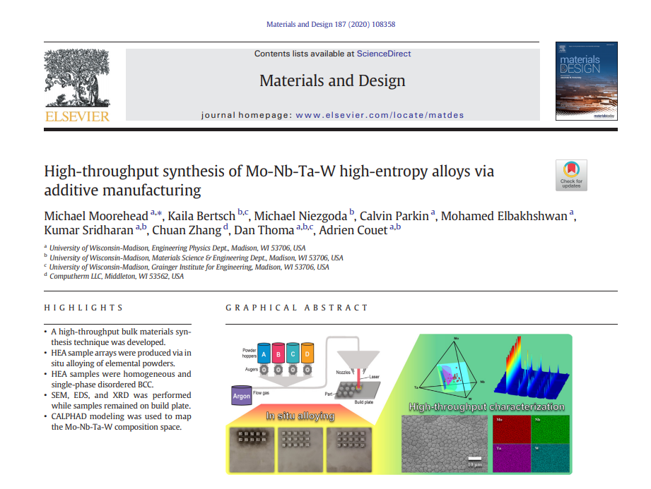
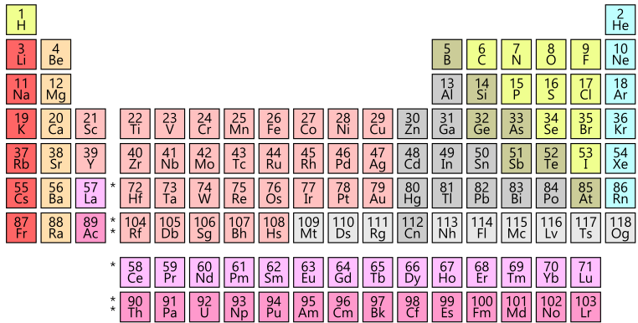
Elements Alloyed In Situ with Additive

Slide 15
Cr-Fe-Mn-Ni Aging Compositions

Slide 16
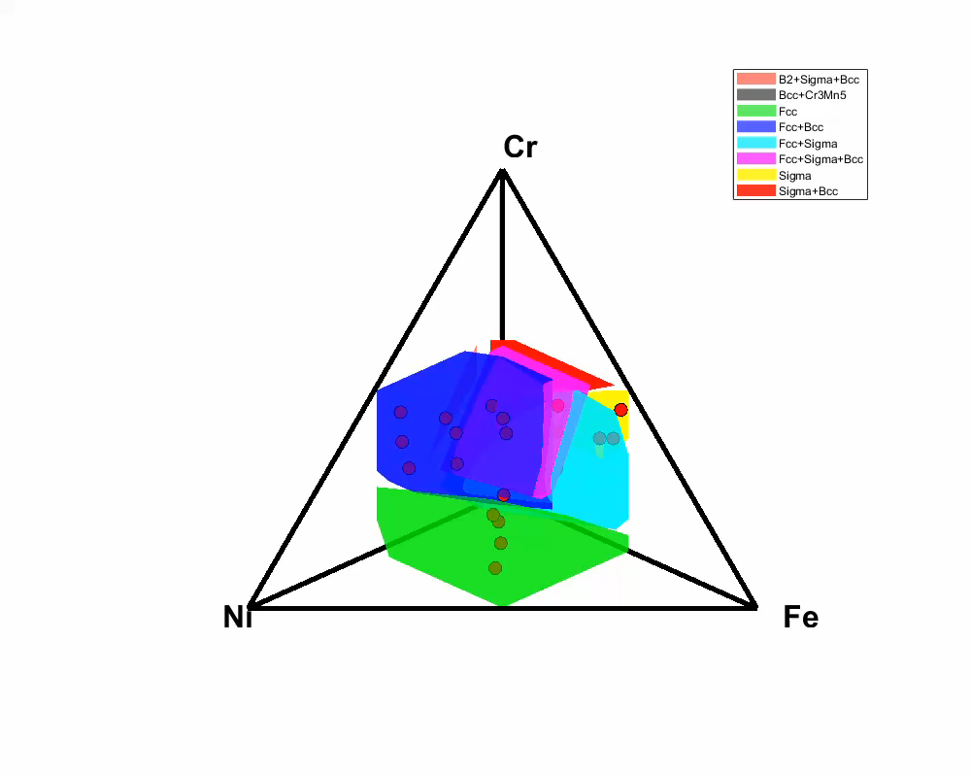
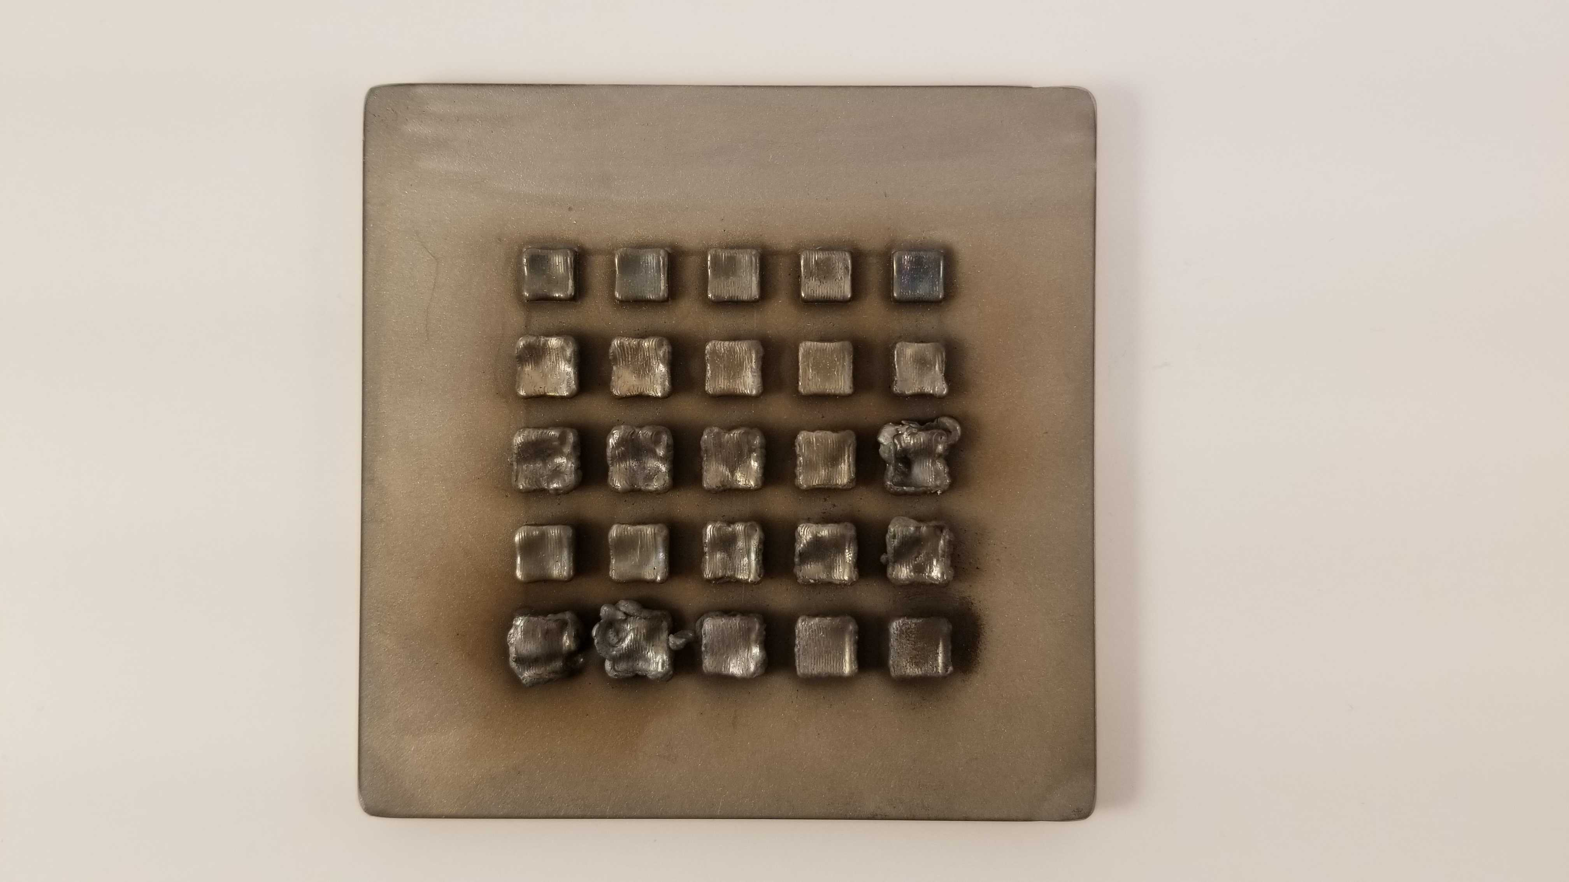
Additively Manufactured Cr-Fe-Mn-Ni: As-Built
Stable phases at 700 °C

Slide 17
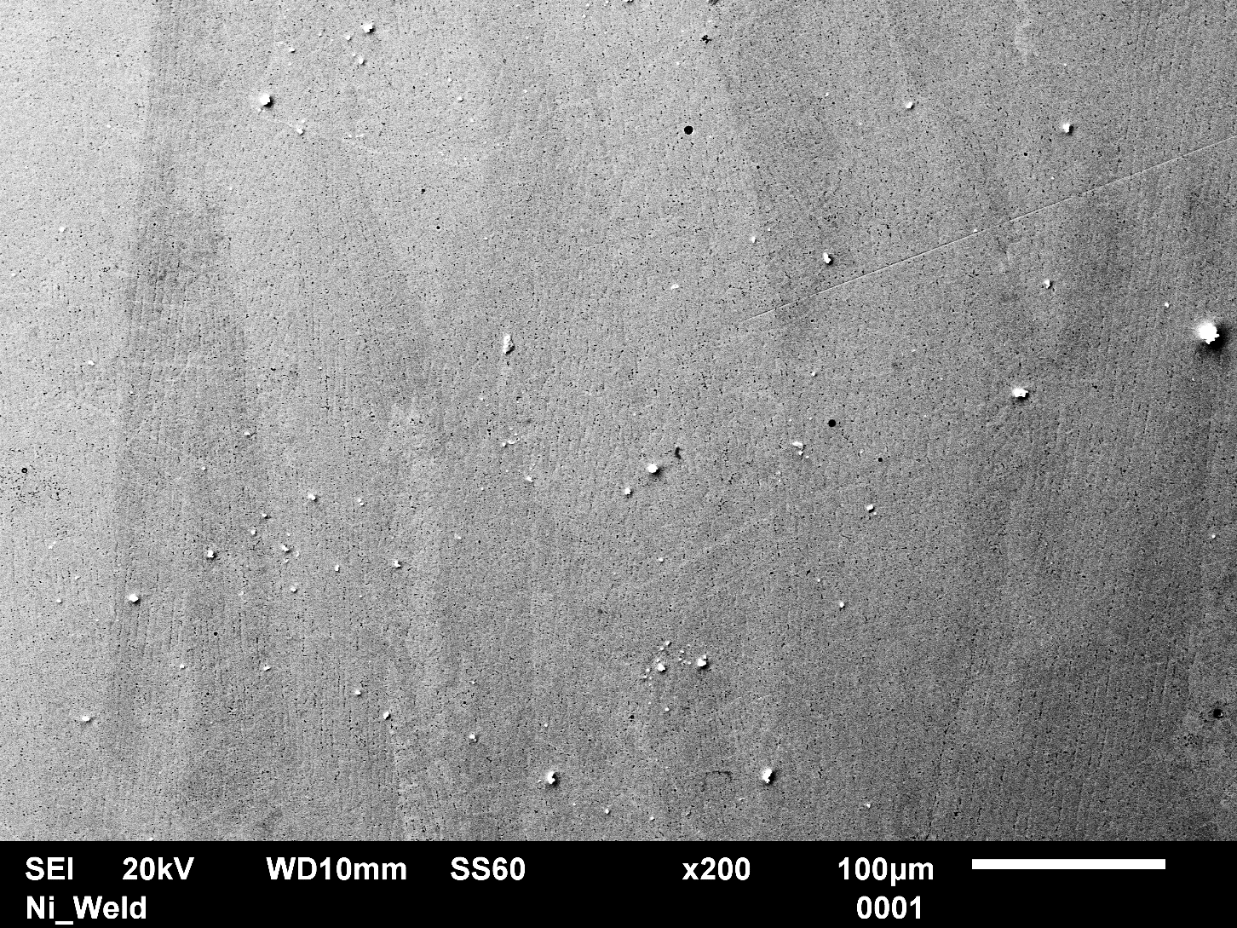
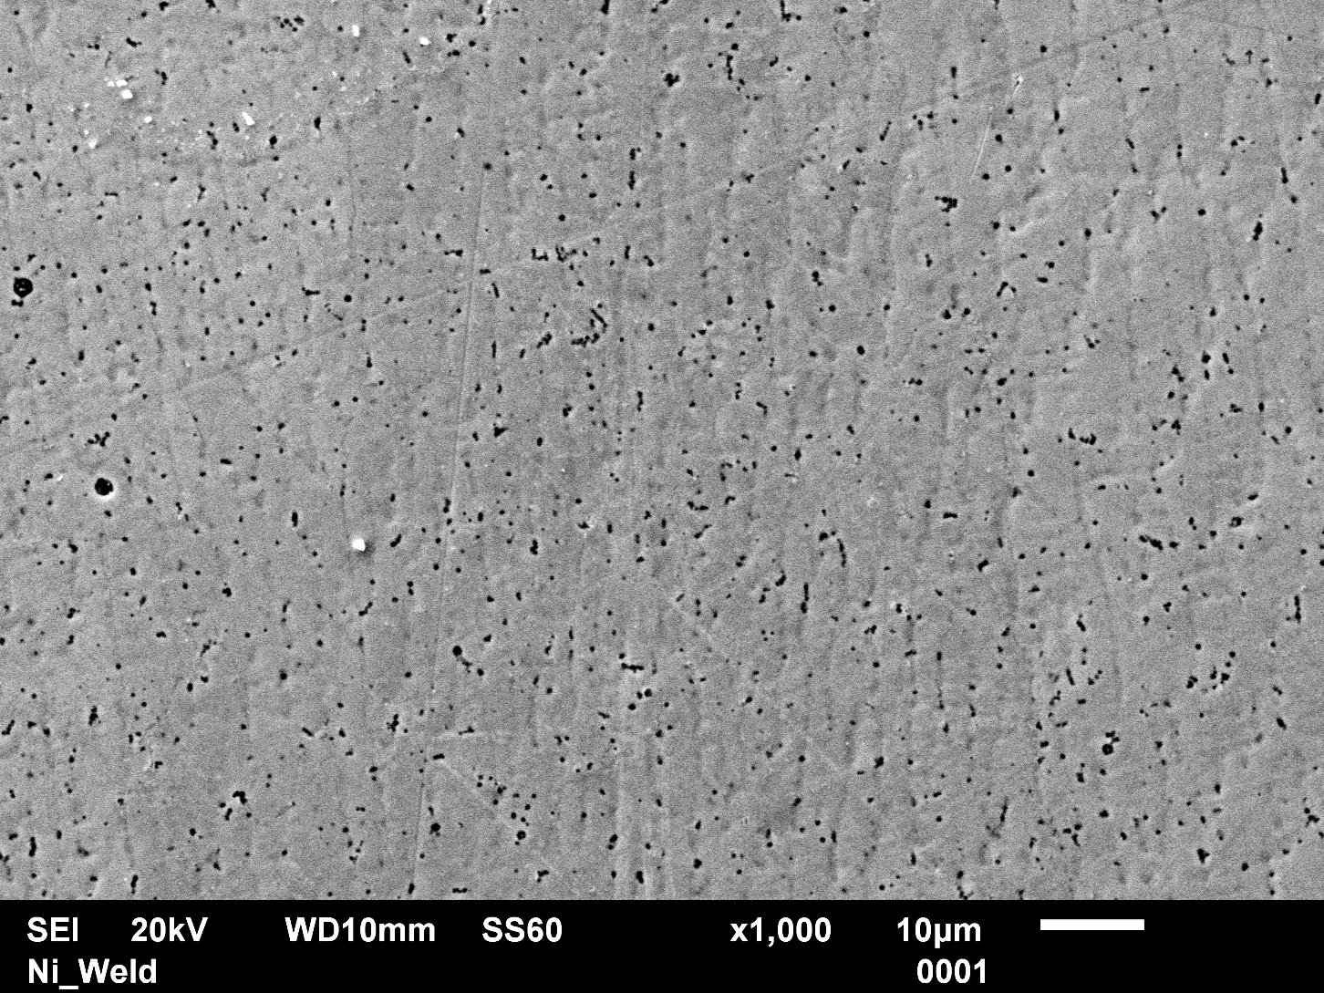
Typical Cr-Fe-Mn-Ni As-Built Microstructure

Slide 18
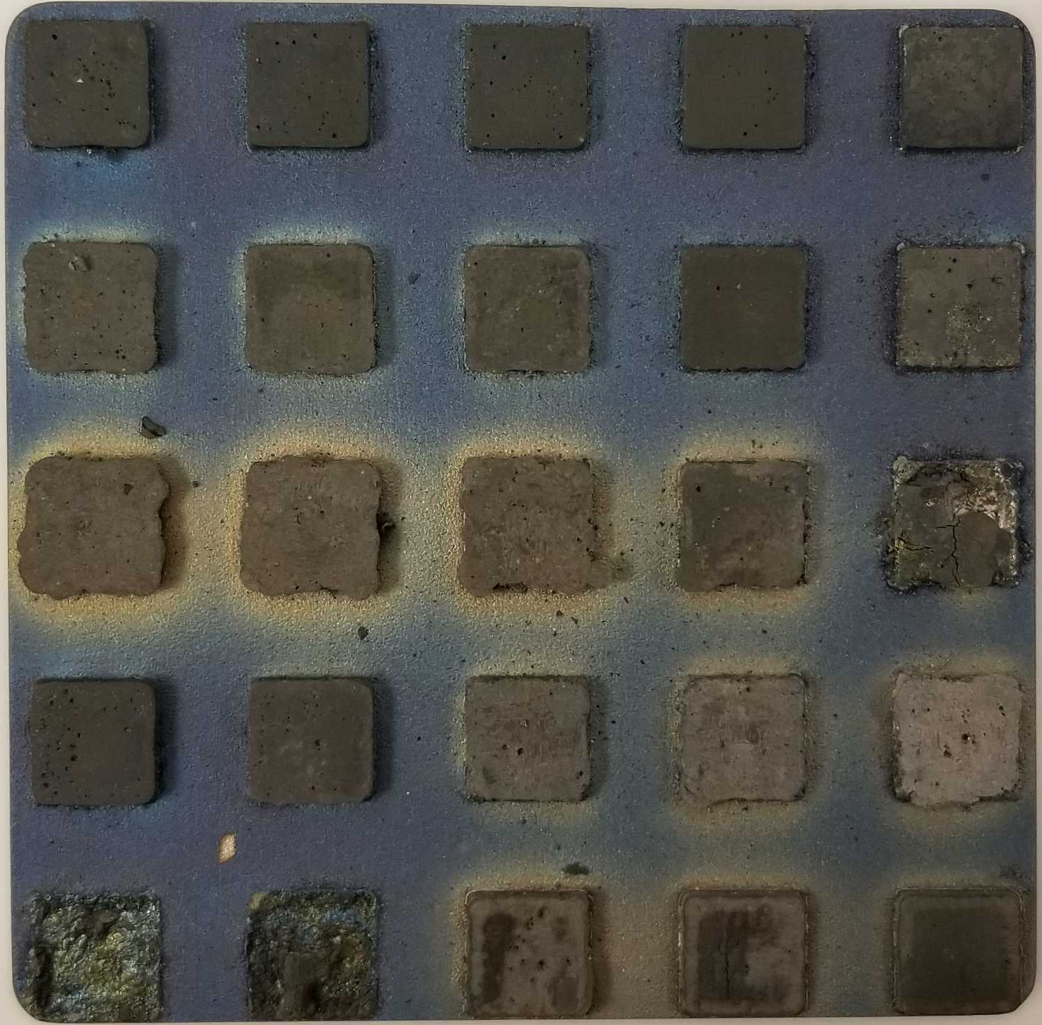
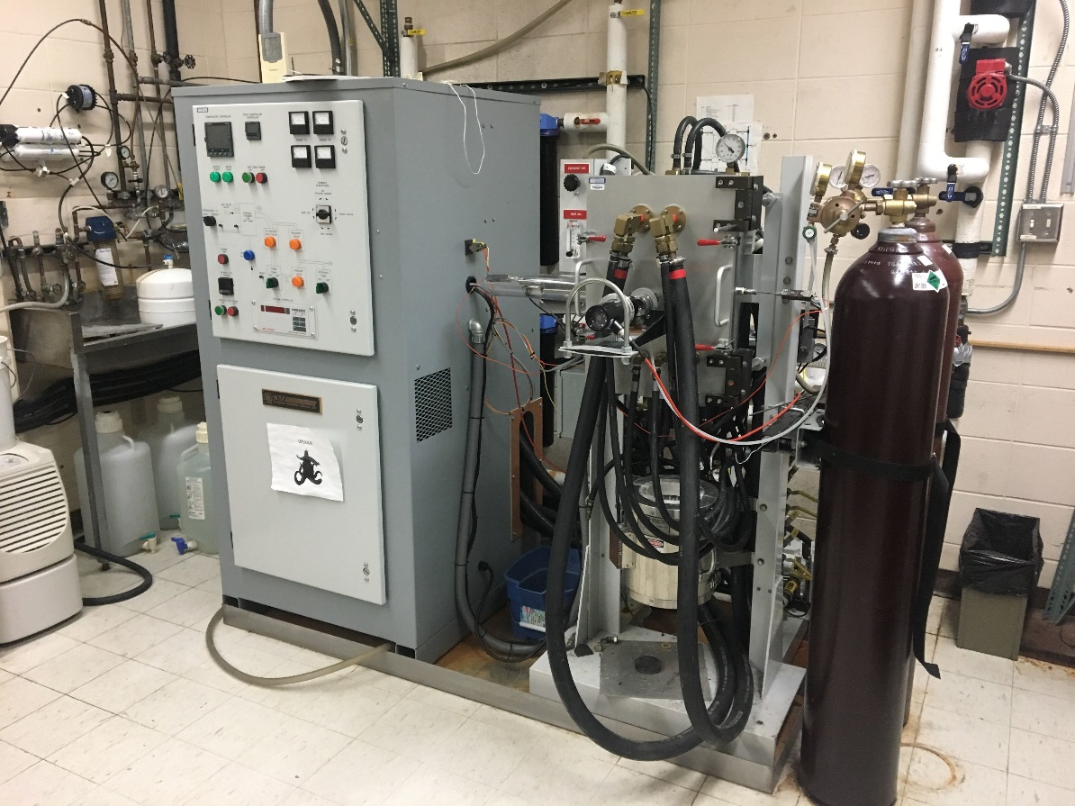
UHV Homogenization/Aging Furnace
UHV MRF vacuum furnace was used
  Water-cooled steel body allows for rapid cooling of samples
Additive plate was homogenized at 1000 °C for 24 hours
Furnace temperature was dropped to 700 °C and held for 24 hours
After aging, furnace was rapidly cooled to RT
Courtesy of John Perepezko | UW-Madison

Slide 19
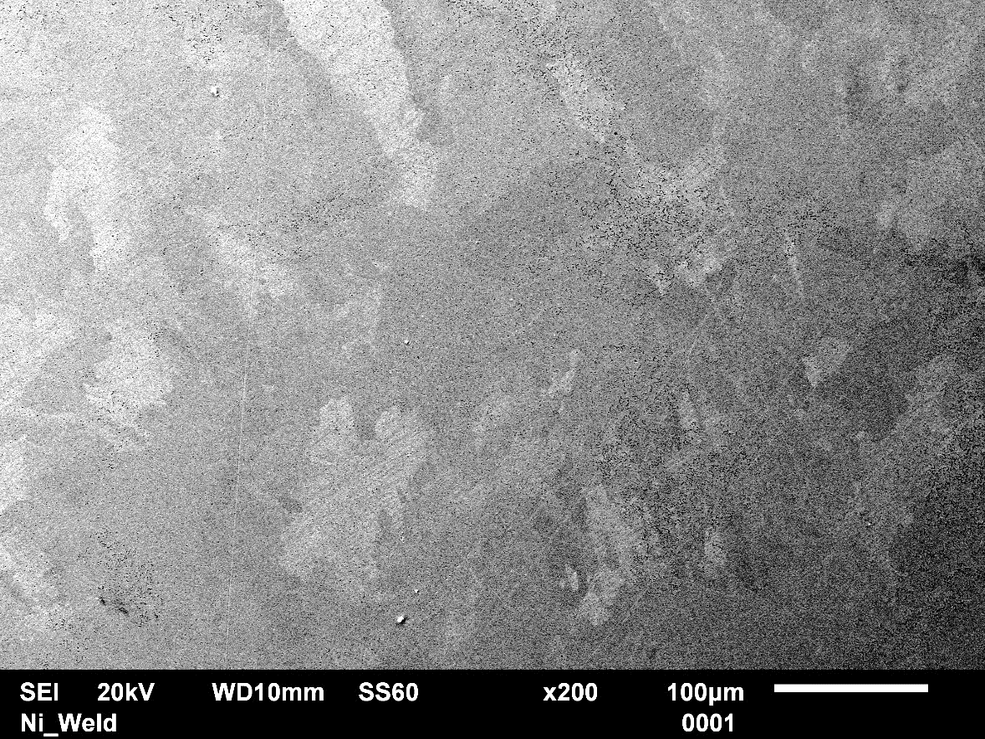
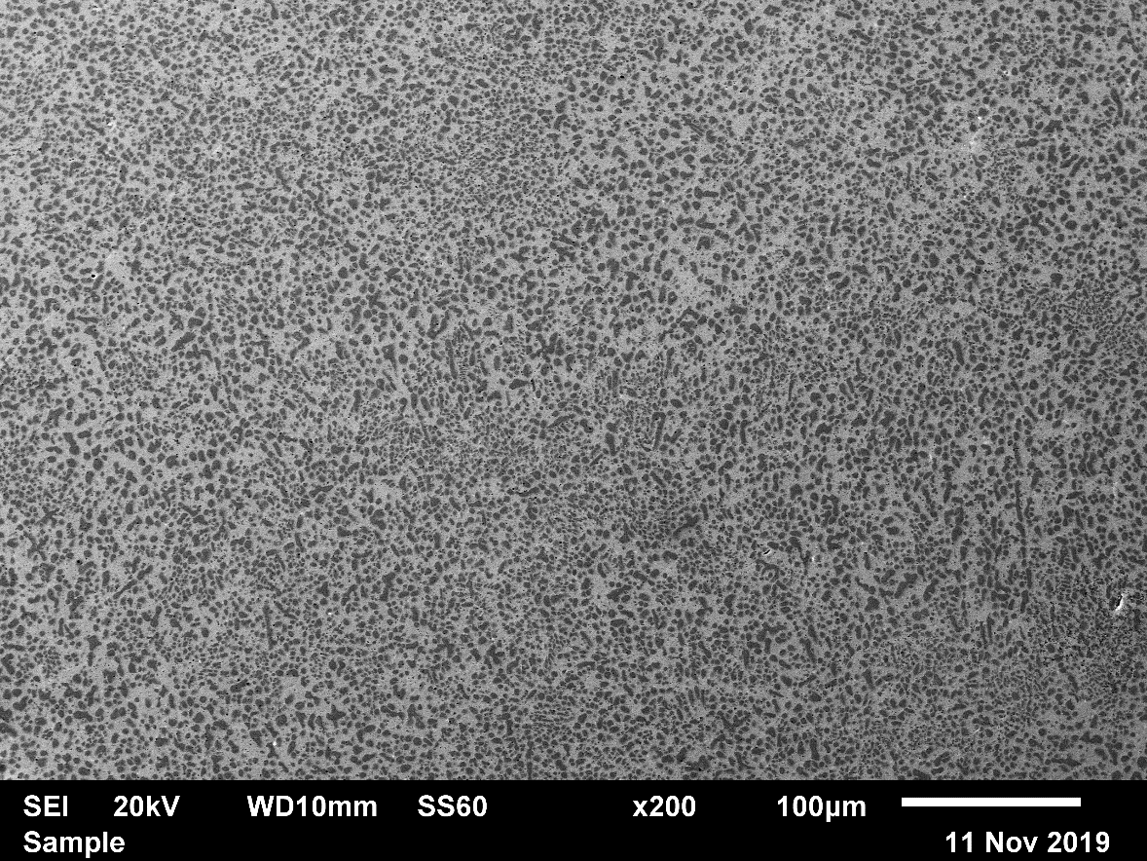
Aged Additive HEA Example: Cr₃₅Fe₁₅Mn₁₅Ni₃₅
_{Aging}
As-Built: Single-Phase FCC
Aged: FCC + BCC

Slide 20
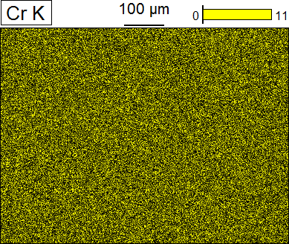
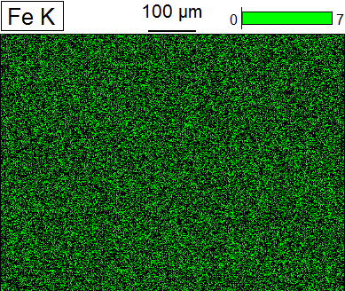
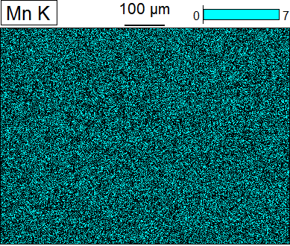
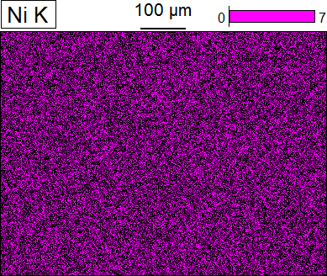
Characterization Example: Cr₃₅Fe₁₅Mn₁₅Ni₃₅
As-built

Slide 21
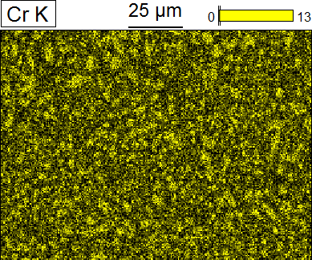
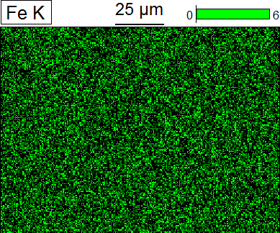
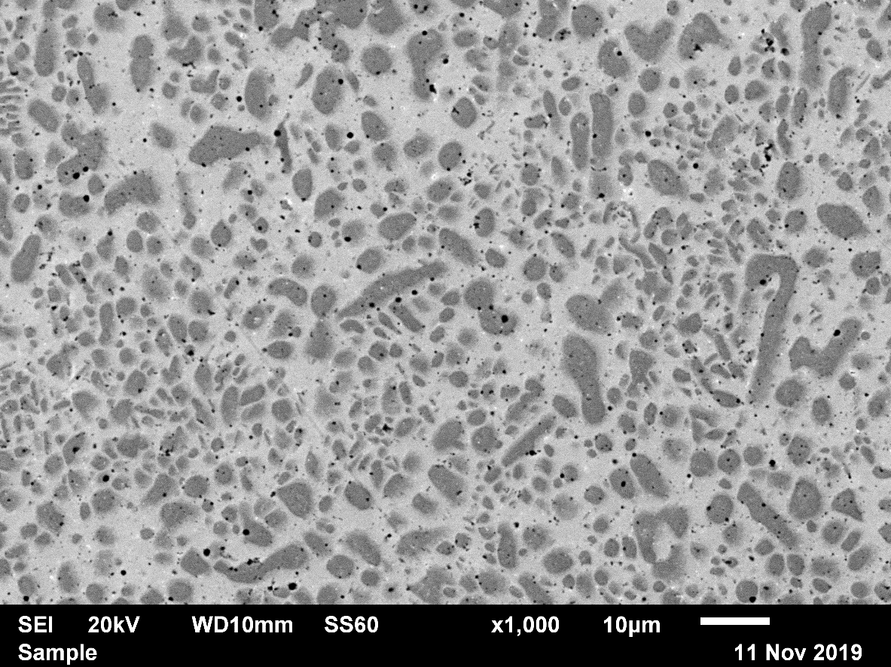
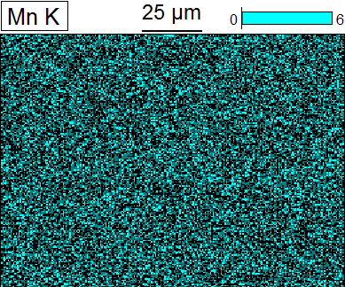
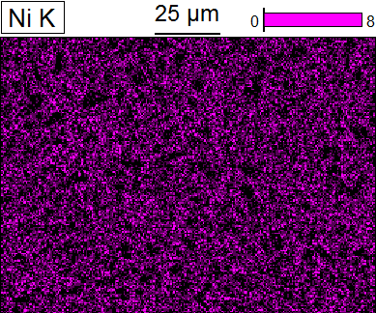
Characterization Example: Cr₃₅Fe₁₅Mn₁₅Ni₃₅
Aged

Slide 22

Characterization Example: Cr₃₅Fe₁₅Mn₁₅Ni₃₅
XRD:
_{2θ}
As-built

Slide 23

Characterization Example: Cr₃₅Fe₁₅Mn₁₅Ni₃₅
XRD:
_{2θ}
Aged

Slide 24
Measured Phase Overview
Cr
_{FCC}
_{BCC}
Ni
Fe
_{Sigma}
_{FCC + BCC}
Mn
_{FCC + Sigma}
X
X
X
X
_{FCC + BCC + Sigma}
As-Built
Aged

Slide 25
Comparison with CALPHAD
?
_{FCC}
_{BCC}
_{Sigma}
_{FCC + BCC}
_{FCC + Sigma}
X
X
X
X
_{FCC + BCC + Sigma}
CALPHAD: Computherm LLC
Aged

Slide 26
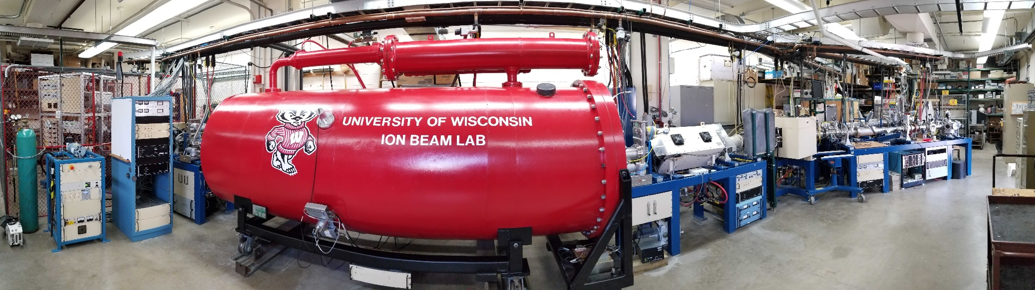
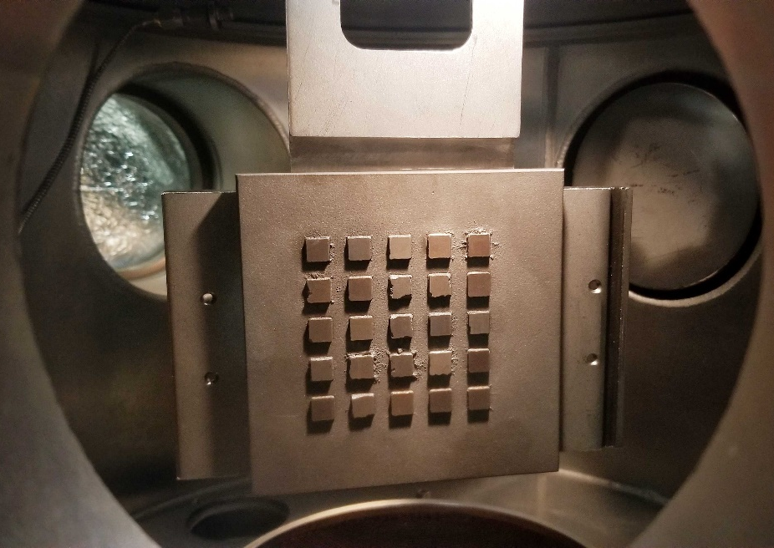
Moving Forward
UW-Madison Ion Beam Laboratory (IBL)
  1.7 MV Tandem Accelerator
  Protons, He ions, heavy ions, etc.
High-throughput ion irradiations
  Use additively manufactured sample arrays to rapidly screen different HEA compositions

Slide 27



Slide 28
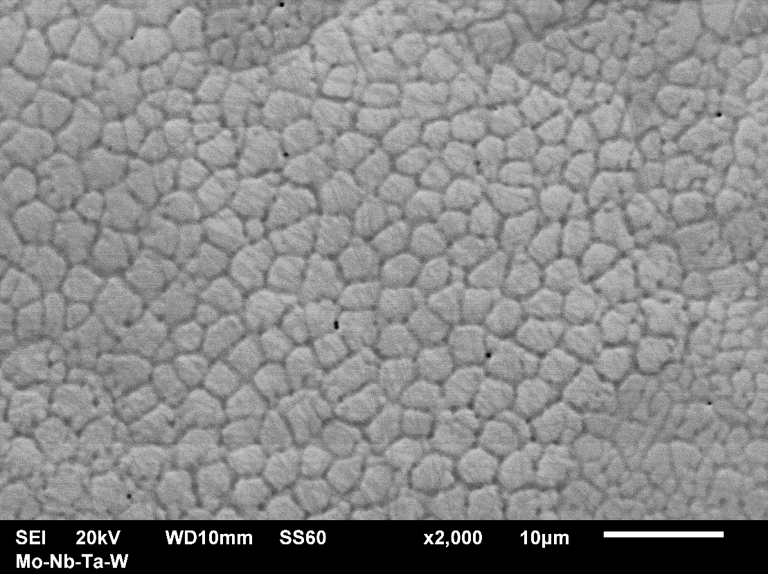
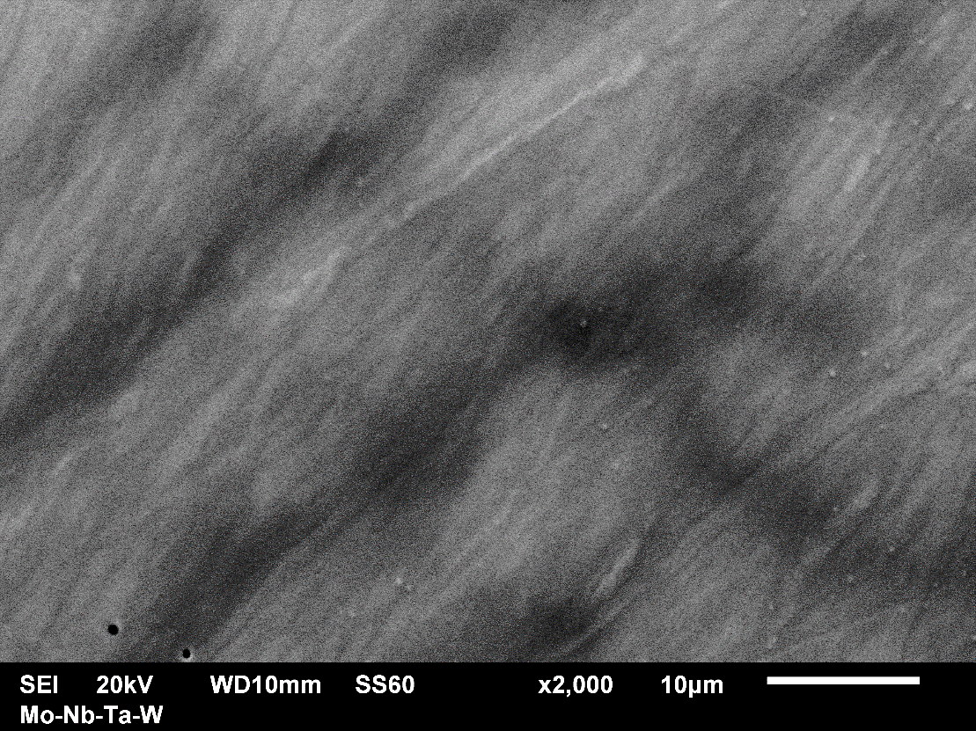
Backup
Additively Manufactured
Arc Melted

Slide 29
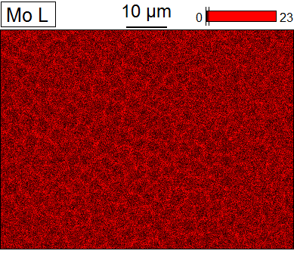
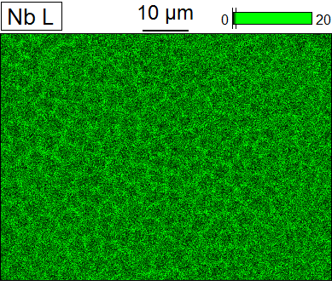
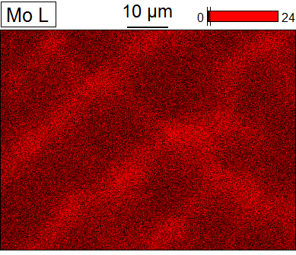
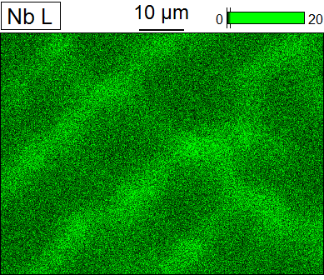
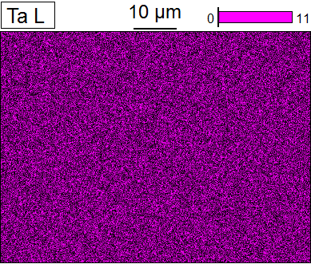
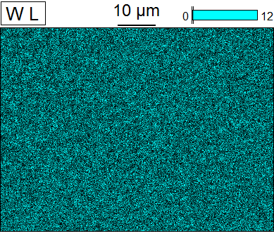
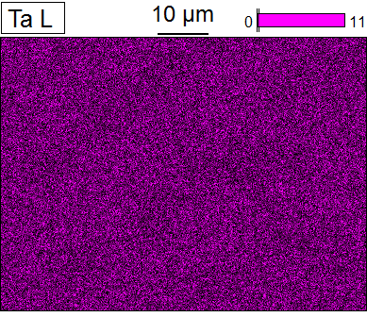
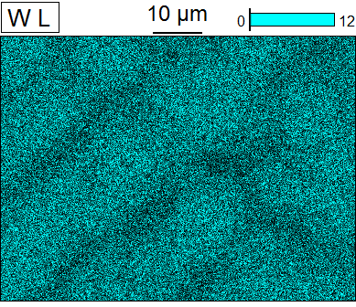
Backup
Additively Manufactured
Arc Melted

Slide 30
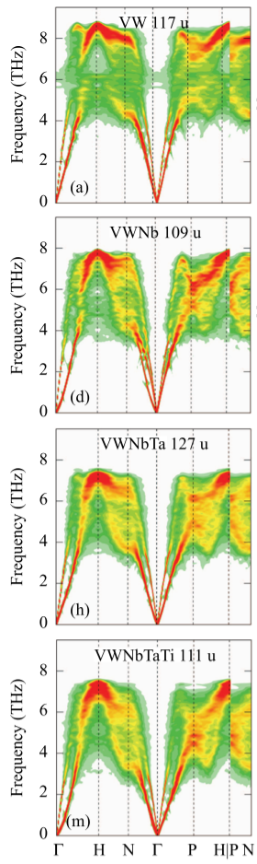

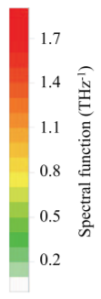
Backup
V-W
Nb-V-W
Nb-Ta-V-W
Nb-Ta-Ti-V-W
0.2
1.0
1.8
(Körmann | 2017)

