Slide 1


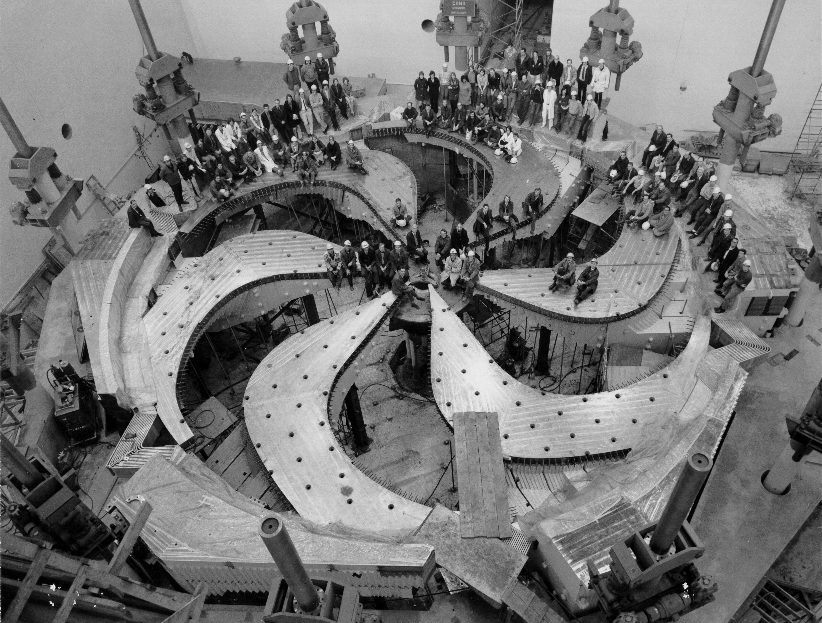
Radiation induced effects in ISOL targets
Luca Egoriti
PhD Candidate, Target & Ion Sources - TRIUMF
TRIUMF – December 10th, 2019
6th RaDIATE Collaboration Meeting

Slide 2
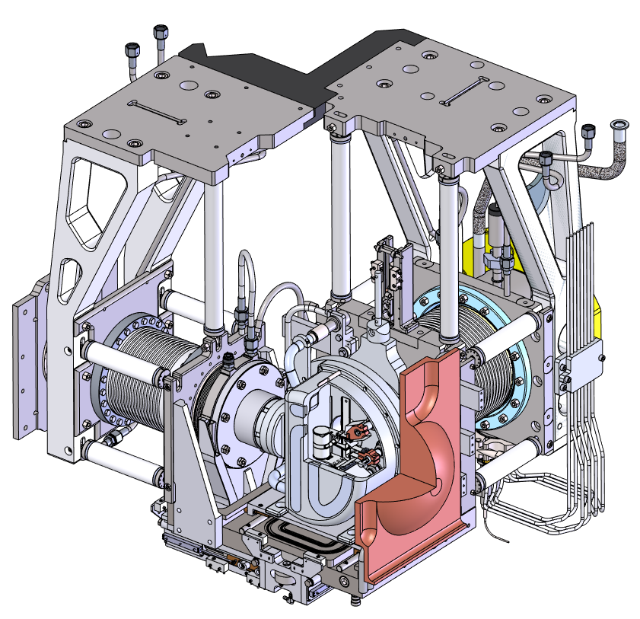
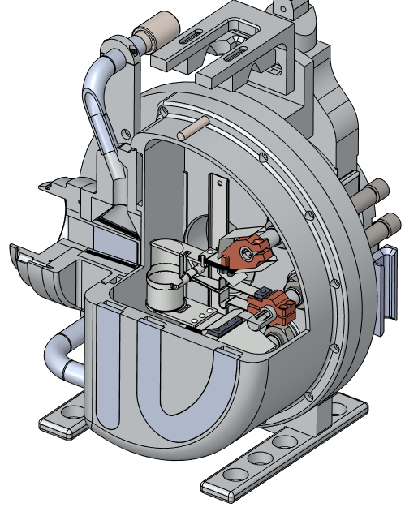
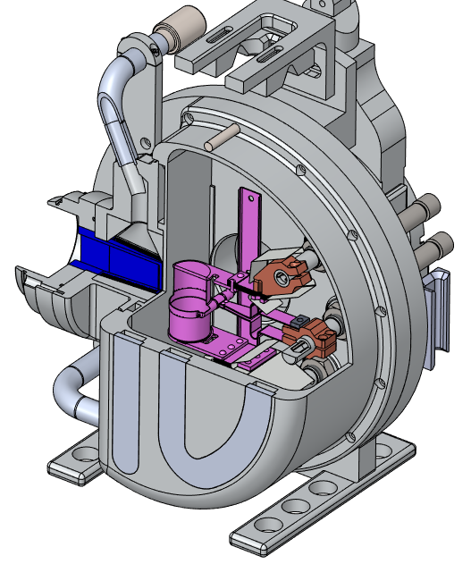
ARIEL Electron Target East (AETE)
RIB
e⁻
Radioactive Ion Beam
30 – 50 MeV electrons
γ

Slide 3
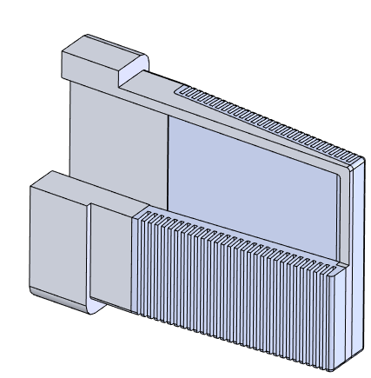
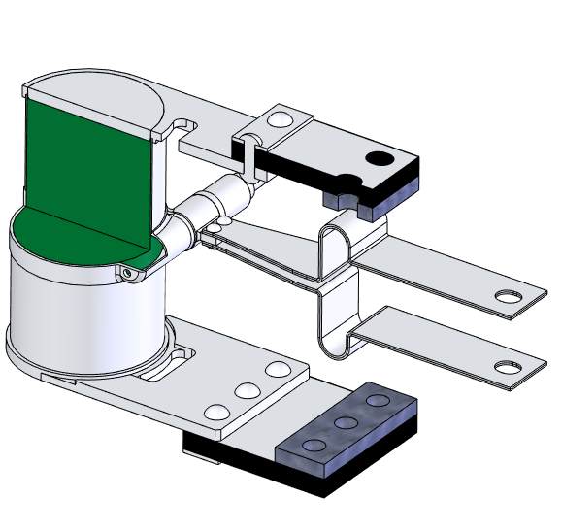
Converter, Target and Ion source assembly

Slide 4
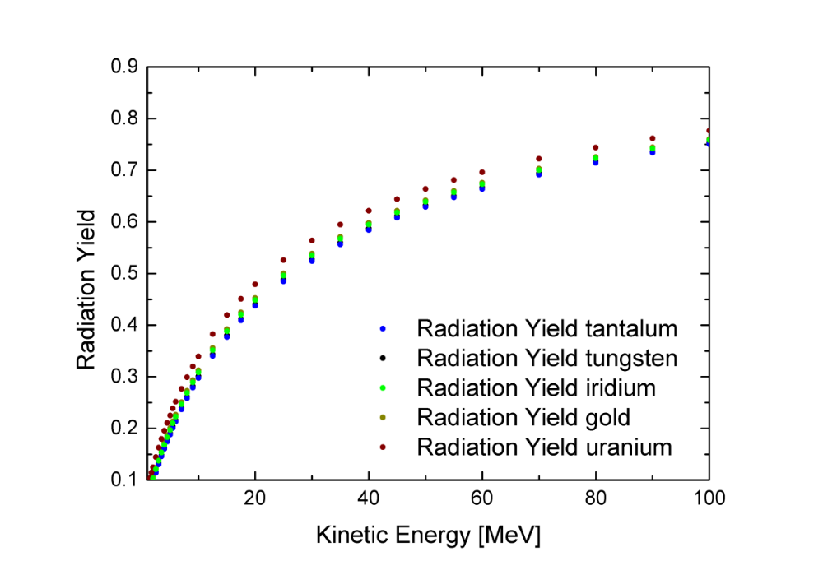

Converter
Objectives:
  Maximize photon production to target
  Stopping all electrons
First high-Z layer
Second low-Z water-cooled bulk
Which high-Z and low-Z materials?
How to bond them?
Radiochemical effects?
Radiation damage?

Slide 5
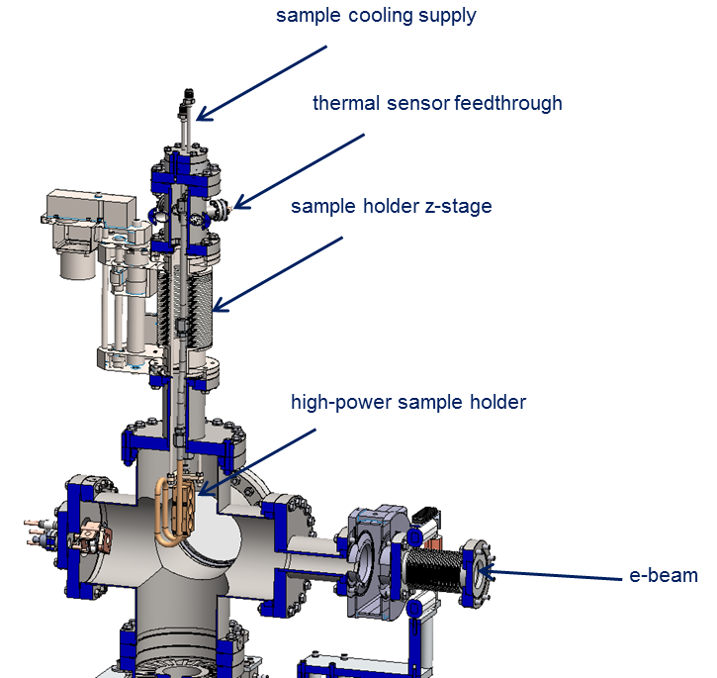
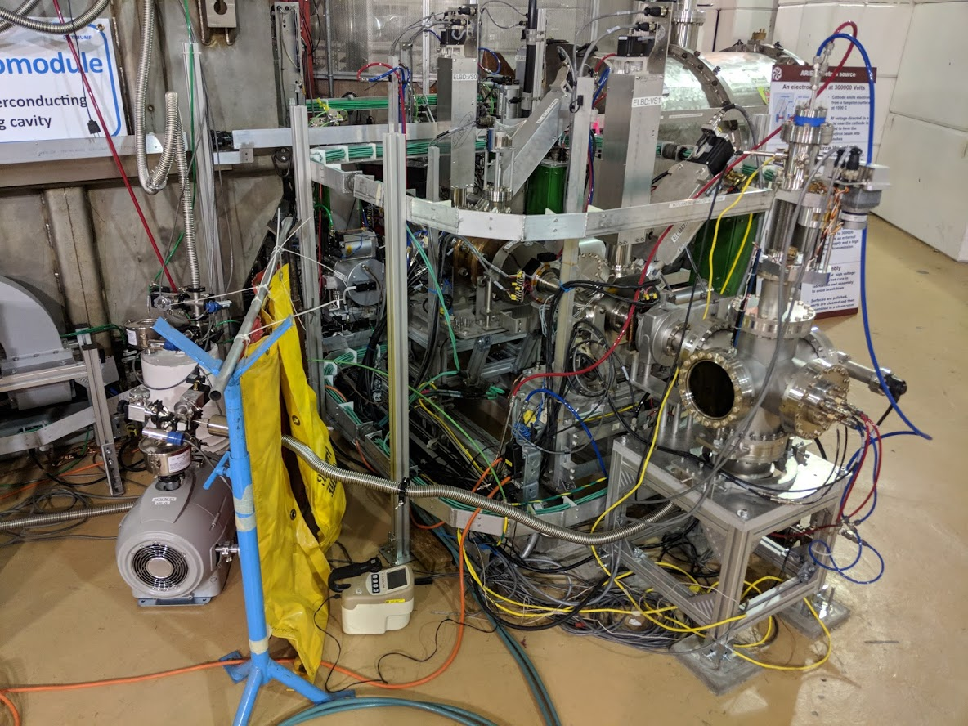
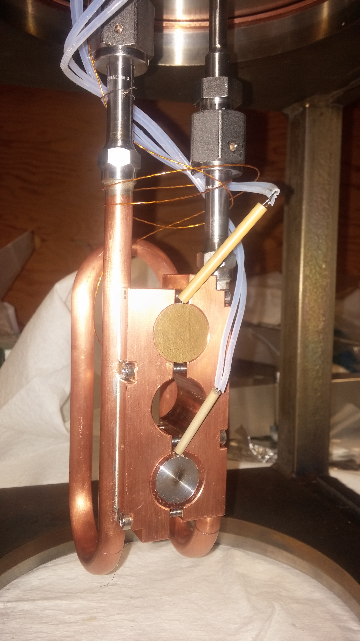
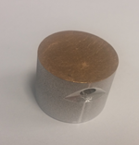
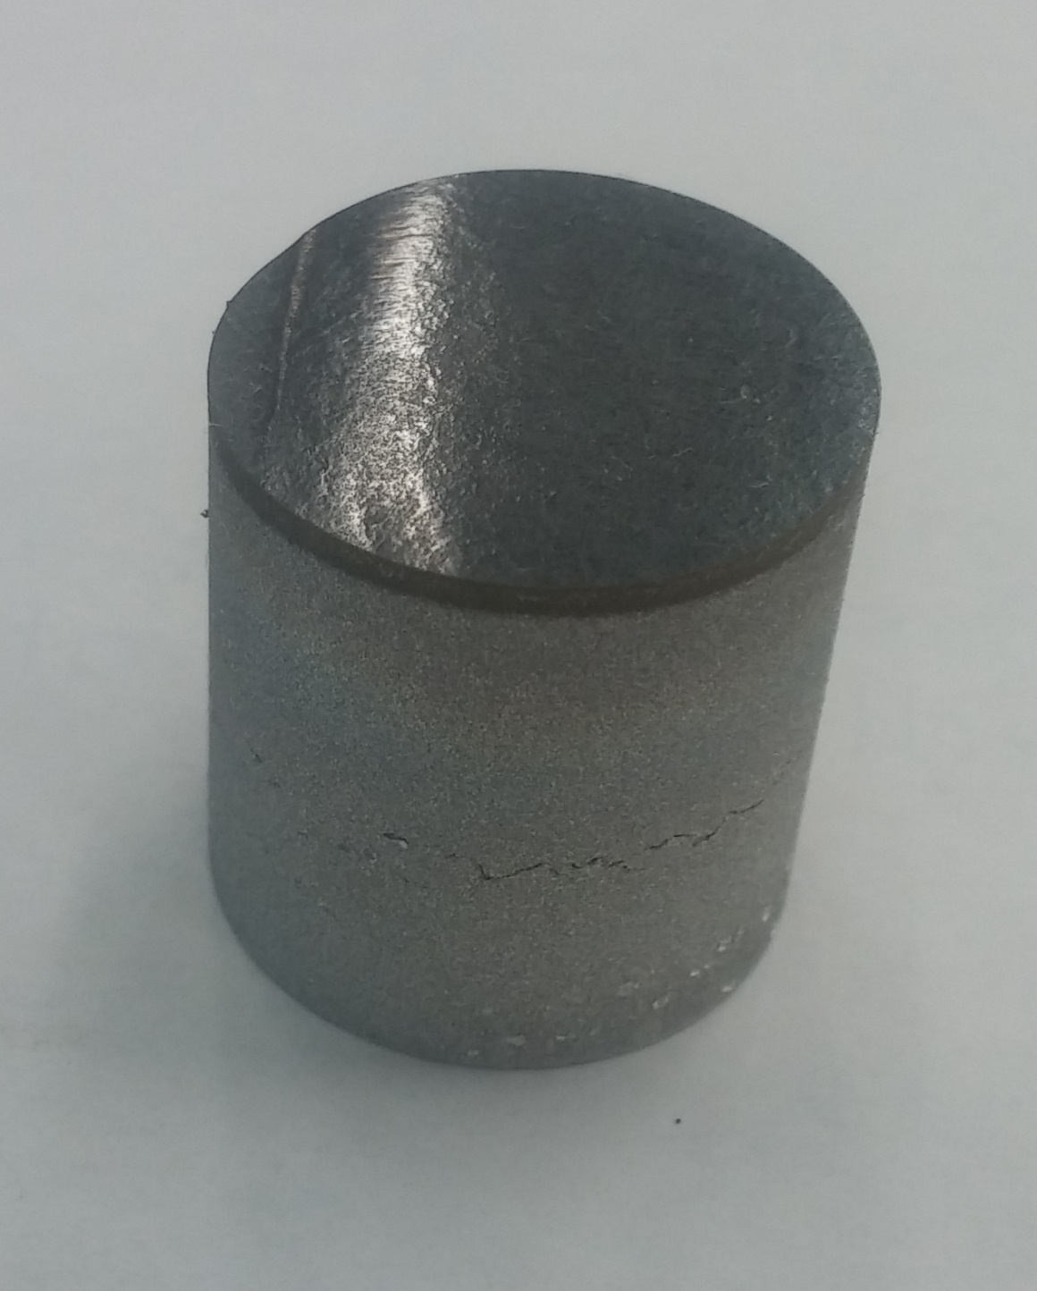
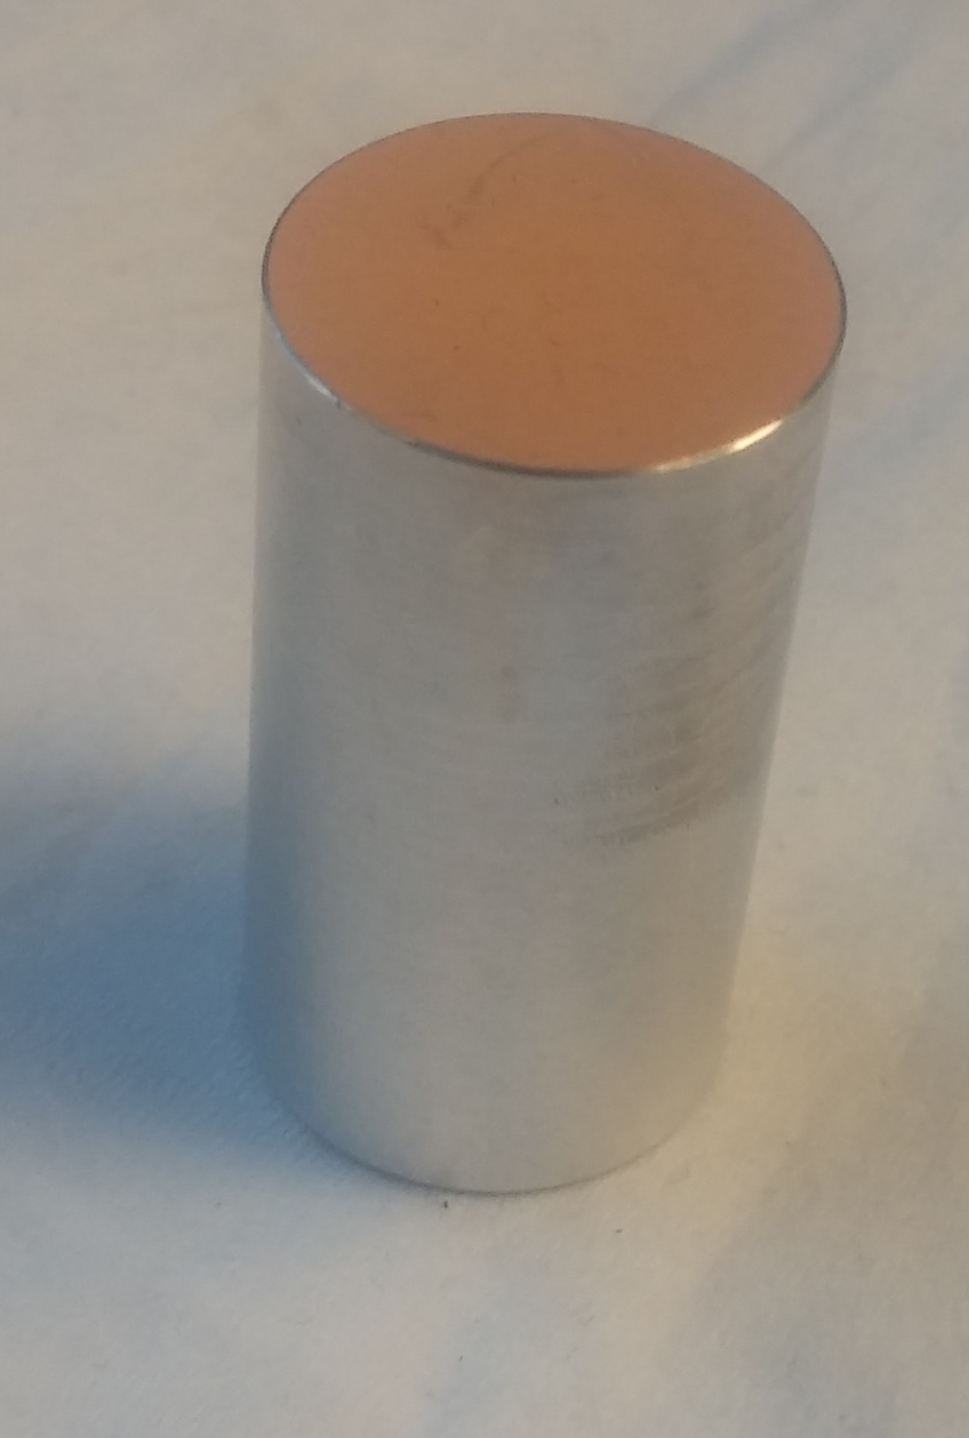
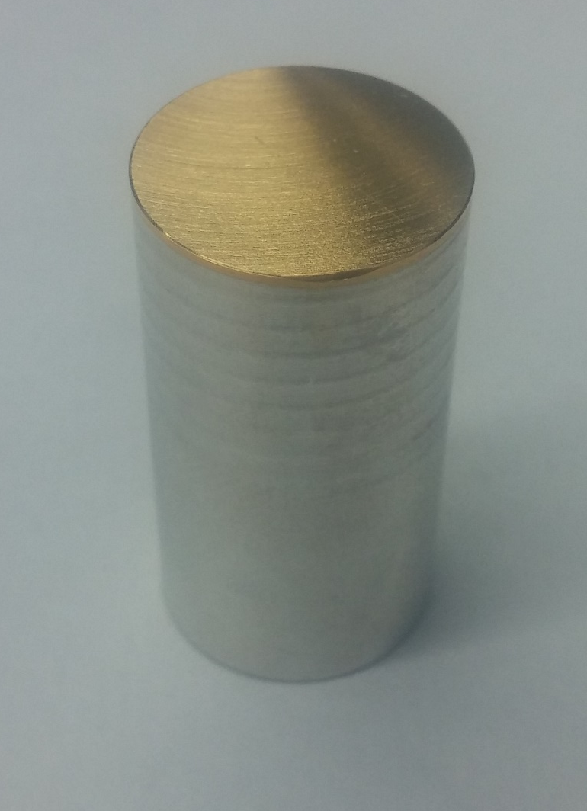
ARIEL e-γ Converter Test Stand (CTS)
Testing conditions:
Electron current = 1.6 mA
Electron energy = 300 kV
Integrated 500 h (~ 3 weeks)
At least 50 heating cycles per sample
12 W/mm²
e⁻
a) Au-Al Expl. Weld
b) Au-Al E.D. + Ni
c) Au-Al E.D.
d) Ta-Al Expl. Weld

Slide 6
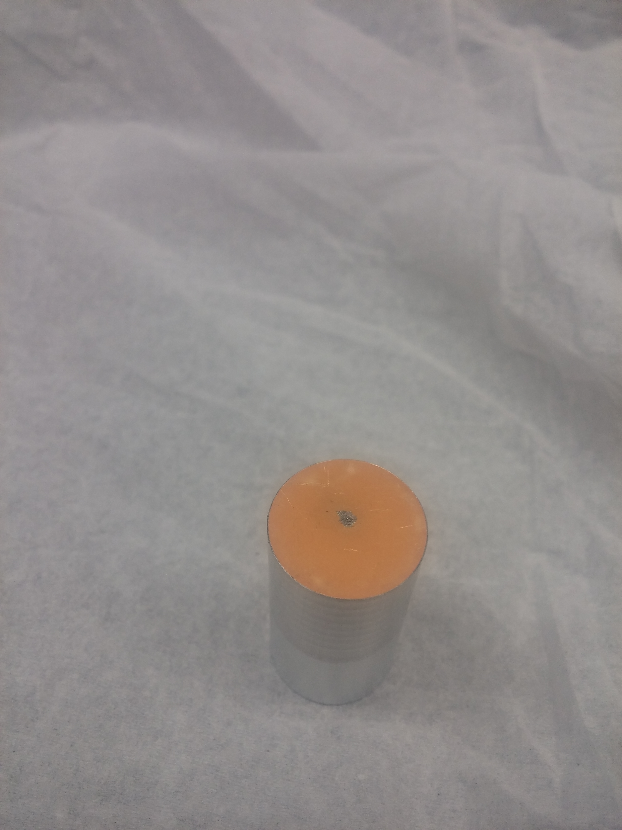
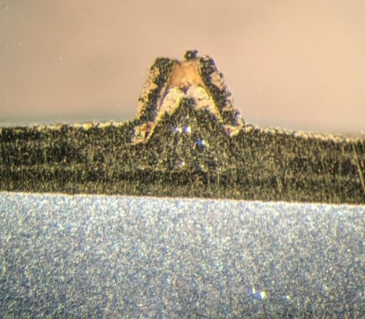


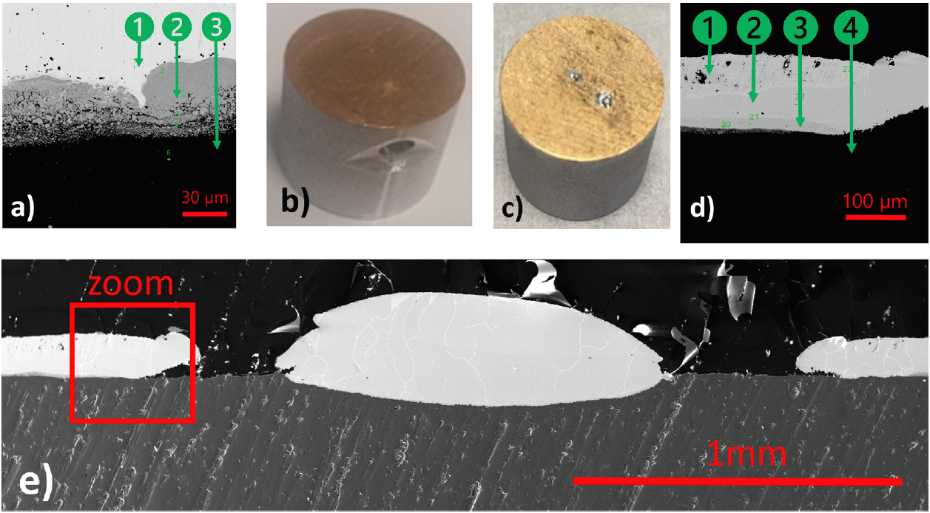
Pre-Acceptance Tests Au
a) Au-Al Expl. Weld
b) Au-Al E.D. + Ni
c) Au-Al E.D.
d) Ta-Al Expl. Weld
Pristine sample
3.5%
51%
97%
Irradiated sample
    1.5%
    28%
    32%
    98 %
Outcome:
Temperature increase during irradiation
Au-Al diffusion and intermetallic formation

Slide 7
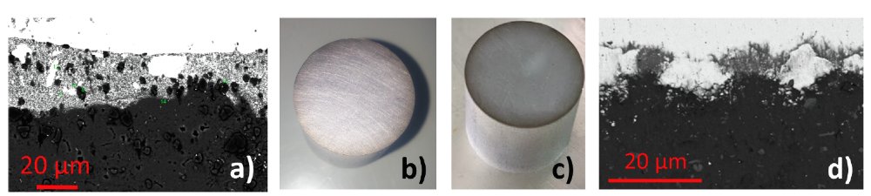
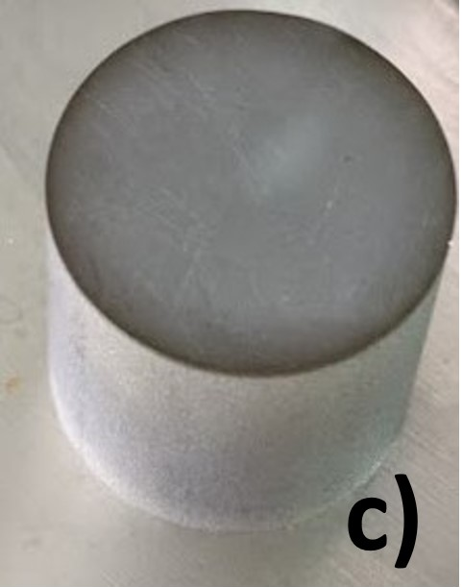
Acceptance Tests on Tantalum
Pristine
a) Au-Al Expl. Weld
b) Au-Al E.D. + Ni
c) Au-Al E.D.
d) Ta-Al Expl. Weld
Irradiated
    Outcome:
    Temperature stable over the irradiation period
    No evident damage by eye inspection or SEM
    Temperature stable over 500 h of irradiation
    Surface microscopy shows no damage
    Operational 24/7

Slide 8
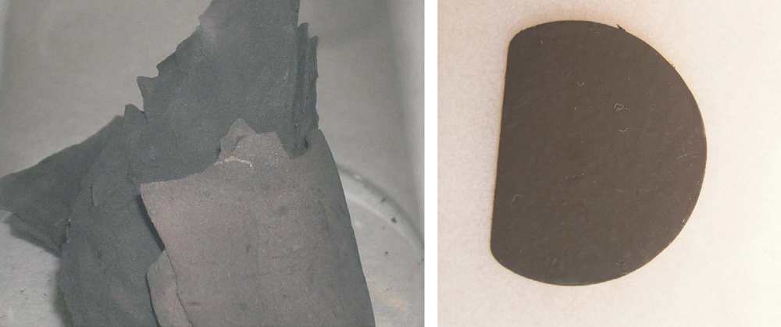
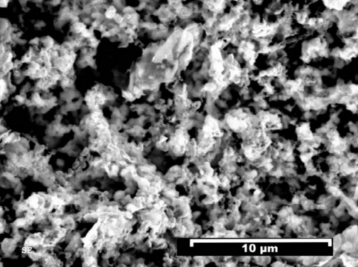
Converter, Target and Ion source assembly
Kunz, P. et al, J. of Nuc Mat 440 (2013) 110–116

Slide 9
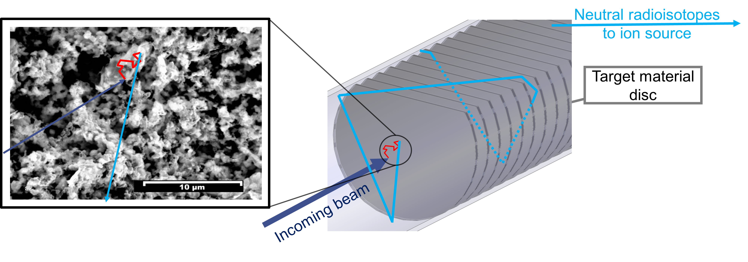
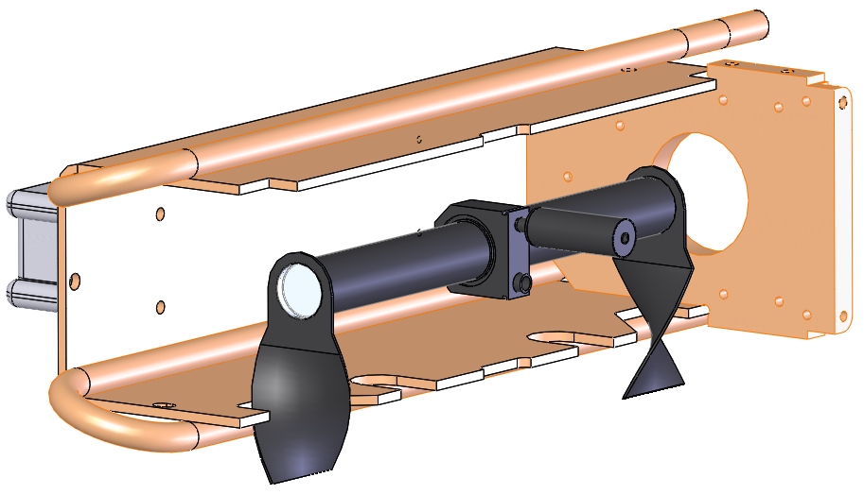
ISAC/ARIEL: porous carbide target materials
ARIEL - AETE
Kunz, P. et al, J. of Nuc Mat 440 (2013) 110–116
Water-cooled copper Heat Shield
Tantalum target container
ISAC
Ion Source

Slide 10
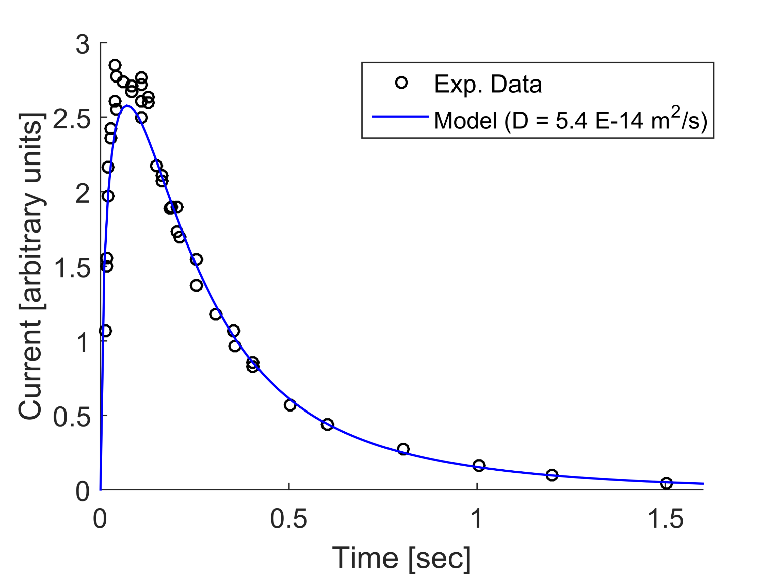
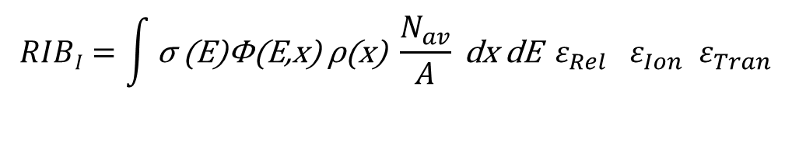
Radioisotope extraction from an ISOL target
Kunz, P. et al, J. of Nuc Mat 440 (2013) 110–116
    $$RIBI=\int{\text{σ}\text{ (}\text{E}\text{)}\text{Φ}\text{(}\text{E}\text{,}\text{x}\text{) }\text{ρ}\text{(}\text{x}\text{)} \frac{N_{av}}{A}} \text{dx} \text{dE} ε_{Rel} { ε}_{Ion} ε_{Tran}$$
In target production
Release efficiency

Slide 11
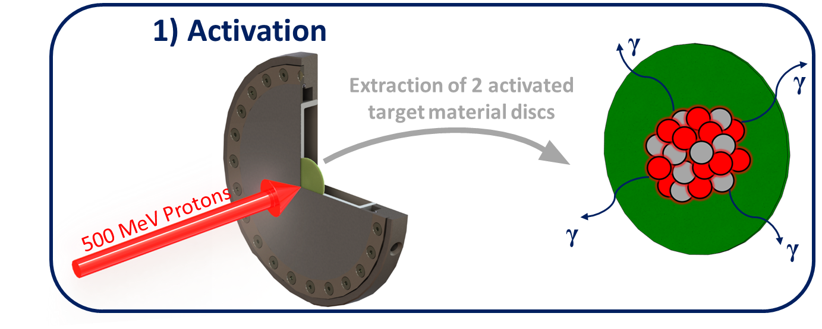
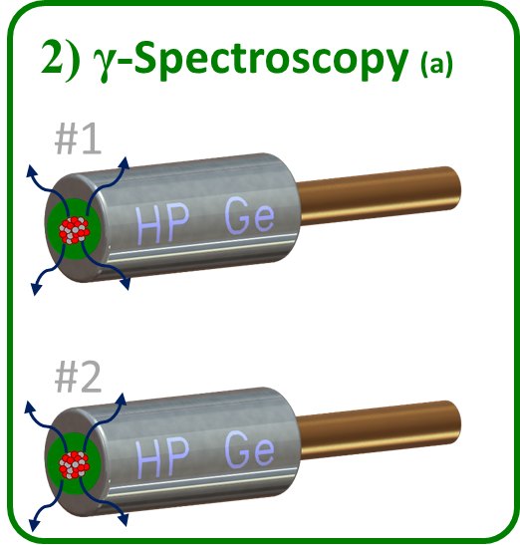
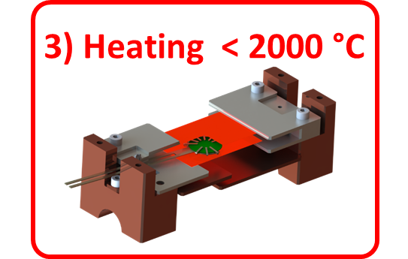
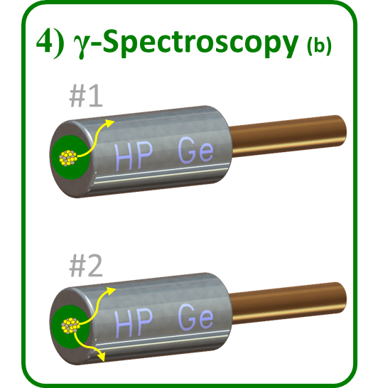


Release tests: procedure
Procedure developed at ALTO/IPNO¹
Neutron/photon facilities
Systematic tests on UC_{x} release
Tests procedure at TRIUMF:
Proton 500 MeV
  More materials
  Diverse inventory
Mildly irradiated pellets and spent ISAC targets
Systematic tests on several ISOL target materials
Room
Temperature

Slide 12
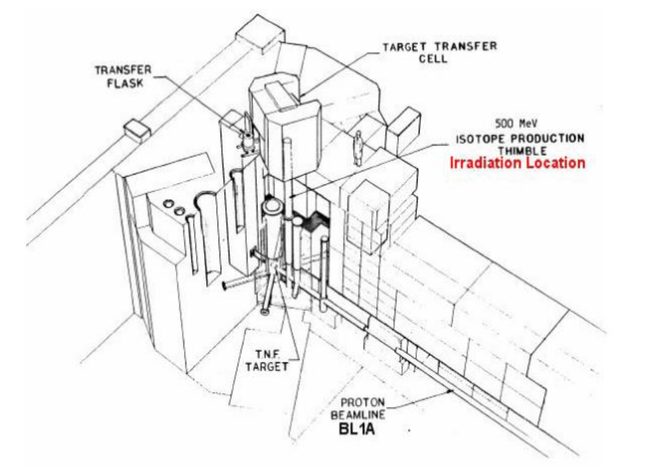
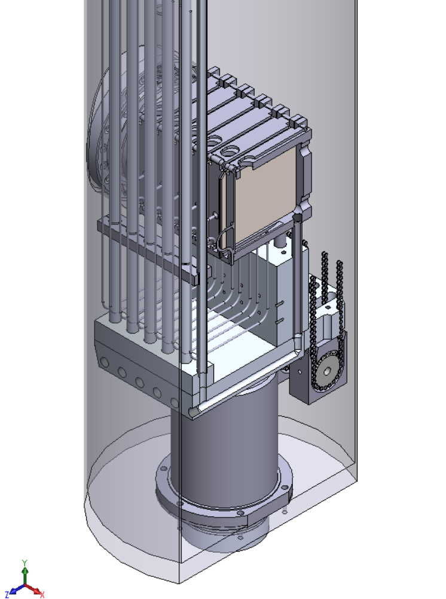
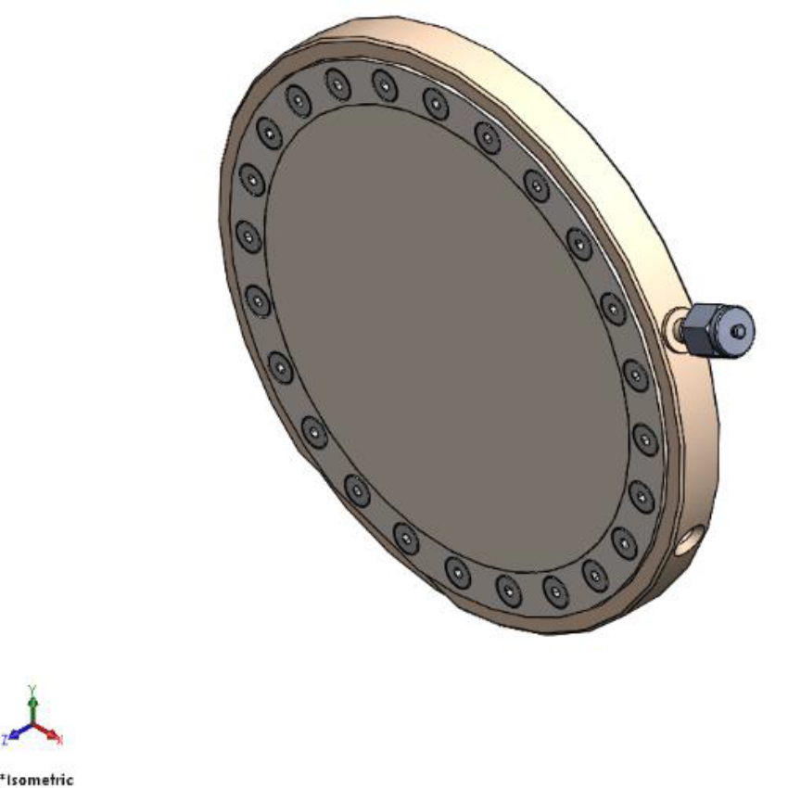
Isotope Production Facility (IPF)
P⁺ beam

Slide 13
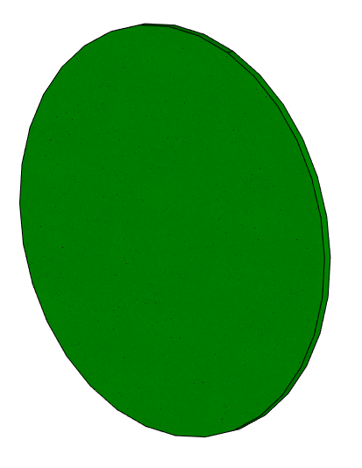


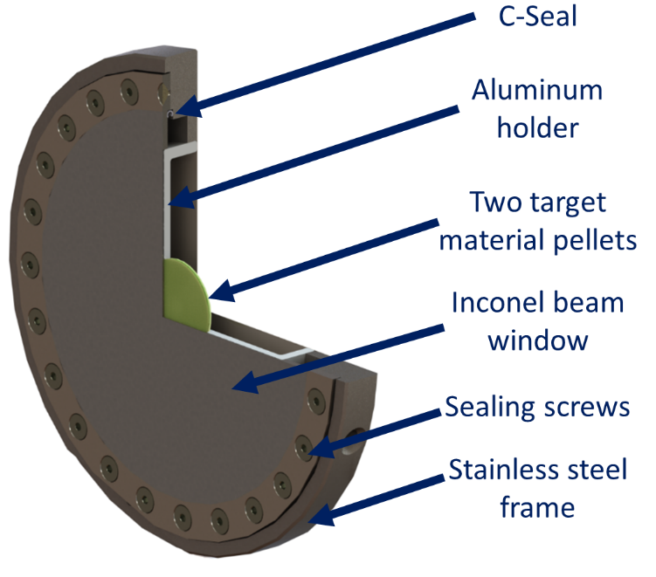
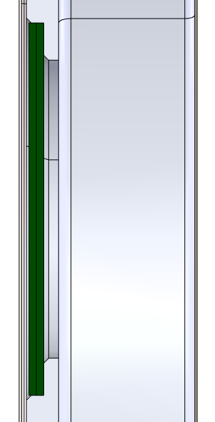
Target design
Target disc:
Ø = 19mm
Ceramic of interest = 0.25 mm(UC_{x}, SiC_{x}, ZrC_{x})
Graphite layer = 0.13mm
Target design and testing: Louis Moskven

Slide 14
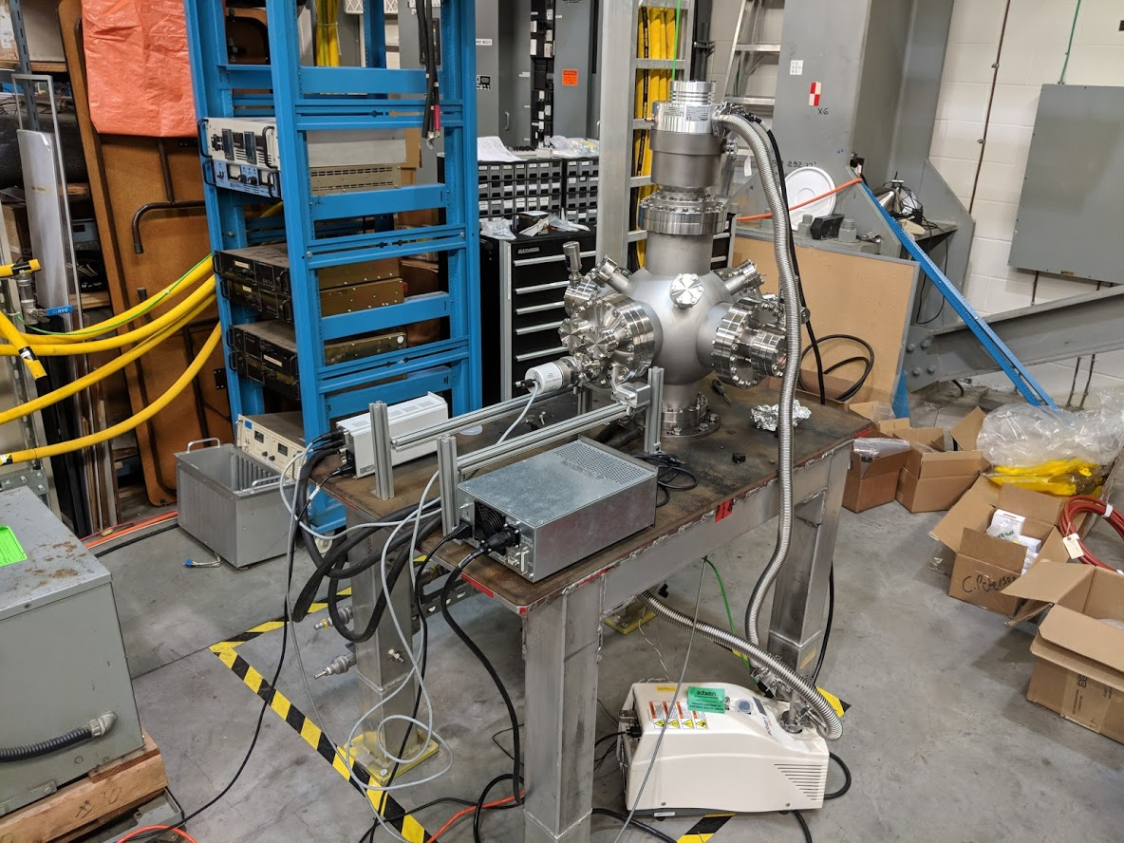
Chamber for Heating Investigations (CHI-stand)
Vacuum stand equipped with:
Exchangeable sample flange
Glass windows
Thermocouple feedthrough (type K-C)
Nuclear ventilation
Plastic glovebag handling

Slide 15
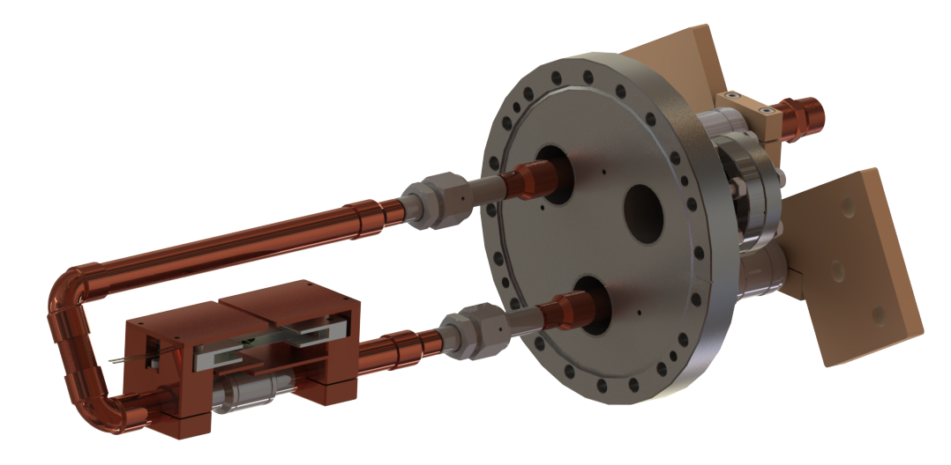
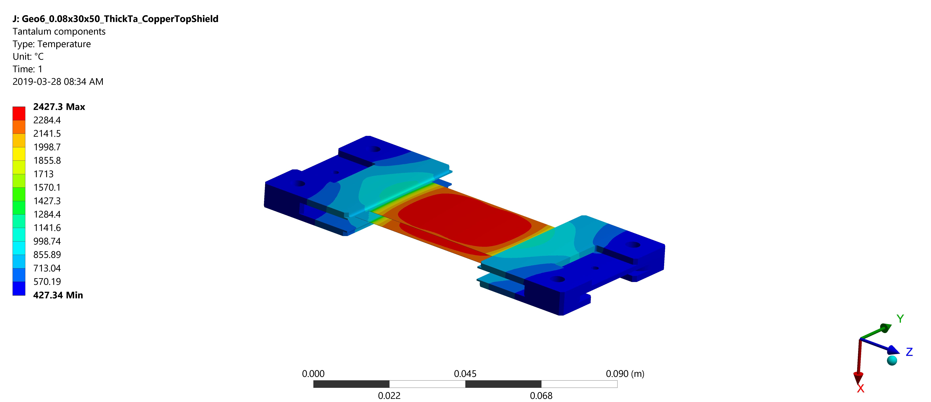
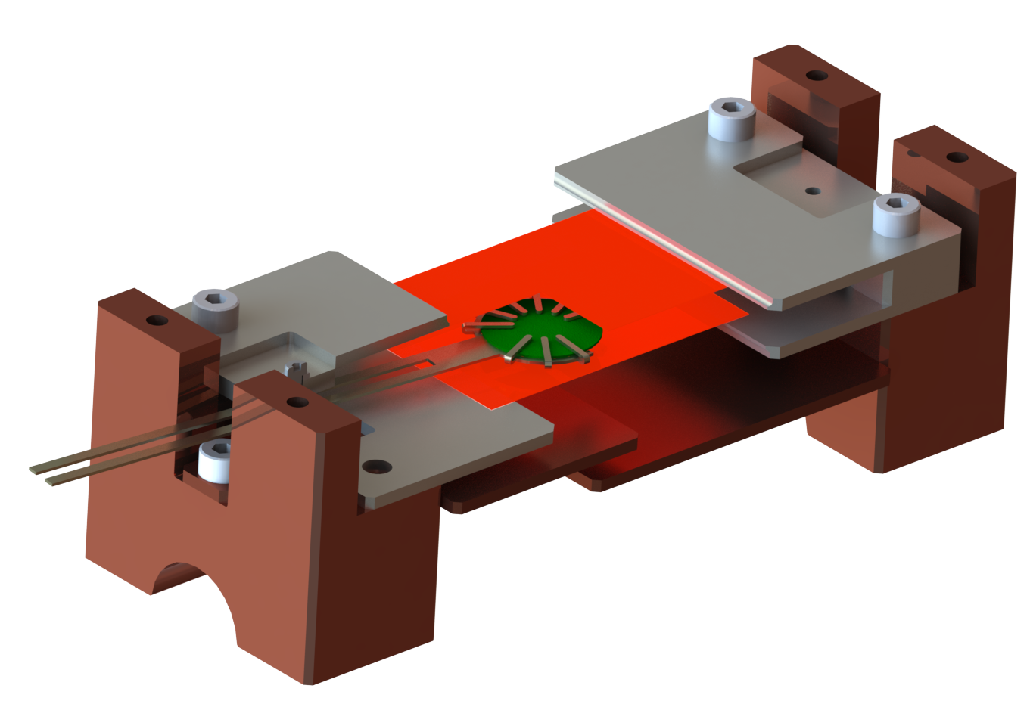
CHI - Release studies
Vacuum furnace for release tests:
Current delivery up to 500 A
Target heating up to 2000 °C
Fast insertion extraction of test sample

Slide 16
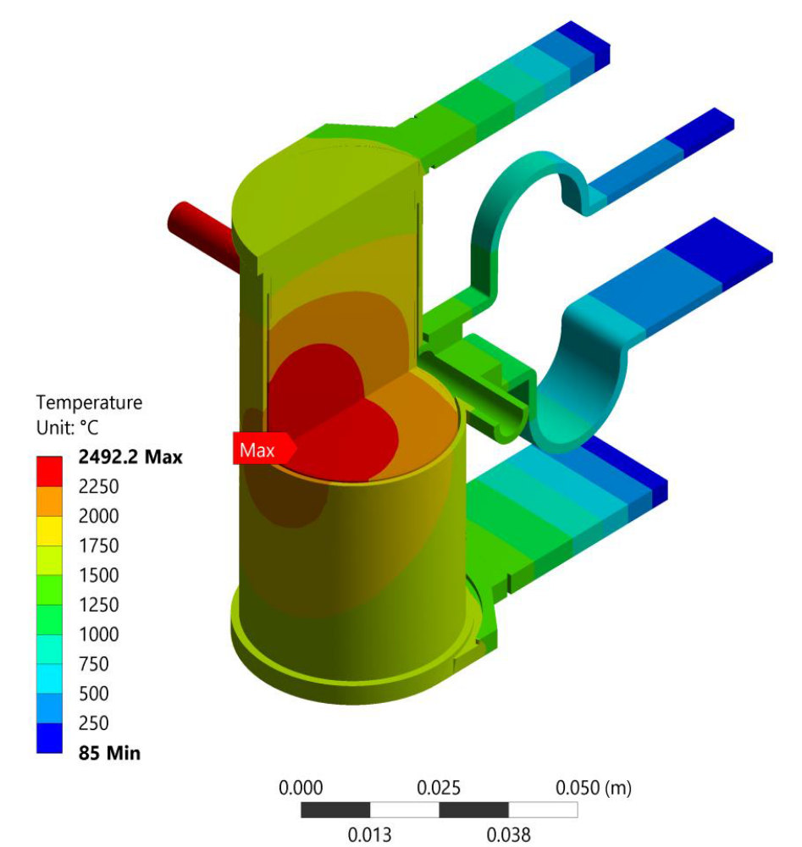
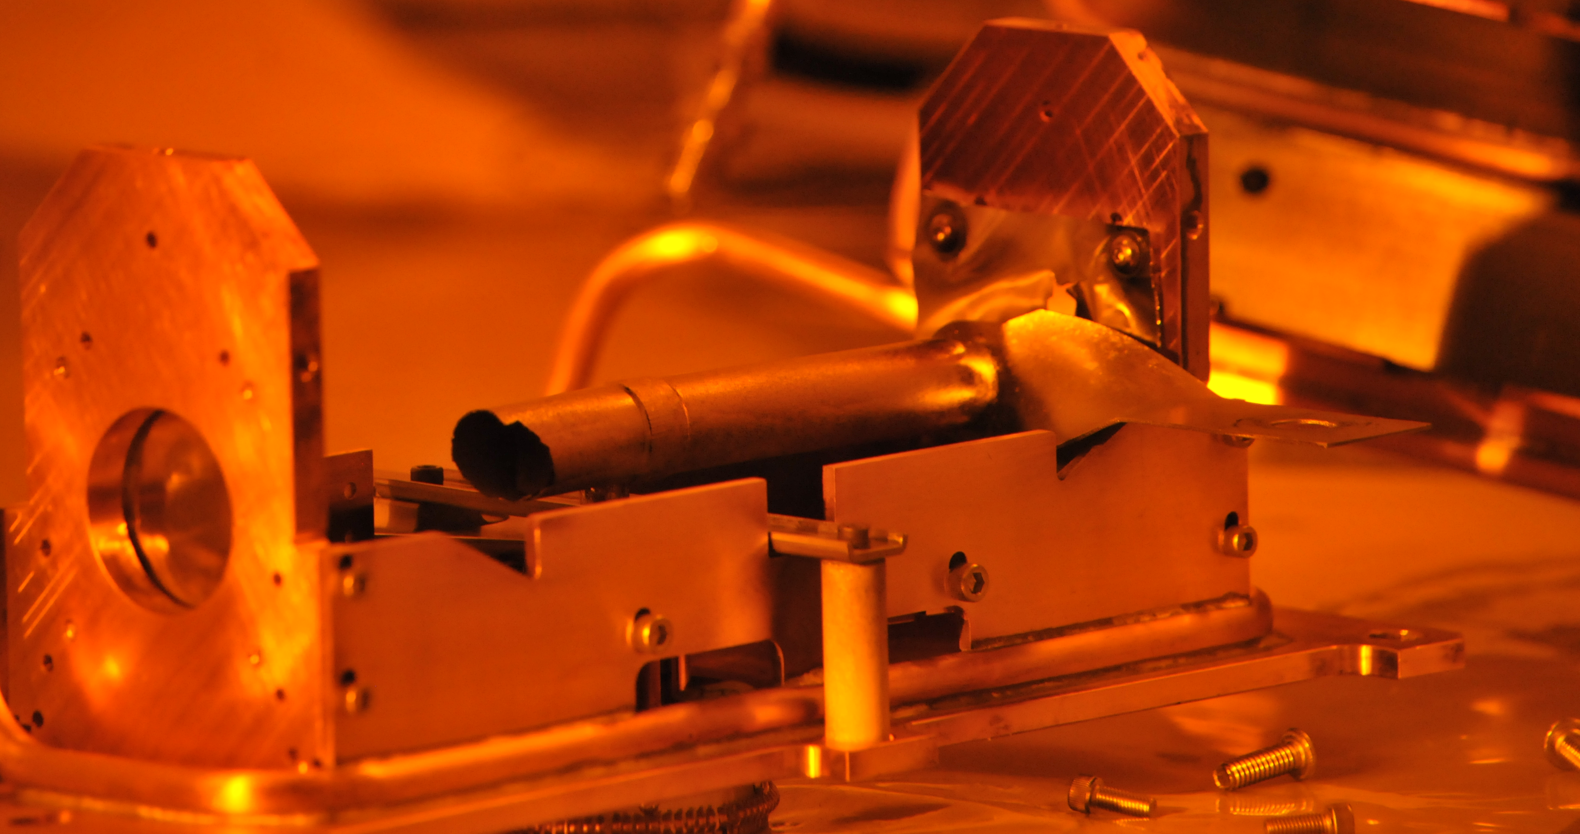
Thermal conductivity studies
See Mia Au’s poster
Temperature gradients too high and broad
Max temperature too high
ARIEL - AETE
Tantalum target container
Water-cooled copper Heat Shield
ISAC
Ion Source
Picture from Target Production & Operation, Remote Handling groups

Slide 17
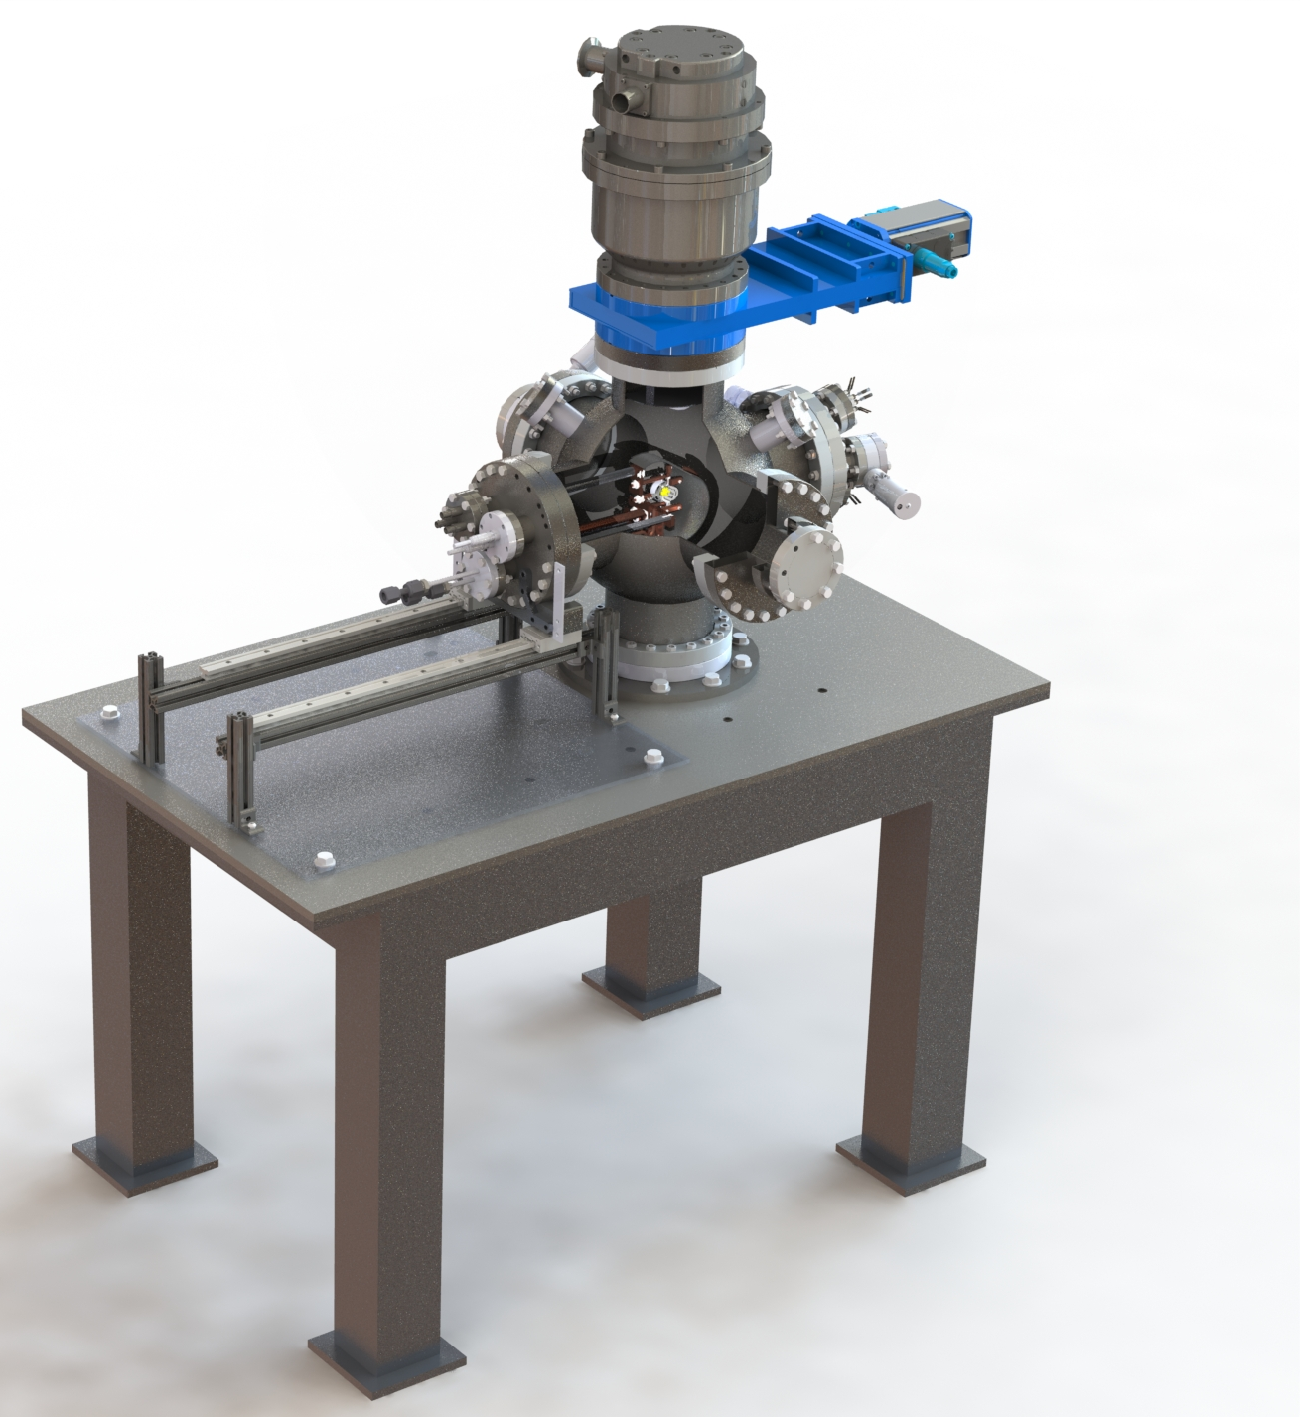
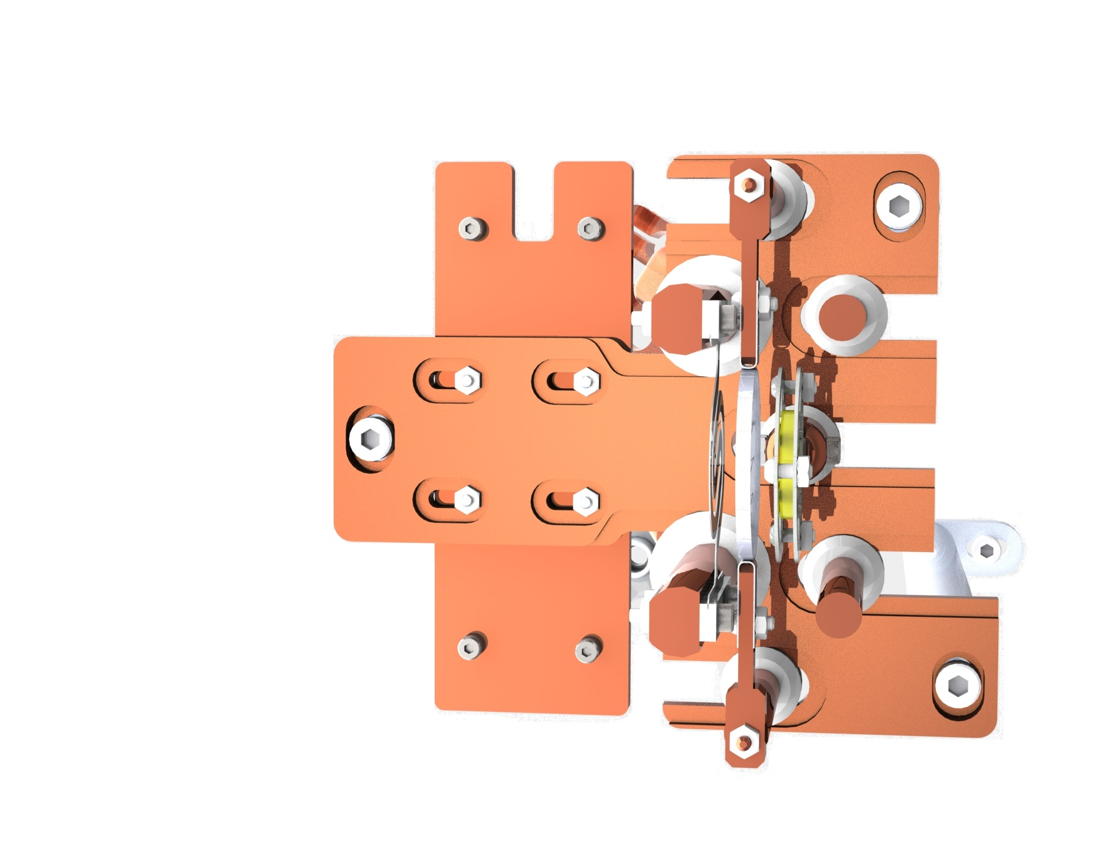
CHI - Thermal conductivity studies
Axial thermal gradients
Time-dependent measurements
→ Model-independent k_{th} measurement
Material disc
Hot cathode
Accelerating grid

Slide 18
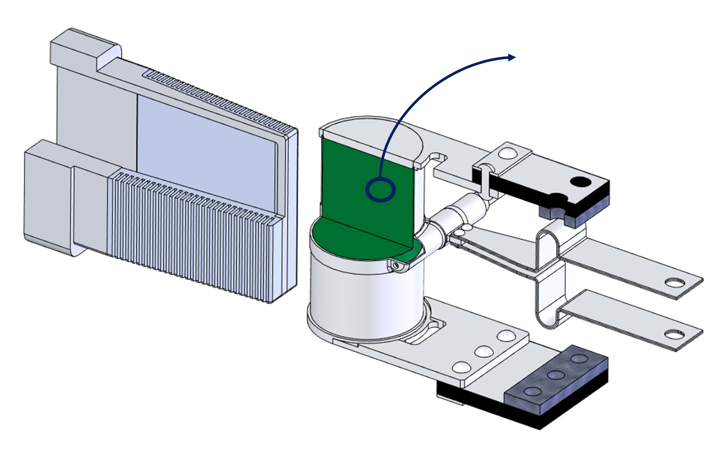
Summary
Converter Test Stand (CTS):
Material pairing identified (Ta-Al)
Tested under same thermal loads
Release from target materials
Irradiation procedure to be tested soon
Vacuum furnace under commissioning
Activated samples tests in Summer 2020
Thermal conductivity tests
Essential input for target design
Measurements on actinide samples in Spring 2020
Tantalum target container
Water-cooled copper Heat Shield
Ion Source

Slide 19
Thank you
Merci

Slide 20
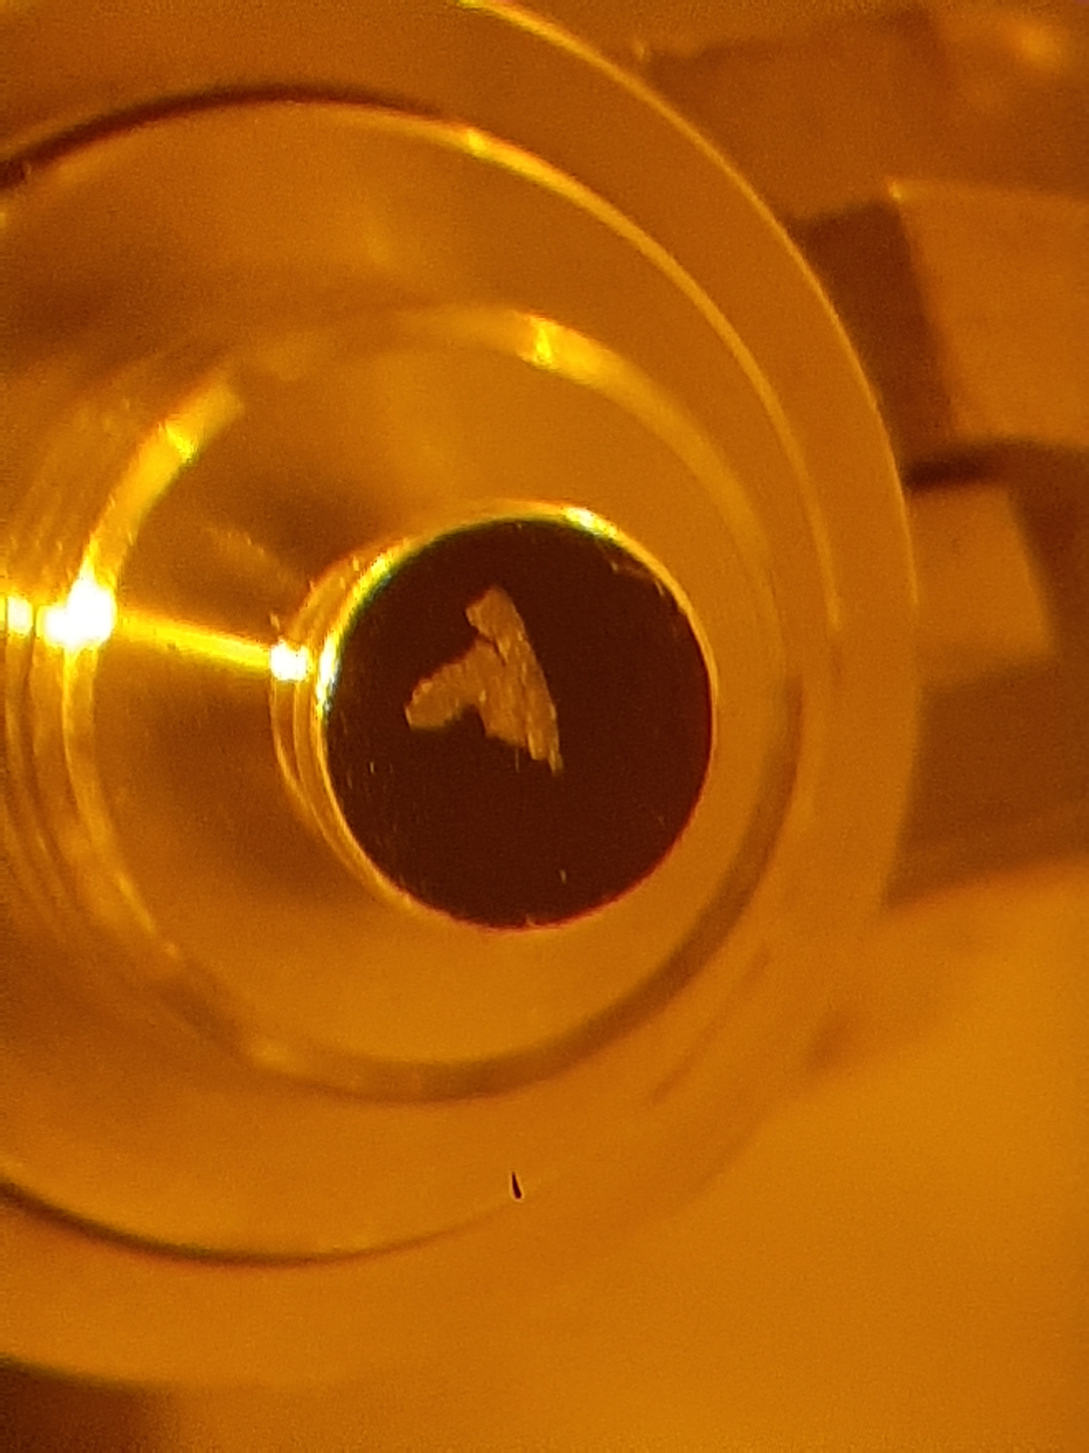
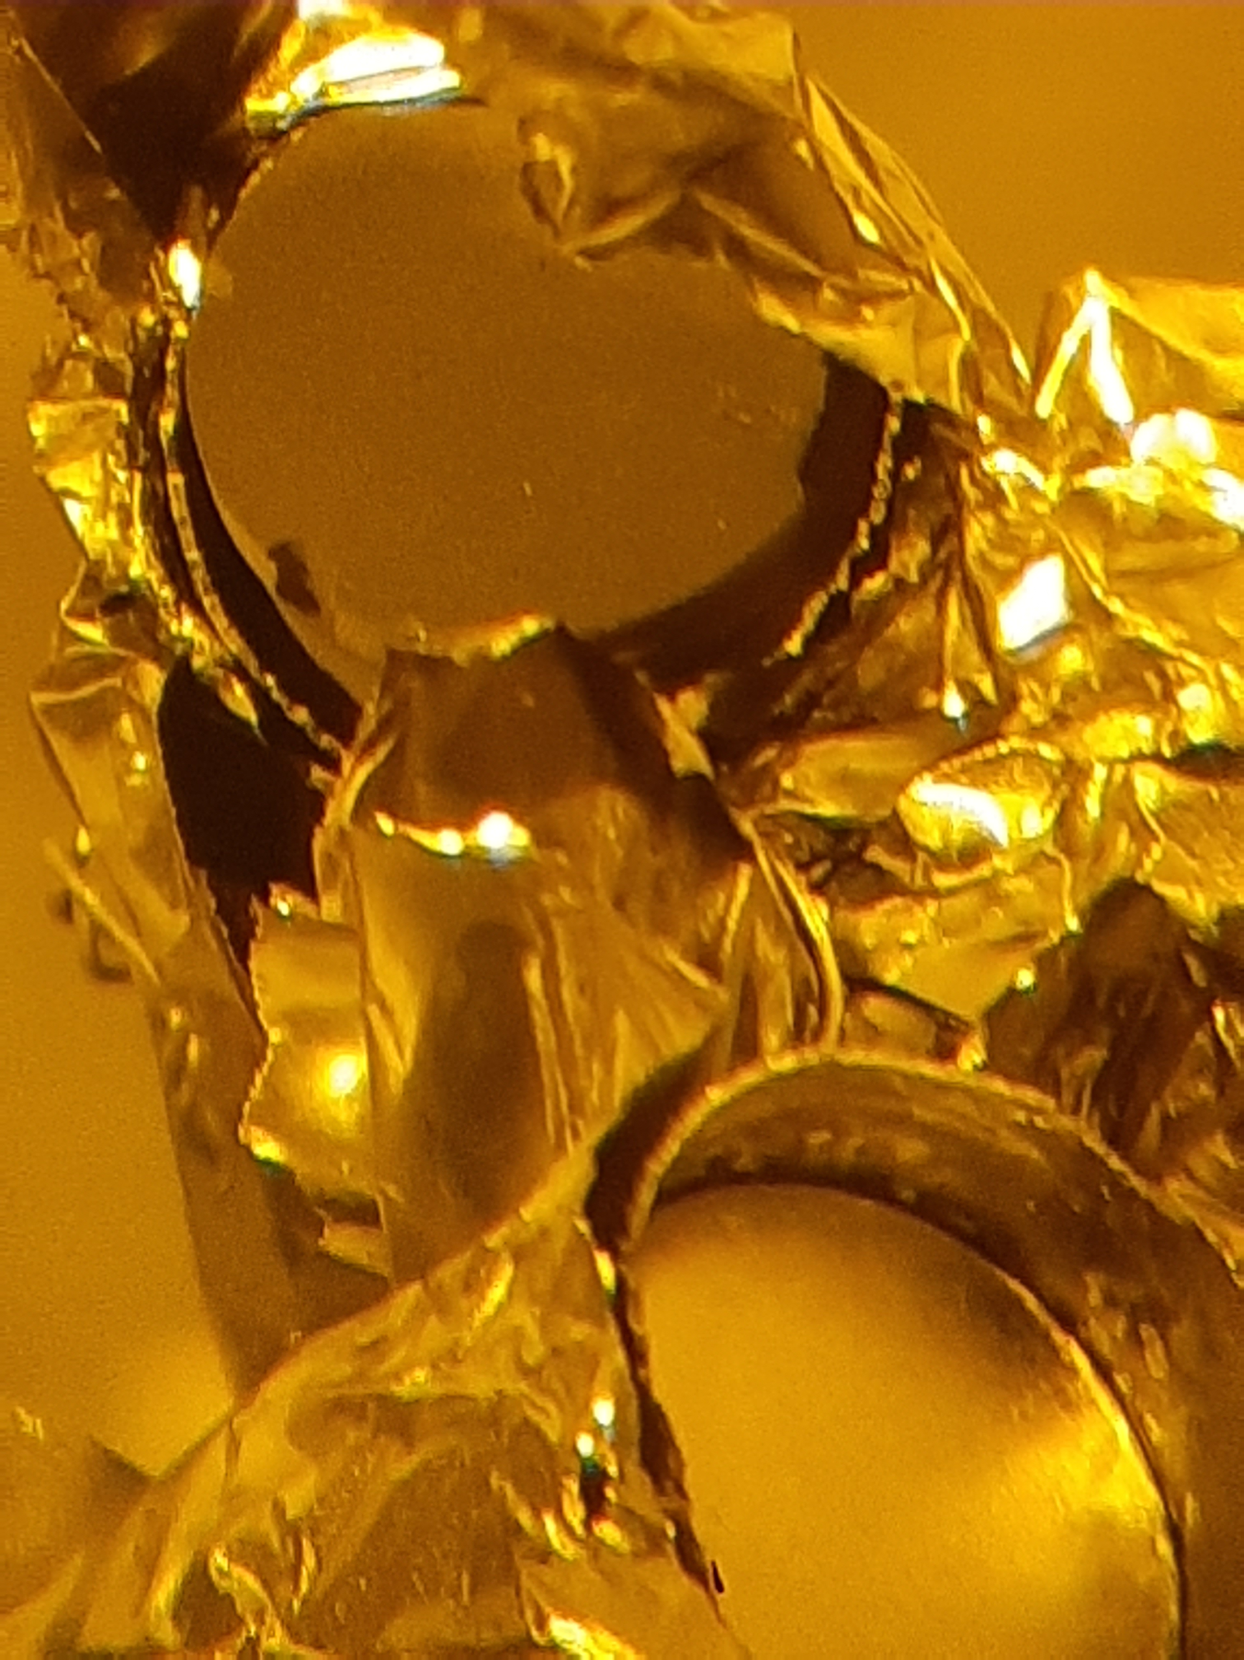
Ucx #27 retrieval

Slide 21
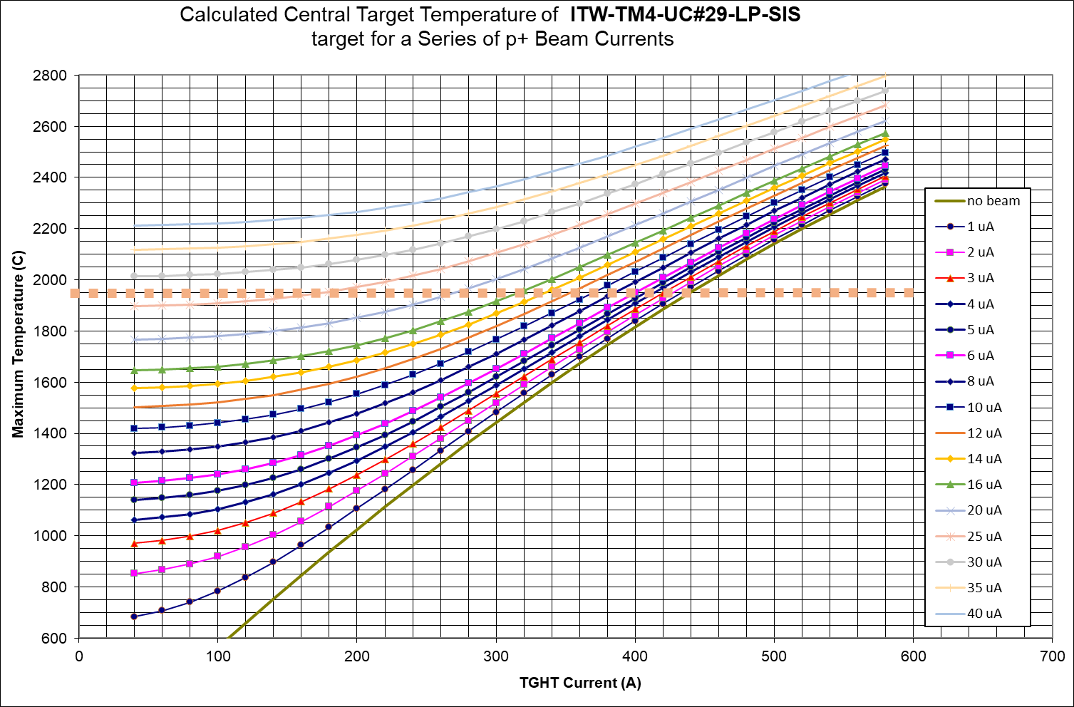
Ucx beam heating curve
s

Slide 22
CHI

Slide 23
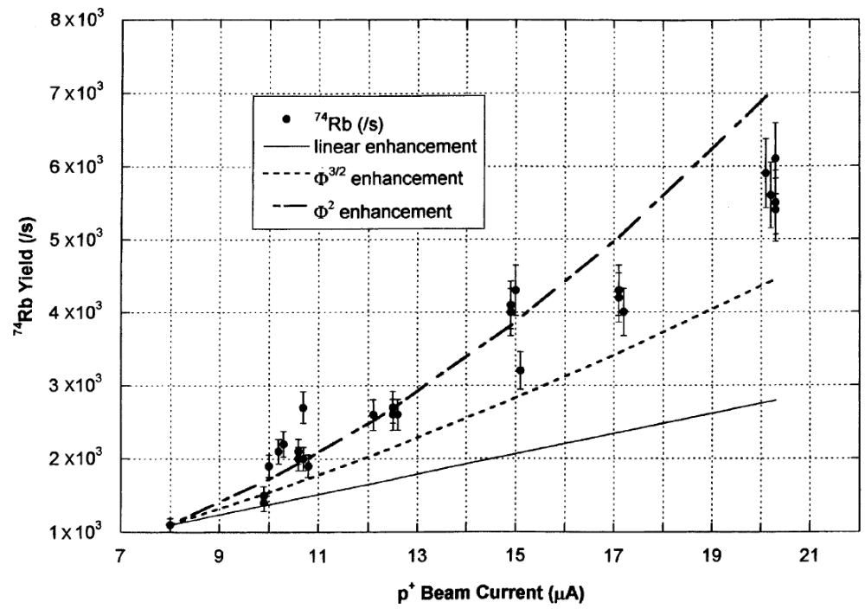
RED
Recoil nucleus kicked off the grain
→ Enhanced release
→ Diffusion length avoided

Slide 24
Electron-to-photon: radiation yield

Slide 25
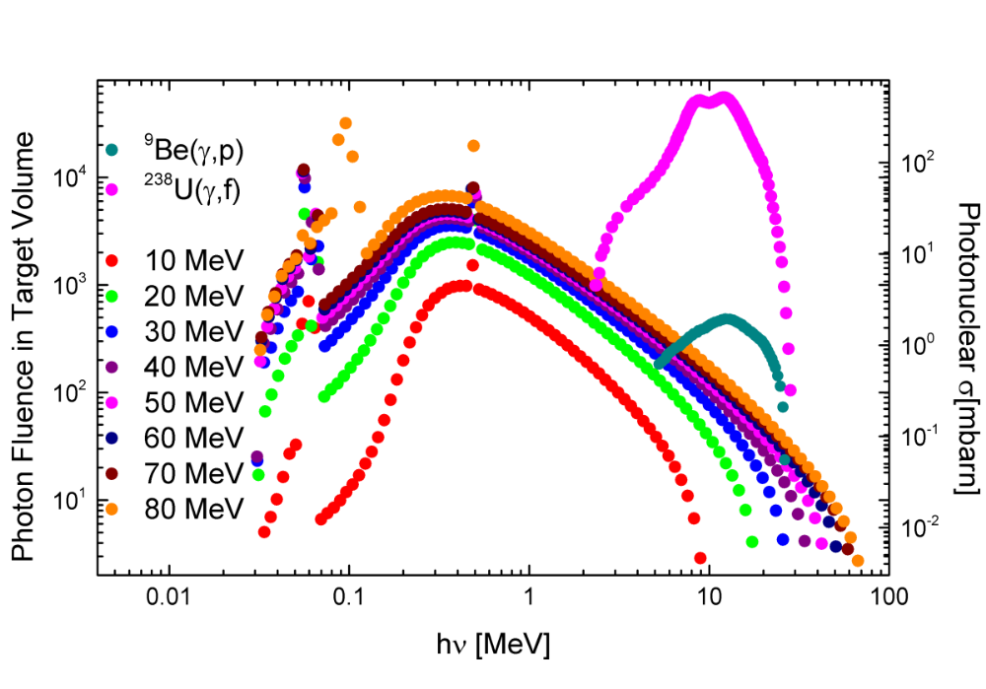
Photon flux and Photo-fission cross sections

Slide 26
Aluminum % pre-post irradiation: Au-Al explosion bonded
Pristine sample
3.5%
51%
97%
Irradiated sample
    1.5%
    28%
    32%
    98 %
Fig. 4. Sample 1 before (b) and after (c) irradiation for 50 h. Al % in pristine sample (a): 1) 3.5% 2) 51% 3) 97% Al % in irradiated sample (d): 1) 1.5% 2) 28% 3) 32%
4) 98% Zoomed-out SEM interface where gold gaps are evident after irradiation (e).

Slide 27
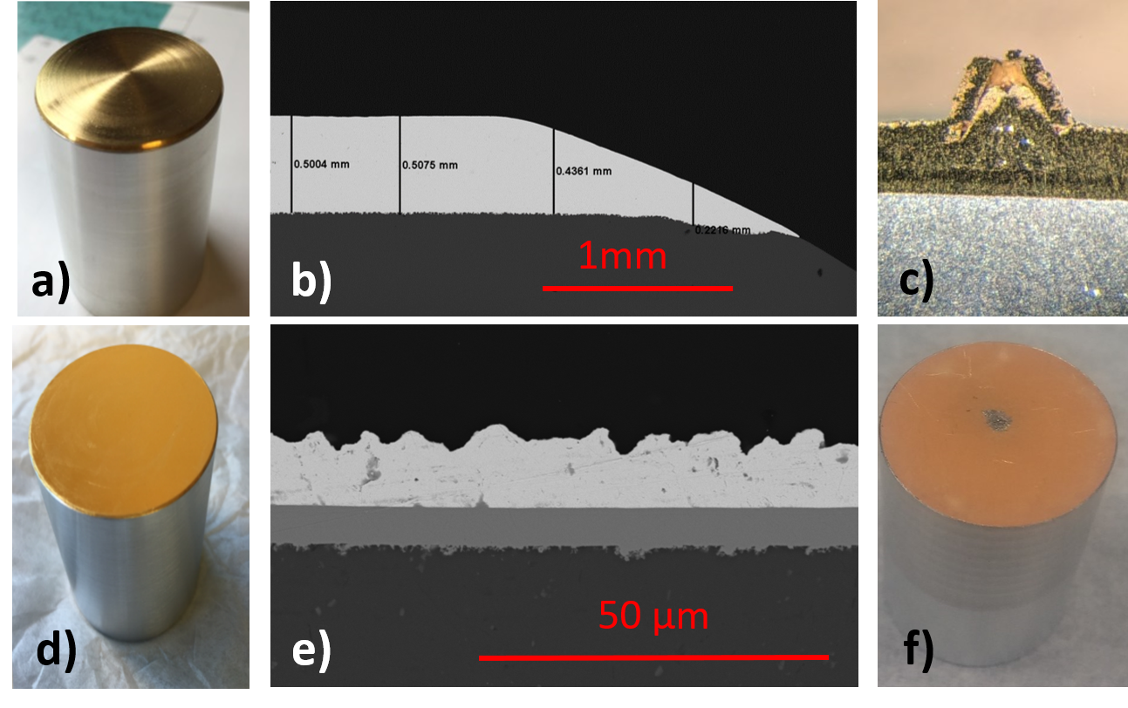
Aluminum % pre-post irradiation: Au-Al electroplated
Fig. 6. Sample 2 (top) and sample 3 (bottom). Pristine samples (a), (d) and their interface microstructure (b), (e). Pictures of both post-irradiation samples are shown in (c) and (f).

Slide 28



Slide 29


Neutral radioisotopes to ion source
Target material disc
Incoming beam

Slide 30


Slide 31

SiCx beam heating curves
s

Slide 32
ZrCx beam heating curves

Slide 34


Disposal
Once Dose_{@10cm} < 10 µSv/h:
Place target container in plastic bag
Bring target in a plastic bag into Hot-Lab fumehood
  Take a swipe
Undo IPF target screws
SiC pellet:
  Extract SiC pellet and place it two sealed plastic bags
  Bring it to ISAC hot cell: to be disposed of in ISAC pale
Openable target assembly:
  Take a swipe
  Place this in a plastic sealed bag
  Bring it to a RPG disposal area
  If Dose_{@10cm}< 10 µSv/h: ready to reuse
Ø = 4”

Slide 35

Window vacuum suction

Slide 36


Unshielded doses of target container + 2 pellets
FLUKA: proton flux (top view)
Target container + 2 pellets

