Slide 1

Measurement of displacement cross section in J-PARC for proton kinematic energy range from 0.4 GeV to 30 GeV
RaDIATE 2019 meeting at TRIUMF 9 -13 Dec 2019
(JAEA/J-PARC) Shin-ichiro. Meigo,
H. Matsuda, Y. Iwamoto,
S. Hasegawa, F. Maekawa,
H. Iwamoto
(KEK/J-PARC) M. Yoshida, T. Nakamoto, T. Ishida,
and S. Makimura
Present study includes the results of “Measurement of displacement cross section at J-PARC for structural material utilized at ADS” entrusted to JAEA by MEXT

Slide 2
Outlook
Introduction
Measurement of displacement cross section experiment in J-PARC
Comparison with calculation by PHITS
Plan of experiment at other facilities
Summary

Slide 3
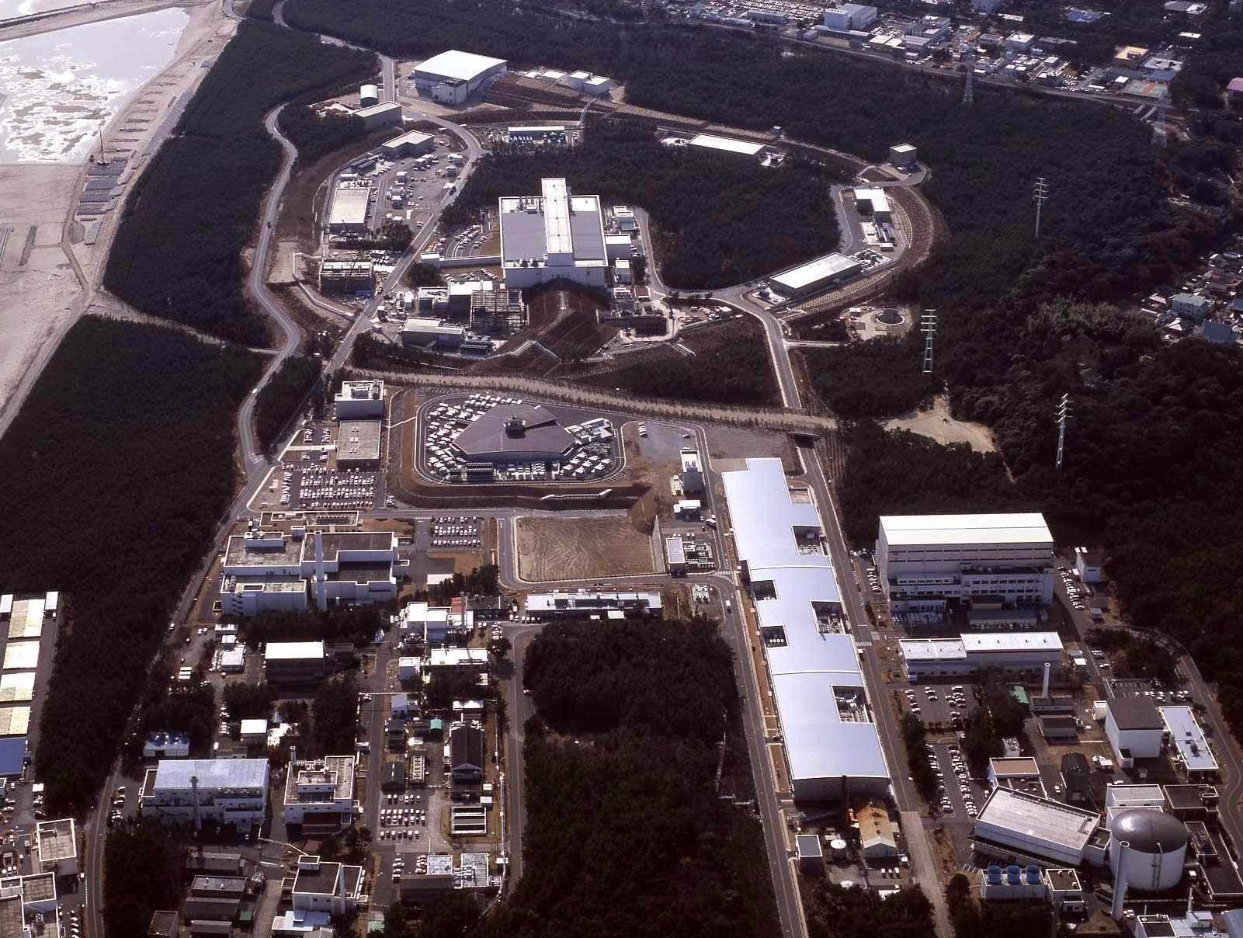

Hadron Experiment Facility
30GeV Synchrotron
MR (0.75MW)
Materials & Life Science Facility (MLF)
Bird’s eye photo
3GeV Synchrotron
RCS (25Hz,1MW)
Neutrino Exp. Facility
(294km to Super KAMIOKANDE)
Transmutation
Facility (TEF)
(Phase II）
Linac
400MeV(50mA)
JFY2007 Beam
JFY2008 Beam
JFY2009 Beam
JRR-3M
800m to MLF
Neutron beam lines (23)
J-PARC = Japan Proton Accelerator Research Complex

Slide 4
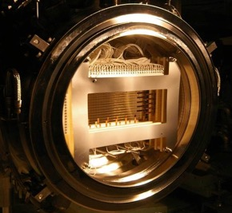
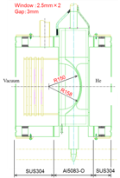
Target for high-intensity hadron accelerator and superconductor in high radiation area
Proton beam window in J-PARC spallation neutron source: Aluminum alloy (φ 0.6 m)
T2K beam window
Titanium alloy (Ti-6Al-4V)
For damage estimation of beam intercepting material, DPA is utilized based on displacement cross section.
High accuracy of the displacement cross-section is required.
Proton
3 GeV
Proton 30 GeV
Resistivity change due to radiation is crucial for Superconductor(SC) magnet sustaining damage.
SC magnet system in beam line of COMET (J-PARC)

Slide 5
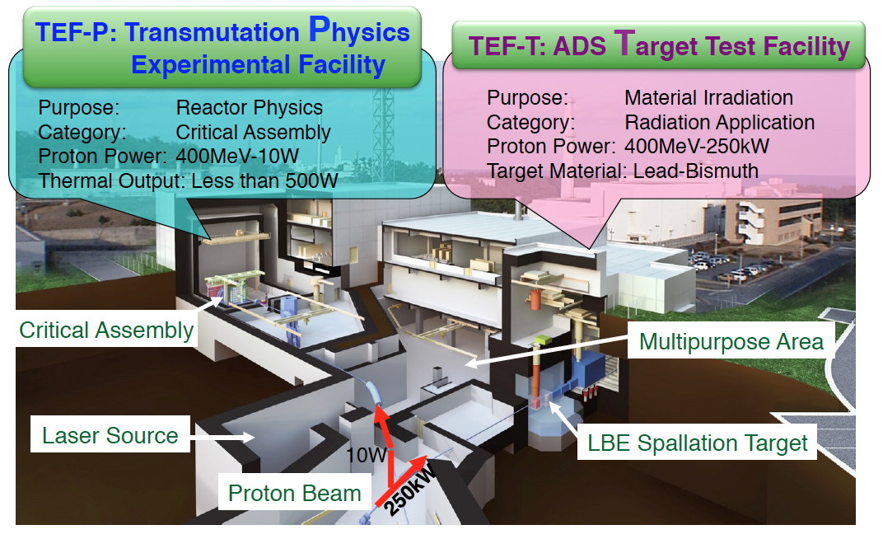
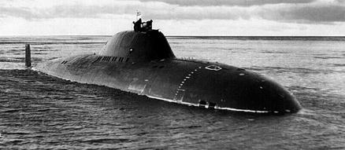
Transmutation Experimental Facility (TEF)
Soviet submarine (LBE)
For R&D of ADS, 0.4 GeV beam by LINAC will be delivered to TEF.

Slide 6
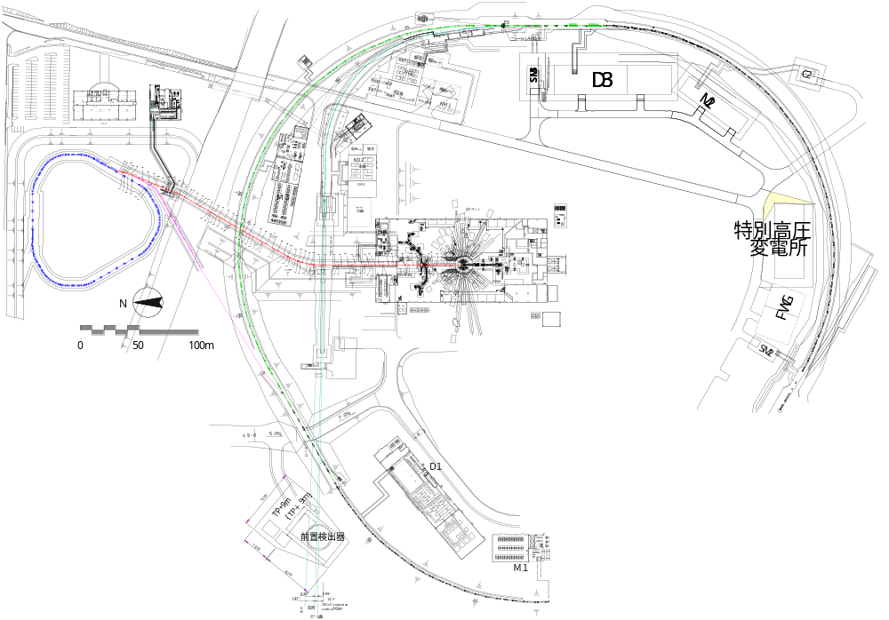
Beam transport from RCS to MLF
600ns
600ns
Ep: 3GeV
Power: 1MW
Already demonstrated
Rep.: 25Hz
50-GeV MR
FWHM ~150ns
road to
coast
Material and Life Science Experimental Facility (MLF)
Dump
Neutrino line
3NBT
MUSE
JSNS
3-GeV
RCS
3-50BT
Muon target
Neutron target

Slide 7
PKA and DPA
    Damage characteristics may be described as a function of DPA, gas production and temperature.
    DPA = flux × Displacement cross section
DPA (Displacement per Atom) is estimated by calculation based on PKA (Primary Knock-on Atom)

Slide 8
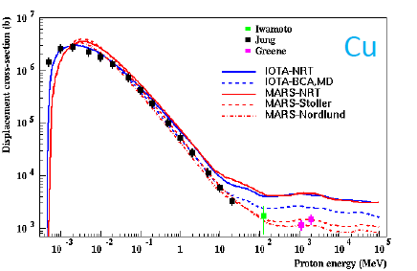
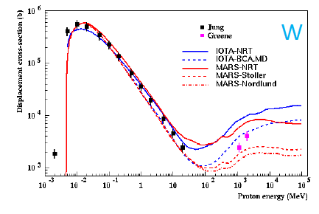
DPA and displacement cross section
Although DPA is widely utilized to estimate damage, displacement cross section has not been enough validated.
  Cross section exp. data for Ep>20 MeV are scarce.
    Only 5 Data (Cu: 3, W: 2)
    No data for Al, Fe
  Showing large discrepancies among calculation models
N. Mokhov HPTW2016
x8 times

Slide 9
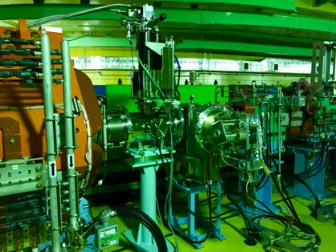
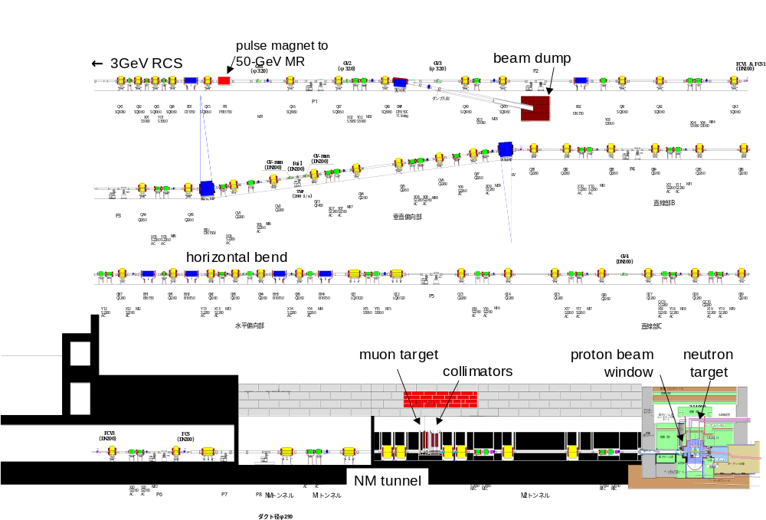

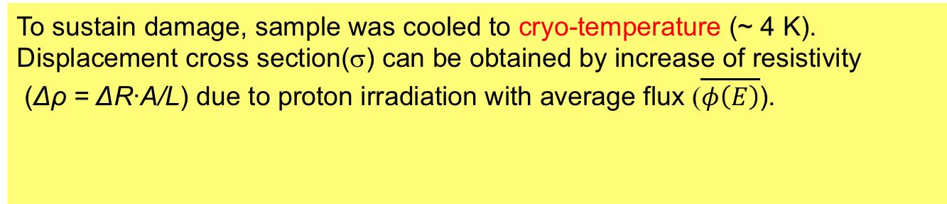
Measurement of displacement cross section
for 0.4～3 GeV proton
Experiment at the RCS with change of radiation license
To sustain damage, sample was cooled to cryo-temperature (~ 4 K).
Displacement cross section(σ) can be obtained by increase of resistivity
(Δρ = ΔR∙A/L) due to proton irradiation with average flux ($\overline{φ\left(E\right)}$).
$$σ\left(E\right)=∆ρ/\left(\overline{φ\left(E\right)}ρ_{FP}\right)$$
ρ_{FP}: Resistivity change by a Frankel pair (Cu: 2.2x10⁻⁶ Ωm±23%)
Vacuum chamber with
4 K cryo-cooler
To MLF
From RCS
Beam dump
Beam
Vertical view
1 m

Slide 10
Al, Fe, Cu and W samples
3NBT for 0.4 – 3 GeV
MR for 3 – 30 GeV
Cascade scheme of 4 pieces (Al, Fe, Cu, W) with Φ0.25 mm were applied
Samples were annealed ~T_{melt} before installation.
Wire direction
  3NBT: Horizontal
  MR: Vertical
  After trial and error, the temperature was achieved <4 K.
  To obtain resistance accurately, 4 wires with delta mode switching polarity with 10 Hz and averaging was applied.
40 mm
PC
V+
L<30 m
Nano-V meter
(2182A Keithley)
V-
x16
MUX
(2700 Keithley)
Source ±0.1A (2182A Keithley)
I+
Sample
I-

Slide 11
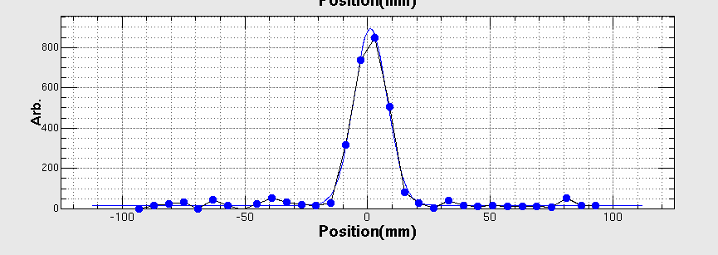
Result of experiment
Resistance and temperature during irradiation
Vertical beam profile
∆R
Obtained by multi wire profile monitor placed in front of the sample
Scanned at sample position by steering magnet
Experiment was carried out for protons of 0.4, 0.8, 1.3, 2.2 and 3.0 GeV by changing of acceleration time in RCS.

Slide 12
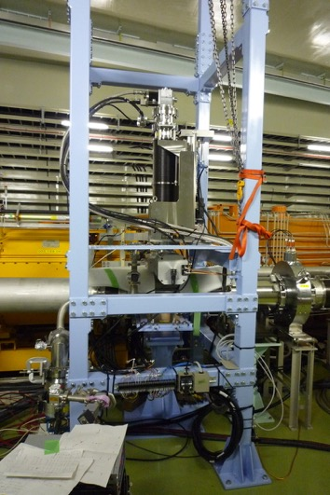
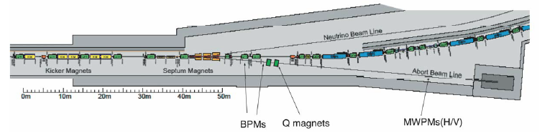
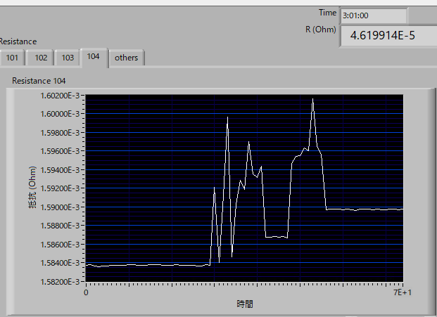
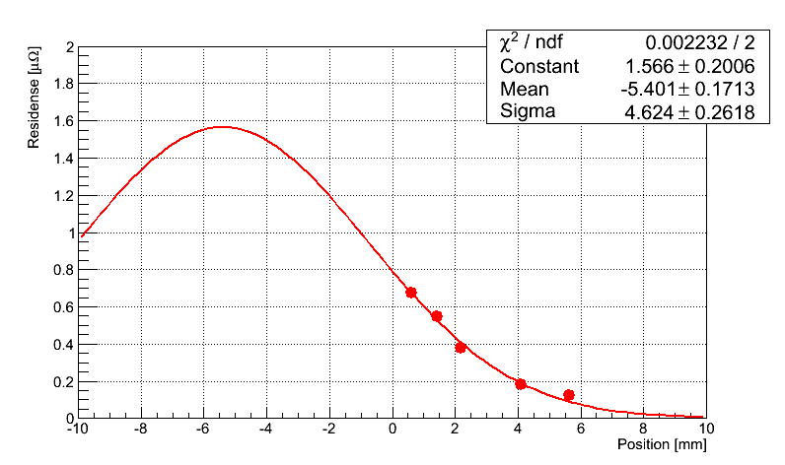
Experiment for 30-GeV protons
GM cryo-cooler
T2K
Dump
Beam was misaligned ~10 mm at sample due to fit the position toward T2K.
Even full strength of steering magnet, the position was not centralized without adjustment of EXT KM.
Data acquisition PC malfunctioned 2 times. Cryo-cooler malfunctioned by unknown reason.
After recovery, do again w/ orbit correction (hopefully Dec 20).
Resistance w/ beam for W
STR MAX
Obs. X-sec
Using the scan result the average flux and cross section obtained.
STR 0A

Slide 13
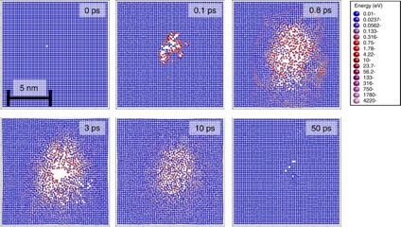
Calculation with PHITS code
Displacement cross section with PHITS implemented following models
  Norgett-Robinson-Torrens (NRT) model: Widely utilized
  Athermal recombination corrected (arc) model
    Nordlund parameter : Nature comm. 9 1084 (2018)
NRT (Cu Ed 33 eV):
arc-Nordlund (Cu Ed 33 eV):
N_{d}: Number of displacement
T_{d}: Displ. energy
N_{d} different for T_{d}>83 eV
X 3
ー NRT
ー arc Nordlund

Slide 14
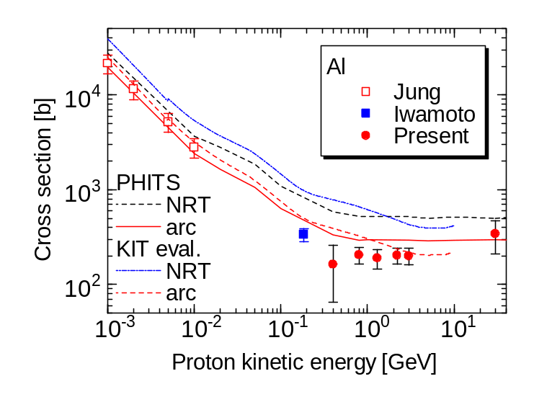
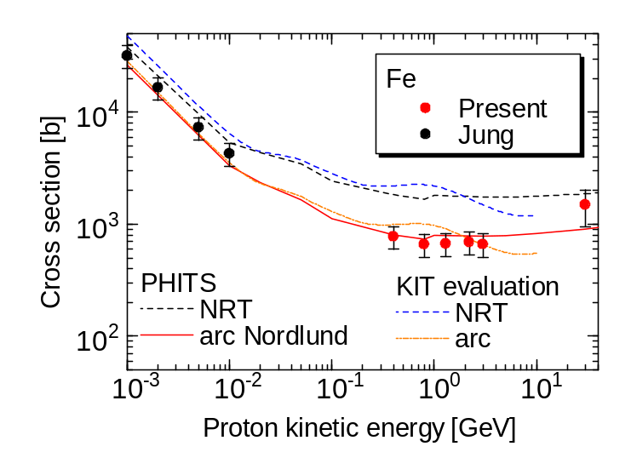
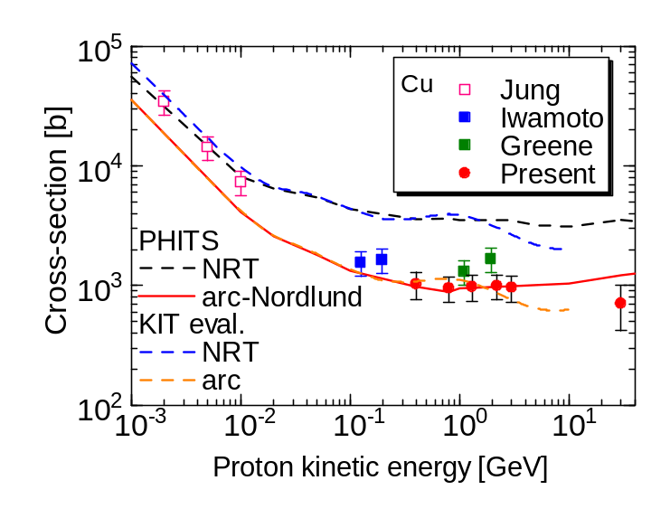
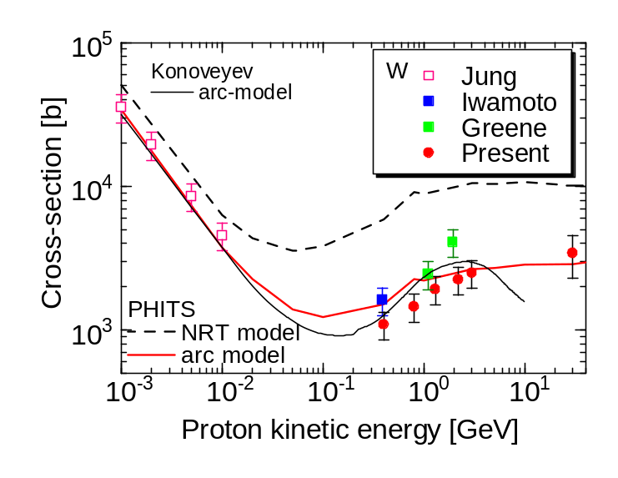
Comparison Calc. vs Exp.
NOTE: 30 GeV experiment very preliminary result

Slide 15
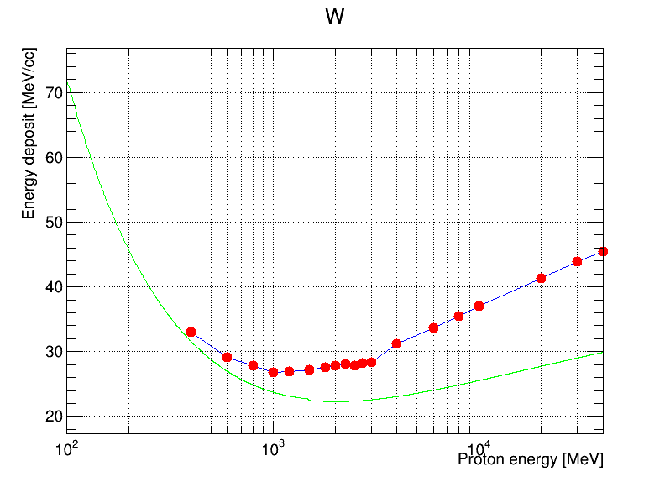
Displacement cross section ~30 GeV
As increase proton kinematic energy, heat density on material (W) increase
Regardless of increase heat deposition for Ep~30 GeV, displacement cross-section sustains almost constant . Why?
● Heat density
ー Bethe-Bloch
30 GeV
On Wed, Y. Iwamoto’s talk

Slide 16
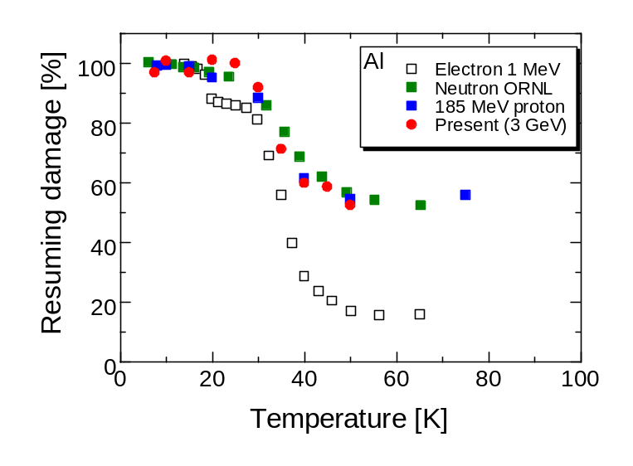
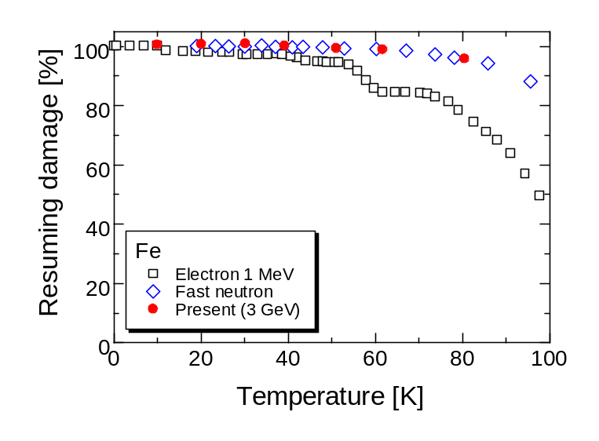
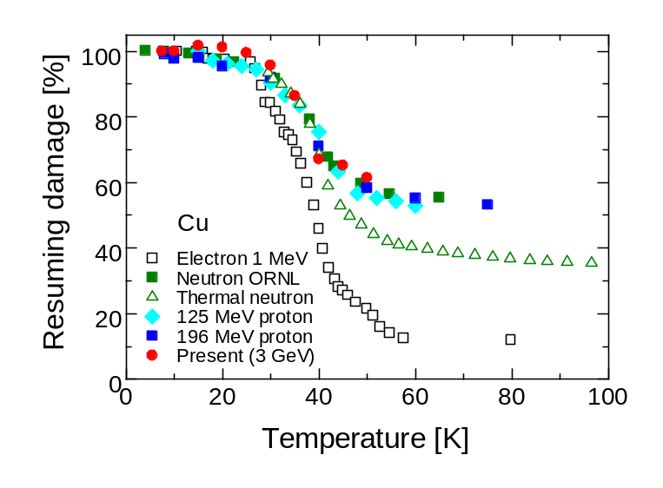
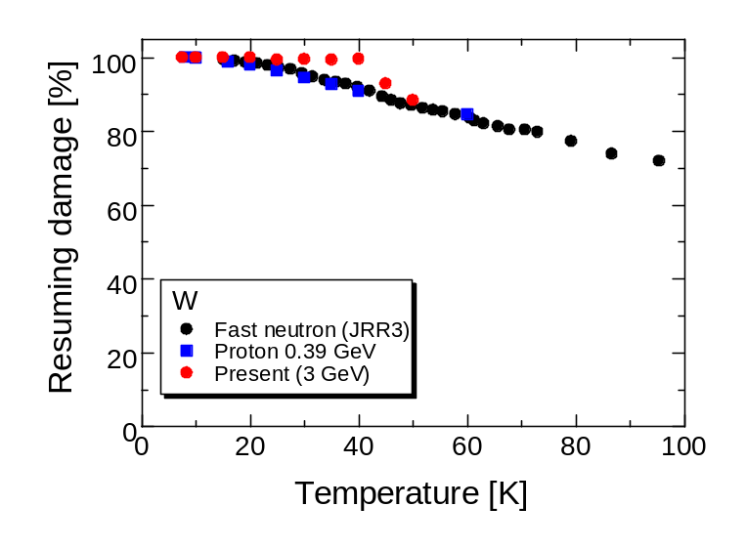
Isochronal recovery result
To observe recovery dependence of temp., irradiated sample heated to certain temp and cooled cryotemp (~4 K) again.

Slide 17
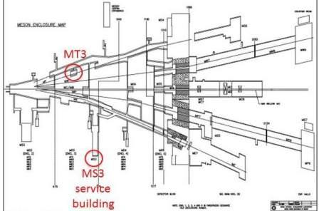
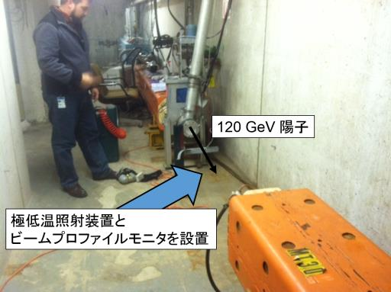
Experiment at FNAL for 120 GeV
Budget already approved by MEXT for some of our collaborators
Experiment will start for 120 GeV proton in next JFY 2020.
MT3
120 GeV proton
Cryo chamber and beam instruments will be placed

Slide 18
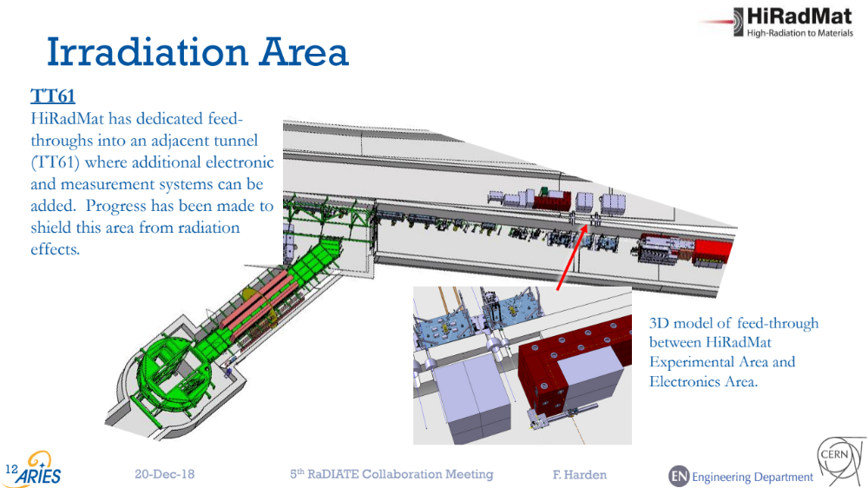
Ep 400 GeV at HiRadMat in CERN (plan)

Slide 19
Summary
To understand the damage on beam intercepting materials, displacement cross section was obtained for Al, Fe, Cu, and W for proton 0.4 - 30 GeV.
  NRT model: 4 times overestimation
  arc model: good agreement with present results.
To obtain the cross section, similar experiment will be carried out at FNAL and HiRadMat for 120 and 400 GeV protons.

Slide 20
Thank you for attention
Memorial snap shot completed beam test of 1MW for 1 h.
This year successfully completed for 10 h. Next year 1 week?
Successfully completed 1 MW beam test!
2018 July 3rd

Slide 22
1 MW beam operation at MLF
Last year memorial snap shot at 1MW for 1 h test (2018/7/3)
1 MW
Result of this year
Beam intensity trend at 1MW for 10.5 h test (2019/7/3)
Availability ~ 98%

Slide 23
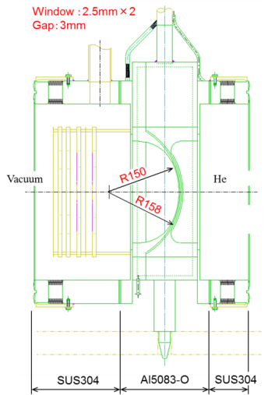
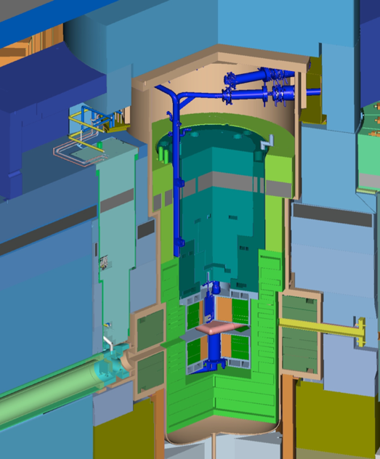
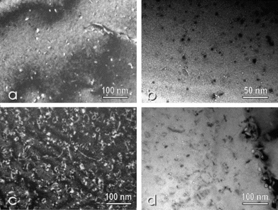
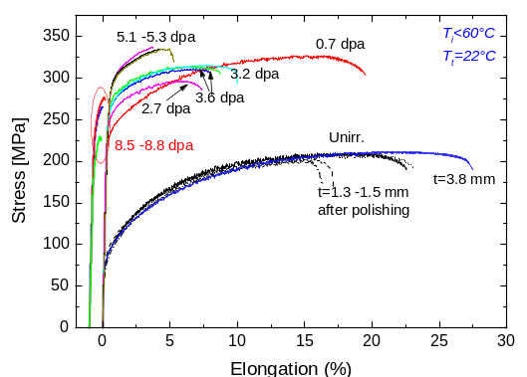
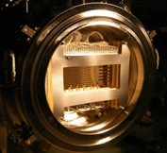
Proton Beam Window at MLF (A5083)
Lifetime estimation based on Post Irradiation Examination (PIE) for safety shroud (AlMg3) at SINQ in PSI
Considering difference of proton energy, to predict lifetime of the PBW with high accuracy for validation of calculation
Result at SINQ/PSI for 0.6GeV
Y. Dai, et al, J. Nucl Mat. 343 184 (2005)
Lifetime of PBW: Determined by He gas production (1200 appm) 2 years*
By recent PIE result of the SINQ (2400 apmm), lifetime may be applicable to 3 years.
Height: 3.8m
Weight：10t
* S. Meigo, et al, J. Nucl Mat. 450 141 (2012)

Slide 24
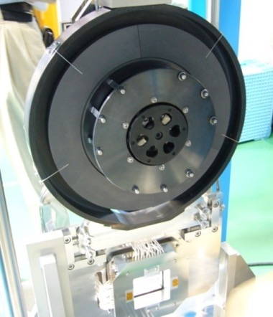
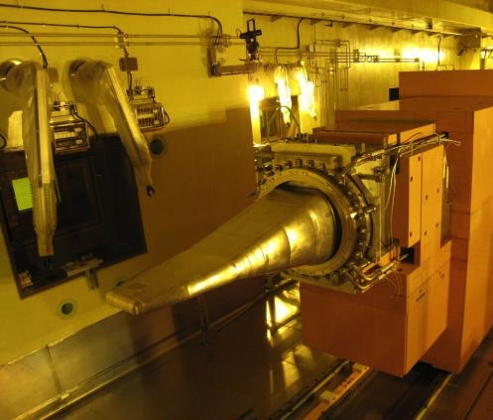
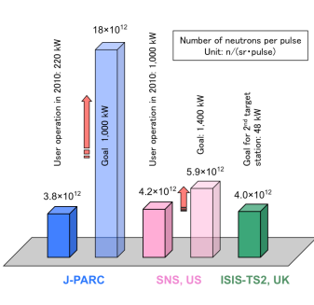
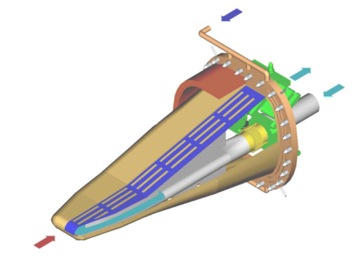
Targets in Material Life Experimental Facility (MLF)
Muon production target
  Carbon graphite
  Highest μ⁻ intensity
Neutron production target
  Mercury (Hg)
Highest pulse intensity in the world
SS container
Thick. 2cm
Diam. Φ33cm
L 2m
W 34cm
Light water
Safety hull
Double wall: Helium layer observed radiation
Hg
8% beam loss
Ptron

Slide 25
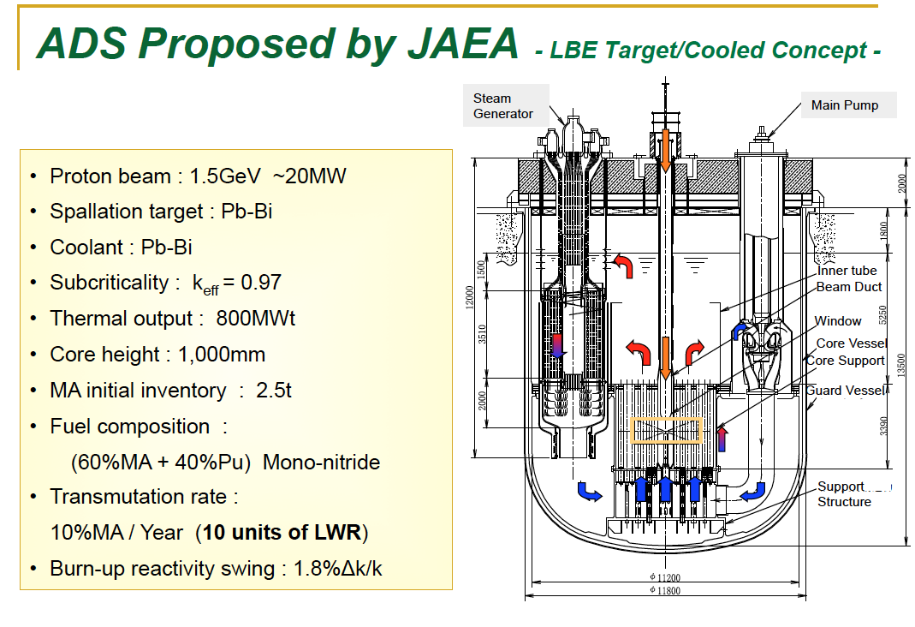
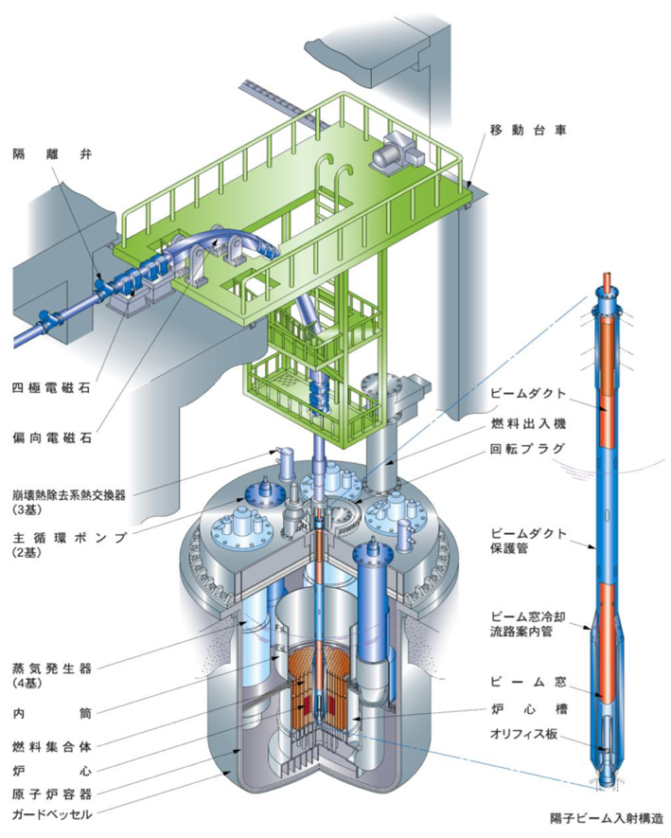
ADS proposed by JAEA
Belgium ADS program MYRRHA at SCK・CEN (Mol) approved 558 M€
~ 30 MW
Beam window
Beam window: 20 dpa/year. Accuracy of dpa is required for damage estimation.

Slide 26
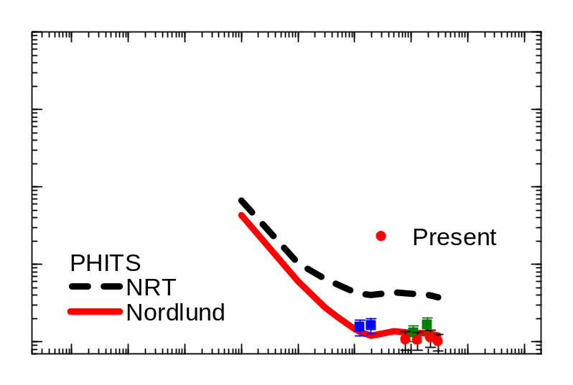
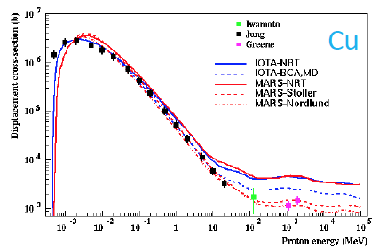
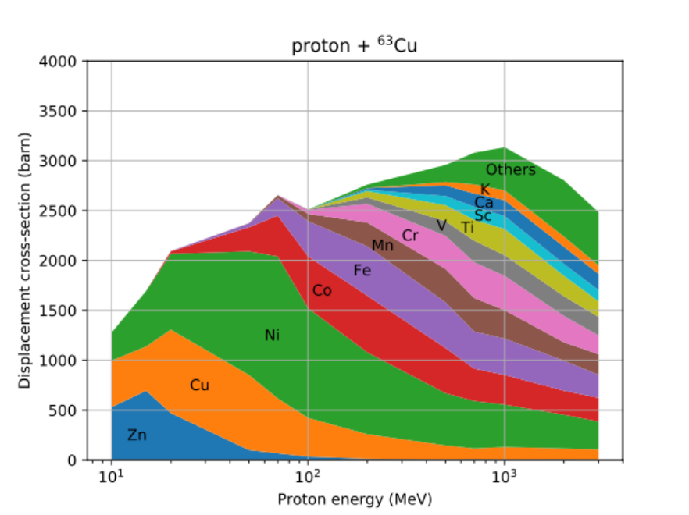
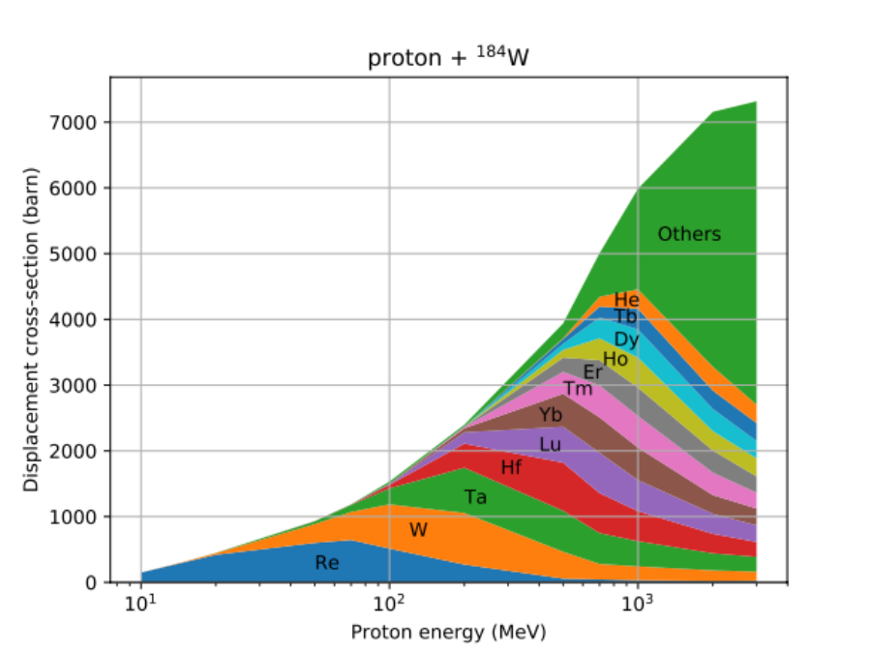
Contribution for displacement
Fission and spallation fragment dominating

Slide 27
