Slide 1
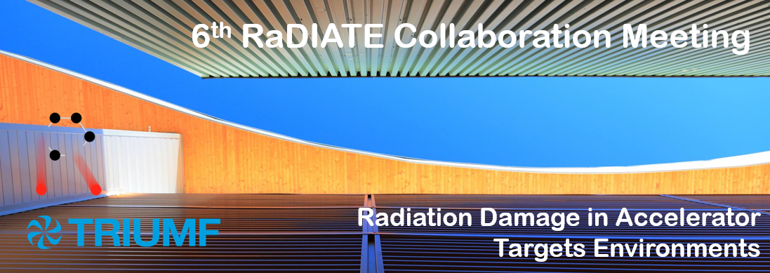
6th Annual Collaboration Meeting 09 Dec 2019
Meeting Objectives
Radiation Damage In Accelerator Target Environments

Slide 2
Since we last met…
Post Irradiation Examinations of specimens irradiated at BLIP, BNL underway at PNNL
  Titanium alloys & Beryllium
  CERN capsules awaiting shipment to Europe
  Fatigue testing of Ti alloys underway at Fermilab
New BLIP capsule design, analysis and QA begun
  Short QA irradiation planned for spring 2020
HiRadMat experiment (HRMT-43) PIE starting at CCFE
  Irradiated specimens & Novel materials
New collaborative projects with Universities
  Abe Burleigh (IIT) – ion irradiation of graphite
  Ming (Eric) Jiang (Bristol) – characterization of graphite
  Jianqi Xi (UW) – modeling He bubble formation in Be

Slide 3
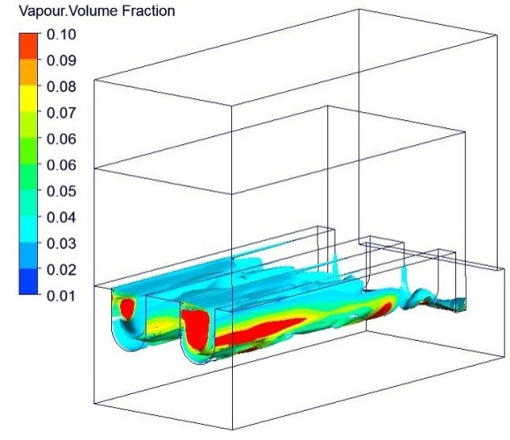
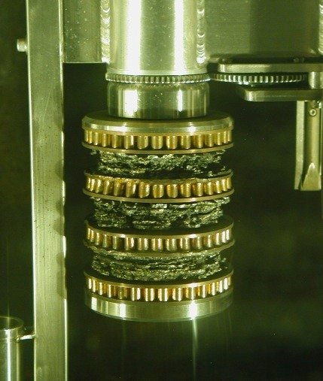
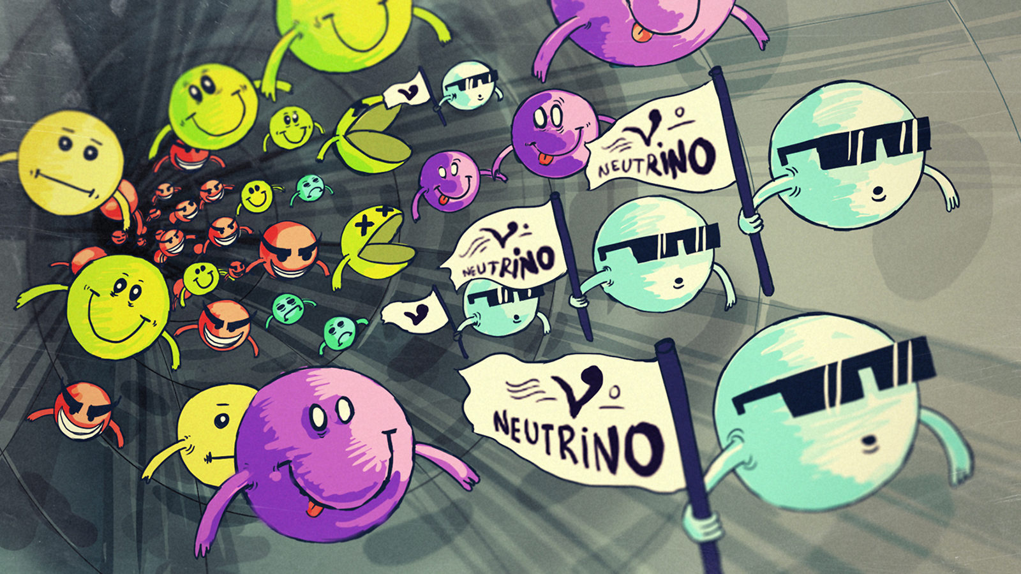
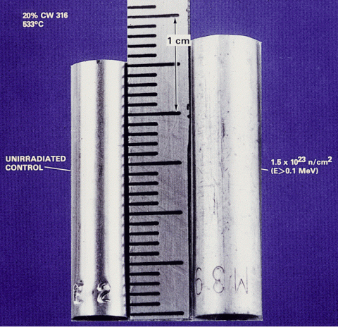
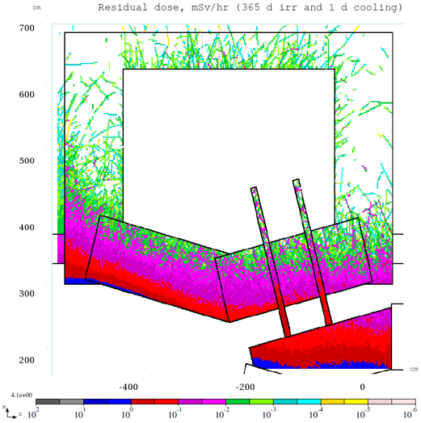
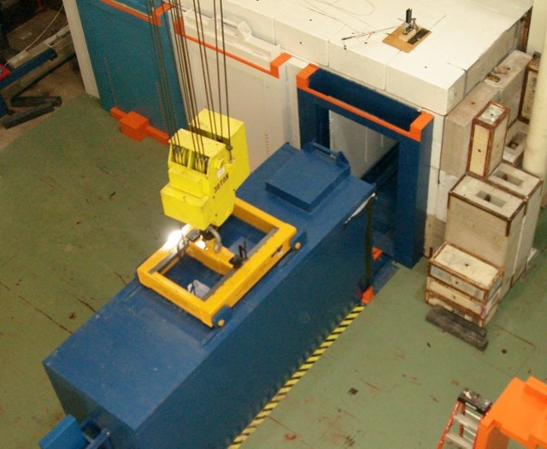
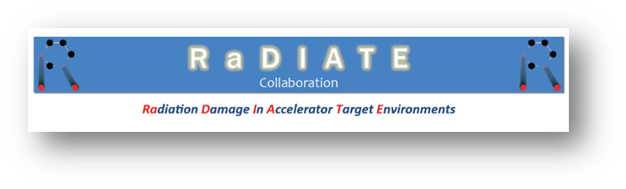
High Power/Intensity Targetry Challenges
Heat removal
Thermal shock
Subjects of the RaDIATE Collaboration
Physics performance
Radiation damage
Operational safety
Storage and disposal
At the Proton Accelerators for Science and Innovation Workshop (PASI 2012), workshop participants from a range of high power accelerator facilities identified radiation damage and thermal shock as the most cross-cutting challenges facing high power target facilities

Slide 4
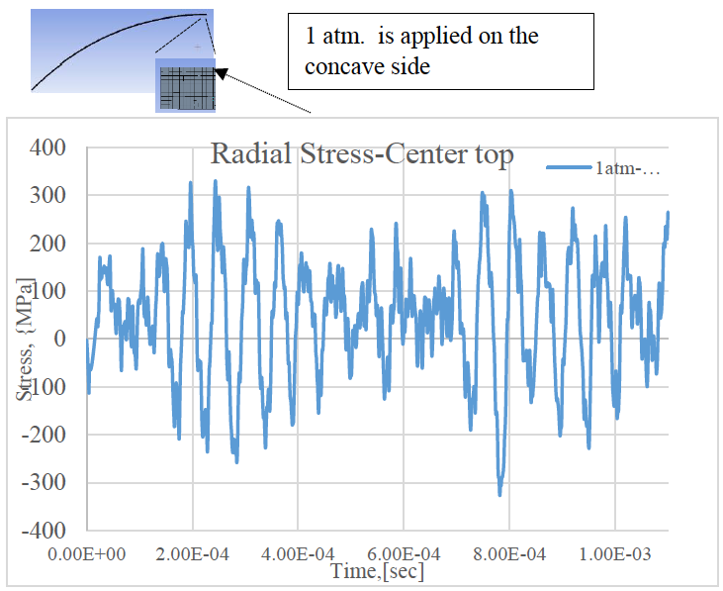
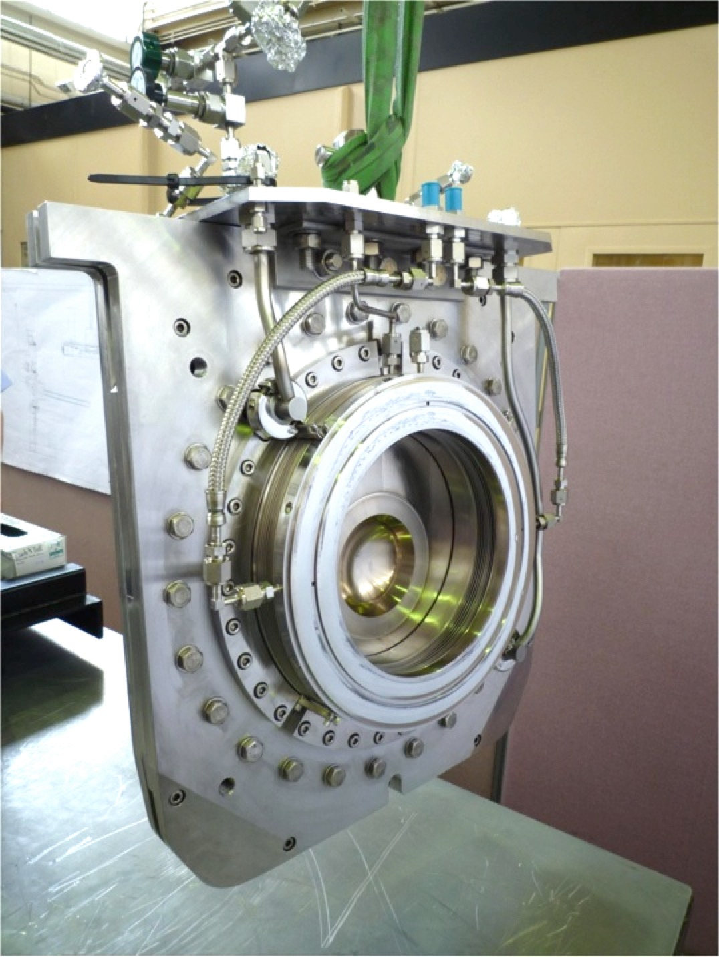
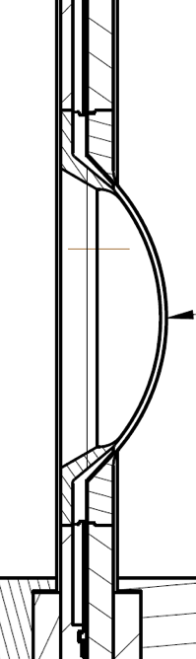
Thermal Shock (Stress Waves)
Example: T2K beam window
Material response dependent on:
Specific heat (temperature jump)
Coefficient of thermal expansion (induced strain)
Modulus of elasticity (associated stress)
Flow stress behavior (plastic deformation)
Strength limits (yield, fatigue, fracture toughness)
Dynamic stress waves may result in plastic deformation, cracking, and fatigue
Heavy dependence on material properties, but:
material properties dependent upon Radiation Damage

Slide 5
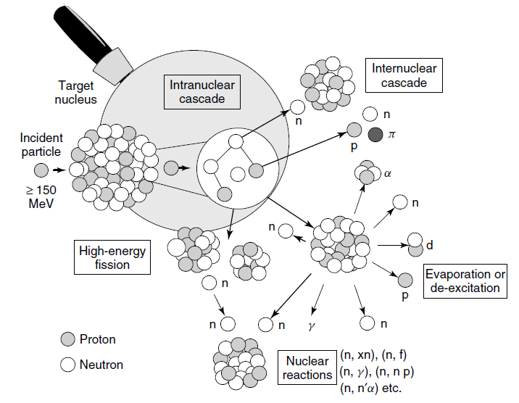
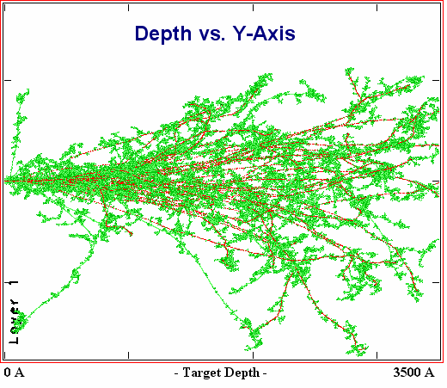
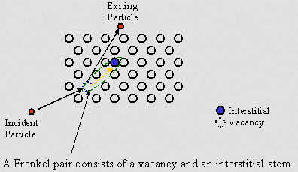
Radiation Damage Disorders Microstructure
Microstructural response:
Creation of transmutation products
Atomic displacements (cascades)
  Displacements Per Atom (DPA) = Average number of stable interstitial/vacancy pairs created
From D. Filges, F. Goldenbaum, in:, Handb. Spallation Res., Wiley-VCH Verlag GmbH & Co. KGaA, 2010, pp. 1–61.

Slide 6







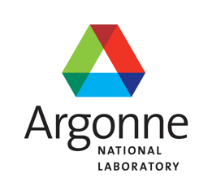



RaDIATE
Collaboration
Radiation Damage In Accelerator Target Environments
radiate.fnal.gov
Broad aims are threefold:
to generate new and useful materials data for application within the accelerator and fission/fusion communities
to recruit and develop new scientific and engineering experts who can cross the boundaries between these communities
to initiate and coordinate a continuing synergy between research in these communities, benefitting both proton accelerator applications in science and industry and carbon-free energy technologies

Slide 7
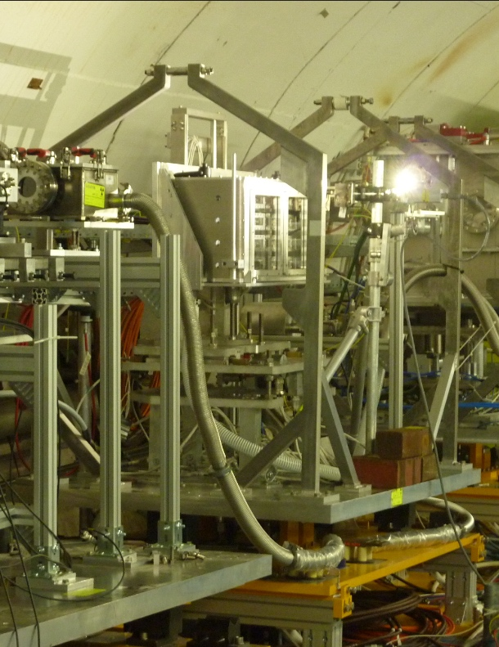
Neutrino Target & Beam Window Materials R&D Progress
Benefits to multi-MW targets (e.g. LBNF):
alloy/grade choice
cooling system design
tolerable beam intensities
expected lifetimes
Graphite (target core material) studies:
  Swelling/fracture studies
  Preparing for HE proton irradiation at BLIP (2020/21) to confirm elevated temperature annealing
Beryllium (beam window material) studies:
  Examination of BLIP irradiated Be specimens underway
  Helium implantation studies show bubble formation at irradiation temperatures above 360 ˚C
Titanium Alloys (beam window material) studies:
  Examination of BLIP irradiated specimens underway
  World first high cycle fatigue testing of
  irradiated titanium underway at FNAL
In-beam thermal shock testing of BLIP irradiated Be and Ti alloys at CERN

Slide 8
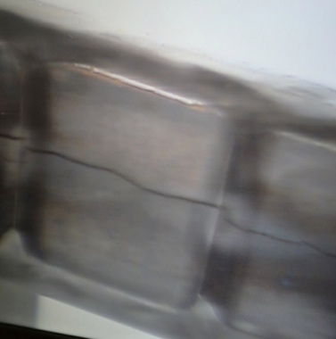
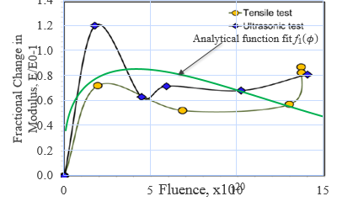
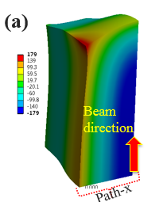
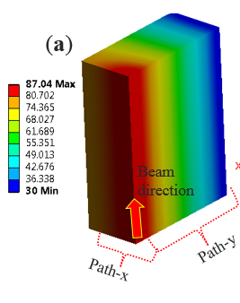
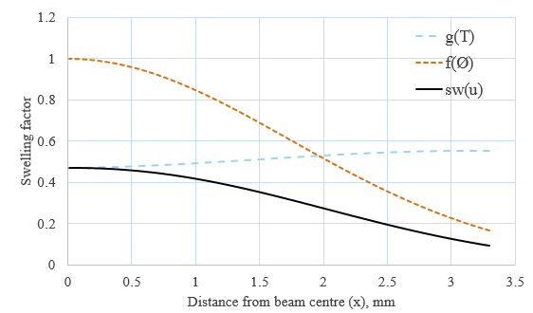
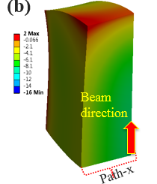
Modeling of graphite swelling predicts fracture
Sujit Bidhar (FNAL) – User defined material model in ANSYS
Elastic modulus as a function of dose and temperature
Swelling (NSLS-II) as a function of dose and temperature
Tensile strength of graphite:
79 MPa (0 DPA)
110 MPa (0.1 DPA)
179 Mpa !!
Stress
E change
Thermal Response
2 MPa
Swelling
No radiation damage effects
Stress

Slide 9
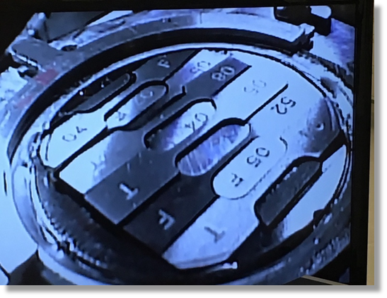
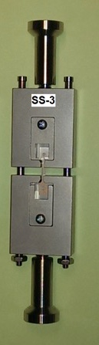
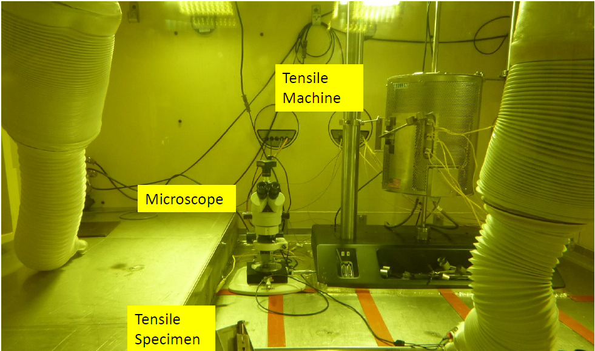
BLIP Irradiation Examinations Underway
Significant hardening at low dose in Be and Ti
  Less hardening in higher temperature specimens
First ever fatigue study on irradiated Ti alloys begun
  Indicates about 10% reduction in fatigue strength
Microstructural examinations underway
Irradiation hardening of S-65F Be
Reduction of strain to failure
Increased strength
Custom Fatigue Testing Machine for Irradiated Materials (FNAL)
D. Senor & A. Casella

Slide 10
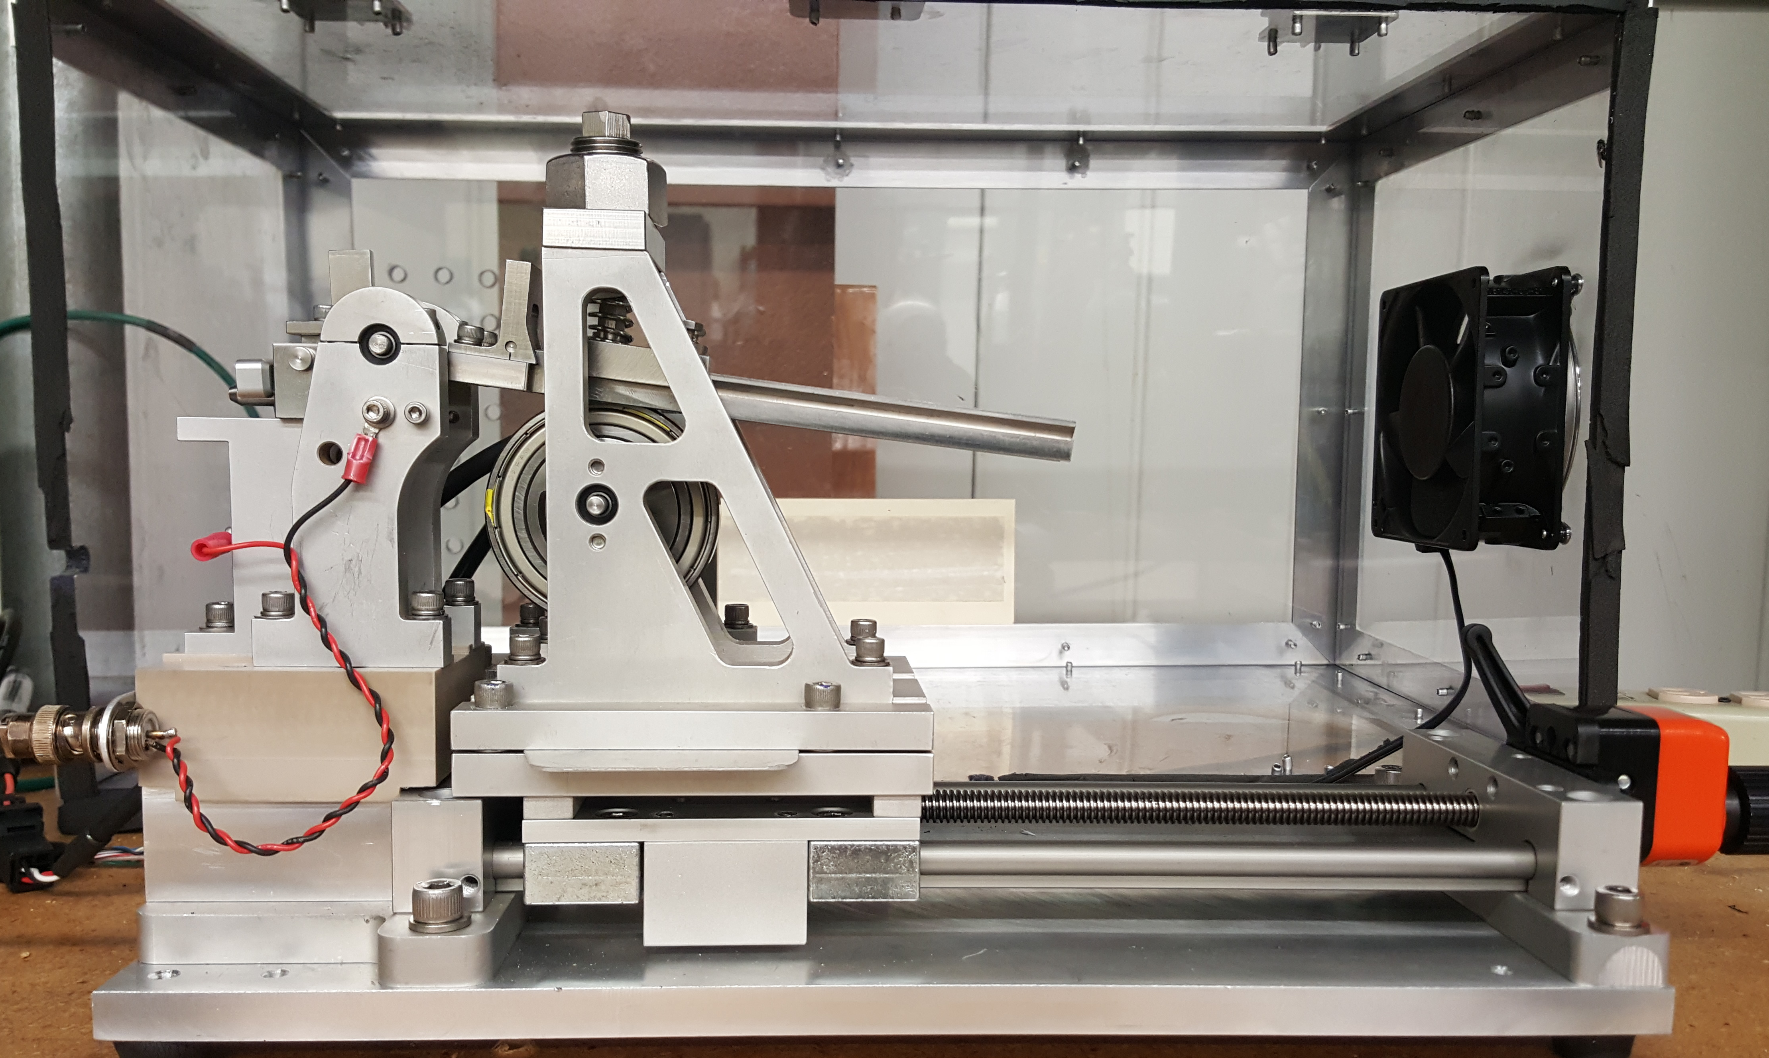
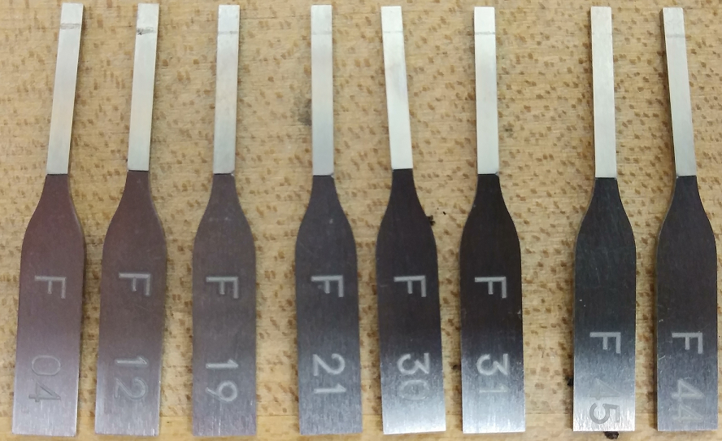
Fatigue Testing of Irradiated Ti Alloys Underway
Fermilab designed Fatigue Testing Machine
  20 Hz
  Variable Stress Amplitude
  Digital Controller
  Automatic Stop Switch
  Monitor On Internet
Ti Grade 5 and 23
Testing complete in Feb 2020
Spring preload
Sample holder
Lever arm
Eccentric Cam
Slider
S. Bidhar

Slide 11
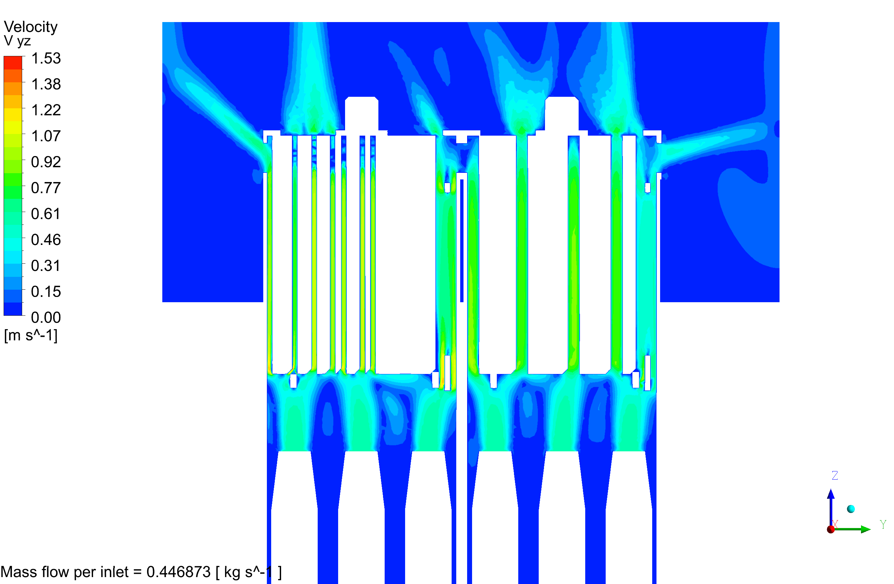
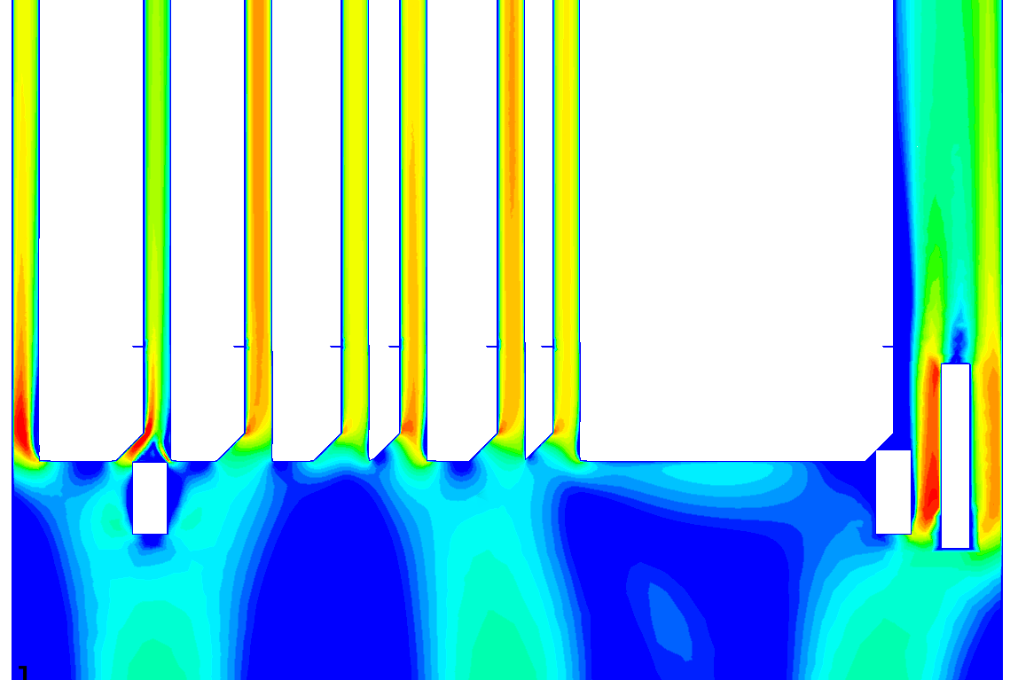
BLIP Irradiation Analysis and QA Run
CFD Analysis of target box configuration
Laser weld procedure testing underway
QA process improvements
Irradiation procedure under development for handling test capsules
Short test run in spring 2020?
  Graphite in single capsule
  2 – 4 week irradiation
  Prove out improvements
K. Ammigan
M. Parkin, RAL

Slide 12
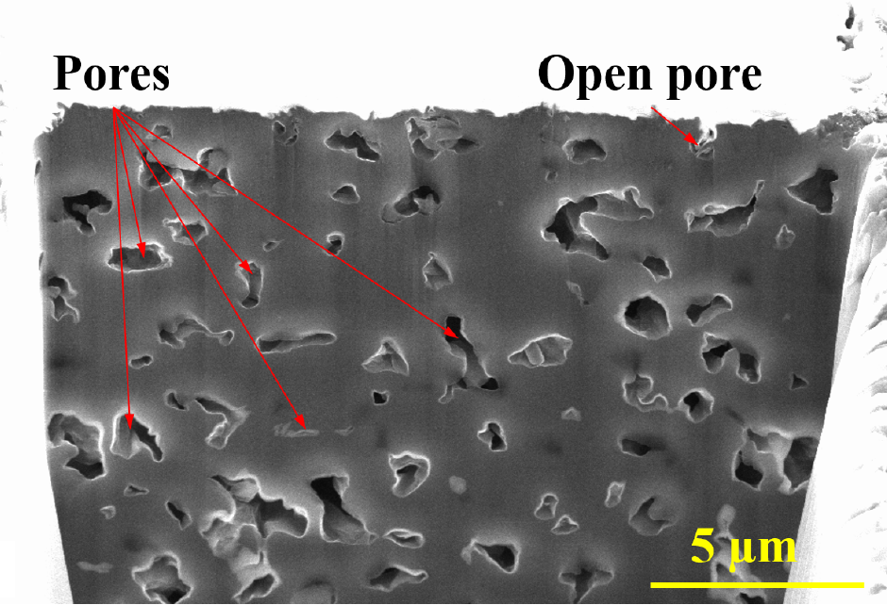
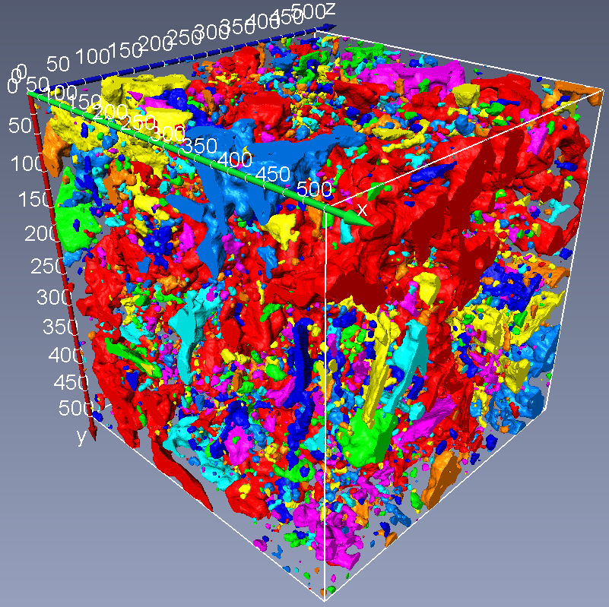
Significant University Involvement in HPT R&D
High Dose Ion Irradiation of Graphite
  Abraham Burleigh (PhD student, IIT) under Dr. J. Terry
Characterization of Graphite by Raman Spectroscopy and Nano-tomography
  Ming (Eric) Jiang (MSc student, Bristol) under Dr. D. Liu
Modeling of He bubble Nucleation and Growth in irradiated Beryllium
  Jianqi Xi (Post-Doc, UW) under Dr. I. Szlufarska
Radiation Mapping Drone & Machine Vision for Remote Handling
  Senior Design Team Projects at UIC under Dr. J. Komperda

Slide 13
Need for low energy irradiation studies to explore radiation damage effects at high doses
High energy, high fluence, large volume proton irradiations are expensive and time consuming
Long irradiation beam times required to achieve high dose (months to years)
PIE on highly activated specimens is challenging
Low energy, small volume ion irradiations are inexpensive and can achieve high DPA rate
Low to zero activation (PIE in ‘normal’ lab areas)
Greatly accelerated damage rates (several DPAs in hours)
However
  Very shallow penetration depths (0.5 – 100 µm) and irradiation volume
  Little gas production (transmutation) in specimens
Promising Solutions:
Micro-mechanics: coupled with advanced microscopy techniques can enable evaluation of critical properties
Simultaneous implantation of He and H ions (triple-beam irradiation) to mimic gas production
Still need HE proton irradiations to correlate and validate LE irradiation studies and do final qulaification
But what is ideal irradiation facility for accelerator targetry materials??

Slide 14
New this year: Seminars/Demonstations
Cross-training
  Nuclear Materials Science <-> Accelerator Targetry
3 parallel sessions
  Monte Carlos Radiation Transport Codes
  TEM Image Interpretation for Radiation Damage Effects
  Remote Handling at TRIUMF
Build on this at future meetings?
  Increase student involvement
  Add course to Particle Accelerator Schools?
  Please suggest topics for future meetings

Slide 15
Meeting Objectives
Hear about recent results from RaDIATE relevant studies
Learn about PIE and modeling techniques and methods
Discuss new material ideas for targets, windows, collimators
Plan for the rest of PIE activities related to RaDIATE BLIP run
Plan the next HE proton and LE ion irradiations
Update on administrative issues for RaDIATE
Strengthen the RaDIATE Community
Enjoy Vancouver!

Slide 16
RaDIATE
Enjoy the meeting!
10 keV protons into Beryllium (simulated with SRIM 2008 and artistically rendered with Graphic Converter by P. Hurh)
Radiation Damage In Accelerator Target Environments

