Slide 1


6th RaDIATE Collaboration Meeting
WELCOME TO TRIUMF!
Radiation Damage in Accelerator
Targets Environments
December 9-12, 2019
Vancouver, Canada

Slide 2
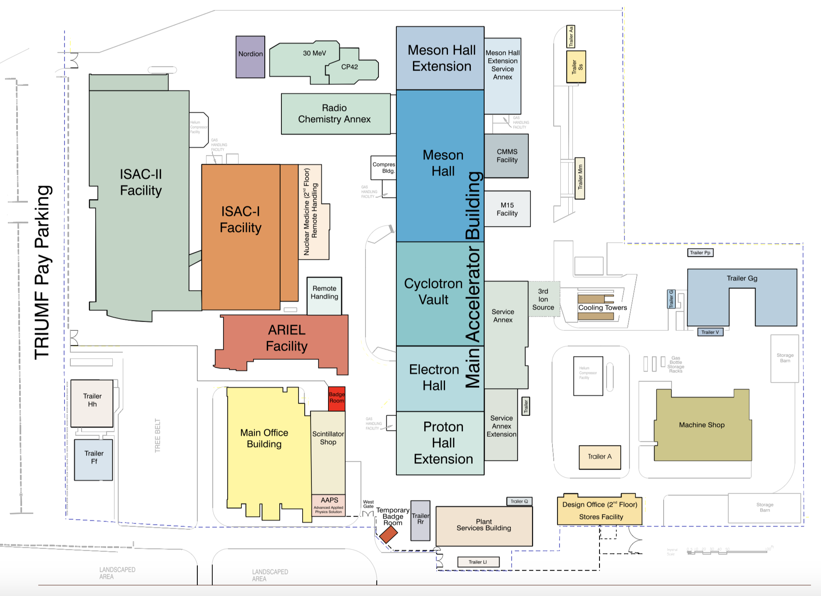
Overview
Radiation Control Area
Please always wear your meeting badge when on site.
When entering the Radiation Control Area (for tutorials, visits) a dosimeter is required, and you need to be accompanied by a TRIUMF employee.
Information will be provided.
You are here
Main Office Building

Slide 3
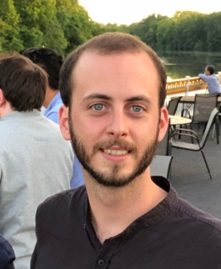
Overview
Main Office Building is accessible without dosimeter.
Entrance through reception
8:30 – 4:30 pm. Exit at any time.
Any questions?
You are in the
Auditorium
TRIUMF Reception
Alex Gottberg:
+1 778 788 7222
gottberg@triumf.ca
Ferran Boix Pamies:
+1 236 987 8661
fboixpamies@triumf.ca
Emergency Assembly Area

Slide 4
WIFI
If you don’t have eduroam you can use the TRIUMF Visitor Wi-Fi
Let us know in case of bandwidth or accessibility issues, a password for TRIUMF WLAN can be provided.

Slide 5
Program
RaDIATE 2019 program runs from Monday 9 am till Thursday 5 pm
Lunches and coffee breaks in this auditorium - tbc
Welcome drink today at 5:45 pm in cafeteria downstairs.
Dinners: Vancouver offers a great variety of restaurants.
Kitsilano (4th Avenue), Main Street (more alternative), Gastown (more touristic), Yaletown (fancier)

Slide 6
TRIUMF Visit Tuesday 2:30 pm to 5 pm
short introduction at 2:30 pm in auditorium
Tour: cyclotron roof, IPF (Isotope Production Facility), NIF (Neutron Irradiation Facility), e-linac, ISAC hot cells, ISAC II experimental hall
Group 1
Main guide: Luca Egoriti
Abe Burleigh
Andy
Ram Devanathan
Paige Abel
Mat Brownell
Roger Caballero-Folch
Arghya Dey
Katharina Domnanich
Kavin Ammigan
Mia Au
Sujit Bidhar
Ferran Boix Pamies
Marco Calviani
Marla Cervantes
Chris Densham
Group 2
Main guide: Tom Day Goodace
Inbal Gavish Segev
Yosuke Iwamoto
Aurelia Laxdal
Fernando Maldonado
Johannes Jobs
David McClintock
Cassidy Donaldson
Phil Earp
Danny Edwards
Taku Ishida
Dohyun Kim
Slava
Yongjoong Lee
Sam McEwen
Alexander Gottberg
Group 3
Main guide: Carla Babcock
Michael Moorehead
Nikolai Mokhov
Jianqi Xi
Shin
Allon Messenberg
Anders Mjos
Aaron Schmidt
Dave Senor
Josh Smith
Joachim Vollaire
Shaohong Wei
Louis Moskven
Darwin Ortiz Rosales
Mauricio Pong
John Wong
Taku Ishida

Slide 7
Slides Online
Indico page will stay up and available to the public after the meeting.
Please let us know if you wish to have specific material removed or changed.

Slide 8
Tutorials

Slide 9
Tutorials – Wednesday 2 pm to 5 pm
Leaving from Auditorium to tutorials at 2 pm, please be in auditorium a few minutes in advance.
Monte Carlo
Main Office Building TRIUMF Innovations Boardroom
Michael Moorehead
Ewart Blackmore
Andy
Ram Devanathan
Inbal Gavish Segev
Alexander Gottberg
Yosuke Iwamoto
Aurelia Laxdal
Fernando Maldonado
Shin
Nikolai Mokhov
Jianqi Xi
Shin
Remote Handling
ISAC II Room 222, Meson Hall RH area, ISAC RH area
Paige Abel
Mat Brownell
Roger Caballero-Folch
Arghya Dey
Katharina Domnanich
Johannes Jobst
David McClintock
Allon Messenberg
Anders Mjos
Aaron Schmidt
Dave Senor
Josh Smith
Joachim Vollaire
Shaohong Wei
Taku Ishida
TEM
Main Office Building Auditorium
Kavin Ammigan
Mia Au
Sujit Bidhar
Marco Calviani
Marla Cervantes
Tom Day Goodacre
Chris Densham
Cassidy Donaldson
Phil Earp
Danny Edwards
Patrick Hurh
Dohyun Kim
Slava
Yongjoong Lee
Sam McEwen
Louis Moskven
Darwin Ortiz Rosales
Mark Palmer
Mauricio Ponga
John Wong
Shunsuke Makimura
Abe Burleigh

Slide 10
Dinner

Slide 13
Dinner
RaDIATE dinner on Wednesday in the Vancouver Aquarium
Weather does not permit stopover
Meeting in auditorium at 5:50 pm.
Bus leaves from TRIUMF at 6:00 pm.
Individual arrival at aquarium is possible. Please be ther at 7 pm sharp.
Bus back at 11 pm – 11:30 pm with stops downtown, at TRIUMF House and at TRIUMF

Slide 14
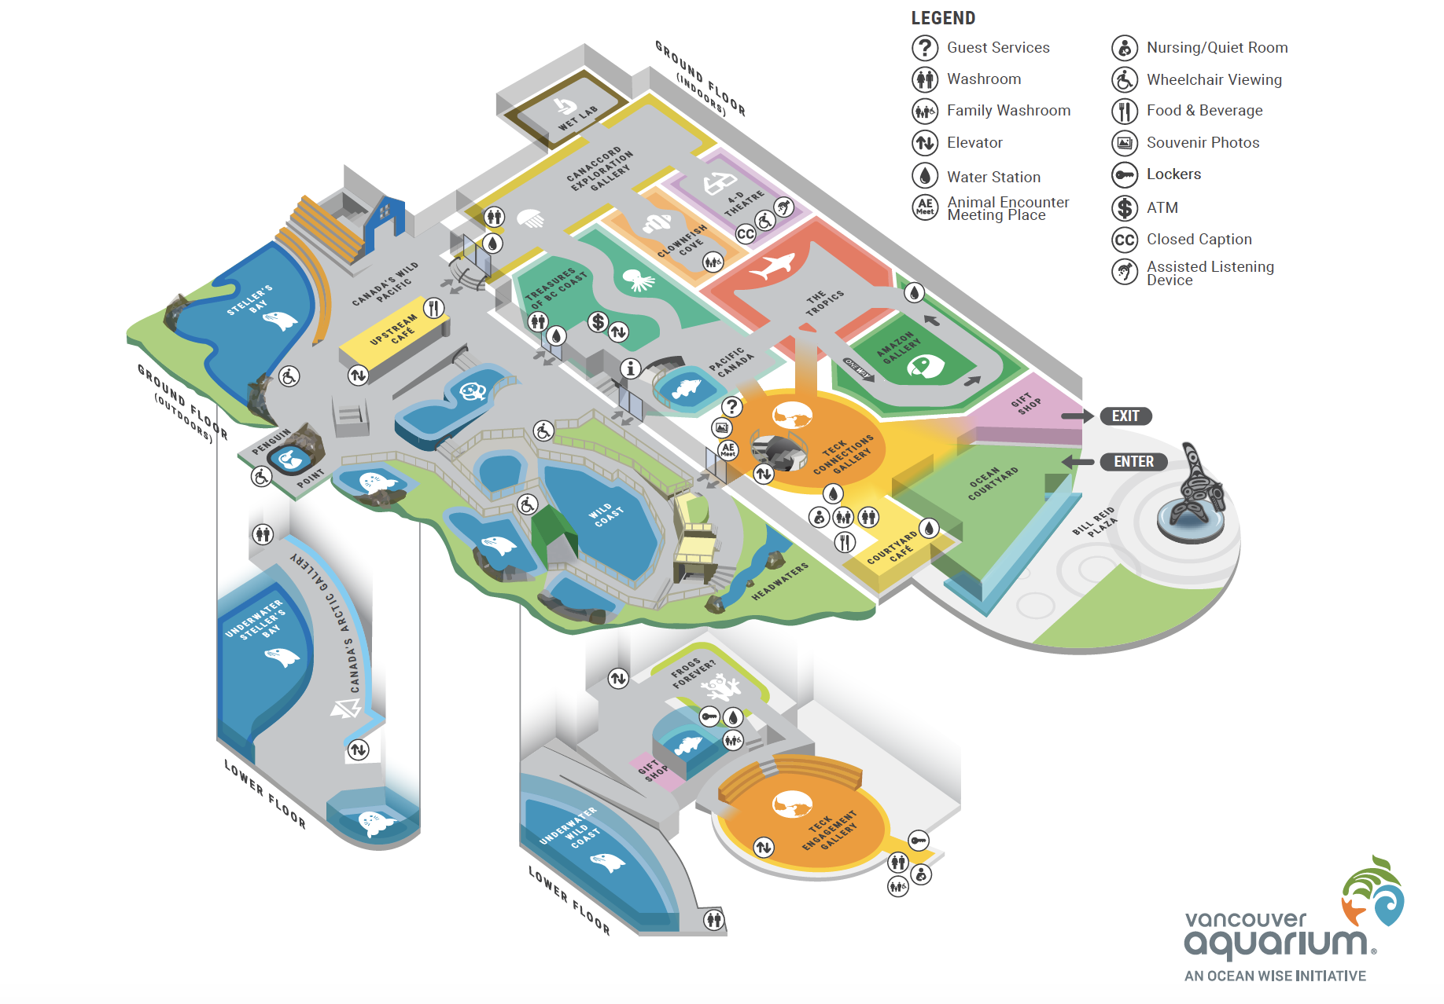
Aquarium Map
Arrival 7 pm
Free strolling through entire exhibition 7 pm – 7:20 pm
Dinner starts at STELLER’S BAY UNDERGROUND ARE at aquarium at 7:30 pm.
Steller’s Bay

Slide 15
Slides available on Indico in
Monday morning welcome presentation

Slide 16
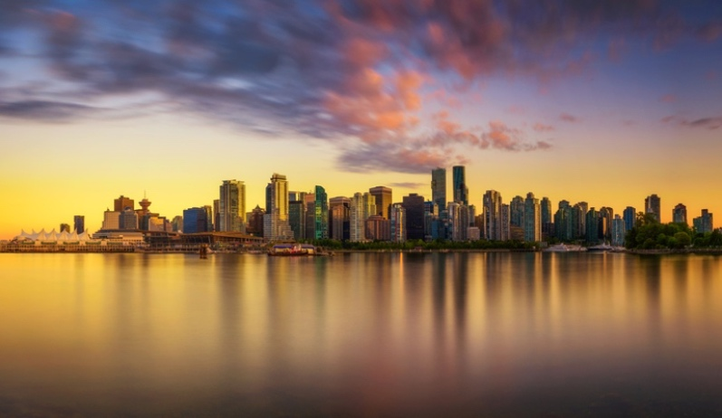
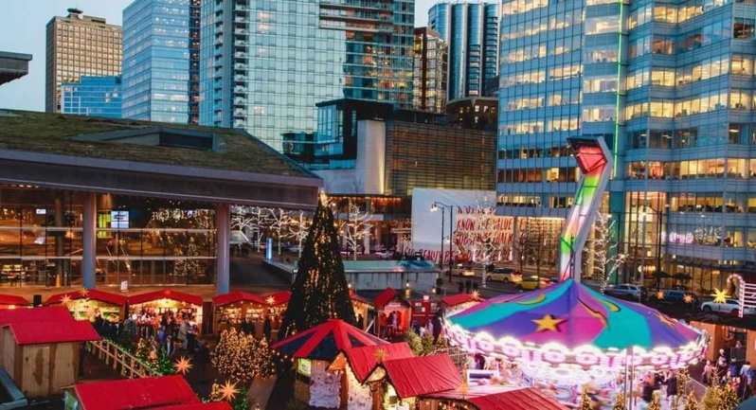
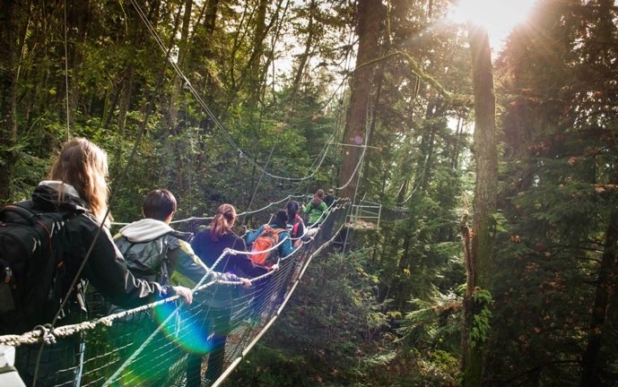
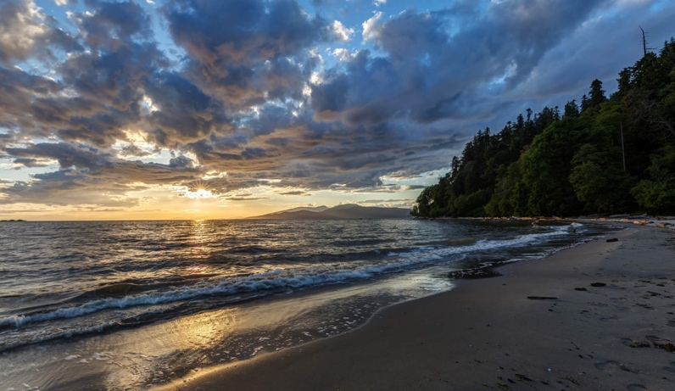
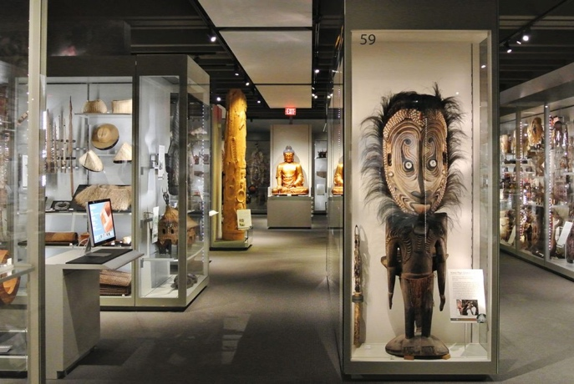
Things to do in Vancouver
Visit downtown
  Canada Place (float planes, harbor view, Fly Over Canada)
  Robson Street (shopping)
Capilano Suspension Bridge and Tree Walk with typical BC forest, Christmas illumination at night
UBC Botanical Garden is close by
Vancouver Christmas Market
Wreck Beach in 20 minutes walking distance
UBC Museums of Anthropology and Beaty Biodiversity Museum

