Slide 1
Calculations of damage energy of nuclear reaction products and experimental plan for DPA cross section using 120 GeV protons at FNAL
6th RaDIATE Collaboration Meeting, 9th-13th Dec. 2019 at TRIUMF
Y. Iwamoto¹, S. Hashimoto¹, M. Yoshida², H. Iwamoto¹, S. Meigo¹,
K. Yonehara³, T. Spina³ and P. Hurh³
1. JAEA, 2. KEK, 3. FNAL
This work is supported by JSPS KAKENHI Grant Number JP19H02652.
Present study includes the results of “Measurement of displacement cross section at J-PARC for structural material utilized at ADS” entrusted to JAEA by MEXT.

Slide 2
Outline
1. Introduction
2. DPA calculation method in high-energy region
3. Calculations of DPA cross sections and damage energy
4. Plan for DPA measurements using 120 GeV protons
5. Summary

Slide 3
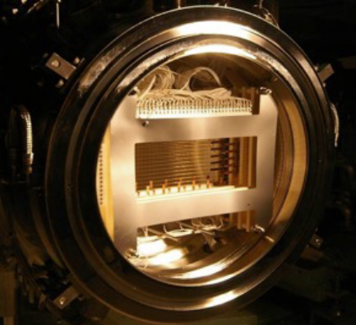
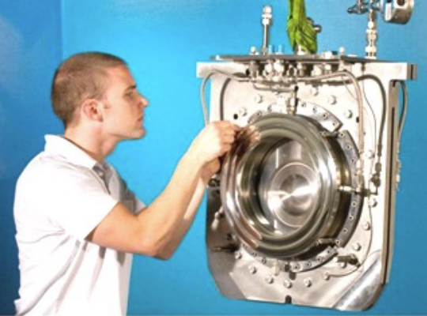
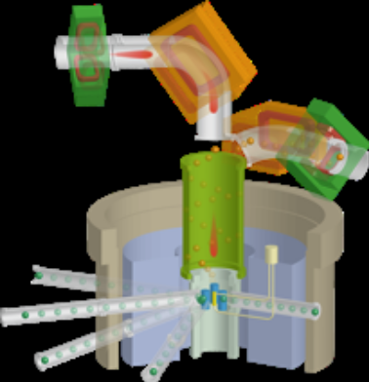
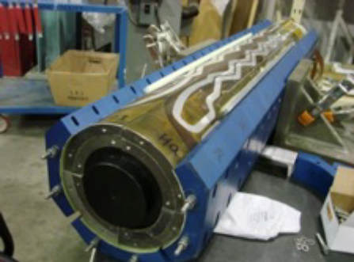
Introduction
Prediction of usable lifetime of materials under high-energy (E>100 MeV) particle irradiation is essential for the design.
Beam windows in J-PARC MLF (Al alloy)
Beam window in neutrino facility (Ti alloy)
CERN LHC superconducting magnet (Nb alloy)
2nd target in J-PARC MLF (W)
Displacement per atom (DPA) value is used as a damage-based exposure unit.

Slide 4

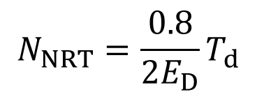

Microscopic effects on material
DPA: average number of displaced atoms per atom of a material
σ_{d} : displacement cross-section (m²)
DPA=
$$σ_{d}φ$$
$φ$: irradiation fluence (particles/m²)
Interstitial atom
Primary Knock-
on Atom (PKA)
Frenkel-pairs cause cascade damage.
vacancy
The number of atomic displacement
Conventional method: NRT model (Norgett, Robinson, Torrens)
Nuclear Engineering and Design 33 (1975) 50.
$$N_{NRT}=\frac{0.8}{2E_{D}}T_{d}$$
Damage energy transferred to lattice atoms
Threshold displacement energy
15 – 90 eV
G. S. Was, Fundamentals of Radiation Materials Science, New York, USA: Springer Press, 2017

Slide 5
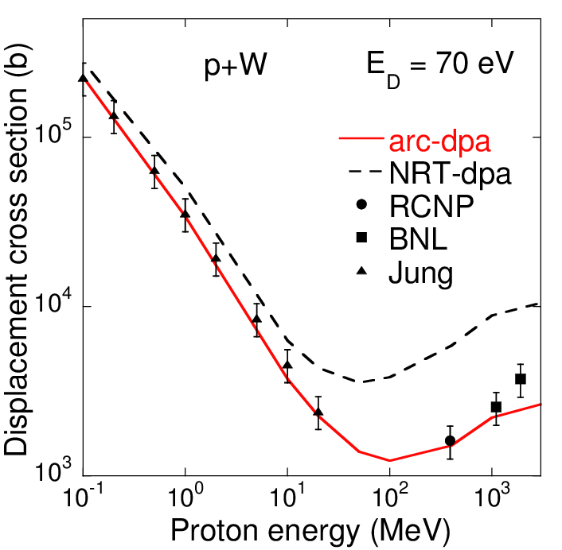
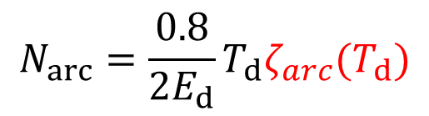
Problem for dpa calculations in high-energy
New method: athermal recombination correction (arc)
$$N_{arc}=\frac{0.8}{2E_{d}}T_{d}ζ_{arc}(T_{d})$$
K. Nordlund et al., Nature Communications 9 (2018) 1084.
Monte Carlo codes with nuclear reactions.
e.g. PHITS, MARS, FLUKA, MCNP
T. Sato et al., J. Nucl. Sci. Technol., 55 (2018) 684-695.
High-energy region above 100 MeV
Relationship between nuclear products and their damage energies are unclear.
Contribution of relativistic Coulomb scattering cross section between proton and target is not considered in PHITS.
No data with proton energy over 30 GeV
PHITS
NRT and arc dpa cross sections for p-W.

Slide 6
Purpose
Implementation of relativistic differential Coulomb scattering cross section for DPA calculation in PHITS
Calculations of arc-dpa cross sections and damage energy up to 120 GeV protons
Introduction of plan for DPA cross section measurements with 120 GeV protons at FNAL

Slide 7
Outline
1. Introduction
2. DPA calculation method in high-energy region
3. Calculations of DPA cross sections and damage energy
4. Plan for DPA measurements using 120 GeV protons
5. Summary

Slide 8

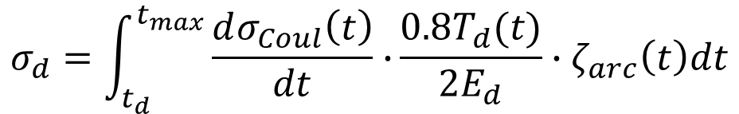
DPA calculation method in PHITS
(1) Nuclear interaction
(2) Energy transfer
with Coulomb scattering
(3) Cascade damage
approximation
Proton
Proton or
nuclear products
Ionization: ATIMA
Nuclear products
DPA=
$$σ_{d}\overline{φ}$$
target atom
Intra-nuclear cascade
(INCL4.6 and JAM)
Evaporation (GEM)
Y. Iwamoto et al., Nucl. Instr. Meth. B 274 (2012) 57-64.
DPA cross section
$$σ_{d}=\int_{t_{d}}^{t_{max}}{\frac{dσ_{Coul}\left(t\right)}{dt}∙}\frac{0.8T_{d}(t)}{2E_{d}}∙ζ_{arc}\left(t\right)dt$$
t: dimensionless transferred energy
Differential Coulomb scattering cross section
Number of displacement
Defect production efficiency

Slide 9
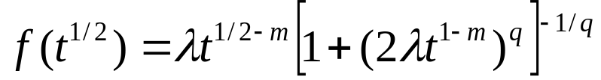
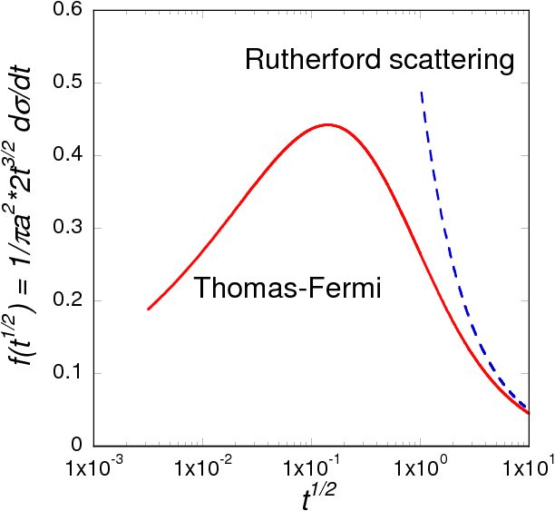

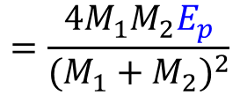
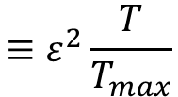
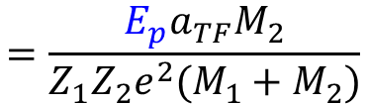
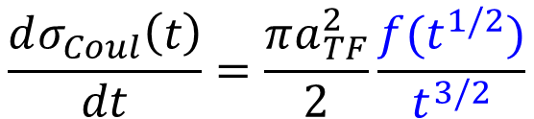
Differential Coulomb scattering cross section
(Z₁, M₁)
E_{p} :kinetic energy of proton or nuclear products
(Z₂, M₂)
T: transferred energy to target atom
Screening functions:
$$\frac{dσ_{Coul}\left(t\right)}{dt}=\frac{πa_{TF}^{2}}{2}\frac{f(t^{1/2})}{t^{3/2}}$$
t: dimensionless transferred energy
$$≡ε^{2}\frac{T}{T_{max}}$$
T_{max}: maximum T
$$=\frac{{4M}_{1}M_{2}E_{p}}{{(M_{1}+M_{2})}^{2}}$$
λ=1.309, m=1/3, q=2/3
:dimensionless energy
$$=\frac{E_{p}a_{TF}M_{2}}{Z_{1}Z_{2}e^{2}(M_{1}+M_{2})}$$
Large t large T in close collisions
Small t small T in distant collisions

Slide 10
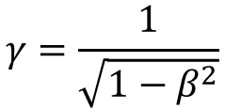
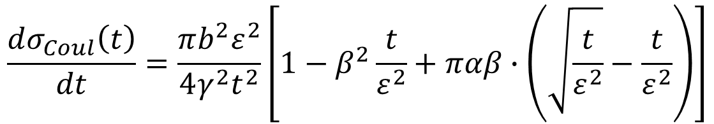
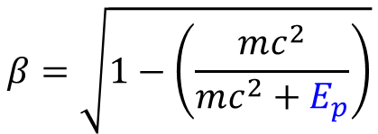
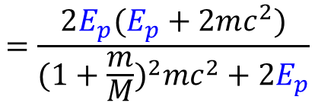
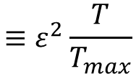
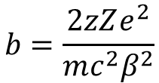
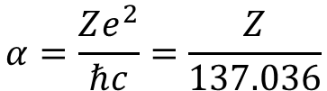
Relativistic differential Coulomb scattering cross section
(Z₁=z, M₁=m)
E_{p} :kinetic energy of high-energy (>100 MeV) proton
(Z₂=Z, M₂=M)
T: energy transferred to target atom
Relativistic differential Coulomb scattering cross section:
$$\frac{dσ_{Coul}\left(t\right)}{dt}=\frac{πb^{2}ε^{2}}{4γ^{2}t^{2}}\left[1−β^{2}\frac{t}{ε^{2}}+παβ∙\left(\sqrt{\frac{t}{ε^{2}}}−\frac{t}{ε^{2}}\right)\right]$$
implementation into PHITS
I. Jun, IEEE Trans. Nucl. Sci. 48 (2001) 162.
t: dimensionless transferred energy
$$≡ε^{2}\frac{T}{T_{max}}$$
Relativistic correction for high-energy proton
T_{max}: maximum T
$$=\frac{2E_{p}(E_{p}+2mc^{2})}{{(1+\frac{m}{M})}^{2}mc^{2}+2E_{p}}$$
$$b=\frac{2zZe^{2}}{mc^{2}β^{2}}$$
Impact parameter
$$β=\sqrt{1−\left(\frac{mc^{2}}{mc^{2}+E_{p}}\right)}$$
$$γ=\frac{1}{\sqrt{1−β^{2}}}$$
$$α=\frac{Ze^{2}}{ℏc}=\frac{Z}{137.036}$$
Next: Damage energy to lattice atom

Slide 11
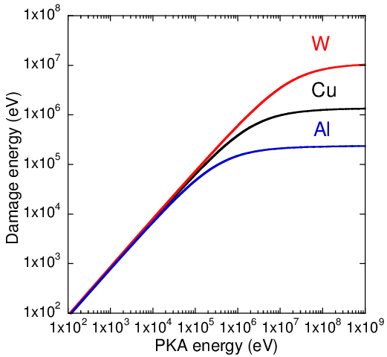
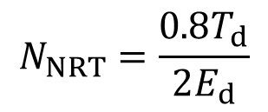
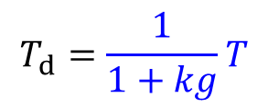
Damage energy transferred to the lattice atom
Number of displaced atoms using phenomenological approach by Lindhard.
$$N_{NRT}=\frac{0.8T_{d}}{2E_{d}}$$
Damage among same atoms
$$T_{d}=\frac{1}{1+kg}T$$
T_{d} :damage energy is the energy available to generate atomic displacements by elastic collisions
T_{d}
The energy lost in the cascade by electron excitation is subtracted.
1 MeV
T
Damage energies are saturated with PKA energy over 1 MeV.
Relationship between PKA energy and damage energy
J. Lindhard et al., Dan Vidnsk Selsk Mat Fyf Medd 33:1 (1963).
Next: Defect production efficiency

Slide 12
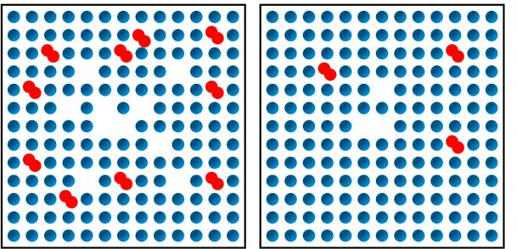
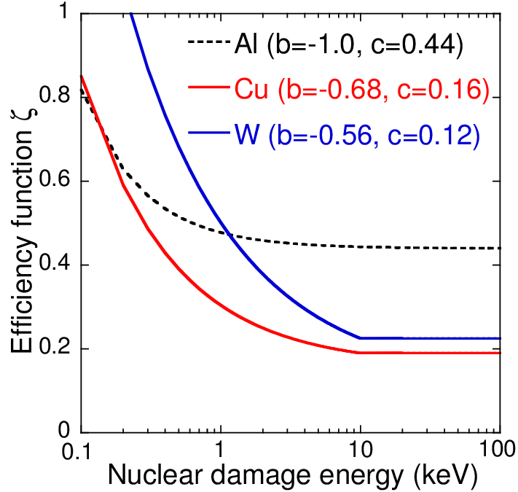
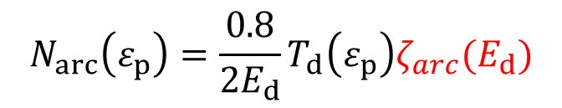
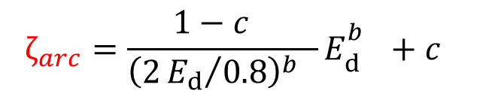
Athermal recombination correction
Molecular dynamic simulation study
Vacancy
Figure 2 : K. Nordlund et al., Nature Comm. 9 (2018) 1084.
Interstitial atom
NRT damage model
Actual damage production
Schematic illustration of the damage for the case of ~1 keV damage energy in a metal
$$N_{arc}\left(ε_{p}\right)=\frac{0.8}{2E_{d}}T_{d}\left(ε_{p}\right)ζ_{arc}(E_{d})$$
Efficiency function based on tabulated parameters
$$ζ_{arc}=\frac{1−c_{}}{{\left(2{E_{d}}/{0.8}\right)}^{b_{}}}E_{d}^{b_{}}+c_{}$$
Cu: b = -0.68, c = 0.16
W: b = -0.56, c = 0.12
Defect production efficiency

Slide 13
Outline
1. Introduction
2. DPA calculation method in high-energy region
3. Calculations of DPA cross sections and damage energy
4. Plan for DPA measurements using 120 GeV protons
5. Summary

Slide 14
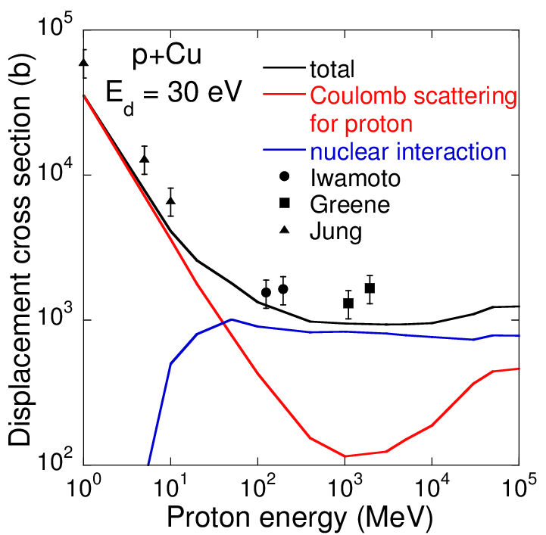
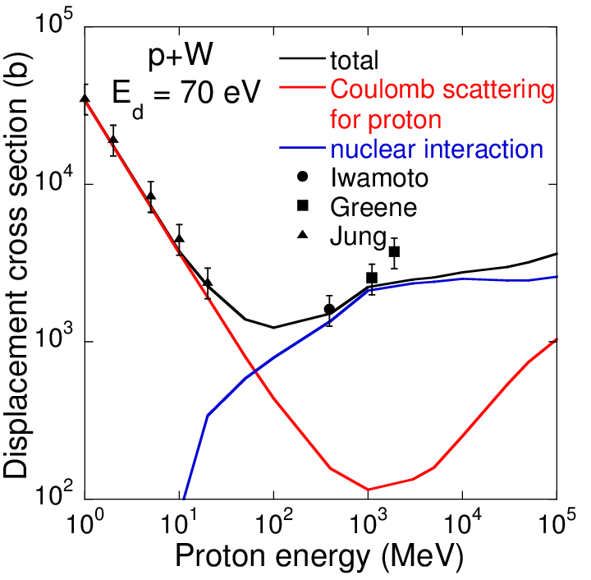
Arc-dpa cross section for proton irradiation
Arc-dpa cross sections for p+Cu and p+W
Contribution of Coulomb scattering for p+target increases with Ep over 1 GeV.
i.e. 9% at 1 GeV, 19% at 30 GeV, 29% at 100 GeV for tungsten
Nuclear reaction product is dominant with proton energy over 100 MeV.
Next slide: arc-dpa cross section of nuclear interaction product

Slide 15
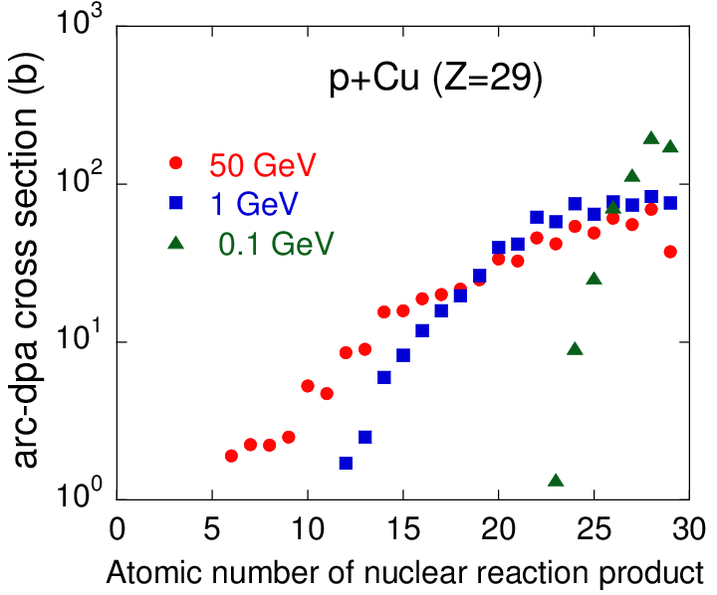
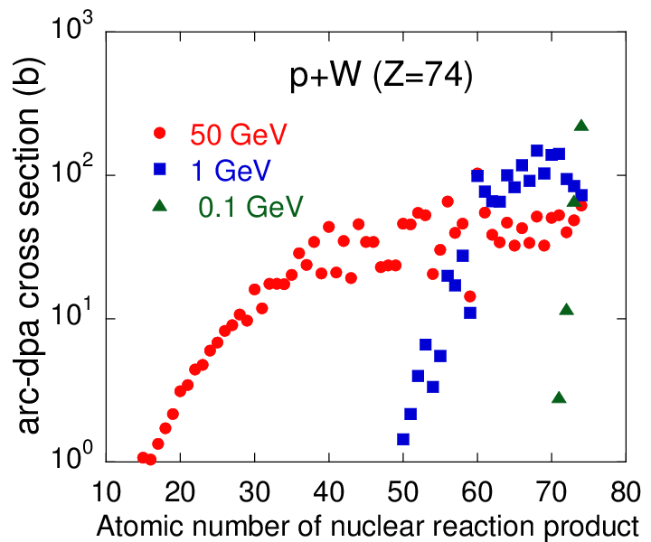
Arc-dpa cross section of nuclear interaction product
Arc-dpa cross sections of nuclear interaction product
Arc-dpa cross sections are widely distributed with increasing proton energy.
This trend is strong for heavier target material.
Next slide: Damage energies for 1 GeV protons incident on W.

Slide 16
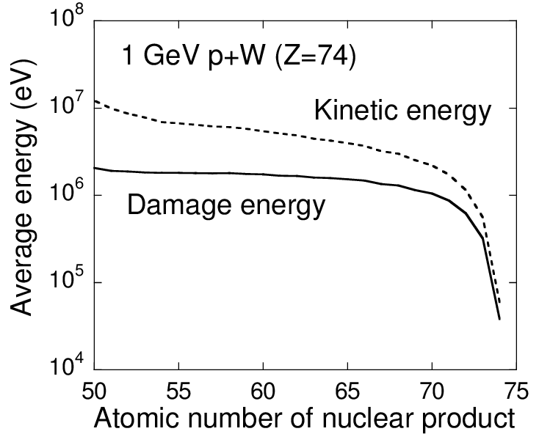
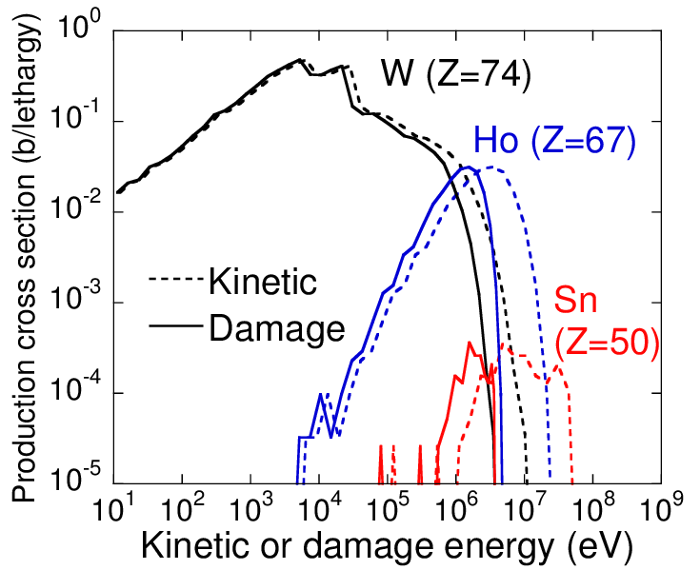
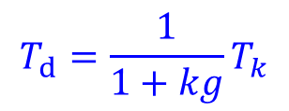
Damage energy of each nuclear product for 1 GeV p+W
Nuclear elastic
Nuclear in-elastic
$$T_{d}=\frac{1}{1+kg}T_{k}$$
Average damage energy distribution
Energy spectra of W, Ho and Sn
Damage energy is smaller than kinetic energy because the energy lost in the cascade by electron excitation is subtracted.
For target nucleus (tungsten), contribution of nuclear elastic scattering is dominant below 50 keV.
In-elastic scattering components are dominant for 50 keV – 5 MeV.
Next slide: Damage energies for 50 GeV protons incident on W.

Slide 17
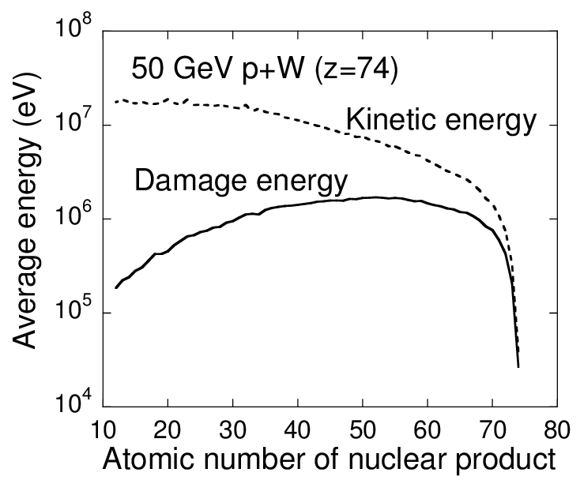
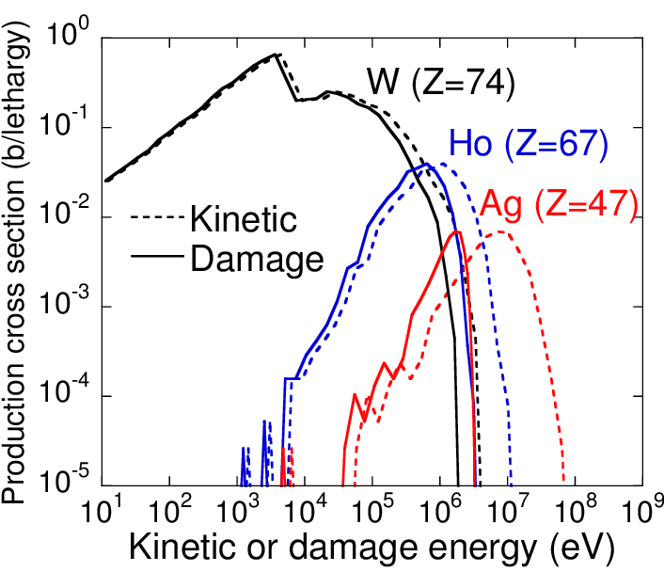
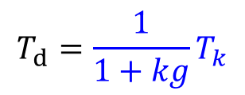
Damage energy of each nuclear product for 50 GeV p+W
Nuclear elastic
Nuclear in-elastic
$$T_{d}=\frac{1}{1+kg}T_{k}$$
Average damage energy distribution
Energy spectra of W, Ho and Ag
Damage energies of nuclear products also range from 50 keV to 5 MeV.
Damage energy range are almost same in the proton energy region from 1 to 120 GeV.

Slide 18
Outline
1. Introduction
2. DPA calculation method in high-energy region
3. Calculations of DPA cross sections and damage energy
4. Plan for DPA measurements using 120 GeV protons
5. Summary

Slide 19
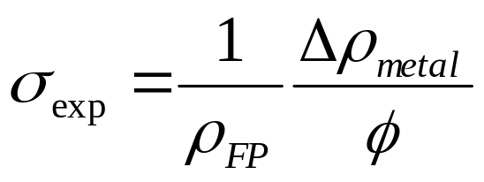
Measurement method of dpa cross section
Irradiation on metal at cryogenic temperature
Recombination of Frenkel pairs by thermal motion is well suppressed.
Damage rate
Δρ_{metal}: Electrical resistivity change(Ωm)
Φ: Average Beam fluence(1/m²)
ρ_{FP}: Frenkel-pair resistivity (Ωm)
Resistivity increase is the sum of resistivity per Frenkel pair
Before our experiments, the data have been measured using 1 – 2 GeV protons at BNL.
G.A. Greene et al., Proc. of AccApp '03, 1-5 Jun 2003. San Diego.
In BNL experiments, cryostat assembly for sample irradiation consisted of
complicated system to deliver a flow of liquid cryogen.
We have developed liquid cryogen-free cooling system and measured dpa cross sections at accelerator facilities in Japan.

Slide 20
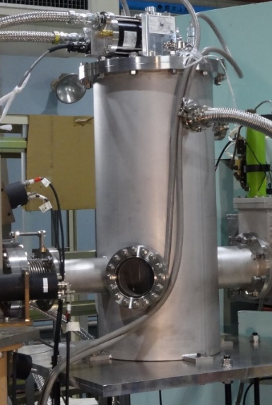
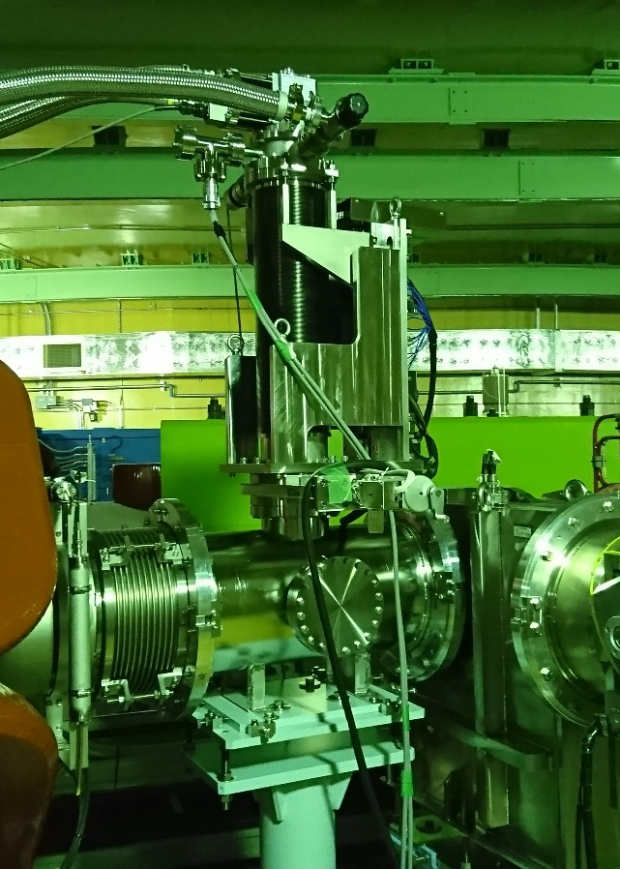
dpa cross section measurements
No experimental data above 30 GeV
Experimental plan with 120 GeV proton at FNAL.
125 - 400 MeV proton + Al, Cu, W
0.4 - 30 GeV proton+Al,Cu,Fe,W
FFAG facility, Kyoto Univ.
J-PARC
RCNP, Osaka Univ.
Y. Iwamoto et al., J. Nucl. Mater., 458, (2015) 369-375.
Dr. Meigo will present at this workshop
Y. Iwamoto et al., J. Nucl. Mater., 508, (2018) 195-202.

Slide 21
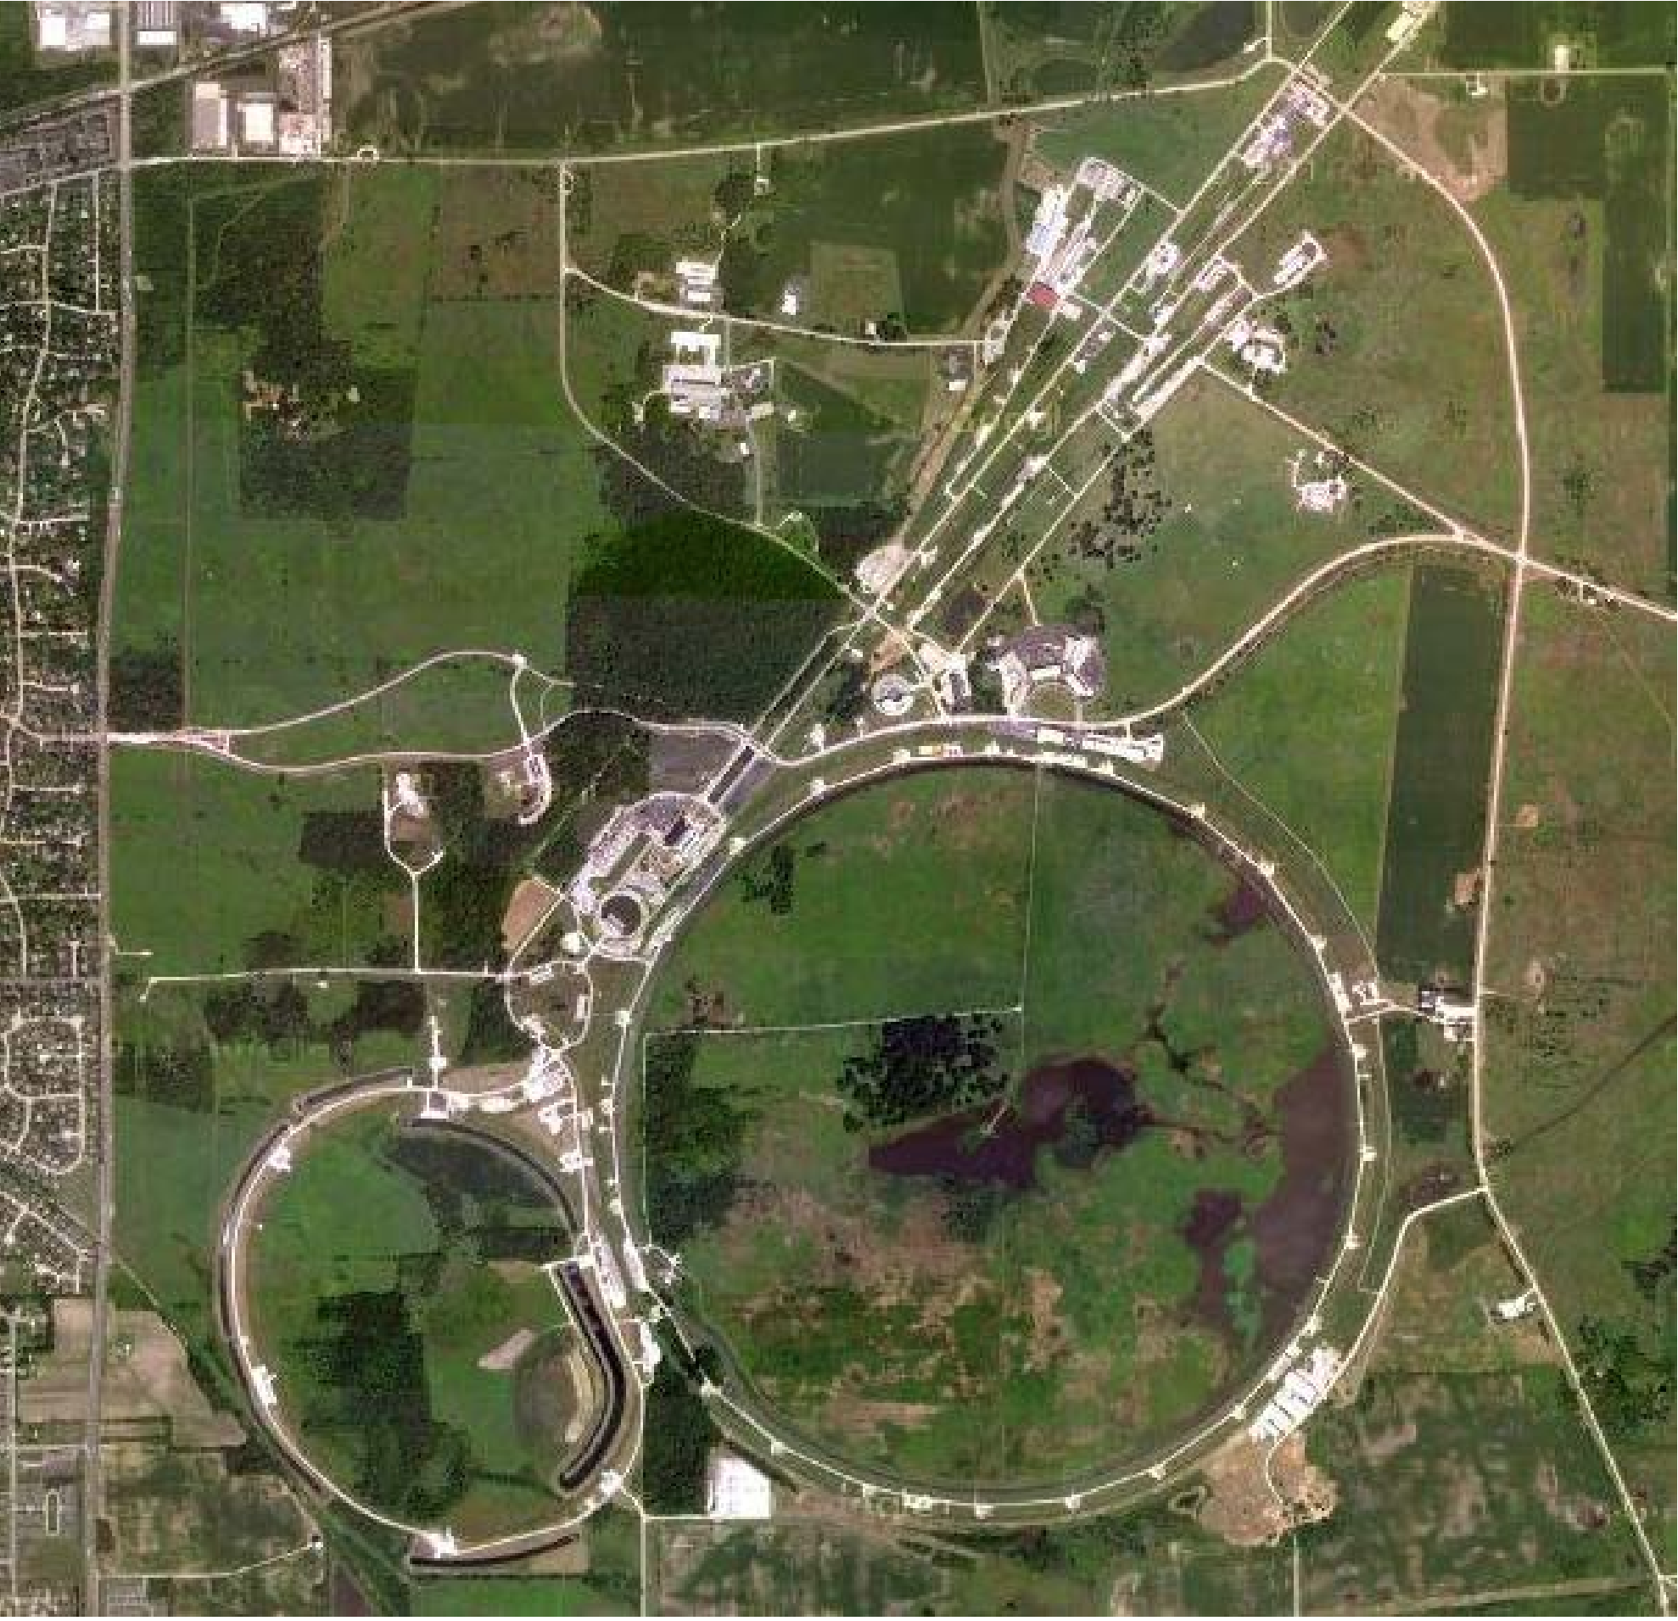
Fermilab Test Beam Facility (FTBF) located on FNAL
MS3/M03
Tevatron
Main injector
21/26

Slide 22
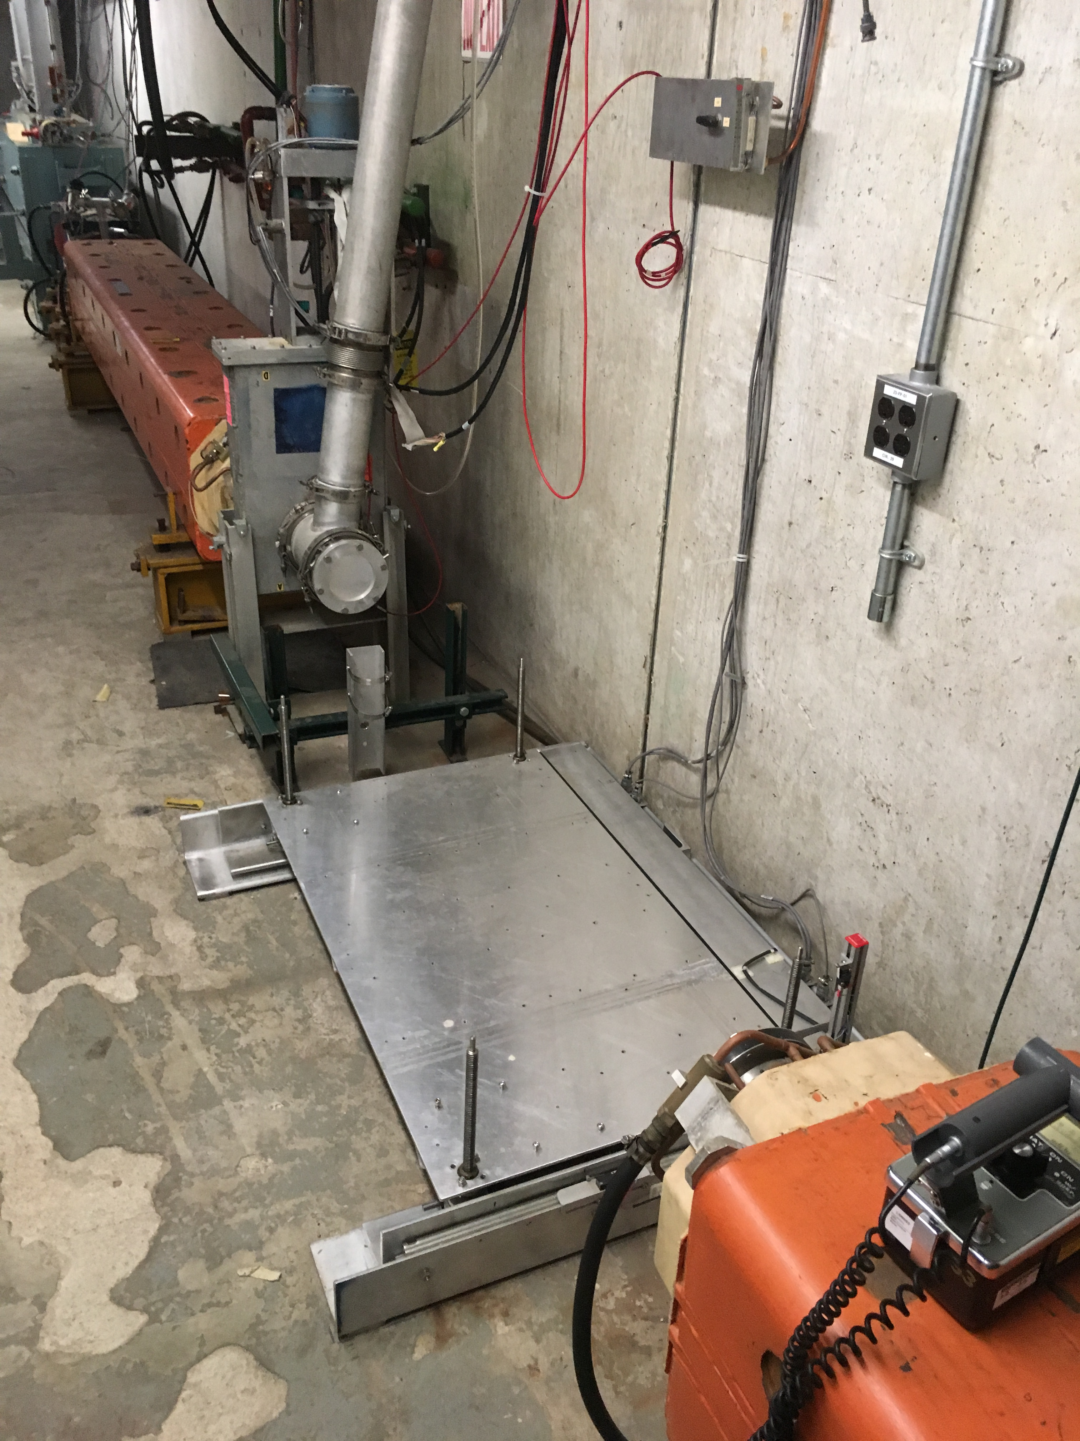
Experimental area in M03 beam Line
Collimator
4.2 sec
10¹¹ proton/min
60 sec
Quad Magnet
24 h irradiation: 8.64 x 10¹⁵ protons
RMS beam size can be 4 mm for protons
Beam structure
120 GeV protons
158.75 cm
φ32 cm
62 cm
Segmented Wire Ionization Chambers (SWICs) will be installed.
Experimental area
Irradiation chamber used at RCNP
22/26

Slide 23
Irradiation chamber and target assembly
GM refrigerator
RDK-408D2, Sumitomo Inc.
Helium gas
Supply
Return
OFHC
Al
1st stage of cold head (40K)
140 mm
2nd stage of cold head (4K)
542 mm
Resistance thermometer
Sample assembly
Measure the changes in electrical resistivity of sample under proton irradiation
1mm thick thermal shield
Schematic of the cryogenic irradiation chamber

Slide 24
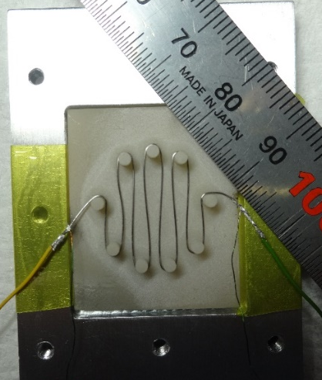
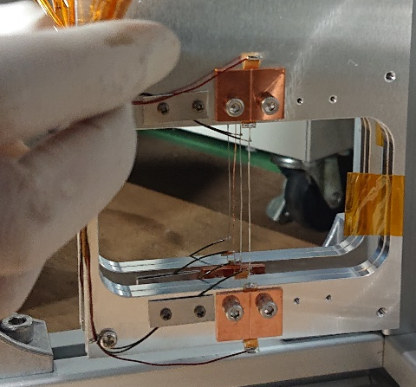
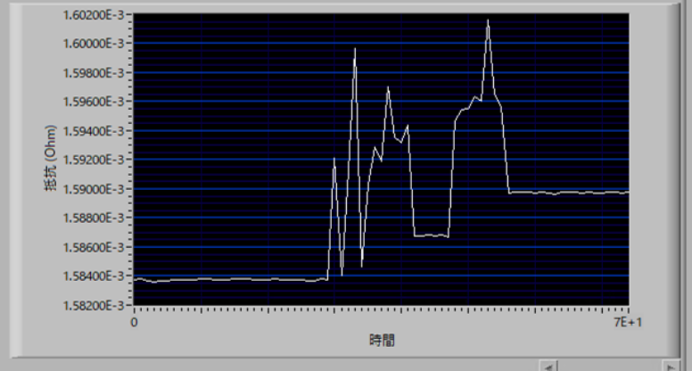
Improvement of samples
Wire sample with 125 μm diameter
V+
Nano-voltmeter
V-
2182A Keithley Inc.
Four point technique
Total thickness of AlN and Al plates:2.2 cm
I+
PC
Labview
Source:6221
I-
±100 mA
25 mm
Sample used in RCNP
Precision
±0.001μΩ @ 3 K
Beam loss permits less than 3 % of interaction length in area at M03.
1.2 cm for 120 GeV proton on Al.
W
Success to measure change of resistance.
Electrical resistance
This method will be applied to the FNAL expt.
J-PARC MR
6th Nov. 2019
Time
Four wire samples
Trend of electrical resistance with 30 GeV protons
Production method of four wire samples (Al, Fe, Cu, W) was established.

Slide 25
Outline
1. Introduction
2. DPA calculation method in high-energy region
3. Calculations of DPA cross sections and damage energy
4. Plan for DPA measurements using 120 GeV protons
5. Summary

Slide 26
Summary
Contribution of Coulomb scattering for proton + target increases with proton energy over 1 GeV.
Damage energy to the lattice atom ranges from around 50 keV to 5 MeV for high-energy proton irradiation over 1 GeV.
i.e. 29% at 100 GeV.
Production method of four wire samples (Al, Fe, Cu, W) was established for DPA cross section measurements with 120 GeV protons at FNAL.

Slide 27
Back-up

Slide 28
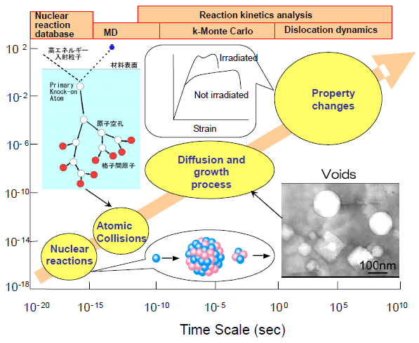
Scale on total irradiation effect
Nuclear reaction model
Molecular
Dynamics
K-Monte Carlo
Dislocation dynamics
Irradiated
Primary Knock-on Atom (PKA)
Not irradiated
Property changes
10⁻²
Interstitial atom
Strain
10⁻⁶
Vacancy
Diffusion and growth process
Size (m)
10⁻¹⁰
Atomic collisions
Voids
10⁻¹⁴
Nuclear reaction
10⁻¹⁸
10⁻²⁰
10⁻¹⁵
10⁻¹⁰
10⁻⁵
10⁰
10⁵
10¹⁰
Time (sec)
DPA focuses on primary damage.
Notes:
First, I’d like to show you scale on total irradiation effect.

Slide 29
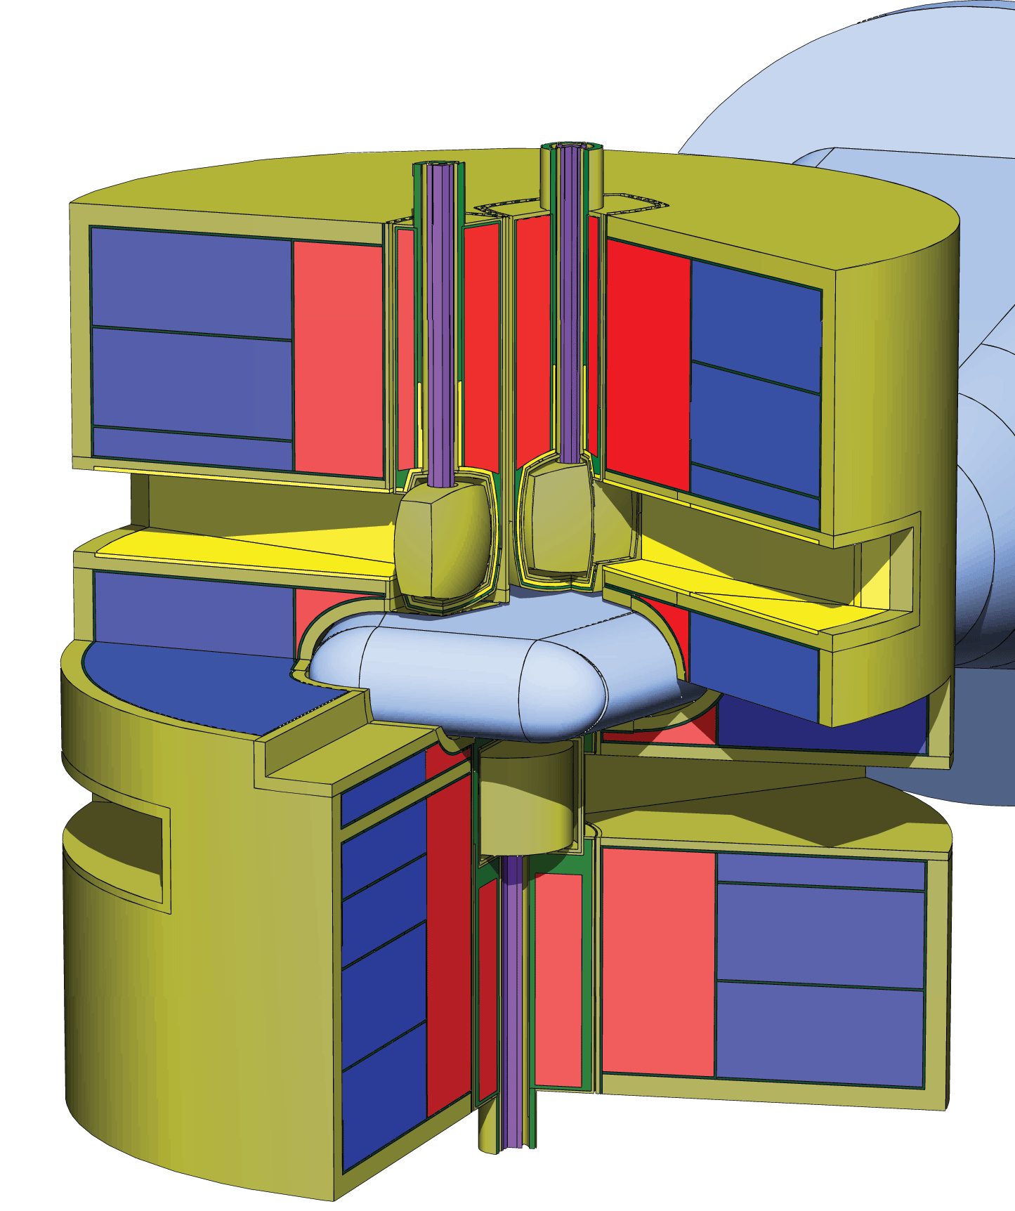
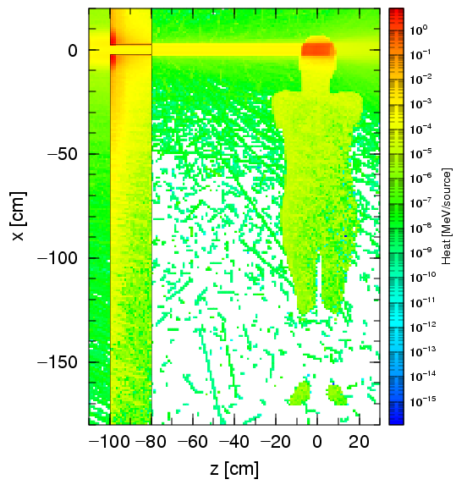

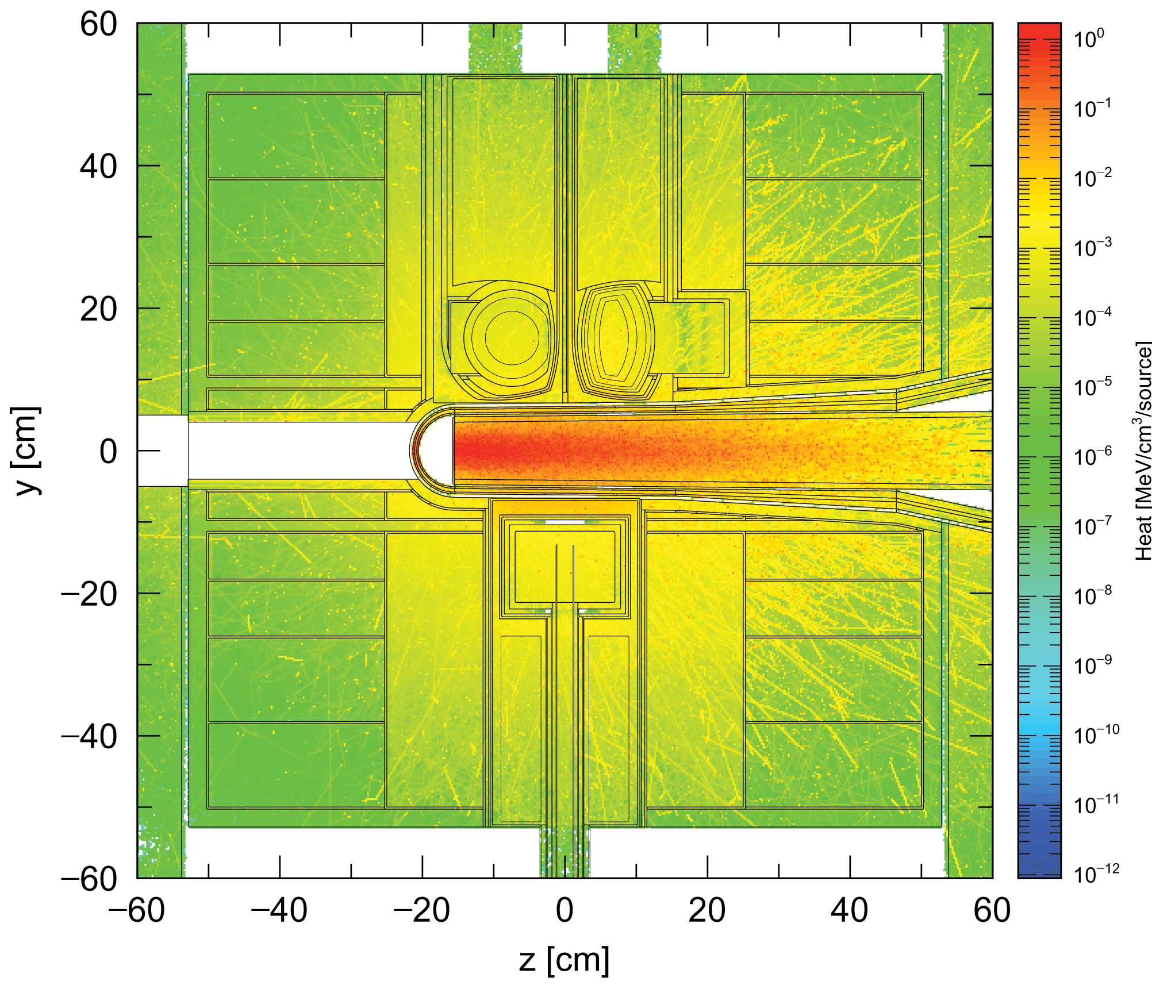

Overview of PHITS
Particle and Heavy Ion Transport code System
Development
JAEA (Japan), RIST (Japan), KEK (Japan), Technische Universitat Wien(Austria)
RIKEN (Japan), CEA (France), Kyushu Univ. (Japan)
Capability
Transport and collision of various particles over wide energy range
in 3D phase space
neutron, proton, meson, baryon electron, photon, heavy ions
up to 1 TeV/u
Application Fields
600
nSv/h
20
Accelerator Design
Radiation Therapy
Space Application
T. Sato et al., J. Nucl. Sci. Technol., 55 (2018) 684-695.

Slide 30


Proton energy dependency of damage energy for nuclear products
Damage energy for p+Cu
Damage energy for p+W
Damage energy of target nucleus (Cu, W) :10 keV – 100 keV.
Decreasing with proton energy.
Damage energy of nuclear reaction products:100 keV – MeV order.
Almost constant with proton energy.

