Slide 1
Development of ultrasonic meso-scale fatigue testing of irradiated titanium alloys for proton beam window applications
6th RaDIATE Collaboration Meeting
TRIUMF, Vancouver, Canada
Presenting Author: Phil Earp
University of Manchester / University of Oxford / Culham
Monday 9th December 2019
Jason Hess, Dr Jicheng Gong, Prof. Angus Wilkinson,
Dr Chris Densham, Dr Slava Kuksenko

Slide 2
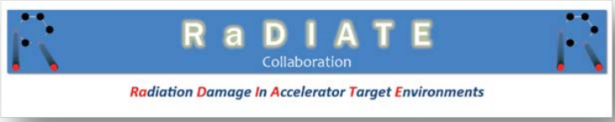



Outline
T2K Neutrino Experiment
  Proton Beam Window
  High Cycle Fatigue
  Radiation Damage
Scientific Question
Experimental Plan
  Ultrasonic Meso-Fatigue Testing
  Radioactive Samples at the Culham Science Centre, UK
UFR Development at Culham MRF

Slide 3
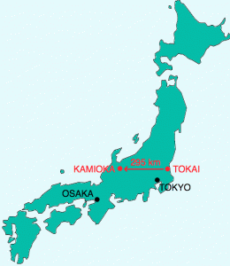
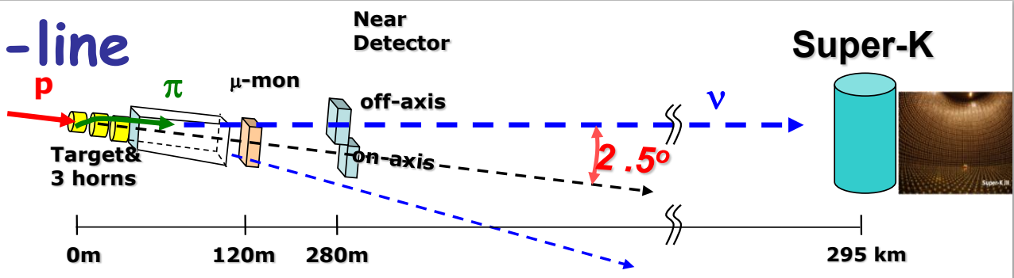
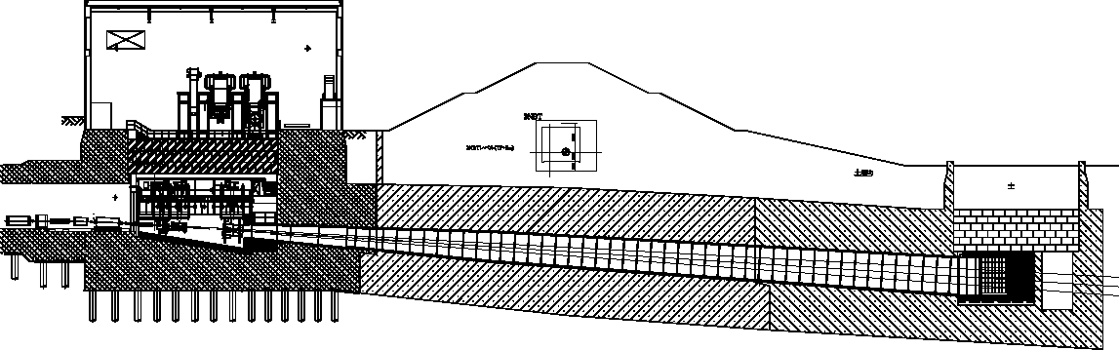
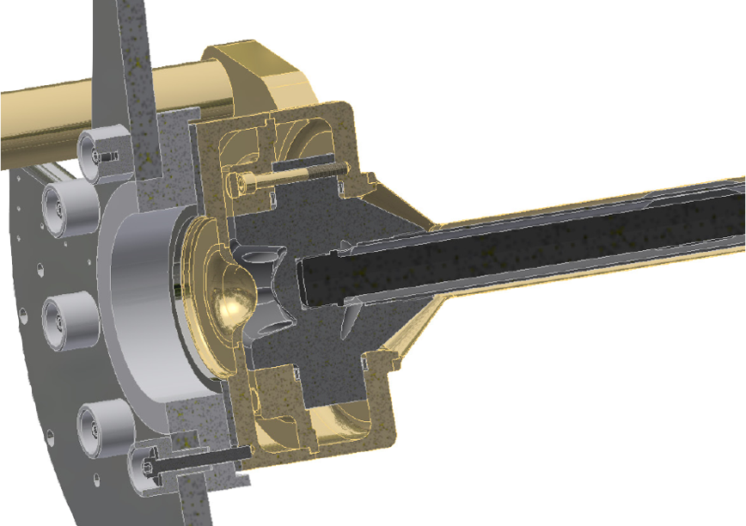


T2K Neutrino Experiment
SOURCE
DETECTOR
Chris Densham, STFC (2010 Presentation)
https://t2k-experiment.org/t2k/
Helium Vessel
L=110m, V=1,500m³
Graphite
Target Station
Pions
Beam Dump
Decay Volume
OA
2º
2.5º
[3º]
Outer tube / beam window (Ti6Al4V)
T. Ishida et al., J-PARC Accelerator, Japan (2019 Presentation)
Proton Beam
Pulsed Proton Beam
30 GeV Energy
750 kW Beam Power
$3.3×{10}^{14}$ protons per pulse
T. Ishida et al., J-PARC Accelerator, Japan (2019 Presentation)

Slide 4
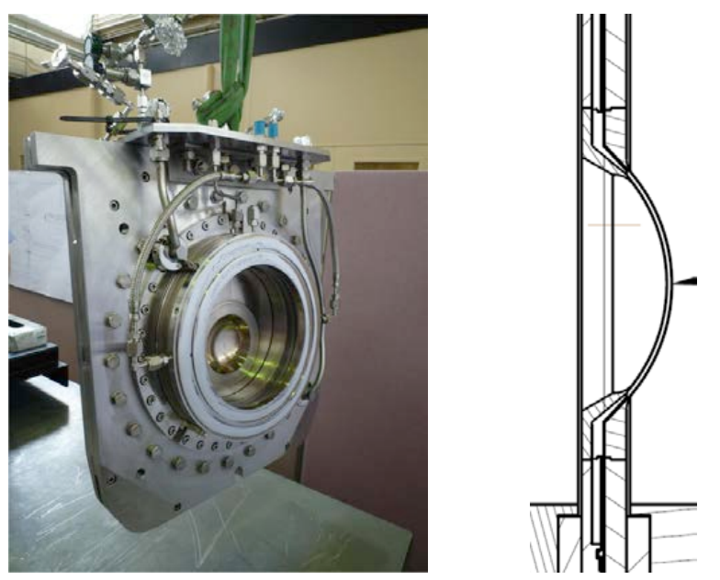
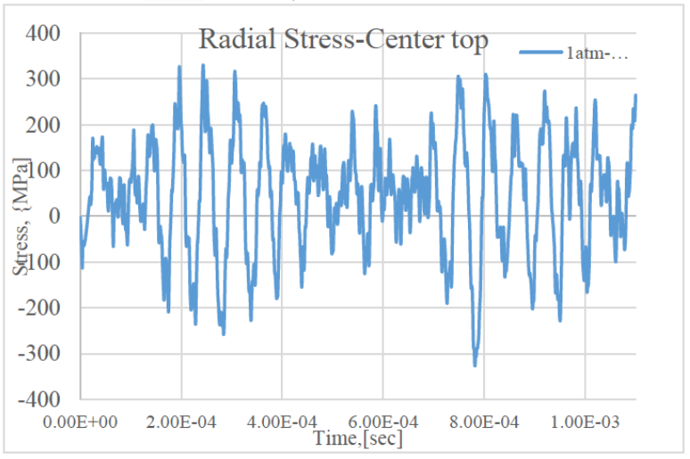
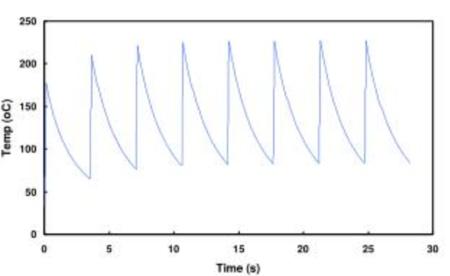


Proton Beam Window
8$×$ 58 ns bunches per pulse
Pulse length ~ 5 $μ$s
Delay of ~ 2 s
Each pulse causes local heating spikes of ~150 degrees C
Thermal shock wave rings through material
Kavin Ammigan (Fermilab) (2017 Presentation)
Rapid thermal shock
Stress waves ‘Ringing’ – typically 150 MPa amplitude
Graphs from Matt Rooney, STFC (2006 Presentation)

Slide 5
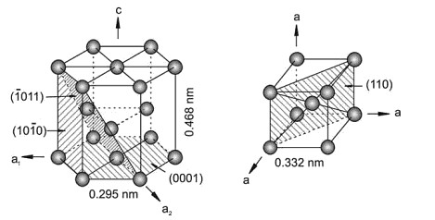
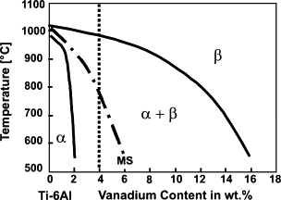

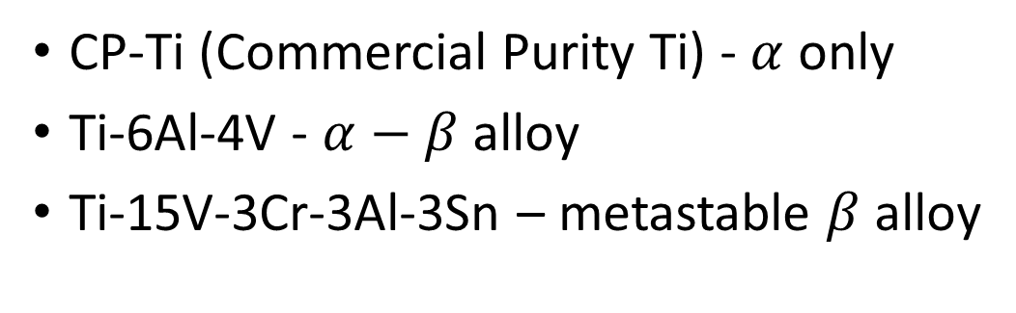


Titanium Alloys
$β$-phase (bcc)
Vanadium is a $β$-stabiliser
$α$-phase (hcp)
Zheng, Yufeng. (2013). Thesis - Nucleation mechanisms of refined alpha microstructure in beta titanium alloys.
High specific strength
Relatively low thermal expansion coefficient
Titanium and Titanium Alloys
Wiley-VCH, Weinheim (2003)
  Good cold formability
CP-Ti (Commercial Purity Ti) - $α$ only
Ti-6Al-4V - $α−β$ alloy
Ti-15V-3Cr-3Al-3Sn – metastable $β$ alloy
  Typical commercial alloy
  ELI – Extra Low Interstitials
  Good cold formability

Slide 6
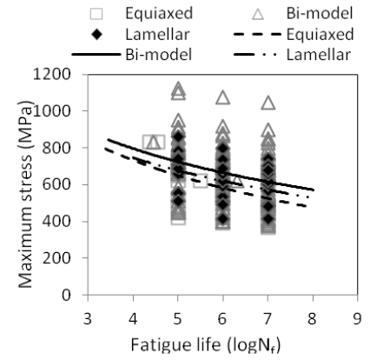
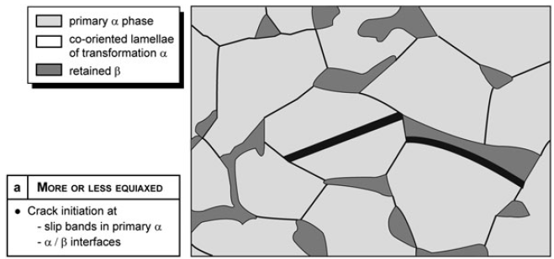
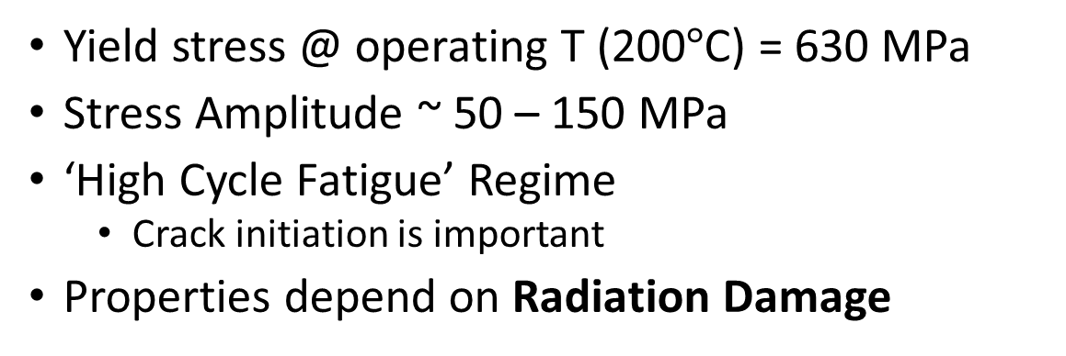
High Cycle Fatigue of Ti-6Al-4V
Yield stress @ operating T (200$°$C) = 630 MPa
Stress Amplitude ~ 50 – 150 MPa
‘High Cycle Fatigue’ Regime
  Crack initiation is important
Properties depend on Radiation Damage
Wu, G.Q., Shi, C.L., Sha, W., Sha, A.X., Jiang, H.R., Effect of microstructure on thefatigue properties of Ti-6Al-4V titanium alloys, Materials and Design (2012), doi: http://dx.doi.org/10.1016/j.matdes.2012.10.059
Fatigue of Beta Processed and Beta Heat Treated Titanium Alloys
Wanhill & Barter, (Springer, 2012)

Slide 7
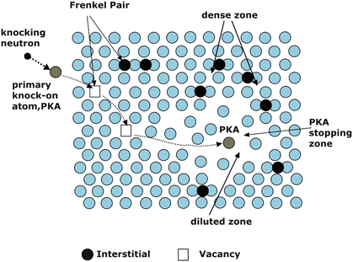
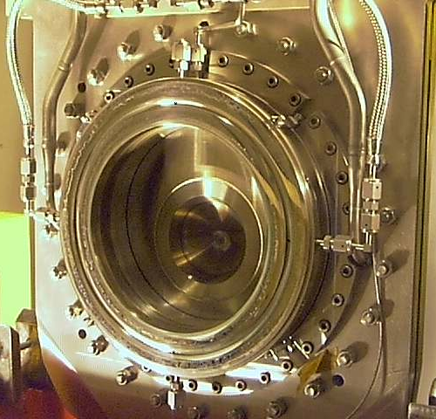
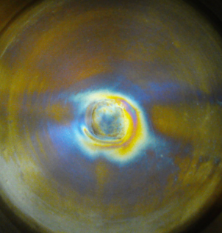
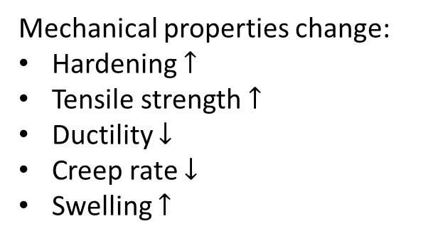
Radiation Damage
Incomingproton
Proton beam interacts with material
Radiation damage accumulates
T. Ishida et al.
Hoffelner W. (2015) Irradiation Damage in Nuclear Power Plants
Mechanism for high-energy protons?
Microstructural changes:
Dislocation loops
Dissolution of precipitates
Void formation
Neutron irradiation – data exist up to 0.3 dpa
Proton irradiation
V. high dose rate
Radionuclide generation
  H & He gas → interstitials or bubbles
>1 dpa per year!
Mechanical properties change:
Hardening $↑$
Tensile strength $↑$
Ductility $↓$
Creep rate $↓$
Swelling $↑$

Slide 8
Scientific Question
“What is the effect of proton irradiation on the high-cycle fatigue behaviour of the Ti-6Al-4V alloy?”
This allows STFC (beam window manufacturer) to predict the component lifetime:
“After how long should the beam window be replaced?”
“Are there more suitable alloys for this purpose?”

Slide 9


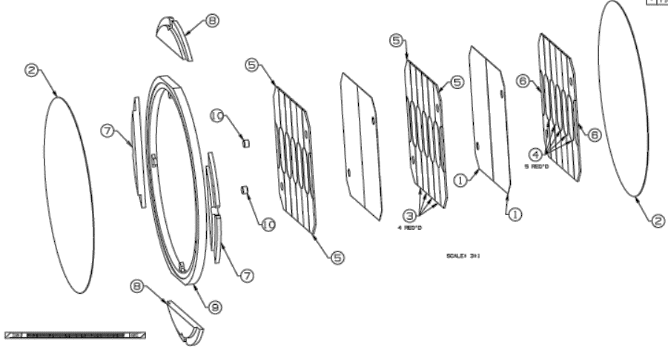
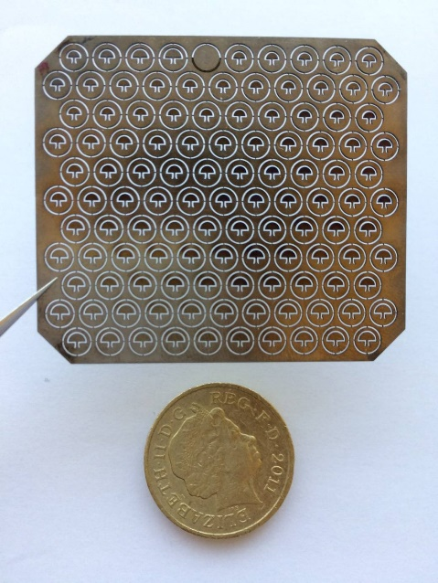
Experimental Plan
BLIP – Brookhaven Linac
Isotope Producer
Irradiation in medical isotope production factility
Specimens manufactured
Ti-6Al-4V
T2K Material
4x Candidate
Grades
HCF Testing
Change in fatigue life with irradiation
Microstructural investigation
Post-test fractography
Optical Microscopy
EBSD – Grain size, texture
EDX – Chemistry
Nanoindentation Hardness Measurement
Hardness change after irradiation
Compare candidate alloys

Slide 10
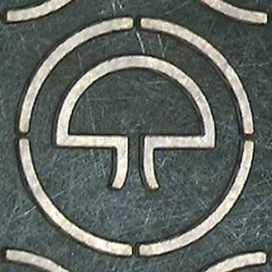
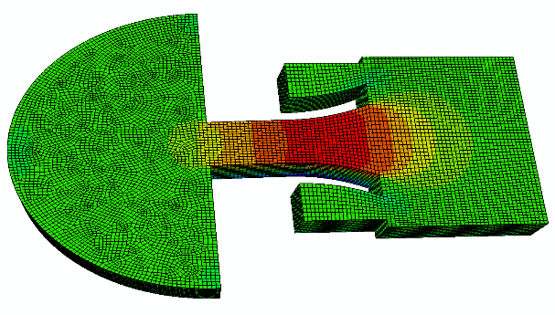
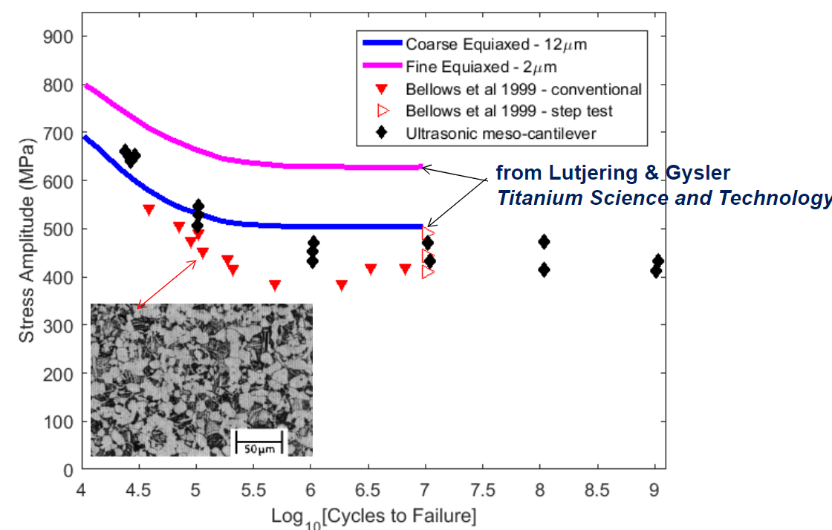
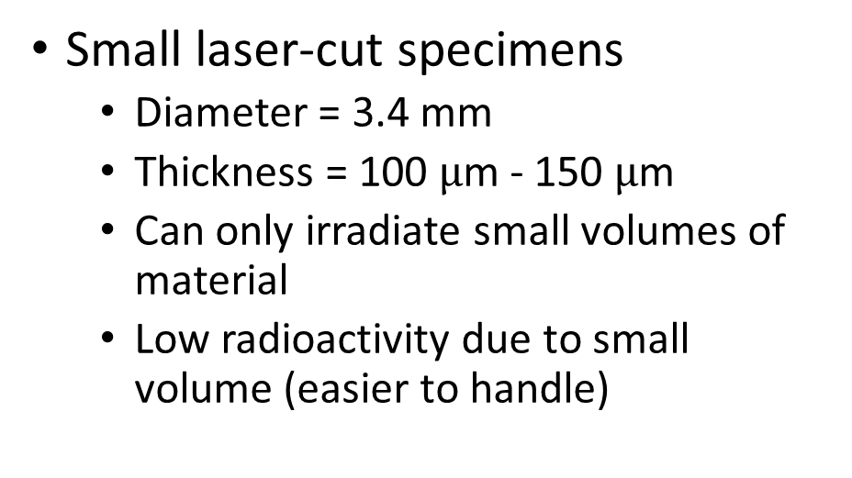
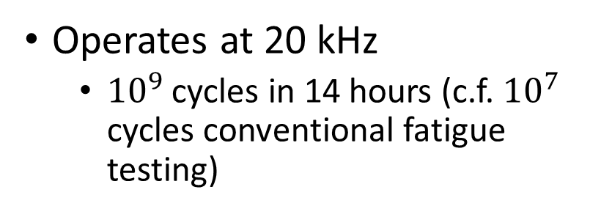
Ultrasonic Meso-Fatigue
Operates at 20 kHz
  ${10}^{9}$ cycles in 14 hours (c.f. ${10}^{7}$ cycles conventional fatigue testing)
Von Mises Stress
Small laser-cut specimens
  Diameter = 3.4 mm
  Thickness = 100 $μ$m - 150 $μ$m
  Can only irradiate small volumes of material
  Low radioactivity due to small volume (easier to handle)
Jicheng Gong et al. (2017 Presentation)

Slide 11
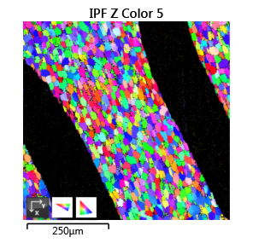
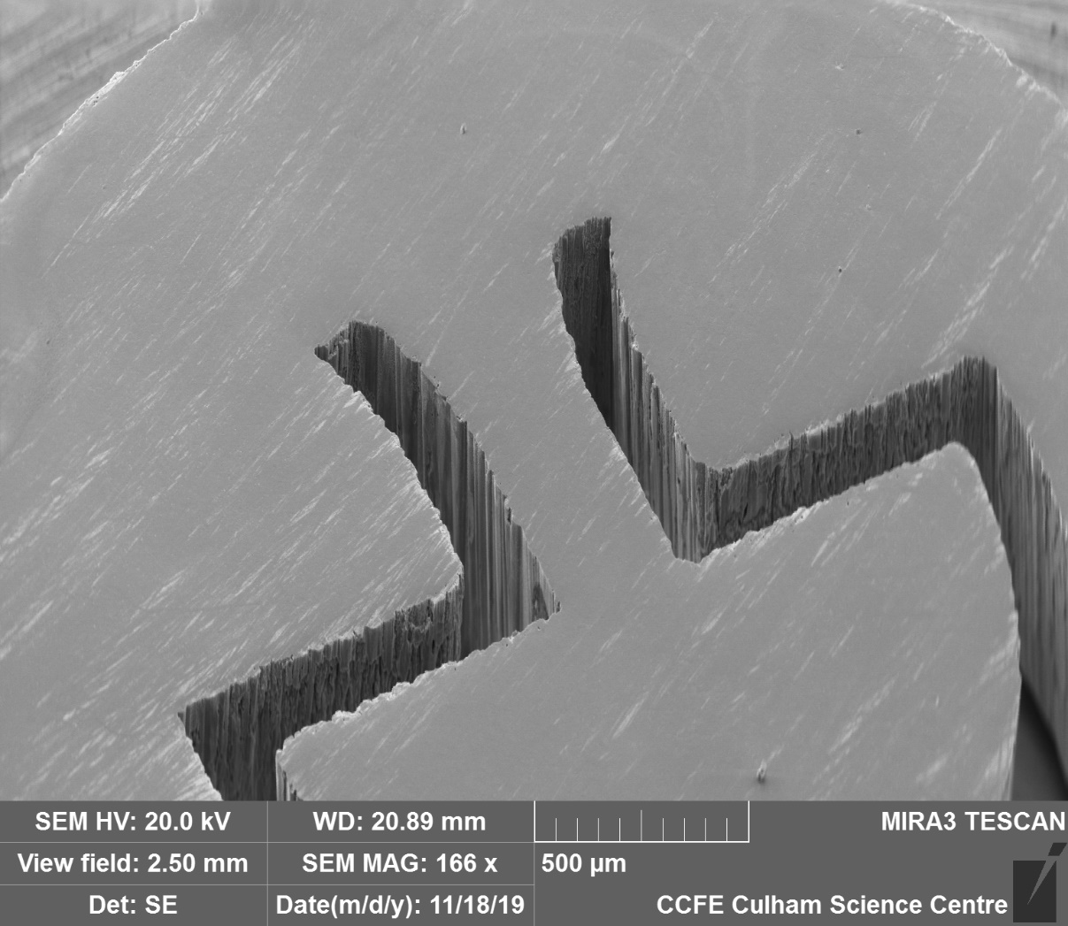
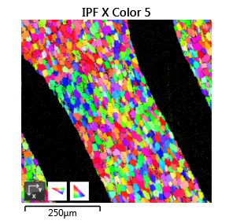
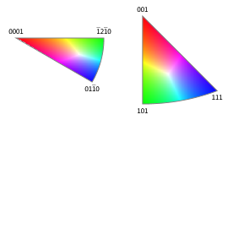
Microstructural analysis

Slide 12
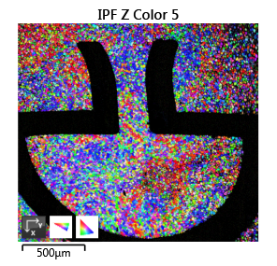
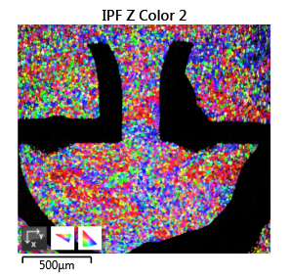
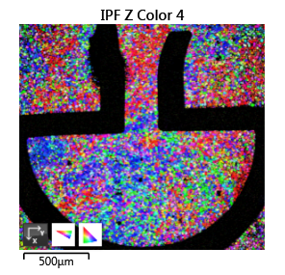
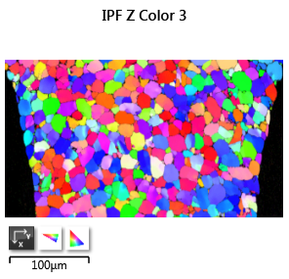
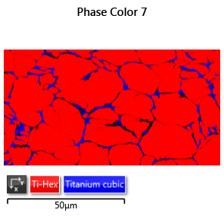
Microstructural analysis
#001
#115
#106
#058

Slide 13
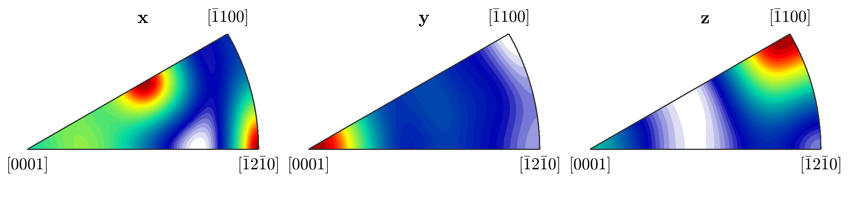
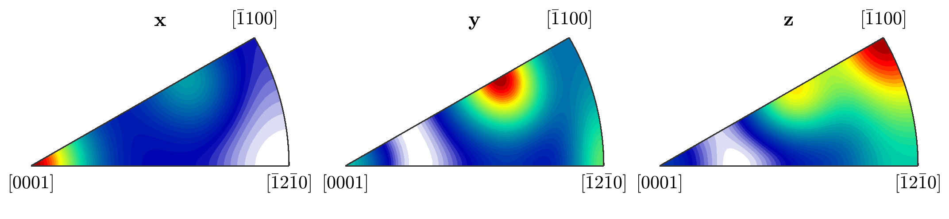
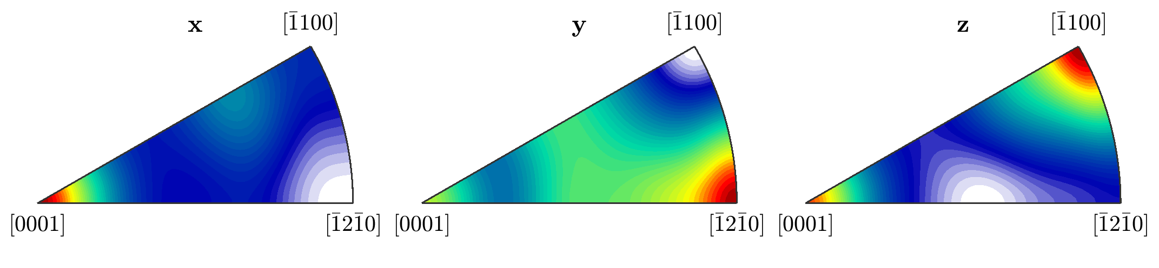
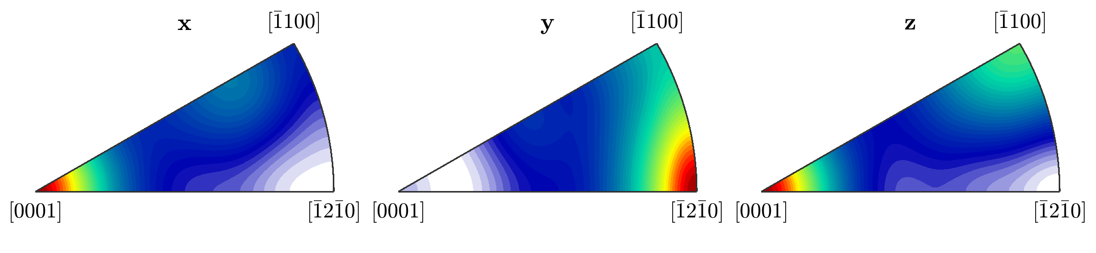
Microstructural analysis (2)
y
x
z
#001
DOUBLE CHECK ORIENTATIONS
#058
#106
#115

Slide 14
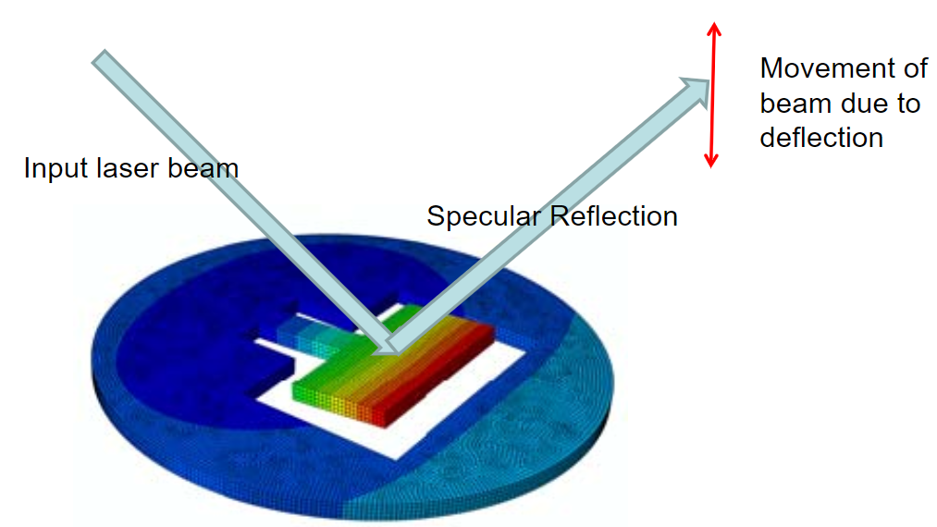
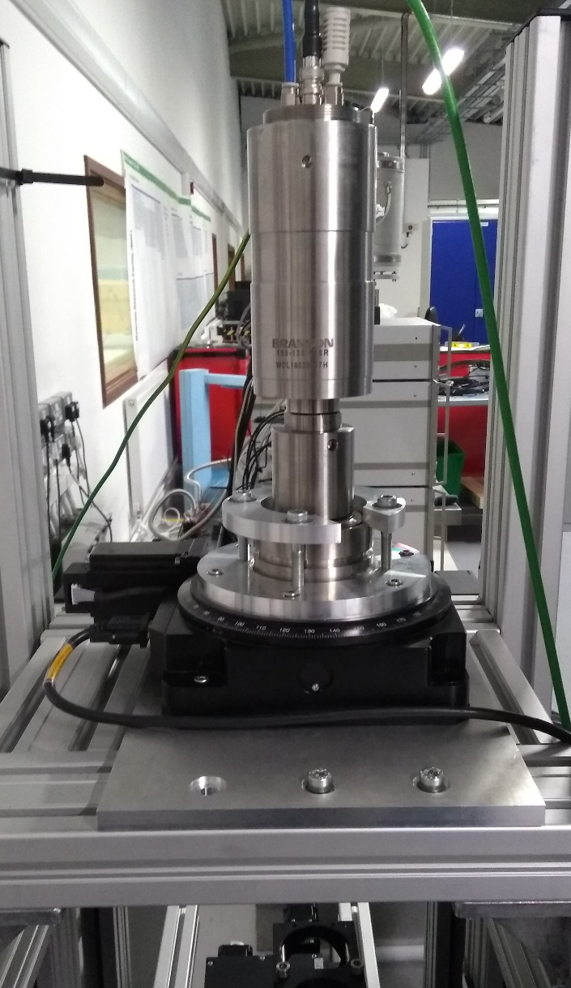
Ultrasonic Meso-Fatigue
Measure cantilever deflection with laser reflection
Jicheng Gong et al. (2017 Presentation)
To accept radioactive specimens
  Remote specimen mounting
  Optics to detect laser position – cannot be observed directly by operator

Slide 15


Experimental Challenges
?
Remote Handling Capability
$$θ$$
?
Sample contained after failure
!
Incoming laser at normal incidence
Specimen
?
Laser Detector
$$2θ$$
Transparent Window
?
Detect large specimen deflections
?
Sample at 100 kHz
Laser
Optics
Detector
?
Angular beam deflection → linear motion on detector
?
Large spot size on detector
?
Specimen Mounting
Detector
?
Small spot size on specimen

Slide 16
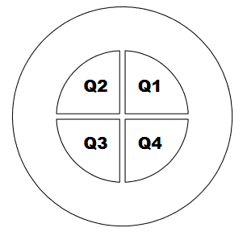
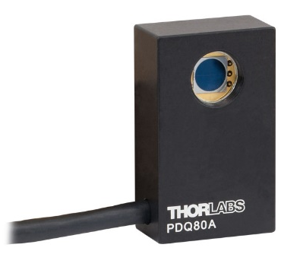
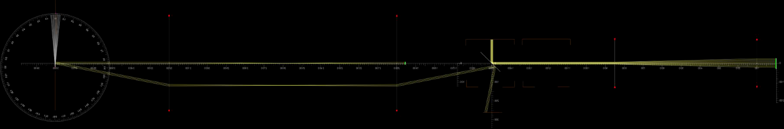
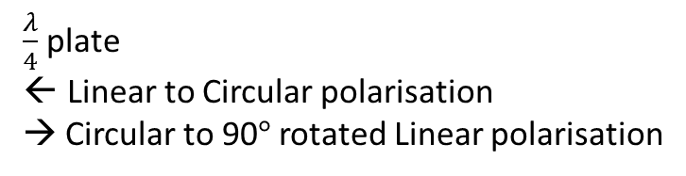
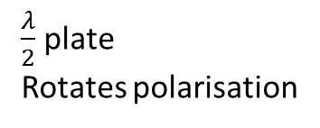
Proposed solution
Polarising Beamsplitters
Alignment Camera
‘4f lenses’
Beam
Diameter Reduction
Specimen
Laser
$\frac{λ}{4}$ plate
Linear to Circular polarisation
→ Circular to 90$°$ rotated Linear polarisation
Beam stop
$\frac{λ}{2}$ plate
Rotates polarisation
Linear Polariser
Quadrant Photodiode Detector
Specimen
Lenses
Beamsplitter
Laser
Detector

Slide 17
Commissioning
Hardware
Optics mounted on 6-axis translation stage for alignment
Cooling air provided for extended ultrasonic use
Remote controlled camera & specimen illumination
Optics
Design, Prototype and Test
Alignment procedure
Calibrate
Assess sensitivity of detector
Software and UI
Data logging and real-time processing
Diagnostics
Implemented in LabView
Use of Fourier Transform to assess changes in oscillation

Slide 18
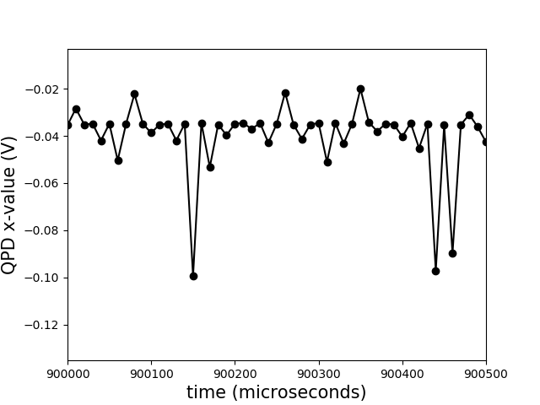
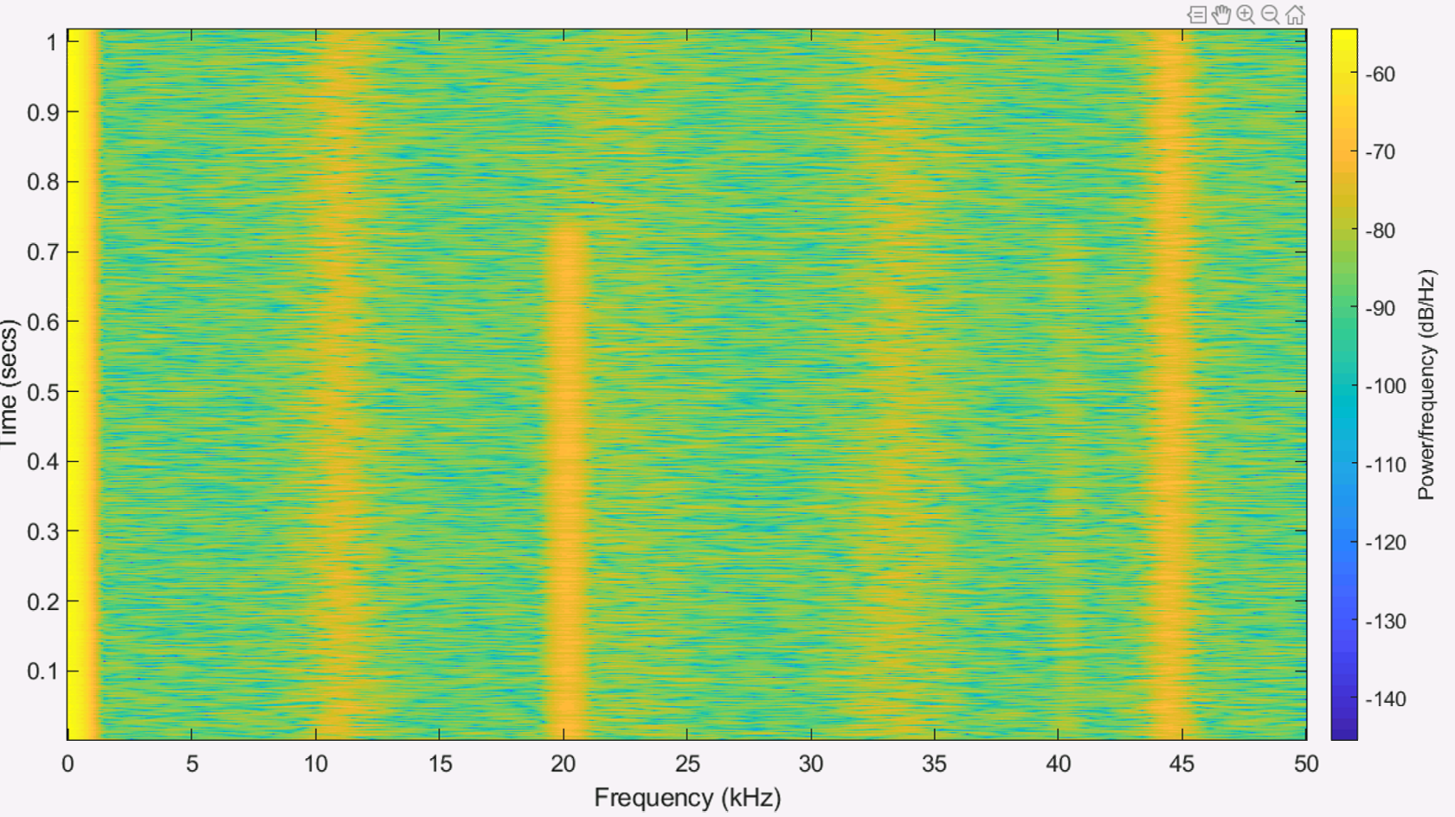
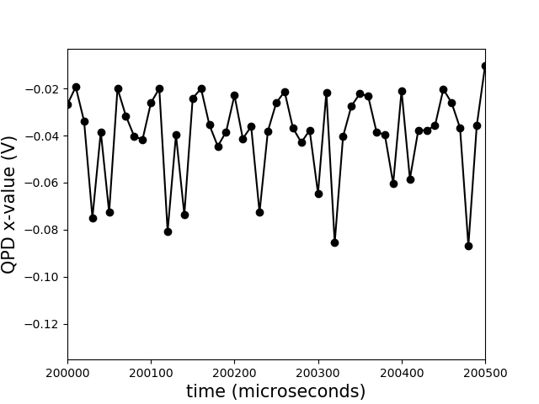
Raw Data
Ultrasound OFF
20 kHz
Ultrasound ON
Time (s)
Frequency (kHz)

Slide 19
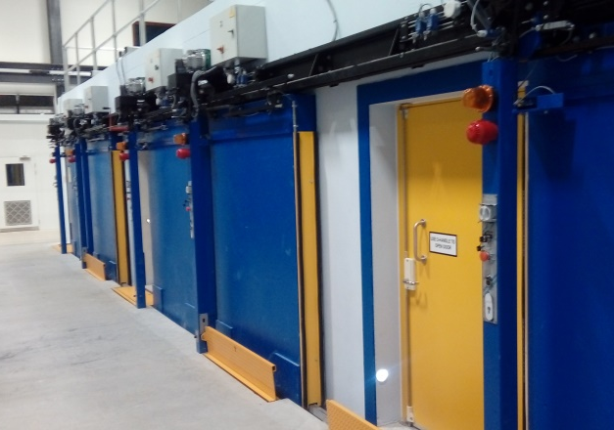
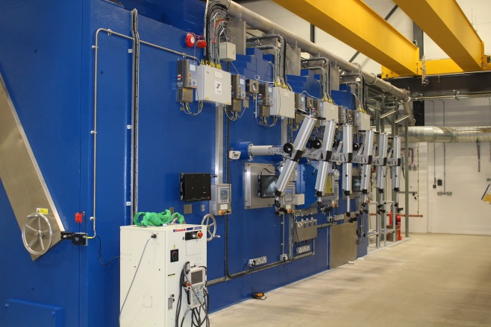

Integration into the MRF
Research rooms
(Contain instruments)
Hot Cells (Active sample preparation)
SEM inside Research Room 3
Remote handling robot on left

Slide 20
Summary
Ti-6Al-4V beam window operates in challenging environment
  High Cycle Fatigue (HCF) from thermal spikes
  Radiation damage from proton irradiation may alter mechanical properties
Specimens of Ti Alloys irradiated in proton beam
Ultrasonic meso-fatigue testing will identify radiation-induced changes to HCF life
Ultrasonic Fatigue Rig (UFR) with continuous amplitude (stress) measurement of amplitude at 20 kHz developed at the Materials Research Facility (MRF) at Culham

Slide 21
Thank you for your attention
Any questions?
Phil Earp
Monday 9th December 2019

