Slide 1

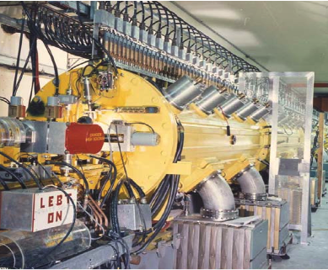
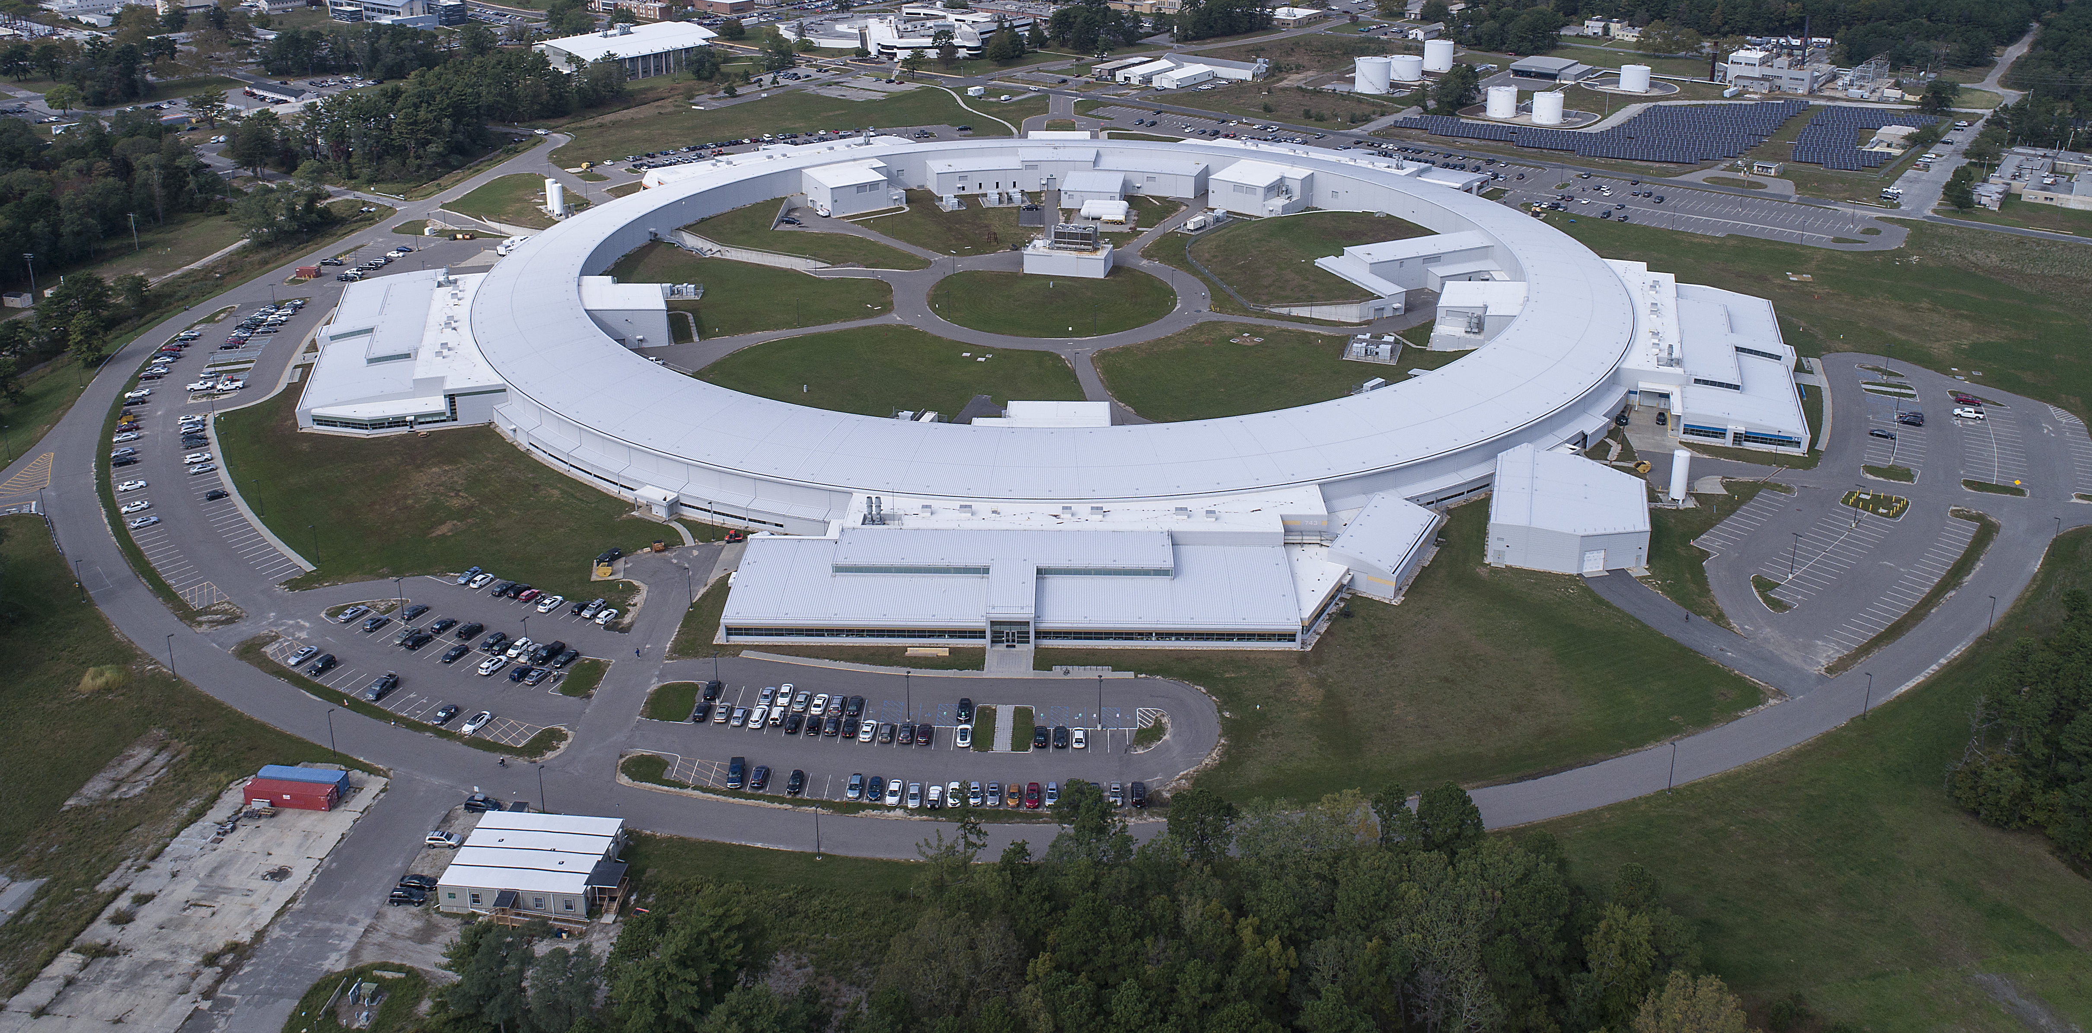
Phase Evolution in
Proton-irradiated (α+β) Ti6Al4V
N. Simos (BNL), D. Sprouster (BNL, Stony Brook U.), M. Palmer (BNL),
N. Charitonidis (CERN), K. McDonald (Princeton U.),
and Z. Kotsina (National Centre of Scientific Research “Demokritos”, Athens)
Brookhaven Linac Isotope
Producer
NSLS-II

Slide 2
Overview
(α+β) Ti6Al4V considered in Neutrino Factory-Muon Collider (mid-Z material)
  Irradiation:
    With protons at BNL-BLIP in two (2) phases to ~5×10²⁰ p/cm² (total)
    Post-irradiation annealing between phases
  Post-irradiation thermal analysis (precision dilatometry) and mechanical testing:
    Thermal analysis to ~810 ºC revealed phase transitions and the effects of irradiation in shifting the temperature ranges for the transitions
    Mechanical testing revealed
      Loss of ductility
      More significantly a almost complete loss of UNIFORM ELONGATION
  Energy Dispersive X-ray Diffraction with in-situ pure bending stress at NSLS synchrotron revealed:
    The appearance of a faint new phase that looks like the ω phase
    Symmetries between tension and compression
  XRD experiments at NSLS-II with in-situ pure bending stress state combined with Refined Rietveld analysis showed:
    Fluctuations between α and β phases as a result of the level of straining
    Further evidence that the ω phase in <10nm size has formed as a result of irradiation

Slide 3
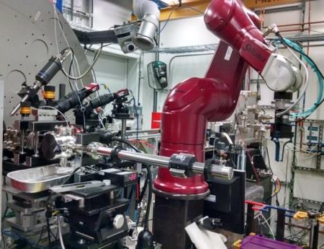
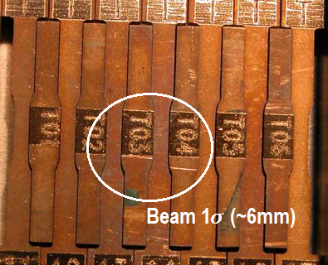
Ti6Al4V Irradiation Experiments
Phase-I: 140 MeV protons at BLIP
  Peak fluence of ~ 1.1×10²⁰ p/cm²
Phase-II: Selected samples from the array were re-irradiated following thermal analysis
between irradiations.
  CTE Samples: Peak fluence of ~2.6×10²⁰ p/cm² following 2nd irradiation
  (Samples: T02 and T04)
  TENSILE samples: Peak fluence of ~5.14×10²⁰ p/cm² after 2nd irradiation
Post-irradiation Analyses:
  Thermal analysis (dilatometry) on CTE type specimens
  Mechanical testing (tensile fracture)
  EDXRD analysis (NSLS) with 200 keV polychromatic X-rays
    In-situ 4-point bending (pure bending stress)
  XRD analysis with 67 keV monochromatic X-rays (NSLS-II XPD beamline)
    Also with in-situ 4-point bending stress
  Refined Rietveld analysis for phase ID

Slide 4
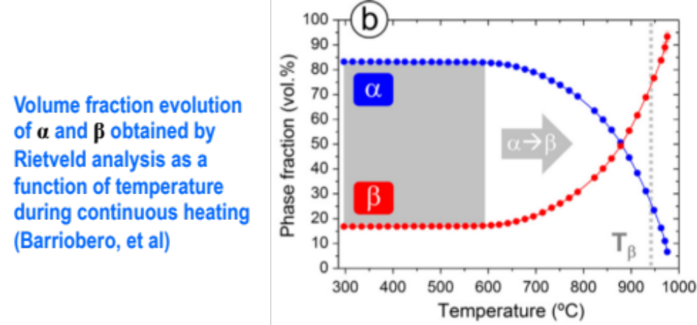
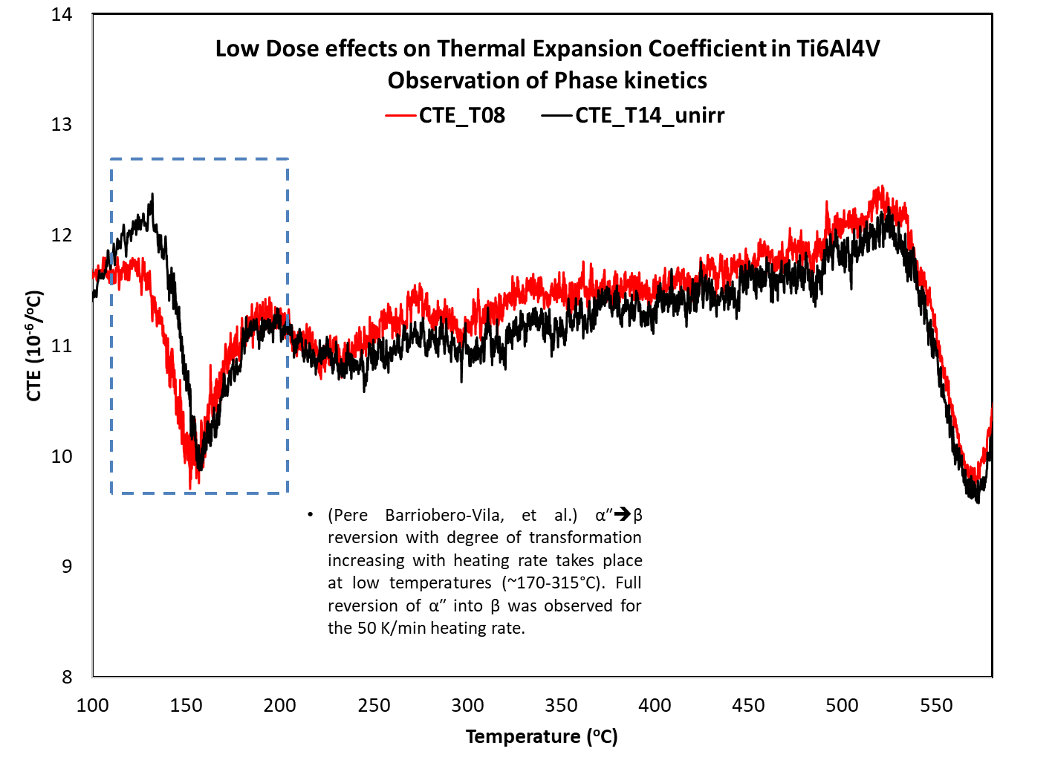
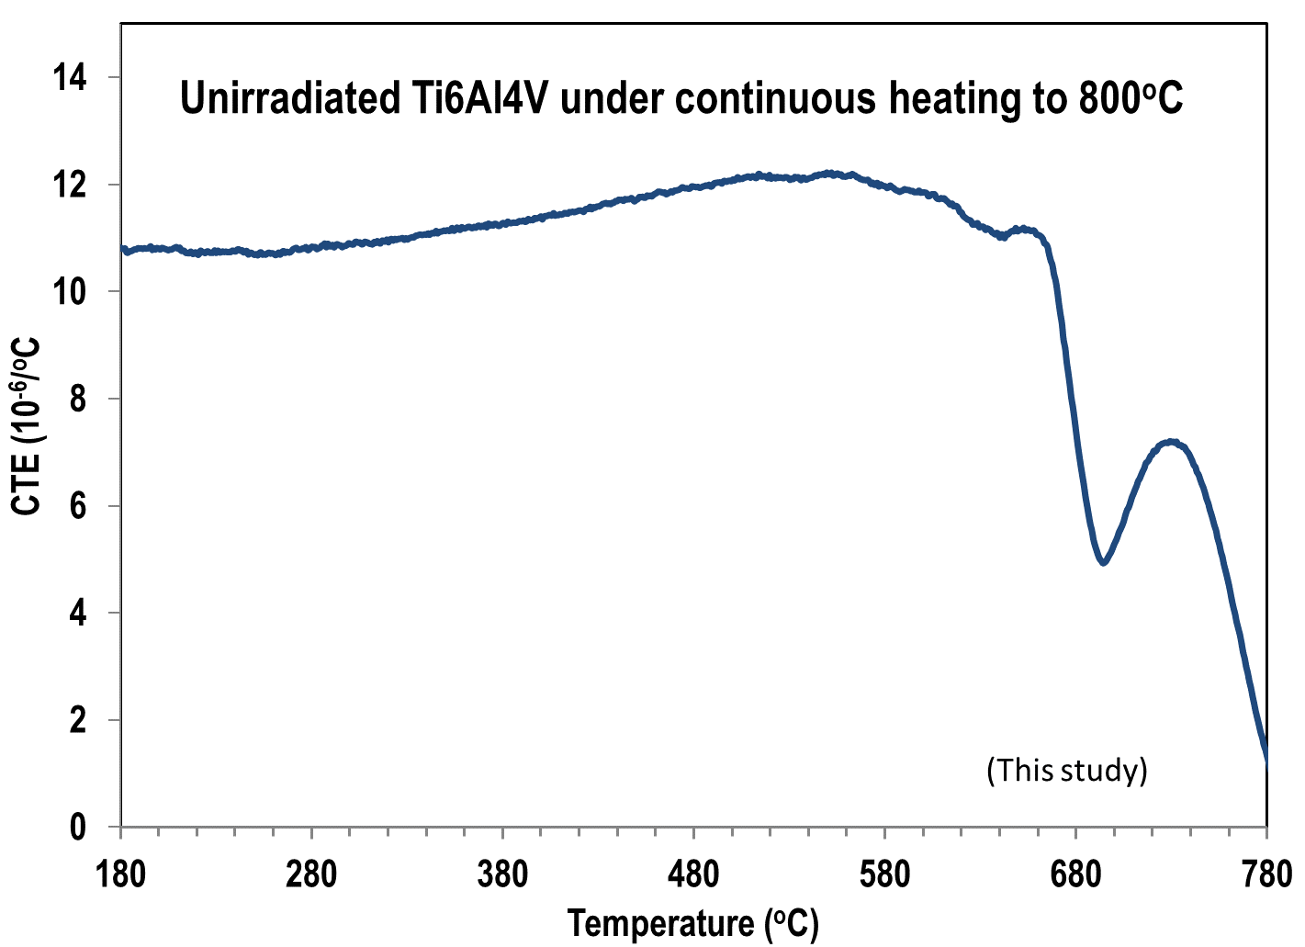
Phase Transformation Kinetics
Linear Heating of (α+β) Ti6Al4V
Dilatometry-based Study
Several studies have studied the kinetics of unirradiated Ti6Al4:
[Dilatometry, Differential Scanning Calorimetry, and HEXRD (Rietveld)]
  Pere Barriobero-Vila, et al.
    “Role of element partitioning on the α-β phase transformation kinetics of a bi-modal Ti-6Al-6V-2Sn alloy during continuous heating”, J. of Alloys and Compounds, 626 (2015), 330-339
    “Phase transformation kinetics during continuous heating of a b-quenched Ti–10V–2Fe–3Al alloy,” J Mater Sci (2015) 50:1412–1426
  P. Homporova et al.
    “Dynamic phase evolution in titanium alloy Ti6Al4V
BNL Study
  Observe the effect of proton irradiation on the
  phase transformations observed through heating
    α” a β at low temperatures
    α a β at high temperatures
    Possible indication of radiation-induced ω phase
  Additional transformation kinetics:
    A fast athermal α″aβ reversion
      Degree of transformation increases with heating rate
      Takes place at low temperatures ~170-315°C
      Full reversion of α″ into β observed for 50 K/min heating
    Ti alloys:
      ω phase forms from β via:
        Quenching from β field
        During isothermal aging of β metastable phase at
        low temperatures (< 500 ºC)
The of α” ➔ β at low temperatures and the α ➔ β at high temperatures are observed in this study using precision dilatometry (see above). Also shown is the low dose irradiation effect on the α” ➔ β.

Slide 5
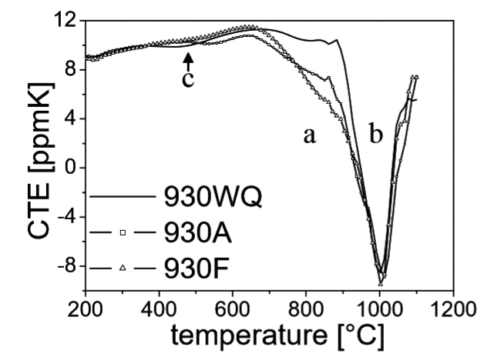
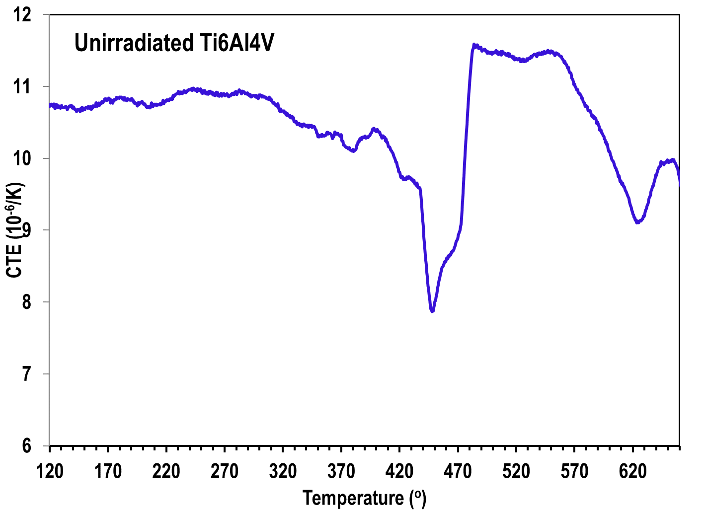
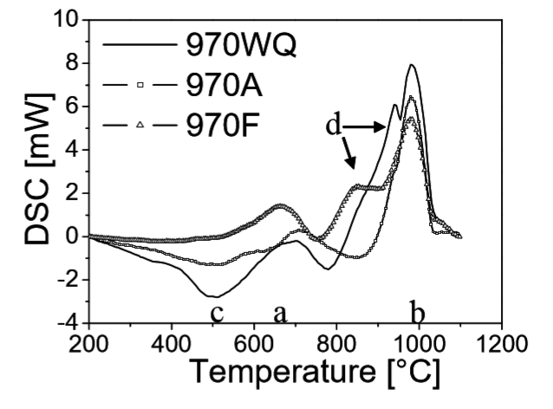
Phase Transformation Kinetics 2
Linear Heating of (α+β) Ti6Al4V
Dilatometry-based Study
Phase transformations
  Detectable retardation of CTE
Phase transformations
  α a β identified by endothermic peaks
  Martensite a β+α produces an exothermic peak
Homporova et al. correlated dilatometry
and DSC in unirradiated Ti6Al4V
αaβ
BNL Study
Martensite a β+α
BNL Study

Slide 6
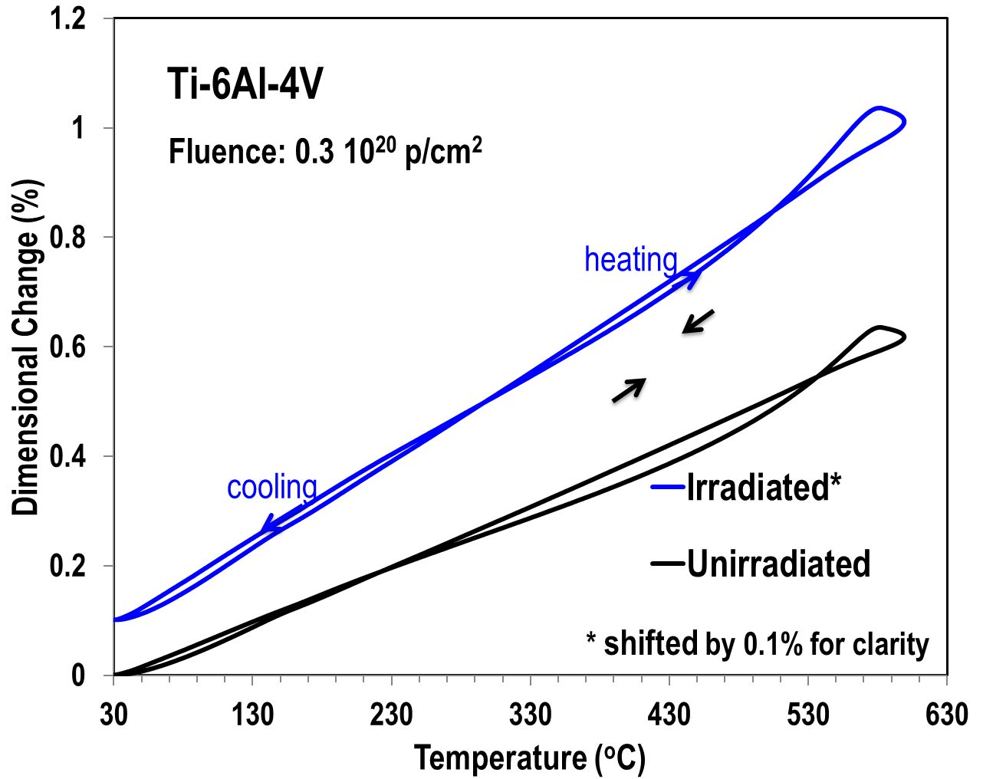
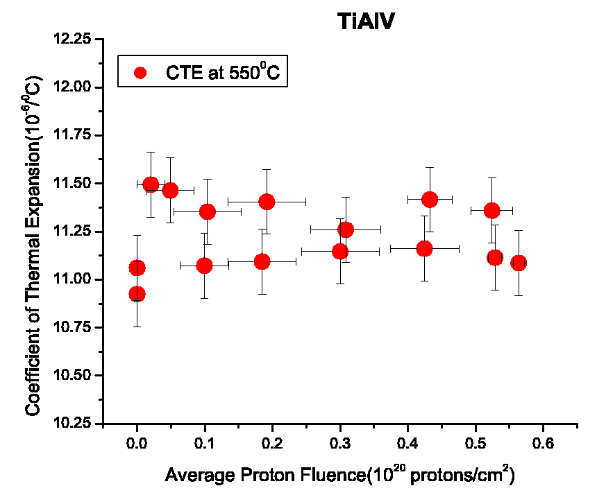
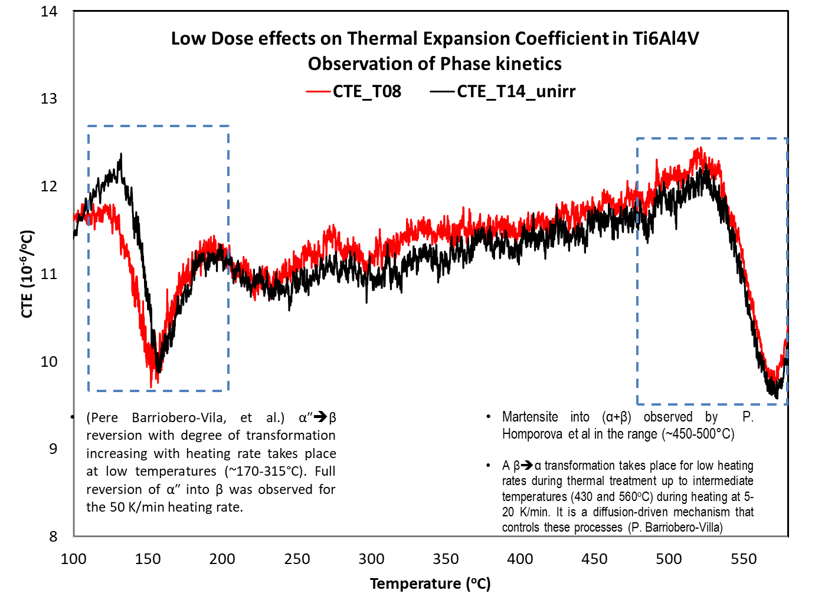
Ti6Al4V: Irradiation Studies
Variation of CTE with fluence at 550ºC (BNL study)

Slide 7
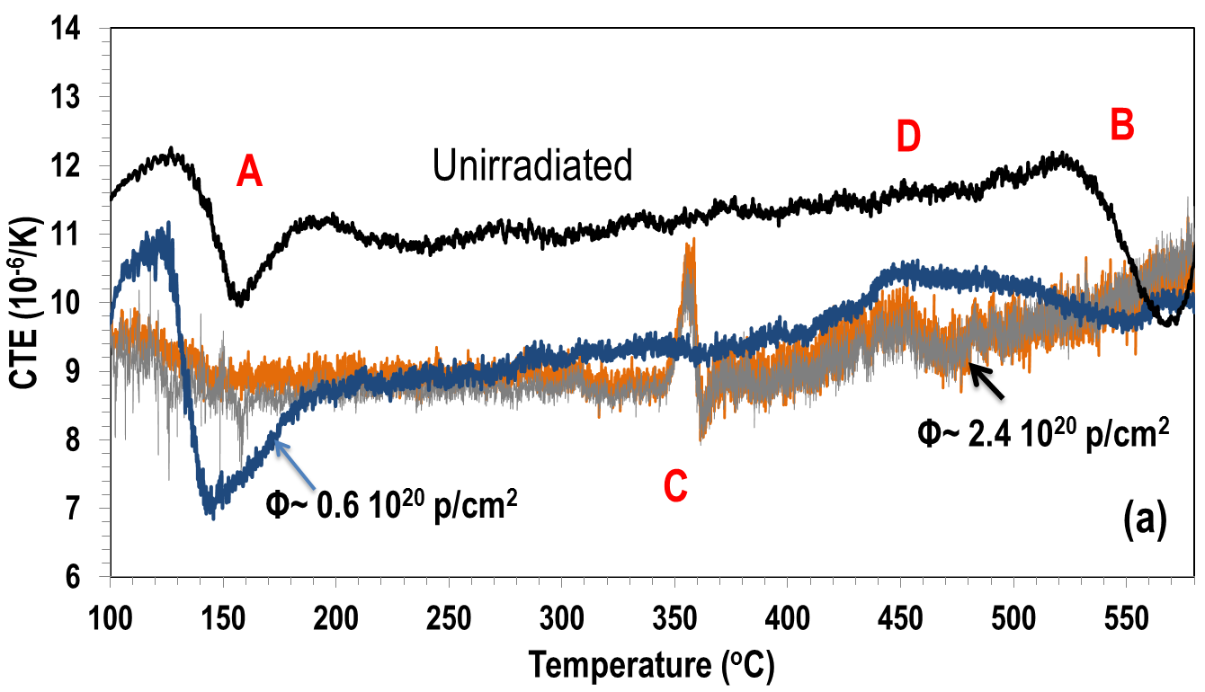
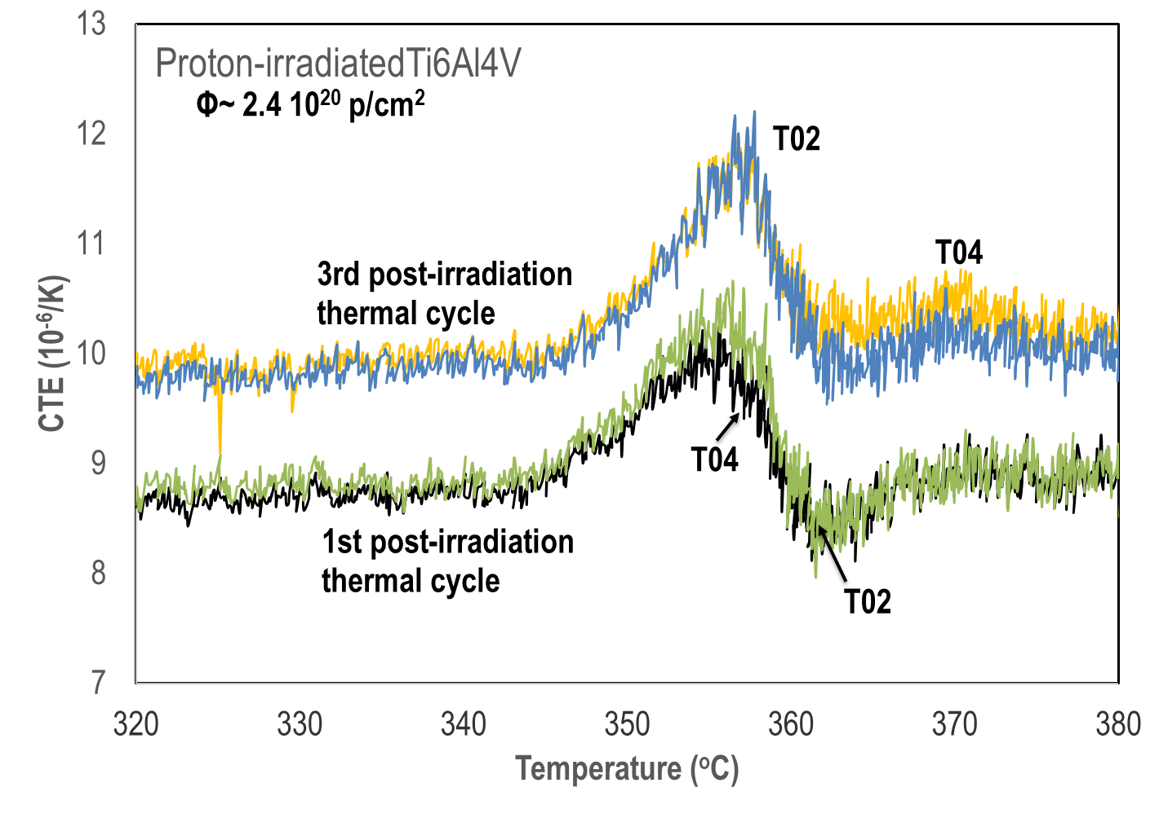
Ti6Al4V: Irradiation Damage Effects
Phase Transformation Kinetics
Higher dose samples were re-irradiated to 2.4×10²⁰ p/cm²
Sample with 0.6×10²⁰ p/cm² shown has undergone several thermal cycles of annealing
Post-irradiation heating to only 600ºC
IMPORTANT OBSERVATIONS:
At C: New transformation seen for 2 different samples irradiated to 2.4×10²⁰ p/cm²
  Peak is exothermic indicating martensitic transformation
  Transformation seems to appear above a threshold fluence - location and occurrence not impacted by thermal cycling!!!
  Recall: Ti-02 and Ti-04 CTE samples thermally annealed between irradiations
At A: α″aβ takes place (as discussed previously)
  Very faint evidence after irradiation to 2.4×10²⁰ p/cm²
At D: Local minima of the α_{β} observed in 430-530ºC range
  5ºC/min
  Rietveld analysis
  αaβ transition observed at ~550ºC (unirradiated) apparently shifts to lower temperature as a result of irradiation (D location)

Slide 8
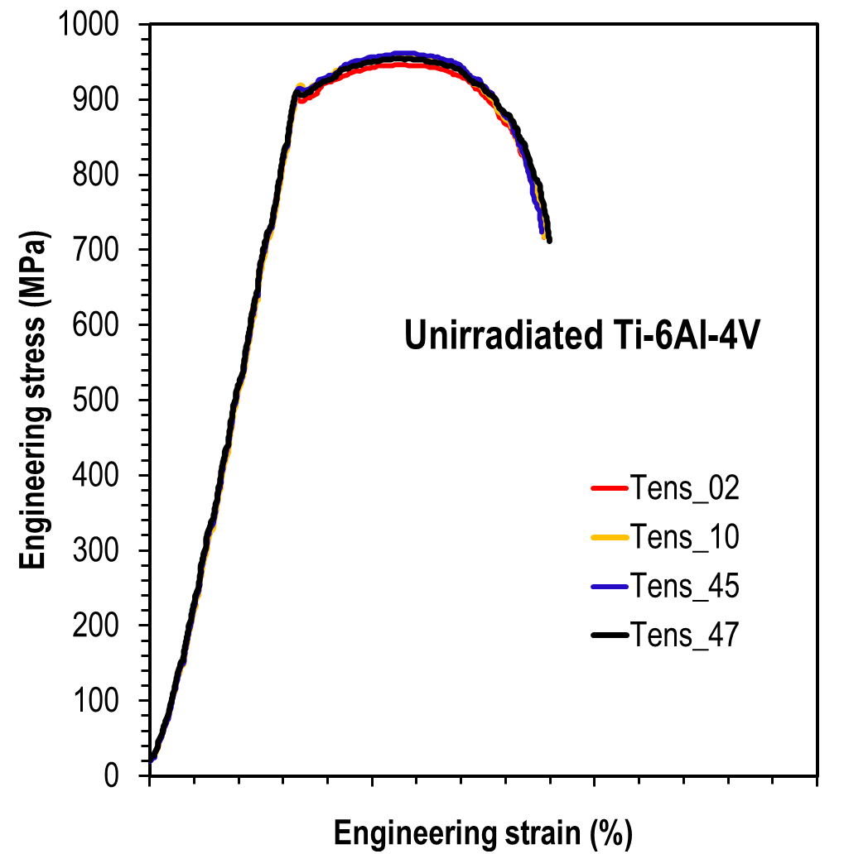
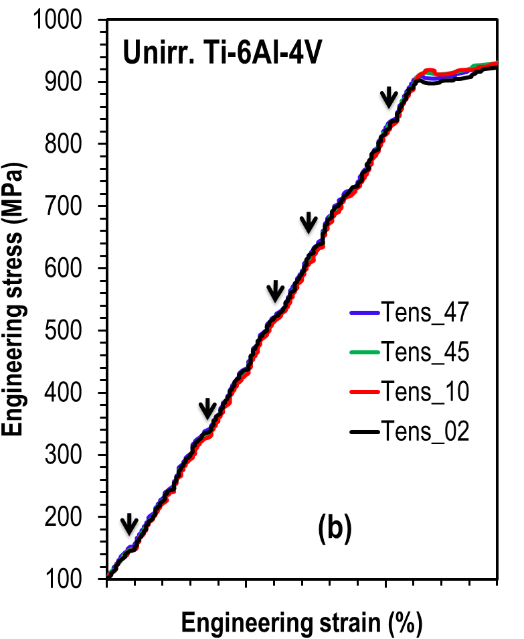
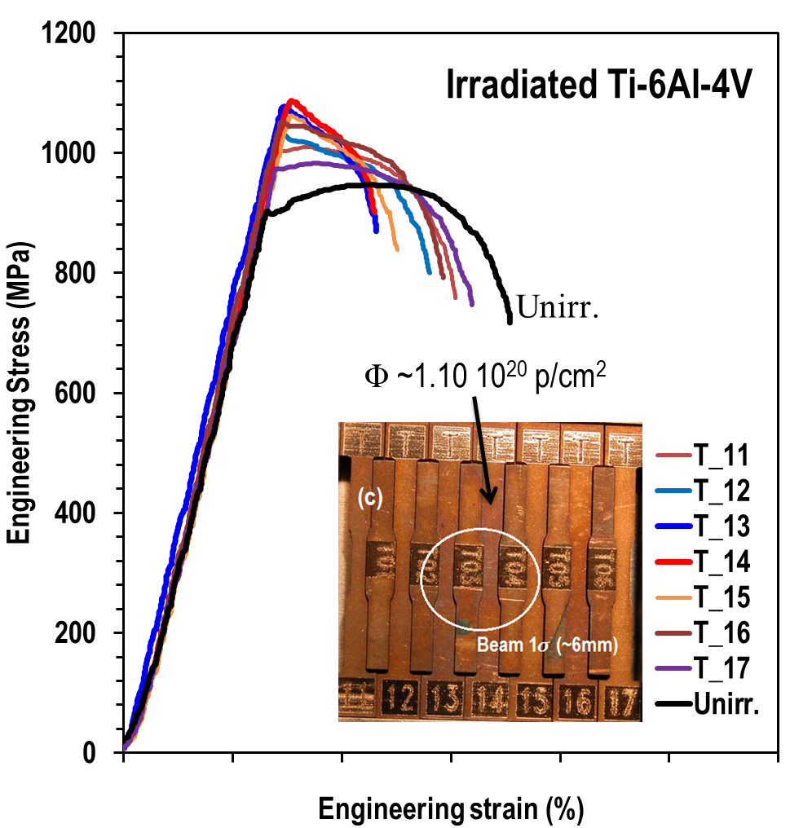
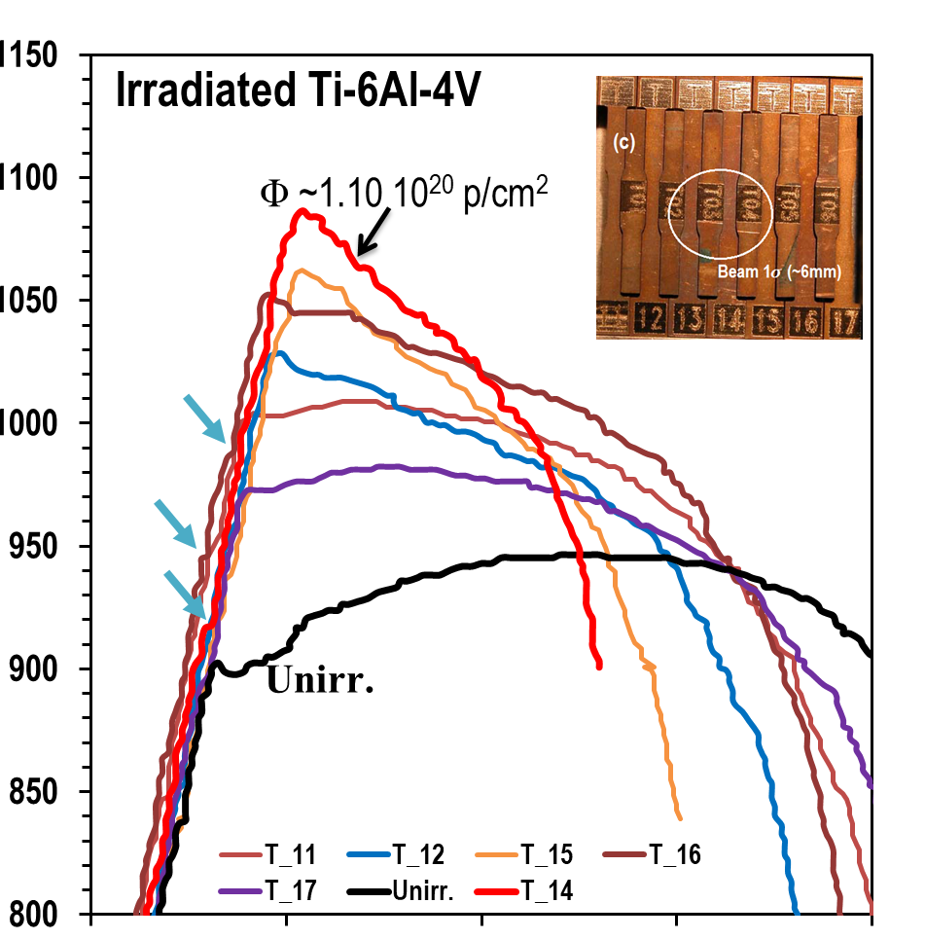
(α+β) Ti6Al4V Irradiation: Stress-Strain
Assessment:
Unirradiated Ti6Al4V shows very reproducible behavior
  Kinks within the elastic range at same locations are most likely attributable to the hcp alpha phase
  Signs of ductile failure and some work hardening
Irradiation at ~180-240∘C leads to:
  Yield stress increase
  Almost no uniform elongation at higher fluences
  Some ductility remains in Ti6Al4V –
  to be compared with Ti alloy Gum metal, which turned completely brittle after the same irradiation process
“Kinks” are still observable following irradiation

Slide 9
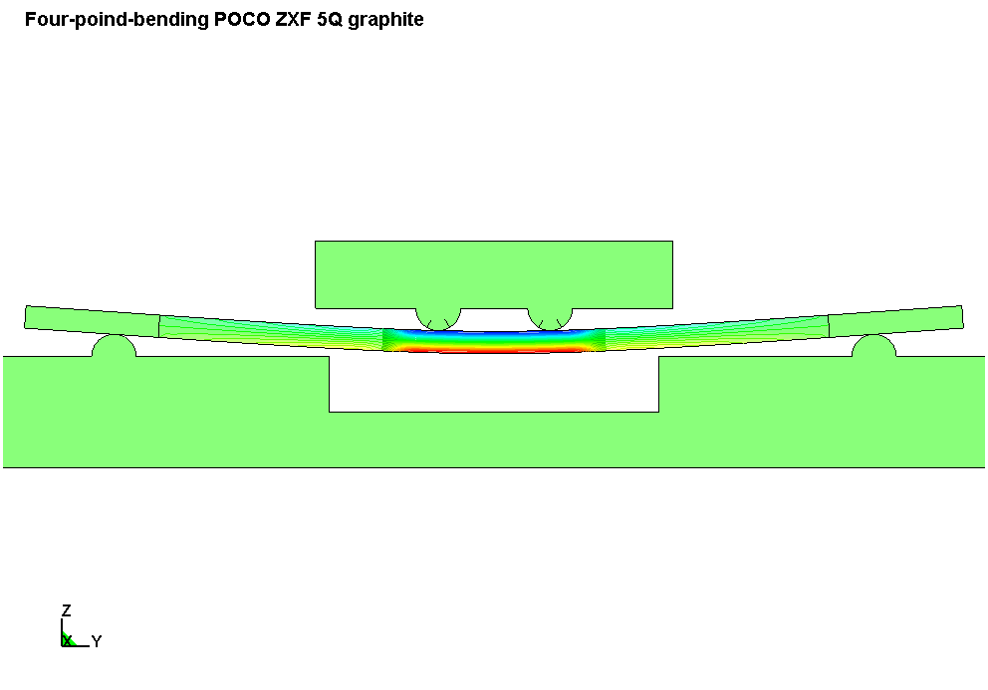
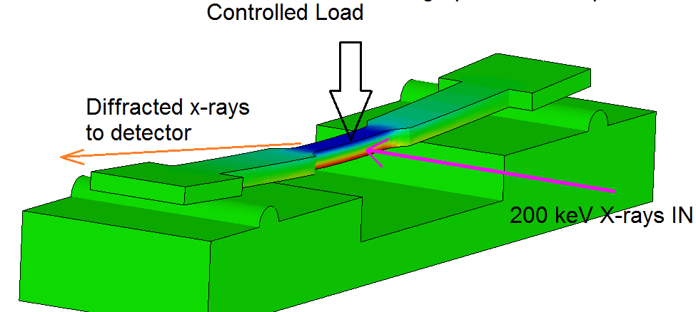
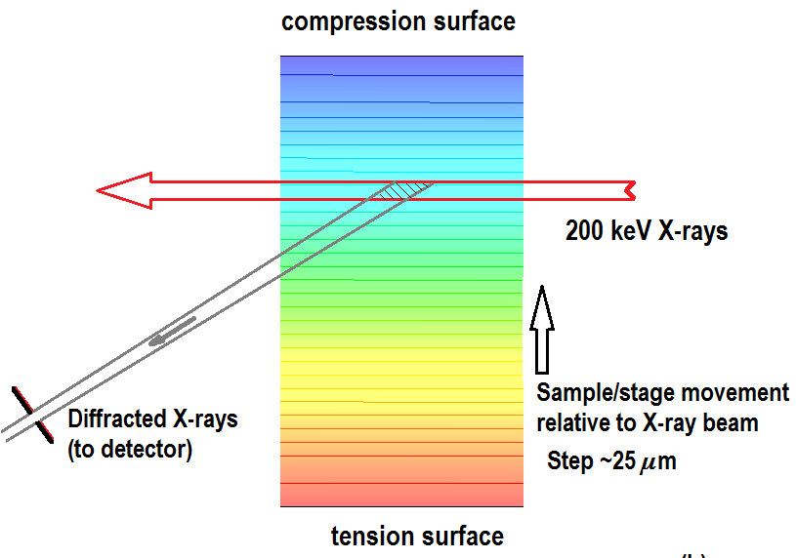
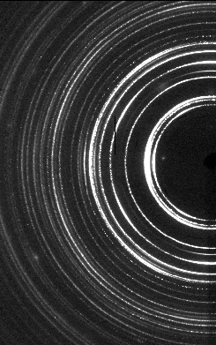
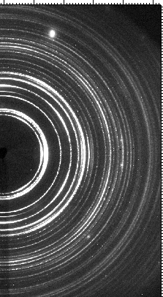
Ti6Al4V Irradiation: X-Ray Diffraction Experiments
Experiments were conducted using:
NSLS X17B1 Beamline
  200 keV polychromatic X-rays
  In-situ four-point bending stress
  EDXRD techniques
NSLS-II XPD Beamline
  67 keV monochromatic X-rays
  In-situ four-point bending
  Refined Rietveld technique
EDXRD (200 keV)
Interaction/diffracting
volume from within the bulk
Unirradiated Ti6Al4V
Irradiated Ti6Al4V
XRD (67 keV)

Slide 10
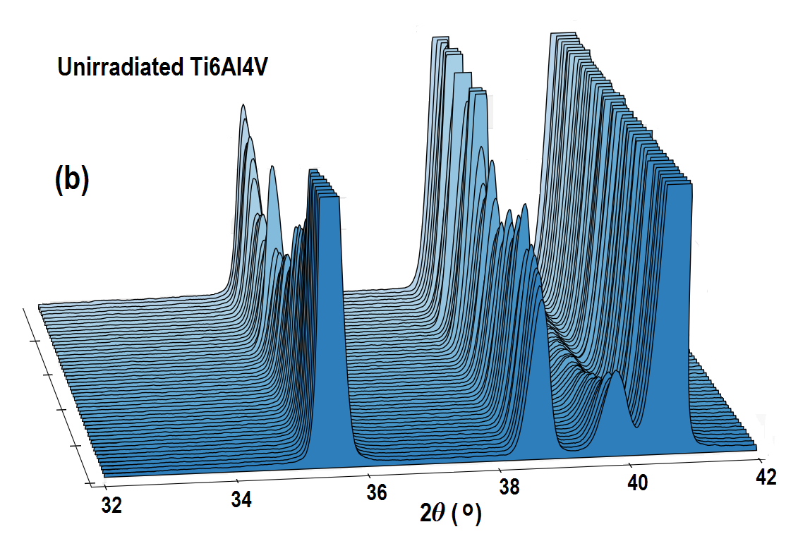
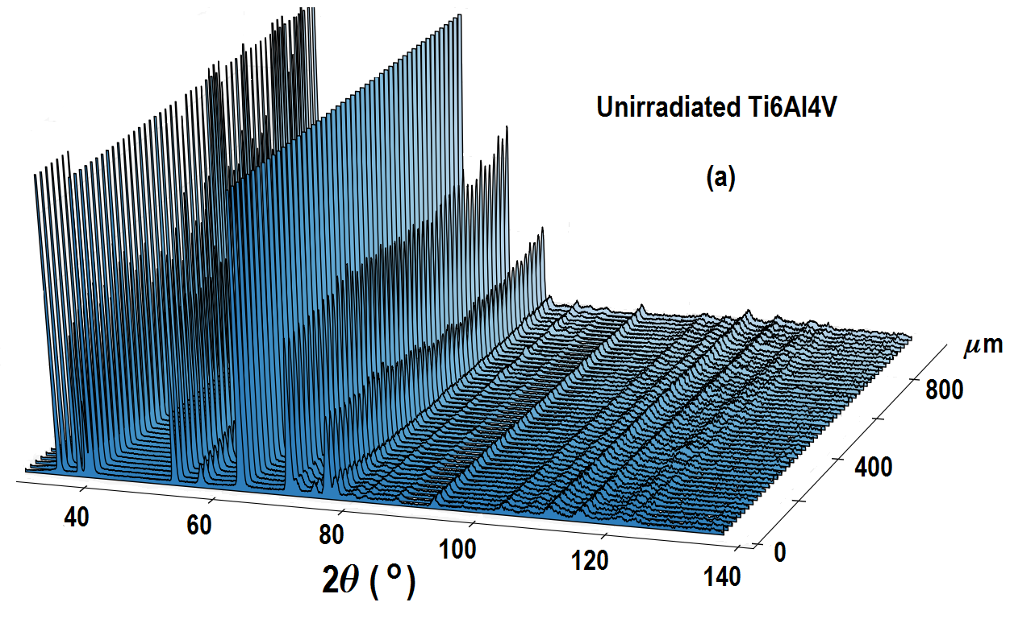
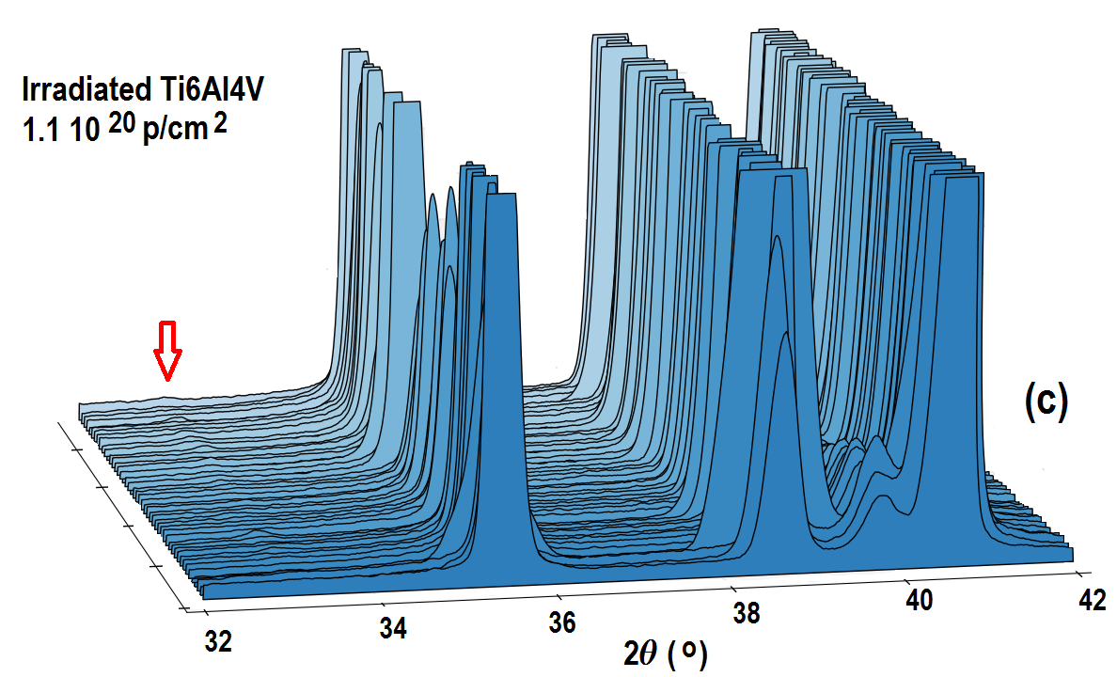
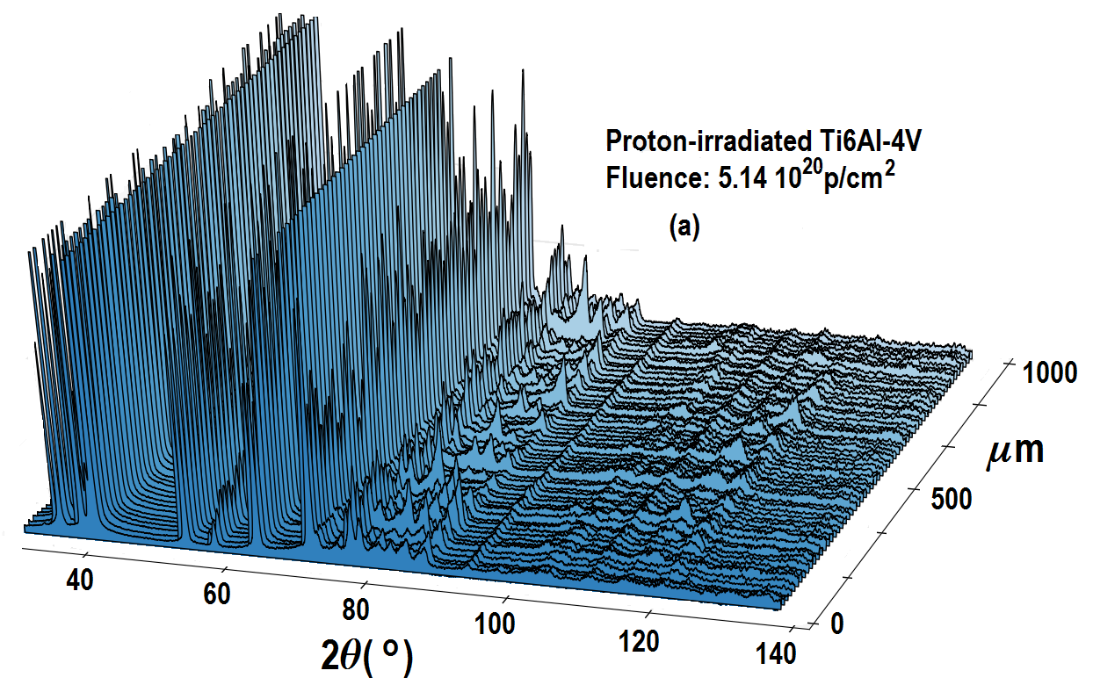
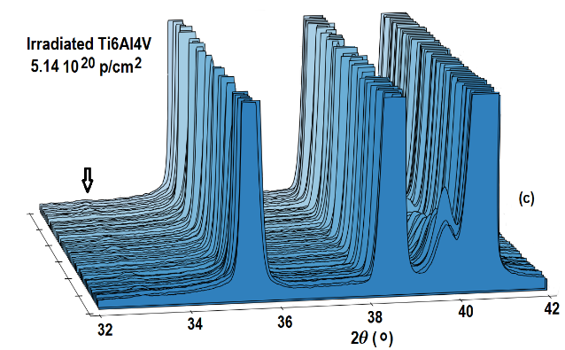
Ti6Al4V EDXRD Results: ω Phase Appearance
Increasing Fluence
ω
Irradiation effects on the microstructure (high 2θ values)
Consistent with
appearance of
new ω phase
throughout bulk
ω

Slide 11
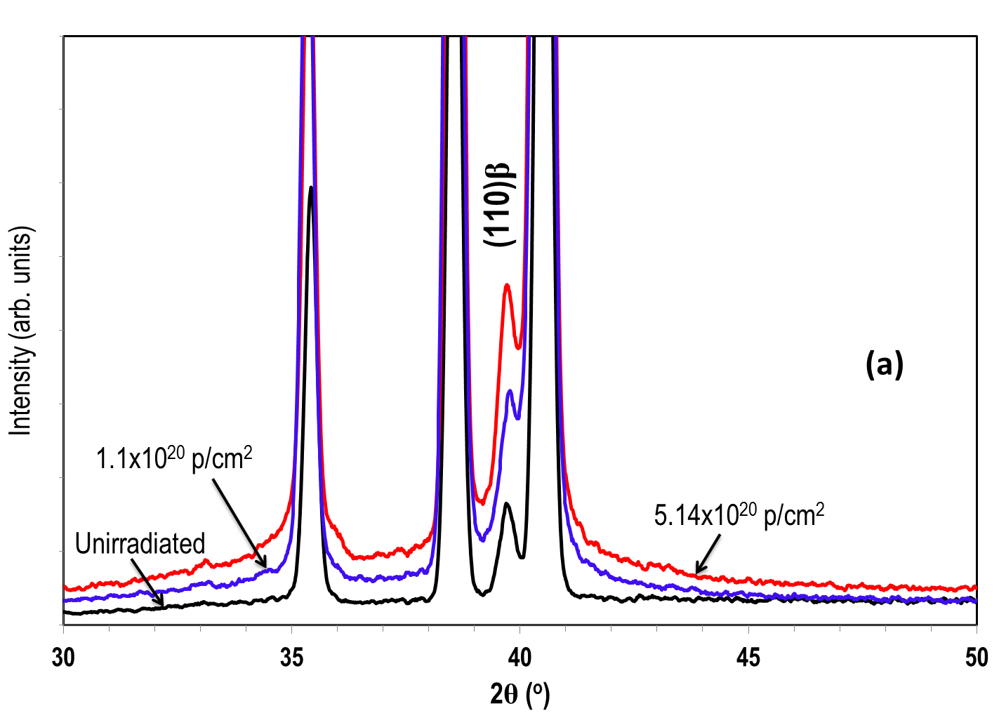
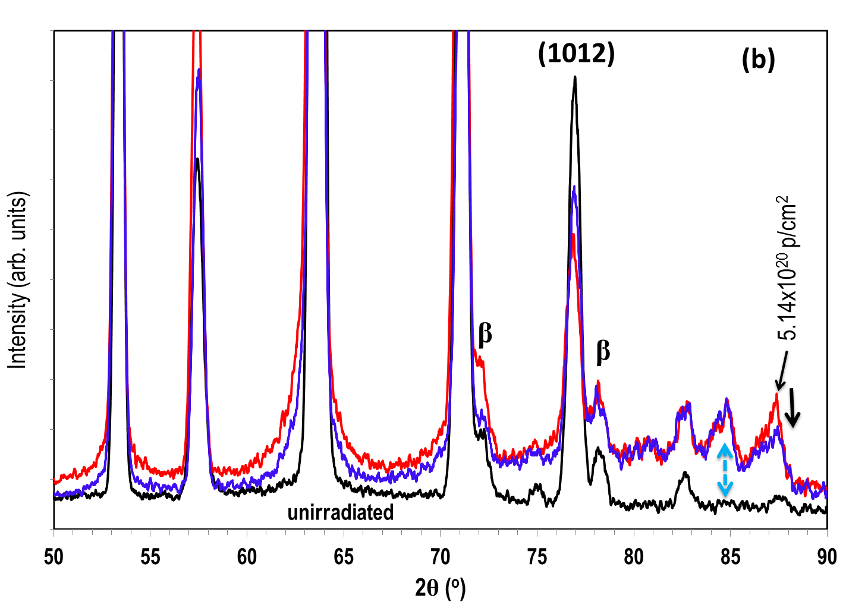
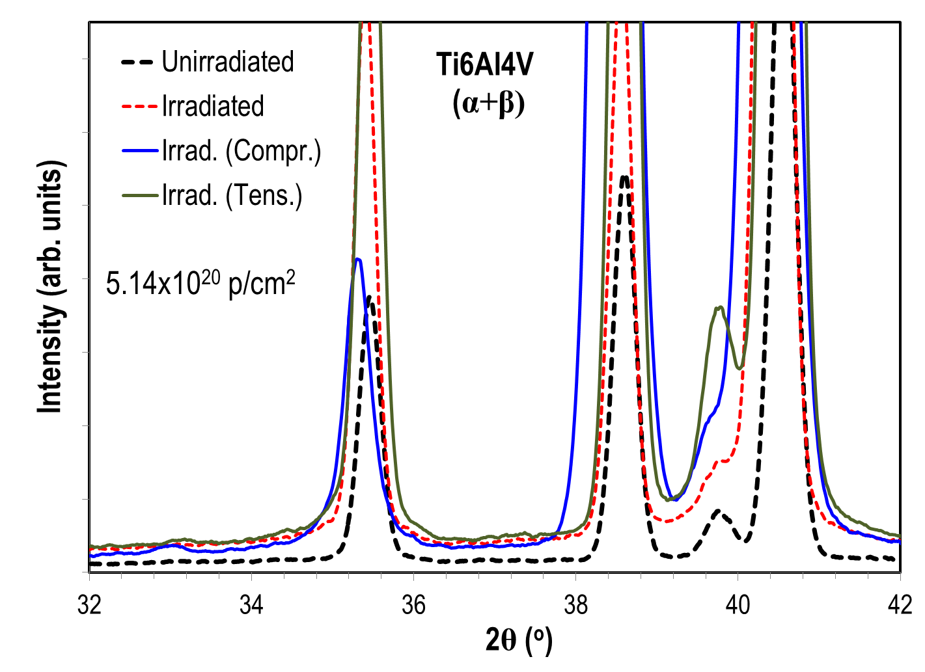
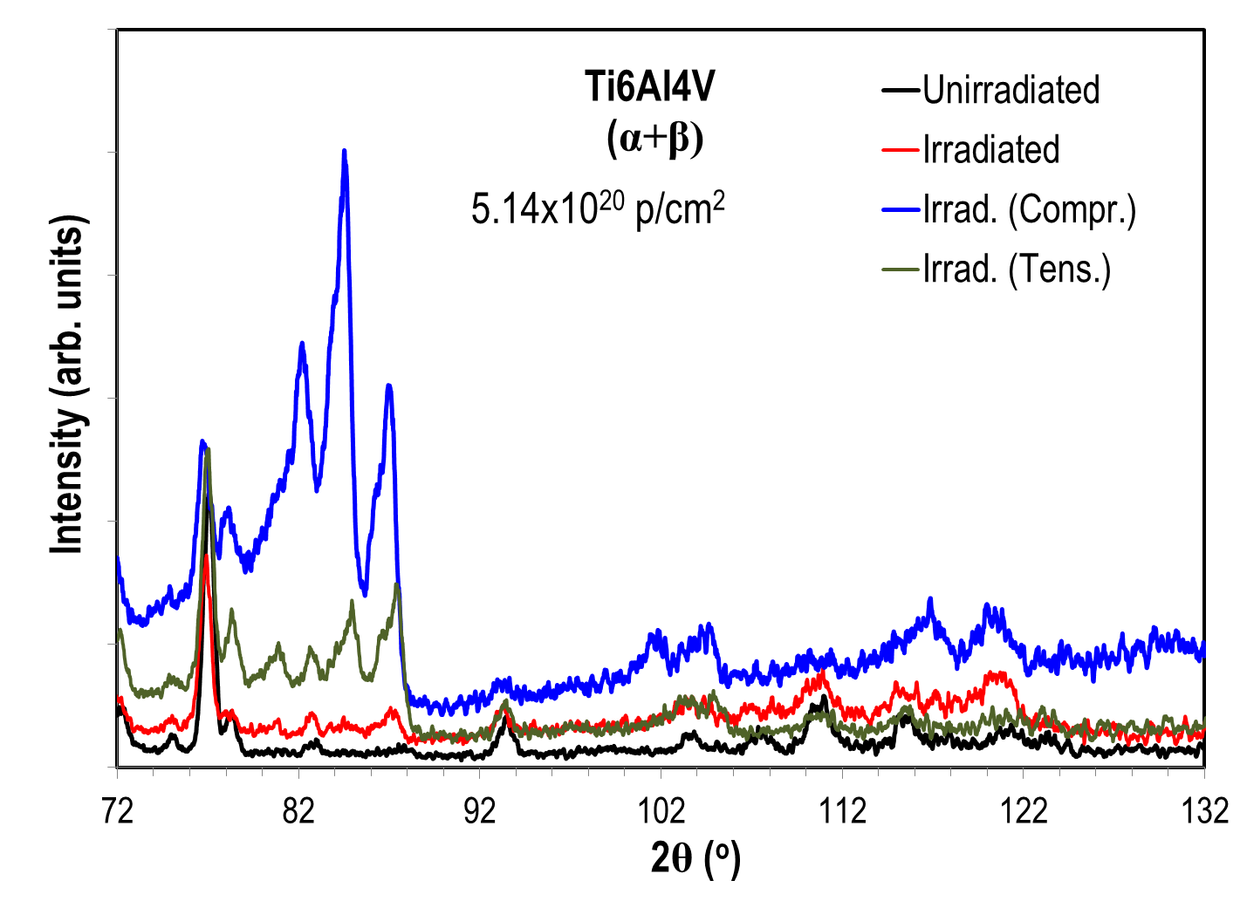
Ti6Al4V EDXRD Results: Irradiation Effects on α, β Phases
Tension-Compression
Asymmetry

Slide 12
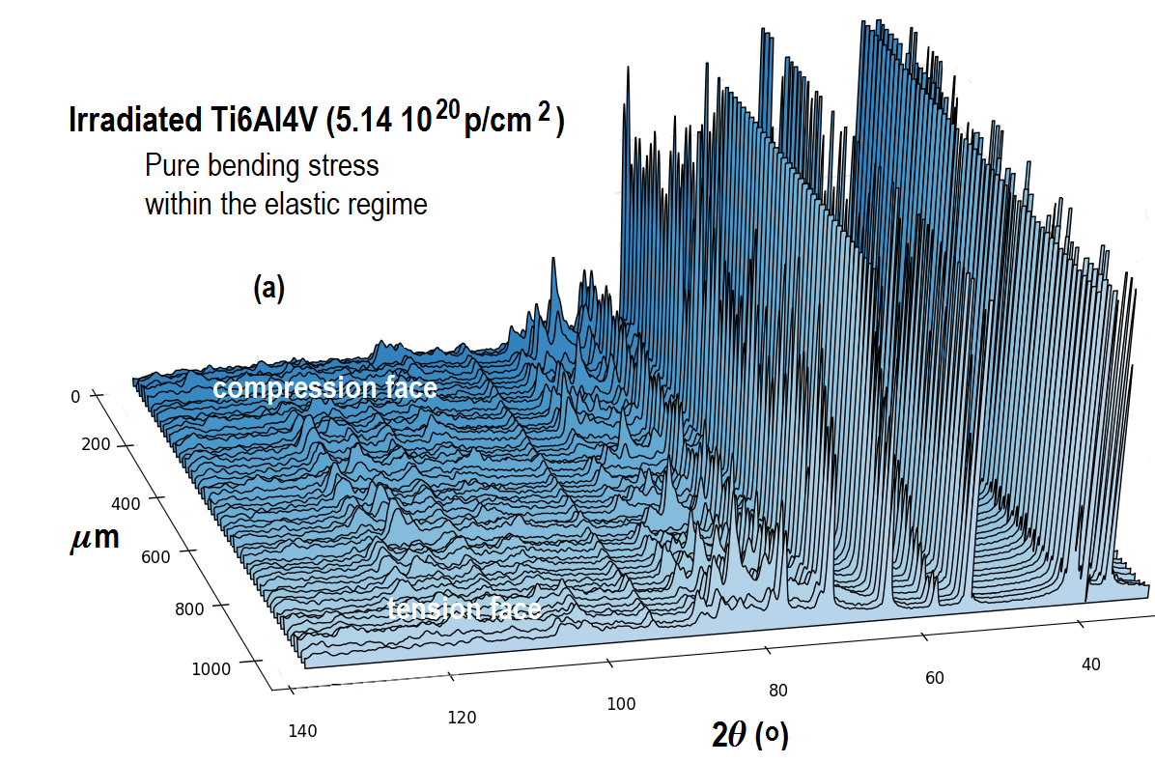
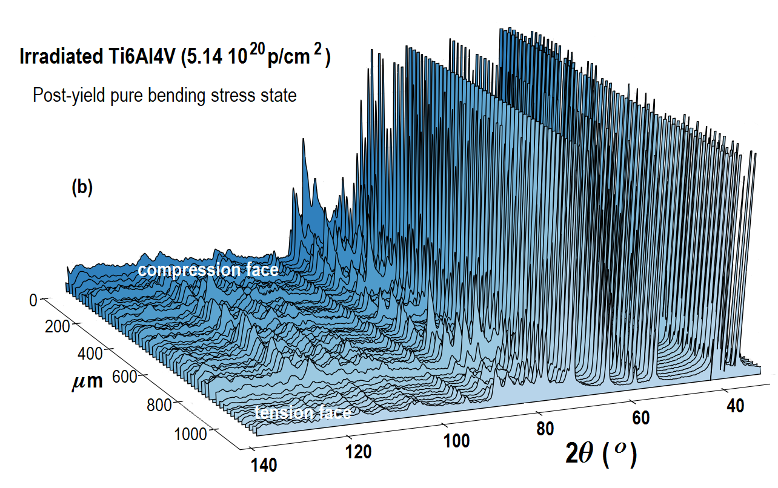
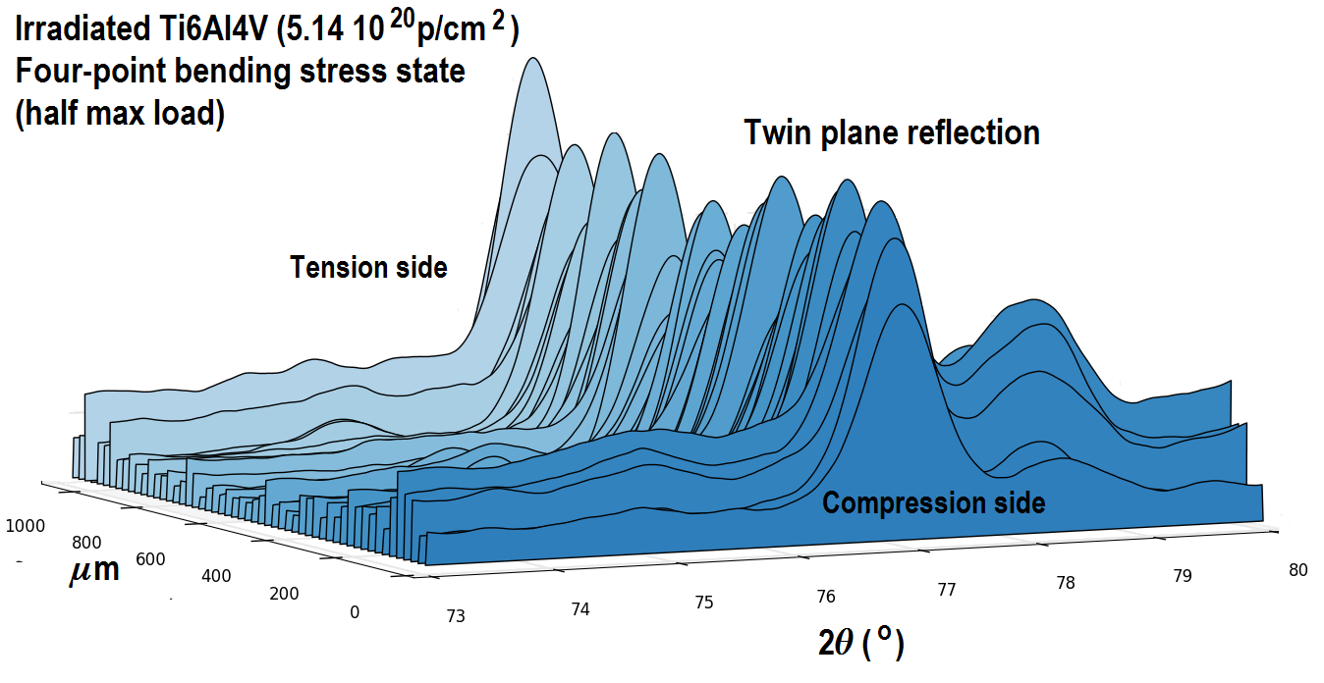
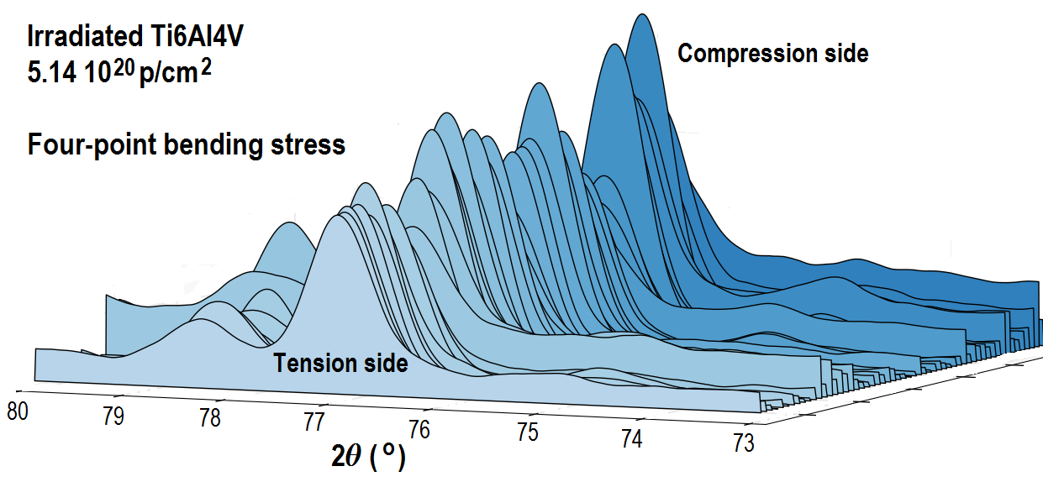
Ti6Al4V EDXRD Results: Tension-Compression Asymmetry
Stress beyond the elastic range
(note reflection map change over the plasticized zone)
Stress in the elastic range
Evolution of Twinning with applied stress
Note the change in reflection intensity as material goes plastic on the tension face

Slide 13
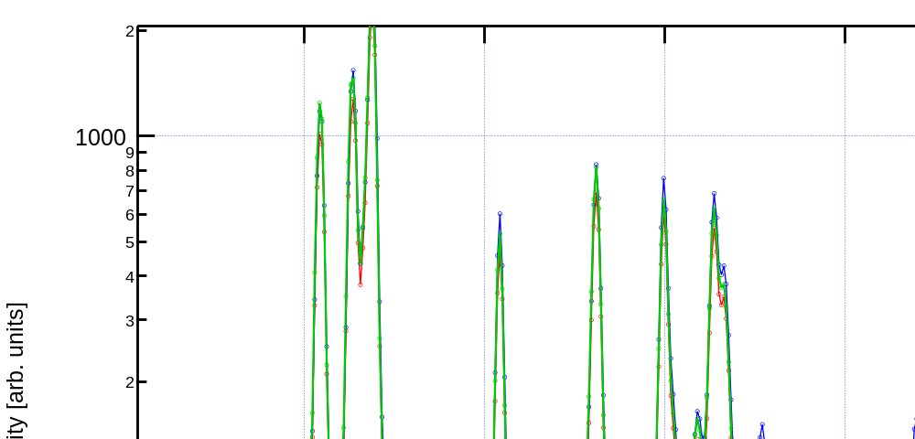
Irradiated Ti6Al4V: Refined Rietveld Analysis
α and β phase fraction as a
result of applied in-situ stress
Stress-state |  | a | ±a | c | ±c | size | ± size | Fraction
 | phase | Å | Å | Å | Å | nm | nm | %
0 Load c/a (a)=1.5948 | β (bcc) | 3.20841 | 0.00128 |  |  | 46.12 | 17.81 | 3
 | α (hcp) | 2.92541 | 0.00019 | 4.66542 | 0.00045 | 125.60 | 4.42 | 97
Elastic c/a=1.5950 | β | 3.20561 | 0.00109 |  |  | 35.76 | 8.40 | 2.5
 | α | 2.92452 | 0.00018 | 4.66484 | 0.00041 | 128.72 | 9.86 | 97.5
Post-yield | β | 3.20699 | 0.00098 |  |  | 35.96 | 2.39 | 2
 | α | 2.92605 | 0.00018 | 4.66713 | 0.00044 | 121.77 | 8.10 | 98

Slide 14
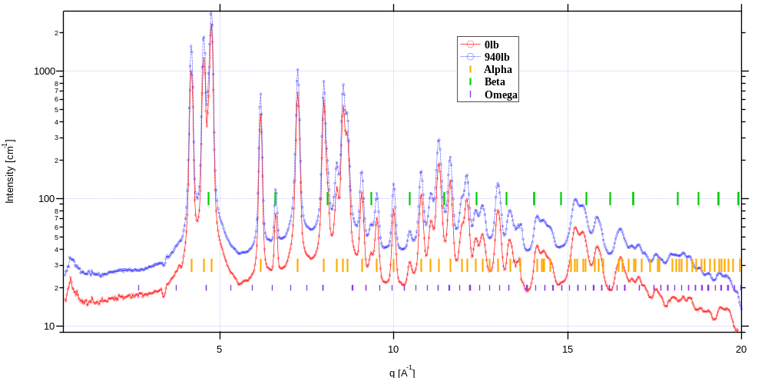
Irradiated Ti6Al4V: Refined Rietveld Analysis
Indications of a
radiation-induced ω phase
Comments:
Stability of α and β phases of Ti-6Al-4V following irradiation (ω phase nano? i.e. <10nm).
To unequivocally say, one would need better angular resolution.
  Future experiments: longer sample to detector distance will to resolve the peaks from this phase.
  These experiments planned for the NSLS-II XPD
Note: EDXRD technique at NSLS has also revealed the appearance of the phase that resembles the ω phase

Slide 15
Ti6Al4V: Summary and Next Steps
Summary:
The BNL irradiation study followed by dilatometric and X-ray characterization revealed
  The effects of irradiation on the α, β evolution
  The appearance of ω-phase as a result of proton exposure
Observed asymmetries between tension and compression and activation of twinning
from the hcp(α) phase
Conducted X-ray diffraction with Refined Rietveld analysis and in-situ four-point
bending stress
  NSLS: EDXRD with polychromatic 200 keV x-rays
  NSLS-II: XRD with monochromatic 67 keV x-rays
Next Steps:
X-ray tomography, small angle scattering with in-situ multidirectional loading
(3-point, 4-point bending)
Tension (to fracture) of irradiated samples combined with compression and/or twisting
Low cycle fatigue
Further verification of the ω phase appearance and the α-β phase volume fraction
Upcoming Experimental Plans:
X-ray tomography/X-ray diffraction with in-situ low-cycle fatigue of proton-irradiated Ti6Al4V
Planned for NSLS-II XPD during Spring 2020 Run
Fracture toughness of pre-notched/irradiated Ti6Al4V
Utilizing the micro-beam achieved at NSLS-II XPD (~20x30 µm)
X-ray imaging and X-ray tomography
Utilizing the NSLS-II HEX beamline (currently under construction)
Commissioning Run for
NSLS-II XPD Spring
Campaign Now Complete

Slide 16
Thank you for your attention!

