Slide 1

Irradiation Induced Failure Analysis of NuMI Target
Sujit Bidhar
Dec 11, 2019

Slide 2
Outline
Background NTO2 Target fin
Fin material properties and response under irradiation
Swelling empirical formula
Finite element implementation and results
Failure analysis

Slide 3
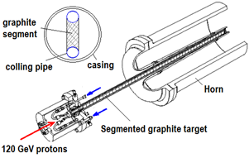
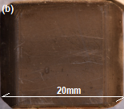
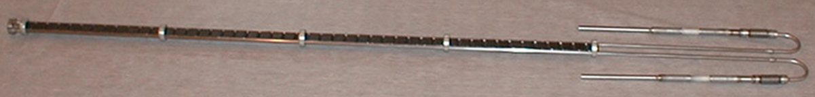
Background- NT02 Target Fin
95 cm
Individual target fin
20mm x 15 mm x 6.6 mm
Segmented Fins- 47 pieces
Material : POCO ZXF 5Q graphite
Isotropic

Slide 4
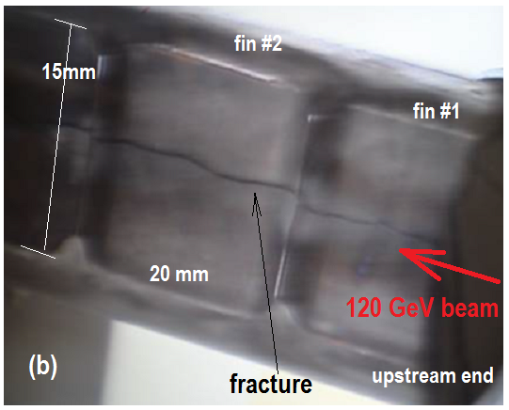
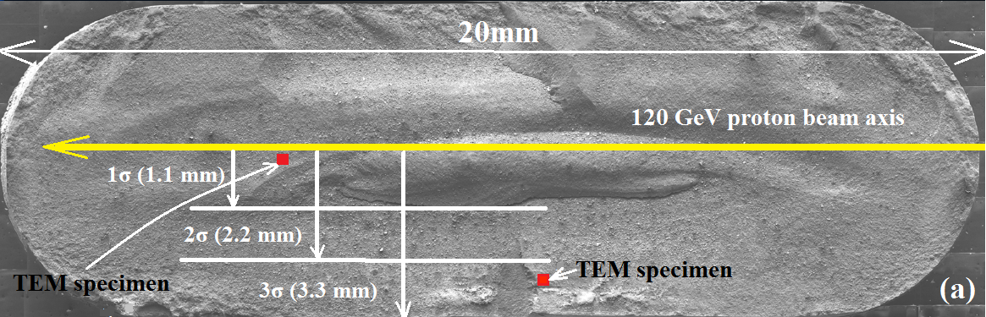
Background- Fracture fin
x
y
z
z
Beam Parameters:
Energy :120 GeV
Beam sigma : 1.1mm
Spill duration : 10µsec, 4x10¹³ protons/pulse
Duty cycle :1.87sec
Peak fluence : 8.6x10²¹ protons/cm²
Bulk swelling of ~2%

Slide 5
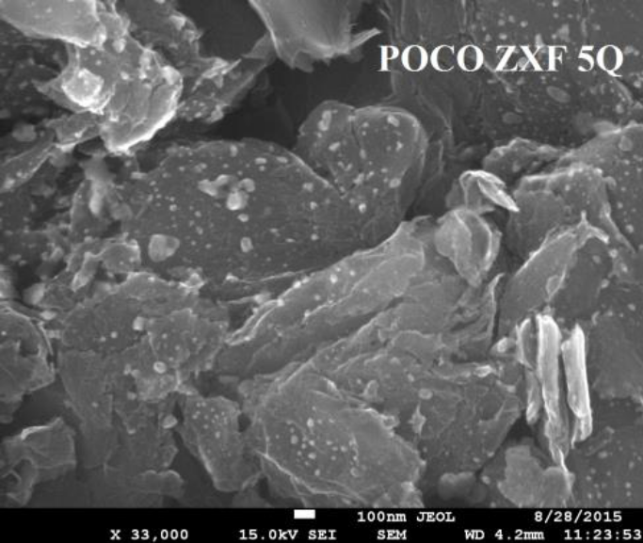
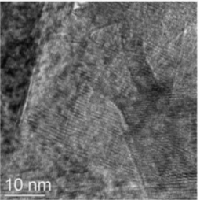
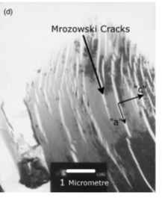
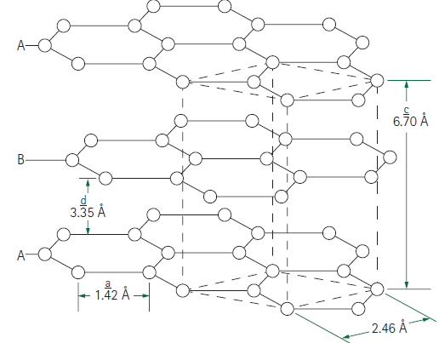
POCO ZXF 5Q Graphite microstructure
Pores
Grain
Particles
c
a
Less Mrozowski cracks
Randomly oriented grains
  isotropic
Pores & particles ~ microns
Particles packed with many grains
  Fine grains (~30nm)
HCP structure
(2 0 0)
c
Hexagonal Basal plane
(1 0 0)
d-spacing
a
Carbon 1971. Vol. 9, pp. 697444.

Slide 6
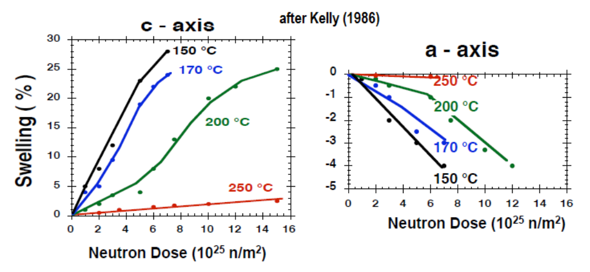
Graphite Swelling→ Fluence factor
XRD – Pyrolytic carbon
C-axis expansion is more than a-axis contraction
Swelling →f(fluence, temperature)
  More swelling at lower temperature
Kelly, J. Vac. Sci. Technol. A 4 (3), 1986

Slide 7
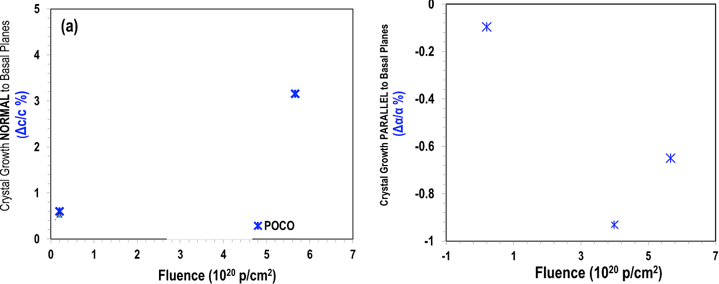
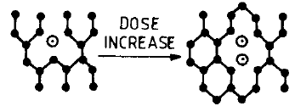
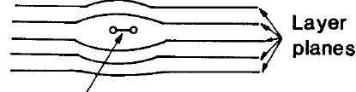
Graphite Swelling→ XRD- POCO ZXF5Q
150 C
150 C
C-axis expansion is more than a-axis contraction → net expansion
c
a
a
Interstitial → expansion
Vacancy →contraction
N. Simos, PRAB 20, 071002 (2017)

Slide 8
Swelling factor function
Local Swelling factor =f(fluence)*g(temperature)
sw(Ø,T)= f(Ø).g(T)
u=u(x,y,z)
Initial guess for f(Ø)
f(Ø)=exp{-b(u/σ)²}

Slide 9
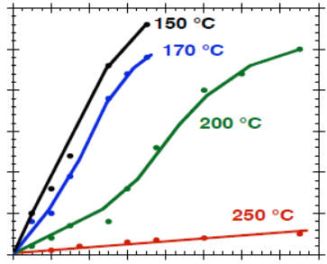
Swelling factor function
(a)
30
∂ g(T)/ ∂T at f(Ø)
25
20
∂(sw)= g(T). ∂f(Ø) + f(Ø).{∂ g(T)}.
Swelling %
15
At constant fluence swelling factor follows a polynomial function with temperature (next slide)
10
5
0
2
4
6
8
10
12
14
16
Neutron dose, p/cm²
Attempting to find form of the function from the swelling trend

Slide 10
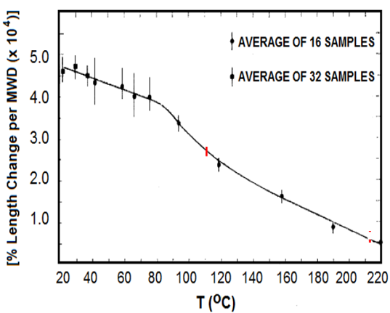

Swelling →Temperature Factor
NTO2 steady state operating temperature range
1 MWD = 7e16 nvt
∂g(T)=$2x10$⁻⁷ T³ - $7x10$⁻⁵ T² + $1.5x10$⁻³ T+1.0083
Pronounced swelling at lower temperatures
D. Schweitzer, Physical Review, Vol 128 (2), 1962, pp .556-559

Slide 11
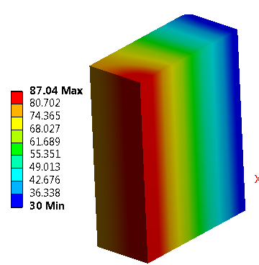
Steady State Thermal Analysis
1/8th symmetry model
Transient Temp. at beam center
(a)
Beam direction
Steady state thermal
Path-y
Path-x
Average irradiation temperature 30C~87C

Slide 12
Swelling factor →combined function of fluence and temperature
sw(u,T)=${C.exp⁡\{−b\left(\frac{u}{σ}\right)}^{2}\}.{\{5x10\text{−}\text{8} \text{T}\text{4}\text{ −} 2x10\text{−5} \text{T}\text{3}\text{ +} 5x10\text{−}\text{4} \text{T}\text{2}\text{+1.0083}T+1}^{}$}
Swelling is reduced at center due to relatively high irradiation temperature

Slide 13
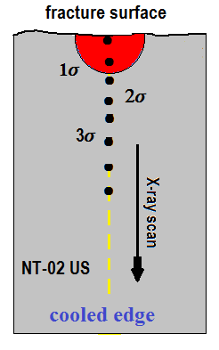
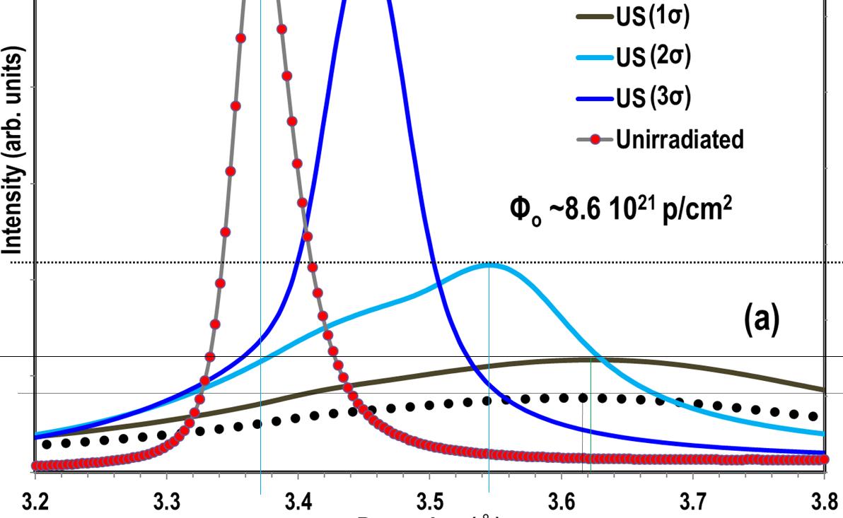
XRD data NTO2
Assumption
Experimental swelling = ∂(d/d0)
3.542
3.37
d-spacing, A⁰
3.621
3.618
XRD scan spot size is 50µm x 50µm x 10mm
In FEA, element size is made ~ 50µm so that it would match to XRD scan volume

Slide 14
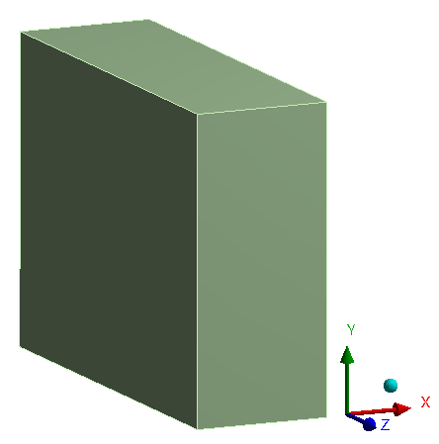
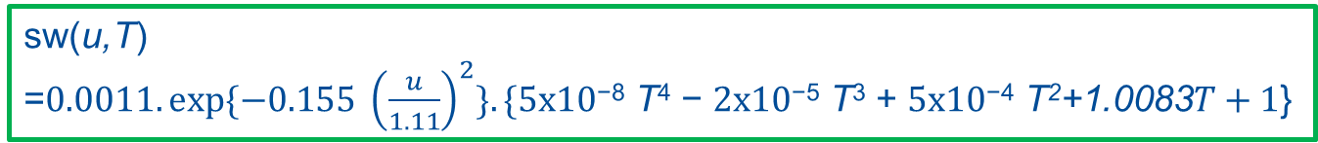
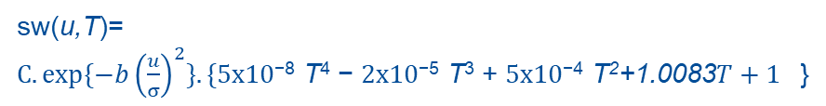
Determining Swelling Coefficient
U (mm) | Temperature | sw | d-spacing | ∂(d/d0) | C
0 | 88 | 0.779 | 3.621 | 0.074481 | 0.000894
1.1 | 84 | 0.686 | 3.618 | 0.073591 | 0.001073
2.2 | 81 | 0.442 | 3.542 | 0.051039 | 0.001211
3.3 | 78 | 0.210 | 3.45 | 0.023739 | 0.001245
u
XRD
sw(u,T)=${C.exp⁡\{−b\left(\frac{u}{σ}\right)}^{2}\}.{\{5x10\text{−}\text{8} \text{T}\text{4}\text{ −} 2x10\text{−5} \text{T}\text{3}\text{ +} 5x10\text{−}\text{4} \text{T}\text{2}\text{+1.0083}T+1}^{}$}
Equating sw(u,T) to ∂(d/d0) ➔ C
Multi-variate regression analysis:
Varying “b” and “σ”to get C curve as flat as possible
→ b= 0.155, C = 0.00107, σ =1.11
sw(u,T)
=${0.0011.exp⁡\{−0.155 \left(\frac{u}{1.11}\right)}^{2}\}.\{5x10\text{−}\text{8} \text{T}\text{4}\text{ −} 2x10\text{−5} \text{T}\text{3}\text{ +} 5x10\text{−}\text{4} \text{T}\text{2}\text{+1.0083}T+1$}

Slide 15
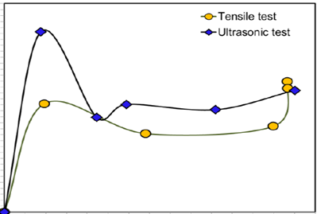



Young’s Modulus variation with Fluence Ø
Peak fluence 8 x10²⁰ p/cm²
Analytical function fit f₁$\left(φ\right)$
$$f_{1}\left(φ\right)=1.5{\left(\frac{Ø}{13}\right)}^{1.3−1}exp{{\left(−\frac{Ø}{13}\right)}^{1.3}}$$
“E” varies with Ø
Ø varies with location.
This two relationship is used to map “E” as a function of location
Ø = Ø₀ exp{-0.5(u/1.1)²}
E=E0[1+f₁(Ø) ]

Slide 16
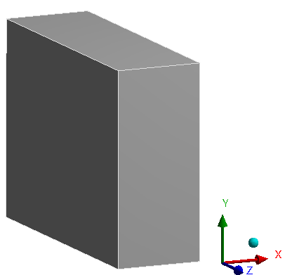
Model- Geometry
1/8th Model →Symmetric in x, y, and z direction
3.3mm
Cooling water temperature 30C
Fixed support
7.5mm
10 mm
Beam along Z-direction
Gaussian Beam in x-y
Symmetric Boundary Condition on x, y and z plane
u_{i,i} =0
θ_{i ,j} = 0 i≠ j
= free i=j

Slide 17
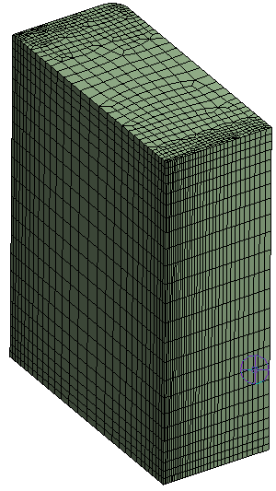
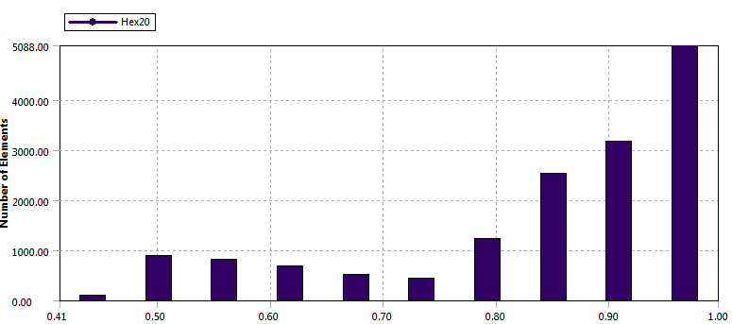
FE Model
Larger temperature gradient within beam center
Mesh Optimization
Finer elements at the beam center
Progressively larger elements
30 elements within 1-σ of beam
Minimum distorted elements
Curvature and proximity refinement.
15000 elements 68,0000 nodes
Check element quality
High Jacobian ratio → spurious stress values
Jacobian Ratio (Gauss points)
Keep J-R as close to 1
JR > 10 can lead to increase in stress by 20%

Slide 18




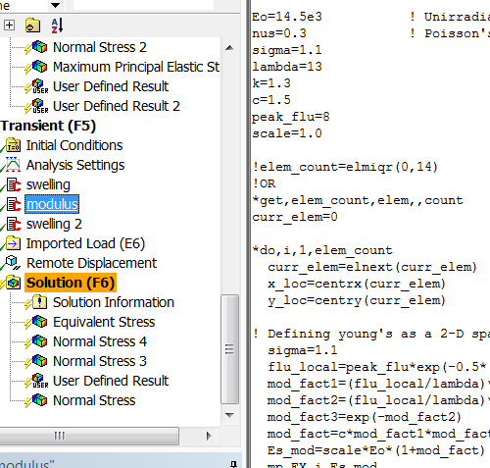
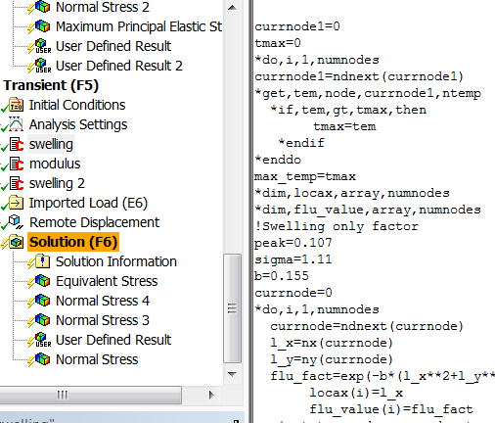

FEM Implementation of Empirical Formula
Total Strain
$$\dot{ε={\dot{ε}}_{el}+{\dot{ε}}_{pl}+{\dot{ε}}_{cr}+{\dot{ε}}_{th}+{\dot{ε}}_{sw}}$$
Linear swelling model
Swelling Strain
No shear, only volume change
APDL Scripts
APDL Scripts

Slide 19
Simulation Frame-work
New
After years of operation
One beam pulse
Dynamic stresses
Deformed
Beam Parameters
Number of protons pulse: 4x10¹³
Pulse duration : 10µsec
Beam σ : 1.1 mm
Energy deposited/ pulse : 480 J/cm³
Steady State Thermal Analysis
Static structural analysis
swelling factor as function of fluence,temperature sw(Ø,T)
Young’s modulus=f(fluence)
CTE→f(Temperature)
Solve stress, strain , deformation states
Transient Thermal-Dynamic analysis
Initialize domain with σ,ε, u from static structural
Turn off g(T) portion of sw(Ø,T)
Young’s modulus=f(fluence)
CTE→f(Temperature)
Few micro-secs of high temperature is not enough to influence any swelling (annealing)

Slide 20

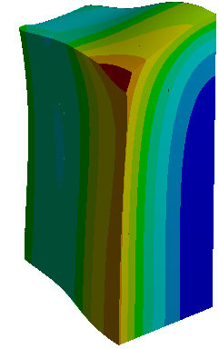
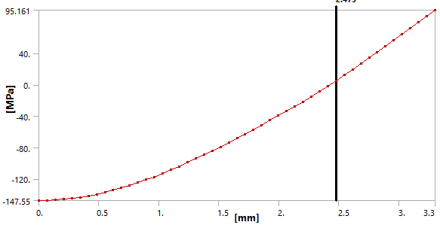
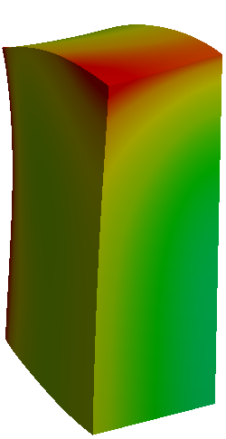

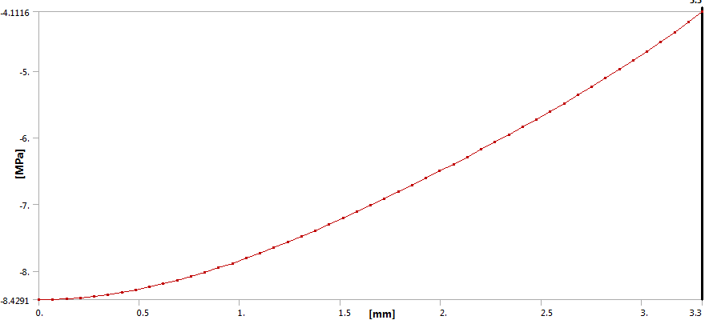
Static Structural analysis – σ_{yy} Distribution
With Swelling
Path-x
Tensile
Compressive
Beam direction
2.45 mm
Path-x
Without Swelling
Path-x
Beam direction
Path-x
State just before beam pulse after number of years of exposure to neutrons

Slide 21
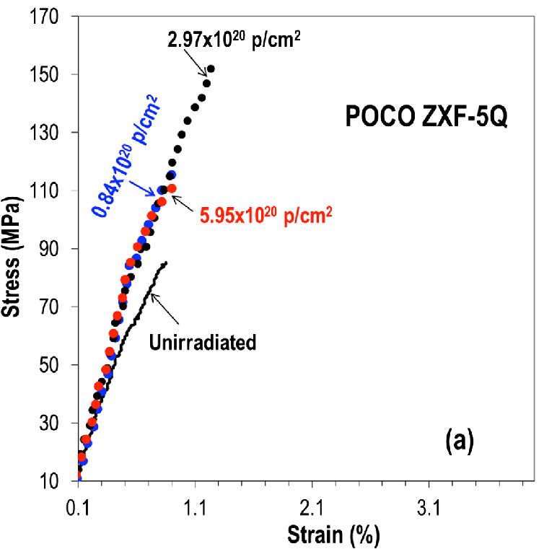
Simulation validation- failure strength
Swelling formulation raised the stress level up to 150 MPa
N. Simos, PRAB 20, 071002 (2017)

Slide 22
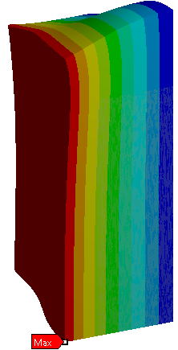

Simulation Validation- amount of swelling
Deformed location
From Simulation
(3.323-3.3)*100/3.3= 0.7 %
Observed bulk swelling at that location ~ 2%
Difference of factor of 2 is not too bad…?
Measurement technique
Assumptions in empirical formulation
3.3 mm

Slide 23
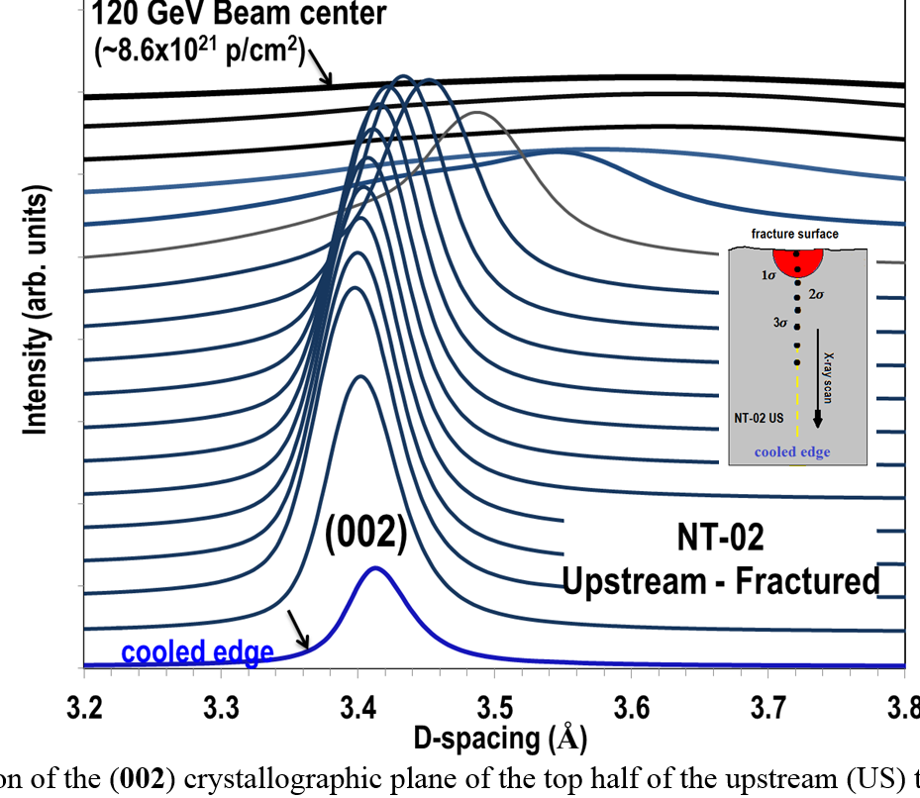
Simulation Validation- Stress states
XRD Scan NTO2
Transition of d -spacing
→state of stress from compression to tension
Predicted by swelling simulation
Undeformed crystallite d-spacing 3.37

Slide 24
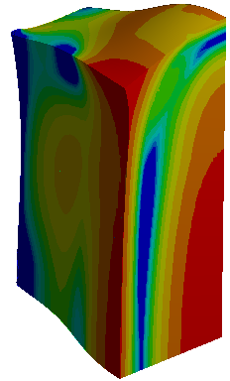
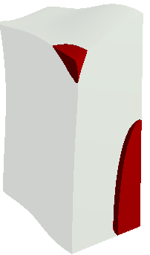

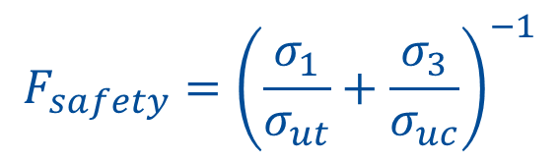
Simulation Validation- Mohr-Coulumb’s factor of safety
FS distribution
FS <1
$$F_{safety}={\left(\frac{σ_{1}}{σ_{ut}}+\frac{σ_{3}}{σ_{uc}}\right)}^{−1}$$
79 MPa
175 MPa
Fracture plane
Beam
Probable crack initiation sites
Fractography suggest crack starting from inside and propagating outward

Slide 25
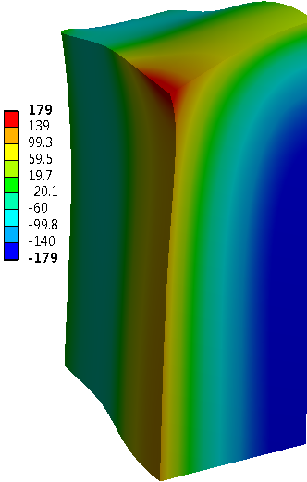
Dynamic stresses- σ_{yy}
Fracture plane
Beam
R=-1 Sever form of fatigue
Two fatigue loading 1) 11MPa with 1.87sec 2) 5MPa with 4µsec
X=2.4mm

Slide 26
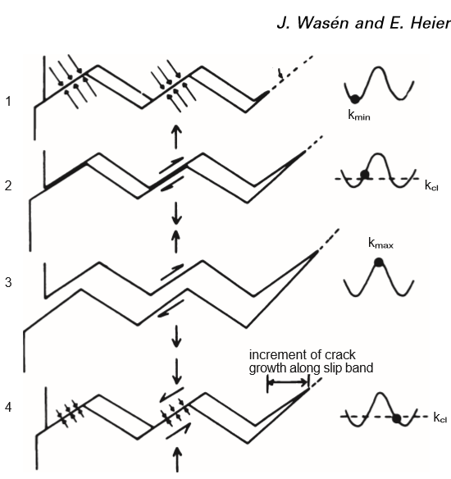
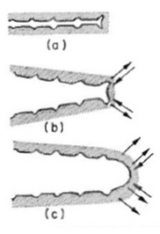
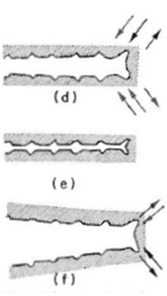
Fatigue Crack growth stages
Crack initiation→ significant portion of fatigue life
Slip lines
Cyclic Max shear stress
→ intrusion protrusion of slip lines
Tension
Sharp crack tip
Blunting
Tensile stress→microcrack growth
compression
compressive stress in (R<-1)
Regain sharp crack
Pores and microcracks local stress concentration
Sharp
Crack initiation in crystallites→ nano-scale, slow
Crack growth/propagation between the particles →micro-scale, fast
Int. J. Fatigue Vol. 20, No. 10, pp. 737–742, 1998

Slide 27
Conclusions
Thermal stresses alone could not have caused crack
Implementing swelling strain effectively raised the stress state close to failure strength.
Simulation could explain probable crack initiation region
  Regions with Factor of safety <1
Dynamic stresses due to beam heating → potential fatigue crack
  High amplitude low frequency→ 11 Mpa 15 million cycles per year
  Low amplitude high frequency → 5 Mpa Gigacycles per year
  Regions of complete load reversal at about 2.45mm from beam center
Graphite has low endurance limit ~14 Mpa (@1million cycle
  Low amplitude gigacycle load can cause fatigue failure

Slide 28
Summary
Developed an empirical formula for local swelling (Temp, fluence)
Simulation results bulk swelling reasonable agreement with measurement
Combined swelling stress and dynamic stress due to beam loading caused failure
Did not take into account
Stress, creep effect on swelling.
Dislocation distribution and type, grain boundary segregation etc.
In Future →Make the model predictive
Obtain parameters from mechanism of swelling rather than XRD

Slide 29
Thank You!

