Slide 1
Material irradiation and investigation capabilities at ISAC-TRIUMF
Ferran Boix Pamies
December 12th, 2019

Slide 2
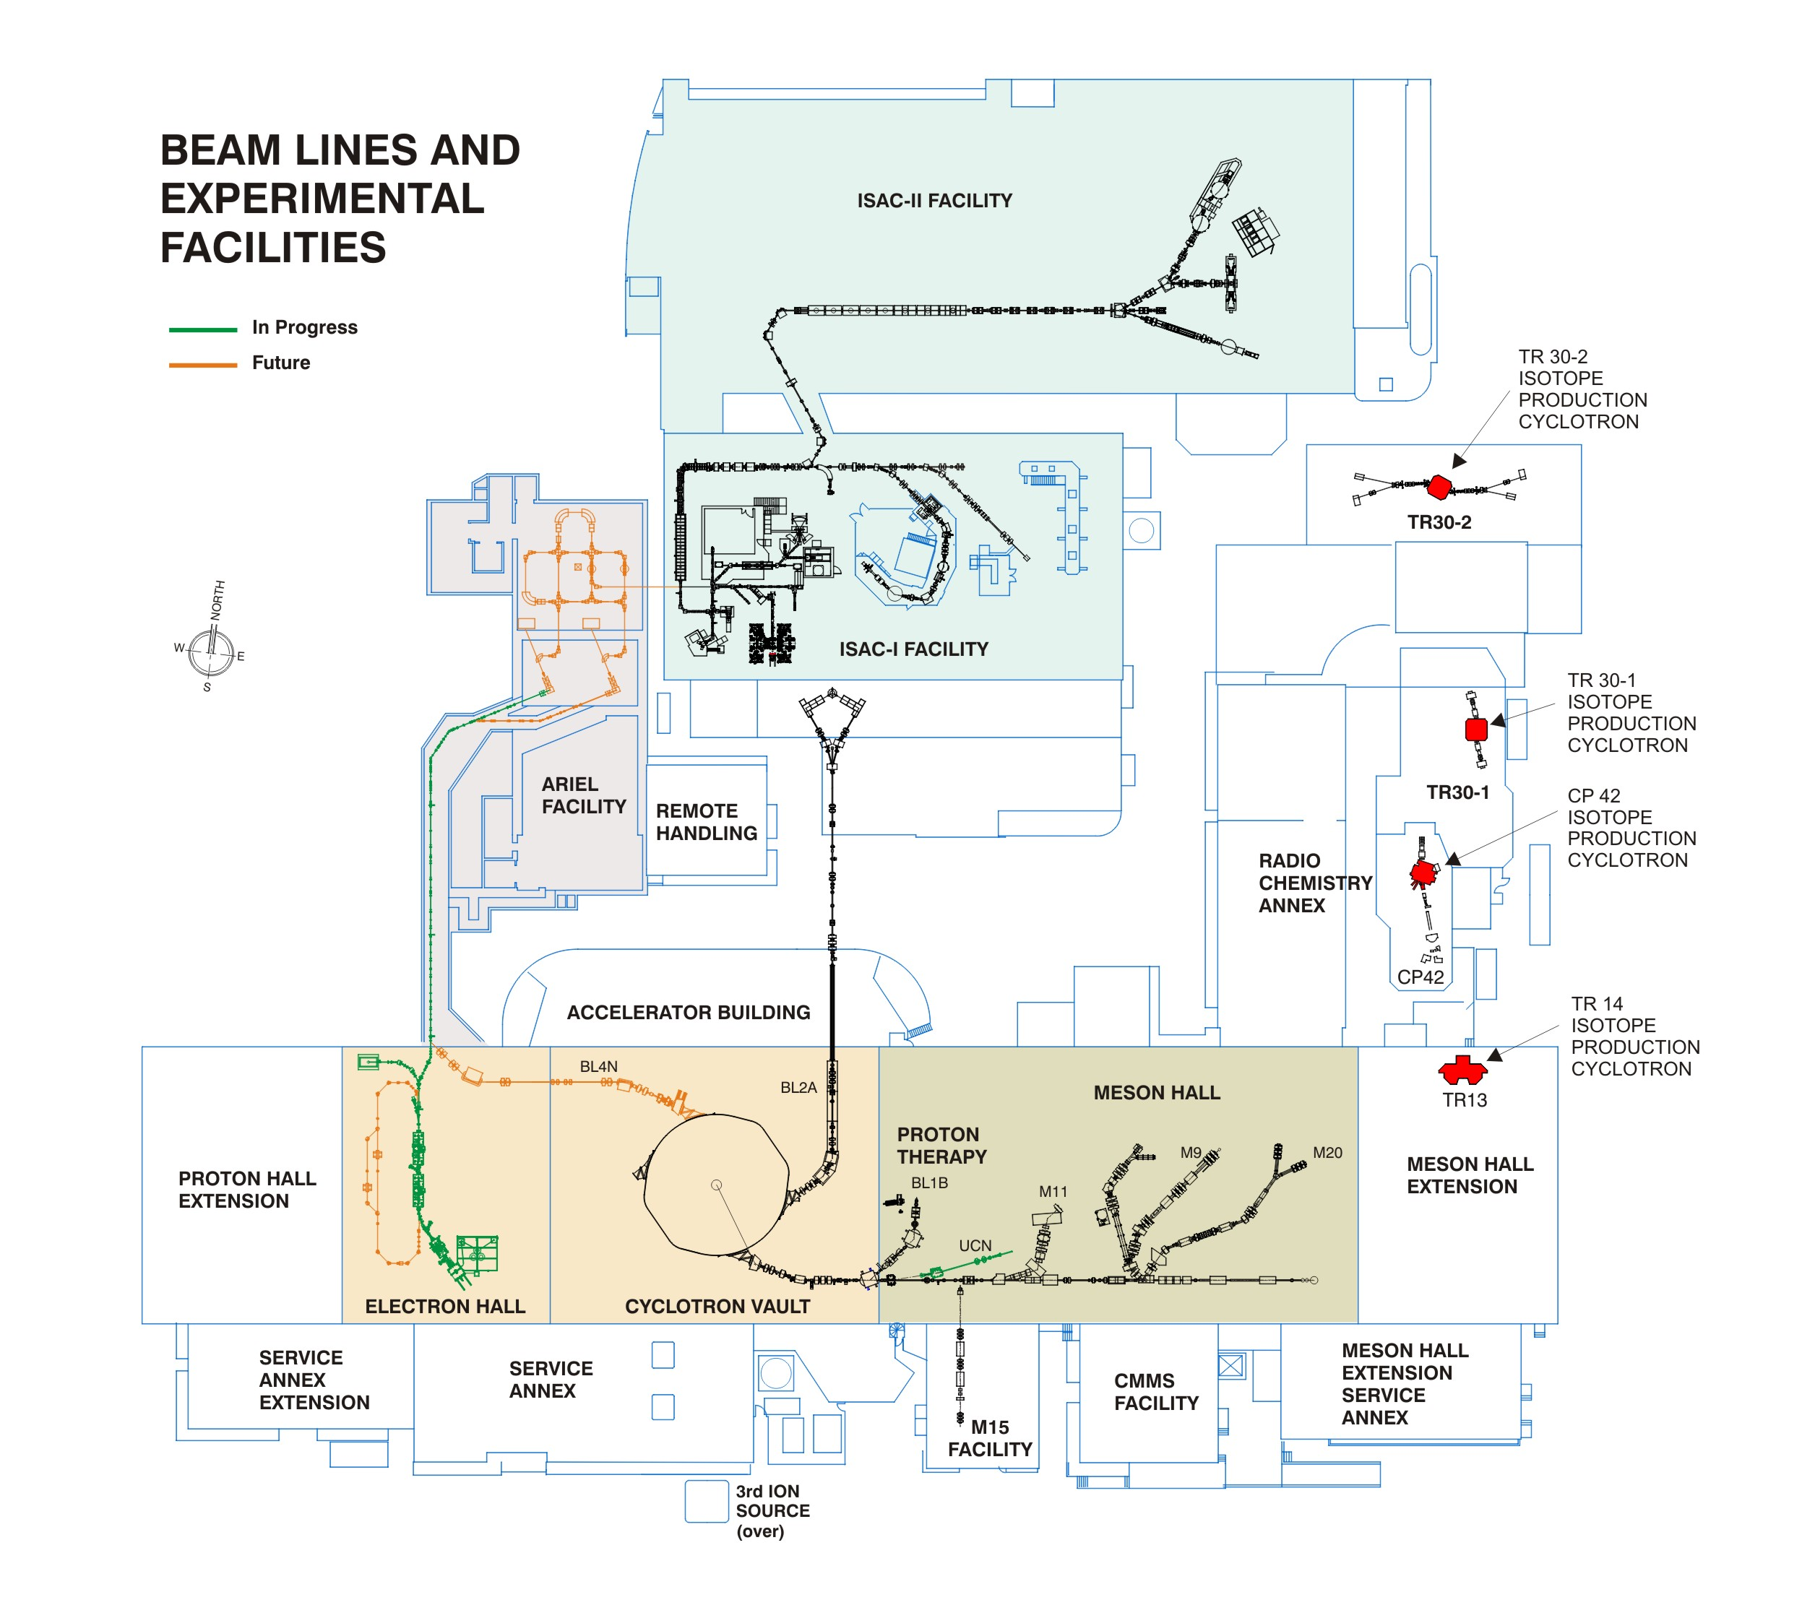
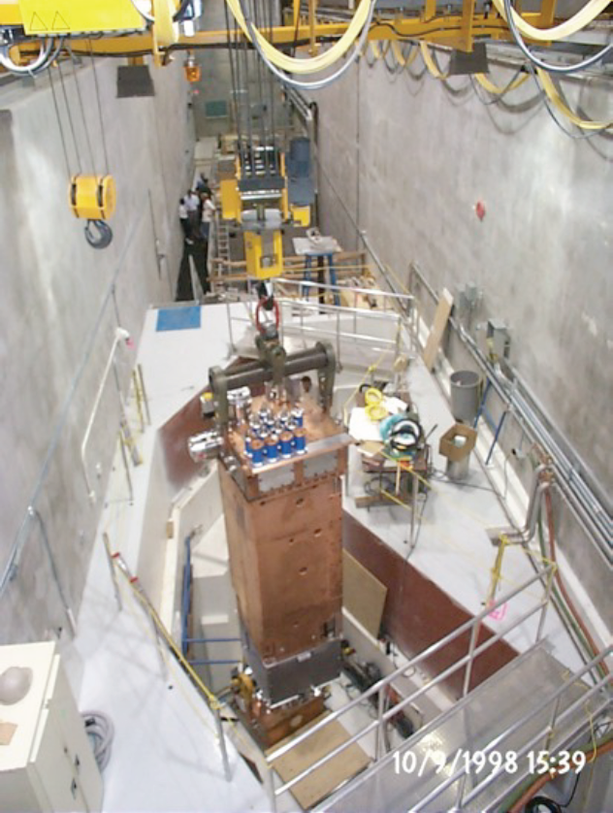
ISAC
RIB Production (since 1995)
2 target stations
Highest power ISOL driver with 50 kW 500 MeV protons
IAMI
TR24

Slide 3
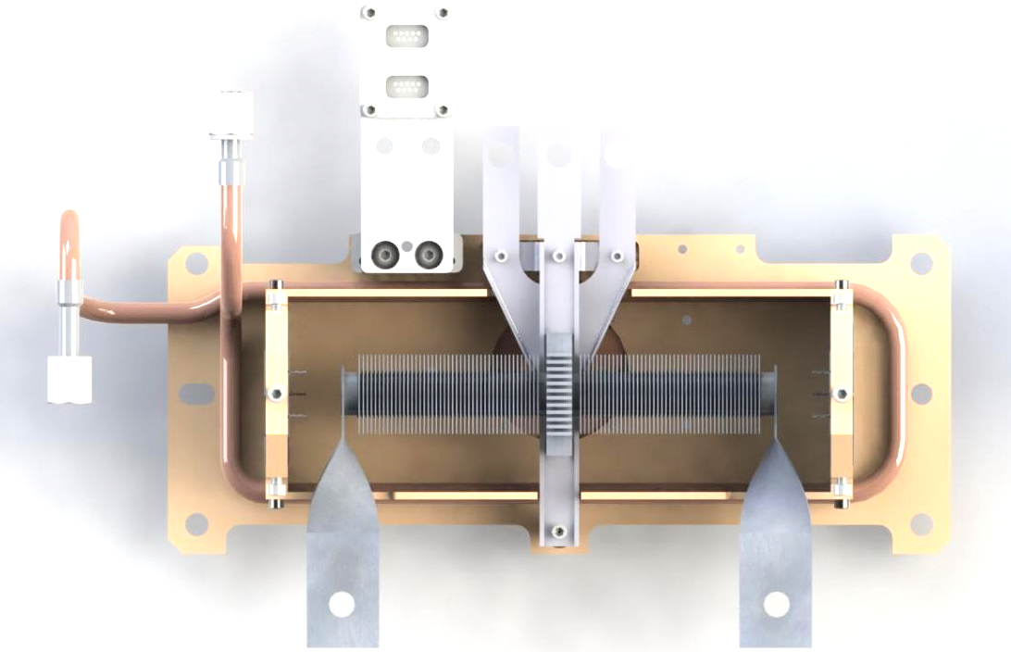
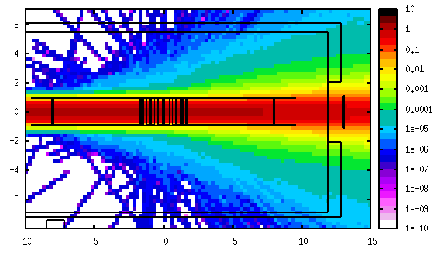
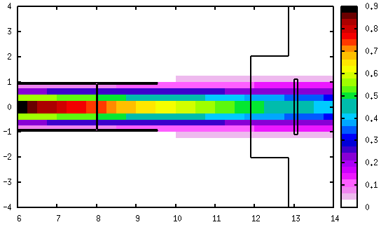
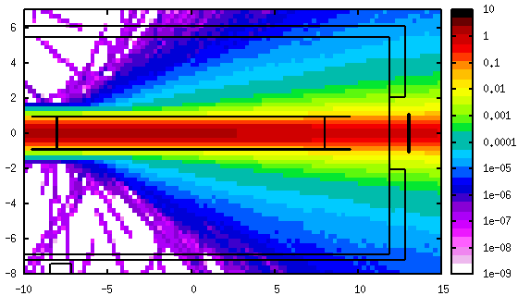
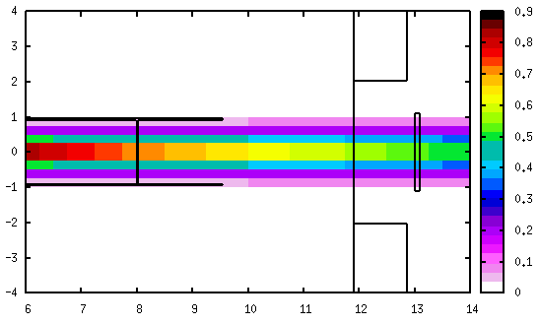
ISAC targets
500 MeV protons 7 mm FWHM
Ta
Target materials:
UC_{x}
UO₂
ThO
Nb
Ta
TaC
NiO
ZrC
TiC
SiC
SiC

Slide 4
ISAC operation
TM1
Online
Maintenance
Conditioning
Target in
Irradiation subordinated to the scheduled ISOL experiment
  Opportunistic planning necessary
TM2
4400µAh
19800µAh
3300µAh
36500µAh
13000µAh
35000µAh
3800µAh
16700µAh
23100µAh
36500µAh
2017
UCx
Ta
UCx
SiC
Ta
Ta
UCx
Ta
SiC
Ta
47600µAh
4400µAh
5300µAh
23500µAh
4000µAh
2500µAh
3800µAh
21500µAh
3800µAh
2200µAh
2018
144500µAh
UCx
Nb
Ta
UCx
UCx
nSiC
Ta
UCx
UCx
54100µAh
16900µAh
Ref irrad. 50000 µAh 1.125E+21 protons 4.5E+20 protons on sample

Slide 5
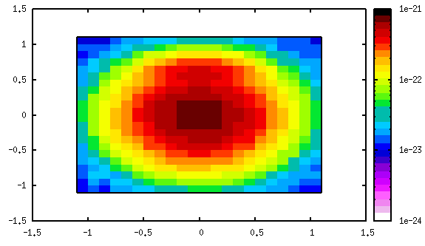
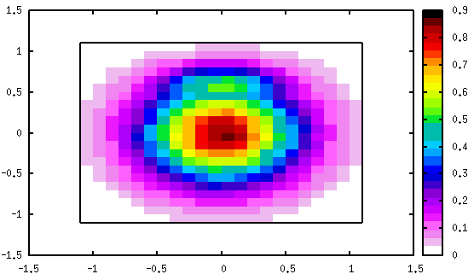
Can we do something with them?
DPA-rates downstream from a SiC target
in Fe, X-Y in cm
DPA- downstream from a SiC target
[DPA/primary proton]
[DPA@50000µAh]
Notes:
Material science:
Radiation damage in materials
Full penetration
Thermal spike – closer damage to high energy environments / reference grain growth
Full penetration (simulate thickness)

Slide 6
Can we do something with them?
He-rates downstream from a SiC target in Fe
Transmutation also generates interesting radionuclide for medical applications
Ti44 - 40MBq

Slide 7
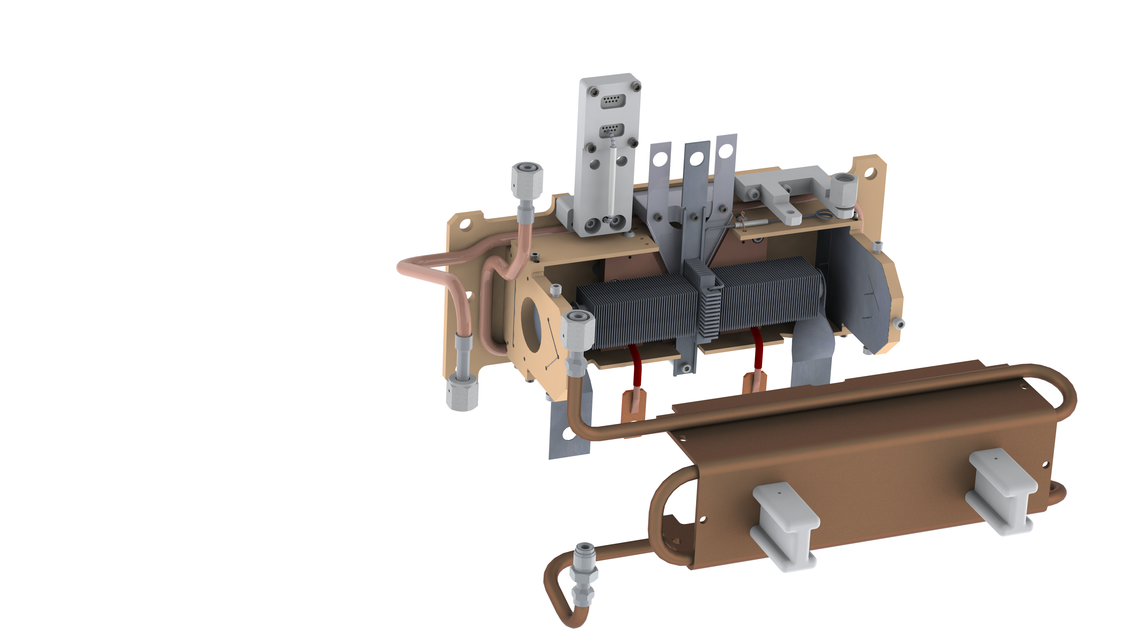
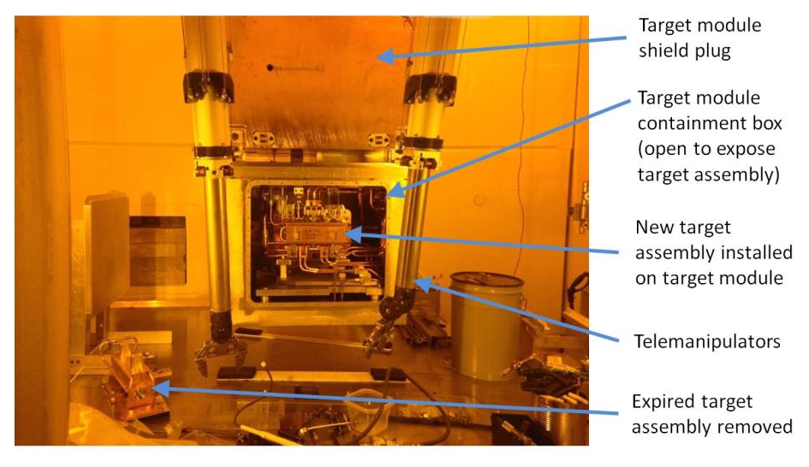
How: Target considerations
target container ~2000 °C
(Ø 20 mm, 60 cm³)
Target ion source service connections
Water-cooled heat shields
Remote handling compatible
Vacuum compatible:
  No outgassing
  No virtual leaks
Thermo-mechanical stability under proton irradiation

Slide 8
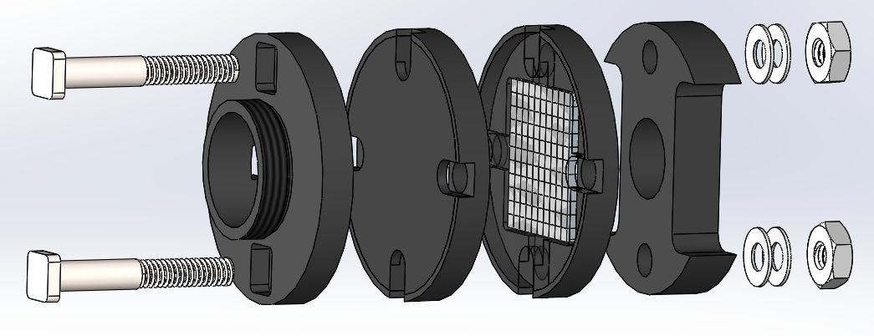
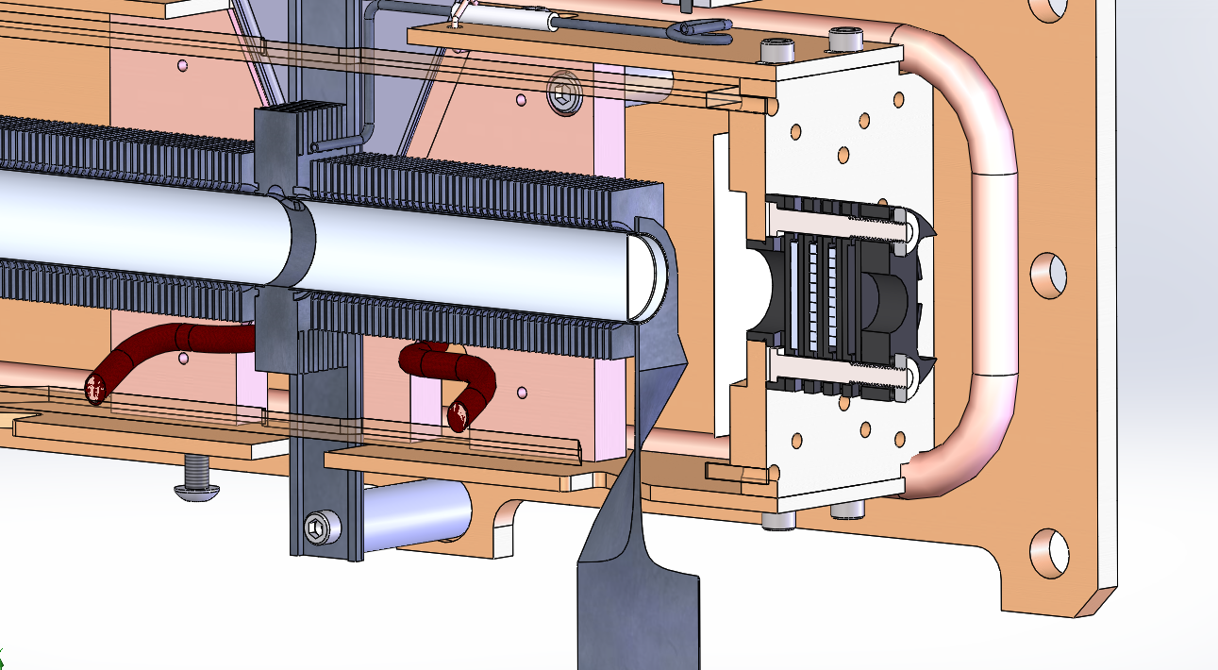
How: Materials Irradiation Studies Target
Graphite thread
Sample disc containers
Graphite handle
Belleville washers
Low energy deposition in graphite structure
Open volumes for venting
Tele-manipulator compatible handle and thread
Disc stack allows for re-organization of samples for different irradiations
Al nut
Al bolts

Slide 9
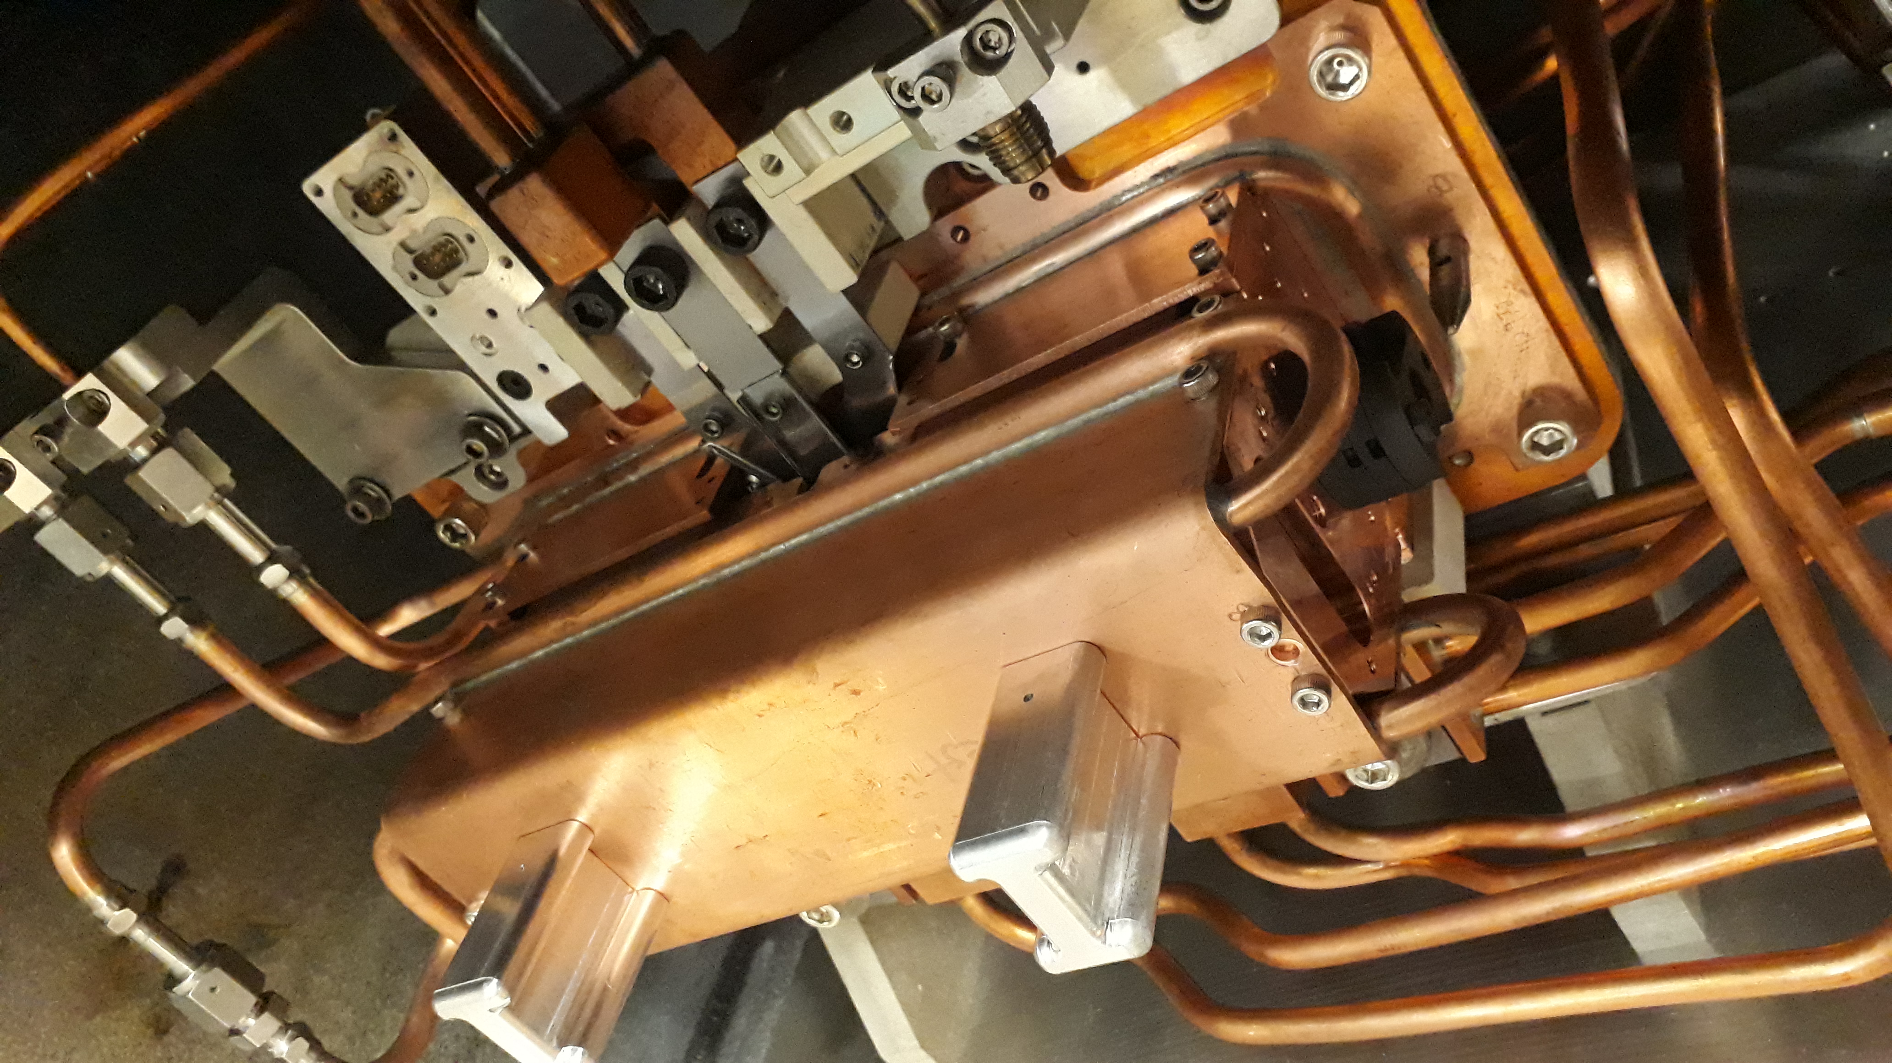
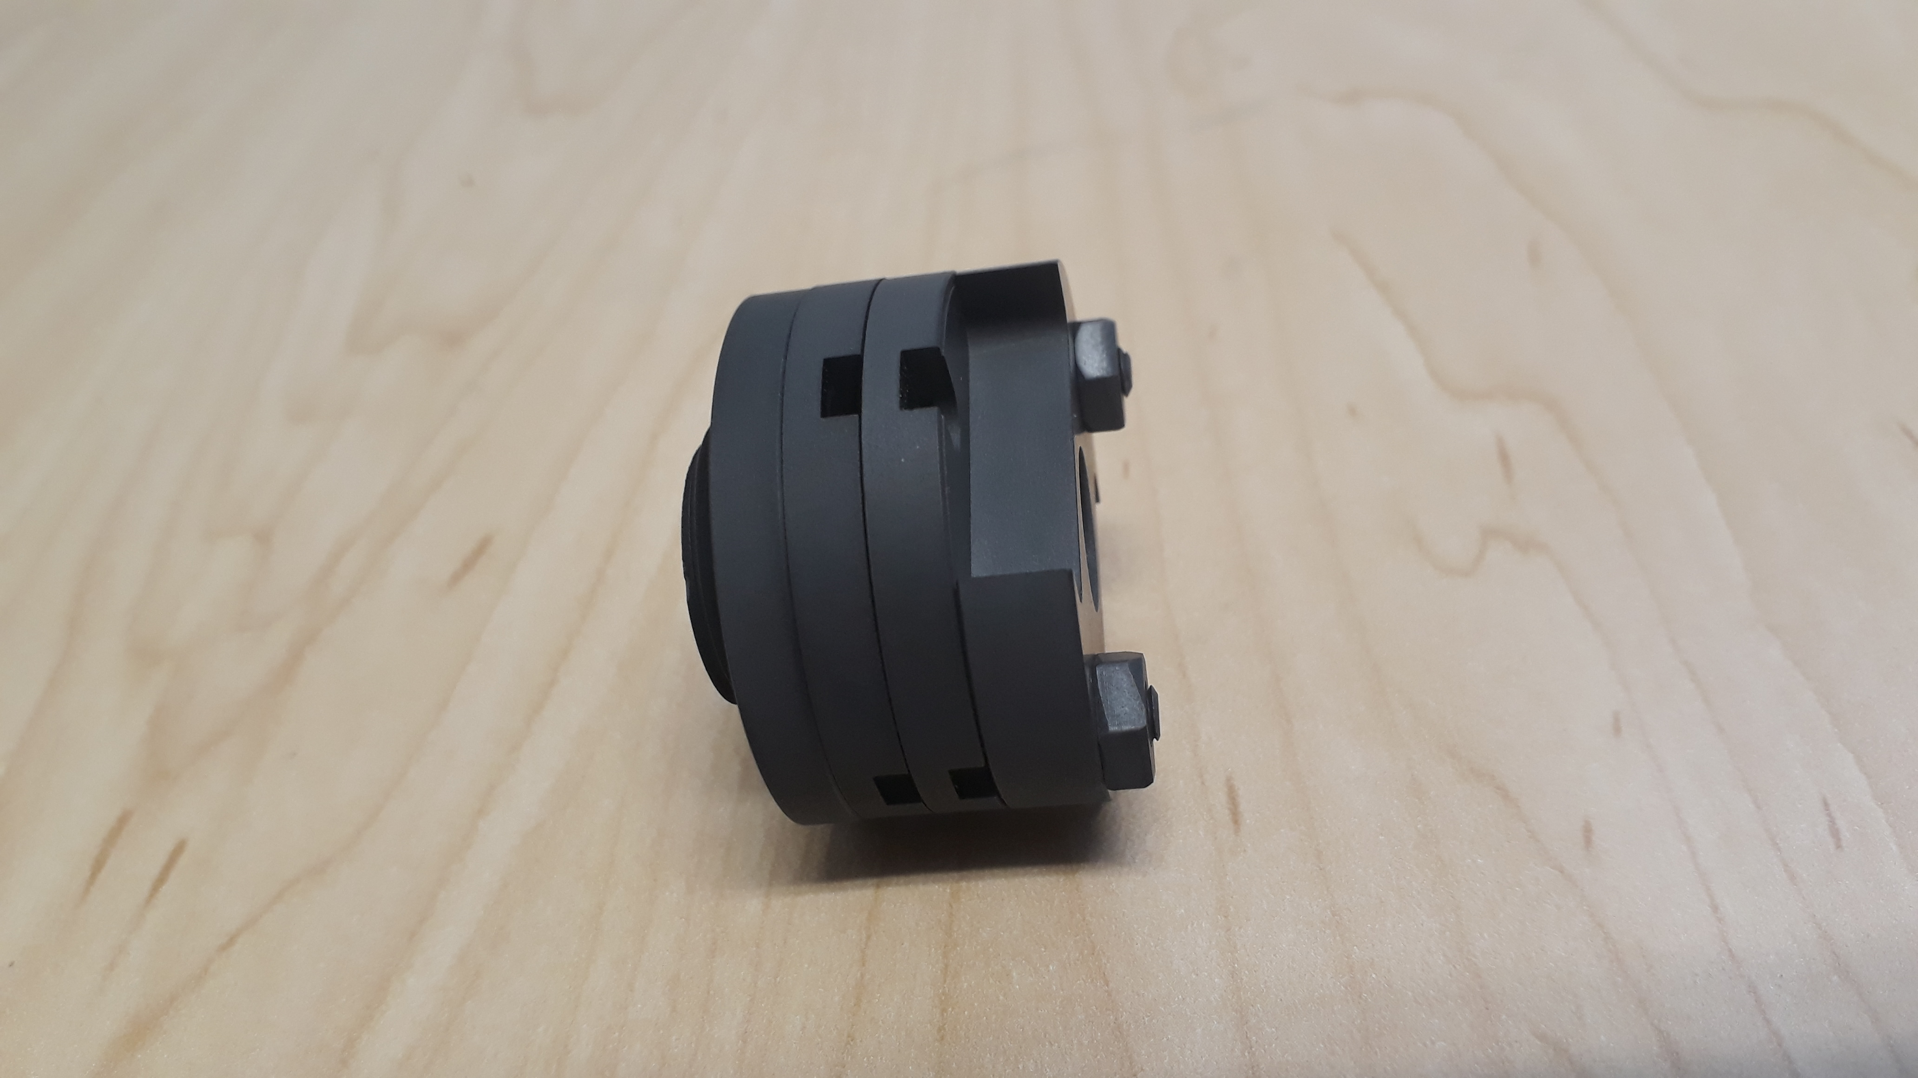
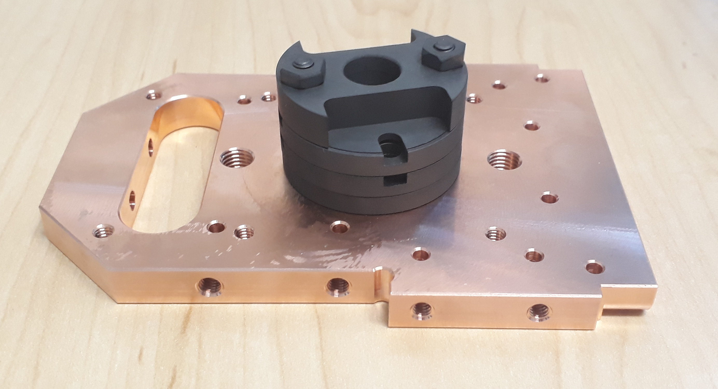
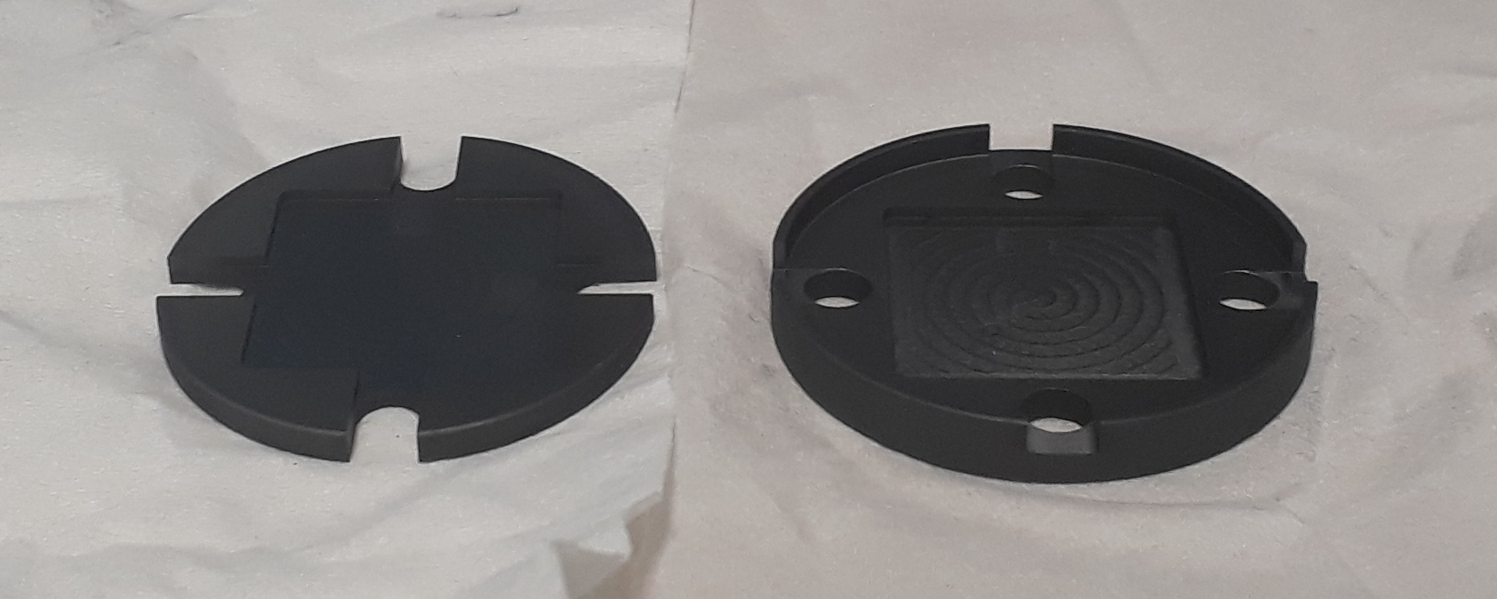
2 Disc Prototype

Slide 10
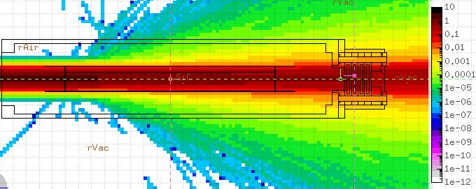
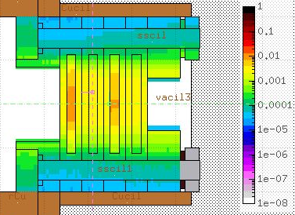
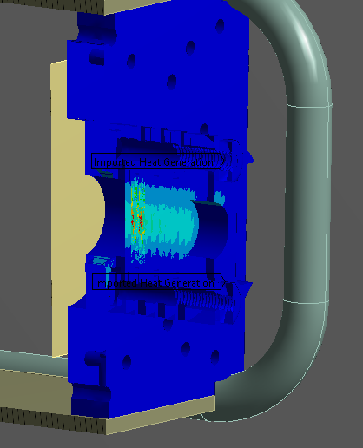
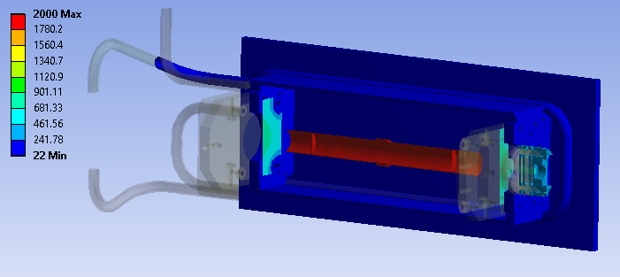
Temperatures under irradiation
[GeV/cm3/pr]
Energy deposition simulation in FLUKA
Imported results in ANSYS as heat generation

Slide 11
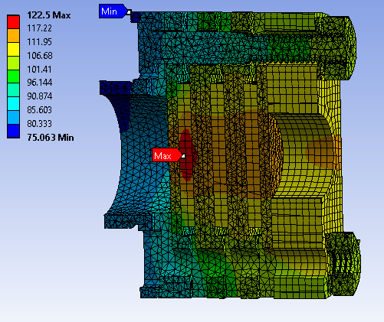
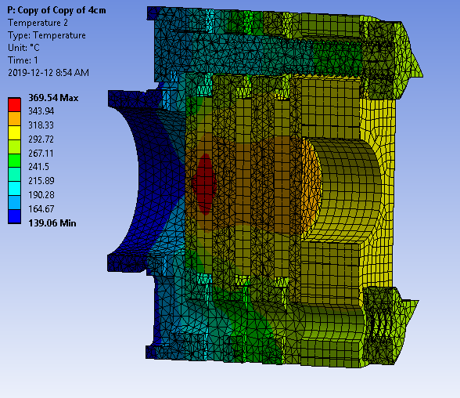
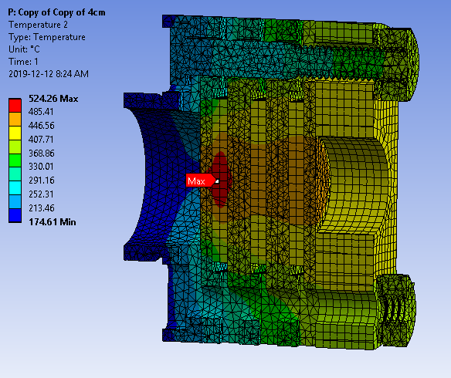
Temperatures in irradiation target
Stainless steel/Aluminum/Graphite as sample materials
Beam current: 15µA
Power deposited: 176.7W
70µA
824.6W
100µA
1178W

Slide 12
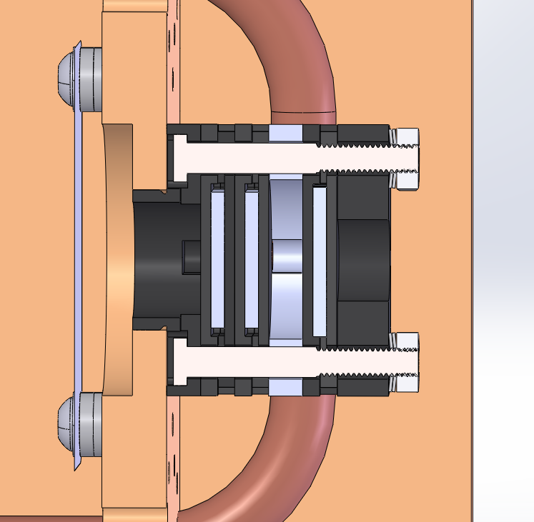
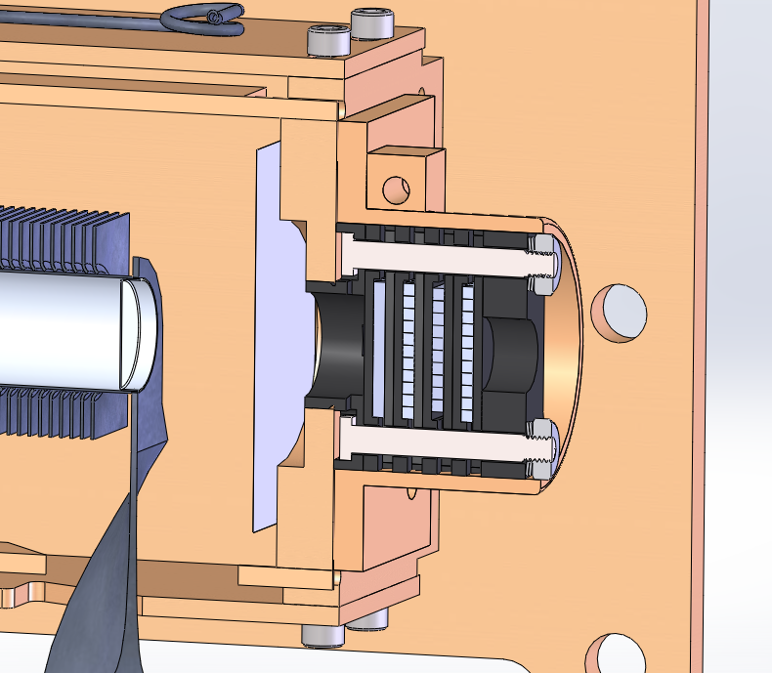
Ongoing studies
Beam intensity independent temperatures
Thermocouples
Heating elements

Slide 13
Sample doses
[µSv/h/mm3]
Dose @40000µAh & 10cm [µSv/h/mm3]
Dose @40000µAh & 1m
Dose @100000µAh & 1m
Simulated doses benchmarked with target data
Module operation “time loss” is less significant than expected
Resume dose range accepted
Decay time [Month]

Slide 14
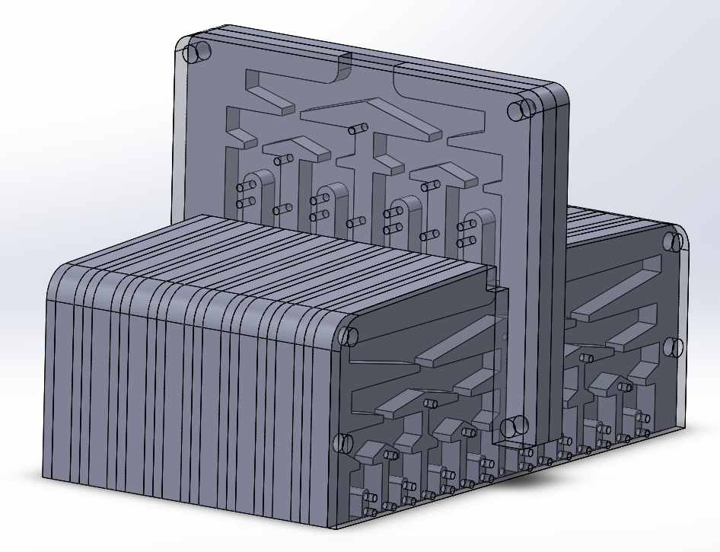
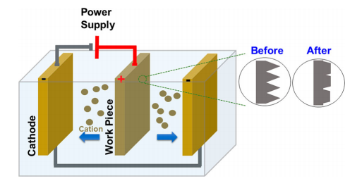
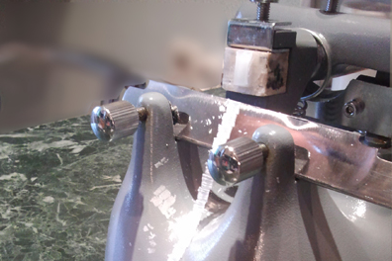
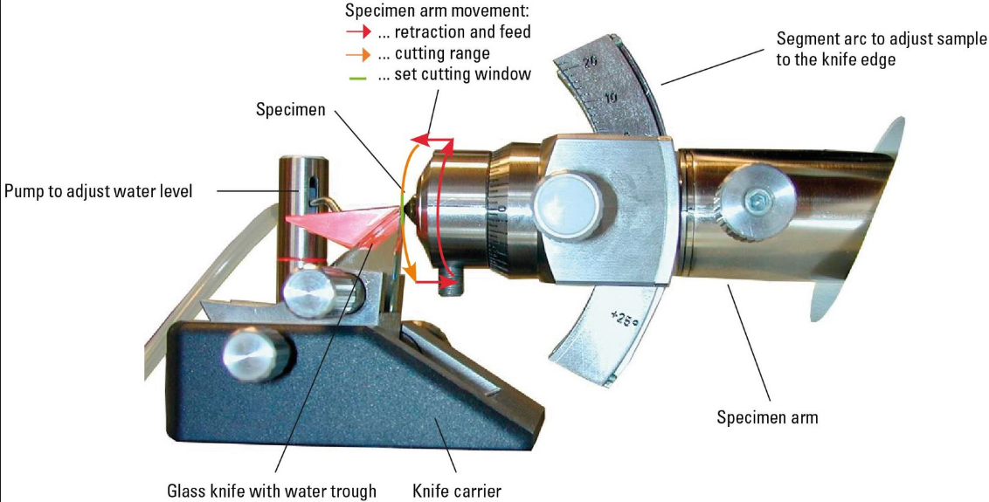
Sample preparation
Outside glovebox (“small sample”)
Reduced sample (some µm3)
Glovebox (“medium sample”)
Raw individual sample (some mm3)
  Mechanical grinding
  Electropolishing
  Ion milling
Inside hotcell (“big sample”)
Disc stack (several cm3)
  Sample Separator
By N.Fedrigo

Slide 15
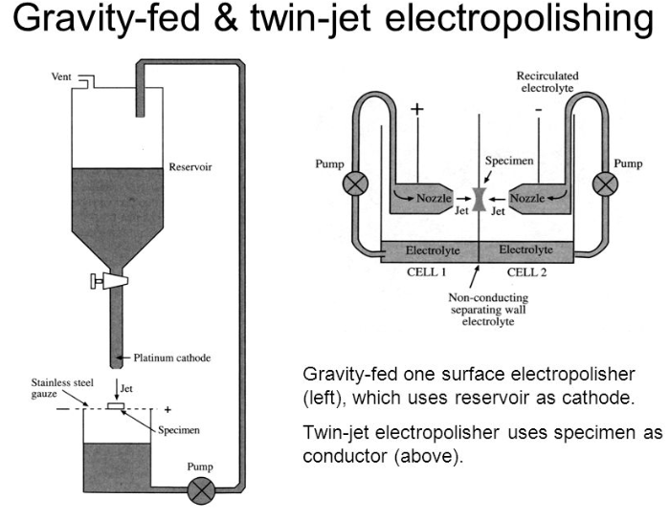
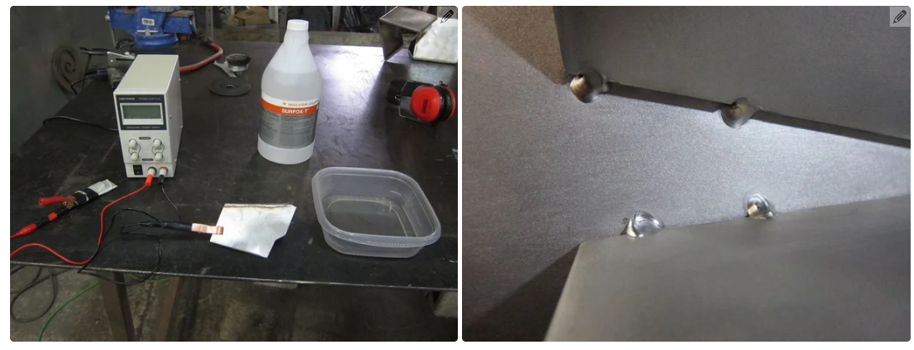
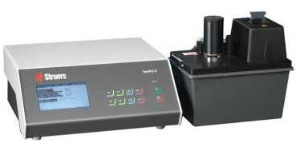
Electropolishing

Slide 16
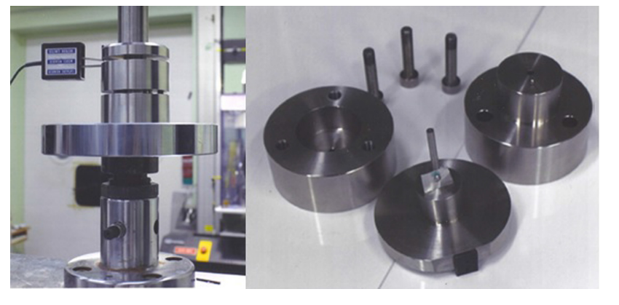
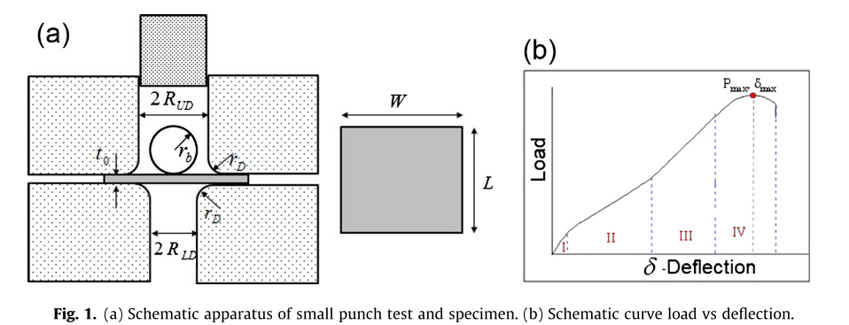
PIE
Inside hotcell (“big sample”)
Big samples for “close to conventional” mechanical testing?
  Glovebox-Hot-cell (“medium sample”)
  SPT
  Optic microscope
Outside glovebox (“small sample”)
SEM,TEM

Slide 17
Summary
Inside hotcell (“big sample”)
Disc stack (several cm3)
  Sample Separator
Load frame
Radiation damage:
(0.1 – 1) DPA
(100-300) appm of He
Glovebox (“medium sample”)
Individual sample (some mm3)
  Mechanical grinding
  Electropolishing
  Ion milling
PIE: SPT
Irradiation temperatures:
(150-600)ºC beam intensity dependent
Ongoing studies to increase temperature boundaries
Outside glovebox (“small sample”)
Reduced sample (some µm3)
PIE: SEM/TEM
New materials will be developed
These materials final experimental test will have to be performed under real High power beam conditions

Slide 18
Thank you
Acknowledgments
Alexander Gottberg, Ricardo Manuel dos Santos Augusto, Fernando Maldonado, Marla Cervantes, Mia Au, Luca Egoriti, Anders Mjos, Chad Fisher, Aaron Schmidt, Darwin Ortiz Rosales, Valery Radchenko, Thomas Day Goodacre, Carla Babcock, Roger Caballero, Matthew Gareau

