Slide 1
Durability Test of Additive Manufactured Target for Isotope Harvesting Experiments
E. Paige Abel, Katharina Domnanich, Colton Kalman, Wes Walker, Todd Barnhart, Jonathan Engle, Greg Severin
Graduate Student

Slide 2
Isotope Harvesting
Way to use “left-over” accelerated beams for isotope production
  Interested in longer-lived radionuclides
  Useful for a wide-range of applications
Isotope Harvesting at the NSCL:
>90% of primary beam remains
Flowing-water Target
Dipole Magnet
Collection
Water system
Foil Target
Primary beam
Mixed primary and secondary beams
Secondary beams
Notes:
Important point: currently 90% primary beam goes into metal block but if we replace this with a flowing water target, we can make radionuclides in the water with this excess beam

Slide 3
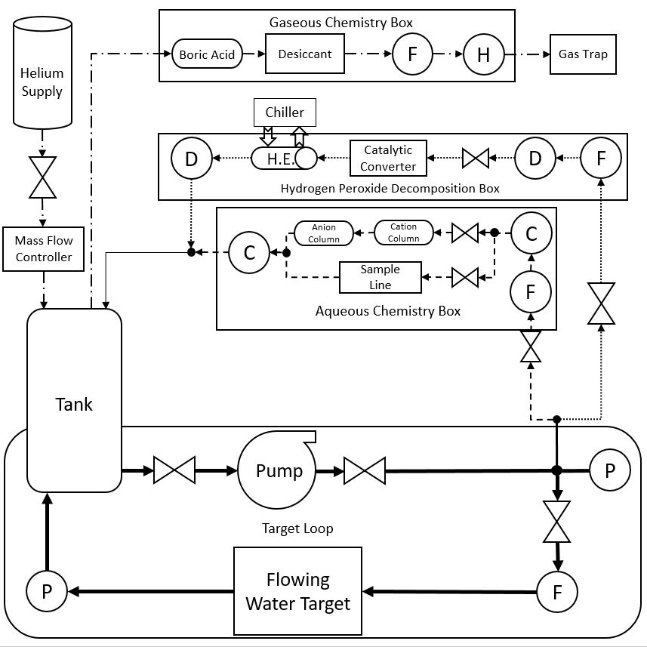
Isotope Harvesting Water System
Water Purification System
36 L
11 L/min
Target loop
Notes:
Overview of target system:
Water purification system- won’t talk about this
Target loop: reservoir (36 L), pump (11 L/min), flowing-water target

Slide 4
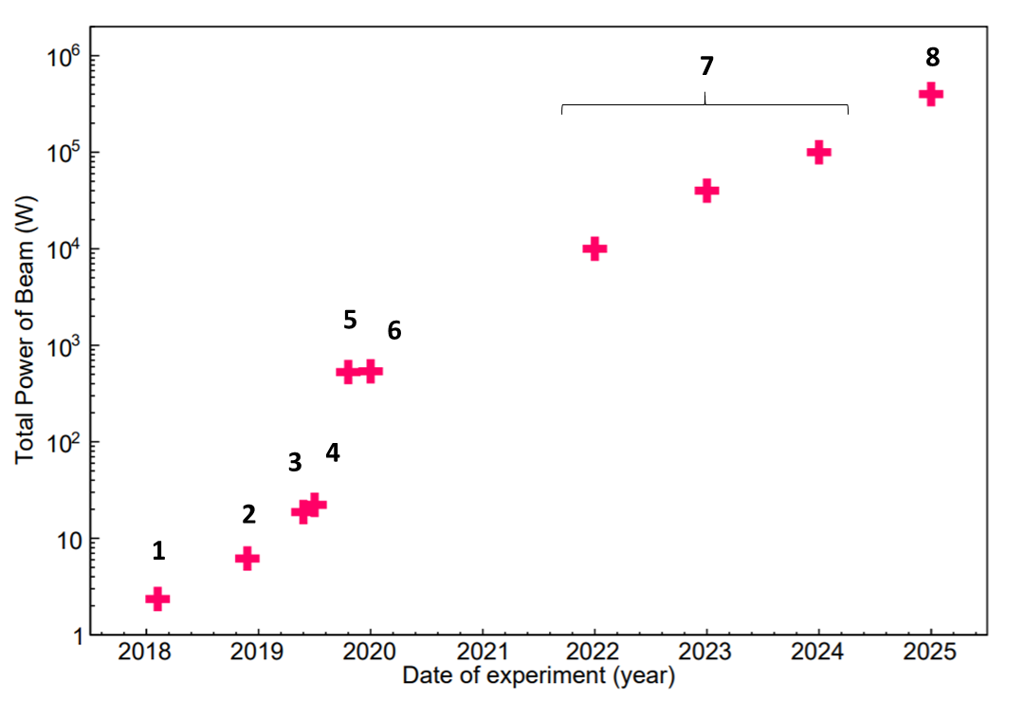
Isotope Harvesting at FRIB
Areas with open questions:
  Chemistry in water system
  Durability of material in system
  Radiolysis effects
Current efforts are “practice” for harvesting at FRIB
Beam Power Comparison
Higher intensity beam
  Higher isotope production
  Potentially more effects from
  radiolysis
Notes:
Bullets:
-We’ve been able to do some low intensity experiments (shown in plot)
-Many open questions we have been trying to answer
-This is practice for harvesting at FRIB with much higher beam intensities (plot)
-These questions become much more important as we increase beam power

Slide 5
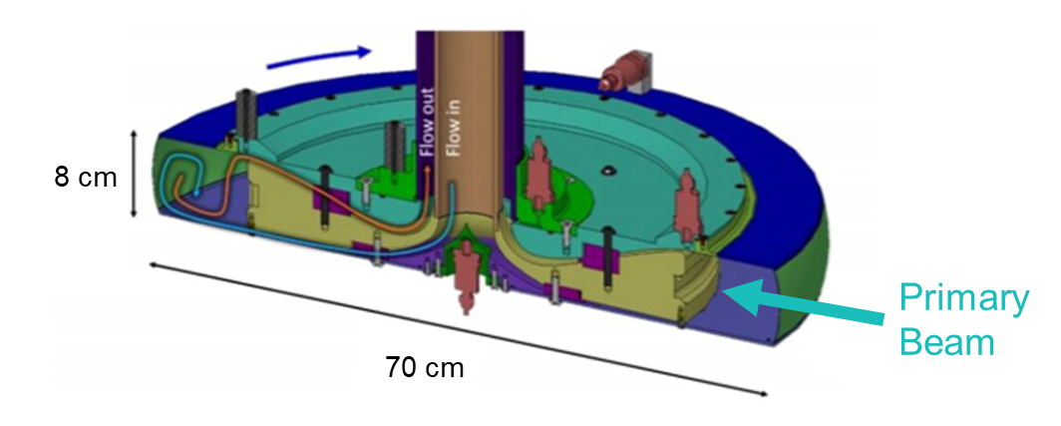
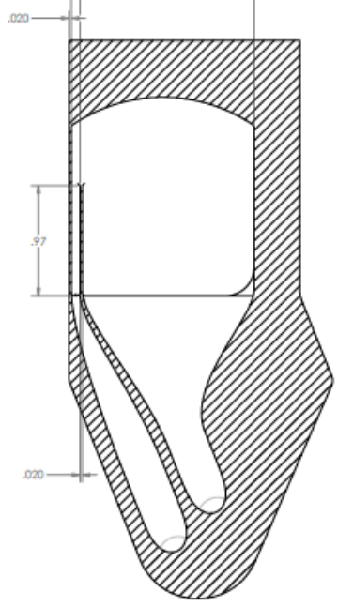
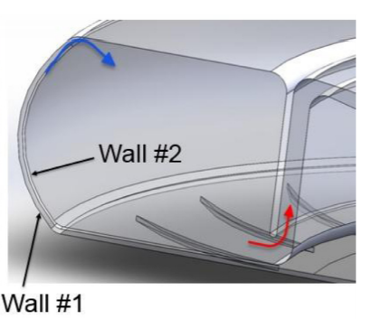
Miniature Beam Dump
FRIB Beam Dump
Prototype Beam Blocker
Primary Beam
12.5 cm
Water in
Water out
Avilov, M; et.al. Thermal, mechanical and fluid flow aspects of the high power beam dump for FRIB. Nucl. Instrum. Methods Phys. Res. B, 2016, 376, 24-27.
Notes:
“Practice” so want to model our beam blocker after FRIB beam dump
Explain FRIB beam dump:
Show where primary beam goes in,
explain rotation with the arrow (###),
show water flow path in stem and in zoomed in picture,
explain small gap
Compare features to prototype:
Beam in same spot throughout
Water in/water out (6 gpm)
Small 2 mm gap
Size/shape to replace current NSCL beam blocker

Slide 6
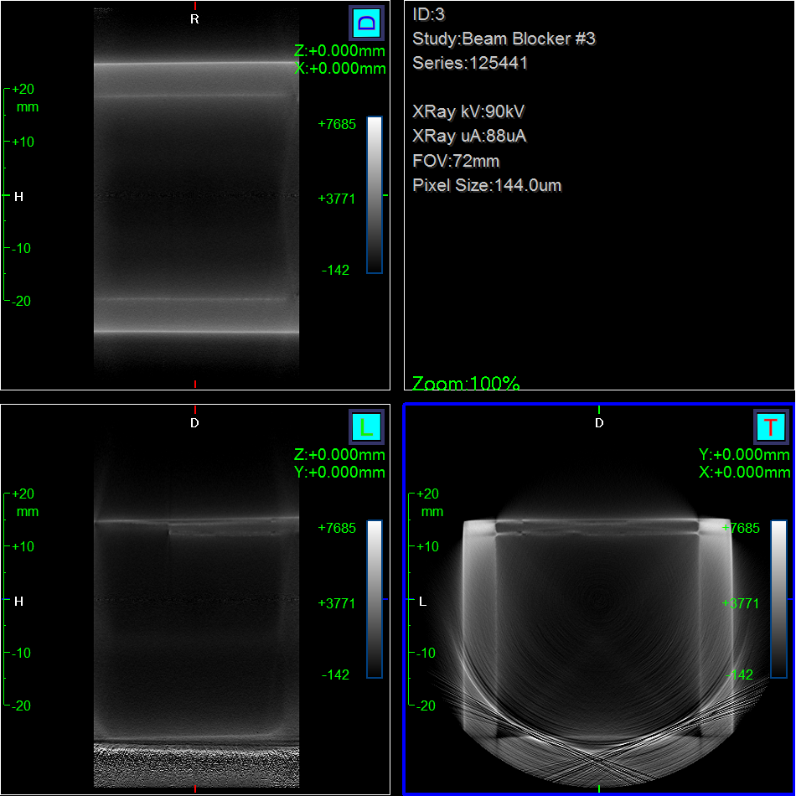
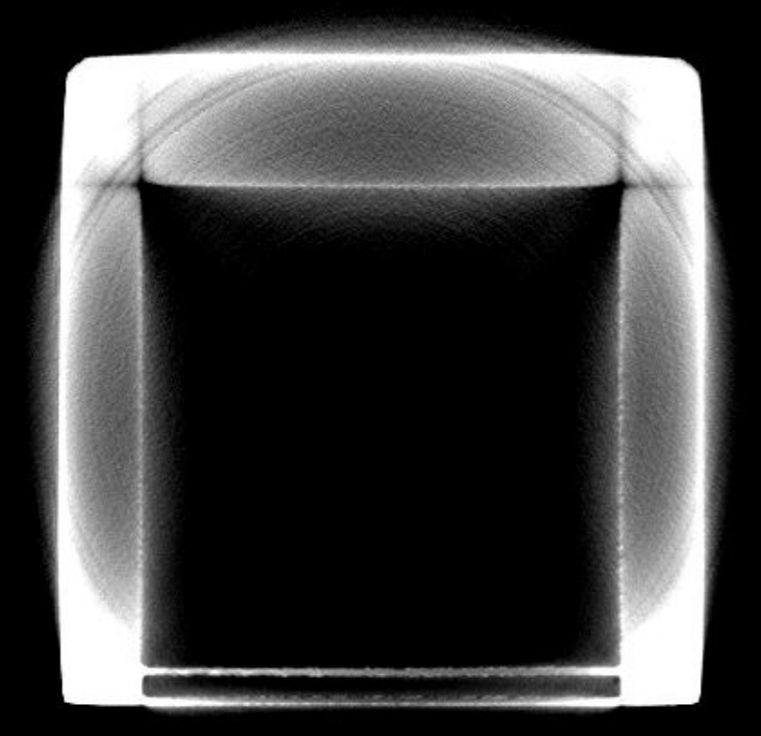
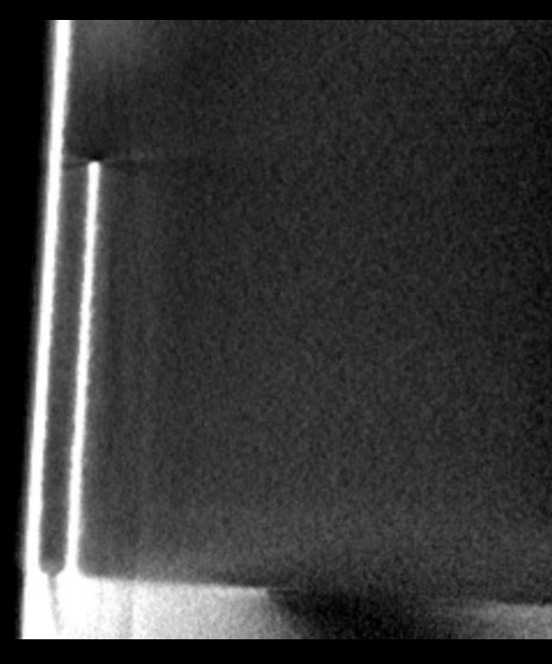
Production of Target
3D printed
  Ti64 alloy powder (EOS Ti64)
  Direct metal laser sintering (DMLS)
CT image of the product
  Measured thicknesses of thin walls
  Looked for bubbles in the walls
Testing the target:
  Irradiate with high beam current
  Look for evidence of degradation in target material
Notes:
CT setting:
90 kV
88 uA
1 hour scan

Slide 7
Proton Irradiation: Radiotracer
Target Face
Inner Wall
Water:
¹⁶O(p,α)¹³N
¹⁸O(p,n)¹⁸F
Target Face:
⁴⁸Ti(p,n)⁴⁸V
⁵¹V(p,n)⁵¹Cr
⁴⁸V
⁴⁸V
p⁺
p⁺
⁴⁸Ti
⁴⁸V
¹⁶O
¹³N
⁴⁸V
Water in
Water out
Notes:
Bullets:
-did produce RN in water portion->isotope harvesting method
-what we were interested in was RN produced in the target shell
-production during irradiation and anything that went into the water was measured in the bulk water indicating corrosion

Slide 8
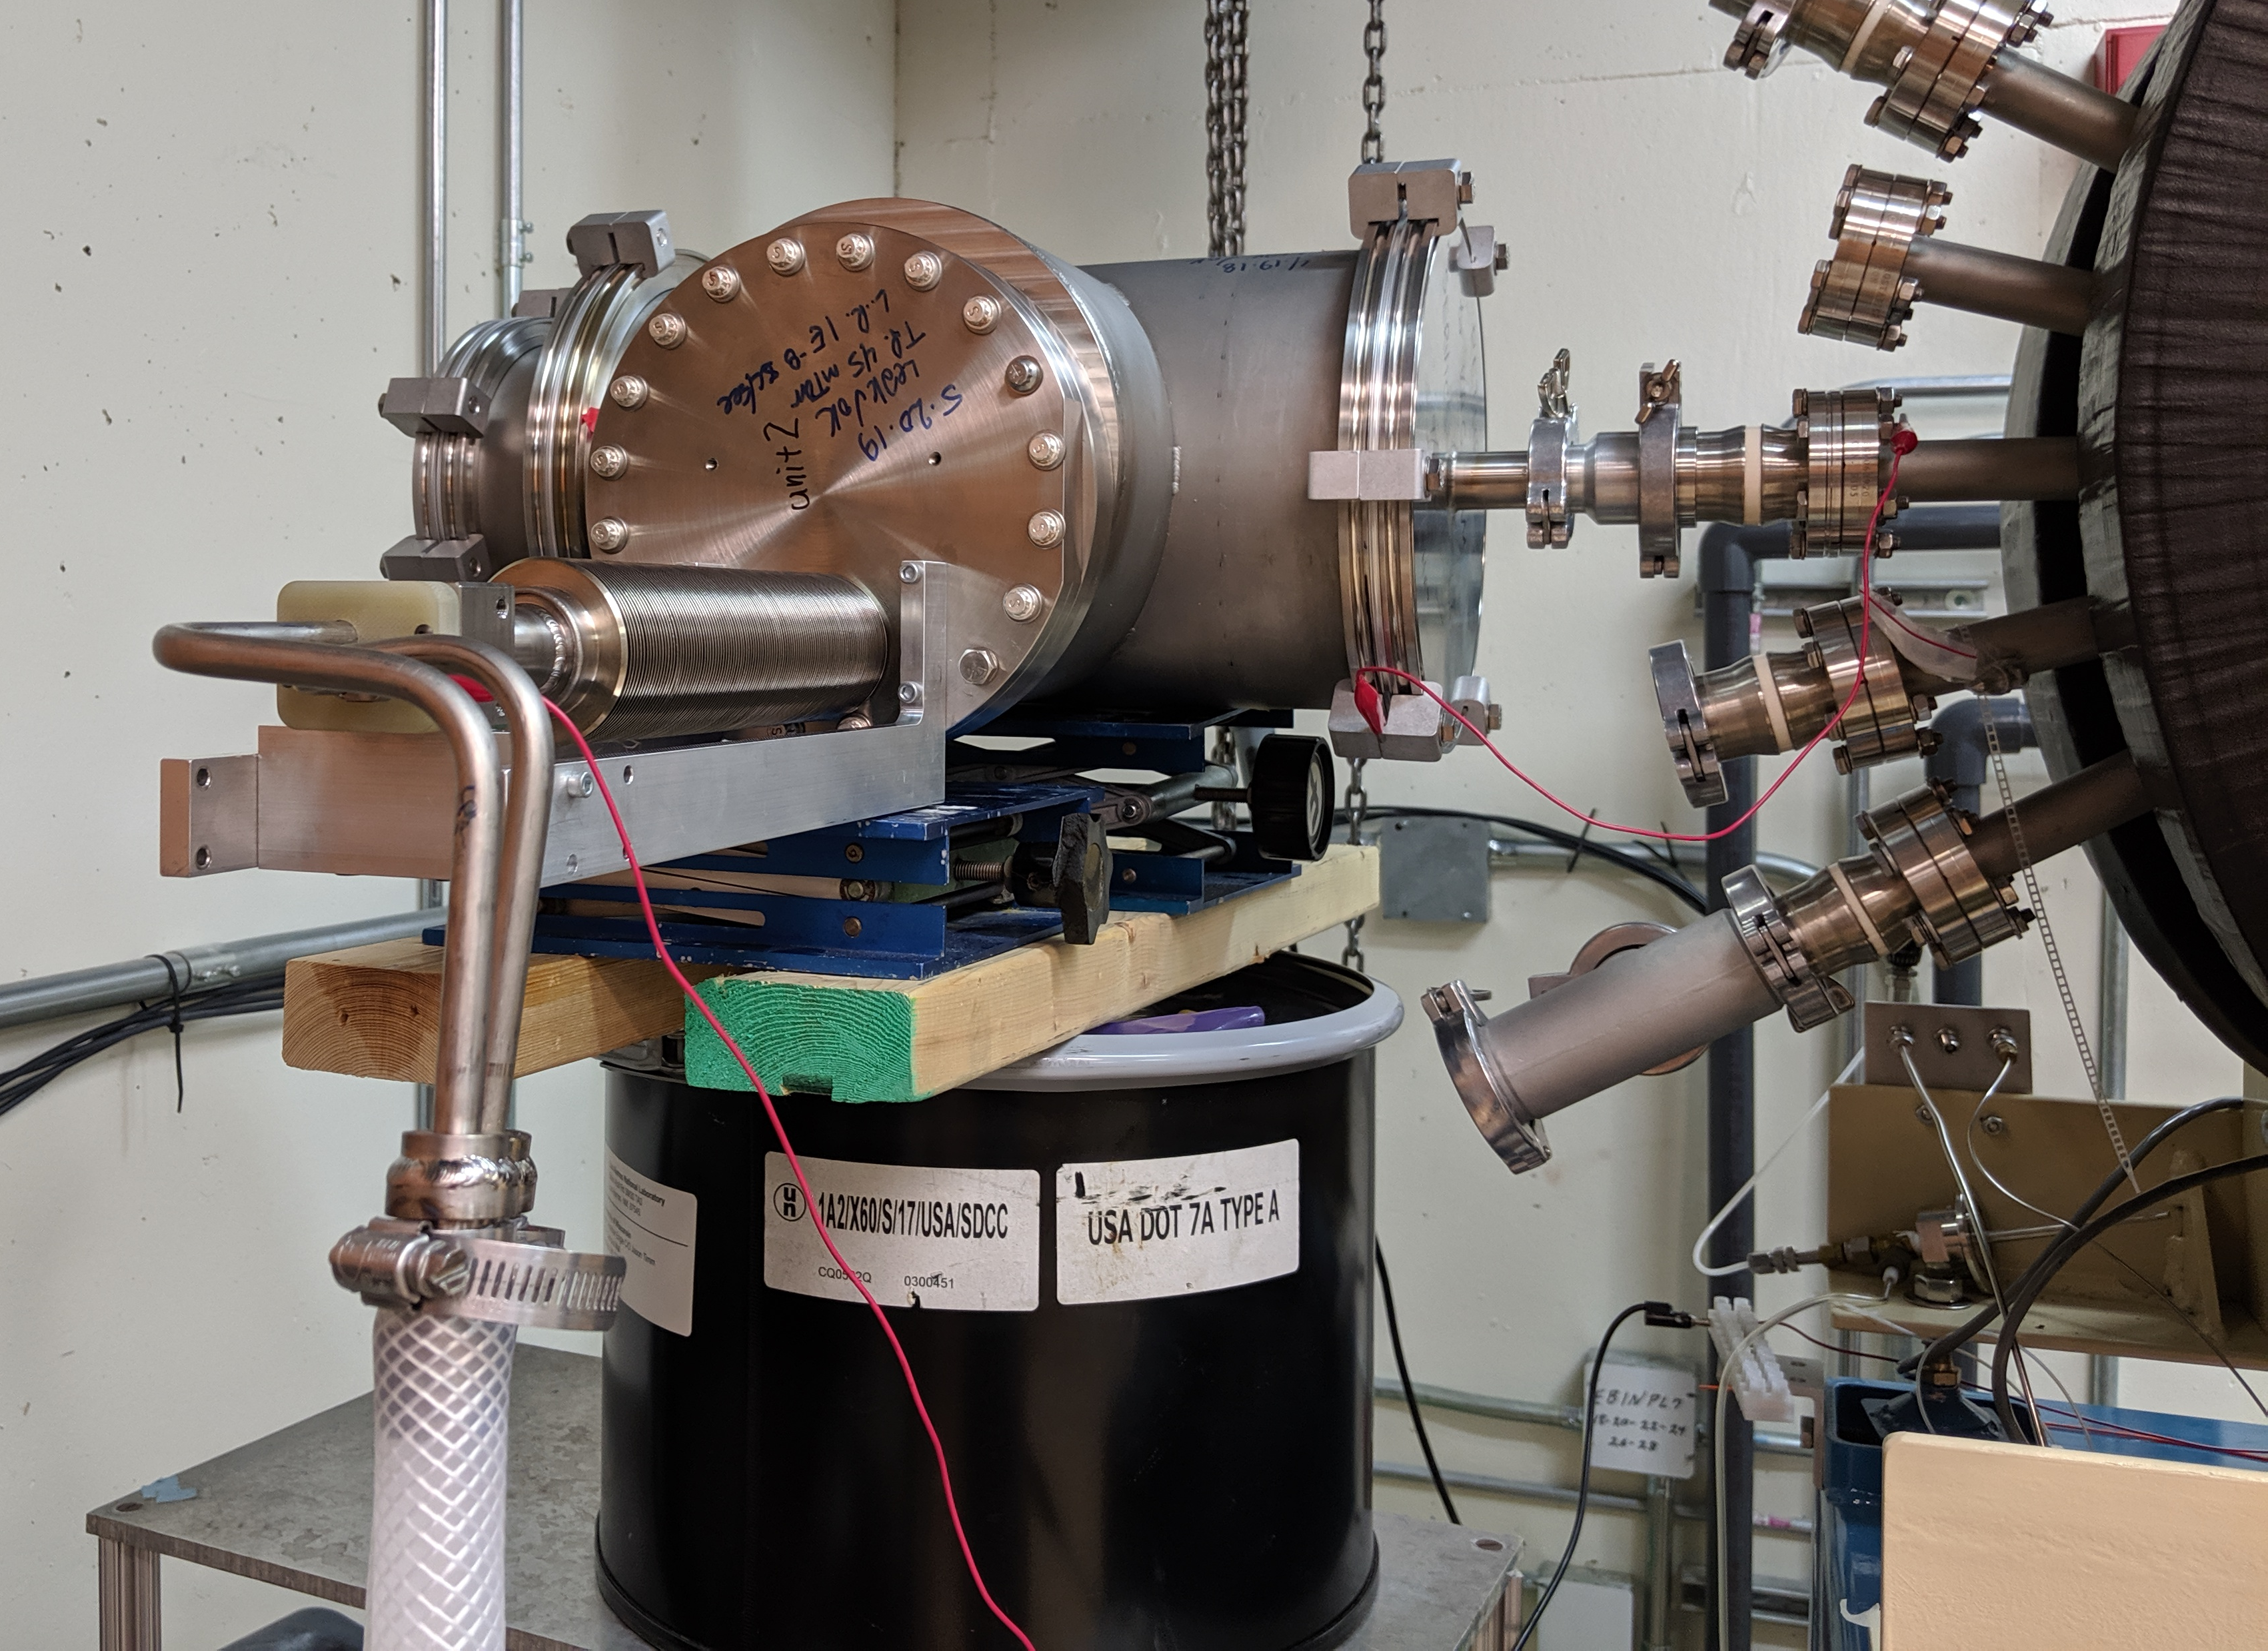
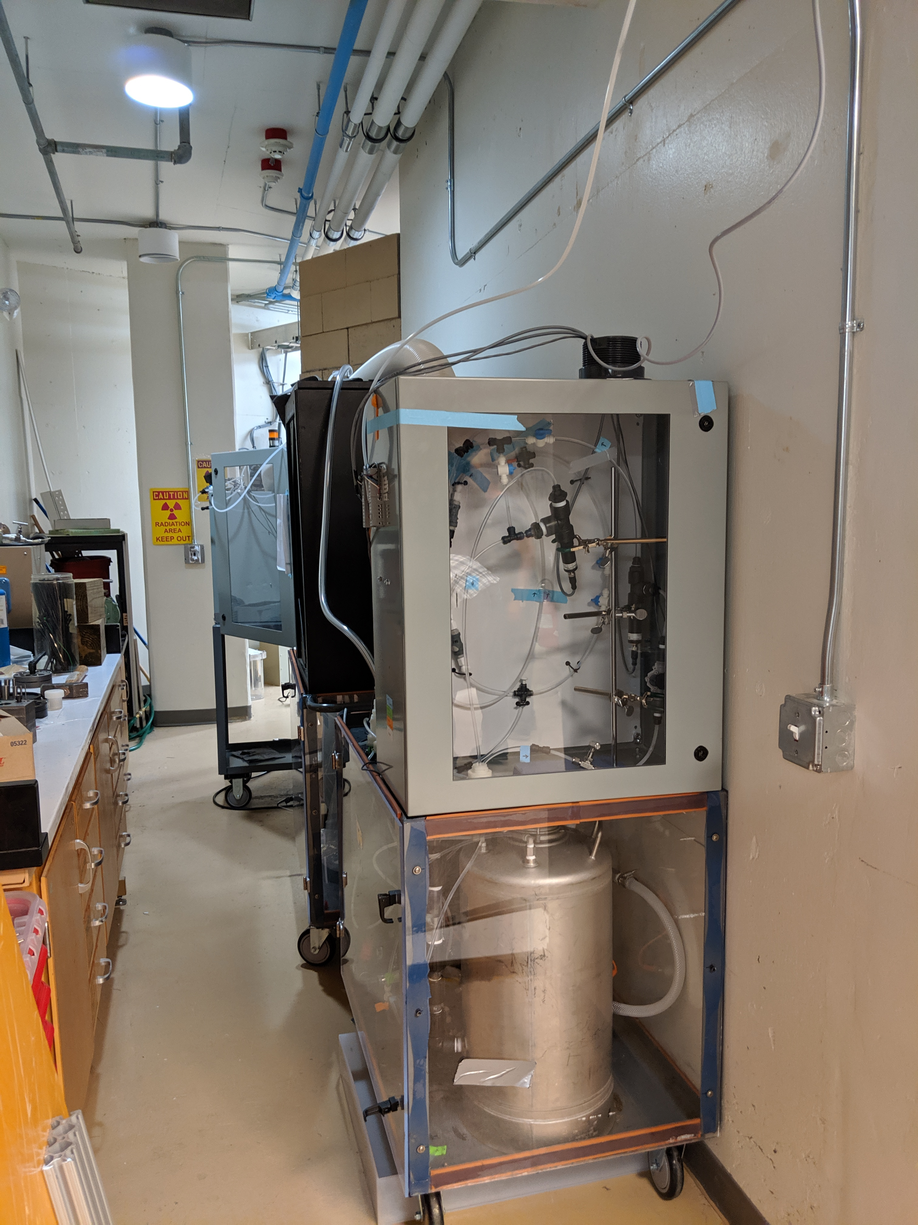
Proton Irradiation Experiment
16 MeV protons from University of Wisconsin Cyclotron Lab
  4 irradiation periods: 6, 19, 28, 33 µA
Measurements
  Activity of ⁴⁸V in system water after each period
  Total activity of ⁴⁸V in target face
One complication: nuclear recoil
  Forward momentum transfer
  Estimated activity that left the window
Alexander, J.M.; Sisson, D.H. Recoil Range Evidence for the Compound-Nucleus Mechanism in Reactions between Complex Nuclei. Phys. Rev. 1962, 128, 2288.

Slide 9
Quantifying Target Degradation
Basic model:
  Small time steps
  Accumulation of ⁴⁸V in target face
  Degradation of ⁴⁸V into the water
    Dependence on beam current and activity in target face
    Remove activity from nuclear recoil
Rate: 1.47E-6 µm/(µA*s)
(X² = 1.4)
Is this a sufficient model?
How does this apply to NSCL and FRIB beams?
Notes:
Bullets:
-point to data points and fitted model in graph
-Talk about model
-Mention rate and that we have tried to scale this to apply to beams at the NSCL

Slide 10
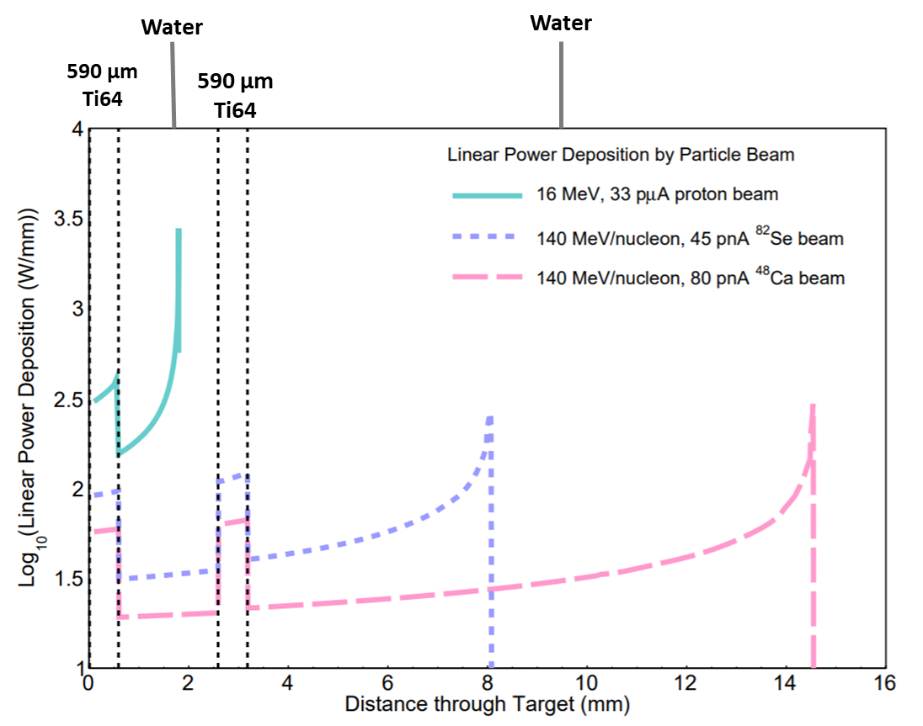
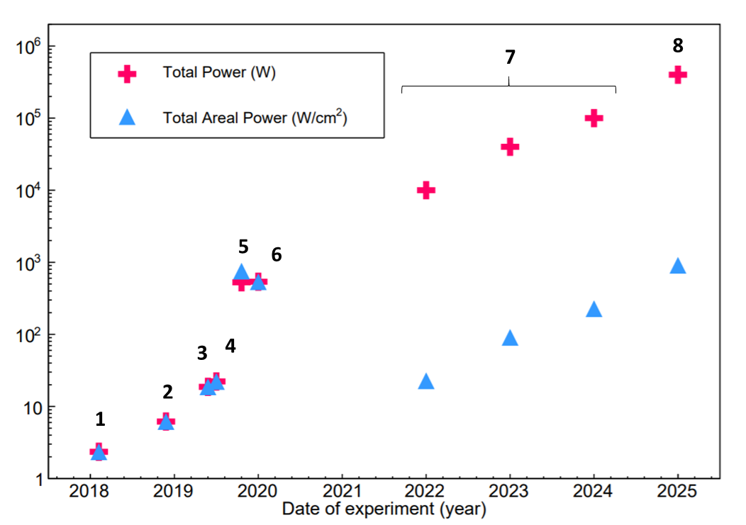
How to Extrapolate?
Average power deposition at the interface of the window and water
Scale degradation rate by areal power deposition
Notes:
Bullets:
-These are a few ways that we applied this measurement to heavy ion beams
-One thing we needed to understand was how to compare the power deposition of the proton beam with heavy ion beams we would use at the NSCL (graph showing power deposition moving through the target)
-Most important comparison is at the interface between the target face and the water
-Compare areal beam power instead of total power

Slide 11
Durability Extrapolation
Extrapolated the time until 10% of the window thickness degrades
Indicates that beam blocker could be safely used at the NSCL for the rest of the year
Use at the NSCL can show us wear on the beam blocker
Unsure how to extrapolate this to situation at FRIB beam dump
Facility | Nucleus | Energy (MeV/nucleon) | Intensity (pps) | Areal Power Deposition (W/cm²) | Time until 10% Degraded (h)
UW-M | ¹H | 16 | 3.12E+14 | 449.9 | 100
NSCL | ⁴⁸Ca | 140 | 4.99E+11 | 34.4 | 1500
NSCL | ⁸²Se | 140 | 2.81E+11 | 55.3 | 900
Notes:
Bullets:
-Based on the measured corrosion rate, made some estimates for irradiation time until 10% is degraded
-Showing these particular beams at the NSCL- 100s of hours of irradiation
-Confidence that BB is safe to use at the NSCL for an extended period of time
-Unsure how to extend this to the beam dump at FRIB because we have a lot of unanswered questions

Slide 12
Reservations and Discussion
What mechanisms of degradation dominates?
How does degradation change with mass, energy, intensity, temperature, etc.?
Are hardening and conditioning effects possible?
What target thickness is safe for operation?
Ideas?
  Better way to extrapolate degradation rate?
  Is there a well-established way to calculate recoil rates?
  Any other suggestions?

Slide 13

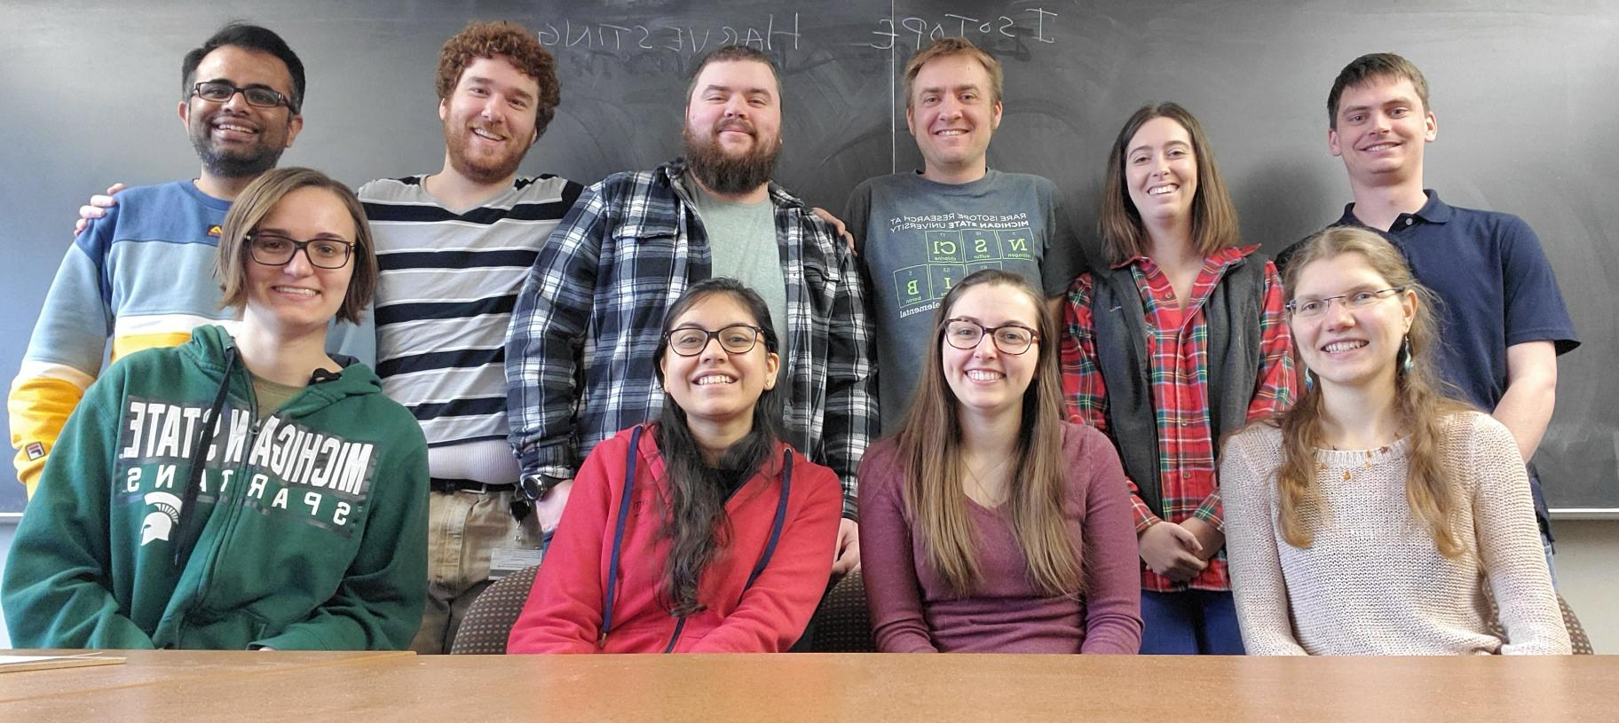




Acknowledgments
Harvesting Group:
  Greg Severin
  Hannah Clause
  Scott Essenmacher
  Samridhi Satija
  Katharina Domnanich
  Chiraq Vygas
  Colton Kalman
  Wes Walker
  Chloe Kleinfeldt
Funding:
  Michigan State University
  U.S. Department of Energy
  (DOE-FOA-0001588)
  DOE NNSA SSGF program
  (DE-NA0003864)
Collaborators:
  Jonathan Engle
  Todd Barnhart
  Frederique Pellemoine

Slide 15
Estimating Activity from Nuclear Recoils
1. Calculated the recoil energy every 1 µm through the target.
  Recoil energy = E_{b}M_{R}M_{b}/(M_{b}+M_{T})²
  About 195 keV throughout target
2. Ran TRIM to find range distribution in Ti64:
  15,000 events for 195 keV ⁴⁸V.
3. Calculated mean and standard deviation for range distribution.
4. Found probability that a recoiled ⁴⁸V would escape the Ti64 layer.
  Using mean, standard deviation, and a normal distribution table
  Using 0.001 µm steps in the last 0.3 µm of the target
5. Calculated escape rate for 48V.
  Atoms ejected/incoming proton
  Scaled production rate of ⁴⁸V by fraction escaped from Ti64 layer
6. Found activity of ejected ⁴⁸V for each irradiation period.
  Used recorded beam current

Slide 16
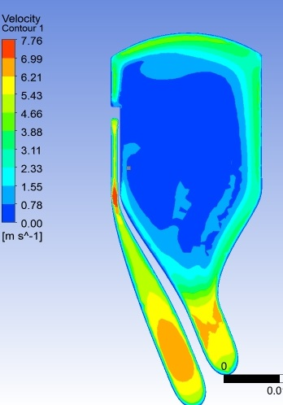
Beam Blocker: Flow Map
Flow Rate: 6 gpm
Minimum of 0.5 m/s in large volume

Slide 17
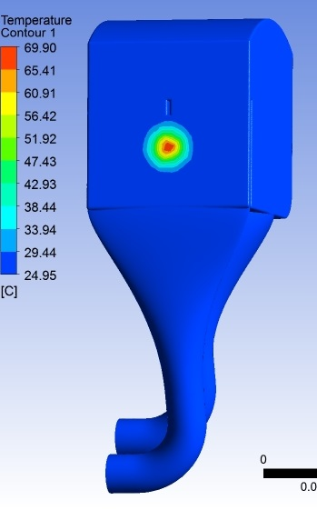
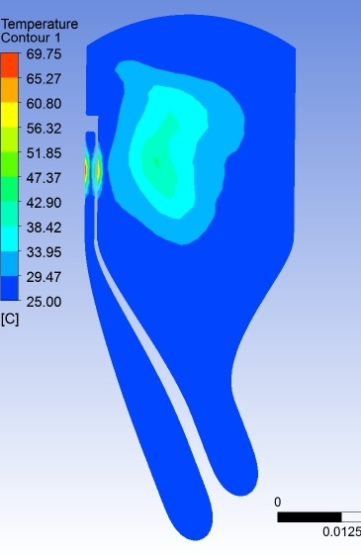
Beam Blocker: Water Temperature ⁴⁸Ca
T_{max} = 69.9 ºC
Flow rate = 6 gpm

Slide 18
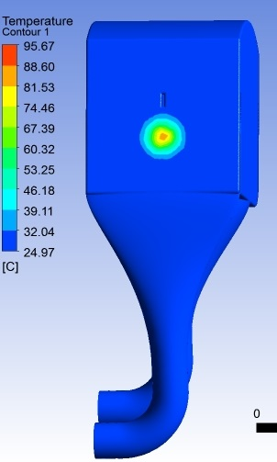
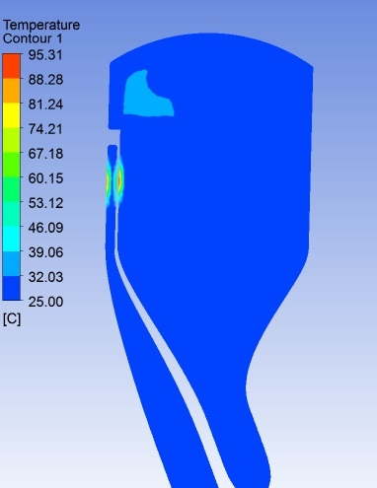
Beam Blocker: Water Temperature ⁸²Se
T_{max} = 95.7 ºC
Flow Rate = 6 gpm
Water boiling
point at 1.5 bar
is ~ 110 ºC

