Slide 1

Overview of the ISOLDE Facility and of the EPIC Project
J. Vollaire, M. Calviani , R. Catherall, T. Giles, G. Neyens
6th Radiate Collaboration Meeting
9-13 December - Triumf, Vancouver (Canada)

Slide 2
Outline
The ISOLDE facility (focusing on targets)
The EPIC project
  New beam dumps
  Possible new irradiation facility
Conclusions

Slide 3
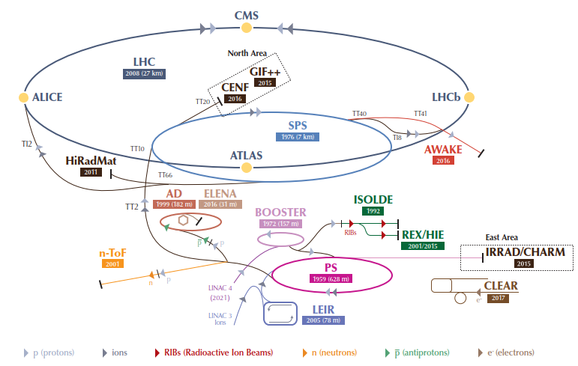
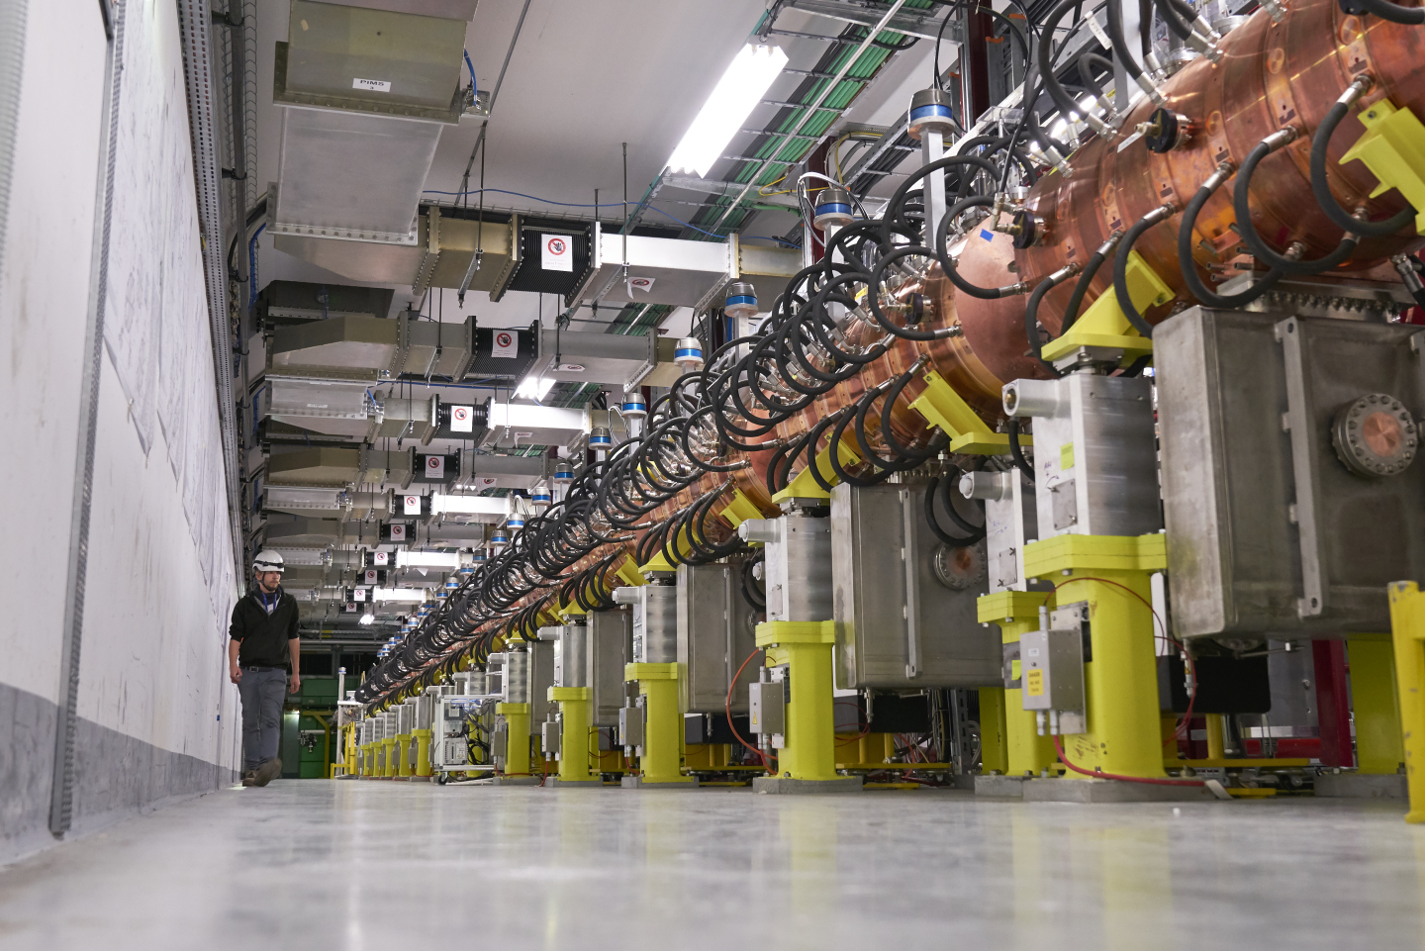
ISOLDE in CERN accelerator chain
Long Shutdown ongoing (LS2)
LHC Injector Upgrade Project (LIU). No proton beam to ISOLDE in 2019
Connection of a new Linac
New injector for protons

Slide 4
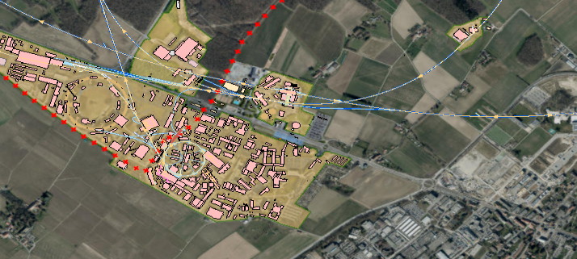


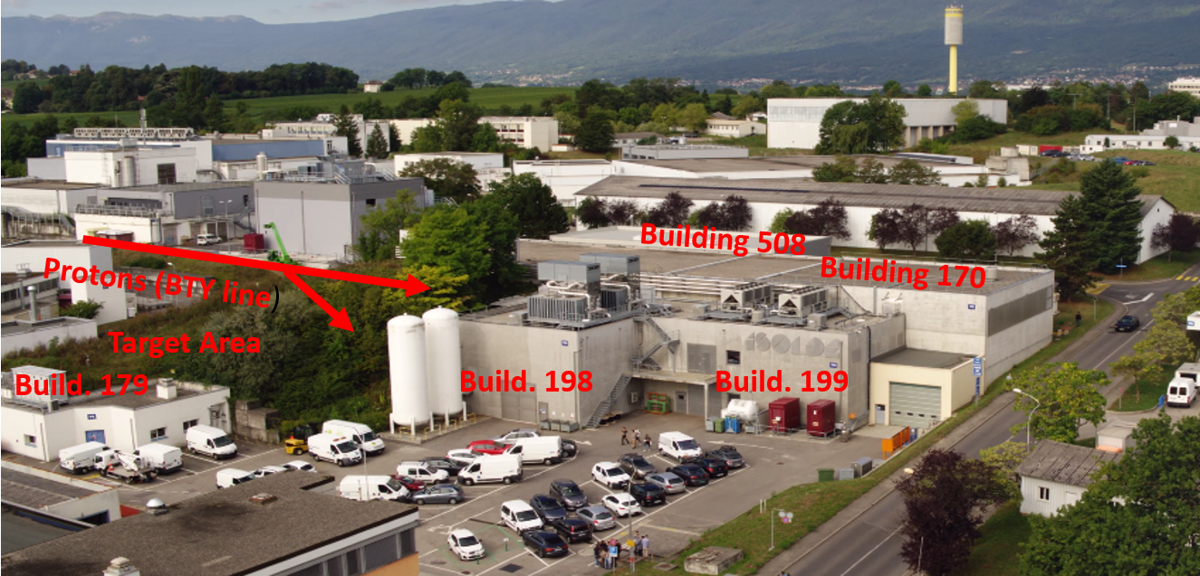
ISOLDE infrastructure
ISOLDE is located on the Meyrin site
Facility located on both sides of the boarder
ISOLDE at the PS Booster since 1992
CERN Meyrin site
ISOLDE is CERN
Radioactive Ion Beam
Facility
Capitalize on 50 years of experience with production of RIBs
1000 isotopes available already (of 3000 known) (60 keV – 10 MeV/u)
  70 different elements
  10 different permanent experimental set-ups (and new ones coming)

Slide 5
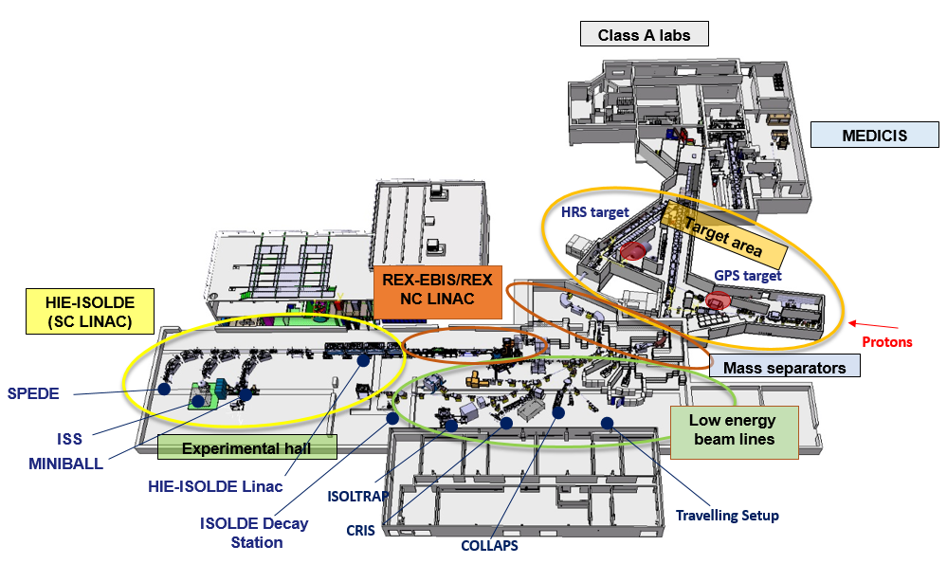
The ISOLDE facility
“Hot” Laboratories (target lifecycle)
Target area (shielded) with two stations
Two mass separators (GPS and HRS)
Low energy beam lines (60 keV)
Post-Accelerator: EBIS source and Linac with NC and SC structures (HIE ISOLDE)
Three High Energy beam lines

Slide 6
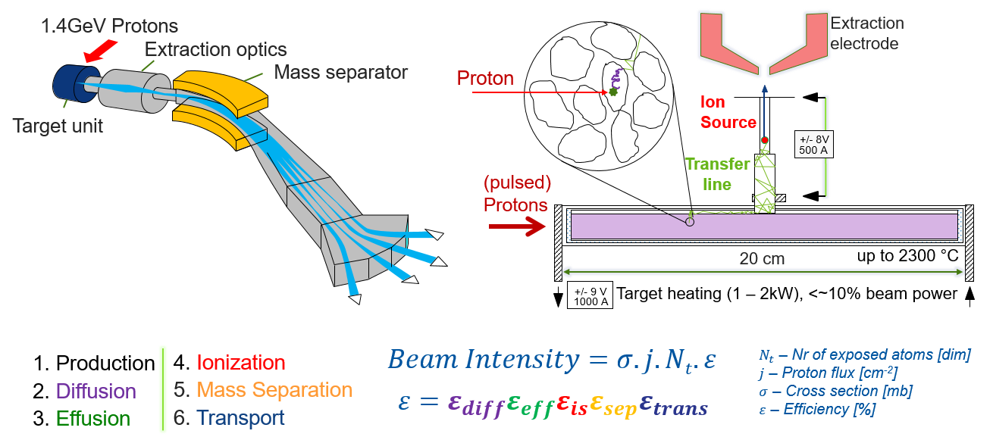

ISOLDE RIB production principle

Slide 7
The PS Booster (proton driver)
The PS Booster (will) receive 160 MeV H⁻ from the Linac4 (charge exchange at injection)
Acceleration and extraction at 2 GeV (after LS2) except for ISOLDE (1.4 GeV only). PS Booster cycle 1.2 s.
Transfer line to ISOLDE (~100 m):
  NORM beams used for solid targets (4 bunches with 4E10¹³ protons max in total and a bunch separation of 572 ns)
  STAGISO (staggered) beams for liquid targets (3 bunches with maximum of 1E10¹³ and a 16 µs bunch spacing)
  Averaged current limited to 2 µA (1.25x10¹³ pps) due to the actual beam dump design and radiation protection issues (air activation)
  Transfer line magnets and power supplies not compatible with 2 GeV
In 2018: 10²⁰ protons have been distributed to the two target stations

Slide 8
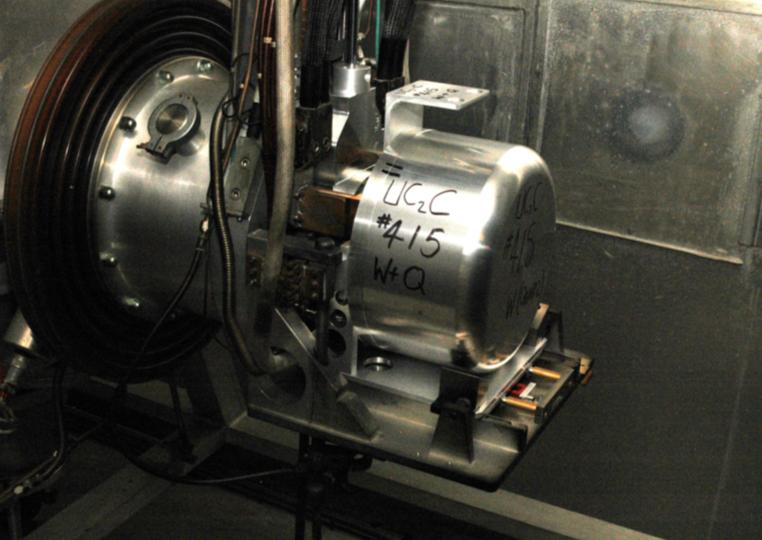
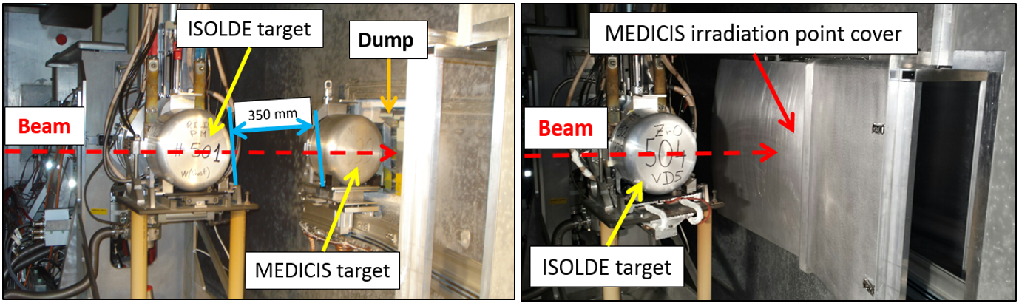
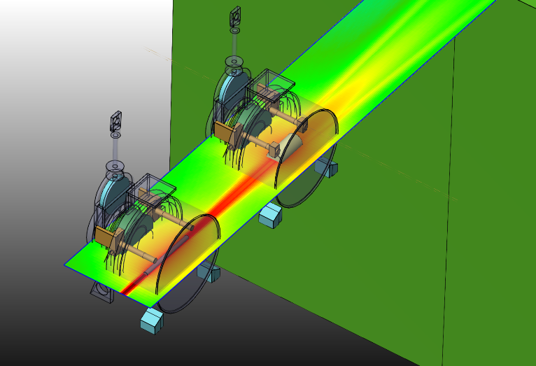
Target Stations
GPS side target station
HRS side: MEDICIS irradiation point
Dump
RIB
PS Booster
protons
Fraction of the beam only interacts in the target material.
Protons are “lost” in the beam dump or used for target irradiation (HRS side)
Irradiated targets used for medical isotopes production (MEDICIS)

Slide 9
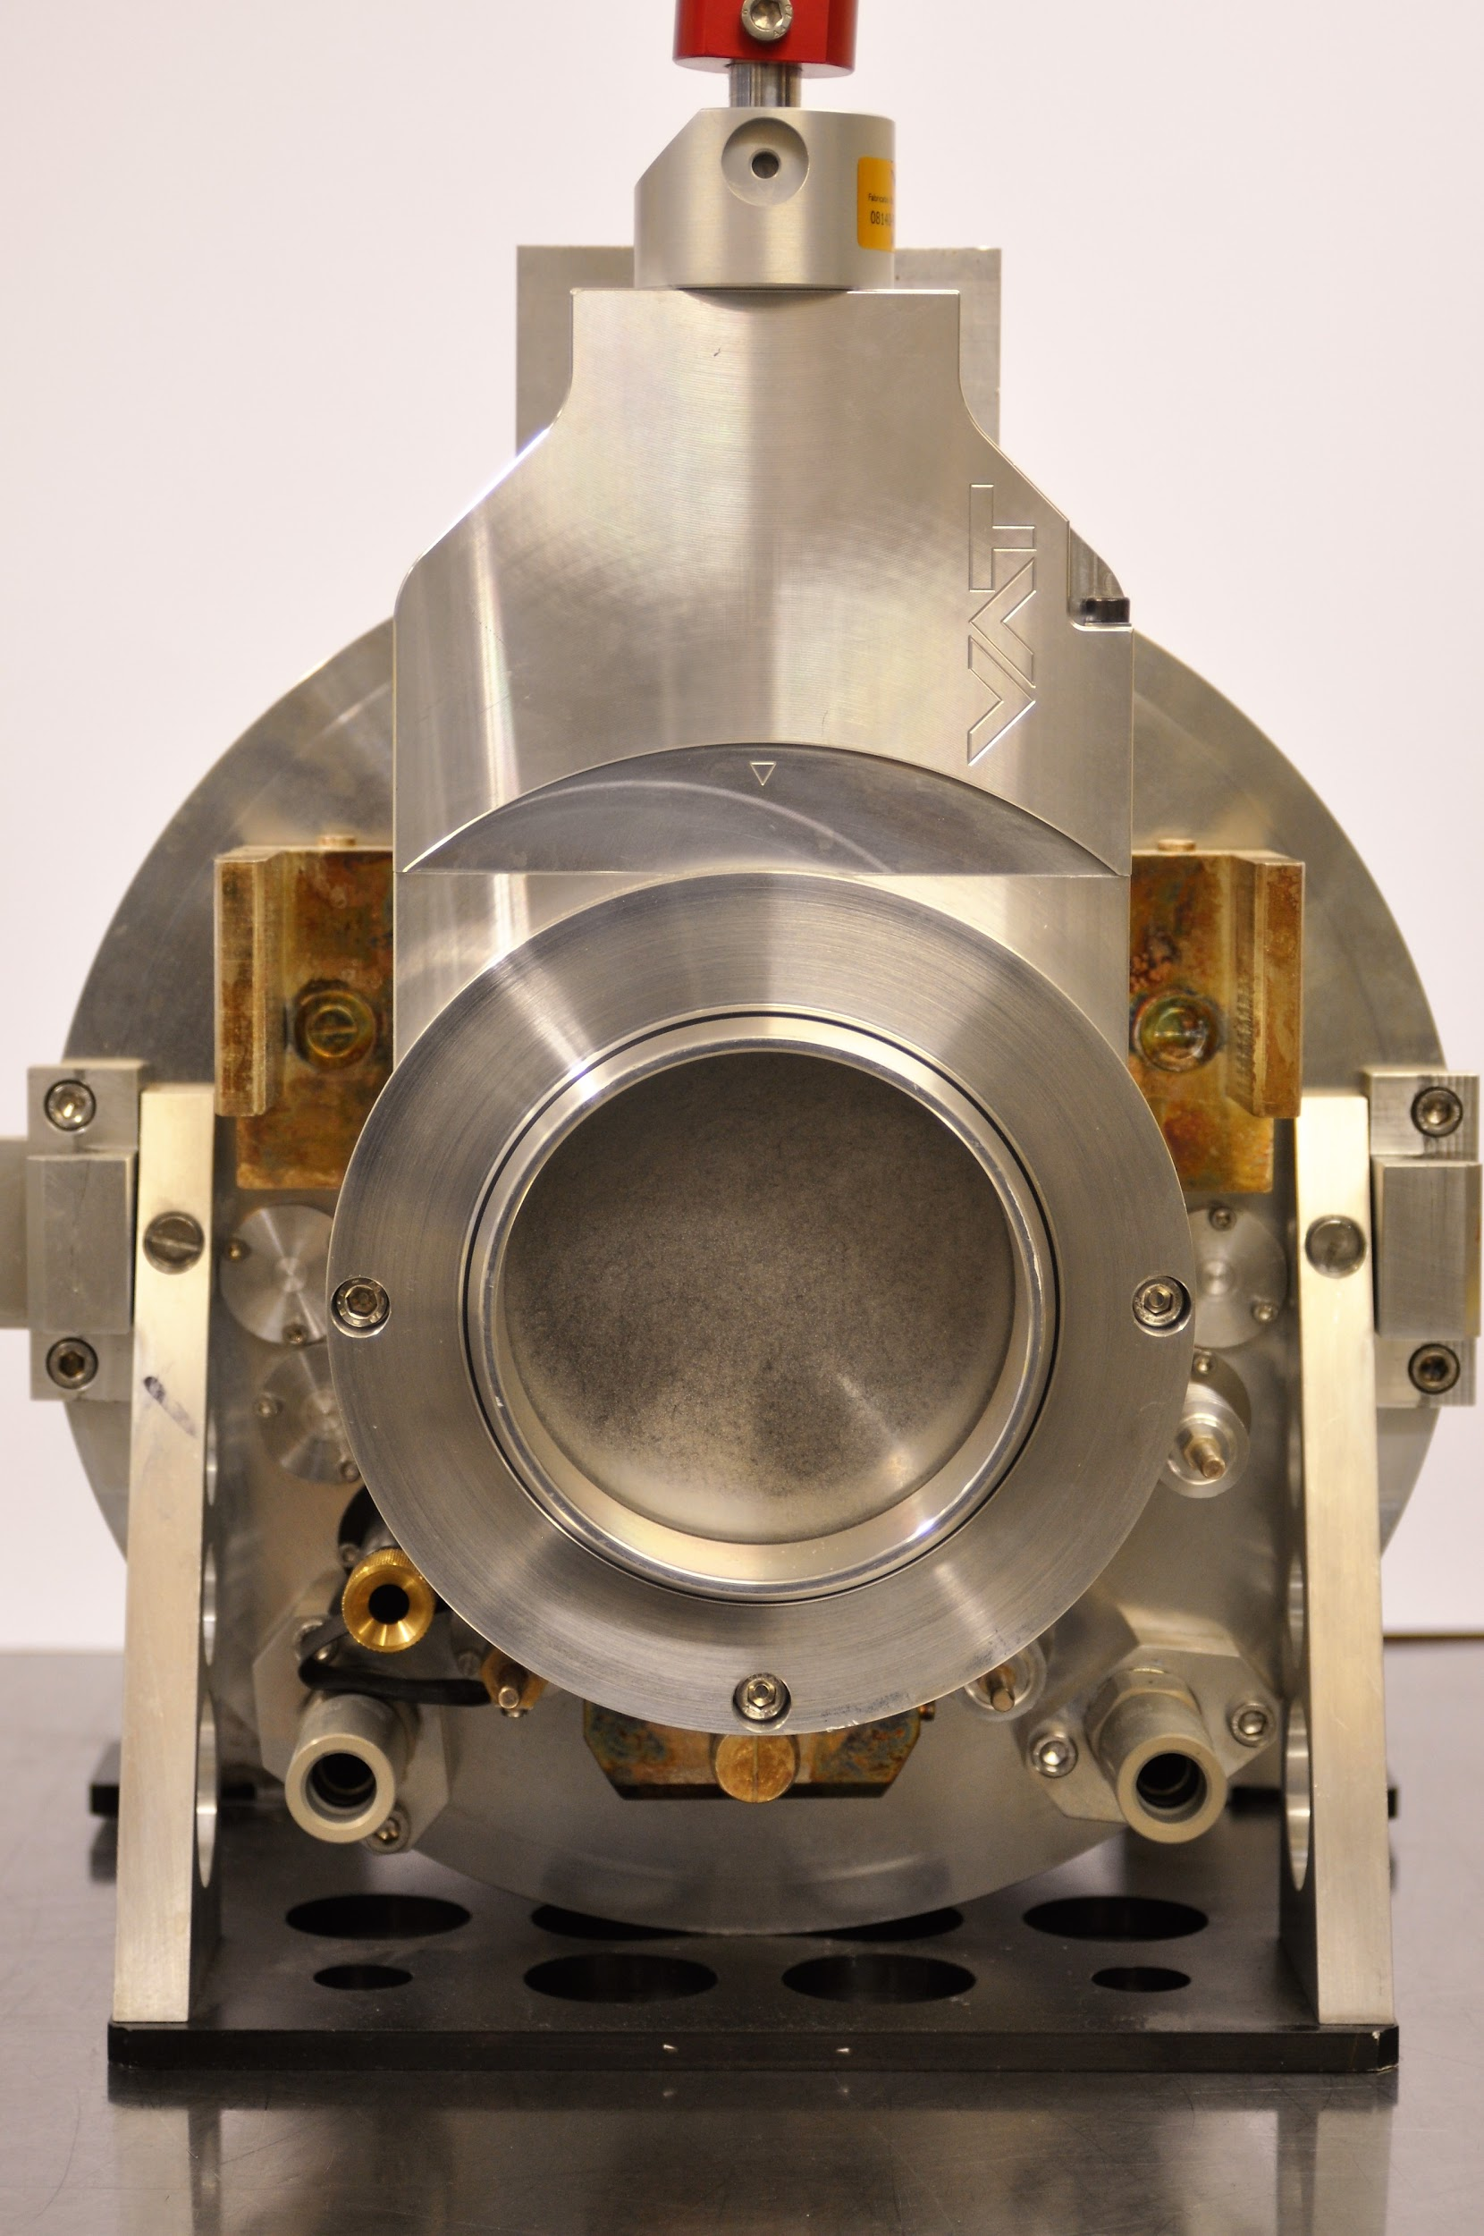
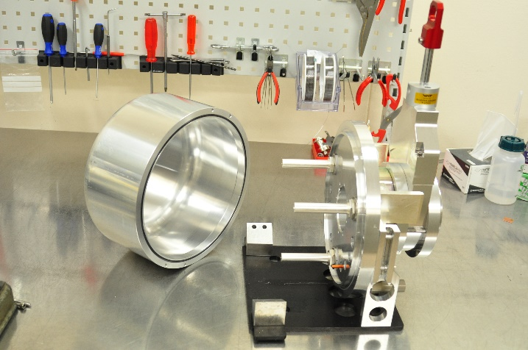
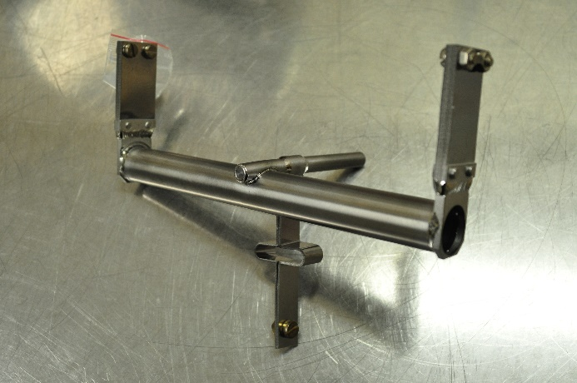
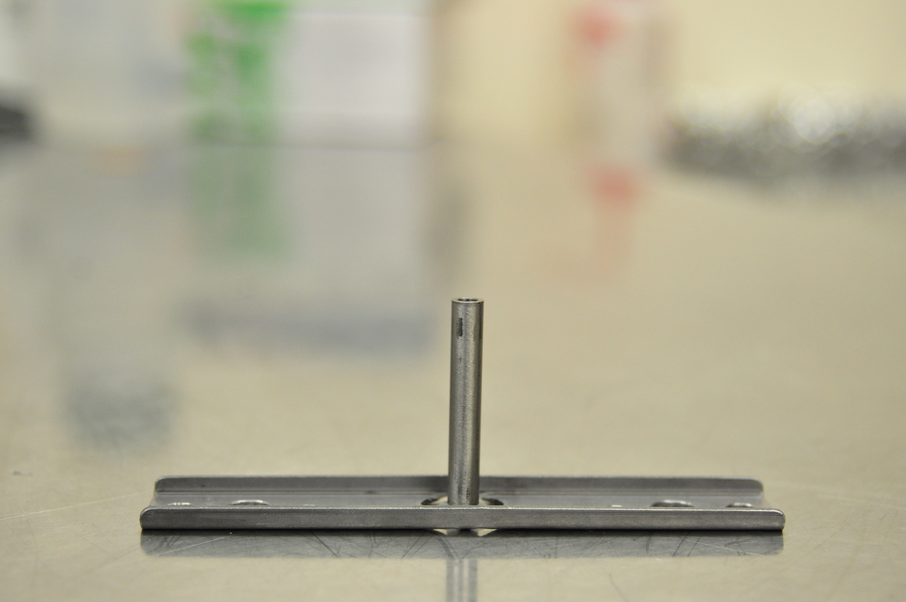
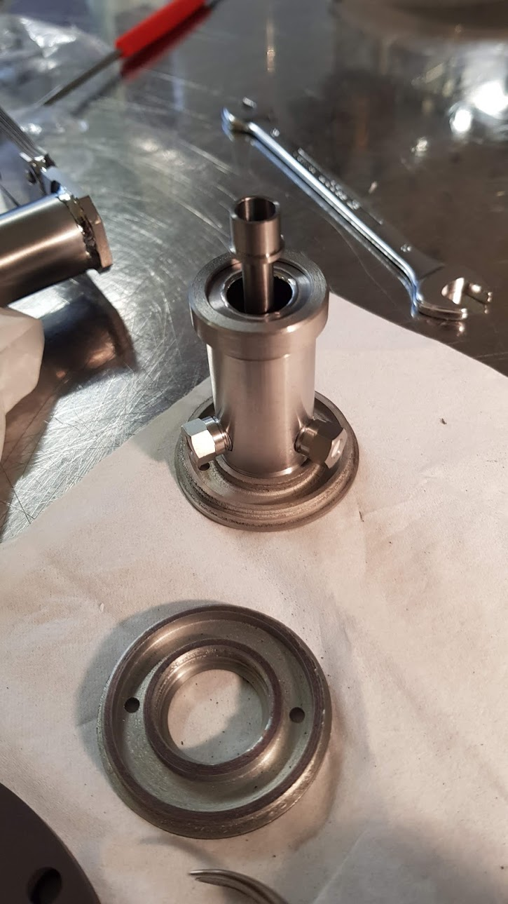
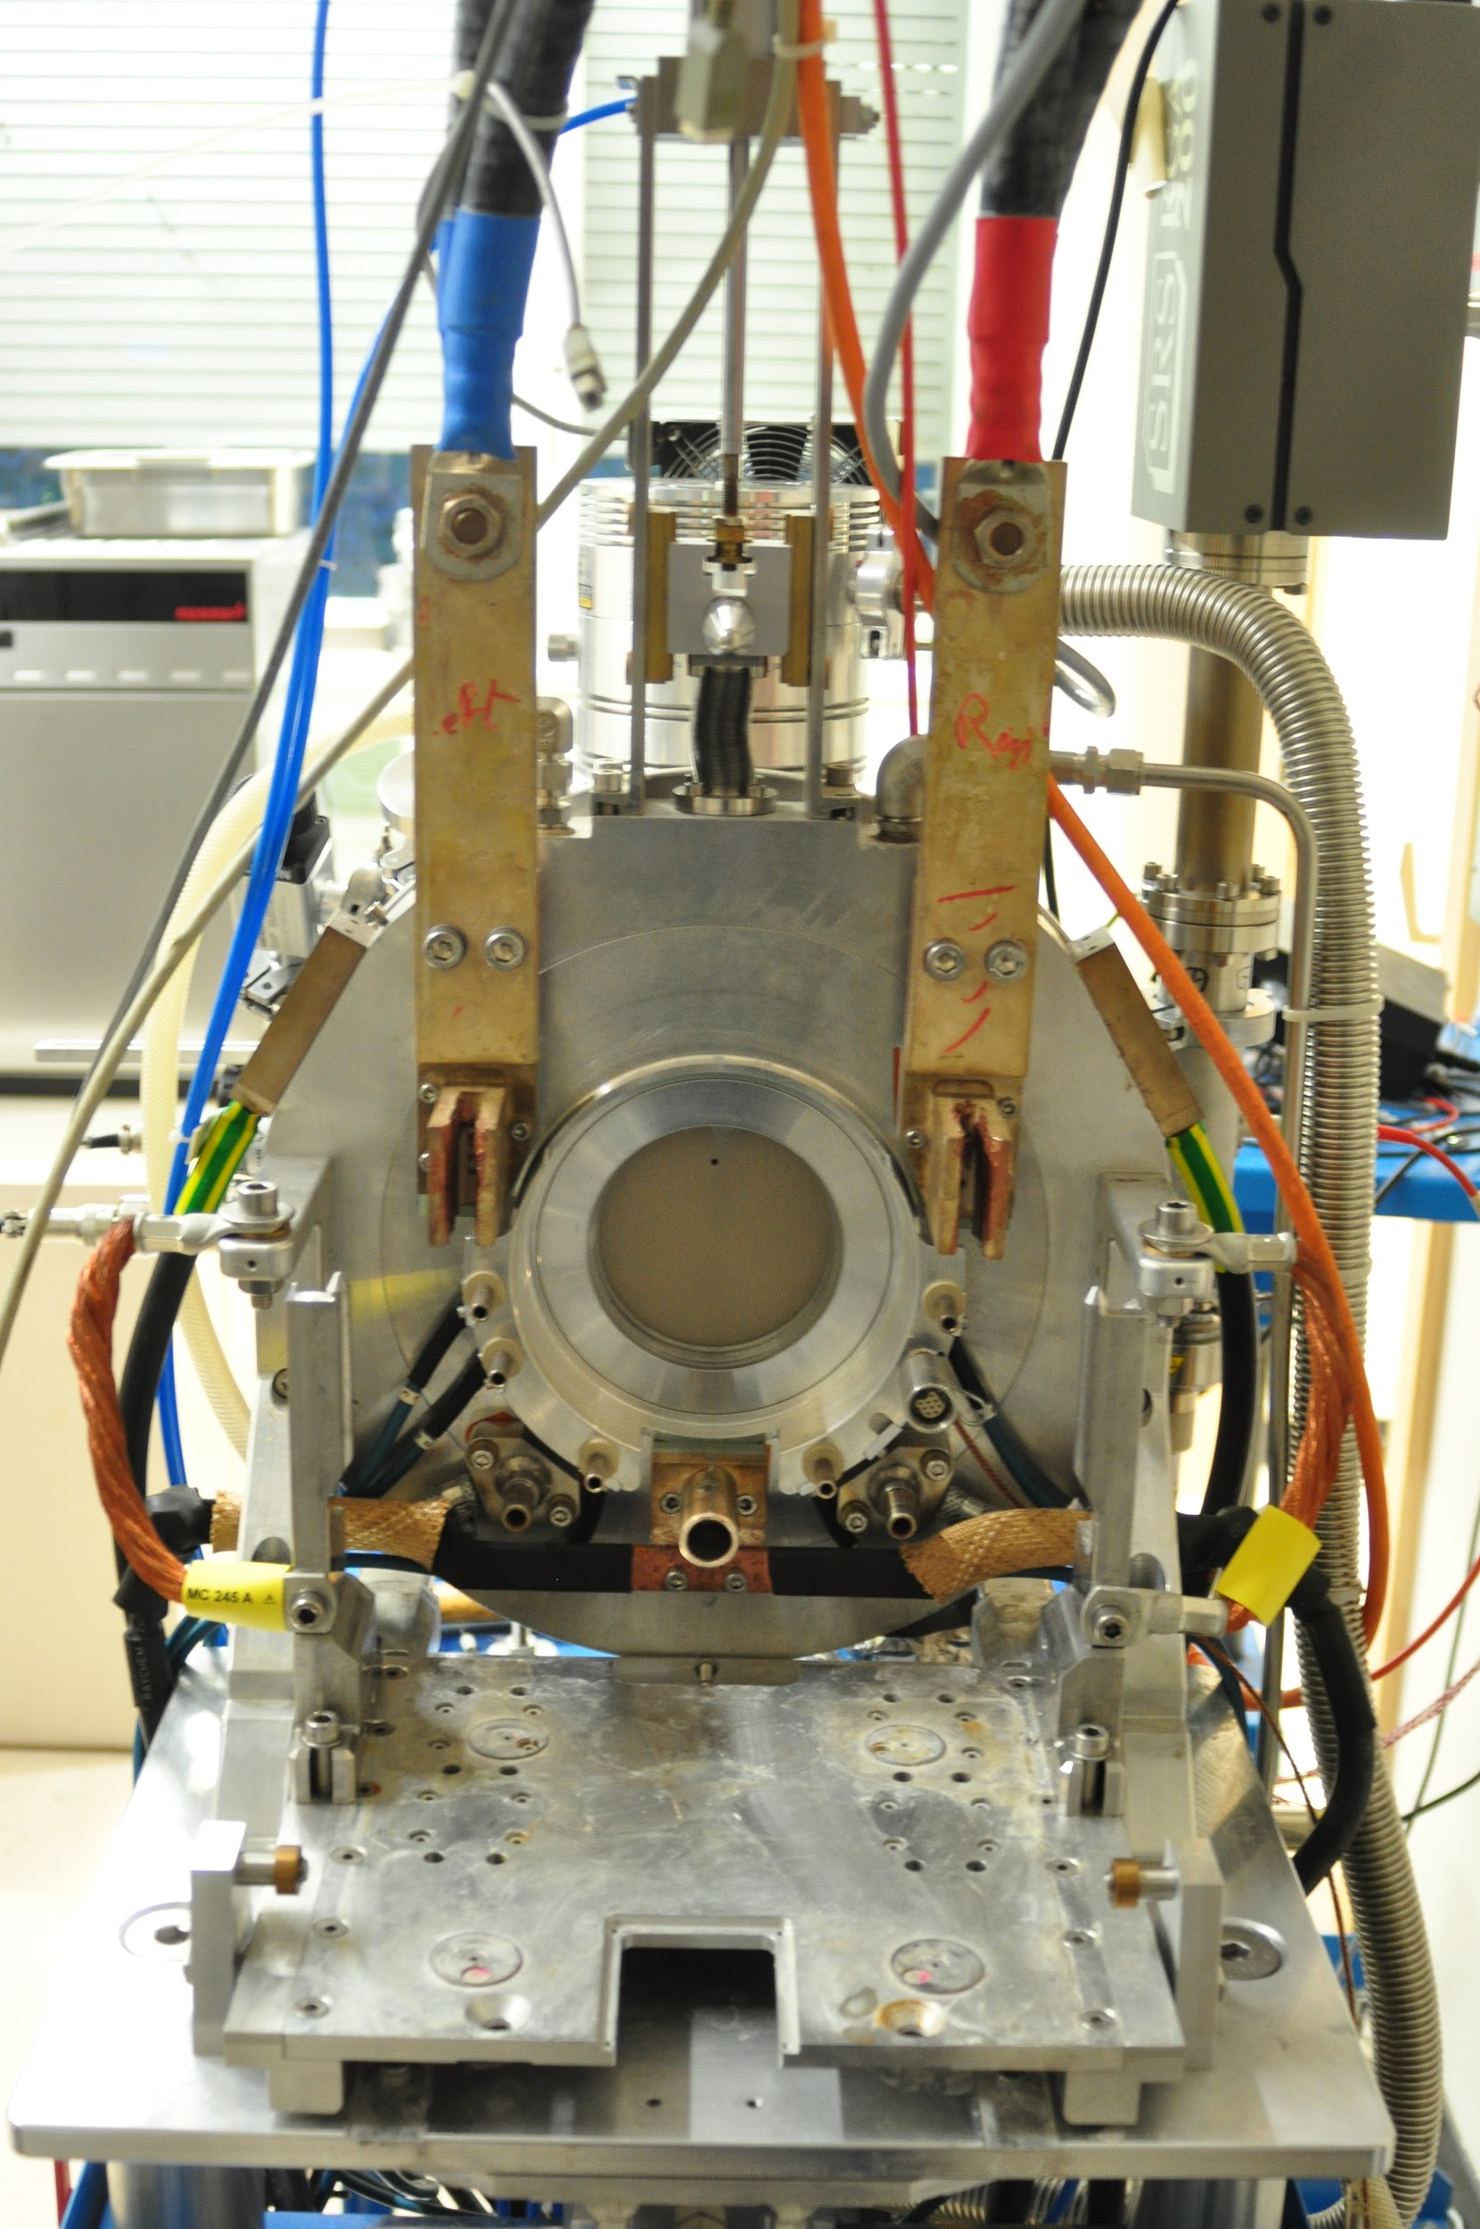
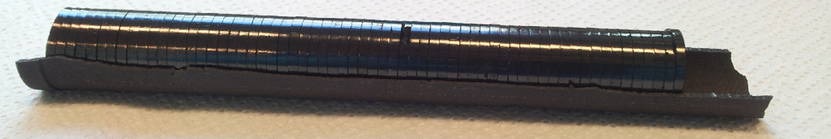
ISOLDE target assembly & coupling
Target Container + transfer line
FE view
Target base
Heating:
Line & target
Oven
(mass marker)
Gas
injection
Surface/Laser ion source
Plasma ion
source
Water connectors
Target material
FRONT END
(target station)

Slide 10
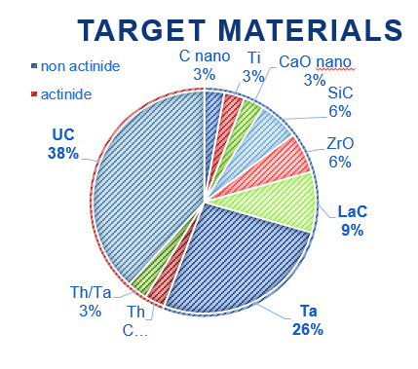
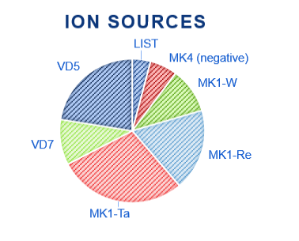
Target Production (2018)
10 different materials
Mostly carbides and metal foils
Most popular: uranium carbide
7 different ion sources
LIST and negative ion source back in action
Total targets assembled end of 2018 : 49
Delivered to ISOLDE: 29 (replaced after 1 to two weeks)
Delivered to MEDICIS: 10 + 2 in December
Used for development: 8 (16%)
Courtesy of S. Rothe

Slide 11
Target Handling and waste disposal
Remote handling capabilities:
  Three industrial robots (made radiations hard) for targets handling
  A rail conveyor system going from the HRS irradiation point (MEDICIS) to the laboratory area (accessible during beam operation)
Shielded storage (inside the target area and in the laboratory)
A shielded hot cell (being commissioned):
  Dedicated mainly to targets dismantling and UC_{x} re-oxidation (for waste disposal) but scope of use could be extended (15 cm lead equivalent)
A “hot-laboratory” with the technical and procedural (close RP support) requirements for handling of radioactive materials:
  Dedicated to target lifecycle and CERN-MEDICIS infrastructure
  Civil engineering for the hot-laboratory extension will start in 2020 (nano-laboratory for actinide target production and shielded storage area)

Slide 12
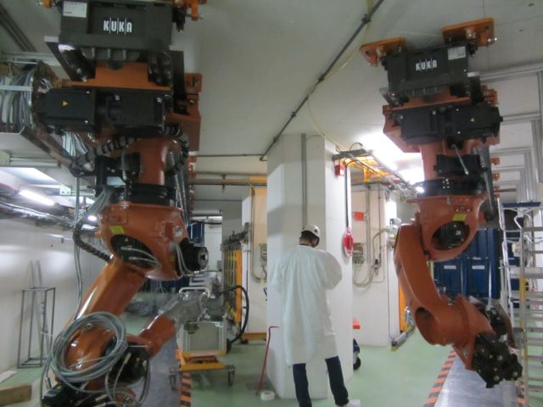
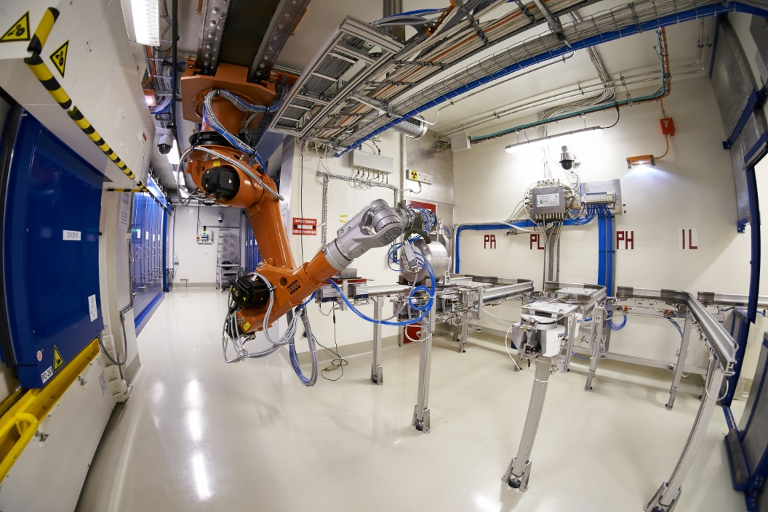
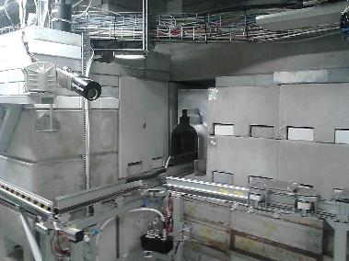
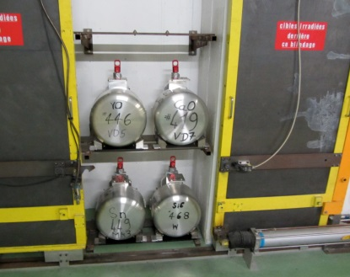
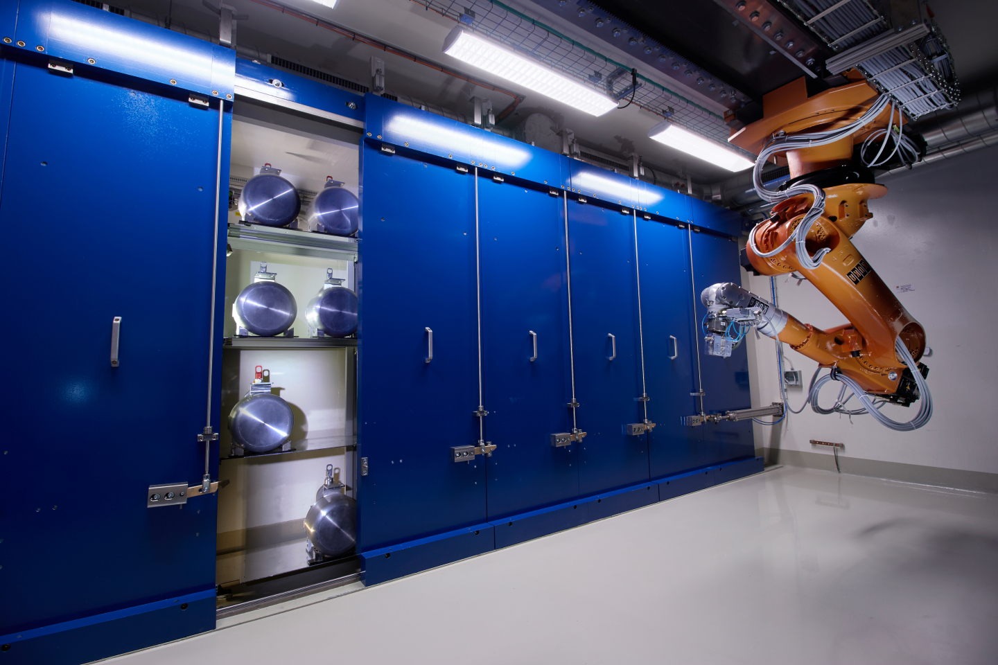
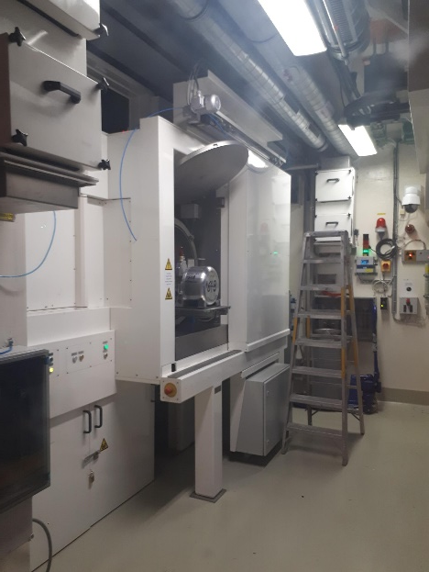
Target Handling and Storage
GPS and HRS robots (target area)
RCS and robot
RCS chicane toward
the laboratory
Hot Cell (back)
Storage (target area)

Slide 13
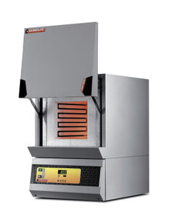
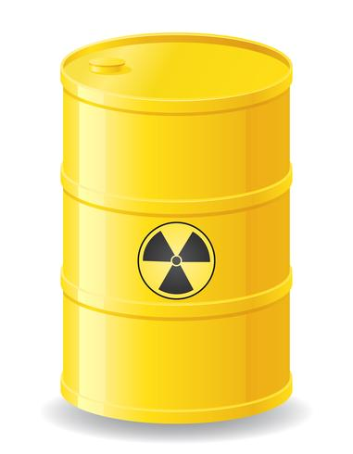
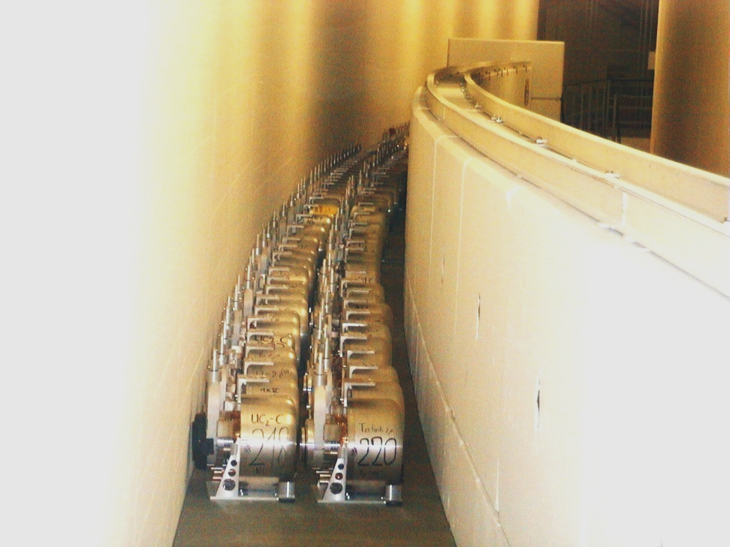
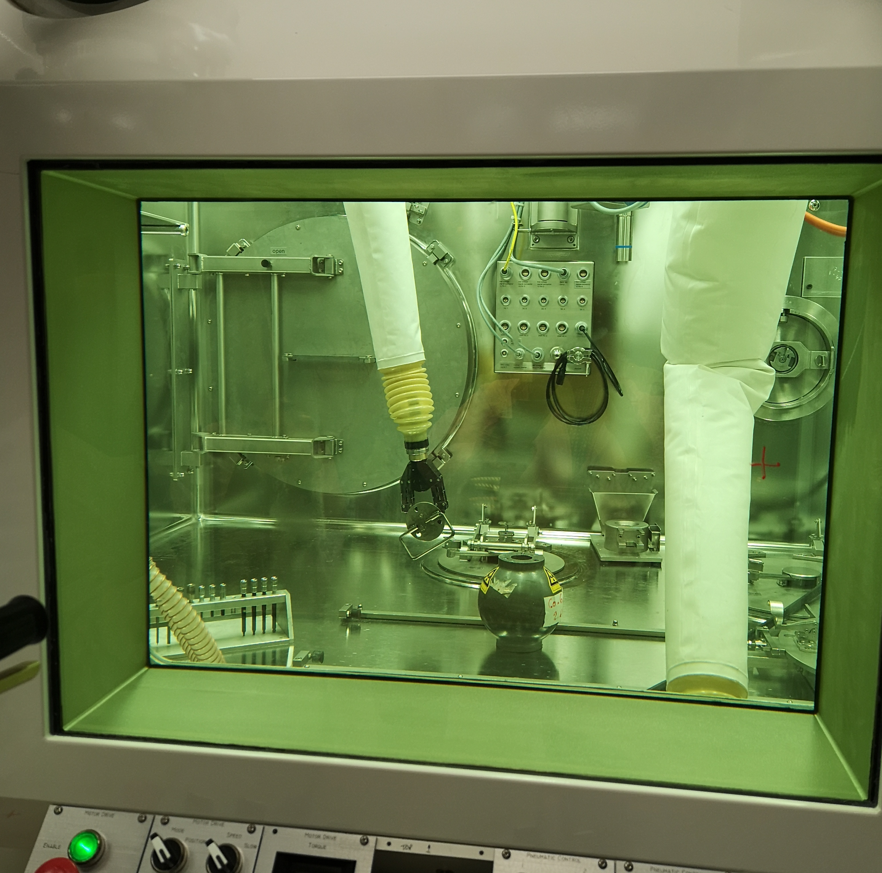
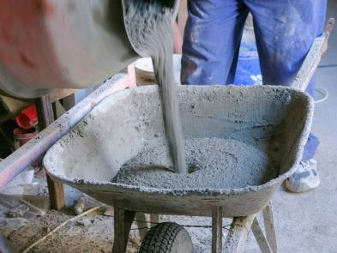
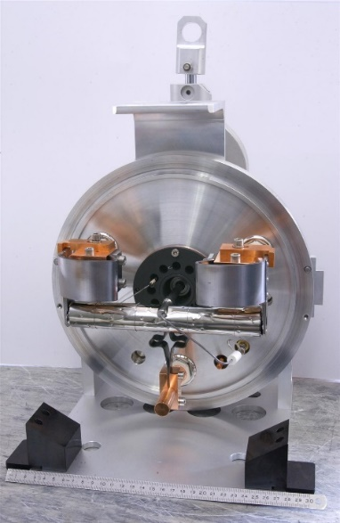

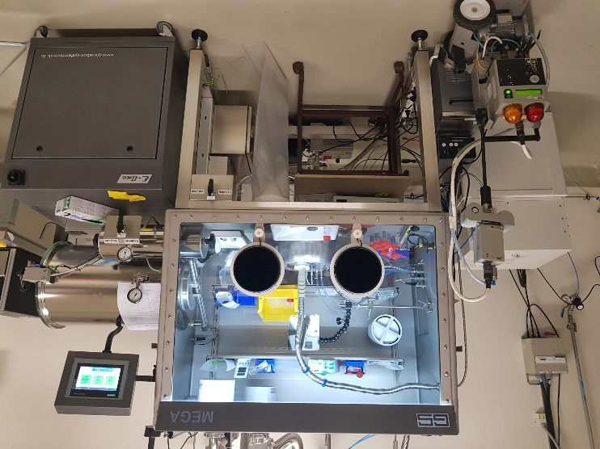
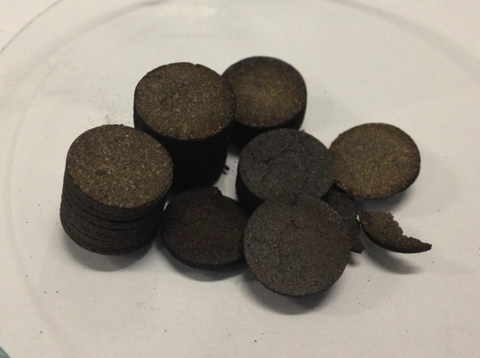
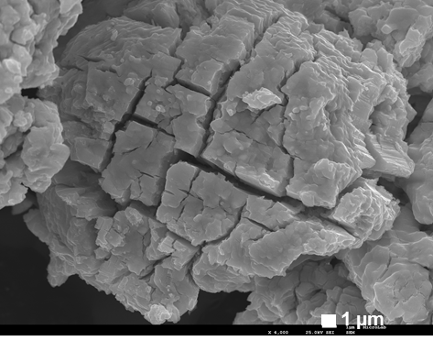
Target disposal (actinide)
Target Storage
Dismantling
(not started)
Oxidation
Cementation for
UxOy-C powder
Conditioning
Work in progress (tests on non-irradiated UC_{X})
Target material
Thermal analysis
Microstructural analysis
Uranium carbide pellets
d=14 mm
Thickness 1.5 mm
Micro UC_{x} after oxidation (U₃O₈) at 350°C under 10% O₂
Courtesy of N.-T. Vuong

Slide 14
The EPIC project
Exploiting the Potential of ISOLDE at CERN, ISOLDE input in view of the definition of European Strategy for Particle Physics
The proposal identifies several ways to increase ISOLDE capabilities and capacities:
  Take advantage of LHC Injector Upgrades (LIU)
    Increase of p-intensity with the new Linac
    Increase of PS-BOOSTER p-energy (1.4 to 2 GeV)
  Allow parallel beam operation with (a) new target station(s)
  Higher quality beams for improved RIB beam purification
  Upgrade the REX-ISOLDE post-accelerator (NC and SC sections)
  Implement a new compact storage ring to store RIBs
  Build a new experimental hall to host new experiments
Discussed in the coming slides

Slide 15
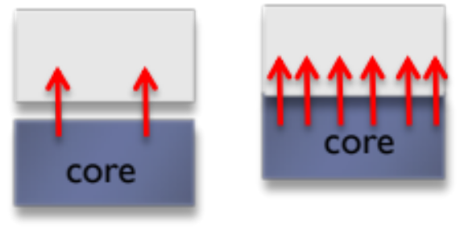
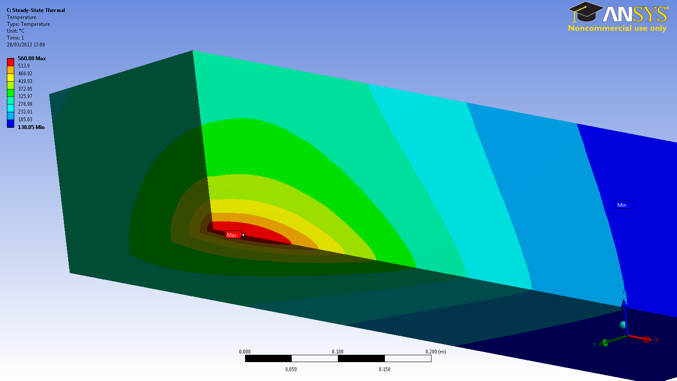
Energy and intensity upgrade
Energy upgrade: electro-magnets in the transfer line can’t cope with the 2 GeV protons. Modifications (higher magnetic rigidity) or relocations of dipoles being studied
Intensity Upgrade: Higher beam power on the targets and on the beam dumps (absorbing the majority of the beam)
  Coupled FLUKA/thermo-mechanical analyses are showing that the dumps operate at their limit in terms of temperature and mechanical stresses with the actual beam parameters (2 A – 1.4 GeV beam). Exclude any increase
Dump material:
Iron Blocks
Unknown thermal contact
560 ℃ steady state for HRS assuming ~3-5 W/m²K HTC

Slide 16
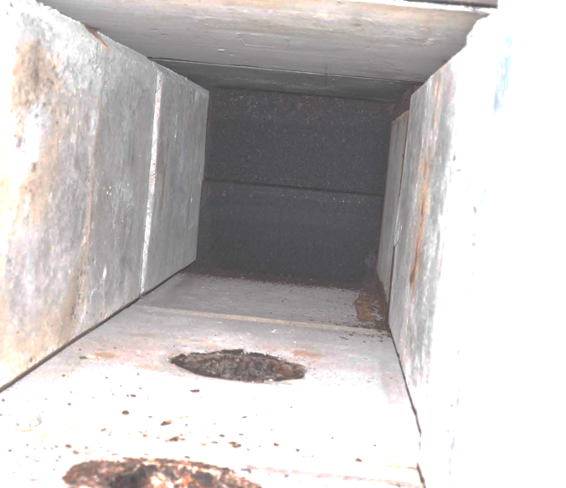
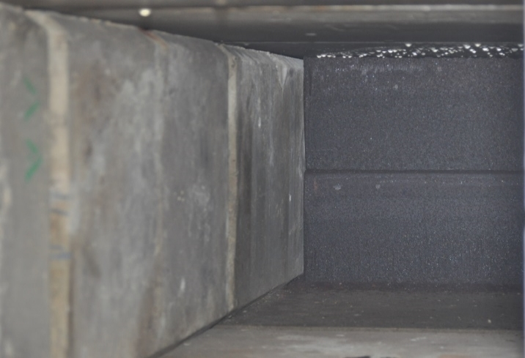
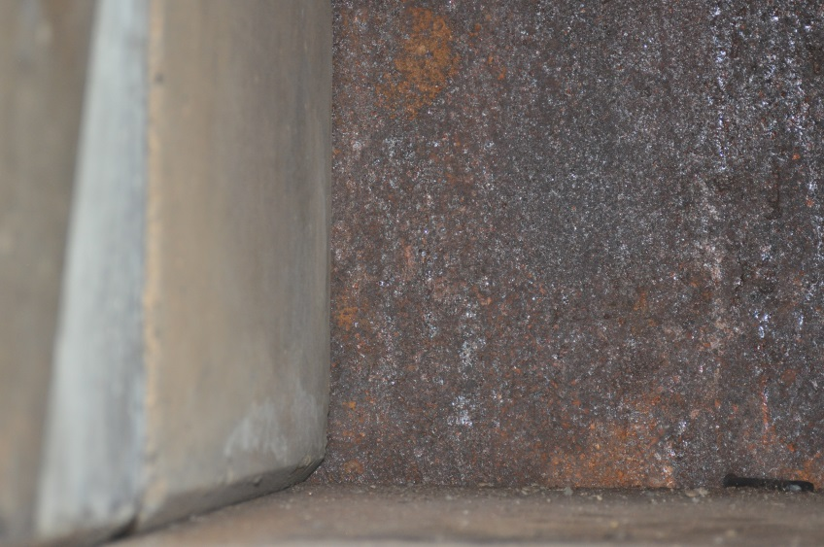
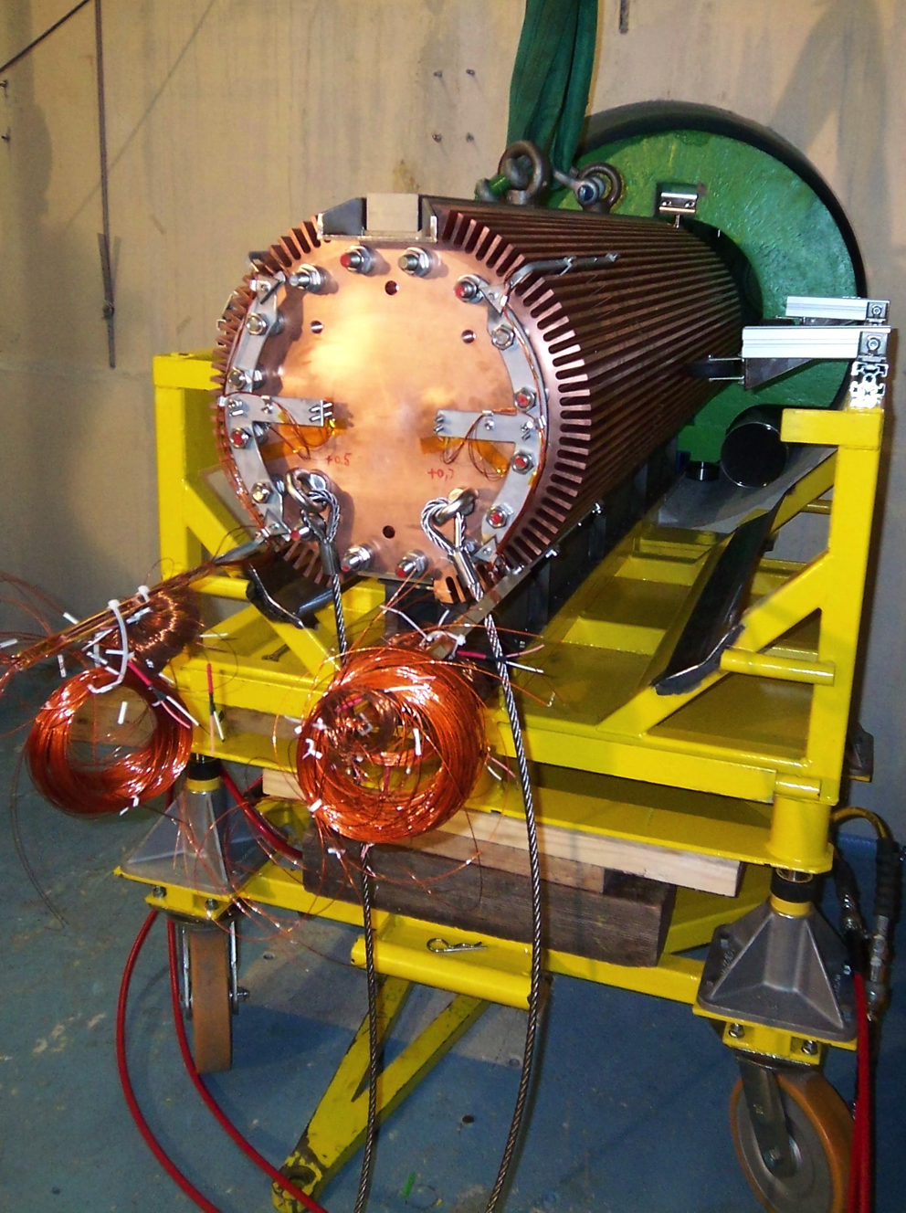
Beam dumps (visual inspection)
Molten material?
Signs of corrosion and condensation on the visible face (accessible from target area)
  Dump material not up to date with best practices in the field
Unknown condition (neither access nor monitoring)
Proposal:
  Study the implementation of PSB type cores (CuCrZr water cooled)
  Improve shielding and limit backscattering of secondary particles (to limit activation)
  Include maintenance and failure scenario in design
2 GeV core (PS Booster)

Slide 17
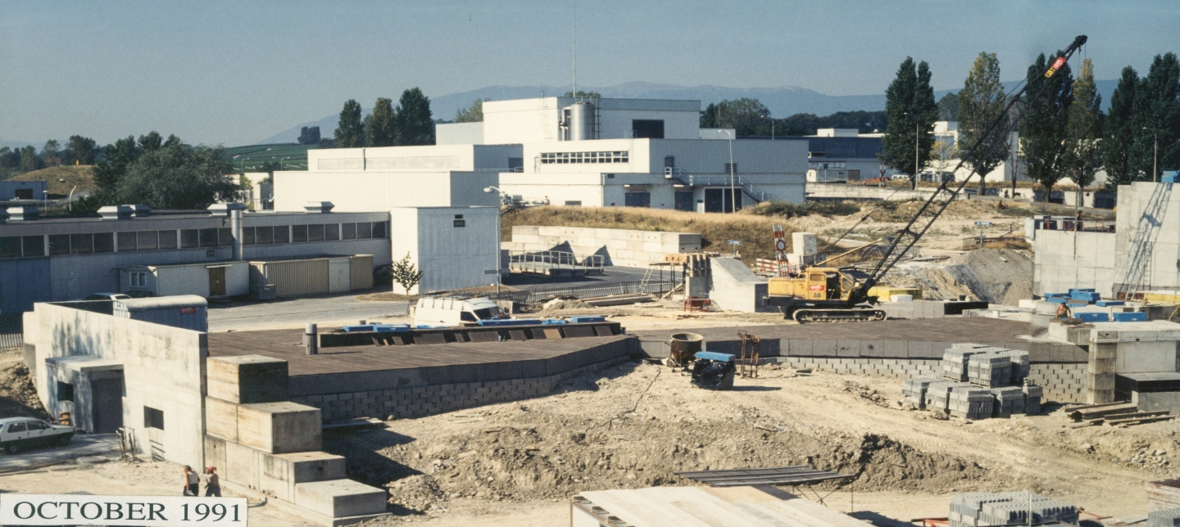
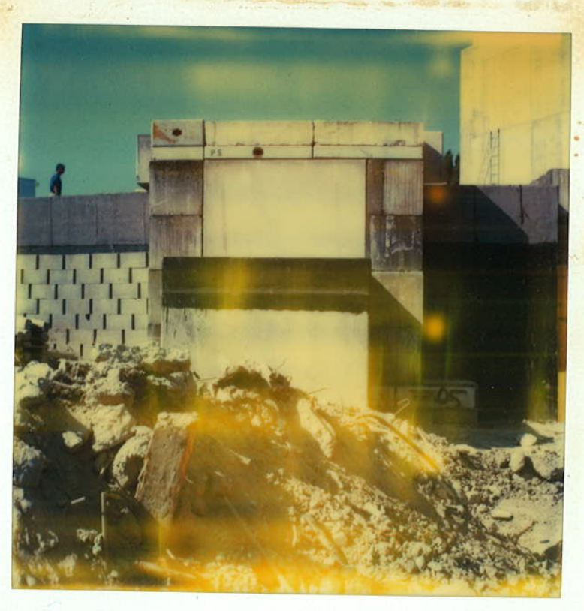
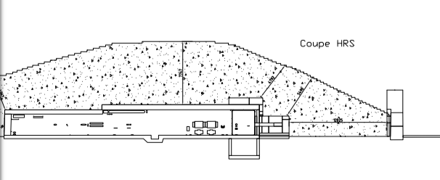
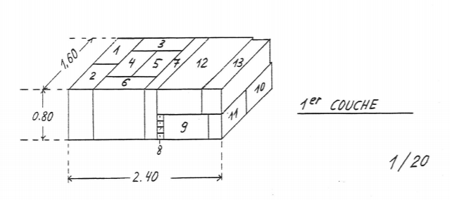
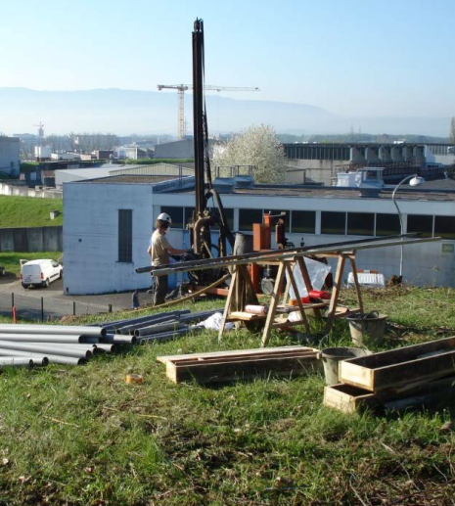
New dumps implementation
Need to remove the soil above the target area
Beam dump HRS
Measured artificial radioactivity (above “Clearance Limits”) with Na-22 and Mn-54 dominating. Sample taken about 4 m from the HRS dump (2 m from shielding)
Careful planning and proper radiation protection

Slide 18
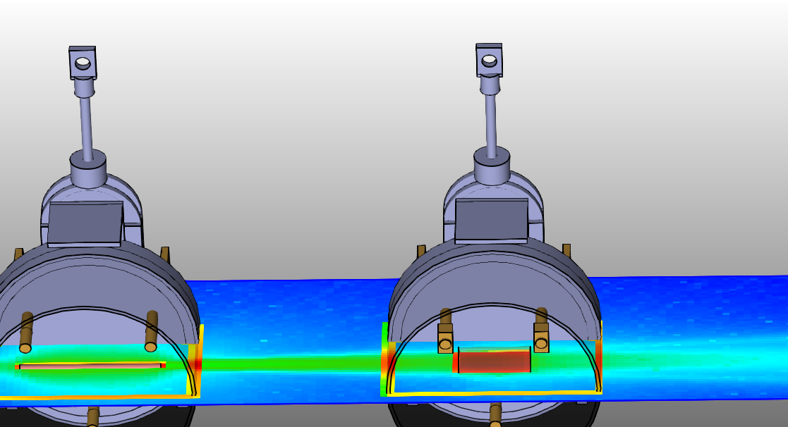
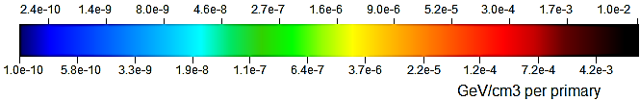
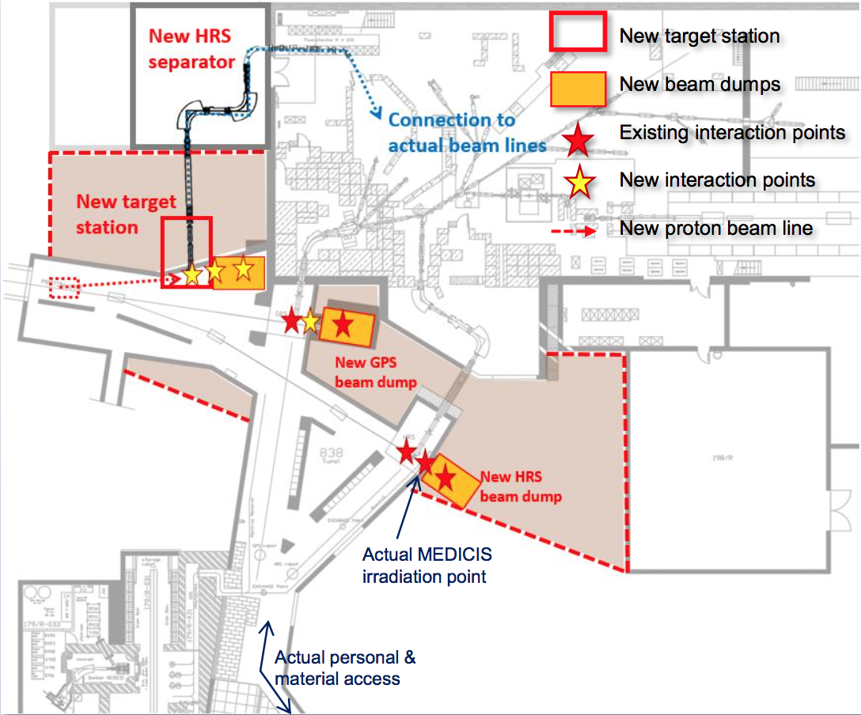
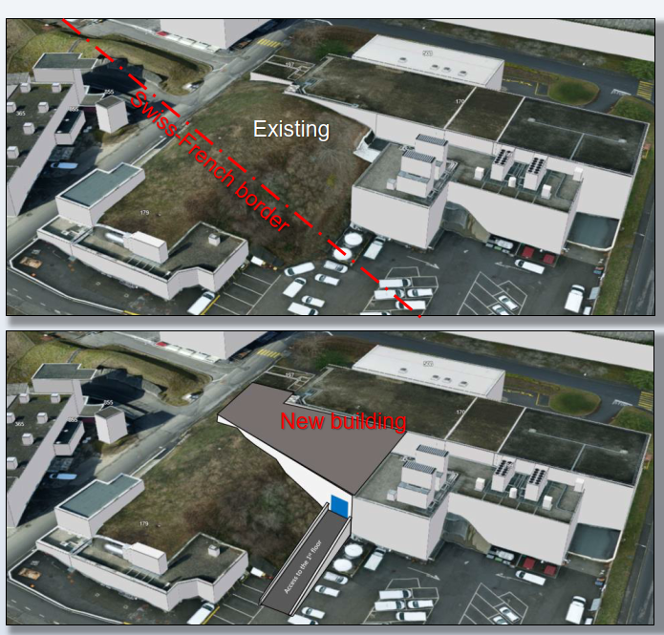
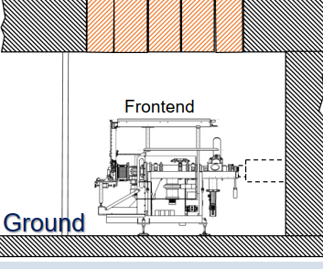
New target station(s) (brainstorming)
Proposal: M. Lozano
FLUKA Simulation: Ch. Duchemin
Two FE solution:
Optimize use of bem
Low/High density
Long/Thick targets
Integration and maintenance challenging
ISOLDE Target #1
UC₂ 3.5 g/cm³
19.6 cm length
0.7 cm radius
ISOLDE Target #2
UC₂ 7.0 g/cm³
10.0 cm length
2.5 cm radius
25 cm
New FE solution:
Surface building
FE removal from the top
New separator
Proposal: S. Marzari

Slide 19
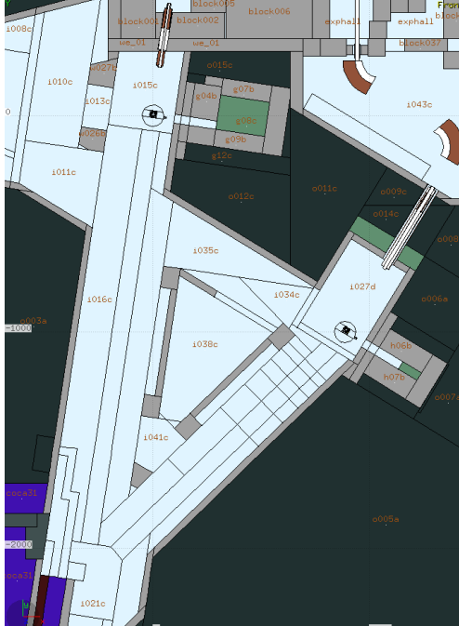


Irradiation facility at ISOLDE
Detailed model of the target and target area implemented in FLUKA
Using “standardized” quantities for comparison of different radiation fields (dose, 1 MeV neutron equivalent, high energy hadron equivalent)
Normalization to 5x10¹⁹ protons (in 2018 ~1x10²⁰ protons equally shared between GPS and HRS). All quantities scale to the number of protons delivered (intensity, irradiation time…)
Comparison of 1.4 GeV/2.0 GeV protons and 3.5/1.3 g/cm³ UCx
FLUKA model

Slide 20






Fluence mapping (1.4 GeV – 3.5 g/cm3 UC_{X})
All particles
Neutrons
Protons
Heavy Hadrons eq.
1 MeV neutrons eq.
ISOLDE 2021 parameters:
@1m from the target:
~ 4-5x10¹⁷ HH along beam
~ 8-9x10¹⁴ HH 90°
~ 2-3x10¹⁷ 1_MeV_n along beam
~ 4-5x10¹⁵ 1_MeV_n_eq 90°

Slide 21





Fluence mapping (2.0 GeV – 1.3 g/cm3 UC_{X})
All particles
Neutrons
Protons
Heavy Hadrons eq.
1 MeV neutrons eq.
ISOLDE 2 GeV low density:
@1m from the target:
~ 1-2x10¹⁸ HH along beam
~ 5-6x10¹⁴ HH 90°
~ 6-7x10¹⁷ 1_MeV_n along beam
~ 2-3x10¹⁵ 1_MeV_n_eq 90°

Slide 22





Dose (deposited energy)

Slide 23



Dose Profiles
Lateral profile
Beam axis profile
~100 MGy/year @ 1 m forward direction
Several hundreds of kGy laterally (Front End)
Higher energy increases dose in the forward direction relatively more than laterally (good for Front End considering that a good dump design can ensure a safe beam absorption)
Going to “thinner” targets, use of the area before the beam dump even more interesting

Slide 24
Conclusions
ISOLDE will not benefit from injector upgrades taking place during the long shutdown at CERN
Studies are being launched in order to define the necessary actions to allow ISOLDE to receive the 2 GeV proton beam from the PS Booster and higher beam intensity (beneficial for some exotic beams)
Important to understand the degradation of target performances and cause of failure considering higher energy/intensity (more systematic post-irradiation analysis). Radiation Hardening of Front Ends.
The modification of the beam dump is a good opportunity to foresee an irradiation station (only a small fraction of the beam interacts inside the target). ~100 MGy a few 10¹⁷ 1 MeV neutrons equivalent per year expected.
Long terms development of ISOLDE with new target stations, better beam purification schemes, an upgrade of the post-accelerator and the extension of the experimental hall are being studied in the context of the EPIC project.

Slide 25
THANK YOU FOR YOUR ATTENTION

Slide 26





Radiation hardness tests
Materials used for the Front End and targets placed behind the GPS beam dump window
  EDPM Ethylenee Propylene Diene (EPDM) O-ring seals (compressed and not compressed during irradiation)
  Kapton (commonly used insulator in radiation environment)
  PEEK samples (High Voltage Insulator for the Front Ends)
Samples placed during the 2018 run (to be analyzed)
Courtesy of J. Cruikshank

Slide 27

1 MeV neutrons equivalent Front End

