Slide 1
The Formation of Radiolysis Products during Isotope Harvesting with a Flowing Water Target
Katharina A. Domnanich, E. Paige Abel, Colton Kalman, Wes Walker, Todd Barnhart, Jonathan Engle, Greg Severin

Slide 2
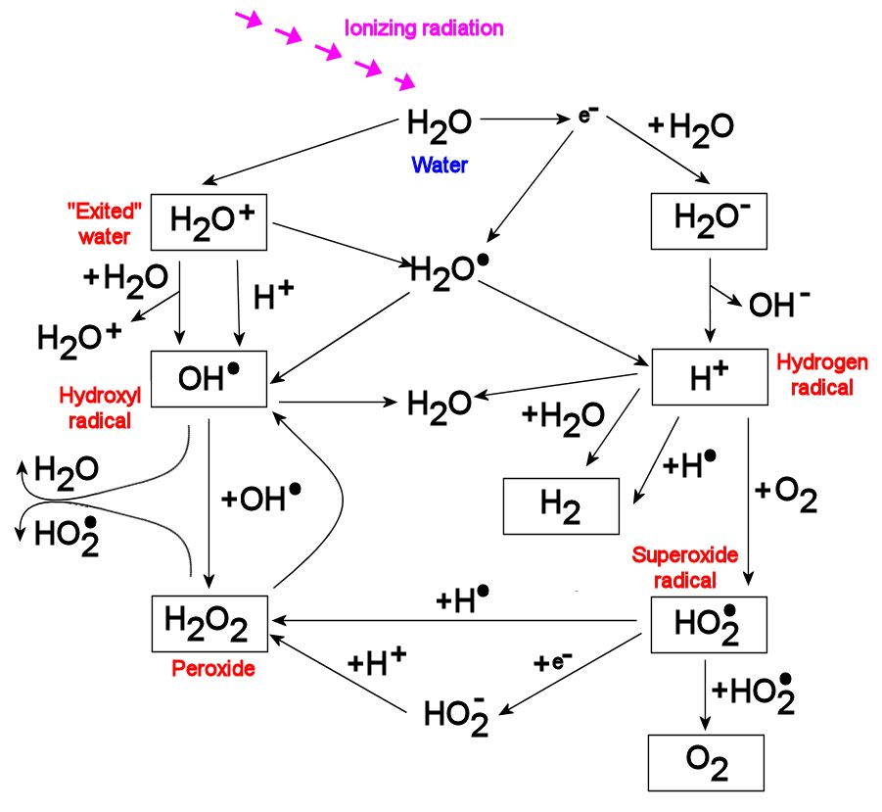
Introduction I
Water radiolysis
  Only molecular species have sufficient lifetimes to accumulate
  Only molecular products long enough life times to accumulate
Reference: S. Le Caer (2011)

Slide 3
Introduction II
Primary radiolytic yield
  Escape yield, G value [molecules/100eV]
    Type of radiation, Linear Energy Transfer, pH of solution
  Knowledge about the behavior of H₂O₂, H₂ and O₂ to ensure adequate
  conditions for isotope harvesting
 | G value [molecules/100 eV]
H₂O₂ | 0.74
H₂ | 0.63
O₂ | 0.073
Reference: Pastina et al (1999), Wasselin-Trupin et al (2002), Elliot et al (1993), Meesungnoen et al (2005)

Slide 4
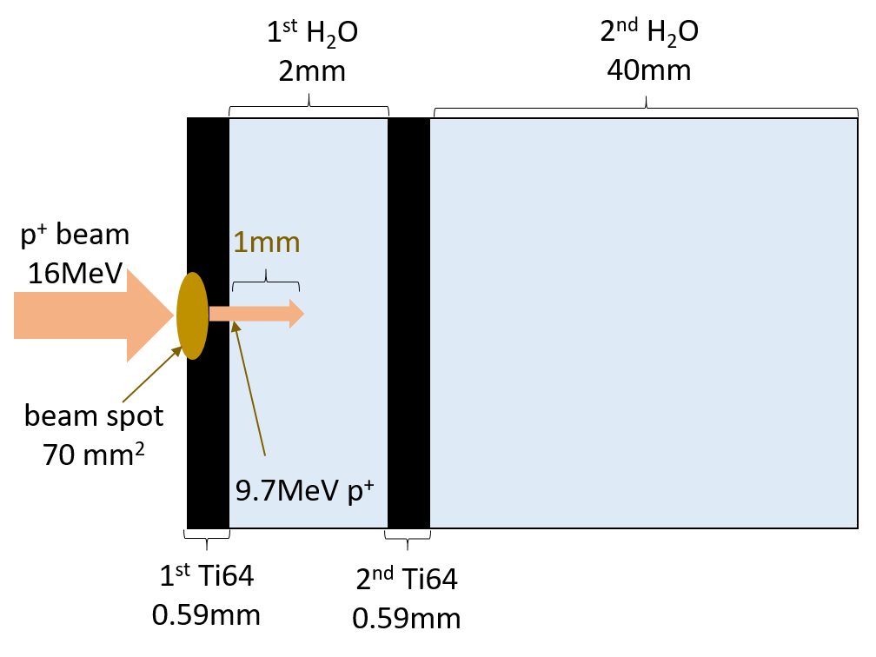
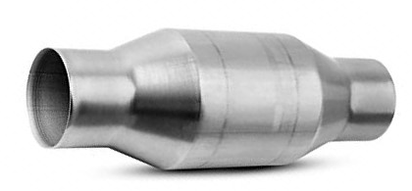

Experimental Setup I
Irradiation at the University of Wisconsin – Madison
Removal of radiolysis products from our system
  Decomposition of H₂O₂ by catalytic converter (KLC)
t_{irr}: 190 min
4 run segments
Int.: 1 - 33 μA
LET: 12.6 keV/μm
H₂O₂ H₂O + ½ O₂
Pd, Zr, Ce

Slide 5
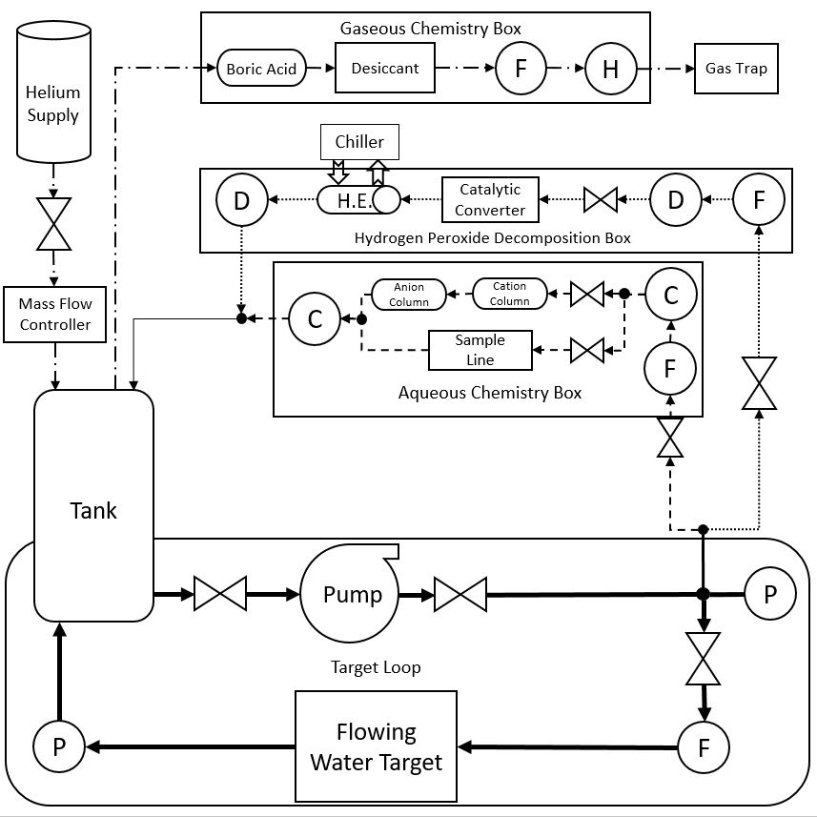
Experimental Setup II
He
H₂
D2
KLC
D1
Tank
water samples
p⁺

Slide 6
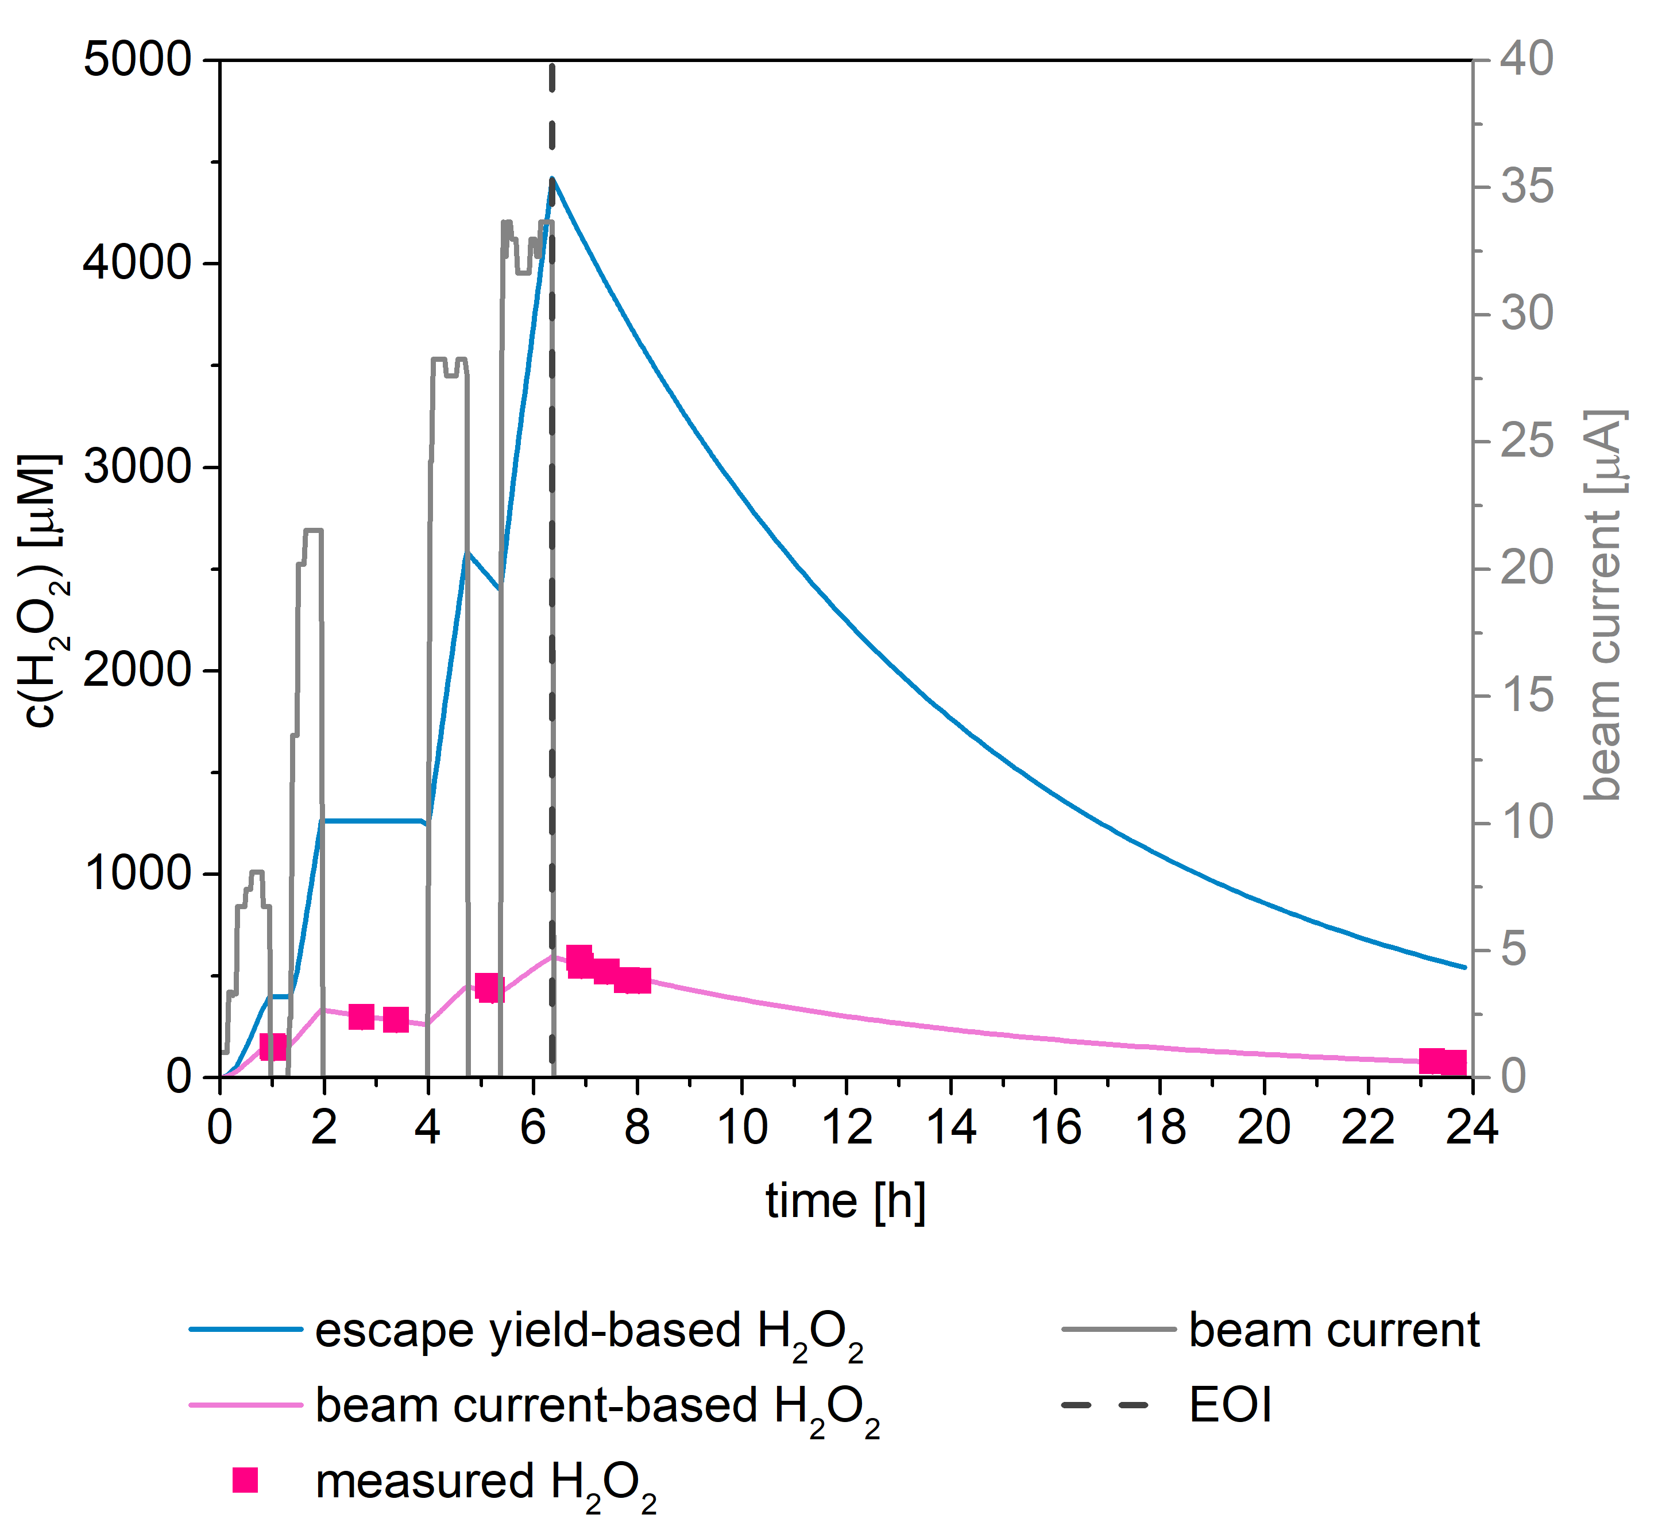
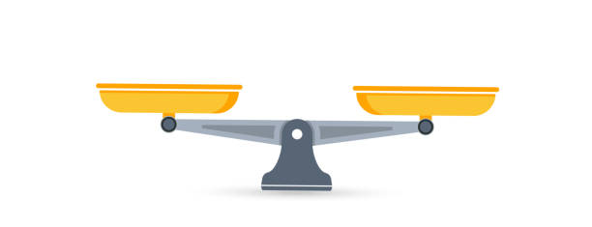
Formation of H₂O₂
Escape yield-based H₂O₂
  Formation based on G value and
  destruction by KLC
  2.5 – 8 times lower [H₂O₂]
  measured
  Long-term irradiations
  Formation
  Destruction
  Steady State
  HO· + HO· → H₂O₂
  HO₂· + HO₂· → H₂O₂ + O₂
  H₂O₂ + e⁻_{aq} → OH⁻ + HO·
  H₂O₂ + HO·/H· → H₂O + HO₂·/HO·
Reference: Pastina et al (1999), Le Caer (2011), Iwamatsu et al (2018), Meesungnoen et al (2005)

Slide 7

Interaction of Spurs
Our harvesting system
  Tank with 36 L H₂O
  Small volume of beam spot (~0.7 mL)
  Low beam currents
H₂O
0.01 – 5 μA:
p⁺
$\frac{V (spurs)}{V(beam spot)}=0.001 −0.5$
p⁺
p⁺

Slide 8

Interaction of Spurs
Our harvesting system
  Tank with 36 L H₂O
  Small volume of beam spot (~0.7 mL)
  Higher beam currents
H₂O
p⁺
10 – 35 μA:
p⁺
$\frac{V(spurs)}{V(beam spot)}=1 −3.6$
p⁺
p⁺
p⁺
p⁺

Slide 9
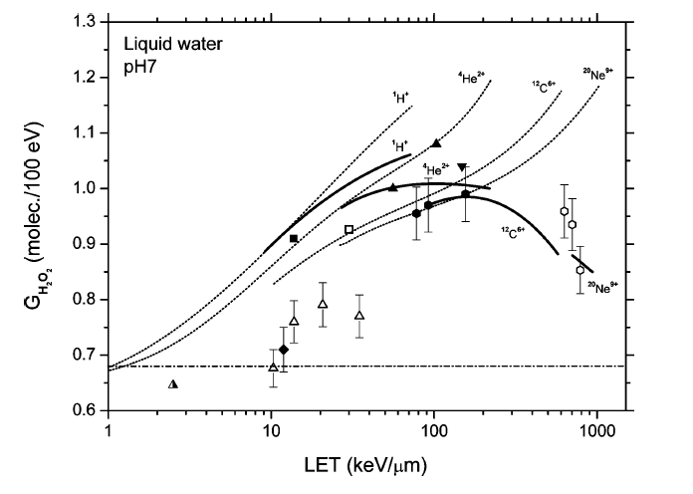
Beam current-based H₂O₂ calculation
  Decreased G(H₂O₂) at higher beam currents
  → overlapping spurs
  Literature: declining G(H₂O₂) with increased ionization densities
Reference: Meesungnoen et al (2005)

Slide 10
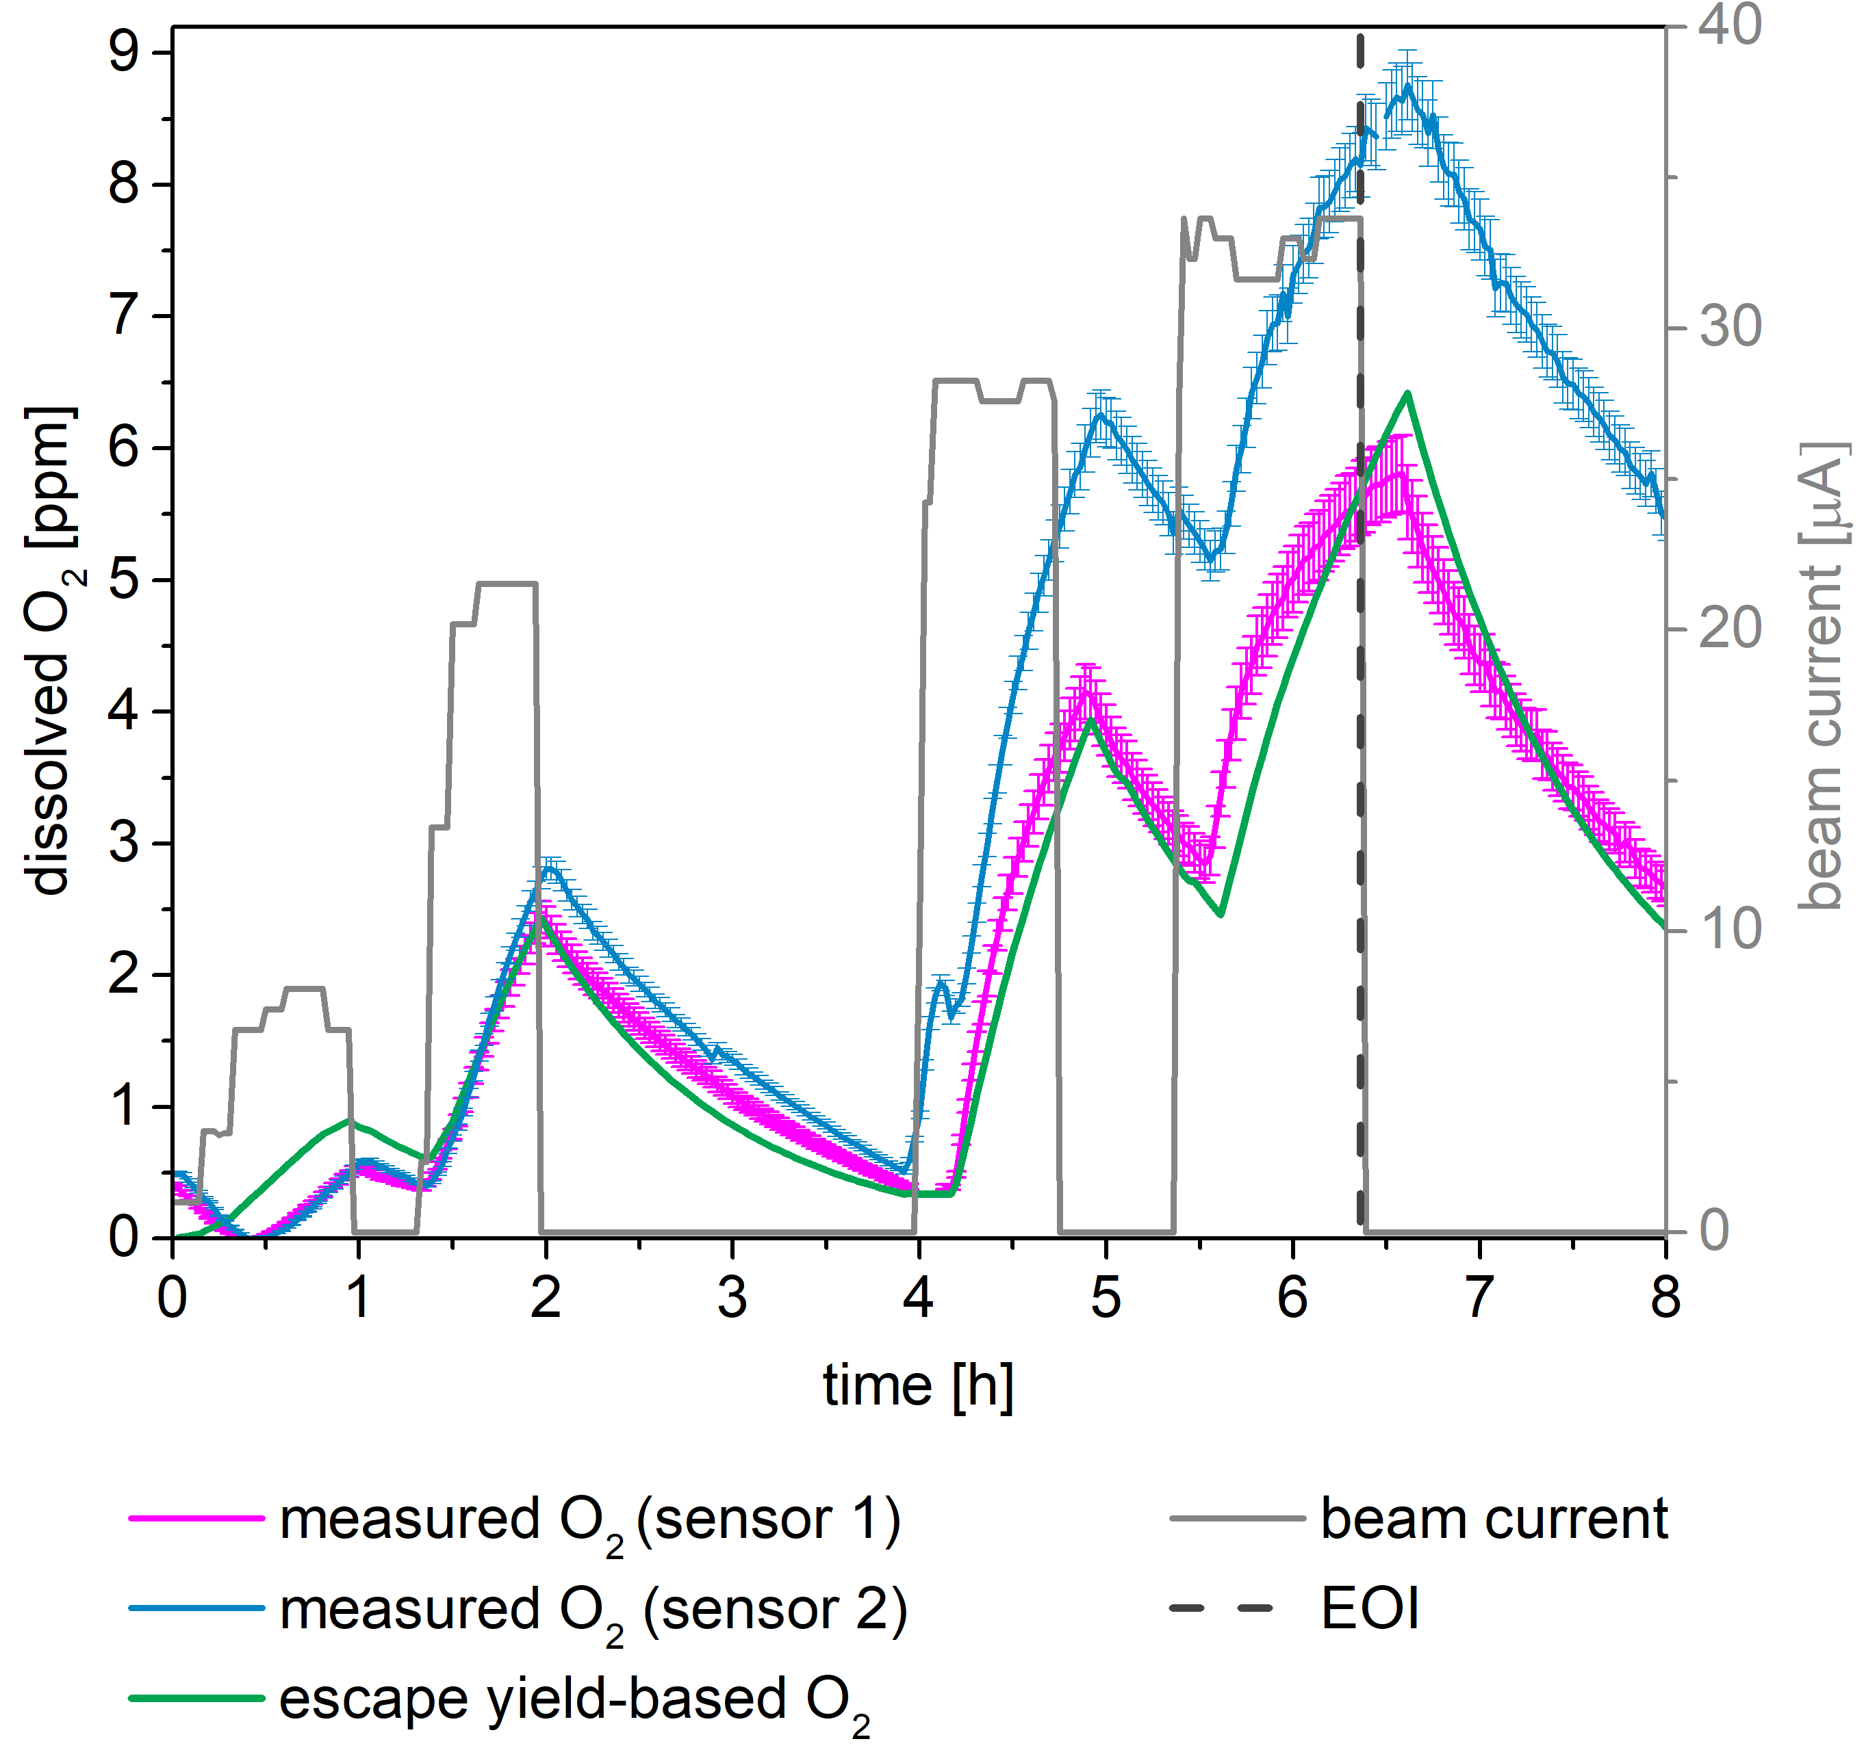
Formation of O₂
  Two dissolved O₂ sensors
  Escape yield-based diss. O₂
  Formation with G value
  Deareation from water by He
  Additional O₂ input by KLC
H₂O
KLC
H₂O₂ → H₂O + ½ O₂
Sensor 1
Sensor 2

Slide 11
Formation of O₂
  Two dissolved O₂ sensors
    Intra-track formation
    HO₂· + HO·/ HO₂· → O₂ + H₂O/H₂O₂
    Intra-track decay
    O₂ + e⁻_{aq}/H· → O₂⁻ + O₂^{·-}
  Agreement with measured diss. O₂ (D1)
  10-times lower G(O₂) → less O₂ track interactions
  Virtually no O₂ data on long term irradiations
H₂O
KLC
H₂O₂ → H₂O + ½ O₂
Sensor 1
Sensor 2
Reference: Burns et al (1981), Meesungnoen et al (2005)

Slide 12
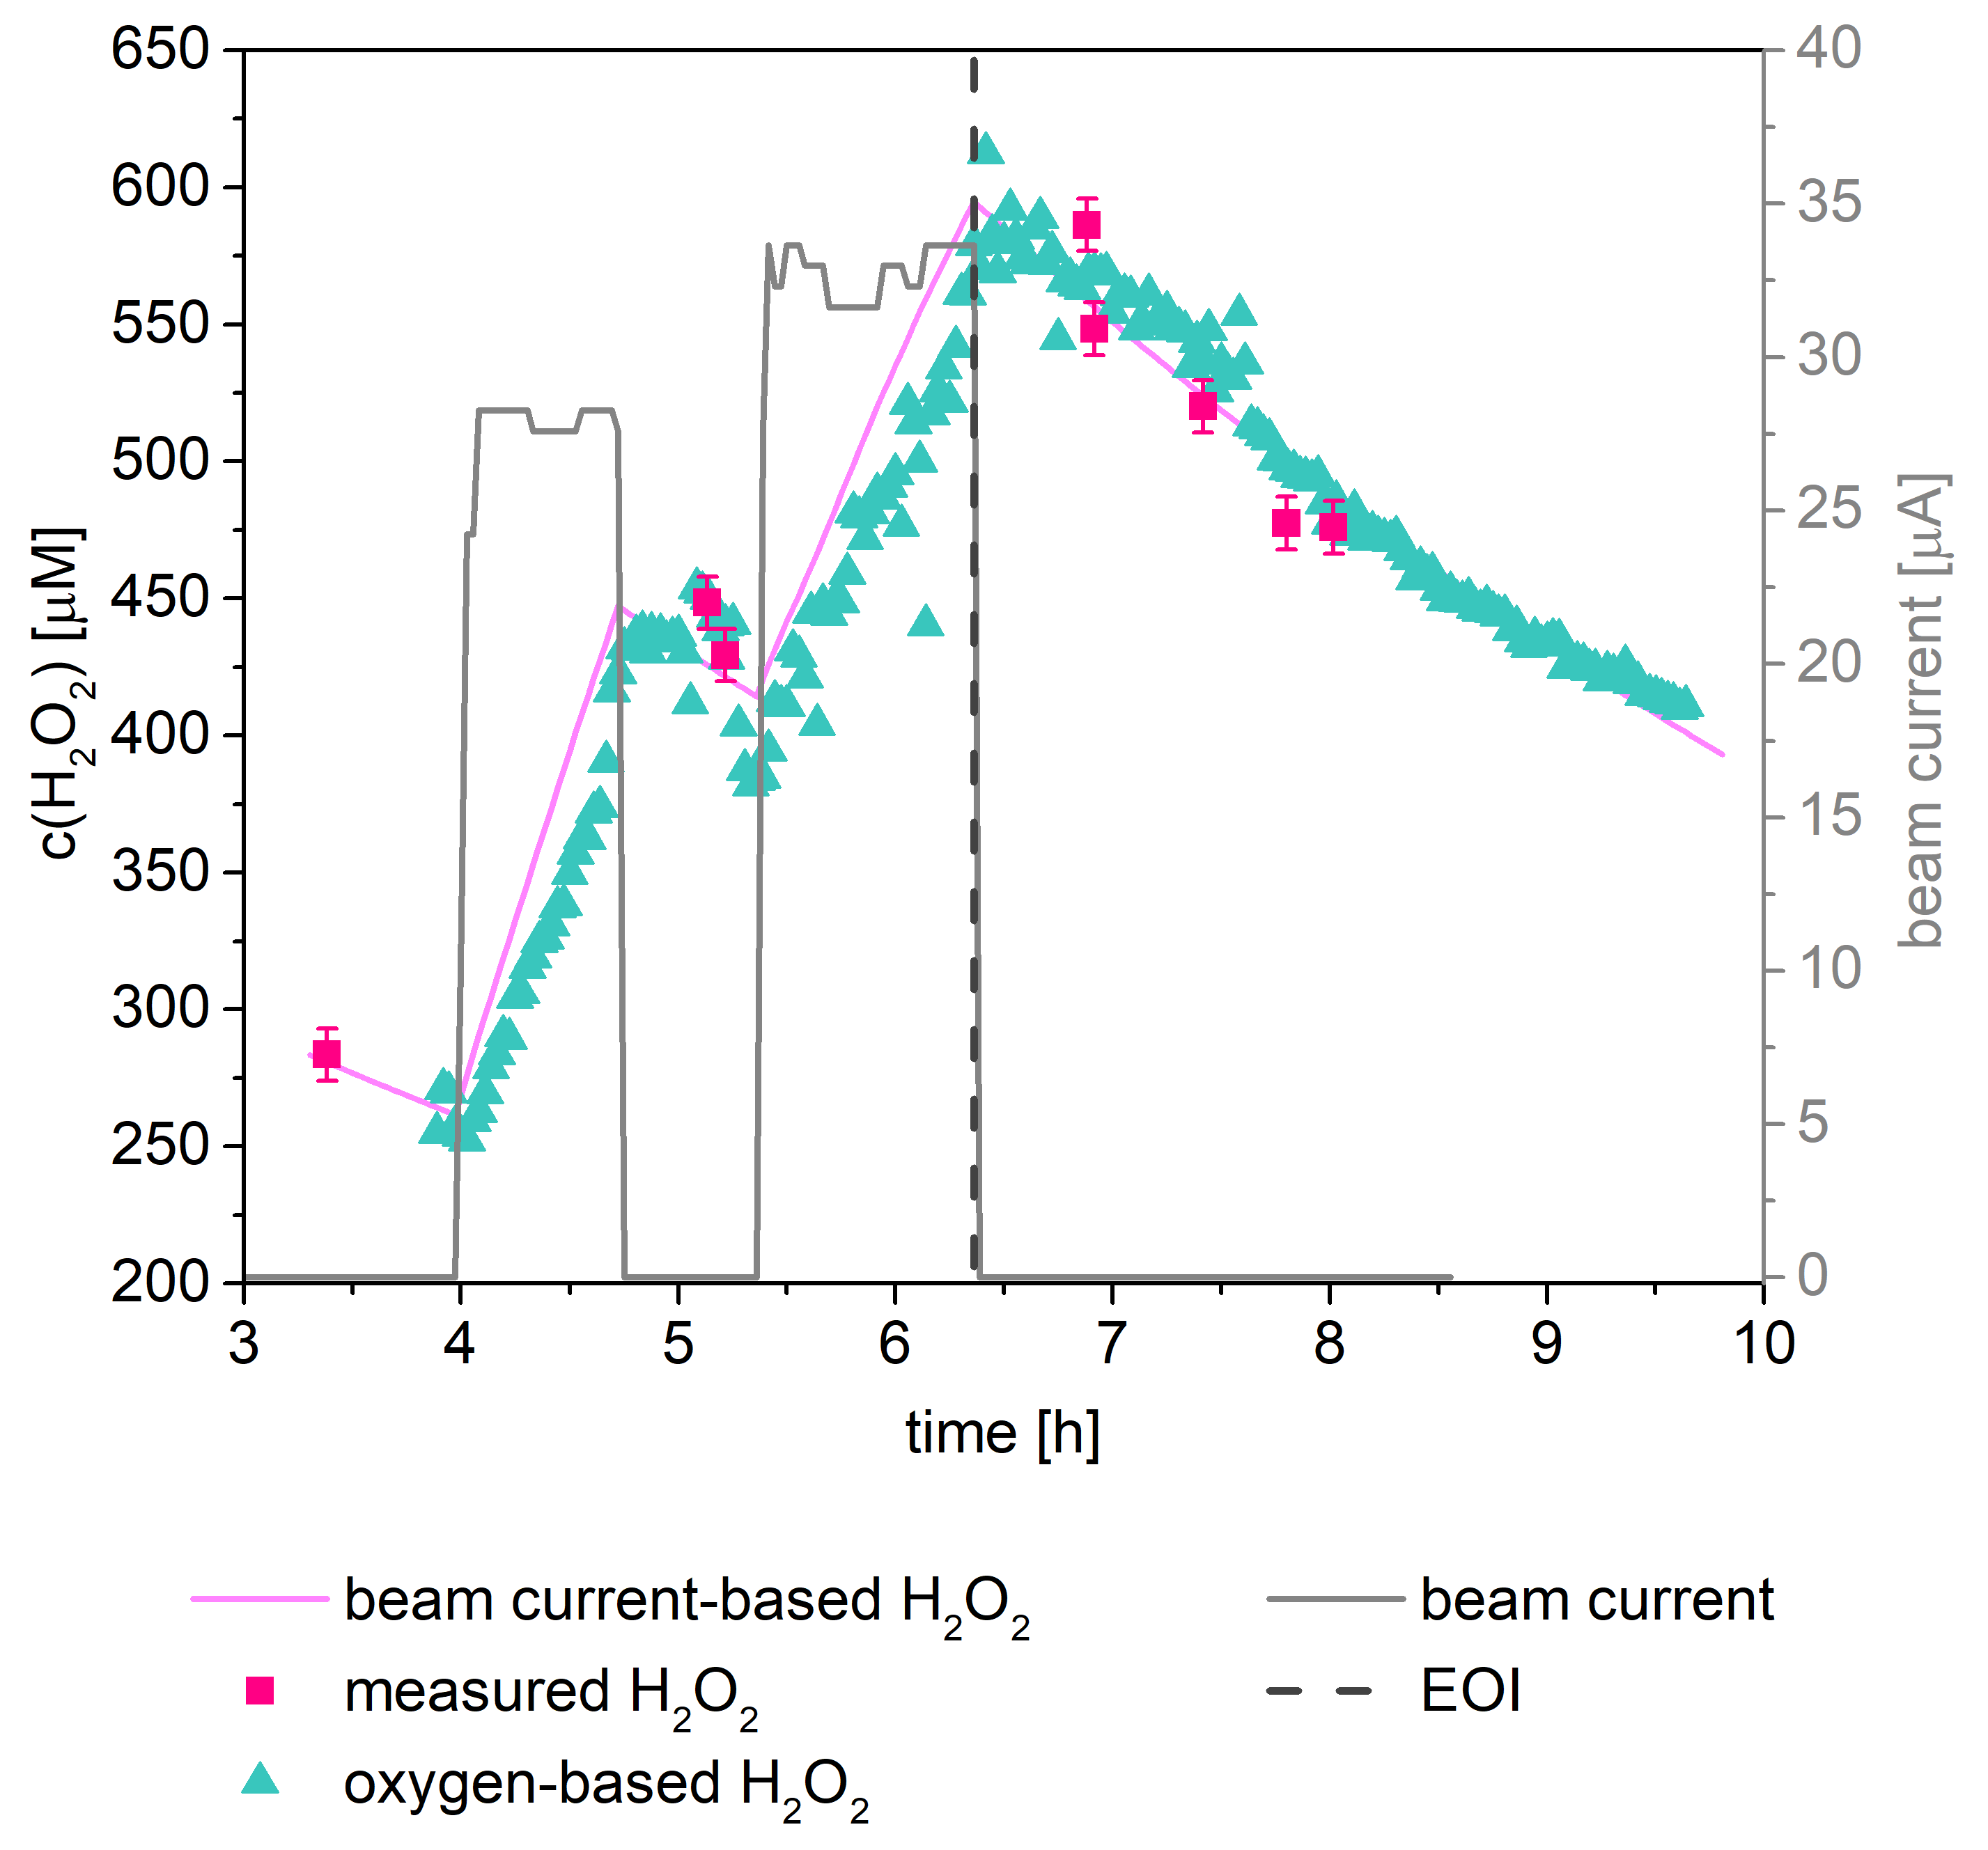
Indirect measurement of [H₂O₂] with diss. O₂
  No on-line determination of
  H₂O₂ in water
  difference of diss. O₂ sensor readings
  H₂O₂ in system water
  Verification of beam current-based
  H₂O₂ calculation
Δ(Sensor 2 – Sensor 1) =
H₂O₂ converted by KLC

Slide 13
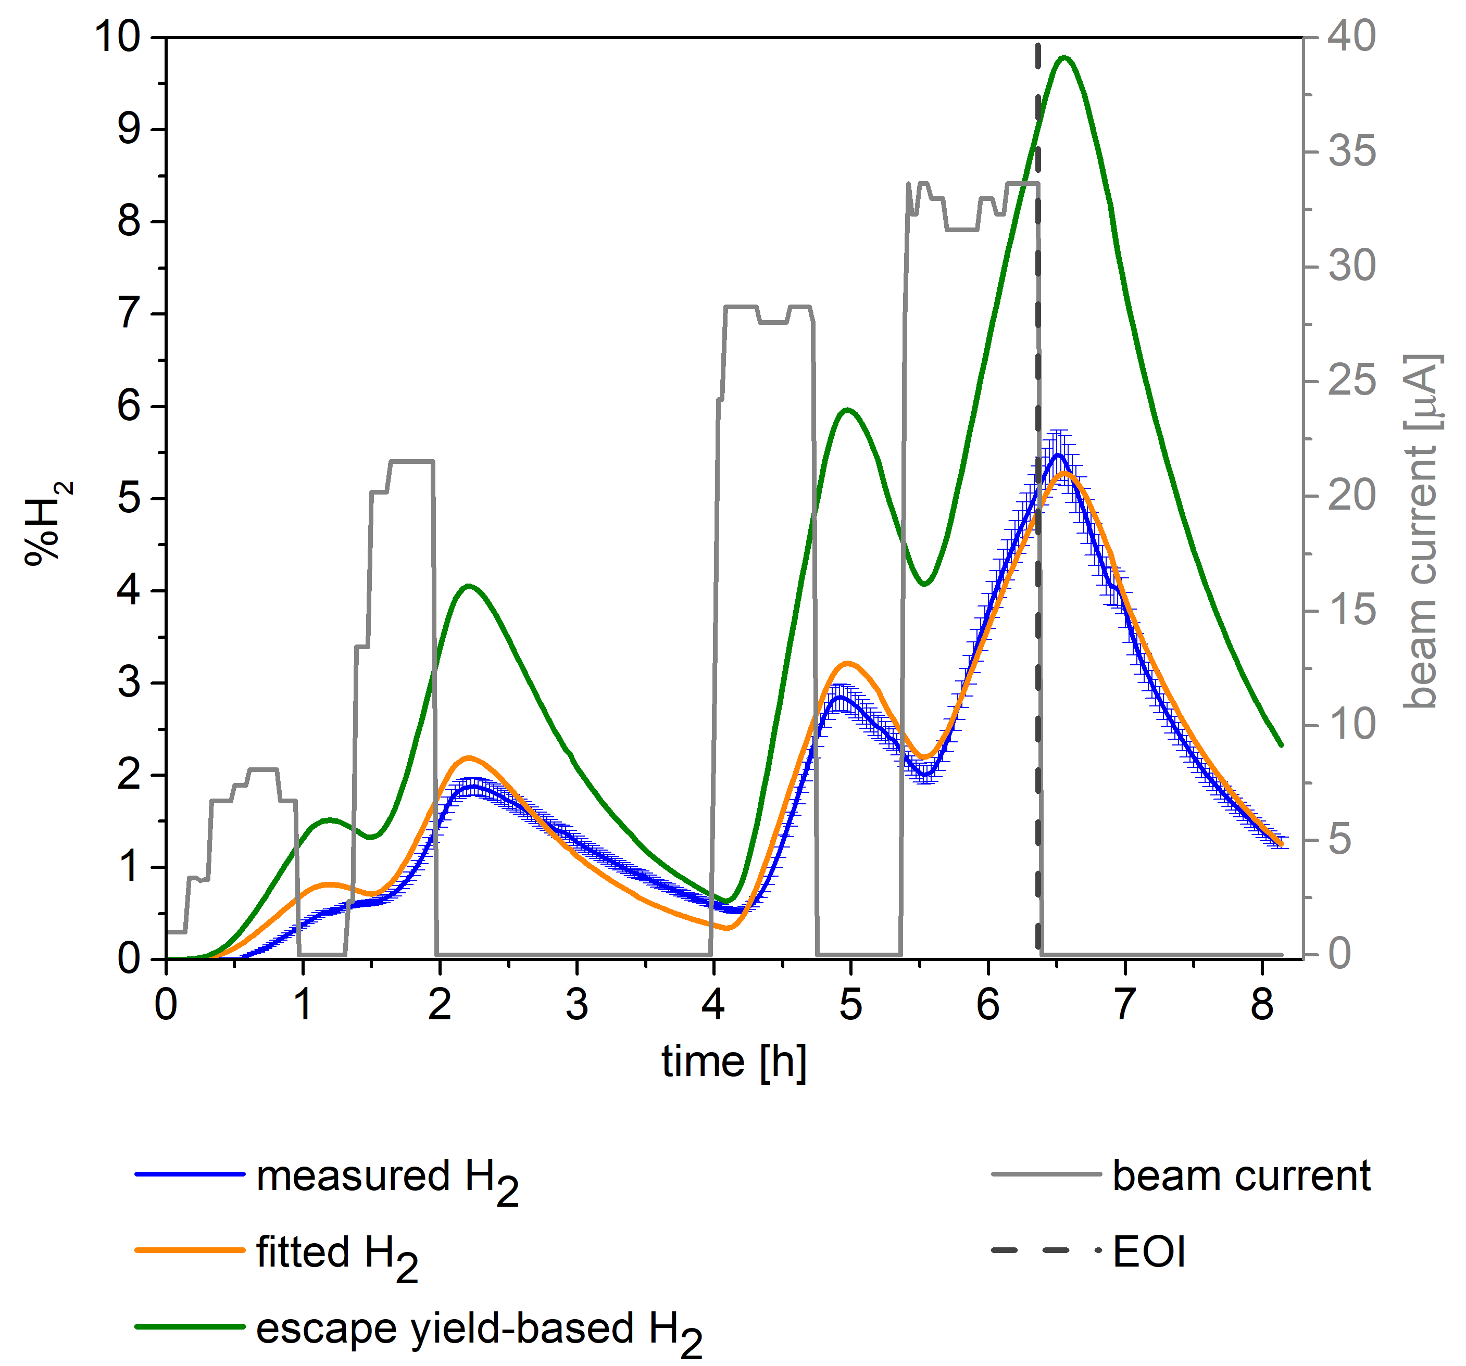
Formation of H₂
  Escape yield-predicted %H₂ 2-times
  higher than measured %H₂
    Formation with G value
    Transfer into headspace and transport
    to H₂ sensor by He
  Formation
  e⁻_{aq} + e⁻_{aq} + 2 H₂O → H₂ + 2 OH⁻
  e⁻_{aq} + H· + H₂O → H₂ + OH⁻
  Allen cycle
    Presence of HO· and H· radicals
    Only sustainable at LET ≤ 20 keV/μm
    HO· + H₂ → H₂O + H·
    H· + H₂O₂ → H₂O + HO·
  Mutual annihilation of H₂O₂ and H₂ can be assumed

Slide 14
Formation of H₂
    Fitted H₂ calculation
      Assumes const. G(H₂) of 0.34
      Transfer into headspace and
      transport to H₂ sensor by He
      Assumed that decreased G(H₂)
      accounts for the H₂ decay within
      Allen-cycle

Slide 15
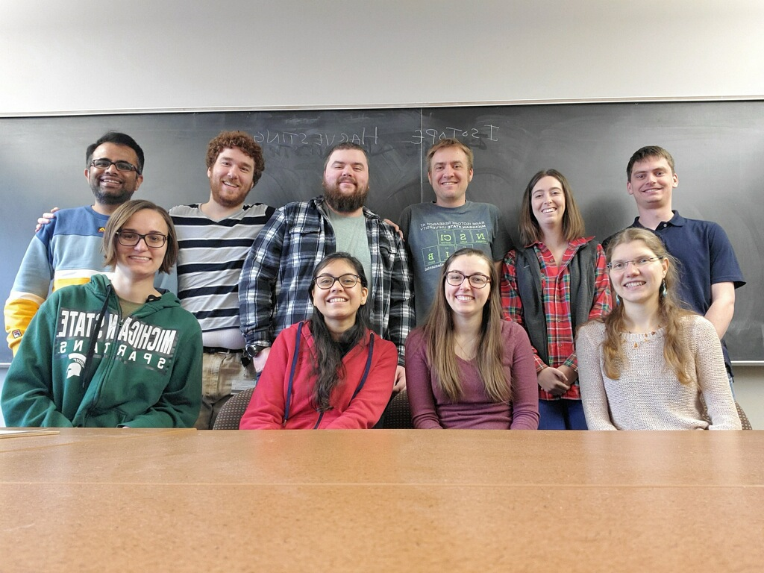


Acknowledgements
The isotope harvesting gang
  Greg Severin
  Paige Abel
  Hannah Clause
  Scott Essenmacher
  Colton Kalman
  Chloe Kleinfeldt
  Samridhi Satisja
  Chirag Vyas
  Wesley Walker
  Funding
  Michigan State University
  U.S. Department of Energy (DOE-FOA-0001588)

