Slide 1
Transmission Electron Microscopy of Dislocations
Danny J. Edwards
Team Lead, Materials Characterization Team
Reactor Materials and Mechanical Design Group
Notes:
Stock image of cloud formations

Slide 2
Outline
Structure of metals
Radiation damage in metals and alloys
What are dislocations?
  History, where did microscopy come into play
  Why are they important?
    Deformation of metals through processing, environmental exposure, applied stresses, irradiation!
How does thermomechanical processing produce dislocations, and how does it alter material property
How does irradiation with energetic particles alter pre-existing dislocations and create new dislocations
    Dislocations act as defect sinks for radiation damage produced atomic defects and their clusters
    Cascade damage simulations
Why we need TEM to document these microstructural changes
Modes of TEM imaging and dislocation analysis (BF, DF, WBDF, lattice imaging, GPA)
Examples of different materials systems
New techniques (STEM imaging, aberration correction, HAADF)

Slide 3
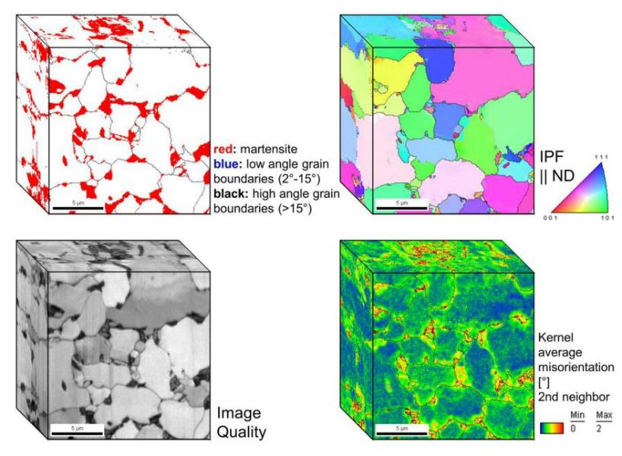
Structure of Metals
Most metals are polycrystalline materials, i.e. small crystal grains of the same crystal arrangement in atomic contact with adjacent grains
Often multiphase, multistructures materials of great complexity
http://www.dierk-raabe.com/ebsd-and-3d-ebsd/

Slide 4
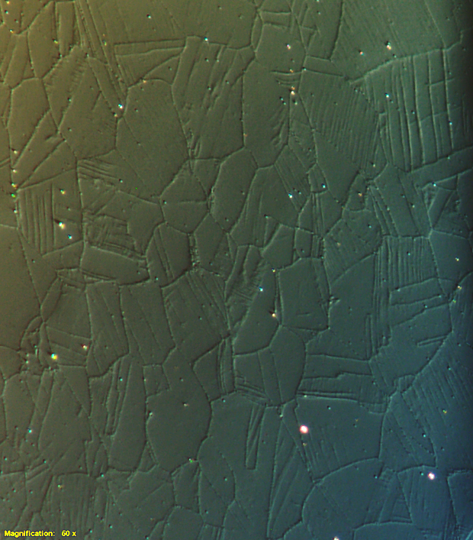
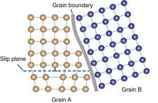
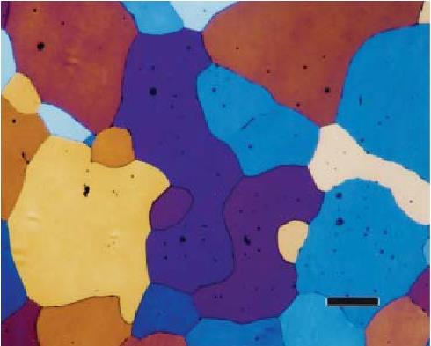
Structure of Metals: Optical Metallography
Deformed Stainless steel
Optical microscopy can reveal grain structures of all but the finest of grain structures (>1 um)
SEM/TEM required for finer grain structure
Grain

Slide 5
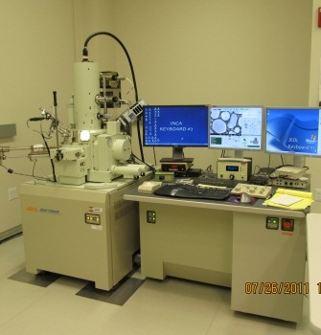
Structure of Metals: Scanning Electron Microscopy
Ti-6Al-4V
Scanning electron microscopy reveals the grain structure through various contrast mechanism
Electron backscatter diffraction can be used to identify individual phases, map out the crystal orientation of each phase, and each grain
Very powerful tool and suite of techniques to document the microstructure of metals

Slide 6
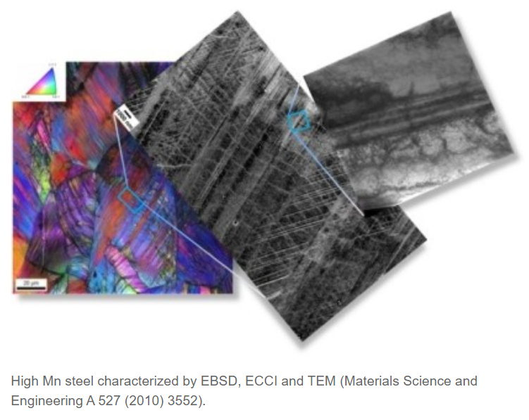
Structure of Metals
TEM
ECCI-SEM
Scanning electron microscopy reveals the grain structure through various contrast mechanism
Electron backscatter diffraction can be used too identify individual phases, map out the crystal orientation of each phase, and each grain
Very powerful tool and suite of techniques to document the microstructure of metals
Electron channeling contrast imaging which shows strong potential to help dislocations over a larger area without TEM
  Can probe below sub-micron
  Complimentary to TEM
EBSD

Slide 7
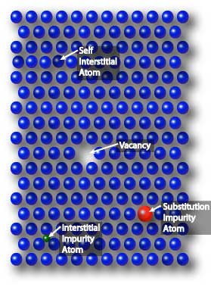
What crystalline defects?
Atomic lattice of most metals and alloys are far from perfect atomic arrangements
Can happen, but takes great effort – single crystal whiskers
Disregistry in atomic lattice leads to interstitial atoms, vacant lattice sites,
  These can discrete atomistic defects can interact and evolve into much larger structures such
    Line defects called dislocations
    Dislocation loops
    Voids, bubbles (the latter if gaseous atoms such as helium are present in metal)
    Vacancy-type tetrahedron
  Atomistic defects can interact with alloying elements, impurities to create new phases, often undesired phases that embrittle the materials
https://warwick.ac.uk/fac/sci/masdoc/current/msc-modules/ma916/mca/

Slide 8
How to image the crystalline defects
Transmission electron microscopy still retains the title for probing the defects in crystalline materials
  Resolution is sub-nanometer, but can image over hundreds of microns
    Reveals phases and their distribution down to the atomic level
    Reveal nature of defects in the crystalline lattice – dislocations in all their glorious configurations!!
    Document grain boundary structure and chemistry
    Chemical differences down to atomic scale
    Oxidation state of elements
When it comes to probing the effects of energetic particle irradiation on metals and alloys, TEM is an essential tool
  Radiation can alter structure and chemistry down to the nanoscale, no other technique can help to visualize this and quantify these changes in the same manner

Slide 9
Radiation Damage in Crystalline Metals
Ions, neutrons, protons, even electrons are the usually the particles of interest when studying radiation effects in materials
Given sufficient energy, ions can create Frenkel defects (displaced atom and associated vacant site)
  This displacement energy threshold is on the order of 30-50 eV for many metals
  Electrons up to 1 MeV usually create only Frenkel defects
When the energy of the incoming particle exceeds this threshold, then you enter the regime of displacement cascades
  Defects created in cascades evolve much differently than in the case of Frenkel defect production
  Cascades occur in picoseconds, but resulting defect structure evolves spatially into discrete defects that build up from minutes to years
  Producing drastic consequences in metals – hardening by defect production, void swelling embrittlement, loss of thermal and electrical conductivity, even transmutation into other elements

Slide 10
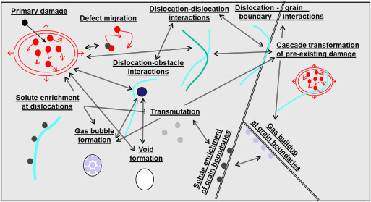
Radiation Damage
Nordlund et al - Journal of Nuclear Materials Volume 512, 15 December 2018, Pages 450-479

Slide 11
Defect Types produced in cascade
Frenkel defects consisting of a displaced atom (interstitial atom) and vacant lattice site (vacancy) – both are discrete entities with own behavior
  Single interstitial atom and vacancy, will recombine with other defects, cluster with like defects, have high mobility with enough temperature, can diffuse readily
Small discrete clusters of interstitials or vacancies
  Can be di-vacancies, loose clusters of interstitials of just a few atoms
  These can evolve into larger 2-D clusters of interstitials or vacancies, 3D structures such as vacancy type stacking fault tetrahedra, gas filled bubbles, and voids
Variables that effect evolution of microstructure:
  Irradiation time, irradiation temperature, damage rate, material chemistry/purity, grain size, pre-existing defects, thermal stability of material are just some of the variables
Irradiation under cascade damage conditions increases kinetics, forcing microstructure in a direction no thermal environment will form
Therefore, hard to predict without proper experiments and modelling

Slide 12
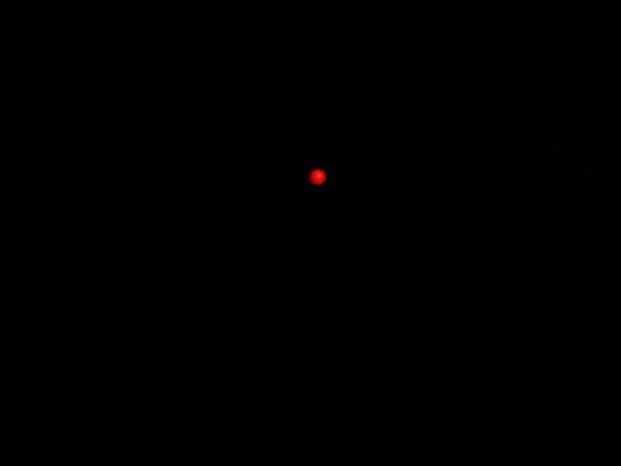
Displacement Cascade in Pure Cu
Forms two closely spaced stacking fault tetrahedra with interstitial loops separated from the SFT
Defect sizes can be too small even for the TEM (<0.2 nm)
4.9 nm loop containing 331 SIAs
2 nm void containing 339 vacancies
SFT edge length of 1.8 nm contains 28 vacancies
SFT edge length of 4.1 nm contains 136 vacancies
SFTs are sessile (don’t move), loops can be very mobile (millimeters in seconds if no traps
Interstitial loops
Stacking fault tetrahedra

Slide 13
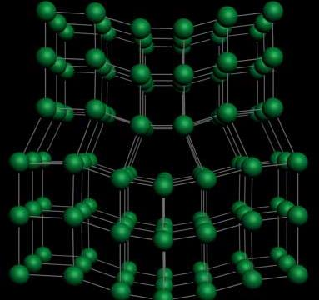
What are Dislocations?
Edge dislocation – inserted half plane yields a highly distorted lattice
Crystalline defects allows metals to deform at much lower stresses than the theoretical stresses that bind atoms together
Too many dislocations actually hardens the material

Slide 14
Dislocations Theoretically Proposed in the 1930s
Solid state physicists developed the theory of dislocations long before they could be imaged – 1930’s – 1950’s
First textbooks by Sir Alan Cottrell published in 1953, W.T. Read in 1954
  Indirect evidence found in growth spirals on surfaces of crystals, etch pits showing dislocations intersecting the surface of metals
  Dislocation theory far outstripped in complexity what could be observed experimentally….

Slide 15
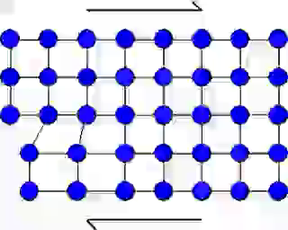
Edge Dislocations
Dislocation Theory Predicted…
Rather than separate all of the atoms at once (theoretical yield stress)
A dislocation allows rapid propagation of slip in the lattice
Line dislocations can move at the speed of sound in metals..or not
From Core Materials Youtube webpage

Slide 16
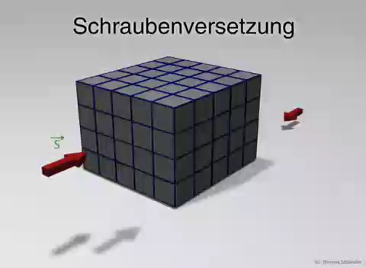
Screw Dislocations
Dislocation Theory Predicted…
Often requires a greater stress to move than an edge dislocation, but very important in BCC materials
From Thomas Schander Youtube webpage

Slide 17
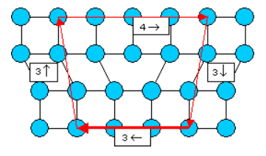
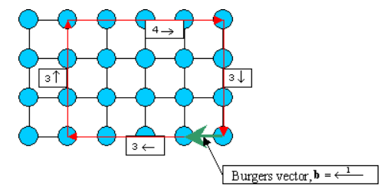
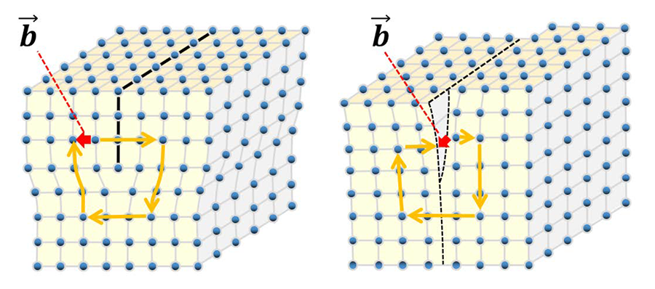
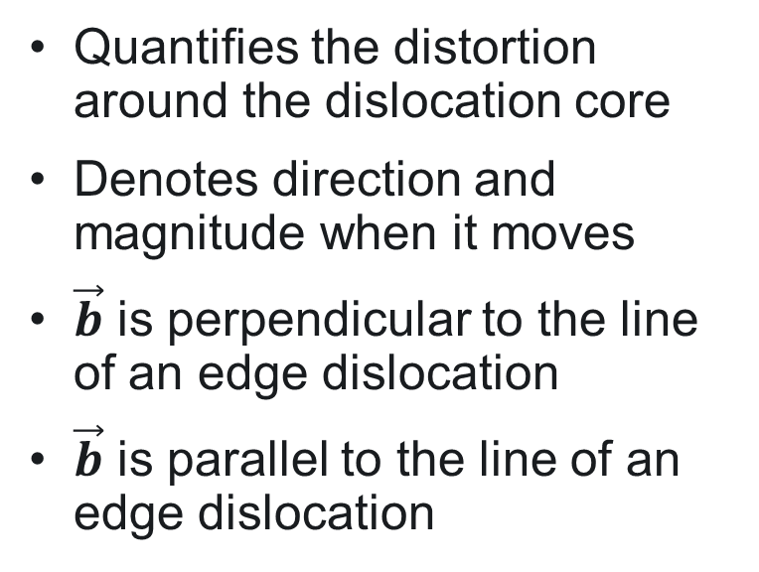
Burger’s Vector of a Dislocation
Edge dislocation with inserted half plane
Perfect crystal
Quantifies the distortion around the dislocation core
Denotes direction and magnitude when it moves
$\vec{b}$ is perpendicular to the line of an edge dislocation
$\vec{b}$ is parallel to the line of an edge dislocation

Slide 18
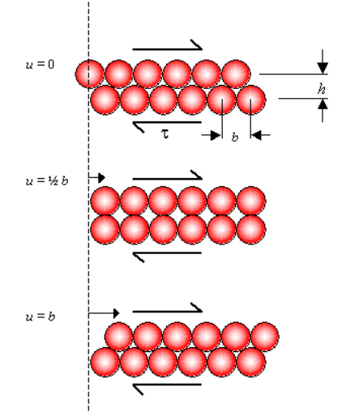


Slip in a Perfect Crystal versus Slip by Dislocations
To break all of the atomic bonds at once requires τ_{crit} = 1/5 the shear modulus G
Dislocation slip involves local movements, breaking individual bonds successively
Stress to move a dislocation line continuously through the lattice is called the Peierls-Nabarro stress: τ_{p}
τ_{p} is ~36x lower than τ_{crit}
University of Cambridge: DoITPoMS

Slide 19
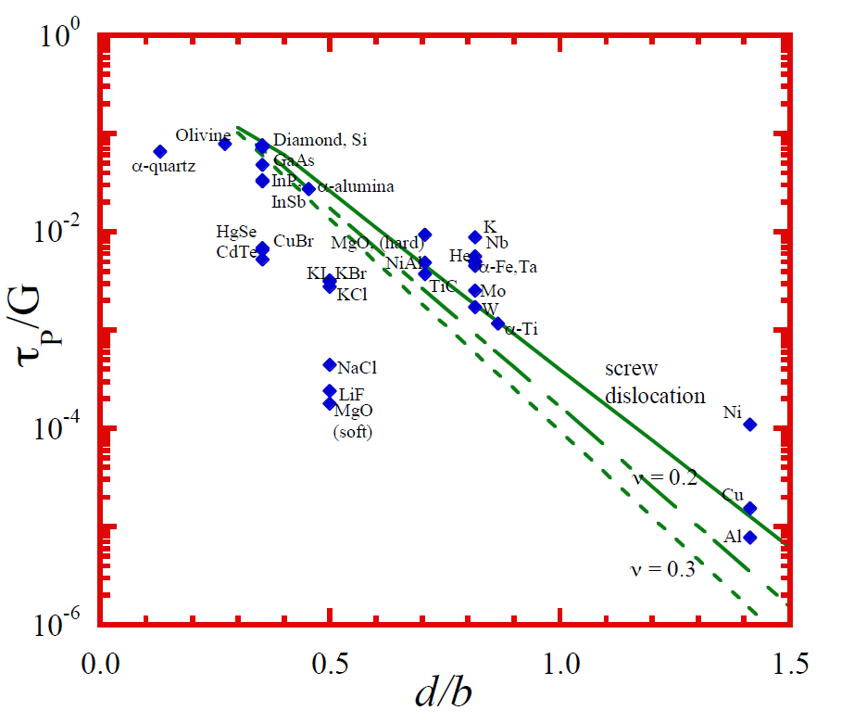

Lattice Resistance to Dislocation Movement
Wide dislocations
Narrow dislocations
Burger’s vector is a crystal vector that quantifies the difference between the distorted lattice and the perfect lattice
  Wider dislocations have a larger Burger’s vector
  Narrower dislocations in Fe and Ti versus Cu

Slide 20
Dislocations Theoretically Proposed in the 1930s
Solid state physicists developed the theory of dislocations long before they could be imaged – 1930’s – 1950’s
First textbooks by Sir Alan Cottrell published in 1953, W.T. Read in 1954
  Indirect evidence found in growth spirals on surfaces of crystals, etch pits showing dislocations intersecting the surface of metals
  Dislocation theory far outstripped in complexity what could be observed experimentally..
  Then came the Siemens Elmiskop I transmission electron microscope, which produced the first published evidence of dislocations
    Large unit cell crystals in 1956 (J.W. Menter)
    Deformed Aluminum, Hirsch and Whelan, July 1956
    Thin foils of stainless steel showing line dislocaitons, W. Bollmann at Battelle Memorial Institute
  Diffraction contrast and lattice imaging (phase contrast) revolutionized materials science, allowing direct evidence of crystalline defects

Slide 21
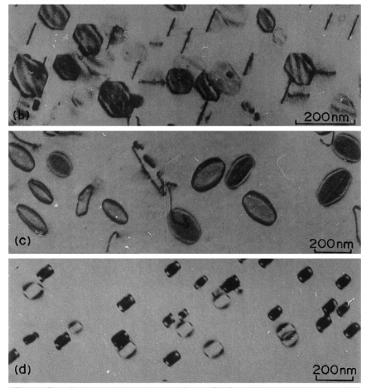
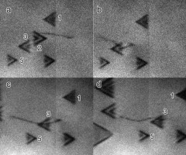
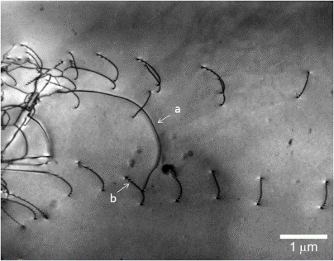
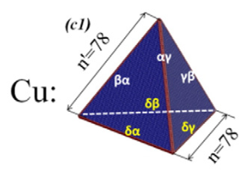
What do they look like in the TEM?
Dislocation Loops
Al
Through atomic scattering of the electron wave, the TEM can produce images through diffraction contrast (Bragg scattering)
  Present in all crystalline materials including metals, ceramics and minerals
  Can be flexible “lines”, faceted or curved “loops”, 3D structural like tetrahedrons
Cu
Fe
Stacking Fault Tetrahedra
Line Dislocations

Slide 22
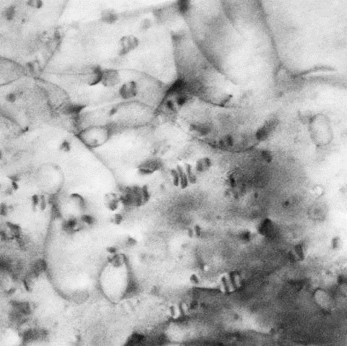
Fresnel Contrast of Voids in Ferritic/Martensitic Steel
(S)TEM Image Contrast at nm Scales
Amplitude Contrast:
fluctuations in number of electrons scattered
outside the Objective aperture/inside the ADF detector
Phase Contrast:
phase differences between scattered & transmitted beams
Mass-Thickness
Diffraction
Moiré, Fresnel,& lattice fringes
interference (BF-CTEM)
absorption (amorphous)
incoherent scattering (HAADF-STEM)
crystal w. defects
coherent scattering
(BF-CTEM)
Voids
Dislocations
Precipitates
50 nm
50 nm
22

Slide 23
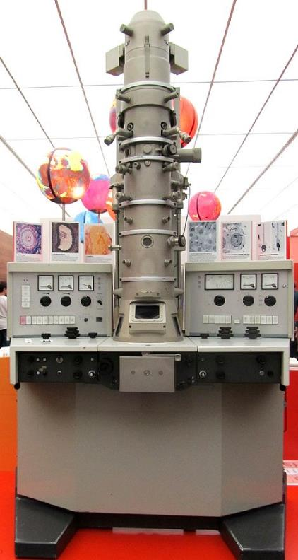
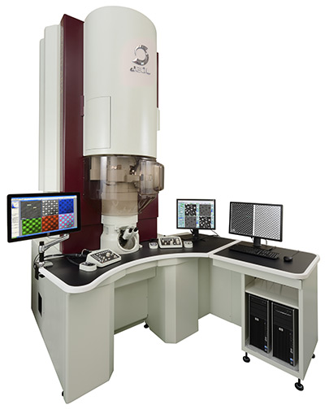
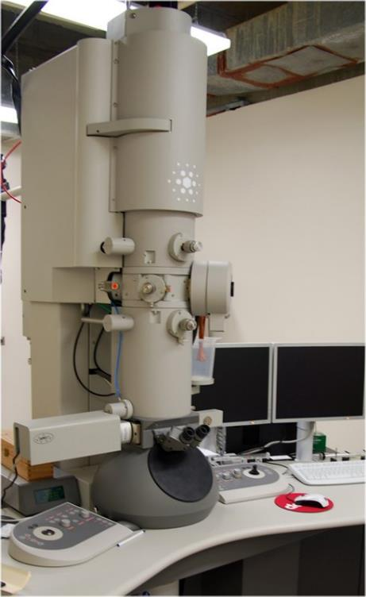
Progress in Microscope Development comes slowly
$4-5 million gets an
Aberration Corrected TEM/STEM
55 picometers resolution
True atomic column imaging/chemistry
Siemens Elmiskop I
Circa 1975, 1 nanometer
resolution
1980-present Conventional TEM
Sub-nanometer resolution
$1 million

Slide 24
Conventional TEM or Aberration Corrected?
Decades of work on dislocations conducted with conventional TEMs (CTEM), still work well for many applications, dominate the literature
  Still good for certain types of imaging
Scanning transmission electron microscopes (STEM) used very little for dislocation imaging, but that is changing
    Recent developments have shown STEM can image dislocations with certain advantages in image contrast, as well as allow simultaneous chemistry to be obtained
    High angle annular darkfield techniques can provide intuitive analysis of atomic positions and types without significant simulation
Advantages of new aberration corrected microscopes, though expensive, are well worth it needing to do analytical work (chemistry in addition to structure)
  Higher resolution in TEM mode and STEM mode
  Higher probe current density in STEM mode, tremendous flexibility to acquire compositional information and images simultaneously

Slide 25
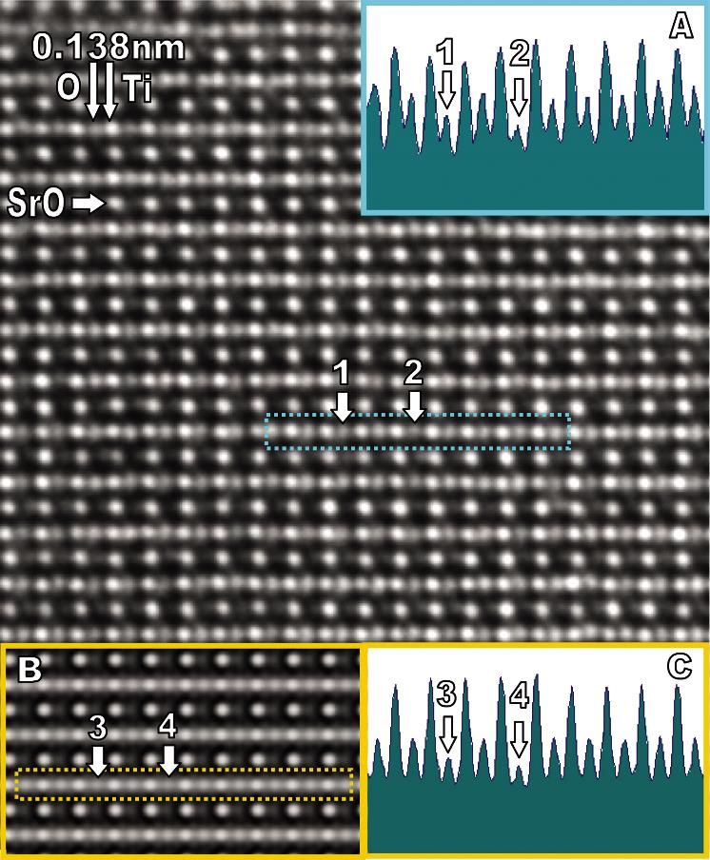
AC-TEM Imaging Allows Oxygen to be Seen
Experimental AC-TEM high resolution lattice image of SrTiO₃
Positions 1 & 2 indicate oxygen atom sites
Inset is an intensity trace
Calculated AC-TEM high resolution lattice image of SrTiO₃
Simulations match experimental images very well

Slide 26
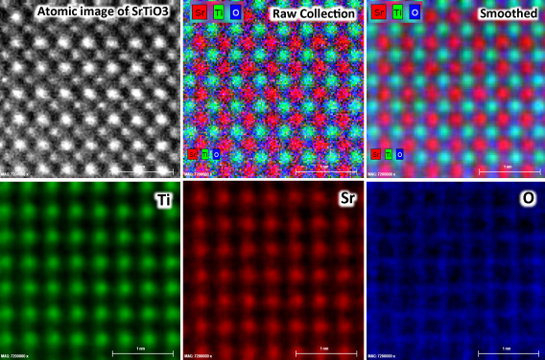
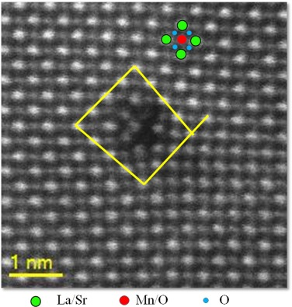
AC-STEM Imaging Reveals Atomic Structure and Chemistry Directly – No simulations needed
Probe corrected STEM allows atomic imaging and EDS chemical analysis of atomic columns in SrTiO₃
Probe corrected STEM allows atomic imaging of edge dislocation core in La/Sr/Mn thin films
https://www.aif.ncsu.edu/2013/05/09/tem-lab/

Slide 27
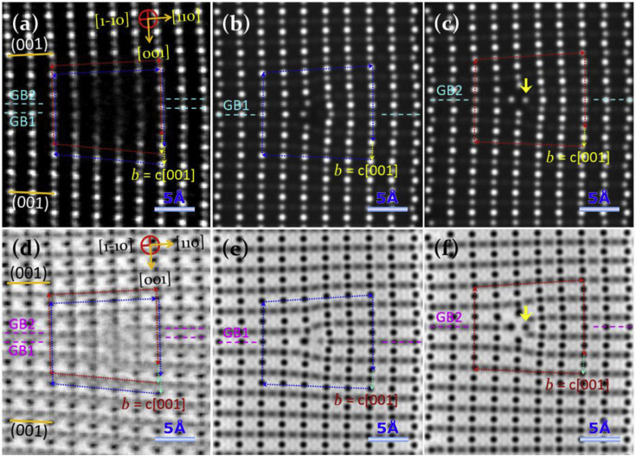
AC-STEM and TEM can Reveal Dislocation Cores
Aberration corrected TEM/STEM can reveal dislocation cores in many oxides (large lattice spacing), often specially prepared thin films
Can be applied in metals, but not widely used in the radiation effects community!
Hope to see increasing usage to help understand small defects not readily imaged in CTEM
Determination of the structure and properties of an edge dislocation in rutile TiO₂, Acta Materialia, 2019, Maras et al.

Slide 28
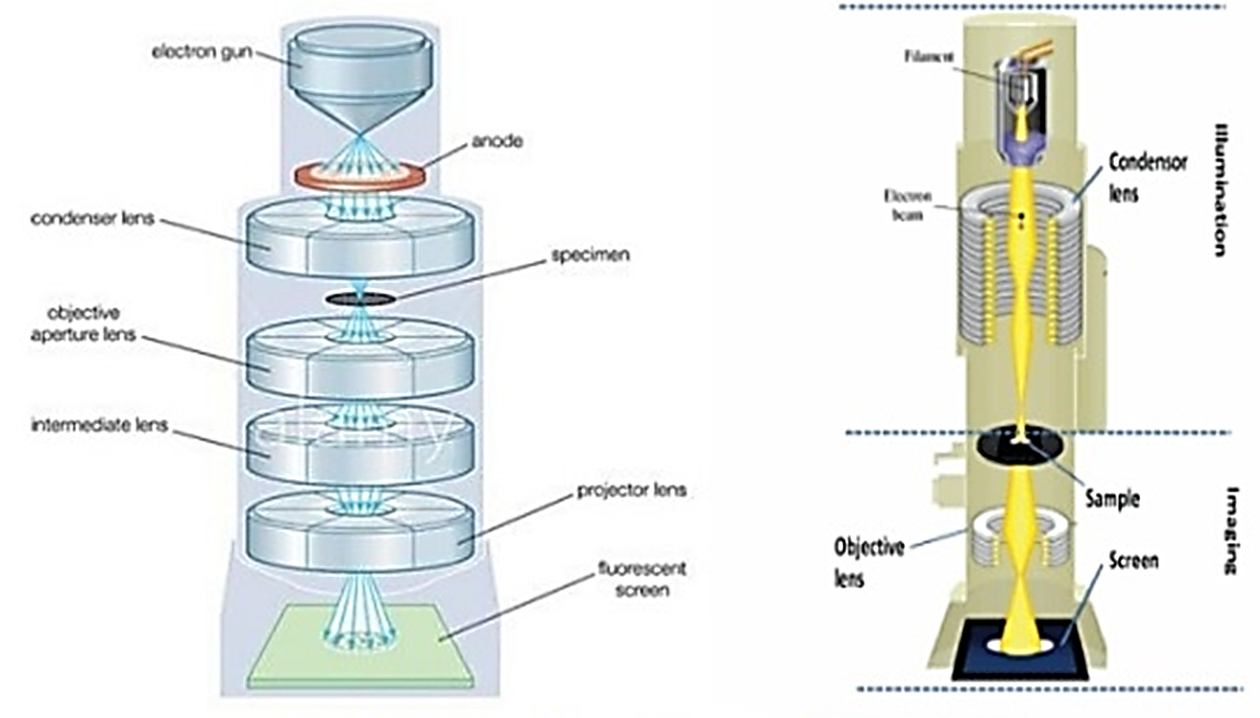
Let’s talk about the TEM
Thermal Schottky field emitters, cold field emitters, LaB₆, tungsten
  Field emission guns are very common, very flexible
  Schottky offers higher total current, larger emission area
  Cold FEG offers higher current density with smaller probe size, less energy spread
Accelerating voltages from 80-300 keV
Capture images with digital cameras (CCD), direct electron cameras
Specimens have to be electron transparent, typically 300 nm or less, for some types of analysis less than 50 nm

Slide 29
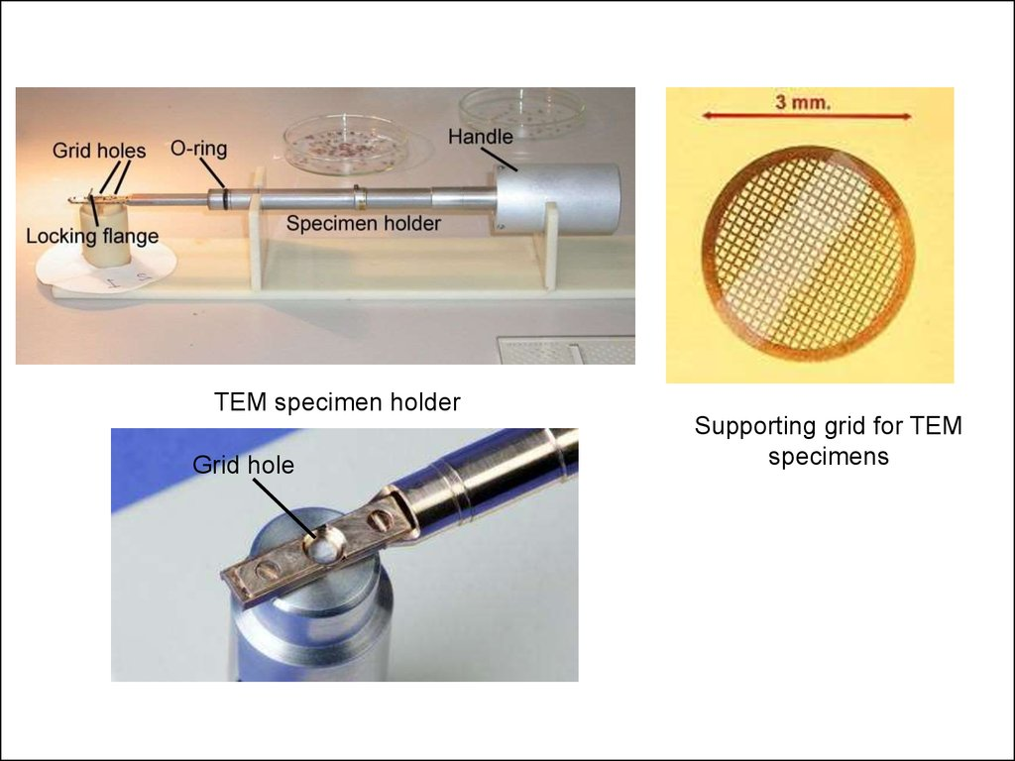
TEM Sample Prep is Half the Battle
TEM is no good without a good sample
Most sample holders designed for 3 mm discs
  Particles on grids
  Electropolished discs
  Ion milled discs
  FIB milled lamella
  Mechanically polished TEM discs

Slide 30
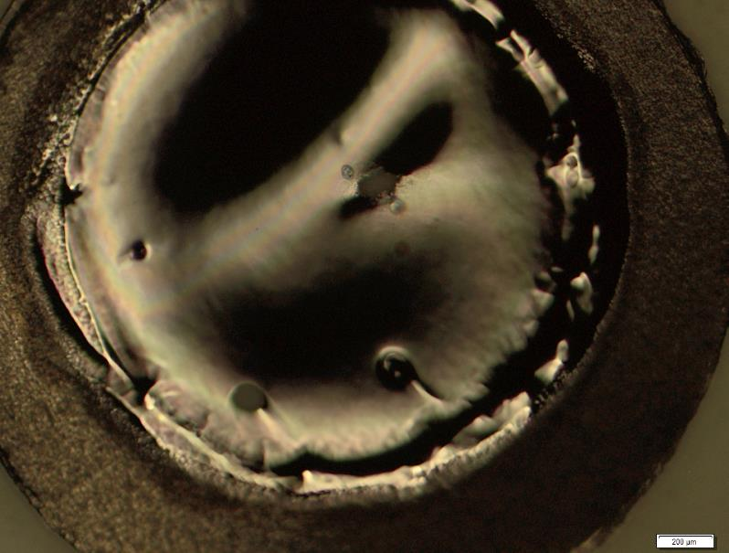
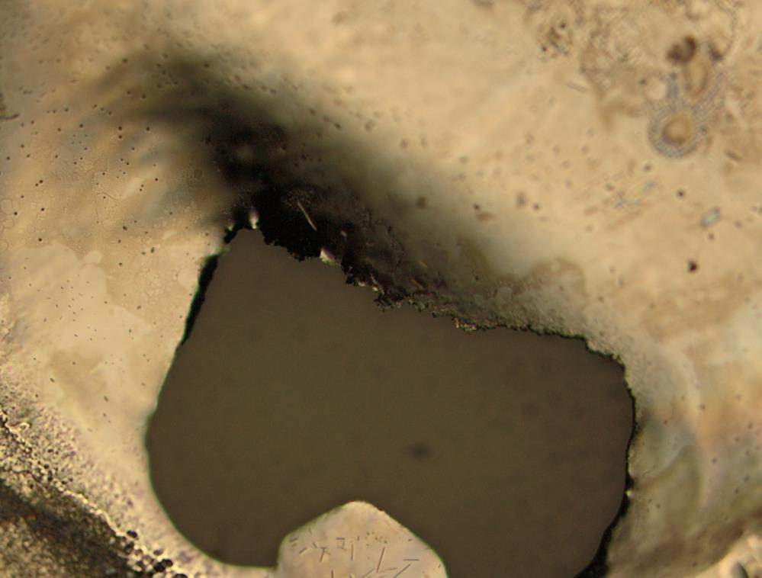
For our studies in metals
Electropolished discs
  Random location for thin area, not site specific
  Used for over 60 years
  No ion beam damage to confuse with real irradiated microstructures
  Need to be rinsed to ensure electrolyte is removed
  Preferential attack of certain phases
  Doesn’t work well for bonded dissimilar metals

Slide 31
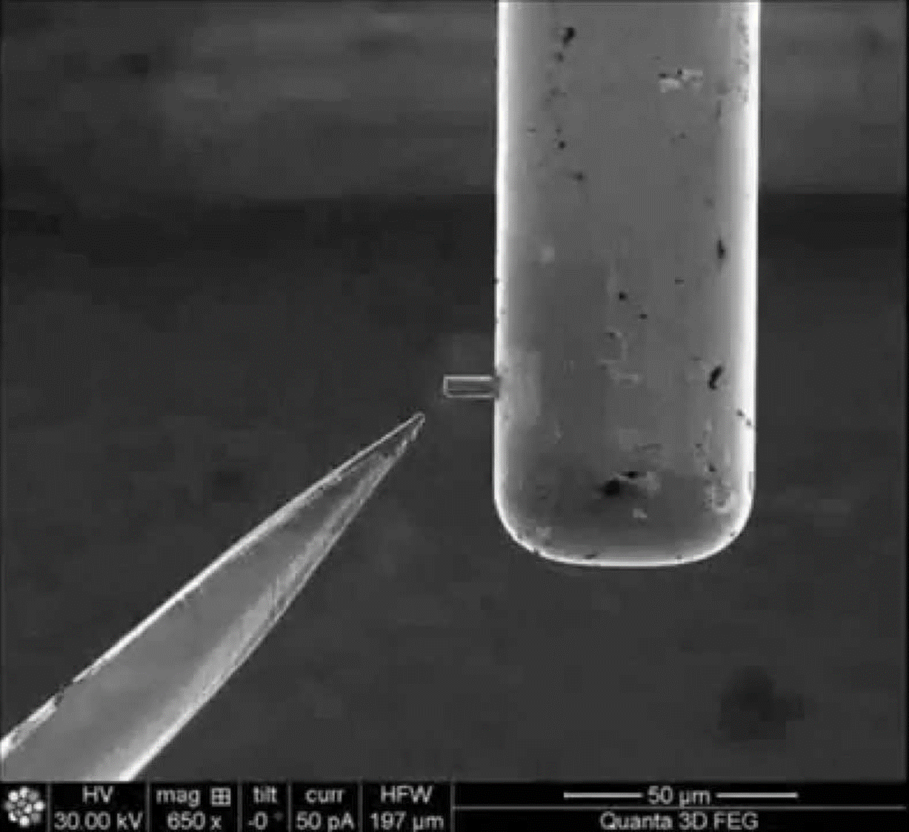
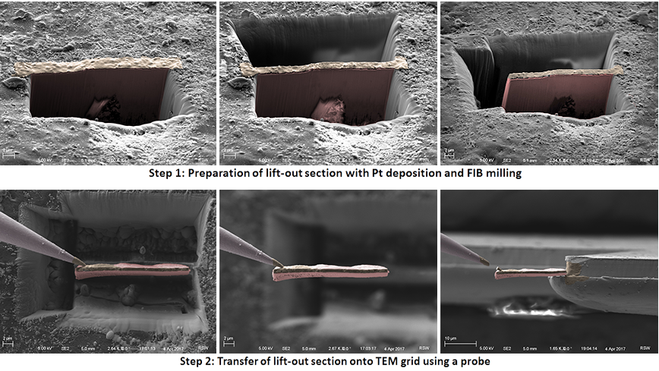
FIB Liftout
FIB/SEM is a high resolution SEM with Ga ion beam and Pt/C guns
Allows site specific samples to be extracted with high precision
Great for radioactive materials, no detectable radioactivity
Downsides: Ga ion beam damage can overshadow radiation damage, limited thin area

Slide 32
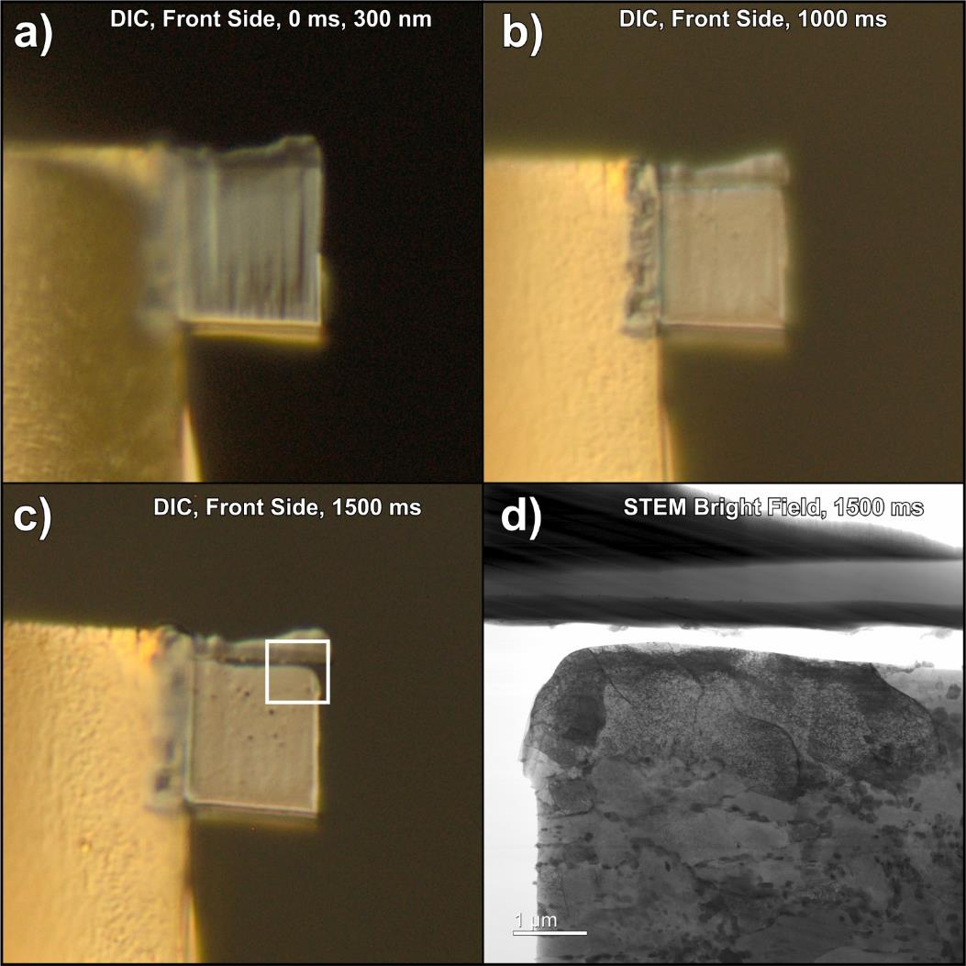
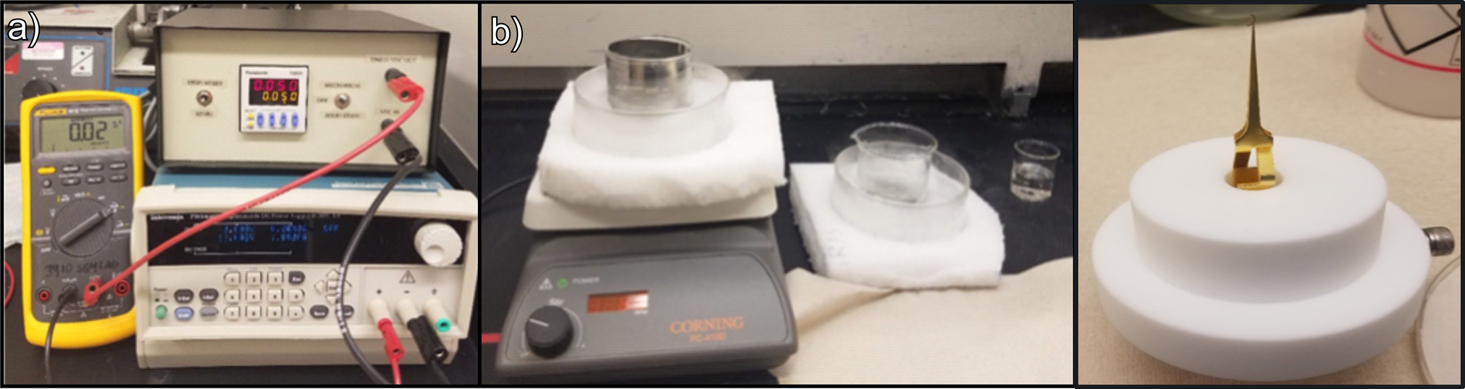
Flash Electropolishing Setup

Slide 33
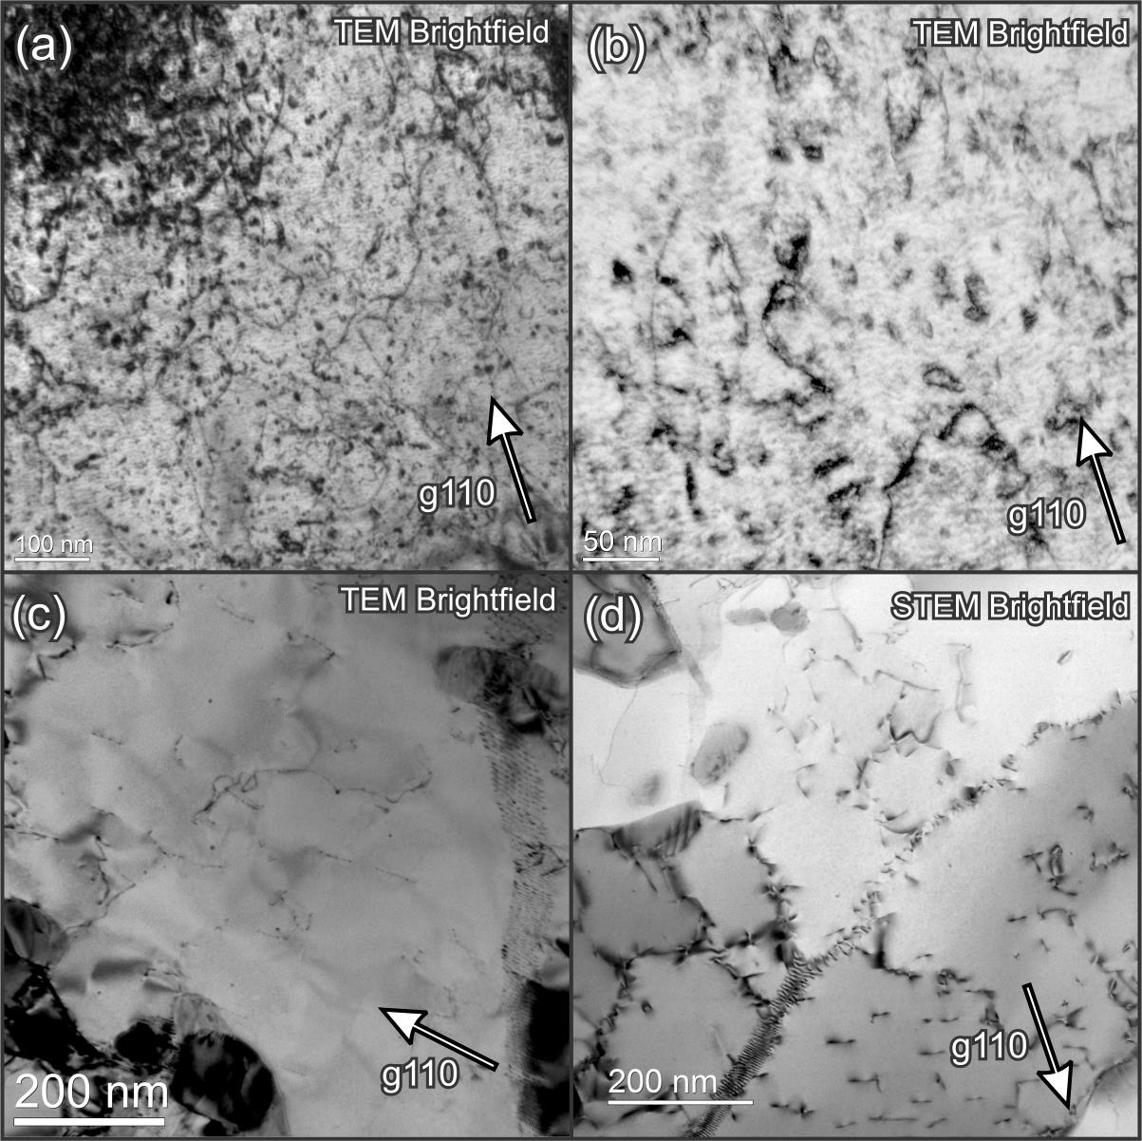
FIB Damage: Black spots, loops
Ga ions produce irradiation damage
  Defect clusters (black spots), dislocation loops, surface artefacts
Developed a flash electropolish technique that works on the tiny FIB lamella for FeCr samples
Completely removes Ga ion damage and Ga deposition in near surface regions
Critical if looking at samples irradiated at low temperatures
Difficult to find right parameters for FEP for various materials

Slide 34
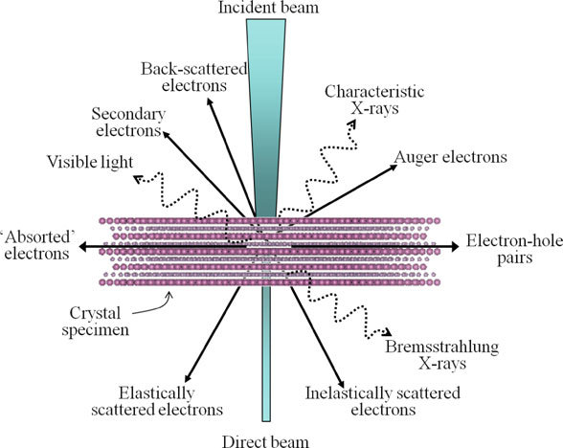
Interaction of High Energy Electrons with a Sample
For imaging defects, primarily concerned with transmitted and Bragg diffracted electrons
Somewhat analogous to x-ray’s of broken bones, we see a 2D projection of transmitted/diffracted electron
  Some absorption, but in thin enough foils, transmitted versus diffracted electrons provide most of the information
Can choose to look just at the transmitted signal, or choose diffracted electrons from sets of crystallographic planes
Very powerful technique, but requires skill

Slide 35
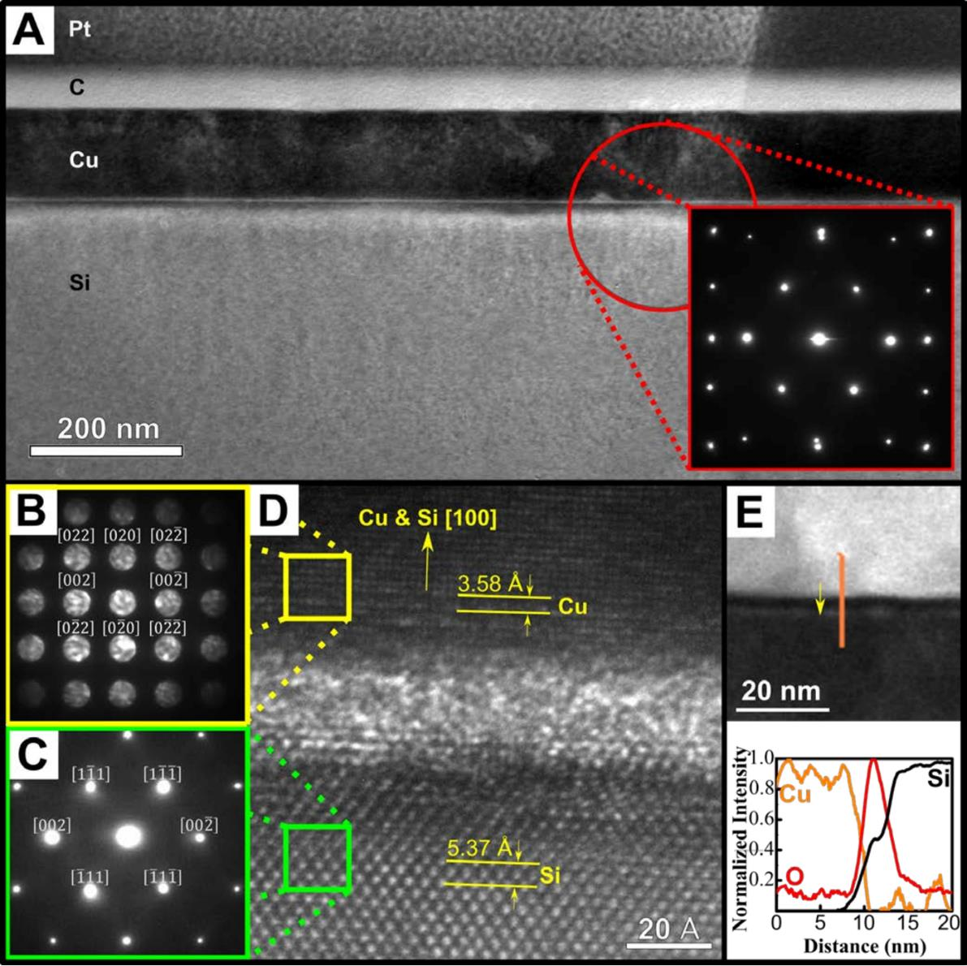
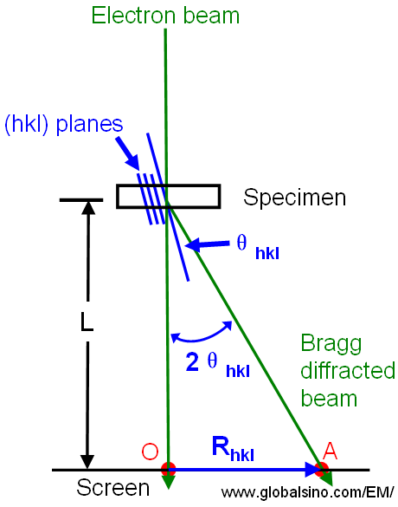
Bragg’s law
n λ = 2 d sin θ_{B}

Slide 36
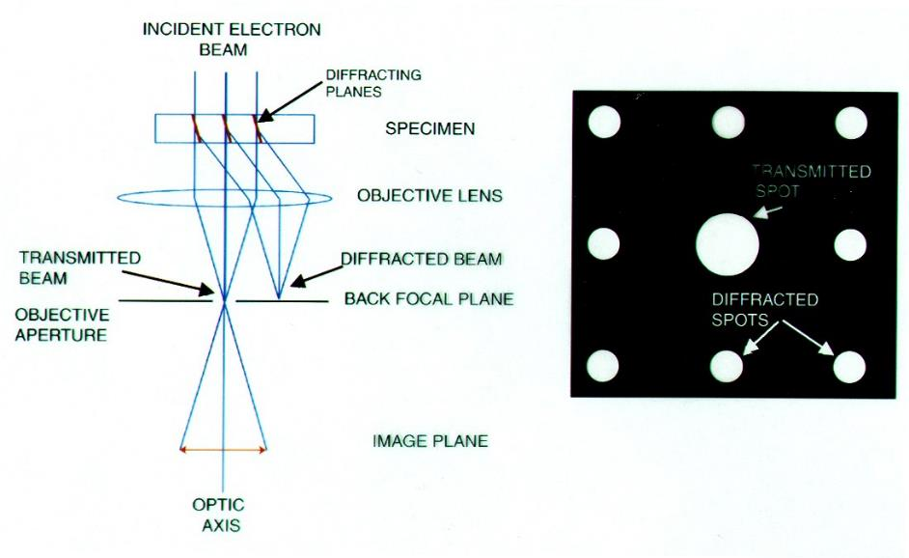
Image formation in the TEM Bright Field (BF)

Slide 37
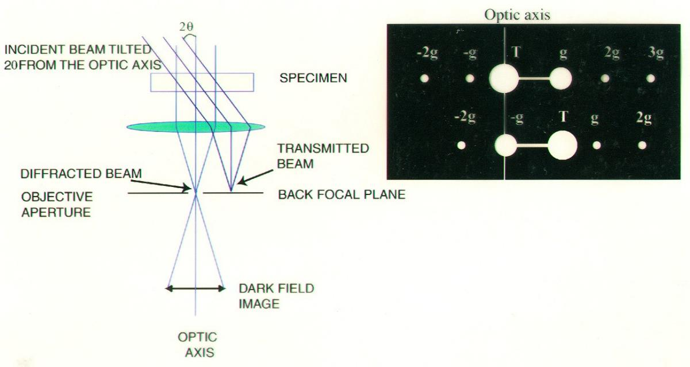
Image formation in the TEM Dark Field (DF)

Slide 38
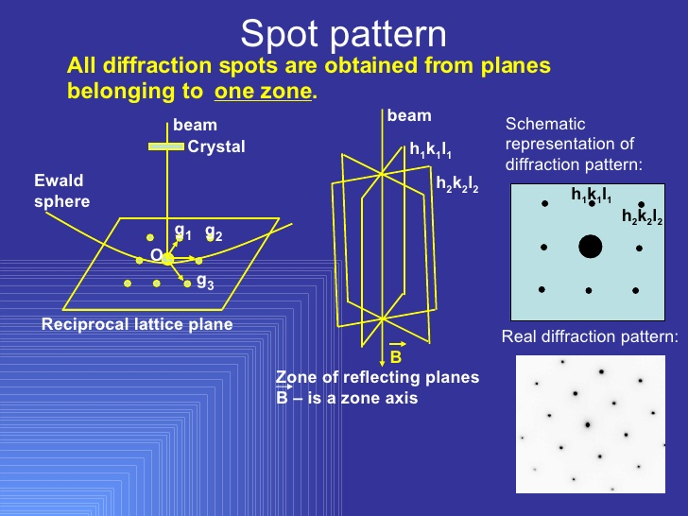
Crystal Orientation for Proper TEM Analysis

Slide 39
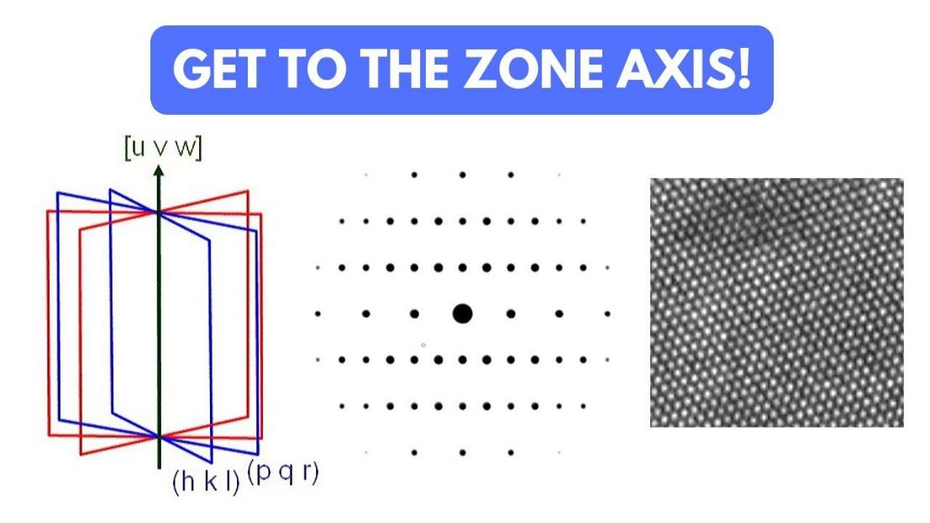
Atomic Column Imaging
Columns of atoms

Slide 40
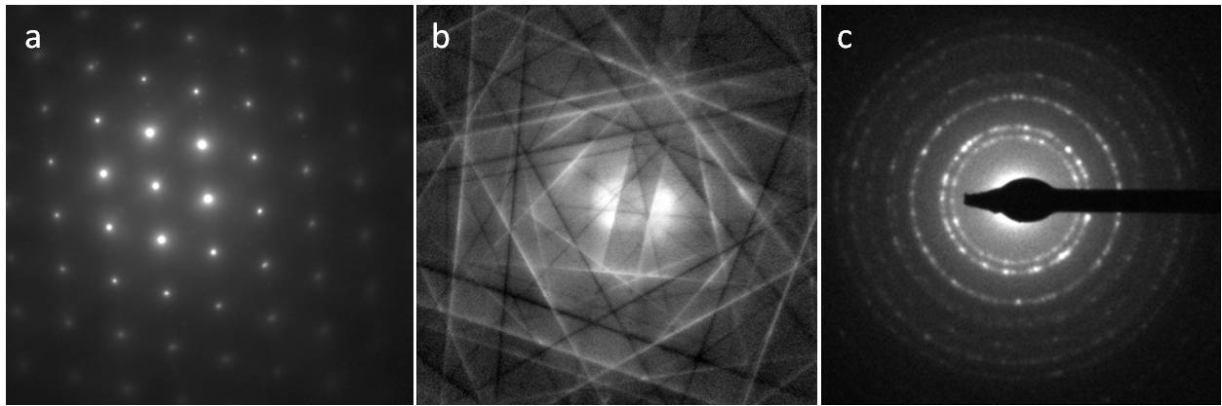
Types of Diffractions Patterns
Parallel Beam Electron Diffraction
Kikuchi patterns
Polycrystalline ring patterns
Selected area apertures define diffraction volume
Electron Beam is spread out, not converged
Very valuable, acts as a map in reciprocal space
Facilitates tilting between crystallographic orientations
Analogous to x-ray powder diffraction patterns

Slide 41
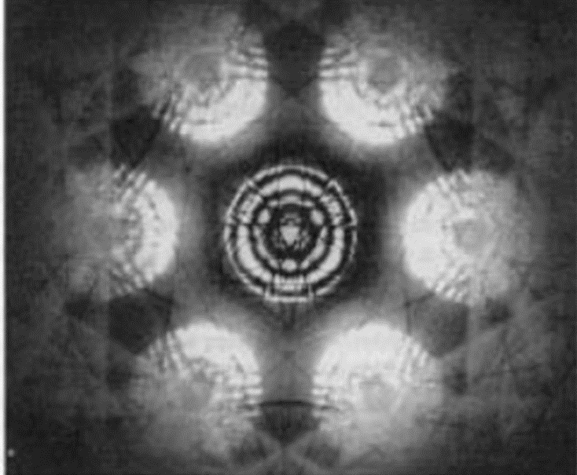
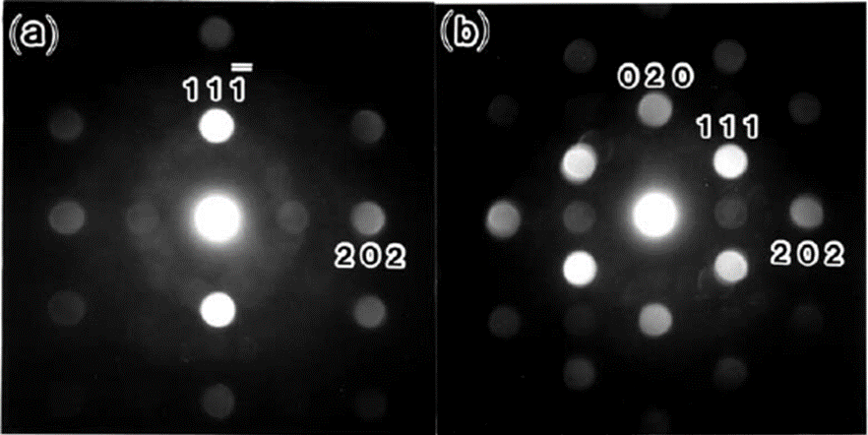
Types of Diffractions Patterns (cont.)
Nano Beam Electron Diffraction
(Precession Electron Diffraction)
Convergent Beam Electron Diffraction
Specimen Thickness
More precise measurement of lattice parameters
True 3D crystal symmetry
Electromagnetic lens changed to produce a 1-2 nm parallel nanoprobe
Useful for diffraction from small volumes such as precipitates, strain measurements

Slide 42
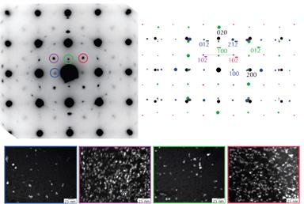
Selected Area Diffraction Captures Matrix and Precipitates

Slide 43



Kikuchi Diffraction: Map through Reciprocal Space
Specimen must be thick enough to generate a large number of incoherently scattered electrons (diffusely scattered electrons in all directions), which are then Bragg diffracted by the planes.
The beam which was initially closest to the optic axis, and therefore more intense, is further away after being scattered. This gives the excess line and the deficient line.

Slide 44

Indexed Zone Axis Patterns for FCC System

Slide 45

Kikuchi Map for HCP System

Slide 46



Kikuchi Maps

Slide 47

Location of dislocation image related to dislocation core

Slide 48



Bright Field and Dark Field Images
Maps of the intensity distribution across the T/D beams
Point-to-point efficiency of diffraction process
The atomic planes near a dislocation core are strained and hence the diffraction conditions surrounding a dislocation are different.
Resolution of DF images are usually better than BF images.

Slide 49

Location of dislocation image related to dislocation core

Slide 50

Two-beam diffraction conditions (used in g • b analysis of dislocations)

Slide 51

Determining the burgers vector – the g • b rule
Technically, the g • b = 0 criterion is really g • b x u = 0 With g = diffraction vector
b = the burgers vector
u = line direction

Slide 52

Images of Dislocations due to diffraction conditions
Single image Two beam BF
Transmitted Diffracted
Double image Three beam BF
Transmitted Diffracted

Slide 53

Weak-beam (WB or WBDF) image formation
Dislocations are white

Slide 54

Bright Field Images
Thin film BF images showing two parallel rows of edge dislocations.
Thickness of the film is ≈ 200 nm.
The photograph above is a projected image of the dislocation lines which are illustrated in the line image.

Slide 55



Quantitative analysis: Dislocations
Quantitative analysis: Crystal defects
  Image characteristics of crystal defects
  Procedures for indentifying/obtaining quantitative information
Determine the direction of b
Computer matching:
the magnitude and sense of b
Solve equations:
(020) (200)
Dislocation line direction: u
The Burgers vector: b
Orientation within the thin foil
The elastic anisotropy of the material
`The same region of an aluminium foil with different operative reflections
– Dynamical conditions
(11-1)

Slide 56

Dark Field Contrast of Dislocations
Screw Dislocations in Si.
The first figure has g {220} vector parallel one set of dislocations and perpendicular to the other.
Second figure is a similar situation.
Third figure has g{400} which reveals both sets of dislocations.
Note the ability to view dislocations with improved contrast

Slide 57


Imaging Techniques (TEM)
First set is a comparison of DF image and a Weak Beam Image.
Second set is a comparison between a Weak beam image and a BF image.
The WB technique is a higher resolution form of DF imaging and is primarily used for imaging closely spaced defect structures on the nanometer scale
Note that in the WB image the contrast and resolution is better than corresponding BF or DF images.

Slide 58


Weak-beam dark field (WBDF) dislocation images
WB
BF

Slide 59

Weak-beam dark field (WBDF) dislocation images
Two beam BF WBDF

Slide 60

Weak-beam dark field (WBDF) dislocation images
Two beam BF
WBDF

Slide 61

Images of Dislocations for different g • b conditions
Single image Two beam BF
Double image g*b=2, s=0
Single image g*b=2,
s is not 0
Double image Three beam BF

Slide 62

Example of using g • b = 0 to determine burgers vectors
Copper foil micrographs taken with different 111 type reflections Burgers vectors of type a/2 [110]
Burgers vectors which disappear:
Burger’s vectors:
Q: Edge or screw? A: Mostly edge
A=[011] B=[110] C=[0-11]
D=[-101]
E=[0-11]
F=[-101]
(a) | (b) | (c)
0-11 | -110 | -101
101 | 011 | 011
110 | 101 | 110
G does not disappear
Most likely faulted dipole a/3 [111]

Slide 63



Stacking Fault and Interstitial Loop Contrast

Slide 64


Thin Foil Effects - Thickness Fringes

Slide 65


Thickness Fringes along Grain Boundaries

Slide 66

Thin Foil Effects - Surface Effects on Dislocations

Slide 67

Thin Foil Effects - Surface Effects on Dislocations
BF images of dislocations in Al showing:
dotted contrast at three locations “A” near the foil surface,
oscillating contrast at the steeply- inclined dislocation “B” due to dynamical effects.

Slide 68

Examples: Grain Boundaries & Dislocations
Dislocations can enter a grain boundary, translate along it, and exit the other side
Grain boundaries are also known to be sources of dislocations
Grain boundaries play an important role in deformation, as well as acting as sinks for defects and gaseous atoms such as helium

Slide 69

Examples: Dislocations

Slide 70

In-situ TEM of Dislocation Movement Under Stress

Slide 71
Examples from over the years
Low Temperature Radiation Hardening Regime
Copper and Cu Alloys, <300°C, 10⁻²-0.3 dpa

Slide 72
Evolution of Cleared Channels in Neutron Irradiated Pure Copper
Dan Edwards¹ and Bachu Singh²
¹ Pacific Northwest National Laboratory
² Risǿ National Laboratory
Journal of Nuclear Materials 329–333 (2004) 1072–1077

Slide 73
Defect Structures in Irradiated Cu
Avg. size is 2.5 nm, density at 0.3 dpa is 5.5 x 10²⁴ m⁻³
Lower density of perfect interstitial loops (1 x 10²² m⁻³), 5-10 nm dia, that interact to form network dislocations at 0.3 dpa
Soley responsible for 7x increase in yield, no uniform elongation at all, necks upon yielding

Slide 74


TEM of Interrupted Tensile Tests of Irradiated Pure Cu
Irradiated with neutrons to 0.3 dpa at 50°C
Goal was to document the change in deformation behavior in irradiated Cu
Before yield, and after yielding
Pure Cu experiences considerable radiation hardening and loss of ductility due to SFT and loops
Most pure metals harden at much doses than alloys such as 316SS

Slide 75

Slip Steps on Surface of Sample
Dislocations move under strain, eventually intersecting the surface of a tensile sample
SEM can document these slip steps
Image (e) was taken from the necked region of sample tested to failure
Slip occurs in a highly localized deformation mode called “dislocation channeling”

Slide 76

Cleared Channels
Cleared channels have formed during tensile testing
Cleared means all defects formed during irradiation have been destroyed by fresh, mobile dislocations generated at grain boundaries
Dislocation motion is confined to these channels
Regions outside of the narrow channels (50-100 nm in width) exhibit little change
Defect density outside the channels is unaltered

Slide 77




Dislocation and SFT Evolution in Neutron Irradiated CuCrZr
SFT are dominate defect
  Avg. size is 2.5 nm, density at 0.3 dpa is 5.5 x 10²⁴ m⁻³, yields 3.5 x 10²⁵ vacancies per m⁻³
  Hardening occurs due to SFT and loops produced by irradiation, some changes in precipitates also occured

Slide 78

Line Dislocation interacting with SFT and loop in pure Cu

Slide 79
Examples from over the years
316SS Irradiated with Neutrons at 315°C, 5 dpa

Slide 80
Line Dislocations and Loops in Neutron Irradiated 316SS, 315°C
TEM BF
TEM BF
STEM BF
Clustering of loops around line dislocations observed, accompanied by Ni/Si enrichment to the line dislocations
Precipitate dark field images in next slide show decoration of GB dislocations with precipitates

Slide 81

Elemental Mapping with Sub-Nanometer Probe Reveals Ni/Si Segregation
STEM BF
Si K
Cr K
Mn K
Fe K
Ni K
Mo K
Elemental mapping reveals extensive radiation-induced precipitation in matrix as isolated precipitates and along line dislocations

Slide 82




Frank loops and Precipitation on Grain Boundary Dislocations
Frank loops imaged using rel streak in diffraction pattern
4.2 x 10²² m⁻³, Avg Size: 7.7 nm
Frank Loops image with rel streak near inclined boundary
γ′ precipitation present in matrix and on GB dislocations
1.2 x 10²² m⁻³, Avg Size: 5.4 nm

Slide 83

Loops, SFT and Precipitates in Neutron Irradiated 316SS
Frank loops imaged using rel streak in diffraction pattern
8.6 x 10²² m⁻³, Avg Size: 6.3 nm
Small SFT present, estimated at 20% of FL density, no voids
~1.0 x 10²² m⁻³, Avg Size: ~ 2 nm
γ′ precipitation believed found
0.9 x 10²² m⁻³, Avg Size: 6.3 nm

Slide 84



HAADF Imaging of Interstitial Loop in Neutron-Irradiated Stainless Steel
Interstitial Frank Loop
Geometrical Phase Analysis
Extra plane of interstitals

Slide 85
Resistance to Void formation in ODS Alloys in the presence of in-situ helium injection
Presented at 19th International Conference on Fusion Reactor Materials, Oct. 2019
D.J. Edwards, H.J. Jung, K. Kruska, R.J. Kurtz
Pacific Northwest National Laboratory
T. Yamamoto, Y. Wu and G.R. Odette
University of California-Santa Barbara
Notes:
Stock Image: Abstract Data Visualization Grid

Slide 86

Experimental: In Situ Helium Injection Used to Mimic Fusion conditions
Thickness of coating determines depth of uniform He injection and He/dpa ratio
Opposite side of TEM disc contains un-injected regions for a direct comparison of neutron irradiated only versus n + He
Takes time to burn in the ⁵⁸Ni so the He/dpa ratio is not constant during the in-reactor exposure

Slide 87


Dislocation Loop Imaging in BCC Fe-Cr Alloys
Oxide particle
Dislocation loops imaged through g∙b criteria near [100] or [110] zone axes
Shape and orientation help to distinguish between ½<111>{111} and <100>{200}
Some “invisible” loops are partially visible due to g∙b x µ
TEM characterization of dislocation loops in irradiated bcc Fe-based steels
B. Yao ⇑, D.J. Edwards, R.J. Kurtz
Journal of Nuclear Materials 434 (2013) 402–410

Slide 88



Results: The Bad - TMS versus ODS Ferritic Alloys
TMS – F82H.mod3+CW
ODS – 14YW
ODS – PM2000
Clear association between loops and bubbles
Visible bubbles and/or voids (assumed to be voids if > ~3 nm diameter) present at a significant density in all the alloys – all grain and lath boundaries decorated with He bubbles
Stringers of voids exist in the grain interiors of TMS alloys, bubbles present in matrix and interfaces
Bubbles form predominately on all dislocation loops and in matrix in ODS PM2000, along with a single large void on all the coarse scale oxides (100x lower density than bubbles)

Slide 89
Synergy between Loops and He Bubbles
Gao et al, as well as others, have indicated that pressurized bubbles can “punch out” SIA loops
  In the presence of an existing loop, possible these bubbles “feed” the growth of the existing loop
  Loop continues to grow, forming new bubbles at the loop periphery while leaving behind interior bubbles, apparently “deactivated” since they don’t grow further
  Loop may preferentially capture SIA clusters, He and vacancies may be captured by adjacent bubbles, continuing the cycle
So why only observed in PM2000 and not other ferritic alloys?
  Composition, precipitation in PM2000 not present in other alloys?
  Lack of competing grain boundaries?
Loop
He bubbles

Slide 90

Comparison of Dislocation Microstructures in the He-Injected Region
There is a moderate density of network dislocations and dislocation loops of ½<111> and <200>-type present in both the TMS and ODS 14YW alloys
There is a distinctly different microstructure in PM2000 with a comparable density of much larger ½<111> and <200>-loops and a 10x lower network dislocation density compared to the other TMS and ODS alloys
Note: Only PM2000 shows explicit visual evidence of association between bubbles and dislocation loops

Slide 91





NFA ISHI Loop Comparisons:
200 vs 111 Loops
For true NFA (14YWT & 12YWT) both types of loops rarely grow beyond 40 nm
Significant fraction of loops grow >40 nm in the 14YW alloy and PM2000
Ratio of {200} to 1/2{111} loops significantly higher in He-injected side of sample
No bubble association with loops in either alloy, more random distribution of loops in matrix
High trapping density due to nanofeatures may directly and indirectly affect loop growth, and indirectly by forming a high density of associated neutron sinks (cavities). If small bubbles are truly neutral sinks then He dispersed in a high number density of small bubbles could be beneficial by promoting SIA – vacancy recombination
Random distribution of bubbles may not be as effective at “feeding” the nearby loops, too many competing sinks

Slide 92
Characterization of As-Received 14YWT
5 µm
Mean particle size:
4.4 ± 1 nm
Particle density:
6.27×10²³ ± 0.32×10²³ m⁻³

Slide 93
Characterization of neutron irradiated (back) side of U14YWT ISHI Disc
Neutron irradiation at 500°C leads to formation of a Cr-rich α’ phase.
Mean precipitate size: 4.1±0.93 nm
Density distribution: 5.18×10²³ m⁻³

Slide 94
Characterization of neutron irradiated (back) side of U14YWT
The α’ phase is not associated with the ODS particles.
Mean particle: 4.2 ± 1 nm,
density: 4.85×10²³ ± 2.7×10²³ m⁻³.
Local density variations (x2) were observed within and between datasets.

Slide 95

Diffraction Contrast Scanning Transmission Electron Microscopy – A Bend-contour-free Way to Image Dislocations, Voids and Precipitates
Yuanyuan Zhu¹, Colin Ophus², Mychailo B. Toloczko¹ and Danny J. Edwards¹
¹ Energy and Environmental Directorate, Nuclear Sciences Division, PNNL,
Richland, WA
² National Center for Electron Microscopy, Molecular Foundry, LBNL, Berkeley, CA
M&M 2018, Baltimore MD

Slide 96


Diffraction Contrast Imaging of Dislocations
Diffraction contrast CTEM-BF
Diffraction contrast STEM-BF
HT-9 tempered martensitic alloy,
Systematic row diffraction condition (s_{g} =0)
Same region,
same diffraction condition
Y. Zhu, C. Ophus, M. B. Toloczko, D. J. Edwards. Ultramicroscopy 2018, 193, 12-23
Notes:
Standard method for imaging strain fields and planar defects
Underdeveloped technique for diffraction contrast imaging; Significant advantages relative to conventional diffraction contrast

Slide 97


Previous Diffraction Contrast STEM Studies
Under “proper conditions”,
STEM suppresses bend contour
while maintaining defect contrast
Recent Theoretical validation
(STEM image simulation of dislocations)
of the g・b invisibility criteria
CTEM
bend contour
“rocking curve”
P. J. Phillips, M. C. Brandes, M. J. Mills, M. De Graef, Ultramicroscopy 2011, 111(9-10), 1483-1487.
STEM
The same bent MoS₂ foil
Questions remain:
How does diffraction contrast STEM suppresses bend contours?
What are the optimum STEM parameters for defect imaging?
D. M. Maher, D. C. Joy, Ultramicroscopy 1976, 1(3), 239-253.
C. J. Humphreys, Ultramicroscopy 1981, 7(1), 7-12.

Slide 98



How STEM Alleviates Bend Contours
TEM-BF mode
𝛂_{S}
bend contour
𝛂_{T}
𝛃_{S}
no contour
𝛂_{T} ~ 0.2 mrad
𝛃_{T} ~ 5.5 mrad
𝛃_{S}
𝛃_{S} ~ 3 mrad
𝛂_{S} ~ 6.2 mrad
𝛂_{T}
𝛃_{T}
𝛂_{S}
𝛃_{T}
STEM-BF mode
STEM Direct disc
Two criteria for mitigating bend contours:
A large convergence 𝛂_{S} of a few mrad → allows access to rocking-curve oscillation in reciprocal space;
A large collection 𝛃_{T} ~ 𝛂_{S} → can even out the bend contours from reciprocal space.
𝛃_{S} = 3 mrad
𝛂_{S} = 6.2 mrad
Y. Zhu, C. Ophus, M. B. Toloczko, D. J. Edwards. Ultramicroscopy 2018, 193, 12-23
Notes:
mitigate

Slide 99
The Optimum Collection Semi-angle
Camera Length
=120cm
Ambiguous
dislocation contrast
BF: 0-3 mrad
ADF:
4.5-18 mrad
20 mrad
The optimum CL offers
a BF 𝛃_{STEM} similar to or slightly larger than 𝛂_{STEM};
meanwhile, a ADF 𝛃_{STEM} (range) includes mainly
low-index diffraction discs (e.g. 1g to 3g)
CL=40cm:
BF: 0-9 mrad
s_{1g} > 0
Kikuchi
band
ADF:
14-55 mrad
Precipitate
60 mrad
CL=12cm:
fading
dislocations contrast
BF: 0-30 mrad
190 mrad
ADF:
45-180 mrad
Y. Zhu, C. Ophus, M. B. Toloczko, D. J. Edwards. Ultramicroscopy 2018, 193, 12-23

Slide 100


Diffraction Contrast STEM Pair Allows Observation of Dislocations, Voids and Precipitates
Rich microstructural features in neutron-irradiated HT-9 (412°C, 111.8 dpa)
Dislocation networks
Voids and Precipitates
Under systematic row diffraction (s_{1g} = 0)
Same region tilting off Bragg
Eliminating bend contours also allows precipitates and voids to be more easily observed
Manuscript in preparation.

Slide 101



Characterization Examples of Unirradiated and Irradiated Zircaloy
Electropolishing of base metal,
FIB milling of oxide scales on irradiation Zircaloys, phase analysis, radiation-induced segregation, depletion, amorphization
C-type dislocation loop comparison

Slide 102
Microstructure of Neutron Irradiated PWR Baffle Bolts
Edwards and Bruemmer
¹ Pacific Northwest National Laboratory

Slide 103


Dislocation Loops and SFT Evolution in Neutron Irradiated 316SS

Slide 104
Irradiated Ti Alloys

Slide 105


Loop and Precipitates in Neutron Irradiated Ti Alloys
Irradiation hardening and lost of ductility occurs due to loops and precipitation after irradiation to 0.3 dpa at 350°C
Ti-6Al-4V exhibited the greatest loss of uniform elongation

Slide 106
Loop and Precipitates in BLIP Proton Irradiated Ti Alloys
Small black spots likely due to defect clusters
ω-phase a possibility, but defects behave more as small loops

