Slide 1
Presenting: The Ideal Irradiation Facility
for Accelerator Targetry Material Studies
Round 2
P. Hurh
RaDIATE 2019
09 Dec 2019

Slide 2
The Ideal Irradiation Facility
This slide intentionally left blank

Slide 3
Why ask?
We often complain about irradiation facilities.
What is it that we really want?
Allows us to evaluate real options against a common metric.
Allows us to answer sponsors when they ask

Slide 4
Capabilities to Consider
Beam parameters
Specimen environment
Operations and Administrative Controls
Activated materials handling
Local PIE facilities
Synergistic uses
What about multiple beams (ions, electrons, protons)

Slide 5
2014 Exercise: PNNL Irradiation Cyclotron Idea
Idea:
  Don’t bring PIE facility to the Accelerator Lab
  Bring the Accelerator to the PIE facility
Beam parameters
  30 MeV protons
  0.5 mA, DC
  20 mm beam sigma, gaussian distribution (no raster)
  Achieves mm scale penetration in low to mid-Z materials
  Relatively available as a “turn-key” medical accelerator
Specimen environment
  Temperature and atmosphere control
  Rapid remote swap out capability (rabbits)
  Complete control over irradiation run parameters

Slide 6
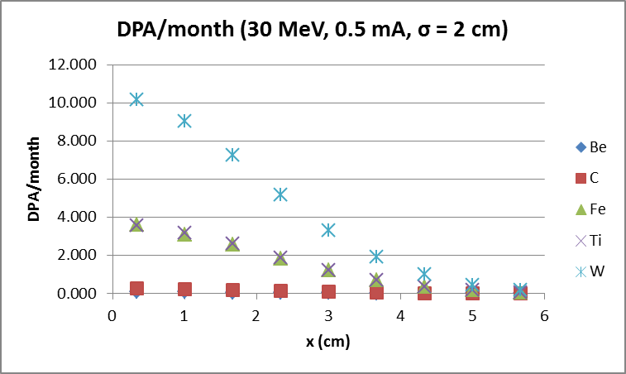
DPA/month
K. Ammigan, 2015, MARS code

Slide 7
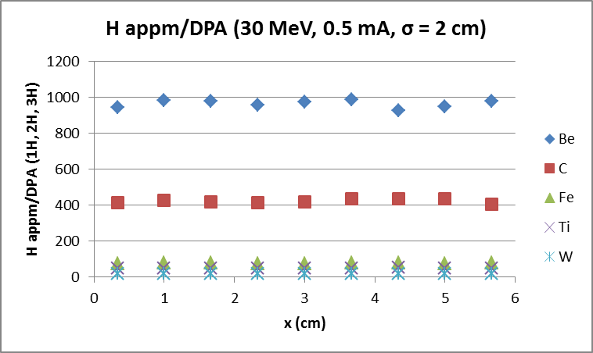
H appm/DPA
K. Ammigan, 2015, MARS code

Slide 8
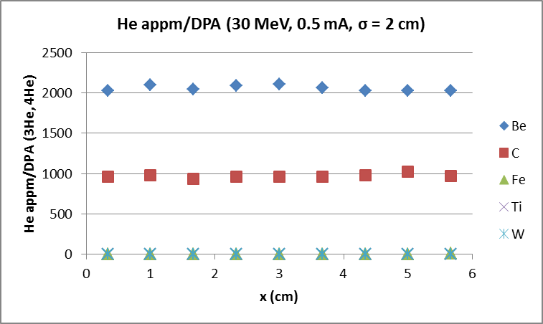
He appm/DPA
K. Ammigan, 2015, MARS code

Slide 9
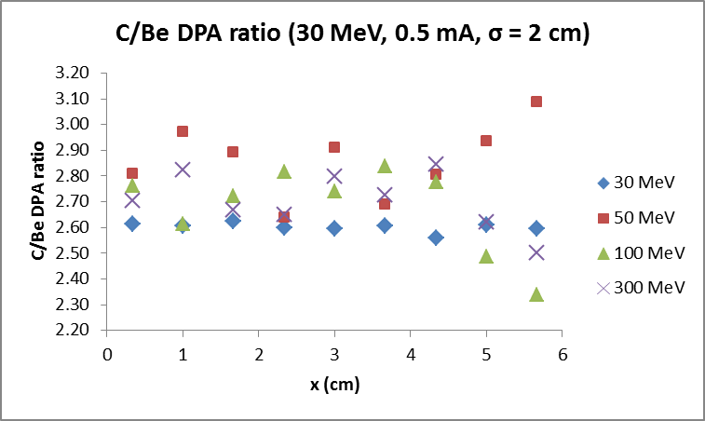
DPA ratio (C/Be)
K. Ammigan, 2015, MARS code

Slide 10
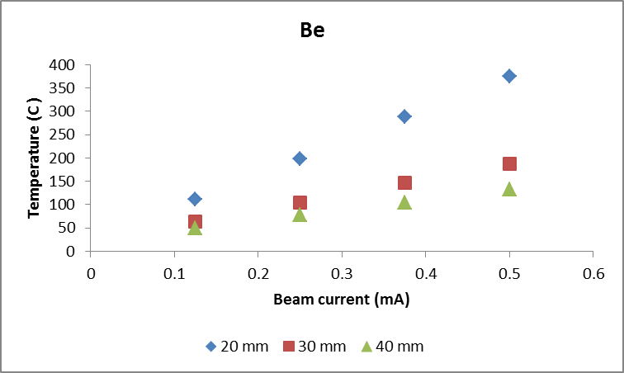
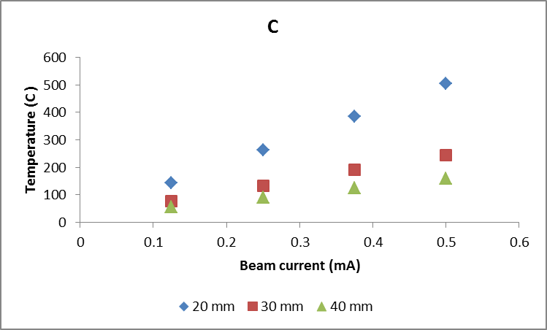
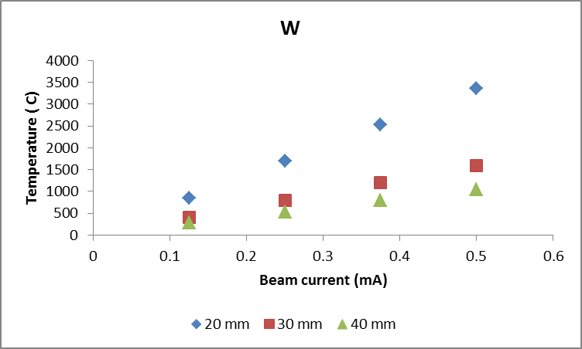
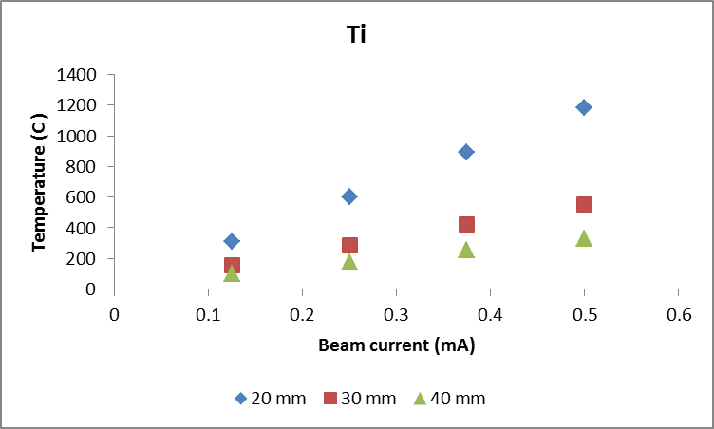
Peak irradiation temperature
Specimen size: radius = 75 mm, thickness = 1 mm.
Assumed 1000 W/m² K cooling on back surface of specimen
K. Ammigan, 2015, MARS code

Slide 11
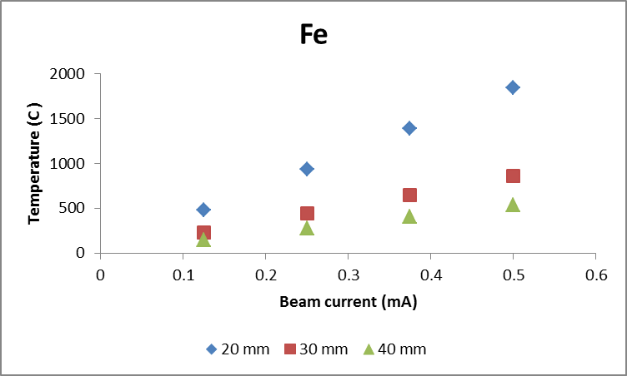
Peak irradiation temperature
K. Ammigan, 2015, MARS code

Slide 12
Let’s Discuss!
Beam Parameters
  Energy range (penetration, transmutation): At least 30 MeV?
  Particle: Protons, but flexibility to run ions desired?
  Flux/Current (DPA rate): 1 DPA Ti within 3 months?
  Beam size (irradiation volume): 3 mm sigma minimum?
  Rastered: Option desired?
  CW, Pulsed: CW fine, but way to study pulsed effects desired?
Another way to ask
  Irradiation Volume?
  Uniform flux or gradient?
  DPA rate (which material)?
  Transmutation (gas production rate)100 – 3000 He appm/DPA?

Slide 13
Let’s Discuss!
Specimen Environment
  Temperature range (heating/cooling): 50 – 800 C?
  Atmosphere: Ideal to choose?
  Separate capsules: ?
  Monitoring (temp, visual)? At least temperature?
  Under mechanical loading? Not needed minimally, but desired
  Other: ?

Slide 14
Let’s Discuss!
Activated Materials Handling
  Time to change out samples: within 1 shift?
  Decay storage area: ?
  Ship out or only local PIE: Both?
  Capsule opening or ship whole capsules?
  Other: ?

Slide 15
Let’s Discuss!
Operations/Administrative Controls
  Typical User Facility: Yes?
  Share beam with other programs: No?
  Users present during irradiation: Yes?
  Other: ?

Slide 16
Let’s Discuss!
How much interest in synergistic uses:
  Spallation for simulation of fission/fusion spectra: ?
  Irradiation to Electronics: ?
  Irradiation to Organics/Biological: ?
  Other: ?

Slide 17
Where to go from here?
If there is enough interest:
Create capability wish list
Evaluate current options against the wish list
Propose new options and evaluate
Pick one and make use-case
Approach sponsors

Slide 18
Ideal Materials?
Categorize material needs?
Irradiated Material Property Database?

