Slide 1


6th RaDIATE Collaboration Meeting
Thank you!
Radiation Damage in Accelerator
Targets Environments
December 9-12, 2019
Vancouver, Canada

Slide 2
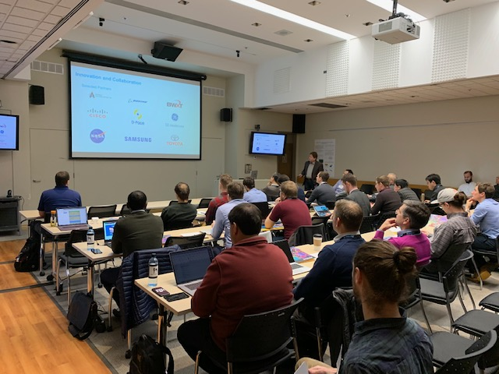

Slide 3
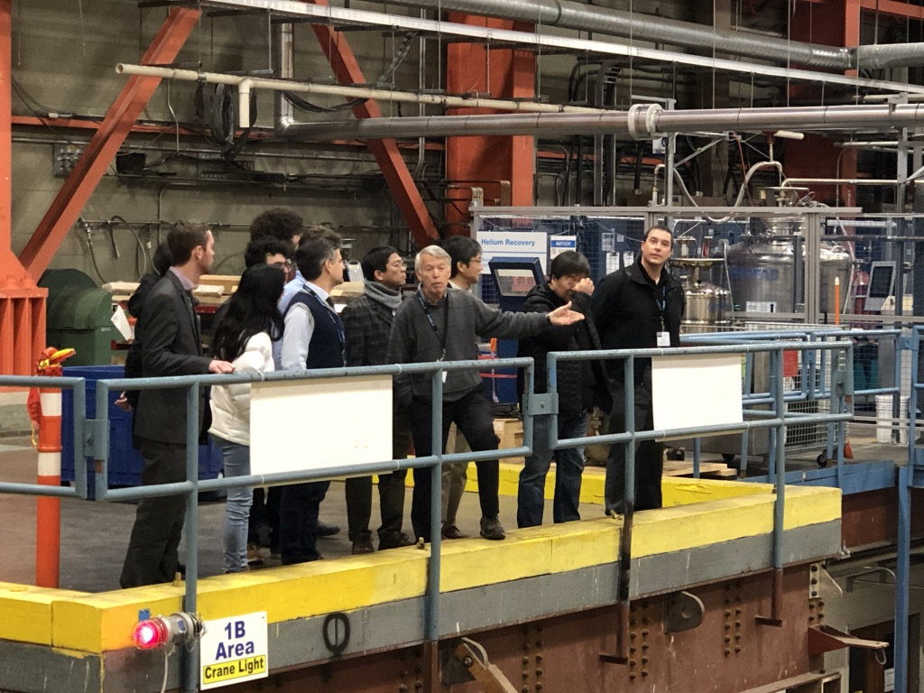

Slide 4
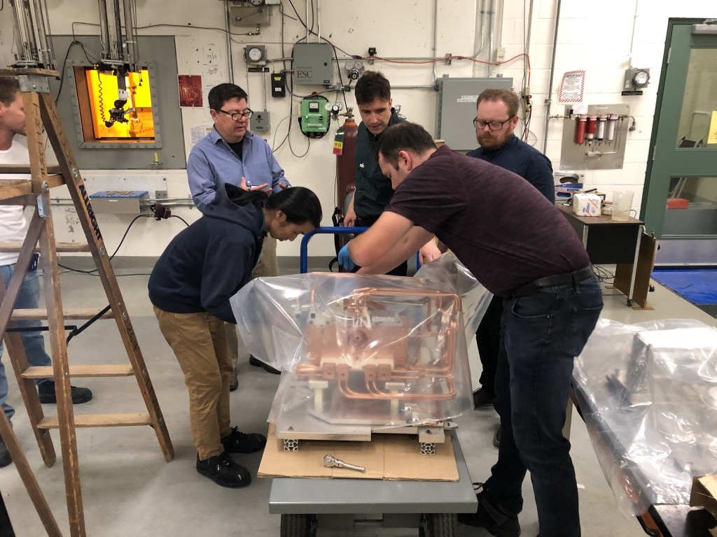

Slide 5

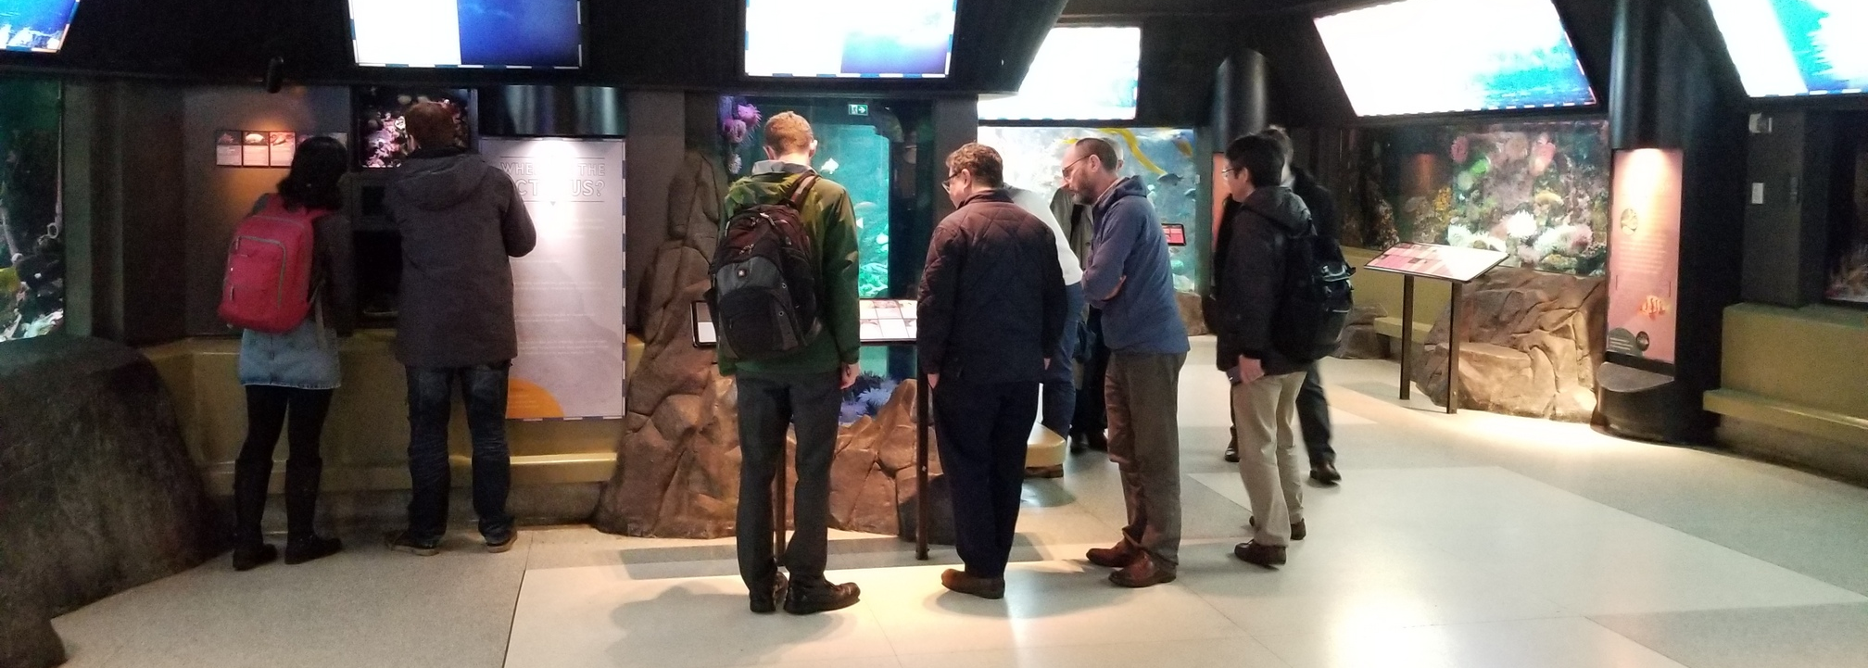

Slide 6
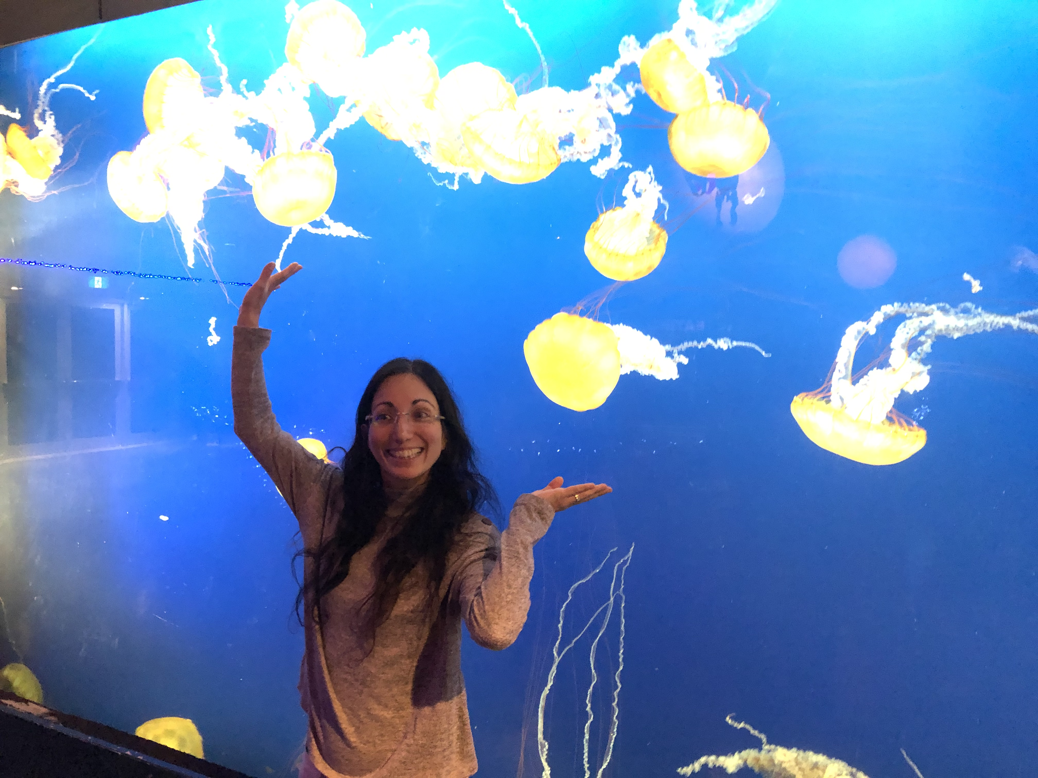

Slide 7
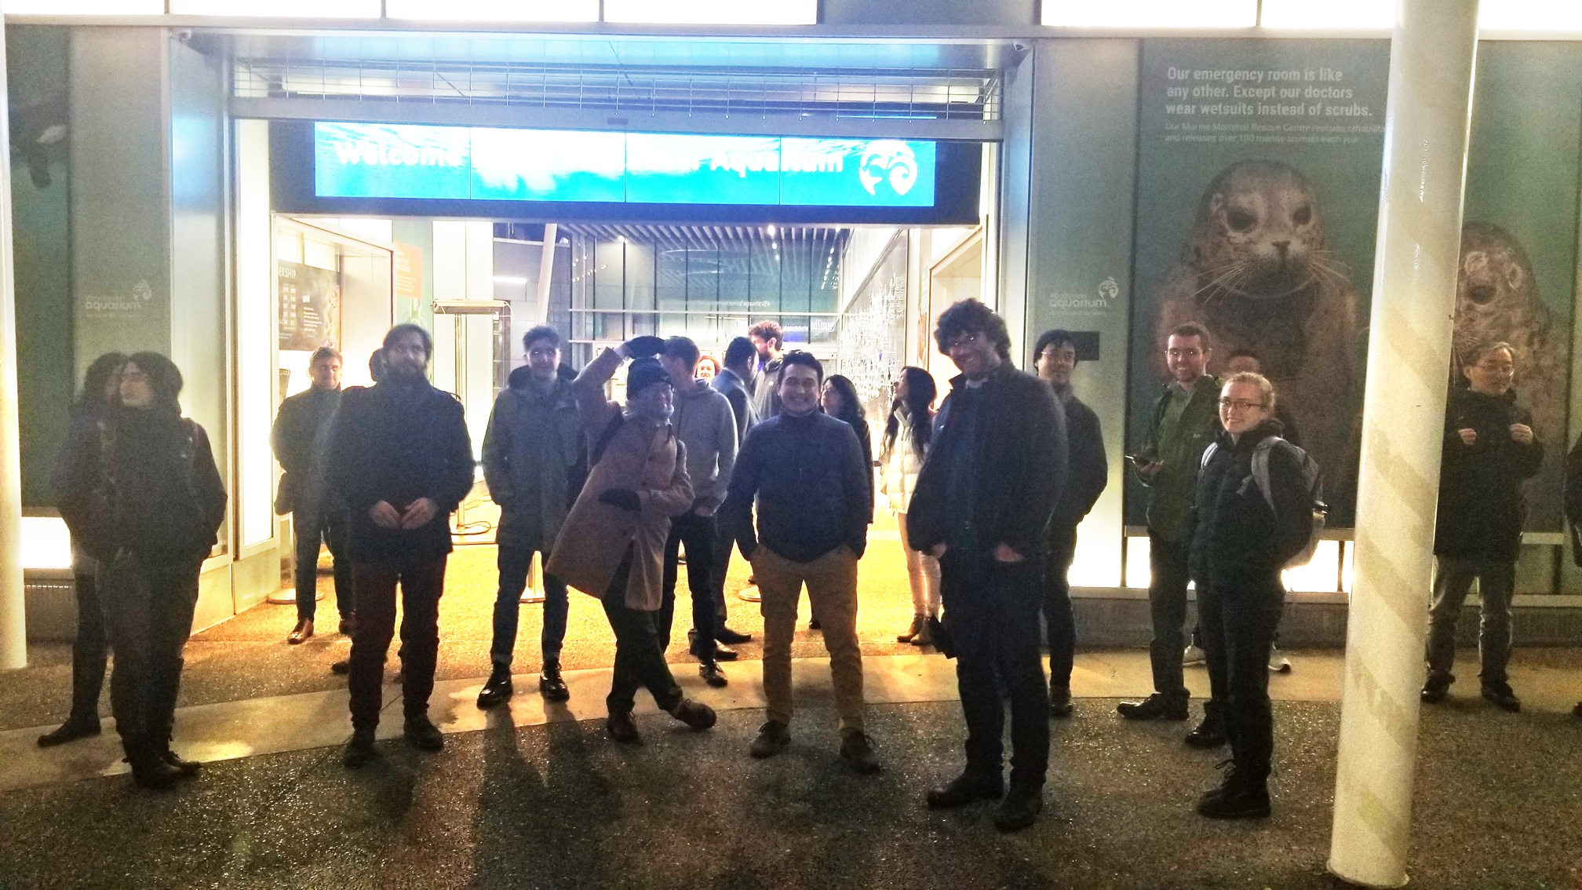

Slide 8
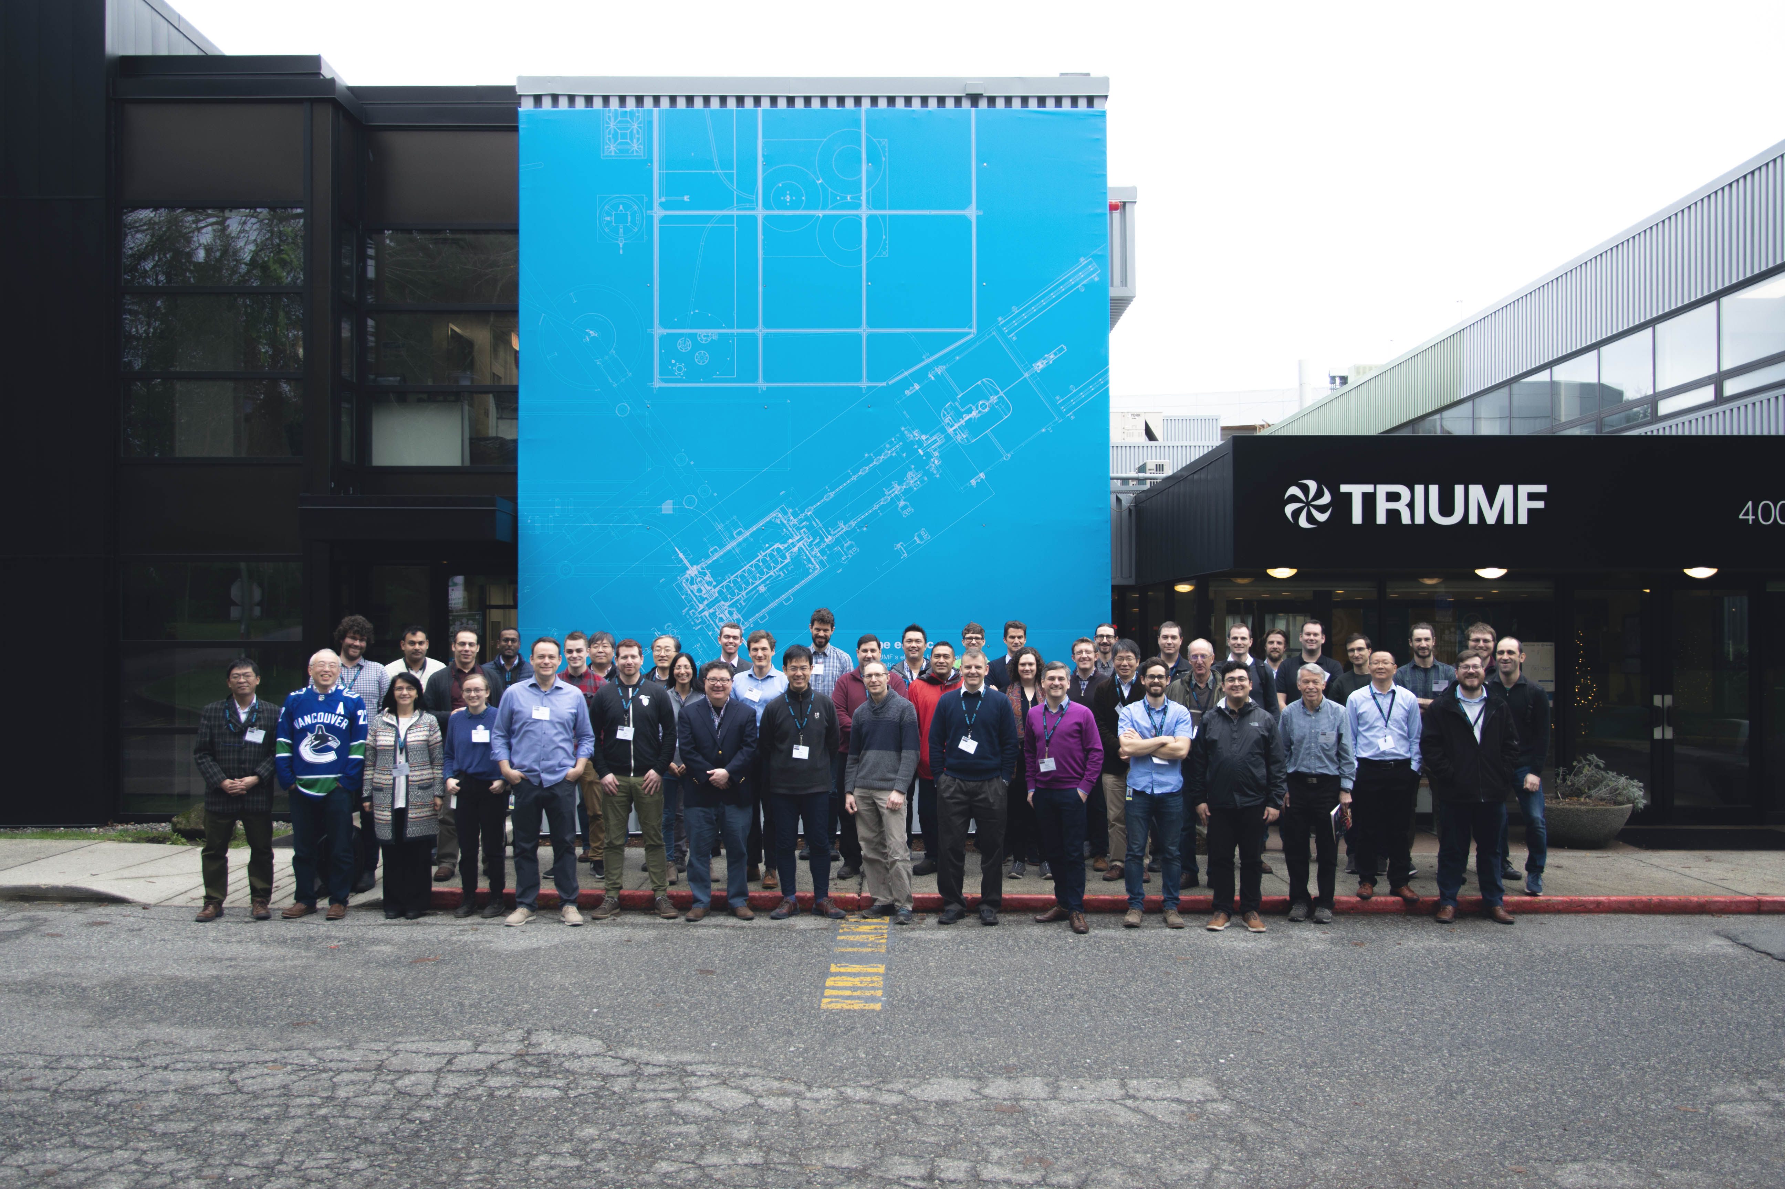

Slide 9
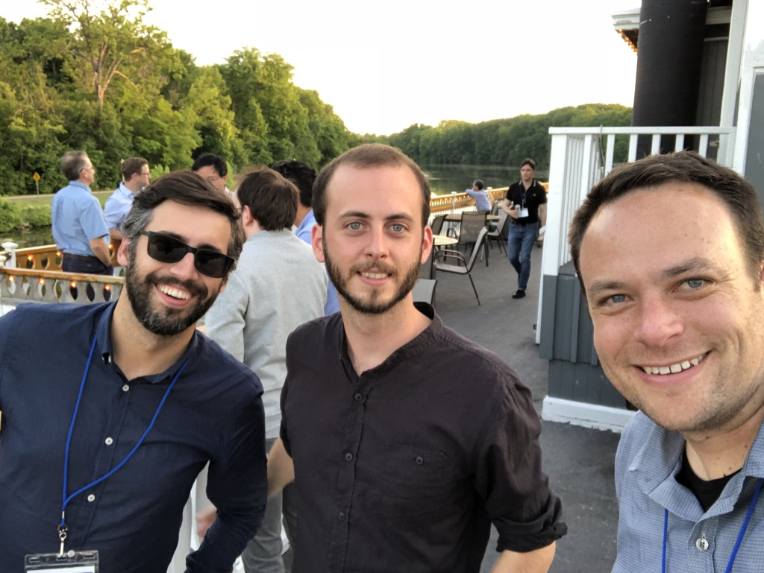

Slide 10
