Slide 1
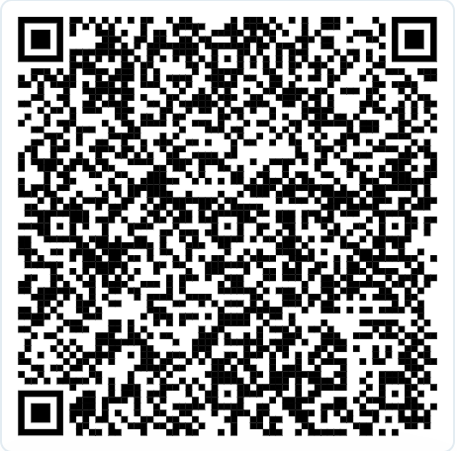
Welcome to the Mixer

Slide 2
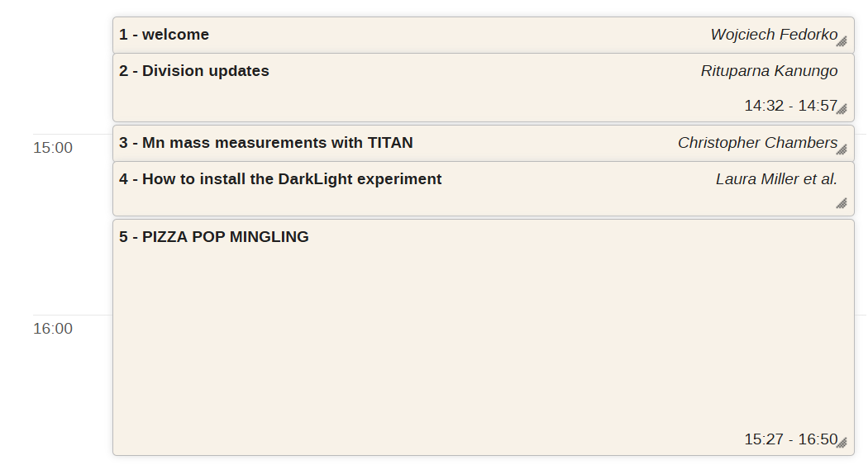
Agenda
Register:

