Slide 1
Studying the Onset of Nuclear Collectivity beyond N=40 with Manganese Mass Measurements
Chris Chambers
Postdoc @ TITAN
July 2025 PSD Mixer

Slide 2
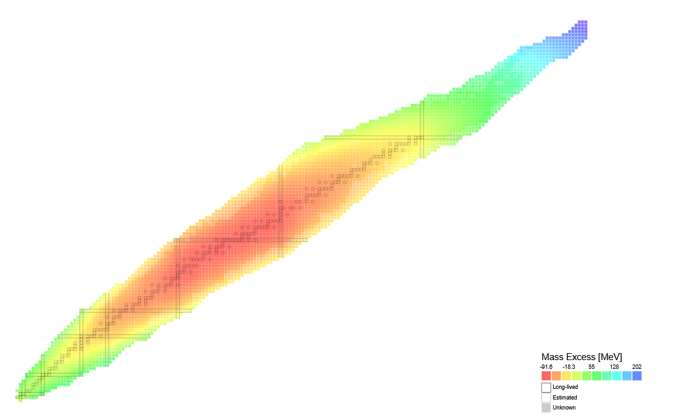
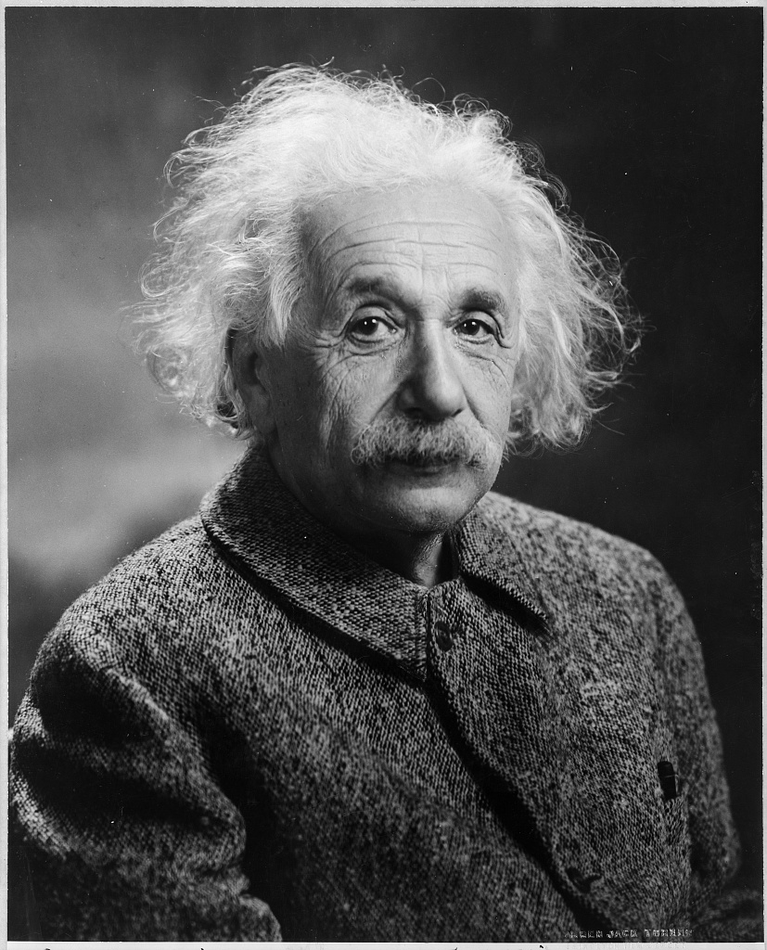


Mass Measurements and Nuclear Structure
Mass excess is the difference between the atomic mass and the atomic number times the atomic mass unit
This tells us about the binding energy thanks to our pal
$$∆M=M\left(A, Z\right)−A ×u$$
$$E=mc^{2}$$
Retrieved from Library of Congress archives
https://people.physics.anu.edu.au/~ecs103/chart/

Slide 3
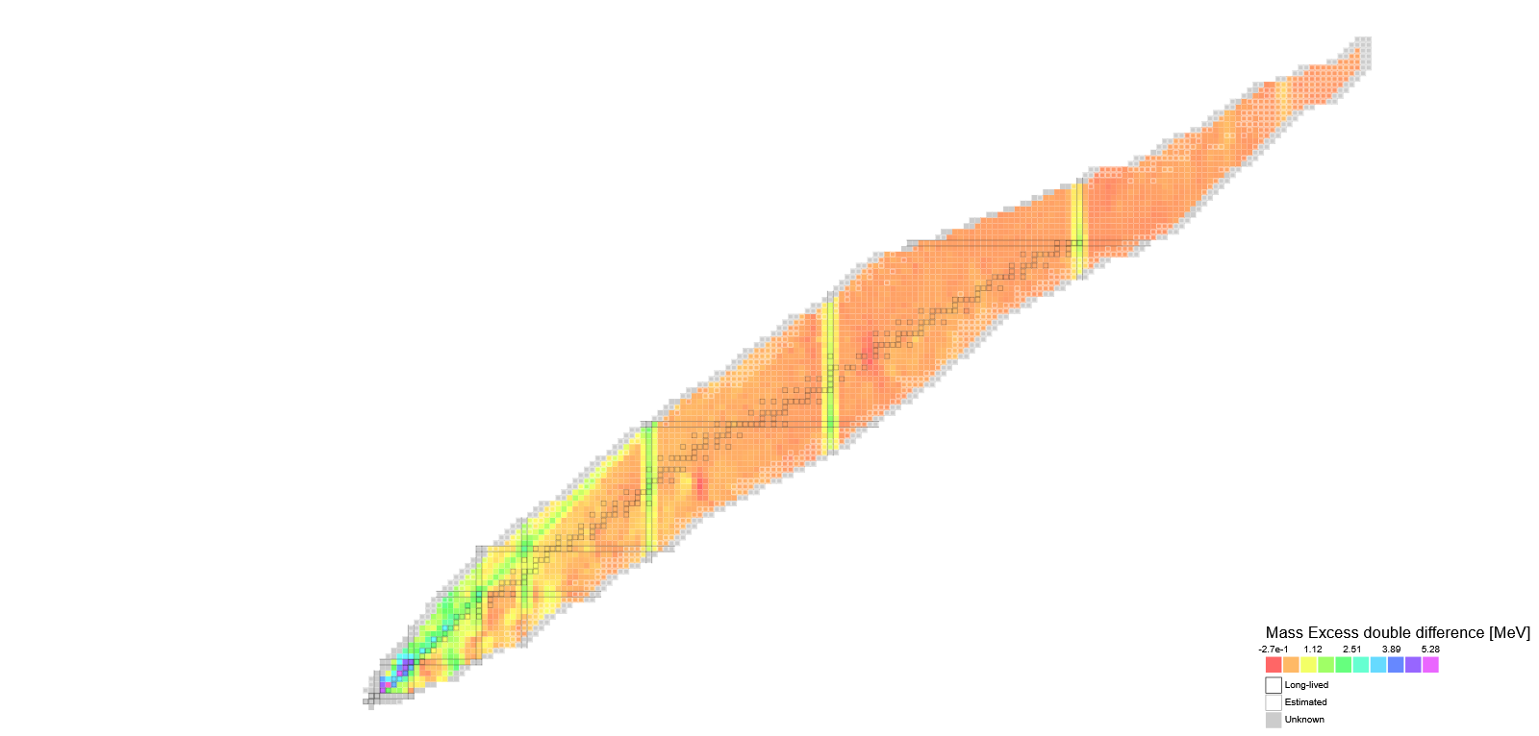
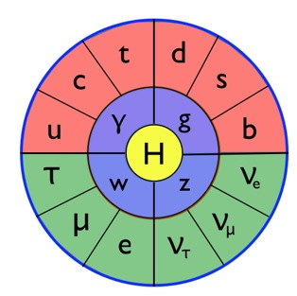
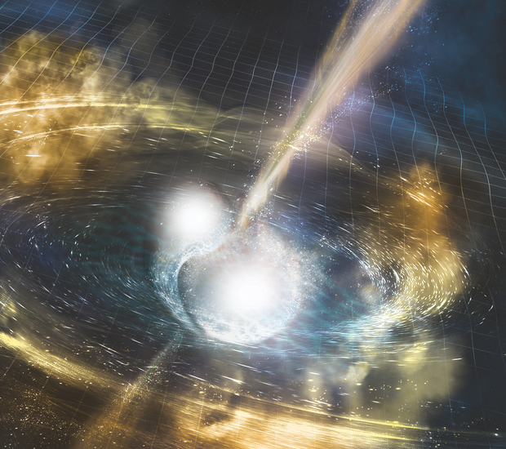
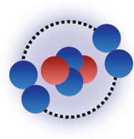
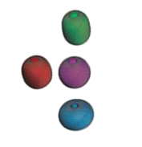
Mass Measurements and Nuclear Structure
If we look at the “2nd derivative” of mass excess, we reveal structure
Stellar Nucleosynthesis
Fundamental symmetries
δm/m < 10⁻⁸
Special nuclear structure
δm/m < 10⁻⁶ – 10⁻⁷
Nuclear shell structure
δm/m = 10⁻⁷
δm/m = 10⁻⁵ – 10⁻⁶
https://people.physics.anu.edu.au/~ecs103/chart/

Slide 4
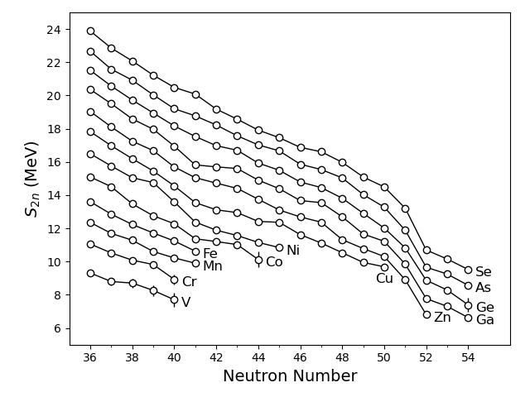
Using S_{2n} to look at Nuclear Structure
S_{2n}: Energy cost to remove 2 neutrons from the nucleus
We see a global behavior at N = 50 indicating a strong neutron shell closure
Well known magic number
There are hints of interesting structure around N =40
Shell closure in ⁶⁸Ni?
Gap appearing in S_{2n} for ⁶⁴Cr?
From AME2020
Notes:
Definition here
“cost of 2 neutrons”

Slide 5
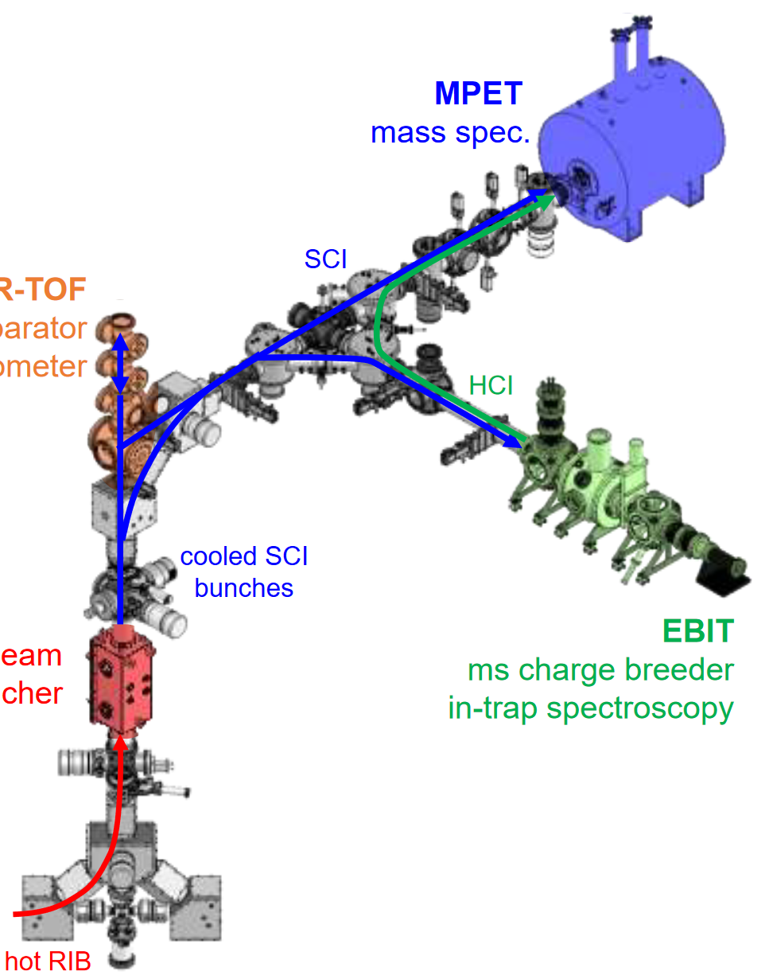
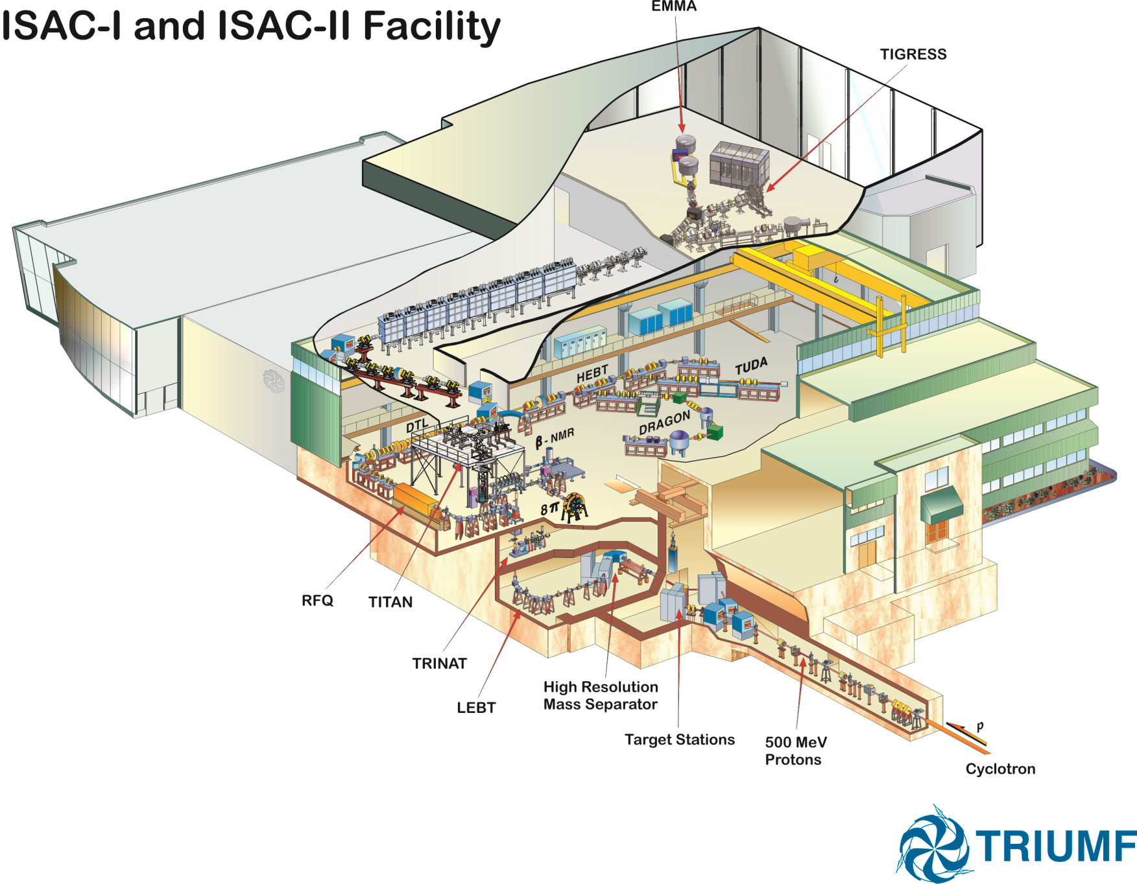
ISAC and TITAN
TRIUMF’s Ion Trap for Atomic and Nuclear science (TITAN)
MPET
MR-TOF
EBIT
TITAN
Low-energy
beam transport
RFQ
Cooler & buncher
500 MeV
protons
Isobar Mass
Separator
ISOL Target

Slide 6
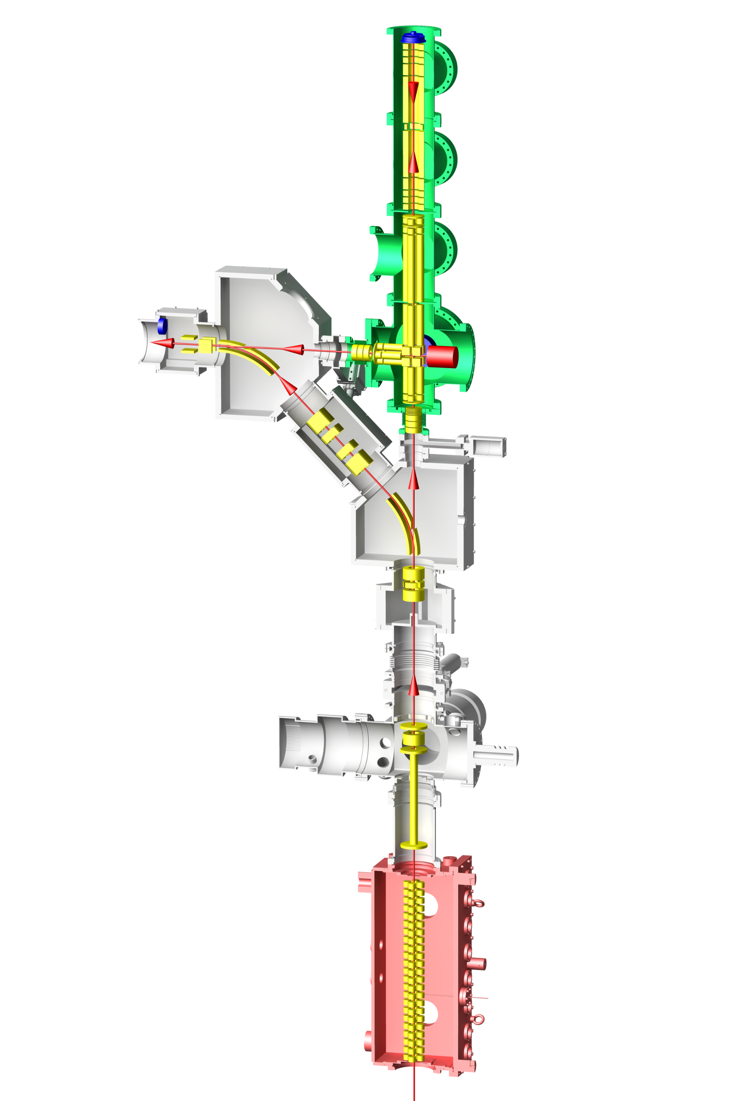
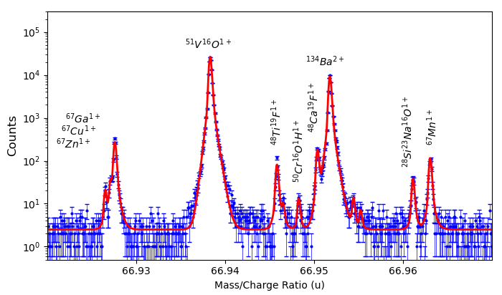

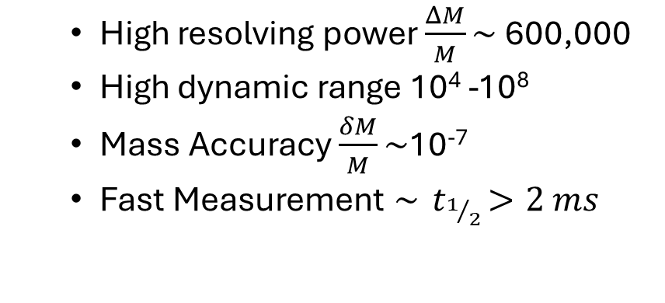
Multi-Reflection Time-of-Flight Mass Spectrometer (MR-TOF)
MagneTOF Detector
High resolving power $\frac{ΔM}{M}\sim$600,000
High dynamic range 10⁴ -10⁸
Mass Accuracy $\frac{δM}{M}\sim$10⁻⁷
Fast Measurement $\sim { t}_{1/2}>2 ms$
TOF Analyzer
Ion Mirrors
RF Injection Trap
Transport RFQ
$$KE= \frac{1}{2}mv^{2}$$
Ions from ISAC
C. Jesch et al., Hyperfine Interact. 235 (2015) 97 M. Yavor et al., Int. J. Mass Spec. 381 (2015) 1-9 T. Dickel et al., J. ASMS 28 (2017) 1079
Notes:
Less time on specs

Slide 7
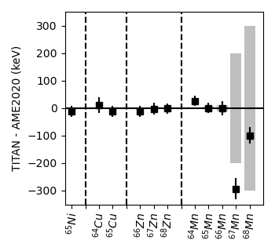
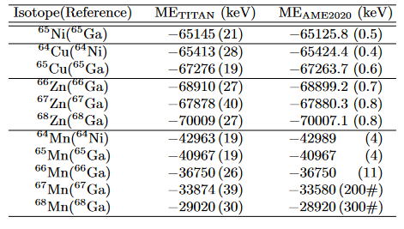
Mass Excess Values
Measured 6 atomic isotopes of Ni, Cu and Zn
Measured 5 isotopes of Mn
Measurements of well-known masses agree well with literature
Accurate and precise mass measurements can change the understanding of nuclear structure
Notes:
Make sure to mention extrapolation

Slide 8
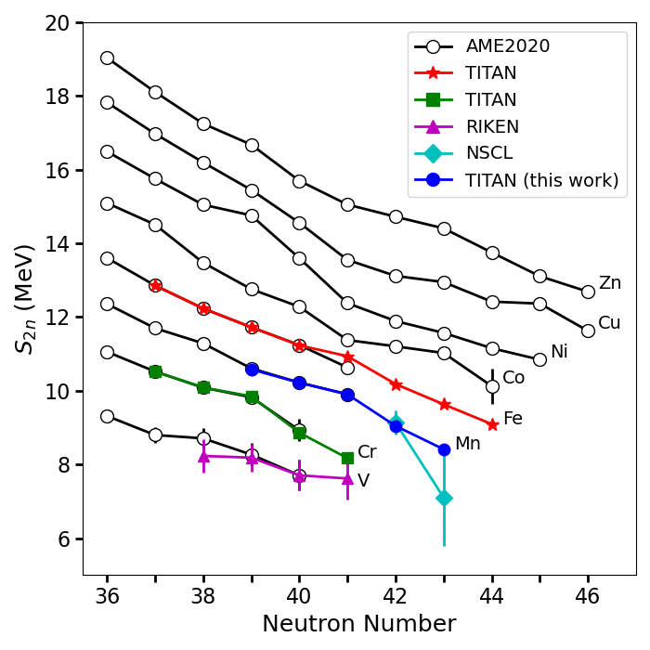
Two-neutron Separation Energy (S_{2n})
Two-neutron separation energy is the energy it takes to remove 2 neutrons from the nucleus
$$S_{2n}=M\left(Z, N+2\right)+2m_{n}−M(Z,N)$$
Observed smooth S_{2n} curve indicates no strong subshell closure at N = 40

Slide 9
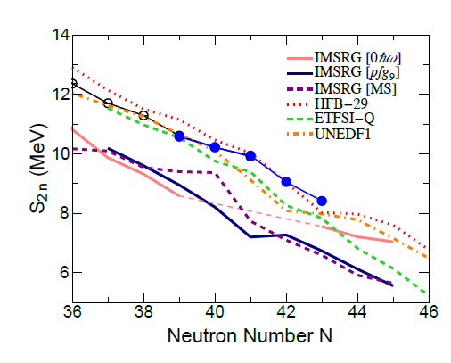
Two-neutron Separation Energy (S_{2n})
Energy density functional results agree well with measured S_{2n}
ab initio methods systematically underbind the nucleus
Indicates the importance of multiparticle-multihole excitations in the N = 40 region
EDF Calculations:
S. Goriely Nuc. Phys. A 933, 68 (2015)
J. Pearson et al. Phys. Lett. B 387, 455 (1996)
M. Kortelainen et al. Phys. Rev. C 85, 024304 (2012)

Slide 10
Summary
TITAN MR-TOF provides high-precision, high-accuracy mass measurements of radioactive isotopes far from stability
First time precision measurements of ⁶⁷Mn and ⁶⁸Mn
Reveals the mass surface around the N = 40 island of inversion
No indication of shell closure at N = 40
Indication of increase in collectivity in N = 40 region
ab initio methods require additional interactions to fully capture collective behavior
Mn mass paper is accepted to PRC
arXiv: https://arxiv.org/abs/2502.18610

Slide 11
Outlook
TITAN MR-TOF has had substantial upgrades since this data was taken
Additional stabilization of switching timing
Ultra-high stability power supplies on most crucial electrodes
MagneTOF detector for higher timing precision and detection efficiency
Ongoing upgrades
Active thermal stabilization of power supplies
Laser Ablation Source (LAS) crucial for enabling off-line science for LS2026
Has been commissioned on test stand, installation in August
Notes:
Highlight off-line science in 2026
Make LAS-centered conclusion slide, put this as backup
Thanks to DSF (pic of PEEK parts)

Slide 12
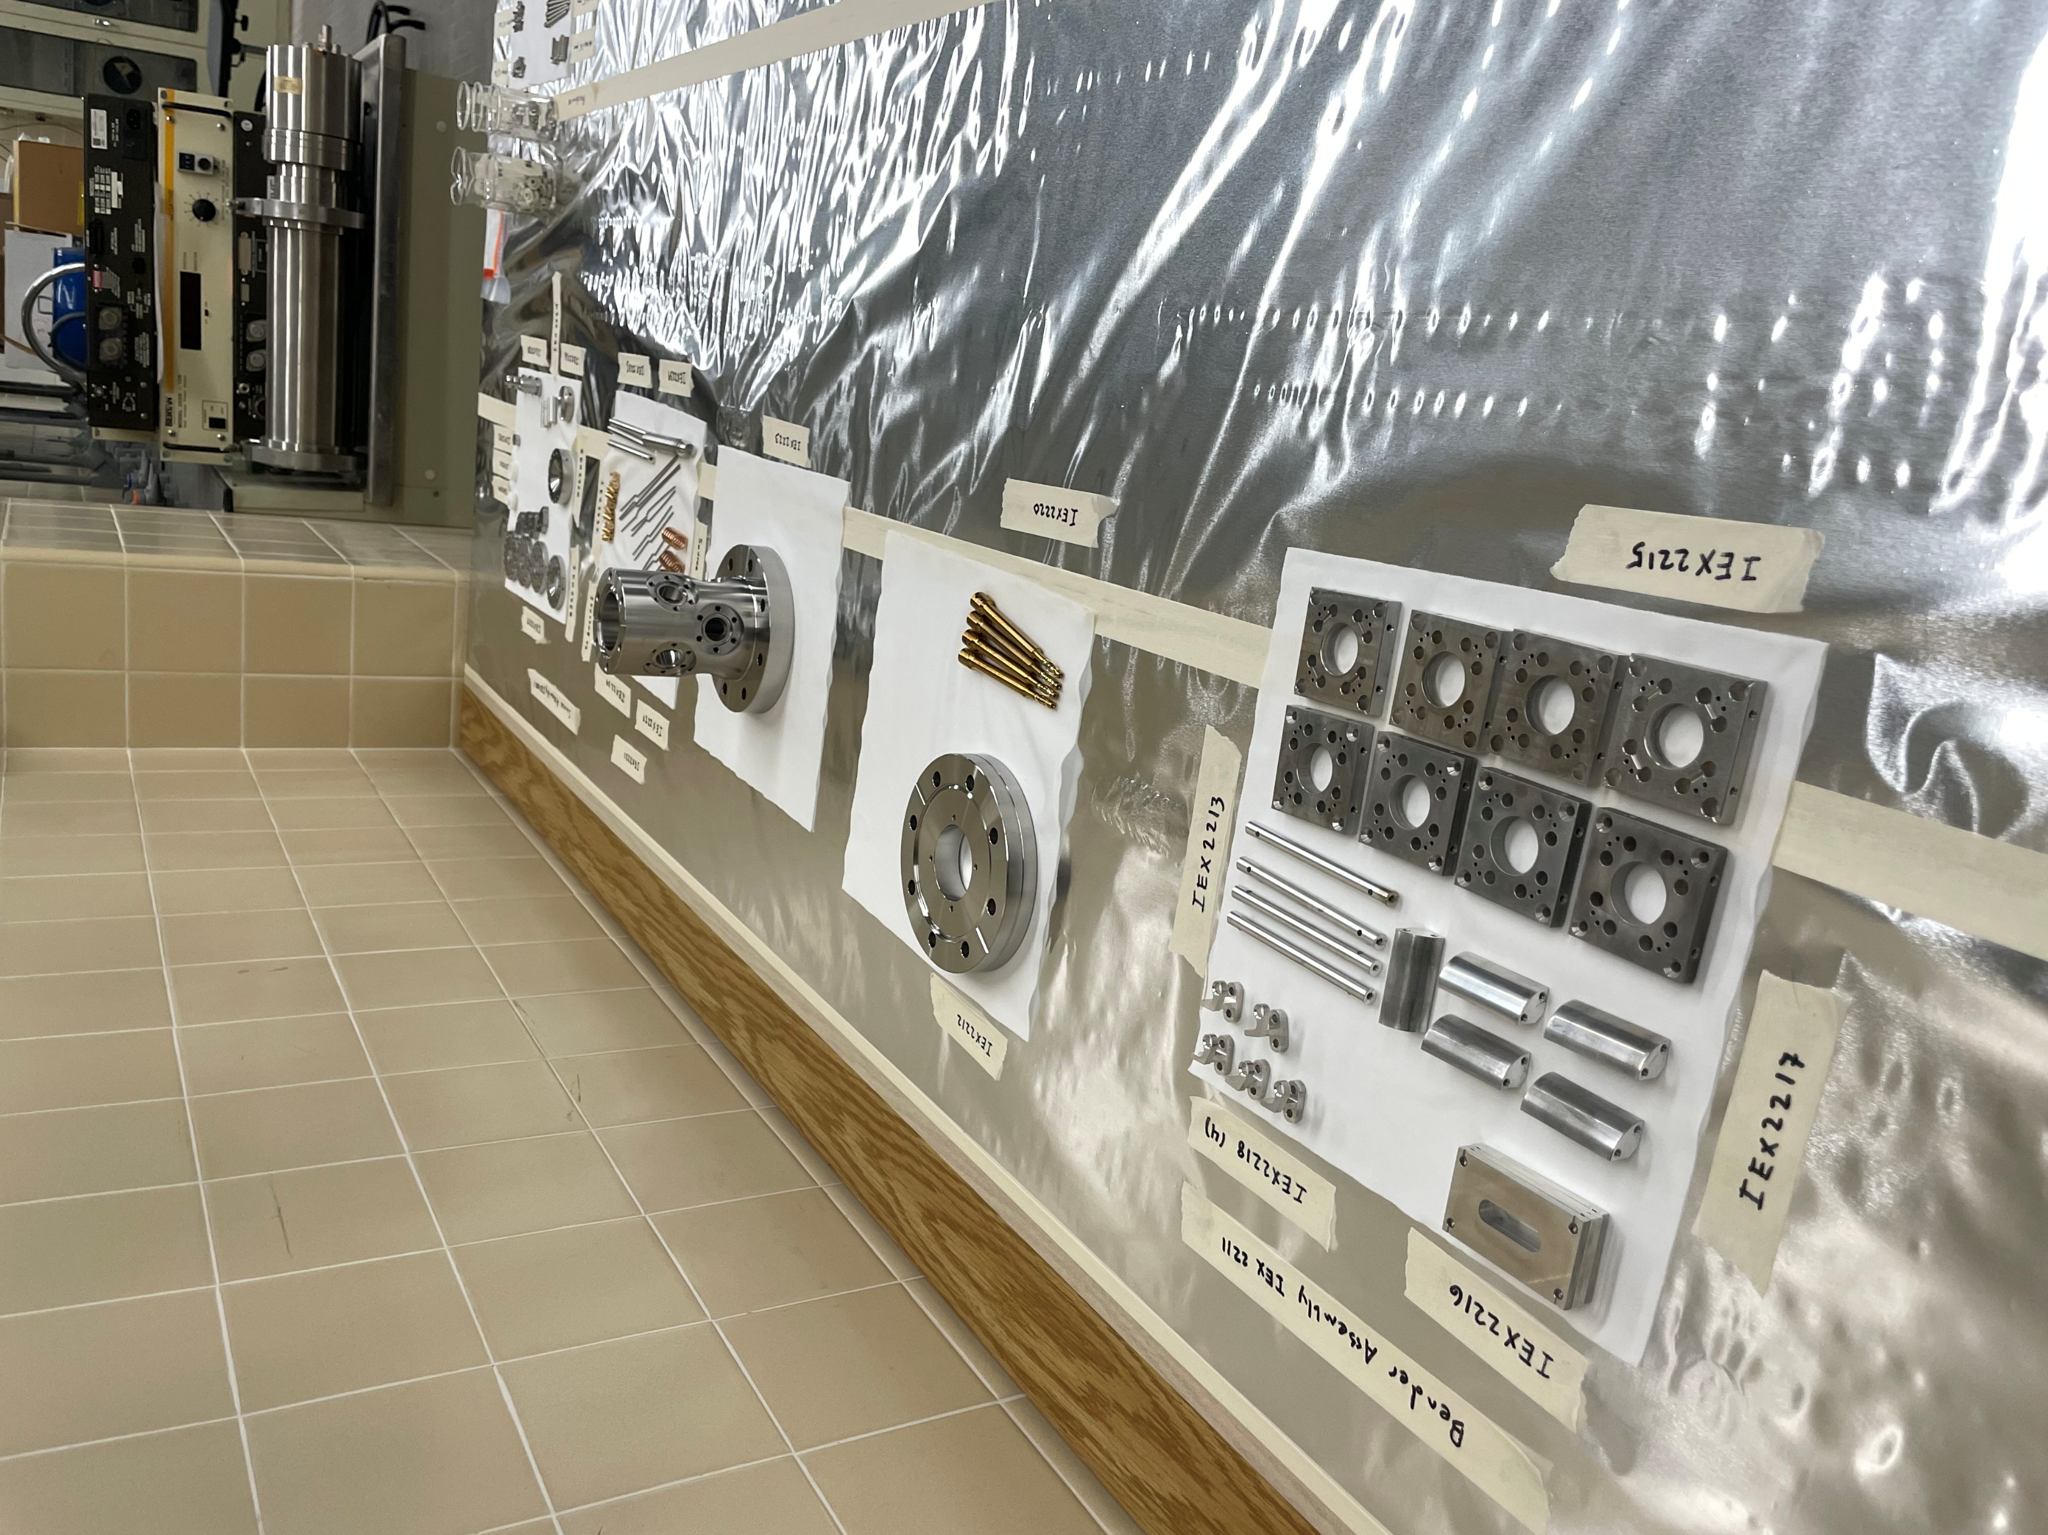
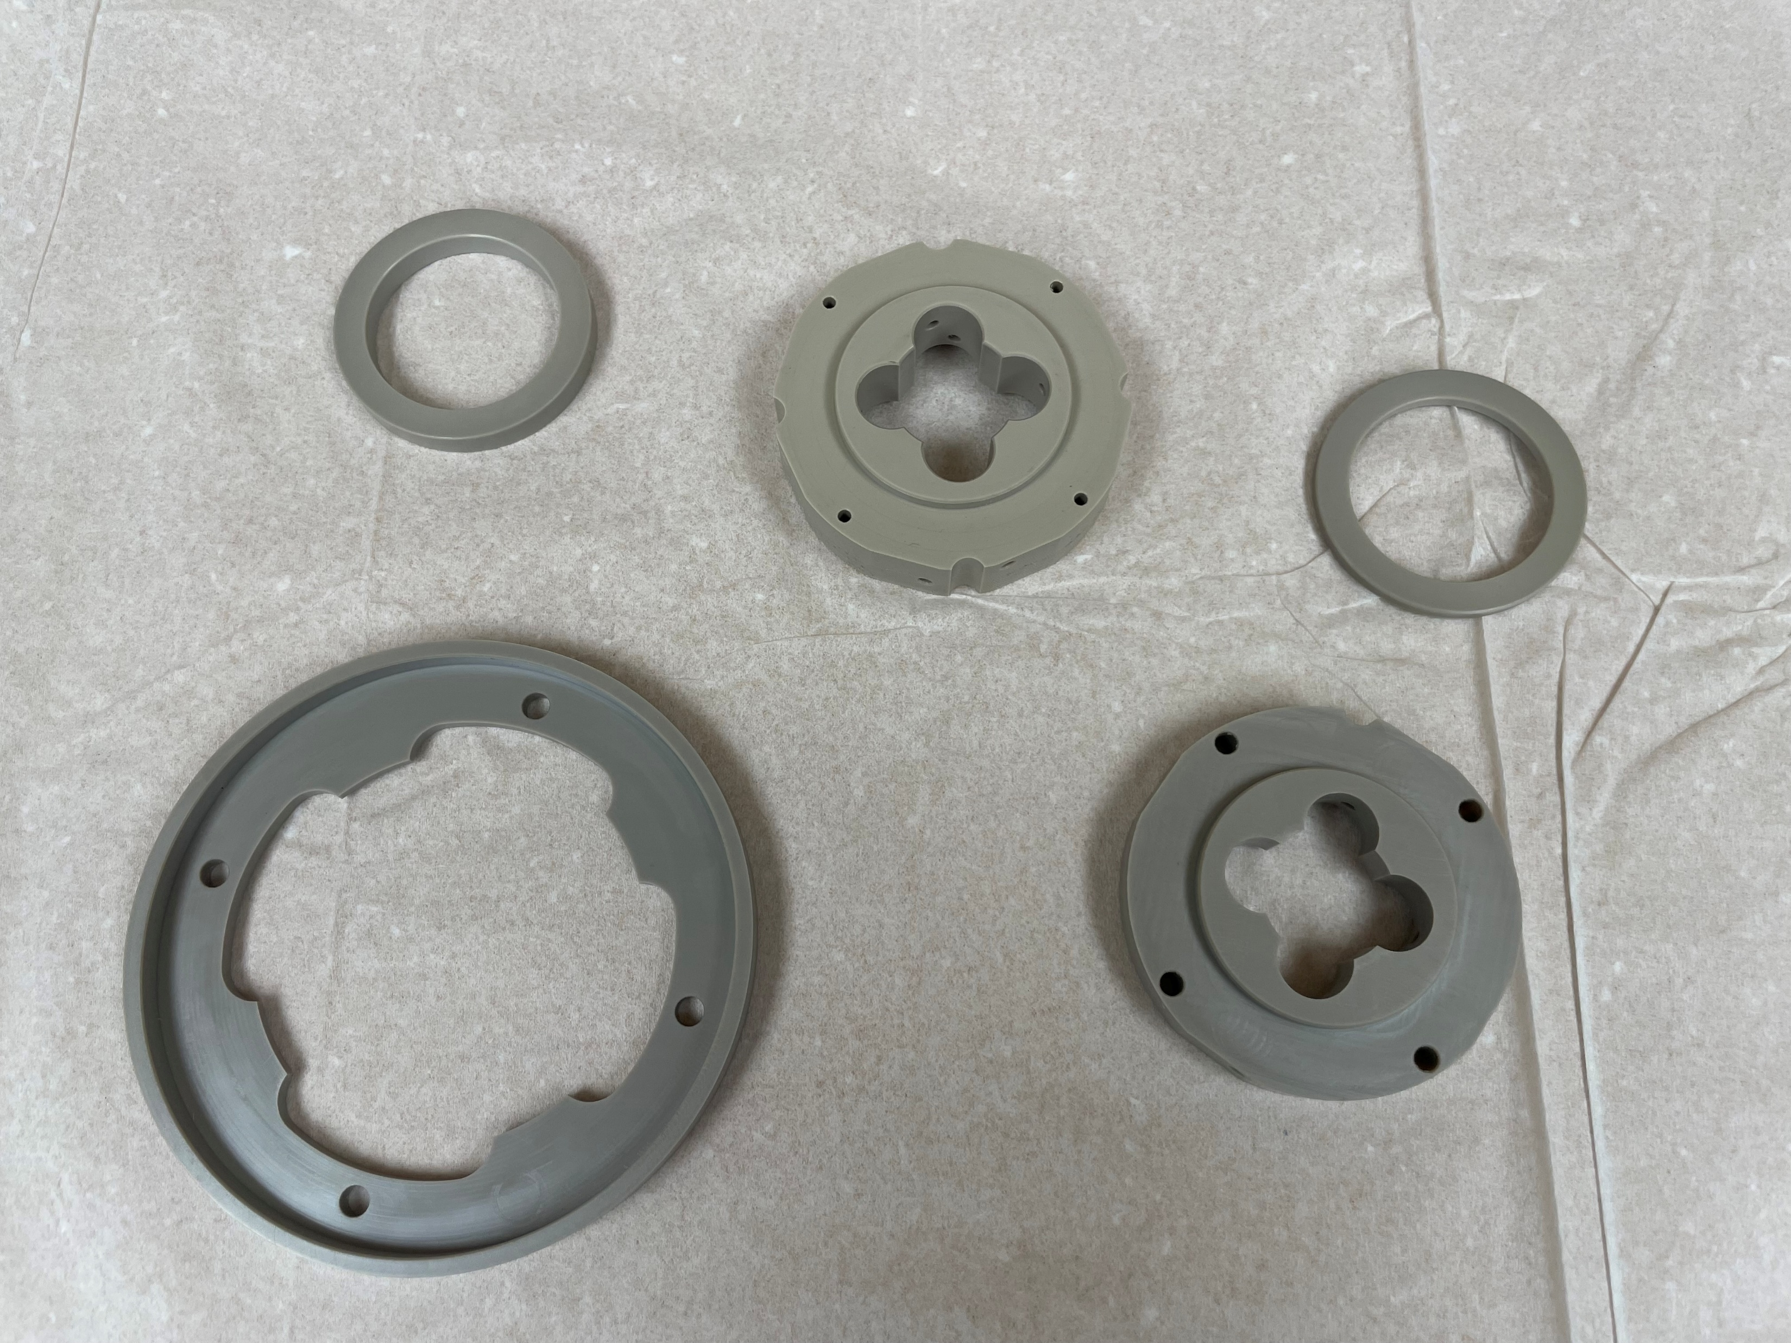
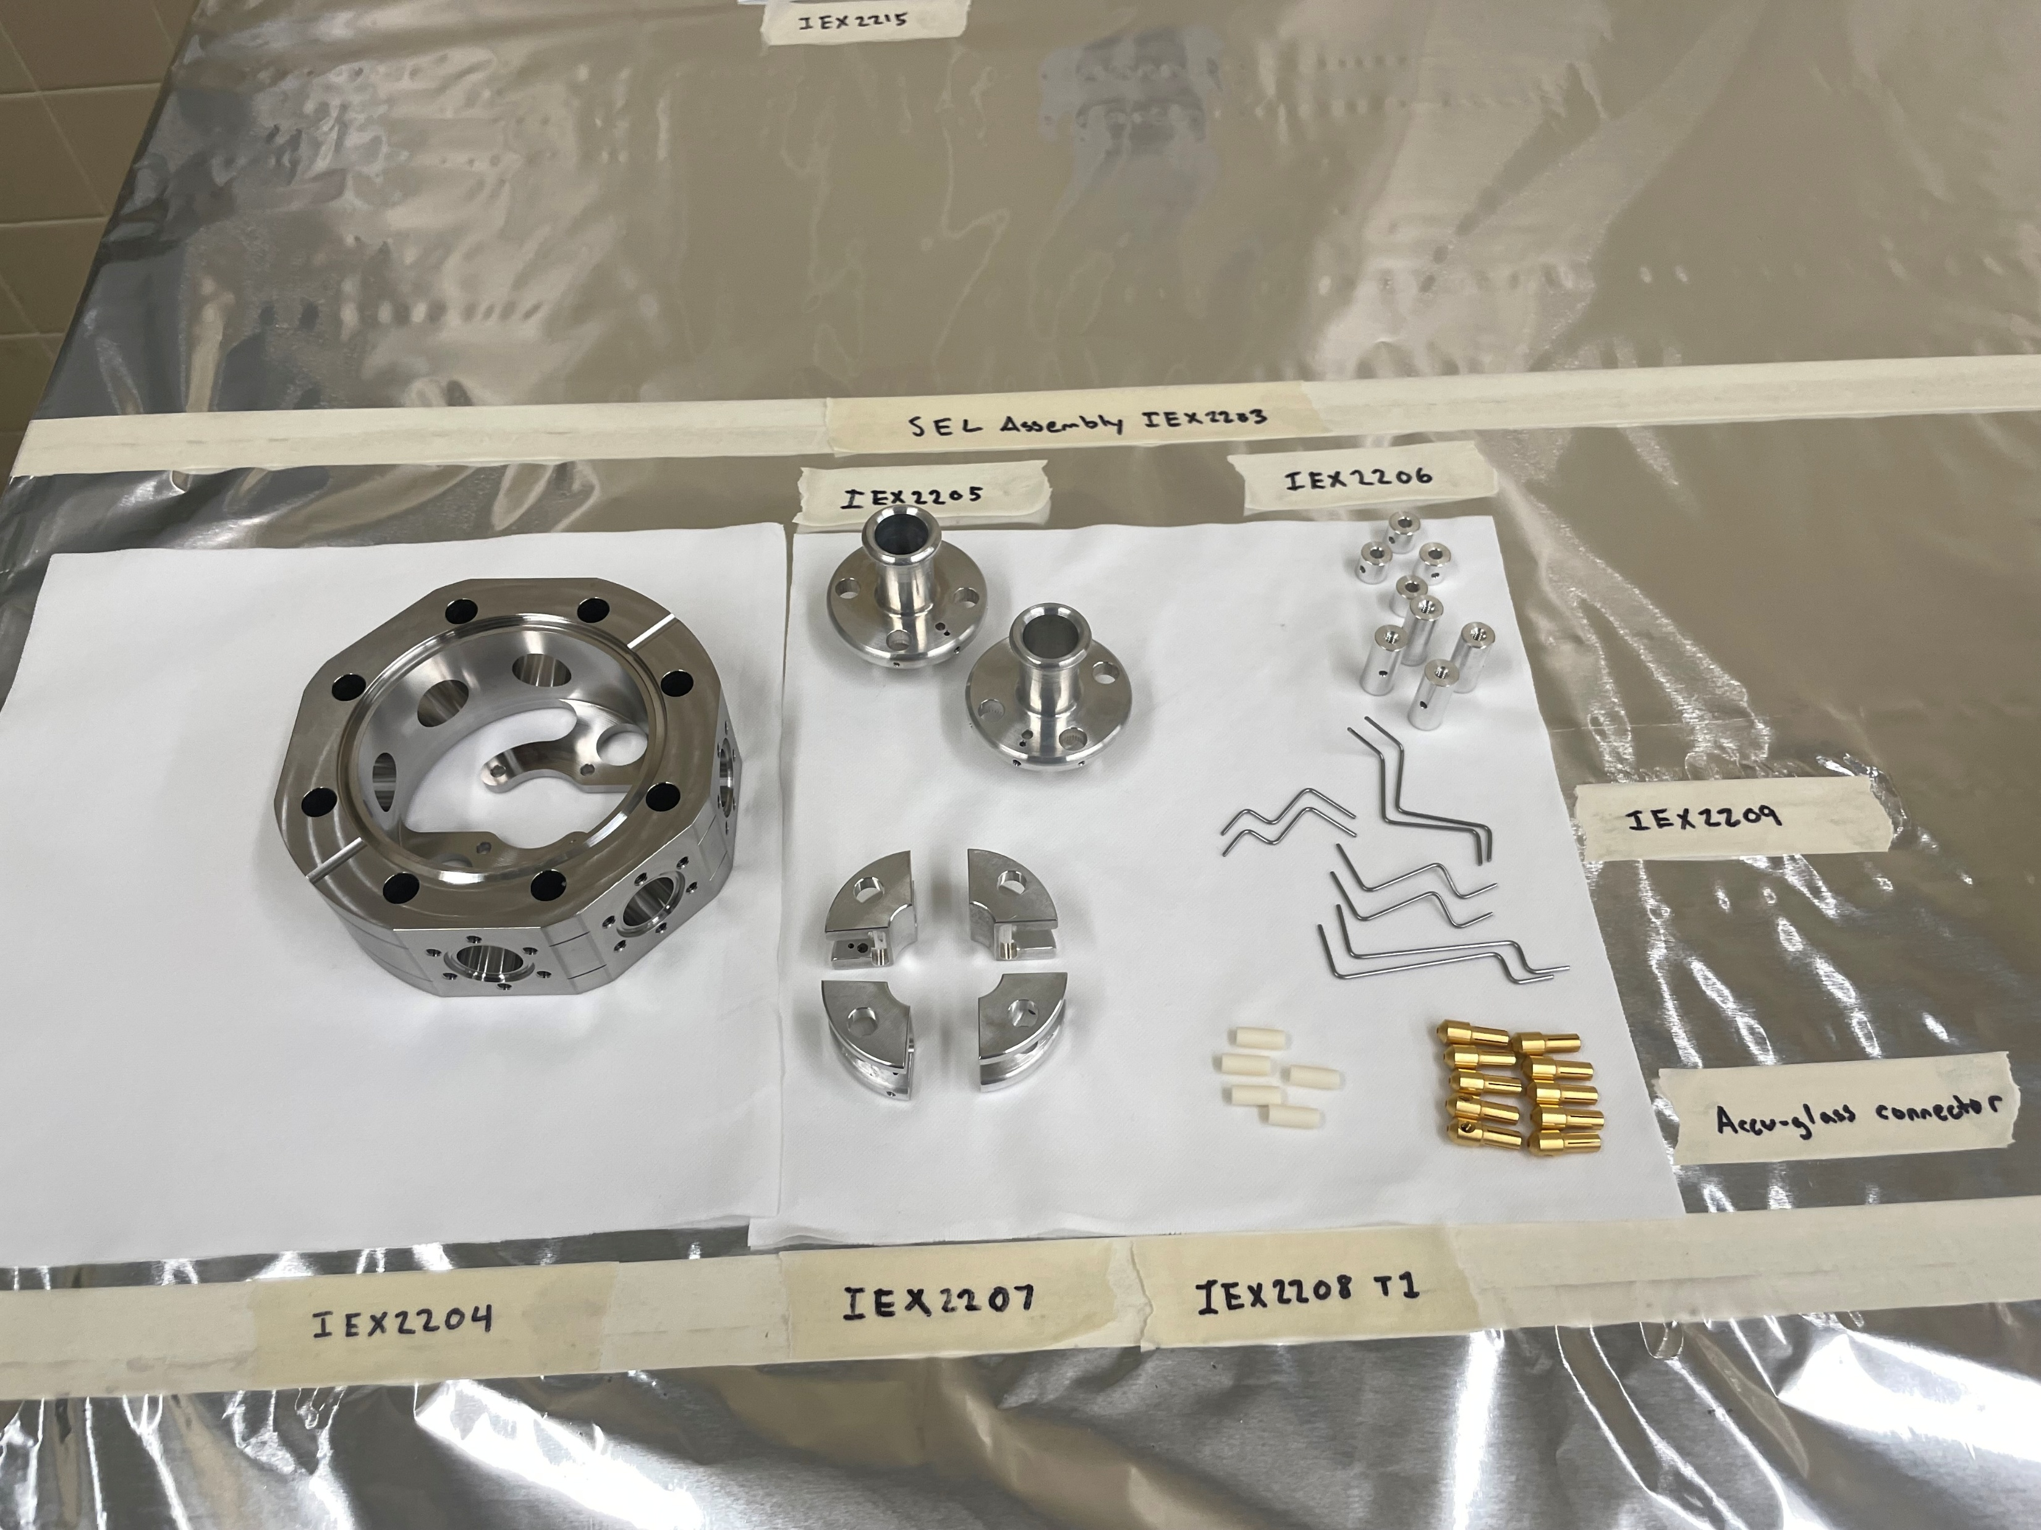
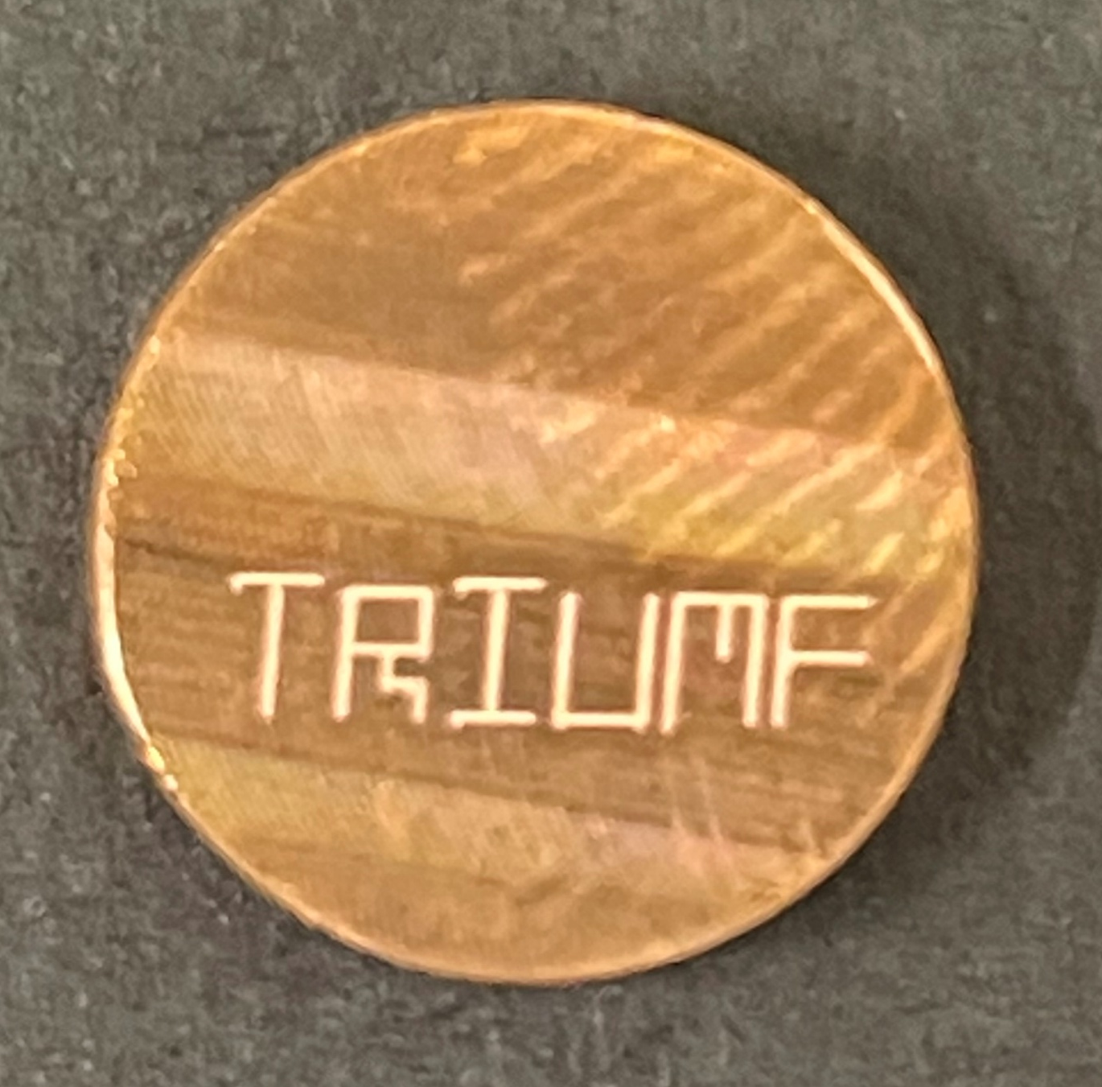
Thanks to the University of Calgary Machine Shop and TRIUMF Detector Support Facility
Notes:
Highlight off-line science in 2026
Make LAS-centered conclusion slide, put this as backup
Thanks to DSF (pic of PEEK parts)

Slide 13
TITAN Collaboration!

Slide 14




Thank you Merci
www.triumf.ca
Follow us @TRIUMFLab

Slide 15
Backup

Slide 16
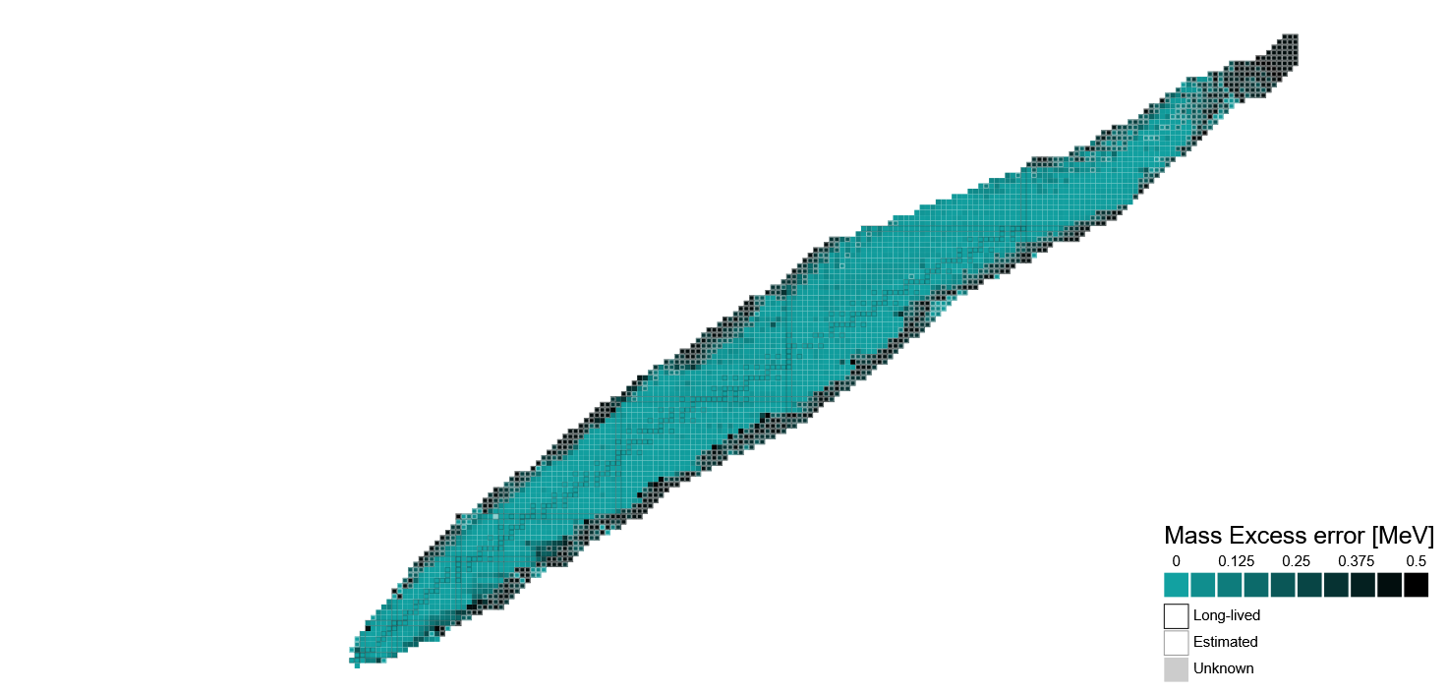
Mass Measurements and Nuclear Structure
Mass measurement precision needs improvement away from stability
Stellar Nucleosynthesis
Fundamental symmetries
δm/m < 10⁻⁸
Special nuclear structure
δm/m < 10⁻⁶ – 10⁻⁷
Nuclear shell structure
δm/m = 10⁻⁷
δm/m = 10⁻⁵ – 10⁻⁶
https://people.physics.anu.edu.au/~ecs103/chart/

Slide 17
Investigating the N = 40 region
Is there a neutron subshell closure at N = 40?
⁶⁸Ni (28,40) shows a large energy gap between first excited 2⁺ and 0⁺ states
Mass measurements show no clear neutron shell gap at N=40 for other species
B(E2; 0⁺₁ → 2⁺₁ ) = 32.(6) W.u. is too large for significant subshell gap at N=40
Could this behavior be explained by deformation from intruder states?
By looking at Mn isotopes across N = 40 we reveal the mass surface
Further investigate existence of subshell closure
Look for evidence of collectivity and deformation
Testing ground for ab initio models in the N = 40 island of inversion
From AME2020

Slide 18
Mass Selective Re-Trapping
MR-TOF Re-Trapping
Allows for 10⁴ suppression of isobaric background ions
How it’s done:
Inject into TOF analyzer and separate in time
Extract towards RF injection trap
Close trap when ion of interest is inside
Re-inject into the TOF analyzer and make mass measurement
Notes:
Re-trapping to backup

Slide 19
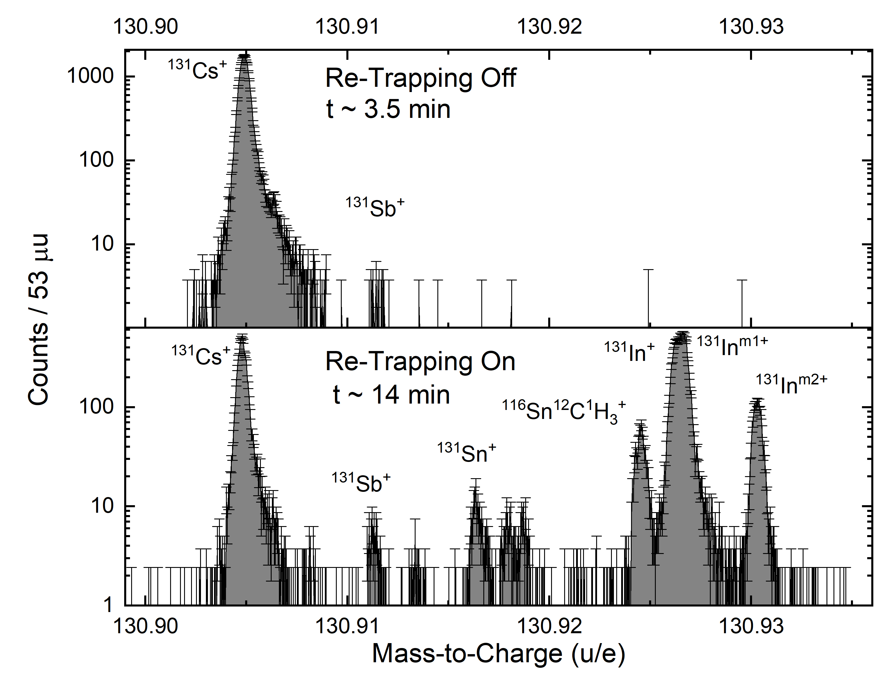
Mass Selective Re-Trapping
4 order of magnitude background suppression

Slide 20
Mass Selective Re-Trapping
4 order of magnitude background suppression
Low-rate isotopes now visible
with higher RIB rate

Slide 21
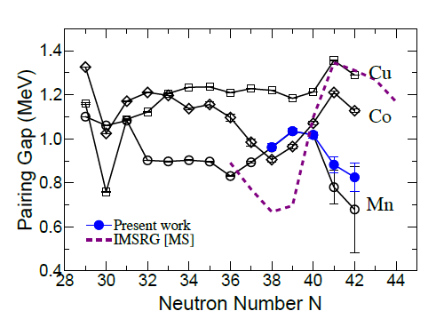
Neutron Pairing Gap (P_{n})
Neutron pairing gap is the energy it takes to separate a neutron pair
S_{n} is the one-neutron separation energy
ab initio methods do not capture this behavior
$$P_{n}(Z,N)=\frac{{\left(−1\right)}^{N+1}}{4}(S_{n}\left(Z, N+1\right)−2S_{n}\left(Z, N\right)+S_{n}\left(Z,N−1\right))$$
Decrease in pairing gap indicates higher collectivity beyond N = 40
Notes:
Backup

Slide 22
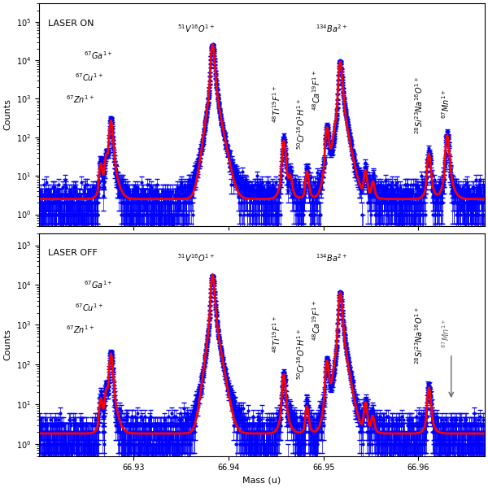
Laser On/Off Effect
The Mn isotopes were resonantly ionized by a 2-step laser scheme
279.910 nm
376.223 nm
When laser is blocked the Mn peak disappears
Confident the mass peak is Mn

Slide 23
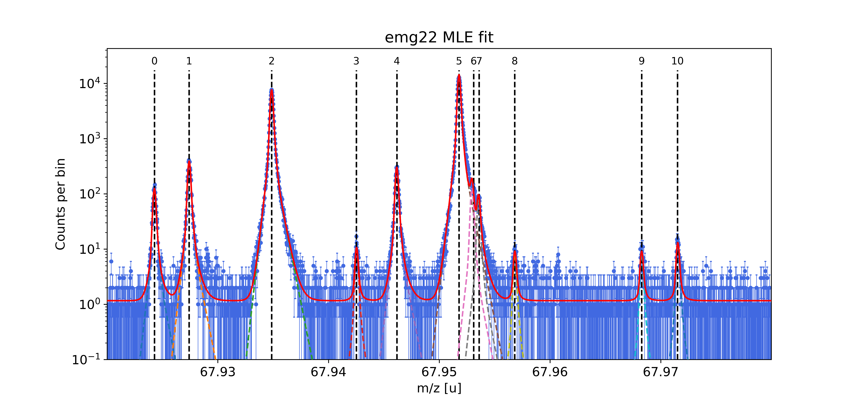
Mass Spectrum m/q = 68
Ba136:-2e
Ce136:-2e
Ca49:F19:-1e
Cr52:O16:-1e
I136:-2e
Ga68:-1e
Zn68:-1e
Mn68:-1e
V51:O17:-1e
2S32:6C12:-2e
V51:O16:H1:-1e
Will re-plot for better readability

