Slide 1
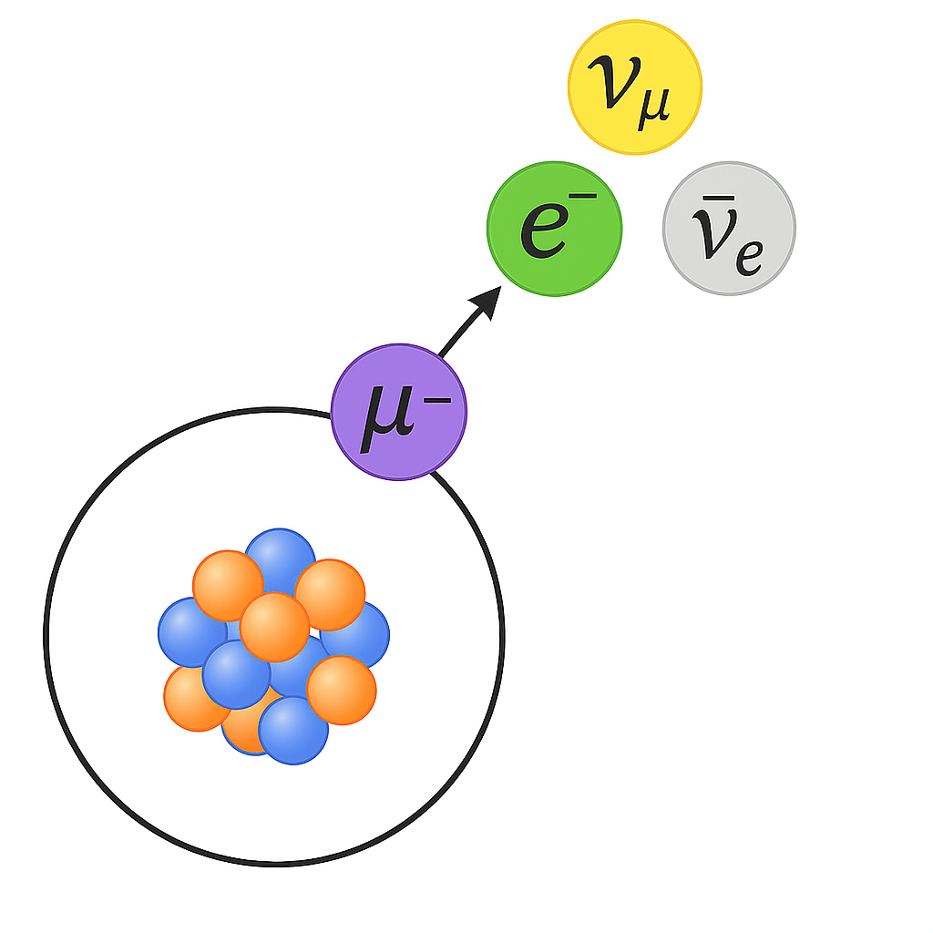


Lifetime of a muon bound to a light nucleus
WNPPC-2026 Conference
Artem Davydov
Supervisor: Prof. Andrzej Czarnecki

Slide 2
Contents
Muon decay: bound vs. free
Current 𝛍→𝗲 conversion experiments: Mu2e and COMET
Contradiction in previous results: numerical vs. theoretical
Mathematical approach to bound muon problem: Spherical waves formalism
Numerical results for (Z=8): resolution of the contradiction
Bound muon decay rates for other nuclei

Slide 3
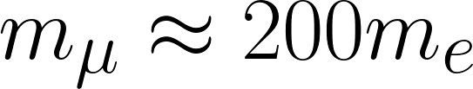
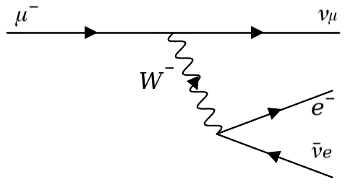
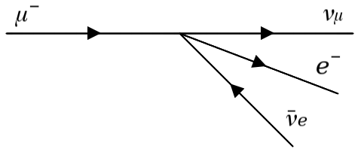
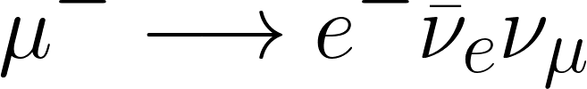
Free muon decay

Slide 4
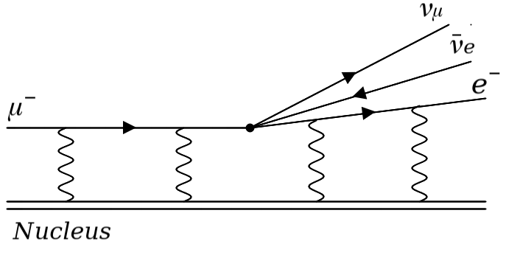
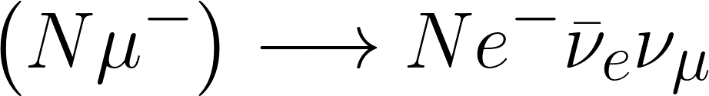
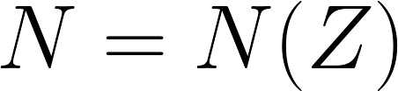
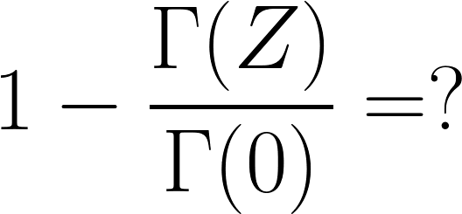
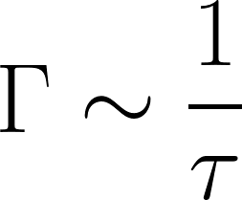
Bound muon decay
Friday, August 1, 2025

Slide 5
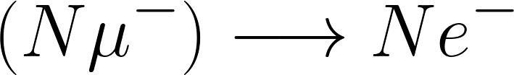
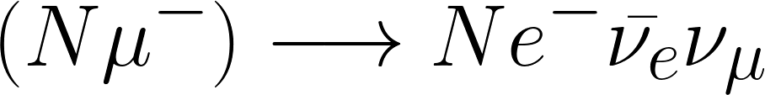
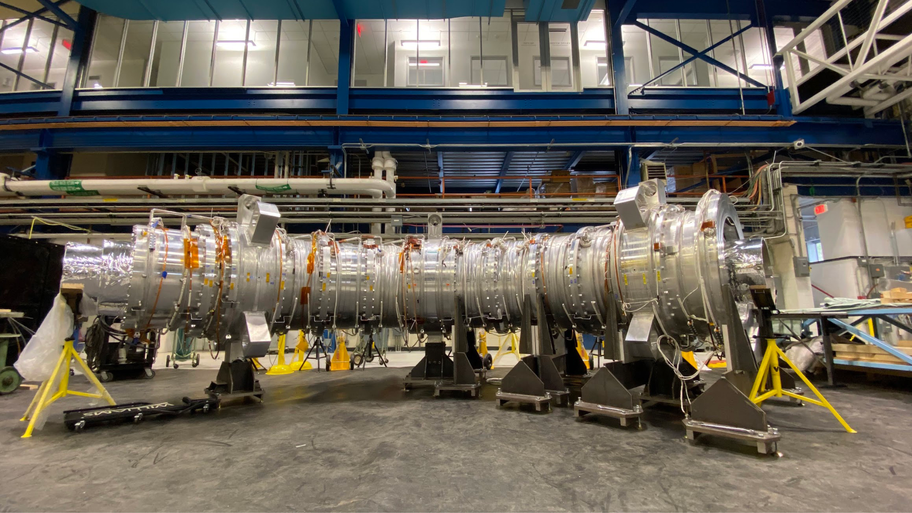
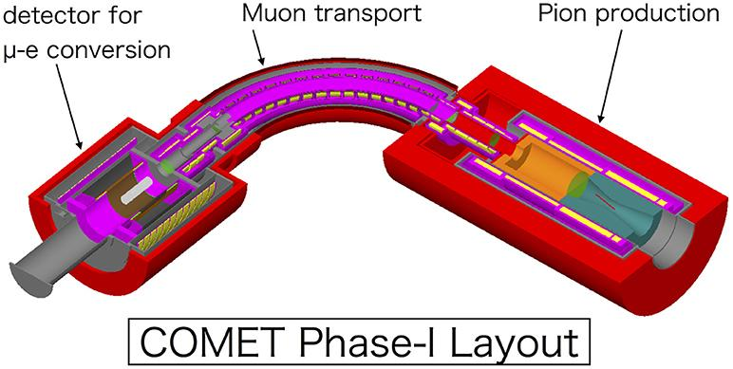
Current and upcoming experiments
Looking for the neutrinoless decay Serves as a background
Mu2e, Fermilab COMET, J-PARC

Slide 6
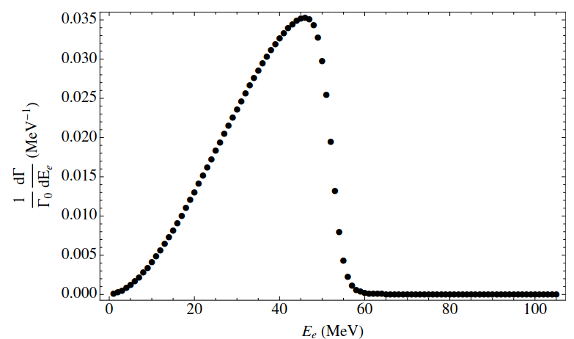
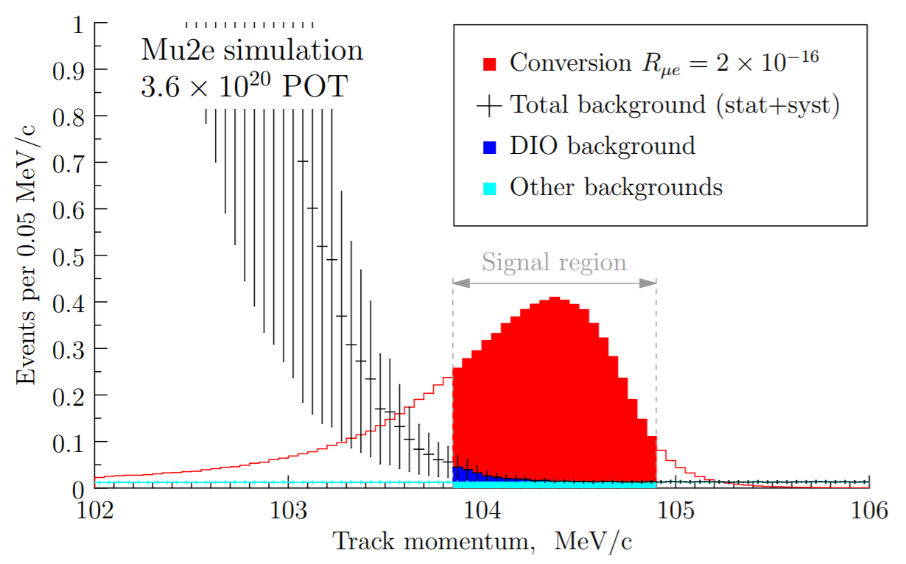
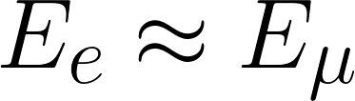
Current experiments
Spectrum of background electrons Peak in the tail region

Slide 7
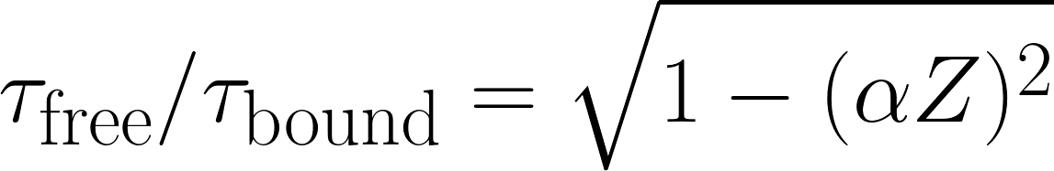
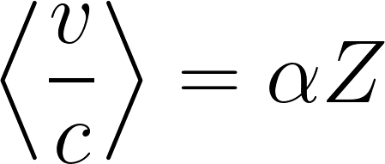
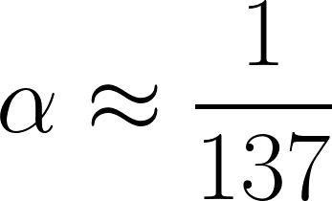
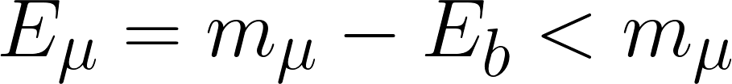
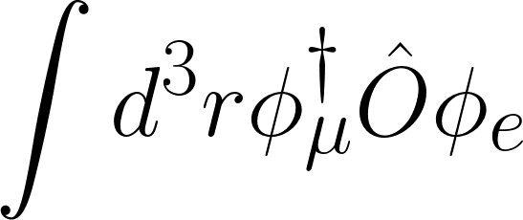
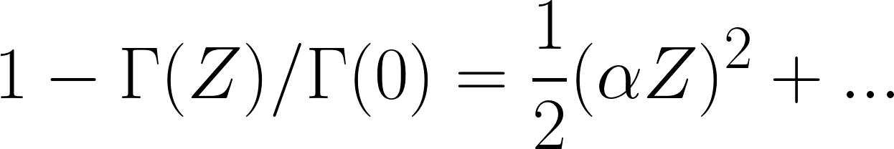
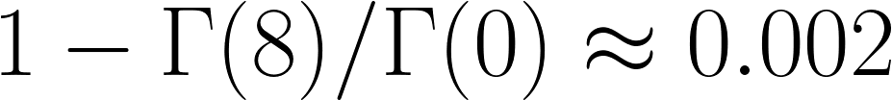
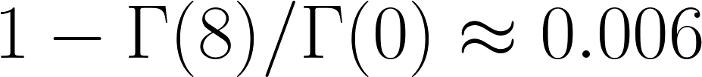
Previous endeavors
What modifies the decay rate?
The relativistic time dilation:
The phase space reduction:
The electron wave function enhancement:
Theory - Uberall (1960)
Numerical - Watanabe, et. al. (1993)

Slide 8
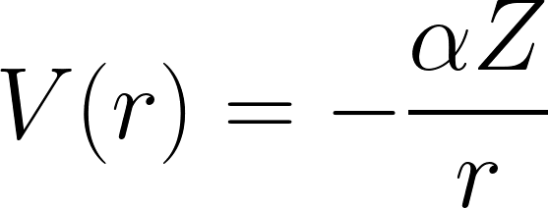
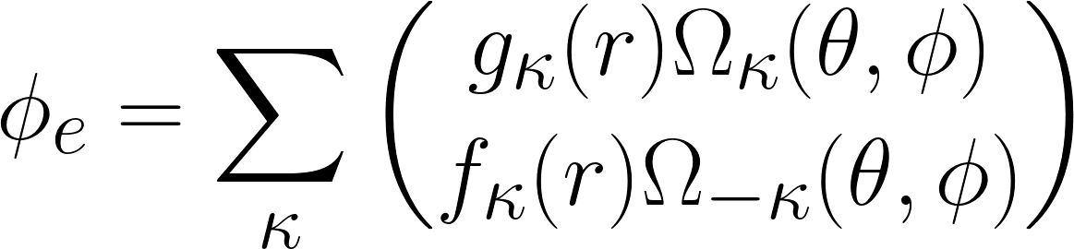
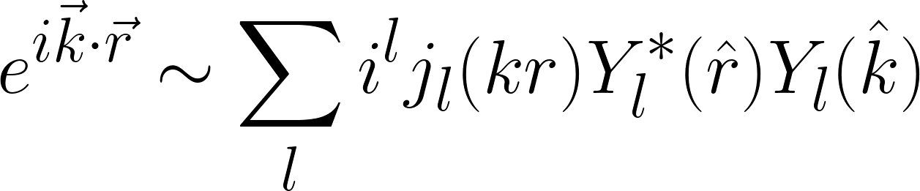
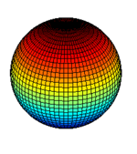
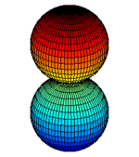


Mathematical background
Dirac Equation:
Solution for electron:
Plane wave decomposition:

Slide 9
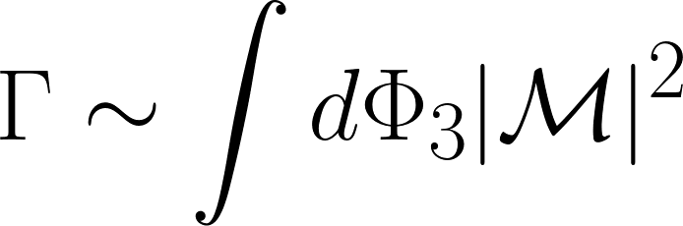
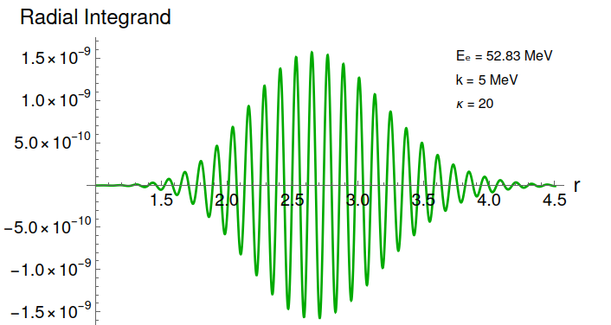
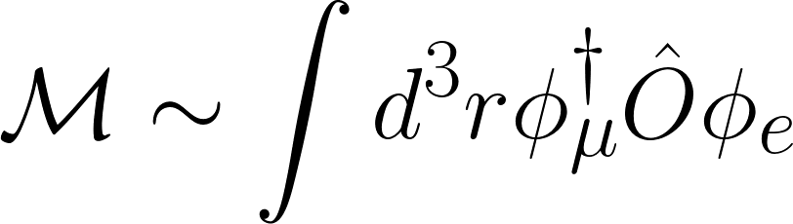
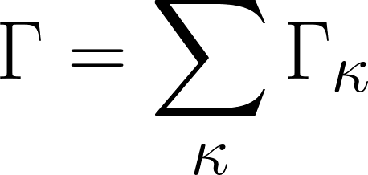
Mathematical background
Decay width:
Matrix element:
Partial summation:

Slide 10
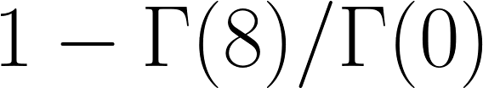


Numerical results
The difference between our numerical result and Uberall’s theoretical number can be attributed to higher order terms in (𝜶𝐙) expansion.
Watanabe’s numerical number is wrong due to incorrect truncation.
 | Theory, Uberall (1960) | Numerical, Watanabe, et. al. (1993) | Current work
 | 0.0019 | 0.006 | 0.0024
Truncation

Slide 11
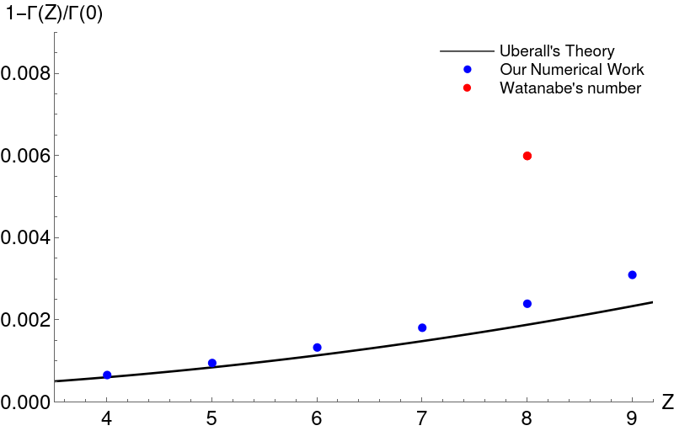

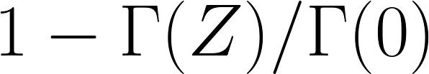
Numerical results
[1] Kaygorodov et. al. arXiv:2506.02416 (2025)
[2] A. Czarnecki, A.O. Davydov, M.Y.Kaygorodov arXiv:2512.23023 (2025)
4 | 0.0007
5 | 0.0010
6 | 0.0013
7 | 0.0018
8 | 0.0024
9 | 0.0031

Slide 12

Summary
The theoretical calculation done by Uberall is correct, meaning that the QED is a valid theory for high precision atomic calculations.
Watanabe’s numerical number is wrong due to incorrect truncation.
The difference between our numerical result and Uberall’s theoretical number can be attributed to higher order terms in (𝜶𝐙) expansion.
Correctness of the tail evaluation gives a solid base for conversion searches

