Slide 1
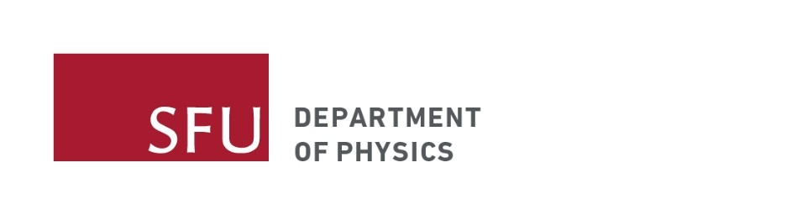
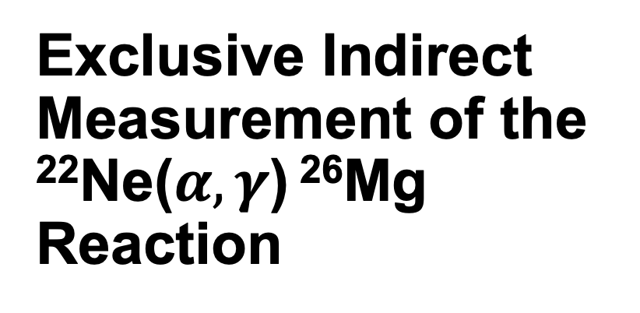
Exclusive Indirect Measurement of the ²²Ne($α,γ$) ²⁶Mg Reaction
Mike-Yizhu Qiu
Supervisor: Barry Davids

Slide 2
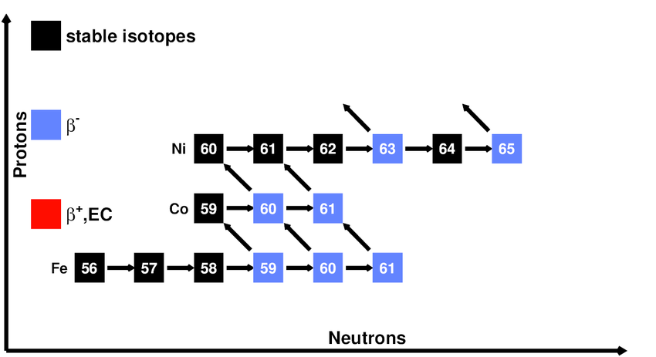
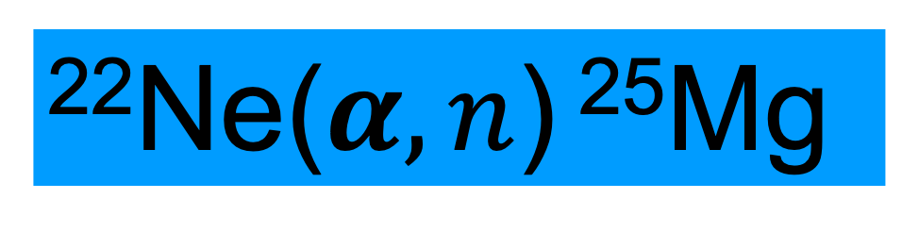
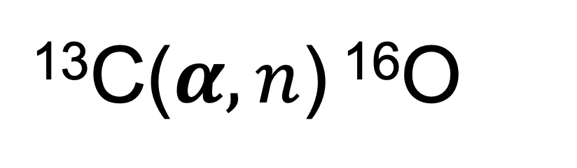
The Slow Neutron Capture Process(s-process)
Makes about half of the heavy elements in the universe!
¹³C($α,n$) ¹⁶O
²²Ne($α,n$) ²⁵Mg
Winter Nuclear & Particle Physics Conference, Feb 12-15, 2026
Image credit: R. Reifarth et al. Nuclear astrophysics with radioactive ions at FAIR (2013)
Notes:
Just as a refresher, the slow neutron capture process contributes...
Inside a star there are two key reactions that affect the s-process rate, the first one being the C reaction and the second one being the Ne alpha n reaction because Both of the reactions change the neutron flux in the interior of a star. In the talk I will focus on the second reaction.

Slide 3
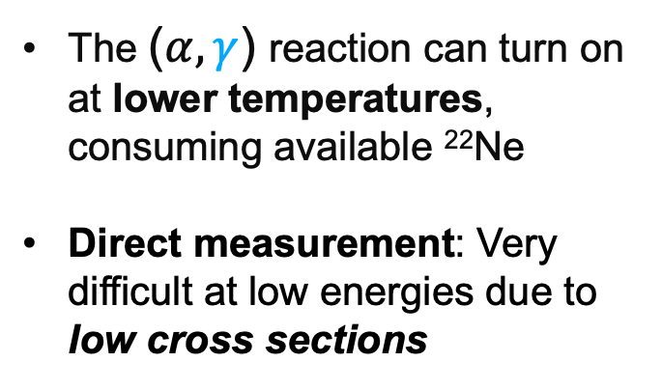
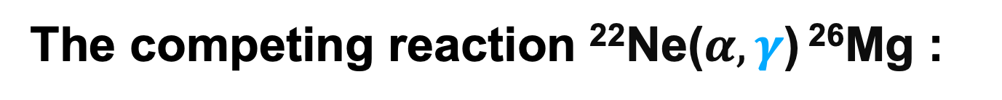





The competing reaction ²²Ne($α,γ$) ²⁶Mg :
E_{x} [MeV]
J^{π}
0.975
3/2⁺
E_{x} [MeV]
J^{π}
E_{r} [MeV]
0.585
1/2⁺
The ($α,γ$) reaction can turn on at lower temperatures, consuming available ²²Ne
Direct measurement: Very difficult at low energies due to low cross sections
11.441
4⁺
+0.976
T = 0.2 – 0.6 GK
E_{c.m.} = 0.46 – 0.96 MeV
11.319
(0⁺,1⁻,2⁺)
²²Ne($α,n$) ²⁵Mg
+0.830
11.153
1⁻ (2⁺,4⁺)
n
+0.635
n
0
5/2⁺
²²Ne($α,γ$) ²⁶Mg
11.093
²⁵Mg
10.615
Neutron threshold
²²Ne+ $α$
$α$ threshold
$$γ$$
Below neutron threshold, ($α,γ$) Channel only
0
0⁺
²⁶Mg
Winter Nuclear & Particle Physics Conference, Feb 12-15, 2026
Level scheme credit: Dr. Thomas Chillery
Notes:
However, the alpha n reaction really only tells half of the story. There is a competing alpha, gamma reaction. There is a lot going on in the diagram to the right but what we really care about is the fact that the neutron threshold lies above the alpha threshold. at lower temperatures the alpha gamma reaction can turn on before the alpha n reaction because it is exothermic, again this consumes the available 22Ne before the alpha n reaction can turn on. This is because the alpha gamma channel is closed below the neutron threshold. People have made direct measurements on the low-lying states above the alpha threshold but but it has proven to be challenging due to the low cross sections.
Low cross-section due to the fight against the coulomb barrier
Backgrounds.

Slide 4
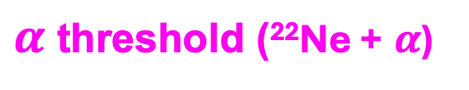
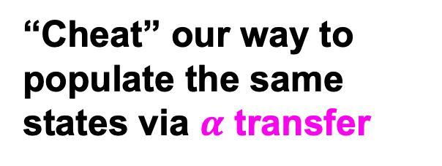
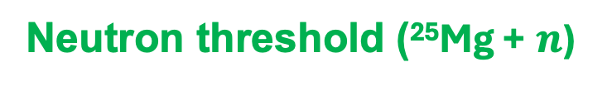
Indirect measurement via ²²Ne(⁷Li,t)²⁶Mg
E_{x} [MeV]
J^{π}
t
11.441
4⁺
“Cheat” our way to populate the same states via $α$ transfer
11.319
(0⁺,1⁻,2⁺)
11.153
1⁻ (2⁺,4⁺)
11.093
Neutron threshold (²⁵Mg + $n$)
10.949
1⁻
$α$ threshold (²²Ne + $α$)
8.148
10.615
²²Ne + ⁷Li
0
0⁺
²⁶Mg
Winter Nuclear & Particle Physics Conference, Feb 12-15, 2026
Notes:
Thankfully, there is a way to cheat our way around this using the alpha transfer reaction. In this case we bombard a Li target with 22Ne beam, the Li nucleus can essentially be thought of as a triton and an alpha particle. This way, the 22Ne nucleus reacts with the alpha particle and forms the same 26Mg states of interest. This is exactly the method used in this experiment! Great!
Lithium: a large wavefunction overlap between it and alpha + t
but its nuclear wavefunction has a strong $α+t$cluster overlap, and that’s enough that the dominant reaction mechanism behaves like $α$-transfer

Slide 5
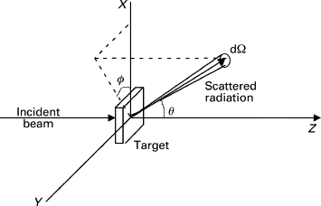
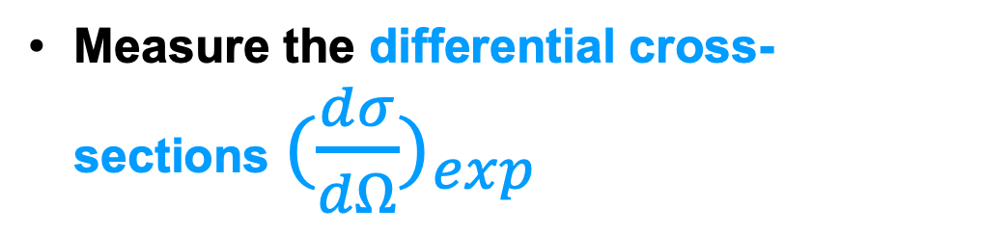
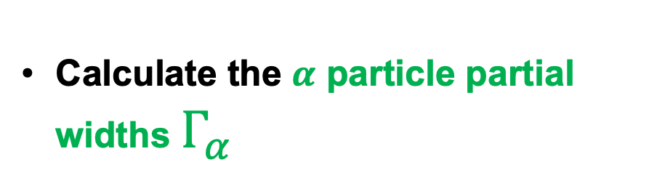
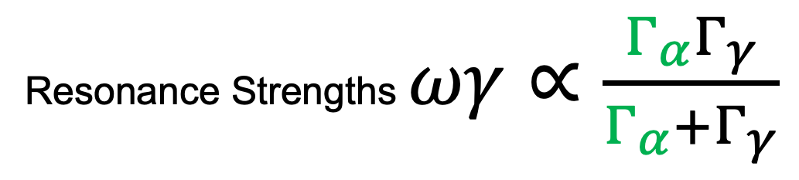
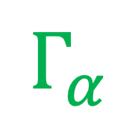
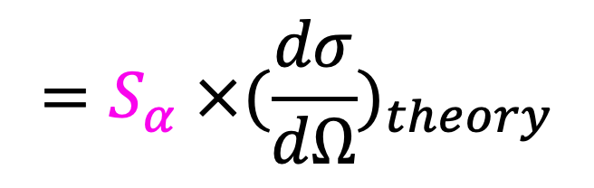
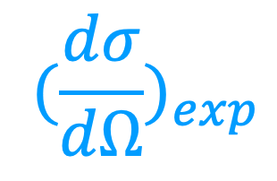
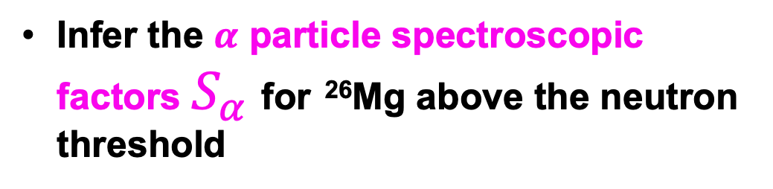
$${(\frac{dσ}{dΩ})}_{exp}$$
$$=S_{α} ×{(\frac{dσ}{dΩ})}_{theory}$$
Goals
Measure the differential cross-sections ${(\frac{dσ}{dΩ})}_{exp}$
$$Γ_{α}$$
Infer the $α$ particle spectroscopic factors $S_{α}$for ²⁶Mg above the neutron threshold
Resonance Strengths $ωγ∝\frac{Γ_{α}Γ_{γ}}{Γ_{α}+Γ_{γ}}$
Calculate the $α$ particle partial widths $Γ_{α}$
Stellar Reaction Rates
Winter Nuclear & Particle Physics Conference, Feb 12-15, 2026
Image: Michael Kotlarchyk, Scattering Theory (1999)
Notes:
So the main goals of the experiment is 1: , from which we can infer…. Then we can calculate… Then we can find the w… subsequently the stellar reaction rates

Slide 6
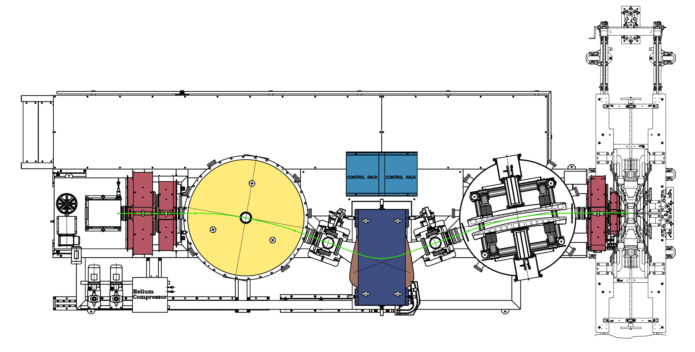
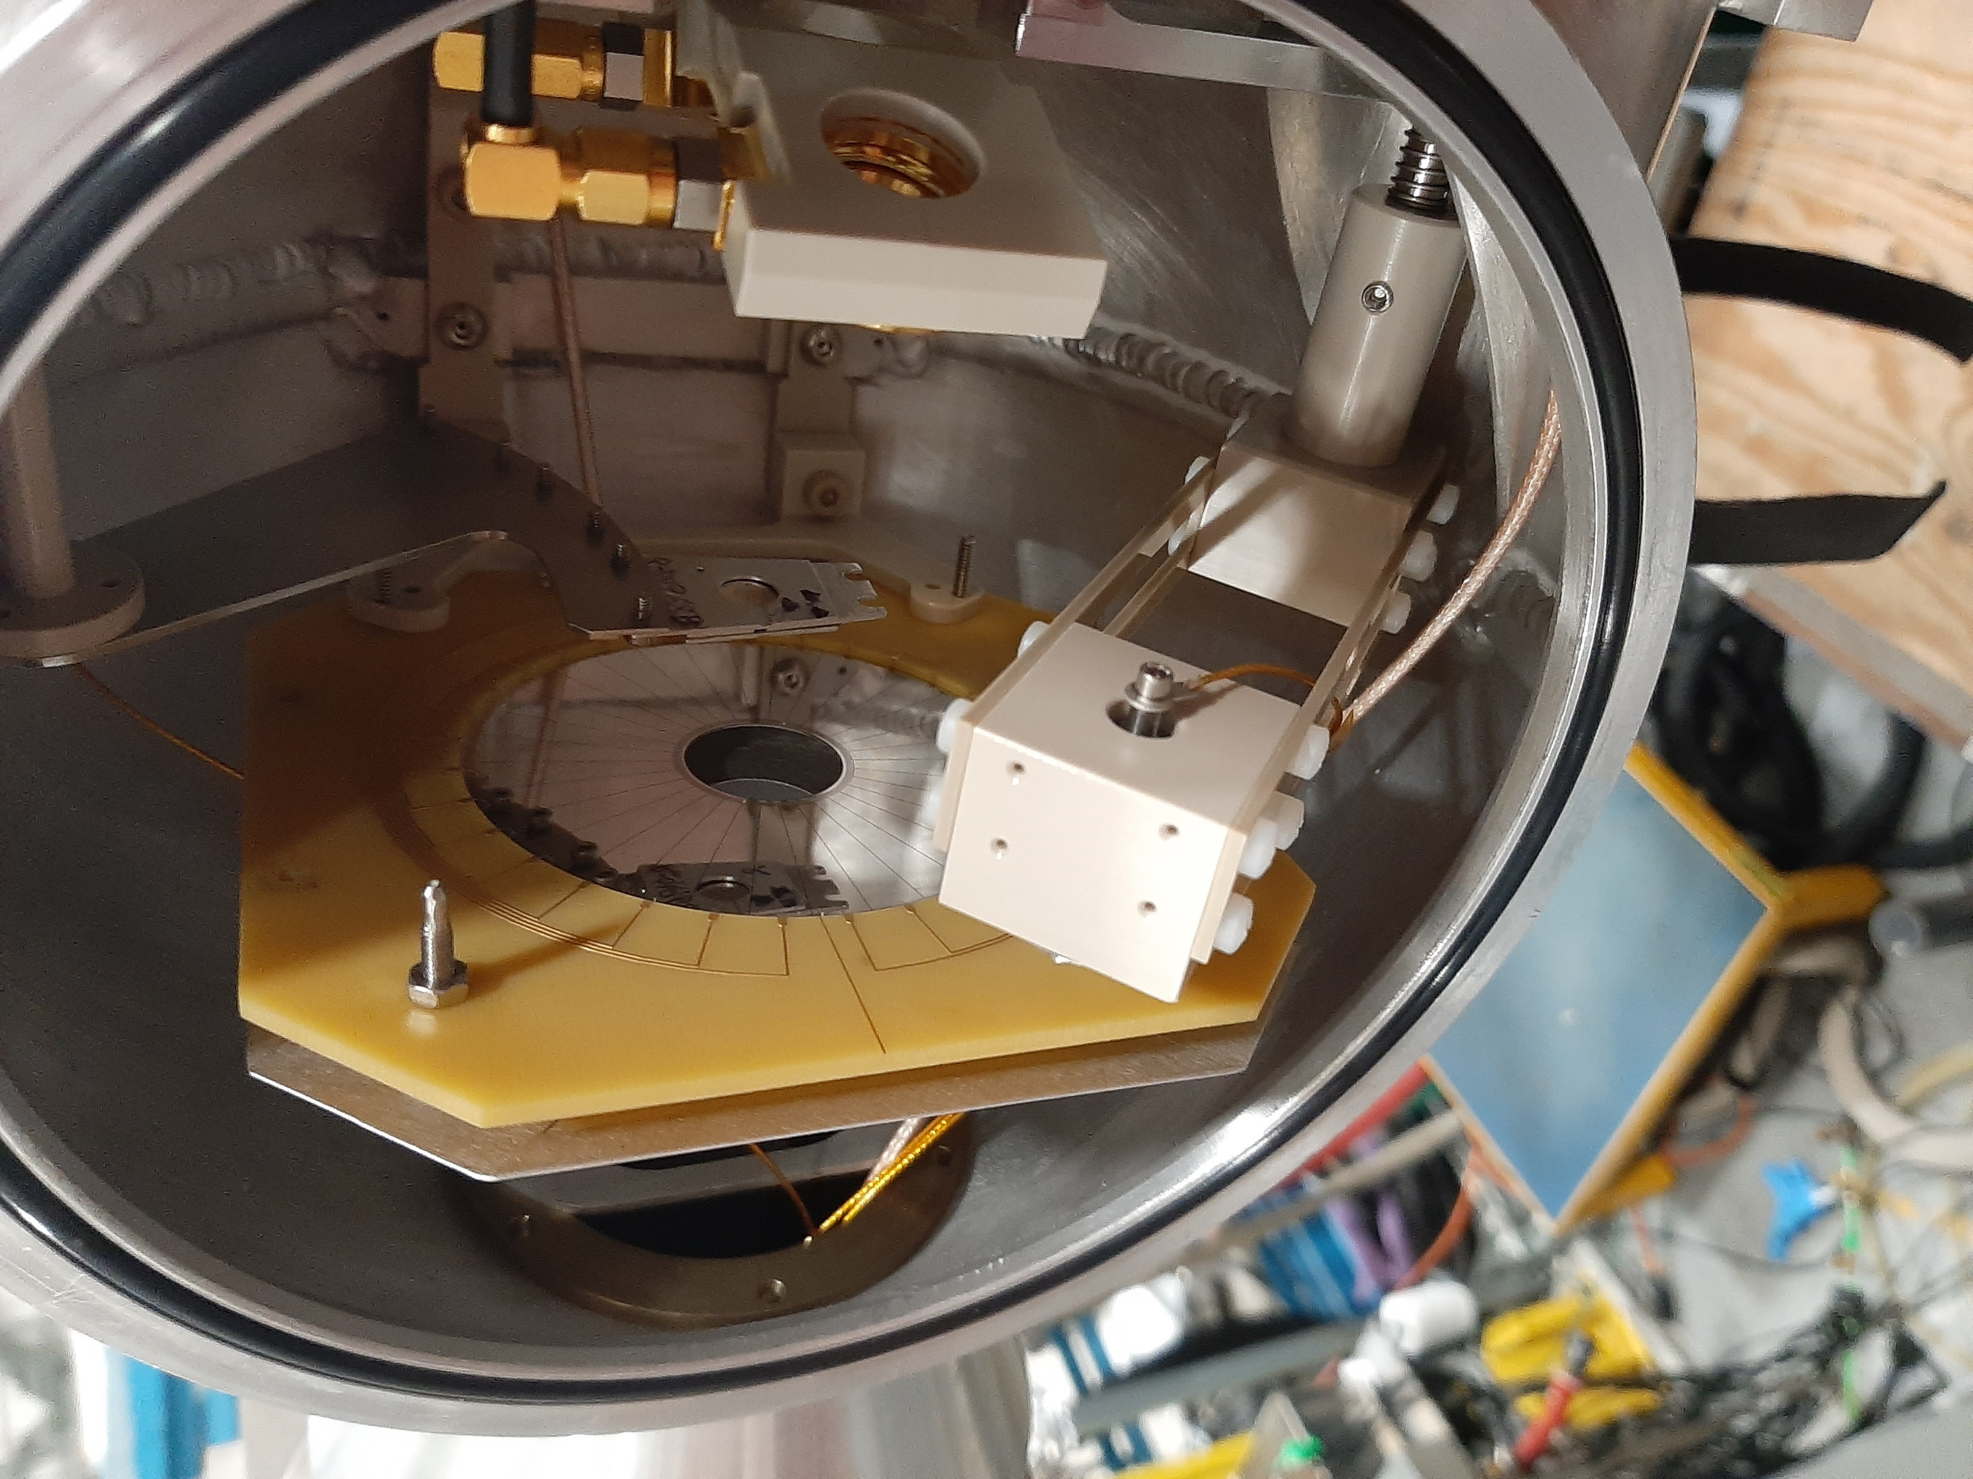
Experiment: Inverse Kinematics ²²Ne(⁷Li,t)²⁶Mg
²⁶Mg recoil identification:
EMMA mass spectrometer
²²Ne Beam
Gamma rays: TIGRESS 12- Clover Ge Gamma Spectrometer
Target
LiF
Beam
Light ejectiles (Tritons): Micron S3 silicon detector (24 rings, 32 sectors) at backwards lab angle 130 to 160 degrees
Winter Nuclear & Particle Physics Conference, Feb 12-15, 2026
Image credit: EMMA Collaboration, TIGRESS Collaboration
Notes:
Here’s the experiment set-up, 66MeV 22Ne beam are sent to react with the LiF target, gamma rays from the reactions are detected by the TIGRESS Ge array, the resulting recoils are sent through the EMMA mass spectrometer, which selects the recoils of interest – in this case the 26Mg. The tritons will be mapped by the Micron S3 silicon detector. By making coincidence measurements among 3 detectors we can hopefully identify the products from the alpha,gamma reaction.

Slide 7
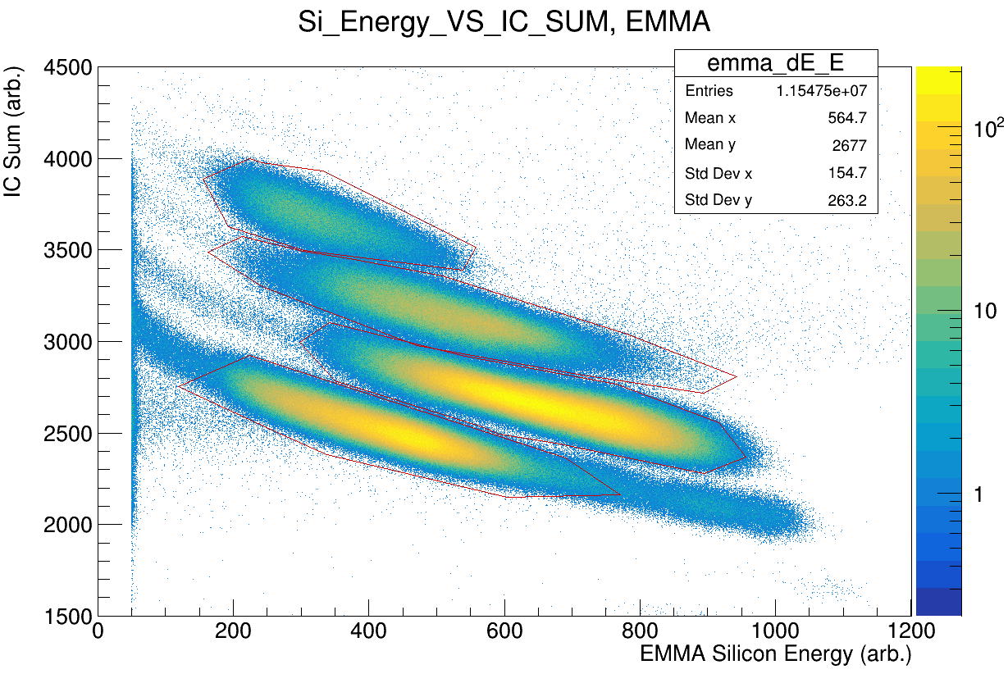
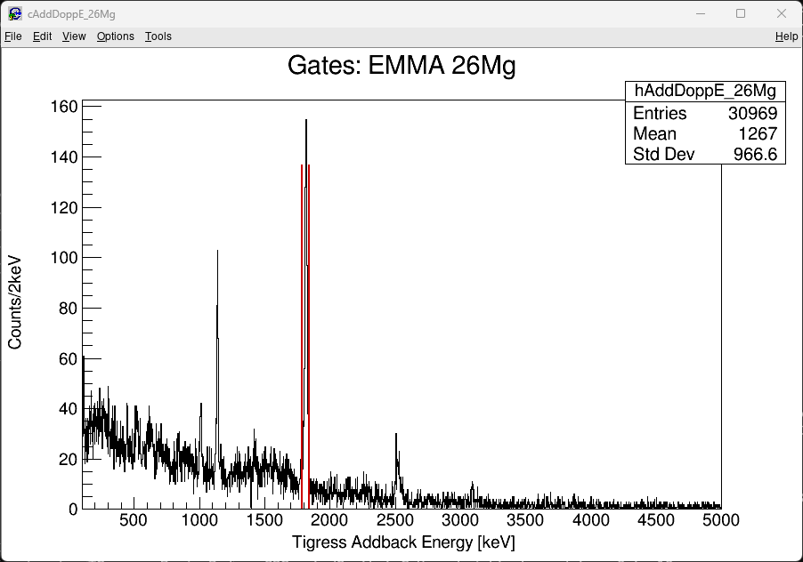
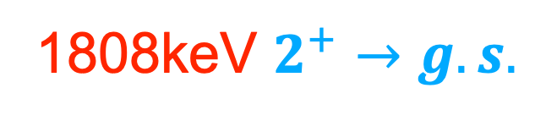
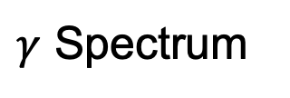
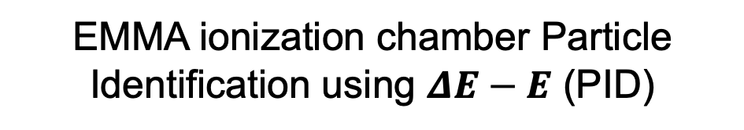
Preliminary Results:
EMMA ionization chamber Particle Identification using $ΔE−E$ (PID)
$γ$ Spectrum
1808keV $2^{+}→g.s.$
Al
Mg
Na
Ne
Counts
Energy [MeV]
Winter Nuclear & Particle Physics Conference, Feb 12-15, 2026
Notes:
And indeed we do! We have successfully identified different recoil clusters in the EMMA ionization chamber, in particular the Mg cluster, Gating on those events we observed the 1808keV transition which is characteristic of the the 2+ to gs transition in 26Mg. And on the left here we can see that the S3 is mostly in working order too besides one dead ring.

Slide 8
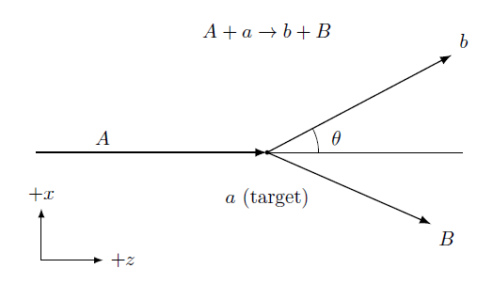
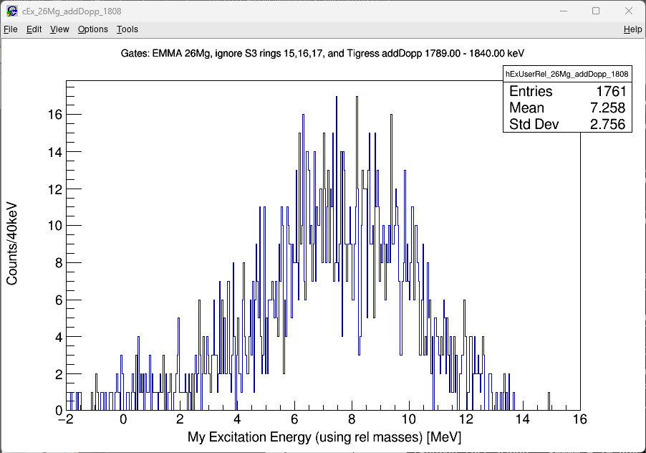
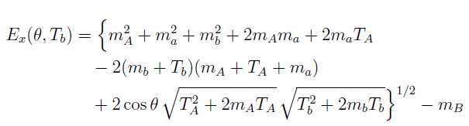

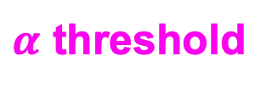

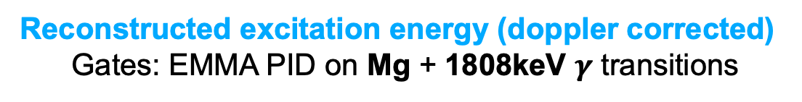
Excitation Energy
Reconstructed excitation energy (doppler corrected)
Gates: EMMA PID on Mg + 1808keV $γ$ transitions
Counts
No obvious peaks resolved…
$n$ threshold
Relativistic two-body kinematics
$α$ threshold
$$(c=1)$$
Excitation Energy[MeV]
Winter Nuclear & Particle Physics Conference, Feb 12-15, 2026
Notes:
Ultimately we want to reconstruct the excitation energy spectrum from the data. We can relate the excitation energy of the recoil to the angle and energy of the tritons and arrive at this expression here. On the right tis the reconstructed spectrum by gating on the Mg events that have the1808keV transition. And…. Unfortunately we do not see a darn thing above the alpha threshold. Oh well…

Slide 9
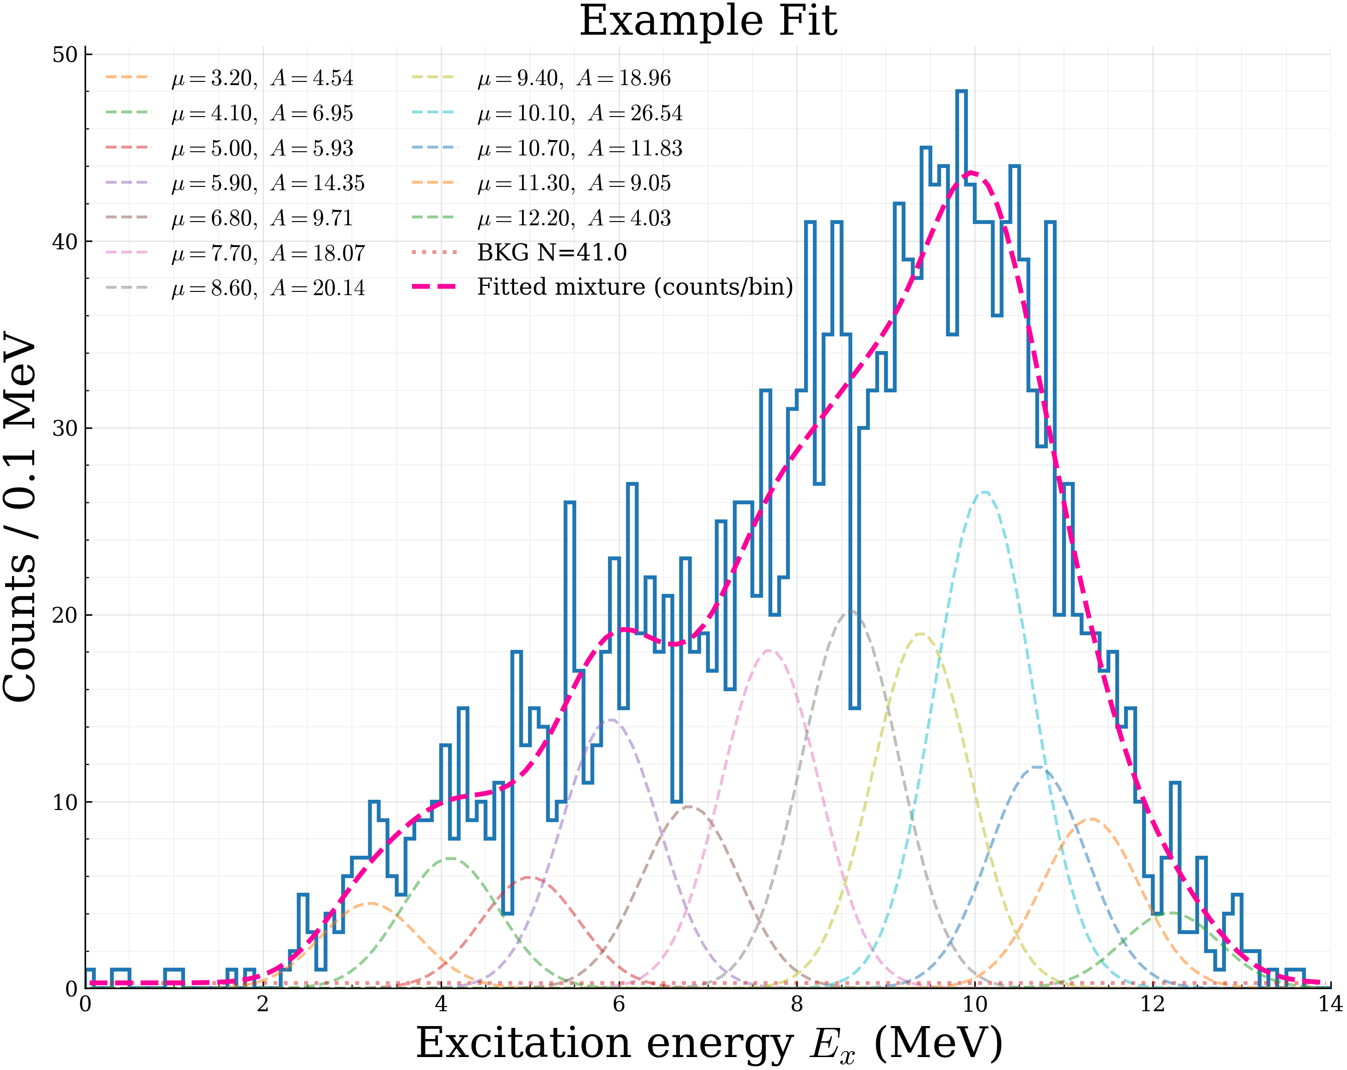
  What now?
We need know the contribution from each state – very difficult from the data
Monte Carlo simulation needed
for different excited states
Fit the sum of individual states to the excitation energy spectrum
Winter Nuclear & Particle Physics Conference, Feb 12-15, 2026
Notes:
So unfortunately I still want to get a degree and realized that one way around it is to resort to monte carlo simualtions. If I can run the simulation for each known excitated state and reconstruct the excitation energy spectrum for each one of them. I can fit the overall spectrum as a sum of the individual excitation energy distribution.

Slide 10
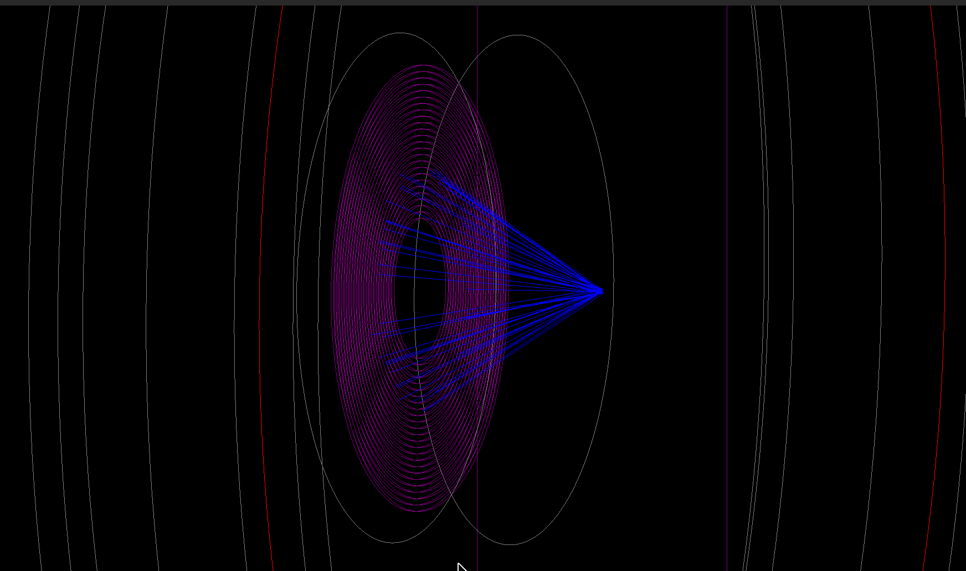
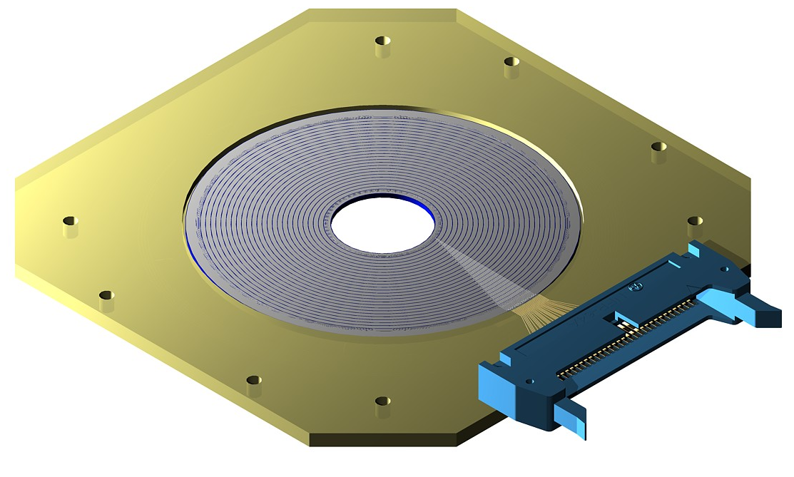
Construct the Experiment Simulation
Beam Energy: $66 MeV$ Target: $6.066 μm$ LiF with $0.225 μm$ Carbon backing
Tracked Tritons
Target
Beam
Reaction points
Randomly sampled
S3 Detector in GEANT4
S3 Detector
Winter Nuclear & Particle Physics Conference, Feb 12-15, 2026
Notes:
I then built the experiment in the simulation, here you can see the simulated S3 detector and the tritons after the reaction. Once I have everything set-up, I can run the experiment in the virtual world!

Slide 11
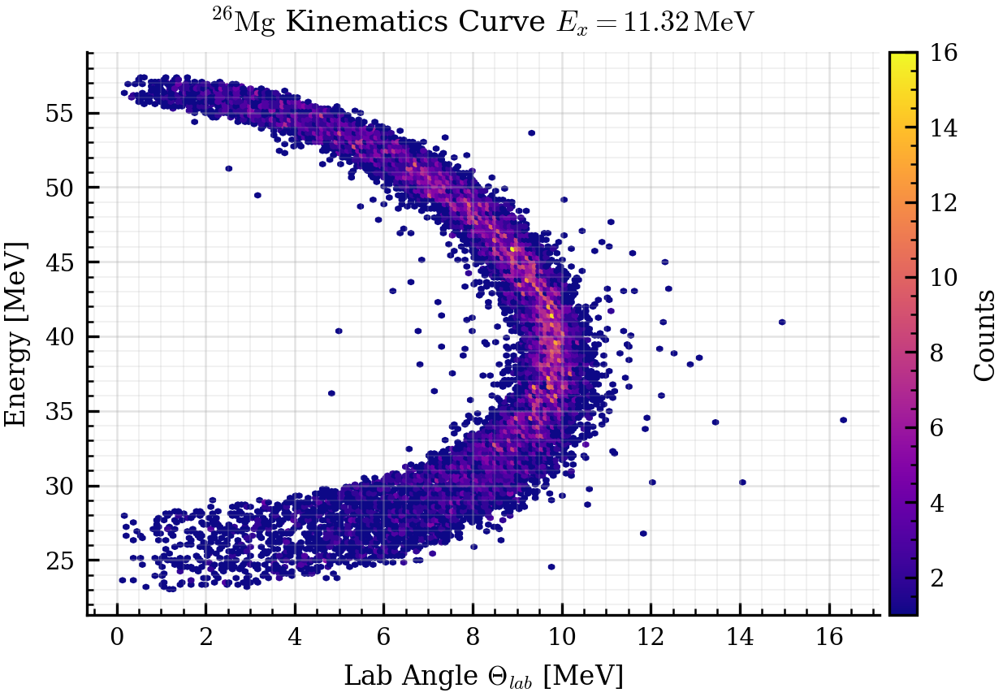
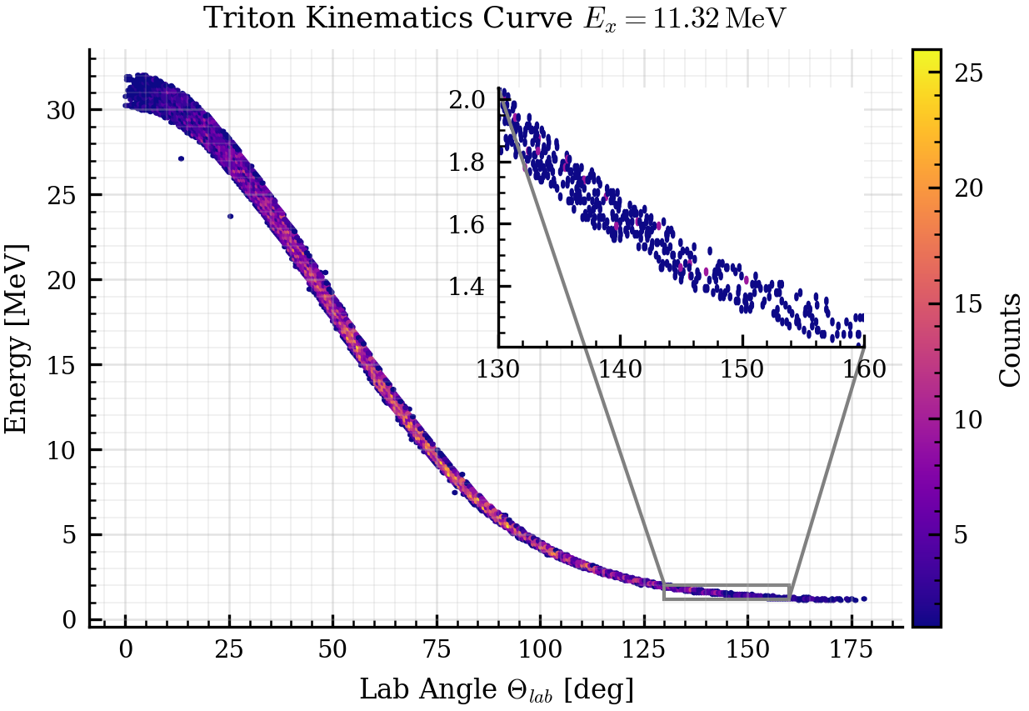
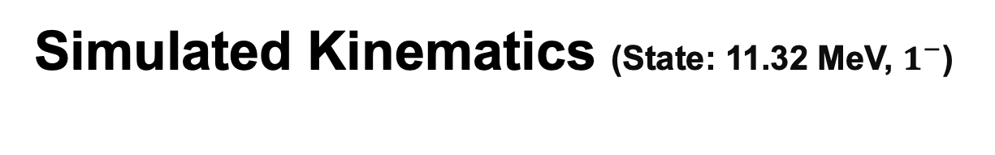
Simulated Kinematics (State: 11.32 MeV, $1^{−}$)
S3 Coverage
Double-valued due to the C.M. to Lab frame boost
for the heavy recoils
Winter Nuclear & Particle Physics Conference, Feb 12-15, 2026
Notes:
The first thing I looked at was the kinematics curves. On the left is the kinematics for the 26Mg recoil and on the right is that for the tritons. Explain the double value..

Slide 12
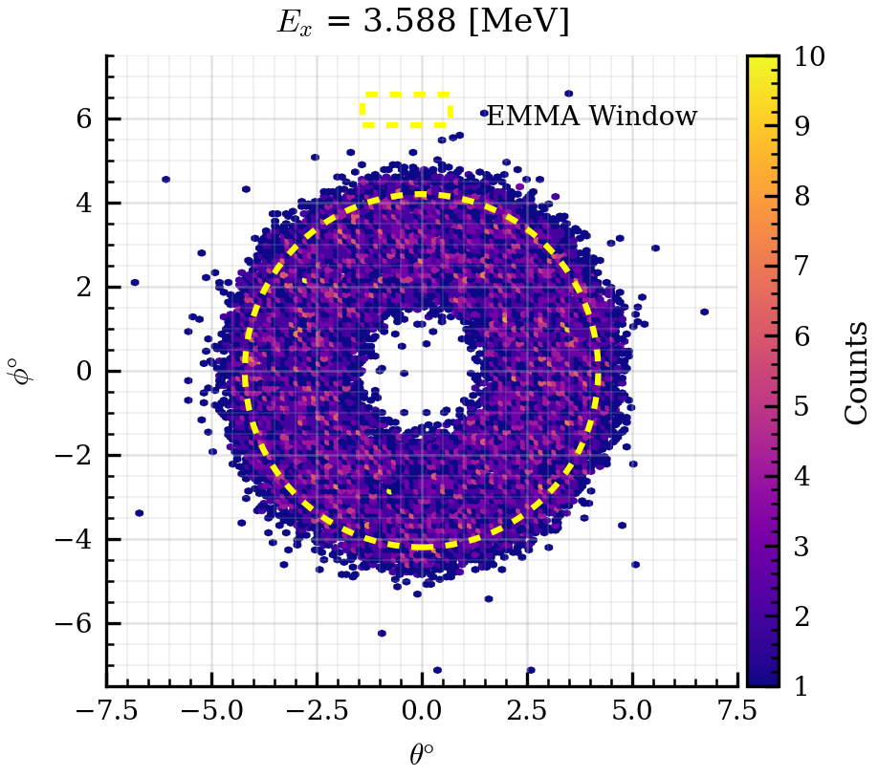
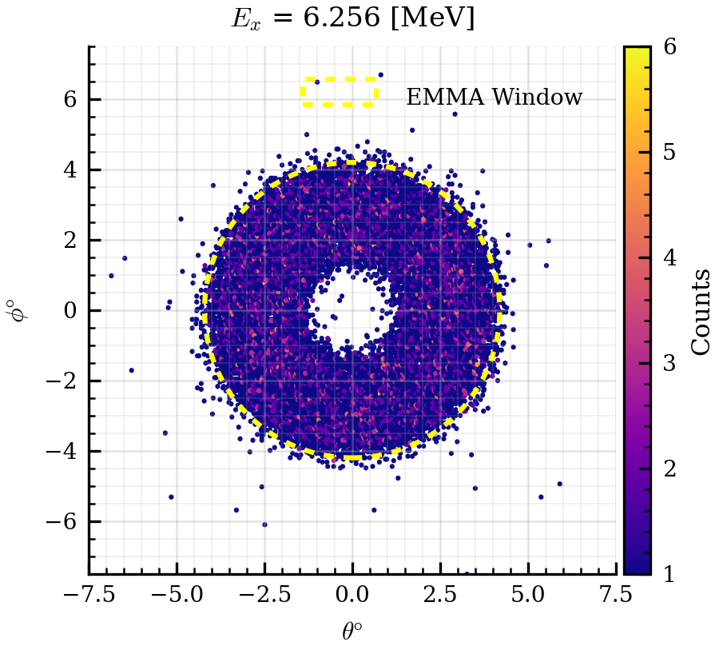
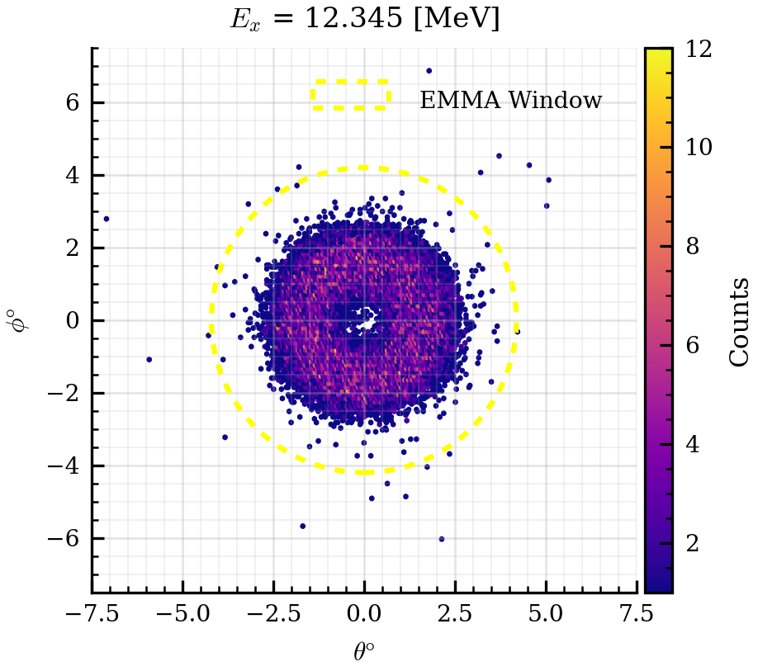




Recoil (²⁶Mg) Distributions
Triton angle $Θ∈\left[130°, 160°\right]$
$E_{x}=3.588 MeV$
$$E_{x}=6.625 MeV$$
$$E_{x}=12.345 MeV$$
Transmission efficiency differs for different states:
Monte Carlo calculation for each state correct for transmission efficiency (ongoing)
Winter Nuclear & Particle Physics Conference, Feb 12-15, 2026
Notes:
We can also look at the recoil distribution that correspond to tritons emitted at different angles, on the left is the distribution of the 26mg recoil corresponding to the tritons hitting the S3 and on the right it shows the 26Mg corresponding the tritons hitting one particular ring.

Slide 13
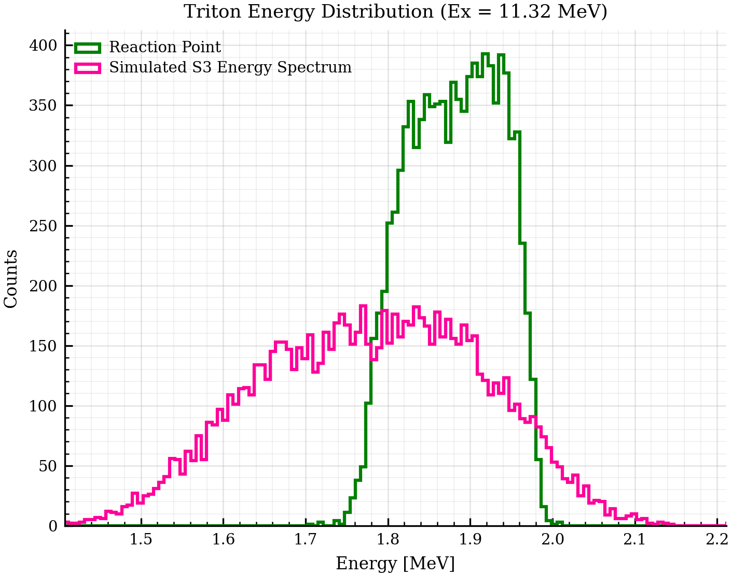
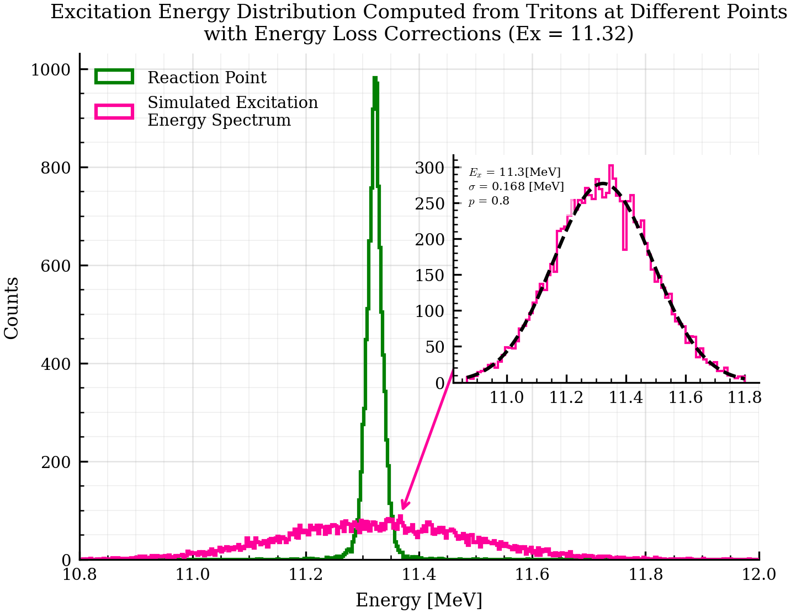
Excitation Energy Reconstruction (11.32 MeV, $1^{−}$ )
Straggling +
Resolution
Winter Nuclear & Particle Physics Conference, Feb 12-15, 2026
Notes:
Here if we look at the inset, that is the simulated excitation energy reconstruction with detector resolution. We can see that the fit tells us the centers and widths of the gaussian. Now we just need to do this for every state of interest and fit the sum of them to the overall spectrum!

Slide 14
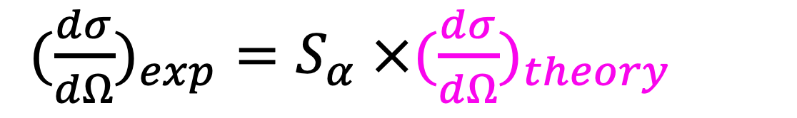
Summary and Future Work
We were able to identify the ²⁶Mg recoils and reconstruct the excitation energies
Monte Carlo methods are needed for fitting the contribution of each state and accounting for EMMA transmission efficiency
Reaction model calculations are needed to model the angular distribution of each state
${(\frac{dσ}{dΩ})}_{exp}$ $=S_{α} ×{(\frac{dσ}{dΩ})}_{theory}$
Winter Nuclear & Particle Physics Conference, Feb 12-15, 2026

Slide 15
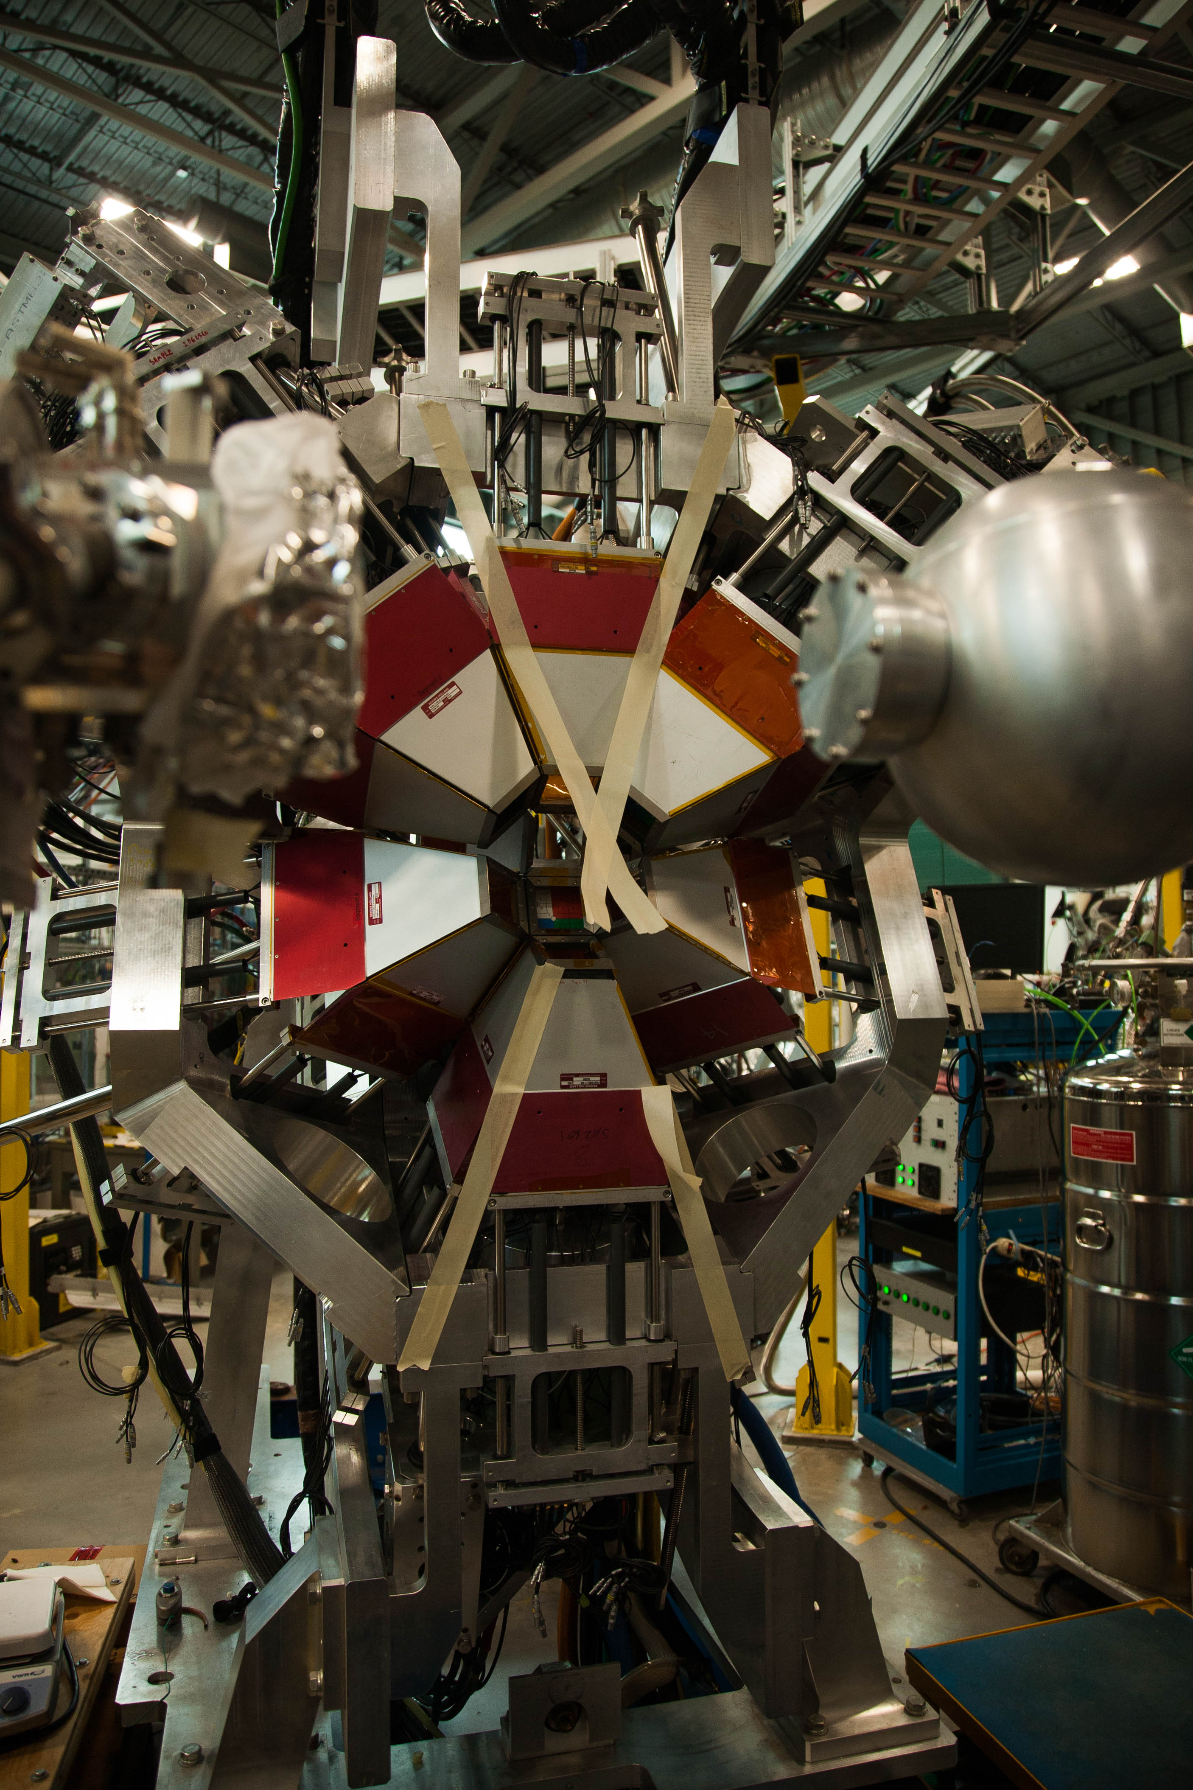
Special thanks to:
Dr. Barry Davids
Dr. Cameron Angus
Dr. Thomas Chillery
…and YOU!

Slide 16

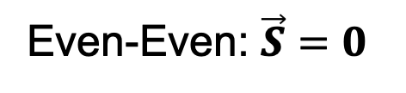
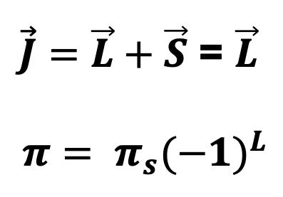
Which states are we expecting to populate?
²²Ne + $α →$ ²⁶Mg*
$\vec{J}=\vec{L}+\vec{S}$ = $\vec{L}$
$$π= π_{s}{(−1)}^{L}$$
Even-Even: $\vec{S}=0$
We populate the natural parity states: $J^{π}= 0^{+},1^{−},2^{+},3^{−},4^{+}……$
Winter Nuclear & Particle Physics Conference, Feb 12-15, 2026

Slide 17
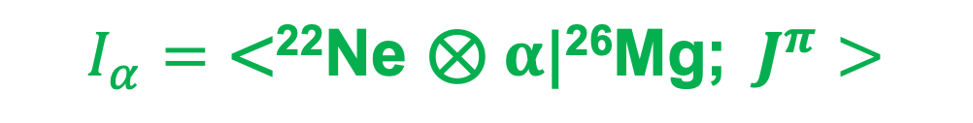


Spectroscopic Factors
A measure of the overlap between the ²²Ne + $α$ and ²⁶Mg wavefunctions.
$\text{|}\text{22}\text{Ne}\text{; }I^{π}>\text{⊗}$ $\text{|}α\text{;}{ 0}^{+}>$
$$\text{|}\text{2}\text{6}\text{Mg}\text{;}{ J}^{π}>$$
$$I_{α}$$
”Overlap”
$$I_{α}=\text{<}\text{22}\text{Ne} \text{⊗} α\text{|}\text{2}\text{6}\text{Mg}\text{;}{ J}^{π}>$$
Winter Nuclear & Particle Physics Conference, Feb 12-15, 2026

Slide 18
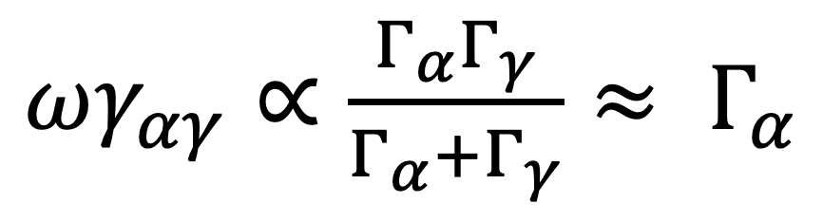
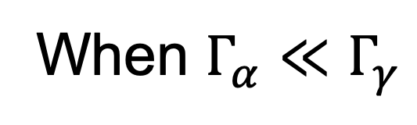
Resonance Strengths
$ωγ_{αγ}∝\frac{Γ_{α}Γ_{γ}}{Γ_{α}+Γ_{γ}}$ $≈ Γ_{α}$
When $Γ_{α}≪Γ_{γ}$
Dominated by the Alpha widths
Winter Nuclear & Particle Physics Conference, Feb 12-15, 2026

Slide 19
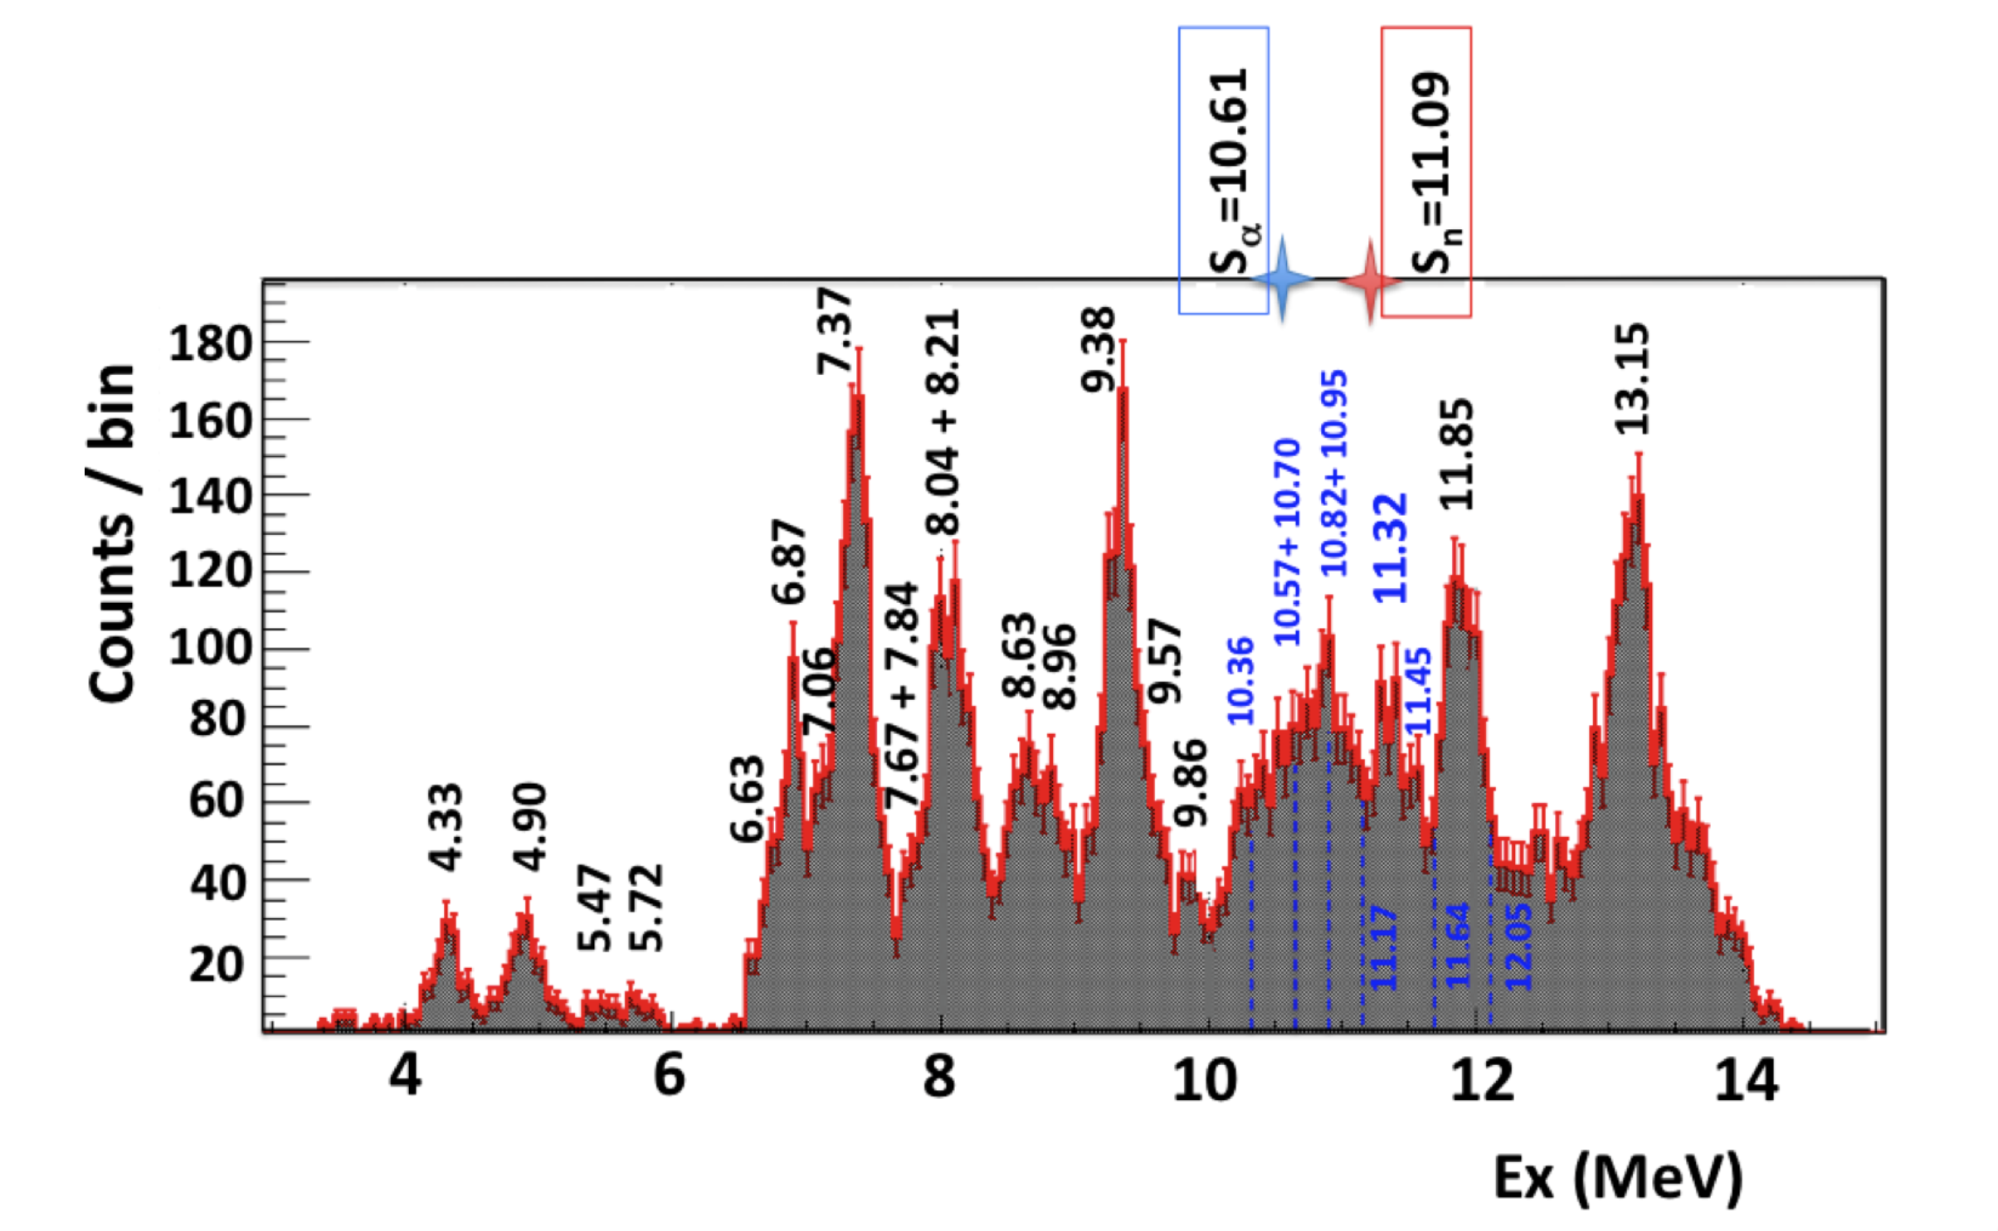
Excited Sates
Winter Nuclear & Particle Physics Conference, Feb 12-15, 2026
Ota et al. (6Li, d) and (6Li, t) reactions on 22Ne and implications for s-process nucleosynthesis

