Slide 1
DLC guides for the TUCAN experiment
WNPPC 12 Feb 2026
Abeer Zahra
University of Manitoba, Canada
Supervisor: Dr. Russell Mammei

Slide 2

Content
TUCAN experiment
Guide coating facility
Components of the coating
Guide tests at TRIUMF
Future optimization
This work builds on a collaborative milestone: the TUCAN team’s world-leading ultracold neutron production!
Notes:
Go faster

Slide 3

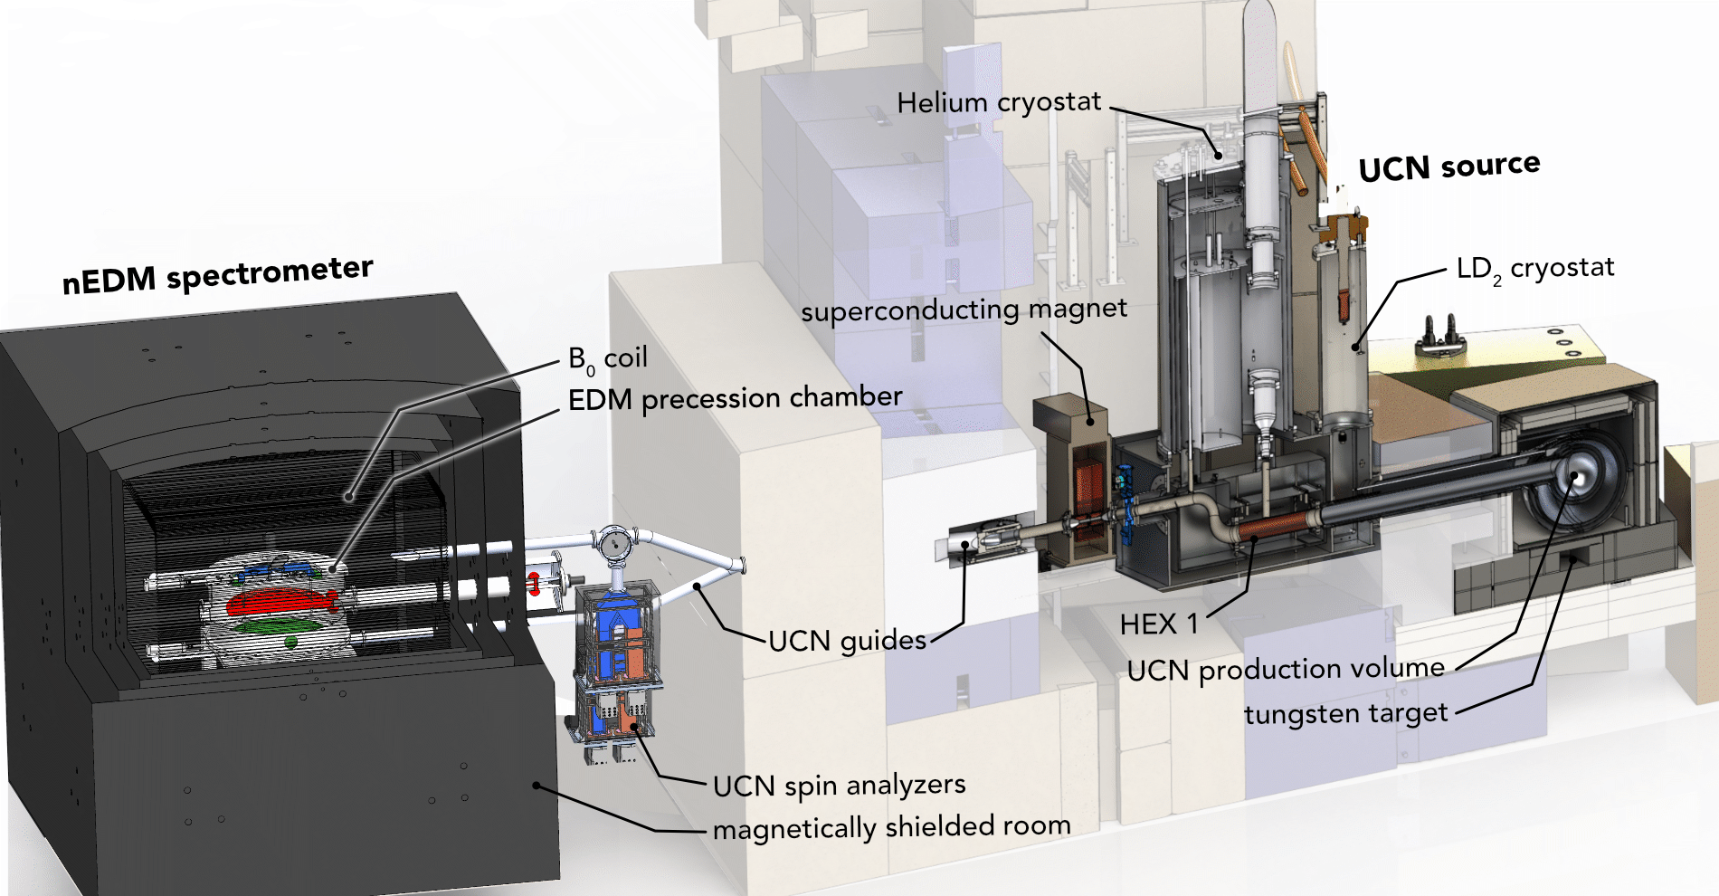
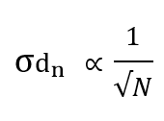
TUCAN EDM experiment
Statistical Uncertainty:

Slide 4
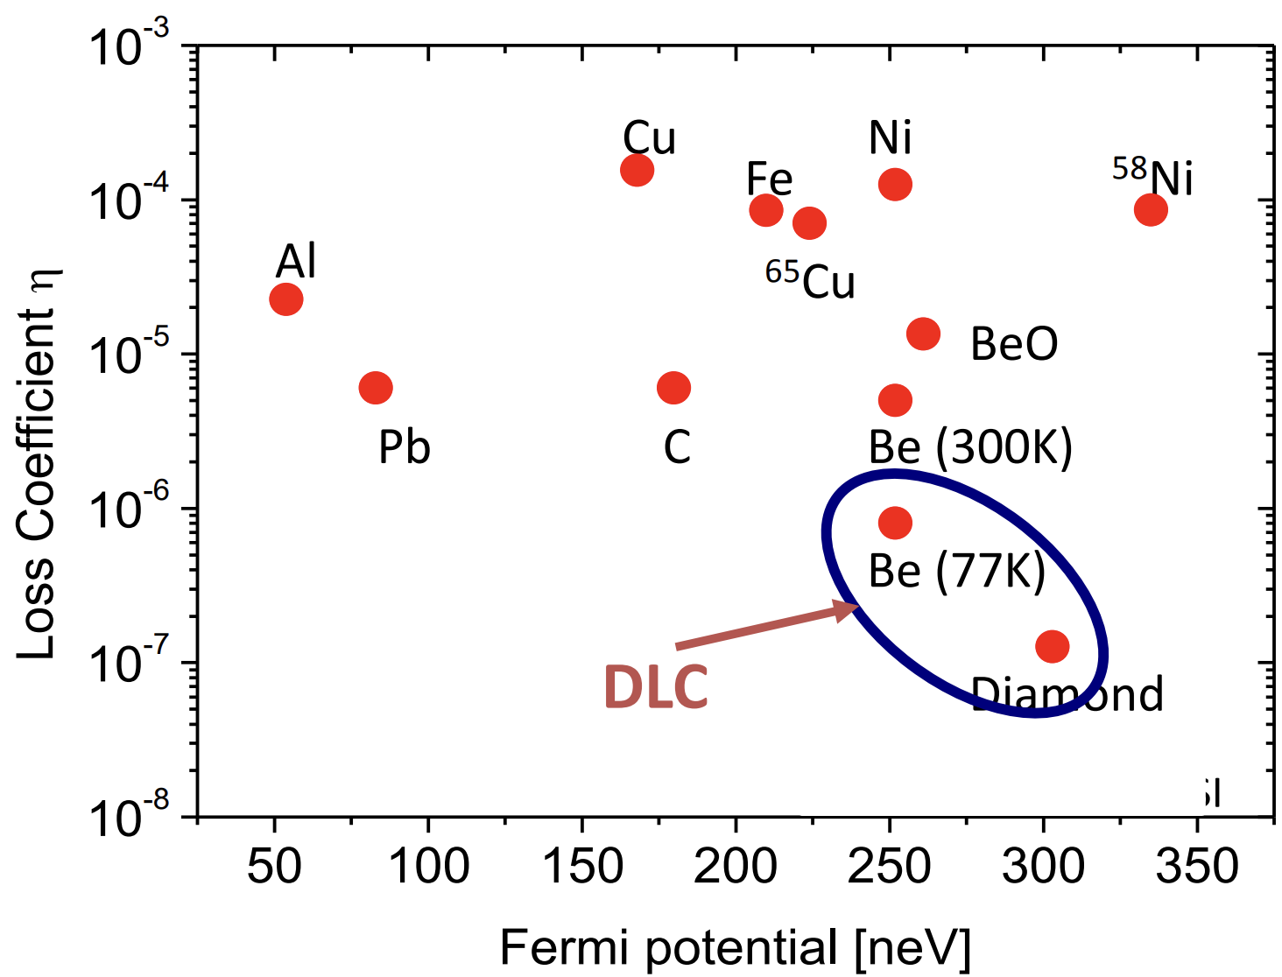
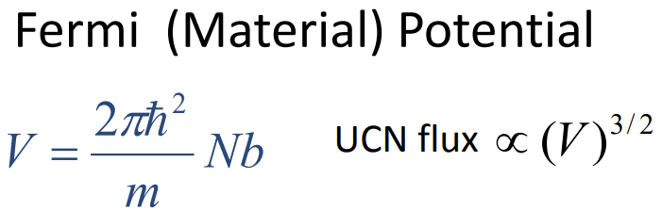
Graph of loss per bounce versus fermi potential
where,
V- Fermi potential
m- mass of the neutron
N- No. density of nuclei of material (no. of nuclei/unit vol.)
b- scattering length (strength of interaction b/w neutron & material nuclei)
UCN flux- No. of UCNs/unit area/unit time
Figure adapted from: R. Golub et al., Ultra-Cold Neutrons (1991); M. Ito et al., Phys. Rev. C 96, 035205 (2017)
‹#›
Notes:
https://www.ncnr.nist.gov/resources/n-lengths/
how “hard” a surface looks to an ultracold neutron.
-If the neutron’s energy is lower than this potential, it reflects
-If the energy is higher, it enters the material and is lost

Slide 5
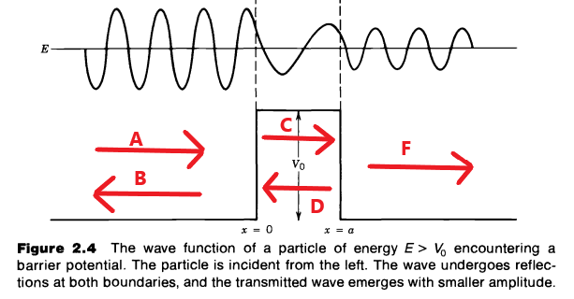
UCN energy vs guide wall barrier
Region A: Incoming UCNs
UCNs traveling in the guide
Energy spectrum: E ≤ 300 neV
Region D: Quantum penetration (loss)
For E < V_{F}, UCNs behave as waves normal to the wall (1D)
Wavefunction penetrates a few nm into the coating →
absorption / upscattering due to H, defects, roughness, Ti/DLC interfaces→ gradual (tunneling-related) loss
Region B: Reflected UCNs (good, no loss)
Condition: E < V_{F} ≈ 250 neV
Region C: DLC
Ti–DLC
Optical (Fermi) potential: V_{F} ≈ 230–250 neV
Region F: High-energy tail (fast loss)
Condition: E ≥ V_{F}
UCNs directly enter the coating → prompt loss
Adapted from D. J. Griffiths, Introduction to Quantum Mechanics (2nd ed.)

Slide 6
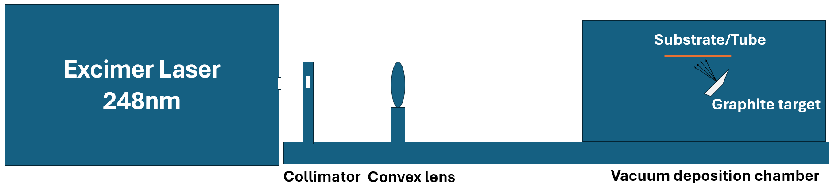
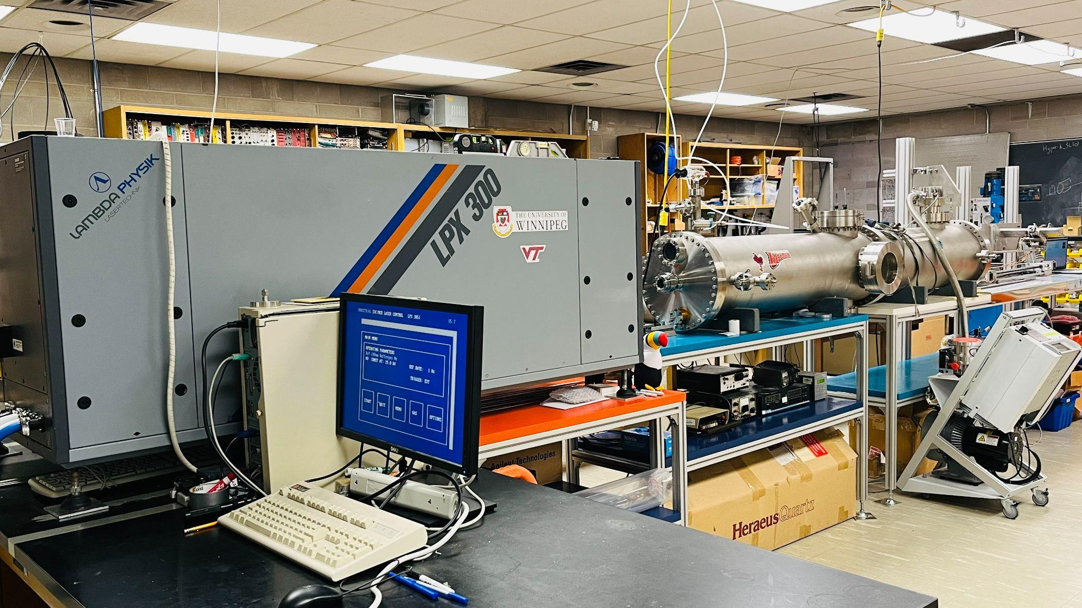
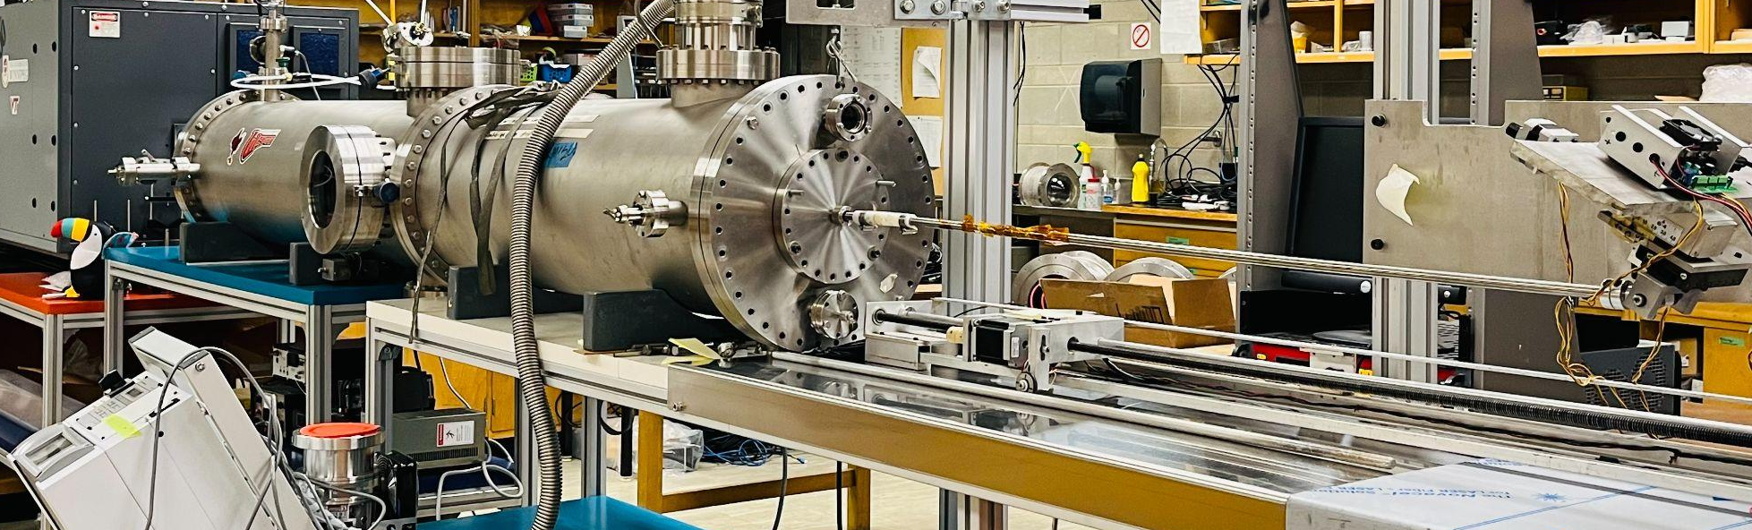
Pulsed Laser Deposition Facility at University of Winnipeg
https://arxiv.org/abs/2510.06289
‹#›

Slide 7
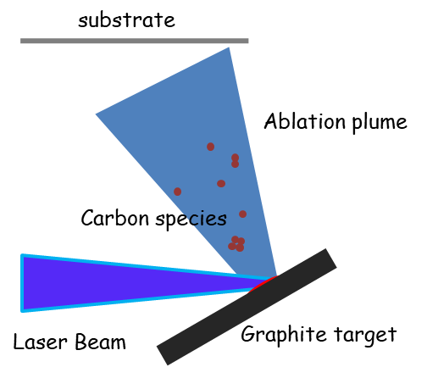
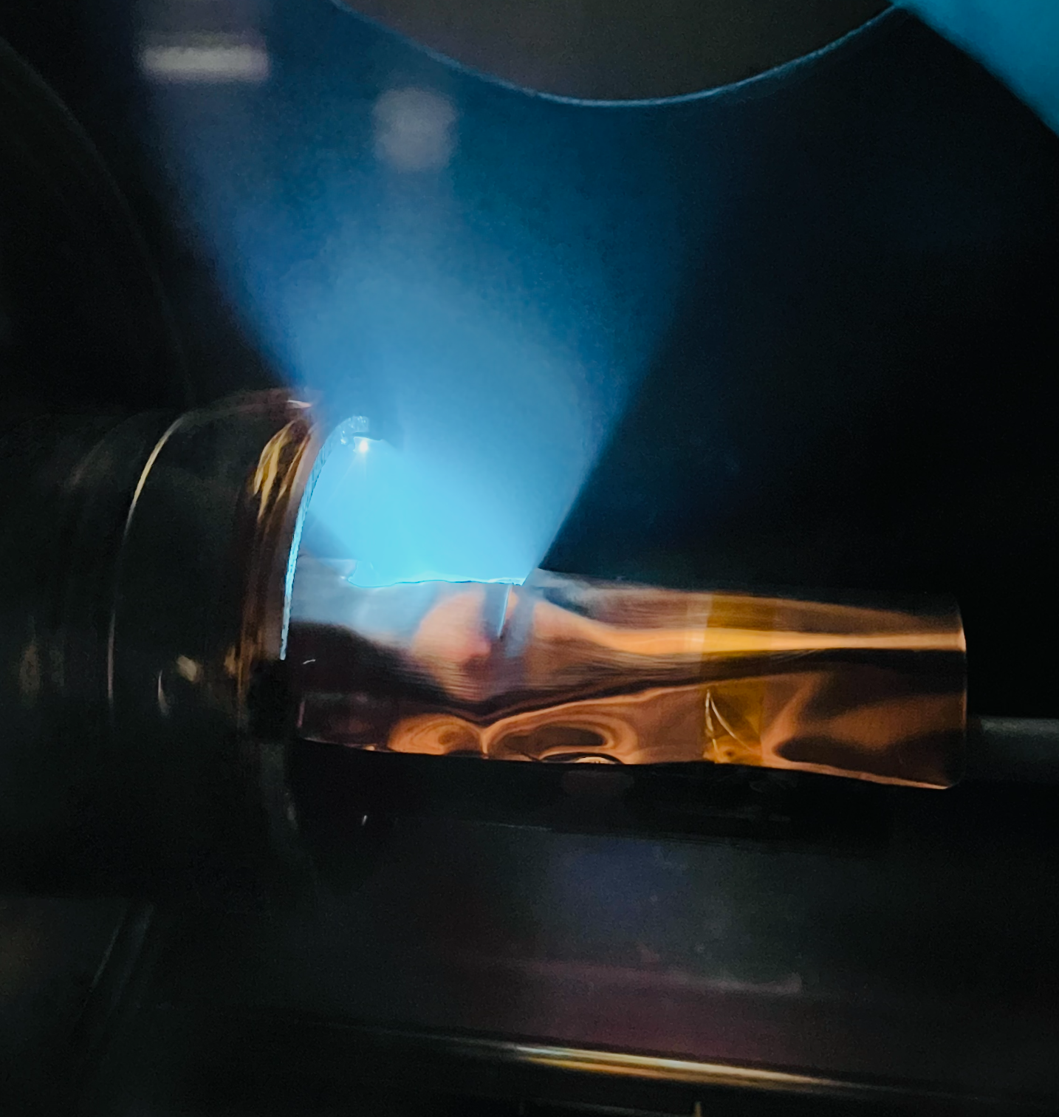
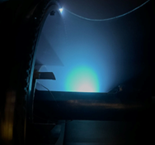
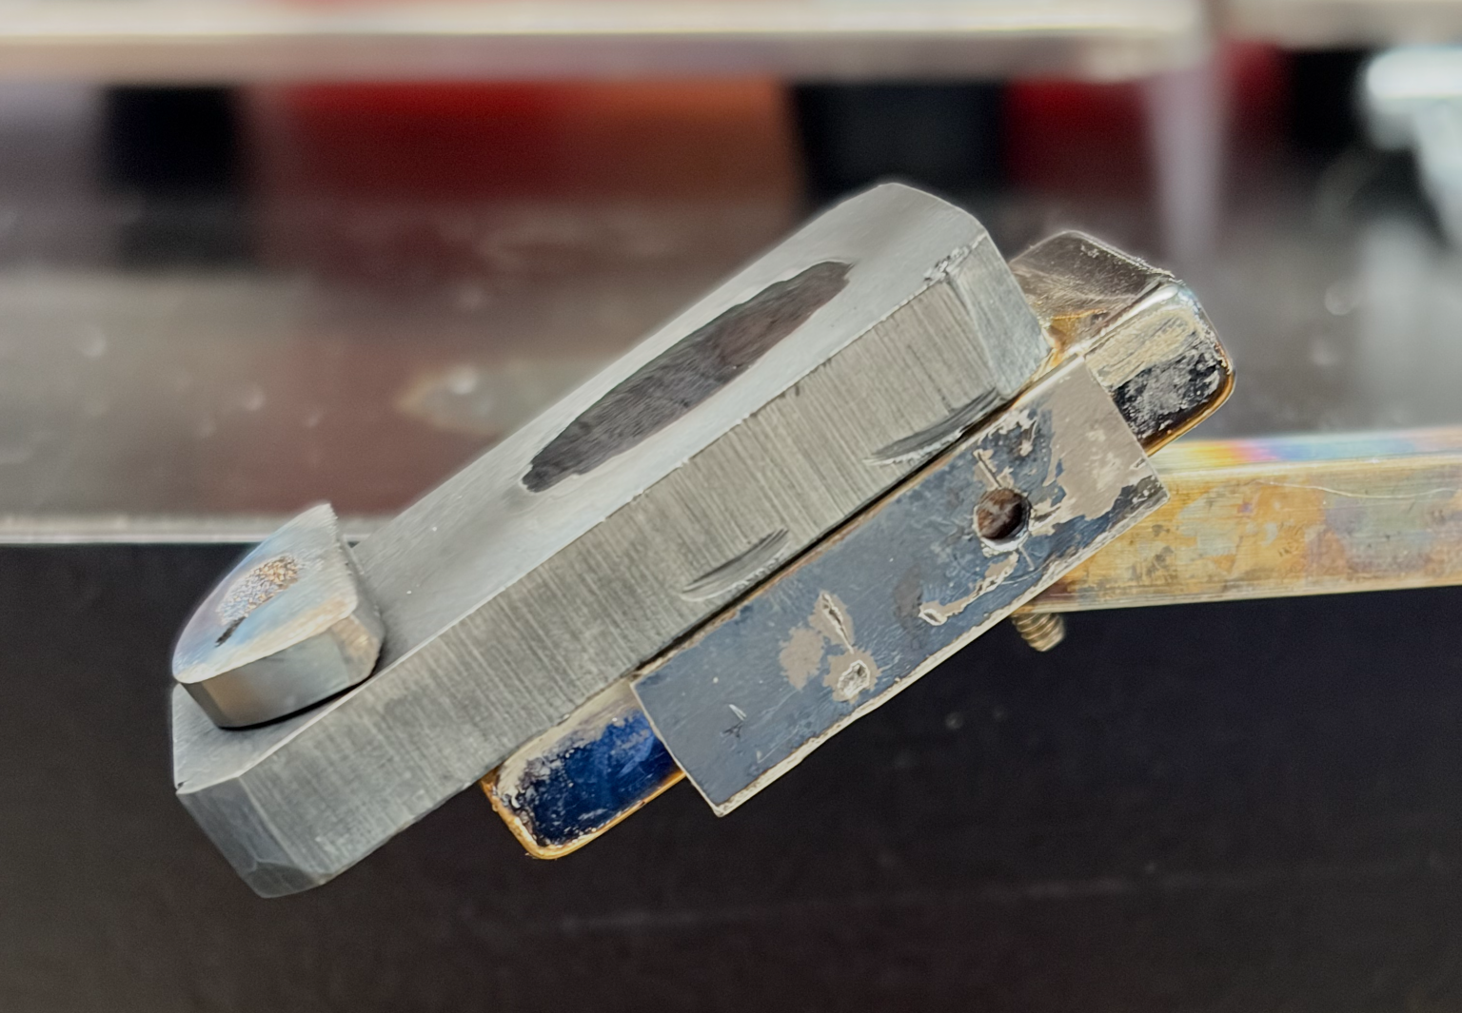
Excimer laser 248nm
-HV discharge creates meta-stable KrF dimer.
-A KrF dimer relaxes, emitting a UV photon which stimulates the other dimers to emit a UV photo too.
-Produces ~1J/pulse of 248 nm light.
‹#›
Real carbon plasma plume
Graphite target with holder

Slide 8
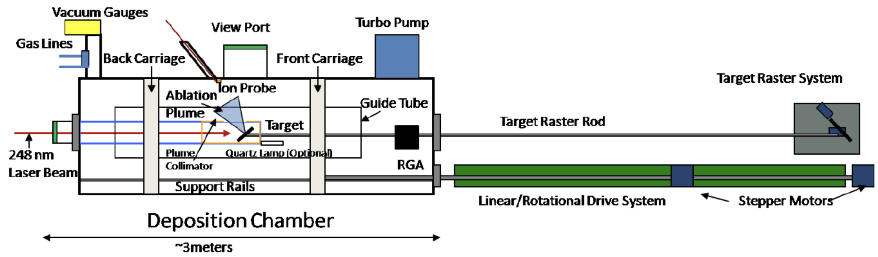
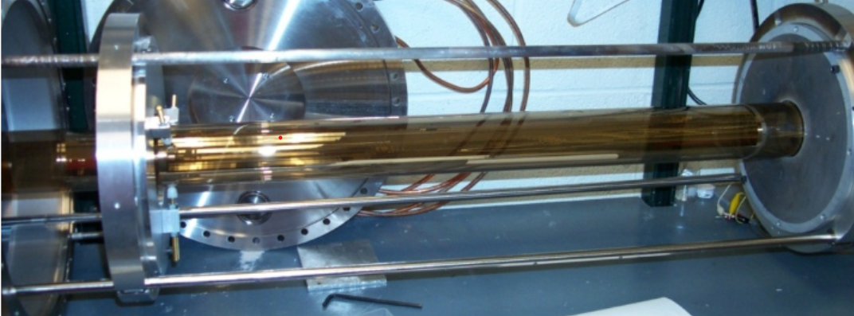
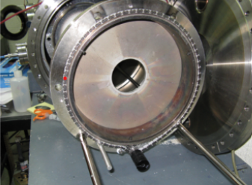
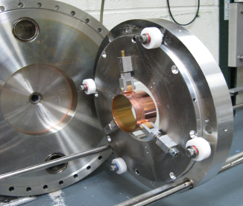
Tube coating chamber
Translation: linear bearings/shafts
Rotation: Chain driven rotational bearing
‹#›
Carriage system
Front carriage
Back carriage

Slide 9
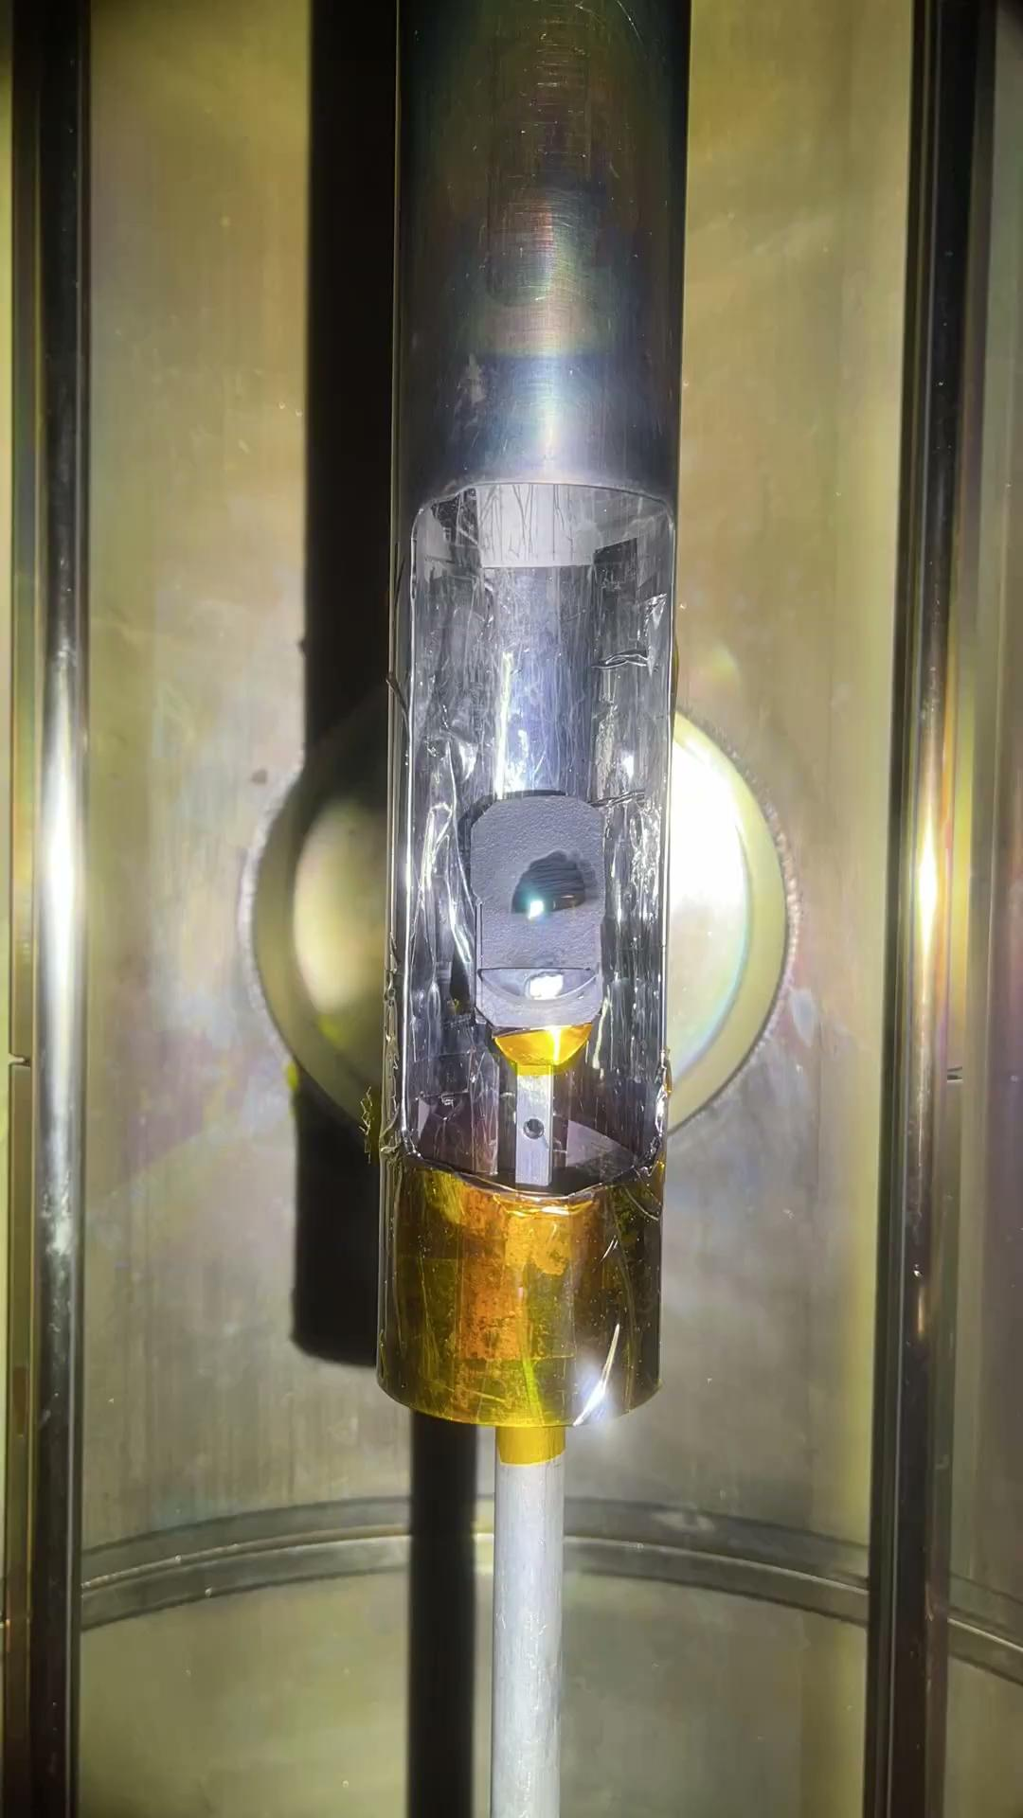
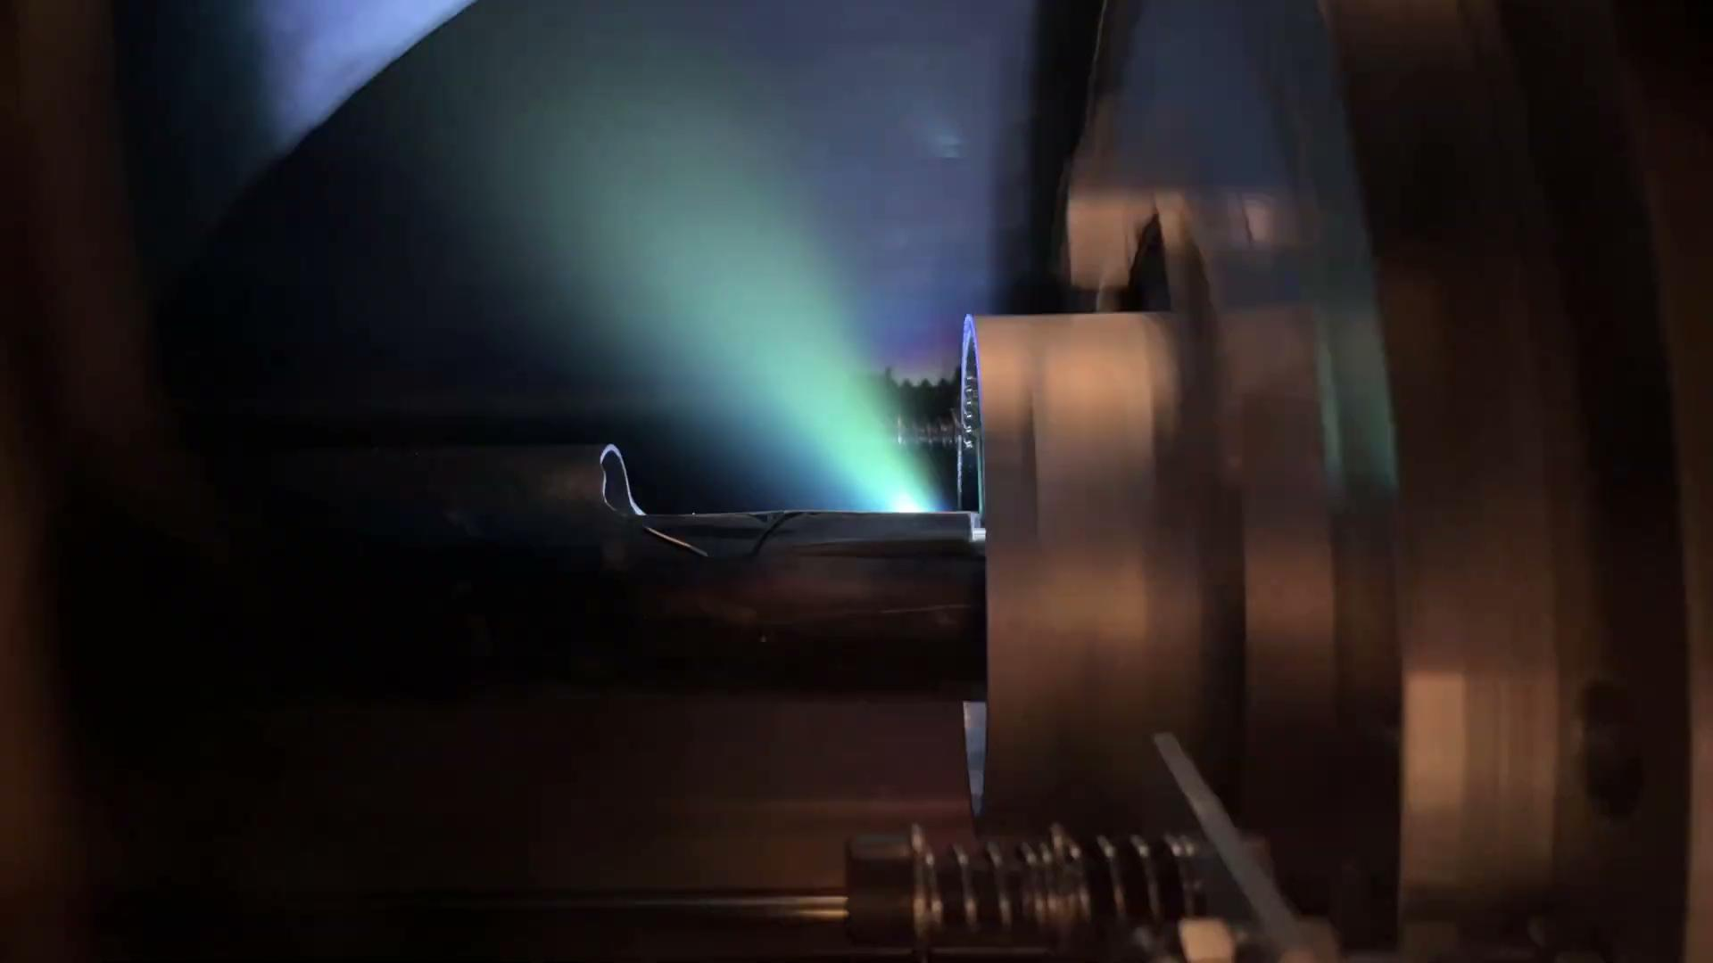
Pulsed Laser Deposition of DLC inside vacuum chamber

Slide 10
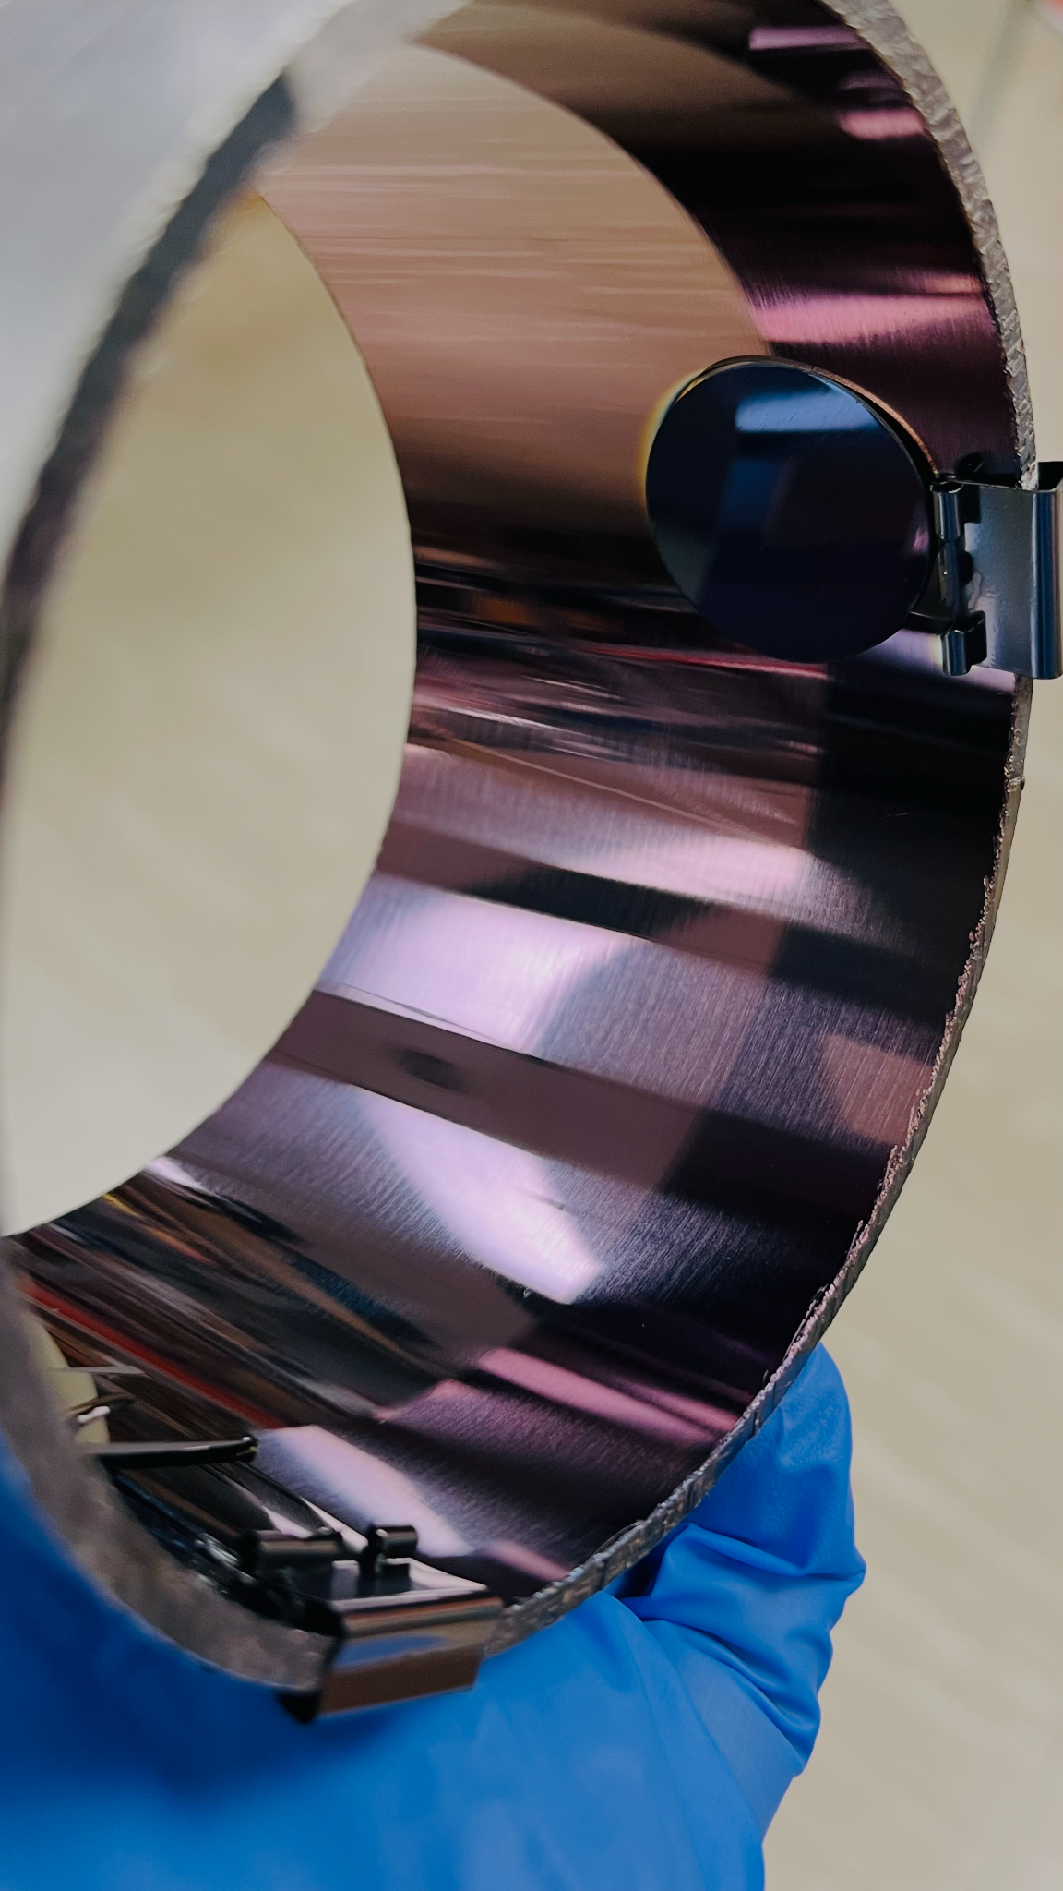
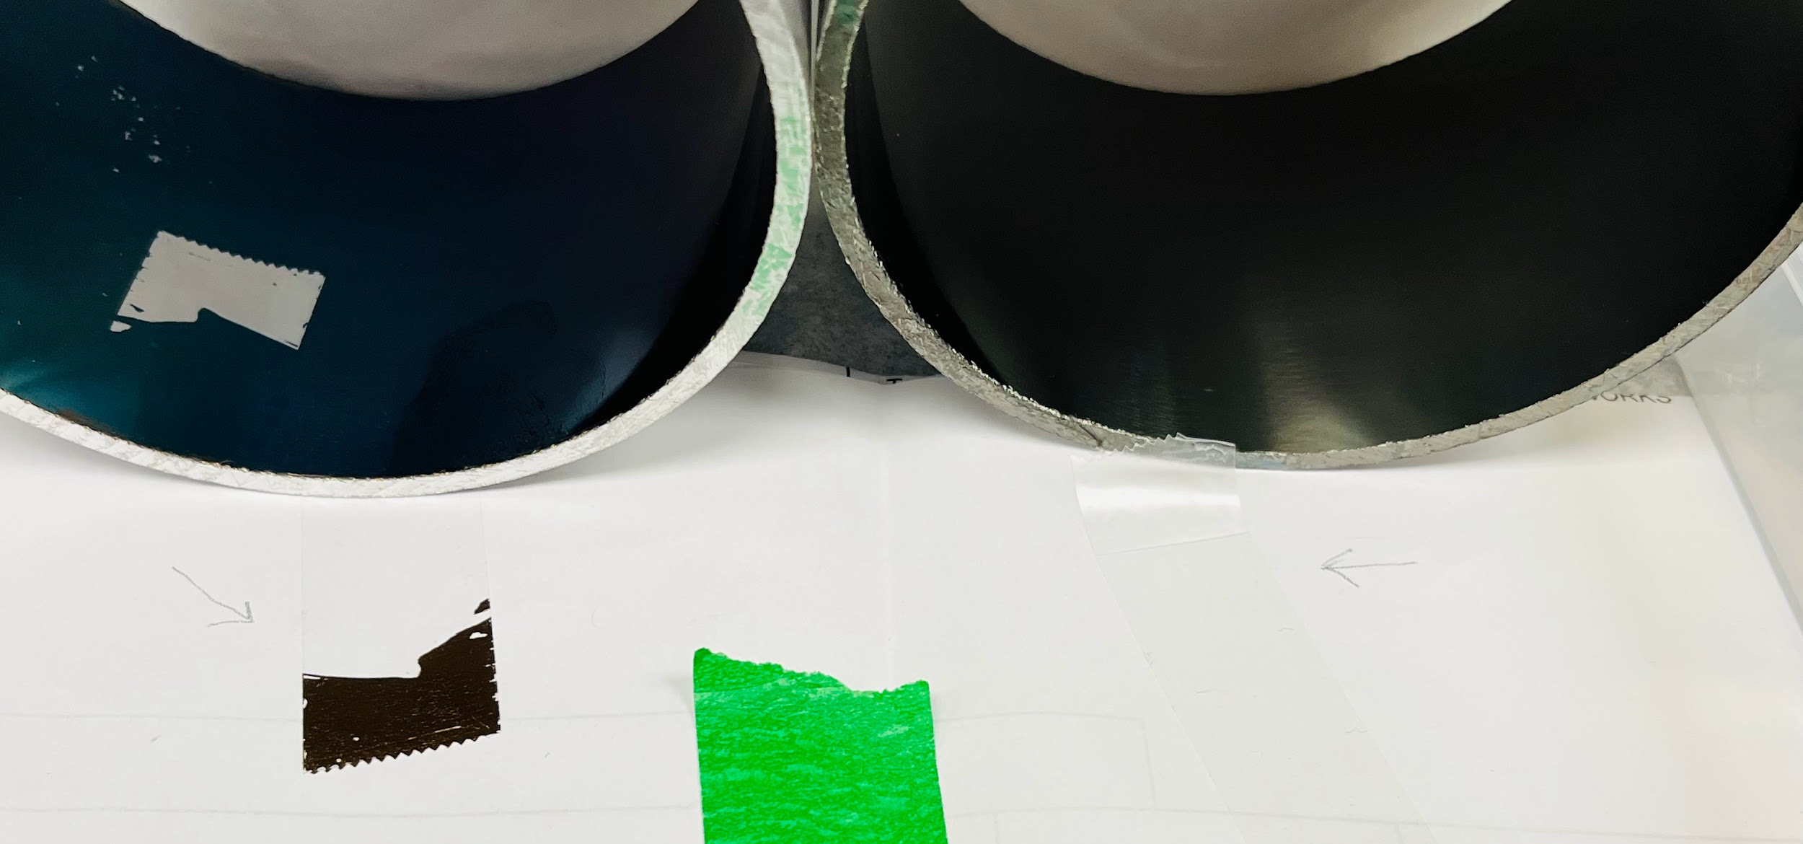
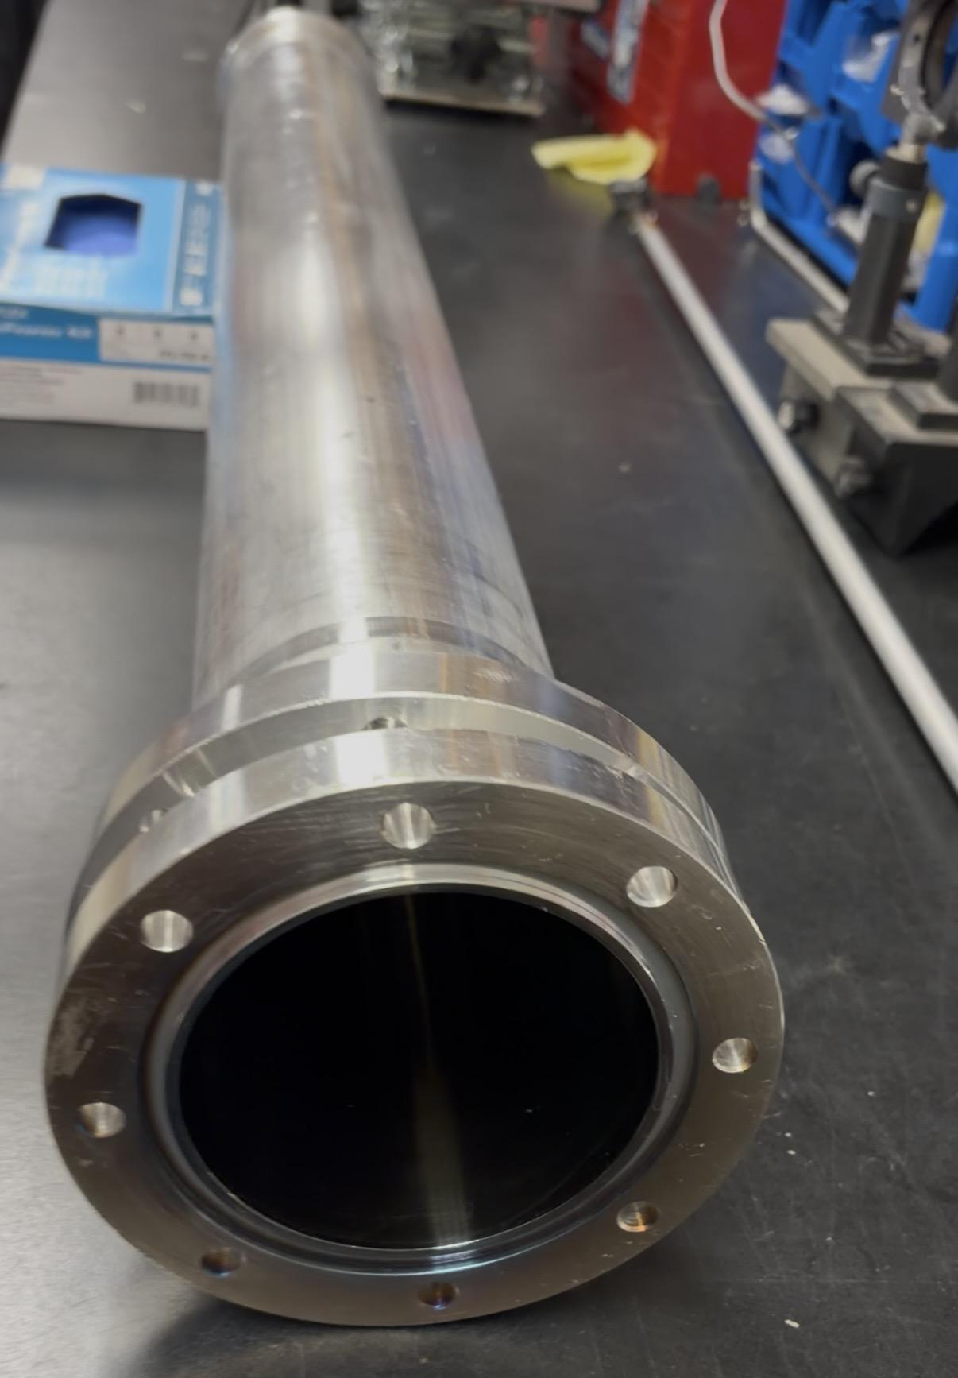
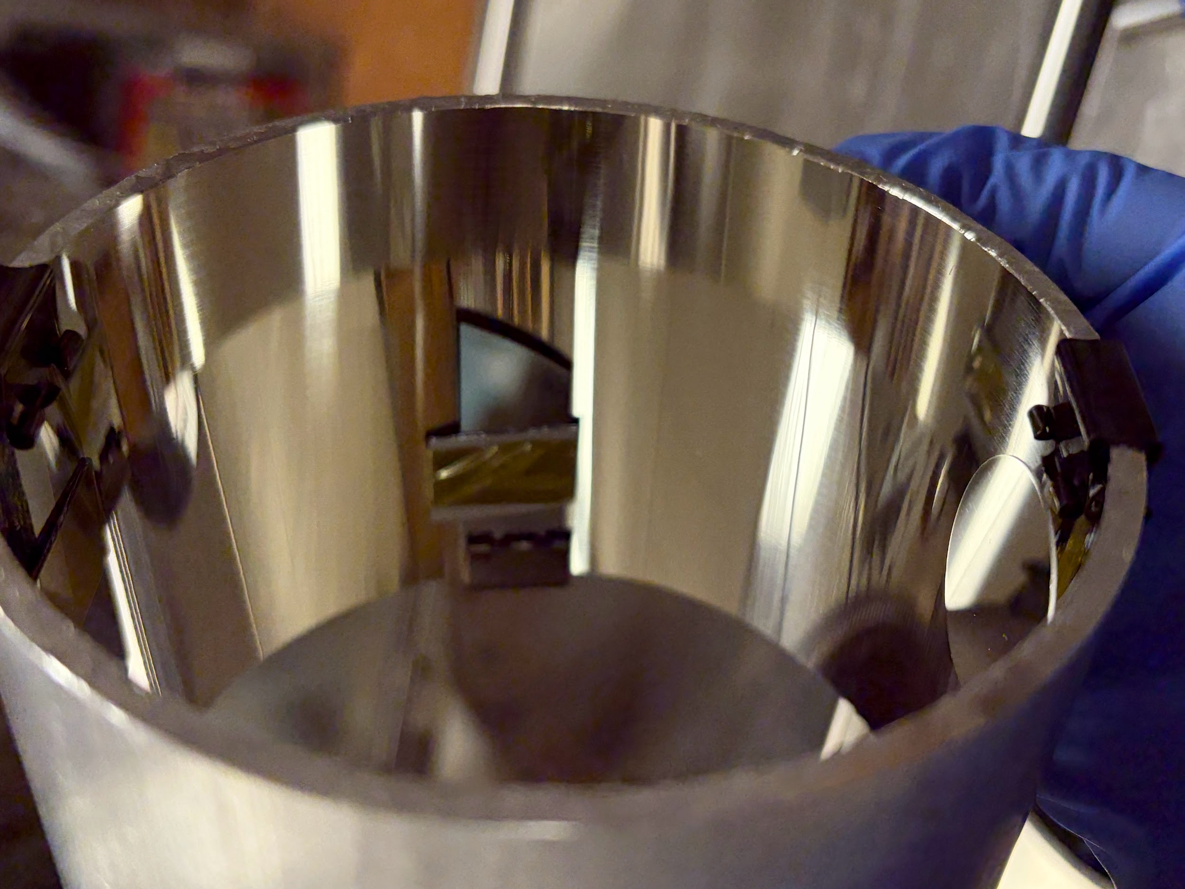
DLC coated samples and 1m guide
1m DLC coated guide
DLC adhesion comparison
Ti+DLC coated sample
Ti-only underlayer: for adhesion

Slide 11
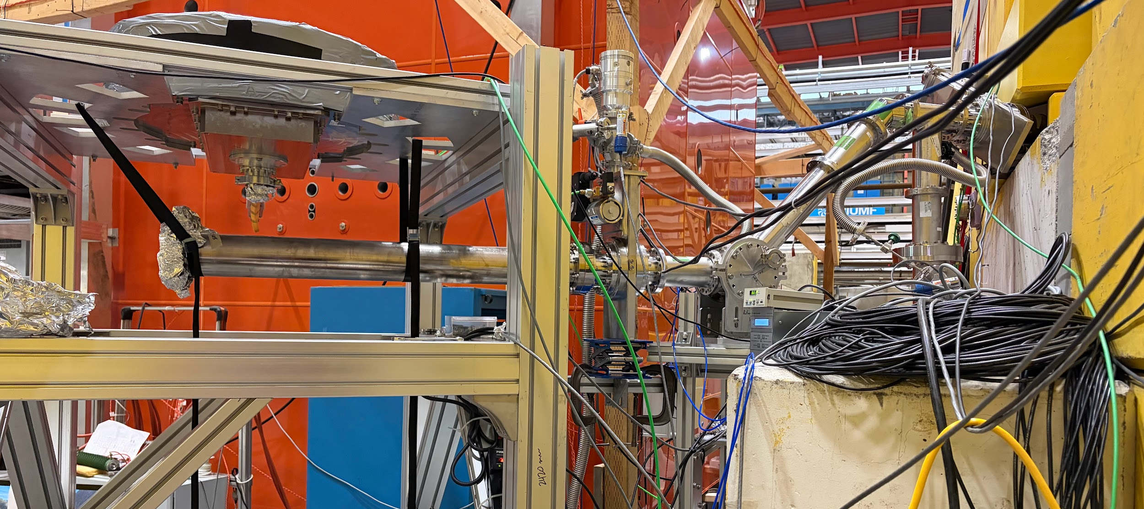
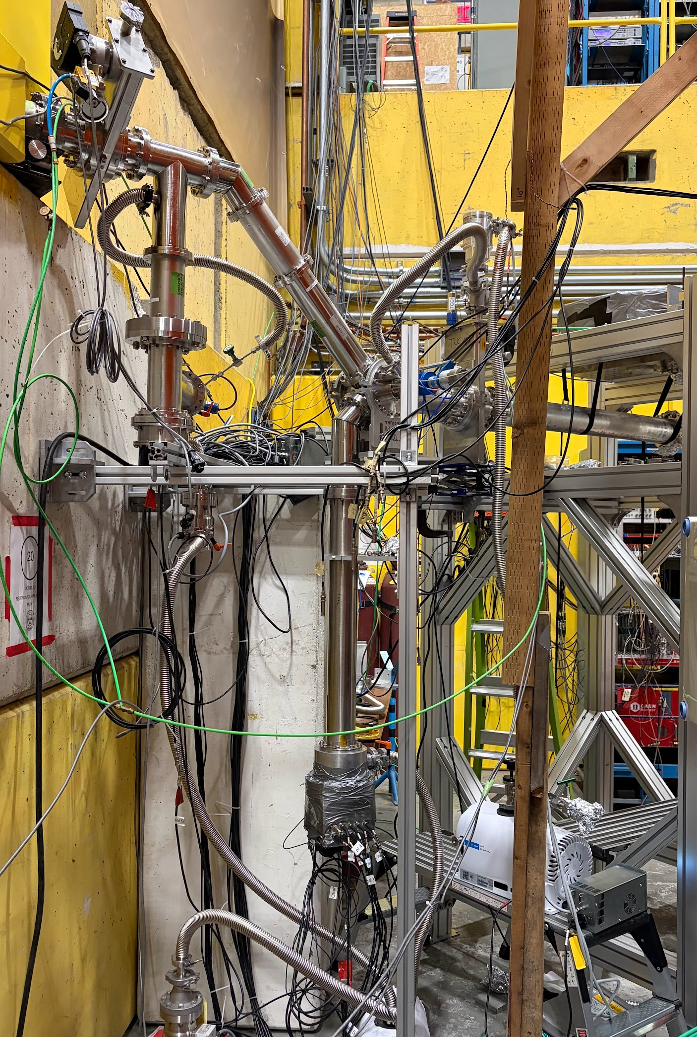
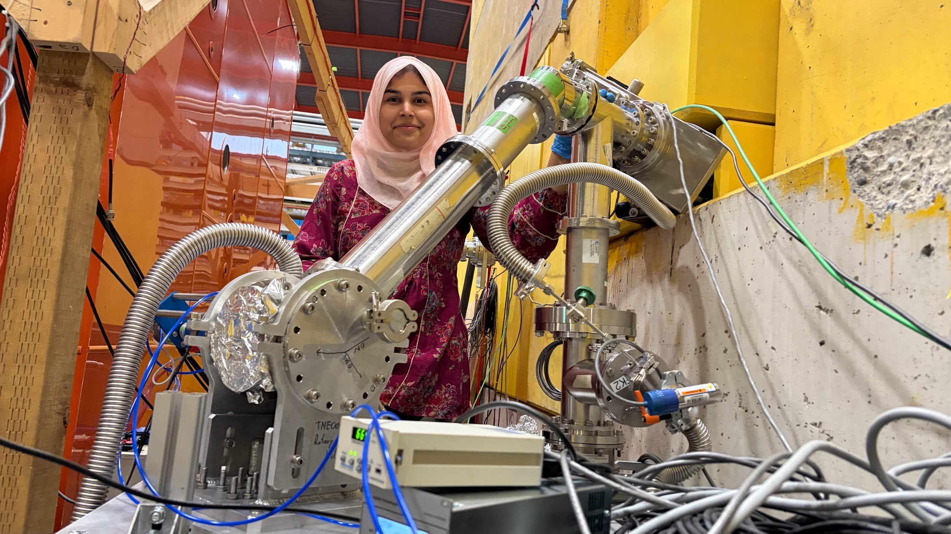
UCN guide setup at TRIUMF
1m guide
UCN beam port
⁶Li detector

Slide 12
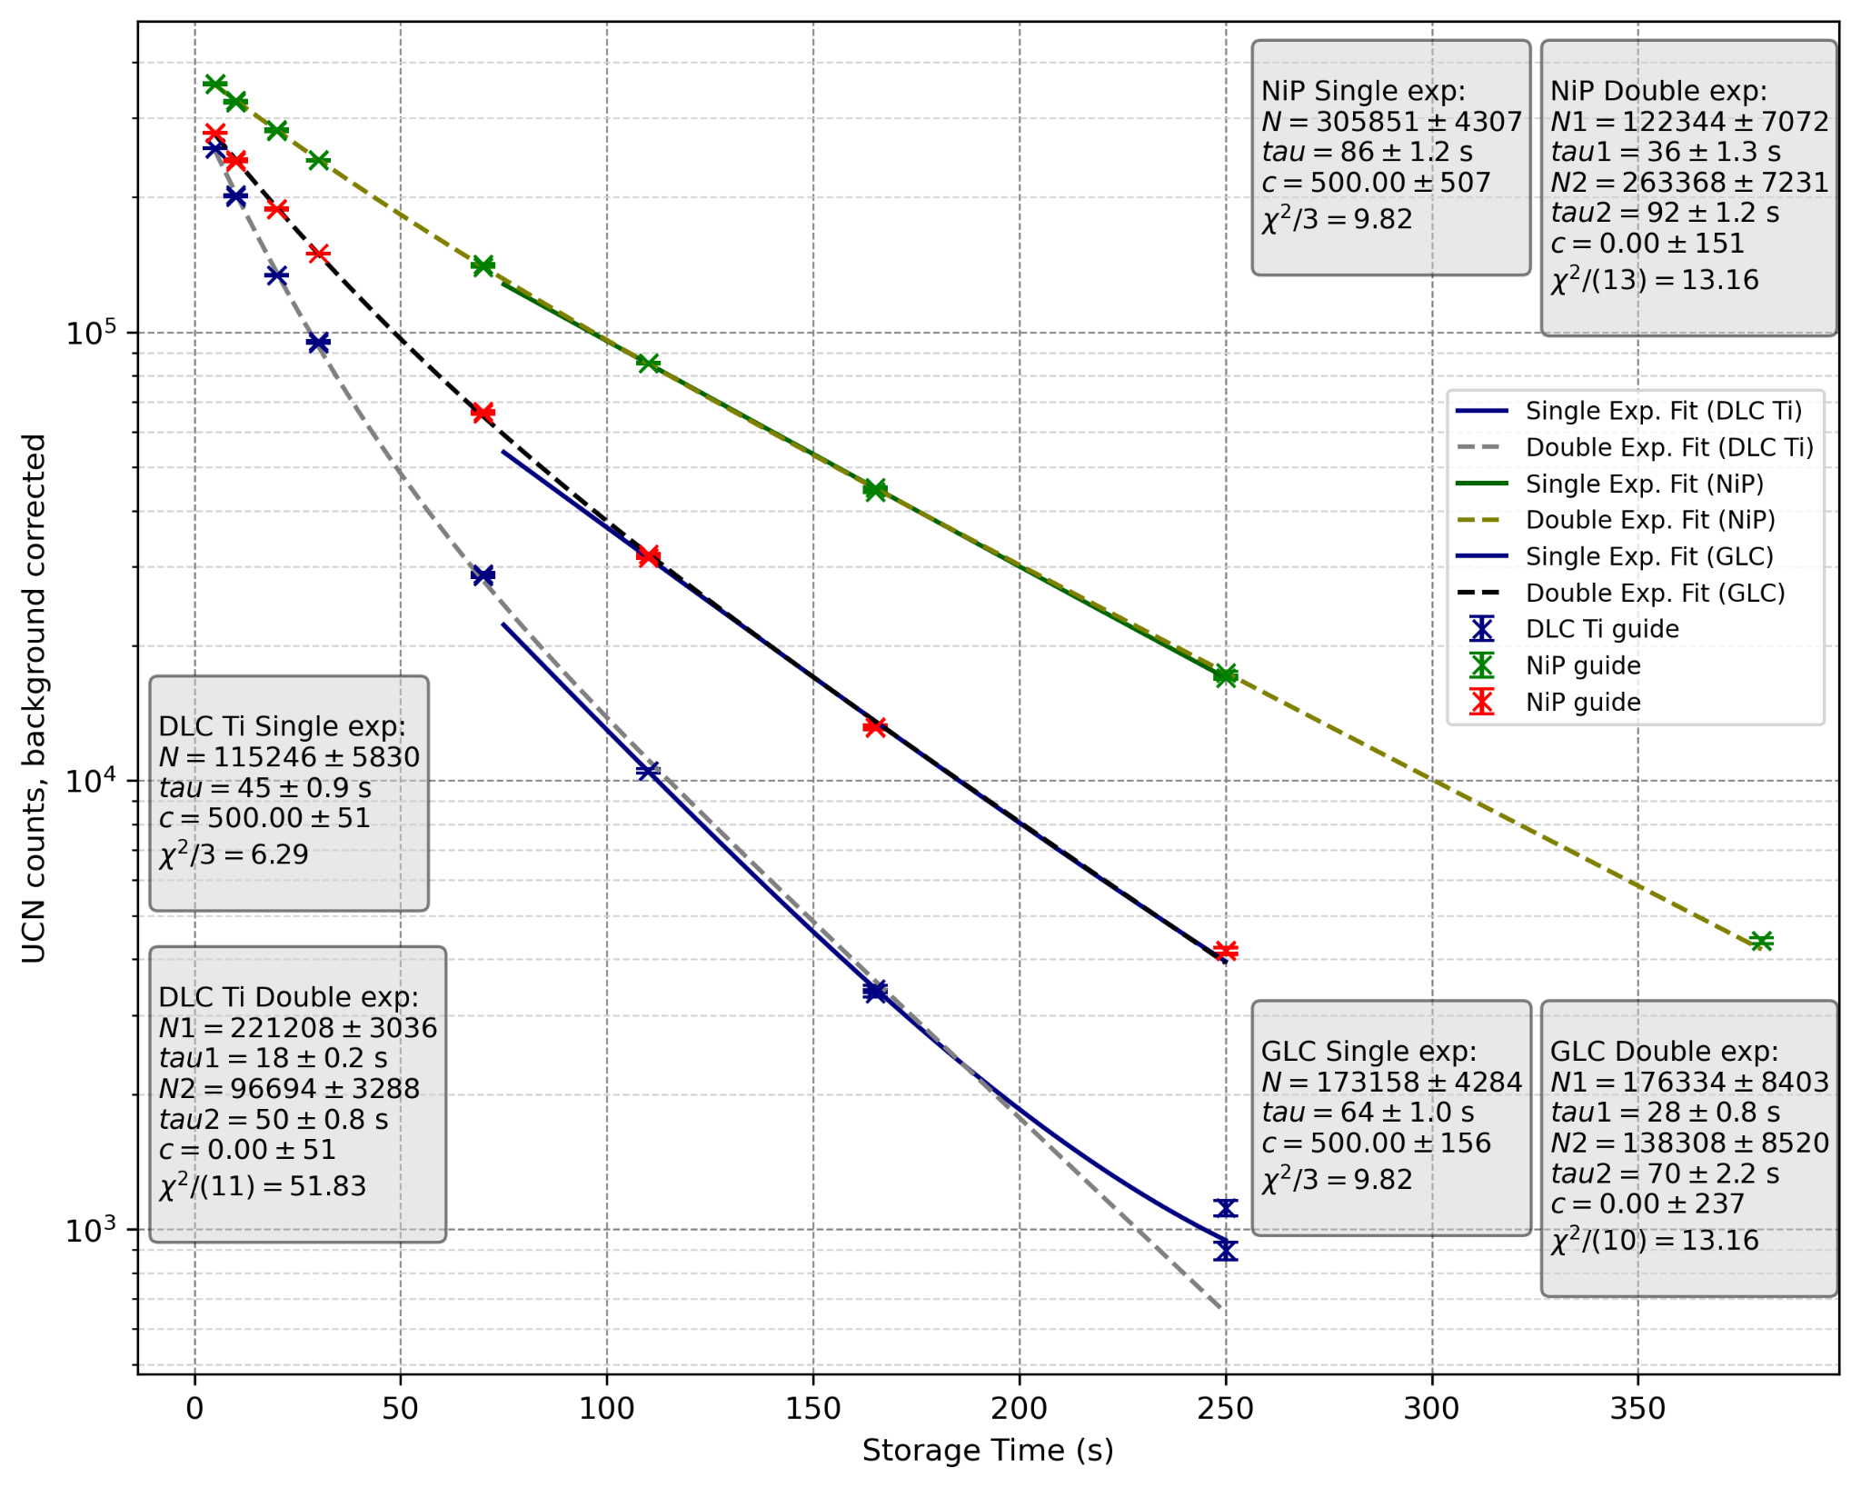
UCN storage performance in 1m guides (TRIUMF)
Relative storage performance:
NiP > GLC > DLC
PRELIMINARY
Coating type | Thickness | Storage time (tau) | Nature of storage/decay
NiP | ≈5000 nm | τ ≈ 86 s | Longest storage lifetime; Slowest decay over time
GLC | ≈100 nm | τ ≈ 64 s | Moderate storage lifetime
DLC | ≈ 70 nm | τ ≈ 45 s | Shortest lifetime; Strong fast-loss component at early times
Notes:
How u obtain different points on slide?
2 parameters:
How many ucn filled in guide, and how long ucn survived in the guide?

Slide 13
DLC guide development: Learning & Next steps
Current optimization focus
Refining deposition parameters, including:
-Slightly larger laser spot size for improved coating uniformity
-Longer continuous DLC deposition within a single vacuum cycle
-Reduced number of Ti/Cr passes to minimize interfaces
Parallel PENTrack / Python simulations to guide optimization
First full 1-m DLC guide
fabricated and tested with real UCN
(transition from small samples → full-length guide)
Beamtime provided critical insight into real-UCN behavior beyond witness samples and lab characterization
Next steps / goal
Fabricate an improved DLC guide
Test with UCN at J-PARC (March)
Move toward optimized DLC guides for future UCN transport

Slide 14
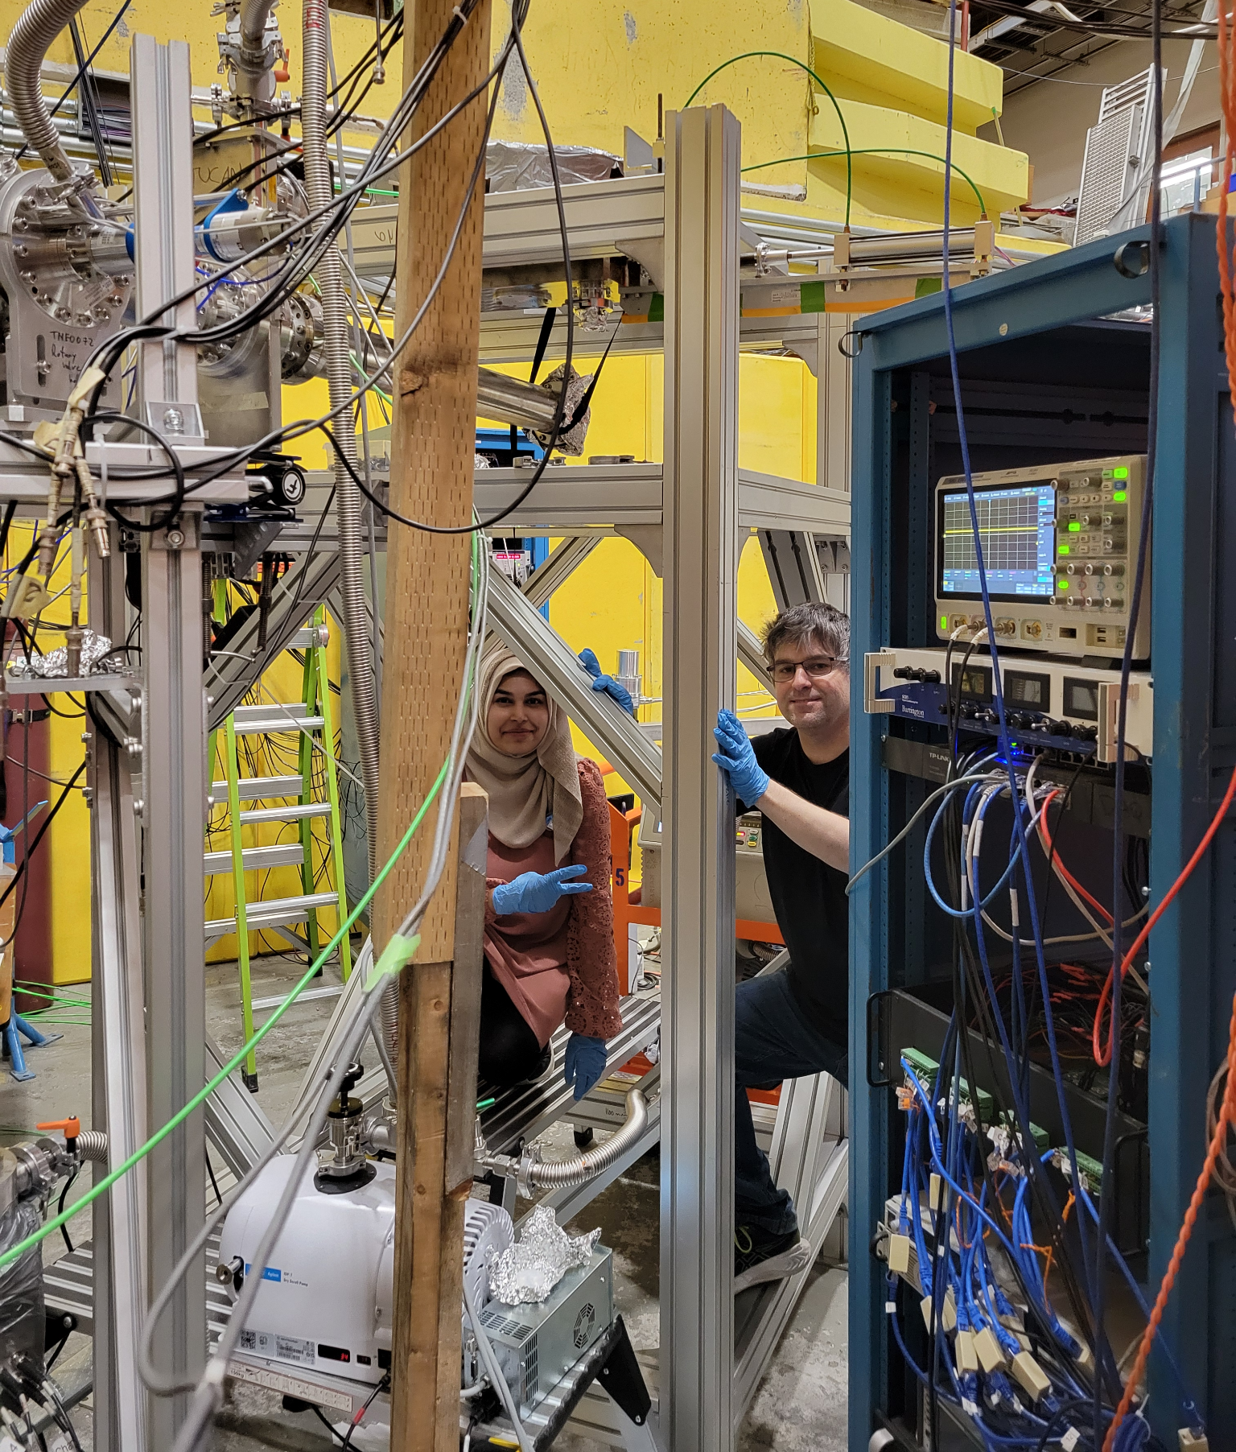
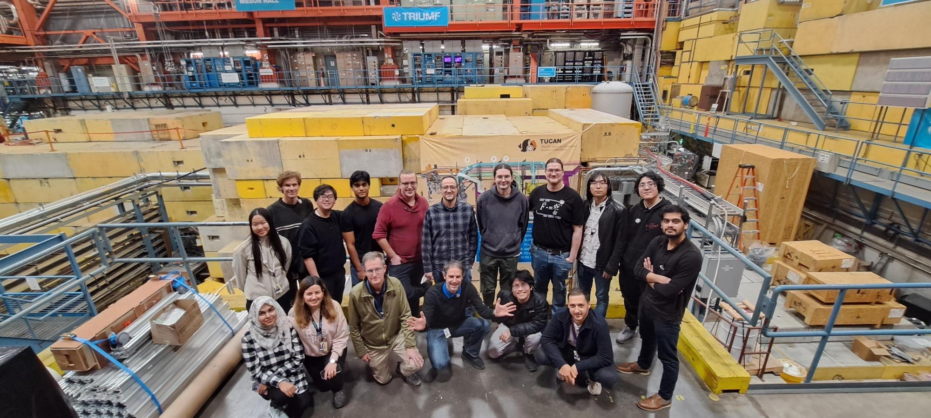
Beamtime at TRIUMF: Team & guide setup

Slide 15


Thank you!
‹#›

Slide 16
Backup slides

Slide 17
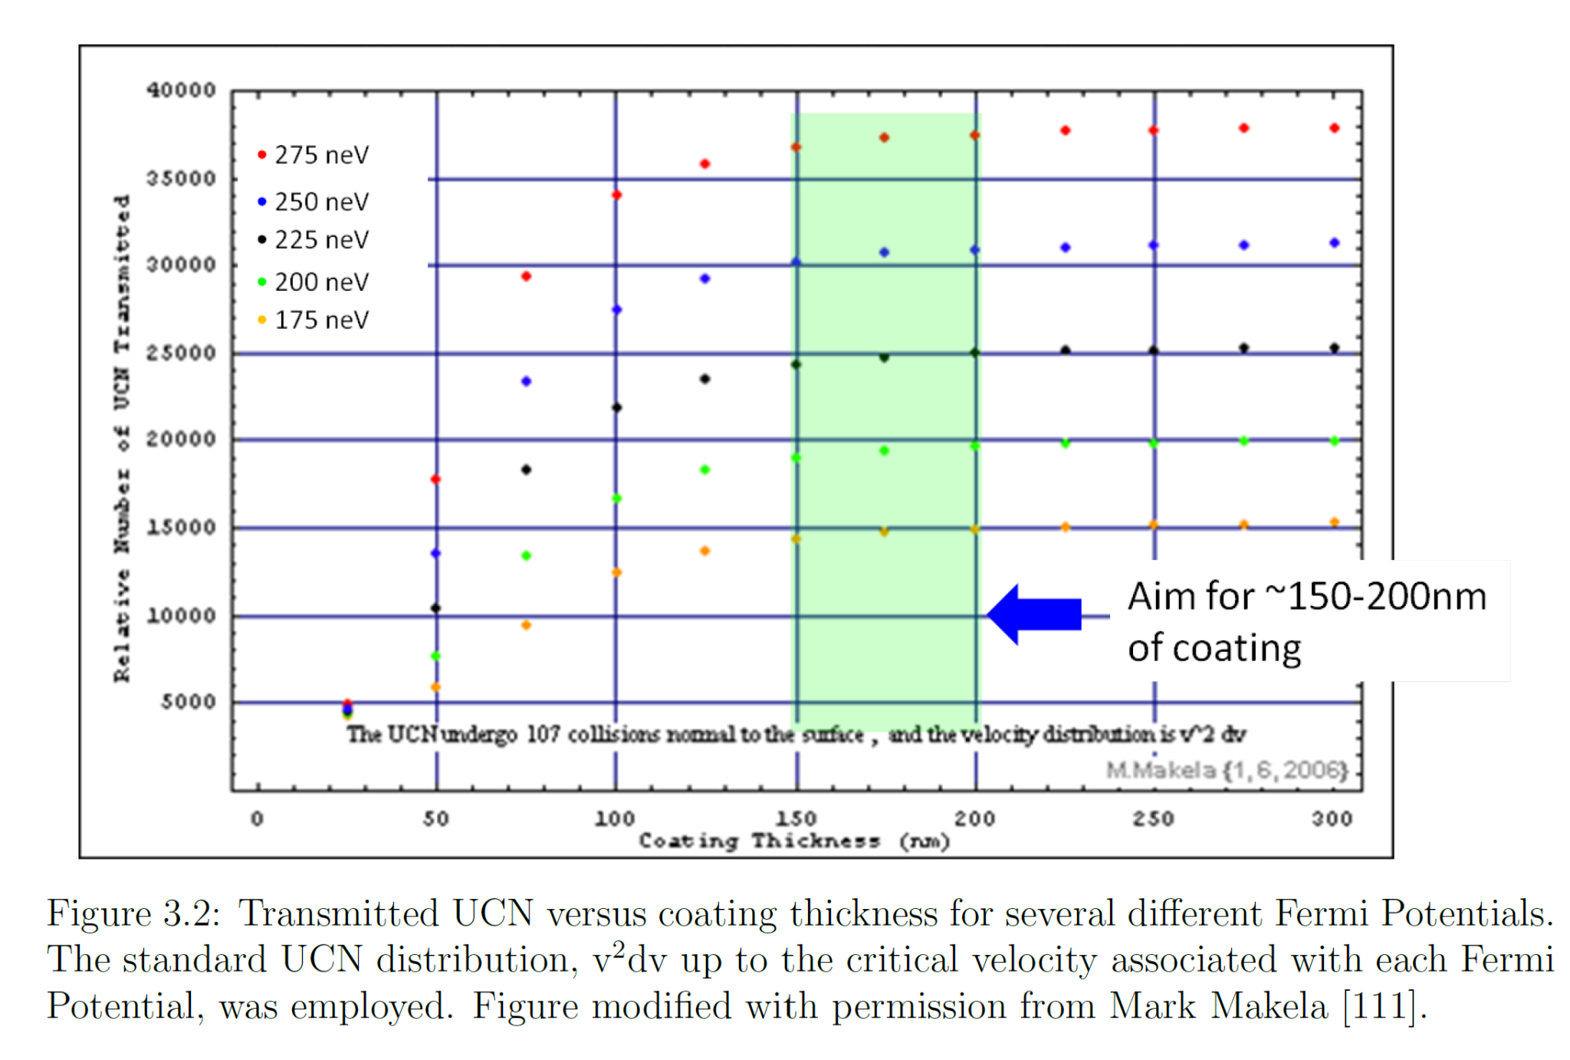
The TUCAN EDM experiment needs DLC films that are > 150 nm.
‹#›
Notes:
1st year quantum mech at 150nm-zero transmission of a potential barrier shows that we need atleast 150nm

Slide 18
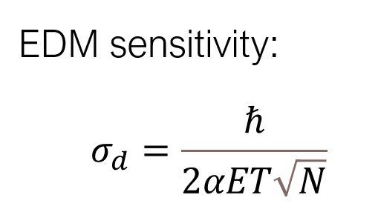
TUCAN experiment
-480 mega-eV (MeV) protons on tungsten create spallation neutrons
-Lead, graphite and heavy water reflect and
moderate fast neutrons (MeV) to thermal neutrons (25 meV: 2200 m/s)​
-Liquid deuterium at 20 K moderates further to
create a large cold flux (1 meV: 500 m/s)​
-4He at around 1 K converts 1 meV (9Å) neutrons to UCN (< 215 neV: 5 m/s)​
T≈180s
⍺≈0.7
N≈10⁴ per cycle
E≈10 kV/cm
Notes:
1 MeV=10⁶ eV

Slide 19
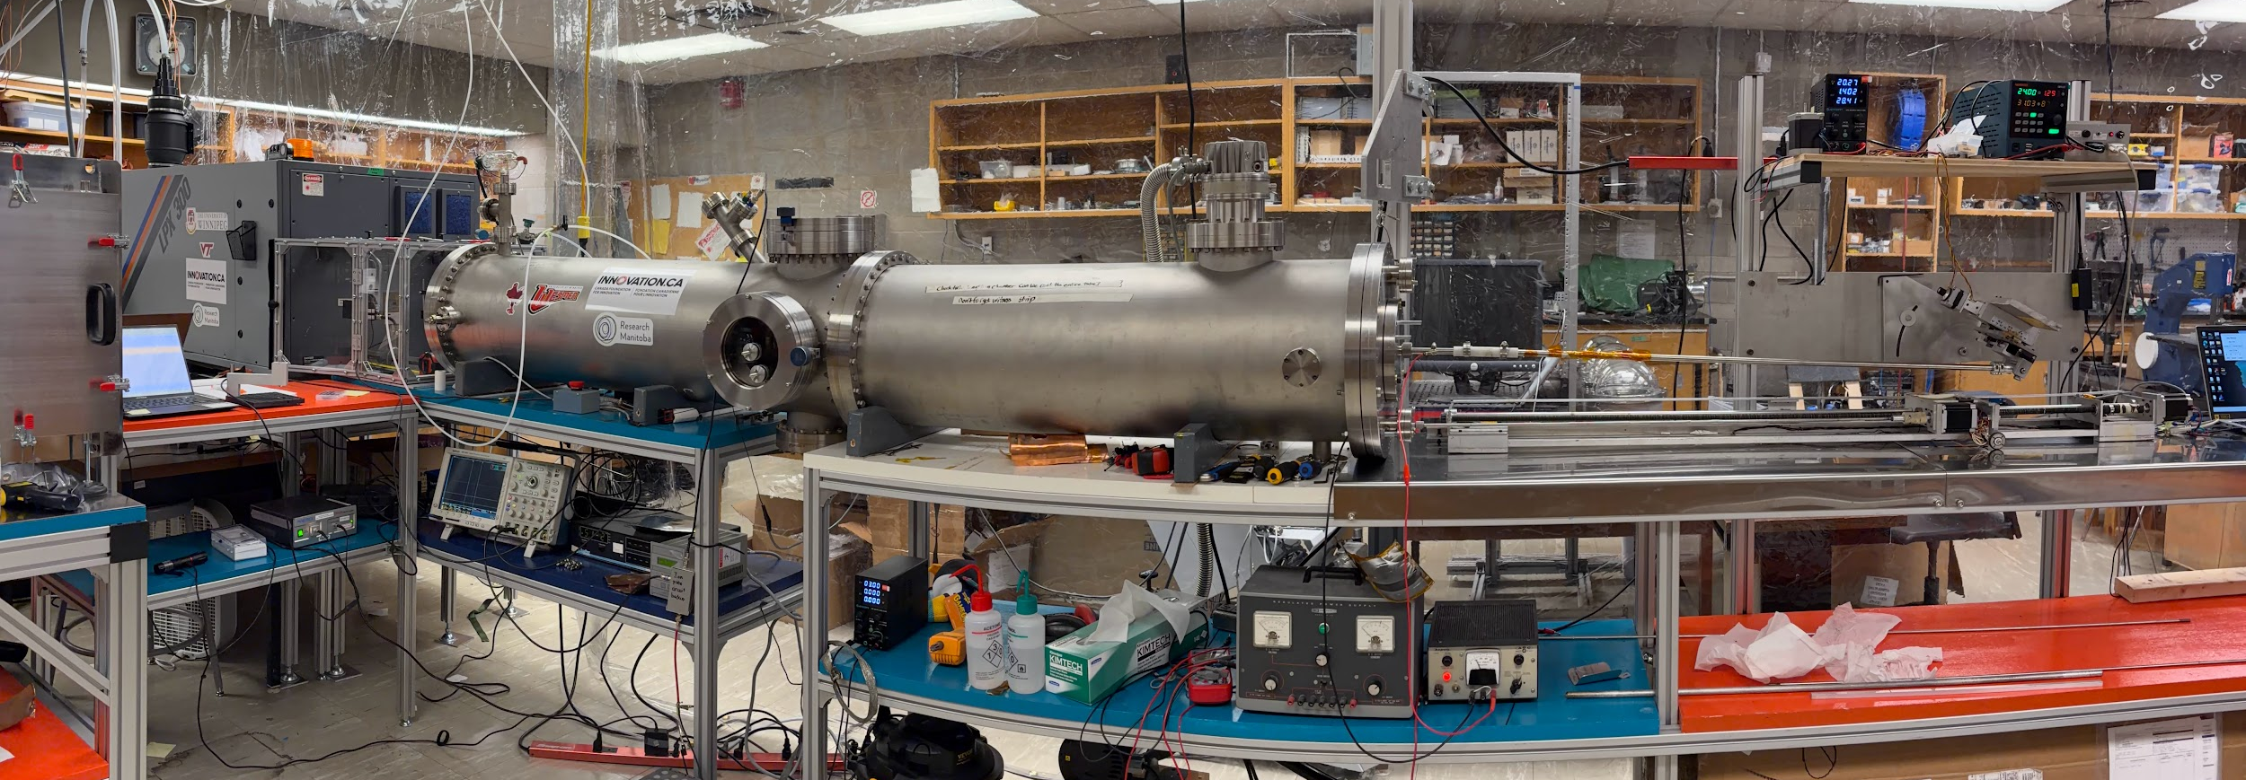

Slide 20
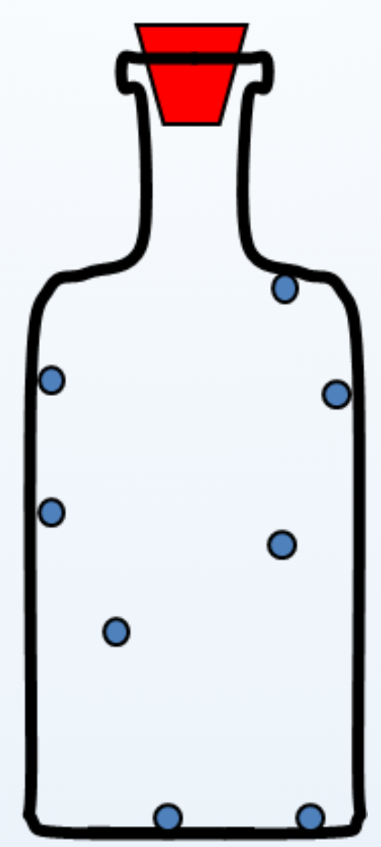
Ultracold Neutrons (UCN)
Neutrons that are moving so slowly that they bounce off surfaces and can be bottled.
Ultracold neutrons (UCNs) have very low energies, below 300 neV. At such low energies, they are affected by magnetic, gravitational, and material potentials-strong force, that can be achieved in a laboratory environment.
– v < 8 m/s = 30 km/h
– T < 4 mK (−273.15 °C)
– K.E. < 300 neV
‹#›

Slide 21
Double exponential fits components arises from “guide-scale effects” (backup)
Guide-scale effects are loss mechanisms that appear only when we go from small samples to a full 1-m guide, and are not visible on witness samples.
In our DLC guide, this include:
Coating non-uniformity along 1 m (thickness or density variations over length)
Multiple interfaces along the guide (Ti/DLC interfaces, recoating boundaries, vacuum breaks)
Surface roughness accumulated over length (more wall collisions → more loss sensitivity)
Hydrogen or contamination variations (adsorbed during handling or between coating steps)
Geometric effects (ends, joints, alignment, or local defects)

Slide 22
Result summary
DLC has a higher neutron optical potential (V_{F} ≈ 230–250 neV) compared to NiP (≈ 210–220 neV), which in principle favors UCN storage and transport; however, the measured effective storage lifetimes in this configuration differ.
This indicates that UCN losses are dominated by technological factors – such as interface quality, hydrogen content, and surface roughness – rather than optical potential alone.
Double-exponential fits reveal a larger fast-loss component for the present DLC guide, highlighting sensitivity to coating configuration and processing history (guide-scale effects).
These results emphasize the necessity of full-length guide testing with real UCN, beyond small-sample characterization.

Slide 23
Material vs thickness
What’s diamonds-like mean?
Diamond-like carbon is an amorphous carbon film that contains a mixture of sp³ bonds, like diamond, and sp² bonds, like graphite. The presence of sp³ bonding gives it diamond-like hardness, chemical inertness, and low friction, even though it’s not a true diamond crystal.
DLC
Ti
Oxygen
DLC
Ti
Al tube

