Slide 1
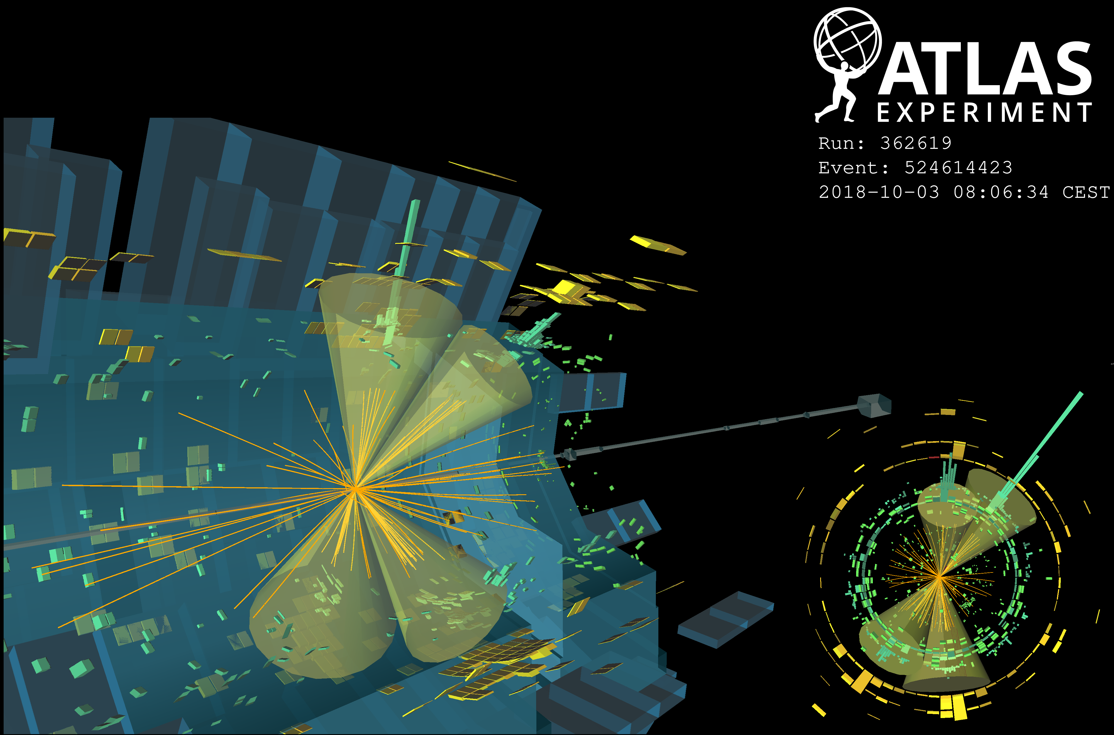
New Background Uncertainty Methods in the ATLAS HH→4b Analysis
Image Credit
Alex Bunka

Slide 2
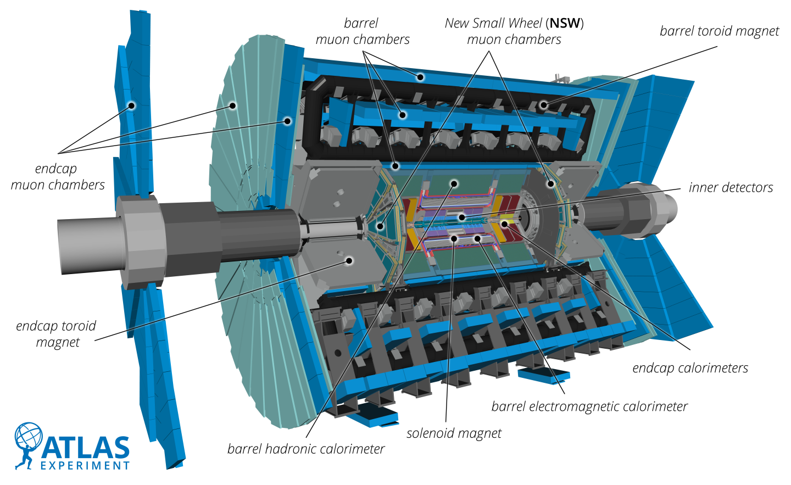
ATLAS and the LHC
LHC is a 27km proton collider
Located near Geneva, Switzerland
Highest energy particle collisions ever achieved
ATLAS is the largest general purpose particle detector ever built
25m diameter, 44m length
Measures position, momentum and energy of billions of particles every second!
Photograph: Bianchi, Riccardo Maria; ATLAS Collaboration. From https://cds.cern.ch/record/2837191

Slide 3
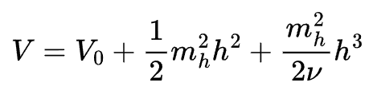

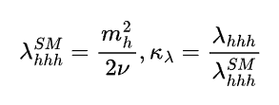
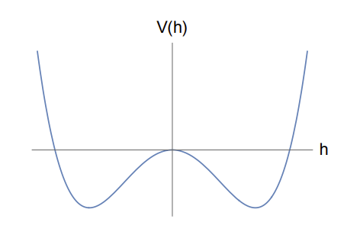
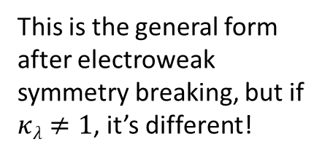




The Higgs Boson
First theorized in 1964, elementary particles gain mass by interacting with the Higgs field
Higgs potential includes Higgs boson mass, Higgs field, h³ term predicts 3 Higgs coupled together
Discovered by ATLAS and CMS (another LHC experiment) in 2012
Many accurate measurements of different properties, not enough data to extricate trilinear Higgs coupling
$$κ_{λ}$$
H
H
H
$$φ$$
This is the general form after electroweak symmetry breaking, but if $κλ≠1$, it’s different!
$$φ$$
https://doi.org/10.1103/PhysRevLett.13.508 Higgs theory paper!
https://doi.org/10.1016/j.physletb.2012.08.020 Higgs discovery paper (ATLAS)!

Slide 4
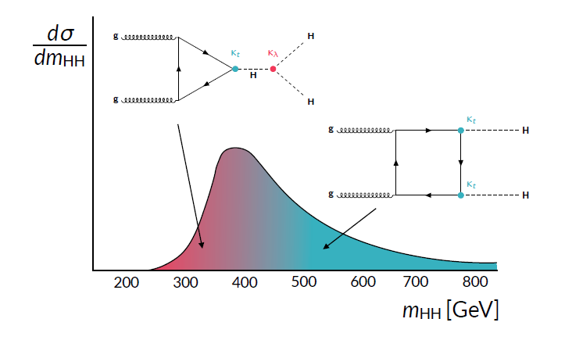
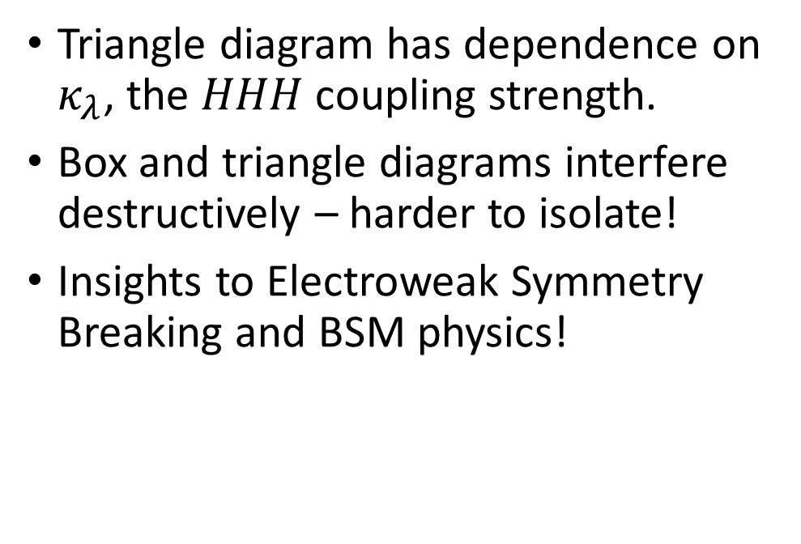
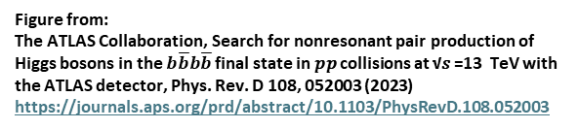
Motivation: HH->4b
Triangle diagram has dependence on $κ_{λ}$, the 𝐻𝐻𝐻 coupling strength.
Box and triangle diagrams interfere destructively – harder to isolate!
Insights to Electroweak Symmetry Breaking and BSM physics!
Figure from:
The ATLAS Collaboration, Search for nonresonant pair production of Higgs bosons in the $b\overline{b}b\overline{b}$ final state in 𝑝𝑝 collisions at √𝑠 =13 TeV with the ATLAS detector, Phys. Rev. D 108, 052003 (2023)
https://journals.aps.org/prd/abstract/10.1103/PhysRevD.108.052003

Slide 5
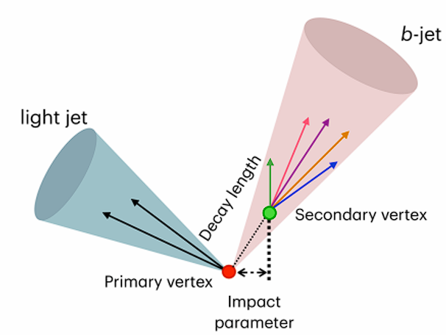
Branching Ratios and B Tagging
Higgs Bosons decay quickly, with many different decay channels
The most common decay is to a pair of bottom quarks, H→bb, at 58%. ~1/3 of HH pairs decay to 4b
4b final state is the most common! But it has the most background
B quarks show up as particle jets, and the ATLAS detector sees a lot of jets from many different sources
Data is sorted by the number of b quark jets. Jets are b tagged based on different features, primarily the long lifetime of b quark hadrons
ATLAS-PHOTO-2025-044-4

Slide 6
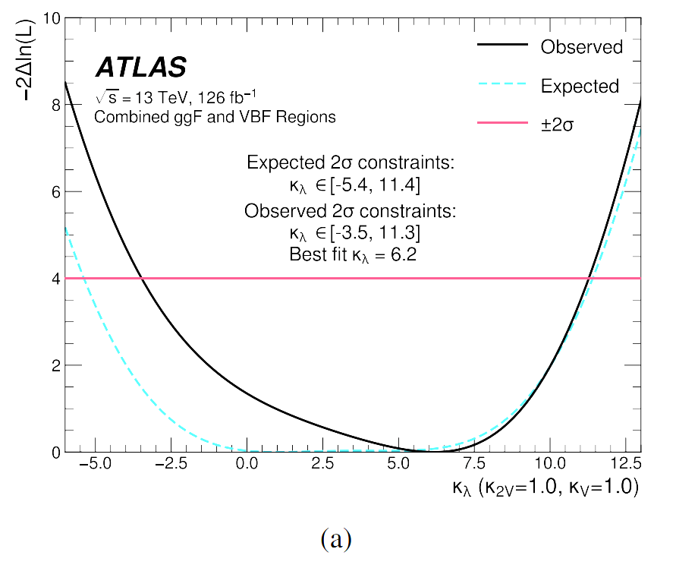
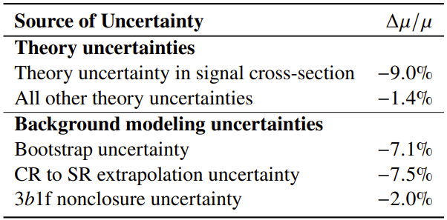
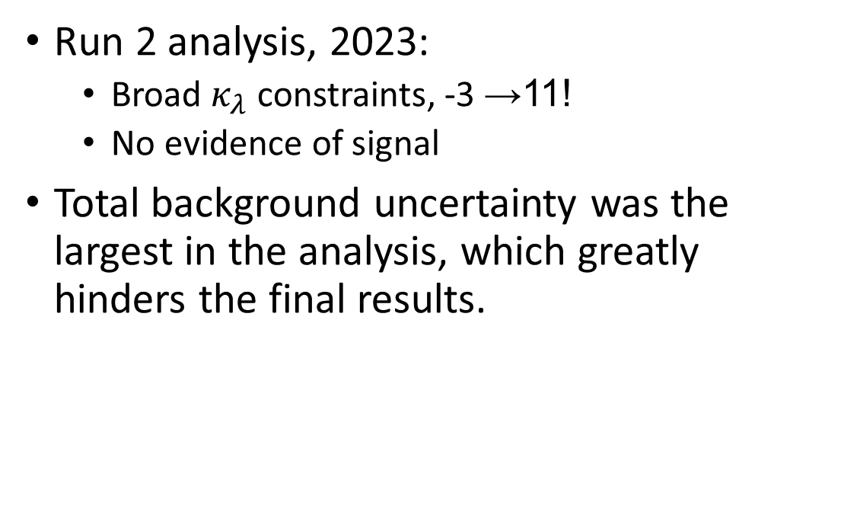
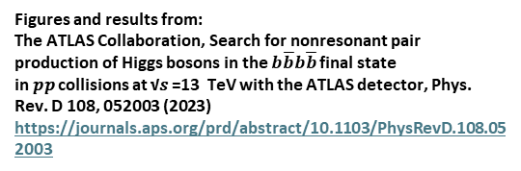
Previous Results
Run 2 analysis, 2023:
Broad $κ_{λ}$ constraints, -3 →11!
No evidence of signal
Total background uncertainty was the largest in the analysis, which greatly hinders the final results.
Figures and results from:
The ATLAS Collaboration, Search for nonresonant pair production of Higgs bosons in the $b\overline{b}b\overline{b}$ final state in 𝑝𝑝 collisions at √𝑠 =13 TeV with the ATLAS detector, Phys. Rev. D 108, 052003 (2023)
https://journals.aps.org/prd/abstract/10.1103/PhysRevD.108.052003
Improve uncertainty,
Improve limit!

Slide 7
Past Methods
The background is primarily multijet events
Very complicated QCD calculations are difficult to model accurately
Previously: 2b to 4b ABCD
Learn the relationship between 2b and 4b backgrounds in a control region
Apply to the 2b signal region to estimate the 4b SR
Sources of background uncertainties
Uncertainty – stdev of 100 reweighting functions, statistical uncertainty in 2b, 3b-4b non closure…
What can we do to improve this?
Signal
Control
A
C
4b
B
D
2b
A=B*(C/D)

Slide 8
New Background Methods
We know the control region, but the signal region is blinded.
Higgs mass is 125 GeV, so the signal region is an ellipse centered around (x, y) = (125, 125).
Outside of this ellipse is the control region.
Control Region
m_{H2}
Signal Region
125
125
m_{H1}

Slide 9
New Background Methods
Fit the 2d histogram of masses to smoothly fill in the signal region, which gives m_{H1} & m_{H2} for the signal.
Learn how to “move” between different m_{H1} ,m_{H2} points in the control region
Interpolate from the control region to the signal region
Control Region
m_{H2}
Signal Region
125
CR: m_{H1} ,m_{H2}
125
m_{H1}

Slide 10
New Background Methods
Use a generative model to morph these first simple variables into other physics features
Start in the signal region, and find the relationship between the mass plane and other physics distributions
Apply this relationship to the signal region mass plane from the previous step
Control Region
m_{H2}
Signal Region
125
SR: m_{H1} ,m_{H2}
CR: m_{H1} ,m_{H2}
Momentum, position…
125
m_{H1}

Slide 11
Why Use 3b for Uncertainty?
The statistics of 4b are limited
Roughly ten times more data passes 3b requirements than 4b
If we randomly downsample the 3b data, we have similar statistical effects with ten versions to show variations
Majority of 3b data is 4b that failed one b-tag
4b is blinded
We cannot look at the 4b signal region data until we have all the background modelling complete
Can’t risk biasing our analysis work!
Bias
Variance

Slide 12
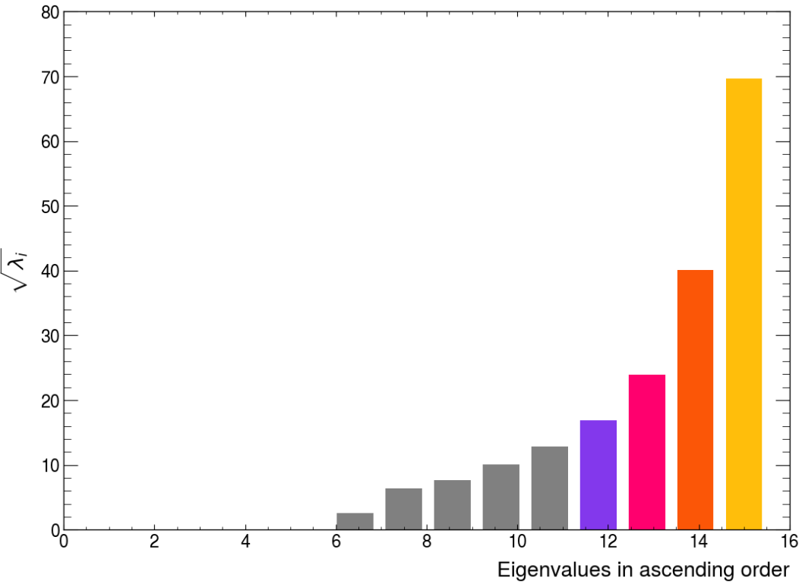

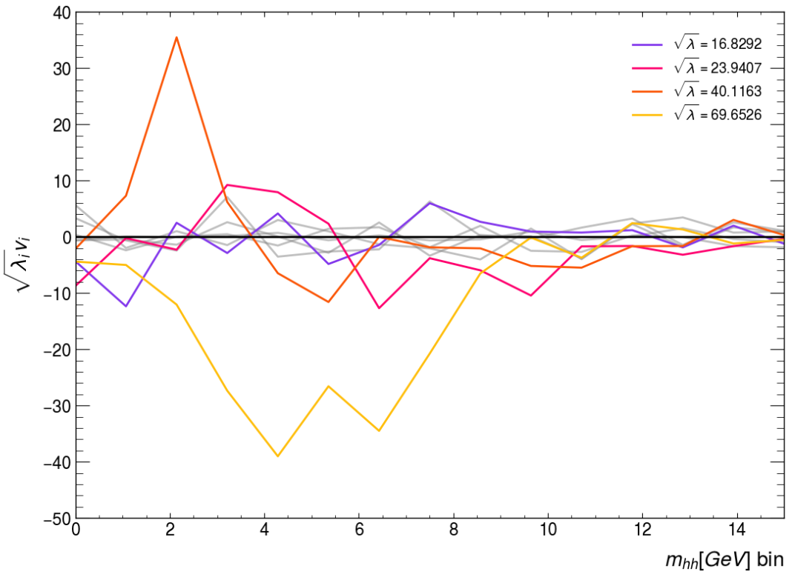
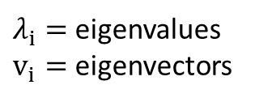
Background Uncertainty: 3b Predictions
Use 3b data for the systematics, N_{3b} = 10N_{4b}, create 10 subsets.
Train a background estimate from each of the subsets (call these replicas).
Principle Component Analysis on the average of the replicas.
Solve an eigenvalue problem:
Eigenvectors are variations in shape, eigenvalues are the magnitude of the changes.
$λ_{i}=$eigenvalues
$v_{i}=$ eigenvectors

Slide 13
Uncertainty in Two Parts
The Variance Step:
How much do the individual replicas differ from their average?
Unconstrained fit of each replica vs average, then iteratively add EVs.
Continue till pulls are uncorrelated.
The Bias Step:
How much does the average differ from data?
Use EVs as nuisance parameters, constrained from variance step.
Unconstrain NPs until the fit is good.

Slide 14
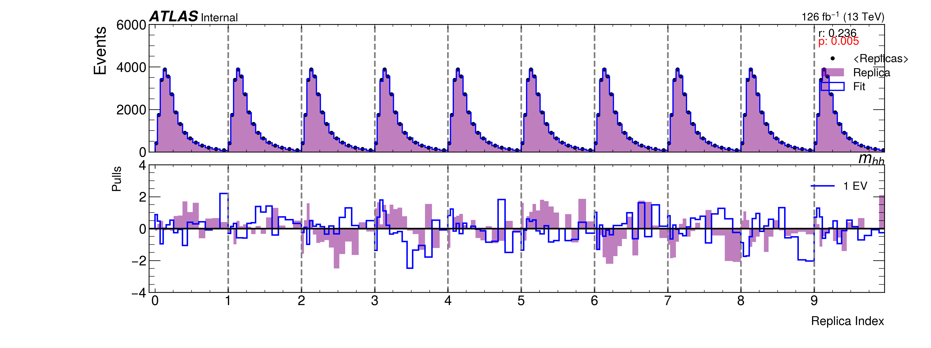
Variance: Fitting Against Average
Work In Progress

Slide 15
The Bias Step
Compare the average of the replicas to real 3b data
Use EVs as nuisance parameters, constrained from variance step
If the lowest correlation was after 6 fits, we have 6 EVs to use
Unconstrain NPs until the fit is good
Different statistical methods tested: Chi2, F-test…
Loosened fit value and variance uncertainty (from before) combined for final uncertainty

Slide 16
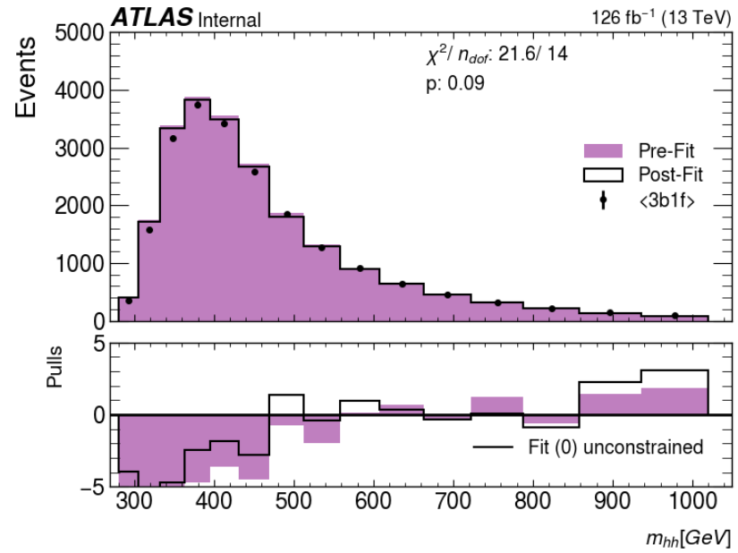
Bias: Fitting Against Data
Work In Progress
Typically achieve closure (p>0.05) with 0 or 1 NP
Does not change with different stats methods
The bias step contributes more to the final uncertainty than the variance
Even though it converges in fewer fit steps, the fit value is much larger

Slide 17
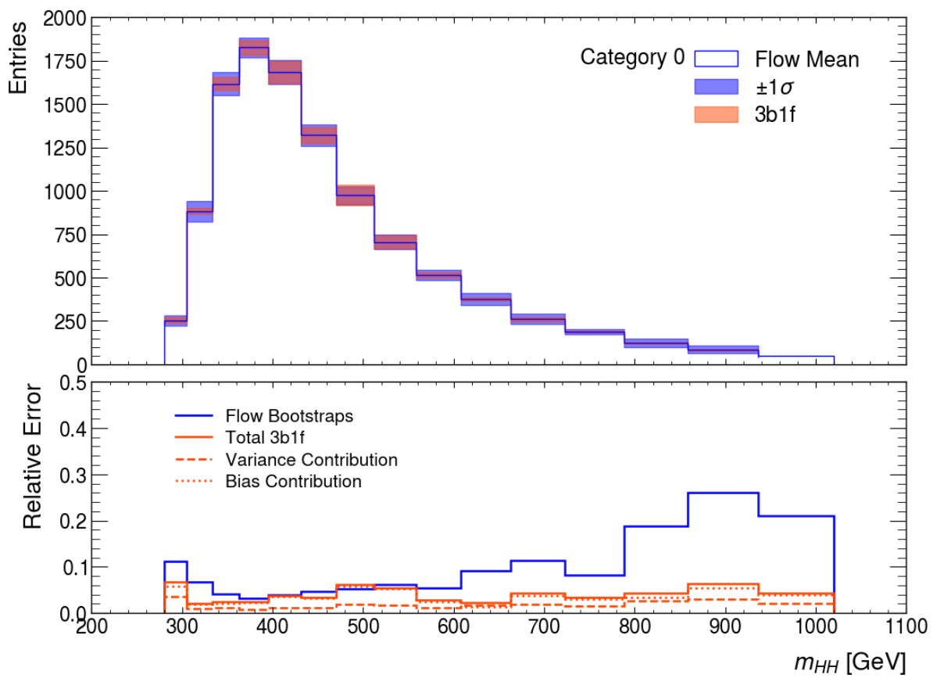
Total Uncertainty
Red lines are the uncertainties from each step, and combined
Blue is the stdev of 25 trainings
Uncertainty less than or equal to that of older methods
Reduced background uncertainty will greatly improve our analysis power!

Slide 18
Summary
The HH->4b analysis is important to investigate the behaviour of the Higgs Boson and study BSM physics.
The power of this analysis can be limited by large uncertainties, and improvements are needed keep up with the increase in data.
Many updates have been made to the background prediction and uncertainty.
The variance/bias method works to produce a reasonable background uncertainty.
Smaller than earlier methods, looks to cover the required range.
Ideally, this will be used in both the partial Run 3 and full Run 3 analyses.

Slide 19
Thank You!

Slide 20

mhh Variance Steps
Work In Progress

Slide 21
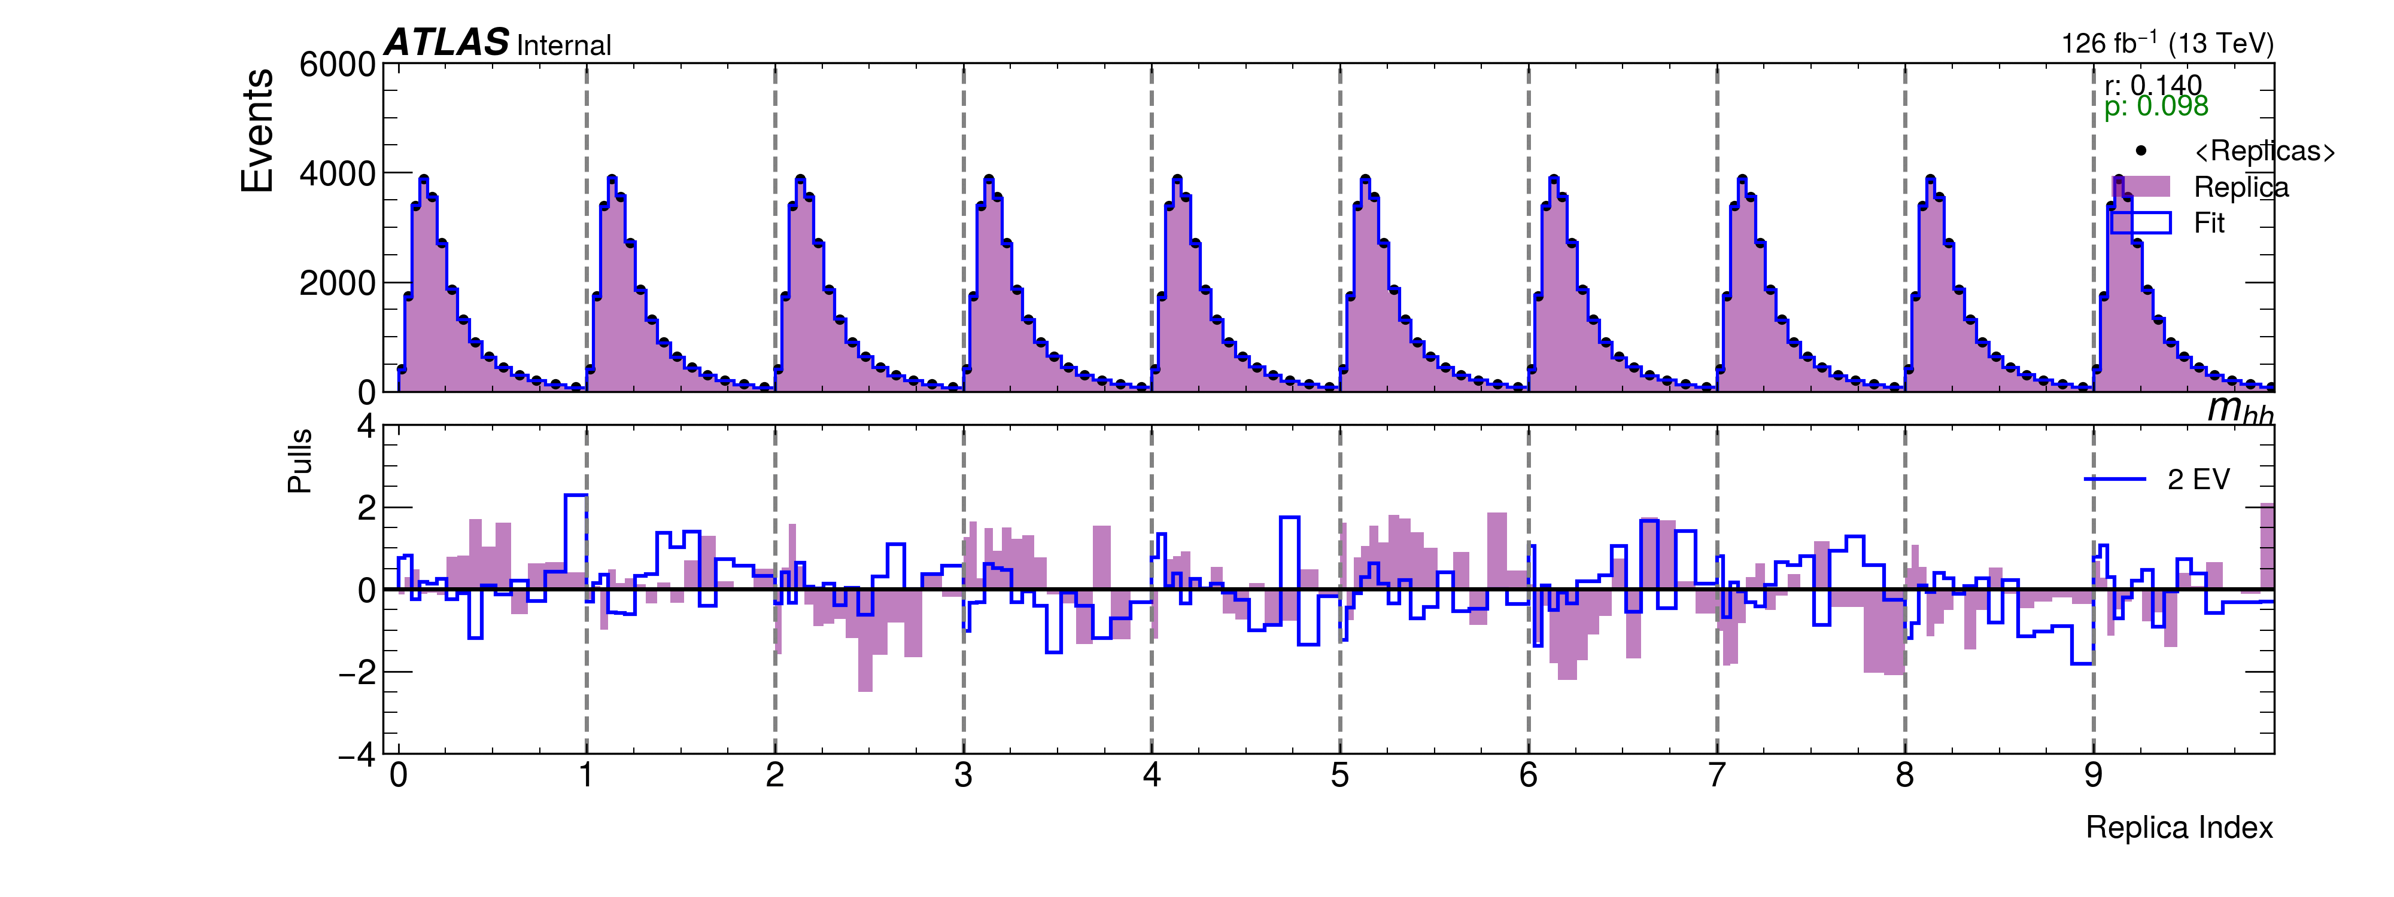
mhh Variance Steps
Work In Progress

Slide 22
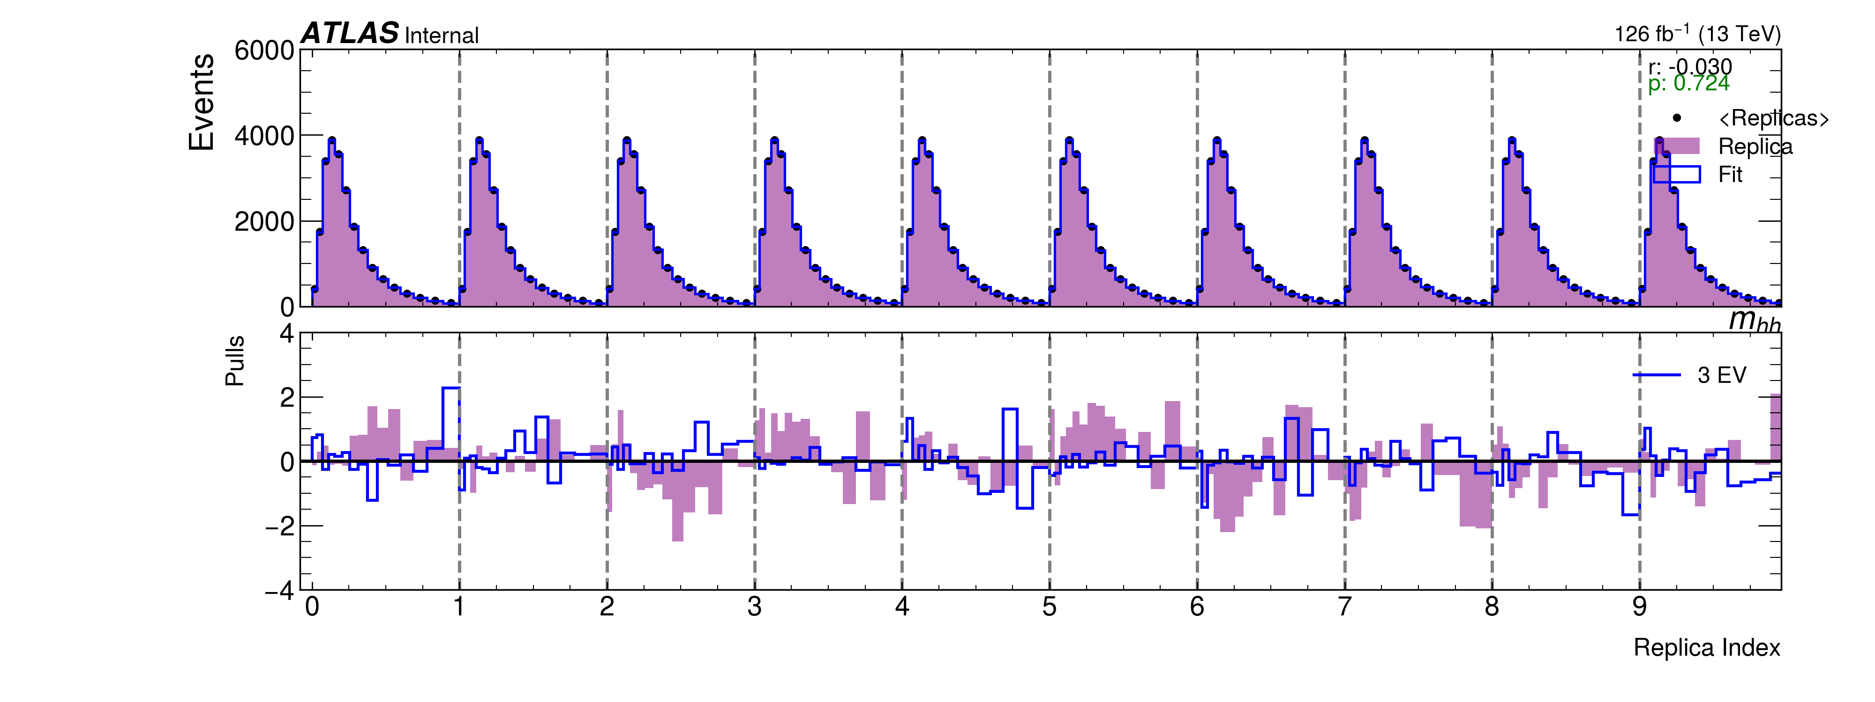
mhh Variance Steps
Work In Progress

Slide 23
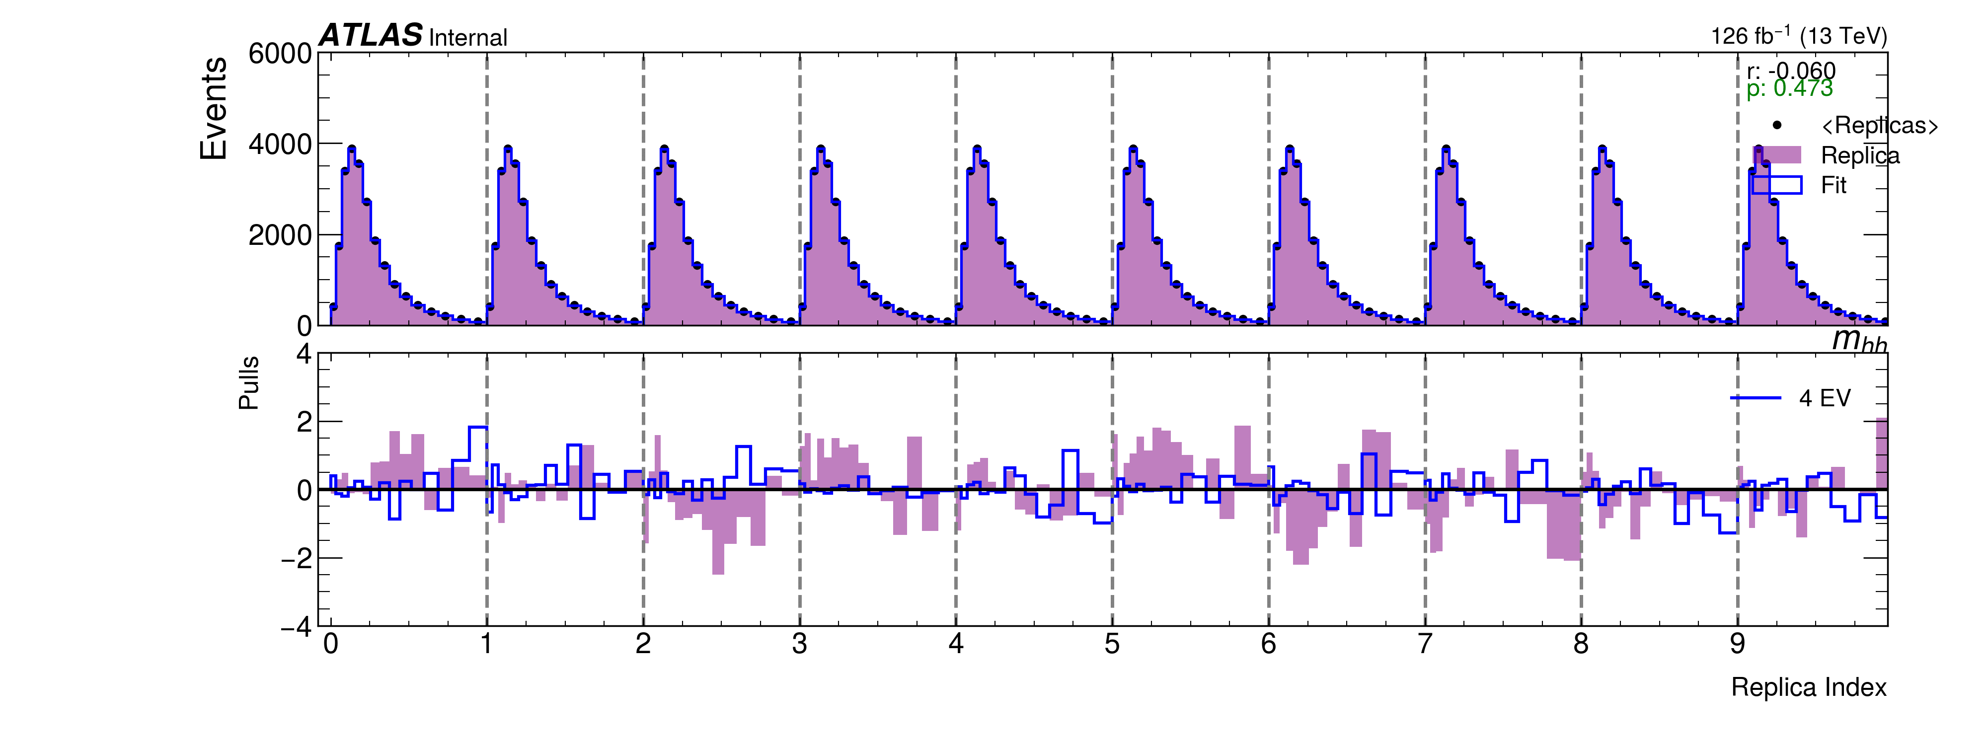
mhh Variance Steps
Work In Progress

Slide 24
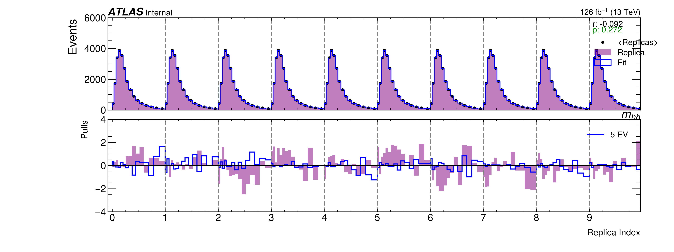
mhh Variance Steps
Work In Progress

Slide 25
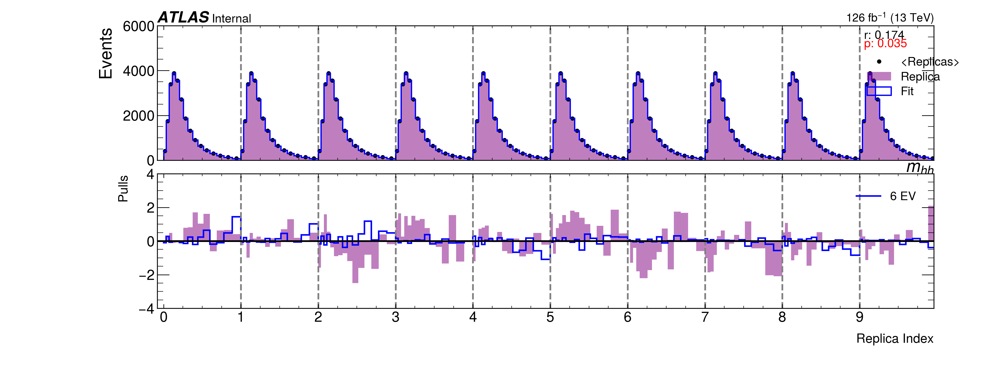
mhh Variance Steps
Work In Progress

Slide 26
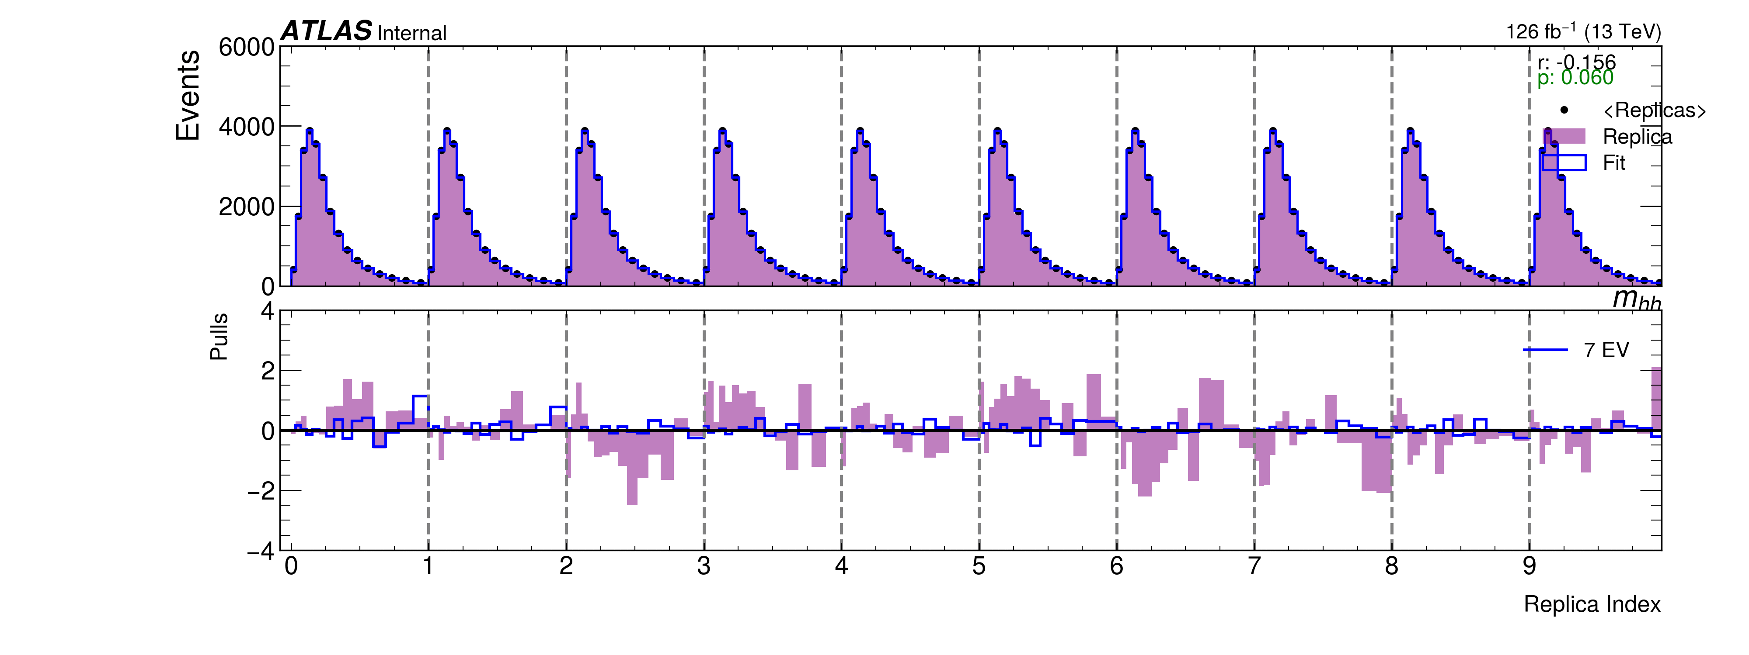
mhh Variance Steps
Work In Progress

Slide 27
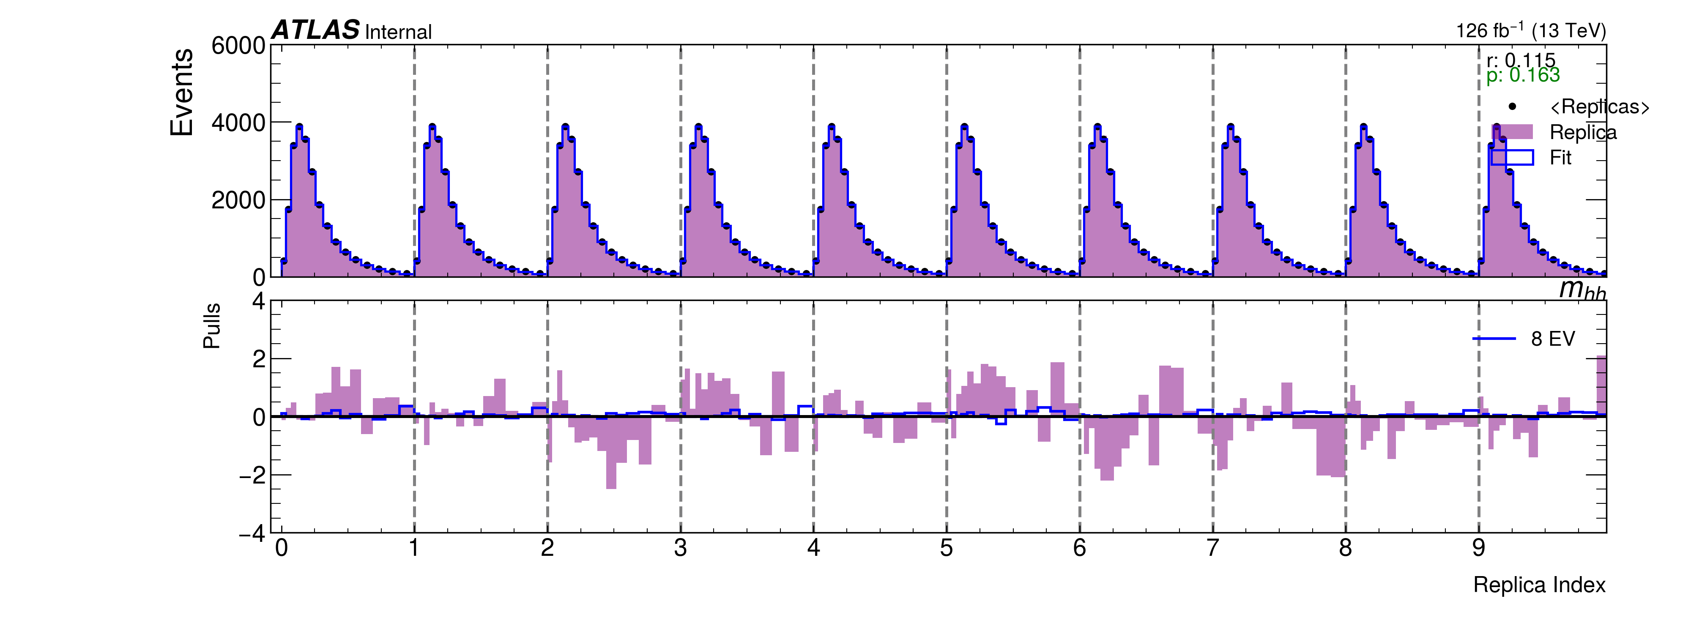
mhh Variance Steps
Work In Progress

Slide 28
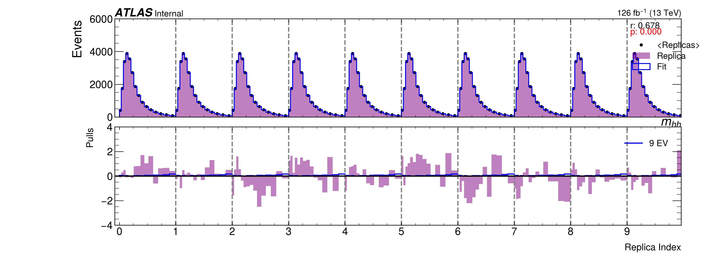
mhh Variance Steps
Work In Progress

Slide 29

mhh Variance Steps
Work In Progress

