Slide 1
KDK+ Systematics and Calibration
KDK+
Cameron Ingo
February 15, 2026
Collaborators:
CNL: T. Domingo, A. Erlandson, K, Hartling, D. Pérez-Loureiro, BNL: M. Yeh, SNOLAB: M. Stukel, ORNL: C. Rasco, K. Rykaczewski, SFU: L. Hariasz, Queen’s: R. Arsenne, G. Croft, Y. Coudiere, P. Di Stefano, L. Hummel, A. Lemaire, L. Lopez-Proville, N. Swidinsky, P. Gros, N. Panchal, G. Savvidis

Slide 2
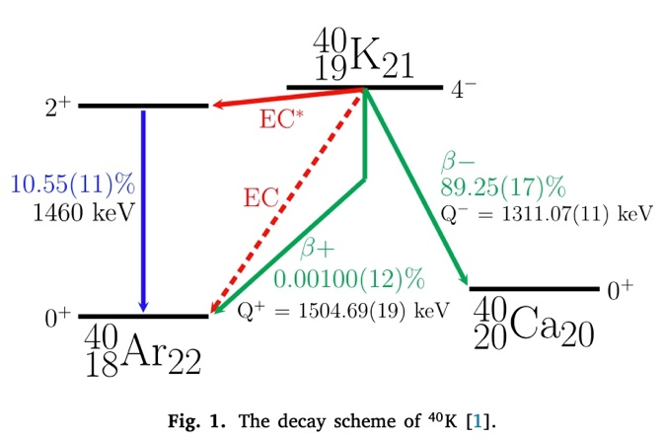
Potassium-40 Decay
1
Potassium-40 (⁴⁰K) can decay through either beta decays or electron captures
The most common decay mode is the β- decay to calcium-40
There are also three decay modes to argon-40, including two extremely rare modes directly to the ground state (electron capture and β+).
Decay scheme for potassium-40 (⁴⁰K)
Ref. M. Stukel, et al., Phys. Rev. Lett. 131, 052503 (2023).
Notes:
Potassium-40 is a naturally occurring radioactive isotope. It is one of the most common naturally occurring radioactive isotopes with a half life

Slide 3
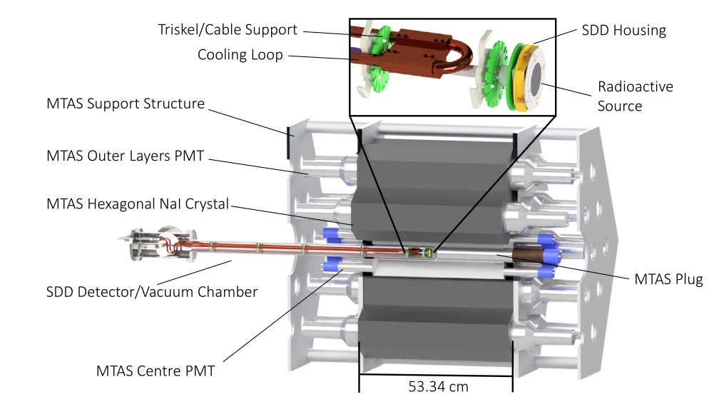
The KDK Experiment
2
KDK collaboration: first measurement of the ⁴⁰K electron capture decay to the ground state of ⁴⁰Ar (PRL 131, 052503).
KCl Source + SDD x-ray detector + large NaI gamma tagger (MTAS)
Measured branching ratio of 0.098 ±_{stat} 0.023 ±_{sys} 0.010
The Modular Total Absorption Spectrometer (MTAS) at ORNL used by the KDK collaboration
Ref. M. Stukel, et al., Phys. Rev. Lett. 131, 052503 (2023).
Notes:
X-ray detecter and large gamma tagger
Mtas contains

Slide 4
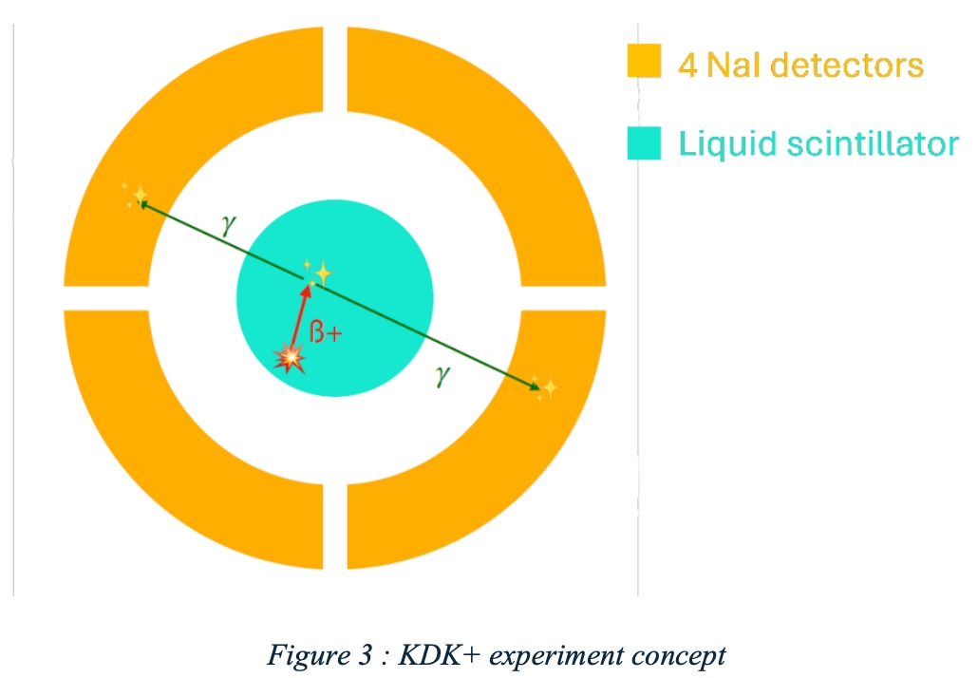
KDK+
3
KDK+: will measure the β+ decay to the ground state of ⁴⁰Ar
This decay was last measured in the early 1960s
Will use a potassium loaded liquid scintillator surrounded by sodium iodide (NaI) crystals
Liquid scintillator will detect positron emission; NaI will detect γs
Aiming to detect 1000 positron emissions in preliminary test
KDK+ experiment concept
Notes:
1000 positron decays
engelkeimer

Slide 5
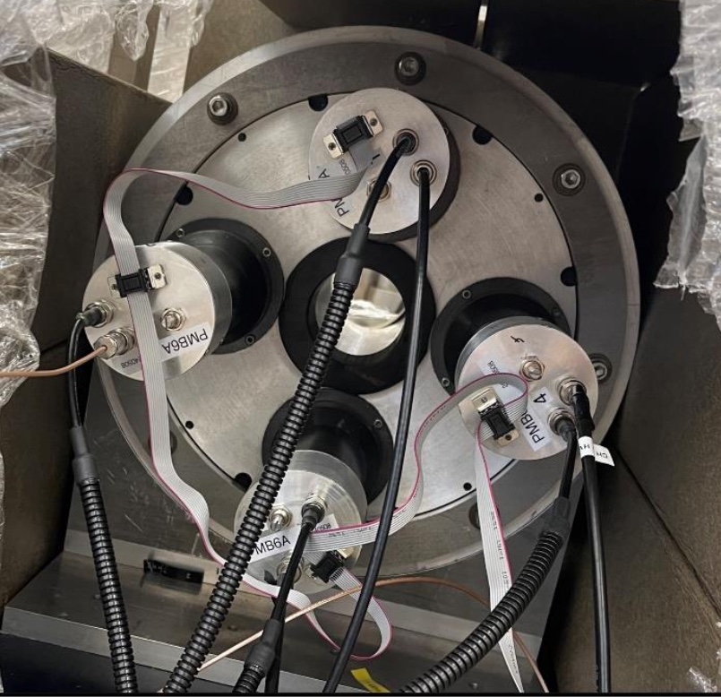
KDK+ Gamma Tagger
4
The preliminary phase of the experiment will be conducted using an annulus containing four NaI crystals
Tagging efficiency will be tested using sodium-22 loaded liquid scintillator
The annulus with four NaI crystals connected to PMTs
Notes:
The preliminary phase of the experiment will be conducted using an annulus containing four NaI crystals. Each crystal is measured by one PMT, and will allow us to identify back-to-back gamma emissions from events seen in a coincident timing window between opposite crystals
Sodium-22 maximum beta plus decay energy is 545.5 keV
Potassium-40 maximum beta plus decay energy is 483 keV
Follow up with MTAS

Slide 6
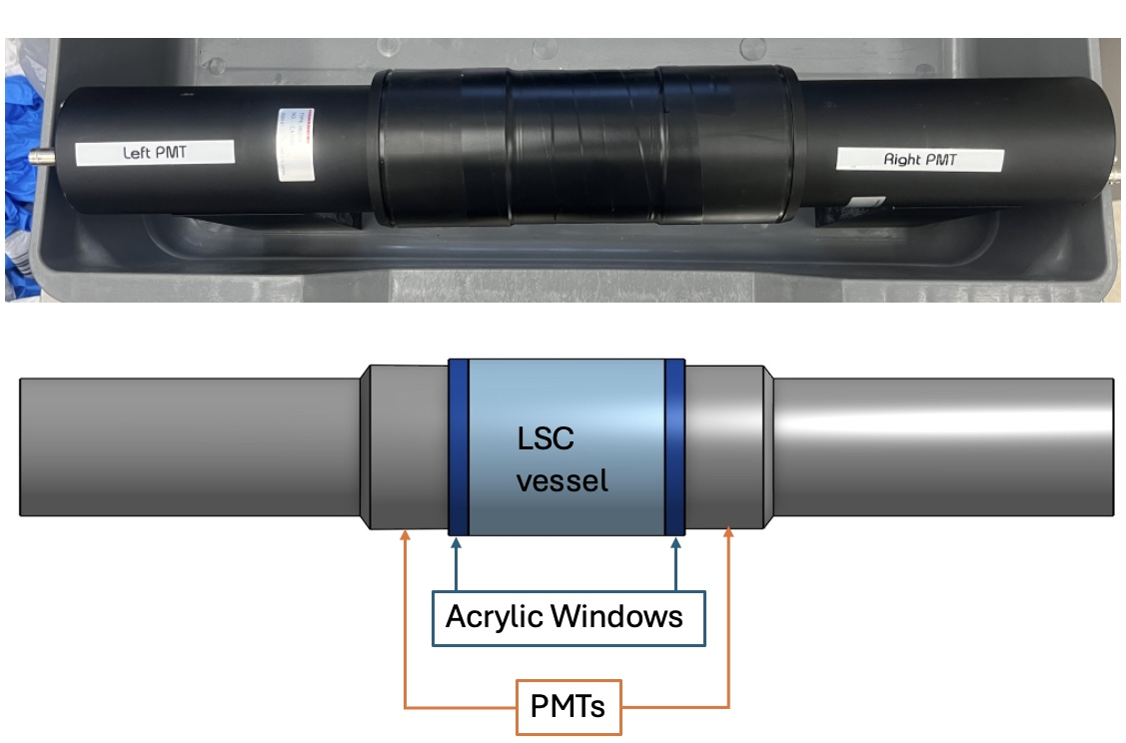
Liquid Scintillator Vessel
5
A liquid scintillator vessel has been designed to fit in the center bore of the annulus with photomultiplier tubes (PMTs).
Has a 300 mL active volume of liquid scintillator
Notes:
A liquid scintillator vessel has been designed to fit in the center bore of the annulus. This vessel has a volume of 300 mL and is designed to be airtight when filled and sealed. PMTs on either end of the vessel attached to acrylic windows will observe decays within the liquid scintillator.

Slide 7
Liquid Scintillator Cocktail Mixing
6
There are three considerations that were taken into account when designing a liquid scintillator cocktail (LSC) for use in this experiment:
01
Potassium mass fraction
02
Light yield
03
Long-term stability
Notes:
There are three important considerations that were made when creating a liquid scintillator cocktail. These include the overall light yield of the scintillator, as well as the stability of that light yield over a long time frame. The third consideration is the amount of potassium that can be loaded into it as the natural abundance of 40K is only 117 ppm, so to avoid an extremely long data collection period, the mass fraction should be as high as possible.
cut text

Slide 8
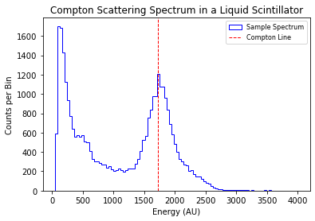
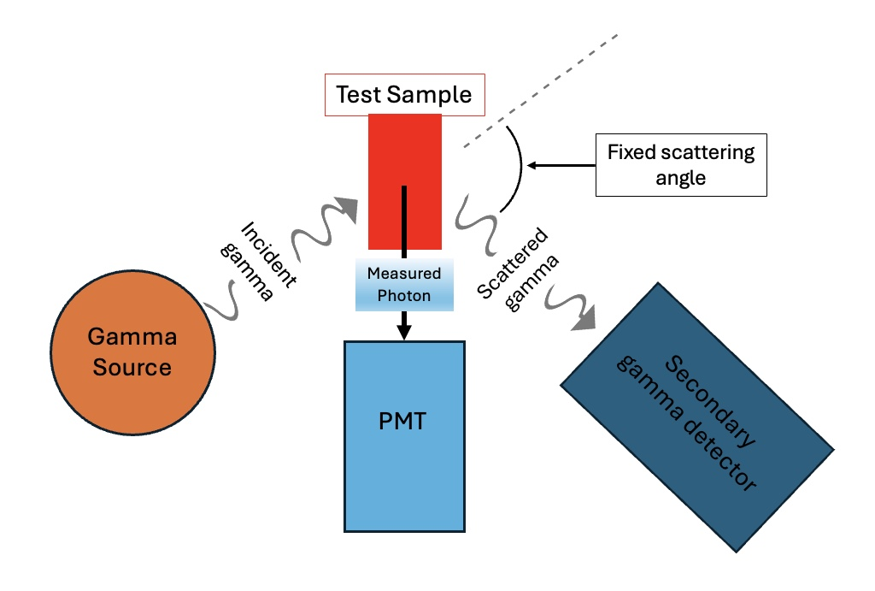
Liquid Scintillator Cocktail Testing
7
To test the overall light yield as well as the stability, a series of Compton scattering experiments can be performed.
Notes:
To test these factors a series of Compton scattering experiments can be performed. By placing a monoenergetic gamma source in a fixed position relative to a liquid scintillator and a second scintillator, a fixed scattering angle can give a consistent energy deposit in the liquid scintillator. This gives a Compton line that can quantify the overall light yield of the scintillator.
remove photon

Slide 9
Liquid Scintillator Cocktail Testing
8
Notes:
This Compton peak can then be fit to a gaussian plus an error function to give a mean value for the observed Compton line

Slide 10
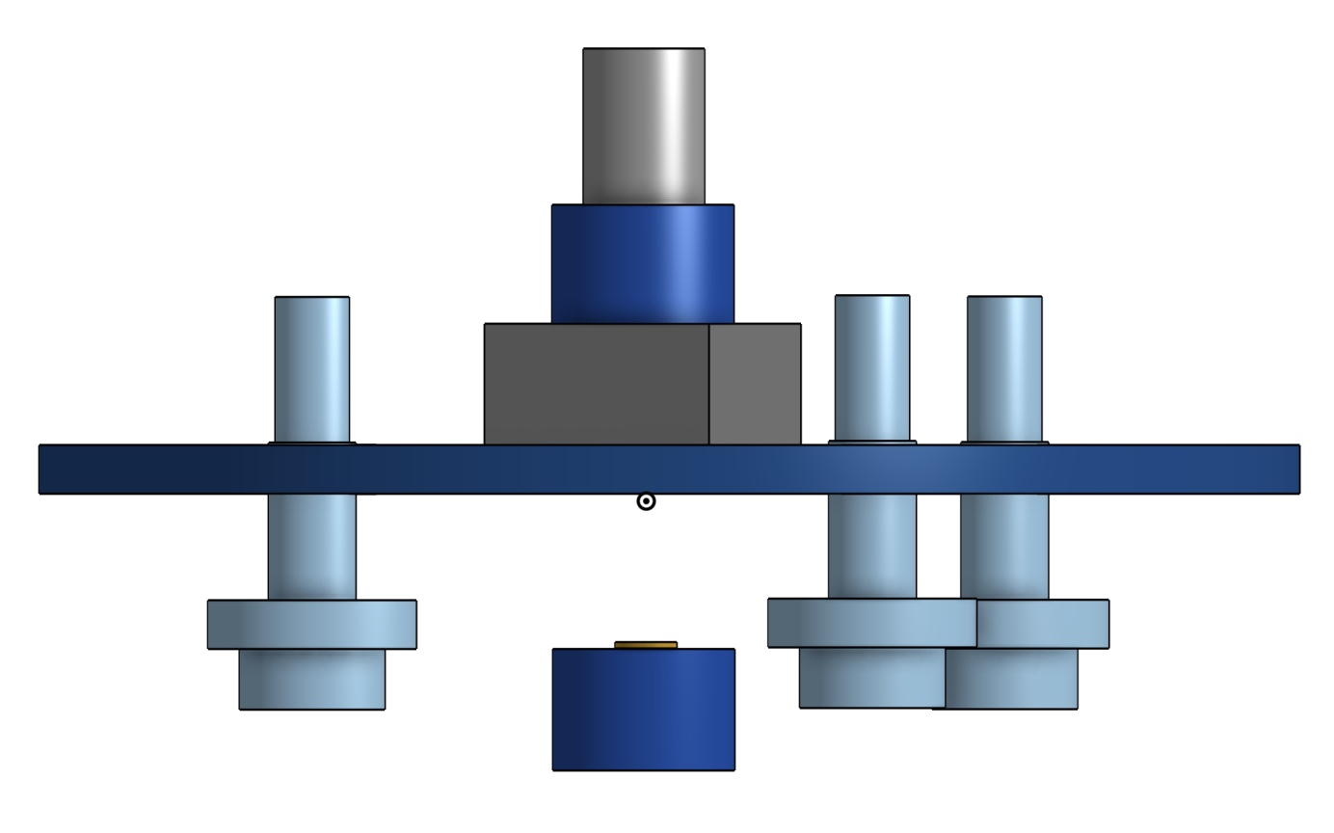
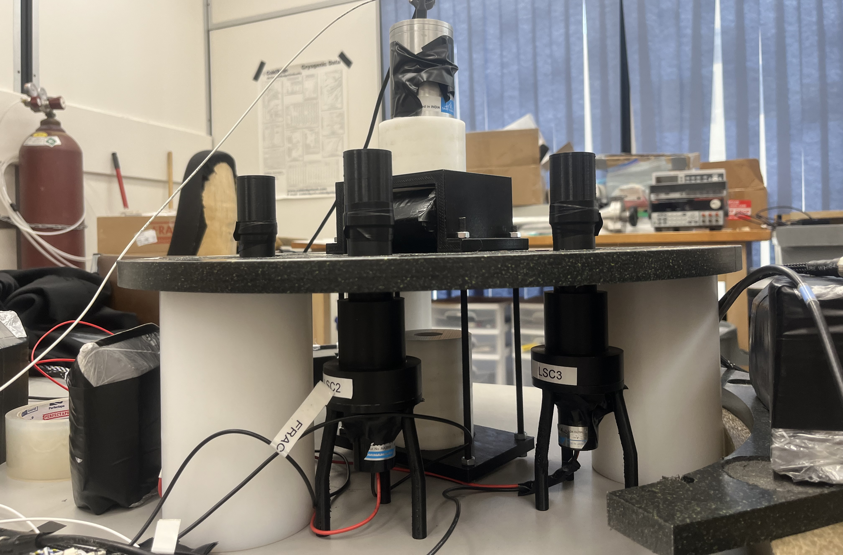
Liquid Scintillator Cocktail: Light Yield
9
Gamma Detector
CAD Drawing HERE
Lead
Liquid scintillator samples
Gamma Source
Notes:
This is the setup for the experimental measurement of the overall light yield. Each sample is measured on each of the three PMTs to ensure identical experimental conditions using a Cs-137 source and a sodium iodide crystal measured by a sipm to detect scattering from samples.

Slide 11
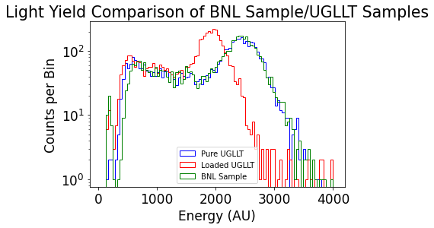
Liquid Scintillator Cocktail: Light Yield
10
A variety of loaded liquid scintillators were tested for light yield
One of the most promising mixtures we tested was Ultima Gold LLT loaded with KCl at 6 g/L
The most successful sample was provided by Brookhaven National Lab (BNL)
Notes:
x-axis- response not energy
Brookhaven National lab
A variety of liquid scintillator cocktails were tested using this technique primarily using variants of Ultima Gold, a commercial scintillator mixed with a variety of potassium compounds dissolved in water. The most successful samples consisted of Ultima Gold LLT loaded with approximately 6 g/L of potassium chloride as well as another water-based liquid scintillator provided by Brookhaven Nuclear Labs with a similar mass fraction of potassium chloride.

Slide 12
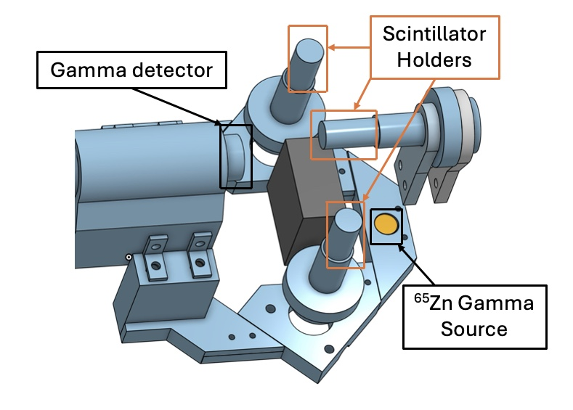
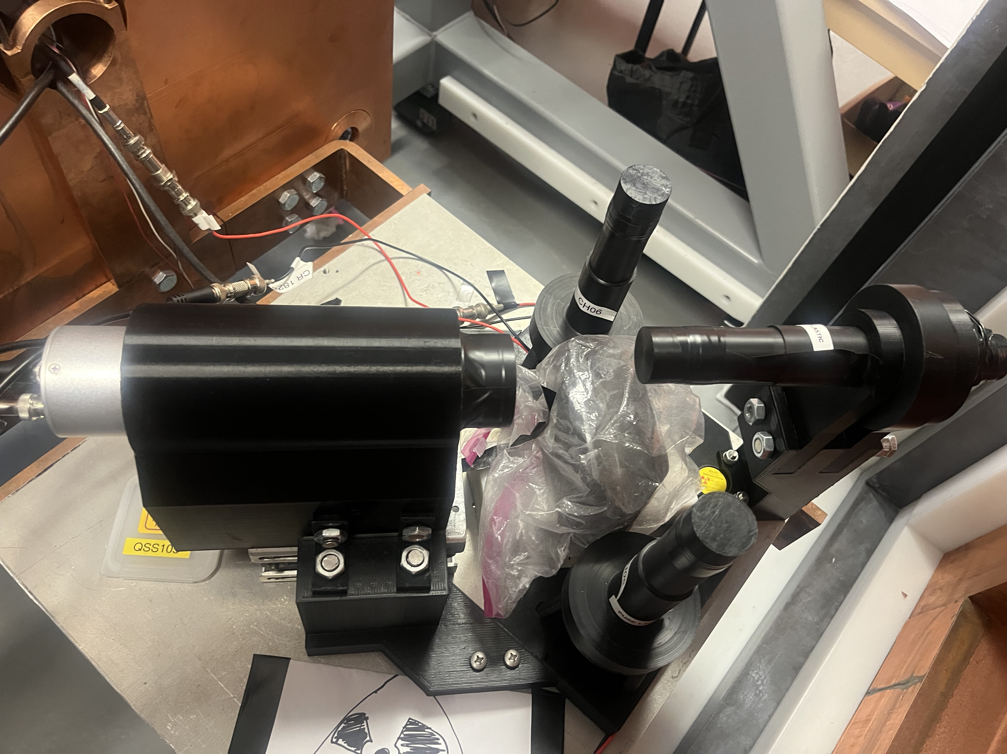
Liquid Scintillators: Stability
11
A second Compton scattering experiment was designed to keep samples fixed in place over a long-term test
This setup allows testing of two liquid samples simultaneously, as well as a plastic scintillator as a stable reference

Slide 13
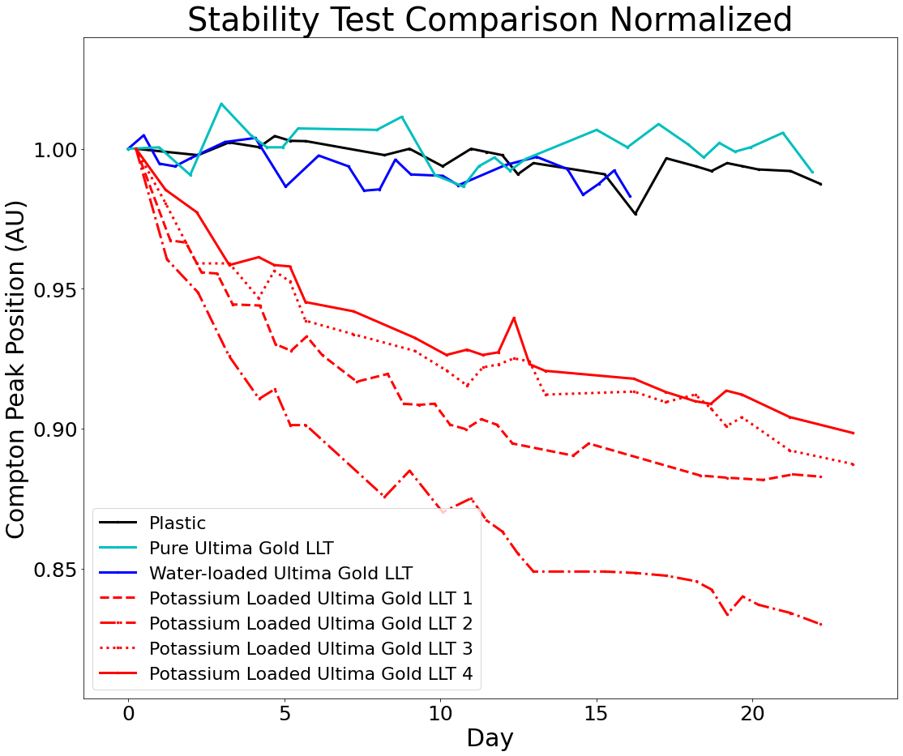
Liquid Scintillator: Stability
12
Using this setup we tested several variations of Potassium loaded LSCs.
Tests included:
-Pure commercial scintillator
-Water-loaded scintillator
-Variety of Potassium loaded scintillators

Slide 14
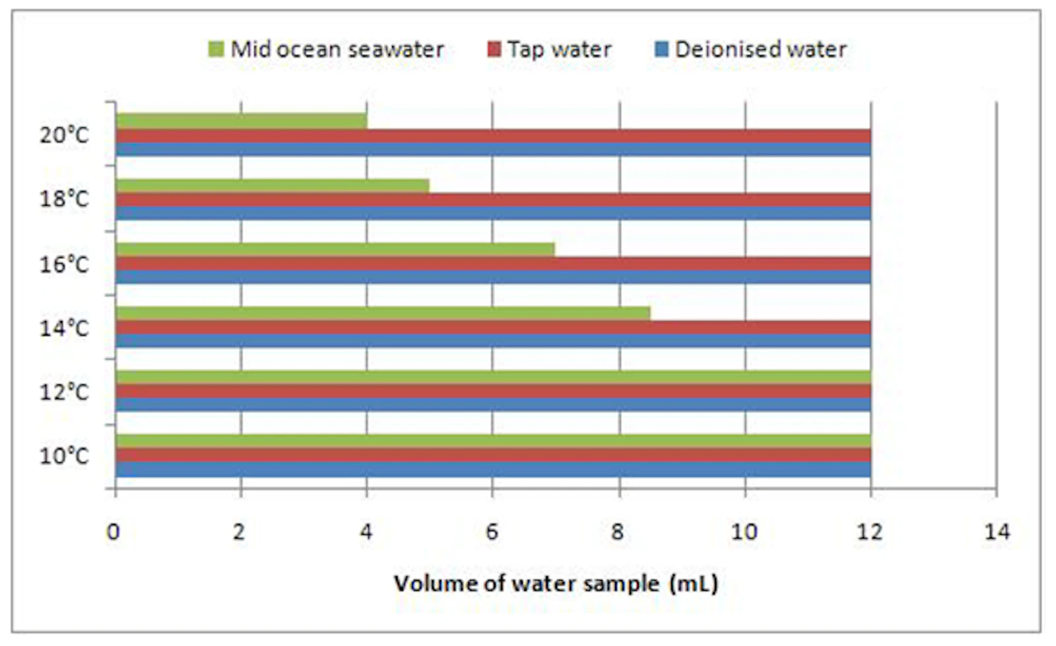
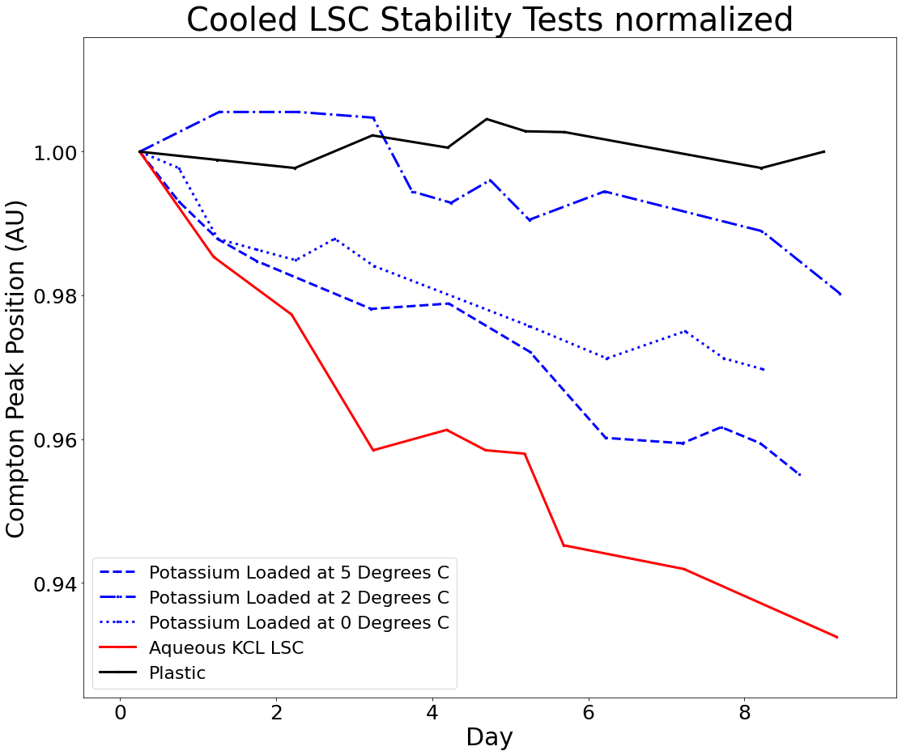
LSC Cooling Tests
13
Ref. https://www.hidex.com/hidex-methods

Slide 15
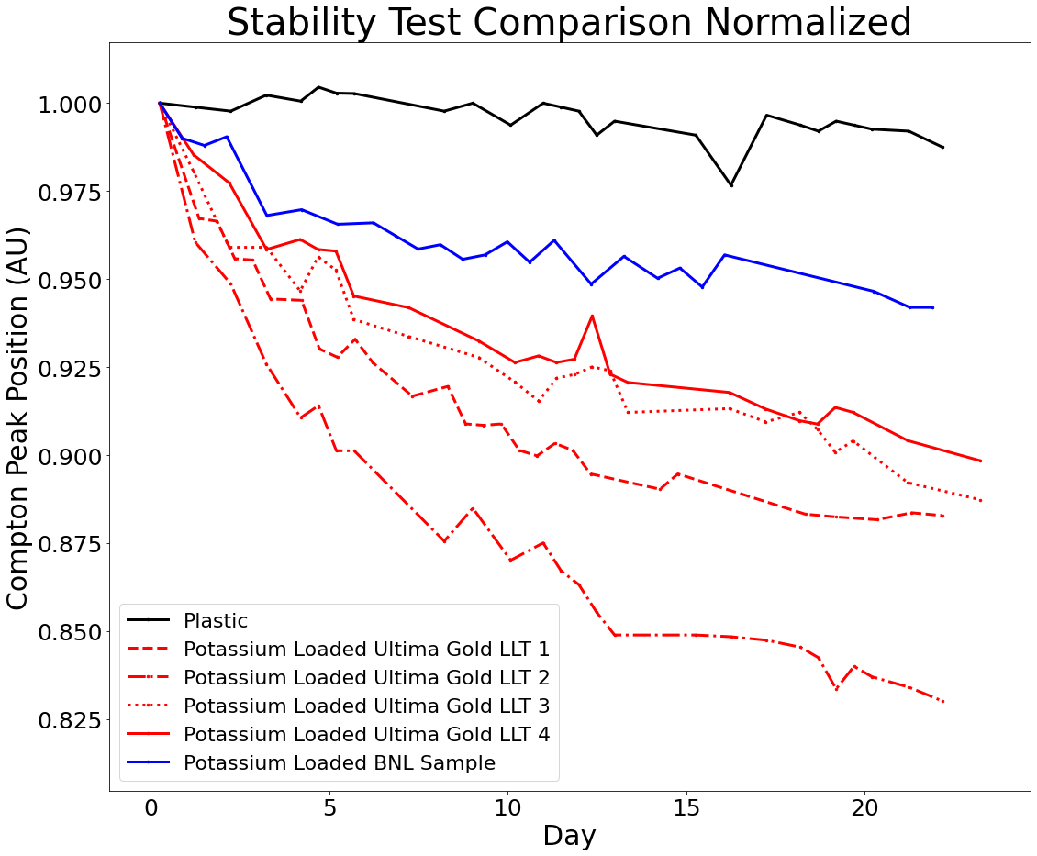
Liquid Scintillator: Stability
14
The most stable potassium loaded scintillator that was tested was the mixture created by BNL.
Performed better than all measured commercial scintillator mixes.
Notes:
The most successful mixture over a month-long period was the sample from BNL, which showed a drop of about 5%, as opposed to the 10-15% drop seen in other samples. From these results it was decided to use this mixture for a preliminary experiment.

Slide 16
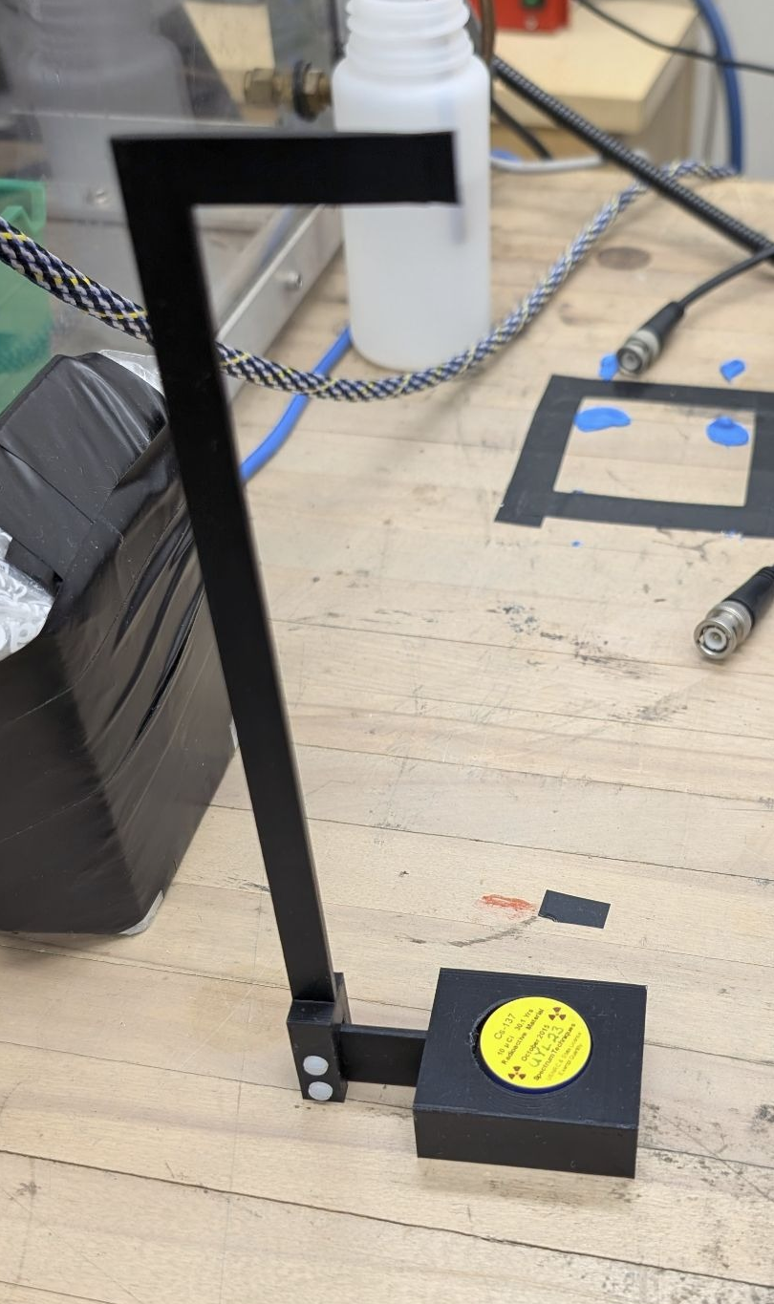
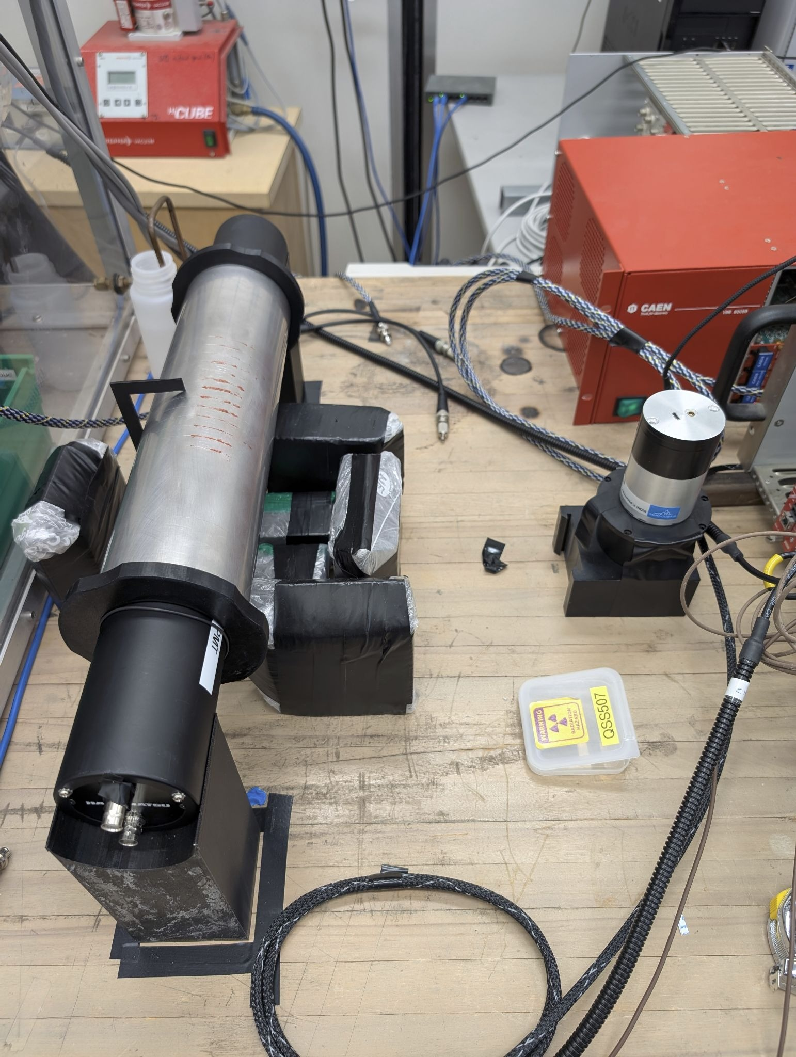
Liquid Scintillator Vessel Calibration
15
The liquid scintillator vessel also needs to be calibrated.
This can be done using another Compton scattering experiment.
Need to calibrate at different positions along the length of the vessel.
Notes:
The PMTs attached to the liquid scintillator vessel must also be calibrated in order to understand the difference in response that will be seen in different areas of the liquid scintillator volume. This was also done through a Compton scattering experiment with a collimated gamma source where a Compton line was measured at various positions along the length of the vessel.

Slide 17
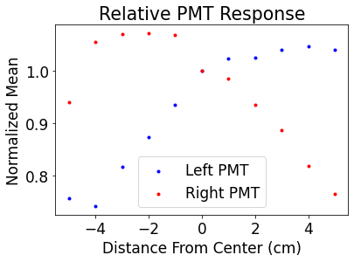
Liquid Scintillator Vessel Response
16
The liquid scintillator vessel calibration again used Compton peak fits from each PMT which can be plotted against the position
The sum of the means can also be plotted where we should expect to see a relatively flat response
Notes:
The measured Compton lines in each PMT were fitted and plotted as a function of the position, normalized to the peak measured in the center of the vessel. These peaks where then summed with the expectation being that the sum would be relatively flat.
Position Response
cut text

Slide 18
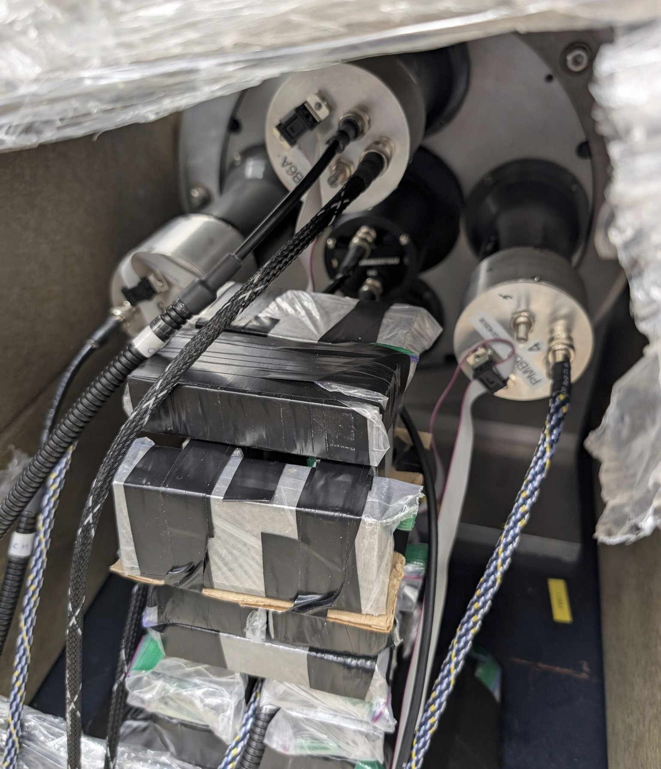
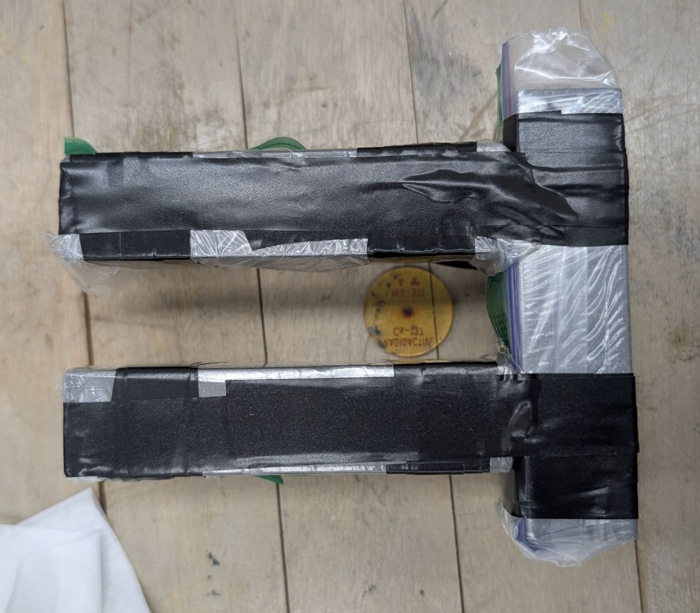
Daily Annulus Energy Calibration
17
Potential instability means daily energy calibrations may be necessary.
Will use a collimated gamma source.
Notes:
Because none of the tested liquid scintillator samples have shown a completely stable long-term light yield, yet another Compton scattering experiment was designed to allow daily energy calibrations of the liquid scintillator. This is has been done by collimating a gamma source along the axis of the liquid scintillator vessel.
potential instability
daily calibrations may be necessary of ls vessel or system

Slide 19
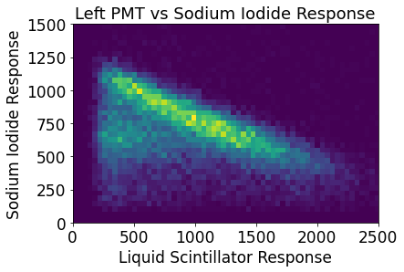
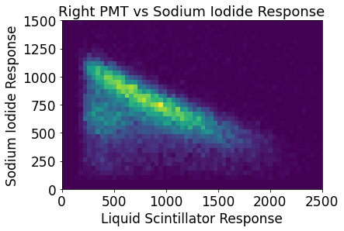
Daily Annulus Energy Calibration
18
We can get a Compton scattering spectrum using a cesium-137 source.
This is indicated by the downward sloping lines.
Can measure this daily to calibrate NaI crystals and liquid scintillator
Notes:
From this collimation we can see a Compton scattering in each sodium iodide crystal indicated by the sloped line in the 2d histogram. A fit can then be applied to this line to get an energy calibration of the liquid scintillator once per day to account for the drift in light yield in the liquid scintillator as well as each of the six PMTs.
update figure (scale, mention source)

Slide 20
Current and Future Work
19
An updated liquid scintillator stability experiment is being set up using a pulsed LED as an additional stable light source.
An initial test of the annulus with the liquid scintillator vessel is currently underway.
The first data collection using a K-loaded liquid scintillator to look for positrons will occur over the next couple of months.
Notes:
Current work for KDK+ includes an updated LS stability experiment utilizing a pulsed LED as an additional stable light source. An initial test of the annulus with the liquid scintillator vessel filled with a pure water-based scintillator is also underway. Later this year the first data collection using a potassium loaded scintillator will occur, and another calibration using a liquid scintillator loaded with sodium-22 which decays purely through positron emission will also be performed.

Slide 21
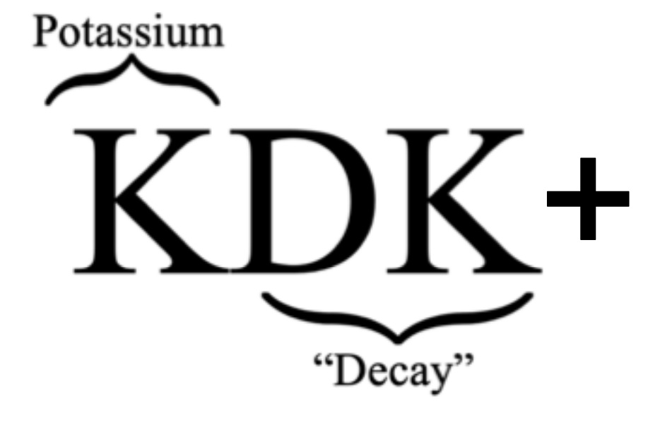




Thank You

Slide 22
Liquid Scintillator Testing
20

Slide 23
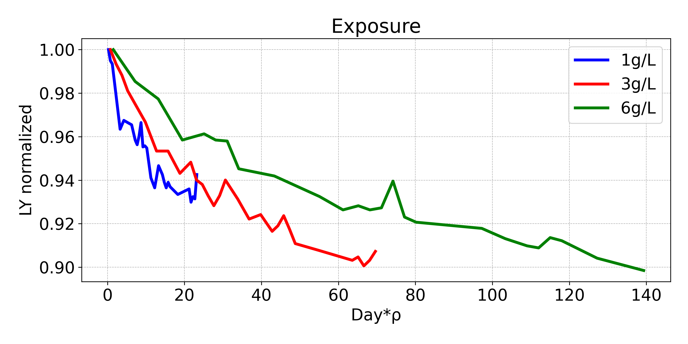
Loading Level Tests
21

Slide 24
